Slide 2
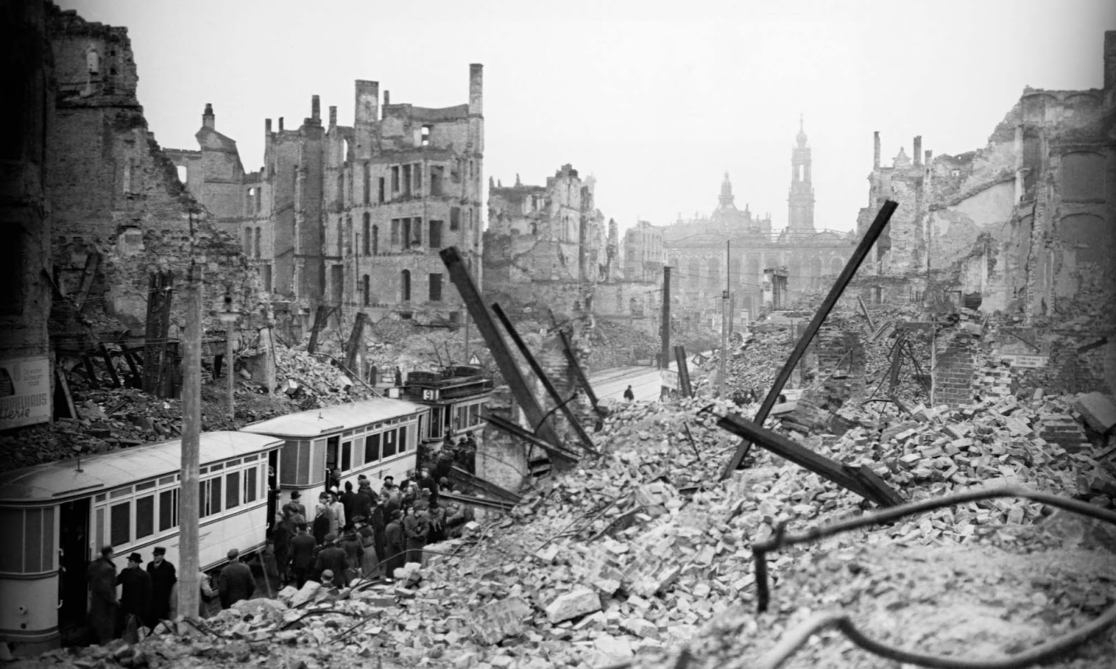
Envoi: Aftermath of World War II
Dresden, 1945

Slide 3
Envoi: Aftermath of World War II

Slide 4
Envoi: Aftermath of World War II
Dresden, 1945

Slide 5
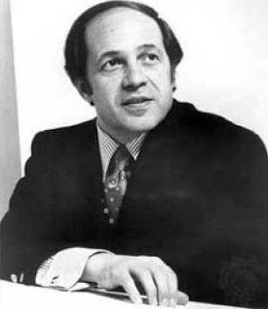
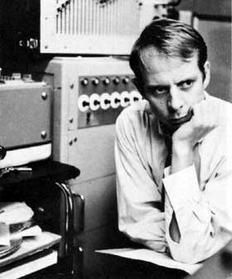
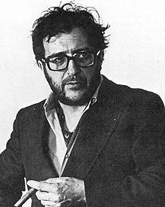
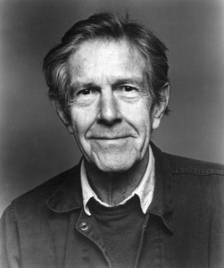
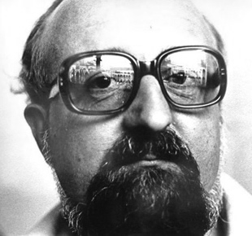
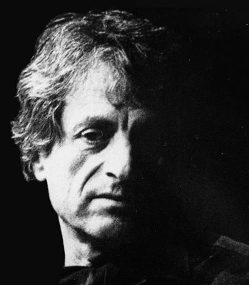
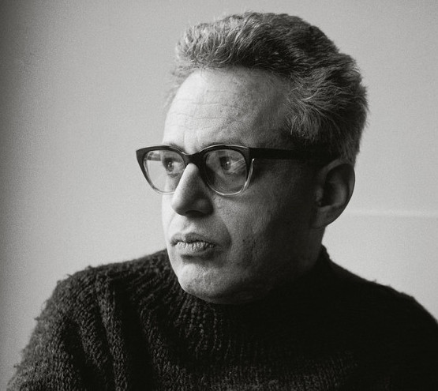
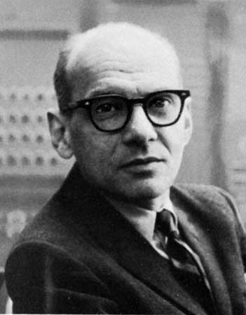
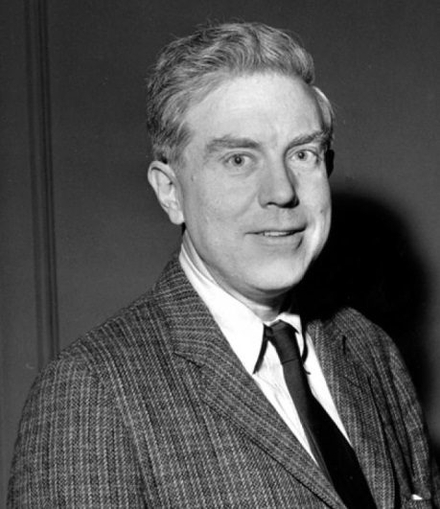
Into the 1950s: New Avant-Gardes
Pierre Boulez Karlheinz Stockhausen Luciano Berio John Cage Krzysztof Penderecki
Iannis Xenakis Gyorgi Ligeti Milton Babbitt Elliot Carter

Slide 6
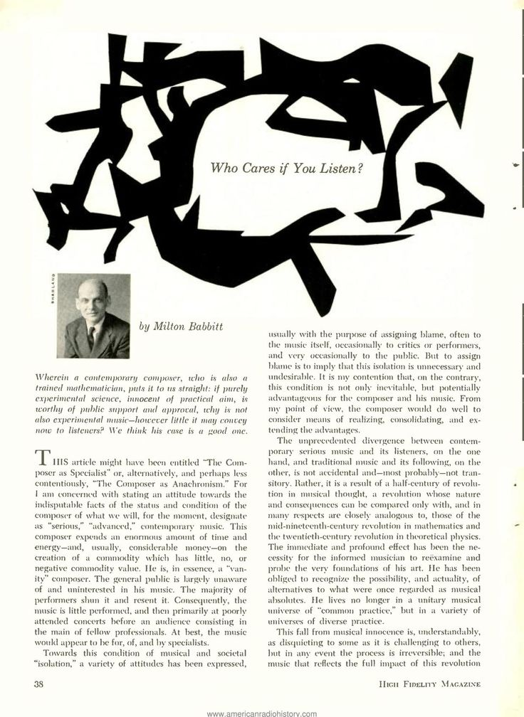
1958

Slide 7
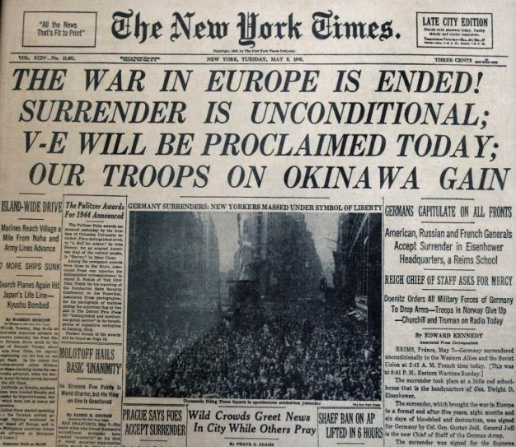

Slide 8
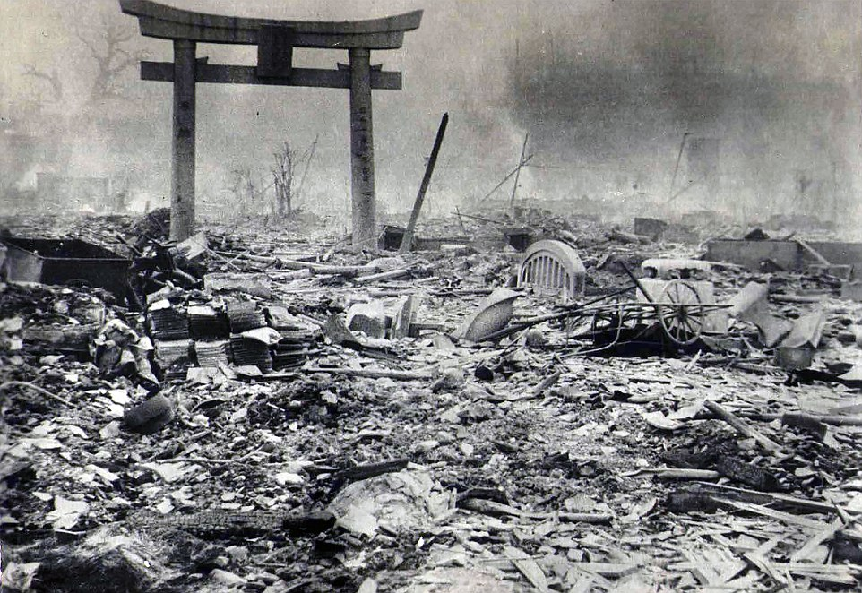
Envoi: Aftermath of World War II
Hiroshima, 1945

Slide 9
Envoi: Aftermath of World War II
Dresden, 1945

Slide 10
Envoi: Aftermath of World War II
Auschwitz, 1945

Slide 11
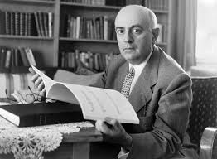
Envoi: Aftermath of World War II
“To write poetry after Auschwitz
is barbaric.”
Theodor W. Adorno

Slide 12
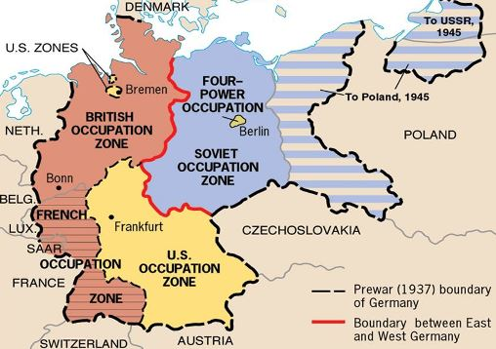
1945: Division of Germany into Four Zones of Occupation

Slide 13
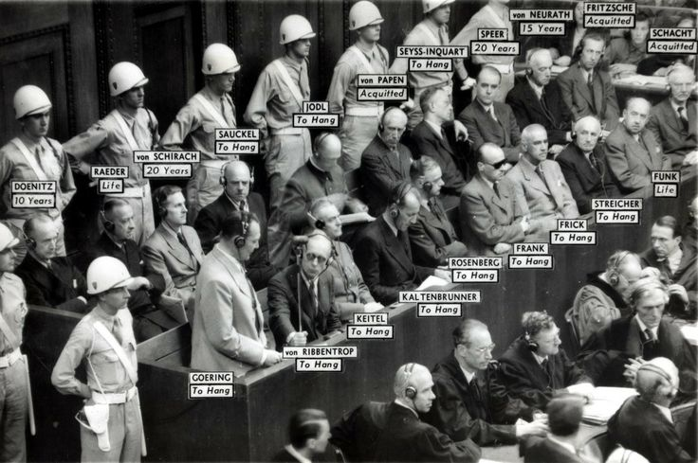
1945-46: Nuremberg Trials

Slide 14
1945: Division of Germany into Four Zones of Occupation

Slide 15
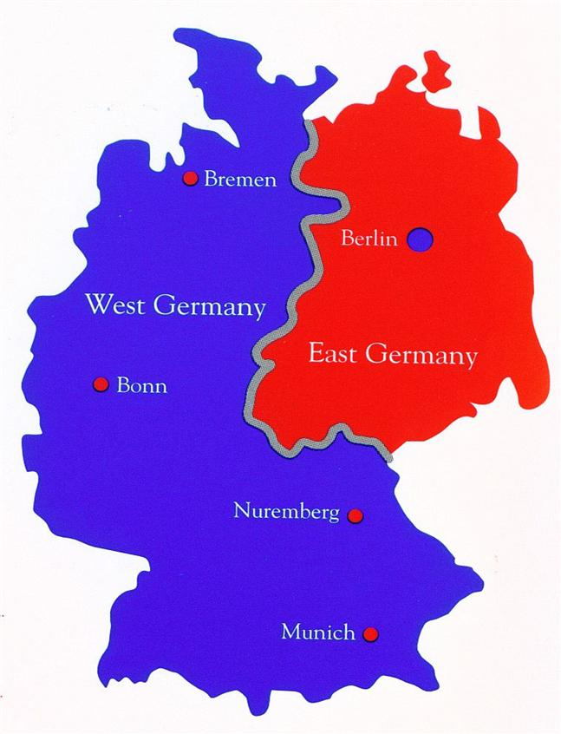
1949: Division of Germany into East and West

Slide 16
Envoi: Aftermath of World War II
“To write poetry after Auschwitz
is barbaric.”
Theodor W. Adorno

Slide 17
Darmstadt Summer Courses, from 1946 onward

Slide 18
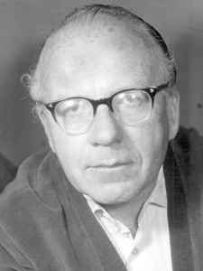
Darmstadt Summer Courses, from 1946 onward
1946 – Wolfgang Fortner

Slide 19
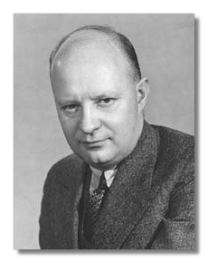
Darmstadt Summer Courses, from 1946 onward
1946 – Wolfgang Fortner
1947 – Paul Hindemith

Slide 20
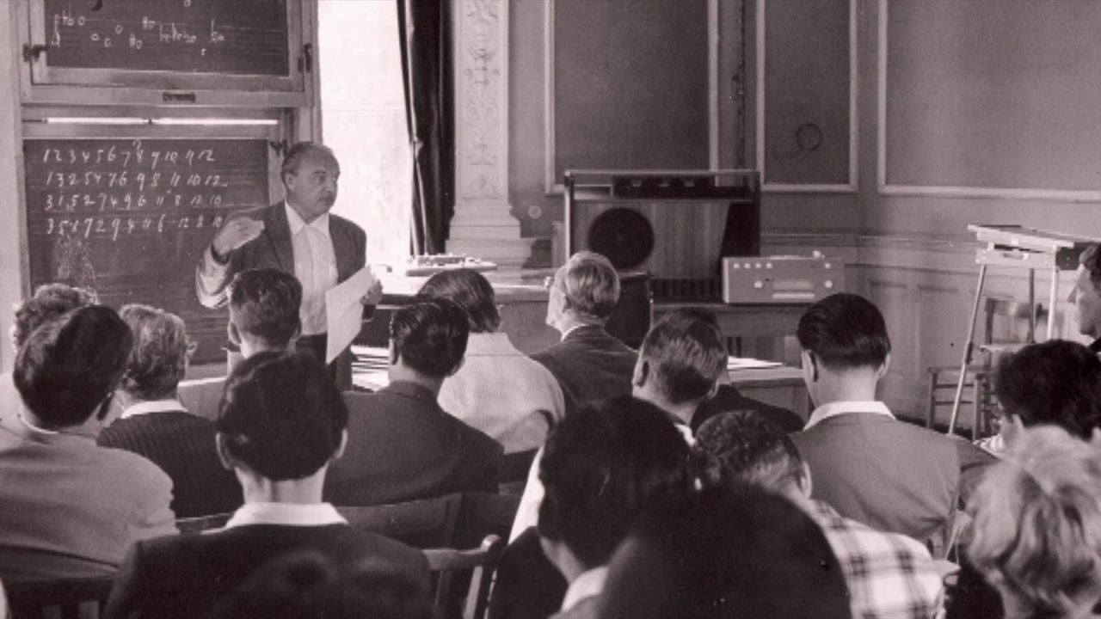
Darmstadt Summer Courses, from 1946 onward
1946 – Wolfgang Fortner
1947 – Paul Hindemith
1948 – René Leibowitz (Schoenberg et son école, 1946)

Slide 21
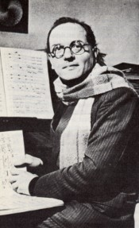
Darmstadt Summer Courses, from 1946 onward
1946 – Wolfgang Fortner
1947 – Paul Hindemith
1948 – René Leibowitz (Schoenberg et son école, 1946)
1949 – Olivier Messiaen; and first admission of foreign students

Slide 22
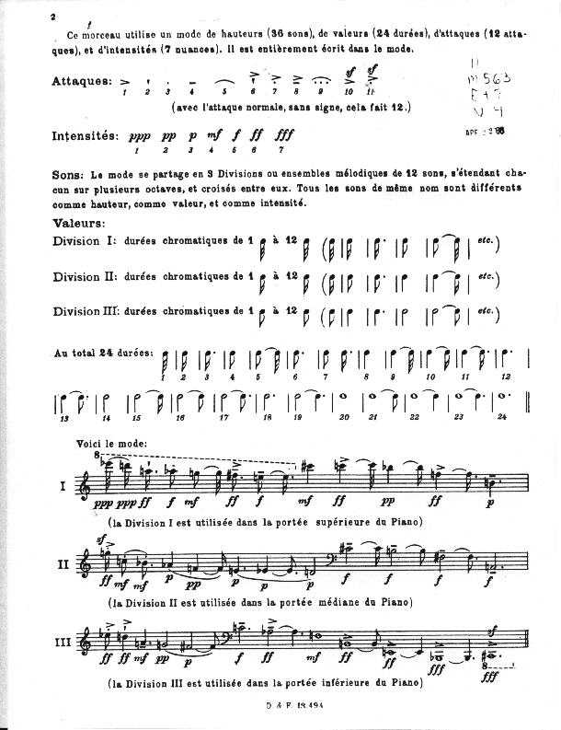
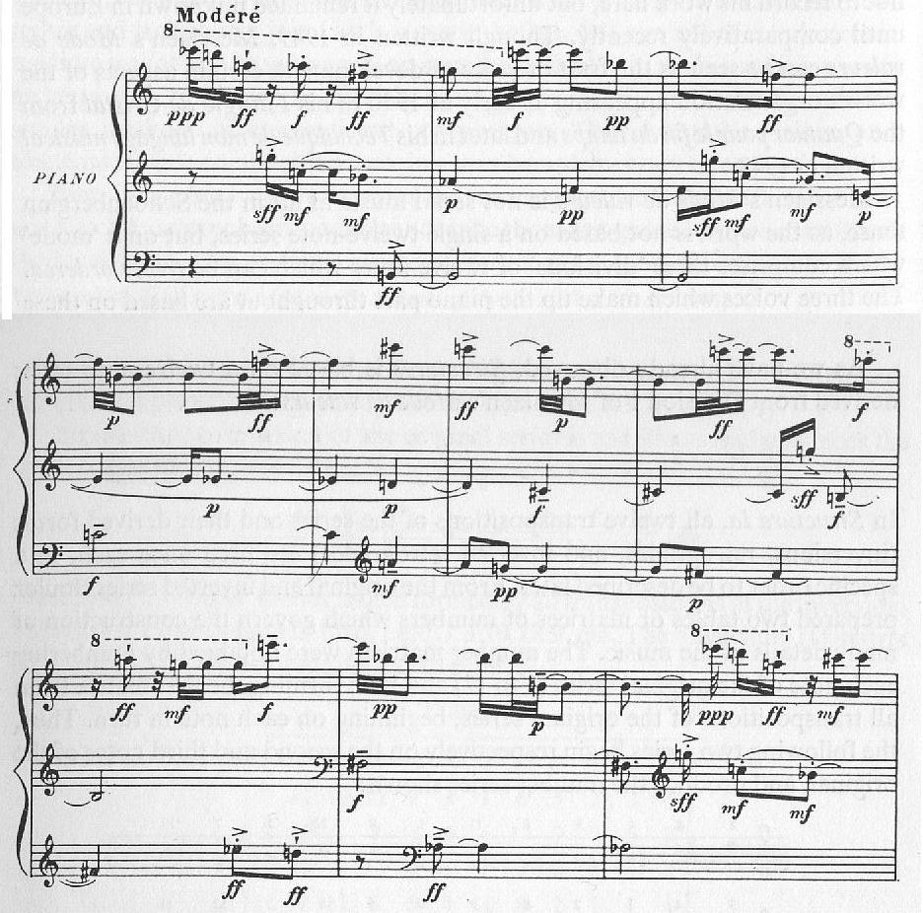
Messiaen, “Mode de valeurs et d’intensités” (1949)

Slide 23
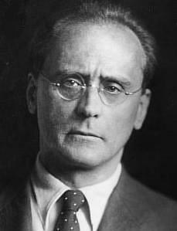
Increasingly admired as a model
in and around postwar Darmstadt, such pieces as:
Variations for Piano, op. 27 (1935-36), second movement, “Sehr Schnell”
Anton Webern

Slide 24
Darmstadt Summer Courses, from 1946 onward
1946 – Wolfgang Fortner
1947 – Paul Hindemith
1948 – René Leibowitz (Schoenberg et son école, 1946)
1949 – Olivier Messiaen; and first admission of foreign students
1950 – Ernst Krenek and Edgard Varèse
. . . . . . . .

Slide 25
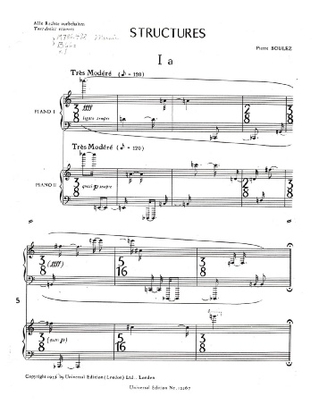
1952
“Total serialism”
or
“Integral serialism”

Slide 26
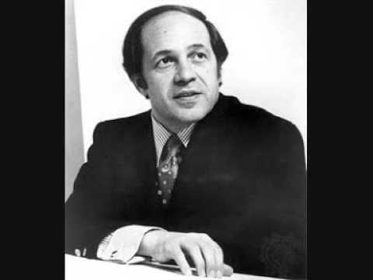
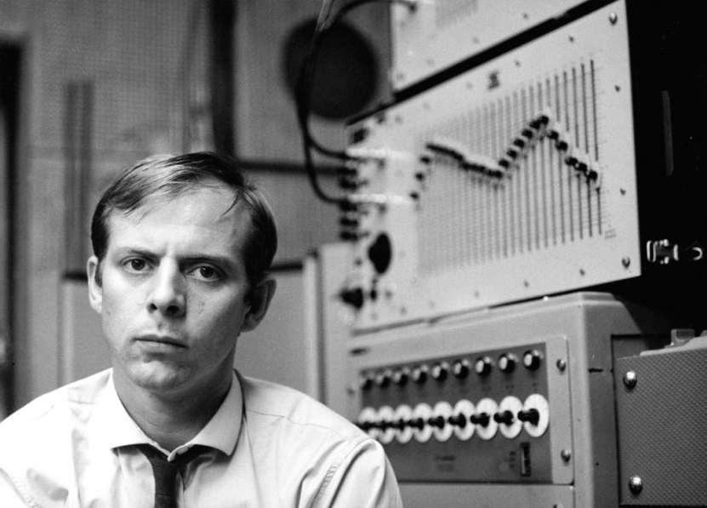
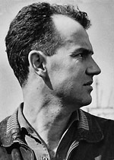
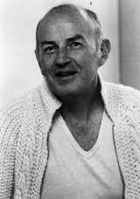
Darmstadt, 1953: Declaration of Allegiance to Webern
Pierre Boulez Karlheinz Stockhausen
Luigi Nono Karel Goeyvaerts

Slide 27
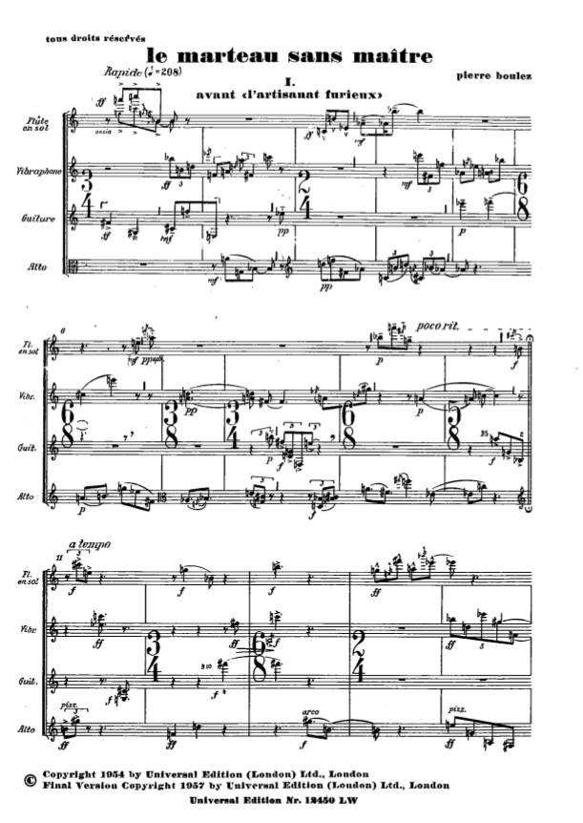

Slide 28
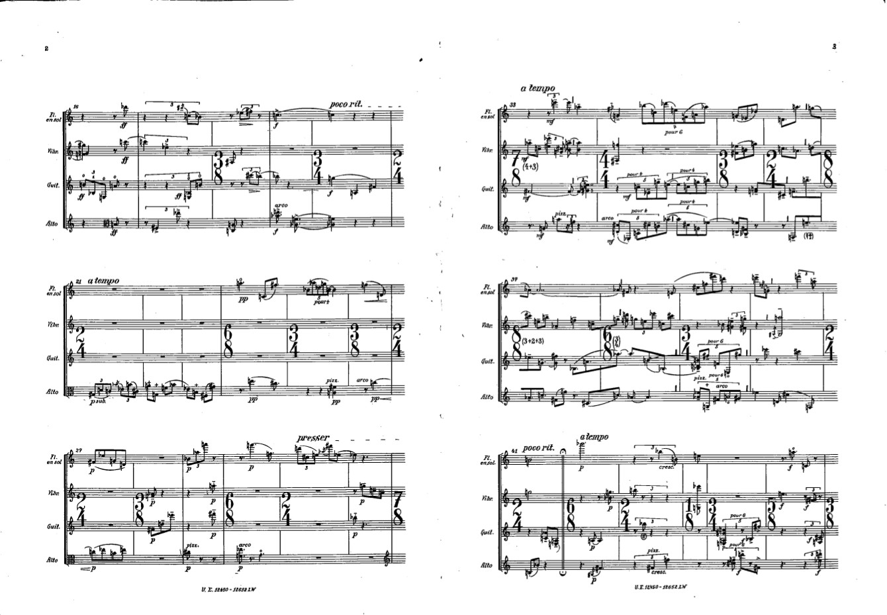

Slide 29
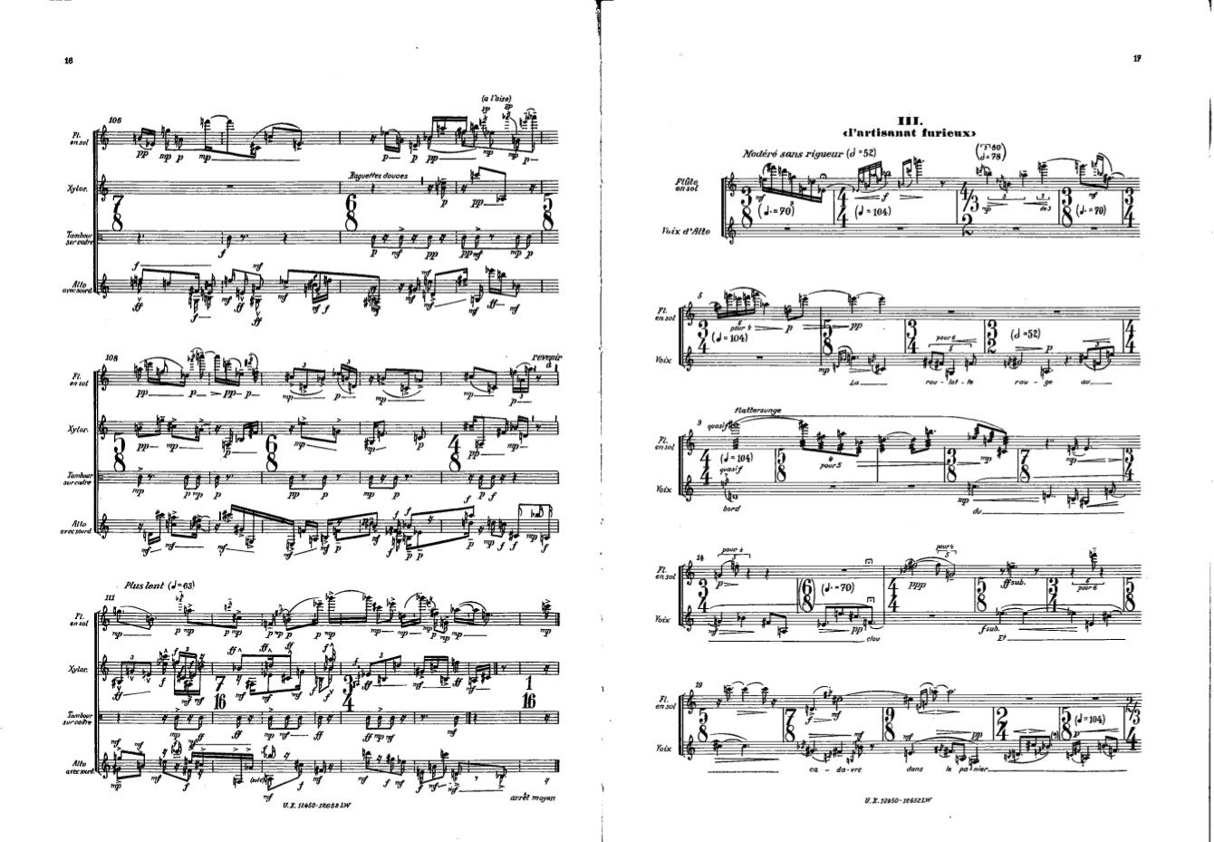

Slide 30
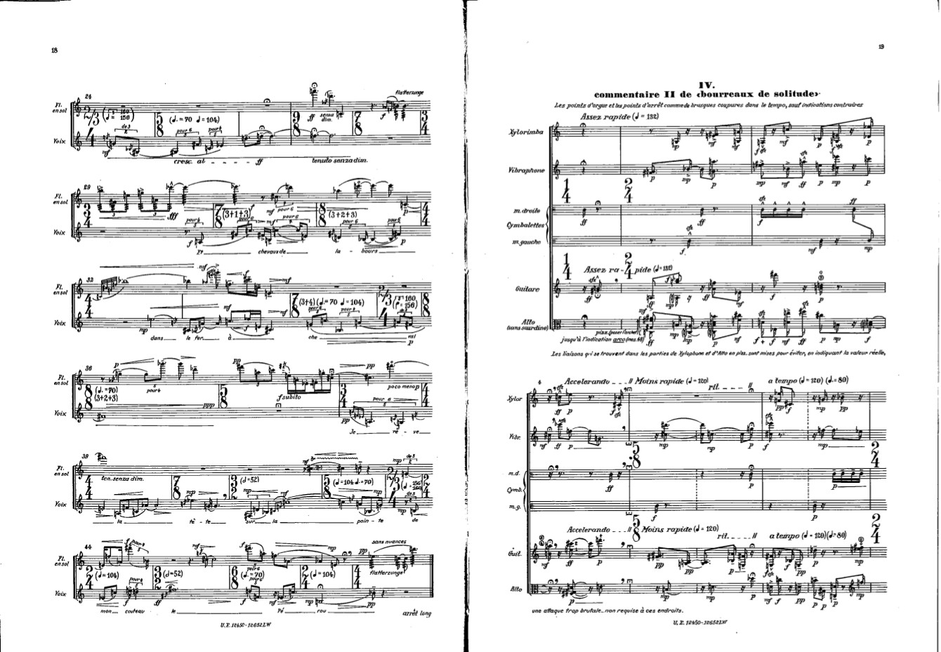

Slide 31
“Indeterminacy”
(Music of chance)
John Cage (1912-1992)

Slide 32
Cage’s Indeterminacy
Influences include the embrace of “noise” of all kinds—often coupled with meditative Zen Buddhism:
John Cage (1912-1992)

Slide 33
Cage’s Indeterminacy
Influences include the embrace of “noise” of all kinds—often coupled with meditative Zen Buddhism:
Abandon “control” over sounds
“Let sounds be themselves”
A valuing of “silence”
John Cage (1912-1992)

Slide 34
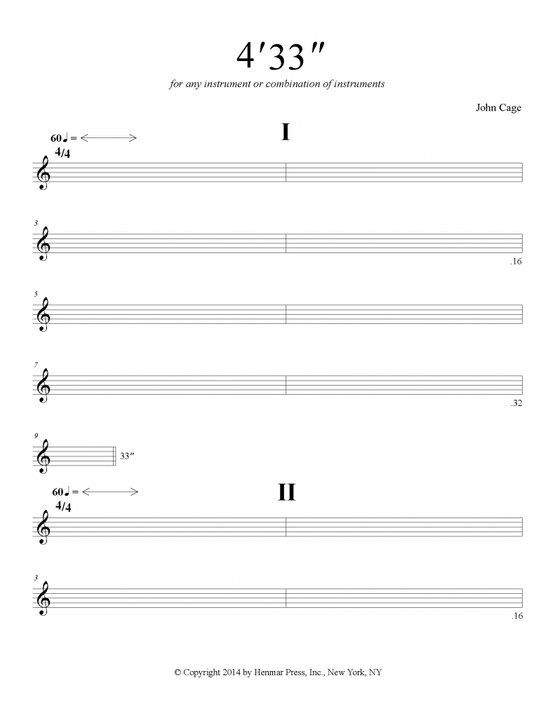
1952
John Cage (1912-1992)

Slide 35
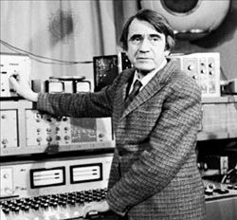
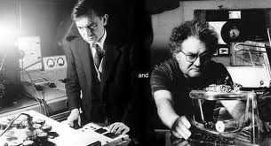
Consumerism and Technology: new worlds of media and commercialization
Advances in cinema technology and radio
Tape recording (introduced publicly, 1948)
Avant-Garde: Pierre Schaeffer, Pierre Henry, musique concrète
(Late 1940s, early 1950s)

Slide 36
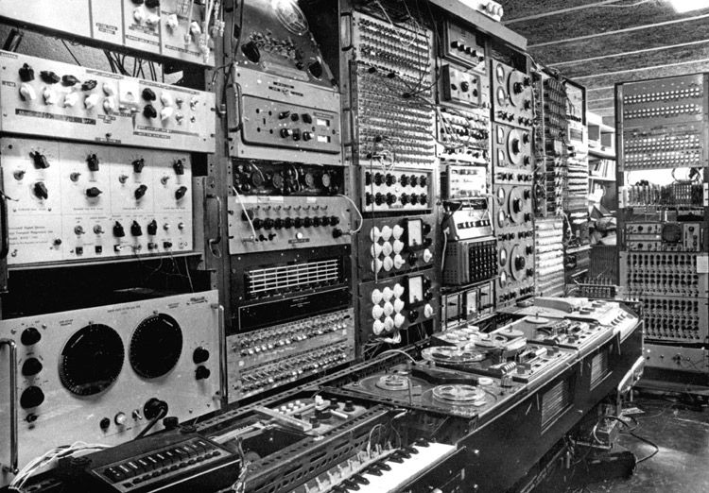
Consumerism and Technology: new worlds of media and commercialization
Advances in cinema technology and radio
Tape recording (introduced publicly, 1948)
Early sound synthesizers (1951 Cologne Electronic Studio)

Slide 37
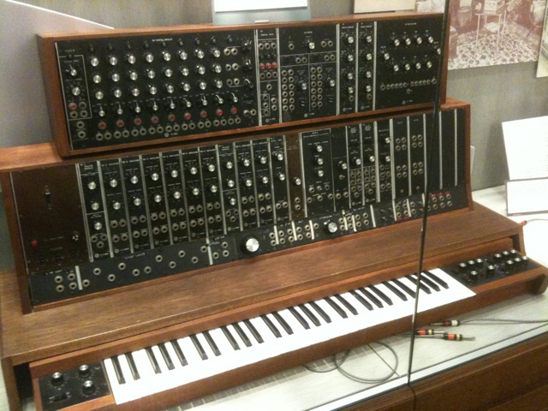
Consumerism and Technology: new worlds of media and commercialization
Advances in cinema technology and radio
Tape recording (introduced publicly, 1948)
Early sound synthesizers (1951 Cologne Electronic Studio);
Moog synthesizer, first to be sold commercially, 1964

Slide 38
Into the 1950s: New Avant-Gardes
Pierre Boulez Karlheinz Stockhausen Luciano Berio John Cage Krzysztof Penderecki
Iannis Xenakis Gyorgi Ligeti Milton Babbitt Elliot Carter

Slide 39
1958

Slide 40
1950s: pluralistic art-music styles of advanced complexity and consciously formulated intellectualized systems and experiments. Losing an audience.

Slide 41
1950s: pluralistic art-music styles of advanced complexity and consciously formulated intellectualized systems and experiments. Losing an audience.
But …… why?

Slide 42
1950s: pluralistic art-music styles of advanced complexity and consciously formulated intellectualized systems and experiments. Losing an audience.
But why?
Reaction to 1930s, 1940s: emotional and sociological effects of economic depression, totalitarianism, and the most brutal of wars; suspicion of emotion and “turning on” an audience

Slide 43
1950s: pluralistic art-music styles of advanced complexity and consciously formulated intellectualized systems and experiments. Losing an audience.
But why?
Reaction to 1930s, 1940s: emotional and sociological effects of economic depression, totalitarianism, and the most brutal of wars; suspicion of emotion and “turning on” an audience
Karlheinz Stockhausen (1971) on his past work: “I am very sensitive to [the periodic beat, which makes people march without knowing it], because that was exactly the way the Nazis tuned in the whole population with marching music on the radio, and whether it’s marching music, pop, or even a rock beat, I don’t like it.”

Slide 44
1950s, 1960s: pluralistic art-music styles of advanced complexity and consciously formulated intellectualized systems and experiments. Losing an audience.
But why?
Reaction to 1930s, 1940s: emotional and sociological effects of economic depression, totalitarianism, and the most brutal of wars; suspicion of emotion and “turning on” an audience

Slide 45
1950s, 1960s: pluralistic art-music styles of advanced complexity and consciously formulated intellectualized systems and experiments. Losing an audience.
But why?
Reaction to 1930s, 1940s: emotional and sociological effects of economic depression, totalitarianism, and the most brutal of wars; suspicion of emotion and “turning on” an audience
Elite-art composers continue to steer clear of the growing power and mass-culture enthusiasms of popular culture: do not succumb the taint of American or European commercialism

Slide 46
1950s, 1960s: pluralistic art-music styles of advanced complexity and consciously formulated intellectualized systems and experiments. Losing an audience.
But why?
Reaction to 1930s, 1940s: emotional and sociological effects of economic depression, totalitarianism, and the most brutal of wars; suspicion of emotion and “turning on” an audience
Elite-art composers continue to steer clear of the growing power and mass-culture enthusiasms of popular culture: do not succumb the taint of American or European commercialism
Intrinsic interest in music-technical development in an increasingly technical age: the appeal of the scientific, mathematical, or intellectual approach to art

Slide 47
1950s, 1960s: pluralistic art-music styles of advanced complexity and consciously formulated intellectualized systems and experiments. Losing an audience.
But why?
Reaction to 1930s, 1940s: emotional and sociological effects of economic depression, totalitarianism, and the most brutal of wars; suspicion of emotion and “turning on” an audience
Elite-art composers continue to steer clear of the growing power and mass-culture enthusiasms of popular culture: do not succumb the taint of American or European commercialism
Intrinsic interest in music-technical development in an increasingly technical age: the appeal of the scientific, mathematical, or intellectual approach to art
The political and cultural impact of non-European world cultures

Slide 48
1950s, 1960s: pluralistic art-music styles of advanced complexity and consciously formulated intellectualized systems and experiments. Losing an audience.
But why?
Reaction to 1930s, 1940s: emotional and sociological effects of economic depression, totalitarianism, and the most brutal of wars; suspicion of emotion and “turning on” an audience
Elite-art composers continue to steer clear of the growing power and mass-culture enthusiasms of popular culture: do not succumb the taint of American or European commercialism
Intrinsic interest in music-technical development in an increasingly technical age: the appeal of the scientific, mathematical, or intellectual approach to art
The political and cultural impact of non-European world cultures
For some: the embrace of Asian spirituality (a rejection of Western linearity and “musical logic”)

Slide 49
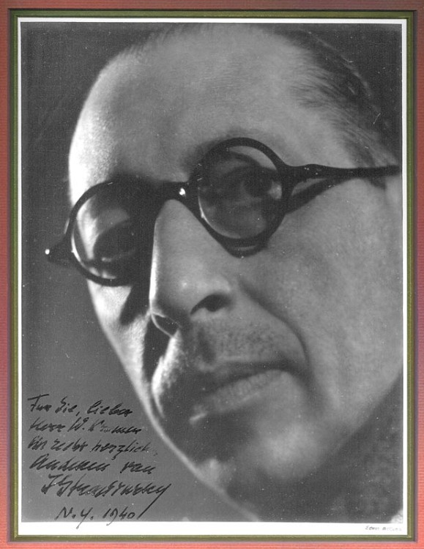
Stravinsky, then a French citizen, moves to the United States
in September 1939 (the outbreak of WWII)

Slide 50
Stravinsky, then a French citizen, moves to the United States
in September 1939 (the outbreak of WWII)
Completes the Symphony in C (1938-40)
New arrangement of “The Star-Spangled Banner” (1941)
Symphony in Three Movements (1945)

Slide 51
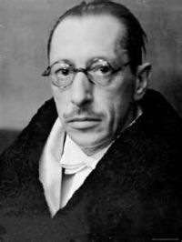
Becomes an American citizen, 1945

Slide 52
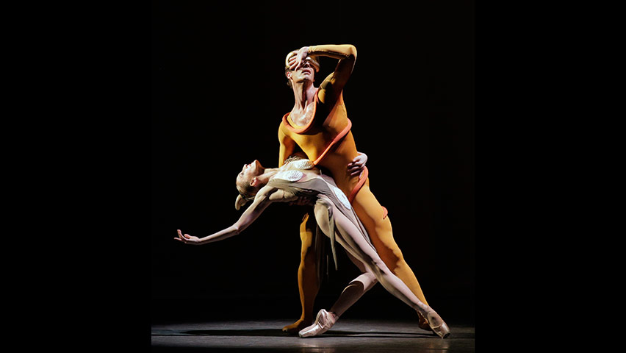
Stravinsky, Orpheus (1947)

Slide 53
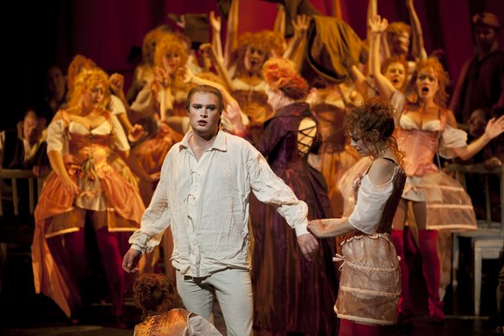
Stravinsky (with Auden, Kallman), The Rake’s Progress (1948-51)

Slide 54
Stravinsky (with Auden, Kallman), The Rake’s Progress (1948-51)
Secco recitative: Anne Truelove’s father and Tom Rakewell

Slide 55
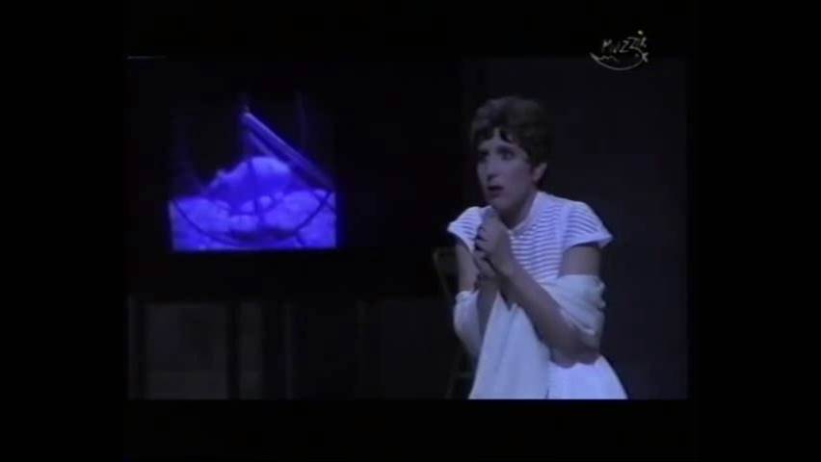
Stravinsky (with Auden, Kallman), The Rake’s Progress (1948-51)
End of tempo di mezzo and concluding cabaletta to coloratura aria:
Anne Truelove, “I Go to Him” (Dawn Upshaw)

Slide 56
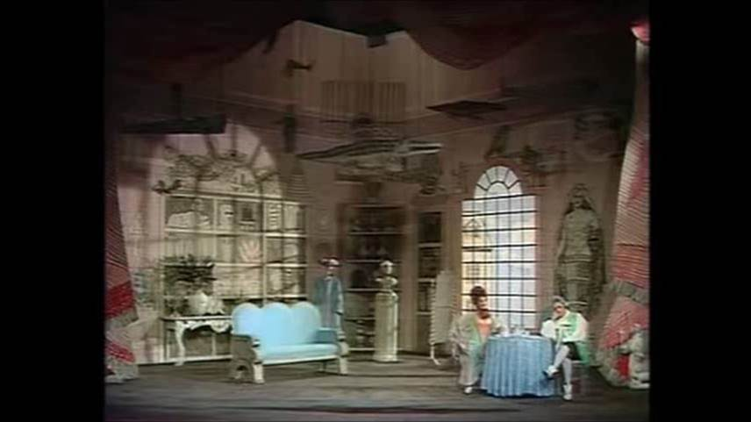
Stravinsky (with Auden, Kallman), The Rake’s Progress (1948-51)
Comic farce: Baba the Turk chatters on to a bored Tom

Slide 57
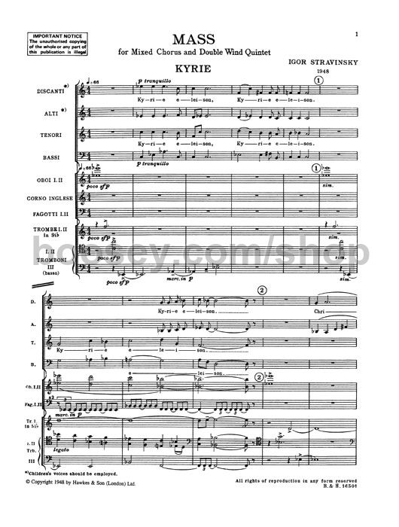
Stravinsky, Mass (1944-48)

Slide 58
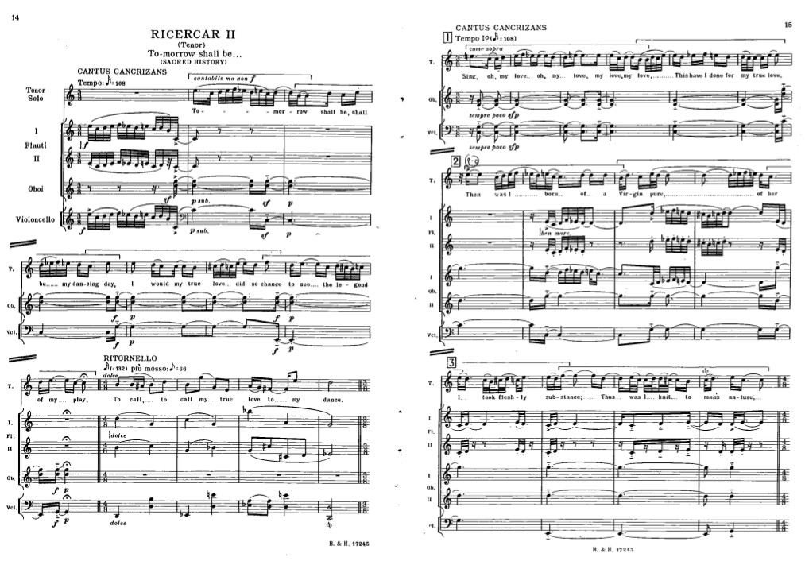
Stravinsky, from Cantata, 1951-52

Slide 59
Stravinsky, from Cantata, 1951-52
P-0
P-0
R-0
I-8
RI-8

Slide 60
Stravinsky in the 1950s: The Path to Serialism
“Ricercar II” from Cantata (1951-52)—11-note row, tonal
Septet (1952-53)—8-note row, tonal
In Memoriam Dylan Thomas (dirge canons, 1954)-5-note row, chromatic
“Surge Aquilo” from Canticum Sacrum (1955)—based entirely on a tone row
Agon (1953-57)—progresses tonal → increasingly non-tonal → non-tonal → return
--------------------------------------------------------------------------------
Threni (1957-58)—non-tonal, single 12-tone row throughout
Movements for Piano and Orchestra (1958-59)—non-tonal, 12-tone

Slide 61
Stravinsky, Agon (ballet, 1953-57)
Succession of individualized dances
serial elements increasingly serial but tonal very serial, non-tonal
FANFARE
(C)
FANFARE
(C)
non-tonal goal:
Pas de deux + Coda
“lost” tonality
returns, precipitated out of atonality

Slide 62
Into the 1950s: New Avant-Gardes
Pierre Boulez Karlheinz Stockhausen Luciano Berio John Cage Krzysztof Penderecki
Iannis Xenakis Gyorgi Ligeti Milton Babbitt Elliot Carter

Slide 63
1950s, 1960s, 1970s: Varied radicalisms, avant-gardes, “experimental musics”
Integral serialism (Boulez, Babbitt, Stockhausen)
Indeterminacy (John Cage, music of chance, “aleatoricism”)
Graphic notation (Earle Brown, John Cage)
Electronic studios, electronic music, computer music, synthesizers
Stochastic music (mathematical, probabilistic: Xenakis)
Sound-mass music (clusters, clouds: Xenakis, some Ligeti, Penderecki)
Open-form music involving performer choice of “moments”
Performance-art music (“happenings,” Fluxus)
Etc.
Minimalism, retrenchment (1960s: Riley, Glass, Reich)
Neo-romanticism, retrenchment (1960s, 1970s, Rochberg and many others)
Postmodern crossovers with popular music, rock, etc. (1970s, 1980s)
And much, more more . . . . . .

Slide 64
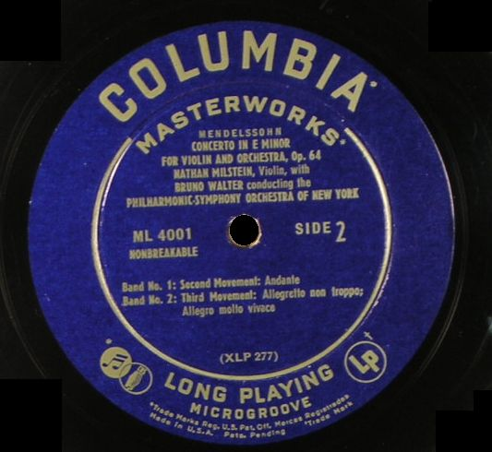
Consumerism: new worlds of media and commercialization
Long-playing record (LP, introduced by Columbia 1948)

Slide 65
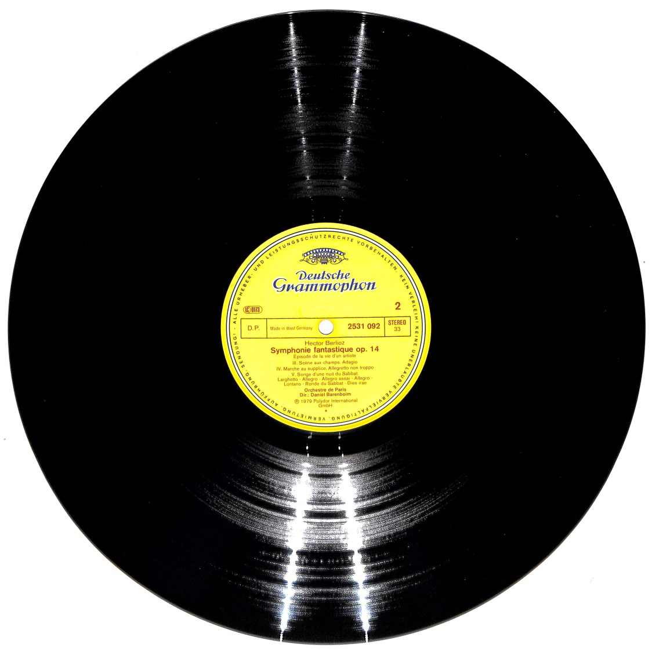
High-Fidelity recordings
Stereo recordings introduced, 1954-58
Columbia Records:
Vinyl LP introduced, 1948—includes
“Columbia Masterworks”

Slide 66
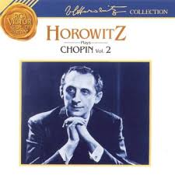
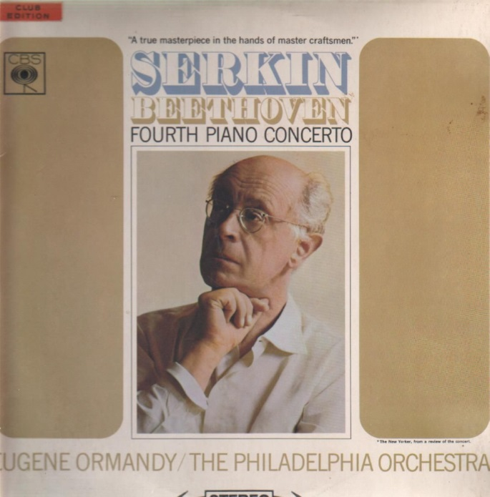

Slide 82
“Selig sind die Toten” (“Blessed Are the Dead”)
(Rev. 14:13)

Slide 83
Beethoven’s “Eroica,” 1949

Slide 84
Chuck Berry,
“Roll Over, Beethoven”
(February 1956)

