Slide 1
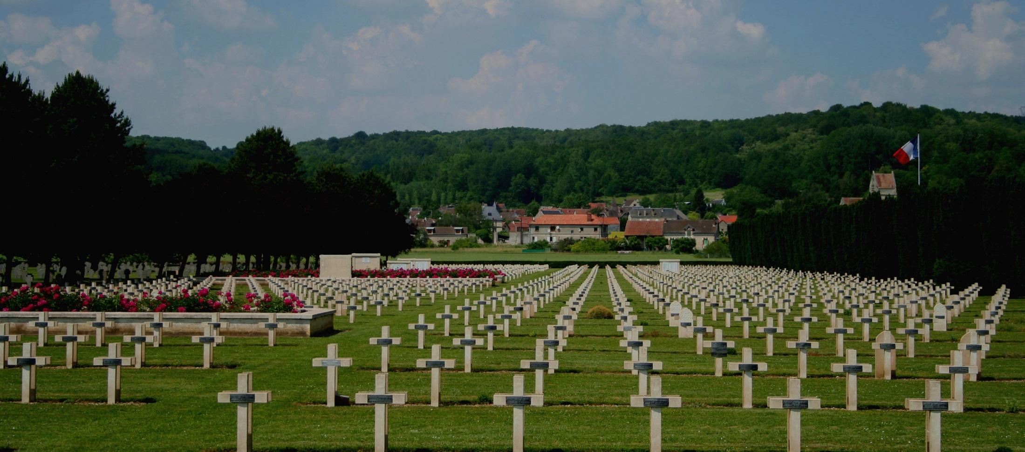

Slide 2
France: The Third Republic, 1870-1940

Slide 3
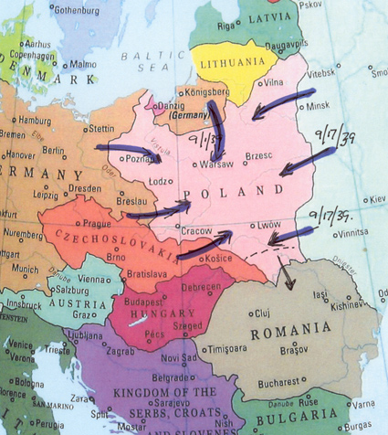
German-Soviet Invasion of Poland, September 1939:
World War II Begins

Slide 4
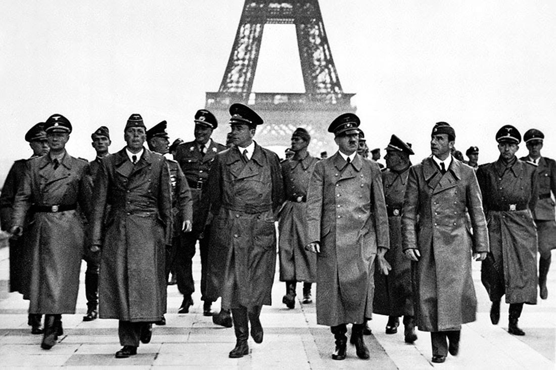

Slide 5
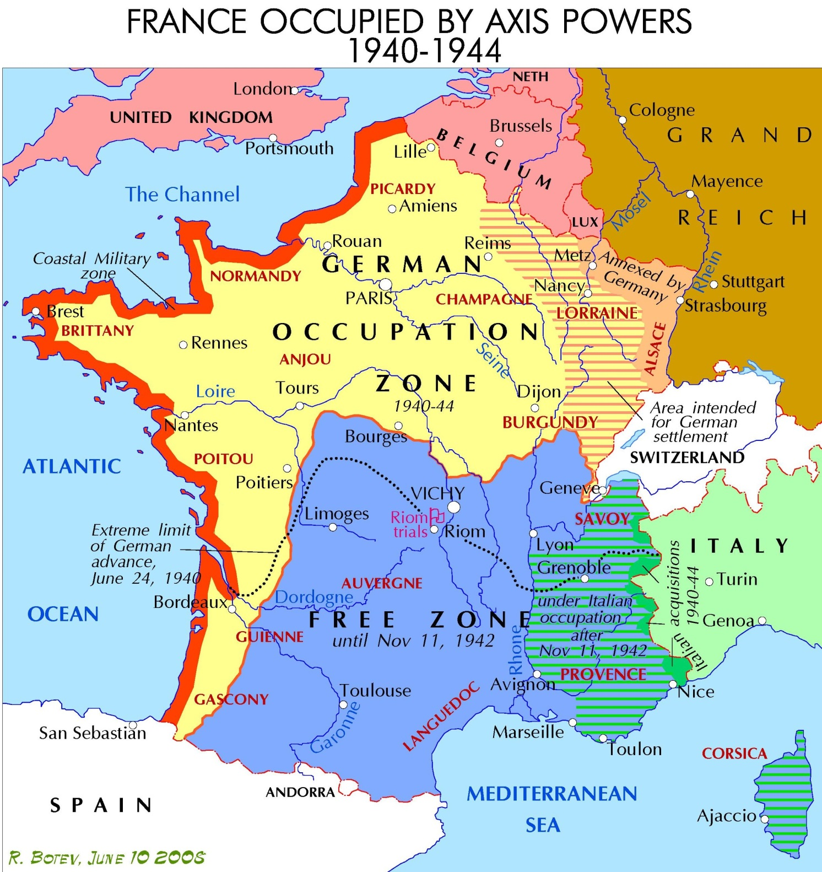

Slide 6
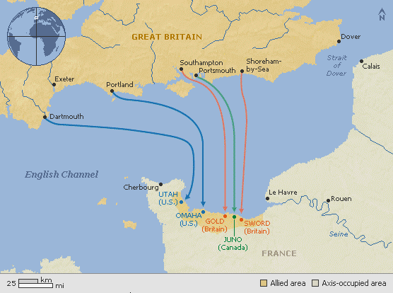
D-Day Invasion, June 6, 1944

Slide 7
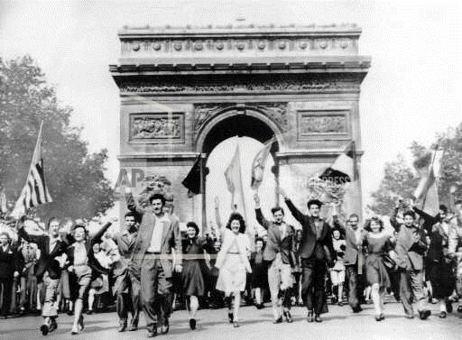
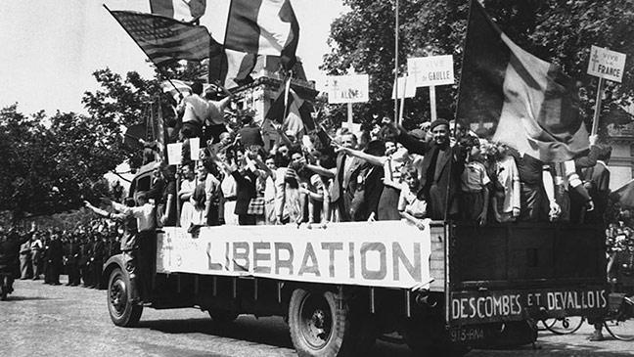
Liberation of Paris,
August 19-24, 1944

Slide 8
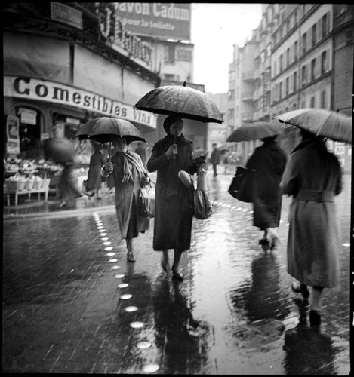
Paris in the 1930s

Slide 9
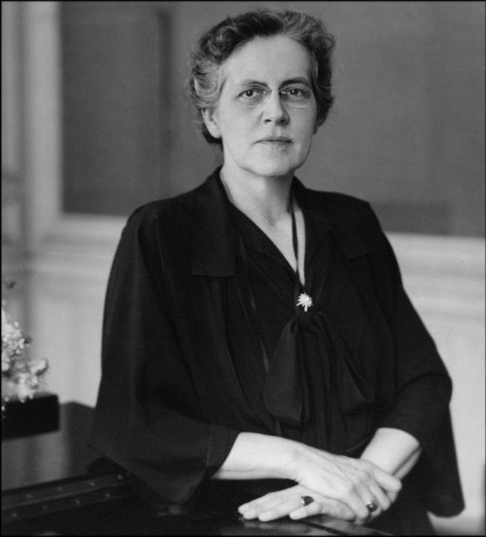
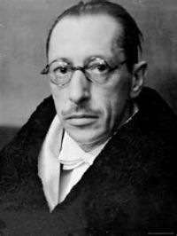
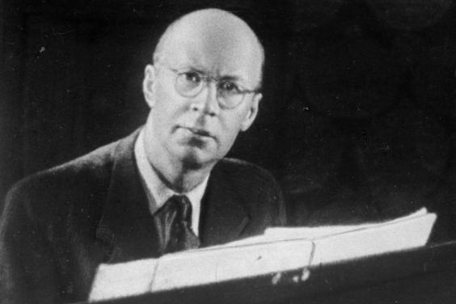

Slide 10
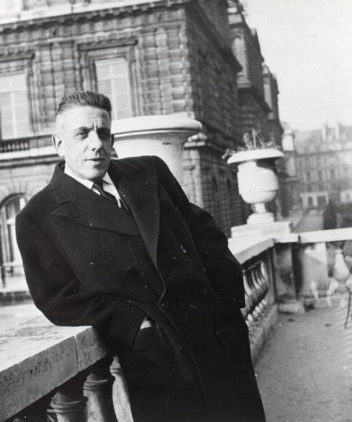
A turn to sacred music:
Litanies à la Vierge Noire (1936)
Mass (1937)
Quatre motets pour un temps de pénitence (1939)
Francis Poulenc

Slide 11
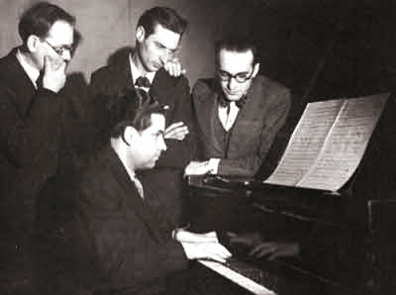
La jeune France (1930s)
Yves Baudrier, Andre Jolivet (at piano), Jean-Yves Daniel-Lesur, Olivier Messiaen

Slide 12
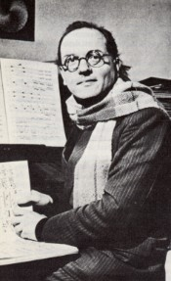
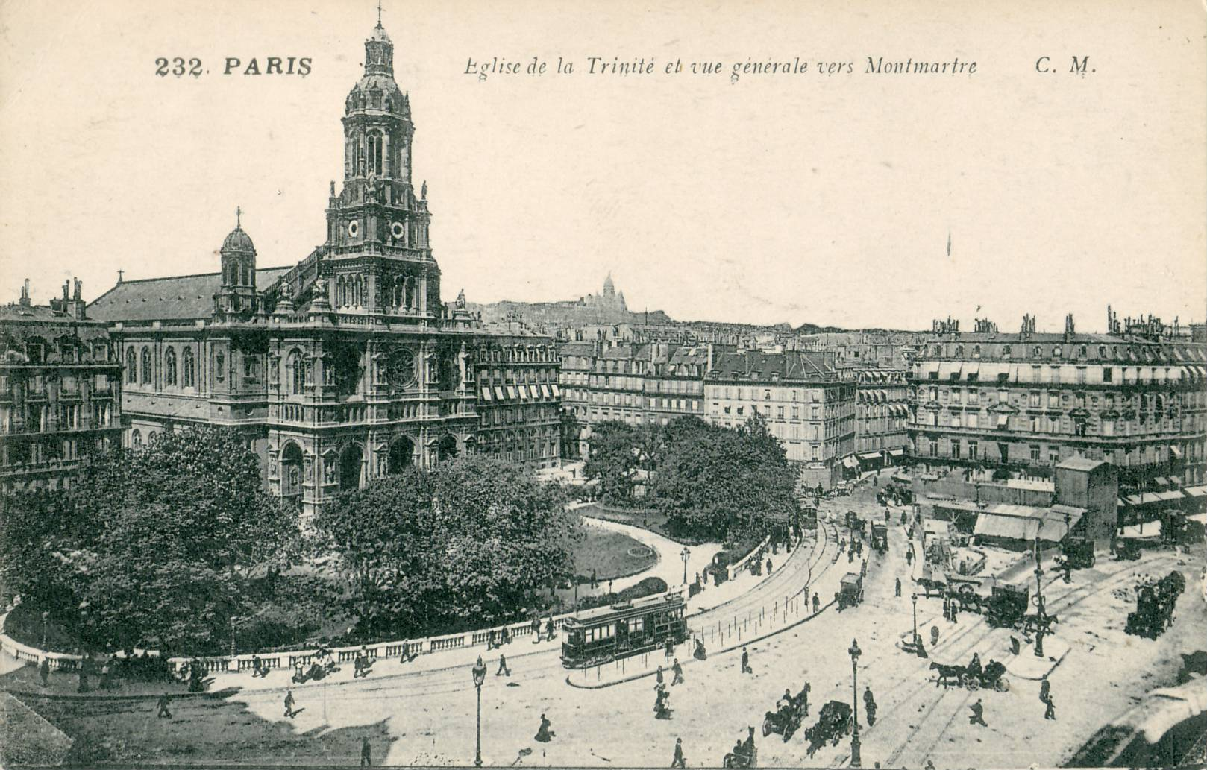
Olivier Messiaen (1908-1992)

Slide 13
Roman Catholic Convictions and Aesthetic
Olivier Messiaen (1908-1992)

Slide 14
Roman Catholic Convictions and Aesthetic
“All my works, religious or not, are an act of faith and glorify the mystery of Christ”
Olivier Messiaen (1908-1992)

Slide 15
Roman Catholic Convictions and Aesthetic
“All my works, religious or not, are an act of faith and glorify the mystery of Christ”
“[I seek to underscore] the theological truths of the Catholic faith. . . . This is the main aspect of my work, the sole aspect which I will perhaps not regret at the hour of my death.”
Olivier Messiaen (1908-1992)

Slide 16
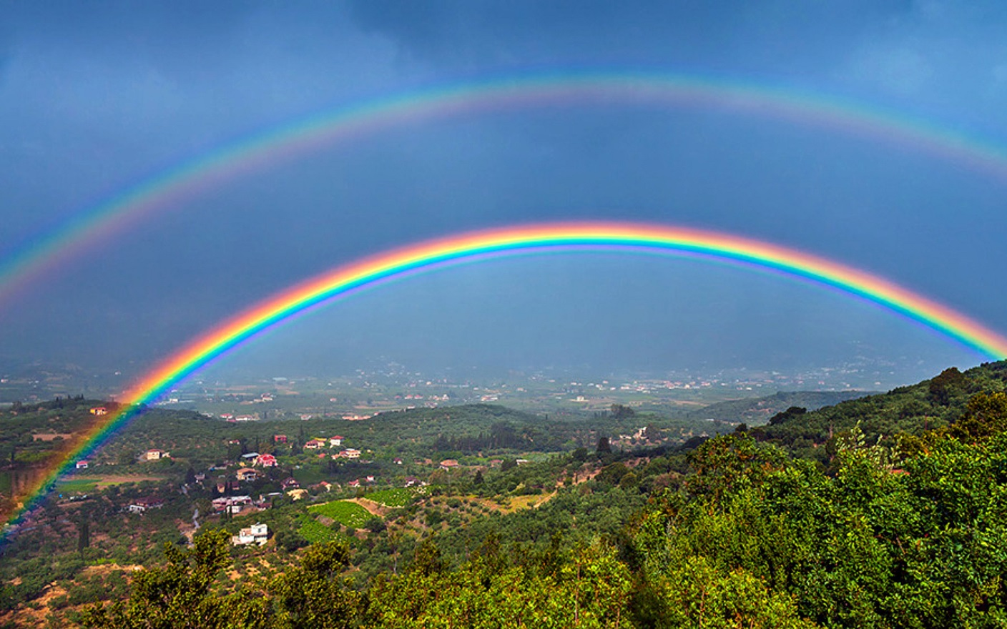
Messiaen, “Antienne de la Conversation intérieur,”
Trois petites liturgies de la Présence Divine, movement 1 (1944)

Slide 17
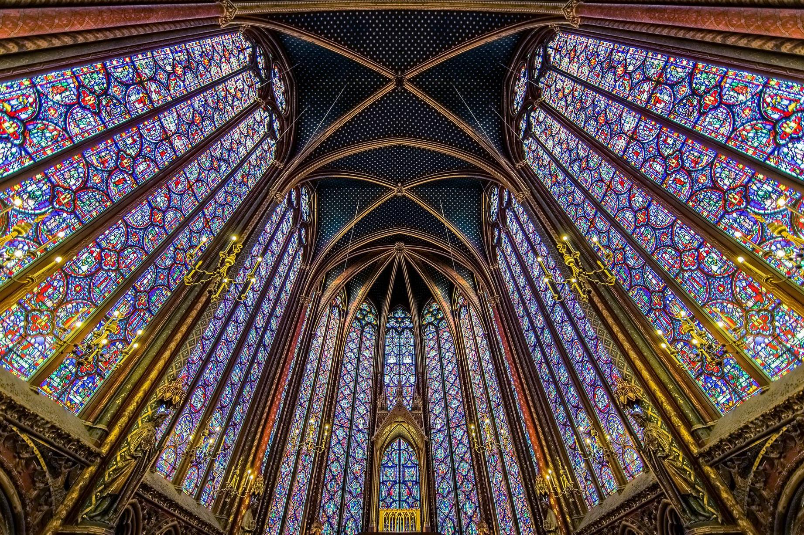
Messiaen, “Antienne de la Conversation intérieur,”
Trois petites liturgies de la Présence Divine, movement 1 (1944)

Slide 18
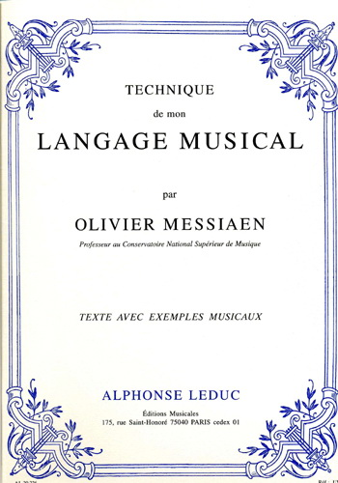
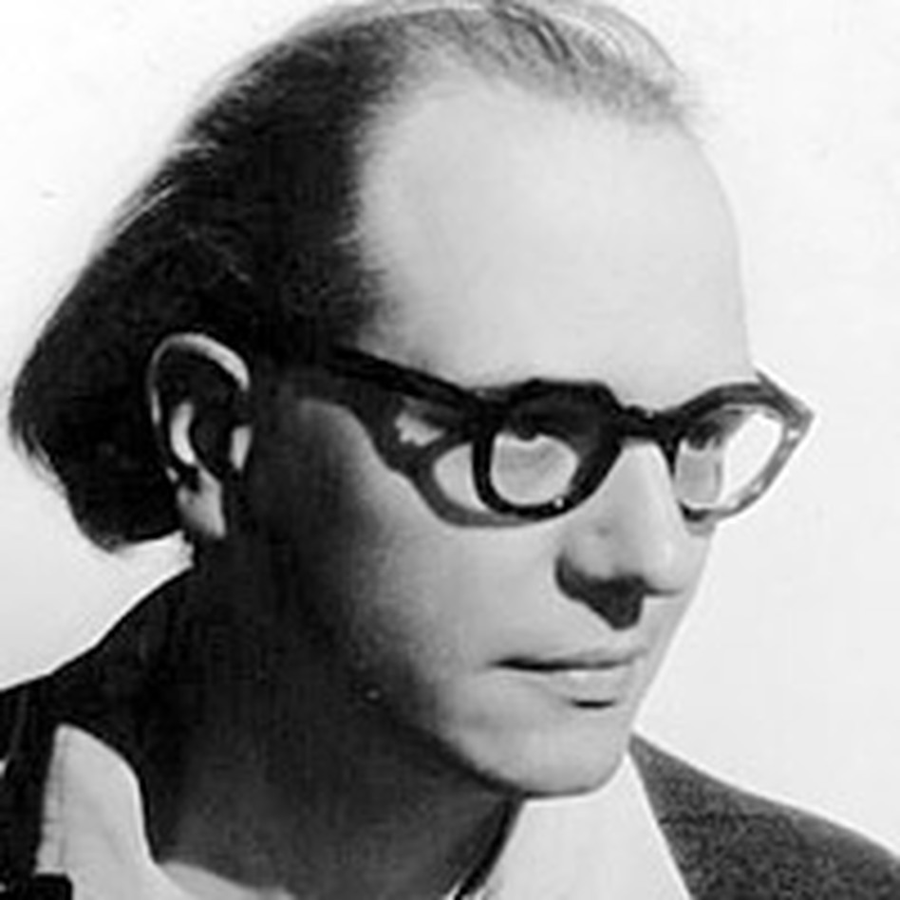
1944

Slide 19
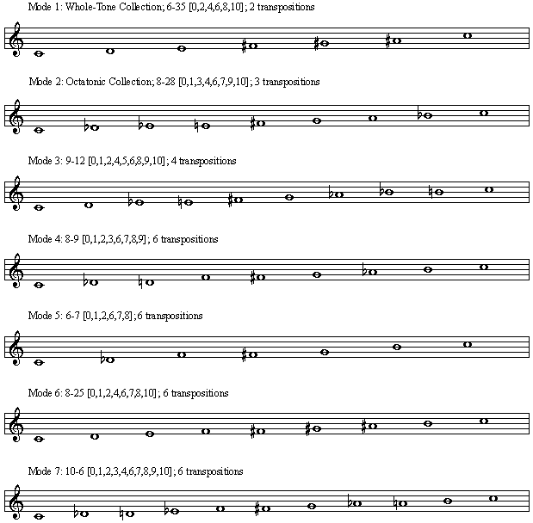
Messiaen: Modes of Limited Transposition

Slide 20
Messiaen: Modes of Limited Transposition

Slide 21
Messiaen, “Antienne de la Conversation intérieur,”
Trois petites liturgies de la Présence Divine, movement 1 (1944)

Slide 22
Messiaen: Theories of Rhythm

Slide 23
Messiaen: Theories of Rhythm
Divisional or additive

Slide 24
Messiaen: Theories of Rhythm
Divisional or additive
Added value; subtracted value

Slide 25
Messiaen: Theories of Rhythm
Divisional or additive
Added value; subtracted value
Augmentation or diminution of a given rhythmic pattern

Slide 26
Messiaen: Theories of Rhythm
Divisional or additive
Added value; subtracted value
Augmentation or diminution of a given rhythmic pattern
Nonretrogradable rhythm

Slide 27
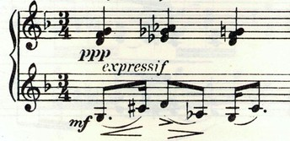
Messiaen: Theories of Rhythm
Divisional or additive
Added value; subtracted value
Augmentation or diminution of a given rhythmic pattern
Nonretrogradable rhythm

Slide 28
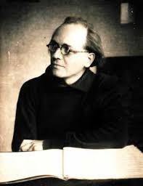
Quatuor pour la fin du temps (1940)
Trois petites liturgies de la Présence Divine (1944)
Vingt regards sur l’Enfant-Jésus (1944)
Turangalîla Symphony (1946-48)
Oiseaux exotiques (1955-56)
Catalogue d’oiseaux (1956-58)

Slide 29
Messiaen, Turangalîla Symphony (1946-48)
Opening of movement 2, “Chant d’amour I”
Cycle 1 Cycle 2
A
B
A
B
A
B
A
B
Intro Episode
Ringing, vigorous Intro & A
Calm, peaceful B, including the sound of the ondes martenot (also heard in the episode)

Slide 30
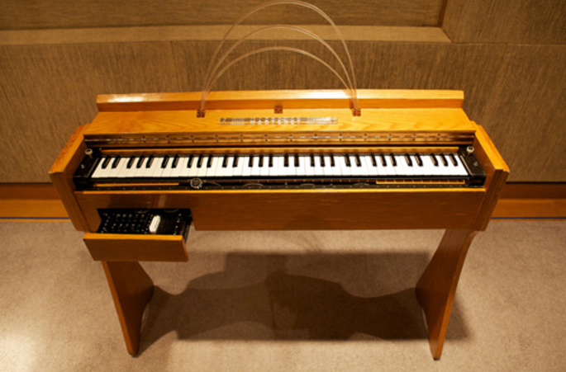
Ondes Martenot

Slide 31
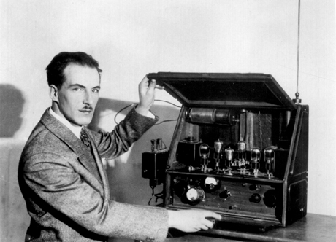
Theremin (early 1920s)
Lev Termen

Slide 32
Messiaen, Turangalîla Symphony (1946-48)
Opening of movement 2, “Chant d’amour I”
Cycle 1 Cycle 2
A
B
A
B
A
B
A
B
Intro Episode
Ringing, vigorous Intro & A
Calm, peaceful B, including the sound of the ondes martenot (also heard in the episode)

Slide 33
Quatuor pour la fin du temps (1940)
Trois petites liturgies de la Présence Divine (1944)
Vingt regards sur l’Enfant-Jésus (1944)
Turangalîla Symphony (1946-48)
Oiseaux exotiques (1955-56)
Catalogue d’oiseaux (1956-58)

Slide 34
Quatuor pour la fin du temps (1940)
Trois petites liturgies de la Présence Divine (1944)
Vingt regards sur l’Enfant-Jésus (1944)
Turangalîla Symphony (1946-48)
Oiseaux exotiques (1955-56)
Catalogue d’oiseaux (1956-58)

Slide 35
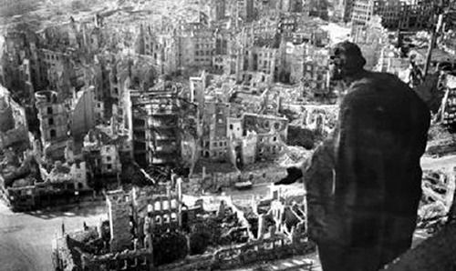
1945

Slide 36
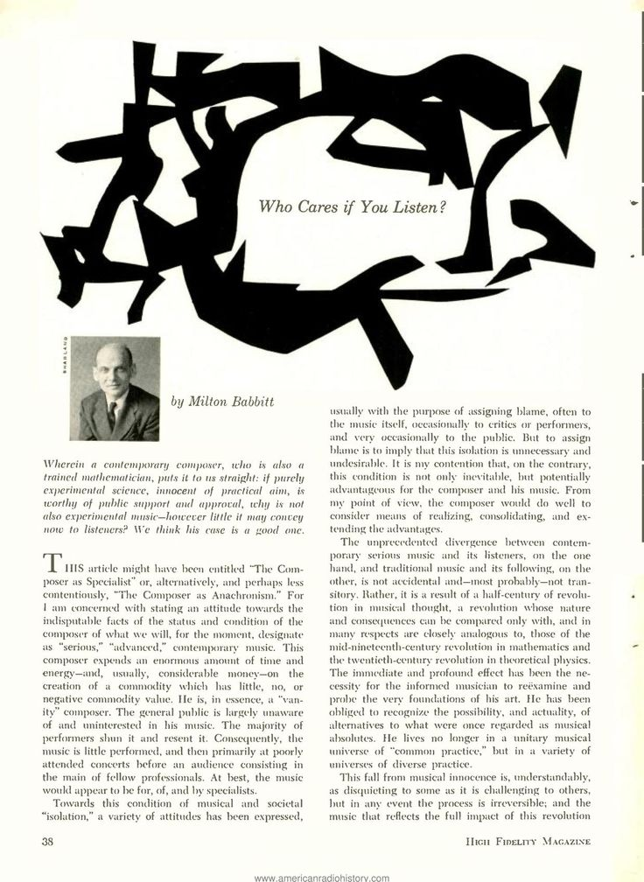
1958

Slide 37
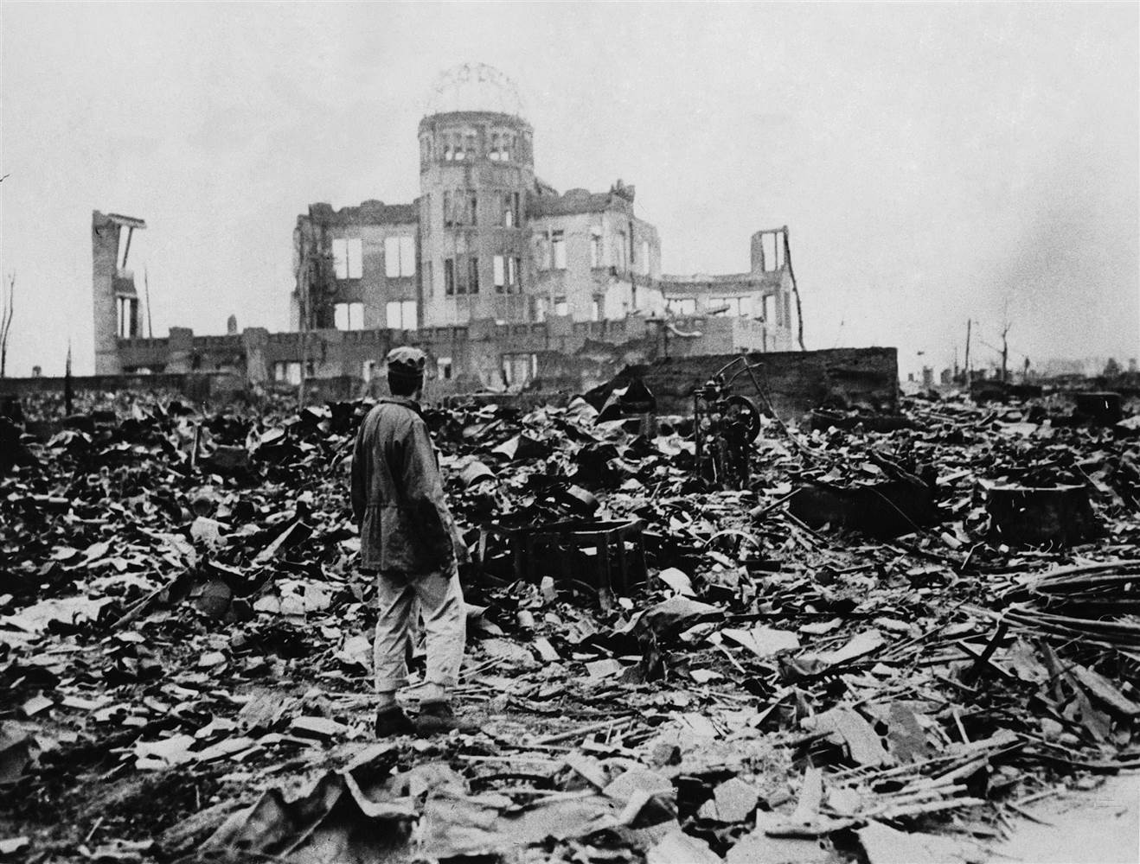
Hiroshima

Slide 38
Dresden

Slide 39
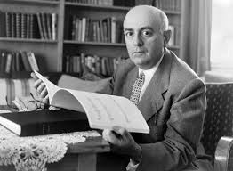
“To write poetry after Auschwitz
is barbaric.”
Theodor W. Adorno

Slide 40
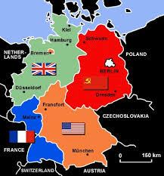
1945: Division of Germany into Four Zones of Occupation

Slide 41
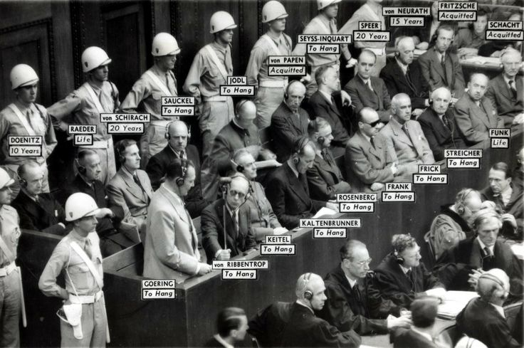
1945-46: Nuremberg Trials

Slide 42
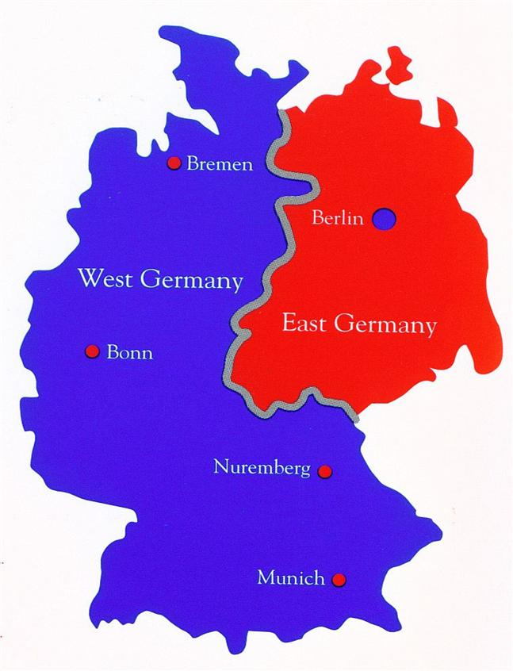
1949: Division of Germany into East and West

Slide 43
“To write poetry after Auschwitz
is barbaric.”
Theodor W. Adorno

Slide 44
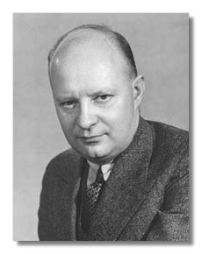
Paul Hindemith

Slide 45
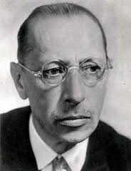
Igor Stravinsky

Slide 46
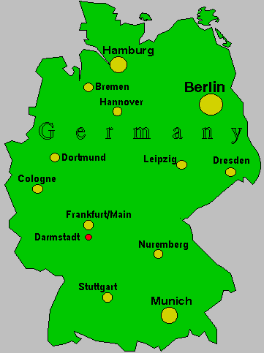

Slide 47
Darmstadt Summer Courses, from 1946 onward

Slide 48
Darmstadt Summer Courses, from 1946 onward
1946 – Wolfgang Fortner

Slide 49
Darmstadt Summer Courses, from 1946 onward
1946 – Wolfgang Fortner
1947 – Paul Hindemith

Slide 50
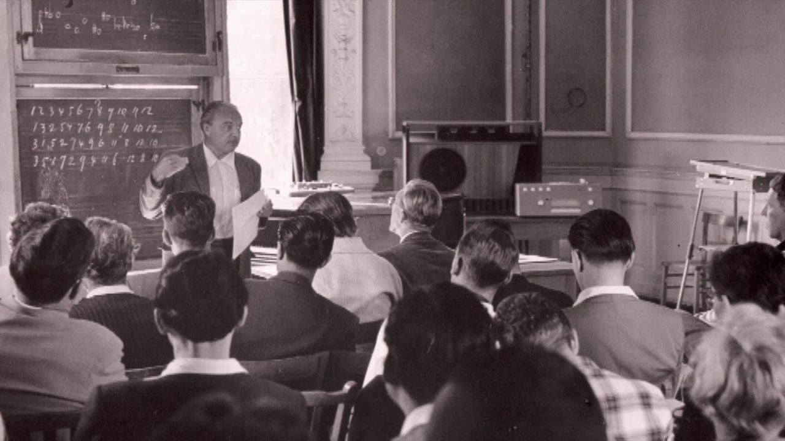
Darmstadt Summer Courses, from 1946 onward
1946 – Wolfgang Fortner
1947 – Paul Hindemith
1948 – René Leibowitz (Schoenberg et son école, 1946)

Slide 51
Darmstadt Summer Courses, from 1946 onward
1946 – Wolfgang Fortner
1947 – Paul Hindemith
1948 – René Leibowitz (Schoenberg et son école, 1946)
1949 – Olivier Messiaen; and first admission of foreign students

Slide 52
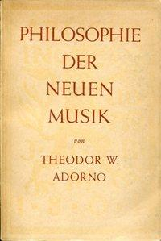
Darmstadt Summer Courses, from 1946 onward
1946 – Wolfgang Fortner
1947 – Paul Hindemith
1948 – René Leibowitz (Schoenberg et son école, 1946)
1949 – Olivier Messiaen; and first admission of foreign students
pro-Schoenberg
anti-Stravinsky
and . . .

Slide 53
Darmstadt Summer Courses, from 1946 onward
1946 – Wolfgang Fortner
1947 – Paul Hindemith
1948 – René Leibowitz (Schoenberg et son école, 1946)
1949 – Olivier Messiaen; and first admission of foreign students
1950 – Ernst Krenek and Edgard Varèse
. . . . . . . .

Slide 54
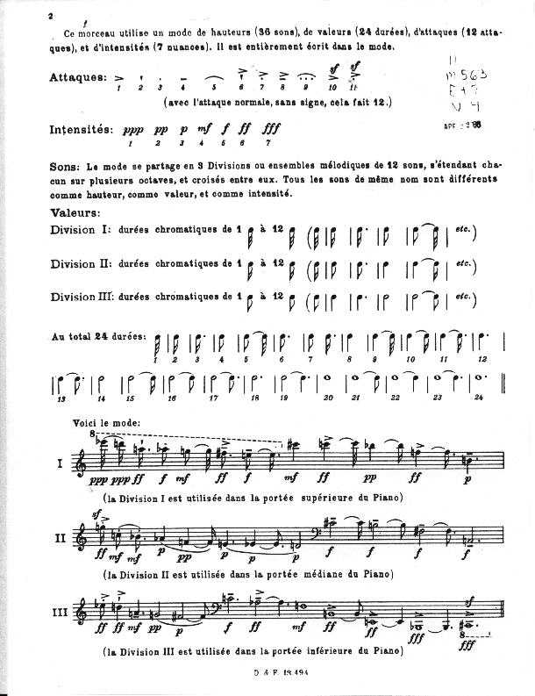
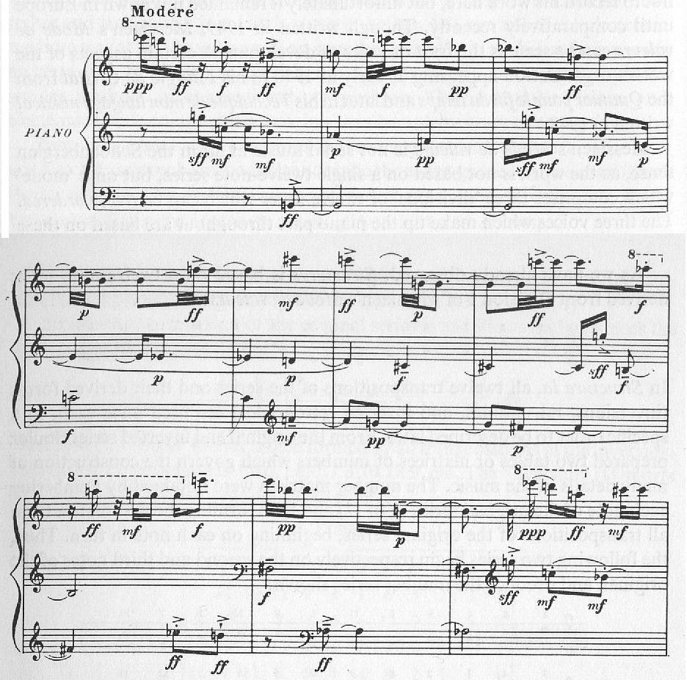
Messiaen, “Mode de valeurs et d’intensités” (1949)

Slide 55
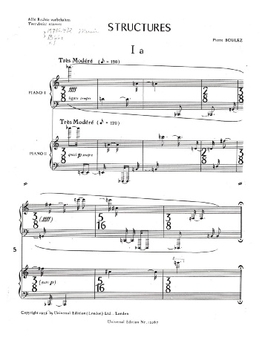

Slide 56
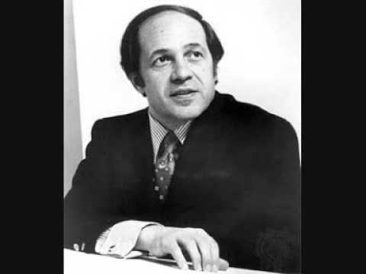
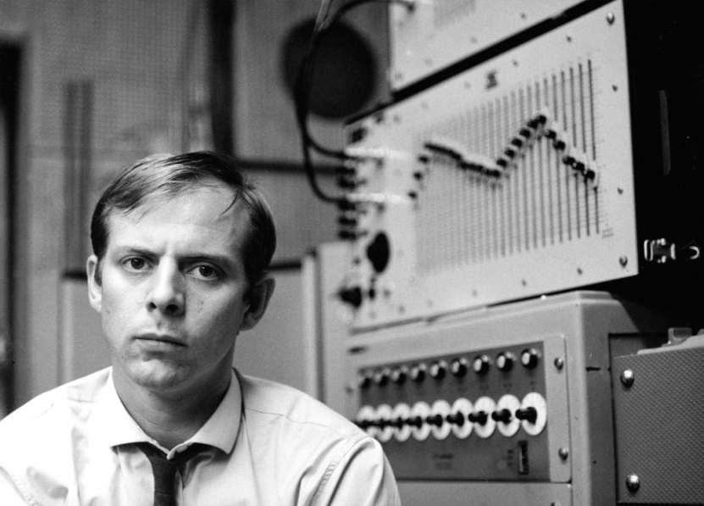
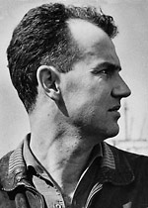
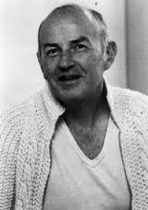
Darmstadt, 1953: Declaration of Allegiance to Webern
Pierre Boulez Karlheinz Stockhausen
Luigi Nono Karel Goeyvaerts

