Slide 1
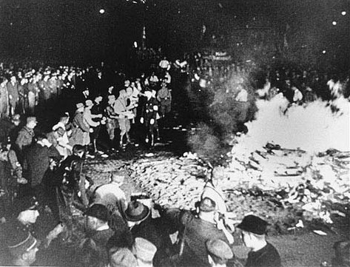
Germany, 1920-1945

Slide 2
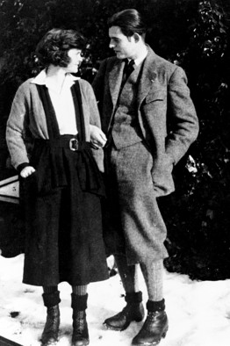
The Arts in the 1920s
The collapse of pre-war idealism – disillusion, “the lost generation”

Slide 3
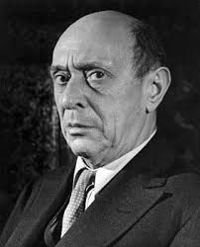
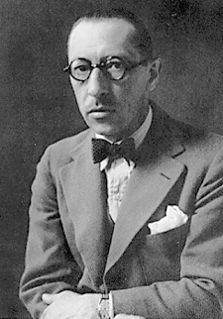
The Arts in the 1920s
The collapse of pre-war idealism – disillusion, “the lost generation”
Within art music: searches for new systems of objective order

Slide 4
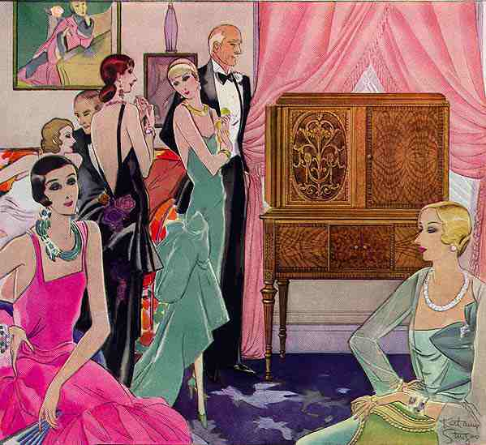
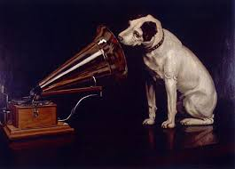
The Arts in the 1920s
The collapse of pre-war idealism – disillusion, “the lost generation”
Within art music: searches for new systems of objective order
New, commercialized media technologies sweep over Europe and America: radio, sound recording, film

Slide 5
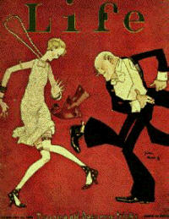
The Arts in the 1920s
The collapse of pre-war idealism – disillusion, “the lost generation”
Within art music: searches for new systems of objective order
New, commercialized media technologies sweep over Europe and America: radio, sound recording, film
And with them, a new age emerges: a broader industrialization of mass/popular culture and post-WWI fashion

Slide 6
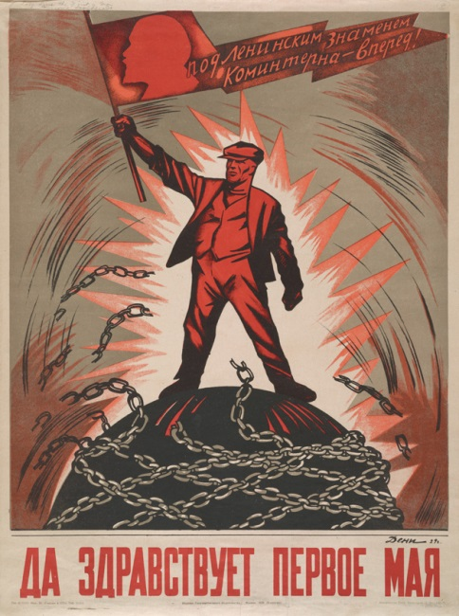
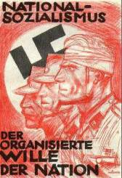
The Arts in the 1920s
The collapse of pre-war idealism – disillusion, “the lost generation”
Within art music: searches for new systems of objective order
New, commercialized media technologies sweep over Europe and America: radio, sound recording, film
And with them, a new age emerges: a broader industrialization of mass/popular culture and post-WWI fashion
Within elite-class European music: the politicization of the aesthetic: politics, left and right, are becoming the primary means of assessing artistic worth and impact.

Slide 7
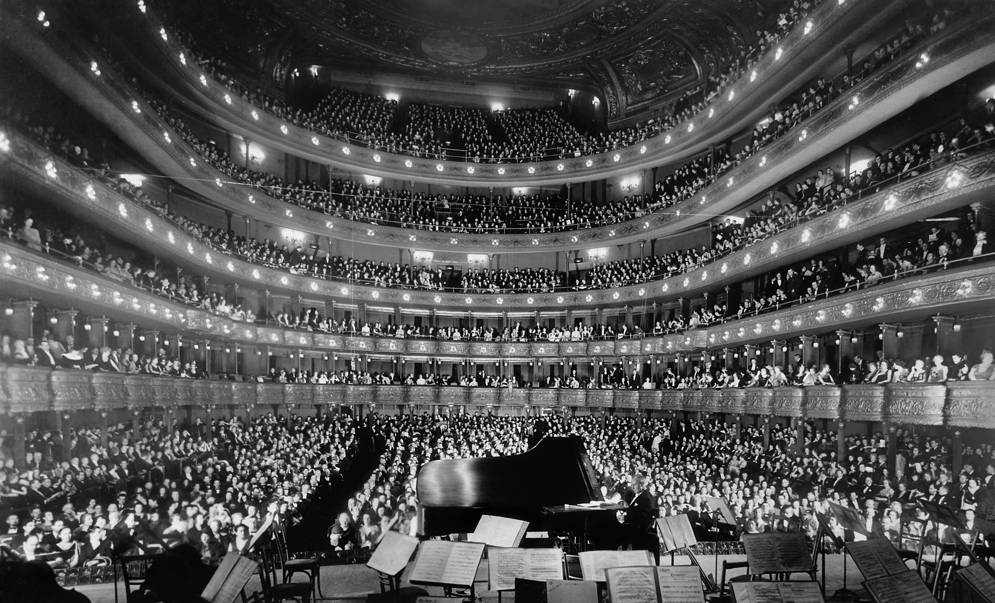

Slide 8
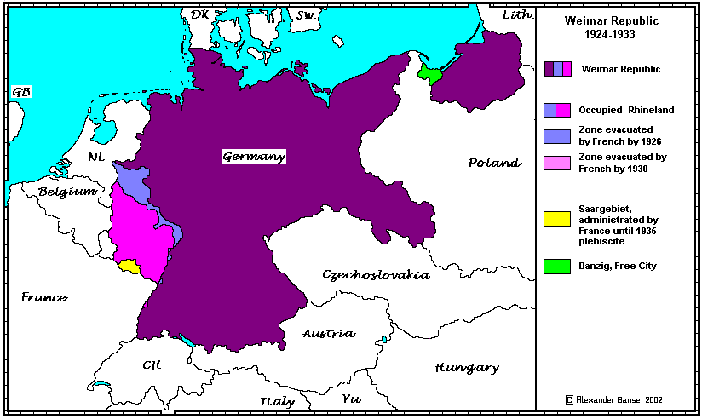

Slide 9
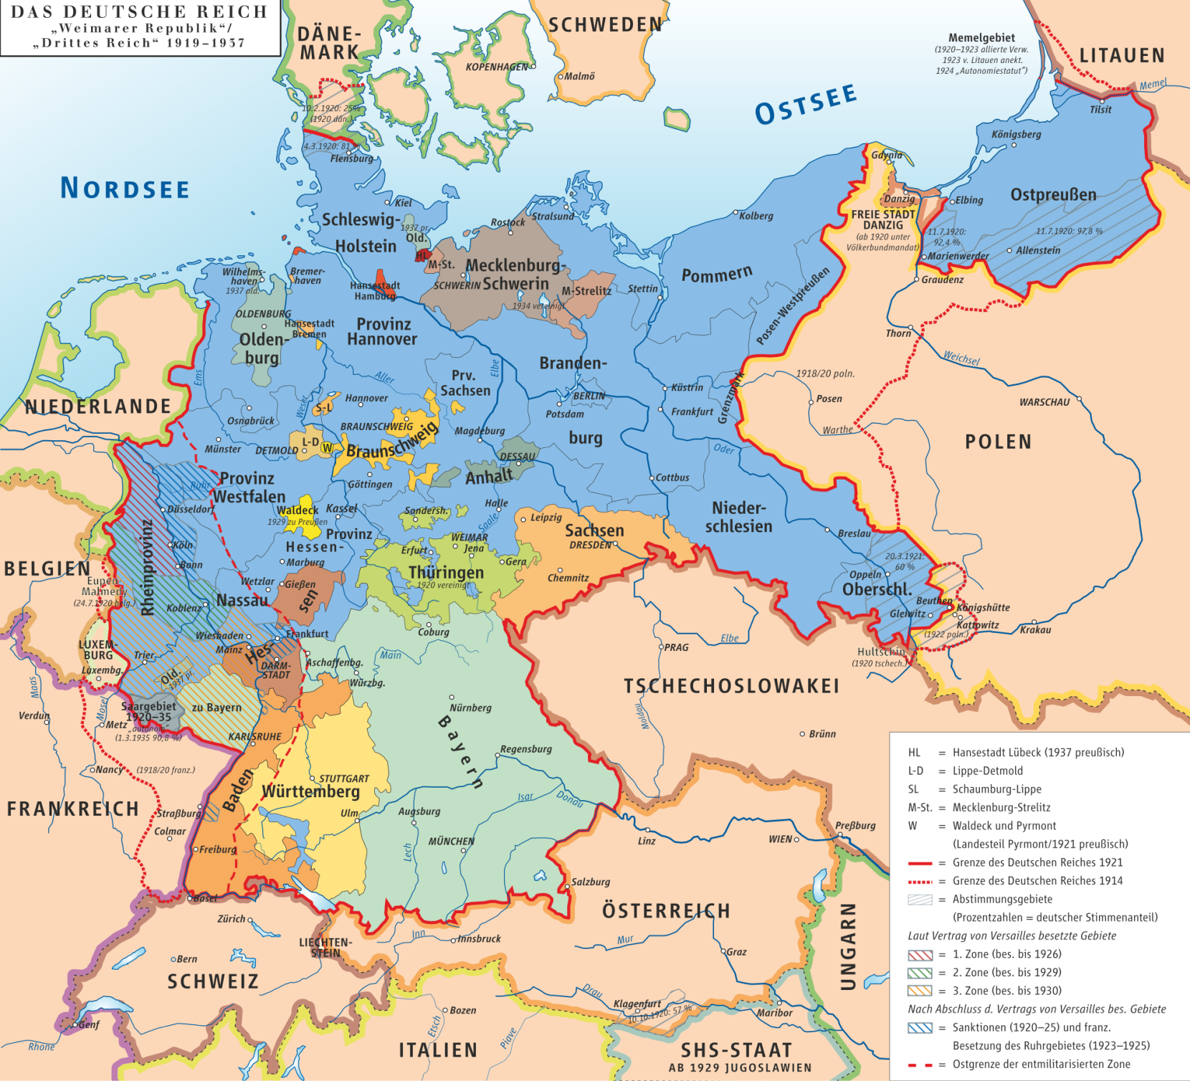

Slide 10
Germany, mid-to-late 1920s:
anti-idealism; the “new objectivity” (Neue Sachlichkeit) movement

Slide 11
Weimar Germany, 1920s: Zeitoper (“opera about the [current] time”)

Slide 12
Weimar Germany, 1920s: Zeitoper (“opera about the [current] time”)
Simpler, more accessible style
Urban-modern up-to-date plots
Incorporation of diverse styles, including jazz, cabaret and dance music

Slide 13
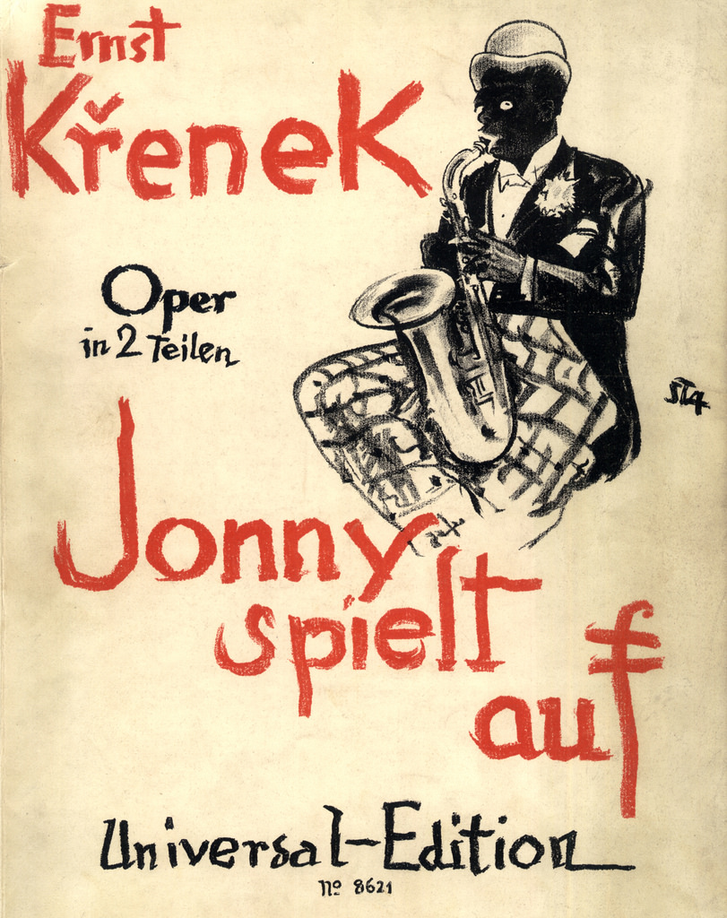
Weimar Germany, 1920s: Zeitoper
1927

Slide 14
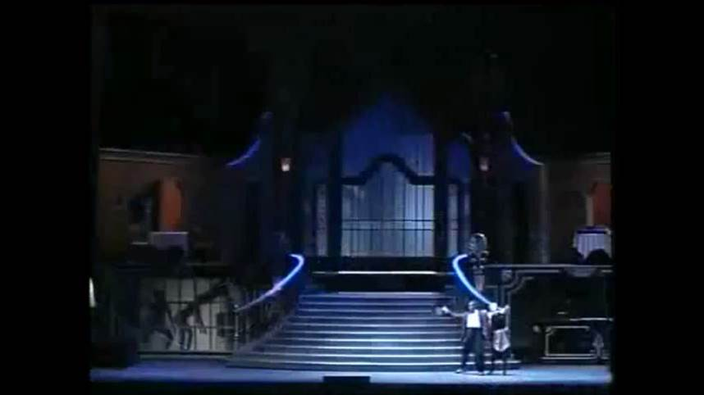
Ernst Krenek, “Leb’ wohl, mein Schatz,” Jonny spielt auf (1927)

Slide 15
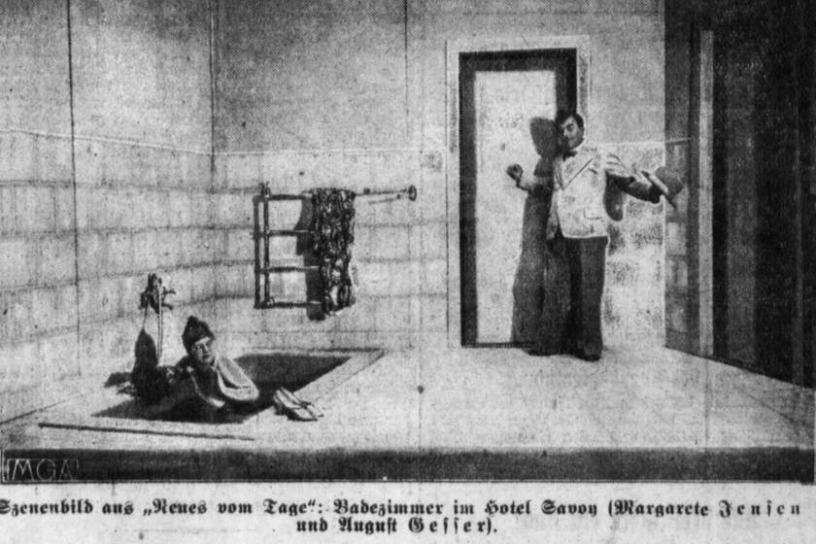
Zeitoper: Hindemith, Neues vom Tage (1929)

Slide 16
Scene-extracts from Hindemith, Neues vom Tage (1929)
Production: Theater Münster (2013)

Slide 17
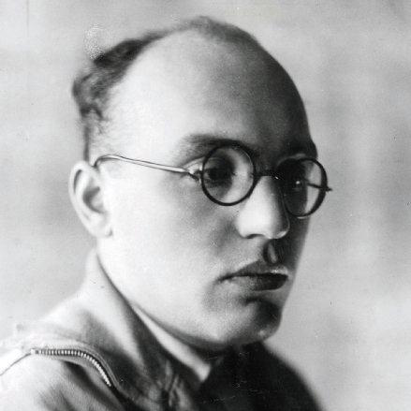
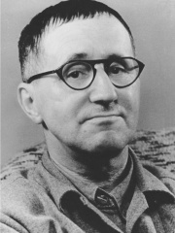
Mahagonny-Songspiel (1927)
Die Dreigroschenoper (1928
Kurt Weill
Bertolt Brecht

Slide 18
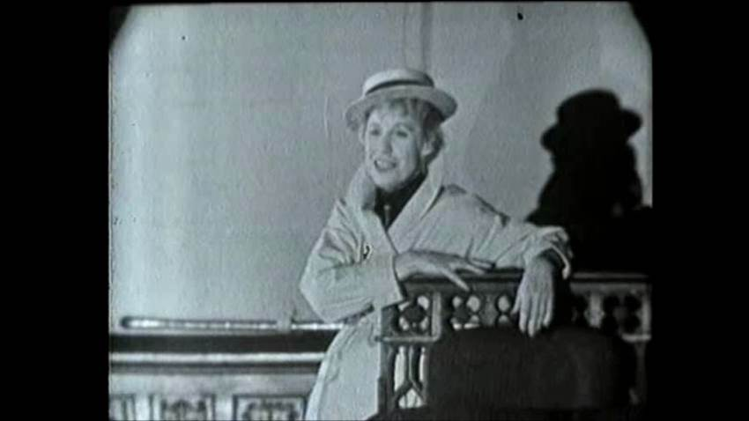
Lotte Lenya sings “Alabama Song” (Mahagonny-Songspiel)

Slide 19
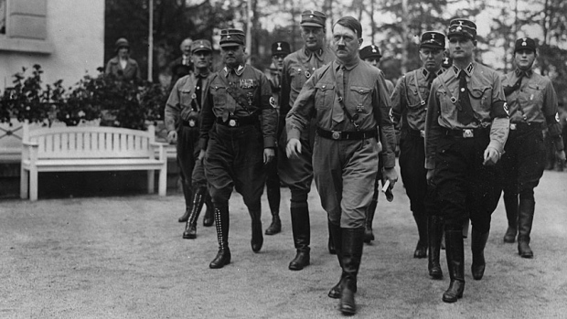
1933

Slide 20
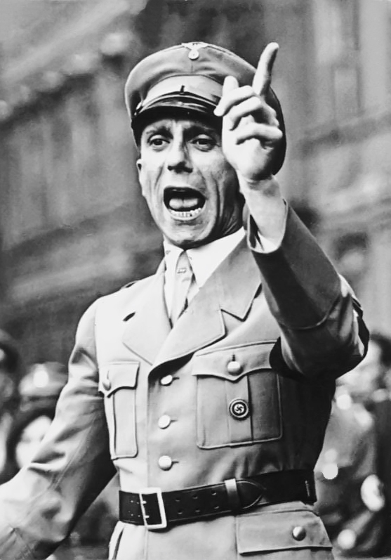
1933

Slide 21
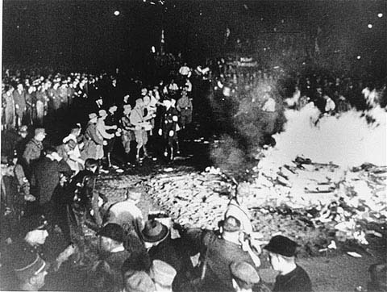
1933

Slide 22
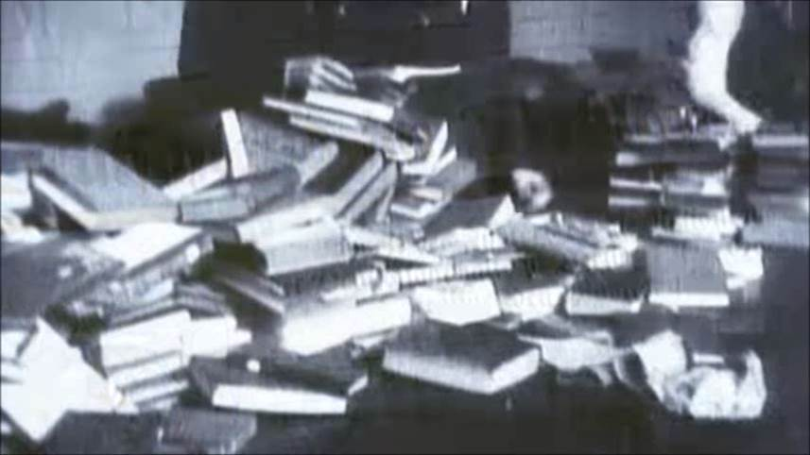
1933

Slide 23
1933
Reichsmusikkammer (Reich Cultural Chamber for Music)

Slide 24
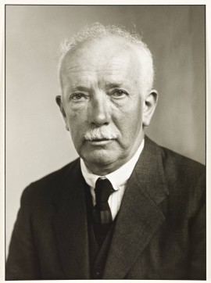
1933
Reichsmusikkammer (Reich Cultural Chamber for Music)
First President, 1933-35
Richard Strauss

Slide 25
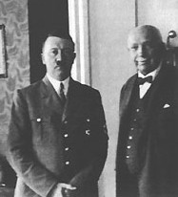
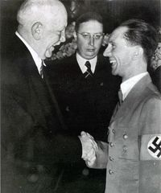
1933
Reichsmusikkammer (Reich Cultural Chamber for Music)

Slide 26
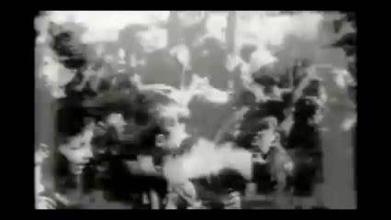
Hitler arrives in Bayreuth, 1940, for a production of Die Meistersinger (1943)

Slide 27
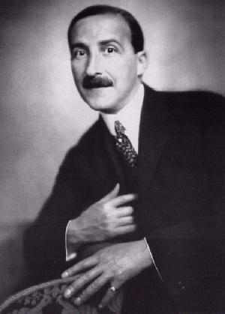
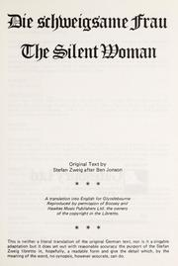
Richard Strauss Stefan Zweig

Slide 28
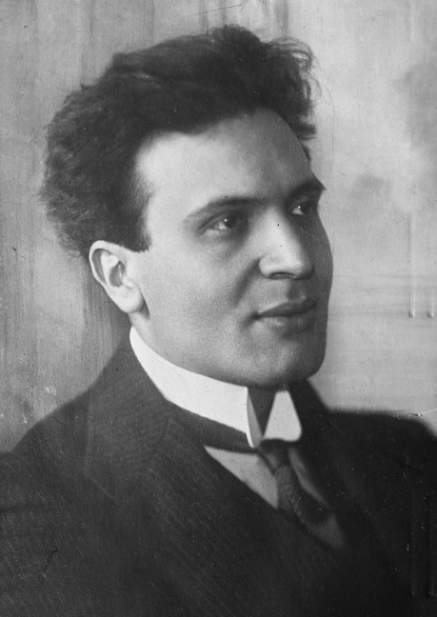
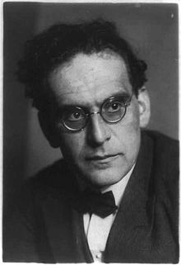
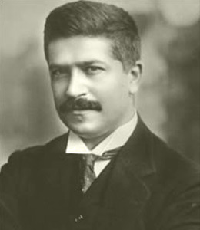
Arnold Schoenberg Kurt Weill
Bruno Walter Otto Klemperer Artur Schnabel

Slide 29
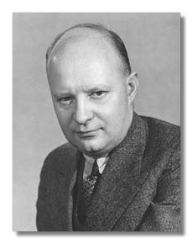
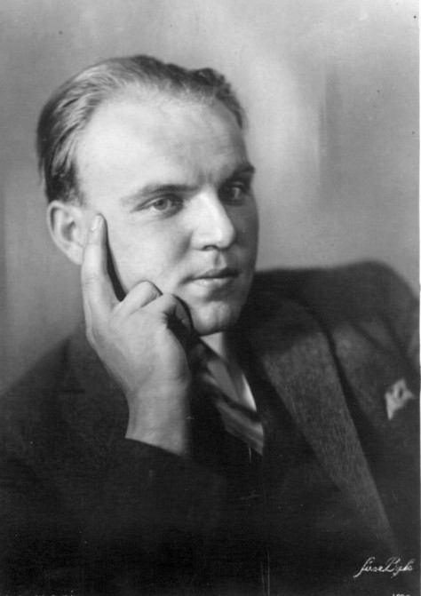
Paul Hindemith Ernst Krenek

Slide 30
Musicologists Fleeing Nazi Germany
(The de facto founding of musicology in America)
Leo Schrade (Yale)
Paul Henry Lang (Columbia)
Willi Apel (Harvard, Indiana University)
Curt Sachs (New York University, New York Public Library)
Karl Geiringer (Boston University)
Manfred Bukofzer (University of California, Berkeley)
Alfred Einstein (Smith, Columbia, Princeton, Michigan)

Slide 31
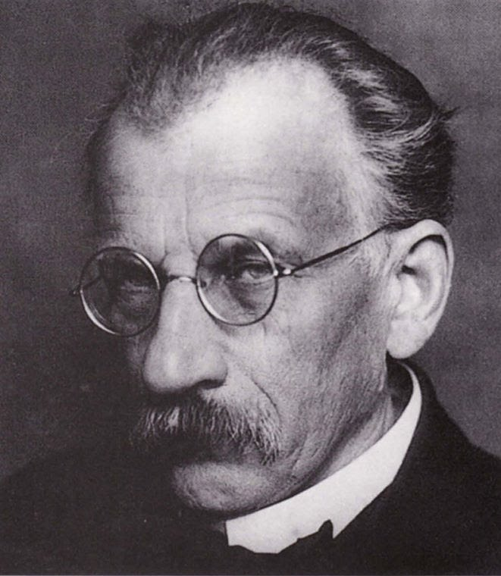
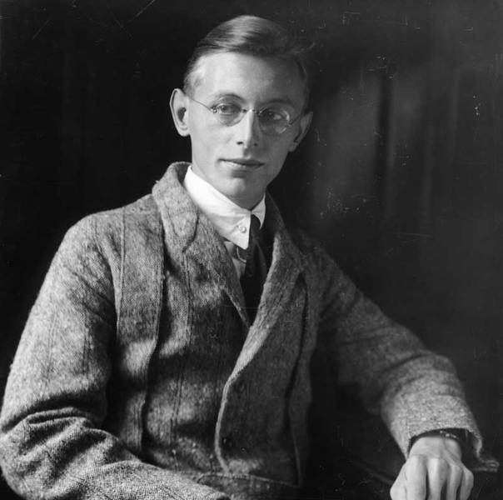
Hans Pfitzner Carl Orff

Slide 32
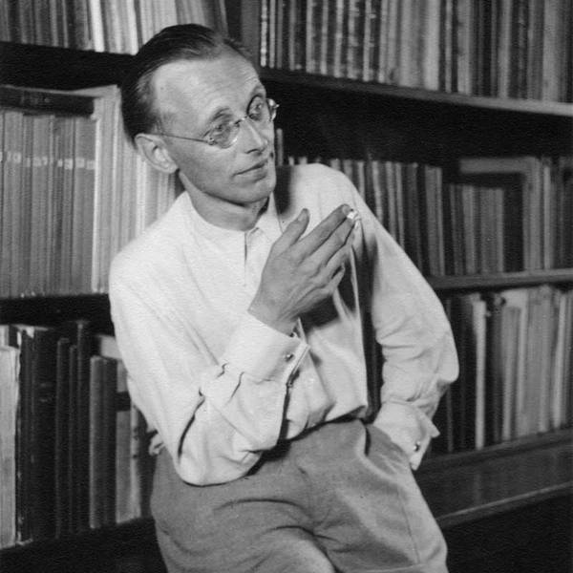
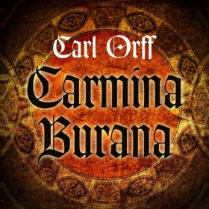
1936

Slide 33
Paul Hindemith (1895-1963)

Slide 34
Opera, Mathis der Maler (1934)
Paul Hindemith (1895-1963)

Slide 35
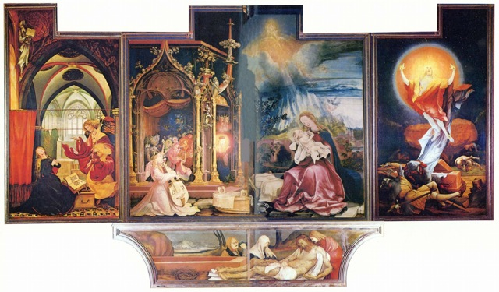
At the center of Mathis der Maler: Mathis Grünewald’s painting of
“The Isenheim Altarpiece” prior to the 16th-century “German Peasants’ War”

Slide 36
Mathis der Maler: Metaphors
The need for
all art to withdraw from political manipulation
Hindemith’s
withdrawal into
contemplative
art
Mathis’s
withdrawal into
art
St. Anthony’s
withdrawal into
religion

Slide 37
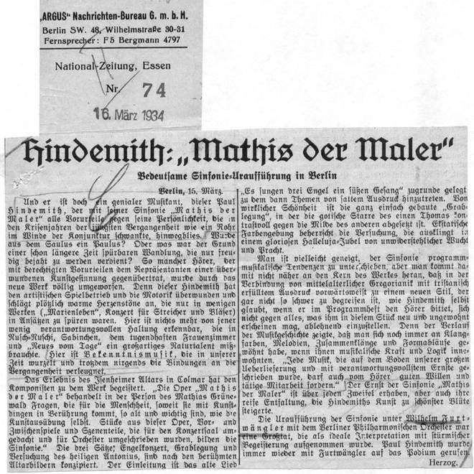
The Campaign against Hindemith

Slide 38
Hindemith: Symphony, “Mathis der Maler,” first movement, introduction
“Es sungen drei Engel”
Solemn
Chords: Invocation
1 2 3
Solemn
Chords: Invocation
Trombones horns full orch + glockenspiel
Sonic Disclosure in Three Cycles

Slide 39
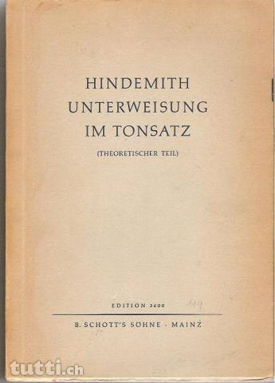
Paul Hindemith (1895-1963)
1937

Slide 40
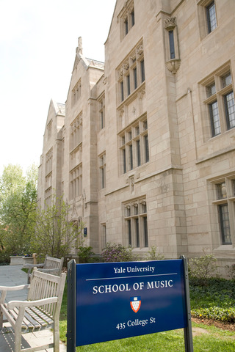
Paul Hindemith (1895-1963)
Yale School of Music, 1940-53

Slide 42
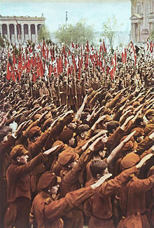
The Horst Wessel Song
Die Fahne hoch! Die Reihen fest geschlossen!
SA marschiert mit ruhig festem Schritt.
Kam'raden, die Rotfront und Reaktion erschossen,
Marschier'n im Geist in unser'n Reihen mit.
Kam'raden, die Rotfront und Reaktion erschossen,
Marschier'n im Geist in unser'n Reihen mit.
Die Straße frei den braunen Batallionen.
Die Straße frei dem Sturmabteilungsmann!
Es schau'n aufs Hakenkreuz voll Hoffnung schon Millionen.
Der Tag für Freiheit und für Brot bricht an!
Es schau'n aufs Hakenkreuz voll Hoffnung schon Millionen.
Der Tag für Freiheit und für Brot bricht an!
The flag on high! The ranks tightly closed!
The SA marches with quiet, steady step.
Comrades shot by the Red Front and reactionaries
March in spirit within our ranks.
Comrades shot by the Red Front and reactionaries
March in spirit within our ranks.
Clear the streets for the brown battalions,
Clear the streets for the storm division!
Millions are looking upon the swastika full of hope,
The day of freedom and of bread dawns!
Millions are looking upon the swastika full of hope,
The day of freedom and of bread dawns!

Slide 44
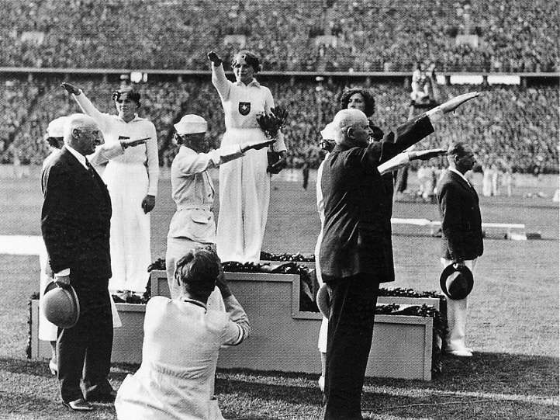
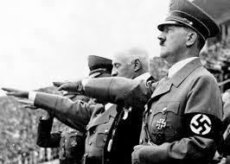
Hitler and the 1936 Olympics in Germany

Slide 45
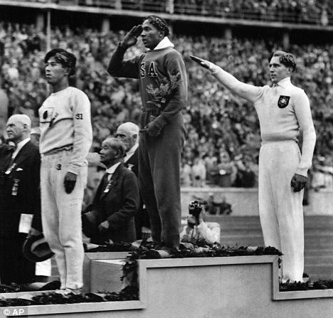
Hitler and the 1936 Olympics in Germany
Jesse Owens, USA Track and Field, Wins Four Gold Medals

Slide 47
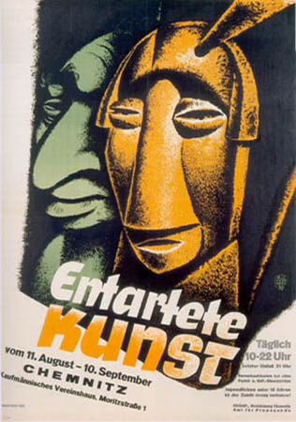
One Climax of Third Reich Artistic Politics:
The Exhibition of “Degenerate Art,” Munich and elsewhere, July-November 1937

Slide 48
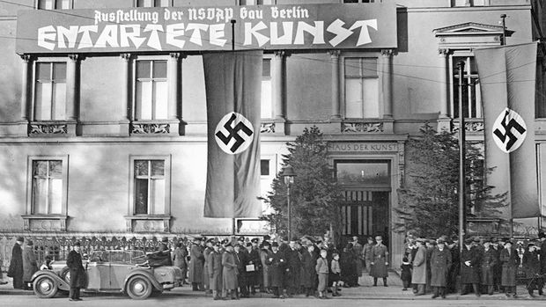
One Climax of Third Reich Artistic Politics:
The Exhibition of “Degenerate Art,” Munich and elsewhere, July-November 1937

Slide 49
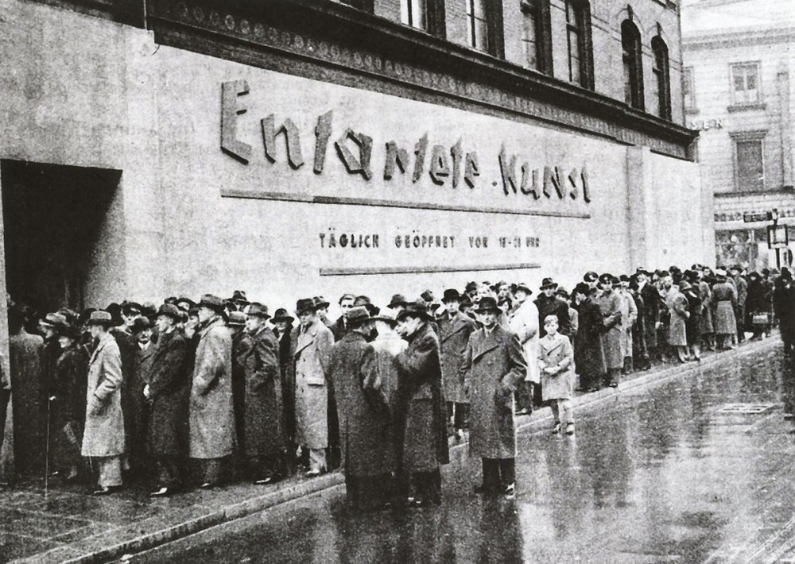
One Climax of Third Reich Artistic Politics:
The Exhibition of “Degenerate Art,” Munich and elsewhere, July-November 1937

Slide 50
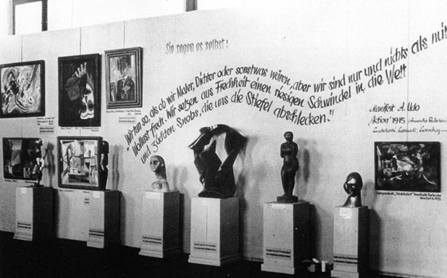
One Climax of Third Reich Artistic Politics:
The Exhibition of “Degenerate Art,” Munich and elsewhere, July-November 1937

Slide 51
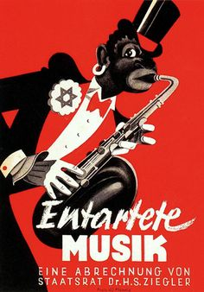
An offshoot of the “Degenerate Art” Exhibition:
The Reichsmusiktage, Düsseldorf, May 22-29, 1938,
including recordings of culturally objectionable “Degenerate Music”

Slide 52
An offshoot of the “Degenerate Art” Exhibition:
The Reichsmusiktage, Düsseldorf, May 22-29, 1938,
including recordings of culturally objectionable “Degenerate Music”

Slide 53
1933-34 – Overt anti-Semitic discrimination; initial concentration camps begun

Slide 54
The Hitler-Stalin Pact, August 23, 1939

Slide 55
German-Soviet Invasion of Poland, September 1939:
World War II Begins

Slide 56
1933-34 – Overt anti-Semitic discrimination; initial concentration camps begun
Late 1939, shortly after outbreak of the war – Hitler approves the mass killing of Jews

Slide 57
1933-34 – Overt anti-Semitic discrimination; initial concentration camps begun
Late 1939, shortly after outbreak of the war – Hitler approves the mass killing of Jews
Mid-1941 – Nazi officials seeking a more “total solution of the Jewish question”

Slide 58
1933-34 – Overt anti-Semitic discrimination; initial concentration camps begun
Late 1939, shortly after outbreak of the war – Hitler approves the mass killing of Jews
Mid-1941 – Nazi officials seeking a more “total solution of the Jewish question”
January 1942 – “The Final Solution,” Wannsee Conference, outside of Berlin: decision to round up all Jews and send them to specially designed extermination camps: Auschwitz, Theresienstadt, Dachau, etc.

Slide 59
Beethoven: Symphony No. 9, conclusion of finale,
Wilhelm Furtwängler, Berlin Philharmonic
“April 20, 1942, Celebration of Hitler’s Birthday”
Alle Menschen werden Brüder / Wo dein sanfter Flügel weilt . . . .
Seid umschlungen, Millionen / Diesen Kuss der ganzen Welt . . . .
Freude, schöne Götterfunken.

