Slide 1
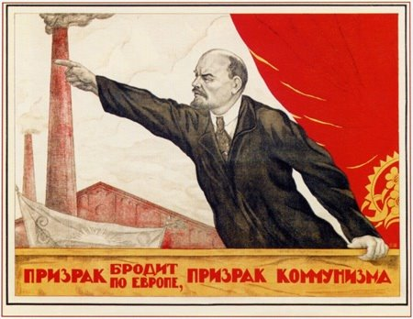

Slide 2
Shostakovich, Symphony No. 5, finale (1937)

Slide 3
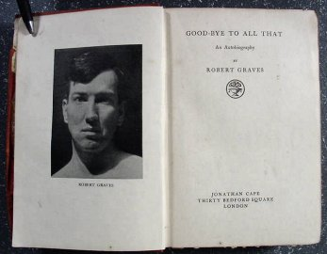

Slide 4
1920s: Decisive Tip of the Balance
“Art”
Politics

Slide 5
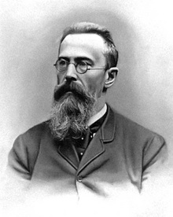
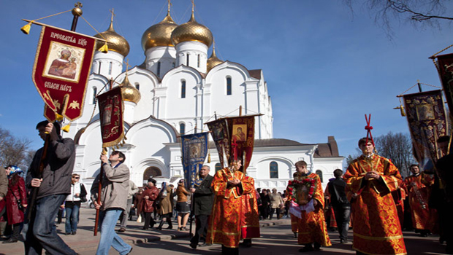
Nikolai Rimsky-Korsakov
“Russian Easter Festival Overture” (1888)

Slide 6
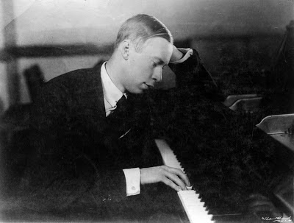
Sergey Prokofiev (1891-1953)

Slide 7
Sergey Prokofiev, Piano Concerto No. 3, first movement:
Prokofiev, piano; Piero Coppola, London Symphony Orchestra (rec. 1932)

Slide 8
The Russian Dilemma
“Art for Art’s Sake”

Slide 9
The Russian Dilemma
“Art for Art’s Sake”
Or: an anti-elitist
“art for the people”
to further social or political agendas?

Slide 10
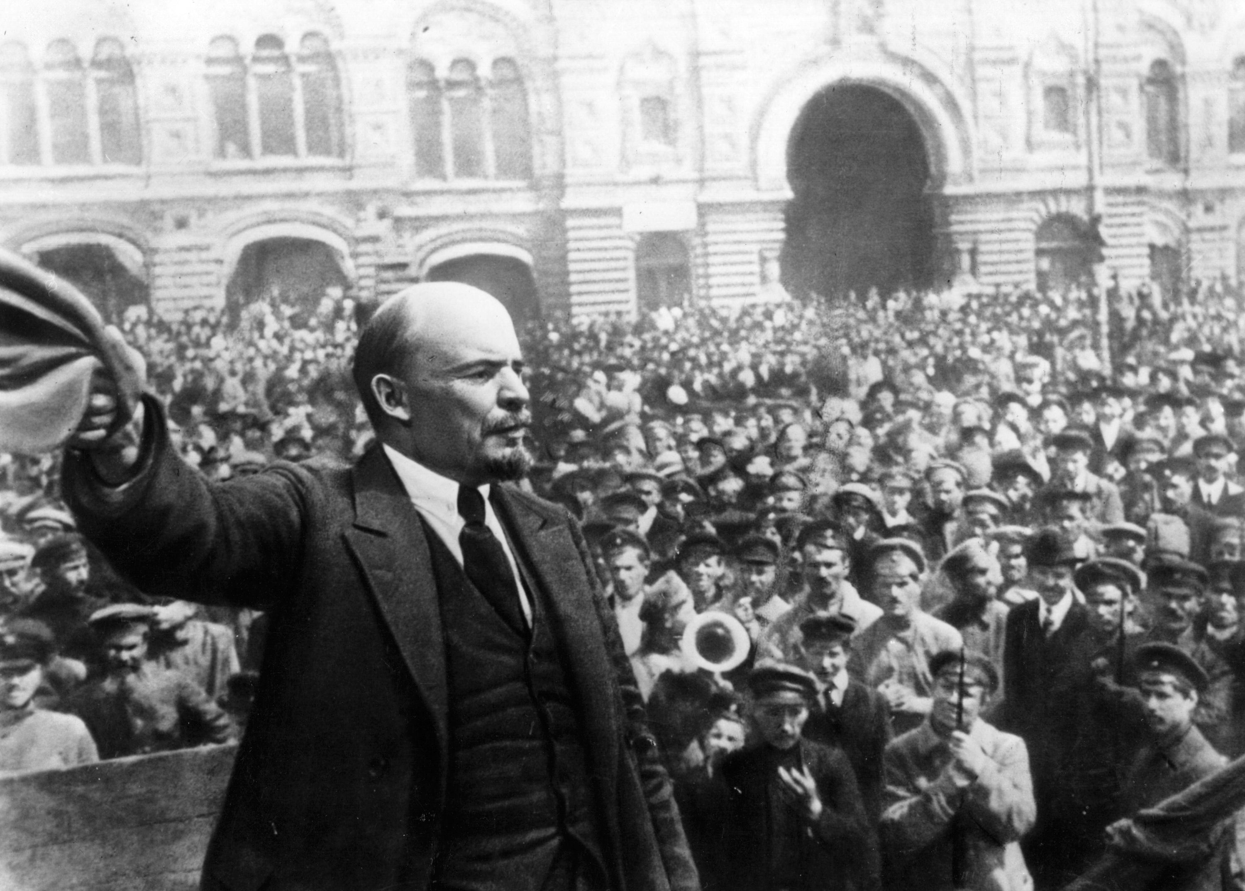
Lenin on art:
“Art belongs to the people. It must have its deepest roots in the broad masses of the workers. . . . Are we to give cake and sugar to a minority when the mass of workers and peasants still lack black bread?”

Slide 11
Lenin on art:
“Art belongs to the people. It must have its deepest roots in the broad masses of the workers. . . . Are we to give cake and sugar to a minority when the mass of workers and peasants still lack black bread?”
In short: there can be no “politically neutral” art.
If you are not explicitly for us, you are objectively against us.

Slide 12
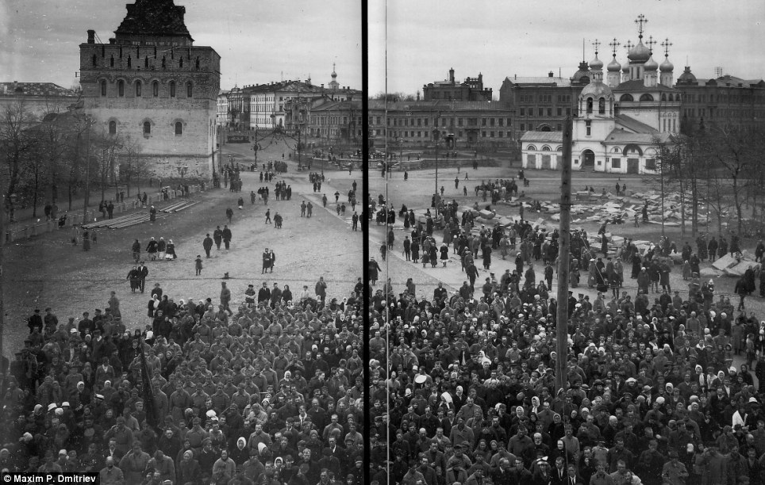
October 1917: The Bolshevik Revolution

Slide 13
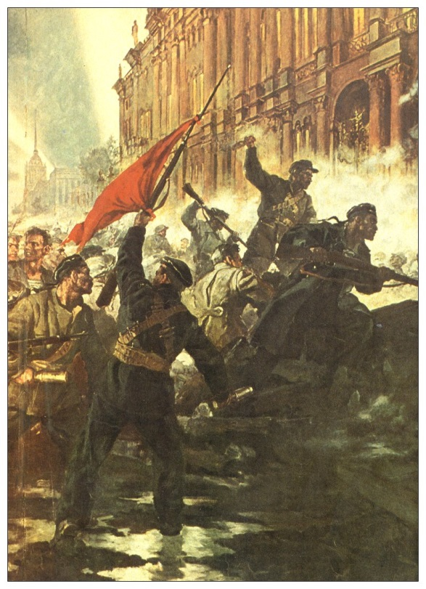
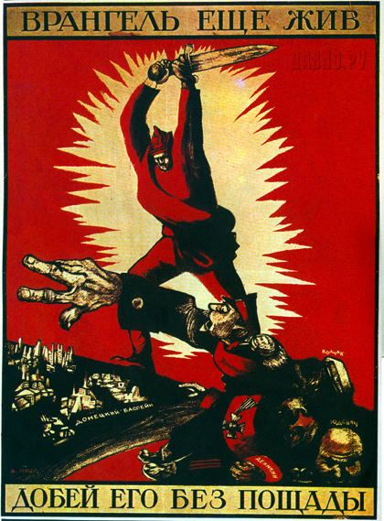
October 1917: The Bolshevik Revolution

Slide 14
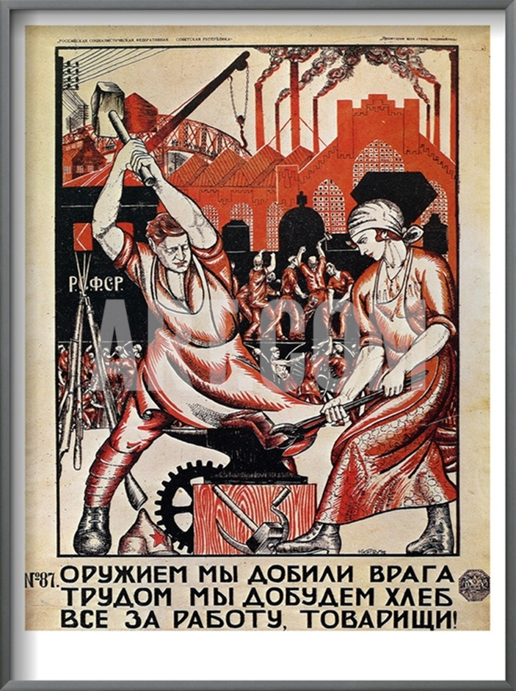
Nikolai Kogout, Poster, 1920
“We have smashed the enemy by force of arms!
We will earn our bread with labor. Comrades, get to work!”

Slide 15
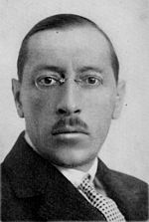
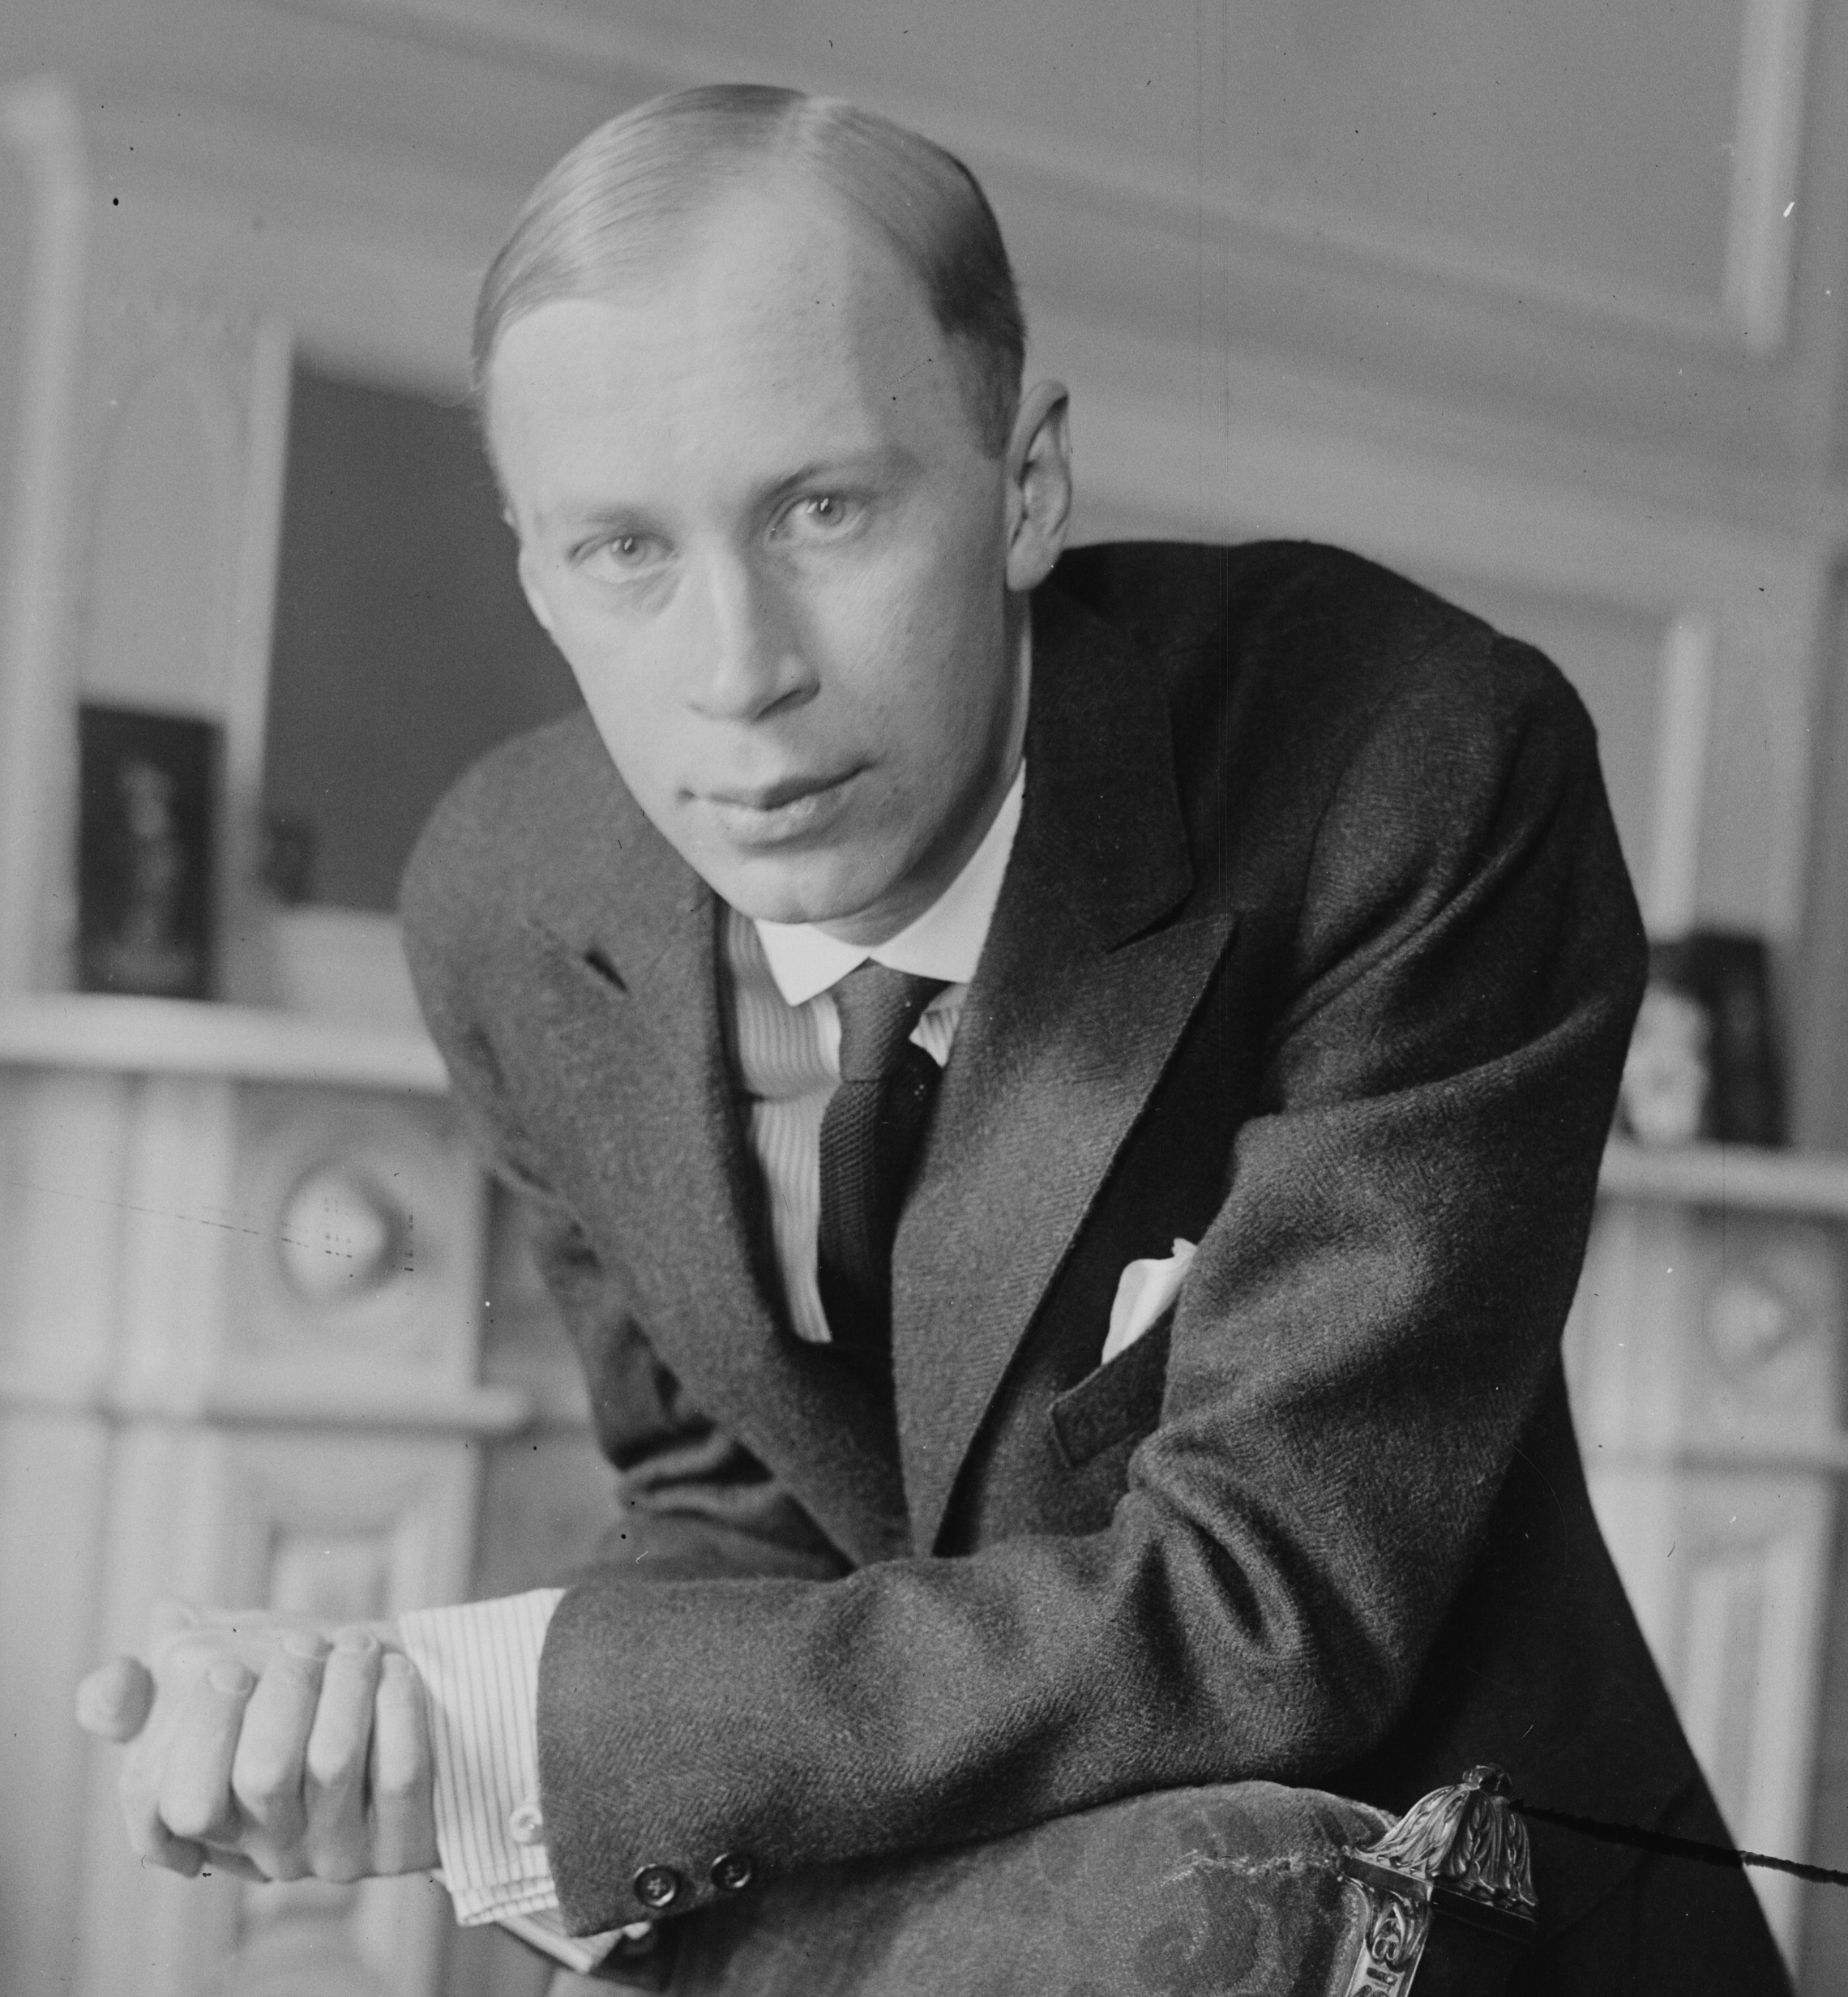
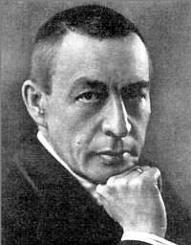
1920s: Not returning to Russia
Stravinsky Prokofiev Rachmaninoff

Slide 16
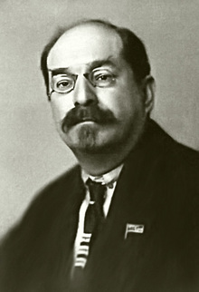
Anatoly Lunacharsky

Slide 17
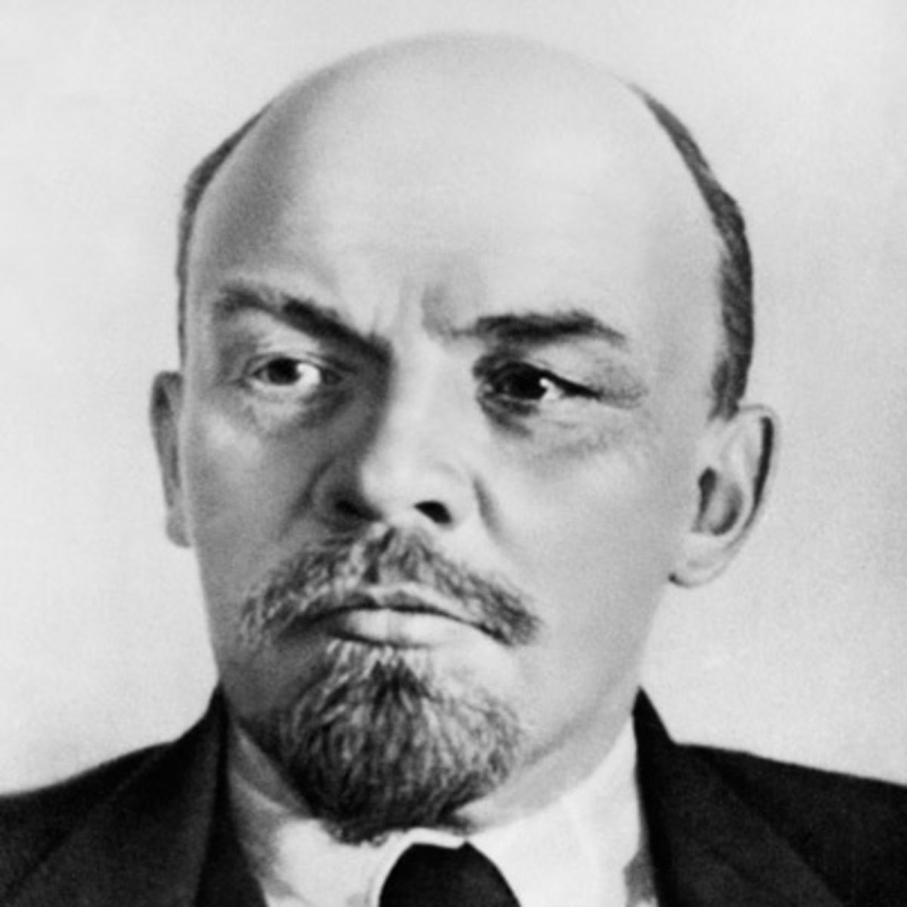
“Cultural problems cannot be solved as quickly as political problems. . . . It is impossible to achieve cultural victory . . . in a short time.” (1921)

Slide 18
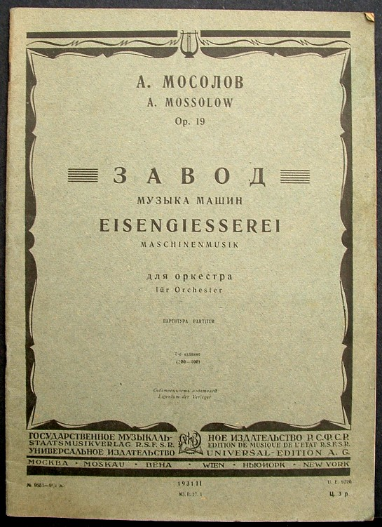
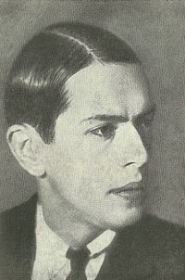
Aleksandr Mosolov
Zavod (Iron Foundry,
from the ballet, Steel, 1926-28)

Slide 19
Russian “constructivism”:
Aleksandr Mosolov, Zavod (Iron Foundry), 1926-28)

Slide 20
Nikolai Kogout, Poster, 1920
“We have smashed the enemy by force of arms!
We will earn our bread with labor. Comrades, get to work!”

Slide 21
Soviet Union, 1920s: Two Rival Musical Factions
ASM (ACM): Association for Contemporary Musicians (1924)

Slide 22
Soviet Union, 1920s: Two Rival Musical Factions
ASM (ACM): Association for Contemporary Musicians (1924)
RAPM: Russian Association of Proletarian Musicians (1923)

Slide 23
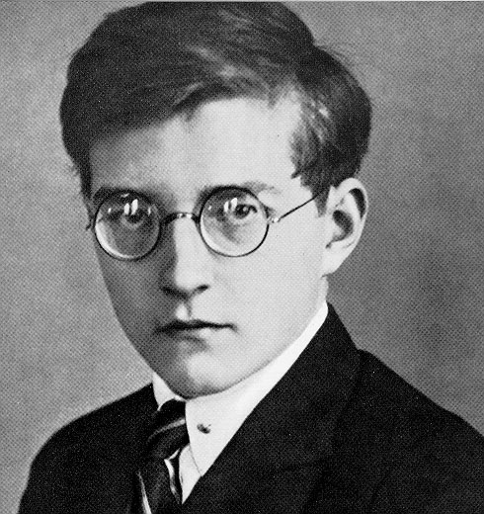
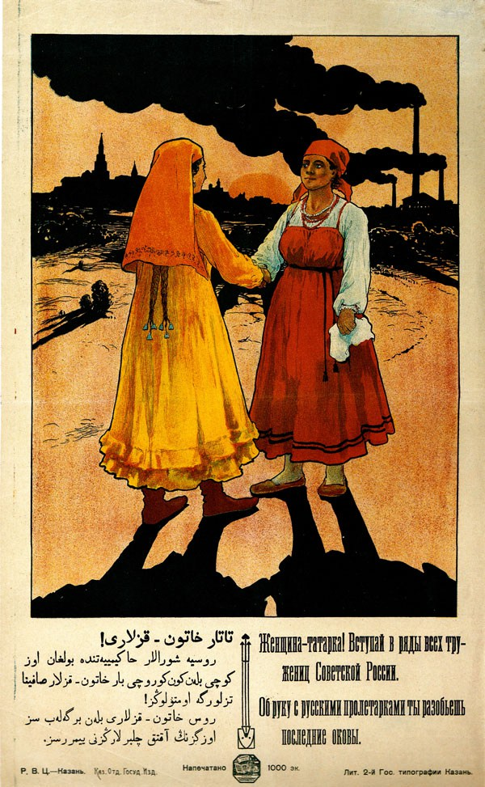
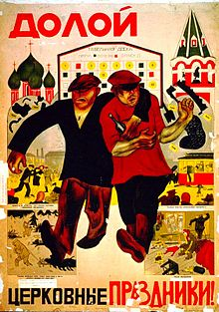
Dmitri Shostakovich (1906-1975)

Slide 24
Symphony No. 1 (1925)
Dmitri Shostakovich (1906-1975)

Slide 25
Symphony No. 1 (1925)
Movement 1
Dmitri Shostakovich (1906-1975)

Slide 26
Symphony No. 2, “October Revolution” (1928)
Dmitri Shostakovich (1906-1975)

Slide 27
Symphony No. 2, “October Revolution” (1928)
Concluding words:
“There is the banner, the name of living generations! October! The Commune! and Lenin!”
Dmitri Shostakovich (1906-1975)

Slide 28
1932: The Party Resolution, nationalizing all artistic, literary, and musical groups

Slide 29
1932: The Party Resolution, nationalizing all artistic, literary, and musical groups
1932: formation of the Soviet Composer’s Union, with its eventual journal
for information, review, and official policy, Sovetskaya Muzïka.

Slide 30
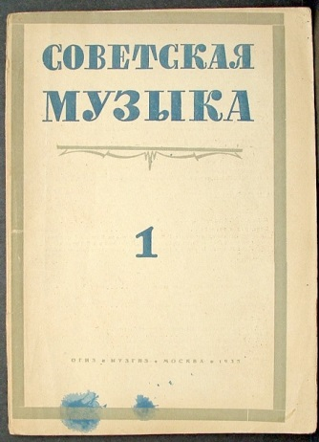
1932: The Party Resolution, nationalizing all artistic, literary, and musical groups
1932: formation of the Soviet Composer’s Union, with its eventual journal
for information, review, and official policy, Sovetskaya Muzïka.

Slide 31
1932: The Party Resolution, nationalizing all artistic, literary, and musical groups
1932: formation of the Soviet Composer’s Union, with its eventual journal
for information, review, and official policy, Sovetskaya Muzïka.
1933: doctrine of “socialist realism” (contra “formalism”), with official guidelines laid down by the Party Congress in 1934

Slide 32
1932: The Party Resolution, nationalizing all artistic, literary, and musical groups
1932: formation of the Soviet Composer’s Union, with its eventual journal
for information, review, and official policy, Sovetskaya Muzïka.
1933: doctrine of “socialist realism” (contra “formalism”), with official guidelines laid down by the Party Congress in 1934
1933: “The main attention of the Soviet composer must [now] be directed toward the victorious, progressive principles of reality, toward all that is heroic, bright, and beautiful. . . . Socialist realism demands an implacable struggle against folk-negating modernistic directions that are typical of the decay of contemporary bourgeois art, against subservience and servility toward modern bourgeois culture.”

Slide 33
1932: The Party Resolution, nationalizing all artistic, literary, and musical groups
1932: formation of the Soviet Composer’s Union, with its eventual journal
for information, review, and official policy, Sovetskaya Muzïka.
1933: doctrine of “socialist realism” (Maxim Gorky, contra “formalism”), with
official guidelines laid down by the Party Congress in 1934
Art Music Must Be:
Proletarian: art relevant to the workers and understandable to them.
Typical: scenes of everyday life of the people.
Realistic: in the representational sense.
Partisan: supportive of the aims of the State and the Party.

Slide 34
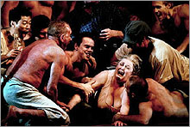
Shostakovich, Lady Macbeth of Mtsensk (premiere, January 1934)

Slide 35
Shostakovich, Lady Macbeth of Mtsensk (premiere, January 1934)

Slide 36
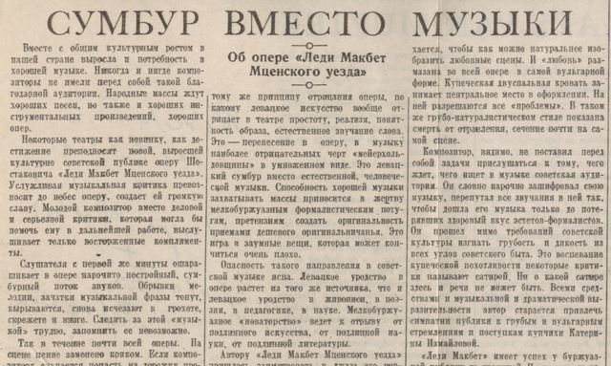
Pravda, 1936: “Muddle instead of Music”

Slide 37
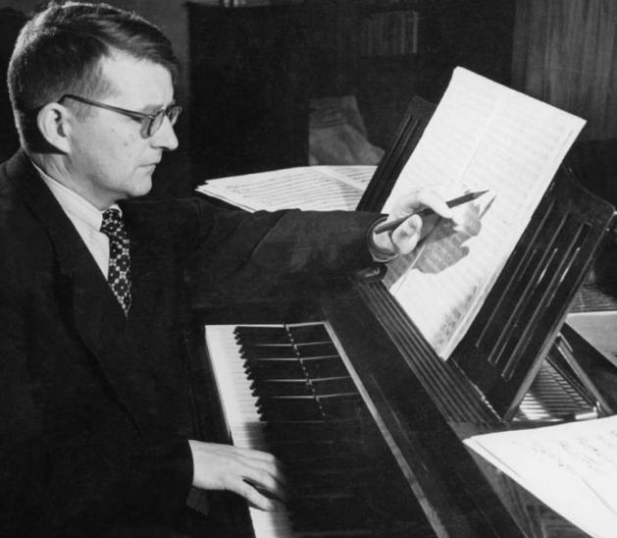
Shostakovich: Symphony No. 5 (1937)

Slide 38
Shostakovich: Symphony No. 5 (1937)
first movement: exposition
= 76
P = Four Cycles or Subrotations
1 2 3 4
P¹ P² P¹ P¹ P¹
D minor
= 84
No closing cadence!
= 92
S¹ (empty/vacant) S¹
Dev.
P²
Tonally migratory restart on B minor
………….Cb E!

Slide 39
Shostakovich: Symphony No. 5 (1937)
first movement: exposition
= 76
P = Four Cycles or Subrotations
1 2 3 4
P¹ P² P¹ P¹ P¹
D minor
= 84
No closing cadence!
= 92
S¹ (empty/vacant) S¹
Dev.
P²
Tonally migratory restart on B minor
………….Cb E!

Slide 40
Shostakovich: Symphony No. 5 (1937)
first movement: exposition
= 76
P = Four Cycles or Subrotations
1 2 3 4
P¹ P² P¹ P¹ P¹
D minor
= 84
No closing cadence!
= 92
S¹ (empty/vacant) S¹
Dev.
P²
Tonally migratory restart on B minor
………….Cb E!

Slide 41
Shostakovich: Symphony No. 5 (1937)
first movement: exposition
= 76
P = Four Cycles or Subrotations
1 2 3 4
P¹ P² P¹ P¹ P¹
D minor
= 84
No closing cadence!
= 92
S¹ (empty/vacant) S¹
Dev.
P²
Tonally migratory restart on B minor
………….Cb E!

Slide 42
Shostakovich: Symphony No. 5 (1937)
first movement: exposition
= 76
P = Four Cycles or Subrotations
1 2 3 4
P¹ P² P¹ P¹ P¹
D minor
= 84
No closing cadence!
= 92
S¹ (empty/vacant) S¹
Dev.
P²
Tonally migratory restart on B minor
………….Cb E!

Slide 43
Shostakovich: Symphony No. 5 (1937)
first movement: exposition
= 76
P = Four Cycles or Subrotations
1 2 3 4
P¹ P² P¹ P¹ P¹
D minor
= 84
No closing cadence!
= 92
S¹ (empty/vacant) S¹
Dev.
P²
Tonally migratory restart on B minor
………….Cb E!

Slide 44
Shostakovich: Symphony No. 5 (1937)
first movement: exposition
= 76
P = Four Cycles or Subrotations
1 2 3 4
P¹ P² P¹ P¹ P¹
D minor
= 84
No closing cadence!
= 92
S¹ (empty/vacant) S¹
Dev.
P²
Tonally migratory restart on B minor
………….Cb E!

Slide 45
Shostakovich: Symphony No. 5 (1937)
first movement: exposition
= 76
P = Four Cycles or Subrotations
1 2 3 4
P¹ P² P¹ P¹ P¹
D minor
= 84
No closing cadence!
= 92
S¹ (empty/vacant) S¹
Dev.
P²
Tonally migratory restart on B minor
………….Cb E!

Slide 46
Shostakovich: Symphony No. 5 (1937)
first movement: exposition
= 76
P = Four Cycles or Subrotations
1 2 3 4
P¹ P² P¹ P¹ P¹
D minor
= 84
No closing cadence!
= 92
S¹ (empty/vacant) S¹
Dev.
P²
Tonally migratory restart on B minor
………….Cb E!

Slide 47
Shostakovich: Symphony No. 5 (1937)
first movement: exposition
= 76
P = Four Cycles or Subrotations
1 2 3 4
P¹ P² P¹ P¹ P¹
D minor
= 84
No closing cadence!
= 92
S¹ (empty/vacant) S¹
Dev.
P²
Tonally migratory restart on B minor
………….Cb E!

Slide 48
Shostakovich: Symphony No. 5 (1937),
finale: conclusion

Slide 49
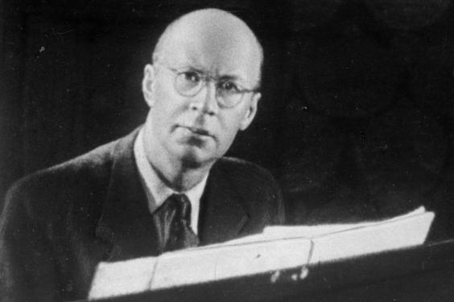
Sergey Prokofiev

Slide 50
1927-36: Considering an eventual return to Soviet Russia: beginning to accept commissions, visits, etc.
Sergey Prokofiev

Slide 51
1936: Returns permanently to Soviet Russia
Sergey Prokofiev

Slide 52
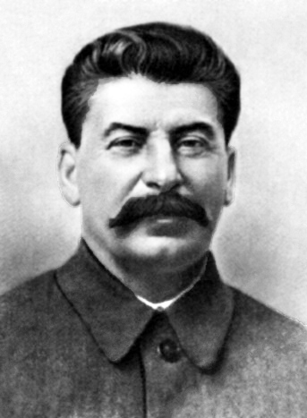
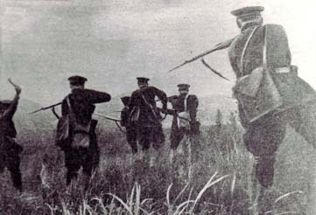
1936: Returns permanently to Soviet Russia
(coincident with the onset of the Stalinist “Great Terror”)
Sergey Prokofiev

Slide 53
1936: Returns permanently to Soviet Russia
(coincident with the onset of the Stalinist “Great Terror”)
By 1933-34: the style of “the new simplicity,” “light-serious music”
Sergey Prokofiev

Slide 54
1936: Returns permanently to Soviet Russia
(coincident with the onset of the Stalinist “Great Terror”)
By 1933-34: the style of “the new simplicity,” “light-serious music”
1933-34 – Film music for
Poruchnik Kizhe (Lieutenant Kizhe)
Sergey Prokofiev

Slide 55
1936: Returns permanently to Soviet Russia
(coincident with the onset of the Stalinist “Great Terror”)
By 1933-34: the style of “the new simplicity,” “light-serious music”
1933-34 – Film music for
Poruchnik Kizhe (Lieutenant Kizhe)
1935 – Violin Concerto No. 2
Sergey Prokofiev

Slide 56
1936: Returns permanently to Soviet Russia
(coincident with the onset of the Stalinist “Great Terror”)
By 1933-34: the style of “the new simplicity,” “light-serious music”
1933-34 – Film music for
Poruchnik Kizhe (Lieutenant Kizhe)
1935 – Violin Concerto No. 2
1935-36 – Ballet, Romeo and Juliet
Sergey Prokofiev

Slide 57
1936: Returns permanently to Soviet Russia
(coincident with the onset of the Stalinist “Great Terror”)
By 1933-34: the style of “the new simplicity,” “light-serious music”
1933-34 – Film music for
Poruchnik Kizhe (Lieutenant Kizhe)
1935 – Violin Concerto No. 2
1935-36 – Ballet, Romeo and Juliet
1936: Petya i volk
Sergey Prokofiev

Slide 58
1936: Returns permanently to Soviet Russia
(coincident with the onset of the Stalinist “Great Terror”)
By 1933-34: the style of “the new simplicity,” “light-serious music”
1933-34 – Film music for
Poruchnik Kizhe (Lieutenant Kizhe)
1935 – Violin Concerto No. 2
1935-36 – Ballet, Romeo and Juliet
1936: Petya i volk
1938 – Film music for Eisenstein’s Alexander Nevsky
Sergey Prokofiev

Slide 59
Prokofiev, 1938 – Film music for Eisenstein’s Alexander Nevsky

Slide 60
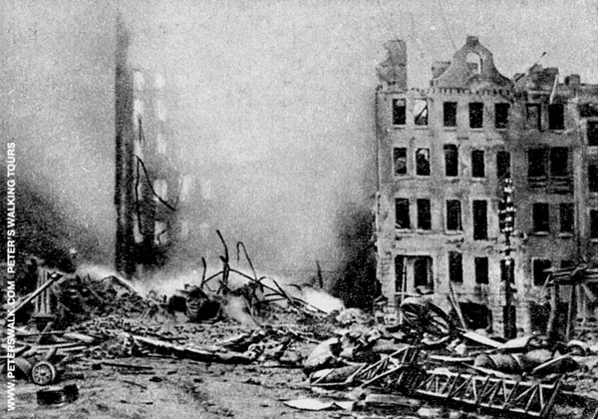
World War II: Leningrad under siege, 1941-44

Slide 61
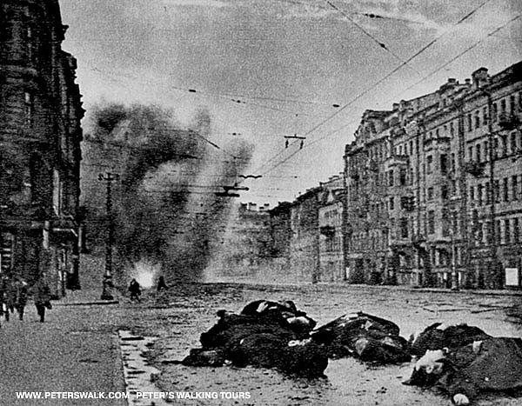
World War II: Leningrad under siege, 1941-44

Slide 62
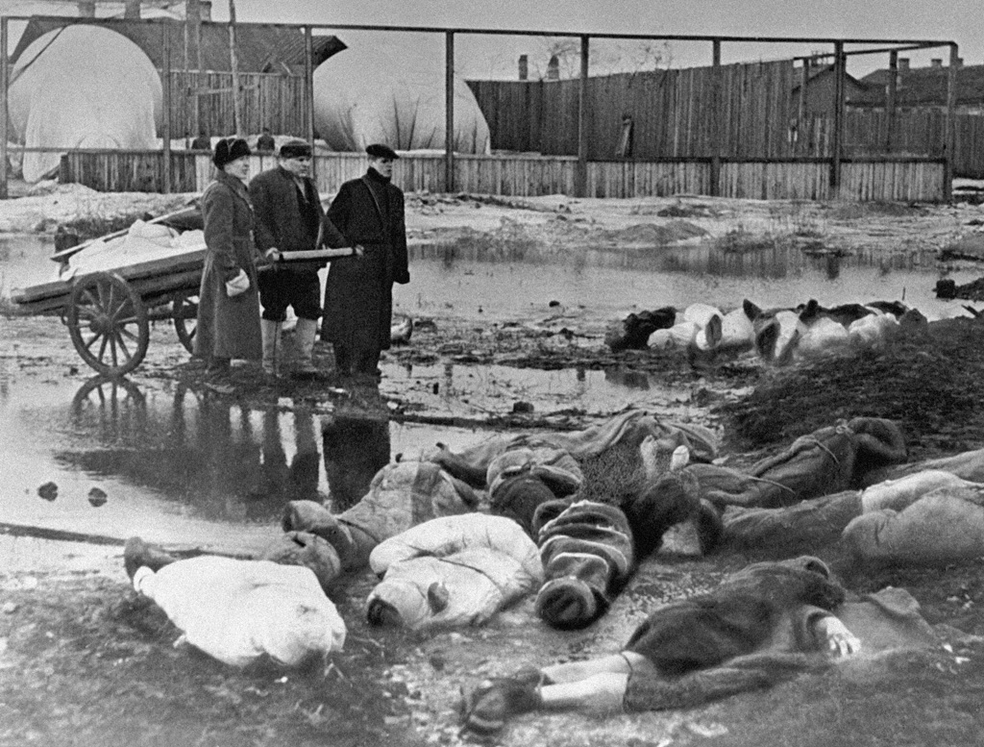
World War II: Leningrad under siege, 1941-44

Slide 63
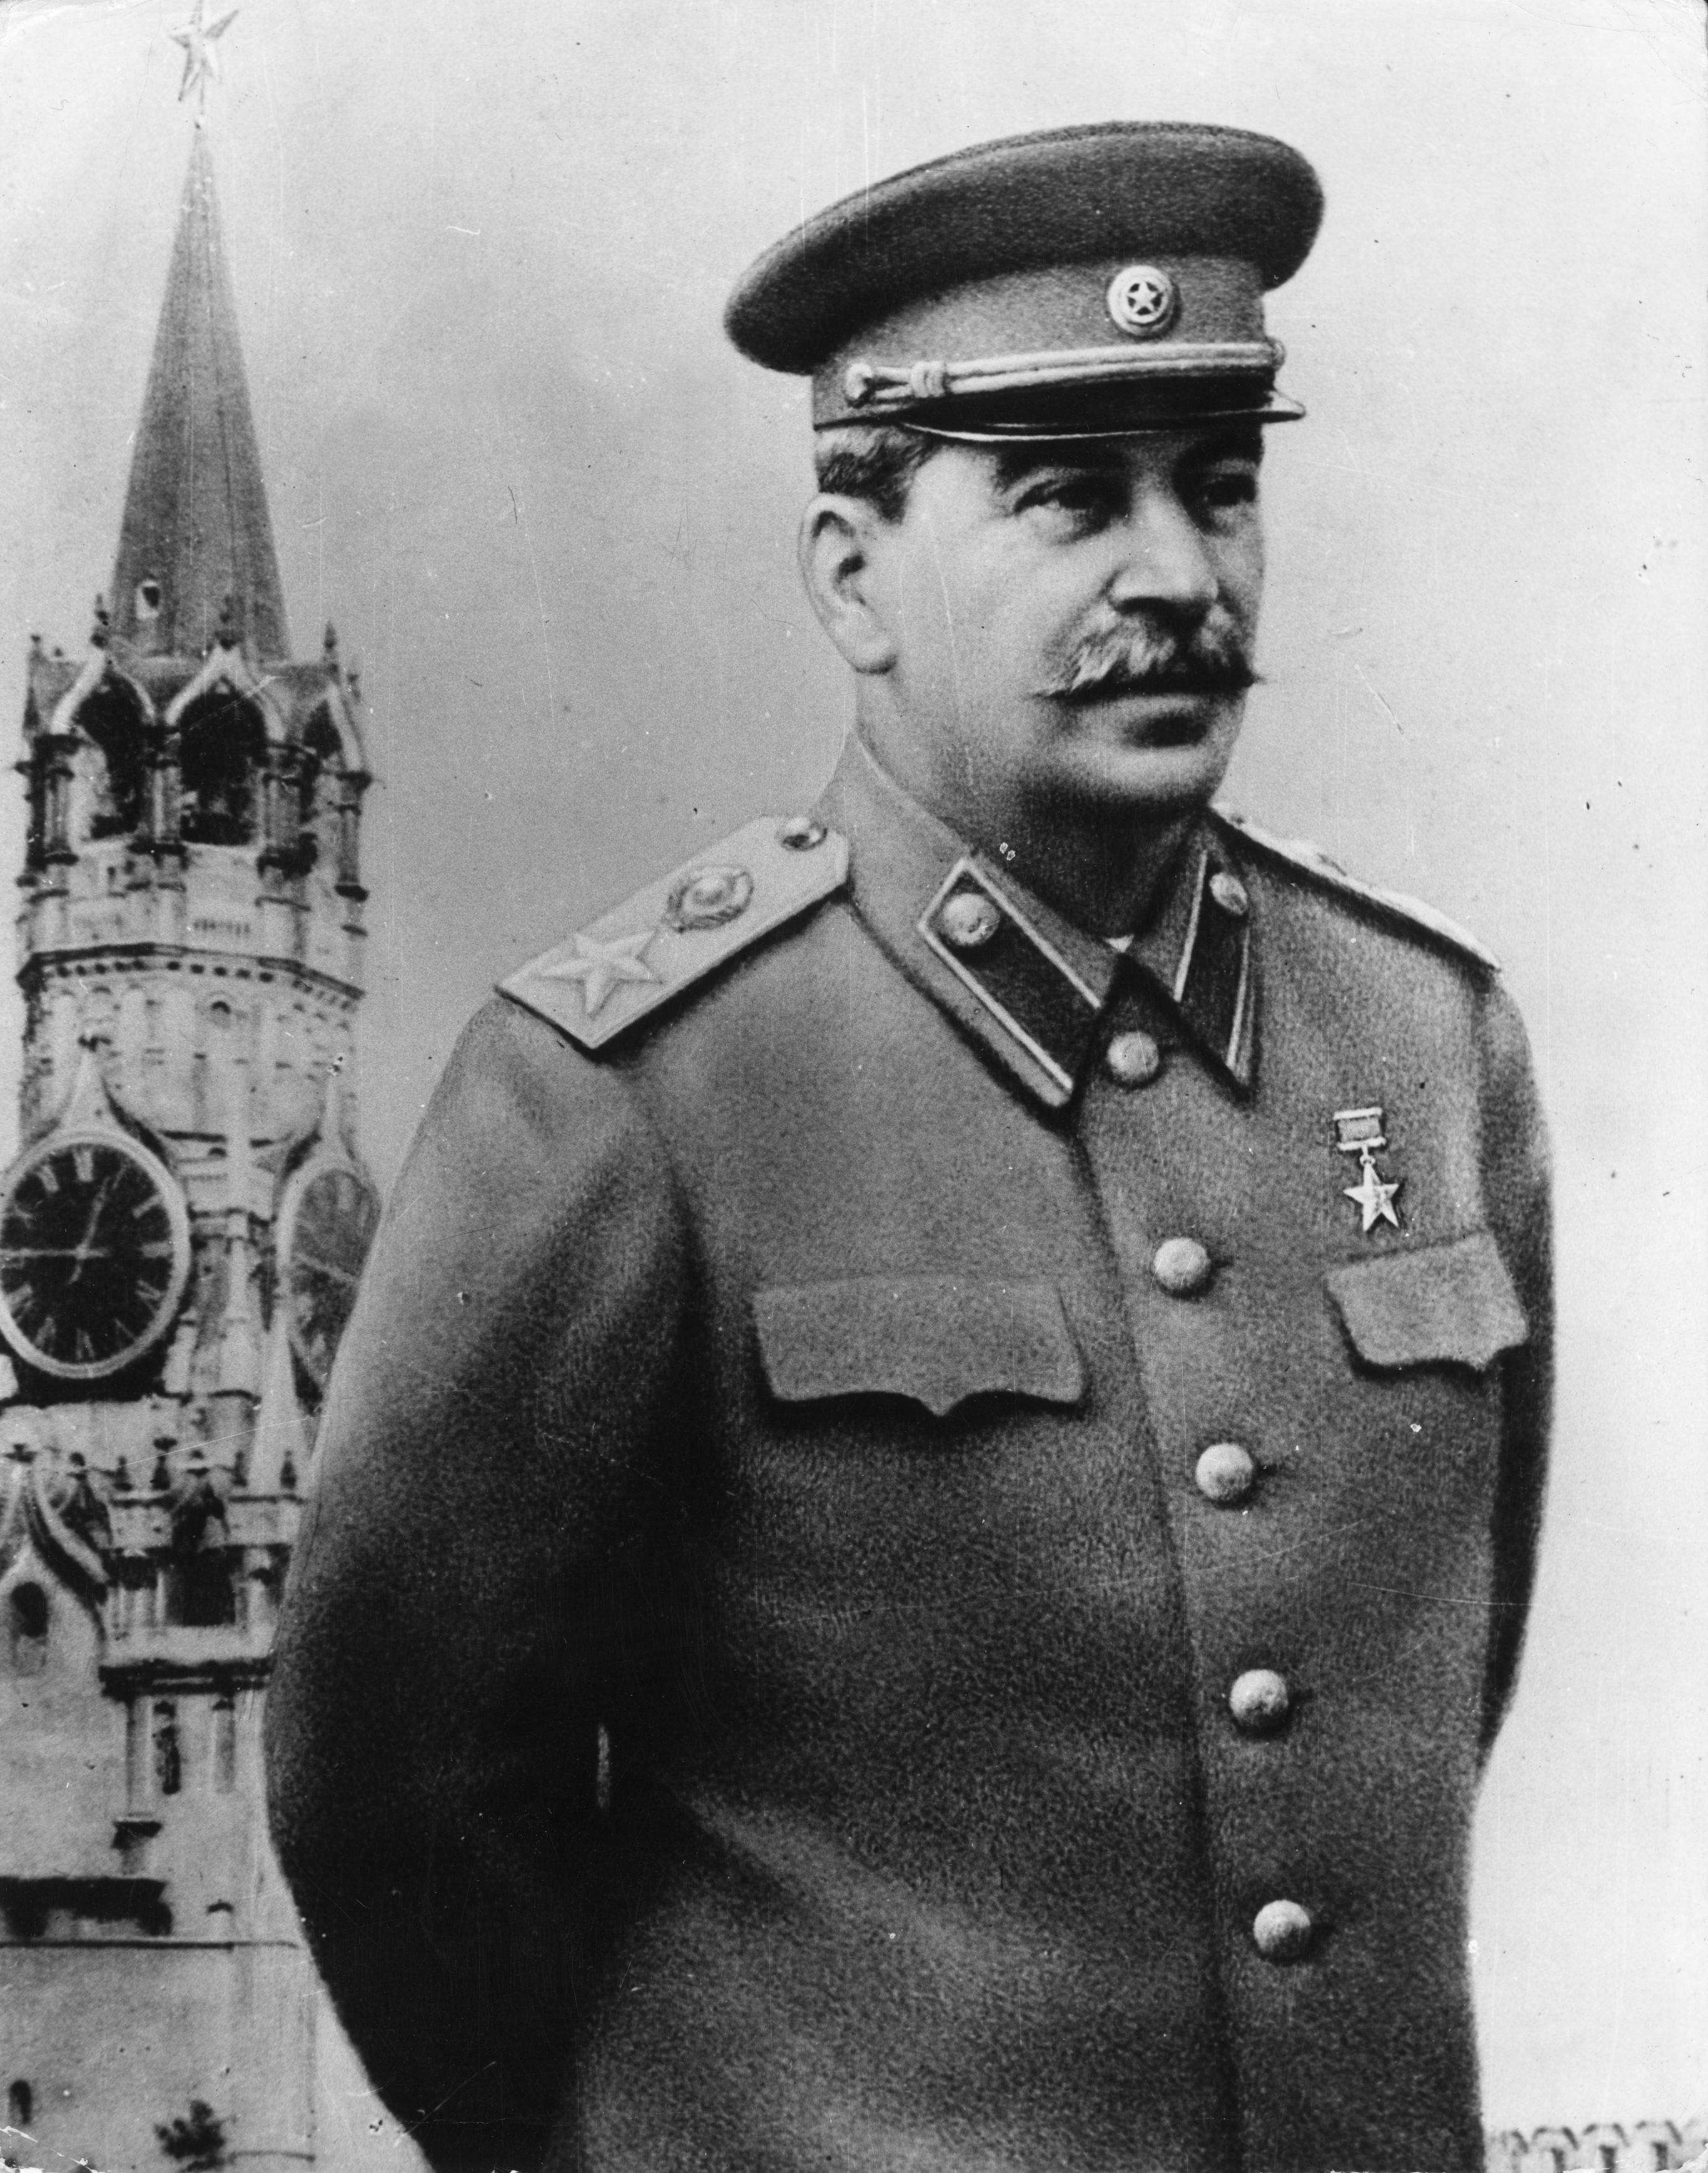
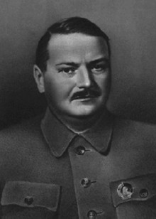
1948: the Zhdanov Crackdown!
Andrey Zhdanov

Slide 64
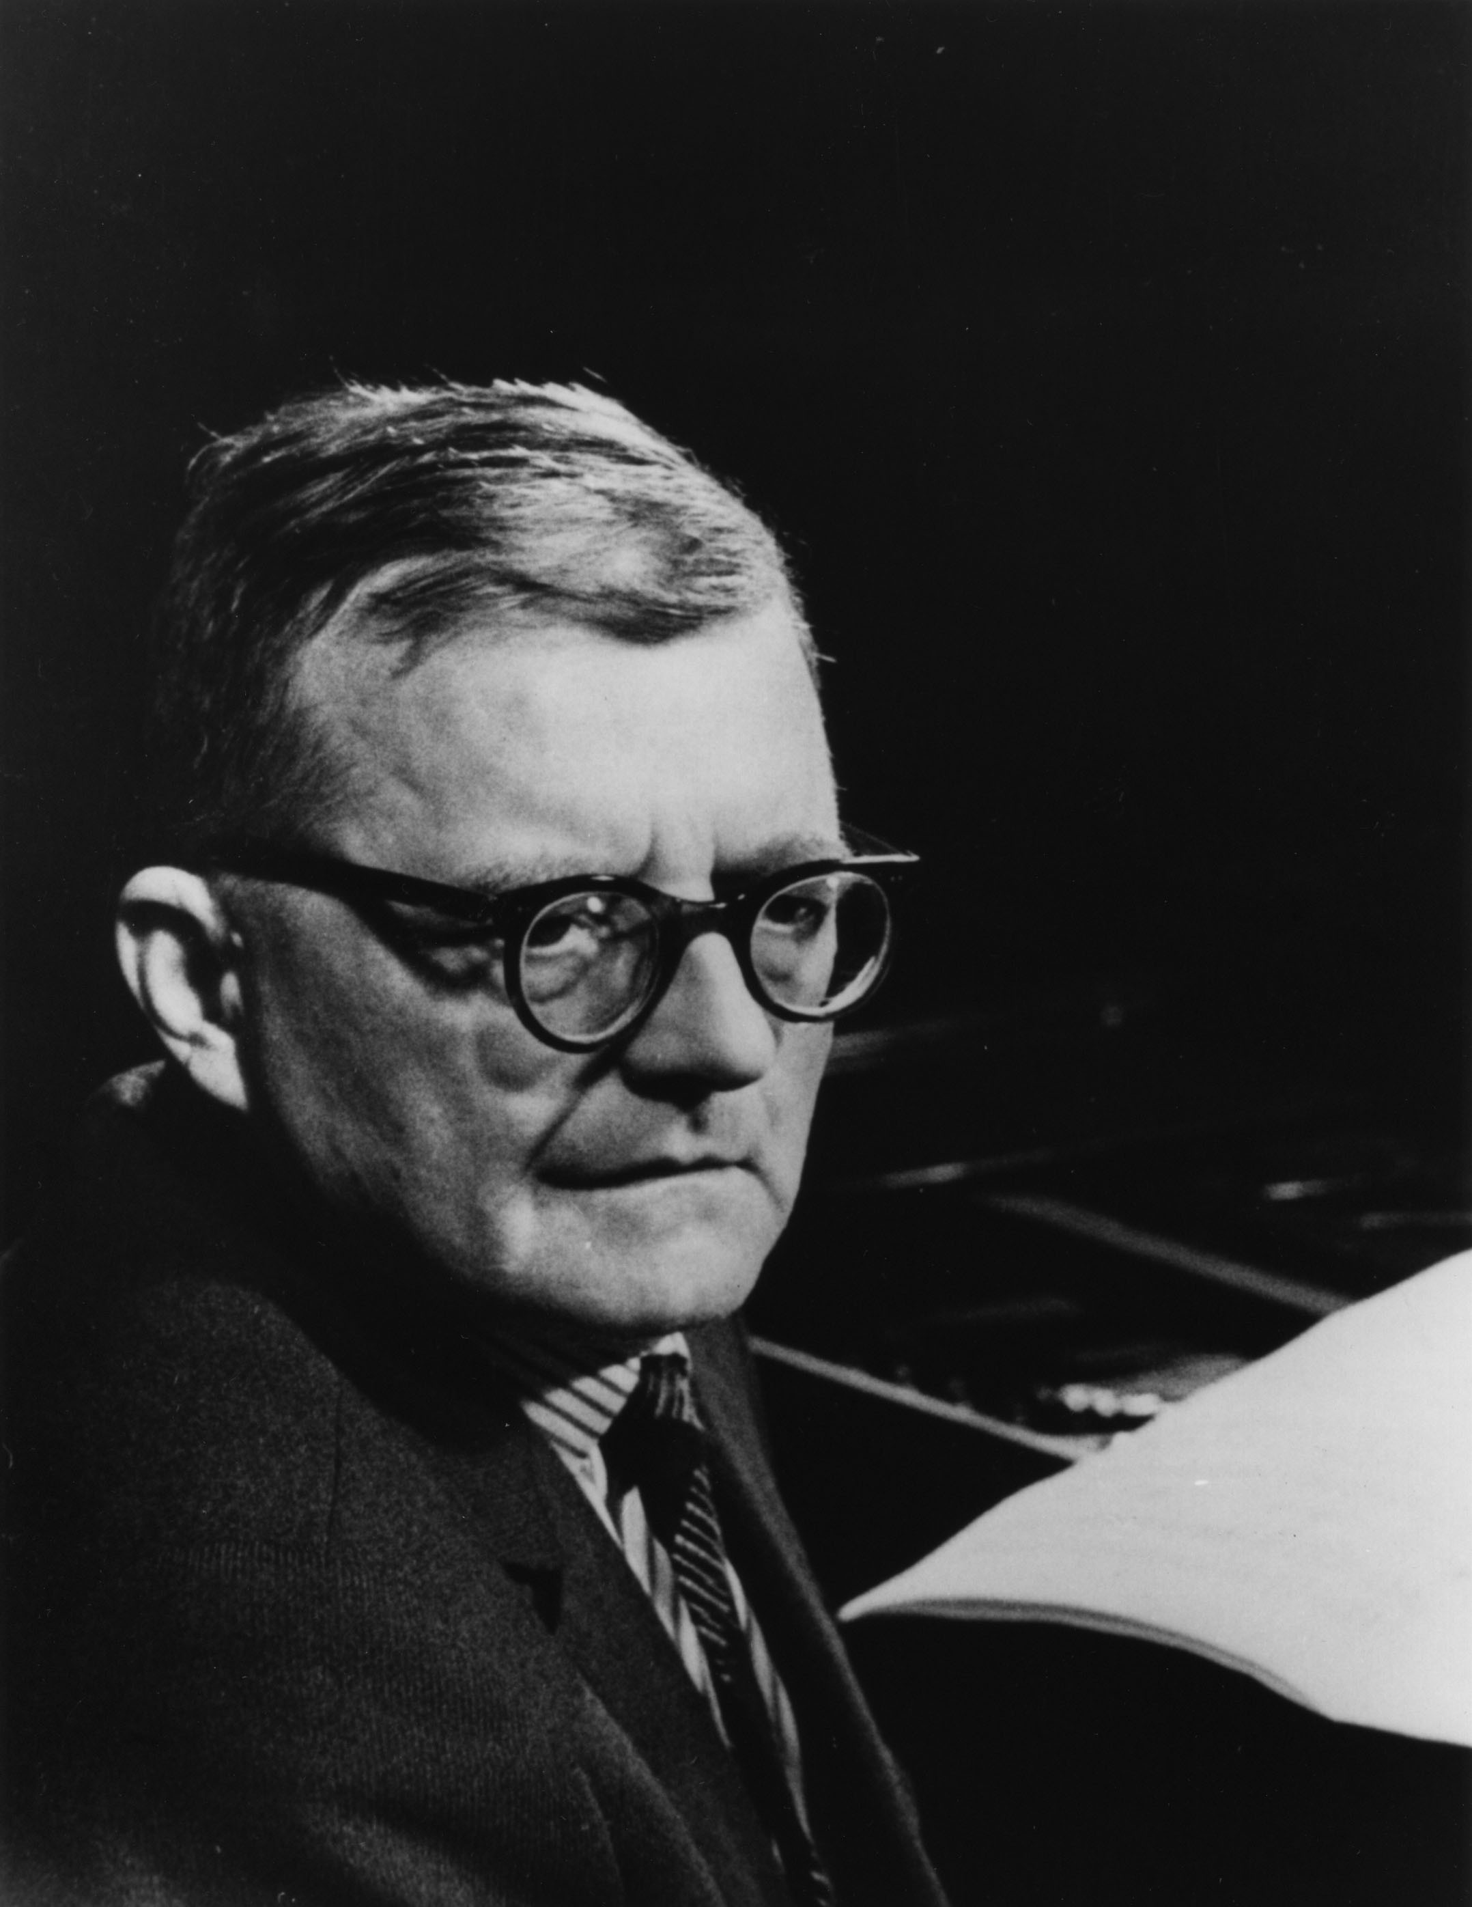
1948
“I can now clearly see that I overestimated the thoroughness of my reconstruction. . . . I again deviated in the direction of formalism. . . . ”

Slide 65
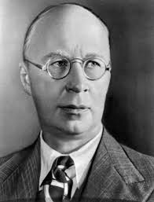
1948
“I welcome the Resolution of the Central Committee. . . . .”

Slide 66
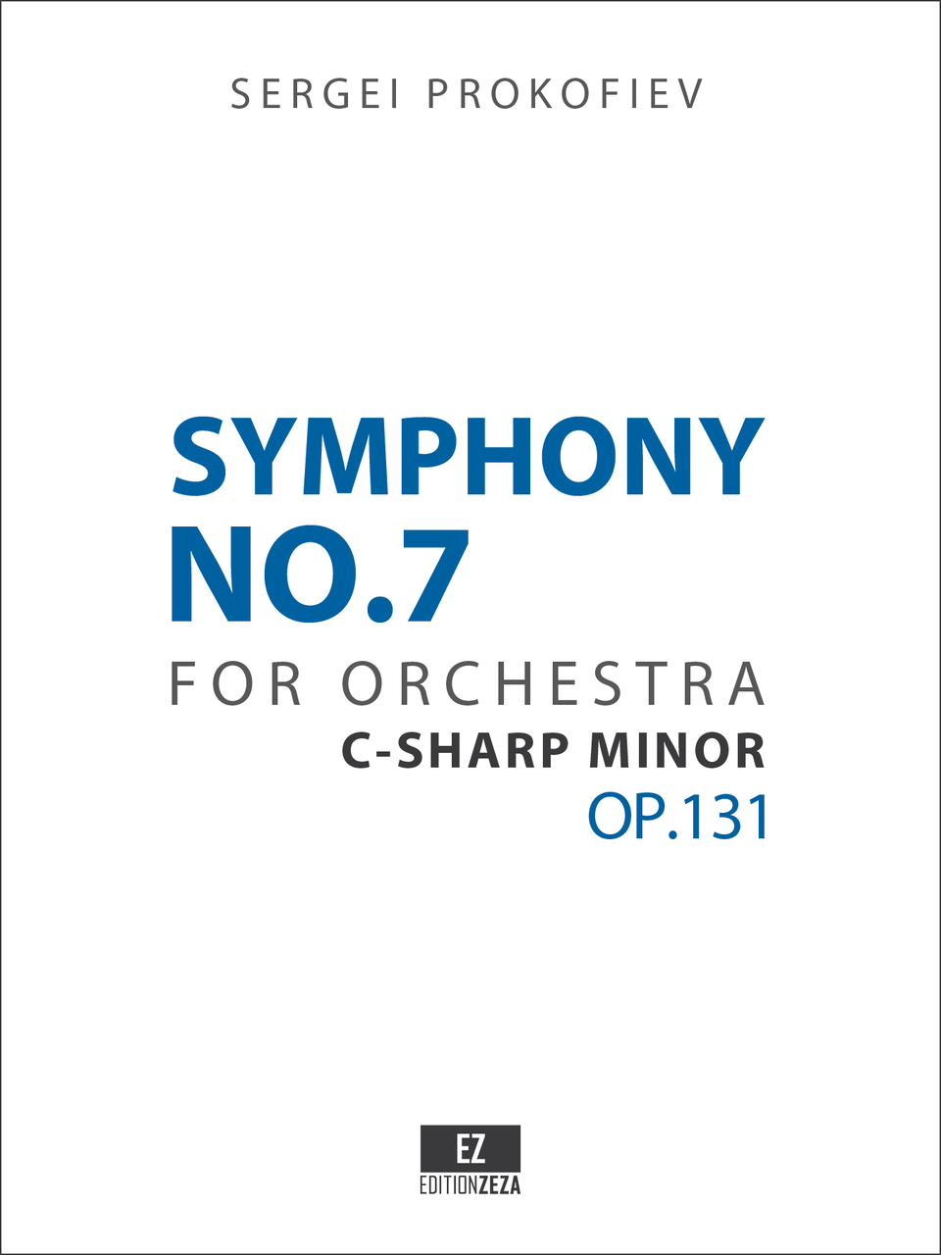
1951-52

Slide 67
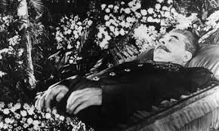
Death: March 4, 1953

Slide 68
Death: March 4, 1953

