Slide 1
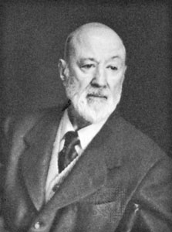
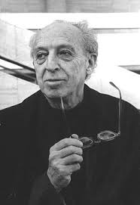
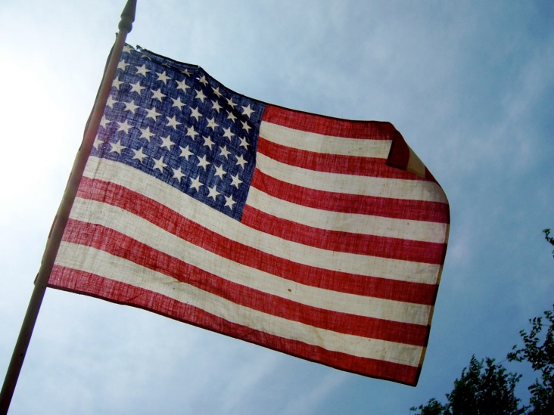
American Art Music in the Early Twentieth Century

Slide 2
The American Dilemma?
Imitate high-prestige European styles?

Slide 3
The American Dilemma?
Imitate high-prestige European styles?
Or somehow (?) try to devise/construct an “American” sound in music?

Slide 4
The typical “nationalist” strategy
merge/blend
“Folk” culture
The established, high-prestige art-music styles of Western Europe: the cultivated styles of Europe’s cultural elite

Slide 5
The typical “nationalist” strategy
merge/blend
“Folk” culture
?
The established, high-prestige art-music styles of Western Europe: the cultivated styles of Europe’s cultural elite
But America lacks this!
Or do we? Or what could be the substitute for it here?

Slide 6
Possible Solutions?
Struggle—via education—to attain an American musical legitimacy

Slide 7
Possible Solutions?
Struggle—via education—to attain an American musical legitimacy
Search for some kind of distinctive “American” voice
to graft onto the tradition?

Slide 8
Possible Solutions?
Before c. 1900
Struggle—via education—to attain an American musical legitimacy
Search for some kind of distinctive “American” voice
to graft onto the tradition?

Slide 9
Phase 1: establish America as
a faithful outpost of Western European “Great Music”

Slide 10
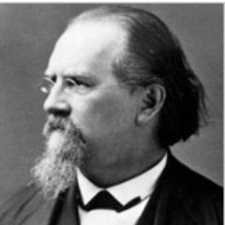
Phase 1: establish America as
a faithful outpost of Western European “Great Music”
Gustave Stoeckel, Yale Organist, Glee Club Director 1849-94

Slide 11
Phase 1: establish America as
a faithful outpost of Western European “Great Music”
Create conservatories along the Austro-Germanic model!
1865 – Oberlin Conservatory

Slide 12
Phase 1: establish America as
a faithful outpost of Western European “Great Music”
Create conservatories along the Austro-Germanic model!
1865 – Oberlin Conservatory
1867 – Cincinnati Conservatory

Slide 13
Phase 1: establish America as
a faithful outpost of Western European “Great Music”
Create conservatories along the Austro-Germanic model!
1865 – Oberlin Conservatory
1867 – Cincinnati Conservatory
1867 – Boston Conservatory

Slide 14
Phase 1: establish America as
a faithful outpost of Western European “Great Music”
Create conservatories along the Austro-Germanic model!
1865 – Oberlin Conservatory
1867 – Cincinnati Conservatory
1867 – Boston Conservatory
1867 – New England Conservatory

Slide 15
Phase 1: establish America as
a faithful outpost of Western European “Great Music”
Create conservatories along the Austro-Germanic model!
1865 – Oberlin Conservatory
1867 – Cincinnati Conservatory
1867 – Boston Conservatory
1867 – New England Conservatory
1869 – Peabody Conservatory

Slide 16
Phase 1: establish America as
a faithful outpost of Western European “Great Music”
Create conservatories along the Austro-Germanic model!
1865 – Oberlin Conservatory
1867 – Cincinnati Conservatory
1867 – Boston Conservatory
1867 – New England Conservatory
1869 – Peabody Conservatory
1885 – National Conservatory of Music in America (NYC)

Slide 17
Phase 1: establish America as
a faithful outpost of Western European “Great Music”
Create conservatories along the Austro-Germanic model!
1865 – Oberlin Conservatory
1867 – Cincinnati Conservatory
1867 – Boston Conservatory
1867 – New England Conservatory
1869 – Peabody Conservatory
1885 – National Conservatory of Music in America (NYC)
Model:
Leipzig Conservatory

Slide 18
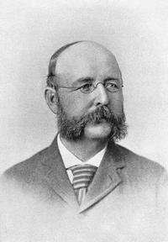
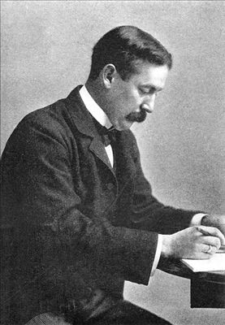
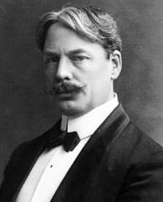
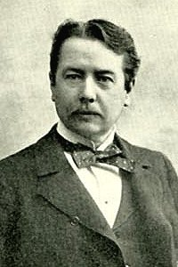
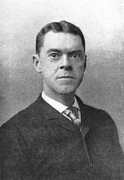
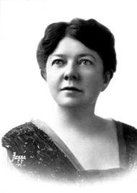
“The Second New England School” of American Composers, c. 1870-1914
John Knowles Paine Horatio Parker Edward MacDowell
George Chadwick Amy Beach Arthur Foote

Slide 19
“The Second New England School” of American Composers, c. 1870-1914
Harvard, 1870s
John Knowles Paine Horatio Parker Edward MacDowell
George Chadwick Amy Beach Arthur Foote

Slide 20
“The Second New England School” of American Composers, c. 1870-1914
Harvard, 1870s
Yale, 1894
John Knowles Paine Horatio Parker Edward MacDowell
George Chadwick Amy Beach Arthur Foote

Slide 21
“The Second New England School” of American Composers, c. 1870-1914
Harvard, 1870s
Yale, 1894
Columbia, 1896
John Knowles Paine Horatio Parker Edward MacDowell
George Chadwick Amy Beach Arthur Foote

Slide 22
“The Second New England School” of American Composers, c. 1870-1914
Harvard, 1870s
Yale, 1894
Columbia, 1896
John Knowles Paine Horatio Parker Edward MacDowell
New England Conservatory, 1897
George Chadwick Amy Beach Arthur Foote

Slide 23
“The Second New England School” of American Composers, c. 1870-1914
Harvard, 1870s
Yale, 1894
Columbia, 1896
John Knowles Paine Horatio Parker Edward MacDowell
New England Conservatory, 1897
Boston composer & prominent violinist
George Chadwick Amy Beach Arthur Foote

Slide 24
“The Second New England School” of American Composers, c. 1870-1914
Harvard, 1870s
Yale, 1894
Columbia, 1896
John Knowles Paine Horatio Parker Edward MacDowell
New England Conservatory, 1897
Boston composer & prominent violinist
Organist, First Church in Boston
George Chadwick Amy Beach Arthur Foote

Slide 25
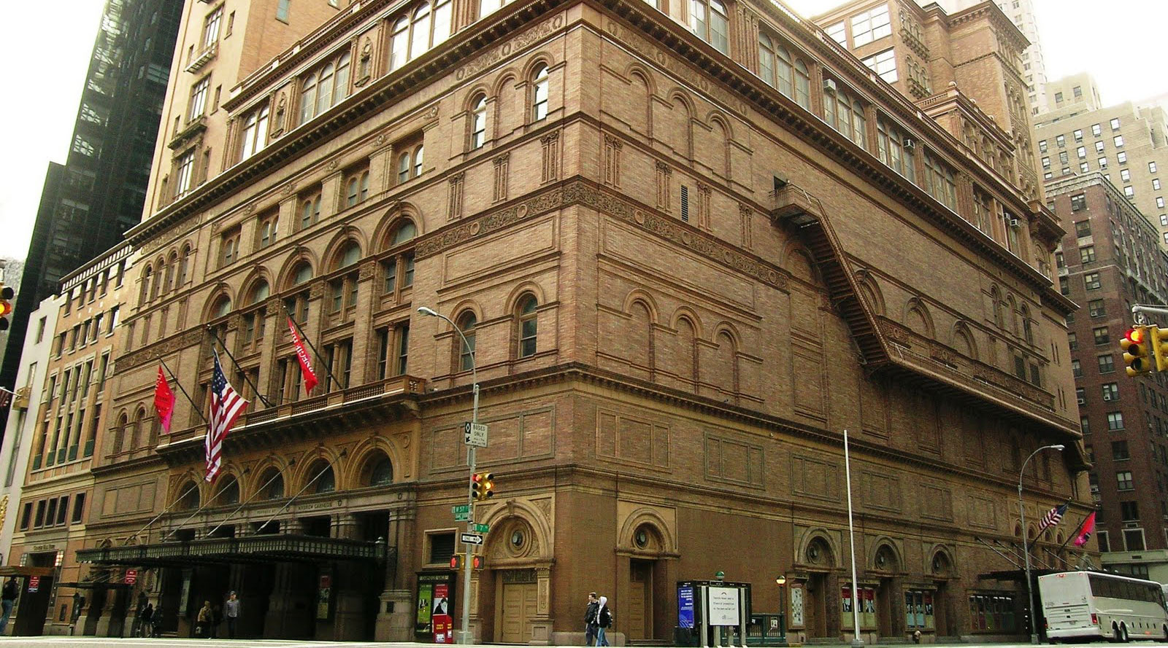
Carnegie Hall (1891)

Slide 26
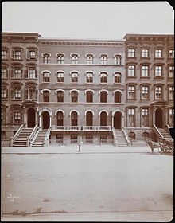
New York: National Conservatory of American Music (W. 25th St.)

Slide 27
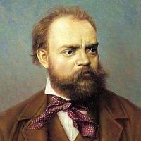
1892-95
New York: National Conservatory of American Music (W. 25th St.)

Slide 28
Symphony in E Minor,
“From the New World” (1893)
1892-95
New York: National Conservatory of American Music (W. 25th St.)

Slide 29
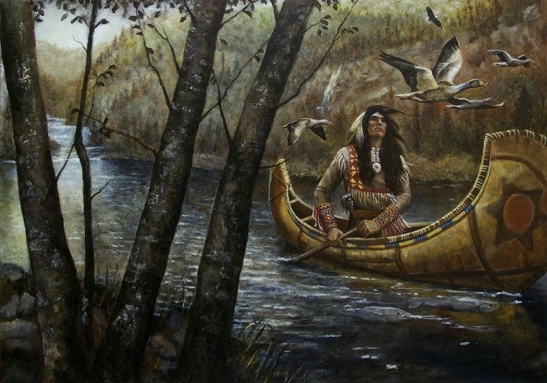
Symphony in E Minor,
“From the New World” (1893)
1892-95
The Song of Hiawatha (Longfellow)

Slide 30
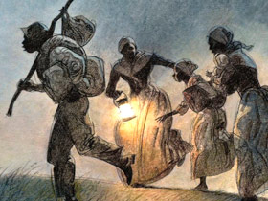
Symphony in E Minor,
“From the New World” (1893)
1892-95
African-American Spirituals

Slide 31
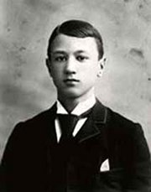
Entering Yale College Student, 1894
Charles Ives

Slide 32
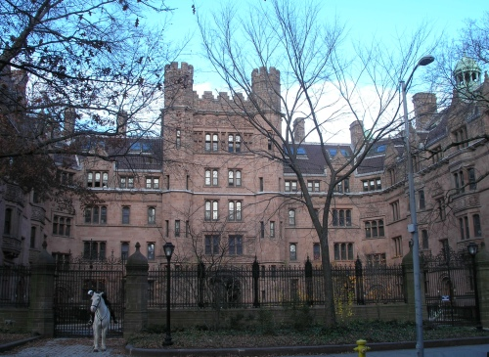
Yale in 1894: Vanderbilt Hall built

Slide 33
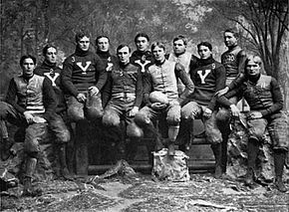
Yale in 1895: The Football Team

Slide 34
Parker – Ives Yale, 1894-98

Slide 35
Entering Yale College Student, 1894
Charles Ives

Slide 36
Entering Yale College Student, 1894
Americanism in music?
Instead of in “folk” sources,
ground the music in America-specific “truth languages”:
Civil War tunes
American patriotic songs
Parlor songs (by Stephen Foster
and others)
Revival and camp-meeting hymns
Charles Ives

Slide 37
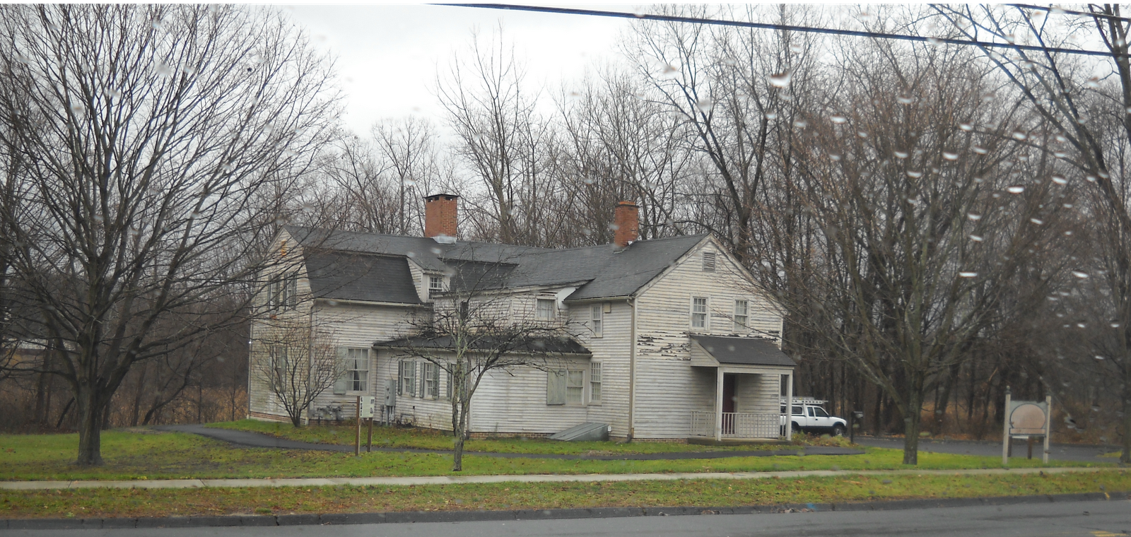
Danbury, CT: Charles Ives House

Slide 38
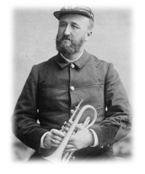

Slide 39
Parker – Ives Yale, 1894-98

Slide 40
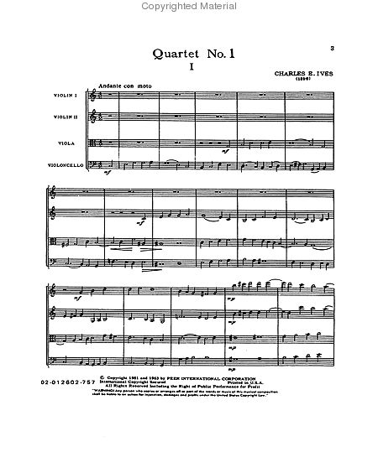

Slide 41
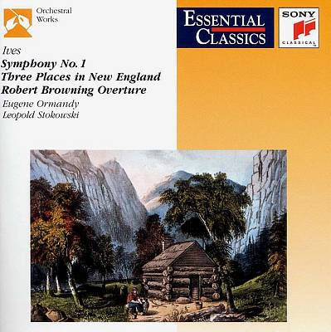

Slide 42
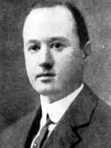
By 1905-08: song fragments inlaid into increasingly aggressive, dissonant,
and often seemingly chaotic music—actively rebelling against the European norm

Slide 43
Ives, Symphony No. 2—a reply [?] to Dvořák?

Slide 44
Charles Ives: central aesthetic ideas: motivations of his mature (post-1907) music
New England Transcendental philosophy

Slide 45
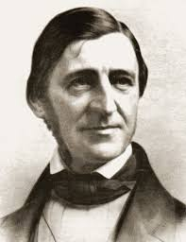
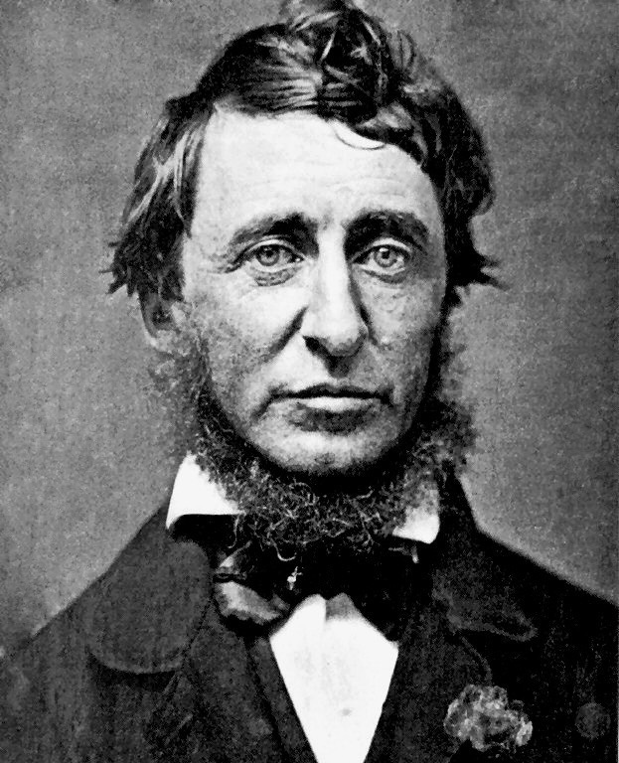
Charles Ives: central aesthetic ideas: motivations of his mature (post-1907) music
New England Transcendental philosophy
Ralph Waldo Emerson, David Thoreau as heroes

Slide 46
Charles Ives: central aesthetic ideas: motivations of his mature (post-1907) music
New England Transcendental philosophy
Ralph Waldo Emerson
All things share a kinship (unity of the whole)

Slide 47
Charles Ives: central aesthetic ideas: motivations of his mature (post-1907) music
New England Transcendental philosophy
Ralph Waldo Emerson
All things share a kinship (unity of the whole)
A special sacredness on the humble, the low, the common

Slide 48
Charles Ives: central aesthetic ideas: motivations of his mature (post-1907) music
New England Transcendental philosophy
Ralph Waldo Emerson
All things share a kinship (unity of the whole)
A special sacredness on the humble, the low, the common
The mysterious, vast “Over-soul,” encompassing all contradictions: in constant motion, in flux

Slide 49
Charles Ives: central aesthetic ideas: motivations of his mature (post-1907) music
New England Transcendental philosophy
Ralph Waldo Emerson
All things share a kinship (unity of the whole)
A special sacredness on the humble, the low, the common
The mysterious, vast “Over-soul,” encompassing all contradictions: in constant motion, in flux
Ives, “The Unanswered Question” (c. 1908)

Slide 50
Charles Ives: central aesthetic ideas: motivations of his mature (post-1907) music
New England Transcendental philosophy
Ralph Waldo Emerson
All things share a kinship (unity of the whole)
A special sacredness on the humble, the low, the common
The mysterious, vast “Over-soul,” encompassing all contradictions: in constant motion, in flux
One can only grasp grand truths vaguely, as intimations, as storming the door of the infinite

Slide 51
Charles Ives: central aesthetic ideas: motivations of his mature (post-1907) music
New England Transcendental philosophy
Ralph Waldo Emerson
All things share a kinship (unity of the whole)
A special sacredness on the humble, the low, the common
The mysterious, vast “Over-soul,” encompassing all contradictions: in constant motion, in flux
One can only grasp grand truths vaguely, as intimations, as storming the door of the infinite
“Emerson,” first movement of Piano Sonata No. 2, “Concord, Mass., 1840-1860” (1910s)

Slide 52
Charles Ives: central aesthetic ideas: motivations of his mature (post-1907) music
New England Transcendental philosophy
Ralph Waldo Emerson
All things share a kinship (unity of the whole)
A special sacredness on the humble, the low, the common
The mysterious, vast “Over-soul,” encompassing all contradictions: in constant motion, in flux
One can only grasp grand truths vaguely, as intimations, as storming the door of the infinite
“Hawthorne,” first movement of Piano Sonata No. 2, “Concord, Mass., 1840-1860” (1910s)

Slide 53
Charles Ives: central aesthetic ideas: motivations of his mature (post-1907) music
New England Transcendental philosophy
Ralph Waldo Emerson
All things share a kinship (unity of the whole)
A special sacredness on the humble, the low, the common
The mysterious, vast “Over-soul,” encompassing all contradictions: in constant motion, in flux
One can only grasp grand truths vaguely, as intimations, as storming the door of the infinite
The most central commitment: be honest with yourself; “self-reliance”

Slide 54
Charles Ives: central aesthetic ideas: motivations of his mature (post-1907) music
New England Transcendental philosophy
= Rugged, honest “substance” . . . . . . . Not mere, superficial “manner”
(“What a piece of music sounds like might not be what it is.”)

Slide 55
Charles Ives: central aesthetic ideas: motivations of his mature (post-1907) music
New England Transcendental philosophy
Recapturing the thrill and wholeness of his Danbury boyhood

Slide 56
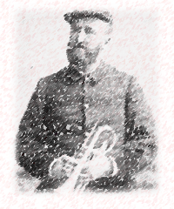
Charles Ives: central aesthetic ideas: motivations of his mature (post-1907) music
New England Transcendental philosophy
Recapturing the thrill and wholeness of his Danbury boyhood (and of his father’s world)
Religious/revivalist experiences Patriotic celebrations

Slide 57
Charles Ives: central aesthetic ideas: motivations of his mature (post-1907) music
New England Transcendental philosophy
Recapturing the thrill and wholeness of his Danbury boyhood (and of his father’s world)
“At the River” (1916)
Religious/revivalist experiences Patriotic celebrations

Slide 58
Charles Ives: central aesthetic ideas: motivations of his mature (post-1907) music
New England Transcendental philosophy
Recapturing the thrill and wholeness of his Danbury boyhood (and of his father’s world)
“The Things Our Fathers Loved” (1917)
Religious/revivalist experiences Patriotic celebrations

Slide 59
Charles Ives: central aesthetic ideas: motivations of his mature (post-1907) music
New England Transcendental philosophy
Recapturing the thrill and wholeness of his Danbury boyhood (and of his father’s world)
The question of music and masculinity

Slide 60
Charles Ives: central aesthetic ideas: motivations of his mature (post-1907) music
New England Transcendental philosophy
Recapturing the thrill and wholeness of his Danbury boyhood (and of his father’s world)
The question of music and masculinity
America’s mission to save the world: the “people” and the democratic voting process.

Slide 61
Charles Ives: central aesthetic ideas: motivations of his mature (post-1907) music
New England Transcendental philosophy
Recapturing the thrill and wholeness of his Danbury boyhood (and of his father’s world)
The question of music and masculinity
America’s mission to save the world: the “people” and the democratic voting process.
“He is There” (c. 1917-18)

Slide 62
Charles Ives performs “They Are There” (1943)

Slide 63
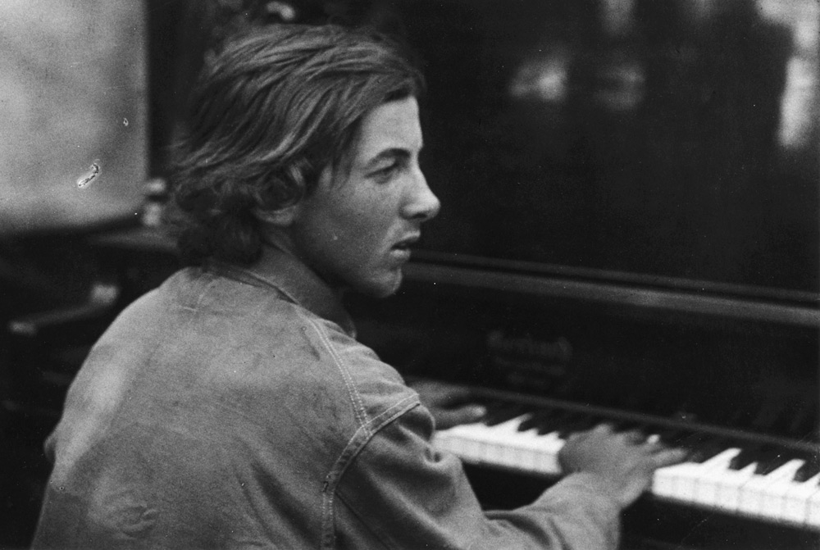
Henry Cowell, California, 1913

Slide 64
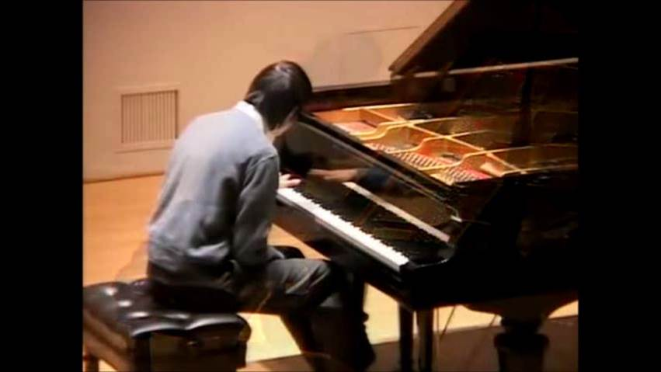
Cowell, “The Tides of Manaunan” (1912)

Slide 65
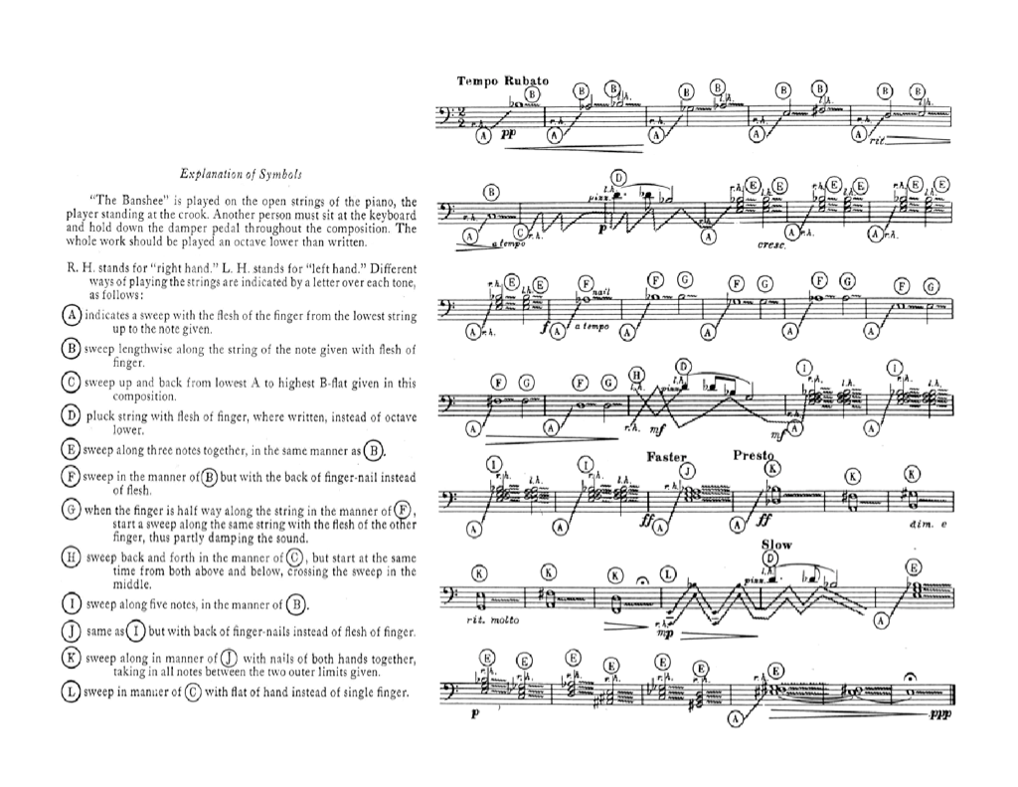
Cowell, “The Banshee” (1923)

Slide 66
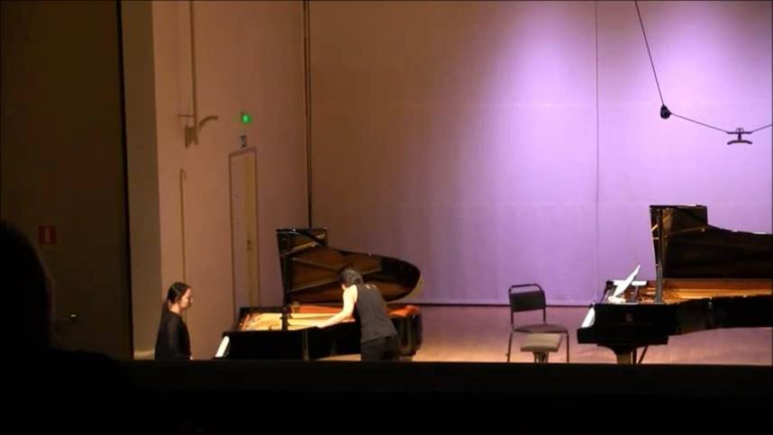
Cowell, “The Banshee” (1923)

Slide 67
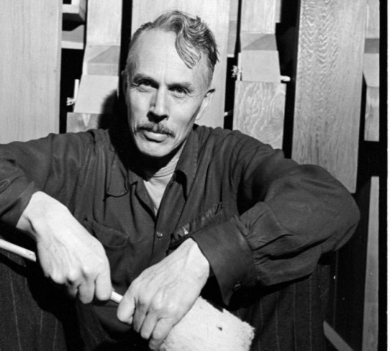
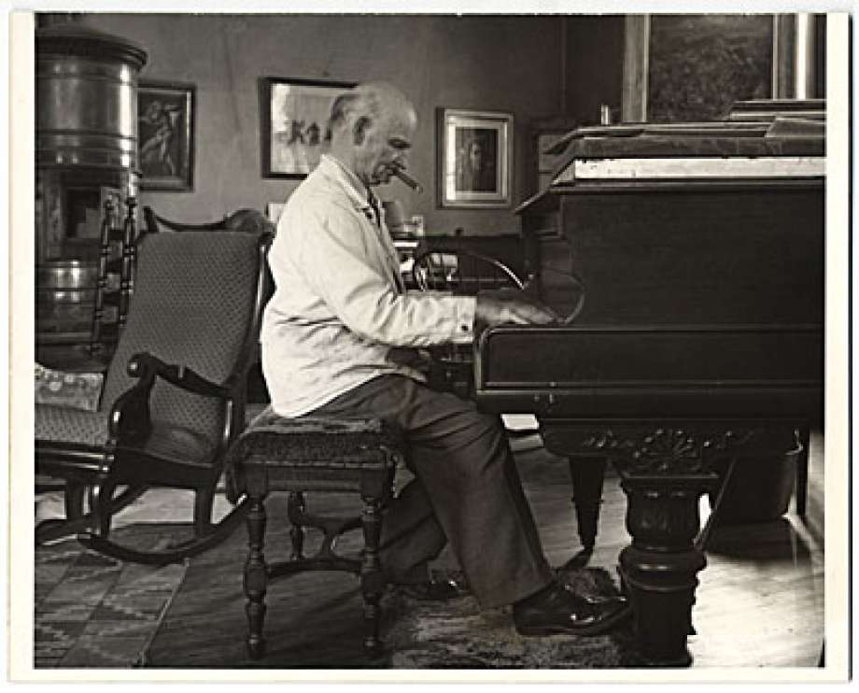
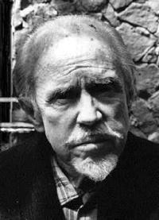
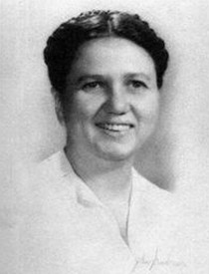
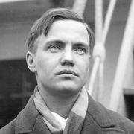
Beyond Ives and Cowell: American pioneers
in “experimental” or avant-garde composition, 1920s and beyond
Harry Partch
Carl Ruggles
Conlon Nancarrow
Ruth Crawford Seeger
George Antheil

Slide 68
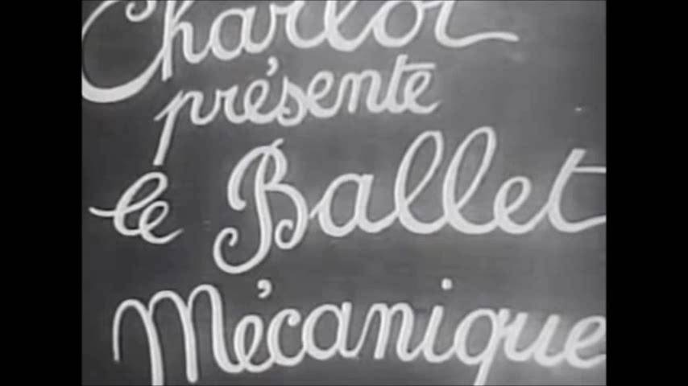
George Antheil, Fernand Léger, and others: Ballet Mécanique (1923-24)

Slide 69
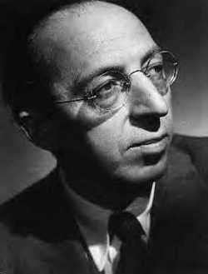
Aaron Copland (1900-1990)

Slide 70
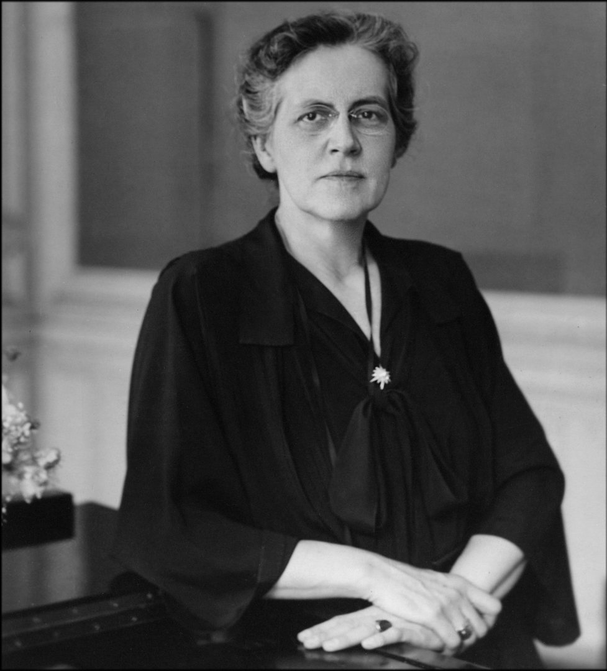
Nadia Boulanger (1887-1979)

Slide 71
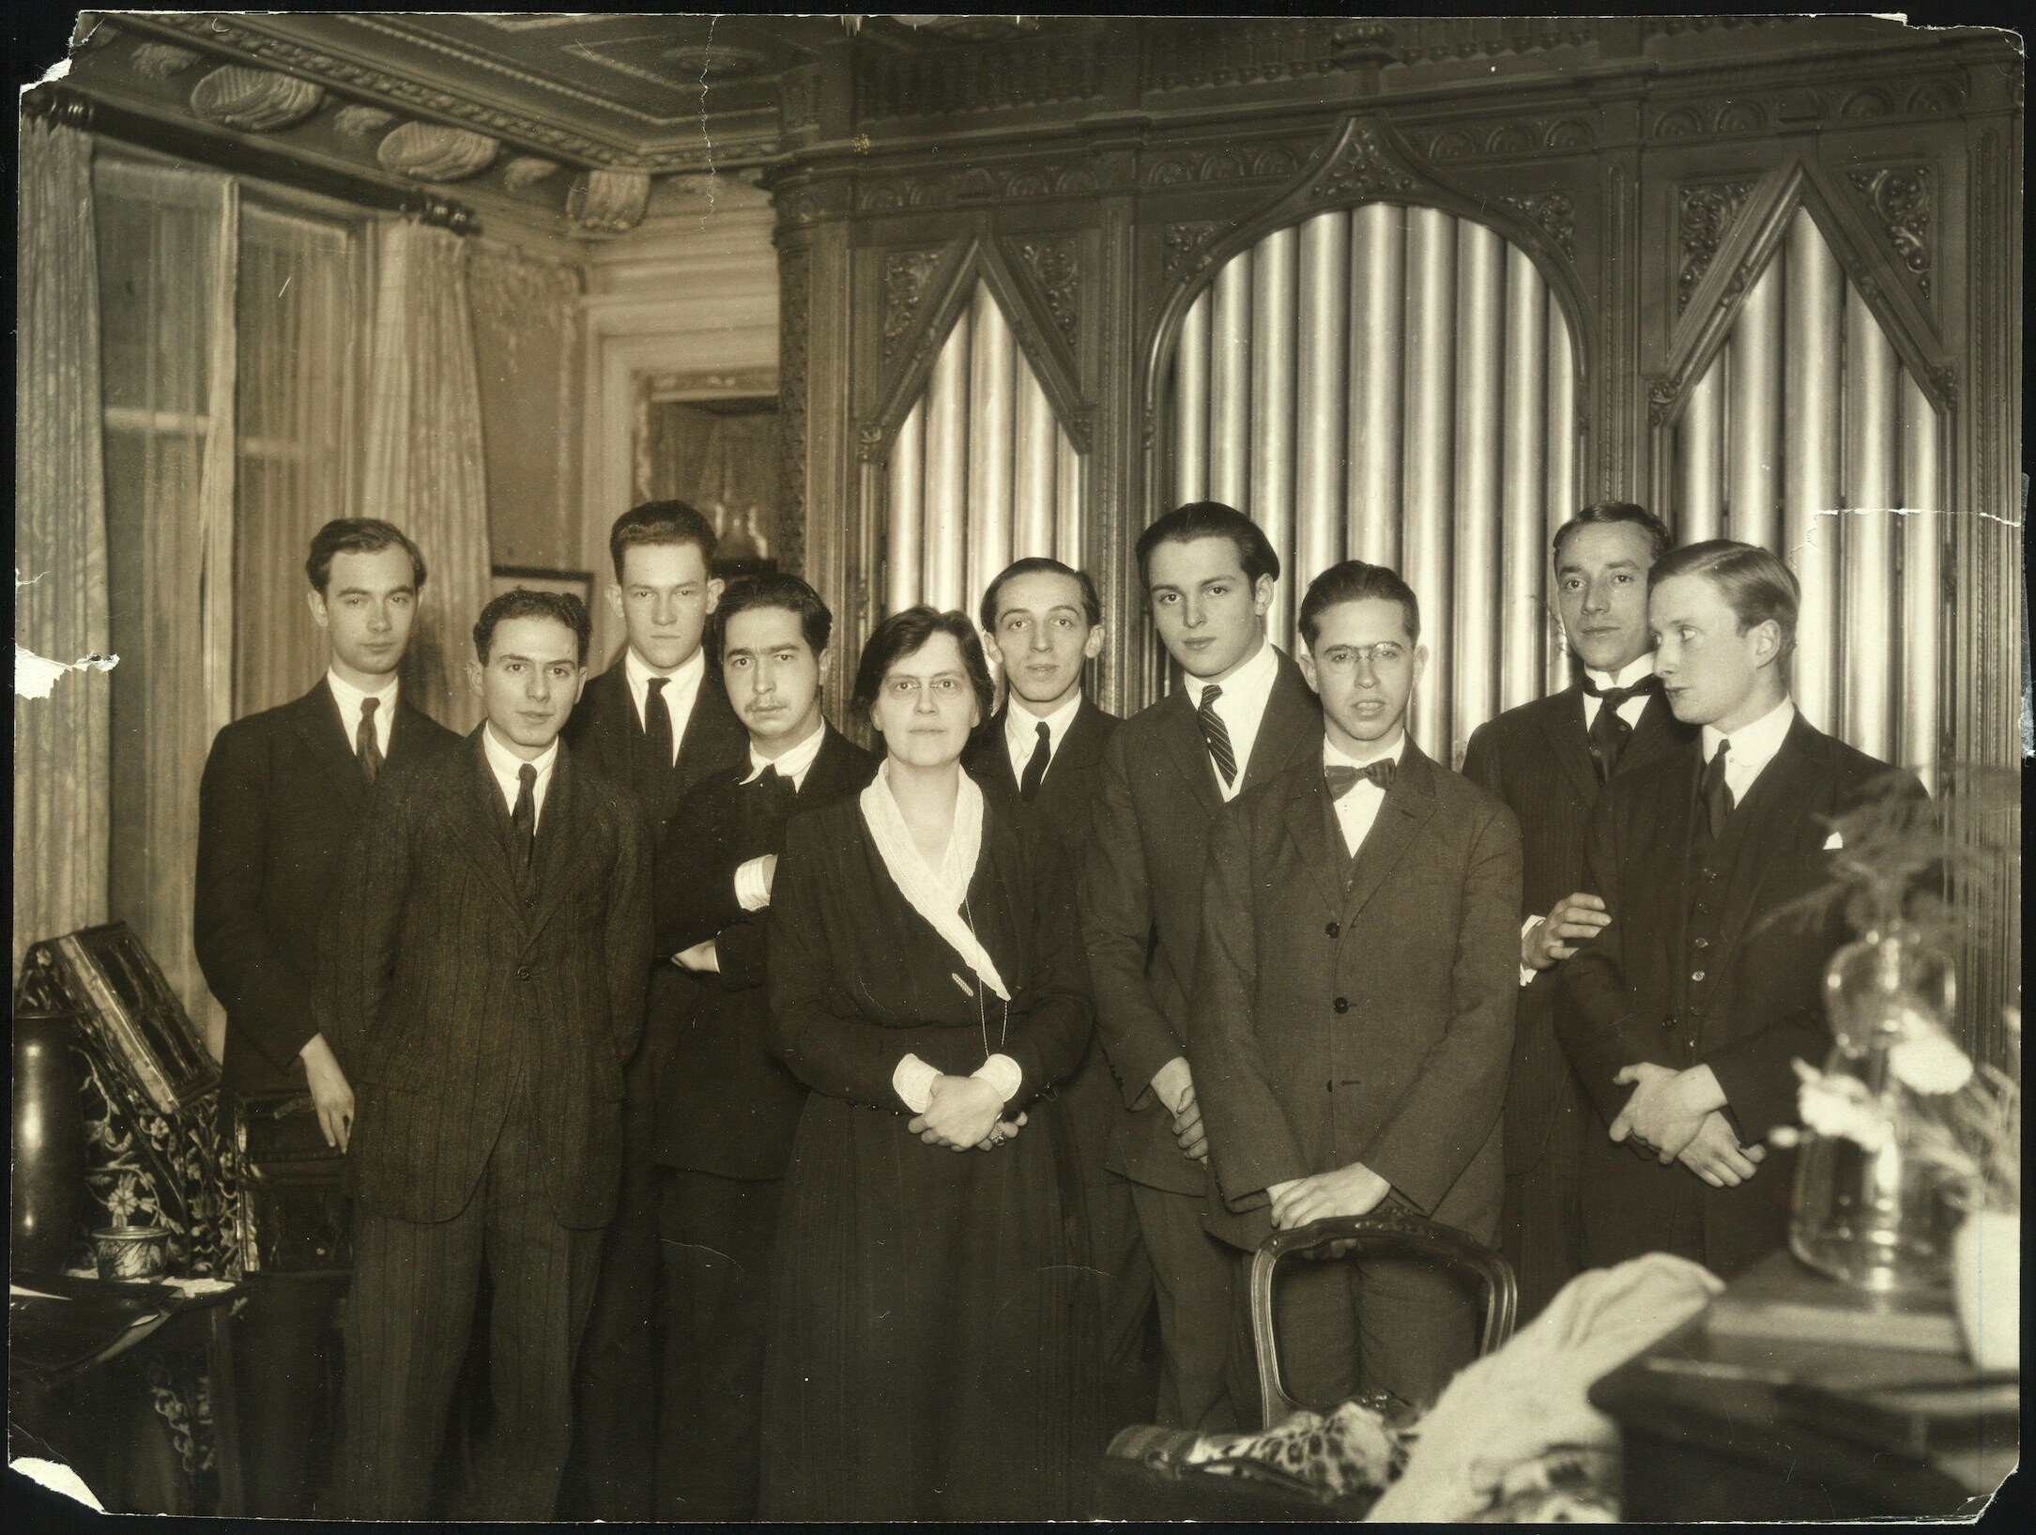
Boulanger Studio, American Conservatory at Fontainebleau, 1923

Slide 72
Boulanger Studio, American Conservatory at Fontainebleau, 1923

Slide 73
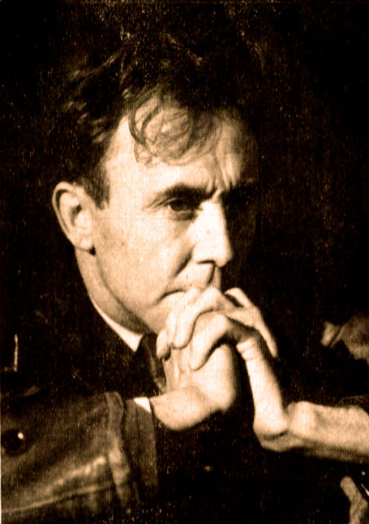
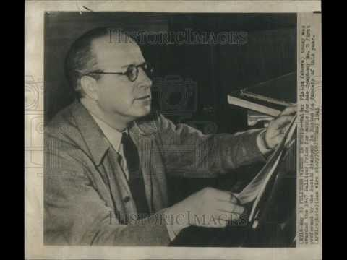
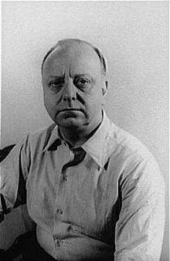
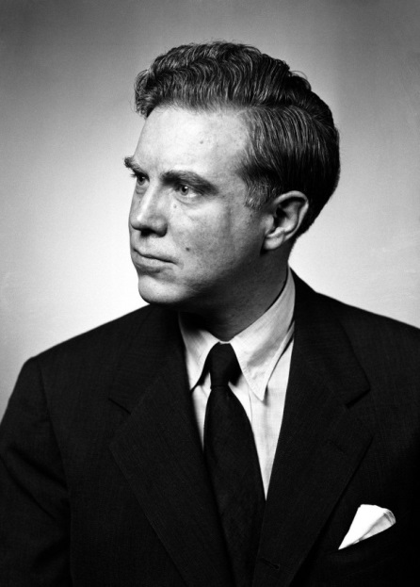
Roy Harris Walter Piston
Virgil Thomson Elliot Carter

Slide 74
Aaron Copland (1900-1990)

Slide 75
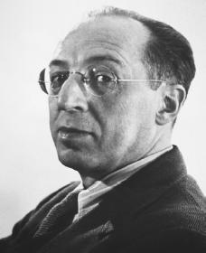
Three Style Periods
1923-c. 1929: French or “Jazz” Period
1929-c. 1935: Esoteric or Austere Period
c. 1934-35 onward: “Imposed Simplicity”
Aaron Copland

Slide 76
Three Style Periods
1923-c. 1929: French or “Jazz” Period
Symphony for Organ and Orchestra (premiere, 1925)
Aaron Copland

Slide 77
Three Style Periods
1923-c. 1929: French or “Jazz” Period
Symphony for Organ and Orchestra (premiere, 1925)
Music for the Theatre (1925)
Aaron Copland

Slide 78
Three Style Periods
1923-c. 1929: French or “Jazz” Period
Symphony for Organ and Orchestra (premiere, 1925)
Music for the Theatre (1925)
Piano Concerto (1927)
Aaron Copland

Slide 79
Three Style Periods
1923-c. 1929: French or “Jazz” Period
1929-c. 1935: Esoteric or Austere Period
Piano Variations (1930)
Aaron Copland

Slide 80
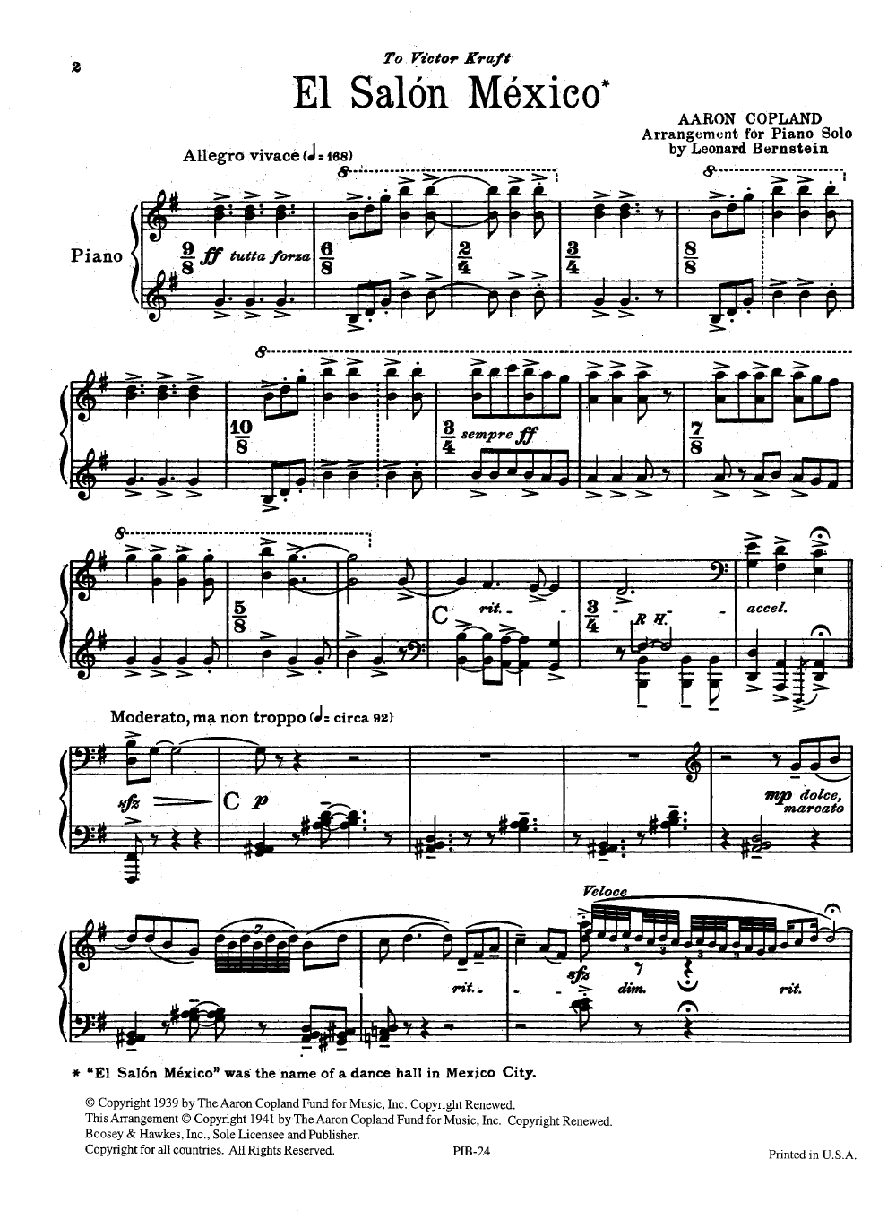

Slide 81
Three Style Periods
1923-c. 1929: French or “Jazz” Period
1929-c. 1935: Esoteric or Austere Period
c. 1934-35 onward: “Imposed Simplicity”
El Salón México (1935-36)
Billy the Kid (1938)
Rodeo (1942)
Appalachian Spring (1944)
Aaron Copland

Slide 82
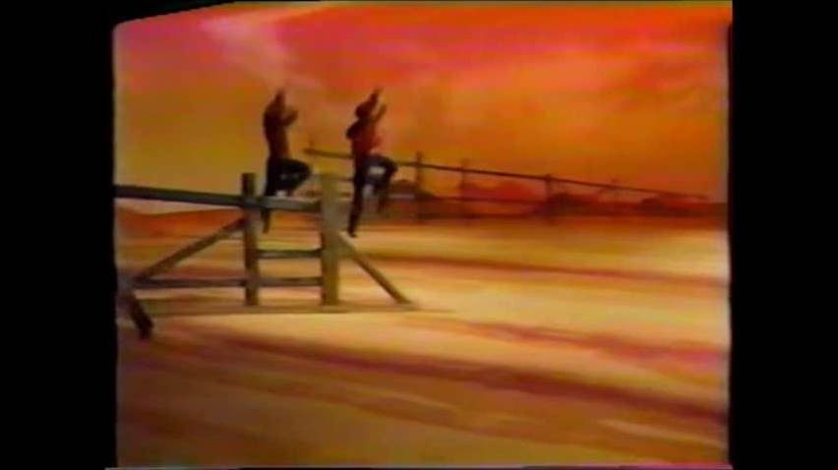
Copland, Rodeo (1942)

Slide 83
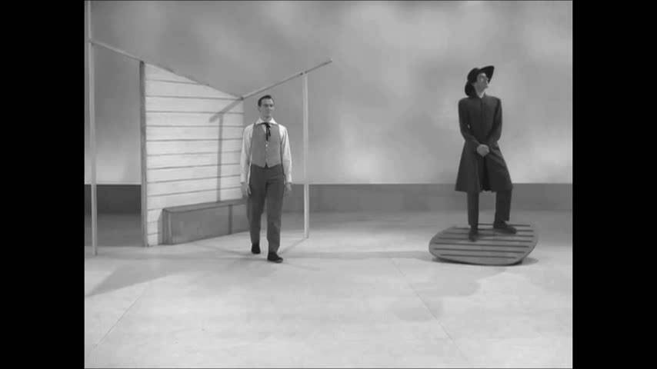
Copland, Appalachian Spring (1944)

