Slide 2
Shatters the Liberal-Humanist
Concept of Art

Slide 3
“Liberal-Humanist Culture” and “The Grand Tradition”
Europe at its height: increasingly “bourgeois” – secular – scientific/technological; functionally differentiated;
democracy, capitalism, “Great Art” and its institutions, etc.)
Pre-WWI
Post-WWI
1914 1918

Slide 4
“Liberal-Humanist Culture” and “The Grand Tradition”
Europe at its height: increasingly “bourgeois” – secular – scientific/technological; functionally differentiated;
democracy, capitalism, “Great Art” and its institutions, etc.)
Pre-WWI
Post-WWI
1914 1918
“Artificial” systems of order – created or willed worlds of aesthetic meaning

Slide 5
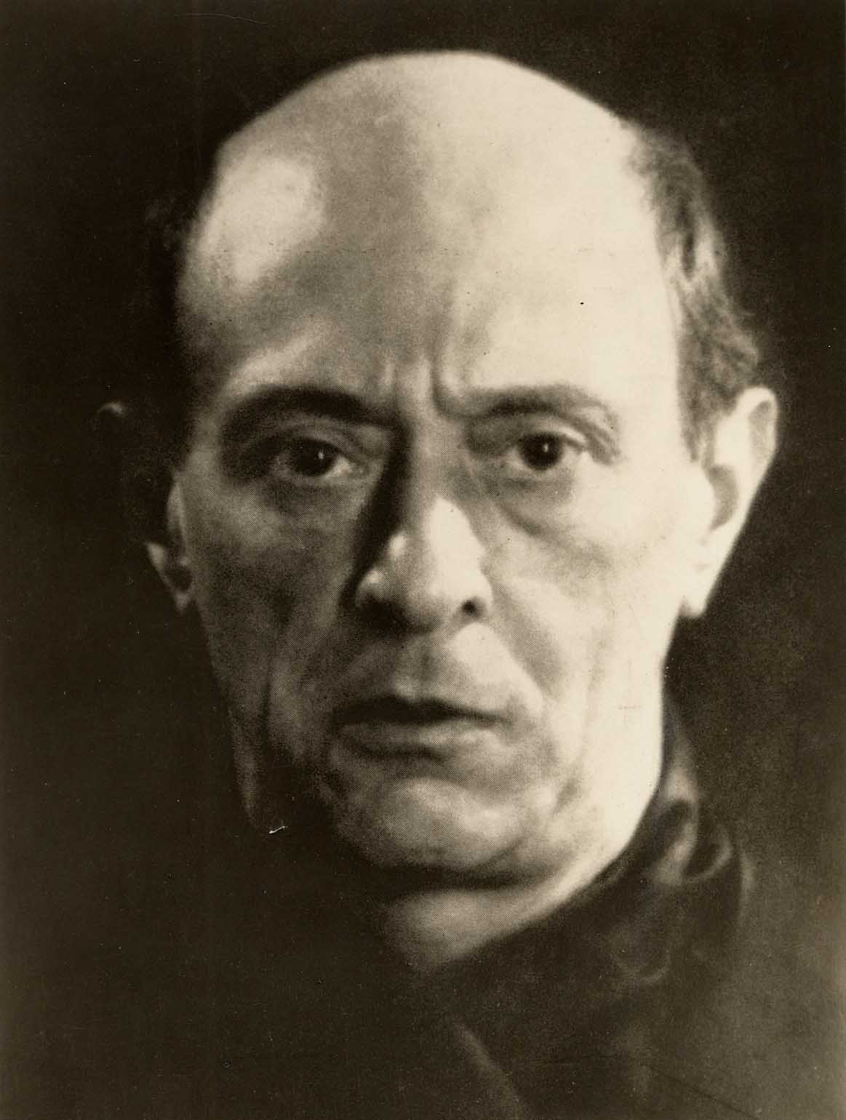
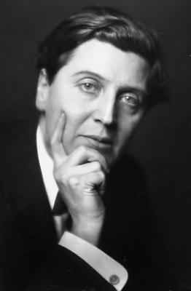
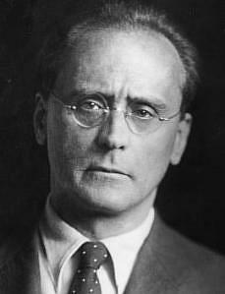
1920s: Arnold Schoenberg and the “Twelve-Tone Method” ( = pitch-class serialism)
“The Second Viennese School”
Schoenberg Berg Webern

Slide 6
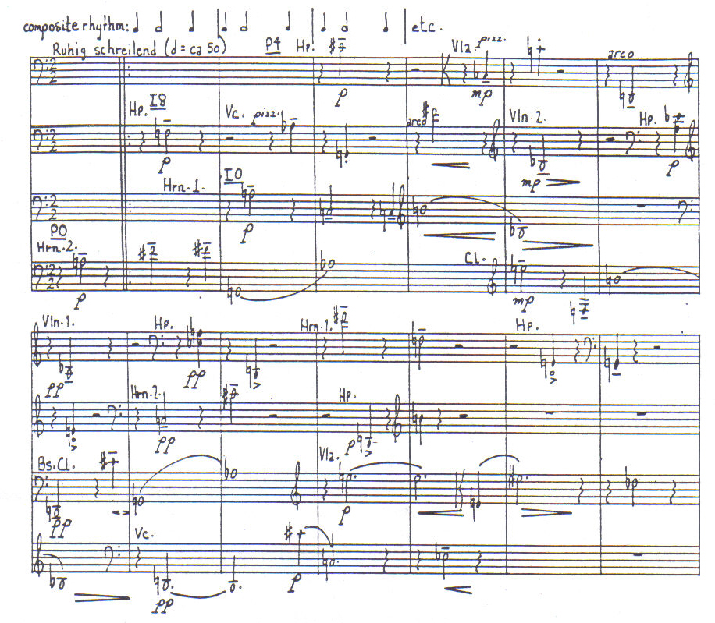
Webern, Symphony, op. 21, movement 1 (1928)

Slide 7
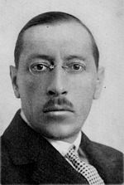
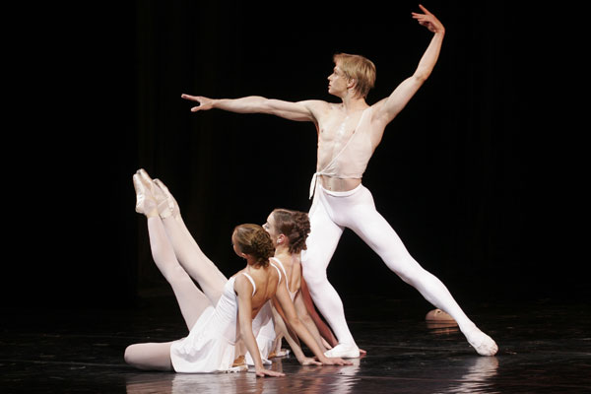
Apollon-Musagète (1927-28)

Slide 8
Concept (1920s): “New Music” (Neue Musik)

Slide 9
Concept (1920s): “New Music” (Neue Musik)
Schoenberg’s “Society for Private Musical Performances” (1919 ff)
Hindemith-led Donaueschingen Summer Festivals (1921 ff)
ISCM: International Society for Contemporary Music (founded by
Egon Wellesz and Rudolph Reti, 1922)
Baden-Baden Festivals (later 1920s)
Creating alternative outlets and institutions
to promote “new music”

Slide 10
“Liberal-Humanist Culture” and “The Grand Tradition”
Europe at its height: increasingly “bourgeois” – secular – scientific/technological; functionally differentiated;
democracy, capitalism, “Great Art” and its institutions, etc.)
Pre-WWI
Post-WWI
1914 1918
“Artificial” systems of order – created or willed worlds of aesthetic meaning

Slide 11
“Liberal-Humanist Culture” and “The Grand Tradition”
Europe at its height: increasingly “bourgeois” – secular – scientific/technological; functionally differentiated;
democracy, capitalism, “Great Art” and its institutions, etc.)
Pre-WWI
Post-WWI
1914 1918
“Artificial” systems of order – created or willed worlds of aesthetic meaning
Religious orthodoxy (retrenchment);
variants:
“classical” orthodoxy;
neo-conservatism, neo-traditionalism

Slide 12
Religious Orthodoxy, 1920s, 1930s: Commitments, Conversions, Reconversions
Igor Stravinsky – reconversion to Russian orthodoxy, Easter 1926
Jean Cocteau – conversion to Catholicism, 1925-26
T. S. Eliot – conversion to Anglicanism, 1927
Catholic “neo-Thomist” movement – 1920s
Francis Poulenc – reconversion to Catholicism, 1936

Slide 13
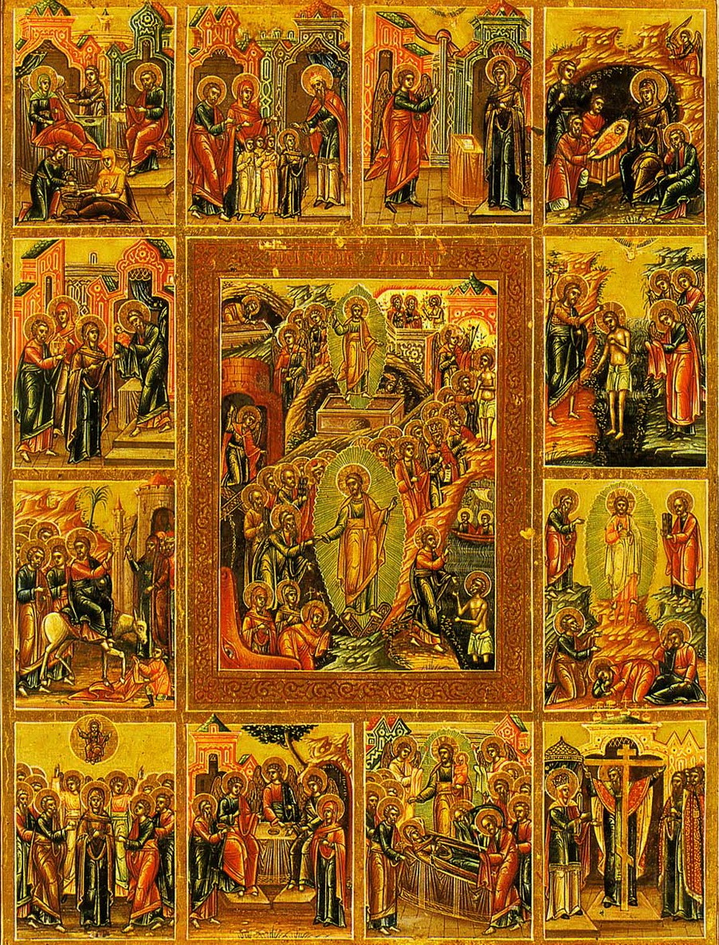
Stravinsky, Symphony of Psalms,
movement 1, “Exaudi orationem meam, Domine” (Ps 39: 12-13)

Slide 14
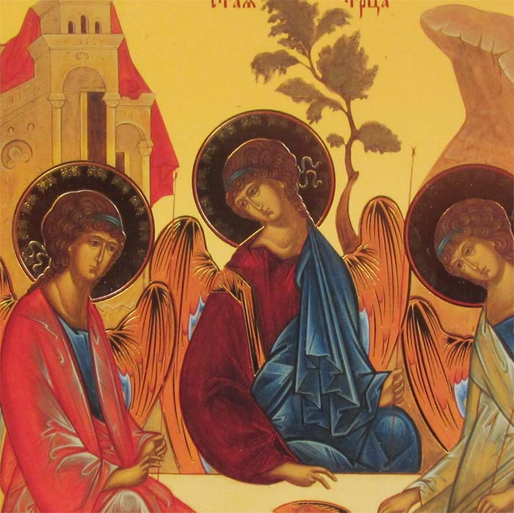
Stravinsky, Symphony of Psalms,
movement 3, “Alleluia . . . Laudate Dominum” (Ps 150)

Slide 15
“Liberal-Humanist Culture” and “The Grand Tradition”
Europe at its height: increasingly “bourgeois” – secular – scientific/technological; functionally differentiated;
democracy, capitalism, “Great Art” and its institutions, etc.)
Pre-WWI
Post-WWI
1914 1918
“Artificial” systems of order – created or willed worlds of aesthetic meaning
Religious orthodoxy (retrenchment);
variants:
“classical” orthodoxy;
neo-conservatism, neo-traditionalism

Slide 16
“Liberal-Humanist Culture” and “The Grand Tradition”
Europe at its height: increasingly “bourgeois” – secular – scientific/technological; functionally differentiated;
democracy, capitalism, “Great Art” and its institutions, etc.)
Pre-WWI
Post-WWI
1914 1918
“Artificial” systems of order – created or willed worlds of aesthetic meaning
Religious orthodoxy (retrenchment);
variants:
“classical” orthodoxy;
neo-conservatism, neo-traditionalism
Authoritarian (non-liberal)
political commitment,
either left (communism, marxism) or right (fascism, extreme nationalism)

Slide 17
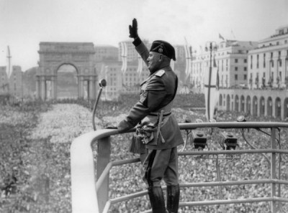
Benito Mussolini: Partito Nazionale Fascista, Prime Minister 1922-43

Slide 18
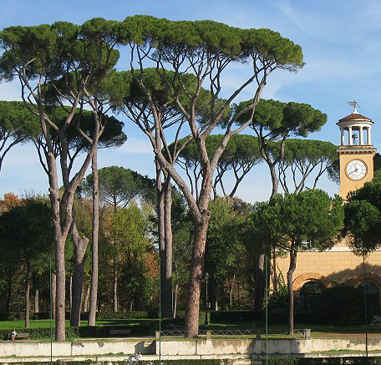
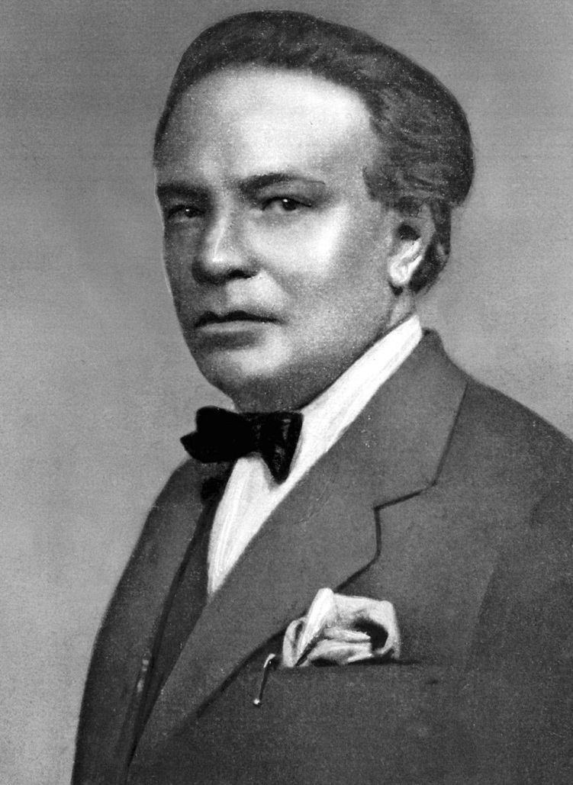
Ottorino Respighi (1879-1936)
Pini di Roma (1923-24), movement 1, “I pini della Villa Borghese”

Slide 19
Ottorino Respighi (1879-1936)
Pini di Roma (1923-24), movement 1, “I pini della Villa Borghese”

Slide 20
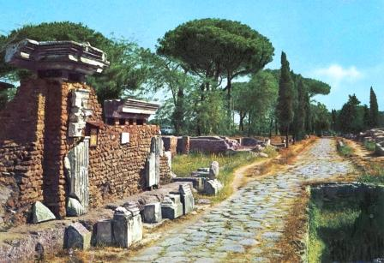
Ottorino Respighi (1879-1936)
Pini di Roma (1923-24), movement 4, “I pini della Via Appia”

Slide 21
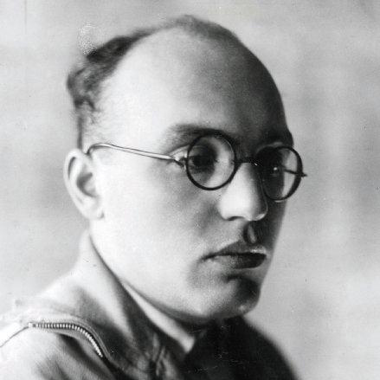
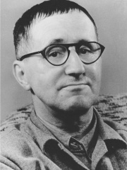
Mahagonny-Songspiel (1927)
Die Dreigroschenoper (1928)
Kurt Weill
Bertolt Brecht

Slide 22
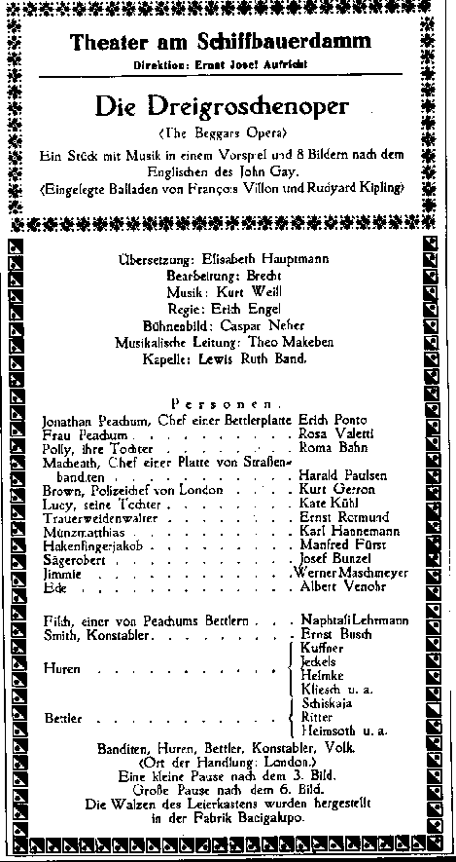
1928
Kurt Weill
“Moritat von
Mackie Messer”
(recording from Berlin, 1930)
Bertolt Brecht

Slide 23
“Liberal-Humanist Culture” and “The Grand Tradition”
Europe at its height: increasingly “bourgeois” – secular – scientific/technological; functionally differentiated;
democracy, capitalism, “Great Art” and its institutions, etc.)
Pre-WWI
Post-WWI
1914 1918
“Artificial” systems of order – created or willed worlds of aesthetic meaning
Religious orthodoxy (retrenchment);
variants:
“classical” orthodoxy;
neo-conservatism, neo-traditionalism
Authoritarian (non-liberal)
political commitment,
either left (communism, marxism) or right (fascism, extreme nationalism)

Slide 24
“Liberal-Humanist Culture” and “The Grand Tradition”
Europe at its height: increasingly “bourgeois” – secular – scientific/technological; functionally differentiated;
democracy, capitalism, “Great Art” and its institutions, etc.)
Pre-WWI
Post-WWI
1914 1918
“Weakened” liberalism
(now challenged or suspect): retaining of democracy, mixed capitalism, etc.
“Artificial” systems of order – created or willed worlds of aesthetic meaning
Religious orthodoxy (retrenchment);
variants:
“classical” orthodoxy;
neo-conservatism, neo-traditionalism
Authoritarian (non-liberal)
political commitment,
either left (communism, marxism) or right (fascism, extreme nationalism)

Slide 25
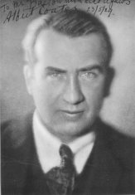
Albert Coates and the “Symphony Orchestra” (London Symphony Orchestra?)
One of the first recordings
of Beethoven’s Ninth Symphony (1923)
produced on sixteen 78-rpm sides
reduced orchestra
chorus of eight voices

Slide 26
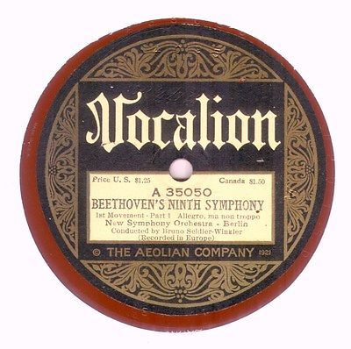
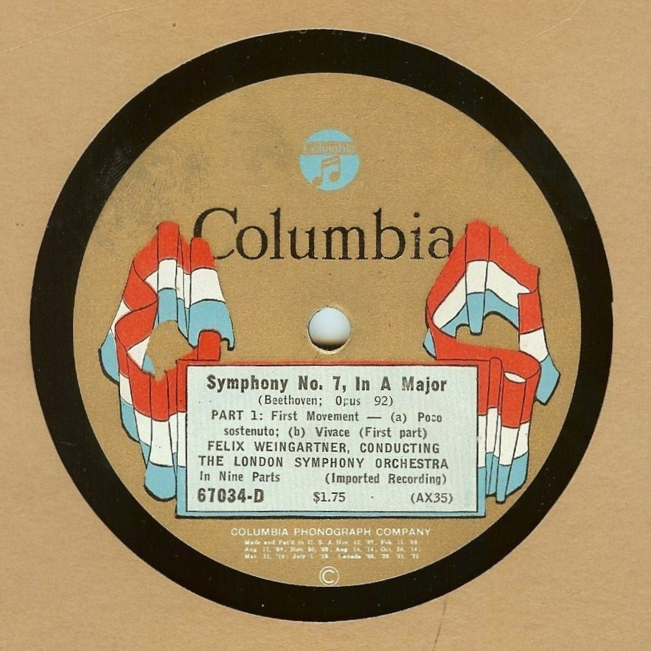
Bruno Seidler-Winkler, 1923 Felix Weingartner, 1927

Slide 27
“Liberal-Humanist Culture” and “The Grand Tradition”
Europe at its height: increasingly “bourgeois” – secular – scientific/technological; functionally differentiated;
democracy, capitalism, “Great Art” and its institutions, etc.)
Pre-WWI
Post-WWI
1914 1918
“Weakened” liberalism
(now challenged or suspect): retaining of democracy, mixed capitalism, etc.
“Artificial” systems of order – created or willed worlds of aesthetic meaning
Religious orthodoxy (retrenchment);
variants:
“classical” orthodoxy;
neo-conservatism, neo-traditionalism
Authoritarian (non-liberal)
political commitment,
either left (communism, marxism) or right (fascism, extreme nationalism)

Slide 28
“Liberal-Humanist Culture” and “The Grand Tradition”
Europe at its height: increasingly “bourgeois” – secular – scientific/technological; functionally differentiated;
democracy, capitalism, “Great Art” and its institutions, etc.)
Pre-WWI
Post-WWI
1914 1918
“Weakened” liberalism
(now challenged or suspect): retaining of democracy, mixed capitalism, etc.
“Artificial” systems of order – created or willed worlds of aesthetic meaning
Religious orthodoxy (retrenchment);
variants:
“classical” orthodoxy;
neo-conservatism, neo-traditionalism
Authoritarian (non-liberal)
political commitment,
either left (communism, marxism) or right (fascism, extreme nationalism)
Tidal wave of popular mass culture (radio, sound recordings, film, etc.)

Slide 29
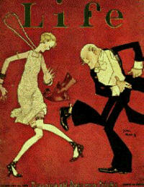
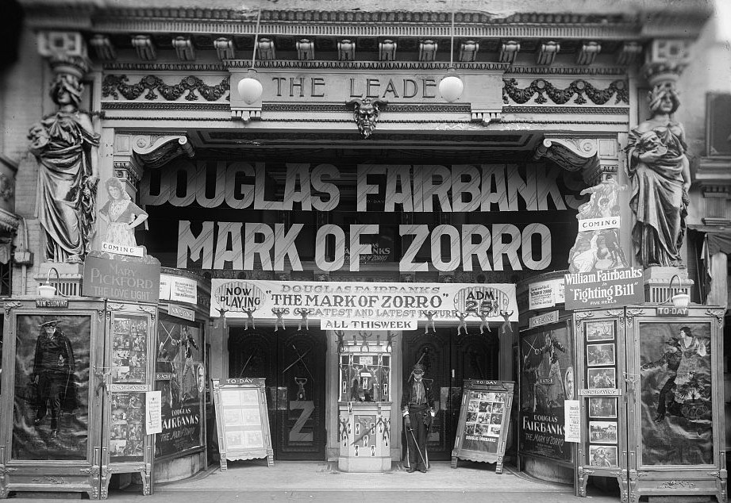

Slide 30
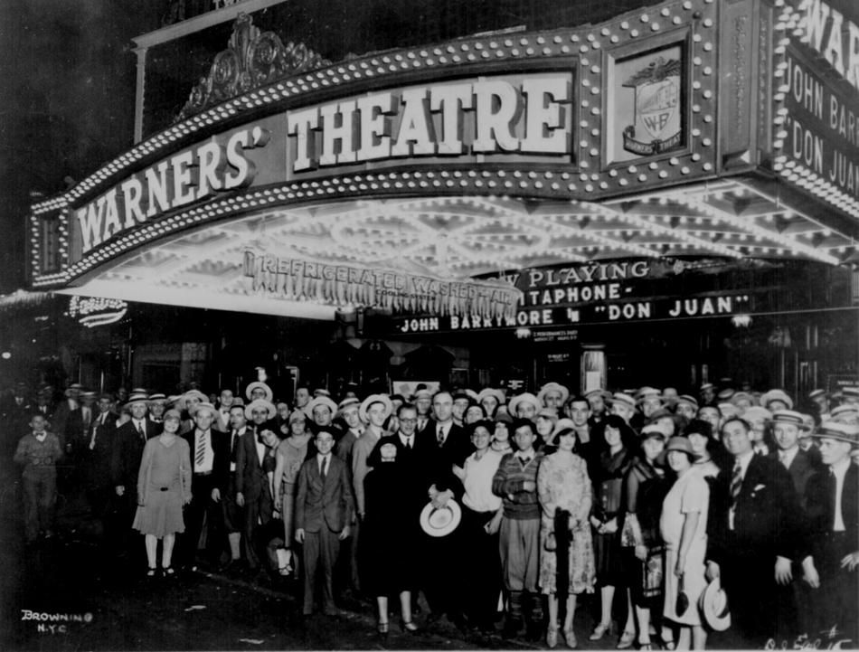

Slide 31
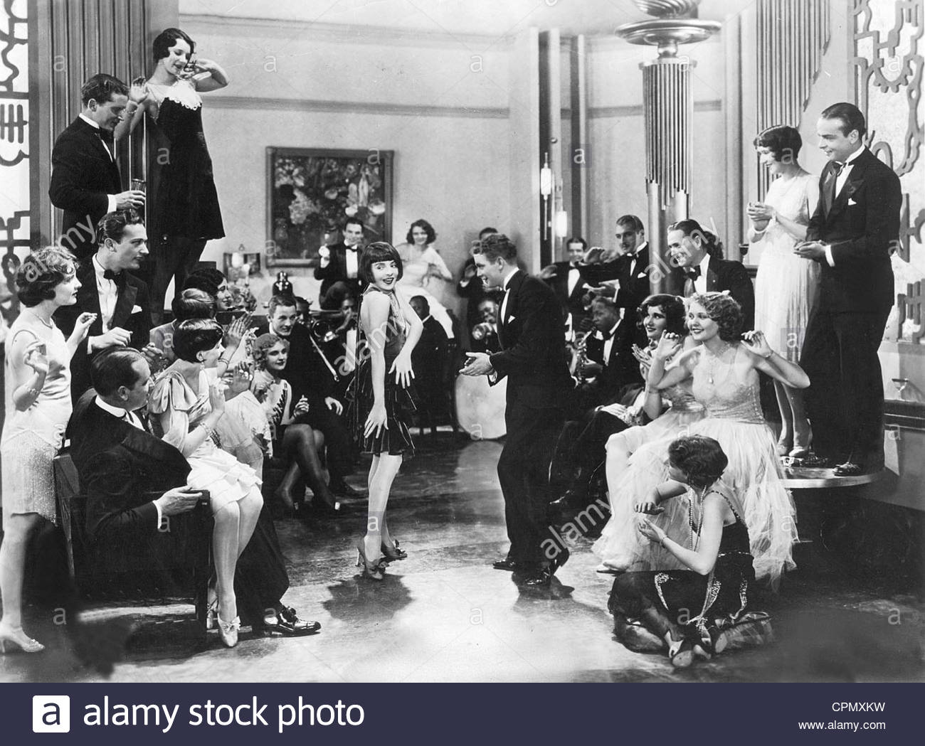

Slide 32
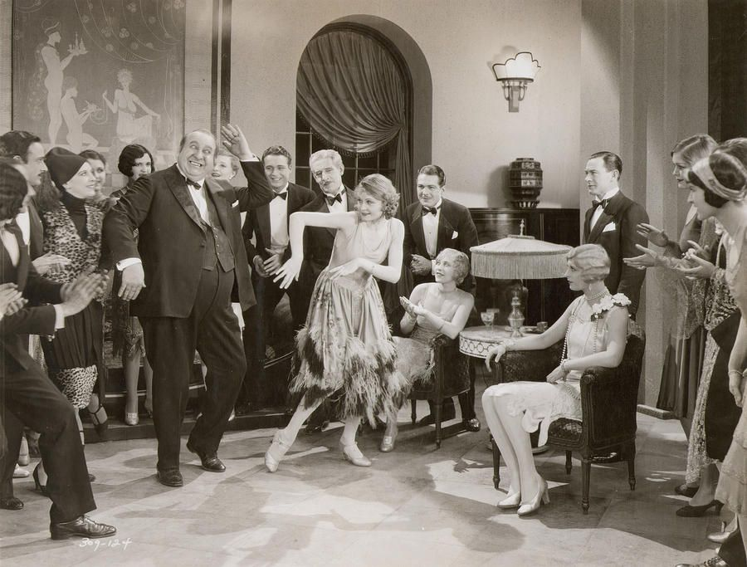

Slide 33
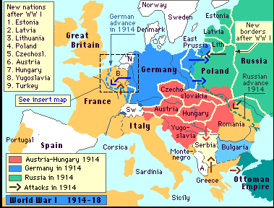

Slide 34
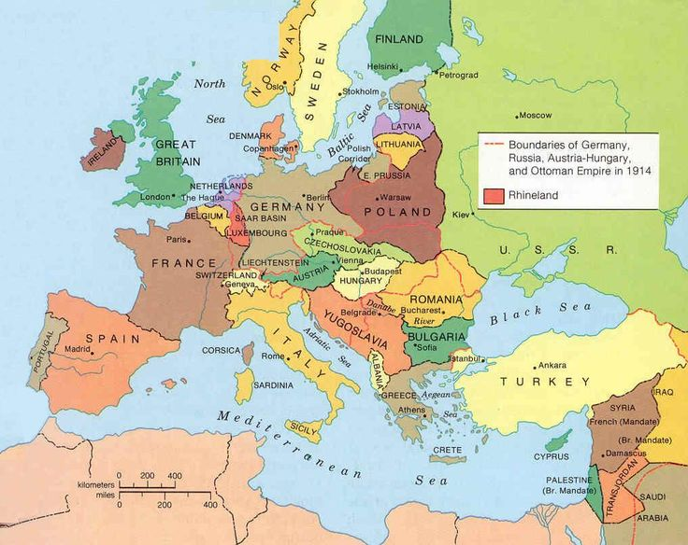

Slide 35
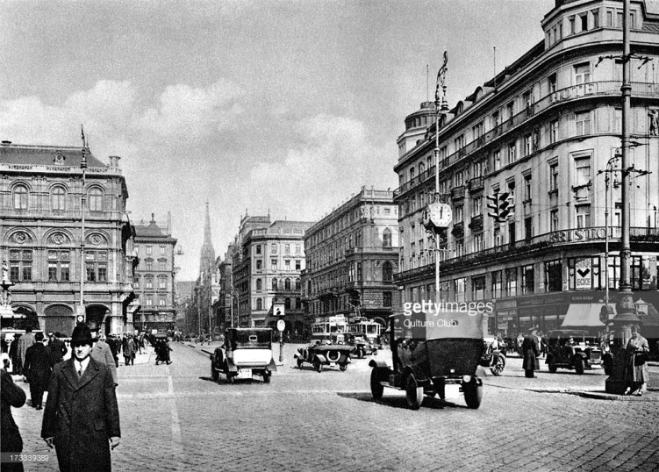
Vienna in the 1920s

Slide 37
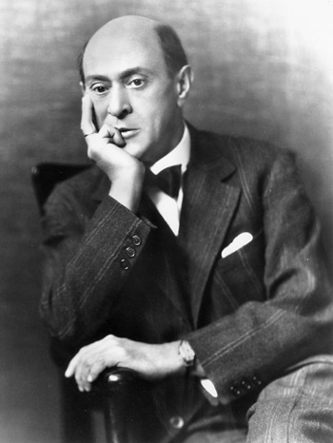
Verklärte Nacht (1899) -- sextet
Gurrelieder (1901-02) – massive “cantata”
Pelléas et Mélisande (1903) – tone poem
String Quartet, op. 7 (1904-05)
Chamber Symphony (1906)
String Quartet No. 2 (1907-08)
The Book of the Hanging Gardens
(1908-09)—song cycle
Three Piano Pieces, op. 11 (1909)
Five Pieces for Orchestra, op. 16 (1909)
Erwartung, op. 17 (1909) –”monodrama)
Pierrot lunaire, op. 21 (1912)
“Tonal”
“Transitional”
“Atonal”

Slide 38
Verklärte Nacht (1899) -- sextet
Gurrelieder (1901-02) – massive “cantata”
Pelléas et Mélisande (1903) – tone poem
String Quartet, op. 7 (1904-05)
Chamber Symphony (1906)
String Quartet No. 2 (1907-08)
The Book of the Hanging Gardens
(1908-09)—song cycle
Three Piano Pieces, op. 11 (1909)
Five Pieces for Orchestra, op. 16 (1909)
Erwartung, op. 17 (1909) –”monodrama)
Pierrot lunaire, op. 21 (1912)
“Tonal”
“Transitional”
“Atonal”
The “seven-year silence,” 1917-23

Slide 39
Schoenberg, Aesthetic Convictions 1918-21:
The Search for Control

Slide 40
Schoenberg, Aesthetic Convictions 1918-21:
The Search for Control
Tonal music now played out; to embrace it is nothing short of a moral failure

Slide 41
Schoenberg, Aesthetic Convictions 1918-21:
The Search for Control
Tonal music now played out; to embrace it is nothing short of a moral failure
Hence: avoid explicit references to key and embrace the full emancipation of dissonance

Slide 42
Schoenberg, Aesthetic Convictions 1918-21:
The Search for Control
Tonal music now played out; to embrace it is nothing short of a moral failure
Hence: avoid explicit references to key and embrace the full emancipation of dissonance
Rely instead on sets of pitch constellations, “basic shapes” defined by intervals, to be developed and manipulated organically throughout a piece

Slide 43
Schoenberg, Aesthetic Convictions 1918-21:
The Search for Control
Tonal music now played out; to embrace it is nothing short of a moral failure
Hence: avoid explicit references to key and embrace the full emancipation of dissonance
Rely instead on sets of pitch constellations, “basic shapes” defined by intervals, to be developed and manipulated organically throughout a piece
To keep works non-tonal, refrain from
over-emphasizing any single pitch – treat them
all equally

Slide 44
Schoenberg, Solution Found, 1921!
Remark to Josef Rufer:
“I have discovered something that will assure the supremacy of German music for the next one hundred years”

Slide 45
Schoenberg, Solution Found, 1921!
Remark to Josef Rufer:
“I have discovered something that will assure the supremacy of German music for the next one hundred years”
“Discovery” and exploration of
“the twelve-tone method,” 1921-24

Slide 46
Schoenberg, Solution Found, 1921!
Remark to Josef Rufer:
“I have discovered something that will assure the supremacy of German music for the next one hundred years”
“Discovery” and exploration of
“the twelve-tone method,” 1921-24
Held as a “secret,” 1921-22—until the “open meeting” of pupils in February 1923, when he divulged the system to insiders

Slide 47
Schoenberg, Solution Found, 1921!
Remark to Josef Rufer:
“I have discovered something that will assure the supremacy of German music for the next one hundred years”
“Discovery” and exploration of
“the twelve-tone method,” 1921-24
Held as a “secret,” 1921-22—until the “open meeting” of pupils in February 1923, when he divulged the system to insiders
The method finally made more public by Erwin Stein, essay, “New Principles of Form” (1924)

Slide 48
Schoenberg, Solution Found, 1921!
Remark to Josef Rufer:
“I have discovered something that will assure the supremacy of German music for the next one hundred years”
“Discovery” and exploration of
“the twelve-tone method,” 1921-24
Op. 23 – Five Piano Pieces
Op. 24 – Serenade
Op. 25 – Suite for Piano
Op. 26 – Woodwind Quintet

Slide 49
Schoenberg, Solution Found, 1921!
Remark to Josef Rufer:
“I have discovered something that will assure the supremacy of German music for the next one hundred years”
“Discovery” and exploration of
“the twelve-tone method,” 1921-24
Op. 23 – Five Piano Pieces
Op. 24 – Serenade
Op 25 – Suite for Piano
Op. 26 – Woodwind Quintet

Slide 50
The row is not a melody, a theme, or a harmony. Instead:

Slide 51
The row is not a melody, a theme, or a harmony. Instead:
A pitch-generative idea or source that dwells under or behind what one hears on the music’s surface.

Slide 52
The row is not a melody, a theme, or a harmony. Instead:
A pitch-generative idea or source that dwells under or behind what one hears on the music’s surface.
Thus: a subthematic principle generating what one does hear.

Slide 53
The row is not a melody, a theme, or a harmony. Instead:
A pitch-generative idea or source that dwells under or behind what one hears on the music’s surface.
Thus: a subthematic principle generating what one does hear.
The subthematic principle thus regulates the musical surface by assimilating it to its abstracted source (the twelve-tone row and its derivatives)

Slide 54
The row is not a melody, a theme, or a harmony. Instead:
A pitch-generative idea or source that dwells under or behind what one hears on the music’s surface.
Thus: a subthematic principle generating what one does hear.
The subthematic principle thus regulates the musical surface by assimilating it to its abstracted source (the twelve-tone row and its derivatives)
Invites a quasi-mystical metaphor: an “unheard” presence (qua creator) calls forth the sound-world of the piece: “Let there be light!”

Slide 55
The row is not a melody, a theme, or a harmony. Instead:
A pitch-generative idea or source that dwells under or behind what one hears on the music’s surface.
Thus: a subthematic principle generating what one does hear.
The subthematic principle thus regulates the musical surface by assimilating it to its abstracted source (the twelve-tone row and its derivatives)
Invites a quasi-mystical metaphor: an “unheard” presence (qua creator) calls forth the sound-world of the piece: “Let there be light!”
Row The created work
as idea of audible, shaped
sound

Slide 56
Schoenberg, Solution Found, 1921!
Remark to Josef Rufer:
“I have discovered something that will assure the supremacy of German music for the next one hundred years”
“Discovery” and exploration of
“the twelve-tone method,” 1921-24
Op. 23 – Five Piano Pieces
Op. 24 – Serenade
Op 25 – Suite for Piano
Op. 26 – Woodwind Quintet

Slide 57
Schoenberg: Piano Suite, op. 25; Woodwind Quintet, op. 26
Schoenbergian “classicizing”? – the dialectical pull of two principles:
Rigorous “objective” control built into the twelve-tone method
Yet the resultant music is molded into the traditional forms of the past—suggesting an honorific link that tradition.
The most advanced concepts of dissonance and non-tonality via the twelve-tone method

Slide 58
Schoenberg, Suite for Piano, op. 25 (1921-23): Repeat Schemes
Präludium (no repeats)
Gavotte (no repeats but)
Musette ||: rep. :|| no rep. ||
Gavotte da capo
Intermezzo (no repeats)
Minuet ||: rep. :|| no rep. ||
Trio ||: rep. :||: rep. :||
Minuet da capo
Gigue ||: rep. :|| no rep. ||

Slide 59
Why this obsession with twelve-tones and pitch-counting?

Slide 60
Why this obsession with twelve-tones and pitch-counting?
To insure that all twelve pitches get equal treatment—thus leading to a resultant work that is non-tonal (provided that the row is constructed non-tonally, i.e., to produce that impression)

Slide 61
Why this obsession with twelve-tones and pitch-counting?
To insure that all twelve pitches get equal treatment—thus leading to a resultant work that is non-tonal (provided that the row is constructed non-tonally, i.e., to produce that impression)
To deploy a fundamental principle of organization that: a) ipso facto guarantees the “organic unity” of a piece (grounded in the twelve-tone intervallic set as “basic idea”); and b) thereby harnesses the energies of the dissonances released before WWI.

Slide 62
Why this obsession with twelve-tones and pitch-counting?
To insure that all twelve pitches get equal treatment—thus leading to a resultant work that is non-tonal (provided that the row is constructed non-tonally, i.e., to produce that impression)
To deploy a fundamental principle of organization that: a) ipso facto guarantees the “organic unity” of a piece (grounded in the twelve-tone intervallic set as “basic idea”); and b) thereby harnesses the energies of the dissonances released before WWI.
To create a new musical universe that follows its own inherent and internal laws: “the method of composing with twelve tones related only to each other”

Slide 63
Why this obsession with twelve-tones and pitch-counting?
To insure that all twelve pitches get equal treatment—thus leading to a resultant work that is non-tonal (provided that the row is constructed non-tonally, i.e., to produce that impression)
To deploy a fundamental principle of organization that: a) ipso facto guarantees the “organic unity” of a piece (grounded in the twelve-tone intervallic set as “basic idea”); and b) thereby harnesses the energies of the dissonances released before WWI.
To create a new musical universe that follows its own inherent and internal laws: “the method of composing with twelve tones related only to each other”
To advocate on behalf of a method that can now claim to be the next—and inevitable—step of “historical progress” in the modern age

Slide 64
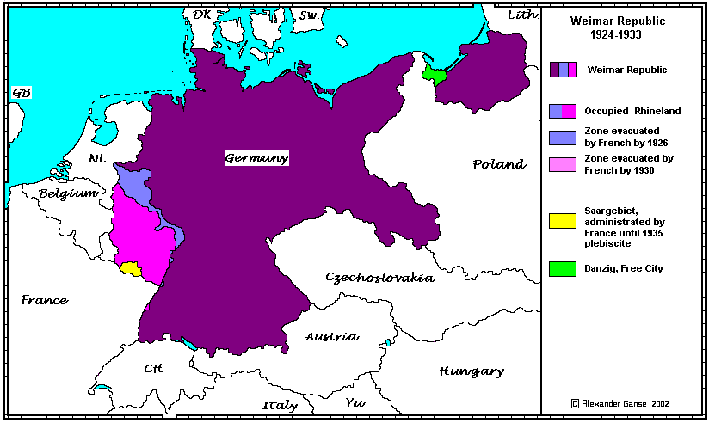

Slide 65
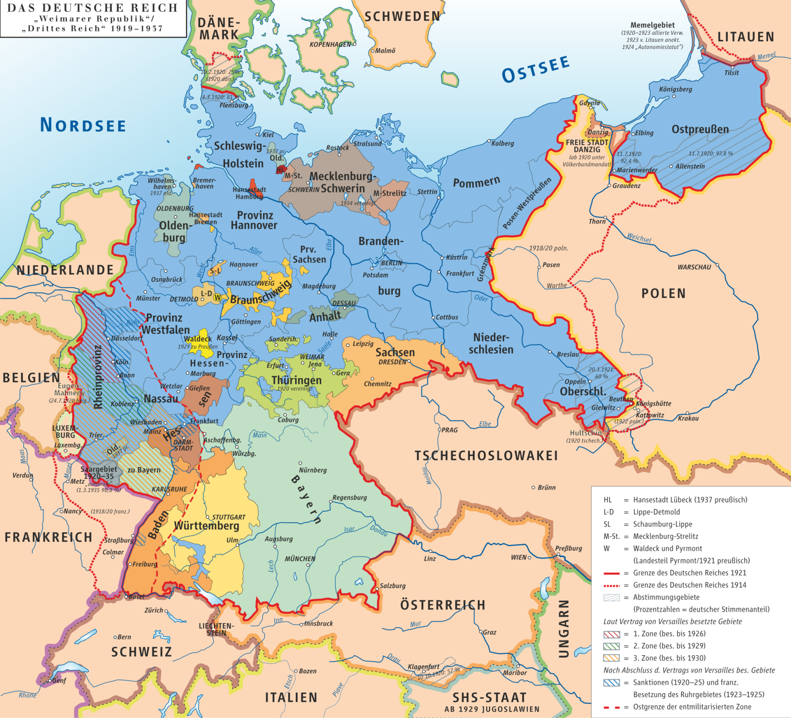

Slide 66
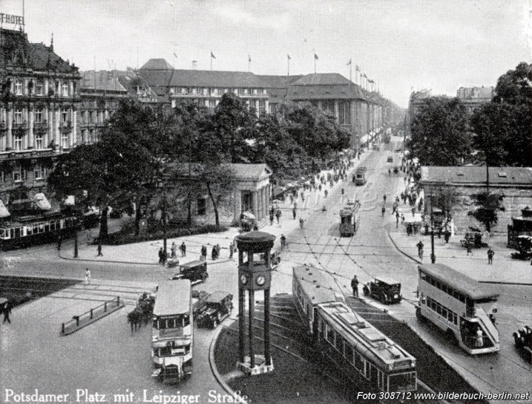
Berlin in the 1920s

Slide 67
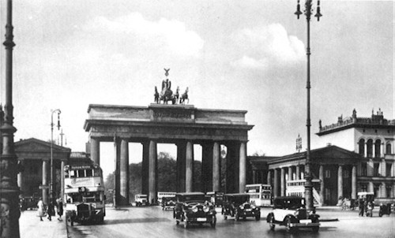
Berlin in the 1920s

Slide 68
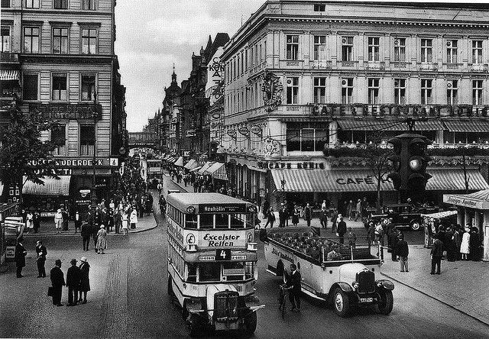
Berlin in the 1920s

Slide 69
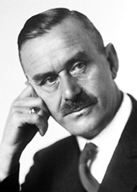
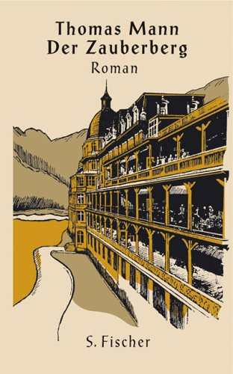
The Magic Mountain (1924)

Slide 70
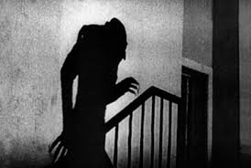
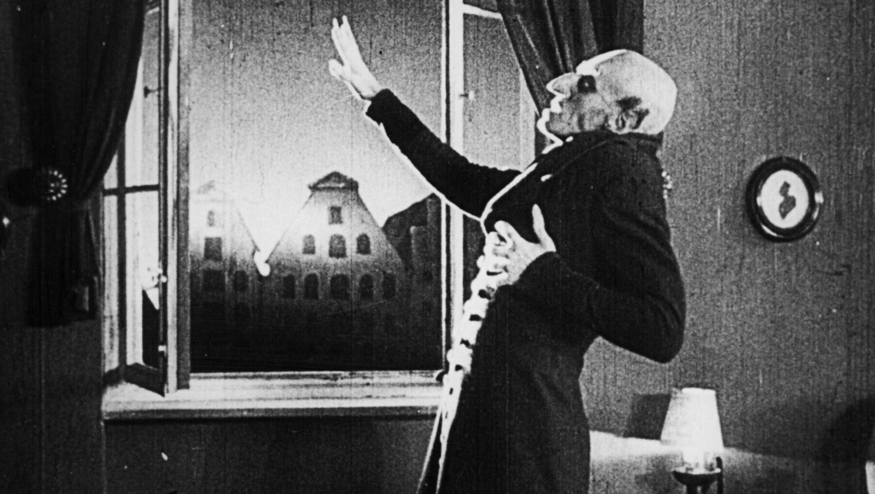
Nosferatu: A Symphony of Horror
dir. F. W. Murnau (1921-22)

Slide 71
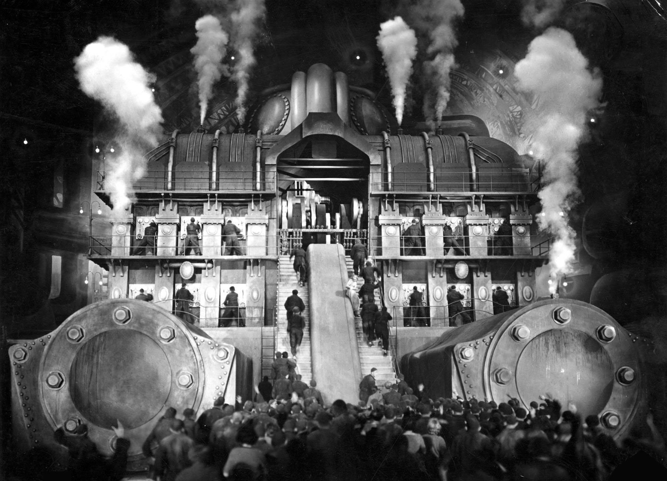
Metropolis (1927)

Slide 72
The Blue Angel (1930)

Slide 73
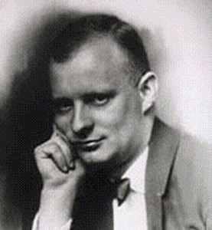
Paul Hindemith: begins as a cultural radical—
with musical scandals in the early 1920s
1895-1963

Slide 74
Paul Hindemith: begins as a cultural radical—
with musical scandals in the early 1920s
1919-1921: three one-act operas:
Murderers, the Hope of Women
Das Nusch-Nuschi
Sancta Susanna
1895-1963

Slide 75
Paul Hindemith: begins as a cultural radical—
with musical scandals in the early 1920s
1921: Honorary Chairman of the summer chamber-music concerts in Donaueschingen
1895-1963

Slide 76
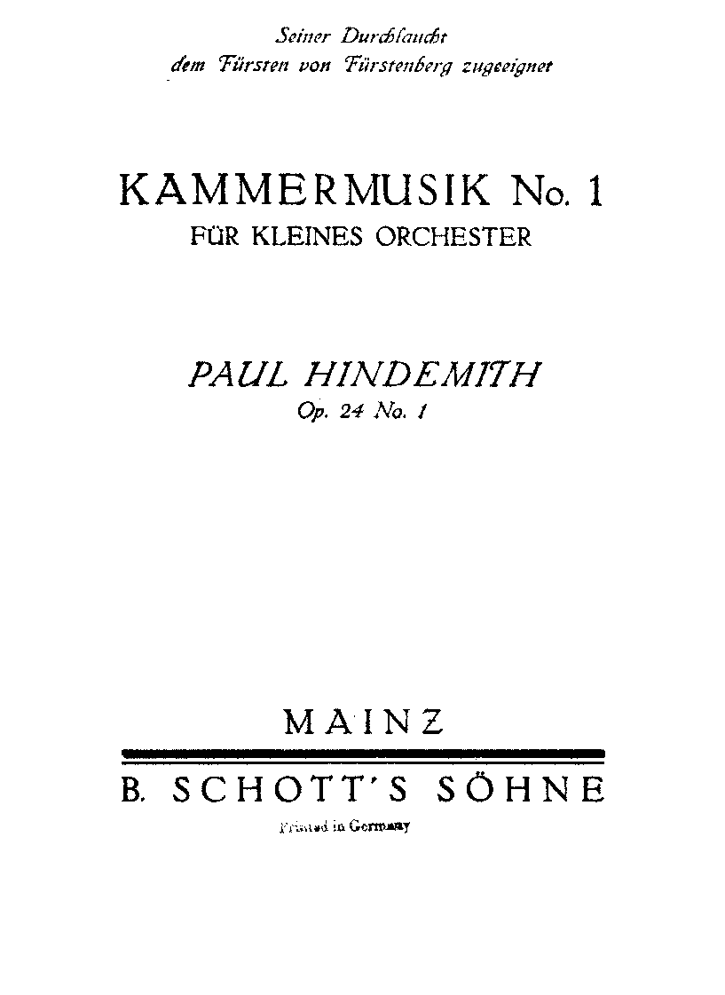
Composed for the Donaueschingen Summer Concerts, 1922

Slide 77
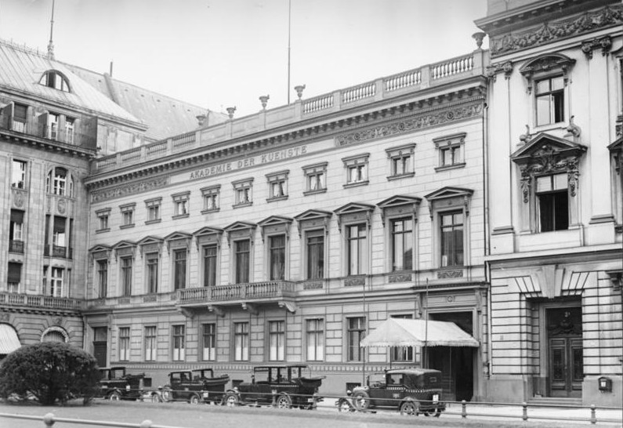
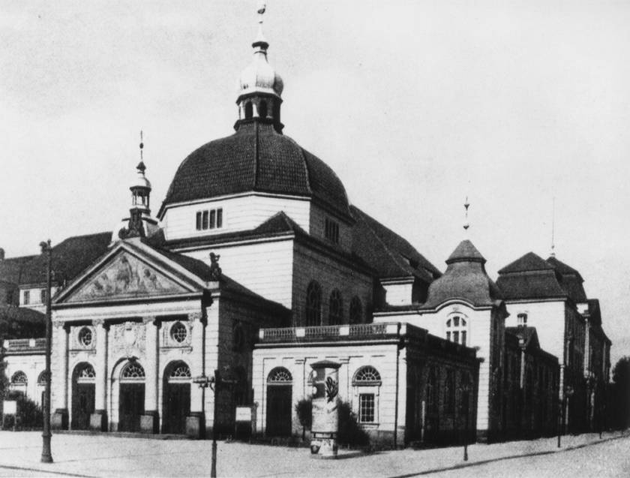
Academic Appointments
in Berlin
1926: Schoenberg begins teaching at
the Akademie der Künste
1927: Hindemith begins teaching
at the Musikhochschule

Slide 78
Berlin: Art Music in the 1920s
Berlin Philharmonic – Wilhelm Furtwängler
Municipal Opera (and Berlin Philharmonic) – Bruno Walter
State Opera – Erich Kleiber
Kroll Opera – Otto Klemperer
Innumerable recitals, soloists, choral concerts, etc.
Schoenberg begins teaching at the Akademie der Künste, 1926
Paul Hindemith begins teaching at the Musikhochschule, 1927

Slide 79
The Predominant Rival (“Modern”) Art-Music Traditions by the Late 1920s
Paris
Berlin
(& Vienna)

