Slide 1
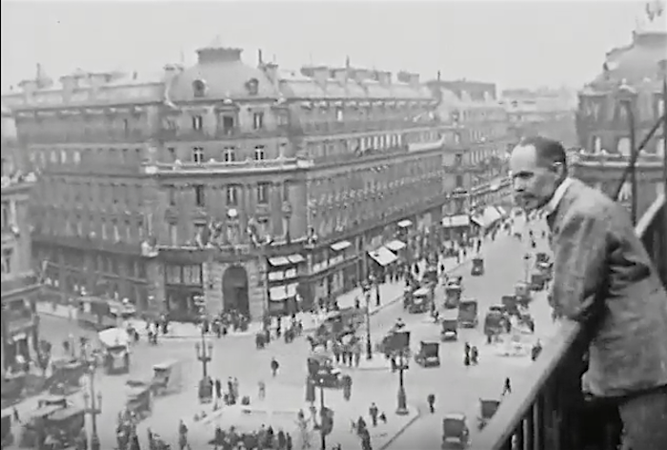
“Neoclassicism” and France in the 1920s

Slide 2
World War I: 1914-18

Slide 3
World War I: 1914-18

Slide 4
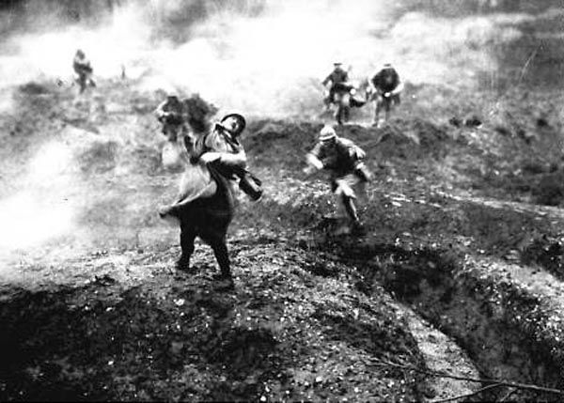
World War I: 1914-18

Slide 5
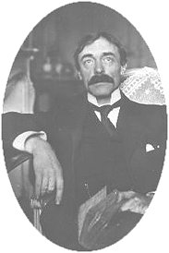
“We later civilizations . . . we too know that we are mortal.”
Paul Valéry, “Crisis of the Mind” (1919)

Slide 6
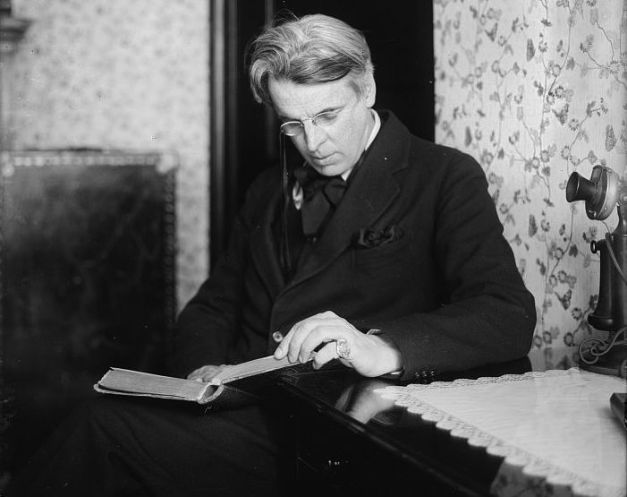
William Butler Yeats,
“The Second Coming” (1919)
Turning and turning in the widening gyre The falcon cannot hear the falconer; Things fall apart; the centre cannot hold; Mere anarchy is loosed upon the world, The blood-dimmed tide is loosed, and everywhere The ceremony of innocence is drowned; The best lack all conviction, while the worst Are full of passionate intensity.

Slide 7
European and American music in the first half of the twentieth-century:
Emergence of different, culturally competing styles of “modernism,” each semiotically marked by old-world/new-world connotations of class, race, generation, etc.
“Elite modernism,” the “classical tradition,” carrying on the high-Art interests of cultivated Europe (the old world), targeted at a limited sector of the public
“Popular modernism,” rejection of or indifference to old-world concepts of “art” in favor of a more volatile, highly diverse array of popular rhythms, sounds and styles; explicitly linked with the commercial music industry; attuned to the musical interests of a mass public
The different styles and their connotations heightened after World War I (post-1918)

Slide 8
European and American music in the first half of the twentieth-century:
Emergence of different, culturally competing styles of “modernism,” each semiotically marked by old-world/new-world connotations of class, race, generation, etc.
“Elite modernism,” the “classical tradition,” carrying on the high-Art interests of cultivated Europe (the old world), targeted at a limited sector of the public
“Popular modernism,” rejection of or indifference to old-world concepts of “art” in favor of a more volatile, highly diverse array of popular rhythms, sounds and styles; explicitly linked with the commercial music industry; attuned to the musical interests of a mass public
The different styles and their connotations heightened after World War I (post-1918)

Slide 9
European and American music in the first half of the twentieth-century:
Emergence of different, culturally competing styles of “modernism,” each semiotically marked by old-world/new-world connotations of class, race, generation, etc.
“Elite modernism,” the “classical tradition,” carrying on the high-Art interests of cultivated Europe (the old world), targeted at a limited sector of the public
“Popular modernism,” rejection of or indifference to old-world concepts of “art” in favor of a more volatile, highly diverse array of popular rhythms, sounds and styles; explicitly linked with the commercial music industry; attuned to the musical interests of a mass public
Issue: how to rejuvenate a moribund, played-out (?) high-Art project via new but emphatically “modernist” languages or styles appropriate to radically changed social/cultural conditions?
The different styles and their connotations heightened after World War I (post-1918)

Slide 10
The 1920s: a [high-modernist] call back to order?

Slide 11
The 1920s: a [high-modernist] call back to order?
Tame down the dissonant excesses of the 1910s?

Slide 12
The 1920s: a [high-modernist] call back to order?
Tame down the dissonant excesses of the 1910s?
Search for new systems of order and control—within a newly fashioned aesthetic of high modernism.

Slide 13
The 1920s: a [high-modernist] call back to order?
Tame down the dissonant excesses of the 1910s?
Search for new systems of order and control—within a newly fashioned aesthetic of high modernism. E.g.:
Schoenberg—”the twelve tone method” (serialism of pitches)

Slide 14
The 1920s: a [high-modernist] call back to order?
Tame down the dissonant excesses of the 1910s?
Search for new systems of order and control—within a newly fashioned aesthetic of high modernism. E.g.:
Schoenberg—”the twelve tone method” (serialism of pitches)
Satie, Cocteau, “Les six” call for a new clarity and simplicity

Slide 15
The 1920s: a [high-modernist] call back to order?
Tame down the dissonant excesses of the 1910s?
Search for new systems of order and control—within a newly fashioned aesthetic of high modernism. E.g.:
Schoenberg—”the twelve tone method” (serialism of pitches)
Satie, Cocteau, “Les six” call for a new clarity and simplicity
Stravinsky’s codification of the idea of “neoclassicism”

Slide 16
The 1920s: a [high-modernist] call back to order?
Tame down the dissonant excesses of the 1910s?
Search for new systems of order and control—within a newly fashioned aesthetic of high modernism. E.g.:
Schoenberg—”the twelve tone method” (serialism of pitches)
Satie, Cocteau, “Les six” call for a new clarity and simplicity
Stravinsky’s codification of the idea of “neoclassicism”
Stravinsky: Octet (Octuor, 1922-23)

Slide 17
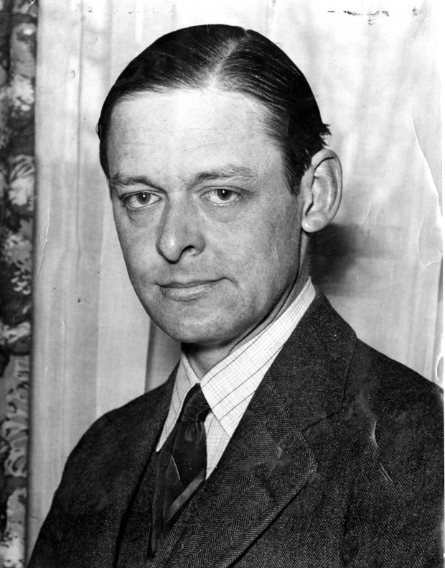
What are the roots that clutch, what branches grow
Out of this stony rubbish? Son of man,
You cannot say, or guess, for you know only
A heap of broken images, where the sun beats,
And the dead tree gives no shelter, the cricket no relief,
And the dry stone no sound of water. . . .
I will show you fear in a handful of dust.
T. S. Eliot, “The Waste Land,” 1922

Slide 18
“Neoclassicism”

Slide 19
“Neoclassicism”
A modernized reworking of older music or musical styles into a contemporary language of clarity and emotional restraint

Slide 20
“Neoclassicism”
A modernized reworking of older music or musical styles into a contemporary language of clarity and emotional restraint
Fragments of a dead past, no longer available for immediate, non-reflective use.

Slide 21
“Neoclassicism”
A modernized reworking of older music or musical styles into a contemporary language of clarity and emotional restraint
Fragments of a dead past, no longer available for immediate, non-reflective use.
Ironized distance (cooler objectivity)

Slide 22
“Neoclassicism”
A modernized reworking of older music or musical styles into a contemporary language of clarity and emotional restraint
Fragments of a dead past, no longer available for immediate, non-reflective use.
Ironized distance (cooler objectivity)
Downplaying of the concept of personal assertion or aggressive, confessional
self-expression

Slide 23
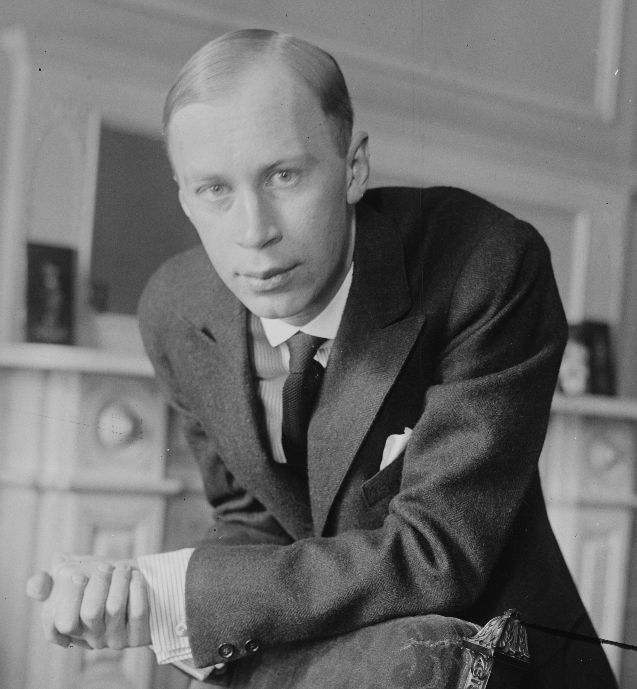
“Neoclassicism”
A modernized reworking of older music or musical styles into a contemporary language of clarity and emotional restraint
Fragments of a dead past, no longer available for immediate, non-reflective use.
Ironized distance (cooler objectivity)
Downplaying of the concept of personal assertion or aggressive, confessional
self-expression
Prokofiev, “Classical” Symphony (1916-17)

Slide 24
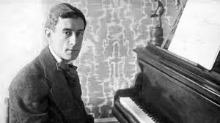
“Neoclassicism”
A modernized reworking of older music or musical styles into a contemporary language of clarity and emotional restraint
Fragments of a dead past, no longer available for immediate, non-reflective use.
Ironized distance (cooler objectivity)
Downplaying of the concept of personal assertion or aggressive, confessional
self-expression
Ravel, Le tombeau de Couperin (1917)

Slide 25
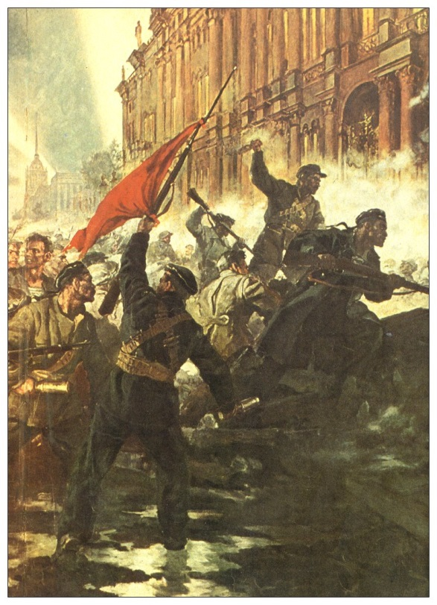
October 1917: The Bolshevik Revolution

Slide 26
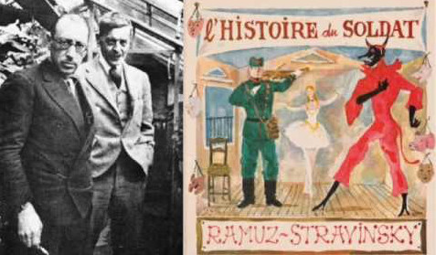
1918

Slide 27
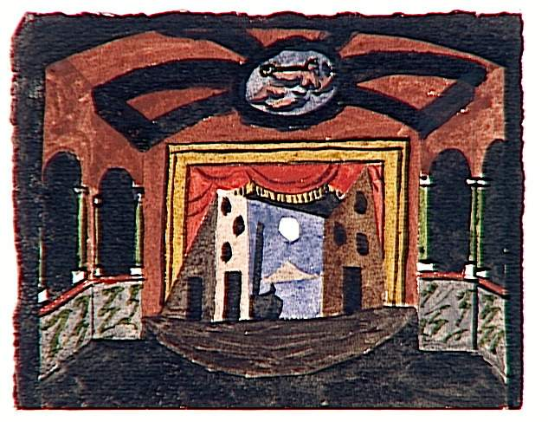
Pulcinella, set design (Picasso)

Slide 28
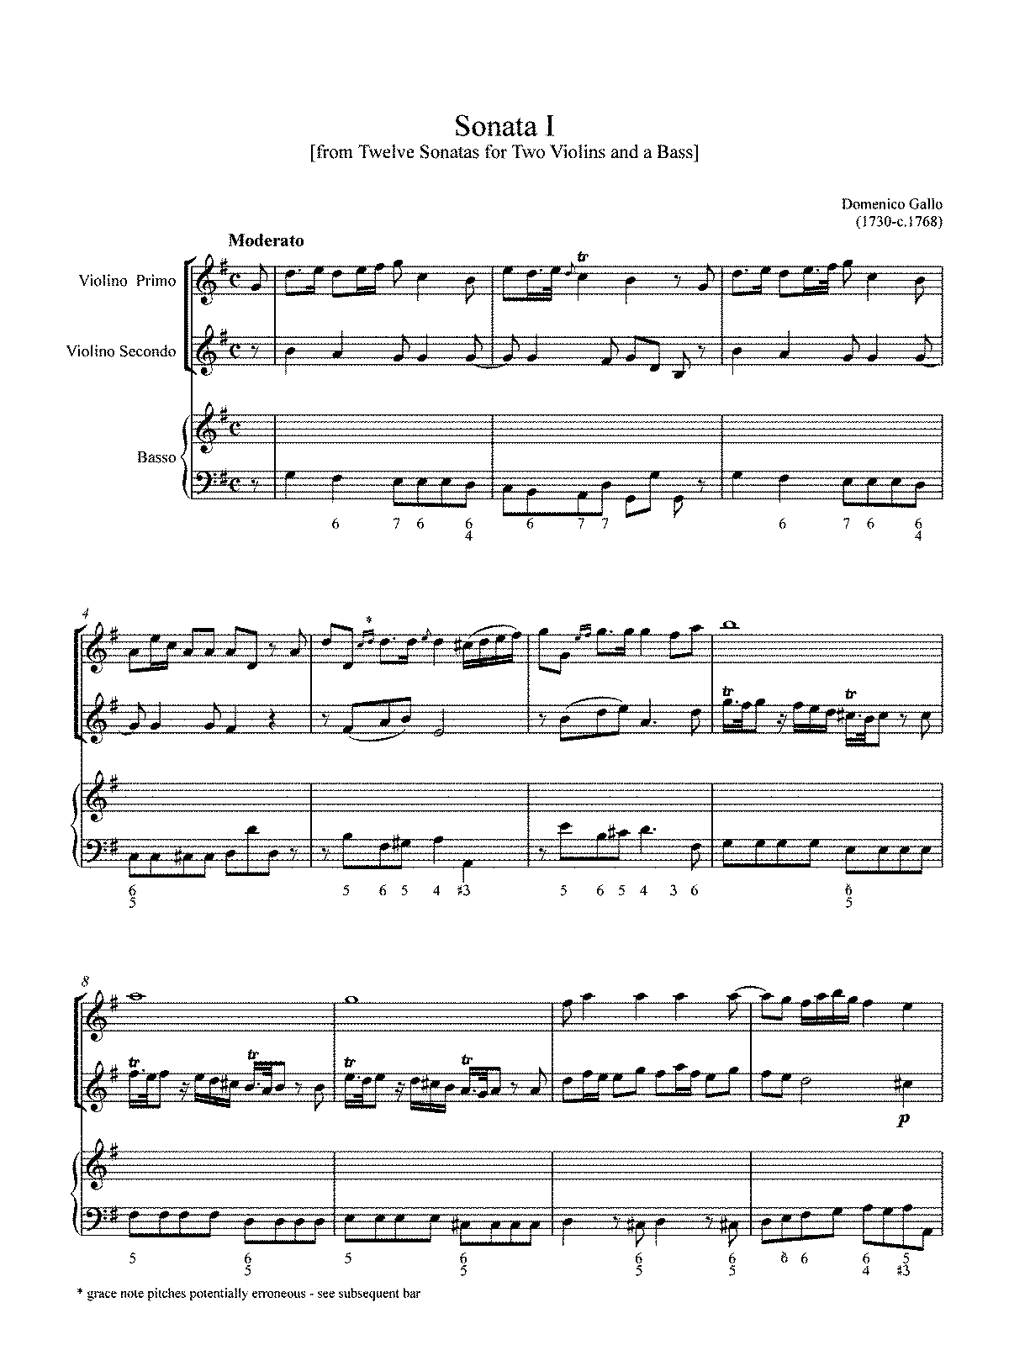

Slide 29
1920s, 1930s, 1940s: Stravinskian Neoclassicism

Slide 30
1920s, 1930s, 1940s: Stravinskian Neoclassicism
Clear, crisp rhythms, often with recurrent staccato articulations

Slide 31
1920s, 1930s, 1940s: Stravinskian Neoclassicism
Clear, crisp rhythms, often with recurrent staccato articulations
Frequent ostinato patterns

Slide 32
1920s, 1930s, 1940s: Stravinskian Neoclassicism
Clear, crisp rhythms, often with recurrent staccato articulations
Frequent ostinato patterns
Vigorous but controlled rhythmic and metrical energy

Slide 33
1920s, 1930s, 1940s: Stravinskian Neoclassicism
Clear, crisp rhythms, often with recurrent staccato articulations
Frequent ostinato patterns
Vigorous but controlled rhythmic and metrical energy
Emphasis on counterpoint

Slide 34
1920s, 1930s, 1940s: Stravinskian Neoclassicism
Clear, crisp rhythms, often with recurrent staccato articulations
Frequent ostinato patterns
Vigorous but controlled rhythmic and metrical energy
Emphasis on counterpoint
Lean, spare textures, often with registrally wide-spaced chords

Slide 35
1920s, 1930s, 1940s: Stravinskian Neoclassicism
Clear, crisp rhythms, often with recurrent staccato articulations
Frequent ostinato patterns
Vigorous but controlled rhythmic and metrical energy
Emphasis on counterpoint
Lean, spare textures, often with registrally wide-spaced chords
Tonal but dissonant (often “polarity”—tonality via assertion—rather than “functional tonality”)

Slide 36
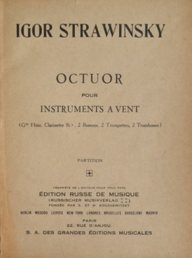
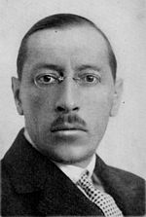
1922-23

Slide 37
Stravinsky, “Some Ideas about My Octuor” (1924)
“My Octuor is a musical object. . . . [It is] “not an ‘emotive’ work but a musical composition based on objective elements which are sufficient in themselves. . . .
I have excluded from this work all sorts of nuances. . . . [Instead we have only the] play of volumes [forte and piano] . . . [objectively] coordinated musical sensations.”
“Form . . . derives from counterpoint . . . on purely musical questions.”

Slide 38
(Chabrier, Saint-Saëns)
Satie
[Fauré]
[Debussy]
[Ravel]
“Les Six” (c. 1919-22)—Milhaud, Poulenc, Honegger, Tailleferre, Auric, Durey

Slide 39
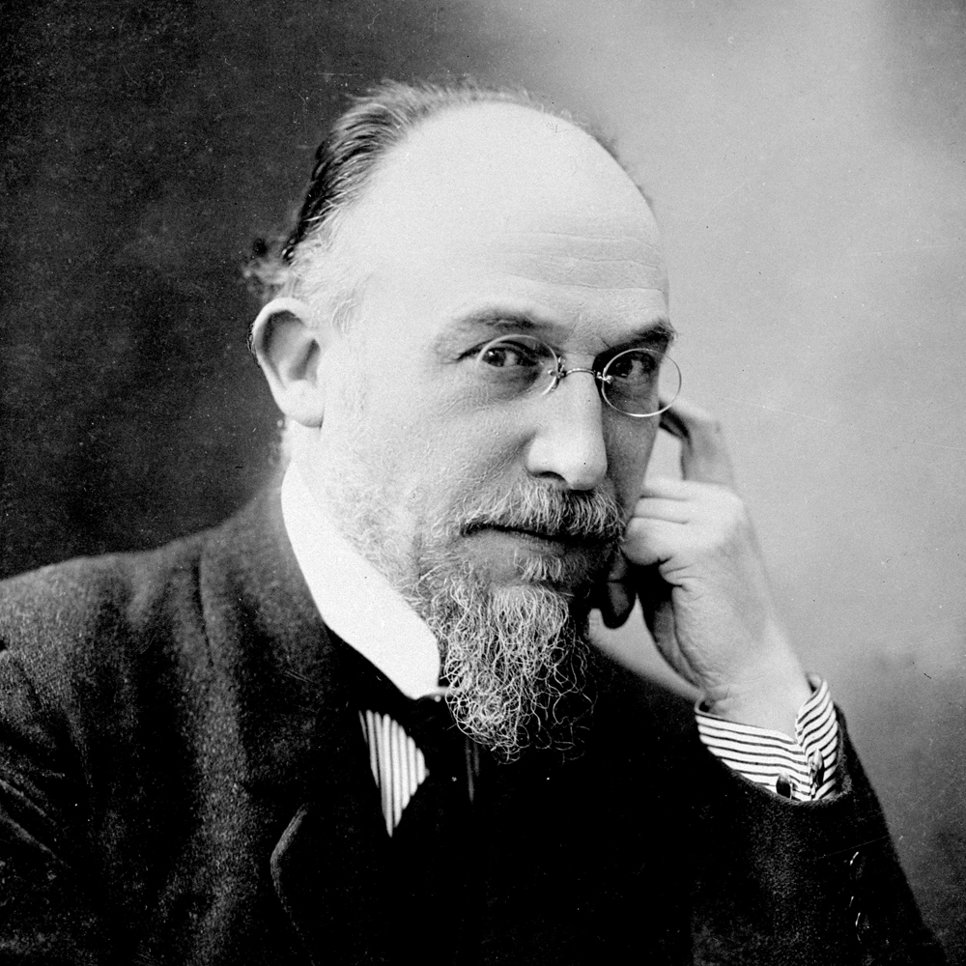
3 Sarabandes (1887)
3 Gymnopédies (1888)
Erik Satie (1866-1925)

Slide 40
3 Sarabandes (1887)
3 Gymnopédies (1888)
3 morceaux en forme de poire (1903)
Erik Satie (1866-1925)

Slide 41
3 Sarabandes (1887)
3 Gymnopédies (1888)
3 morceaux en forme de poire (1903)
Préludes flasques (pour un chien) (1912)
Erik Satie (1866-1925)

Slide 42
3 Sarabandes (1887)
3 Gymnopédies (1888)
3 morceaux en forme de poire (1903)
Préludes flasques (pour un chien) (1912)
Embryons desséchés (1913)
Erik Satie (1866-1925)

Slide 43
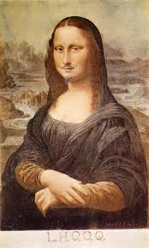
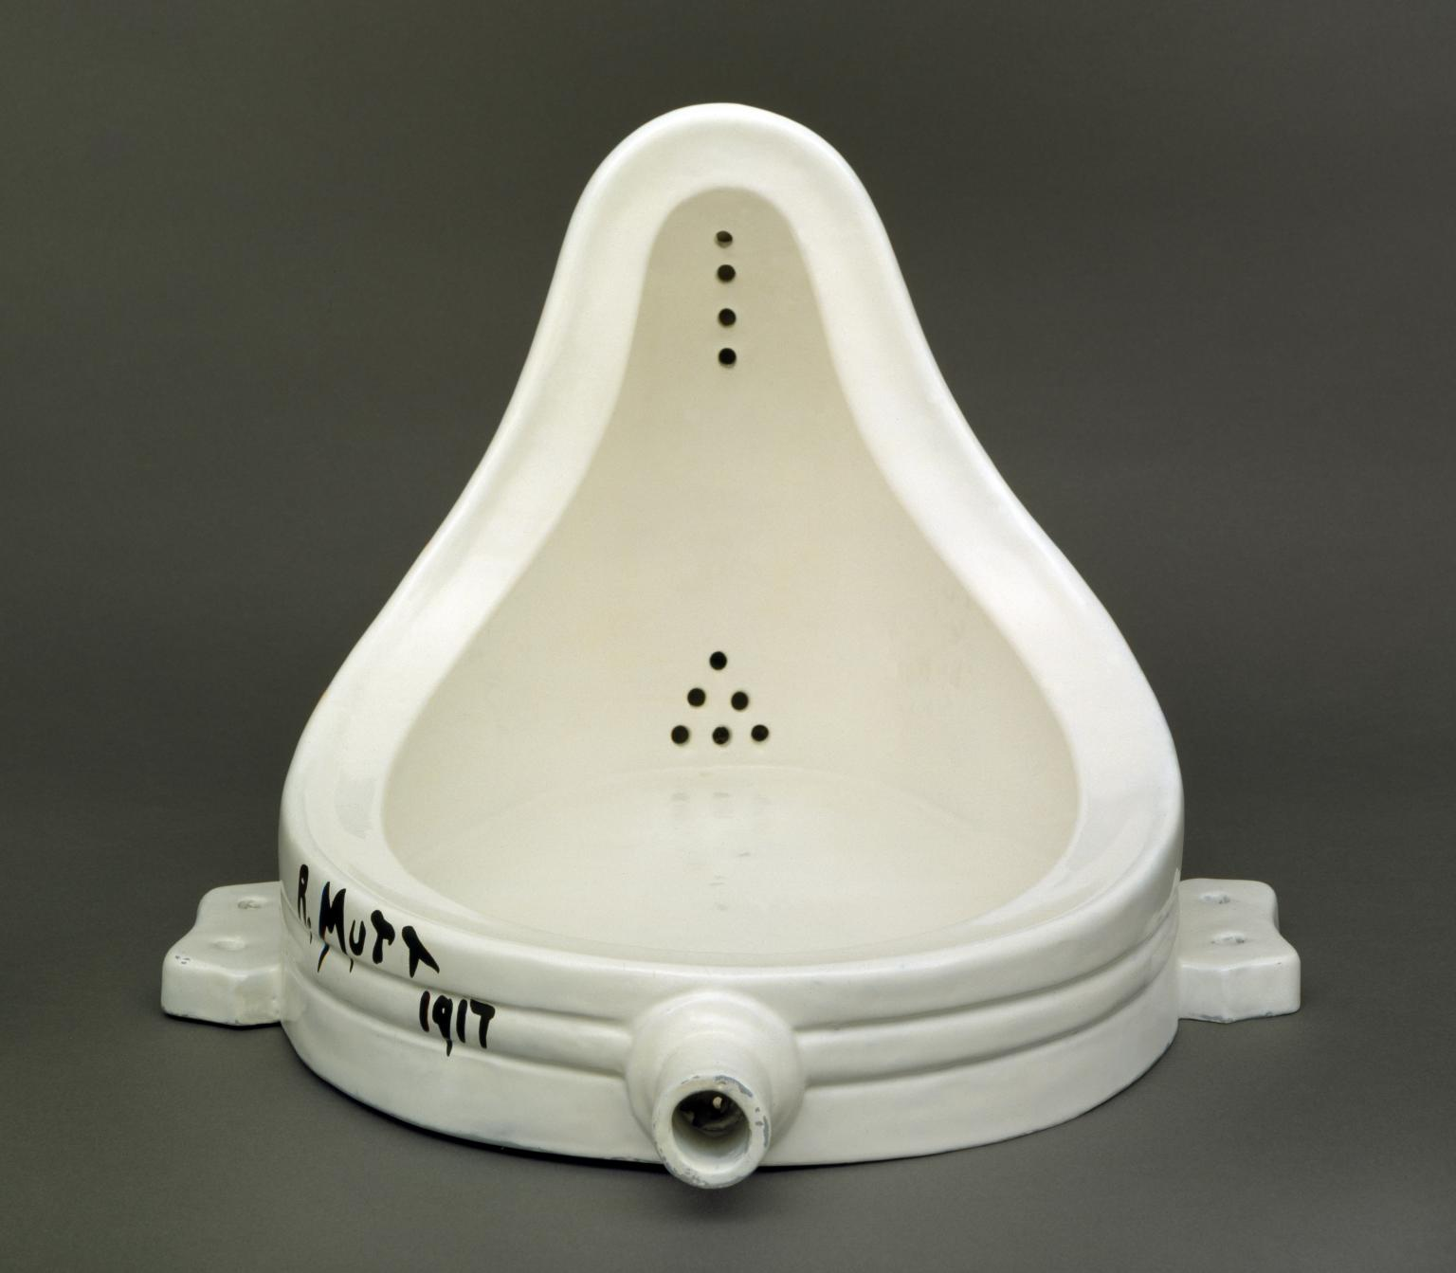
The Dada Movement—e.g., Marcel Duchamp
“Fountain” (1917) (1919)

Slide 44
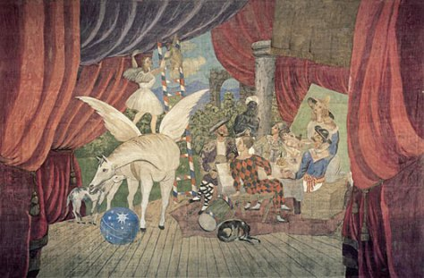
Satie, Picasso, Cocteau, Parade (1917)

Slide 45
Satie, Picasso, Cocteau: Parade (1917) -- reconstruction

Slide 46
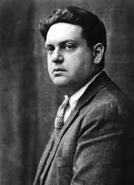
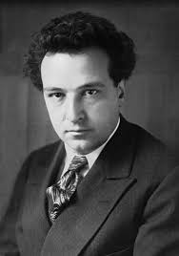
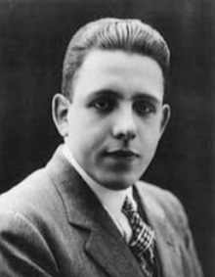
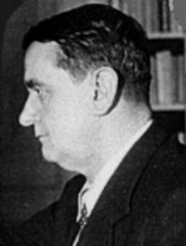
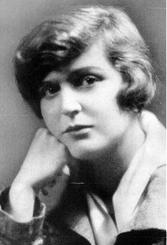
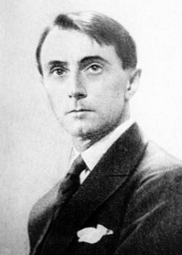
Les nouveaux jeunes (“Les six”), early 1920s
Darius Milhaud Arthur Honegger Francis Poulenc
Georges Auric Germaine Tailleferre Louis Durey

Slide 47
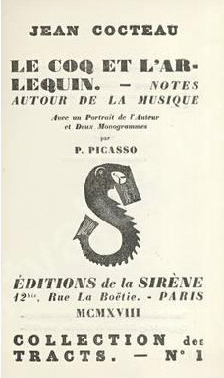
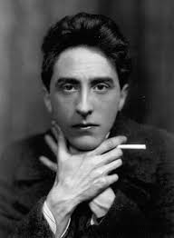

Slide 48
Model for us: Satie’s Parade

Slide 49
Model for us: Satie’s Parade
French music should be free of foreign influence

Slide 50
Model for us: Satie’s Parade
French music should be free of foreign influence
Our music: neither lofty nor idealistic

Slide 51
Model for us: Satie’s Parade
French music should be free of foreign influence
Our music: neither lofty nor idealistic
Instead: simplicity, unpretentiousness

Slide 52
Model for us: Satie’s Parade
French music should be free of foreign influence
Our music: neither lofty nor idealistic
Instead: simplicity, unpretentiousness
Inspiration: popular music, music of the circus, etc.

Slide 53
Les nouveaux jeunes (“Les six”), early 1920s
Darius Milhaud Arthur Honegger Francis Poulenc
Georges Auric Germaine Tailleferre Louis Durey

Slide 54
Les nouveaux jeunes (“Les six”), early 1920s
Darius Milhaud Arthur Honegger Francis Poulenc
Georges Auric Germaine Tailleferre Louis Durey

Slide 55
Darius Milhaud (1892-1974)

Slide 56
Saudades do Brasil (1920-21)
Darius Milhaud (1892-1974)

Slide 57
Saudades do Brasil (1920-21)
Le boeuf sur le toit (1920)
Darius Milhaud (1892-1974)

Slide 58
Saudades do Brasil (1920-21)
Le boeuf sur le toit (1920)
La création du monde (1923)
Darius Milhaud (1892-1974)

Slide 59
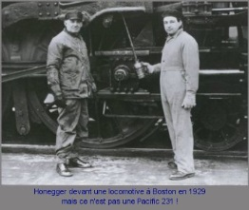
Pacific 231 (1924)

Slide 60
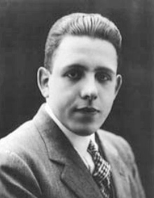
Francis Poulenc (1899-1963)

Slide 61
Trois mouvements perpétuels (1918)
Francis Poulenc (1899-1963)

Slide 62
Trois mouvements perpétuels (1918)
Les biches (1924)
Francis Poulenc (1899-1963)

Slide 63
Trois mouvements perpétuels (1918)
Les biches (1924)
Nocturne No. 1 in C (1929)
Francis Poulenc (1899-1963)

Slide 64
Trois mouvements perpétuels (1918)
Les biches (1924)
Nocturne No. 1 in C (1929)
Concerto for Two Pianos (1931)
Francis Poulenc (1899-1963)

Slide 65
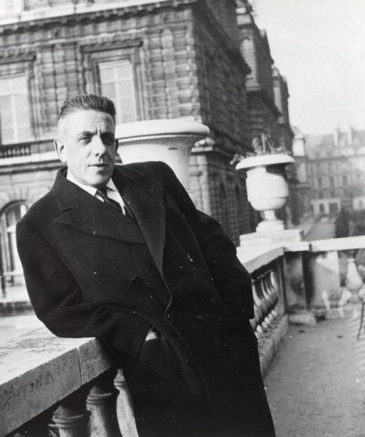
Concerto for Two Pianos,
“Larghetto” (1931)

