Slide 1
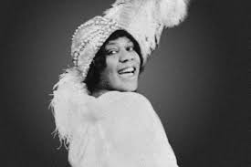
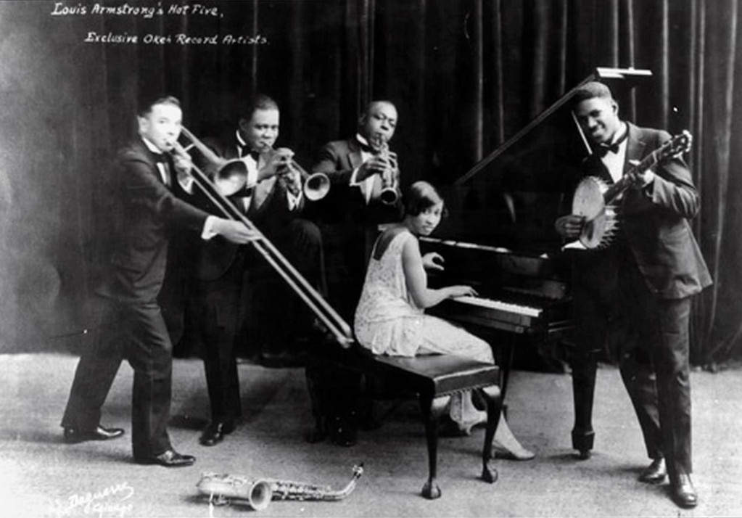
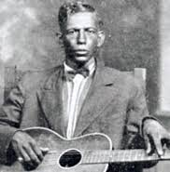
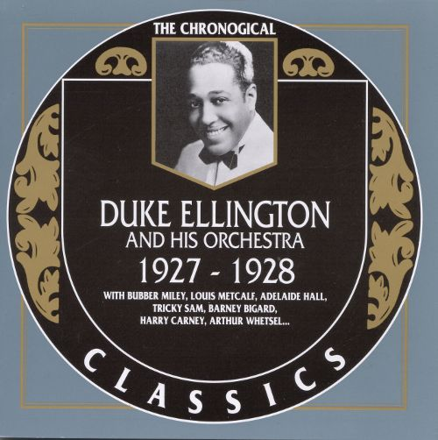
1920s
Blues
Jazz

Slide 2
European and American music in the first half of the twentieth century:
Emergence of different, culturally competing styles of “modernism,”
each semiotically marked by old-world/new-world connotations of class, race, generation, etc.

Slide 3
European and American music in the first half of the twentieth century:
Emergence of different, culturally competing styles of “modernism,”
each semiotically marked by old-world/new-world connotations of class, race, generation, etc.
In the twentieth century, what does it mean to be “modern”?

Slide 4
European and American music in the first half of the twentieth century:
Emergence of different, culturally competing styles of “modernism,”
each semiotically marked by old-world/new-world connotations of class, race, generation, etc.
In the twentieth century, what does it mean to be “modern”?
NOT ONE THING OR ONE STYLE, BUT A CONTINUUM OF MUSICAL “MODERNISMS,”
EACH WITH VERY DIFFERENT CULTURAL PURPOSES AND INTERESTS

Slide 5
European and American music in the first half of the twentieth century:
Emergence of different, culturally competing styles of “modernism,”
each semiotically marked by old-world/new-world connotations of class, race, generation, etc.
In the twentieth century, what does it mean to be “modern”?
NOT ONE THING OR ONE STYLE, BUT A CONTINUUM OF MUSICAL “MODERNISMS,”
EACH WITH VERY DIFFERENT CULTURAL PURPOSES AND INTERESTS
“Elite modernism,” the “classical tradition,” carrying on the high-Art interests of cultivated Europe (the old world), targeted
at a limited sector of the public
“Popular modernism,” rejection of or indifference to old-world concepts of “art” in favor of a more volatile, highly diverse array of popular rhythms, sounds, and styles; explicitly linked with the commercial music industry; attuned to the musical interests of a mass public

Slide 6
European and American music in the first half of the twentieth century:
Emergence of different, culturally competing styles of “modernism,”
each semiotically marked by old-world/new-world connotations of class, race, generation, etc.
In the twentieth century, what does it mean to be “modern”?
NOT ONE THING OR ONE STYLE, BUT A CONTINUUM OF MUSICAL “MODERNISMS,”
EACH WITH VERY DIFFERENT CULTURAL PURPOSES AND INTERESTS
“Elite modernism,” the “classical tradition,” carrying on the high-Art interests of cultivated Europe (the old world), targeted
at a limited sector of the public
“Popular modernism,” rejection of or indifference to old-world concepts of “art” in favor of a more volatile, highly diverse array of popular rhythms, sounds, and styles; explicitly linked with the commercial music industry; attuned to the musical interests of a mass public
The different styles and their connotations heightened after World War I (post-1918)

Slide 7
European and American music in the first half of the twentieth century:
Emergence of different, culturally competing styles of “modernism,”
each semiotically marked by old-world/new-world connotations of class, race, generation, etc.
In the twentieth century, what does it mean to be “modern”?
NOT ONE THING OR ONE STYLE, BUT A CONTINUUM OF MUSICAL “MODERNISMS,”
EACH WITH VERY DIFFERENT CULTURAL PURPOSES AND INTERESTS
“Elite modernism,” the “classical tradition,” carrying on the high-Art interests of cultivated Europe (the old world), targeted
at a limited sector of the public
“Popular modernism,” rejection of or indifference to old-world concepts of “art” in favor of a more volatile, highly diverse array of popular rhythms, sounds, and styles; explicitly linked with the commercial music industry; attuned to the musical interests of a mass public
The different styles and their connotations heightened after World War I (post-1918)

Slide 8
1920s
Bessie Smith, “St. Louis Blues” (rec. 1925)
Jazz
Blues

Slide 9
Standard 12-Bar Blues
1 2 3 4 5 6 7 8 9 10 11 12
.
.
I I I I IV IV I I V V I I
.
.
(V/IV) (IV) (V⁷)

Slide 10
The Blues: Traditional Text Structure
Not “a a b” for each blues cycle but rather,
taking a more precise account of the rhyme pattern:
repeated lines new, rhyming line
a a a’
b b b’
c c c’
d d d’
. . . . . . . . . . . . . . . . . . . . . .
etc.

Slide 11
Twelve-Bar Blues with Text-Pattern 1 (a a a’, b b b’, c c c’. . . .)
Harmonic/rhythmic motion through three zones:
Initial text Text repetition New, rhyming text (completion)
(IV)
V
IV
recycle?
I
(V⁷/IV)
I
I
(V⁷/I)
1 2 3 4 5 6 7 8 9 10 11 12
Zone 1 Zone 2 Zone 3

Slide 12
Twelve-Bar Blues with Text-Pattern 1 (a a a’, b b b’, c c c’. . . .)
Harmonic/rhythmic motion through three zones:
Initial text Text repetition New, rhyming text (completion)
(statement/proposition) (intensification; harmonic motion) (resolution, closure)
(IV)
V
IV
recycle?
I
(V⁷/IV)
I
I
(V⁷/I)
1 2 3 4 5 6 7 8 9 10 11 12
Zone 1 Zone 2 Zone 3

Slide 13
Twelve-Bar Blues with Text-Pattern 1 (a a a’, b b b’, c c c’. . . .)
Harmonic/rhythmic motion through three zones:
reflection/symmetry by text
Initial text Text repetition New, rhyming text (completion)
(statement/proposition) (intensification; harmonic motion) (resolution, closure)
(IV)
V
IV
recycle?
I
(V⁷/IV)
I
I
(V⁷/I)
1 2 3 4 5 6 7 8 9 10 11 12
Zone 1 Zone 2 Zone 3

Slide 14
Twelve-Bar Blues with Text-Pattern 1 (a a a’, b b b’, c c c’. . . .)
Interlocking Symmetries
reflection/symmetry by text
Initial text Text repetition New, rhyming text (completion)
(statement/proposition) (intensification; harmonic motion) (resolution, closure)
(IV)
V
IV
recycle?
I
(V⁷/IV)
I
I
(V⁷/I)
1 2 3 4 5 6 7 8 9 10 11 12
Zone 1 Zone 2 Zone 3
reflection/symmetry by harmonic contour

Slide 15
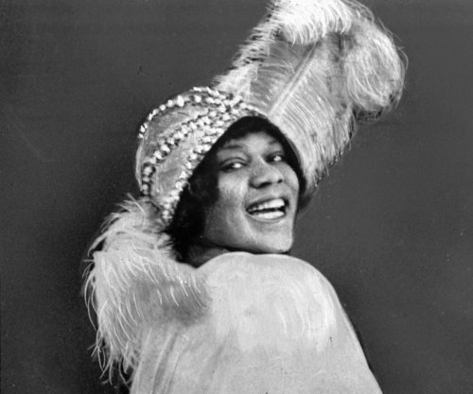
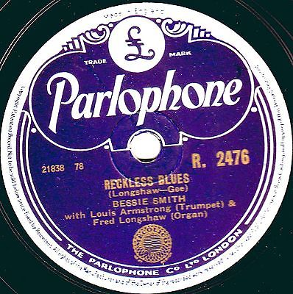
Twelve-Bar Blues with Text-Pattern 1 (a a a’, b b b’, c c c’. . . .)
Initial text Text repetition New, rhyming text (completion)
V
IV
I
I
I
(IV)
(V⁷/IV)
recycle?
reflection/symmetry by harmonic contour
(V⁷/I)
1 2 3 4 5 6 7 8 9 10 11 12
Zone 1 Zone 2 Zone 3
Bessie Smith
“Reckless Blues,” January 14, 1925

Slide 16
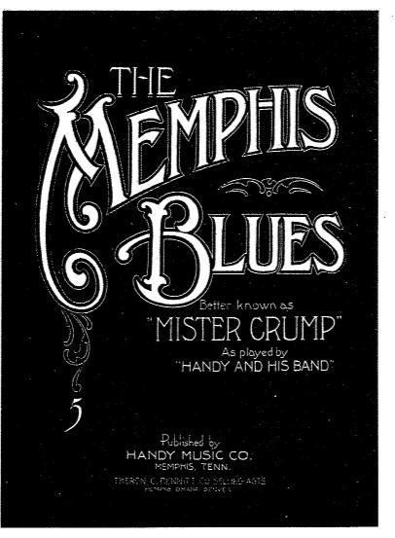
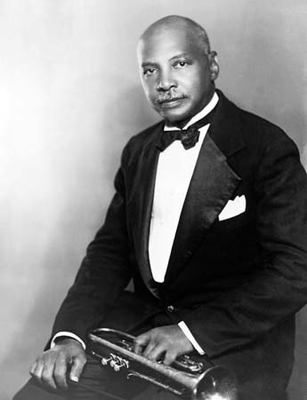
W. C. Handy
1912

Slide 17
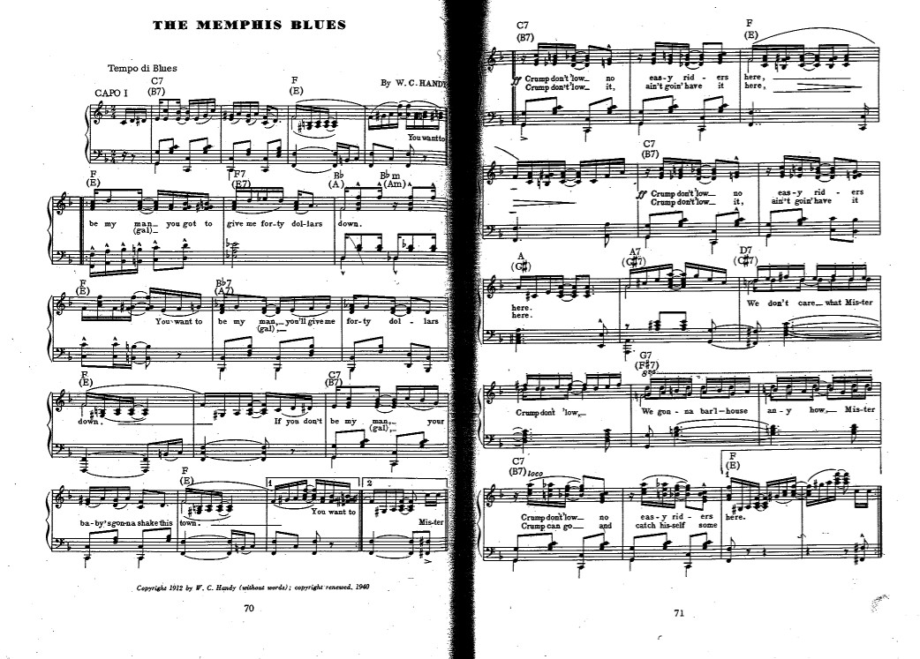

Slide 19
Non-Blues
Blues

Slide 20
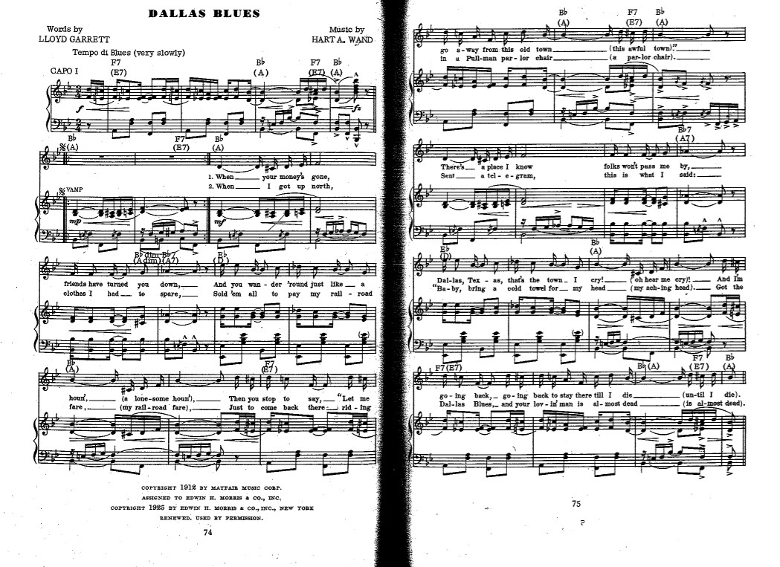

Slide 21
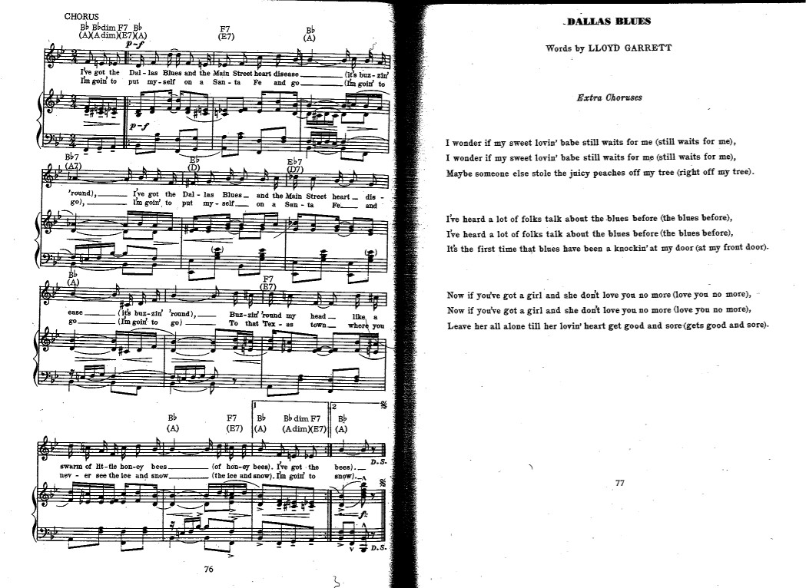

Slide 22
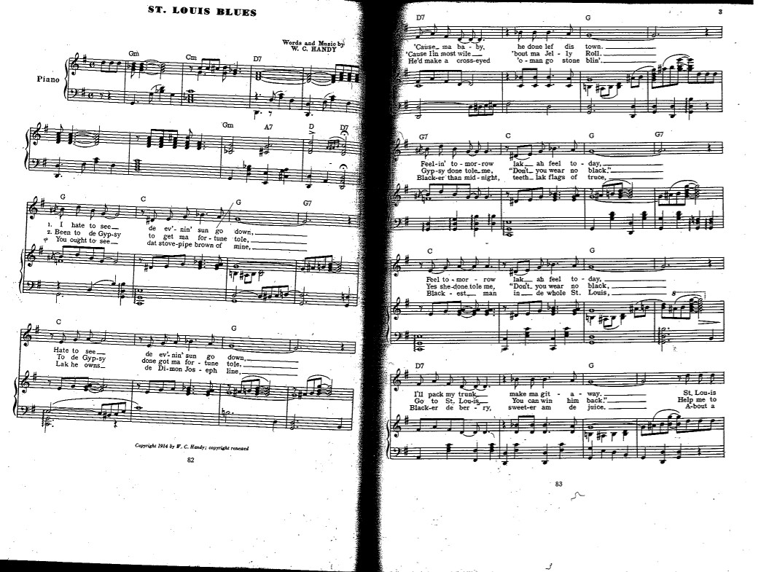
“Tango” style
12-bar “blues”

Slide 23
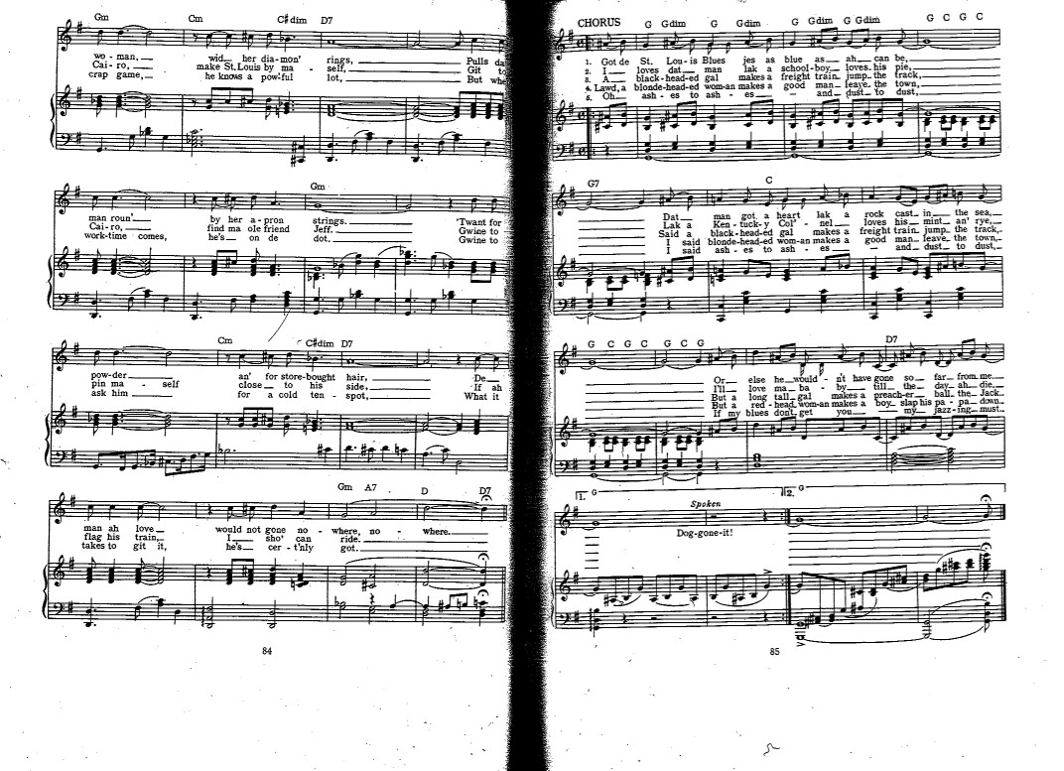
Tango

Slide 24
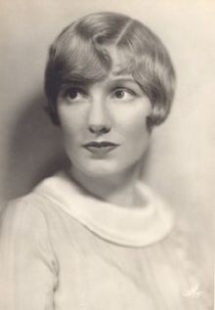
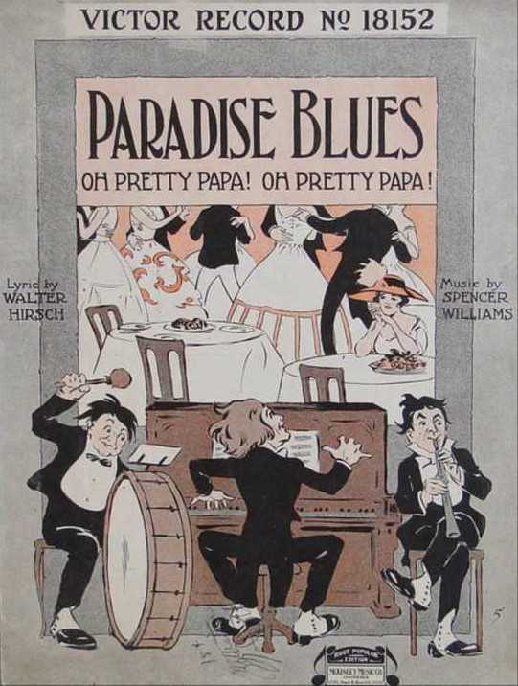
Early recordings of songs called “blues”: by popular white singers
Marion Harris
“Paradise Blues,” rec. November 17, 1916
(but not a 12-bar blues at all!)

Slide 25
Early recordings of songs called “blues”: by popular white singers
Honey, don’t play me no opera,
Play me some blue melody.
I don’t care nothin’ ‘bout Carmen
When I hear these harmonies. . . .
Marion Harris
“Paradise Blues,” rec. November 17, 1916
(but not a 12-bar blues at all!)

Slide 26
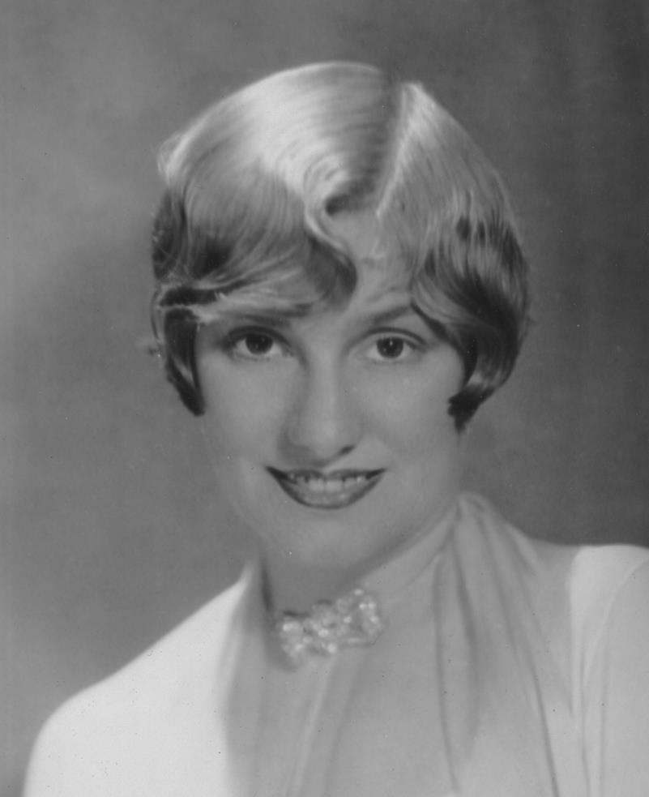
Marion Harris
“St. Louis Blues,” April 16, 1920

Slide 27
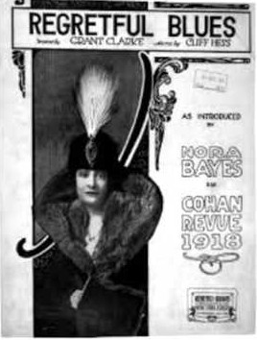
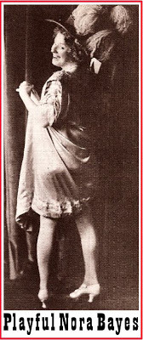

Slide 28
1910s, Initial impact of African-American popular-music styles and influences
(= overlapping styles, often also combined, blurred, and picked up,
imitated as “new 20th-c. urban-modern style” by white America)

Slide 29
1910s, Initial impact of African-American popular-music styles and influences
(= overlapping styles, often also combined, blurred, and picked up,
imitated as “new 20th-c. urban-modern style” by white America)
Minstrelsy

Slide 30
1910s, Initial impact of African-American popular-music styles and influences
(= overlapping styles, often also combined, blurred, and picked up,
imitated as “new 20th-c. urban-modern style” by white America)
Minstrelsy
Ragtime

Slide 31
1910s, Initial impact of African-American popular-music styles and influences
(= overlapping styles, often also combined, blurred, and picked up,
imitated as “new 20th-c. urban-modern style” by white America)
Minstrelsy
Ragtime
Black Vaudeville entertainments (black dialects, etc.)

Slide 32
1910s, Initial impact of African-American popular-music styles and influences
(= overlapping styles, often also combined, blurred, and picked up,
imitated as “new 20th-c. urban-modern style” by white America)
Minstrelsy
Ragtime
Black Vaudeville entertainments (black dialects, etc.)
“Blues” as a style of singing—or a genre
determined by the nature of its text

Slide 33
1910s, Initial impact of African-American popular-music styles and influences
(= overlapping styles, often also combined, blurred, and picked up,
imitated as “new 20th-c. urban-modern style” by white America)
Minstrelsy
Ragtime
Black Vaudeville entertainments (black dialects, etc.)
“Blues” as a style of singing—or a genre
determined by the nature of its text
Prototypical 12-bar blues

Slide 34
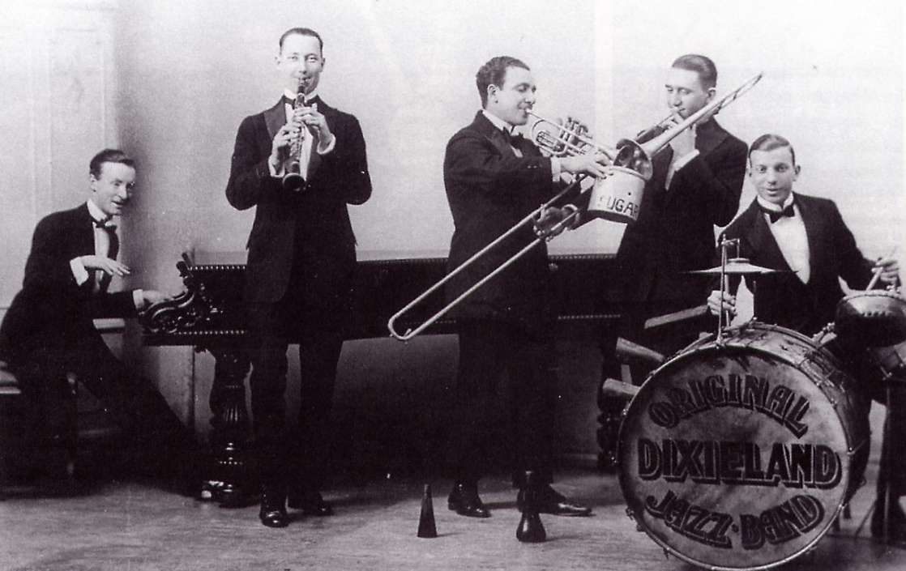
The first-recorded “jazz” instrumental version of the blues
The Original Dixieland Jazz Band:
“Livery Stable Blues,” February 26, 1917

Slide 35
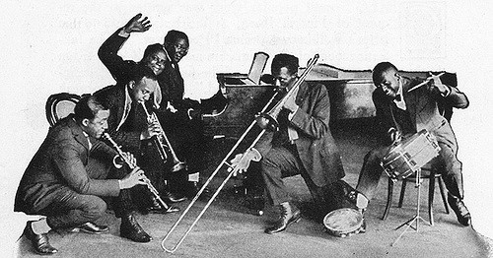
One of the first African-American recordings of jazz/blues
Wilbur Sweatman’s Original Jazz Band
“Dallas Blues,” October 4, 1918

Slide 36
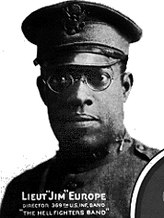
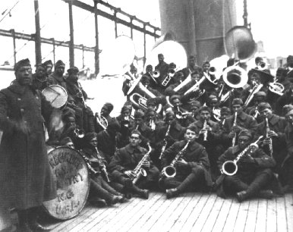
Also very early: James Reese Europe (returning from WWI)
James Reese Europe
“Memphis Blues,” March 7, 1919
“St. Louis Blues,” March 3-7, 1919
369th U.S. Infantry Band (“Hellfighters Band”)

Slide 37
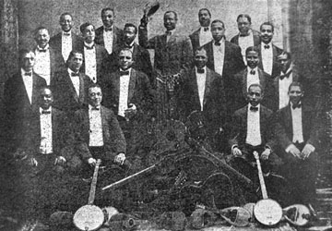
James Reese Europe’s Clef Club Orchestra, c. 1912

Slide 39
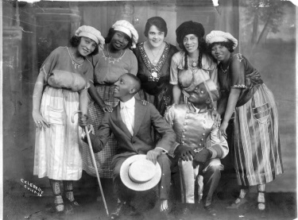
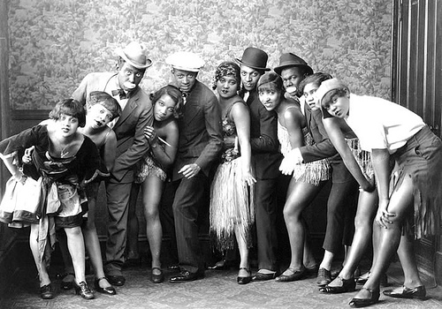
“Black Vaudeville,” 1870s-1930s
Music (popular styles, ragtime, minstrelsy adaptations,
eventually “blues”)
Dance
Comedy
Traveling circuits of troupes

Slide 40
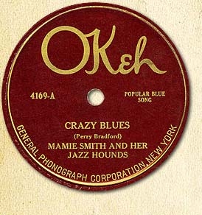
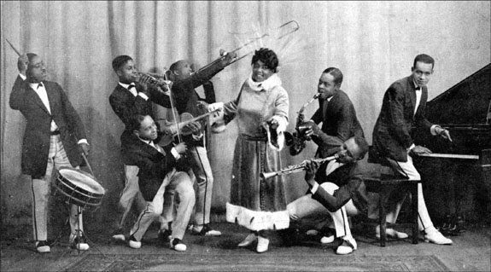
Mamie Smith
“Crazy Blues,” August 10, 1920

Slide 41
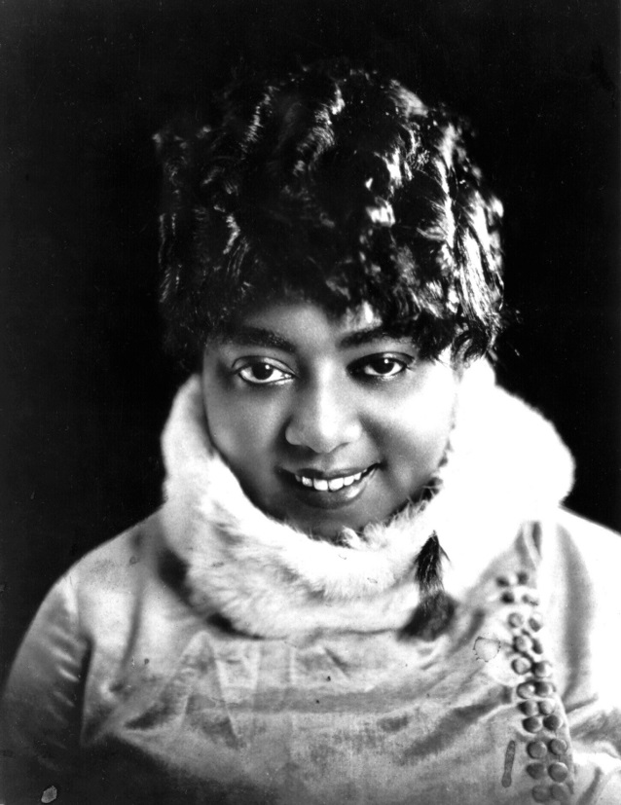
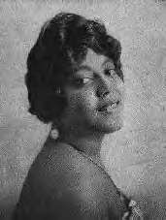
The first “blues” recording by an African-American singer, 1920
Mamie Smith
“Crazy Blues,” August 10, 1920
Verse-Chorus Format (Vaudeville / Tin Pan Alley / Commercial Song)
Verse 1? - - Verse 2? - Chorus? - - - Verse 3? . . . . .Verse 4? Chorus variant?
BLUES BLUES BLUES

Slide 42
The first “blues” recording by an African-American singer, 1920
Mamie Smith
“Crazy Blues,” August 10, 1920
Verse-Chorus Format (Vaudeville / Tin Pan Alley / Commercial Song)
Verse 1? - - Verse 2? - Chorus? - - - Verse 3? . . . . .Verse 4? Chorus variant?
BLUES BLUES BLUES

Slide 43
The first “blues” recording by an African-American singer, 1920
Mamie Smith
“Crazy Blues,” August 10, 1920
Verse-Chorus Format (Vaudeville / Tin Pan Alley / Commercial Song)
Verse 1? - - Verse 2? - Chorus? - - - Verse 3? . . . . .Verse 4? Chorus variant?
BLUES BLUES BLUES

Slide 44
The first “blues” recording by an African-American singer, 1920
Mamie Smith
“Crazy Blues,” August 10, 1920
Verse-Chorus Format (Vaudeville / Tin Pan Alley / Commercial Song)
Verse 1? - - Verse 2? - Chorus? - - - Verse 3? . . . . .Verse 4? Chorus variant?
BLUES BLUES BLUES

Slide 45
The first “blues” recording by an African-American singer, 1920
Mamie Smith
“Crazy Blues,” August 10, 1920
Verse-Chorus Format (Vaudeville / Tin Pan Alley / Commercial Song)
Verse 1? - - Verse 2? - Chorus? - - - Verse 3? . . . . .Verse 4? Chorus variant?
BLUES BLUES BLUES

Slide 46
The first “blues” recording by an African-American singer, 1920
Mamie Smith
“Crazy Blues,” August 10, 1920
Verse-Chorus Format (Vaudeville / Tin Pan Alley / Commercial Song)
Verse 1? - - Verse 2? - Chorus? - - - Verse 3? . . . . .Verse 4? Chorus variant?
BLUES BLUES BLUES

Slide 47
The first “blues” recording by an African-American singer, 1920
Mamie Smith
“Crazy Blues,” August 10, 1920
Verse-Chorus Format (Vaudeville / Tin Pan Alley / Commercial Song)
Verse 1? - - Verse 2? - Chorus? - - - Verse 3? . . . . .Verse 4? Chorus variant?
BLUES BLUES BLUES

Slide 49
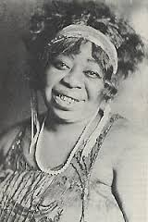
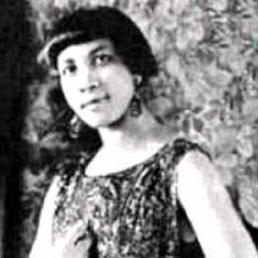
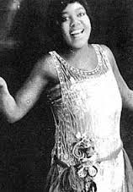
Urban Blues (Vaudeville Blues) of the 1920s:
Some of the earliest recordings of blues unmixed with other formats or styles
Ma Rainey Ida Cox Bessie Smith

Slide 50
Urban Blues (Vaudeville Blues) of the 1920s:
Some of the earliest recordings of blues unmixed with other formats or styles
Ma Rainey Ida Cox Bessie Smith
“Booze and Blues,”
October 15, 1924

Slide 51
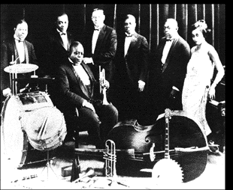
King Oliver’s Creole Jazz Band
“Dippermouth Blues,” April 6, 1923

Slide 52
King Oliver, “Dippermouth Blues” (rec. April 6, 1923)
BLUES CYCLES
INTRO:
1. Ensemble improvisation
2. Ensemble improvisation
3. Clarinet solo (Johnny Dodds)
4. Clarinet solo continues
5. Ensemble improvisation
6. Cornet solo (King Oliver)
7. Cornet solo continues
8. Cornet solo continues
“Oh play that thing!”
9. Ensemble improvisation
TAG ENDING
King Oliver’s Creole Jazz Band

Slide 53
King Oliver, “Dippermouth Blues” (rec. April 6, 1923)
BLUES CYCLES
INTRO:
1. Ensemble improvisation
2. Ensemble improvisation
3. Clarinet solo (Johnny Dodds)
4. Clarinet solo continues
5. Ensemble improvisation
6. Cornet solo (King Oliver)
7. Cornet solo continues
8. Cornet solo continues
“Oh play that thing!”
9. Ensemble improvisation
TAG ENDING
King Oliver’s Creole Jazz Band

Slide 54
King Oliver, “Dippermouth Blues” (rec. April 6, 1923)
BLUES CYCLES
INTRO:
1. Ensemble improvisation
2. Ensemble improvisation
3. Clarinet solo (Johnny Dodds)
4. Clarinet solo continues
5. Ensemble improvisation
6. Cornet solo (King Oliver)
7. Cornet solo continues
8. Cornet solo continues
“Oh play that thing!”
9. Ensemble improvisation
TAG ENDING
King Oliver’s Creole Jazz Band

Slide 55
King Oliver, “Dippermouth Blues” (rec. April 6, 1923)
BLUES CYCLES
INTRO:
1. Ensemble improvisation
2. Ensemble improvisation
3. Clarinet solo (Johnny Dodds)
4. Clarinet solo continues
5. Ensemble improvisation
6. Cornet solo (King Oliver)
7. Cornet solo continues
8. Cornet solo continues
“Oh play that thing!”
9. Ensemble improvisation
TAG ENDING
King Oliver’s Creole Jazz Band

Slide 56
King Oliver, “Dippermouth Blues” (rec. April 6, 1923)
BLUES CYCLES
INTRO:
1. Ensemble improvisation
2. Ensemble improvisation
3. Clarinet solo (Johnny Dodds)
4. Clarinet solo continues
5. Ensemble improvisation
6. Cornet solo (King Oliver)
7. Cornet solo continues
8. Cornet solo continues
“Oh play that thing!”
9. Ensemble improvisation
TAG ENDING
King Oliver’s Creole Jazz Band

Slide 57
King Oliver, “Dippermouth Blues” (rec. April 6, 1923)
BLUES CYCLES
INTRO:
1. Ensemble improvisation
2. Ensemble improvisation
3. Clarinet solo (Johnny Dodds)
4. Clarinet solo continues
5. Ensemble improvisation
6. Cornet solo (King Oliver)
7. Cornet solo continues
8. Cornet solo continues
“Oh play that thing!”
9. Ensemble improvisation
TAG ENDING
King Oliver’s Creole Jazz Band

Slide 58
King Oliver, “Dippermouth Blues” (rec. April 6, 1923)
BLUES CYCLES
INTRO:
1. Ensemble improvisation
2. Ensemble improvisation
3. Clarinet solo (Johnny Dodds)
4. Clarinet solo continues
5. Ensemble improvisation
6. Cornet solo (King Oliver)
7. Cornet solo continues
8. Cornet solo continues
“Oh play that thing!”
9. Ensemble improvisation
TAG ENDING
King Oliver’s Creole Jazz Band

Slide 59
King Oliver, “Dippermouth Blues” (rec. April 6, 1923)
BLUES CYCLES
INTRO:
1. Ensemble improvisation
2. Ensemble improvisation
3. Clarinet solo (Johnny Dodds)
4. Clarinet solo continues
5. Ensemble improvisation
6. Cornet solo (King Oliver)
7. Cornet solo continues
8. Cornet solo continues
“Oh play that thing!”
9. Ensemble improvisation
TAG ENDING
King Oliver’s Creole Jazz Band

Slide 60
King Oliver, “Dippermouth Blues” (rec. April 6, 1923)
BLUES CYCLES
INTRO:
1. Ensemble improvisation
2. Ensemble improvisation
3. Clarinet solo (Johnny Dodds)
4. Clarinet solo continues
5. Ensemble improvisation
6. Cornet solo (King Oliver)
7. Cornet solo continues
8. Cornet solo continues
“Oh play that thing!”
9. Ensemble improvisation
TAG ENDING
King Oliver’s Creole Jazz Band

Slide 61
King Oliver, “Dippermouth Blues” (rec. April 6, 1923)
BLUES CYCLES
INTRO:
1. Ensemble improvisation
2. Ensemble improvisation
3. Clarinet solo (Johnny Dodds)
4. Clarinet solo continues
5. Ensemble improvisation
6. Cornet solo (King Oliver)
7. Cornet solo continues
8. Cornet solo continues
“Oh play that thing!”
9. Ensemble improvisation
TAG ENDING
King Oliver’s Creole Jazz Band

Slide 62
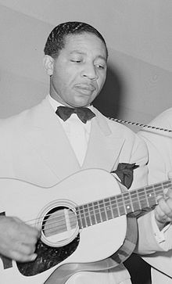
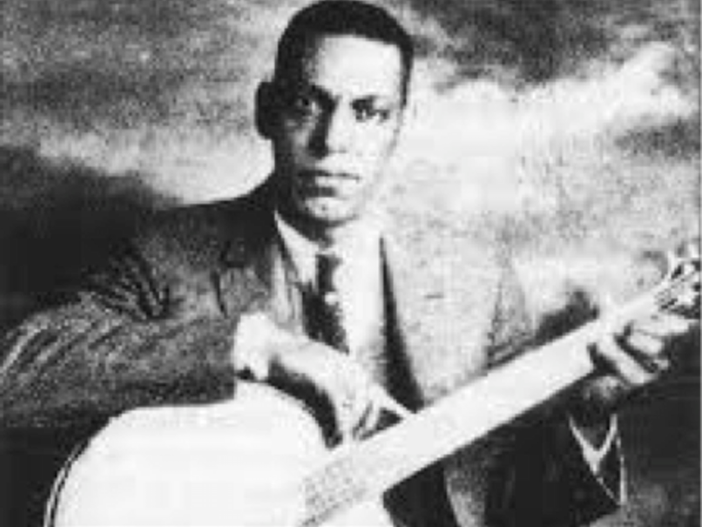
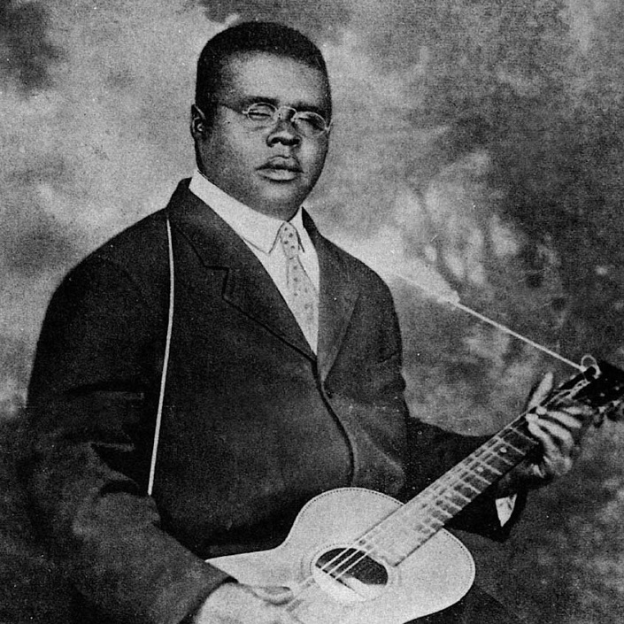
Rural Blues (Country Blues, Downhome Blues):
male singer with guitar or banjo, recordings from 1925 onward
Papa Charlie Jackson
Blind Lemon Jefferson
Lonnie Johnson

Slide 63
Rural Blues (Country Blues, Downhome Blues):
male singer with guitar or banjo, recordings from 1925 onward
Texas Blues
(Holler Blues)
Papa Charlie Jackson
Blind Lemon Jefferson
Lonnie Johnson
“Long Lonesome Blues,”
March 1926

Slide 64
Twelve-Bar Blues with Text-Pattern 1 (a a a’, b b b’, c c c’. . . .)
Interlocking Symmetries
reflection/symmetry by text
Initial text Text repetition New, rhyming text (completion)
(statement/proposition) (intensification; harmonic motion) (resolution, closure)
(IV)
V
IV
recycle?
I
(V⁷/IV)
I
I
(V⁷/I)
1 2 3 4 5 6 7 8 9 10 11 12
Zone 1 Zone 2 Zone 3
reflection/symmetry by harmonic contour

Slide 65
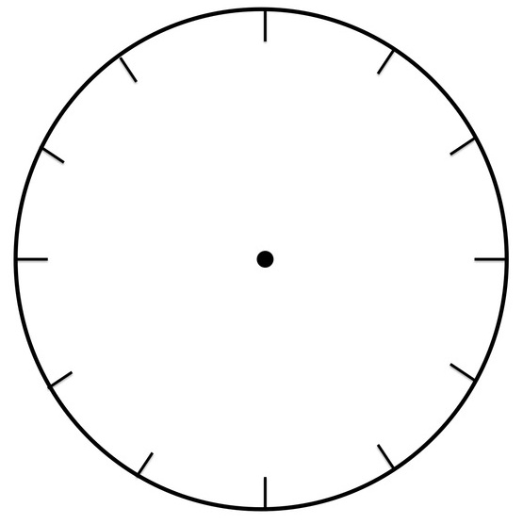
Twelve-Bar Blues Construed as a Repetitive Cycle
“push” into next cycle?
begin the [next] cycle of zones
(with implicit “contract” to complete the cycle)
I:PAC closure of the cycle
(V⁷)
I
I
Zone 1
Zone 3
(IV?)
“windup” for cadential closure of the cycle
V
(V⁷/IV)
IV
“push” into zone 2
I
“relax” back
to tonic
Zone 2

Slide 66
Twelve-Bar Blues Construed as a Set of Recurring Cycles
I:PAC closure of the cycle
I
Zone 1
I
4
4
V
IV
I
Zone 2

Slide 67
Rural Blues (Country Blues, Downhome Blues):
male singer with guitar or banjo, recordings from 1925 onward
Papa Charlie Jackson
Blind Lemon Jefferson
Lonnie Johnson

Slide 68
Rural Blues (Country Blues, Downhome Blues):
male singer with guitar or banjo, recordings from 1925 onward
Papa Charlie Jackson
Blind Lemon Jefferson
Lonnie Johnson
Recording companies and folklorists begin to scout out the deep South: more “authentic”?

Slide 69
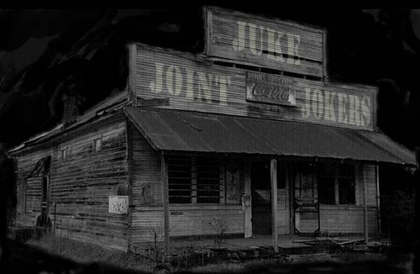
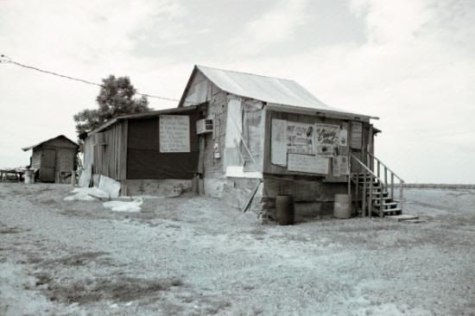
Juke Joints

Slide 70
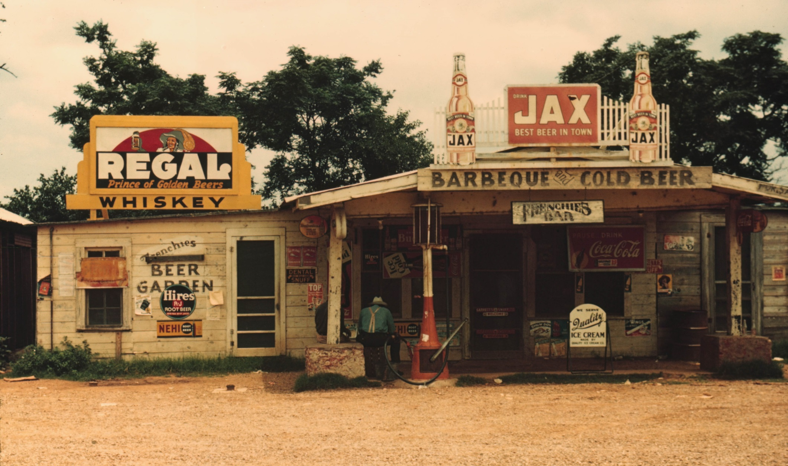
Juke Joint

Slide 71
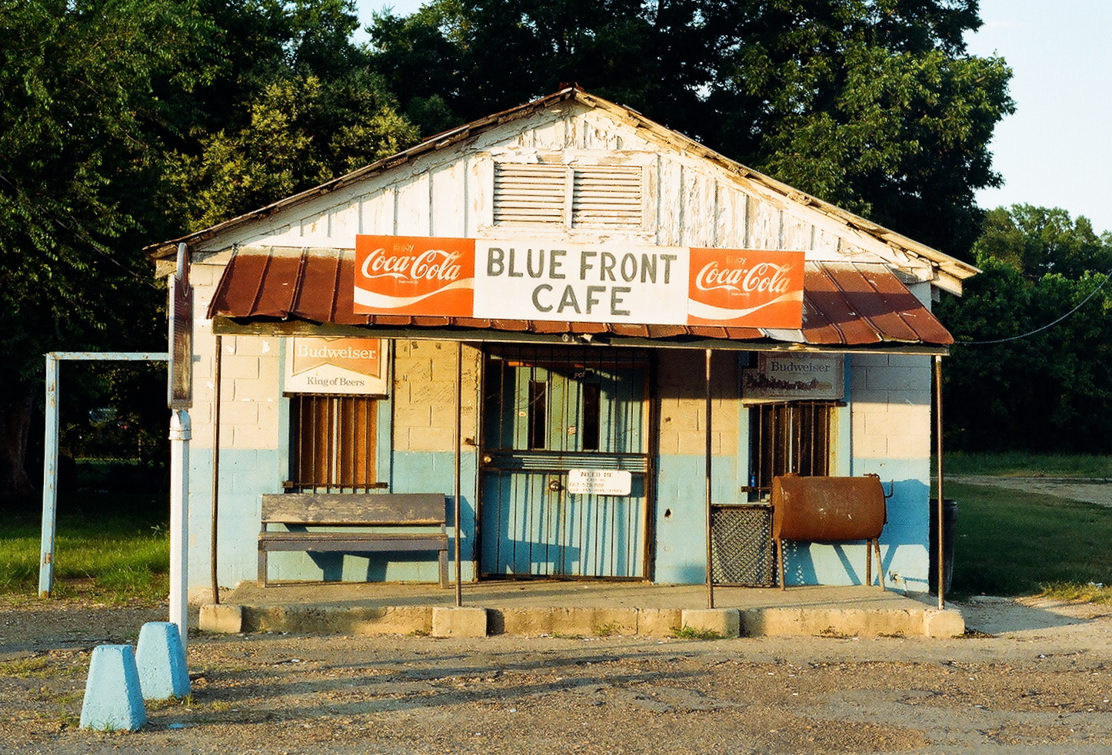

Slide 72
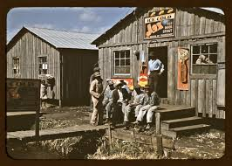
Juke Joint: Lincoln, Nebraska, 1942

Slide 73
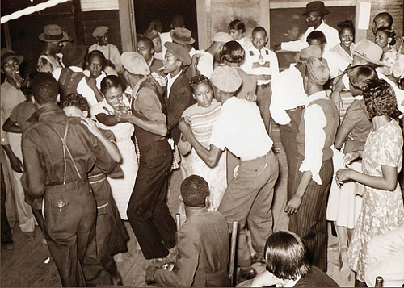
The Earliest Recorded Example of “Hokum Blues” with Refrain in Zones 2 and 3:
Papa Charlie Jackson, “Shake That Thing” (June 27, 1925)

Slide 74
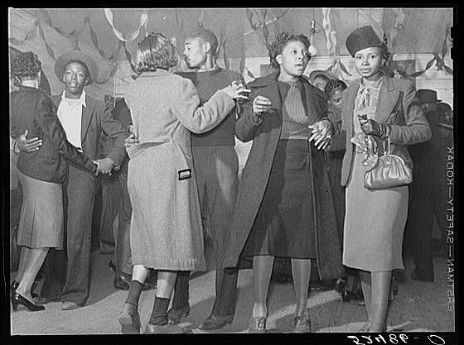
The Earliest Recorded Example of “Hokum Blues” with Refrain in Zones 2 and 3:
Papa Charlie Jackson, “Shake That Thing” (June 27, 1925)

Slide 75
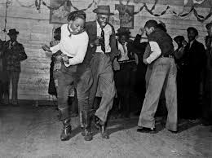
The Earliest Recorded Example of “Hokum Blues” with Refrain in Zones 2 and 3:
Papa Charlie Jackson, “Shake That Thing” (June 27, 1925)

Slide 76
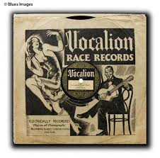
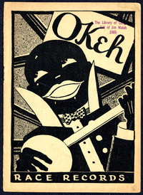
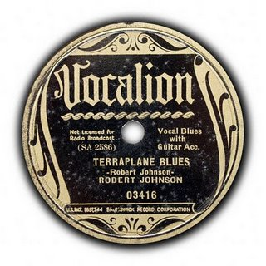
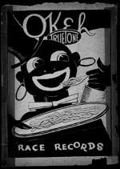
“Race Record” Labels

Slide 77
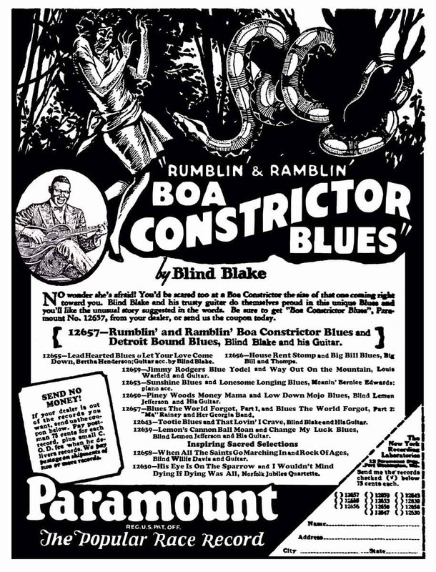

Slide 80
Delta Blues
Charley Patton

Slide 81
Delta Blues
Charley Patton “Pony Blues,” rec. June 14, 1929

Slide 82
Meanwhile, in New York City, 1920s:

Slide 83
Louis Armstrong, the Hot Five

Slide 84
Louis Armstrong, the Hot Five: “Heebie Jeebies” (February 26, 1926)

Slide 85
Louis Armstrong, the Hot Seven

Slide 86
Fats Waller, “The Joint Is Jumpin’”

Slide 87
Later 1920s: emergence of Duke Ellington

Slide 88
NYC, Harlem, 142rd St and Lenox: Black entertainment
(Duke Ellington, Fletcher Henderson, Cab Calloway, etc., for a whites-only audience)

Slide 90
Duke Ellington, “East St. Louis Toodle-O[o]”
Recorded several times, 1926-27 (Bubber Miley, trumpet)

Slide 91
Duke Ellington, Fredi Washington, from the film Black and Tan (1929)

Slide 92
1920s: The emergence of “big-band”
dance-music arrangements
Duke Ellington Fletcher Henderson

Slide 93
1920s: The emergence of “big-band”
dance-music arrangements
Jelly Roll Morton
Fletcher Henderson,
rec. of Morton’s “King Porter Stomp,” March 14, 1928

Slide 94
Duke Ellington, “Take the A Train” (from 1941)

Slide 95
Meanwhile, in New York City, 1920s:
repeated lines new, rhyming line

Slide 96
Early recordings of songs called “blues”: by popular white singers
Honey, don’t play me no opera,
Play me some blue melody.
I don’t care nothin’ ‘bout Carmen
When I hear these harmonies. . . .
Marion Harris
“Paradise Blues,” rec. November 17, 1916
(but not a 12-bar blues at all!)

Slide 97
Bessie Smith, from the film short, St. Louis Blues (1929)

