Slide 1
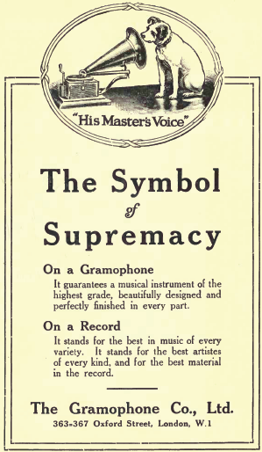
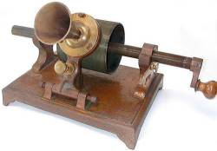
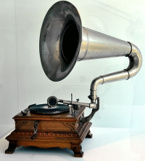
The Rise of Recorded Sound

Slide 2
Music 352, former course title: “History of Western Music”

Slide 3
Better: Not “History” but “Histories” of Different Kinds of Music
Music 352, former course title: “History of Western Music”?

Slide 4
Music 352: “History of Western Music”
Better: Not “History” but “Histories” of Different Kinds of Music
Music 352:
“The Rise and Decline of Western-European Art Music”

Slide 5
Music 352: “History of Western Music”?
Better: Not “History” but “Histories” of Different Kinds of Music
Music 352:
“The Rise and Decline of Western-European Art Music”
c. 1780 1914 1945

Slide 6
Music 352:
“The Rise and Decline of Western-European Art Music”
Initiated by the decline of churchly and courtly patronage, late 1700s
c. 1780 1914 1945

Slide 7
Music 352:
“The Rise and Decline of Western-European Art Music”
Sustained by the emphatic rise of elite, liberal-humanist culture in the 19th century.
Initiated by the decline of churchly and courtly patronage, late 1700s
c. 1780 1914 1945

Slide 8
Music 352:
“The Rise and Decline of Western-European Art Music”
Sustained by the emphatic rise of elite, liberal-humanist culture in the 19th century.
Initiated by the decline of churchly and courtly patronage, late 1700s
c. 1780 1914 1945
Explorations of individualized subjectivity (“soul-states”)

Slide 9
Music 352:
“The Rise and Decline of Western-European Art Music”
Sustained by the emphatic rise of elite, liberal-humanist culture in the 19th century.
Initiated by the decline of churchly and courtly patronage, late 1700s
c. 1780 1914 1945
Explorations of individualized subjectivity (“soul-states”)
Cultivation of a belief in “genius” and the imperatives of individualization and originality

Slide 10
Music 352:
“The Rise and Decline of Western-European Art Music”
Sustained by the emphatic rise of elite, liberal-humanist culture in the 19th century.
Initiated by the decline of churchly and courtly patronage, late 1700s
c. 1780 1914 1945
Explorations of individualized subjectivity (“soul-states”)
Cultivation of a belief in “genius” and the imperatives of individualization and originality
The prizing of an individual artwork over its genre

Slide 11
Music 352:
“The Rise and Decline of Western-European Art Music”
Sustained by the emphatic rise of elite, liberal-humanist culture in the 19th century.
Initiated by the decline of churchly and courtly patronage, late 1700s
c. 1780 1914 1945
Explorations of individualized subjectivity (“soul-states”)
Cultivation of a belief in “genius” and the imperatives of individualization and originality
The prizing of an individual artwork over its genre
The credo of “Art” as an elevated, emancipatory space set apart from everyday culture

Slide 12
Music 352:
“The Rise and Decline of Western-European Art Music”
Sustained by the emphatic rise of elite, liberal-humanist culture in the 19th century.
Initiated by the decline of churchly and courtly patronage, late 1700s
c. 1780 1914 1945
Explorations of individualized subjectivity (“soul-states”)
Cultivation of a belief in “genius” and the imperatives of individualization and originality
The prizing of an individual artwork over its genre
The credo of “Art” as an elevated, emancipatory space set apart from everyday culture
Thus: the related idea of the autonomy of high art—its separation from mass culture

Slide 13
Music 352:
“The Rise and Decline of Western-European Art Music”
Sustained by the emphatic rise of elite, liberal-humanist culture in the 19th century.
Initiated by the decline of churchly and courtly patronage, late 1700s
c. 1780 1914 1945
Explorations of individualized subjectivity (“soul-states”)
Cultivation of a belief in “genius” and the imperatives of individualization and originality
The prizing of an individual artwork over its genre
The credo of “Art” as an elevated, emancipatory space set apart from everyday culture
Thus: the related idea of the autonomy of high art—its separation from mass culture
Belief in the Romantic project of Bildung (self-formation by means of high culture)

Slide 14
Music 352:
“The Rise and Decline of Western-European Art Music”
Sustained by the emphatic rise of elite, liberal-humanist culture in the 19th century.
Initiated by the decline of churchly and courtly patronage, late 1700s
c. 1780 1914 1945
Explorations of individualized subjectivity (“soul-states”)
Cultivation of a belief in “genius” and the imperatives of individualization and originality
The prizing of an individual artwork over its genre
The credo of “Art” as an elevated, emancipatory space set apart from everyday culture
Thus: the related idea of the autonomy of high art—its separation from mass culture
Belief in the Romantic project of Bildung (self-formation by means of high culture)
And thus art music as a marker of educated taste and cultural class

Slide 15
Music 352:
“The Rise and Decline of Western-European Art Music”
Sustained by the emphatic rise of elite, liberal-humanist culture in the 19th century.
Initiated by the decline of churchly and courtly patronage, late 1700s
Crisis of its continuation
in the very different 20th century
c. 1780 1914 1945
Explorations of individualized subjectivity (“soul-states”)
Cultivation of a belief in “genius” and the imperatives of individualization and originality
The prizing of an individual artwork over its genre
The credo of “Art” as an elevated, emancipatory space set apart from everyday culture
Thus: the related idea of the autonomy of high art—its separation from mass culture
Belief in the Romantic project of Bildung (self-formation by means of high culture)
And thus art music as a marker of educated taste and cultural class

Slide 16
Challenges to Sustaining the Elite-Culture Art-Music Project, c. 1880 ff:

Slide 17
Challenges to Sustaining the Elite-Culture Art-Music Project, c. 1880 ff:
Not so much the aggressive, modernist works of individual composers but rather cultural forces from outside—the rising flood of social change

Slide 18
Challenges to Sustaining the Elite-Culture Art-Music Project, c. 1880 ff:
Not so much the aggressive, modernist works of individual composers but rather cultural forces from outside—the rising flood of social change
Increasing urbanization, scientific inquiry, market-driven economies, further challenges to and dissolutions of the old-world class-based social system, etc. = the rapid emergence
of “the modern world”

Slide 19
Challenges to Sustaining the Elite-Culture Art-Music Project, c. 1880 ff:
Not so much the aggressive, modernist works of individual composers but rather cultural forces from outside—the rising flood of social change
Increasing urbanization, scientific inquiry, market-driven economies, further challenges to and dissolutions of the old-world class-based social system, etc. = the rapid emergence
of “the modern world”
The inexorable rise of technology and the gradual emergence of “the age of the machine”

Slide 20
Challenges to Sustaining the Elite-Culture Art-Music Project, c. 1880 ff:
Not so much the aggressive, modernist works of individual composers but rather cultural forces from outside—the rising flood of social change
Increasing urbanization, scientific inquiry, market-driven economies, further challenges to and dissolutions of the old-world class-based social system, etc. = the rapid emergence
of “the modern world”
The inexorable rise of technology and the gradual emergence of “the age of the machine”
And with, it, the inexorable rise of a more aggressively commercialized “mass culture”

Slide 21
The Rise of Recorded Sound

Slide 22
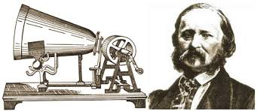
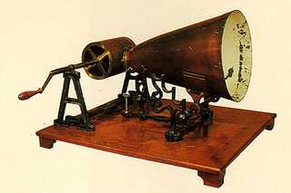
Éduoard-Léon Scott de Martinville’s Phonautograph, c. 1857-60

Slide 23
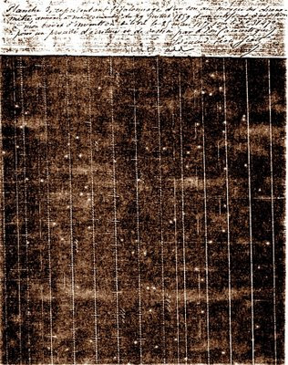
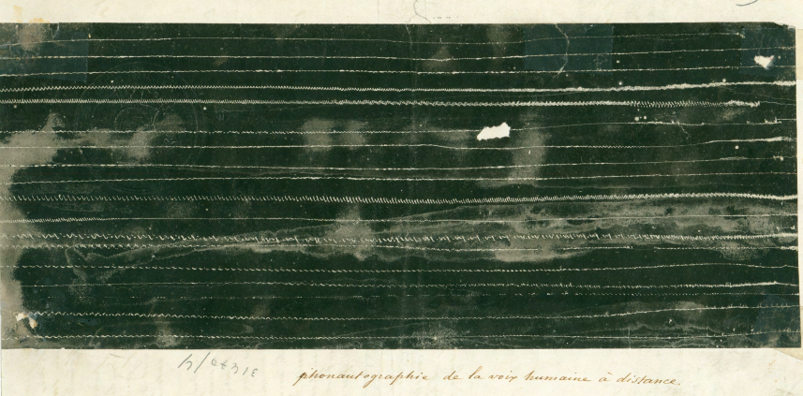
Phonautogram (c. 1860):
Converting sound into a “readable” image

Slide 24
Éduoard-Léon Scott de Martinville’s Phonautograph, c. 1857-60
“Au clair de la lune / Pierrot répondit”

Slide 25
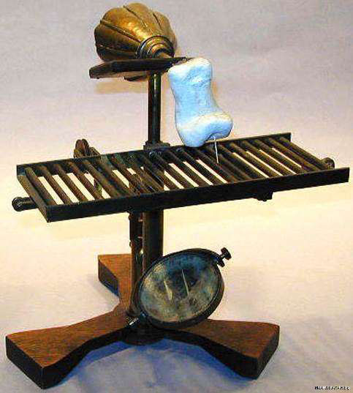
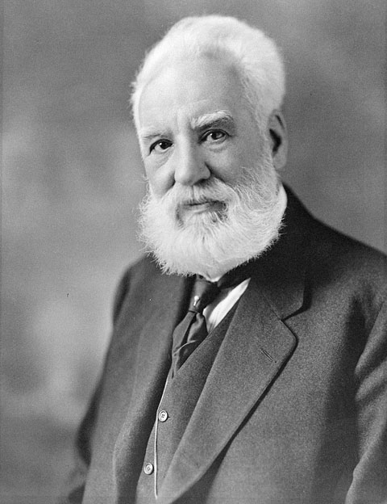
Alexander Graham Bell’s Ear Phonautograph (1874)
(initially imagined as a device potentially useful for the deaf)

Slide 26
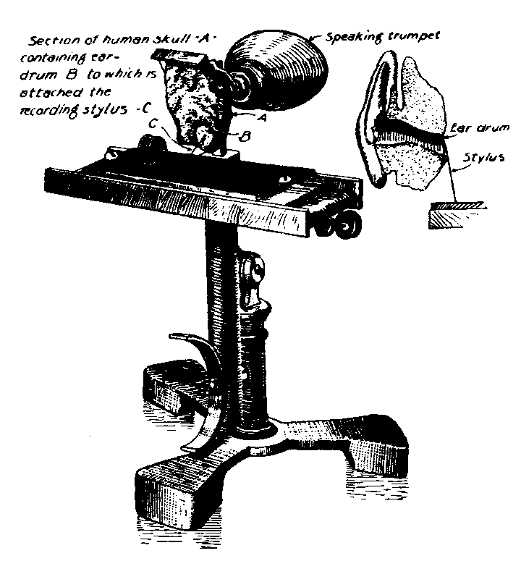
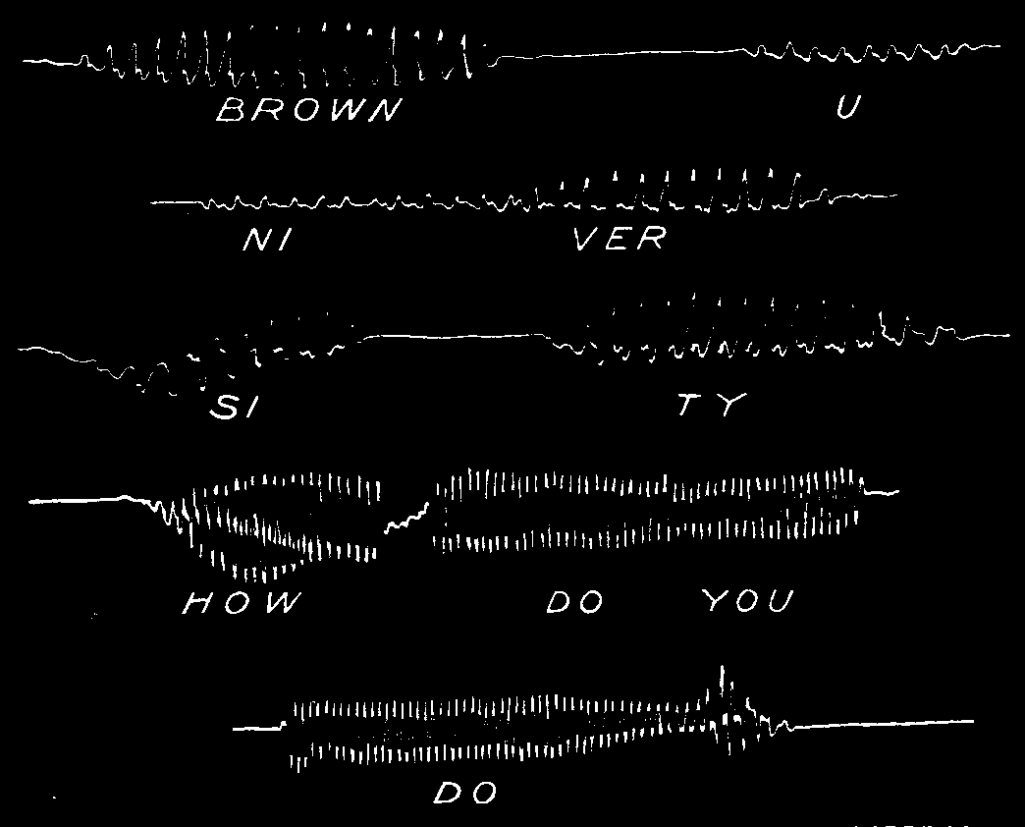
Alexander Graham Bell’s Ear Phonautograph (1874)
(initially imagined as a device potentially useful for the deaf)

Slide 27
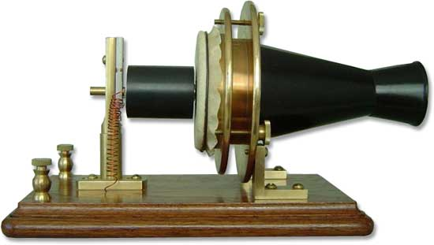
Bell’s “telephone” (1876)—new advance in the transmission of sound as sound

Slide 28
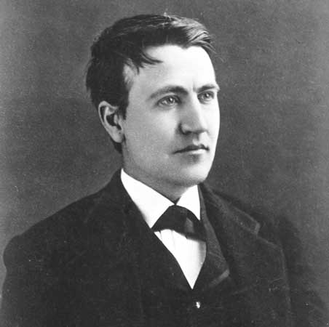
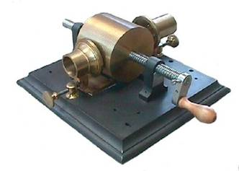
Thomas Edison invents the (tinfoil) “phonograph,” 1877

Slide 29
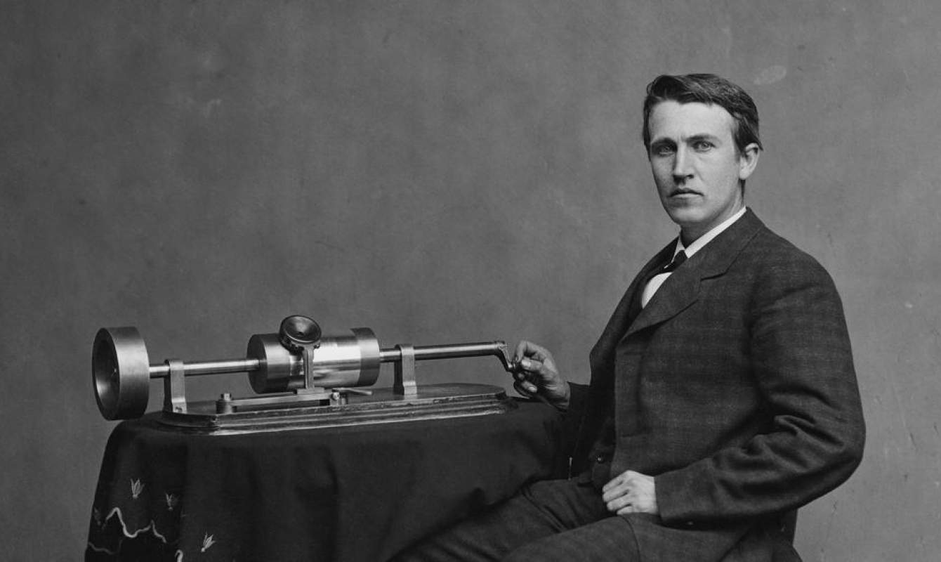
Thomas Edison and the “phonograph” (1877)

Slide 30
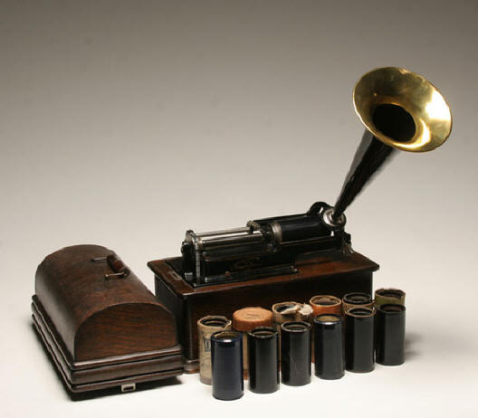
Edison: Wax Cylinders in 1887-1888

Slide 31
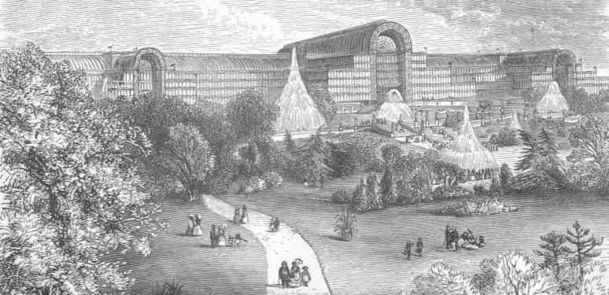
London: Crystal Palace, 1851-1936

Slide 32
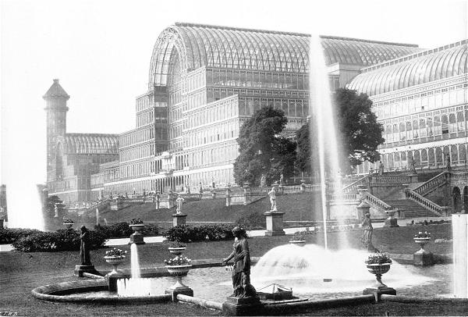
London: Crystal Palace, 1851-1936

Slide 33
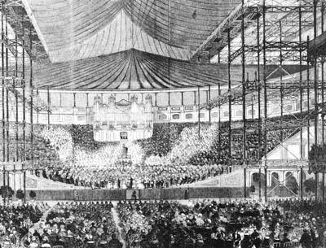
London: Crystal Palace, 1851-1936

Slide 34
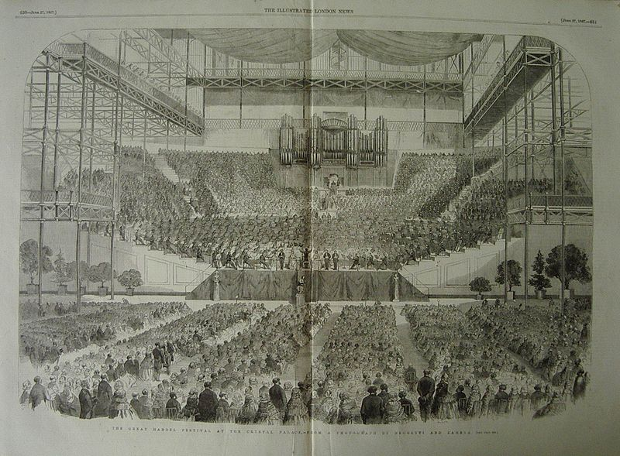
London: Crystal Palace Handel Festival, June 27, 1857

Slide 35
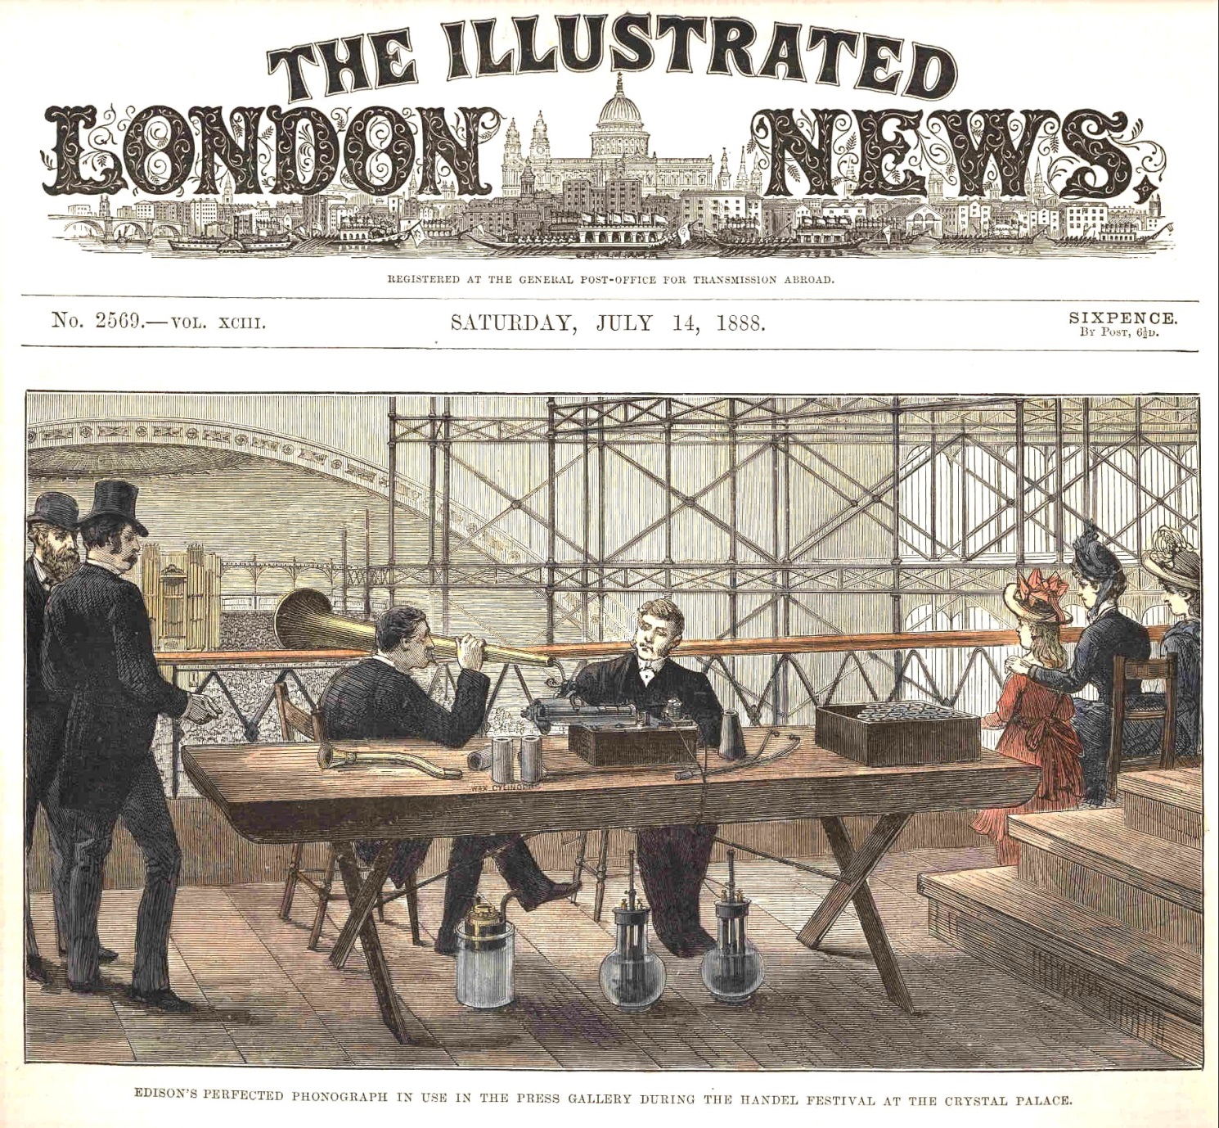
London: Crystal Palace;
Recording Handel, Israel in Egypt, June 29, 1888

Slide 36
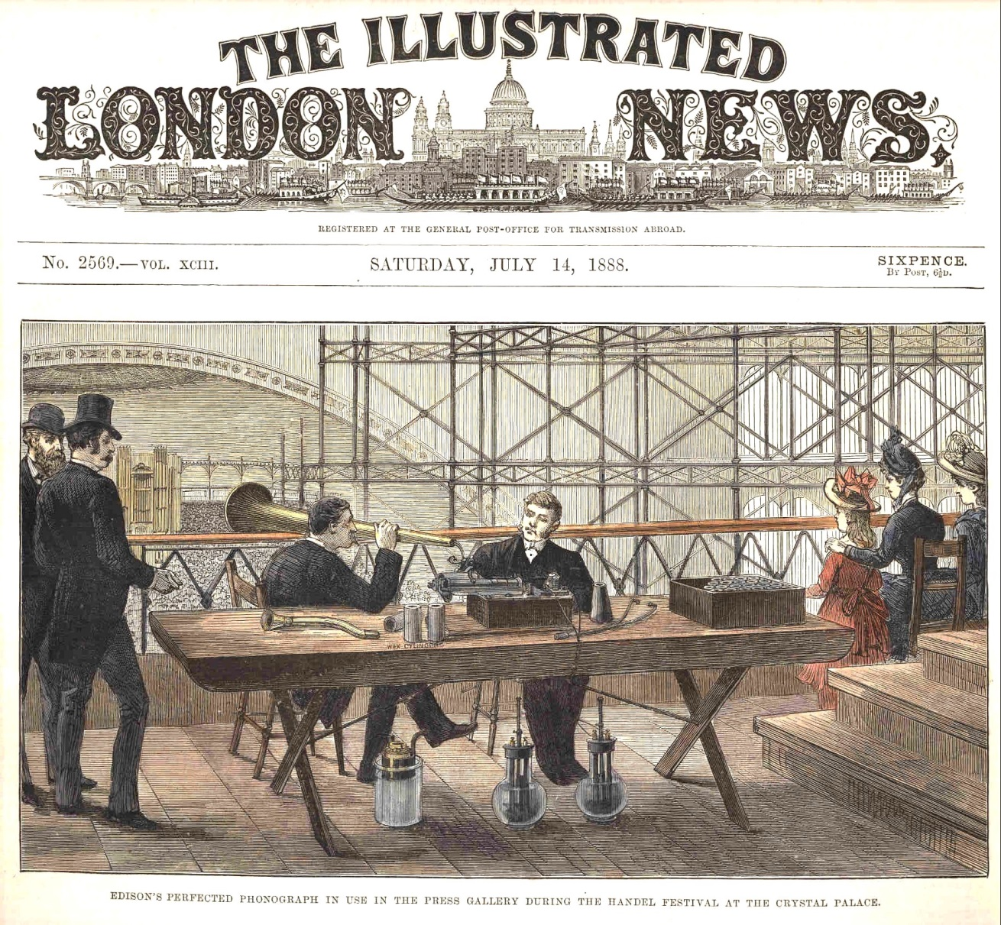
London: Crystal Palace;
Recording Handel, Israel in Egypt, June 29, 1888
Chorus: “Moses and the children of Israel sang this song unto the Lord. . . .

Slide 37
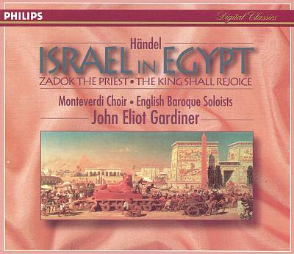
Chorus: “Moses and the children of Israel sang this song unto the Lord. . . .

Slide 38
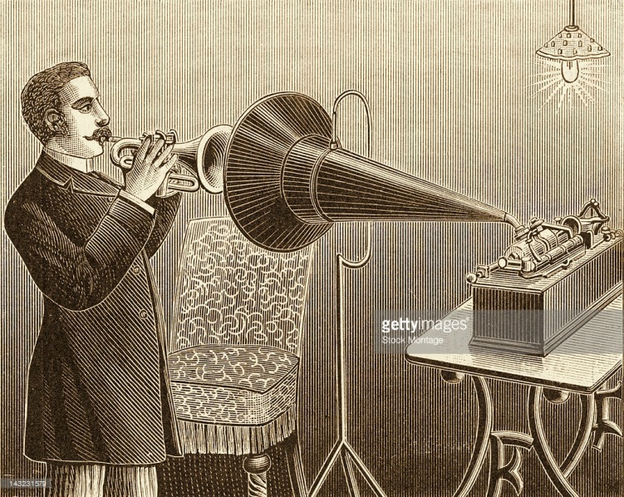
Sir Arthur Sullivan, “The Lost Chord” (Edison cylinder recording , August, 1888)

Slide 39
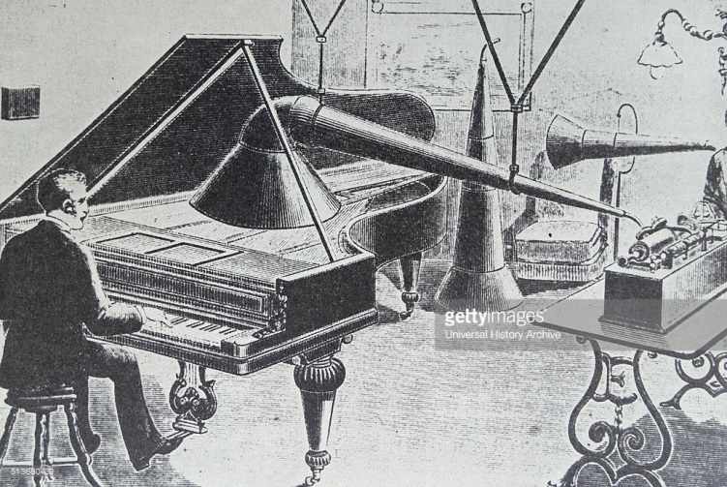
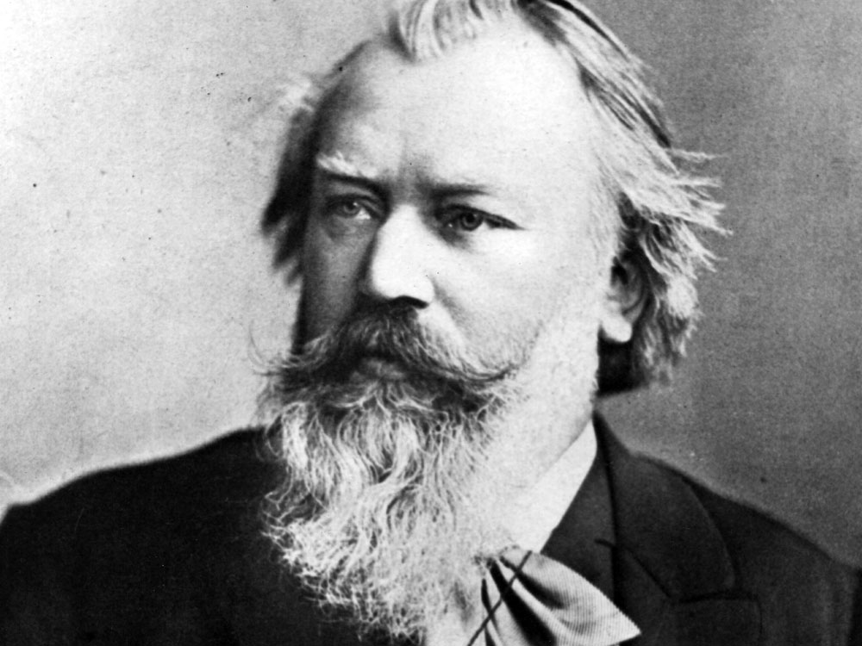
Edison agents record Brahms at the piano, Vienna December 2, 1889
Hungarian Dance No. 1 in G Minor

Slide 40
Edison agents record Brahms at the piano, Vienna December 2, 1889
“. . . House of Herr Dr. Fellinger. I have Dr. Brahms, Johannes Brahms.”
Hungarian Dance No. 1 in G Minor

Slide 41
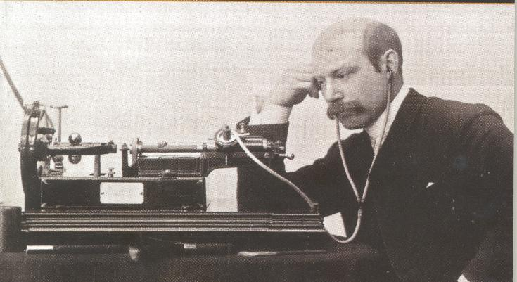
Russia, 1890s: The Julius Block Cylinders

Slide 42
Russia, 1890s: The Julius Block Cylinders
Paul Probst, piano: “Paraphrase on Tchaikovsky’s Sleeping Beauty”
(February 12, 1895)

Slide 43
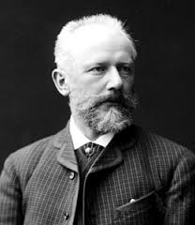
Russia, 1890s: The Julius Block Cylinders
Voice of Tchaikovsky,
“Party” Conversation, January 1890
[Elizaveta Lavrovskaya]: That awful Kuz’min! How dare he call me insidious?
[unidentified]: [Sings a scale out of tune]
[Tchaikovsky]: This trill could have been better!
[Lavrovskaya]: [heard vocalizing]
[Tchaikovsky]: Block is great, but Edison is even better!
[Lavrovskaya sings]: Coo-coo; coo-coo.
[Vasili Safonov]: Peter Jurgenson in Moscow.
[Tchaikovsky]: Who was speaking just now? I think it was Safonov’s voice. [whistles]

Slide 44
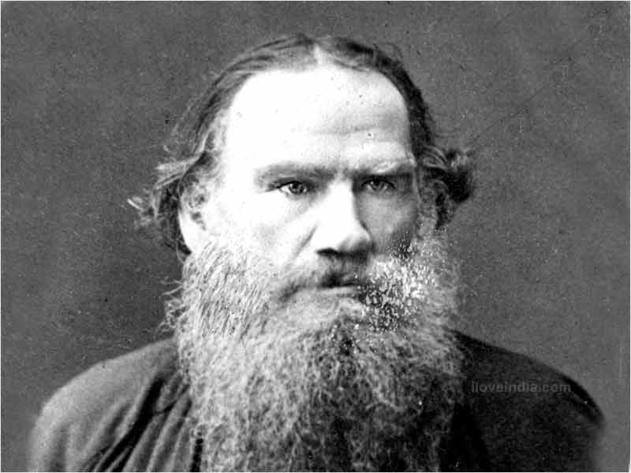
Russia, 1890s: The Julius Block Cylinders
Tolstoy reads
from the gospel of Luke, 1895

Slide 45
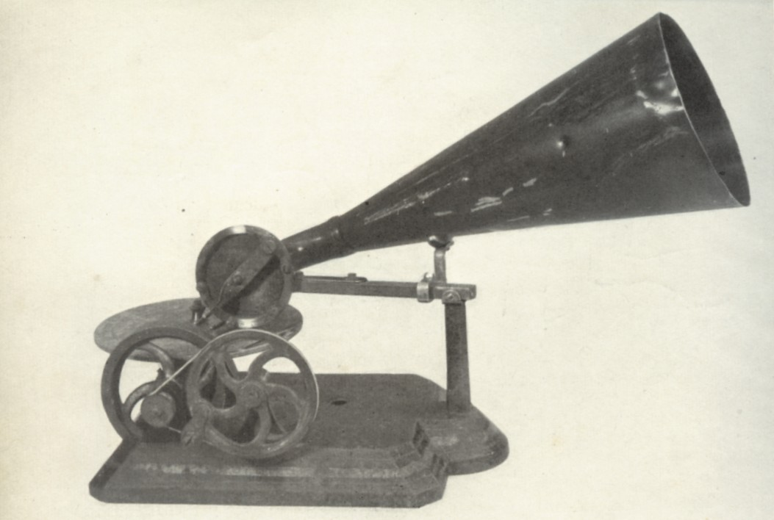
Emile Berliner, “Gramophone,” c. 1888 (flat discs, not cylinders)

Slide 46
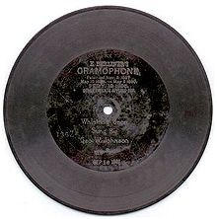
Competitors, 1890s, 1900s, 1910s: cylinders vs. flat discs
“Phonograph” “Gramophone”

Slide 47
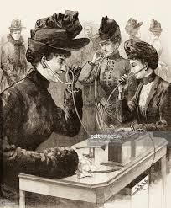
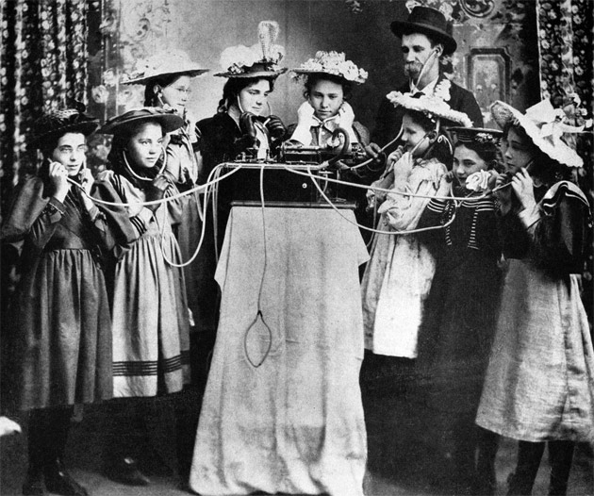
Listening to phonograph recordings as novelties, 1890s

Slide 48
John York Atlee, whistling virtuoso (1890s)
“The Mocking Bird” (1893)

Slide 49
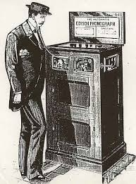
The Edison Quartet
“My Old Kentucky Home ” (1893)

Slide 50
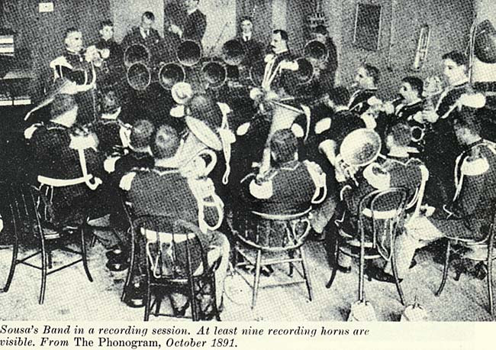
“Washington Post” (1897)

Slide 51
Listening to phonograph recordings as novelties, 1890s

Slide 52
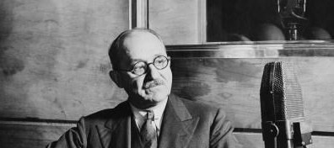
Recording Operatic Vocalists, early 1900s;
Gramophone & Typewriter Co., Ltd (London):
Fred Gaisberg (in later years)

Slide 53
Recording Operatic Vocalists, early 1900s;
Gramophone & Typewriter Co., Ltd (London):
On recording tours (Italy, etc.), 1902 ff
Fred Gaisberg (in later years)

Slide 54
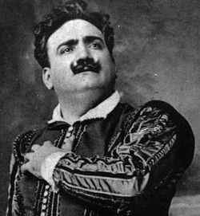
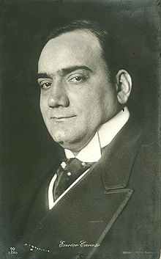
Enrico Caruso

Slide 55
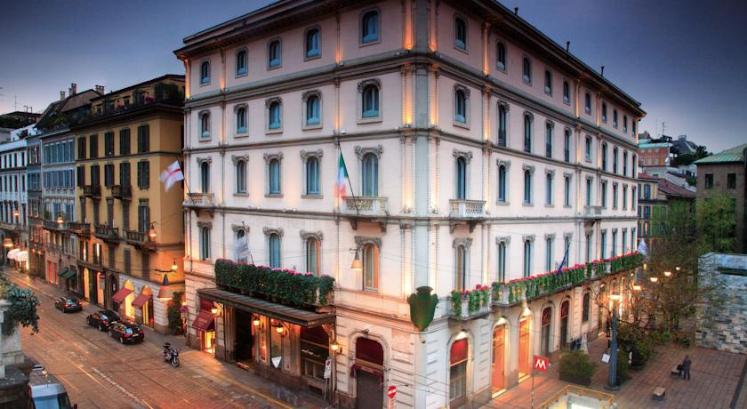
Caruso, first recording session, Hotel di Milan, April 11, 1902 (G&T)

Slide 56
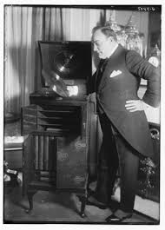
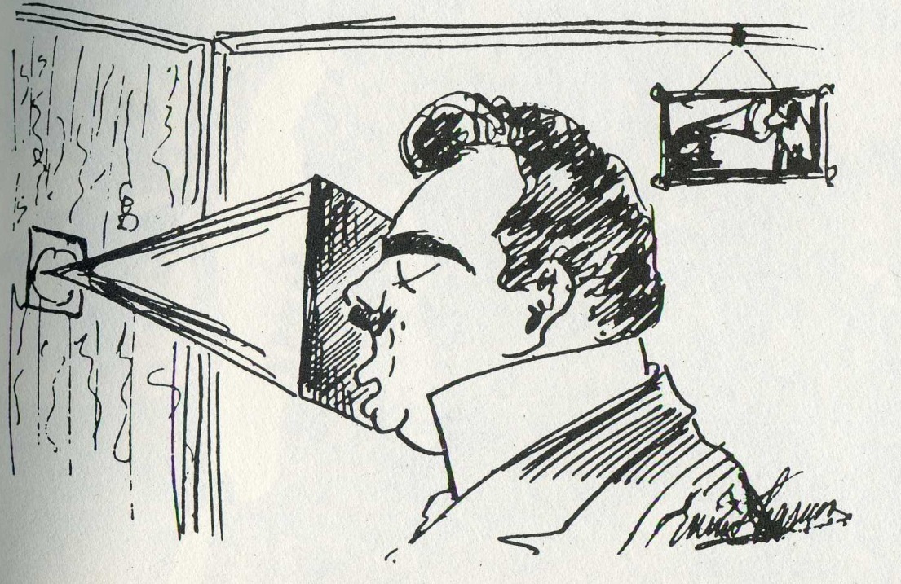
Caruso, first recording session, Hotel di Milan, April 11, 1902 (G&T)
Verdi, “Questa o quella,” Rigoletto

Slide 57
Caruso, first recording session, Hotel di Milan, April 11, 1902 (G&T)
Puccini, “E lucevan le stelle,” Tosca

Slide 58
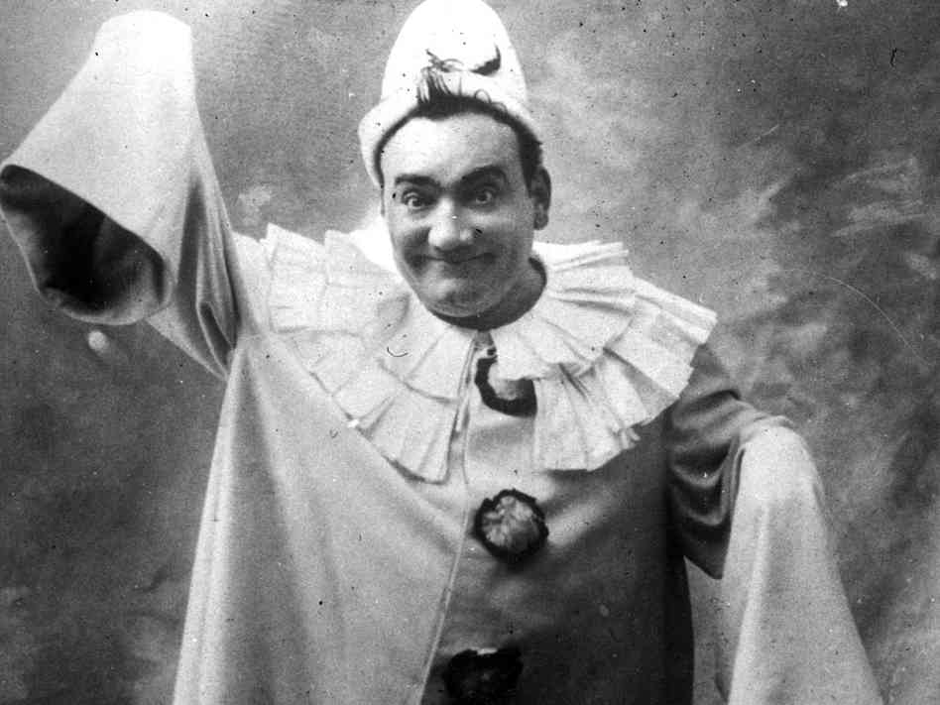
Caruso, first recording session, Hotel di Milan, April 11, 1902 (G&T)
Leoncavallo, “Vesti la giubba,” Pagliacci

Slide 59
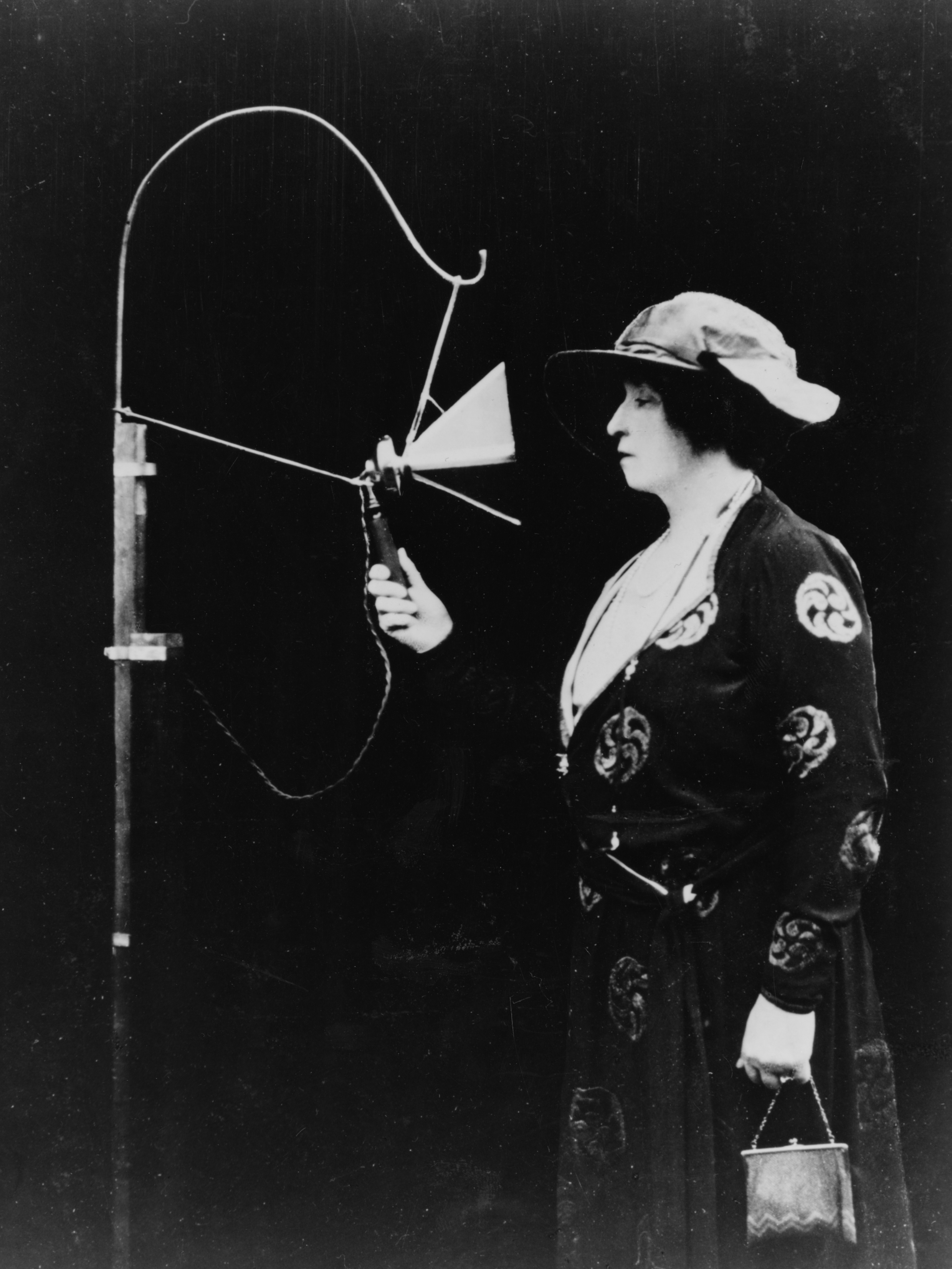
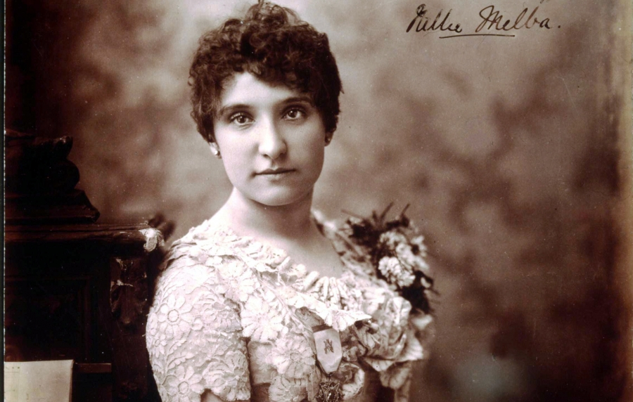
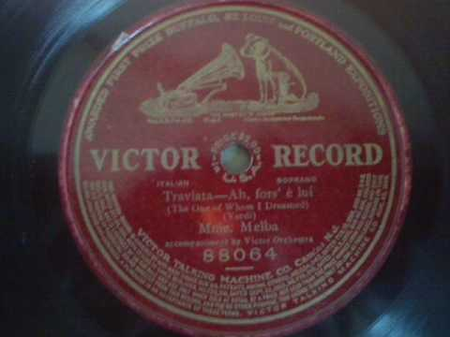
Nellie Melba

Slide 60
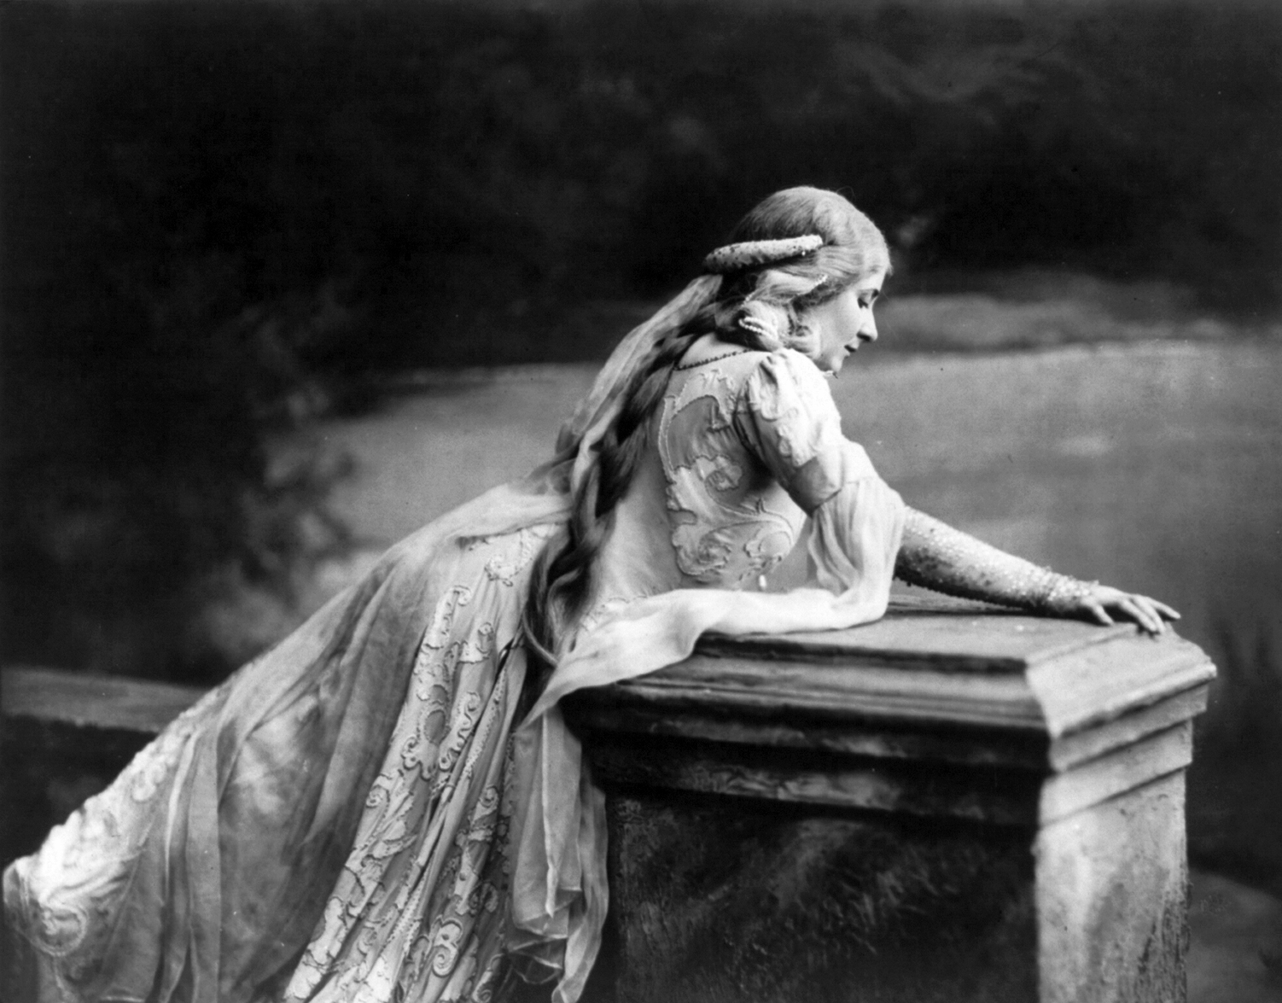
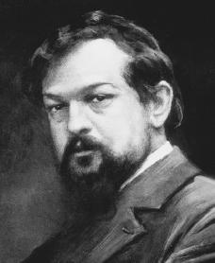
Claude Debussy and Mary Garden
Debussy, “Mes longs cheveux,” Pelléas et Mélisande (Paris 1904)

Slide 61
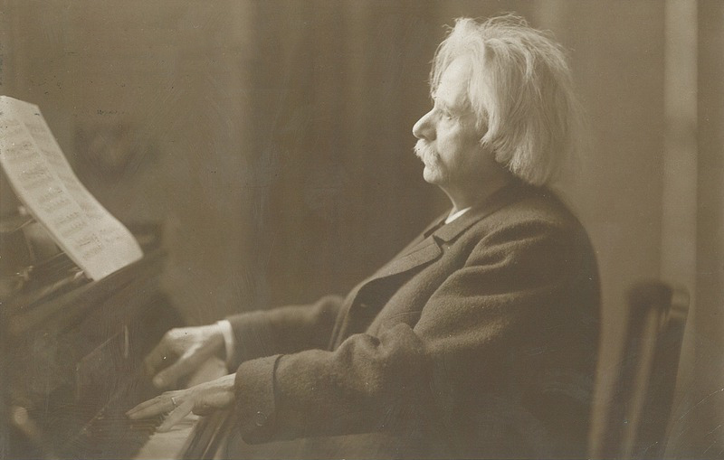
Edvard Grieg, “Wedding Day at Troldhaugen” (May 2, 1903)

Slide 62
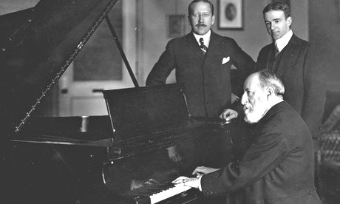
Camille Saint-Saëns, extract from Piano Concerto No. 2 (July 26, 1904)

Slide 63
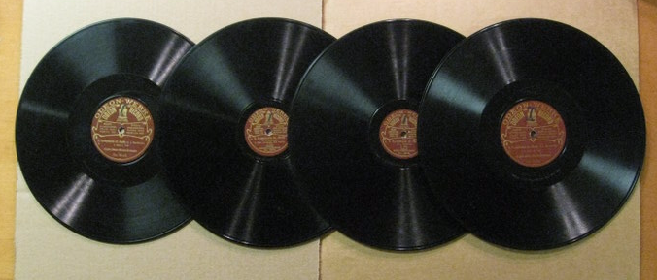
Finally: A Complete Symphony is Recorded
Beethoven’s Fifth Symphony: Grosses Odeon-Streichorchester
(Berlin, Odeon, 1910)

Slide 64
[Grosses] Odeon-Orchester

Slide 65
Recording an Orchestra:
Early 1925: Victor Camden Recording Studio

Slide 66
Arthur Nikisch and the Berlin Philharmonic Orchestra

Slide 67
Beethoven’s Fifth Symphony: Arthur Nikisch, Berlin Philharmonic
(Berlin, Grammophon, 20 November 1913)

Slide 68
Schumann, Piano Concerto in A Minor (first recording, London, November-December 1923)
Alfred Cortot

Slide 69
Schumann, “Préambule,” from Carnaval, recorded
May 1923)
Alfred Cortot

Slide 70
Beethoven, Symphony No. 3 (“Eroica”), Berlin Opera Orchestra: the first complete recording of the work:
July 1924)
Oskar Fried

Slide 71
Tchaikovsky, Piano Concerto No. 1, with Stanley Chapple and The Aeolian Orchestra: the first complete recording of the work (1926)
Vasily Sapelnikov

Slide 72
September 9, 1908

Slide 73
March 7, 1910

Slide 74
August 23, 1920

Slide 75
Paul Whiteman, “My Ohio Home” (1927); trumpet, Bix Beiderbecke

Slide 76
The 1920s: the first decade of radio

Slide 77
1920s: The Charleston Dance

Slide 78
1920s: The Charleston Dance

Slide 79
Emerging in 1920s white-culture America:
The ragtime- and jazz-inflected popular song, now entering its golden age

Slide 80
Emerging in 1920s white-culture America:
The ragtime- and jazz-inflected popular song, now entering its golden age
Vaudeville theater

Slide 81
Emerging in 1920s white-culture America:
The ragtime- and jazz-inflected popular song, now entering its golden age
Vaudeville theater
The Broadway musical (American musical theater)

Slide 82
Emerging in 1920s white-culture America:
The ragtime- and jazz-inflected popular song, now entering its golden age
Vaudeville theater
The Broadway musical (American musical theater)
The Broadway revue/follies/gaieties

Slide 83
Emerging in 1920s white-culture America:
The ragtime- and jazz-inflected popular song, now entering its golden age
Vaudeville theater
The Broadway musical (American musical theater)
The Broadway revue/follies/gaieties
The Tin Pan Alley commercial song

Slide 84
Emerging in 1920s white-culture America:
The ragtime- and jazz-inflected popular song, now entering its golden age
Vaudeville theater
The Broadway musical (American musical theater)
The Broadway revue/follies/gaieties
The Tin Pan Alley commercial song
(After 1927-28) the sound film

Slide 85
Irving Berlin Jerome Kern
George Gershwin Richard Rodgers

Slide 86
The Tin Pan Alley song
32-bar chorus (refrain)
a b || a c
Or (after about 1923/24)
a a’ b || a’’
Verse
(quasi-narrative setup)

Slide 87
1920
Verse Chorus: a b || a c

Slide 88
1920
Verse Chorus: a b || a c

Slide 89
1920
Verse Chorus: a b || a c

Slide 90
1920
Verse Chorus: a b || a c

Slide 91
1920
Verse Chorus: a b || a c

Slide 92
1920
Verse Chorus: a b || a c

Slide 93
1923-1924
Gershwin, “Fascinating Rhythm,” from Lady Be Good (Fred & Adele Astaire)

Slide 94
1923-1924
Gershwin, “Fascinating Rhythm,” from Lady Be Good (Fred & Adele Astaire)

Slide 95
1923-1924
Gershwin, “Fascinating Rhythm,” from Lady Be Good (Fred & Adele Astaire)

Slide 96
1923-1924
Gershwin, “Fascinating Rhythm,” from Lady Be Good (Fred & Adele Astaire)

Slide 97
George Gershwin, “I Got Rhythm” (1931 performance)

Slide 98
Paris, 1920s: Joséphine Baker
“Bye Bye, Blackbird,” Paris, January 1927

Slide 99
The Blue Angel (1930)

Slide 100
Cabaret: Weimar Germany, Berlin, late 1920s, film Der blaue Engel
Marlene Dietrich, “Ich bin die fesche Lola”
(I’m stylish Lola, the darling of the season; I have a pianola at home in my salon;
every man loves me…but they can’t play on my pianola)

Slide 101
Cabaret: Weimar Germany, Berlin, late 1920s, film Der blaue Engel
Marlene Dietrich, “Ich bin von Kopf bis Fuß auf Liebe eingestellt”
(“I’m built for love from head to foot—because that’s my world . . . And nothing else”)

