Slide 1
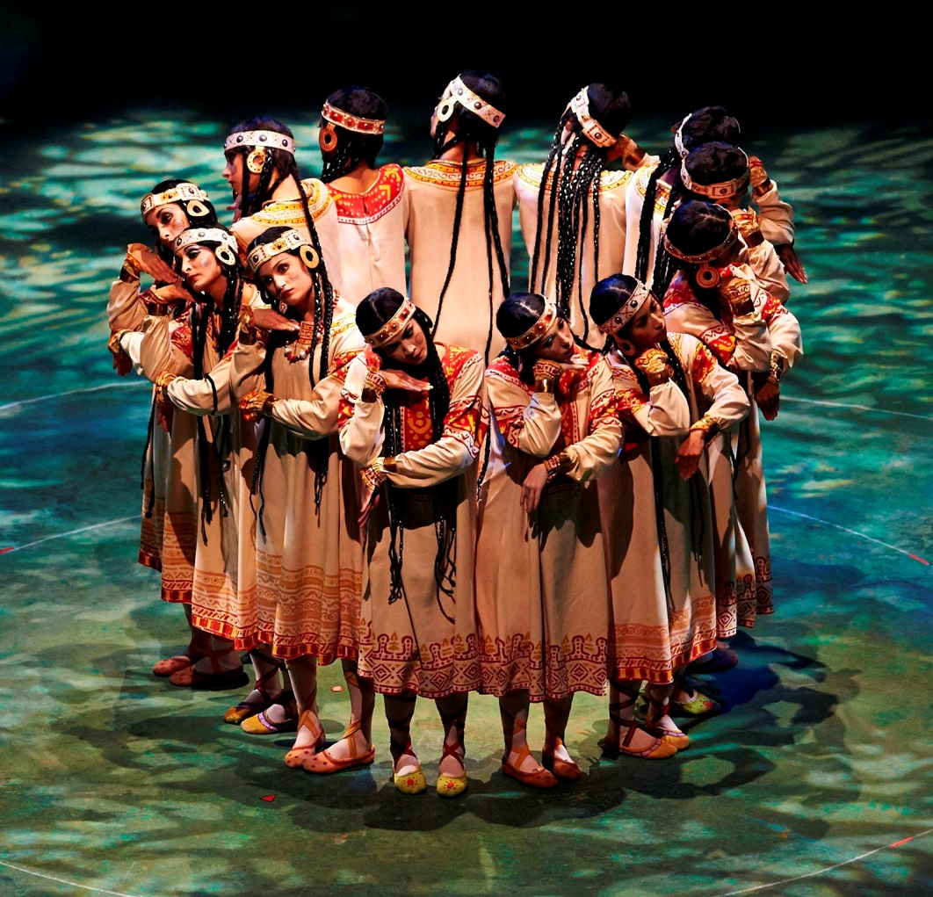
Le sacre du printemps

Slide 2
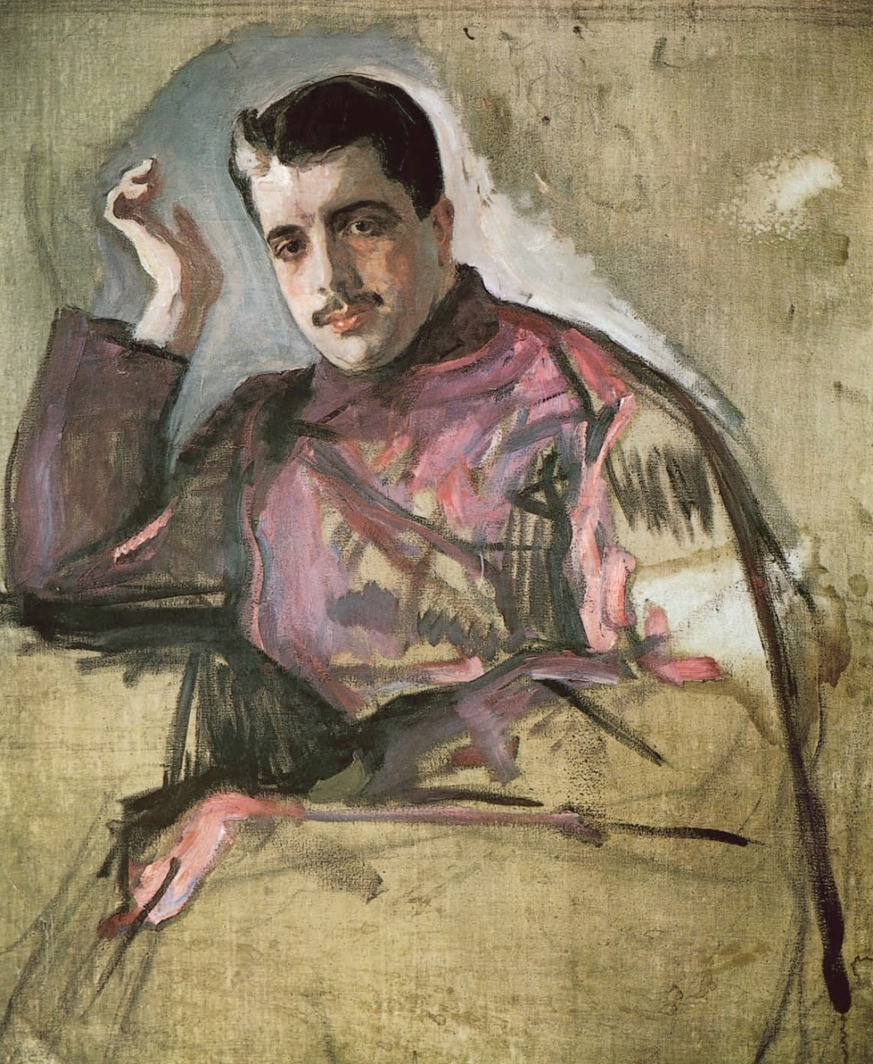
1905 – Russian exhibition of portrait art
1906 – Paris! Exhibition of Russian painting
1907 – Paris! Art and music: five “historical concerts”
1908 – Paris! Boris Godunov, complete, with Fyodor Chaliapin
1909 – Paris! More Russian operas (R-K, Ivan the Terrible; Glinka, Ruslan and Lyudmila; Borodin, Prince Igor) . . . and . . . the Ballets russes!
1910 – Paris: The Firebird!
1911 – Petrushka!
Sergey Diaghilev (Serov portrait, 1904)

Slide 3
1905 – Russian exhibition of portrait art
1906 – Paris! Exhibition of Russian painting
1907 – Paris! Art and music: five “historical concerts”
1908 – Paris! Boris Godunov, complete, with Fyodor Chaliapin
1909 – Paris! More Russian operas
(R-K, Ivan the Terrible; Glinka,
Ruslan and Lyudmila; Borodin,
Prince Igor) . . . and . . .
the Ballets russes!
1910 – Paris! The Firebird!
1911 – Paris! Petrushka!
1912??
Sergey Diaghilev (Serov portrait, 1904)

Slide 4
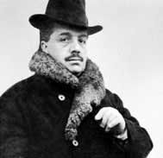
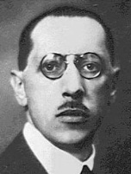
Diaghilev and the Ballets Russes in Paris, 1911-13
1910 – Stravinsky, The Firebird
1911 – Stravinsky, Petrushka
For 1912?: Do it again! More!

Slide 5
Diaghilev and the Ballets Russes in Paris, 1911-13
1910 – Stravinsky, The Firebird
1911 – Stravinsky, Petrushka
No! I need two years for the next one!
For 1912?: Do it again! More!

Slide 6
Diaghilev and the Ballets Russes in Paris, 1911-13
1910 – Stravinsky, The Firebird
1911 – Stravinsky, Petrushka
No! I need two years for the next one!
For 1912?: Do it again! More!
(1913—Le Sacre du printemps)

Slide 7
Diaghilev and the Ballets Russes in Paris, 1911-13
1910 – Stravinsky, The Firebird
1911 – Stravinsky, Petrushka
So…what do I do in 1912?

Slide 8
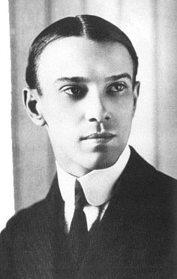
Diaghilev and the Ballets Russes in Paris, 1911-13
1910 – Stravinsky, The Firebird
1911 – Stravinsky, Petrushka
Let me choreograph some ballets!
So…what do I do in 1912?
Vaslav Nijinsky

Slide 9
Diaghilev and the Ballets Russes in Paris, 1911-13
1910 – Stravinsky, The Firebird
1911 – Stravinsky, Petrushka
Let me choreograph some ballets!
So…what do I do in 1912?
!!
Vaslav Nijinsky

Slide 10
Diaghilev and the Ballets Russes in Paris, 1911-13
1910 – Stravinsky, The Firebird
1911 – Stravinsky, Petrushka
1912 – Debussy, Prélude à “L'après-midi d'un faune”
Vaslav Nijinsky

Slide 11
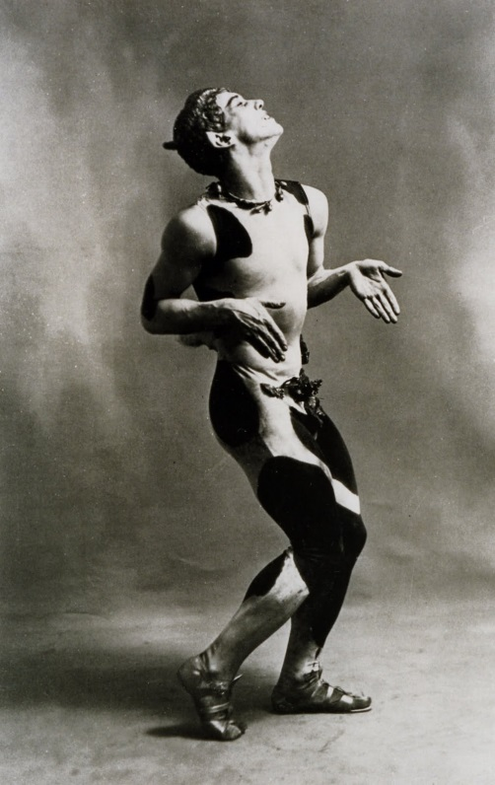
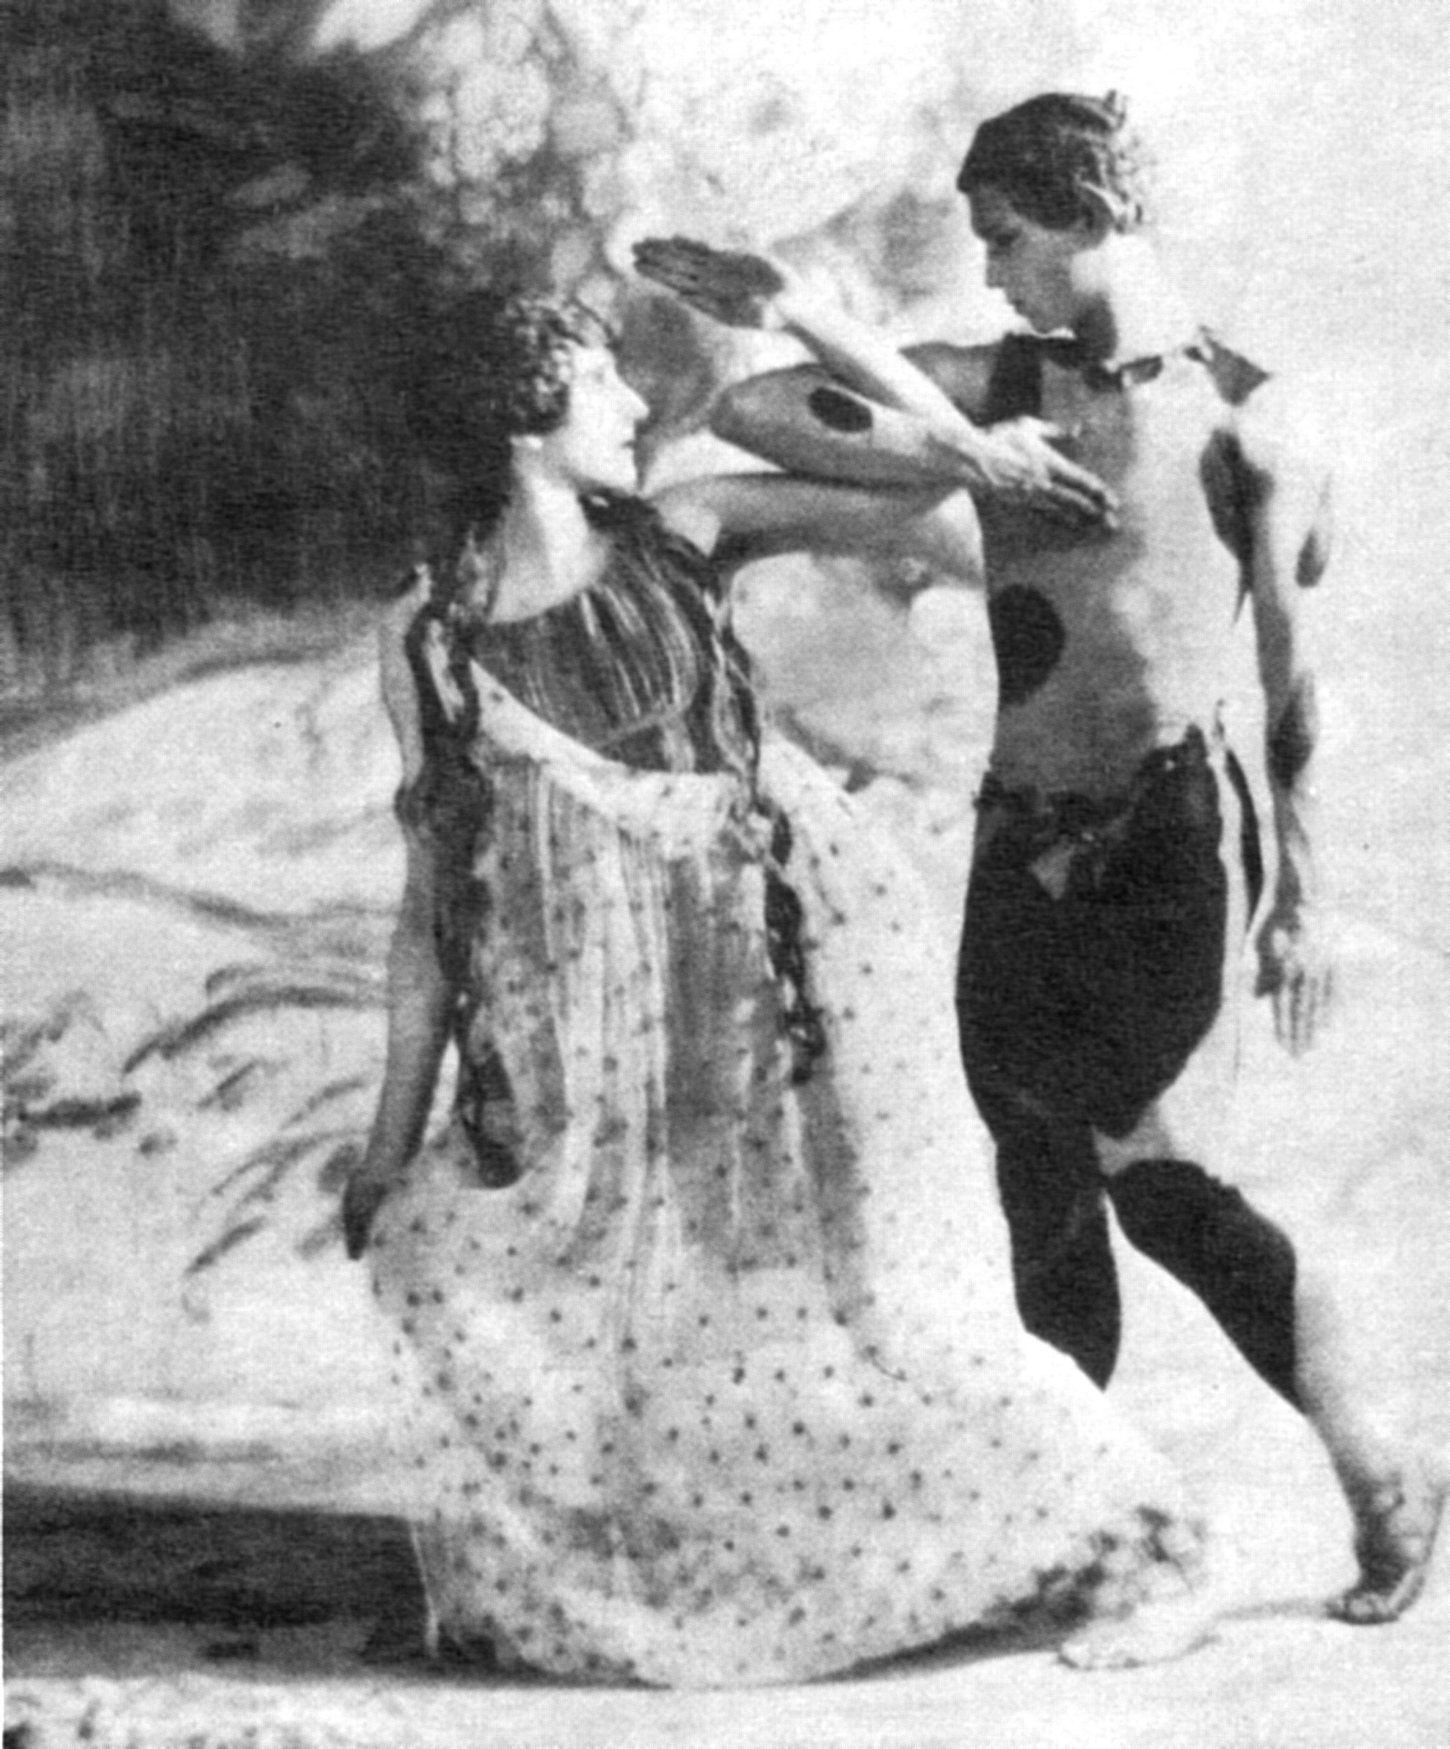
Diaghilev and the Ballets Russes in Paris, 1911-13
1910 – Stravinsky, The Firebird
1911 – Stravinsky, Petrushka
1912 – Debussy, Prélude à “L'après-midi d'un faune”
Vaslav Nijinsky

Slide 12
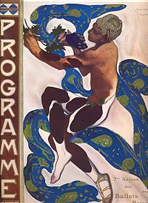
Vaslav Nijinsky
1912 program for the Faun (Léon Bakst)

Slide 13
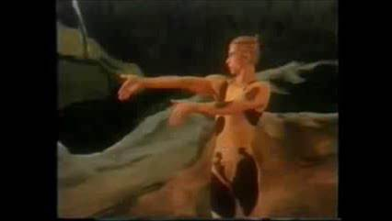
Nijinsky’s Choreography, 1912 : Debussy, Prélude à “L'après-midi d'un faune”
(reconstruction: Rudolf Nureyev as Nijinsky/Faun)

Slide 14
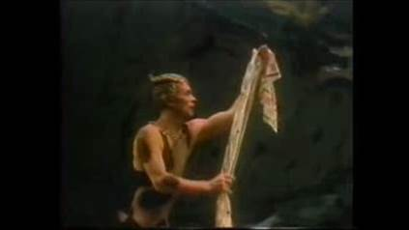
Nijinsky’s Choreography, 1912 : Debussy, Prélude à “L'après-midi d'un faune”
(reconstruction: Rudolf Nureyev as Nijinsky/Faun)

Slide 15
Diaghilev and the Ballets Russes in Paris, 1911-13
1910 – Stravinsky, The Firebird
1911 – Stravinsky, Petrushka
1912 – Debussy, Prélude à “L'après-midi d'un faune”
1912 -- Maurice Ravel, Daphnis et Chloé
Vaslav Nijinsky

Slide 16
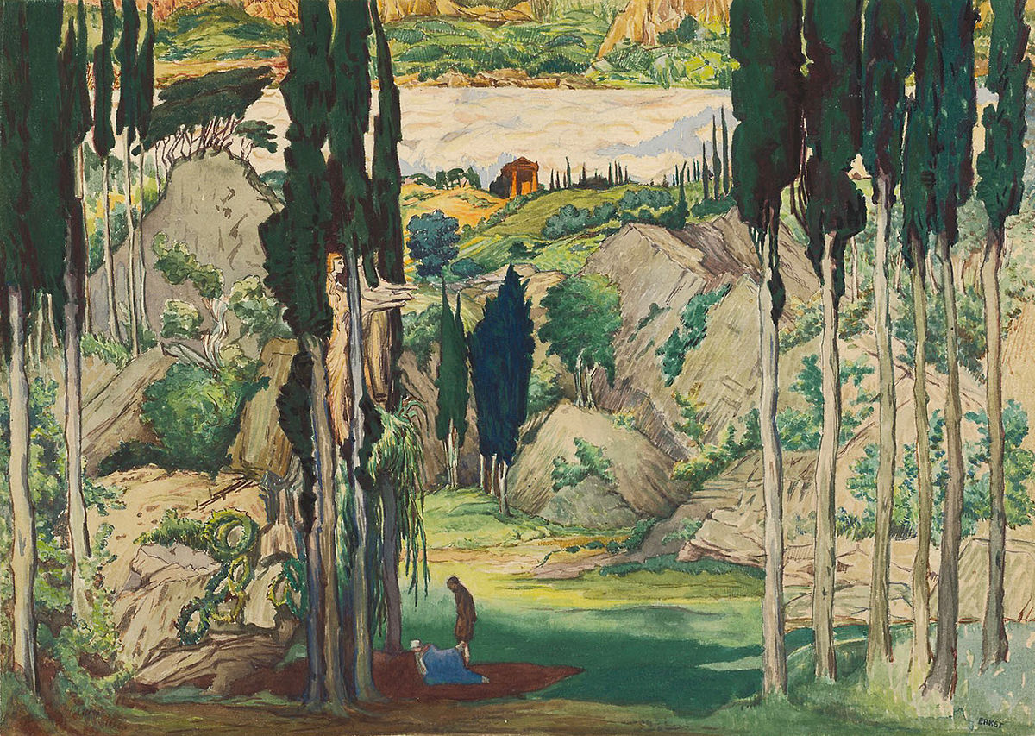
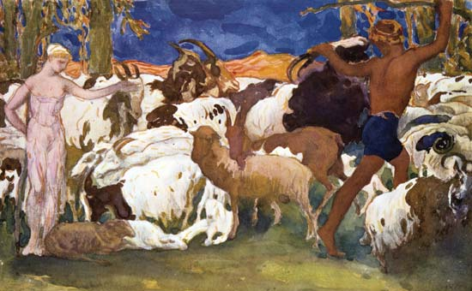
Another modern ballet for Paris, Diaghilev, Ballets russes, 1912
Also in collaboration with
Mikhail Fokine and Léon Bakst—
but not Nijinksy
Maurice Ravel,
Daphnis et Chloé
(“symphonie chorégraphique”)

Slide 17
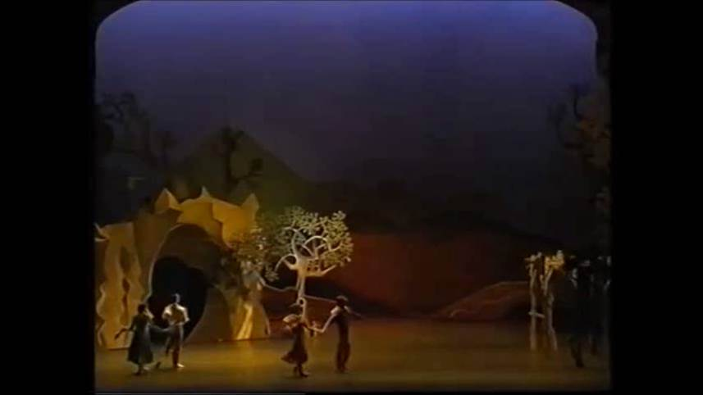
Ravel, Daphnis et Chloé (1912)
Modern production (not the original staging) by the Royal Ballet

Slide 18
Diaghilev and the Ballets Russes in Paris, 1911-13
1910 – Stravinsky, The Firebird
1911 – Stravinsky, Petrushka
1912 – Debussy, Prélude à “L'après-midi d'un faune”
1912 -- Maurice Ravel, Daphnis et Chloé
(1912: Schoenberg: Pierrot lunaire)
Vaslav Nijinsky

Slide 19
Diaghilev and the Ballets Russes in Paris, 1911-13
1910 – Stravinsky, The Firebird
1911 – Stravinsky, Petrushka
1912 – Debussy, Prélude à “L'après-midi d'un faune”
1912 -- Maurice Ravel, Daphnis et Chloé
1913 – Debussy, Jeux (premiere)
Vaslav Nijinsky

Slide 20
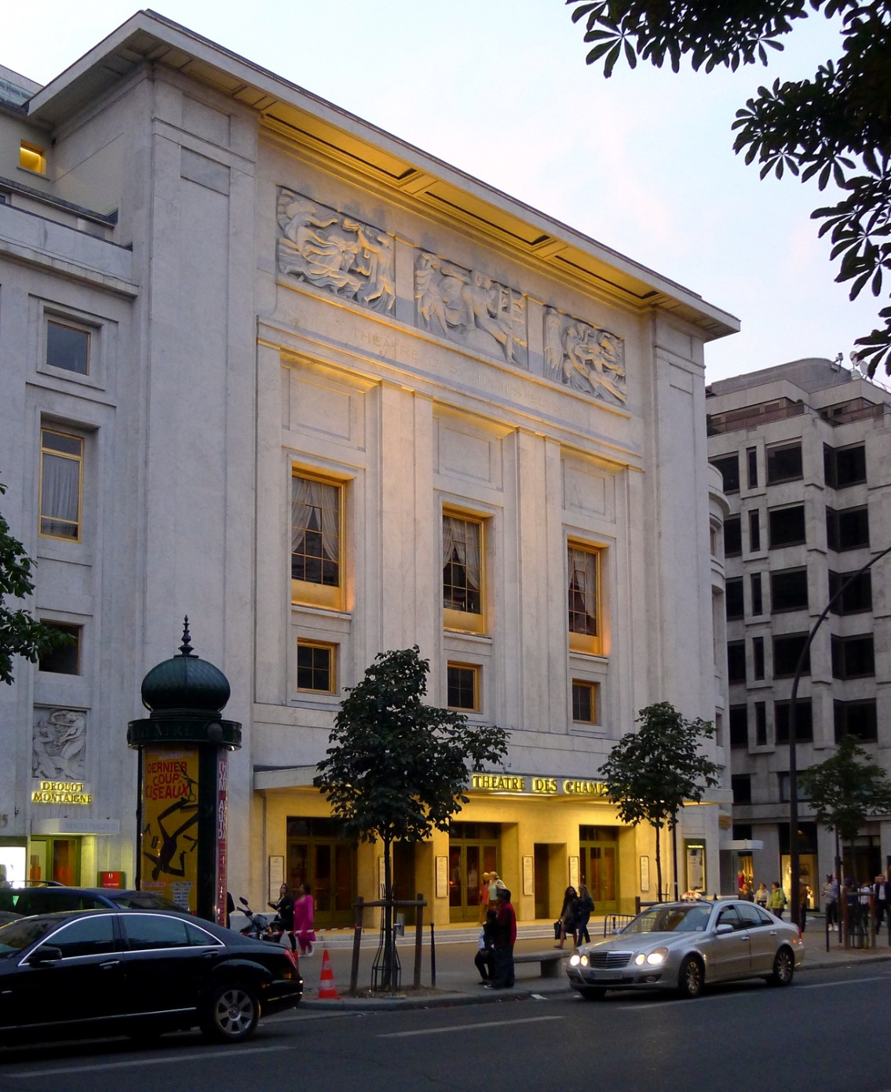
Paris: Théâtre des Champs-Élysées (1913)

Slide 21
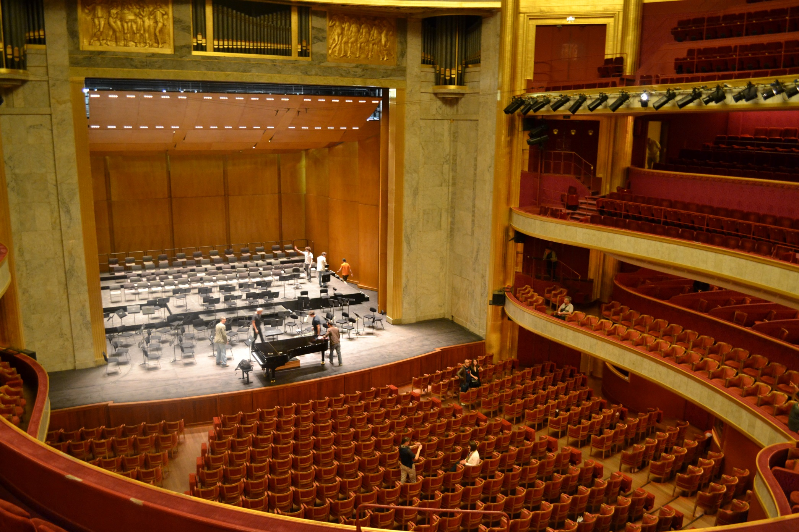
Paris: Théâtre des Champs-Élysées (1913)

Slide 22
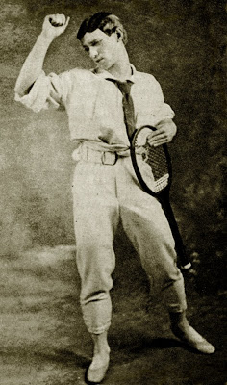
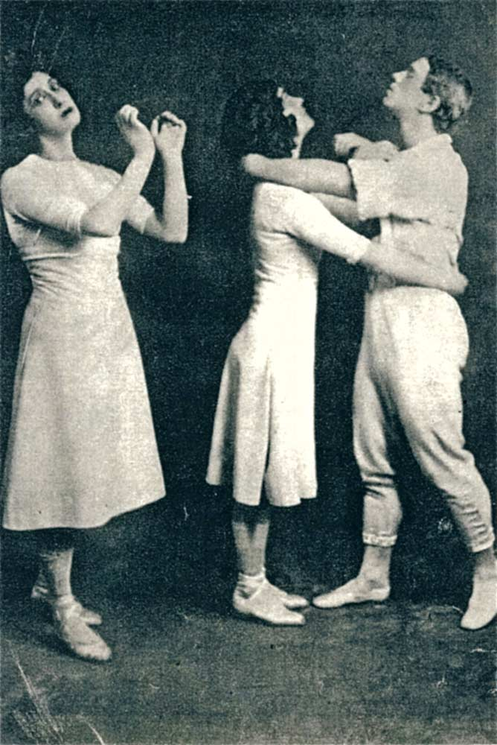
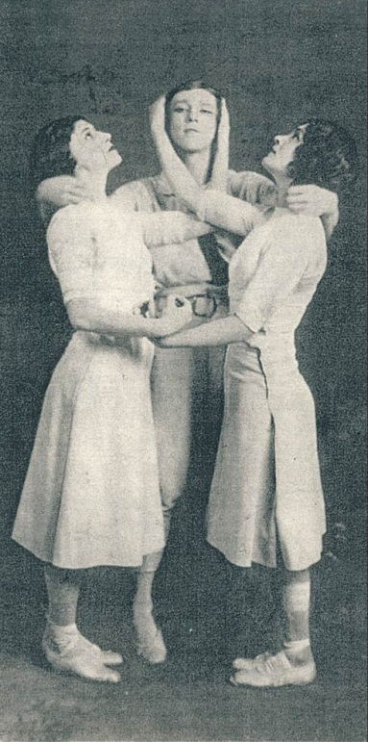
Diaghilev and the Ballets Russes in Paris, 1911-13
1910 – Stravinsky, The Firebird
1911 – Stravinsky, Petrushka
1912 – Debussy, Prélude à “L'après-midi d'un faune”
1913 – Debussy, Jeux (premiere)
Vaslav Nijinsky

Slide 23
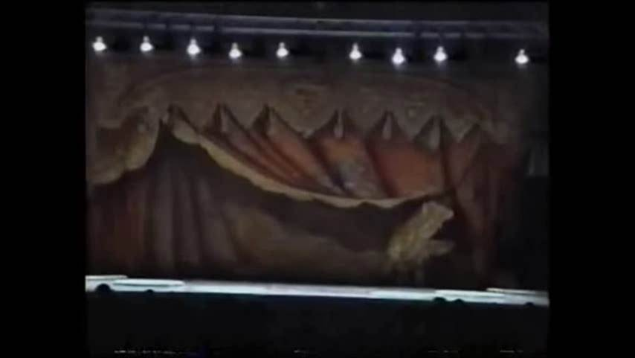
Nijinsky’s Choreography, 1913 : Debussy, Jeux
(reconstruction)

Slide 24
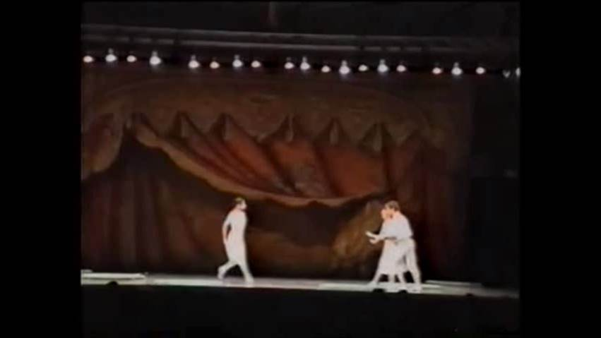
Nijinsky’s Choreography, 1913 : Debussy, Jeux
(reconstruction)

Slide 25
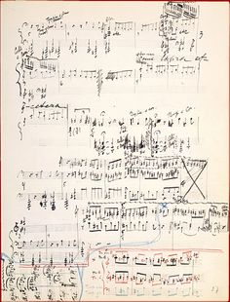
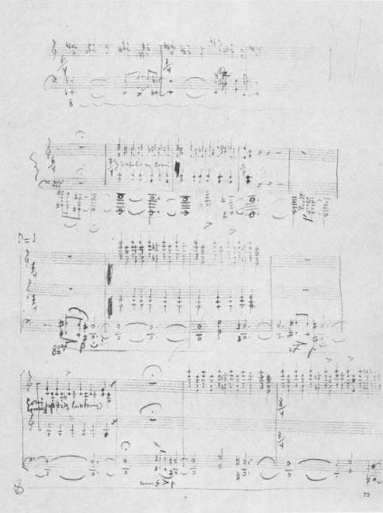
Stravinsky: composing Le sacre du printemps (1912-13)

Slide 26
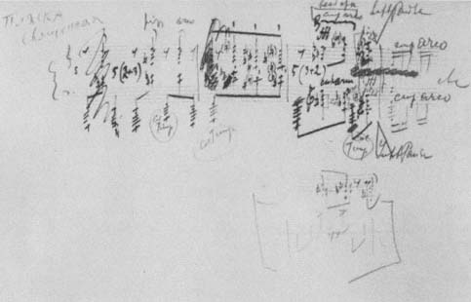
Stravinsky: composing Le sacre du printemps (1912-13)

Slide 27
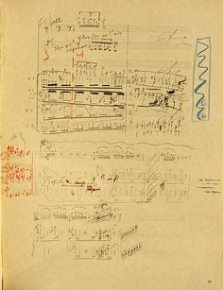
Stravinsky: composing Le sacre du printemps (1912-13)

Slide 28
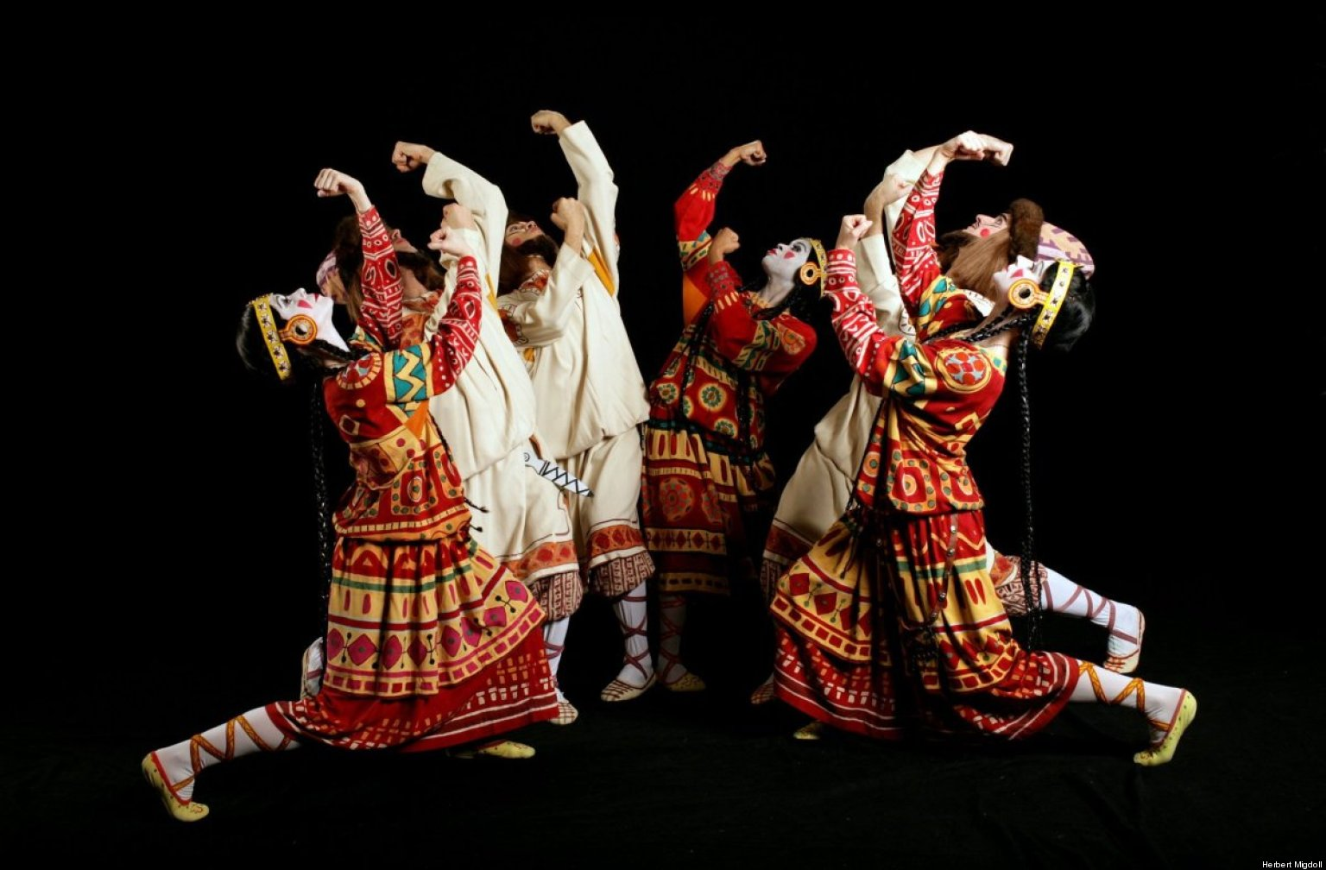
Le sacre du printemps

Slide 29
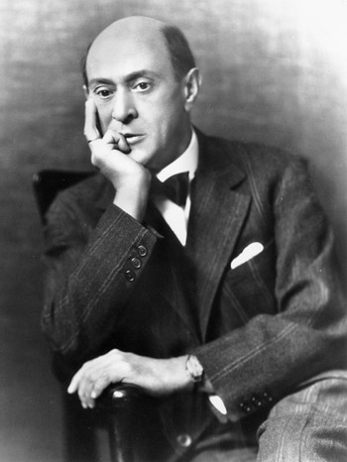
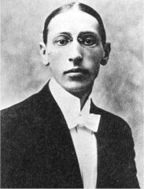
High Modernism in Music
An even greater hypervirtuosity
The “emancipation of dissonance”
Interruption/disruption of the traditional/institutional codes of past practice
Thematic/tonal/structural distortions or deformations
Emphatic claims of the arrival of a truer “authenticity” (implicit, pitiless denunciation of the urban-modern world “as it is”)—coupled with an argument of historical “inevitability”
Search for more intensity of the moment—revelations of “sound itself”

Slide 30
Le sacre du printemps

Slide 31
Present
Present

Slide 32
Present
An imagined modern future of unleashed urban dissonance, mechanistic , motoric technologies
Distant, barbaric past

Slide 33
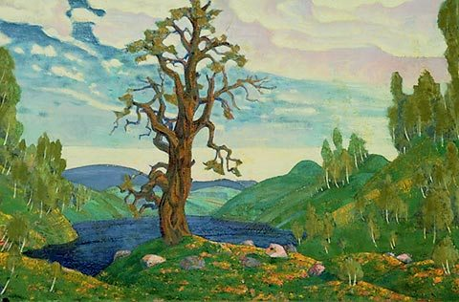
Stravinsky: Le sacre du printemps (1912-13):
Stage décor, Nicholas Roerich

Slide 34
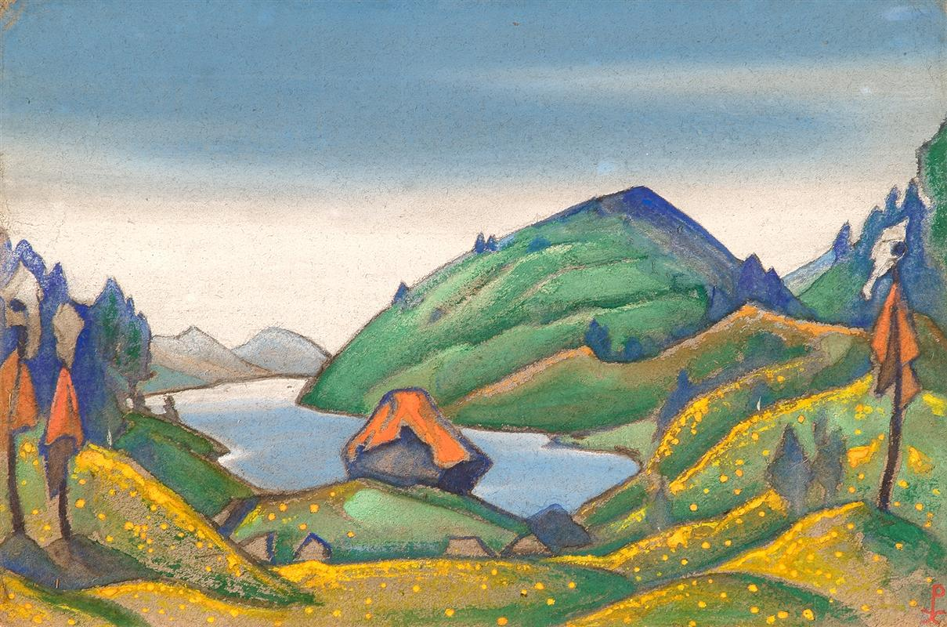
Stravinsky: Le sacre du printemps (1912-13):
Stage décor, Nicholas Roerich

Slide 35
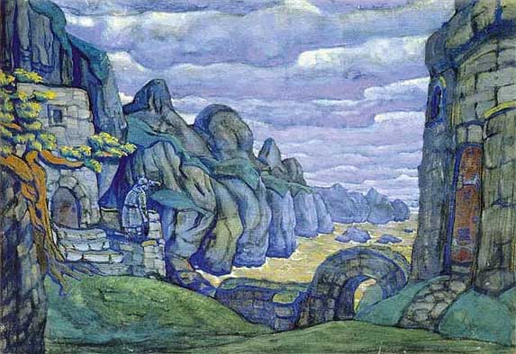
Stravinsky: Le sacre du printemps (1912-13):
Stage décor, Nicholas Roerich

Slide 36
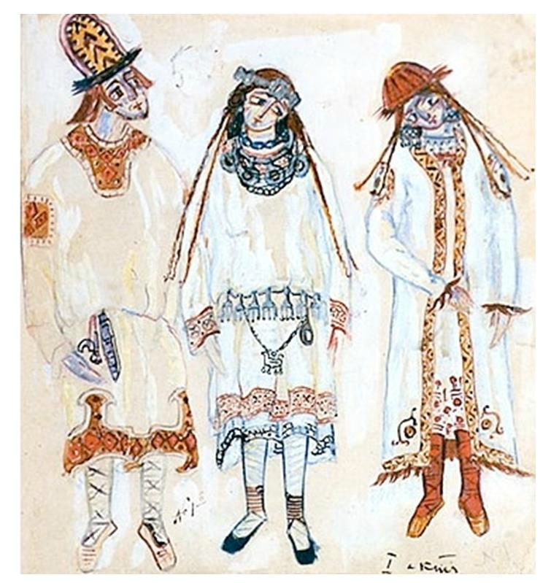
Stravinsky: Le sacre du printemps (1912-13):
Costumes, Nicholas Roerich

Slide 37
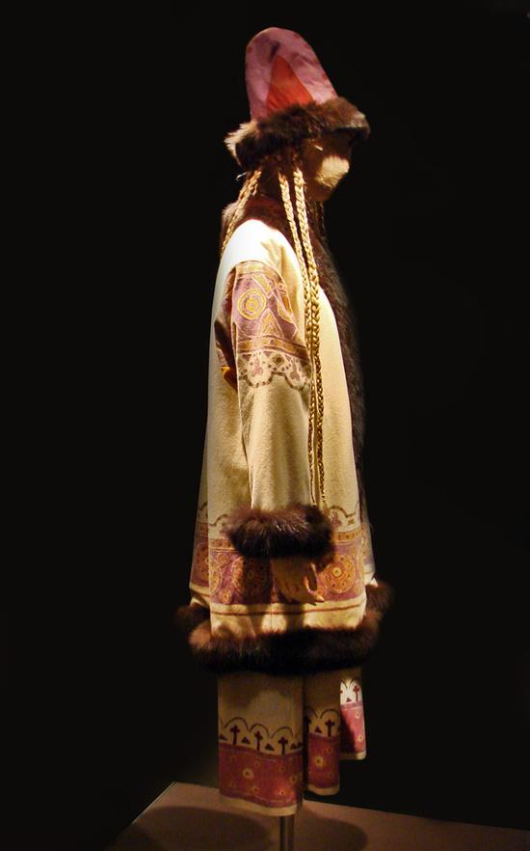
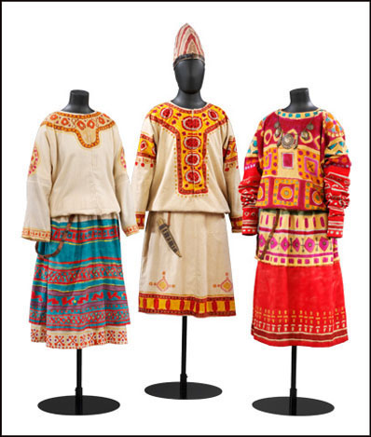
Stravinsky: Le sacre du printemps (1912-13):
Costumes, Nicholas Roerich

Slide 38
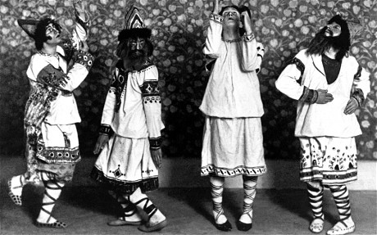
Stravinsky: Le sacre du printemps (1913)

Slide 39
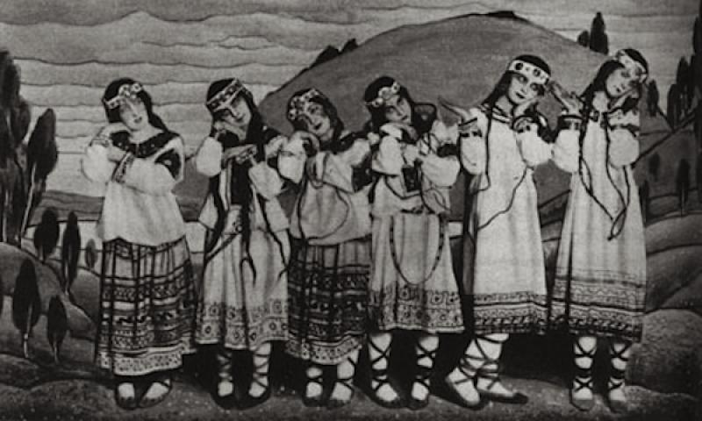
Stravinsky: Le sacre du printemps (1913)

Slide 40
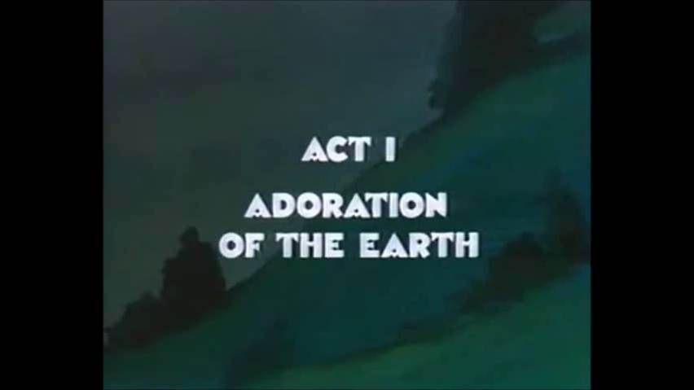
Le sacre du printemps: Joffrey Ballet Reconstruction (1989)

Slide 41
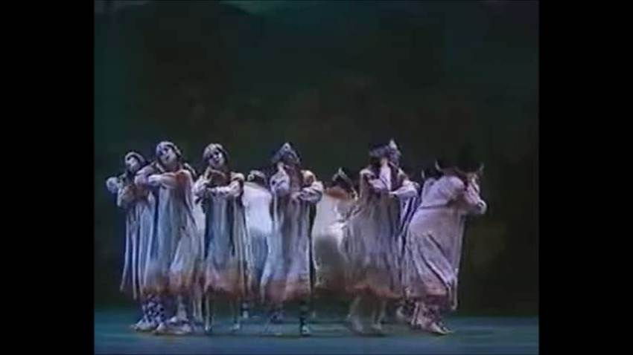
Le sacre du printemps: Joffrey Ballet Reconstruction (1989)

Slide 42
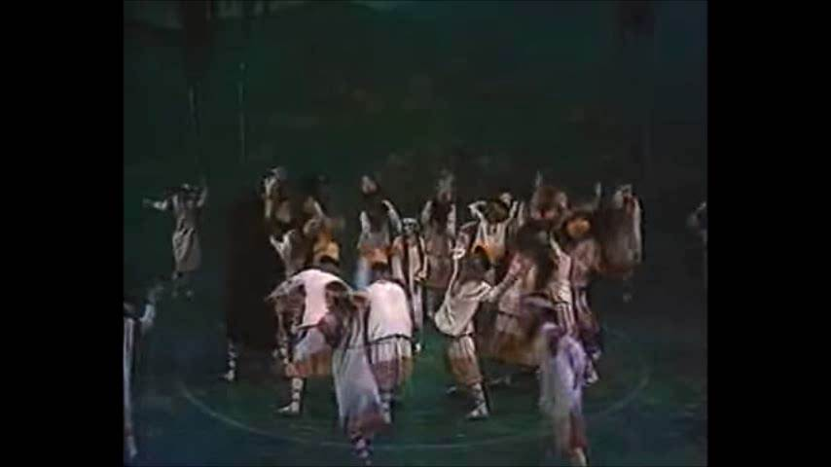
Le sacre du printemps: Joffrey Ballet Reconstruction (1989)

Slide 43
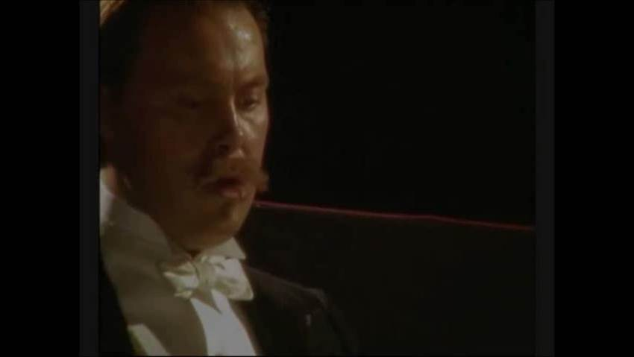
Riot at the Rite: BBC TV Film (2005)

Slide 44
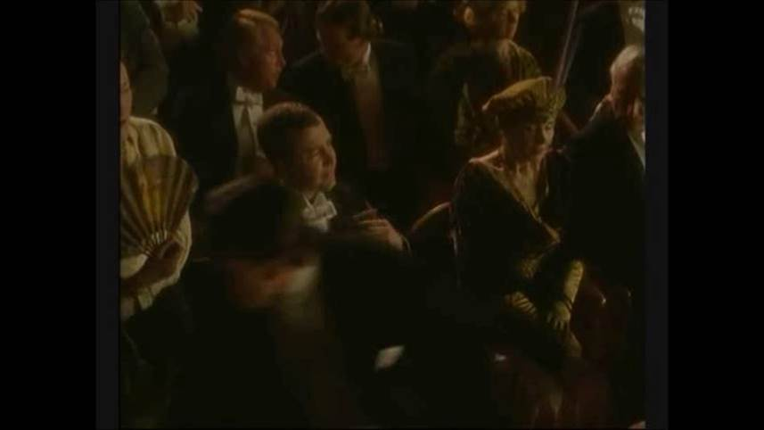
Riot at the Rite: BBC TV Film (2005)

Slide 45
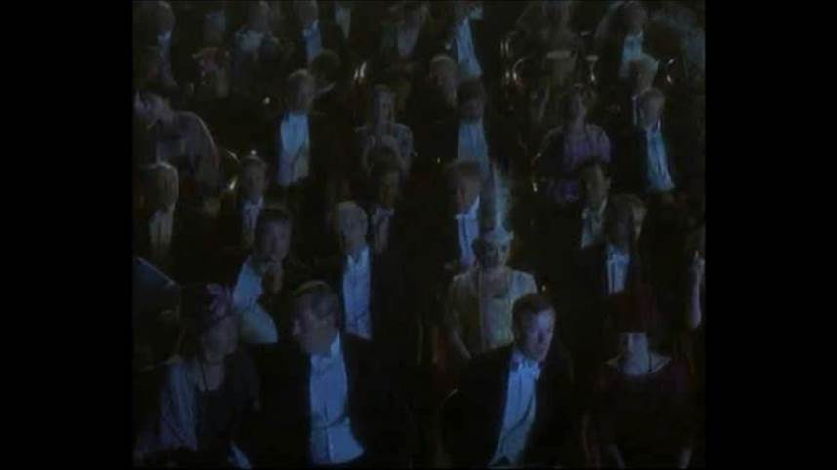
Riot at the Rite: BBC TV Film (2005)

Slide 46
Fundamental Principle of Construction:
Music built by juxtaposition and superimposition of sharply differentiated static blocks of sound

Slide 47
Fundamental Principle of Construction:
Music built by juxtaposition and superimposition of sharply differentiated static blocks of sound
A technique of sectioning, layering of distinct musical planes

Slide 48
Fundamental Principle of Construction:
Music built by juxtaposition and superimposition of sharply differentiated static blocks of sound
A technique of sectioning, layering of distinct musical planes
Abrupt oscillation and intercutting of recurring static ideas: cf. cinematic intercutting and splicing

Slide 49
Harmony:

Slide 50
Harmony:
Dissonant chords (sound objects) as building blocks

Slide 51
Harmony:
Dissonant chords (sound objects) as building blocks
Bichordal sonorities (cf. the “Rite” chord!)

Slide 52
Harmony:
Dissonant chords (sound objects) as building blocks
Bichordal sonorities (cf. the “Rite” chord!)
Octatonic sets

Slide 53
Harmony:
Dissonant chords (sound objects) as building blocks
Bichordal sonorities (cf. the “Rite” chord!)
Octatonic sets
Other, freer chord sets

Slide 54
BUT:
The sound objects/thematic fragments are often not far from the diatonic/modal (fragments of folk song or folklike contours)

Slide 55
BUT:
The sound objects/thematic fragments are often not far from the diatonic/modal (fragments of folk song or folklike contours)
Thus: small diatonic or near-diatonic sound objects can be interspliced and layered

Slide 56
BUT:
The sound objects/thematic fragments are often not far from the diatonic/modal (fragments of folk song or folklike contours)
Thus: small diatonic or near-diatonic sound objects can be interspliced and layered
Result: a ritually contrived, dissonant and pitiless clash of fragmented sound objects

Slide 57
BUT:
The sound objects/thematic fragments are often not far from the diatonic/modal (fragments of folk song or folklike contours)
Thus: small diatonic or near-diatonic sound objects can be interspliced and layered
Result: a ritually contrived, dissonant and pitiless clash of fragmented sound objects
THE FUNDAMENTAL TONAL TENSION OF THE RITE OF SPRING:
The contradiction between the implied “diatonic” source materials and the mechanically grating dissonance that they produce when combined

Slide 58
RHYTHM:
Ostinatos, ostinato fragments

Slide 59
RHYTHM:
Ostinatos, ostinato fragments
Polyrhythm, polymeter

Slide 60
RHYTHM:
Ostinatos, ostinato fragments
Polyrhythm, polymeter
Irregular, frequently changing time-signatures, often of asymmetrical meters

Slide 61
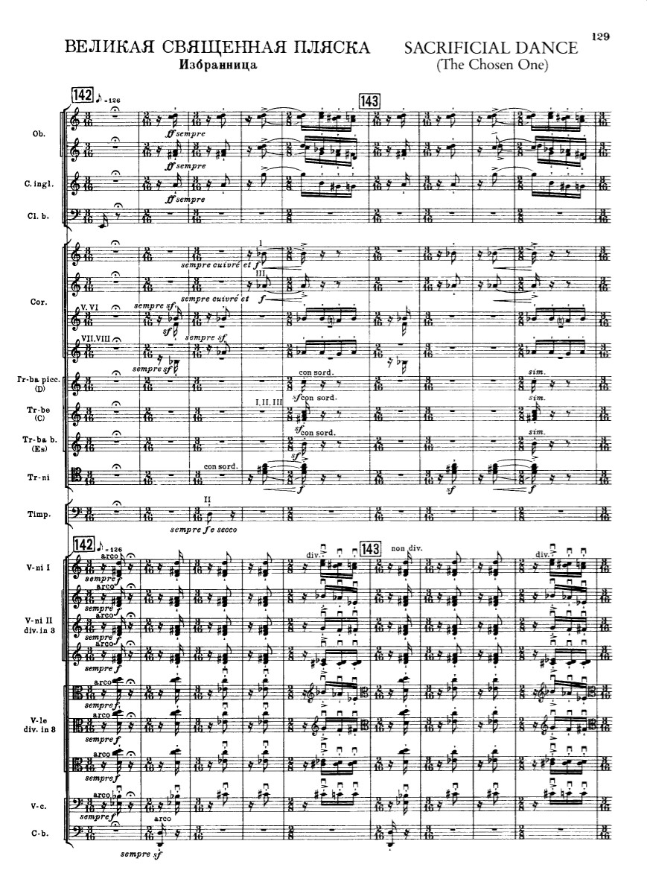
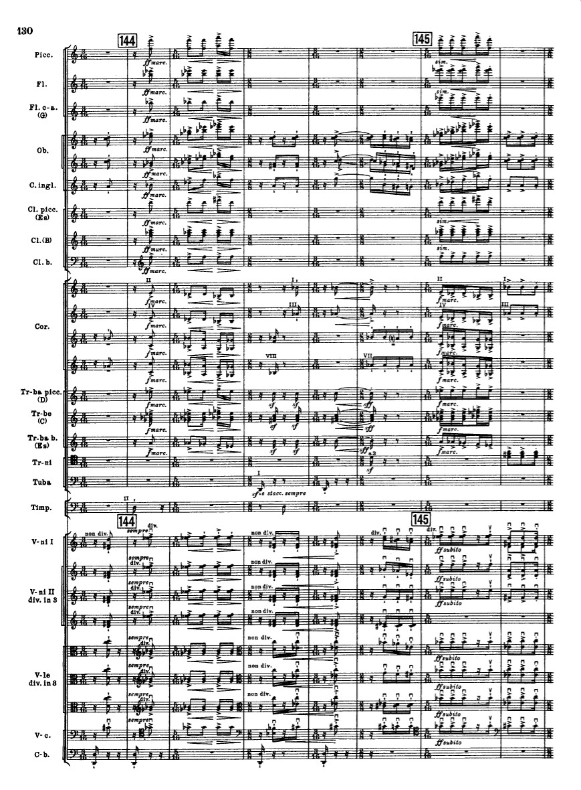
The opening of the “Danse sacrale”

Slide 62
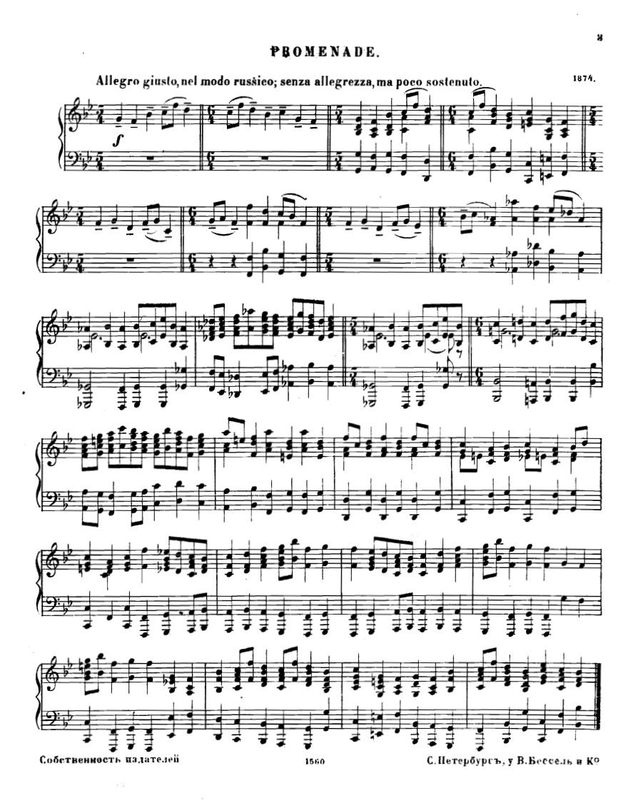

Slide 63
The opening of the “Danse sacrale”

Slide 64
Schoenberg, following a different path, would object to all this!

Slide 65
Schoenberg: Core Convictions; Objections to Stravinsky
All parameters of music should be equally developed: e.g., diatonic melodies should not be artificially “spiced up” with dissonances

Slide 66
Schoenberg: Core Convictions; Objections to Stravinsky
All parameters of music should be equally developed: e.g., diatonic melodies should not be artificially “spiced up” with dissonances
“Tonal” melodies are now historically inauthentic

Slide 67
Schoenberg: Core Convictions; Objections to Stravinsky
All parameters of music should be equally developed: e.g., diatonic melodies should not be artificially “spiced up” with dissonances
“Tonal” melodies are now historically inauthentic
Non-varied repetition is a compositional error, betraying an inorganic emptiness of thought

Slide 68
Schoenberg: Core Convictions; Objections to Stravinsky
All parameters of music should be equally developed: e.g., diatonic melodies should not be artificially “spiced up” with dissonances
“Tonal” melodies are now historically inauthentic
Non-varied repetition is a compositional error, betraying an inorganic emptiness of thought
The combination of tribal primitivism and mechanistic impersonality violates the commitment to hyper-personalism and subjectivity prized by the Austro-Germanic modernists as bearers of musical and cultural truth

Slide 69
Schoenberg: Core Convictions; Objections to Stravinsky
All parameters of music should be equally developed: e.g., diatonic melodies should not be artificially “spiced up” with dissonances
“Tonal” melodies are now historically inauthentic
Non-varied repetition is a compositional error, betraying an inorganic emptiness of thought
The combination of tribal primitivism and mechanistic impersonality violates the commitment to hyper-personalism and subjectivity prized by the Austro-Germanic modernists as bearers of musical and cultural truth
Verdict : Stravinsky is ultimately a charlatan—and on the wrong side of authentic historical progress

