Slide 1
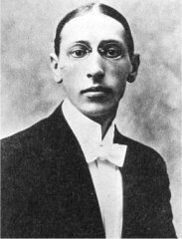
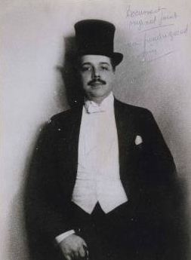
Stravinsky, Diaghilev,
and the Ballets russes

Slide 2
Stravinsky, The Firebird (1910) “Danse infernale”

Slide 3
Mikhail Glinka (1804-57)
St. Petersburg (folklore, Romantic nationalism)
Moscow (more cosmopolitan, “international”)
Original kuchka, ca. 1858-71:
Mily Balakirev (leader of “amateur composers”)
Nikolay Rimsky-Korsakov
Aleksandr Borodin
Modest Musorgsky
César Cui
(initially: anti-institutional; emphasis on Russia’s claim of difference from the West)
1860s, 1870s, early 1880s
Anton Rubinstein
Pyotr Il’yich Tchaikovsky (but “early Tchaikovsky”—1860s and early 1870s—had some ties to Balakirev and the folkloric school)
(pro-institutional; more “Westernizing”)

Slide 4
Mikhail Glinka (1804-57)
St. Petersburg (folklore, Romantic nationalism)
Moscow (more cosmopolitan, “international”)
Original kuchka, ca. 1858-71:
Mily Balakirev (leader of “amateur composers”)
Nikolay Rimsky-Korsakov
Aleksandr Borodin
Modest Musorgsky
César Cui
(initially: anti-institutional; emphasis on Russia’s claim of difference from the West)
1860s, 1870s, early 1880s
Anton Rubinstein
Pyotr Il’yich Tchaikovsky (but “early Tchaikovsky”—1860s and early 1870s—had some ties to Balakirev and the folkloric school)
(pro-institutional; more “Westernizing”)
1880s, 1890s, early 1900s: the “Belyaev Circle” in and around the St. Petersburg Conservatory:
Nikolay Rimsky-Korsakov (leader, now fully
professionalized)
Aleksandr Glazunov
Anatoly Lyadov
(formalization of the kuchka traditons: folklore,
“exotic” harmony, and orchestral color)
Igor Stravinsky
Sergey Prokofiev

Slide 5
Mikhail Glinka (1804-57)
St. Petersburg (folklore, Romantic nationalism)
Moscow (more cosmopolitan, “international”)
Original kuchka, ca. 1858-71:
Mily Balakirev (leader of “amateur composers”)
Nikolay Rimsky-Korsakov
Aleksandr Borodin
Modest Musorgsky
César Cui
(initially: anti-institutional; emphasis on Russia’s claim of difference from the West)
1860s, 1870s, early 1880s
Anton Rubinstein
Pyotr Il’yich Tchaikovsky (but “early Tchaikovsky”—1860s and early 1870s—had some ties to Balakirev and the folkloric school)
(pro-institutional; more “Westernizing”)
1880s, 1890s, early 1900s: the “Belyaev Circle” in and around the St. Petersburg Conservatory:
Nikolay Rimsky-Korsakov (leader, now fully
professionalized)
Aleksandr Glazunov
Anatoly Lyadov
(formalization of the kuchka traditons: folklore,
“exotic” harmony, and orchestral color)
1880s, 1890s, early 1900s
Centering around the Moscow Conservatory and much influenced by the “style of Tchaikovsky.”
Anton Arensky
Sergey Taneyev
(virtuosity; dazzling showmanship; high craft)
Igor Stravinsky
Sergey Prokofiev
Sergey Rachmaninoff
Aleksandr Skryabin

Slide 6
Mikhail Glinka (1804-57)
St. Petersburg (folklore, Romantic nationalism)
Moscow (more cosmopolitan, “international”)
Original kuchka, ca. 1858-71:
Mily Balakirev (leader of “amateur composers”)
Nikolay Rimsky-Korsakov
Aleksandr Borodin
Modest Musorgsky
César Cui
(initially: anti-institutional; emphasis on Russia’s claim of difference from the West)
1860s, 1870s, early 1880s
Anton Rubinstein
Pyotr Il’yich Tchaikovsky (but “early Tchaikovsky”—1860s and early 1870s—had some ties to Balakirev and the folkloric school)
(pro-institutional; more “Westernizing”)
1880s, 1890s, early 1900s: the “Belyaev Circle” in and around the St. Petersburg Conservatory:
Nikolay Rimsky-Korsakov (leader, now fully
professionalized)
Aleksandr Glazunov
Anatoly Lyadov
(formalization of the kuchka traditons: folklore,
“exotic” harmony, and orchestral color)
1880s, 1890s, early 1900s
Centering around the Moscow Conservatory and much influenced by the “style of Tchaikovsky.”
Anton Arensky
Sergey Taneyev
(virtuosity; dazzling showmanship; high craft)
Igor Stravinsky
Sergey Prokofiev
Sergey Rachmaninoff
Aleksandr Skryabin

Slide 7
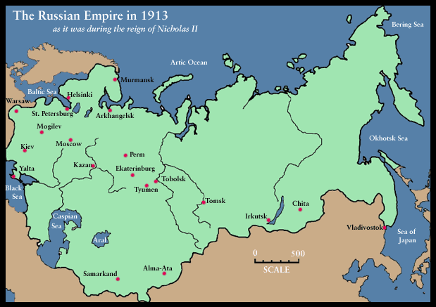

Slide 8
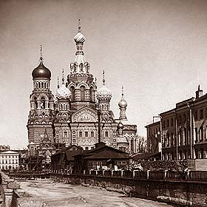
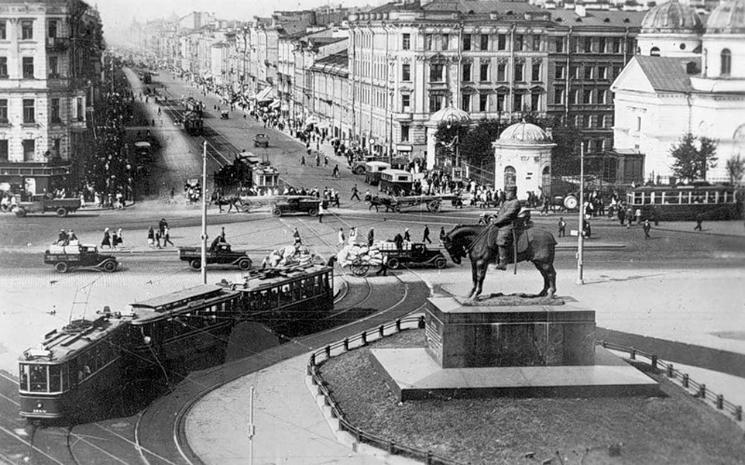
St. Petersburg, c. 1900

Slide 9
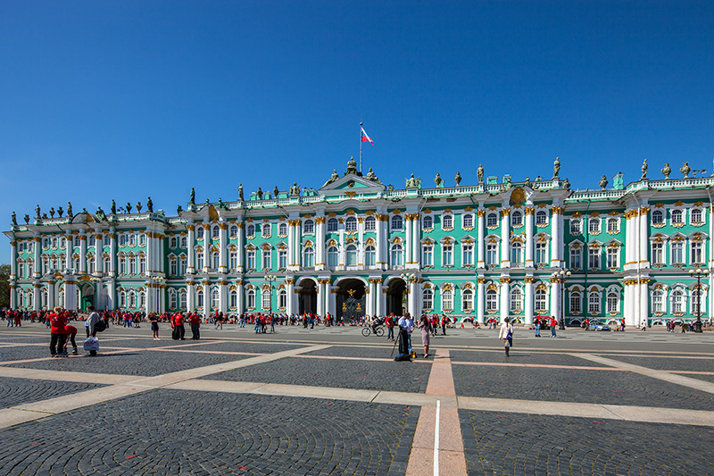
St. Petersburg, Winter Palace

Slide 10
St. Petersburg, Winter Palace, c. 1900

Slide 11
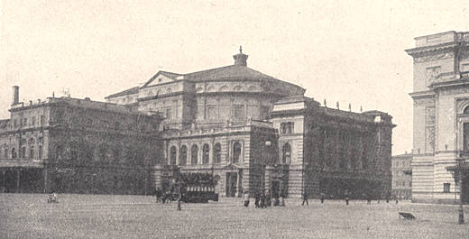
St. Petersburg, Imperial Opera House (Maryinsky Theater)

Slide 12
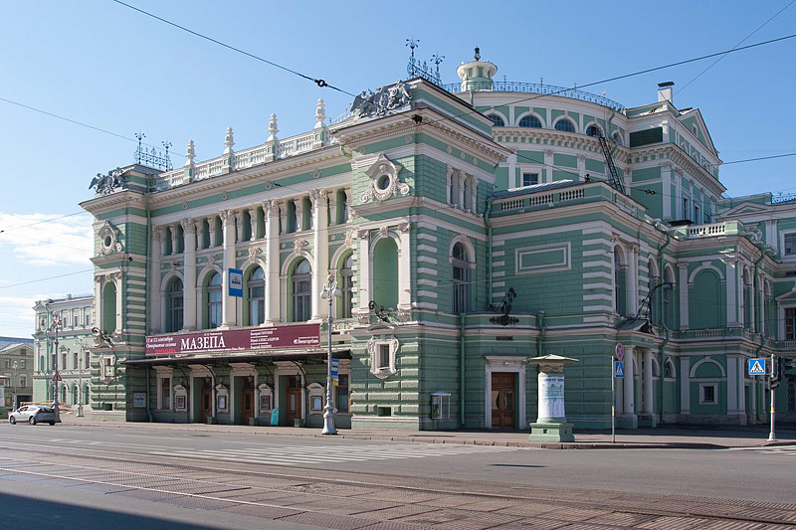
St. Petersburg, Imperial Opera House (Maryinsky Theater)

Slide 13
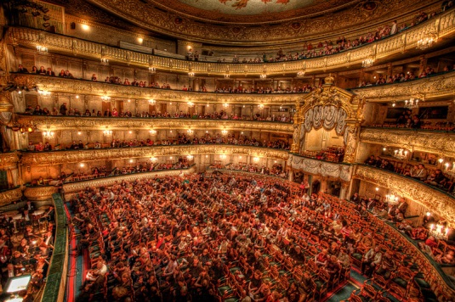
St. Petersburg, Imperial Opera House (Maryinsky Theater)

Slide 14
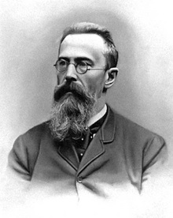
Nikolai Rimsky-Korsakov (1844-1908)

Slide 15
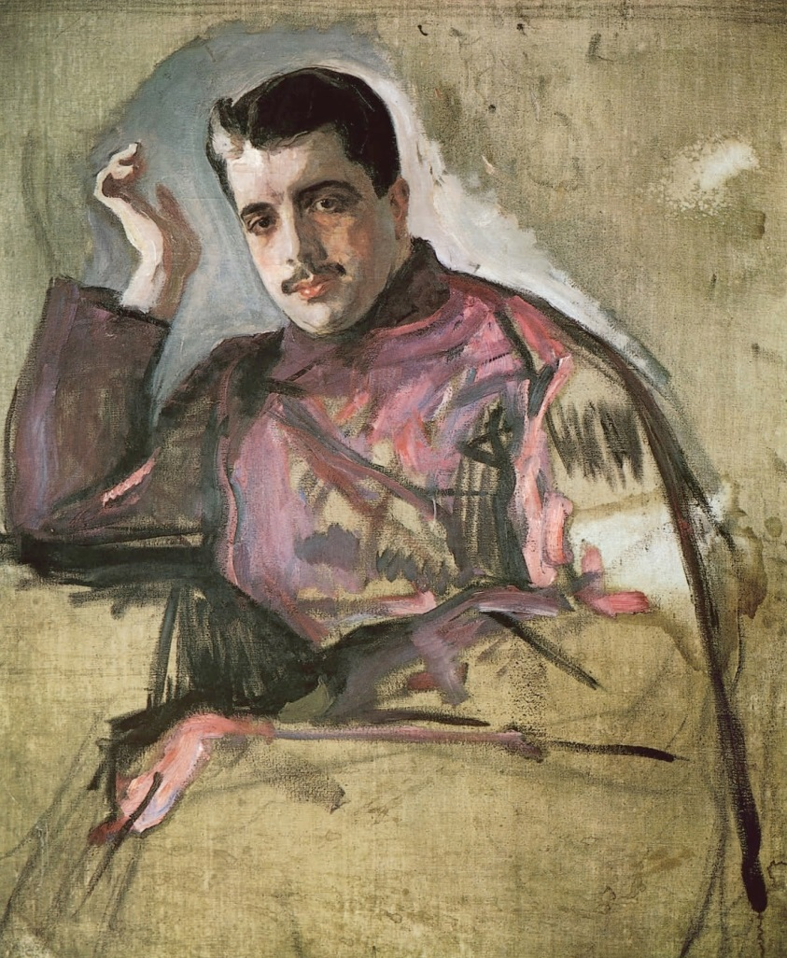
Sergey Diaghilev (Serov portrait, 1904)

Slide 16
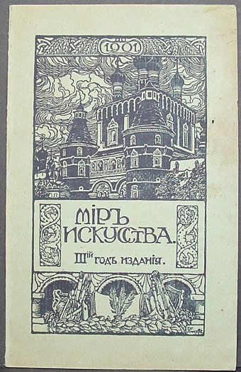
Sergey Diaghilev (Serov portrait, 1904)
Mir iskusstva (The World of Art)

Slide 17
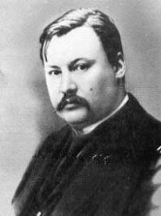
Nikolai Rimsky-Korsakov (1844-1908) Aleksandr Glazunov (1865-1936)

Slide 18
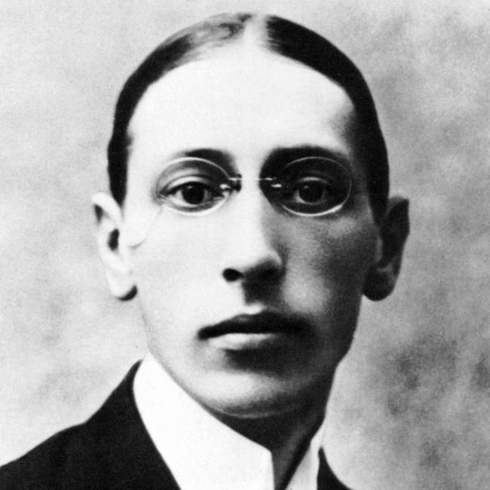
1903-08: Studies with Rimsky-Korsakov

Slide 19
1903-08: Studies with Rimsky-Korsakov
Stravinsky, Symphony in E-flat (1905-07, premiere 1908)

Slide 20
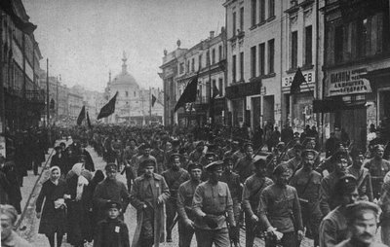
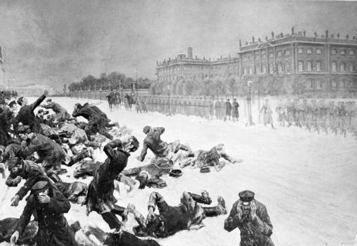
St. Petersburg—Revolution of 1905

Slide 21
St. Petersburg—Revolution of 1905
“Bloody Sunday”

Slide 22
1905 – Russian exhibition of portrait art
Sergey Diaghilev (Serov portrait, 1904)

Slide 23
1905 – Russian exhibition of portrait art
1906 – Paris! Exhibition of Russian painting
Sergey Diaghilev (Serov portrait, 1904)

Slide 24
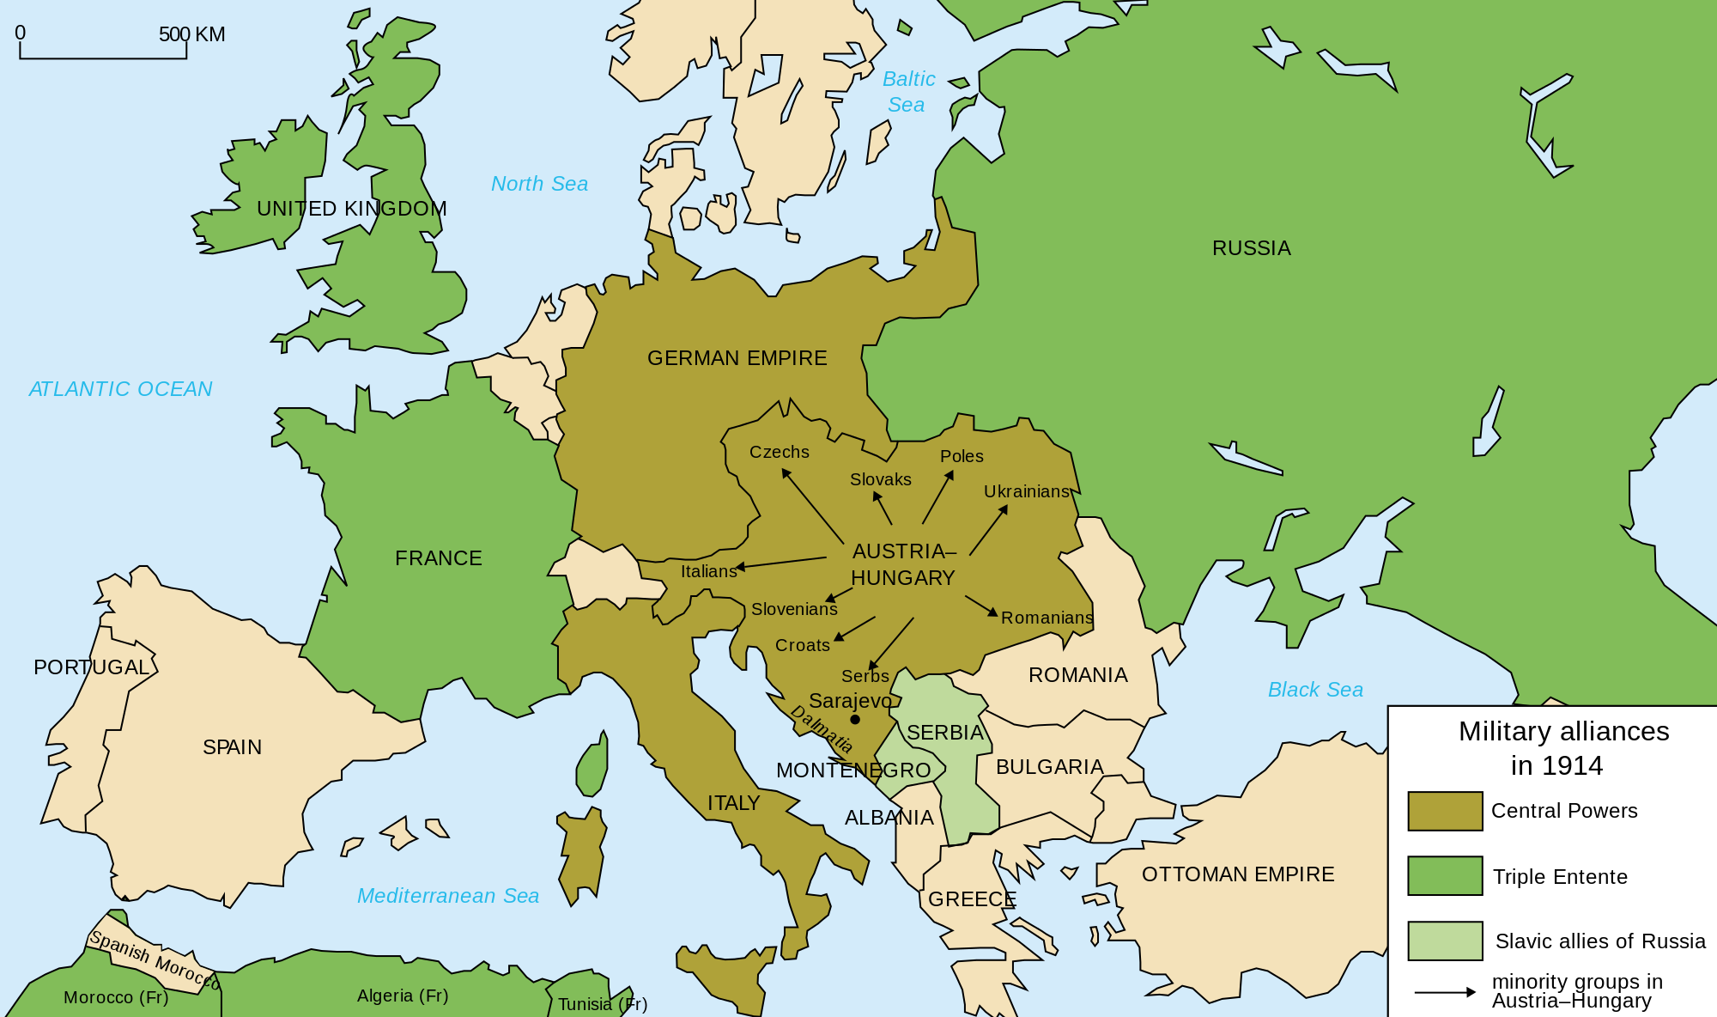
Triple Alliance / Triple Entente

Slide 25
1905 – Russian exhibition of portrait art
1906 – Paris! Exhibition of Russian painting
1907 – Paris! Art and music: five “historical concerts”
Sergey Diaghilev (Serov portrait, 1904)

Slide 26
1905 – Russian exhibition of portrait art
1906 – Paris! Exhibition of Russian painting
1907 – Paris! Art and music: five “historical concerts”
Sergey Diaghilev (Serov portrait, 1904)

Slide 27
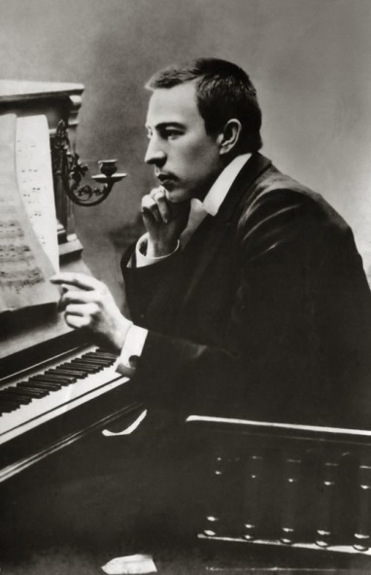
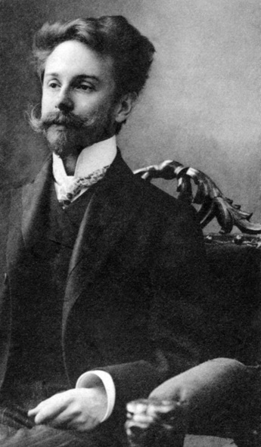
1905 – Russian exhibition of portrait art
1906 – Paris! Exhibition of Russian painting
1907 – Paris! Art and music: five “historical concerts”
Sergey Diaghilev (Serov portrait, 1904)
Rachmaninoff Skryabin

Slide 28
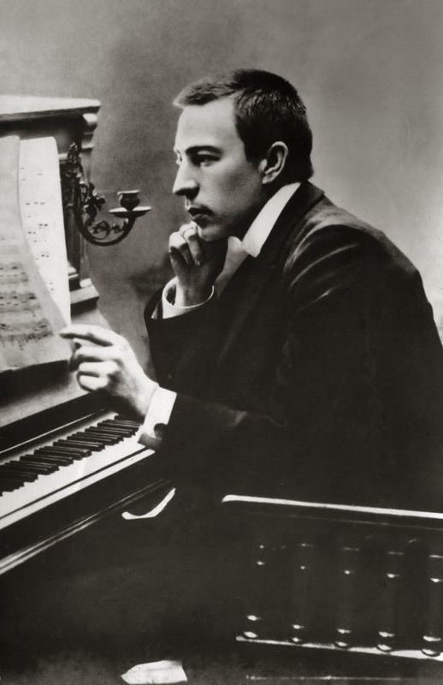
1905 – Russian exhibition of portrait art
1906 – Paris! Exhibition of Russian painting
1907 – Paris! Art and music: five “historical concerts”
Sergey Diaghilev (Serov portrait, 1904)

Slide 29
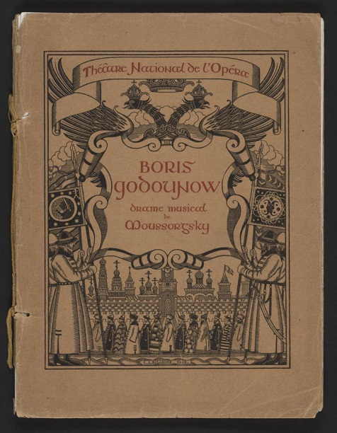
1905 – Russian exhibition of portrait art
1906 – Paris! Exhibition of Russian painting
1907 – Paris! Art and music: five “historical concerts”
1908 – Paris! Boris Godunov, complete, with Fyodor Chaliapin
Sergey Diaghilev (Serov portrait, 1904)

Slide 30
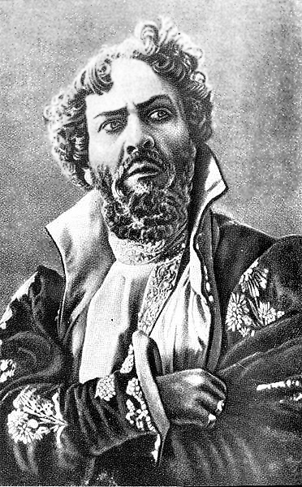
1905 – Russian exhibition of portrait art
1906 – Paris! Exhibition of Russian painting
1907 – Paris! Art and music: five “historical concerts”
1908 – Paris! Boris Godunov, complete, with Fyodor Chaliapin
Sergey Diaghilev (Serov portrait, 1904)

Slide 31
Paris, 1908
Fyodor Chaliapin [Shalyapin], 1911 recording of the Death Scene
from Boris Godunov

Slide 32
1905 – Russian exhibition of portrait art
1906 – Paris! Exhibition of Russian painting
1907 – Paris! Art and music: five “historical concerts”
1908 – Paris! Boris Godunov, complete, with Fyodor Chaliapin
1909 – Paris! More Russian operas (R-K, Ivan the Terrible; Glinka, Ruslan and Lyudmila; Borodin, Prince Igor)
Sergey Diaghilev (Serov portrait, 1904)

Slide 33
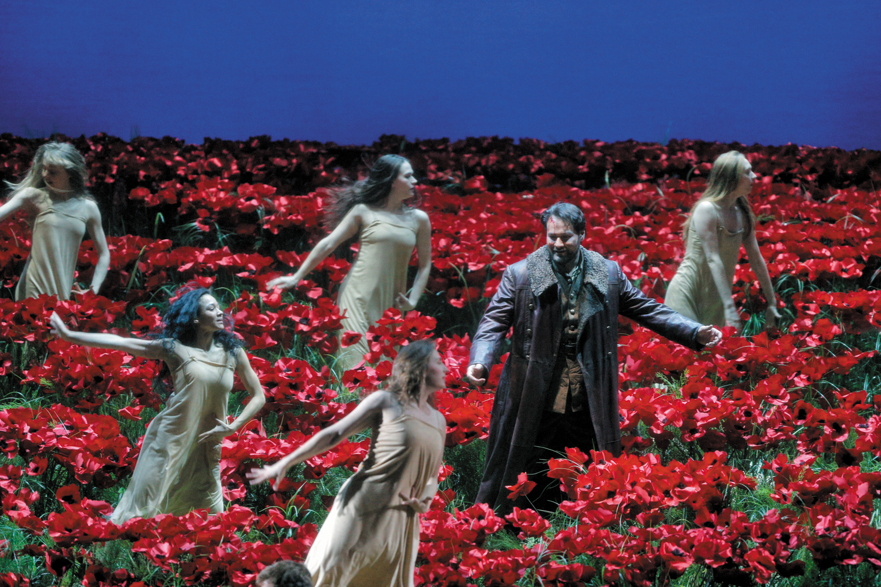
Borodin, Prince Igor: extract from the Polovtsian Dances (performed in Paris, 1909)

Slide 34
1905 – Russian exhibition of portrait art
1906 – Paris! Exhibition of Russian painting
1907 – Paris! Art and music: five “historical concerts”
1908 – Paris! Boris Godunov, complete, with Fyodor Chaliapin
1909 – Paris! More Russian operas (R-K, Ivan the Terrible; Glinka, Ruslan and Lyudmila; Borodin, Prince Igor)
. . . and . . . the Ballets russes!
Sergey Diaghilev (Serov portrait, 1904)

Slide 35
1905 – Russian exhibition of portrait art
1906 – Paris! Exhibition of Russian painting
1907 – Paris! Art and music: five “historical concerts”
1908 – Paris! Boris Godunov, complete, with Fyodor Chaliapin
1909 – Paris! More Russian operas (R-K, Ivan the Terrible; Glinka, Ruslan and Lyudmila; Borodin, Prince Igor)
. . . and . . . the Ballets russes!
Sergey Diaghilev (Serov portrait, 1904)
1910??

Slide 36
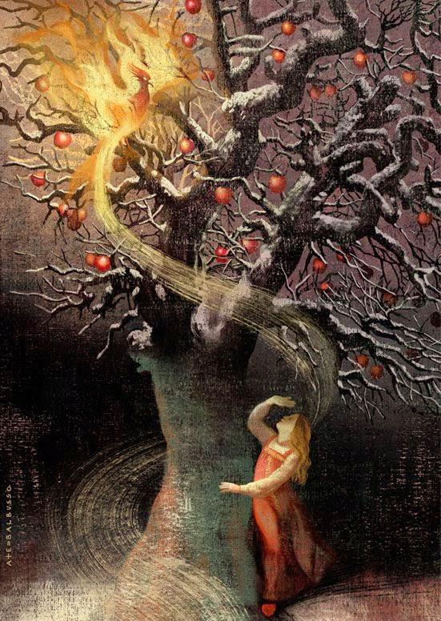
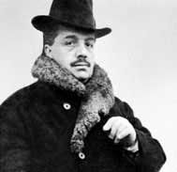
Fairy Tale:
Diaghilev
Zhar’-ptitsa (“The Firebird”)

Slide 37
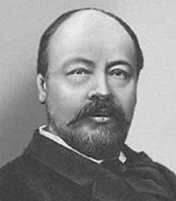
Diaghilev Anatoly Lyadov (1855-1914)

Slide 38
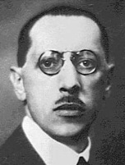
Diaghilev
Stravinsky

Slide 39
Stravinsky ballet: Zhar’-ptitsa (The Firebird; L’oiseau de feu)
Premiere, Paris: June 25, 1910

Slide 40
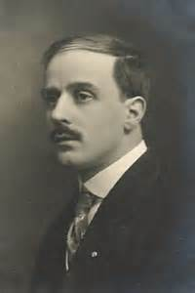
Stravinsky ballet: Zhar’-ptitsa (The Firebird; L’oiseau de feu)
Premiere, Paris: June 25, 1910
Choreography: Mikhail Fokine

Slide 41
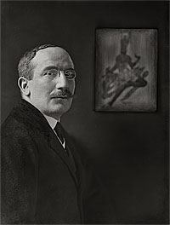
Stravinsky ballet: Zhar’-ptitsa (The Firebird; L’oiseau de feu)
Premiere, Paris: June 25, 1910
Choreography: Mikhail Fokine Costumes: Léon Bakst

Slide 42
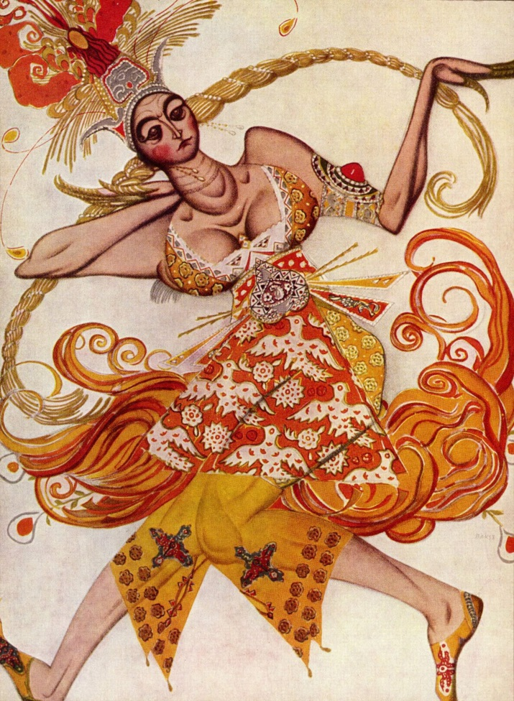
Stravinsky ballet: Zhar’-ptitsa (The Firebird; L’oiseau de feu)
Premiere, Paris: June 25, 1910
Ballerina Costume (Léon Bakst)

Slide 43
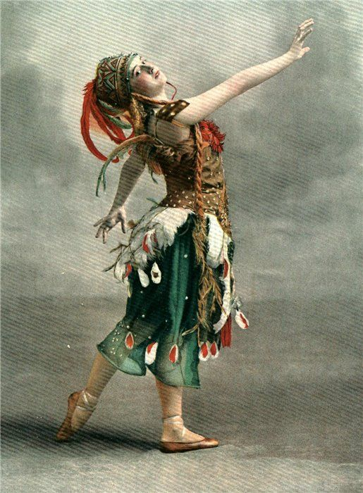
Stravinsky ballet: Zhar’-ptitsa (The Firebird; L’oiseau de feu)
Premiere, Paris: June 25, 1910
Tamara Karsavina

Slide 44
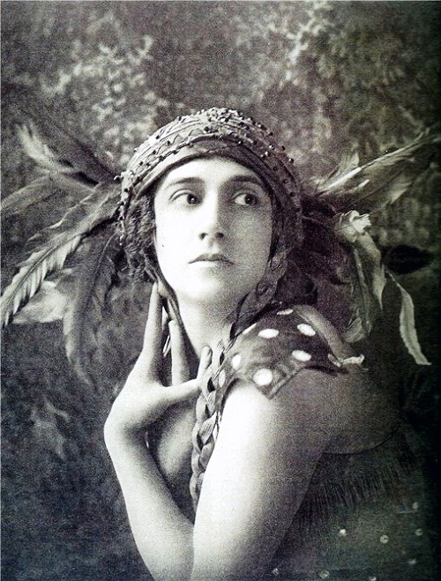
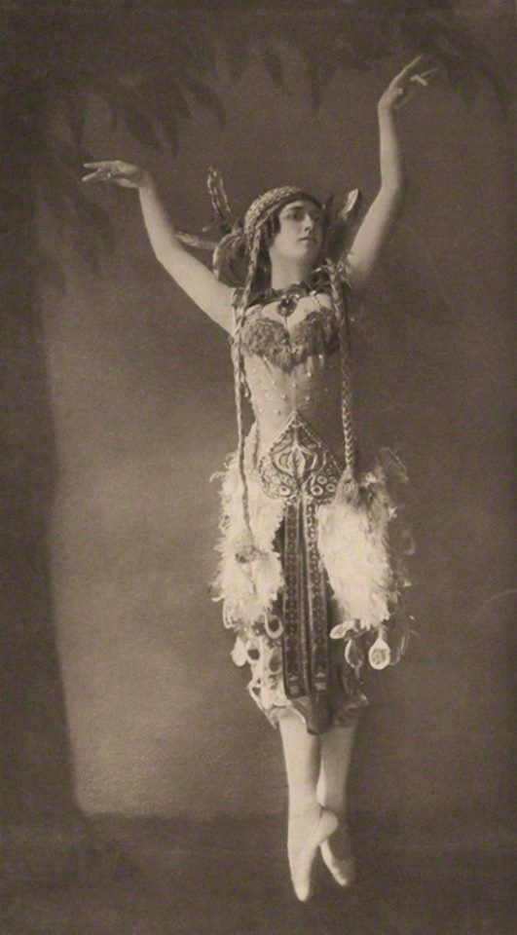
Stravinsky ballet: Zhar’-ptitsa (The Firebird; L’oiseau de feu)
Premiere, Paris: June 25, 1910
Tamara Karsavina

Slide 45
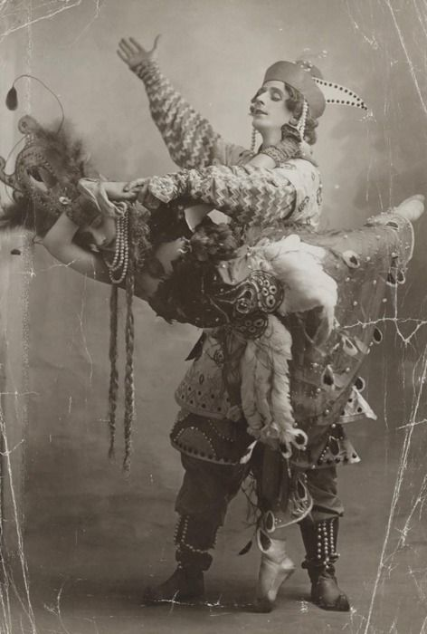
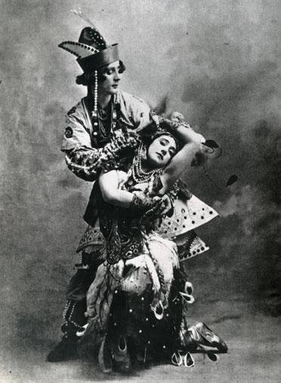
Stravinsky ballet: Zhar’-ptitsa (The Firebird; L’oiseau de feu)
Premiere, Paris: June 25, 1910
Michel Fokine, Tamara Karsavina

Slide 46
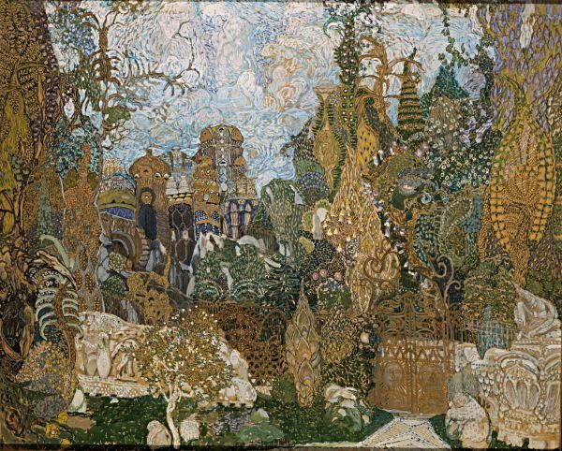
Stravinsky ballet: Zhar’-ptitsa (The Firebird; L’oiseau de feu)
Premiere, Paris: June 25, 1910
Kaschei’s Magic Garden
Stage Décor 1910: Aleksandr Golovin

Slide 47
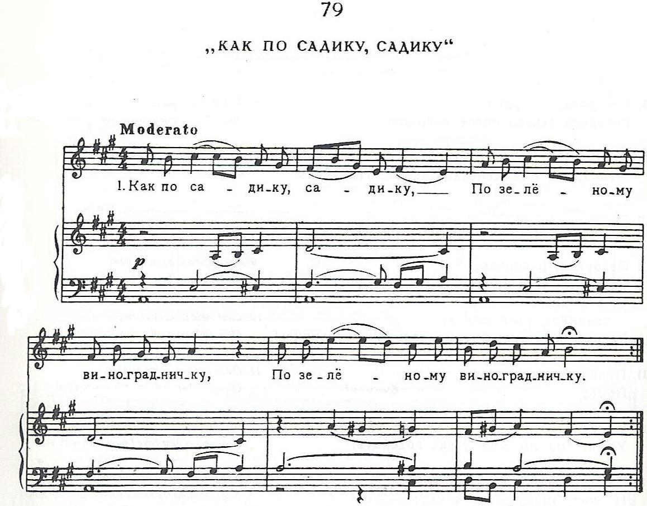
From Rimsky-Korsakov, 100 Russian Folk Songs (1876)

Slide 48
From Rimsky-Korsakov, 100 Russian Folk Songs (1876)
Intro from:

Slide 49
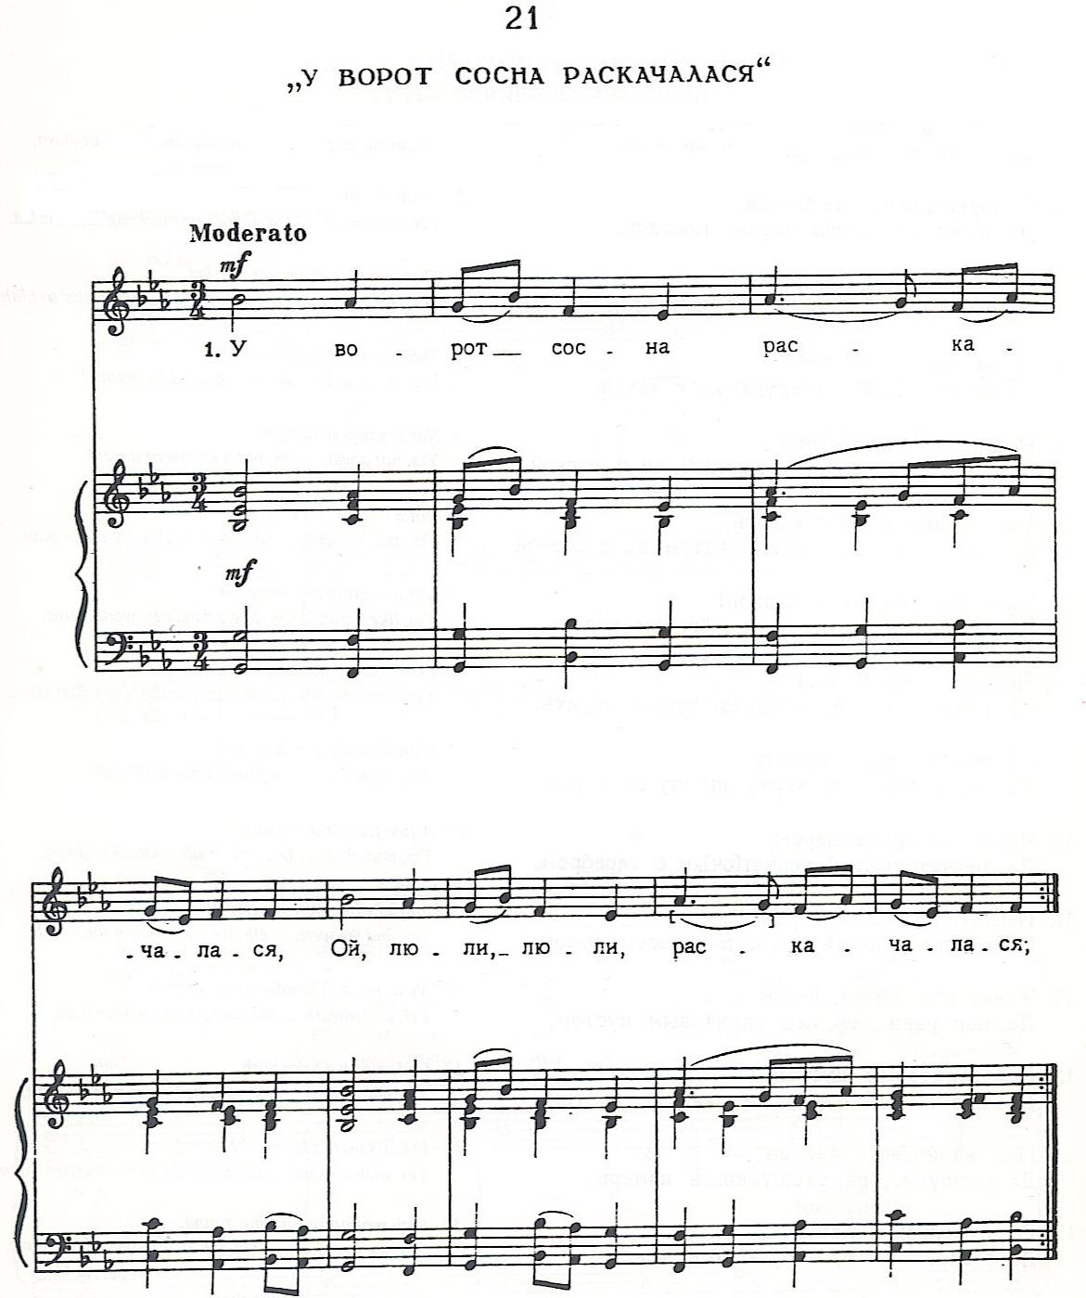
From Rimsky-Korsakov, 100 Russian Folk Songs (1876)

Slide 50
Russian musical tradition stemming from Glinka
Human characters: Supernatural characters/events:
Diatonic music Chromatic or artificial scales/collections

Slide 51
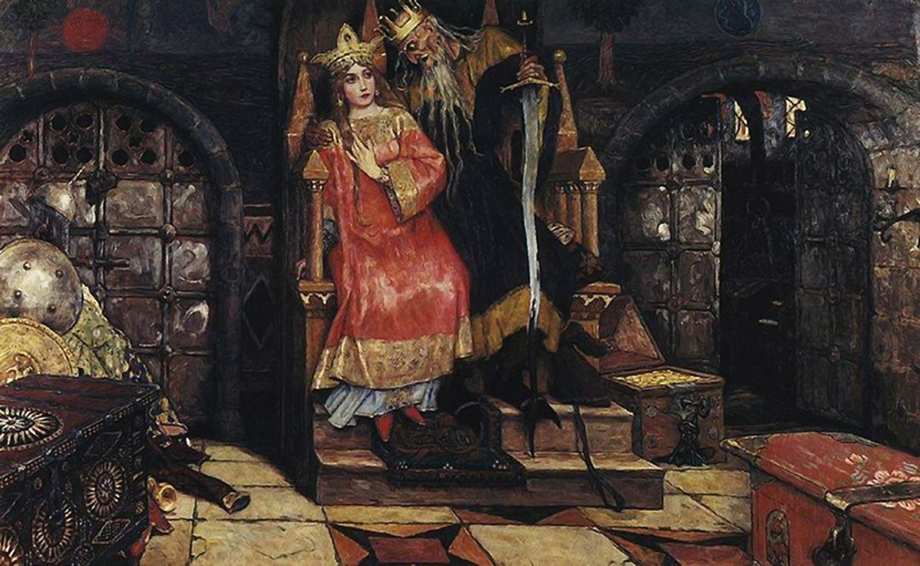
Stravinsky, Firebird, “Infernal Dance of King Kaschei”

Slide 52
Stravinsky, Firebird, “Infernal Dance of King Kaschei”
Sharp-cornered angularity

Slide 53
Stravinsky, Firebird, “Infernal Dance of King Kaschei”
Sharp-cornered angularity
The Stravinskian sforzando accent: !!

Slide 54
Stravinsky, Firebird, “Infernal Dance of King Kaschei”
Sharp-cornered angularity
The Stravinskian sforzando accent: !!
Octatonicism

Slide 55
Stravinsky, Firebird, “Infernal Dance of King Kaschei”
Sharp-cornered angularity
The Stravinskian sforzando accent: !!
Octatonicism
High-modernist “rewriting” of . . . . ?

Slide 56
Stravinsky, Firebird, “Infernal Dance of King Kaschei”
Sharp-cornered angularity
The Stravinskian sforzando accent: !!
Octatonicism
High-modernist “rewriting” of . . . . ?
(Tchaikovsky, Nutcracker, Act 1, “Drosselmeyer’s Presents”)

Slide 57
1905 – Russian exhibition of portrait art
1906 – Paris! Exhibition of Russian painting
1907 – Paris! Art and music: five “historical concerts”
1908 – Paris! Boris Godunov, complete, with Fyodor Chaliapin
1909 – Paris! More Russian operas (R-K, Ivan the Terrible; Glinka, Ruslan and Lyudmila; Borodin, Prince Igor) . . . and . . . the Ballets russes!
1910 – Paris: The Firebird!
1911??
Sergey Diaghilev (Serov portrait, 1904)

Slide 58
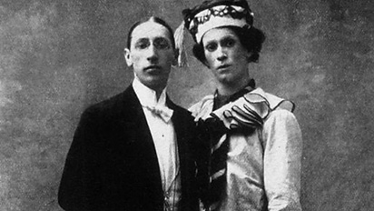
Stravinsky, Petrushka (1911)
Igor Stravinsky, Vaslav Nijinksy

Slide 59
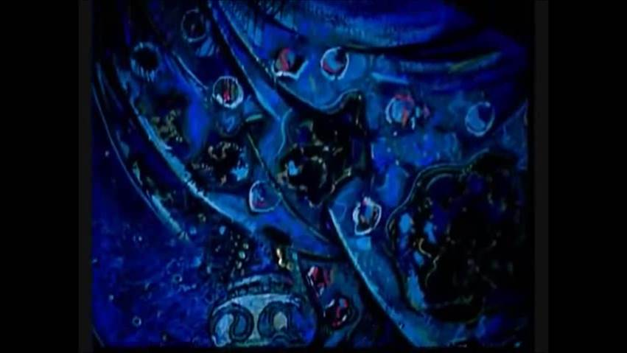
Stravinsky, Petrushka (1911): “Opening Scene ”
Recreation of the 1911 staging (Rudolf Nureyev)

Slide 60
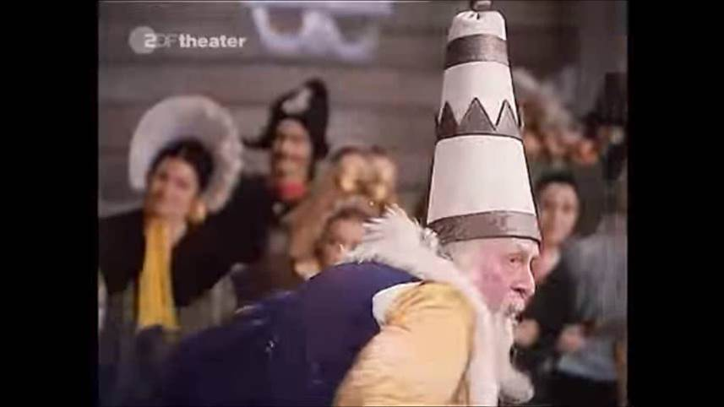
Stravinsky, Petrushka (1911): “Russian Dance”
Recreation of the 1911 staging (Rudolf Nureyev)

Slide 61
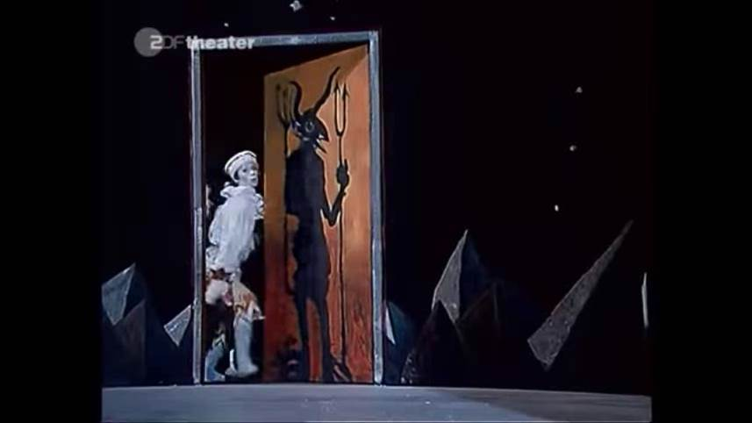
Stravinsky, Petrushka (1911): “Chez Petrouchka”
Recreation of the 1911 staging (Rudolf Nureyev)

Slide 62
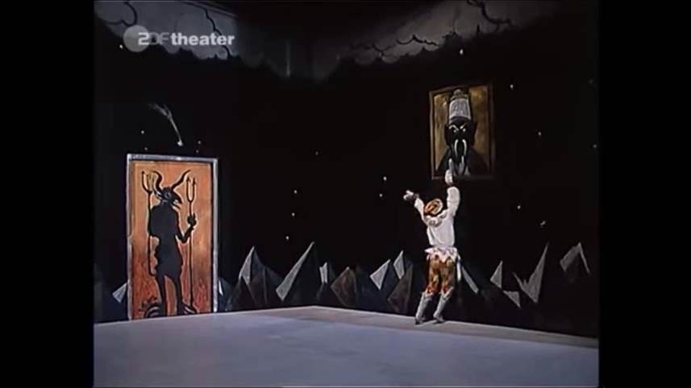
Stravinsky, Petrushka (1911): “Curses of Petrushka”
Recreation of the 1911 staging (Rudolf Nureyev)

