Slide 1
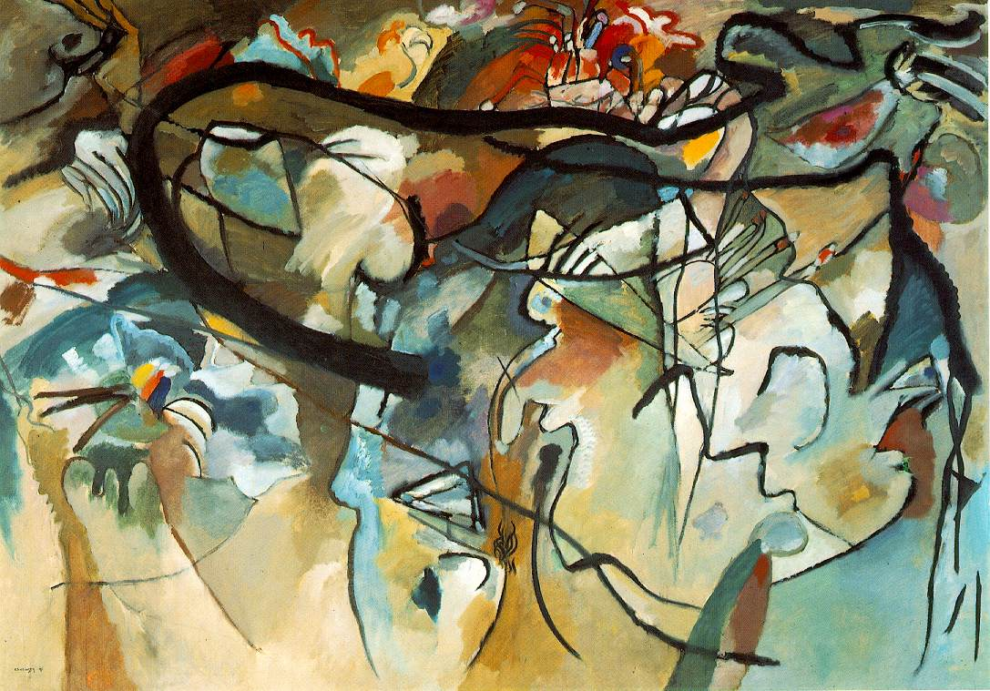
High Modernism, 1900-14
Wassily Kandinsky, Composition 5 (1911)

Slide 2
Early Modernism: The Generation of the 1860s
Janáček (1854)
Elgar (1857)
Puccini (1858)
Mahler (1860)
Wolf (1860)
Debussy (1862)
Delius (1862)
R. Strauss (1864)
Dukas (1865)
Glazunov (1865)
Nielsen (1865
Sibelius (1865)
Busoni (1866)
Satie (1866)

Slide 3
High Modernism: The Generation of the 1880s
Schoenberg (1874)
Berg (1881)
Webern (1882)
Scriabin (1872)
Stravinsky (1882)
Prokofiev (1891)
Bartók (1881)
Varèse (1883)

Slide 4
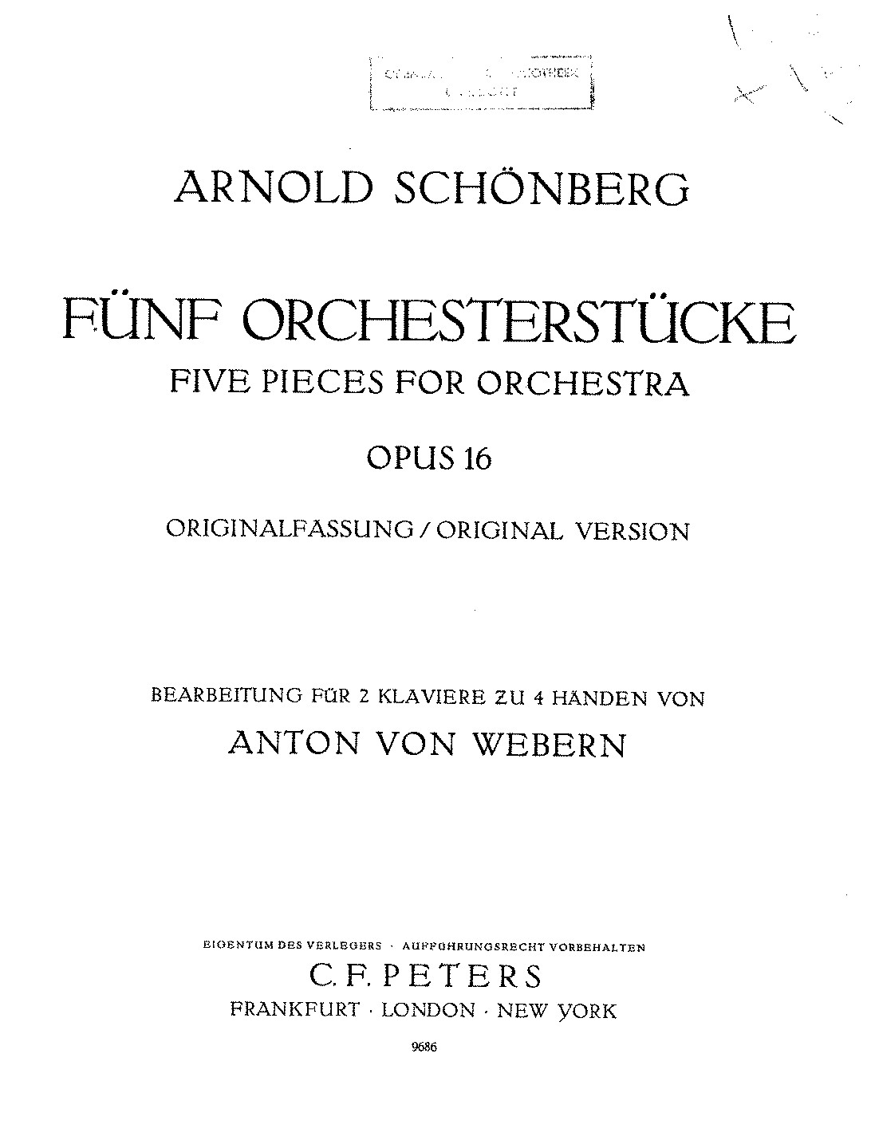
No. 1, “Vorgefühle”
(“Premonitions”)
1909

Slide 5
No. 3, “Farben”
(“Colors”)
1909

Slide 6
No. 3, “Farben”
(“Colors”)
Central aspect: the changing of orchestral tone colors, while holding much else relatively stable.
Demonstrates Klangfarbenmelodie:
“the ‘melody’ of tone colors”
1909

Slide 7
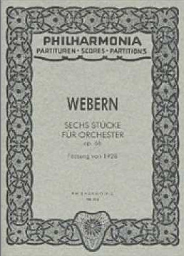
No. 1, Langsam
1909

Slide 8
High Modernism: The Generation of the 1880s
Schoenberg (1874)
Berg (1881)
Webern (1882)
Scriabin (1872)
Stravinsky (1882)
Prokofiev (1891)
Bartók (1881)
Varèse (1883)

Slide 9
The Demands of Historical “Progress”
(What is “the artwork of the future”?)
1909

Slide 10
Transitioning. . . .
Early Modernism
(“Generation of the 1860s”)
High Modernism
(into the 20th century)
By the 1890s, early 1900s:
Emergence of a fully formed Institution of Art Music—ordered and administered by bureaucracies
Postulate of originality: the demand for each composer to forge a unique sound or style in order to compete, to be noticed as a major player within the system
Ominpresent debates about the future of the tradition: what are the imperatives of “musical progress” in a new age?
Aesthetic encounters with the onrush of “real-world” technological modernity, scientific inquiries into acoustics and hearing, etc.
Dilemma: should one embrace the emerging technologized and administered world or offer a critique of it (or an escape from it)?

Slide 11
Transitioning. . . .
Early Modernism
(“Generation of the 1860s”)
“Late Romanticism”?
High Modernism
(into the 20th century)
The “New Music”
By the 1890s, early 1900s:
Emergence of a fully formed Institution of Art Music—ordered and administered by bureaucracies
Postulate of originality: the demand for each composer to forge a unique sound or style in order to compete, to be noticed as a major player within the system
Ominpresent debates about the future of the tradition: what are the imperatives of “musical progress” in a new age?
Aesthetic encounters with the onrush of “real-world” technological modernity, scientific inquiries into acoustics and hearing, etc.
Dilemma: should one embrace the emerging technologized and administered world or offer a critique of it (or an escape from it)?

Slide 12
High Modernism: The Generation of the 1880s
Schoenberg (1874)
Berg (1881)
Webern (1882)
Scriabin (1872)
Stravinsky (1882)
Prokofiev (1891)
Bartók (1881)
Varèse (1883)
Crucial modernist breakthroughs and challenges: 1909-13

Slide 13
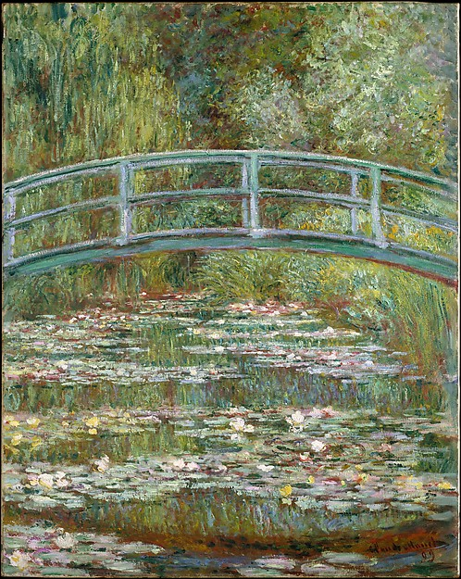
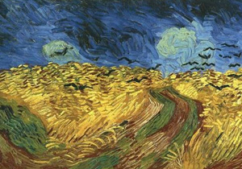
Monet van Gogh

Slide 14
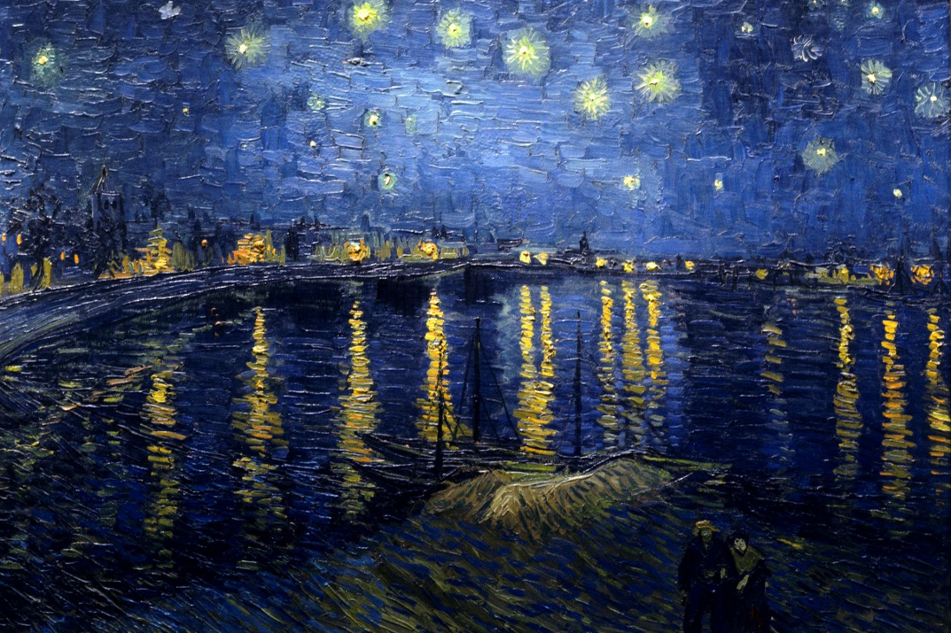
Van Gogh Munch

Slide 15
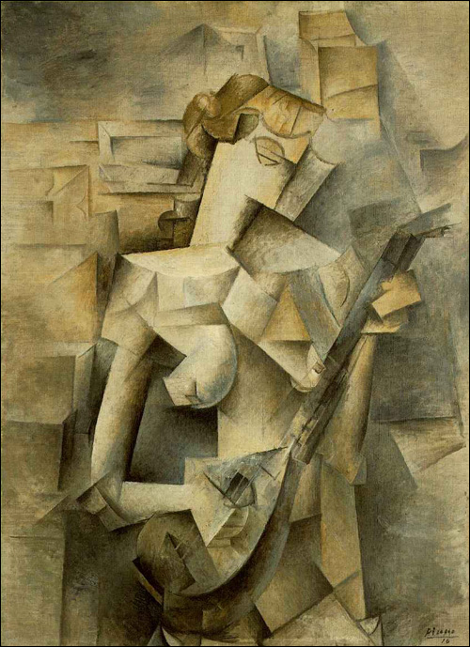
Picasso Matisse

Slide 16
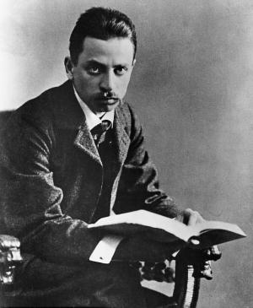
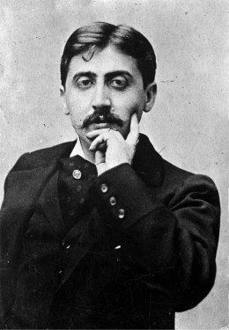
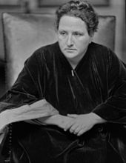
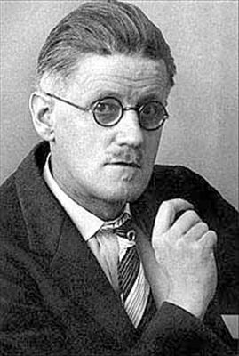
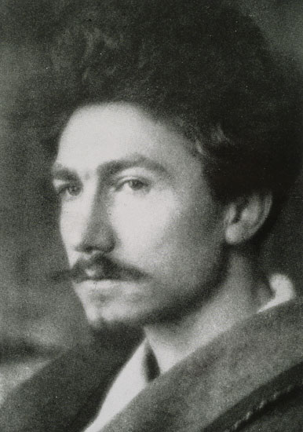
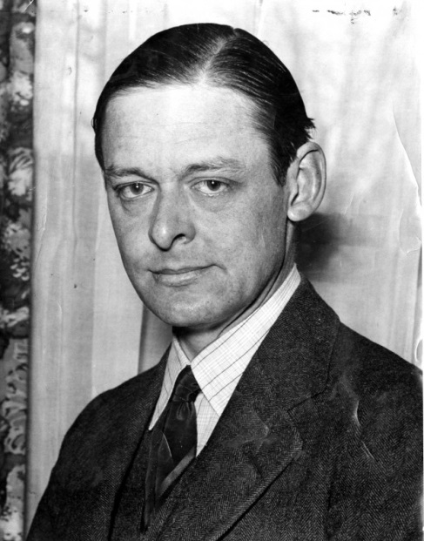
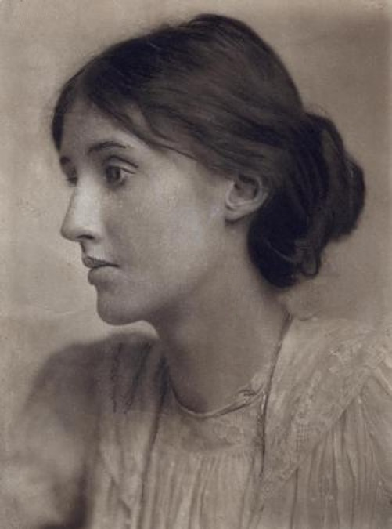
Rilke Kafka Proust Stein
Joyce Pound Eliot Woolf

Slide 17
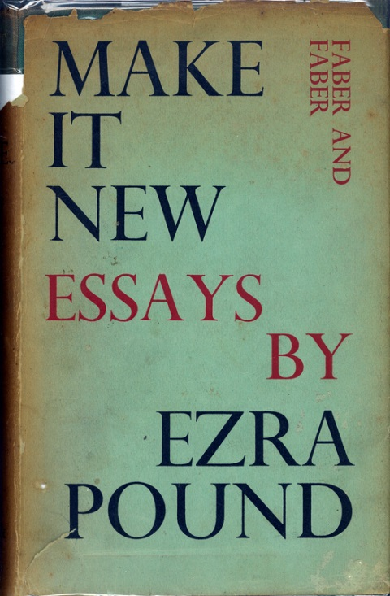
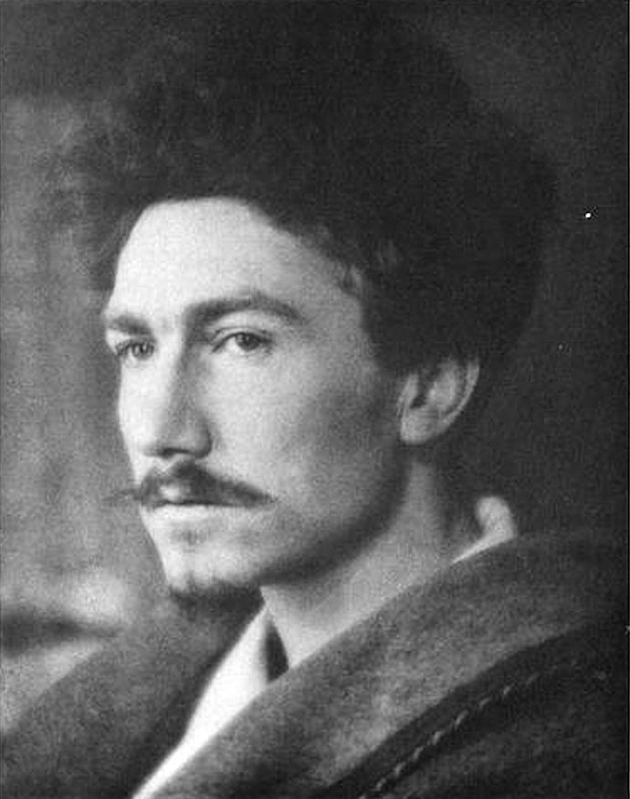

Slide 18
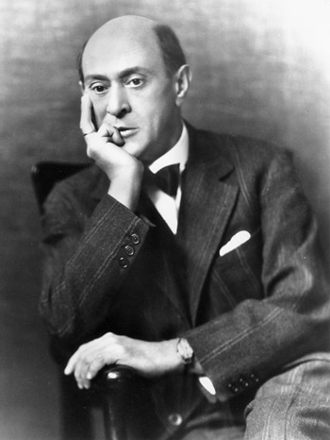
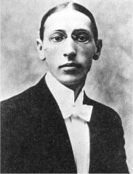
High Modernism in Music

Slide 19
High Modernism in Music
An even greater hypervirtuosity

Slide 20
High Modernism in Music
An even greater hypervirtuosity
The “emancipation of dissonance”

Slide 21
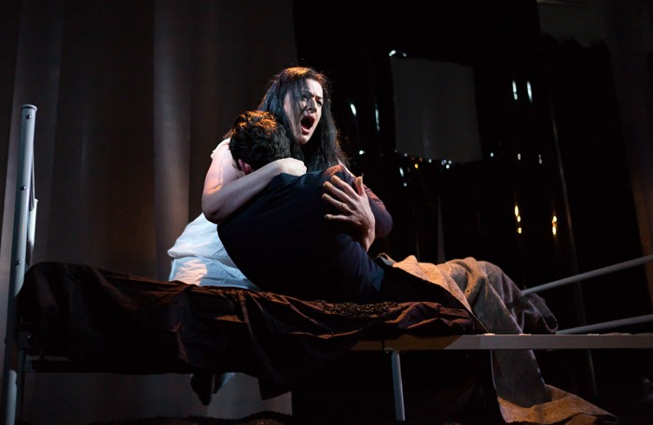
High Modernism in Music
An even greater hypervirtuosity
The “emancipation of dissonance”
Schoenberg, Erwartung, op. 17 (1909):
“Ist das noch der Weg?”

Slide 22
High Modernism in Music
An even greater hypervirtuosity
The “emancipation of dissonance”
Interruption/disruption of the traditional/institutional codes of past practice

Slide 23
High Modernism in Music
An even greater hypervirtuosity
The “emancipation of dissonance”
Interruption/disruption of the traditional/institutional codes of past practice
Schoenberg, Pierrot lunaire, op. 21 (1912): “Rote Messe”

Slide 24
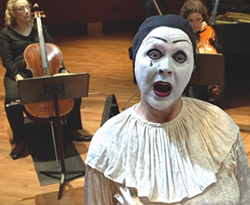
High Modernism in Music
An even greater hypervirtuosity
The “emancipation of dissonance”
Interruption/disruption of the traditional/institutional codes of past practice
Schoenberg, Pierrot lunaire, op. 21 (1912): “Rote Messe”

Slide 25
High Modernism in Music
An even greater hypervirtuosity
The “emancipation of dissonance”
Interruption/disruption of the traditional/institutional codes of past practice
Schoenberg, Pierrot lunaire, op. 21 (1912): “Rote Messe”
Not “singing” but Sprechstimme

Slide 26
High Modernism in Music
An even greater hypervirtuosity
The “emancipation of dissonance”
Interruption/disruption of the traditional/institutional codes of past practice
Thematic/tonal/structural distortions or deformations

Slide 27
High Modernism in Music
An even greater hypervirtuosity
The “emancipation of dissonance”
Interruption/disruption of the traditional/institutional codes of past practice
Thematic/tonal/structural distortions or deformations
Schoenberg, Pierrot lunaire, op. 21 (1912): “Mondfleck”

Slide 28
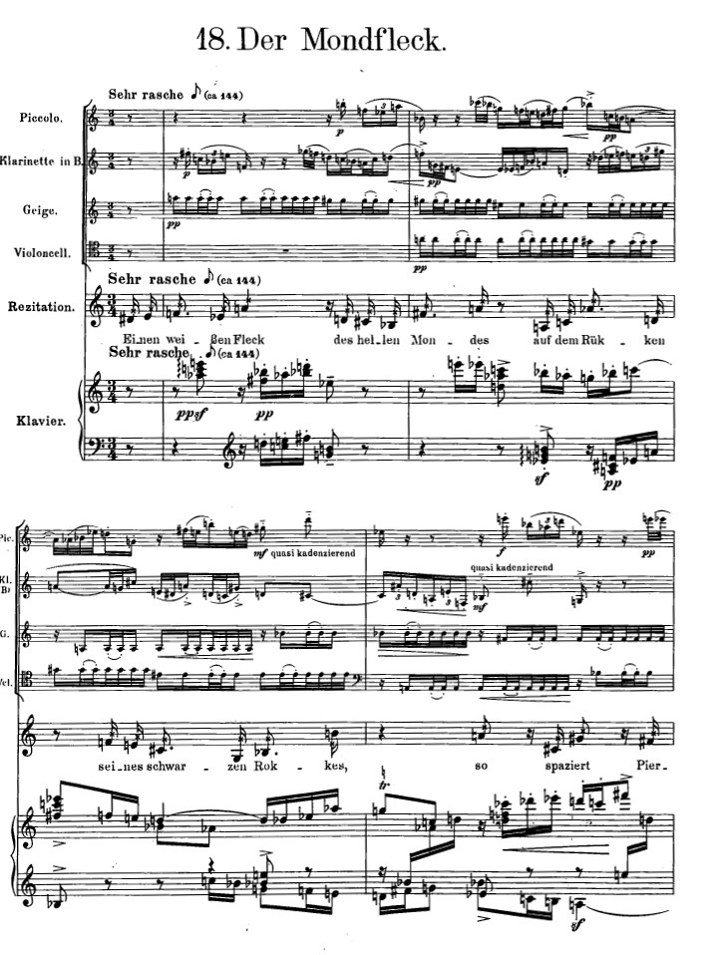
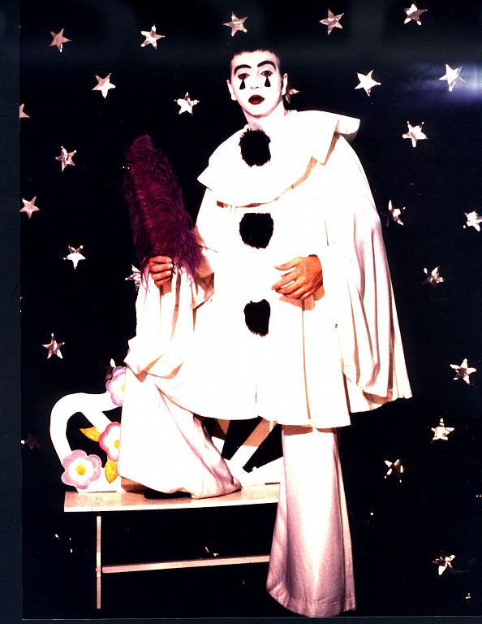
Sprechstimme

Slide 29
High Modernism in Music
An even greater hypervirtuosity
The “emancipation of dissonance”
Interruption/disruption of the traditional/institutional codes of past practice
Thematic/tonal/structural distortions or deformations
Emphatic claims of the arrival of a truer “authenticity” (implicit, pitiless denunciation of the urban-modern world “as it is”)—coupled with an argument of historical “inevitability”

Slide 30
High Modernism in Music
An even greater hypervirtuosity
The “emancipation of dissonance”
Interruption/disruption of the traditional/institutional codes of past practice
Thematic/tonal/structural distortions or deformations
Emphatic claims of the arrival of a truer “authenticity” (implicit, pitiless denunciation of the urban-modern world “as it is”)—coupled with an argument of historical “inevitability”
Search for more intensity of the moment—revelations of “sound itself”

Slide 31
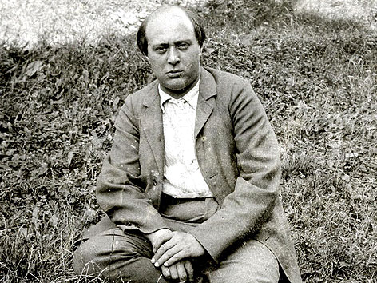
Arnold Schoenberg (1874-1951)

Slide 32
Maximize the claims of the two differing sides of music:
Emotional/spiritual (“heart”) Rational/technical (“mind”)
Essay, “Heart and Brain in Music” (1946)

Slide 33
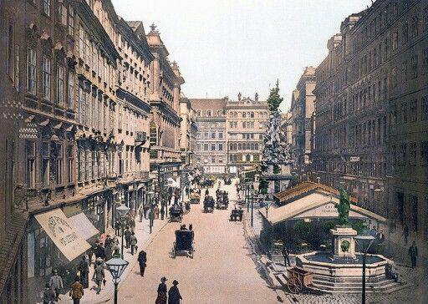
Vienna, 1890s

Slide 34
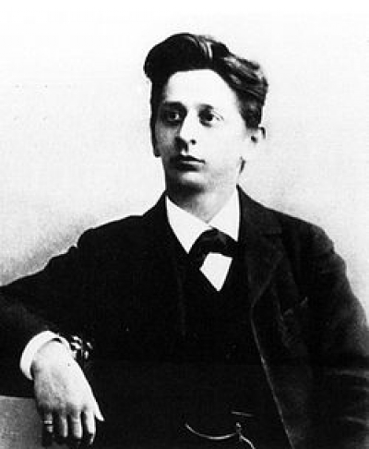
Arnold Schoenberg (1874-1951)
Alexander von Zemlinsky (1871-1942)

Slide 35
Vienna, 1890s

Slide 36
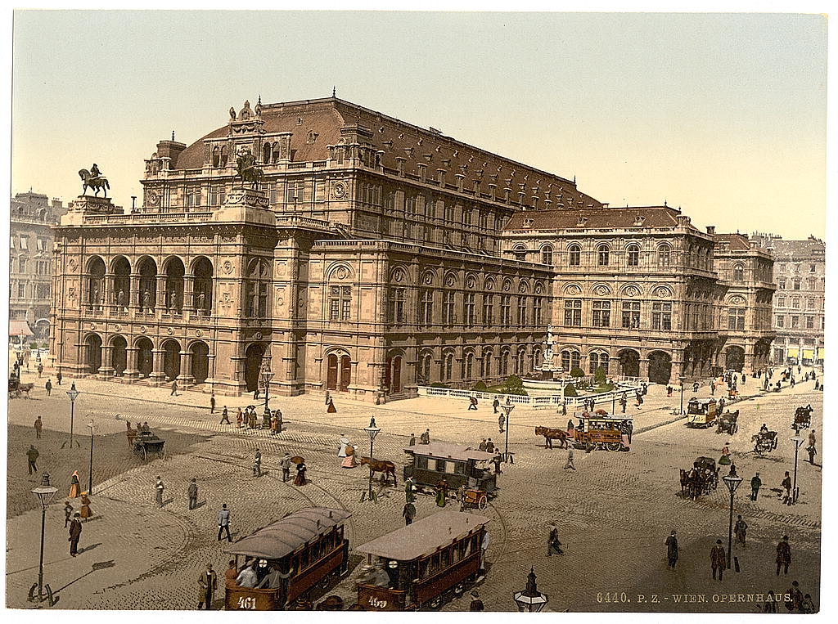
Vienna, 1890s

Slide 37
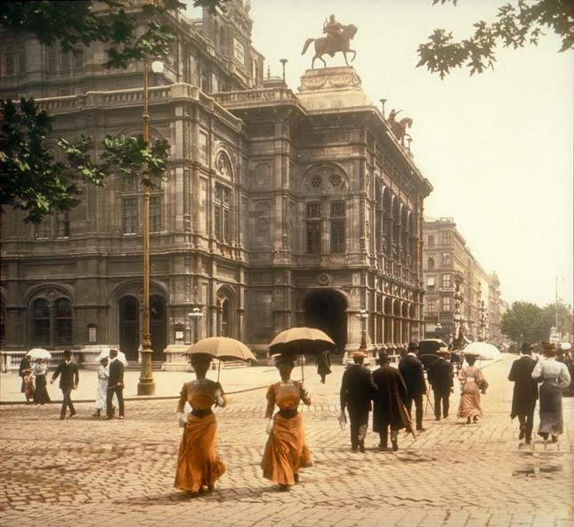
Vienna, 1890s

Slide 38
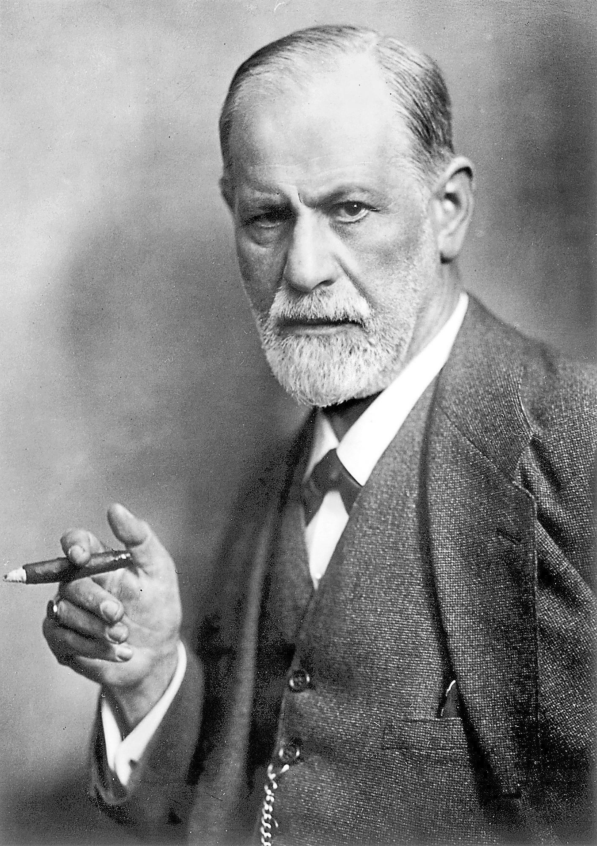
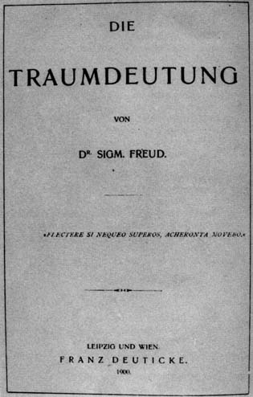

Slide 39
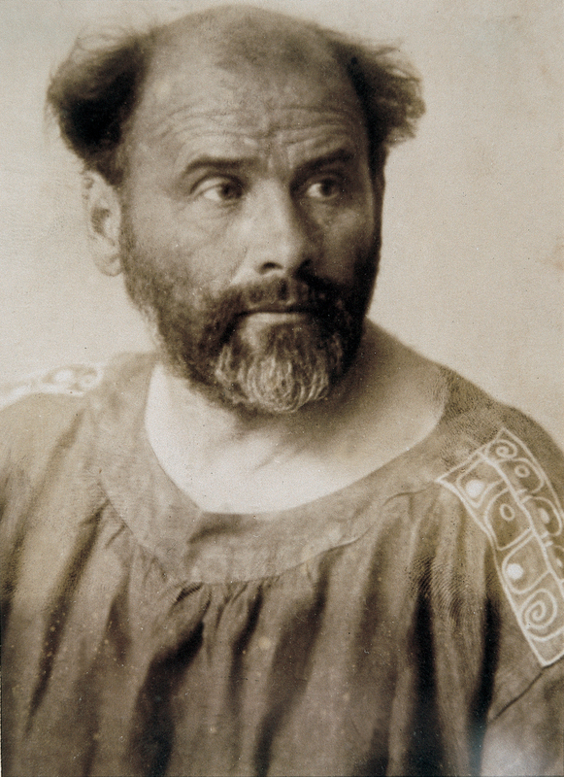
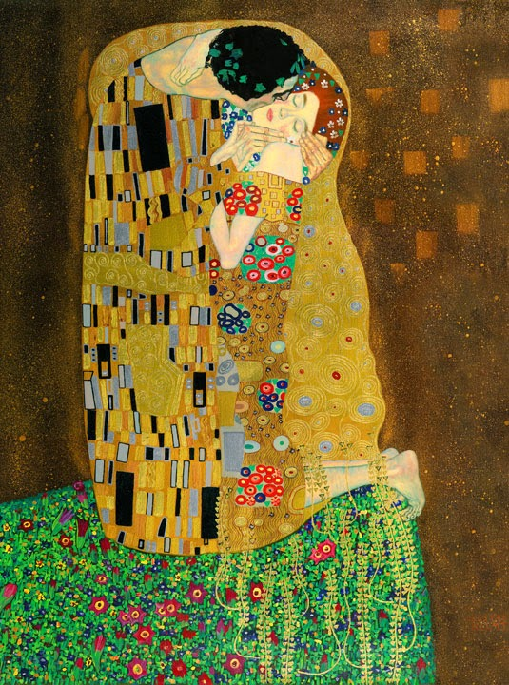
Gustav Klimt “The Kiss” (1907-08)

Slide 40
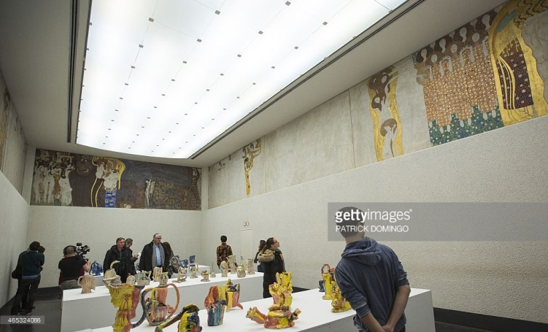
Gustav Klimt, Beethoven Frieze

Slide 41
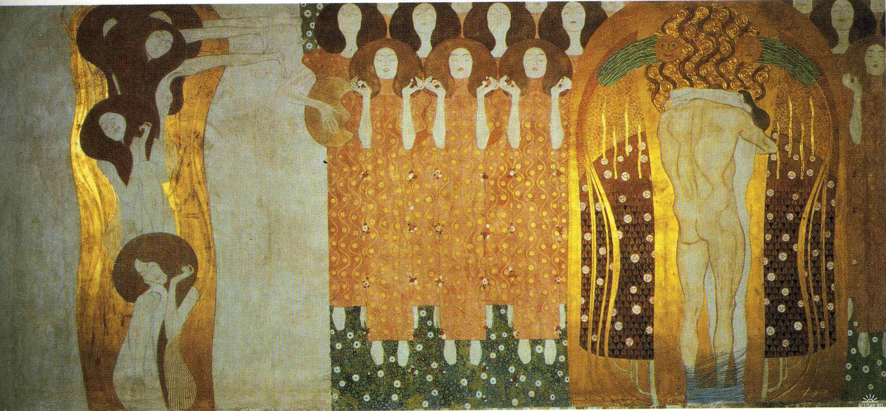
Gustav Klimt, Beethoven Frieze

Slide 42
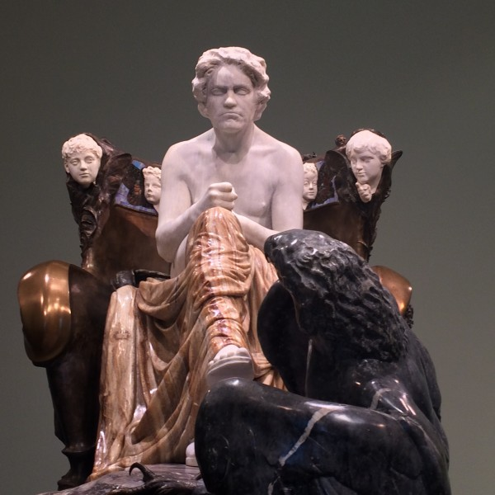
Max Klinger, Beethoven Monument. Displayed at the Vienna Secession Exhibition, 1902

Slide 43
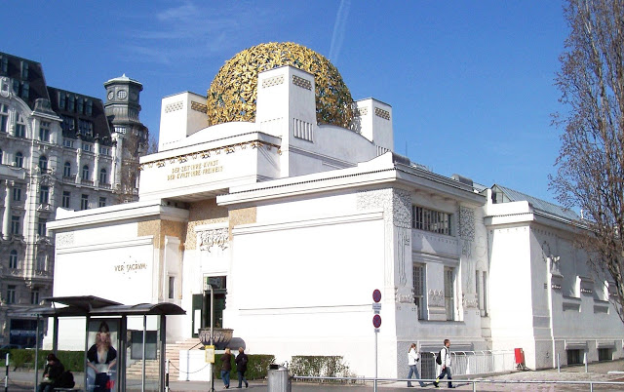
The Vienna Secession Building (1897)
"To every age its art, to every art its freedom"

Slide 44
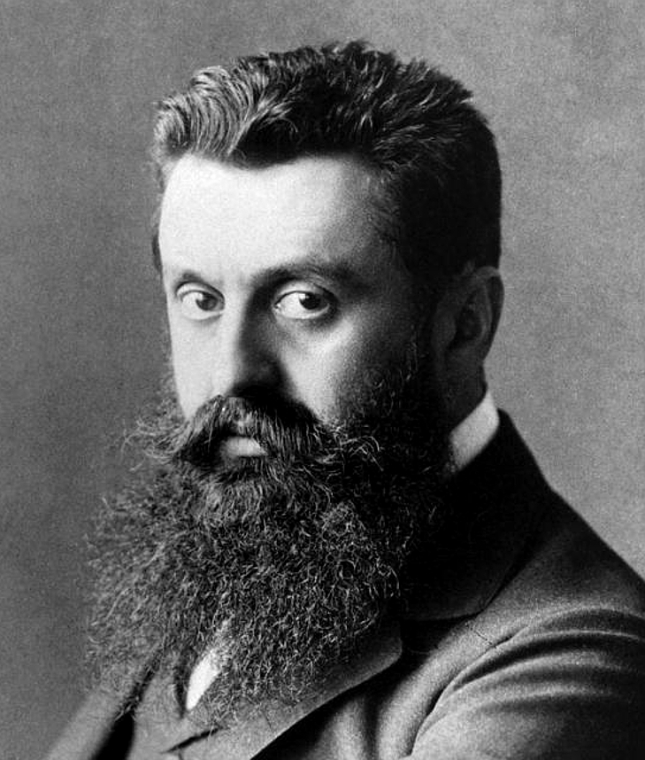
Theodor Herzl

Slide 45
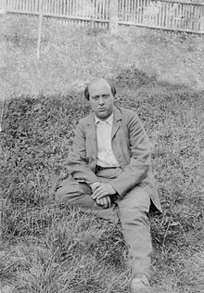
Arnold Schoenberg, 1903

Slide 46
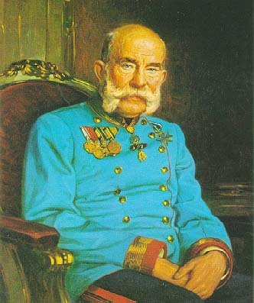
Hapsburg Emperor Franz-Josef
(reigned 1848-1916)

Slide 47
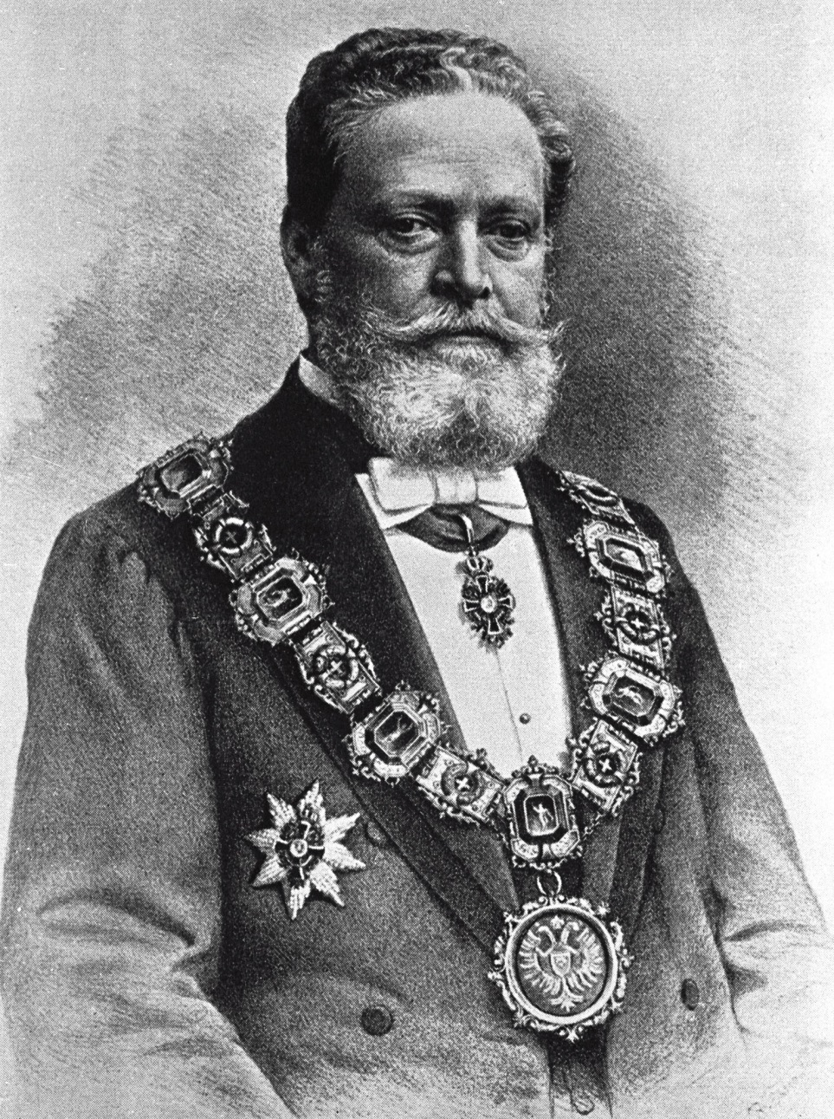
Karl Lueger (Mayor of Vienna, 1897-1910)

Slide 48
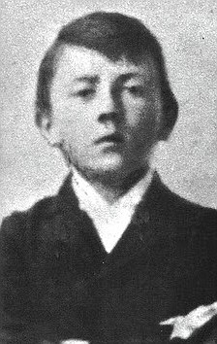
Karl Lueger (Mayor of Vienna, 1897-1910)

Slide 49
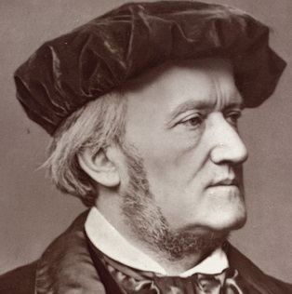
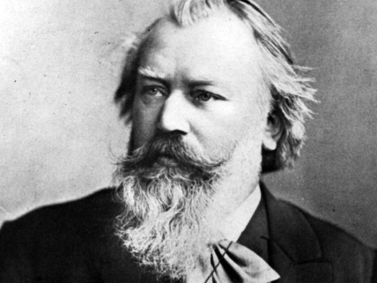
Schoenberg: Attempted Fusion of the Schismatic Extremes
Wagner
Brahms

Slide 50
Schoenberg: Attempted Fusion of the Schismatic Extremes
Wagner
Radical posture concerning music and the necessity of historical “progress”—challenge, even shock audiences with the insistence on inevitable, next step of historical change; no compromise
Brahms

Slide 51
Schoenberg: Attempted Fusion of the Schismatic Extremes
Wagner
Radical posture concerning music and the necessity of historical “progress”—challenge, even shock audiences with the insistence on inevitable, next step of historical change; no compromise
Harmonic and coloristic boldness
Brahms

Slide 52
Schoenberg: Attempted Fusion of the Schismatic Extremes
Wagner
Radical posture concerning music and the necessity of historical “progress”—challenge, even shock audiences with the insistence on inevitable, next step of historical change; no compromise
Harmonic and coloristic boldness
Extreme emotional states
Brahms

Slide 53
Schoenberg: Attempted Fusion of the Schismatic Extremes
Wagner
Radical posture concerning music and the necessity of historical “progress”—challenge, even shock audiences with the insistence on inevitable, next step of historical change; no compromise
Harmonic and coloristic boldness
Extreme emotional states
Composer as exalted “genius” or aesthetic leader with an established cult following
Brahms

Slide 54
Schoenberg: Attempted Fusion of the Schismatic Extremes
Wagner
Radical posture concerning music and the necessity of historical “progress”—challenge, even shock audiences with the insistence on inevitable, next step of historical change; no compromise
Harmonic and coloristic boldness
Extreme emotional states
Composer as exalted “genius” or aesthetic leader with an established cult following
Unquestioned superiority of
Austro-Germanic music—and
its spiritual or metaphysical basis
Brahms

Slide 55
Schoenberg: Attempted Fusion of the Schismatic Extremes
Wagner
Radical posture concerning music and the necessity of historical “progress”—challenge, even shock audiences with the insistence on inevitable, next step of historical change; no compromise
Harmonic and coloristic boldness
Extreme emotional states
Composer as exalted “genius” or aesthetic leader with an established cult following
Unquestioned superiority of
Austro-Germanic music—and
its spiritual or metaphysical basis
Etc.
Brahms

Slide 56
Schoenberg: Attempted Fusion of the Schismatic Extremes
Wagner
Radical posture concerning music and the necessity of historical “progress”—challenge, even shock audiences with the insistence on inevitable, next step of historical change; no compromise
Harmonic and coloristic boldness
Extreme emotional states
Composer as exalted “genius” or aesthetic leader with an established cult following
Unquestioned superiority of
Austro-Germanic music—and
its spiritual or metaphysical basis
Etc.
Brahms
High craftsmanship; total mastery of musical materials

Slide 57
Schoenberg: Attempted Fusion of the Schismatic Extremes
Wagner
Radical posture concerning music and the necessity of historical “progress”—challenge, even shock audiences with the insistence on inevitable, next step of historical change; no compromise
Harmonic and coloristic boldness
Extreme emotional states
Composer as exalted “genius” or aesthetic leader with an established cult following
Unquestioned superiority of
Austro-Germanic music—and
its spiritual or metaphysical basis
Etc.
Brahms
High craftsmanship; total mastery of musical materials
Closely knit counterpoint; music as a dense weave of theme and motive

Slide 58
Schoenberg: Attempted Fusion of the Schismatic Extremes
Wagner
Radical posture concerning music and the necessity of historical “progress”—challenge, even shock audiences with the insistence on inevitable, next step of historical change; no compromise
Harmonic and coloristic boldness
Extreme emotional states
Composer as exalted “genius” or aesthetic leader with an established cult following
Unquestioned superiority of
Austro-Germanic music—and
its spiritual or metaphysical basis
Etc.
Brahms
High craftsmanship; total mastery of musical materials
Closely knit counterpoint; music as a dense weave of theme and motive
“Organic construction”; the music proceeds as the growth and unfolding of small, generative motives (“developing variation”; music as a process of “musical logic”; music as “thought”)

Slide 59
Schoenberg: Attempted Fusion of the Schismatic Extremes
Wagner
Radical posture concerning music and the necessity of historical “progress”—challenge, even shock audiences with the insistence on inevitable, next step of historical change; no compromise
Harmonic and coloristic boldness
Extreme emotional states
Composer as exalted “genius” or aesthetic leader with an established cult following
Unquestioned superiority of
Austro-Germanic music—and
its spiritual or metaphysical basis
Etc.
Brahms
High craftsmanship; total mastery of musical materials
Closely knit counterpoint; music as a dense weave of theme and motive
“Organic construction”; the music proceeds as the growth and unfolding of small, generative motives (“developing variation”; music as a process of “musical logic”; music as “thought”)
Motivic interrelationships among the various themes and harmonies of a work; nothing is superfluous

Slide 60
Schoenberg: Attempted Fusion of the Schismatic Extremes
Wagner
Radical posture concerning music and the necessity of historical “progress”—challenge, even shock audiences with the insistence on inevitable, next step of historical change; no compromise
Harmonic and coloristic boldness
Extreme emotional states
Composer as exalted “genius” or aesthetic leader with an established cult following
Unquestioned superiority of
Austro-Germanic music—and
its spiritual or metaphysical basis
Etc.
Brahms
High craftsmanship; total mastery of musical materials
Closely knit counterpoint; music as a dense weave of theme and motive
“Organic construction”; the music proceeds as the growth and unfolding of small, generative motives (“developing variation”; music as a process of “musical logic”; music as “thought”)
Motivic interrelationships among the various themes and harmonies of a work; nothing is superfluous
Hence: a “systematic” approach to composition

Slide 61
Schoenberg: Attempted Fusion of the Schismatic Extremes
Wagner
Radical posture concerning music and the necessity of historical “progress”—challenge, even shock audiences with the insistence on inevitable, next step of historical change; no compromise
Harmonic and coloristic boldness
Extreme emotional states
Composer as exalted “genius” or aesthetic leader with an established cult following
Unquestioned superiority of
Austro-Germanic music—and
its spiritual or metaphysical basis
Etc.
Brahms
High craftsmanship; total mastery of musical materials
Closely knit counterpoint; music as a dense weave of theme and motive
“Organic construction”; the music proceeds as the growth and unfolding of small, generative motives (“developing variation”; music as a process of “musical logic”; music as “thought”)
Motivic interrelationships among the various themes and harmonies of a work; nothing is superfluous
Hence: a “systematic” approach to composition
Etc.

Slide 62
Verklärte Nacht (1899) -- sextet
Gurrelieder (1901-02) – massive “cantata”
Pelléas et Mélisande (1903) – tone poem
String Quartet, op. 7 (1904-05)
Chamber Symphony (1906)
String Quartet No. 2 (1907-08)
The Book of the Hanging Gardens
(1908-09)—song cycle
Three Piano Pieces, op. 11 (1909)
Five Pieces for Orchestra, op. 16 (1909)
Erwartung, op. 17 (1909) –”monodrama)
Pierrot lunaire, op. 21 (1912)

Slide 63
Verklärte Nacht (1899) -- sextet
Gurrelieder (1901-02) – massive “cantata”
Pelléas et Mélisande (1903) – tone poem
String Quartet, op. 7 (1904-05)
Chamber Symphony (1906)
String Quartet No. 2 (1907-08)
The Book of the Hanging Gardens
(1908-09)—song cycle
Three Piano Pieces, op. 11 (1909)
Five Pieces for Orchestra, op. 16 (1909)
Erwartung, op. 17 (1909) –”monodrama)
Pierrot lunaire, op. 21 (1912)
“Tonal”
“Transitional”
“Atonal”

Slide 64
Verklärte Nacht (1899) -- sextet
Gurrelieder (1901-02) – massive “cantata”
Pelléas et Mélisande (1903) – tone poem
String Quartet, op. 7 (1904-05)
Chamber Symphony (1906)
String Quartet No. 2 (1907-08)
The Book of the Hanging Gardens
(1908-09)—song cycle
Three Piano Pieces, op. 11 (1909)
Five Pieces for Orchestra, op. 16 (1909)
Erwartung, op. 17 (1909) –”monodrama)
Pierrot lunaire, op. 21 (1912)
“Tonal”
“Transitional”
“Atonal”

Slide 65
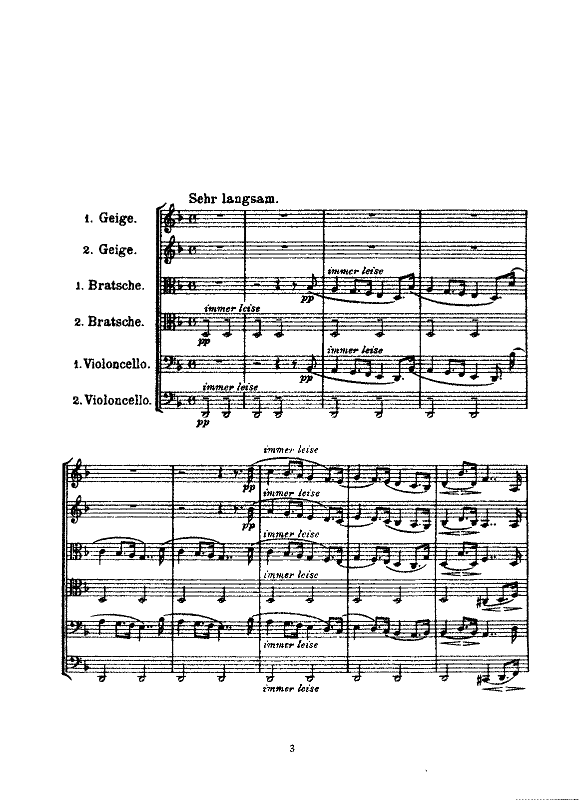
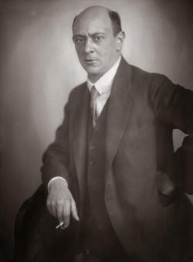
Verklärte Nacht, op. 4 (1899)

Slide 66
Verklärte Nacht (1899) -- sextet
Gurrelieder (1901-02) – massive “cantata”
Pelléas et Mélisande (1903) – tone poem
String Quartet, op. 7 (1904-05)
Chamber Symphony (1906)
String Quartet No. 2 (1907-08)
The Book of the Hanging Gardens
(1908-09)—song cycle
Three Piano Pieces, op. 11 (1909)
Five Pieces for Orchestra, op. 16 (1909)
Erwartung, op. 17 (1909) –”monodrama)
Pierrot lunaire, op. 21 (1912)
“Tonal”
“Transitional”
“Atonal”

Slide 67
Harmonic/Chordal Options, c. 1900
Diatonic
Alternative Color-Options
Major-Minor Modal Pentatonic Hexatonic Octatonic Whole-tone
(or other artificial collections, such as
the “acoustic” collection, #4, flat 7)

Slide 68
Harmonic/Chordal Options, c. 1900-1914
Diatonic
Alternative Color-Options
Major-Minor Modal Pentatonic Hexatonic Octatonic Whole-tone Non-triadic
“Atonal”
(or other artificial collections, such as
the “acoustic” collection, #4, flat 7)

Slide 69
Harmonic/Chordal Options, c. 1900-1914
Aesthetic flights from the ordinary, the everyday
Diatonic
Alternative Color-Options
Major-Minor Modal Pentatonic Hexatonic Octatonic Whole-tone Non-triadic
“Atonal”
(or other artificial collections, such as
the “acoustic” collection, #4, flat 7)

Slide 70
Verklärte Nacht (1899) -- sextet
Gurrelieder (1901-02) – massive “cantata”
Pelléas et Mélisande (1903) – tone poem
String Quartet, op. 7 (1904-05)
Chamber Symphony (1906)
String Quartet No. 2 (1907-08)
The Book of the Hanging Gardens
(1908-09)—song cycle
Three Piano Pieces, op. 11 (1909)
Five Pieces for Orchestra, op. 16 (1909)
Erwartung, op. 17 (1909) –”monodrama)
Pierrot lunaire, op. 21 (1912)
“Tonal”
“Transitional”
“Atonal”

Slide 71
Verklärte Nacht (1899) -- sextet
Gurrelieder (1901-02) – massive “cantata”
Pelléas et Mélisande (1903) – tone poem
String Quartet, op. 7 (1904-05)
Chamber Symphony (1906)
String Quartet No. 2 (1907-08)
The Book of the Hanging Gardens
(1908-09)—song cycle
Three Piano Pieces, op. 11 (1909)
Five Pieces for Orchestra, op. 16 (1909)
Erwartung, op. 17 (1909) –”monodrama)
Pierrot lunaire, op. 21 (1912)
“Tonal”
“Transitional”
“Atonal”

Slide 72
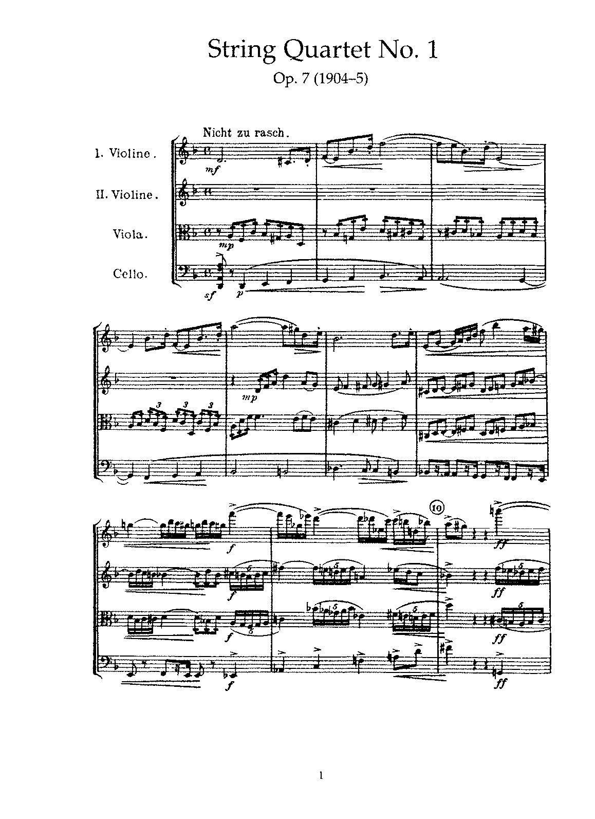

Slide 73
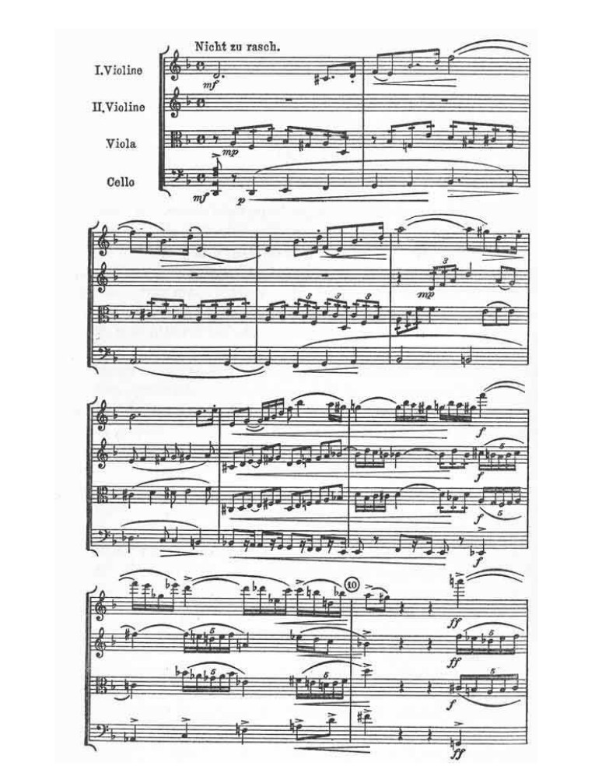
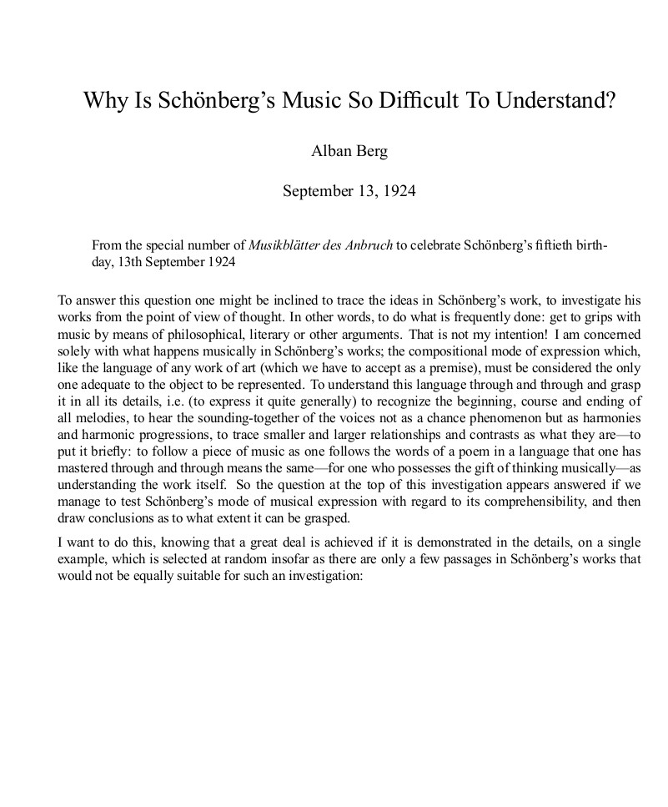

Slide 76
Verklärte Nacht (1899) -- sextet
Gurrelieder (1901-02) – massive “cantata”
Pelléas et Mélisande (1903) – tone poem
String Quartet, op. 7 (1904-05)
Chamber Symphony (1906)
String Quartet No. 2 (1907-08)
The Book of the Hanging Gardens
(1908-09)—song cycle
Three Piano Pieces, op. 11 (1909)
Five Pieces for Orchestra, op. 16 (1909)
Erwartung, op. 17 (1909) –”monodrama)
Pierrot lunaire, op. 21 (1912)
“Tonal”
“Transitional”
“Atonal”

Slide 77
Schoenberg: Stylistic Concerns during the Transformation, 1900-1910

Slide 78
Schoenberg: Stylistic Concerns during the Transformation, 1900-1910
Initially, strive via extreme chromaticism (post-Tristan) ever more insistently to avoid clear enunciations of a tonic (“wandering tonality” “vagrant harmonies”) . . .

Slide 79
Schoenberg: Stylistic Concerns during the Transformation, 1900-1910
Initially, strive via extreme chromaticism (post-Tristan) ever more insistently to avoid clear enunciations of a tonic (“wandering tonality” “vagrant harmonies”) . . .
. . . eventually seeking for new ways of building chords—dissonant complexes that no longer press toward resolutions (“emancipation of the dissonance”)

Slide 80
Schoenberg: Stylistic Concerns during the Transformation, 1900-1910
Initially, strive via extreme chromaticism (post-Tristan) ever more insistently to avoid clear enunciations of a tonic (“wandering tonality” “vagrant harmonies”) . . .
. . . eventually seeking for new ways of building chords—dissonant complexes that no longer press toward resolutions (“emancipation of the dissonance”)
Compress musical space: condense the maximum amount of musical information into the smallest amount of time, producing a music of high specific gravity

Slide 81
Schoenberg: Stylistic Concerns during the Transformation, 1900-1910
Initially, strive via extreme chromaticism (post-Tristan) ever more insistently to avoid clear enunciations of a tonic (“wandering tonality” “vagrant harmonies”) . . .
. . . eventually seeking for new ways of building chords—dissonant complexes that no longer press toward resolutions (“emancipation of the dissonance”)
Compress musical space: condense the maximum amount of musical information into the smallest amount of time, producing a music of high specific gravity
Subordinate as much as possible to a continuing musical process of growth and ramification; “musical logic”; ongoing motivic development (“developing variation”) of a “basic [intervallic] shape” (Grundgestalt)

Slide 82
Schoenberg: Stylistic Concerns during the Transformation, 1900-1910
Initially, strive via extreme chromaticism (post-Tristan) ever more insistently to avoid clear enunciations of a tonic (“wandering tonality” “vagrant harmonies”) . . .
. . . eventually seeking for new ways of building chords—dissonant complexes that no longer press toward resolutions (“emancipation of the dissonance”)
Compress musical space: condense the maximum amount of musical information into the smallest amount of time, producing a music of high specific gravity
Subordinate as much as possible to a continuing musical process of growth and ramification; “musical logic”; ongoing motivic development (“developing variation”) of a “basic [intervallic] shape” (Grundgestalt)
Avoid the exact repetition of musical ideas—steer clear of any such
non-developmental redundancy (“musical prose”)

Slide 83
Schoenberg: Stylistic Concerns during the Transformation, 1900-1910
Initially, strive via extreme chromaticism (post-Tristan) ever more insistently to avoid clear enunciations of a tonic (“wandering tonality” “vagrant harmonies”) . . .
. . . eventually seeking for new ways of building chords—dissonant complexes that no longer press toward resolutions (“emancipation of the dissonance”)
Compress musical space: condense the maximum amount of musical information into the smallest amount of time, producing a music of high specific gravity
Subordinate as much as possible to a continuing musical process of growth and ramification; “musical logic”; ongoing motivic development (“developing variation”) of a “basic [intervallic] shape” (Grundgestalt)
Avoid the exact repetition of musical ideas—steer clear of any such
non-developmental redundancy (“musical prose”)
By means of “basic shape” motives, interrelate chordal structures and thematic structures, producing “the unity of musical space” or “total thematicism”

Slide 84
Schoenberg: Stylistic Concerns during the Transformation, 1900-1910
Initially, strive via extreme chromaticism (post-Tristan) ever more insistently to avoid clear enunciations of a tonic (“wandering tonality” “vagrant harmonies”) . . .
. . . eventually seeking for new ways of building chords—dissonant complexes that no longer press toward resolutions (“emancipation of the dissonance”)
Compress musical space: condense the maximum amount of musical information into the smallest amount of time, producing a music of high specific gravity
Subordinate as much as possible to a continuing musical process of growth and ramification; “musical logic”; ongoing motivic development (“developing variation”) of a “basic [intervallic] shape” (Grundgestalt)
Avoid the exact repetition of musical ideas—steer clear of any such
non-developmental redundancy (“musical prose”)
By means of “basic shape” motives, interrelate chordal structures and thematic structures, producing “the unity of musical space” or “total thematicism”
Try to maintain all of the parameters of style—melody, harmony, phrase rhythm, form, and so on—at a similar, advanced state of musical development; no backsliding into older, comfortable habits or standard, symmetrical, predictable formulas

Slide 85
Verklärte Nacht (1899) -- sextet
Gurrelieder (1901-02) – massive “cantata”
Pelléas et Mélisande (1903) – tone poem
String Quartet, op. 7 (1904-05)
Chamber Symphony (1906)
String Quartet No. 2 (1907-08)
The Book of the Hanging Gardens
(1908-09)—song cycle
Three Piano Pieces, op. 11 (1909)
Five Pieces for Orchestra, op. 16 (1909)
Erwartung, op. 17 (1909) –”monodrama)
Pierrot lunaire, op. 21 (1912)
“Tonal”
“Transitional”
“Atonal”

Slide 86
Verklärte Nacht (1899) -- sextet
Gurrelieder (1901-02) – massive “cantata”
Pelléas et Mélisande (1903) – tone poem
String Quartet, op. 7 (1904-05)
Chamber Symphony (1906)
String Quartet No. 2 (1907-08)
The Book of the Hanging Gardens
(1908-09)—song cycle
Three Piano Pieces, op. 11 (1909)
Five Pieces for Orchestra, op. 16 (1909)
Erwartung, op. 17 (1909) –”monodrama)
Pierrot lunaire, op. 21 (1912)
“Tonal”
“Transitional”
“Atonal”

Slide 87
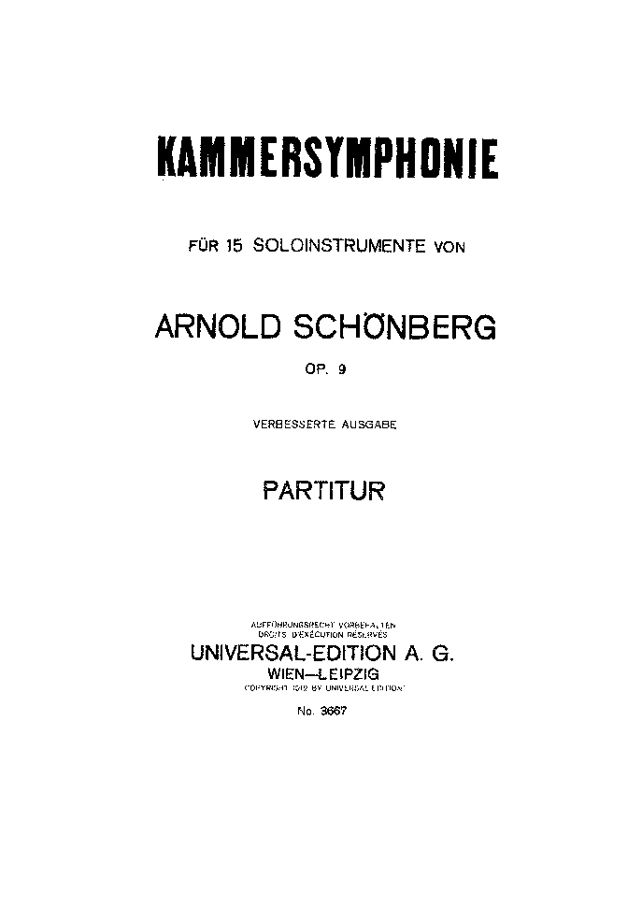
Chamber Symphony (1906) -- Into the Transition Phase
Much of the harmony is grounded in three chord types
Quartal structures Whole-Tone Triads
(built on fourths)
. . . which also provide intervallic grounding for some of the thematic material

Slide 88
A continuum of chord types, classified by degrees of dissonance
4 3 2 1
Totally dissonant Very dissonant Mildly dissonant Resolution

Slide 89
A continuum of chord types, classified by degrees of dissonance
“atonal” or non-tonal
4 3 2 1
Totally dissonant Very dissonant Mildly dissonant Resolution

Slide 90
Verklärte Nacht (1899) -- sextet
Gurrelieder (1901-02) – massive “cantata”
Pelléas et Mélisande (1903) – tone poem
String Quartet, op. 7 (1904-05)
Chamber Symphony (1906)
String Quartet No. 2 (1907-08)
The Book of the Hanging Gardens
(1908-09)—song cycle
Three Piano Pieces, op. 11 (1909)
Five Pieces for Orchestra, op. 16 (1909)
Erwartung, op. 17 (1909) –”monodrama)
Pierrot lunaire, op. 21 (1912)
“Tonal”
“Transitional”
“Atonal”

Slide 91
Schoenberg: String Quartet No. 2, op. 10 (1907-08)
1. Mäßig (Moderate), F sharp minor
2. Sehr rasch (Very brisk), D minor
3. "Litanei", langsam ("Litany,“ slow), E flat minor
4. "Entrückung", sehr langsam ("Rapture," very slow), No key
Instrumental
only
Soprano included: two poems by Stefan George (1907)

Slide 92
Schoenberg: String Quartet No. 2, op. 10 (1907-08)
increasingly
distant from
clear tonality
1. Mäßig (Moderate), F sharp minor
2. Sehr rasch (Very brisk), D minor
3. "Litanei", langsam ("Litany,“ slow), E flat minor
4. "Entrückung", sehr langsam ("Rapture," very slow), No key
Instrumental
only
Soprano included: two poems by Stefan George (1907)

Slide 93
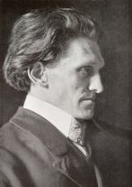
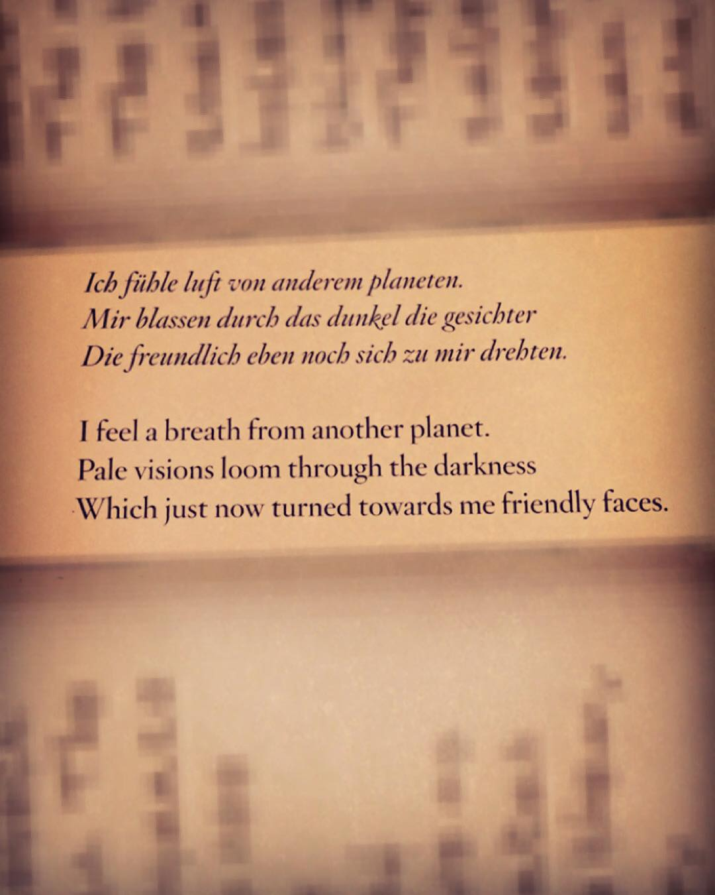
Stefan George (1868-1933) “Entrückung” (“Rapture”)
from The Seventh Ring (1907)

Slide 94
Verklärte Nacht (1899) -- sextet
Gurrelieder (1901-02) – massive “cantata”
Pelléas et Mélisande (1903) – tone poem
String Quartet, op. 7 (1904-05)
Chamber Symphony (1906)
String Quartet No. 2 (1907-08)
The Book of the Hanging Gardens
(1908-09)—song cycle
Three Piano Pieces, op. 11 (1909)
Five Pieces for Orchestra, op. 16 (1909)
Erwartung, op. 17 (1909) –”monodrama)
Pierrot lunaire, op. 21 (1912)
“Tonal”
“Transitional”
“Atonal”

Slide 95
Verklärte Nacht (1899) -- sextet
Gurrelieder (1901-02) – massive “cantata”
Pelléas et Mélisande (1903) – tone poem
String Quartet, op. 7 (1904-05)
Chamber Symphony (1906)
String Quartet No. 2 (1907-08)
The Book of the Hanging Gardens
(1908-09)—song cycle
Three Piano Pieces, op. 11 (1909)
Five Pieces for Orchestra, op. 16 (1909)
Erwartung, op. 17 (1909) –”monodrama)
Pierrot lunaire, op. 21 (1912)
“Tonal”
“Transitional”
“Atonal”

Slide 96
Verklärte Nacht (1899) -- sextet
Gurrelieder (1901-02) – massive “cantata”
Pelléas et Mélisande (1903) – tone poem
String Quartet, op. 7 (1904-05)
Chamber Symphony (1906)
String Quartet No. 2 (1907-08)
The Book of the Hanging Gardens
(1908-09)—song cycle
Three Piano Pieces, op. 11 (1909)
Five Pieces for Orchestra, op. 16 (1909)
Erwartung, op. 17 (1909) –”monodrama)
Pierrot lunaire, op. 21 (1912)
“Tonal”
“Transitional”
“Atonal”

Slide 97
No. 1, “Vorgefühle”
(“Premonitions”)
1909

Slide 98
No. 3, “Farben”
(“Colors”)
Klangfarbenmelodie
(The “melody” of tone colors)
1909

Slide 99
Expressionism
Edvard Munch, “The Scream” (1893)
Franz Marc, “Three Cats” (1913)

Slide 100
Expressionism
Urgent, extreme psychological states, bold colors, distortion
Edvard Munch, “The Scream” (1893)
Franz Marc, “Three Cats” (1913)

Slide 101
Expressionism
Urgent, extreme psychological states, bold colors, distortion
Exploration of morbid violence, eroticism
Edvard Munch, “The Scream” (1893)
Franz Marc, “Three Cats” (1913)

Slide 102
Expressionism
Urgent, extreme psychological states, bold colors, distortion
Exploration of morbid violence, eroticism
Often featuring anxiety, irrational fear
Edvard Munch, “The Scream” (1893)
Emil Nolde, “Masks” (1911)

Slide 103
Expressionism
Urgent, extreme psychological states, bold colors, distortion
Exploration of morbid violence, eroticism
Often featuring anxiety, irrational fear
The source: not external—all comes from within, the psychological interior
Edvard Munch, “The Scream” (1893)
Emil Nolde, “Masks” (1911)

Slide 104
Expressionism
Urgent, extreme psychological states, bold colors, distortion
Exploration of morbid violence, eroticism
Often featuring anxiety, irrational fear
The source: not external—all comes from within, the psychological interior
Thus: a radical turn away from the objective, into the emphatically, irrationally subjective
Edvard Munch, “The Scream” (1893)
Emil Nolde, “Masks” (1911)

Slide 105
Expressionism
Urgent, extreme psychological states, bold colors, distortion
Exploration of morbid violence, eroticism
Often featuring anxiety, irrational fear
The source: not external—all comes from within, the psychological interior
Thus: a radical turn away from the objective, into the emphatically, irrationally subjective
At bottom: a higher truth claim than that provided by the false external world, the corrupted world of the everyday
Edvard Munch, “The Scream” (1893)
Emil Nolde, “Masks” (1911)

Slide 106
1911: The “Blaue Reiter” Group in Munich (Franz Marc, Wassily Kandinsky)

Slide 107
1911: The “Blaue Reiter” Group in Munich (Franz Marc, Wassily Kandinsky)
“Schoenberg’s music leads us into a new realm where musical experiences are not acoustic, but purely spiritual. This is where the ‘music of the future’ begins.” (Wassily Kandinsky, 1912)

Slide 108
Franz Marc, “The Yellow Cow” (1911)

Slide 109
“Expressionism”
Wassily Kandinsky, Improvisation 7 (1910)

Slide 110
Wassily Kandinsky, Composition 5 (1911)

Slide 111
Schoenberg: Paintings and Self-Portraits, 1908-1912
1910

Slide 112
Schoenberg: Paintings and Self-Portraits, 1908-1912
1910 “Red Gaze” (1910)

Slide 113
Schoenberg: Paintings and Self-Portraits, 1908-1912
“Hate” (1910) “Thinking” (1910)

Slide 114
Premiere: Berlin, March 1912

Slide 115
Premiere: Berlin, March 1912

Slide 116
Premiere: Berlin, March 1912

