Slide 1
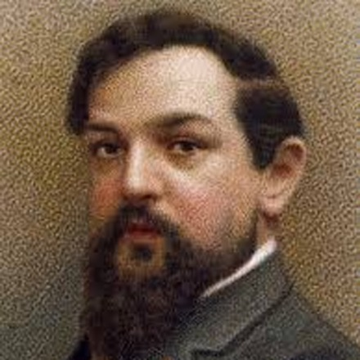
Debussy

Slide 2
Early Modernism
(“Generation of the 1860s”)

Slide 3
Transitioning. . . .
Early Modernism
(“Generation of the 1860s”)
High Modernism
(into the 20th century)

Slide 4
Transitioning. . . .
Early Modernism
(“Generation of the 1860s”)
High Modernism
(into the 20th century)
By the 1890s:
Emergence of a fully formed Institution of Art Music—ordered and administered by bureaucracies

Slide 5
Transitioning. . . .
Early Modernism
(“Generation of the 1860s”)
High Modernism
(into the 20th century)
By the 1890s:
Emergence of a fully formed Institution of Art Music—ordered and administered by bureaucracies
Doctrine of originality: the demand for each composer to forge a unique sound or style in order to compete, to be noticed as a major player within the system

Slide 6
Transitioning. . . .
Early Modernism
(“Generation of the 1860s”)
High Modernism
(into the 20th century)
By the 1890s:
Emergence of a fully formed Institution of Art Music—ordered and administered by bureaucracies
Doctrine of originality: the demand for each composer to forge a unique sound or style in order to compete, to be noticed as a major player within the system
Ominpresent debates about the future of the tradition: what are the imperatives of “musical progress” in a new historical age?

Slide 7
Transitioning. . . .
Early Modernism
(“Generation of the 1860s”)
High Modernism
(into the 20th century)
By the 1890s:
Emergence of a fully formed Institution of Art Music—ordered and administered by bureaucracies
Doctrine of originality: the demand for each composer to forge a unique sound or style in order to compete, to be noticed as a major player within the system
Ominpresent debates about the future of the tradition: what are the imperatives of “musical progress” in a new historical age?
Encounters with the onrush of “real-world” technological modernity, scientific inquiries into acoustics and the physiology of hearing, the palpable materiality of sound, etc.

Slide 8
Transitioning. . . .
Early Modernism
(“Generation of the 1860s”)
High Modernism
(into the 20th century)
By the 1890s:
Emergence of a fully formed Institution of Art Music—ordered and administered by bureaucracies
Doctrine of originality: the demand for each composer to forge a unique sound or style in order to compete, to be noticed as a major player within the system
Ominpresent debates about the future of the tradition: what are the imperatives of “musical progress” in a new historical age?
Encounters with the onrush of “real-world” technological modernity, scientific inquiries into acoustics and the physiology of hearing, the palpable materiality of sound, etc.
Dilemma: should one embrace the emerging technologized and administered world or offer a critique of it (or an escape from it)?

Slide 9
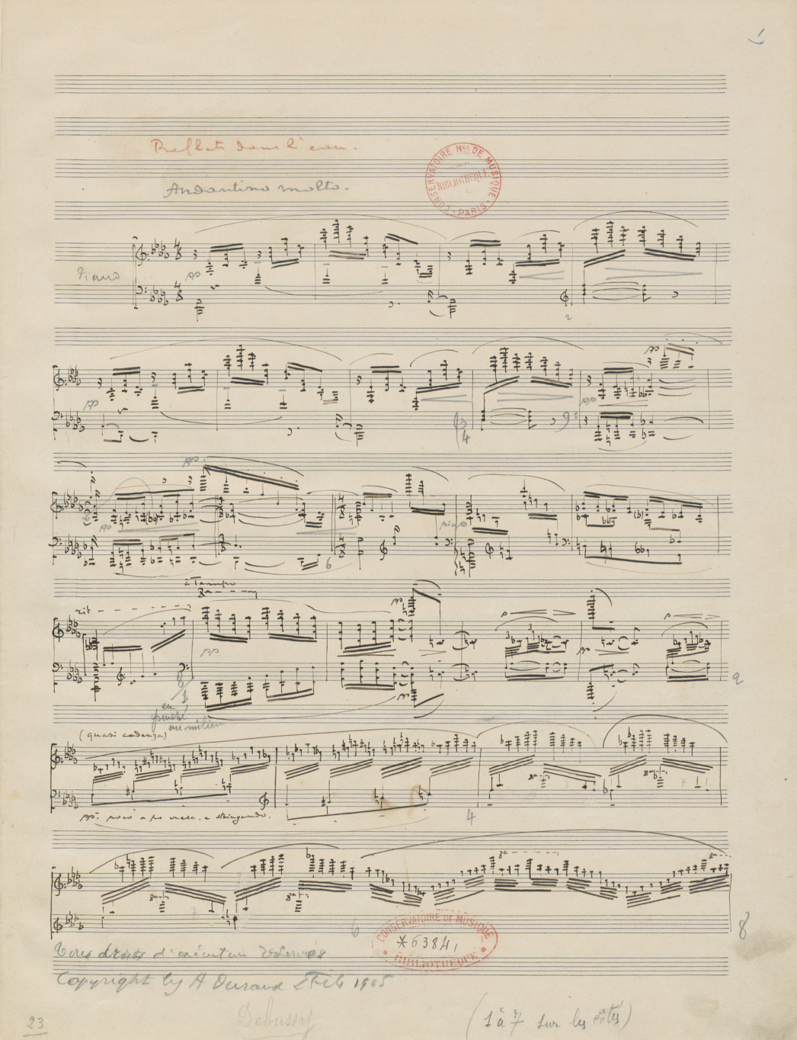
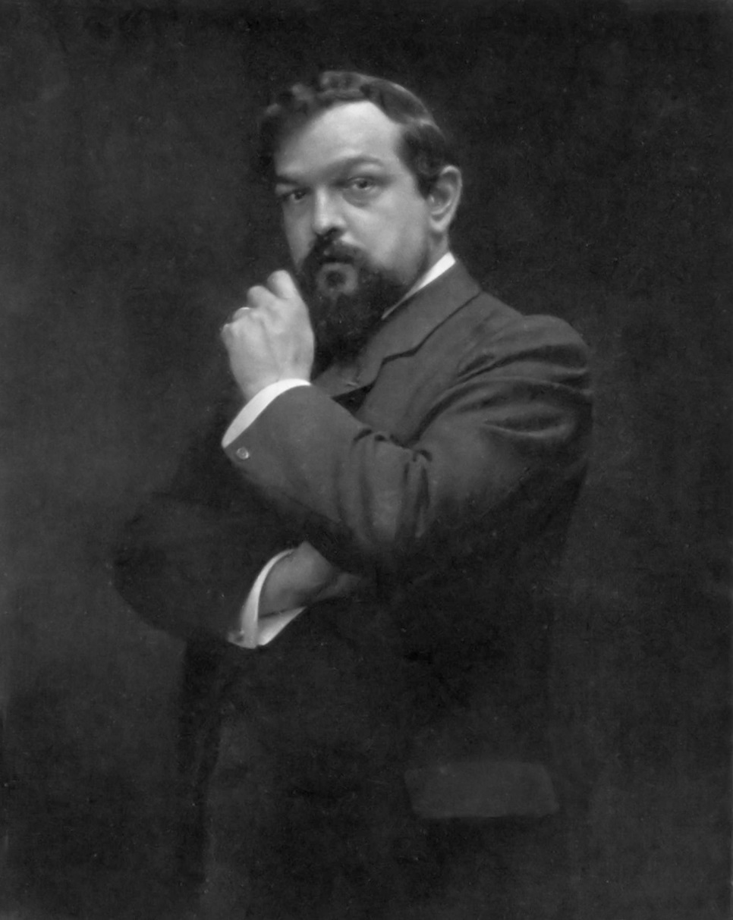
Escape into art: exquisite sensation, shimmering dream-fantasy?
Debussy, “Reflets dans l’eau,”
from Images, Book 1 (1905)

Slide 10
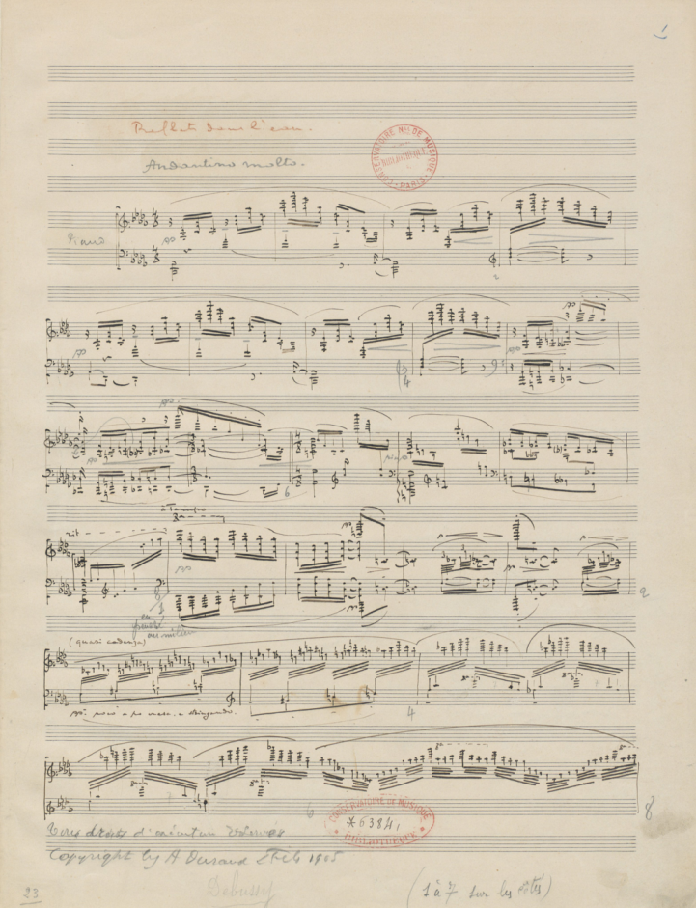
Escape into art: exquisite sensation, shimmering dream-fantasy?
Debussy, “Reflets dans l’eau,”
from Images, Book 1 (1905)
Emerging aesthetic “modernism” as a virtual-world alternative
to “that which is” and “that which is emerging” in current culture?

Slide 11
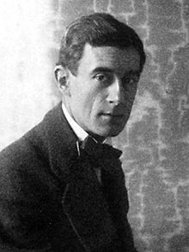
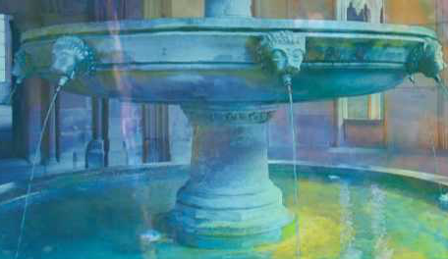
Escape into art: shimmering dream-fantasy? or a new openness to the immediacy—the freshness and reality—of sensory/sonic experience?
Ravel, “Jeux d’eau” (1901)
Emerging aesthetic “modernism” as a virtual-world alternative
to “that which is” and “that which is emerging” in current culture?

Slide 12
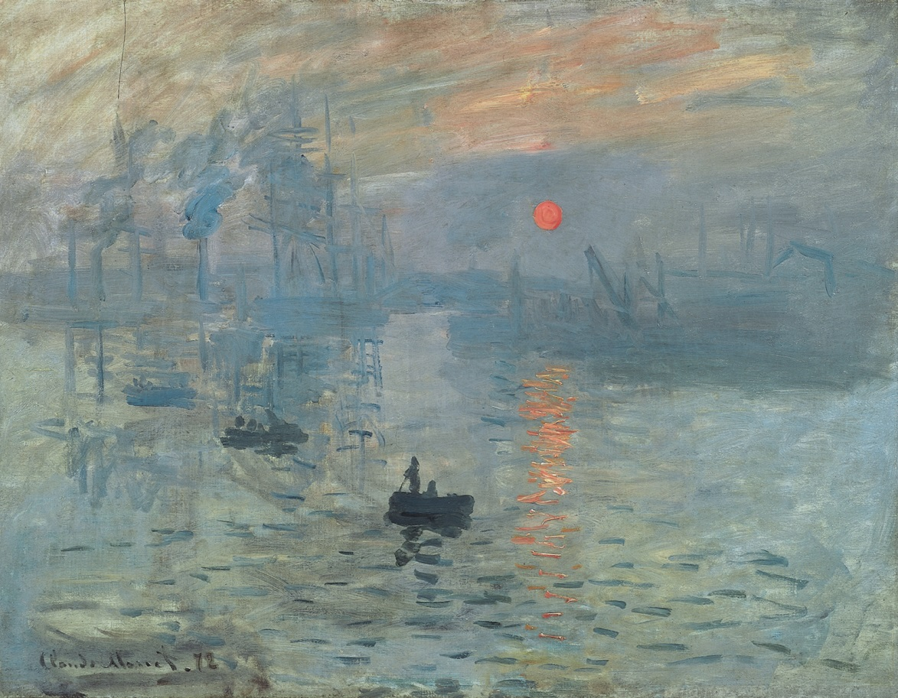
Monet, “Impression—Soleil levant” (1874, “Exhibition of the Impressionists”)

Slide 13
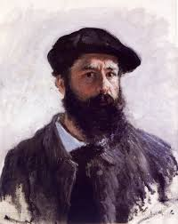
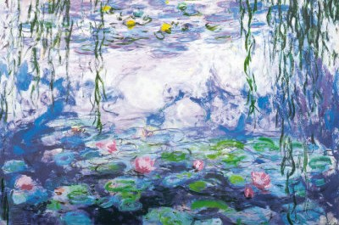
Claude Monet (1849-1926)

Slide 14
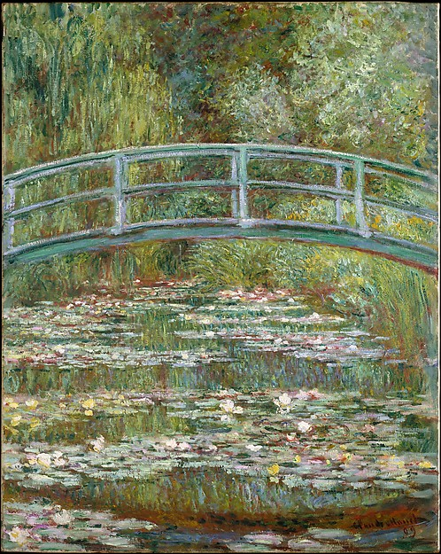
Claude Monet, “Bridge over a Pond of Water Lilies” (c. 1899)

Slide 15
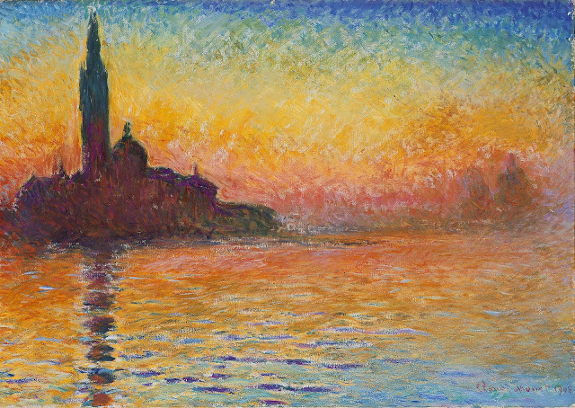
The hyper-aesthetic stance: withdraw from the ever-institutionalized, administered world into a fantasy world of elite connoisseurship

Slide 16
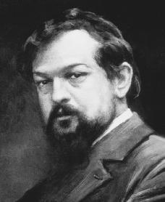
The hyper-aesthetic stance: withdraw from the ever-institutionalized, administered world into a fantasy world of elite connoisseurship
Debussy to Ernest Chausson, September 1893:
“Music really ought to have been a hermetical science, enshrined in texts so hard and laborious to decipher as to discourage the herd of people who treat it as casually as they do a handkerchief.”

Slide 17
The hyper-aesthetic stance: withdraw from the ever-institutionalized, administered world into a fantasy world of elite connoisseurship
Debussy to Ernest Chausson, September 1893:
“Music really ought to have been a hermetical science, enshrined in texts so hard and laborious to decipher as to discourage the herd of people who treat it as casually as they do a handkerchief.”
“Sarabande,” from Images oubliées (1894), as revised for publication in Pour le piano (1901)

Slide 18
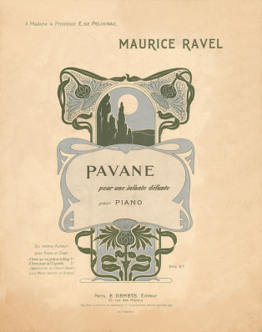
Ravel, Pavane pour une infante défunte (1899)

Slide 19
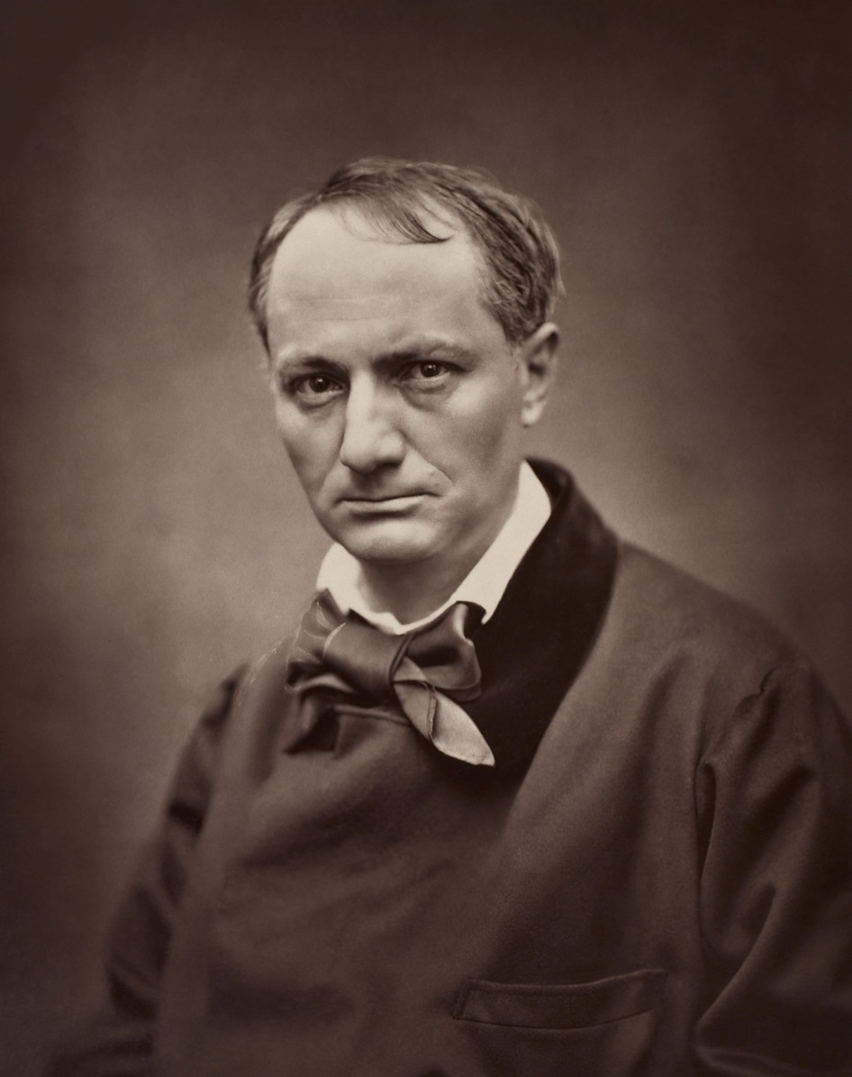
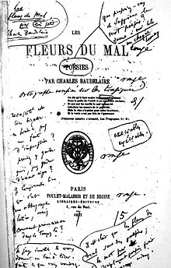
Charles Baudelaire (1821-1867)
(1857)

Slide 20
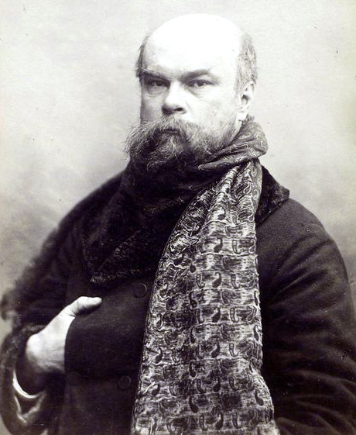
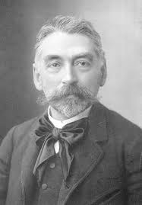
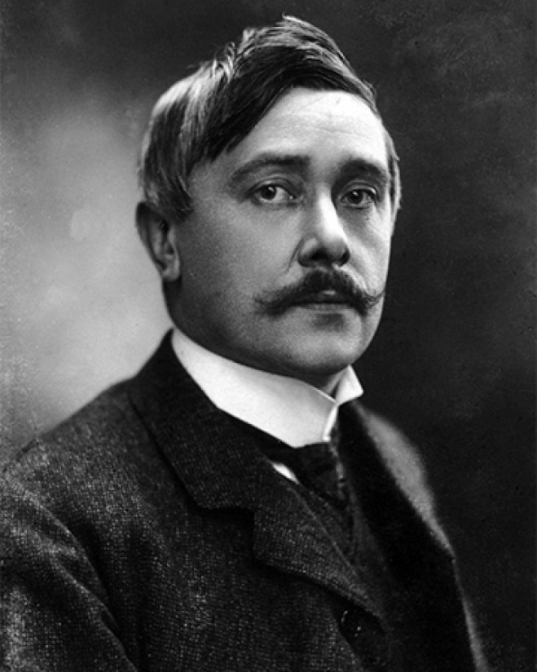
Poetic “Aestheticism”
Paul Verlaine (1844-96) Stéphane Mallarmé (1842-98) Maurice Maeterlinck (1862-1949)

Slide 21
By the 1870s: the “Decadents”
Paul Verlaine (1844-96) Stéphane Mallarmé (1842-98) Maurice Maeterlinck (1862-1949)

Slide 22
By the 1880s: The “Symbolist” Poets
Paul Verlaine (1844-96) Stéphane Mallarmé (1842-98) Maurice Maeterlinck (1862-1949)

Slide 23
The “Symbolist” Movement
Paul Verlaine (1844-96) Stéphane Mallarmé (1842-98) Maurice Maeterlinck (1862-1949)
Exquisite polish; technical refinement; ultra-elegance

Slide 24
The “Symbolist” Movement
Paul Verlaine (1844-96) Stéphane Mallarmé (1842-98) Maurice Maeterlinck (1862-1949)
Exquisite polish; technical refinement; ultra-elegance
Softer, gentler, nuanced, seemingly passive in contrast with earlier, more aggressive art

Slide 25
The “Symbolist” Movement
Paul Verlaine (1844-96) Stéphane Mallarmé (1842-98) Maurice Maeterlinck (1862-1949)
Exquisite polish; technical refinement; ultra-elegance
Softer, gentler, nuanced, seemingly passive in contrast with earlier, more aggressive art
Appeal only to rarefied connoisseurs, the elite: hence an embrace of “difficulty” and purposeful syntax-violation (esp. Mallarmé)

Slide 26
The “Symbolist” Movement
Paul Verlaine (1844-96) Stéphane Mallarmé (1842-98) Maurice Maeterlinck (1862-1949)
Exquisite polish; technical refinement; ultra-elegance
Softer, gentler, nuanced, seemingly passive in contrast with earlier, more aggressive art
Appeal only to rarefied connoisseurs, the elite: hence an embrace of “difficulty” and purposeful syntax-violation (esp. Mallarmé)
Moods of the mysterious, indefinable, the dream-fantasy, the spectral; “anywhere out of this world”

Slide 27
The “Symbolist” Movement
Paul Verlaine (1844-96) Stéphane Mallarmé (1842-98) Maurice Maeterlinck (1862-1949)
Exquisite polish; technical refinement; ultra-elegance
Softer, gentler, nuanced, seemingly passive in contrast with earlier, more aggressive art
Appeal only to rarefied connoisseurs, the elite: hence an embrace of “difficulty” and purposeful syntax-violation (esp. Mallarmé)
Moods of the mysterious, indefinable, the dream-fantasy, the spectral; “anywhere out of this world”
Impression of a luscious vagueness: suggestion rather than the direct statement (esp. Mallarmé)

Slide 28
The “Symbolist” Movement
Paul Verlaine (1844-96) Stéphane Mallarmé (1842-98) Maurice Maeterlinck (1862-1949)
Exquisite polish; technical refinement; ultra-elegance
Softer, gentler, nuanced, seemingly passive in contrast with earlier, more aggressive art
Appeal only to rarefied connoisseurs, the elite: hence an embrace of “difficulty” and purposeful syntax-violation (esp. Mallarmé)
Moods of the mysterious, indefinable, the dream-fantasy, the spectral; “anywhere out of this world”
Impression of a luscious vagueness: suggestion rather than the direct statement (esp. Mallarmé)
Appeal to direct, immediate, physical “sensation”: sonic indulgence, aesthetic sensuality;
the heightening of the sonic moment

Slide 29
In music:
the production of a symbolist-oriented volupté (voluptuousness)
Debussy, Prélude à “L'après-midi d'un faune” (1894), central section

Slide 30
In music:
the production of a symbolist-oriented volupté (voluptuousness)
Ravel, Daphnis et Chloé (1912), “Lever du jour”

Slide 31
Advances of the Symbolists in Poetry/Art/Music

Slide 32
Advances of the Symbolists in Poetry/Art/Music
Encouraged innovation in technique, syntax, sound—a breaking-free from old, stale academic formulas

Slide 33
Advances of the Symbolists in Poetry/Art/Music
Encouraged innovation in technique, syntax, sound—a breaking-free from old, stale academic formulas
Explored regions of consciousness (or pre-consciousness) and immediacy

Slide 34
Advances of the Symbolists in Poetry/Art/Music
Encouraged innovation in technique, syntax, sound—a breaking-free from old, stale academic formulas
Explored regions of consciousness (or pre-consciousness) and immediacy
Demanded a heightened sensitivity to aesthetic experience

Slide 35
Advances of the Symbolists in Poetry/Art/Music
Encouraged innovation in technique, syntax, sound—a breaking-free from old, stale academic formulas
Explored regions of consciousness (or pre-consciousness) and immediacy
Demanded a heightened sensitivity to aesthetic experience
Experimented with the “fusion of the arts” and the “correspondences” among them

Slide 36
De la musique avant toute chose, Et pour cela préfère l'Impair Plus vague et plus soluble dans l'air, Sans rien en lui qui pèse ou qui pose.
Paul Verlaine, “L’art poétique” (1874)

Slide 37
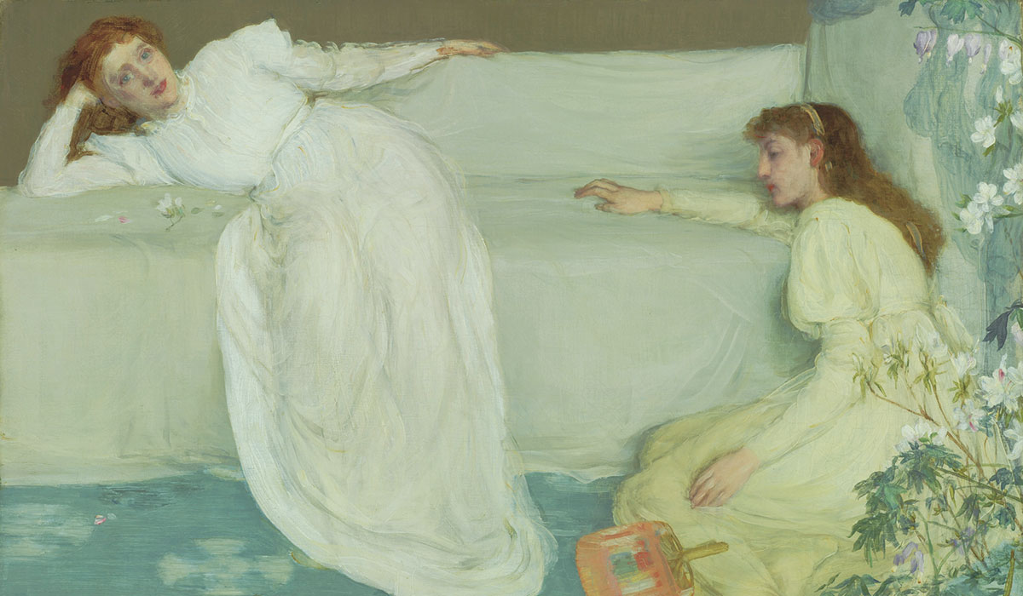
James McNeill Whistler, “Symphony in White, No. 3” (1865-67)

Slide 38
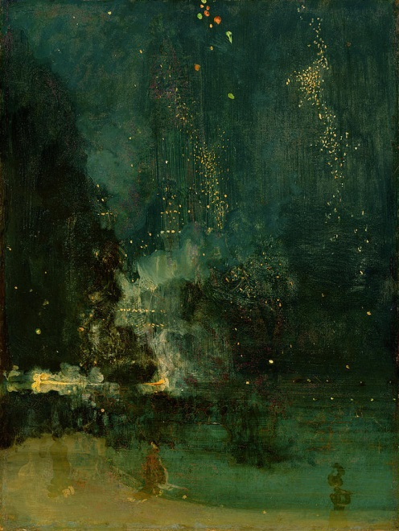
James McNeill Whistler,
“Nocturne in Black and Gold: the Falling Rocket” (c. 1875)

Slide 39
Debussy, “Nuages” (“Clouds”) from Nocturnes (1897-99)

Slide 40
Debussy, “Sirènes” from Nocturnes (1897-99)

Slide 41
Ravel, Daphnis et Chloé (1912), from the opening scene

Slide 42
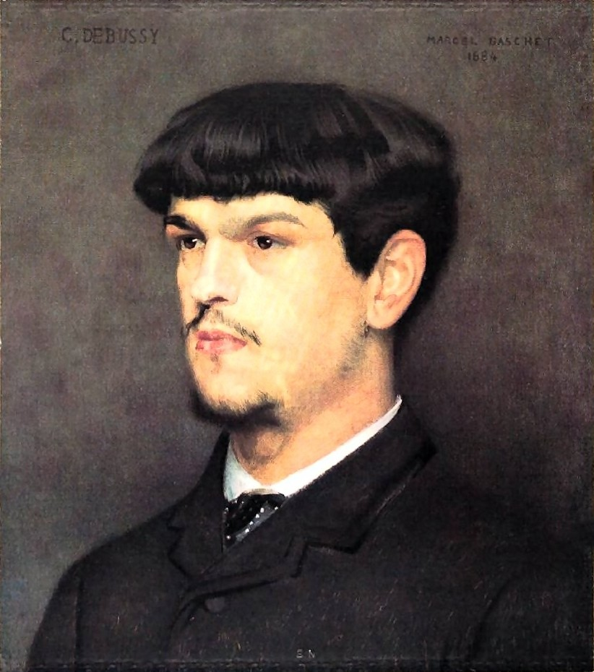
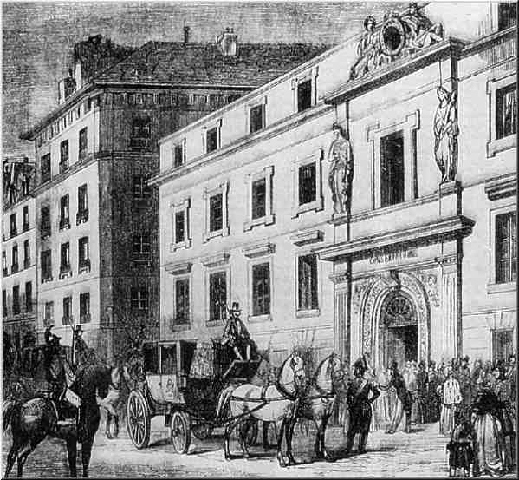
Paris Conservatoire
Claude Debussy in 1884, age 22
(Marcel Baschet)

Slide 43
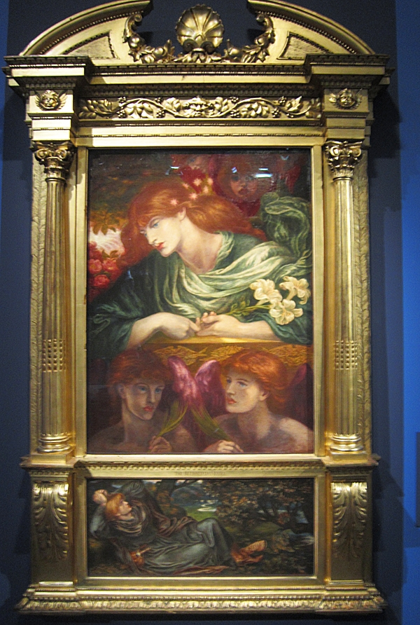
Claude Debussy in 1884, age 22
(Marcel Baschet)
Dante Gabriel Rossetti, “The Blessed Damozel” Pre-Raphaelite Poem, 1850; painting, 1875-78
La damoiselle élue (1887-88)

Slide 44
Debussy: Aesthetic Aspects Include:
Music as enhanced presence

Slide 45
Debussy: Aesthetic Aspects Include:
Music as enhanced presence
An experiential relationship to sound—as physical and immediate sensation

Slide 46
Debussy: Aesthetic Aspects Include:
Music as enhanced presence
An experiential relationship to sound—as physical and immediate sensation
Pelléas et Mélisande (1893-1902), opening

Slide 47
Debussy: Aesthetic Aspects Include:
Music as enhanced presence
An experiential relationship to sound—as physical and immediate sensation
Debussy, “Reflets dans l’eau,”
from Images, Book 1 (1905)

Slide 48
Debussy: Aesthetic Aspects Include:
Music as enhanced presence
An experiential relationship to sound—as physical and immediate sensation
Melodic lines as “arabesques” (curved, floating, weightless)

Slide 49
Debussy: Aesthetic Aspects Include:
Music as enhanced presence
An experiential relationship to sound—as physical and immediate sensation
Melodic lines as “arabesques” (curved, floating, weightless)
“Clair de lune” (1890, rev. 1895), from
Suite bergamasque

Slide 50
Debussy: Aesthetic Aspects Include:
Music as enhanced presence
An experiential relationship to sound—as physical and immediate sensation
Melodic lines as “arabesques” (curved, floating, weightless)
Music as cultic, pseudo-sacralized

Slide 51
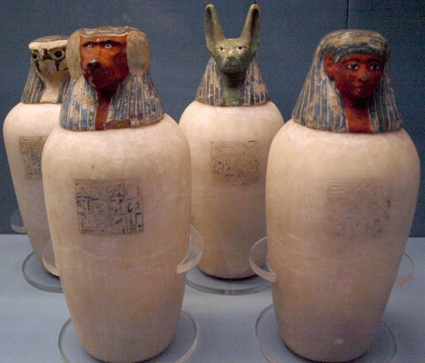
Debussy: Aesthetic Aspects Include:
Music as enhanced presence
An experiential relationship to sound—as physical and immediate sensation
Melodic lines as “arabesques” (curved, floating, weightless)
Music as cultic, pseudo-sacralized
“Canope,” from Préludes, Book 2
(1911-12)

Slide 52
Debussy: Aesthetic Aspects Include:
Music as enhanced presence
A heightened relationship to sound—as physical and immediate sensation
Melodic lines as “arabesques” (curved, floating, weightless)
Music as cultic, pseudo-sacralized
On the one hand: music as
“the most beautiful of lies”

Slide 53
Debussy: Aesthetic Aspects Include:
Music as enhanced presence
A heightened relationship to sound—as physical and immediate sensation
Melodic lines as “arabesques” (floating, weightless)
Music as cultic, pseudo-sacralized
On the one hand: music as
“the most beautiful of lies”
On the other hand, music as less “impressionism” than a recording of sensation-based “réalités”

Slide 54
Debussy: Some Technical Aspects Include:

Slide 55
Debussy: Some Technical Aspects Include:
Weaken the tyranny of the bar-line and the traditional force of metric downbeats (in favor of an impression of metrical “floating”)

Slide 56
Debussy: Some Technical Aspects Include:
Weaken the tyranny of the bar-line and the traditional force of metric downbeats (in favor of an impression of metrical “floating”)
Avoid fifth relations (and strong cadences)

Slide 57
Debussy: Some Technical Aspects Include:
Weaken the tyranny of the bar-line and the traditional force of metric downbeats (in favor of an impression of metrical “floating”)
Avoid fifth relations (and strong cadences)
La damoiselle élue (1887-88) ||: iii – ii - I- ii :||

Slide 58
Debussy: Some Technical Aspects Include:
Weaken the tyranny of the bar-line and the traditional force of metric downbeats (in favor of an impression of metrical “floating”)
Avoid fifth relations (and strong cadences)
Exploit chordal ambiguity (functional ambiguity)

Slide 59
Debussy: Some Technical Aspects Include:
Weaken the tyranny of the bar-line and the traditional force of metric downbeats (in favor of an impression of metrical “floating”)
Avoid fifth relations (and strong cadences)
Exploit chordal ambiguity (functional ambiguity)
Parallel or near-parallel chords (triads, sevenths, ninths)

Slide 60
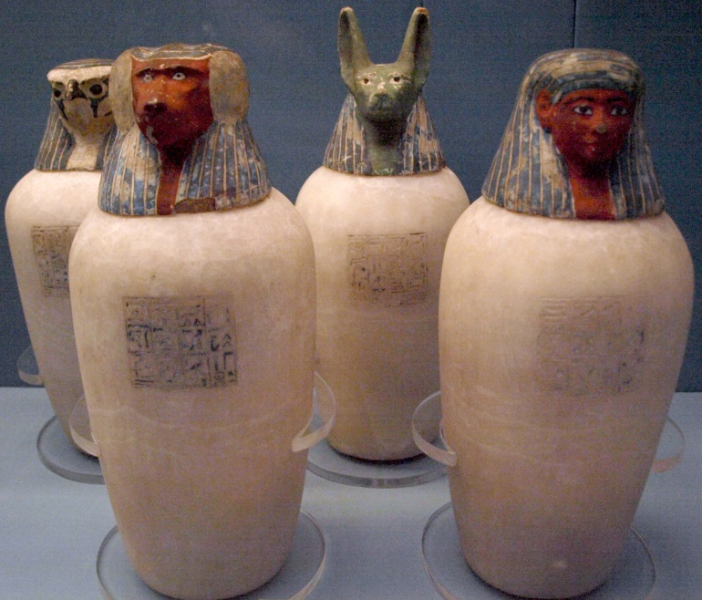
Debussy: Some Technical Aspects Include:
Weaken the tyranny of the bar-line and the traditional force of metric downbeats (in favor of an impression of metrical “floating”)
Avoid fifth relations (and strong cadences)
Exploit chordal ambiguity (functional ambiguity)
Parallel or near-parallel chords (triads, sevenths, ninths)
“Canope,” from Préludes, Book 2 (1912-13)

Slide 61
Debussy: Some Technical Aspects Include:
Weaken the tyranny of the bar-line and the traditional force of metric downbeats (in favor of an impression of metrical “floating”)
Avoid fifth relations (and strong cadences)
Exploit chordal ambiguity (functional ambiguity)
Parallel or near-parallel chords (triads, sevenths, ninths)
“La cathédrale engloutie,” from Préludes, Book 1 (1910)

Slide 62
Debussy: Some Technical Aspects Include:
Weaken the tyranny of the bar-line and the traditional force of metric downbeats (in favor of an impression of metrical “floating”)
Avoid fifth relations (and strong cadences)
Exploit chordal ambiguity (functional ambiguity)
Parallel or near-parallel chords (triads, sevenths, ninths)
“La cathédrale engloutie,” from Préludes, Book 1 (1910)

Slide 63
Debussy: Some Technical Aspects Include:
Weaken the tyranny of the bar-line and the traditional force of metric downbeats (in favor of an impression of metrical “floating”)
Avoid fifth relations (and strong cadences)
Exploit chordal ambiguity (functional ambiguity)
Parallel or near-parallel chords (triads, sevenths, ninths)
Pentatonicism (melodic, chordal, occasional clusters)

Slide 64
Debussy: Some Technical Aspects Include:
Weaken the tyranny of the bar-line and the traditional force of metric downbeats (in favor of an impression of metrical “floating”)
Avoid fifth relations (and strong cadences)
Exploit chordal ambiguity (functional ambiguity)
Parallel or near-parallel chords (triads, sevenths, ninths)
Pentatonicism (melodic, chordal, occasional clusters)
“La fille aux cheveux de lin,” from Préludes, Book 1 (1910)

Slide 65
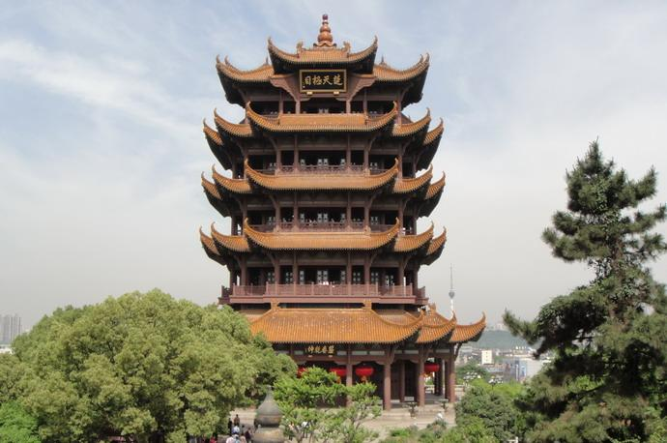
Debussy: Some Technical Aspects Include:
Weaken the tyranny of the bar-line and the traditional force of metric downbeats (in favor of an impression of metrical “floating”)
Avoid fifth relations (and strong cadences)
Exploit chordal ambiguity (functional ambiguity)
Parallel or near-parallel chords (triads, sevenths, ninths)
Pentatonicism (melodic, chordal, occasional clusters)
“Pagodes,” from Estampes (1903)

Slide 66
Debussy: Some Technical Aspects Include:
Weaken the tyranny of the bar-line and the traditional force of metric downbeats (in favor of an impression of metrical “floating”)
Avoid fifth relations (and strong cadences)
Exploit chordal ambiguity (functional ambiguity)
Parallel or near-parallel chords (triads, sevenths, ninths)
Pentatonicism (melodic, chordal, occasional clusters)
“Reflets dans l’eau,” from Images, Book 1 (1905)

Slide 67
Debussy: Some Technical Aspects Include:
Weaken the tyranny of the bar-line and the traditional force of metric downbeats (in favor of an impression of metrical “floating”)
Avoid fifth relations (and strong cadences)
Exploit chordal ambiguity (functional ambiguity)
Parallel or near-parallel chords (triads, sevenths, ninths)
Pentatonicism (melodic, chordal, occasional clusters)
Explore modal scales and/or pitch-collections

Slide 68
Debussy: Some Technical Aspects Include:
Weaken the tyranny of the bar-line and the traditional force of metric downbeats (in favor of an impression of metrical “floating”)
Avoid fifth relations (and strong cadences)
Exploit chordal ambiguity (functional ambiguity)
Parallel or near-parallel chords (triads, sevenths, ninths)
Pentatonicism (melodic, chordal, occasional clusters)
Explore modal scales and/or pitch-collections
Explore synthetic scales (whole-tone; octatonic; hexatonic)

Slide 69
Debussy: Some Technical Aspects Include:
Weaken the tyranny of the bar-line and the traditional force of metric downbeats (in favor of an impression of metrical “floating”)
Avoid fifth relations (and strong cadences)
Exploit chordal ambiguity (functional ambiguity)
Parallel or near-parallel chords (triads, sevenths, ninths)
Pentatonicism (melodic, chordal, occasional clusters)
Explore modal scales and/or pitch-collections
Explore synthetic scales (whole-tone; octatonic; hexatonic)
“Voiles,” from Préludes, Book 1 (1910)

Slide 70
Debussy, “Voiles,” from Préludes, Book 1 (1910)
whole-tone pentatonic whole-tone

Slide 71
Harmonic/Chordal Options, c. 1900
Diatonic
Alternative Color-Options
Major-Minor Modal Pentatonic Hexatonic Octatonic Whole-tone
(or other artificial collections, such as
The “acoustic” collection, #4, flat 7)

Slide 72
Harmonic/Chordal Options, c. 1900
Diatonic
Alternative Color-Options
Major-Minor Modal Pentatonic Hexatonic Octatonic Whole-tone
(or other artificial collections, such as
The “acoustic” collection, #4, flat 7)

Slide 73
Debussy, La mer, movement 1, “De l’aube à midi sur la mer”
Très lent
Pentatonic on B “Dorian” [?] on B “Aeolian on C” “Dorian” [?] Pentatonic on B (accel.)
“C”
B B
Modéré, sans lenteur
Pentatonic on D-flat #^4, b^7 Pentatonic on D-flat etc.
D-flat!

Slide 74
Debussy, La mer, movement 1, “De l’aube à midi sur la mer”
Très lent
Pentatonic on B “Dorian” [?] on B “Aeolian on C” “Dorian” [?] Pentatonic on B (accel.)
“C”
B B
Modéré, sans lenteur
Pentatonic on D-flat #^4, b^7 Pentatonic on D-flat etc.
D-flat!

Slide 75
Harmonic/Chordal Options, c. 1900
Diatonic
Alternative Color-Options
Major-Minor Modal Pentatonic Hexatonic Octatonic Whole-tone
(or other artificial collections, such as
The “acoustic” collection, #4, flat 7)

