Slide 1
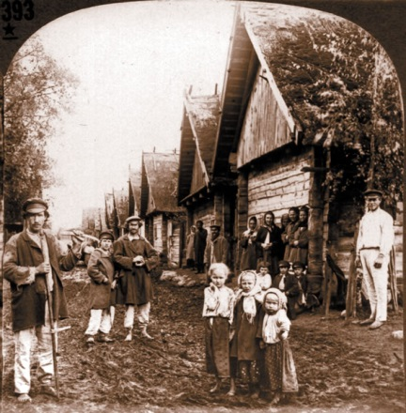
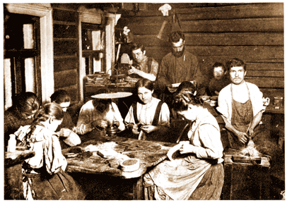
Nineteenth-Century European “Romantic Nationalism”
Russian Peasant Villages, later 1800s

Slide 2
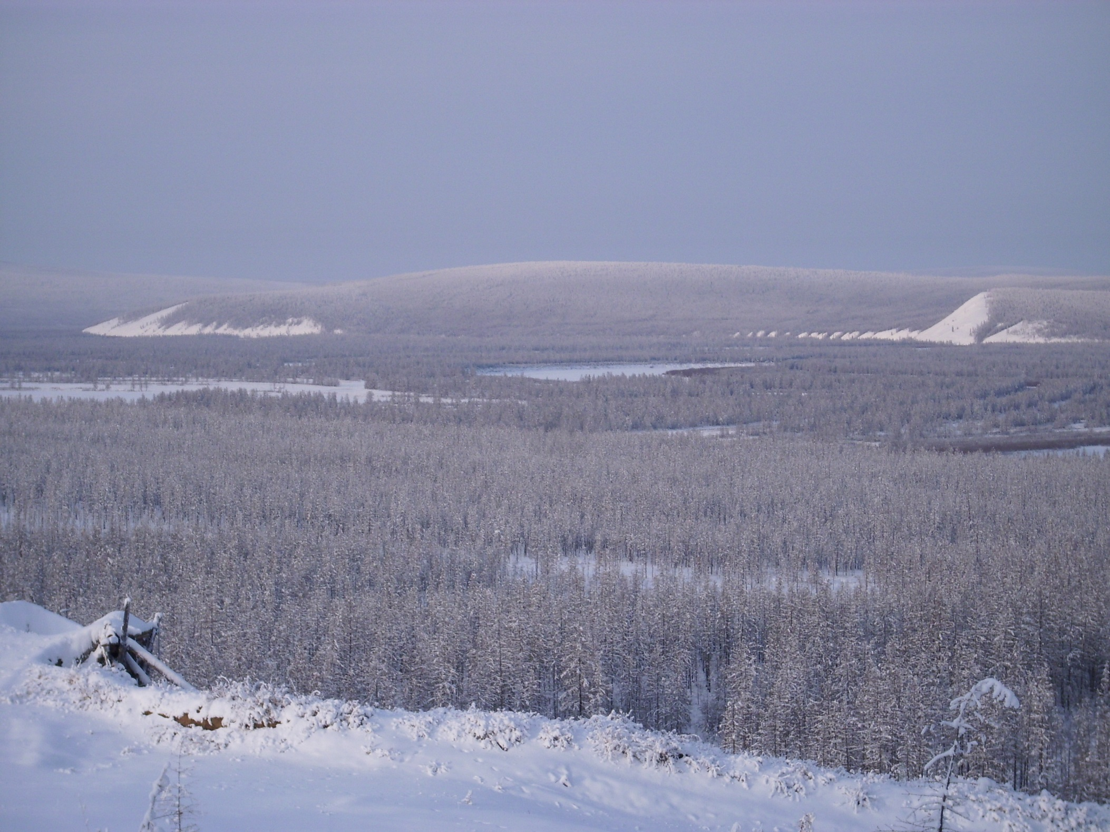
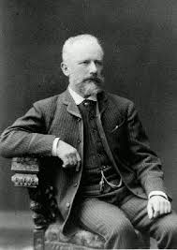
Tchaikovsky, Symphony No. 4 (1877-78), second movement

Slide 3
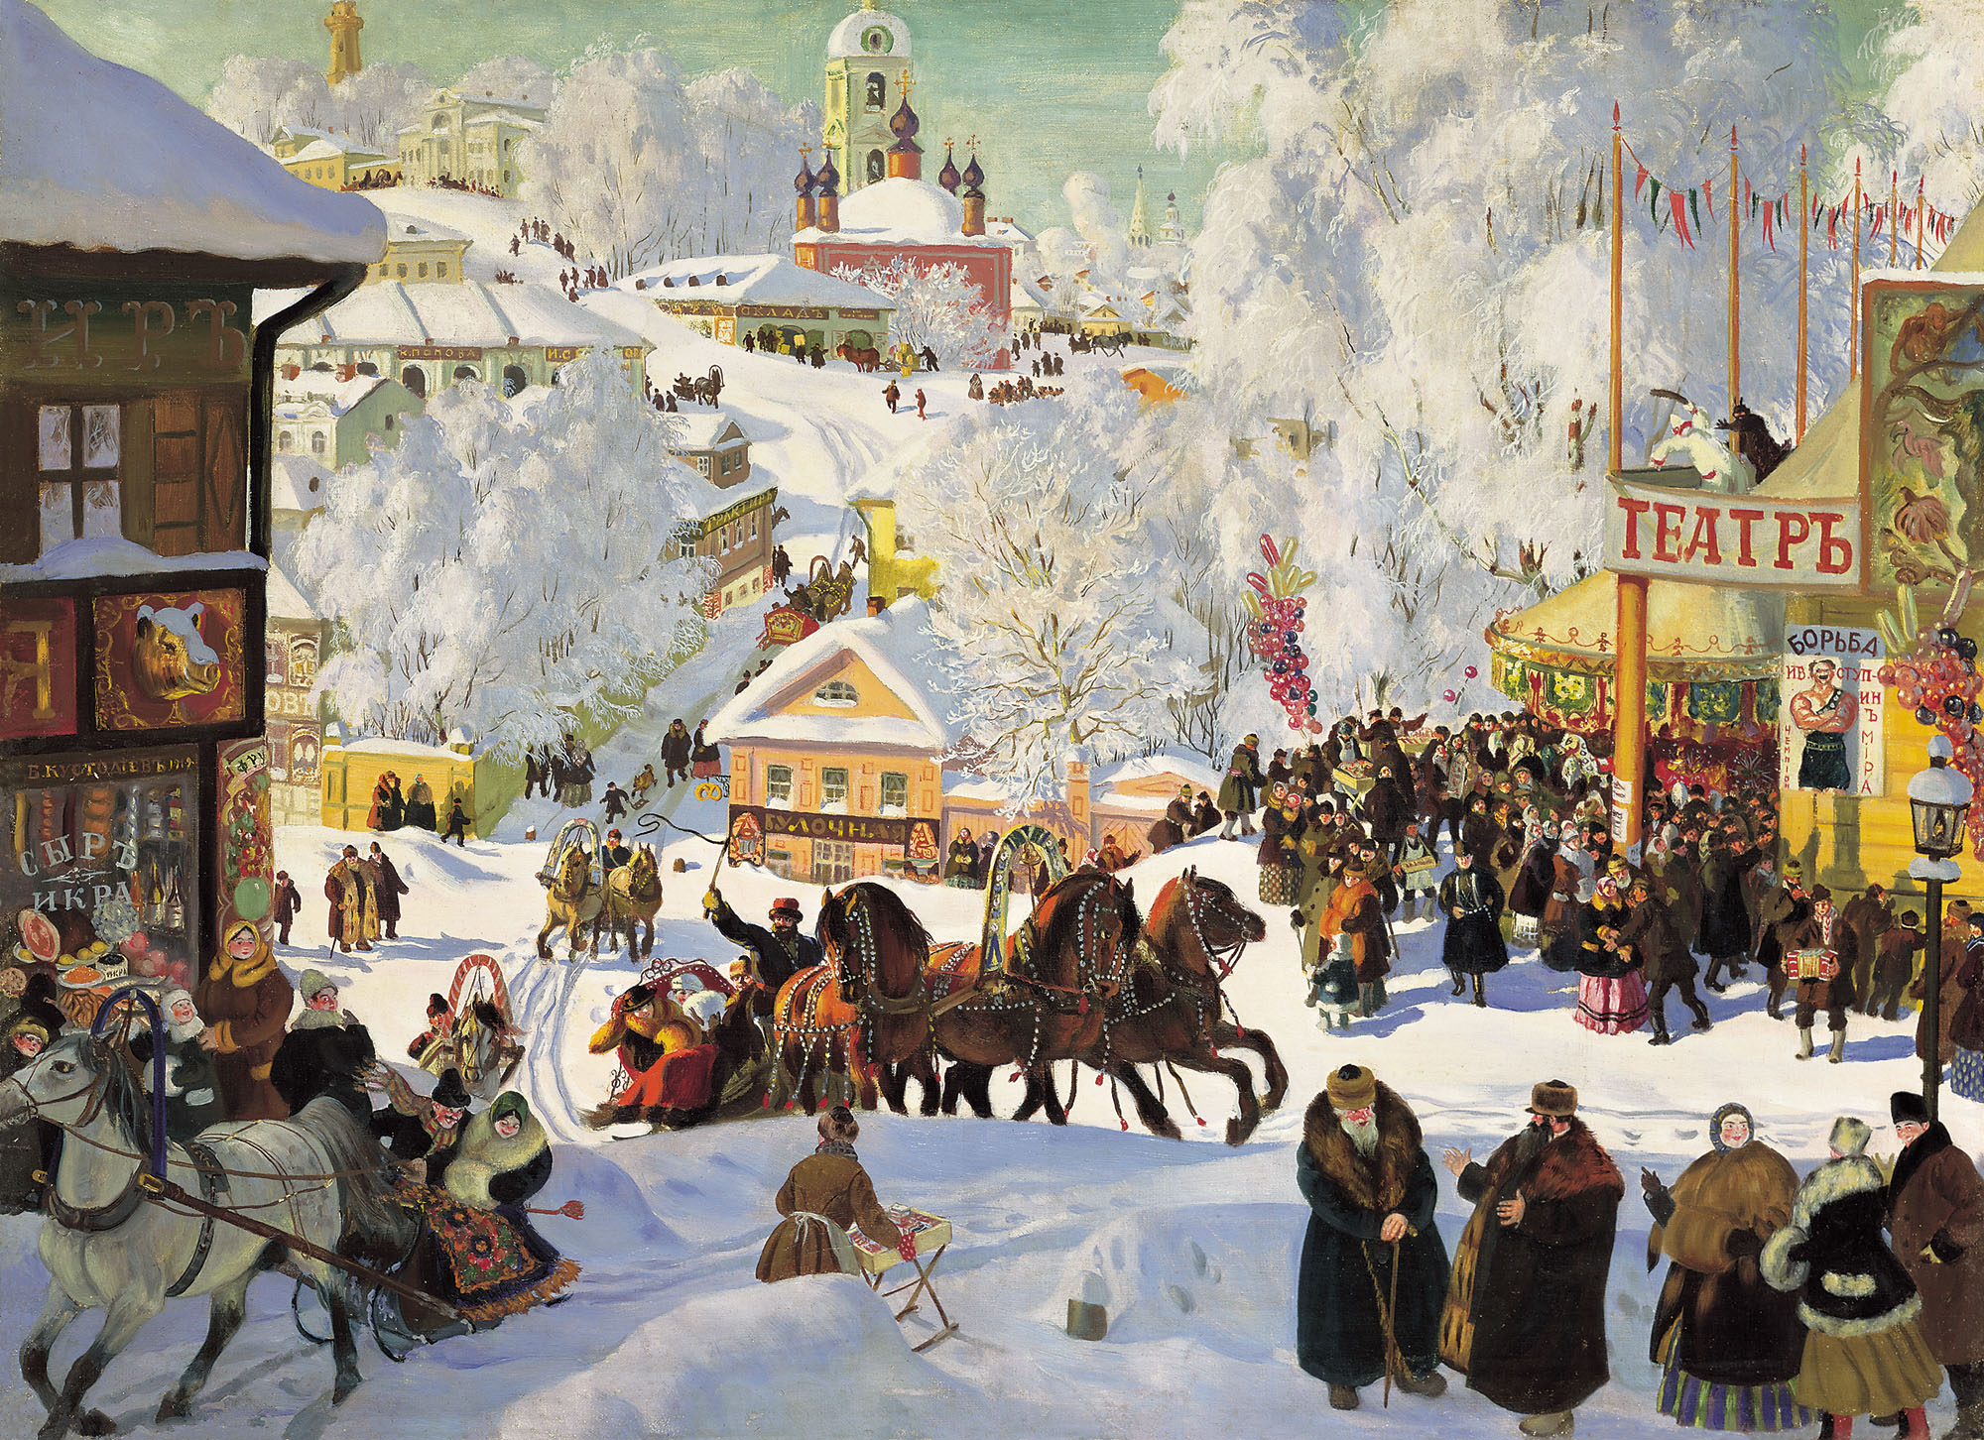
Tchaikovsky, Symphony No. 4 (1877-78), finale

Slide 4
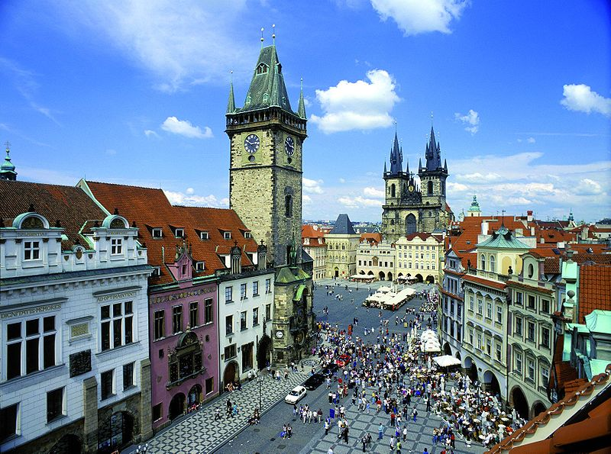
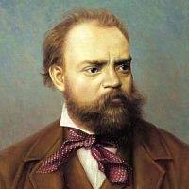
Dvořák, Symphony No. 8 (1889), scherzo

Slide 5
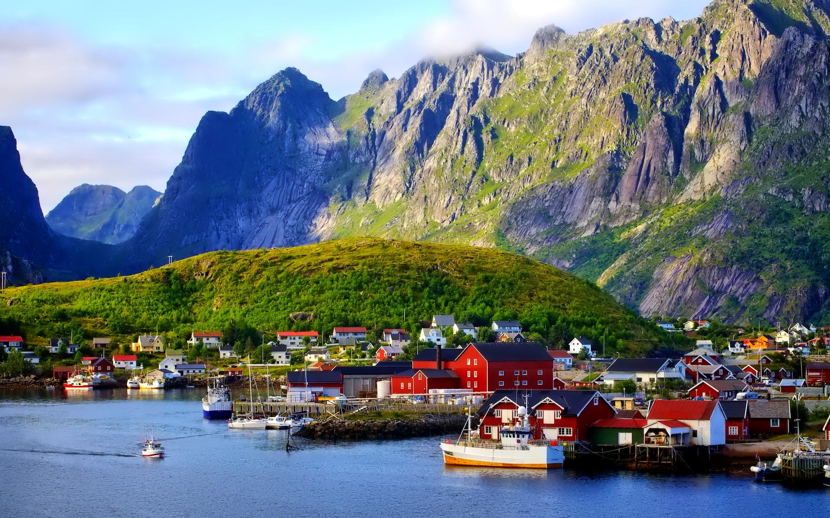
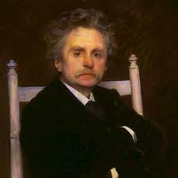
Grieg, Piano Concerto in A Minor (1968), finale
Evoked: the Norwegian “halling” music/dance type:
2/4, “stomping,” vigorous, athletic

Slide 6
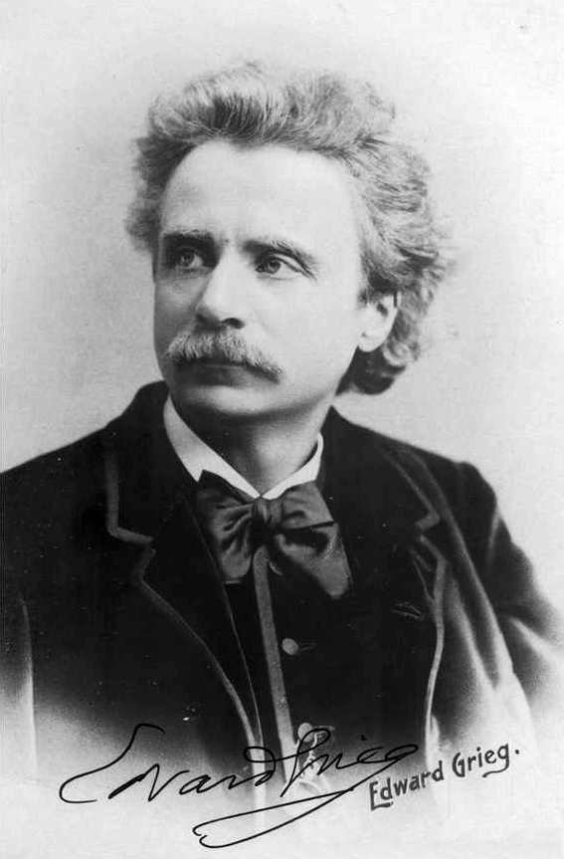
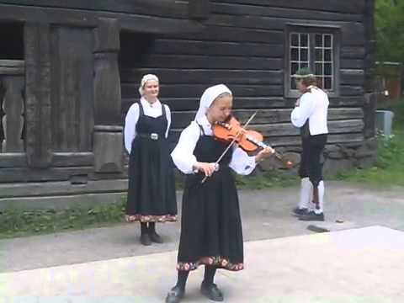
Grieg, “Spring Dance,” from Slåtter (Norwegian Dances), op. 72 (1902-03) (based on transcriptions from hardanger folk-fiddle music)

Slide 7
Nineteenth-Century European “Romantic Nationalism”

Slide 8
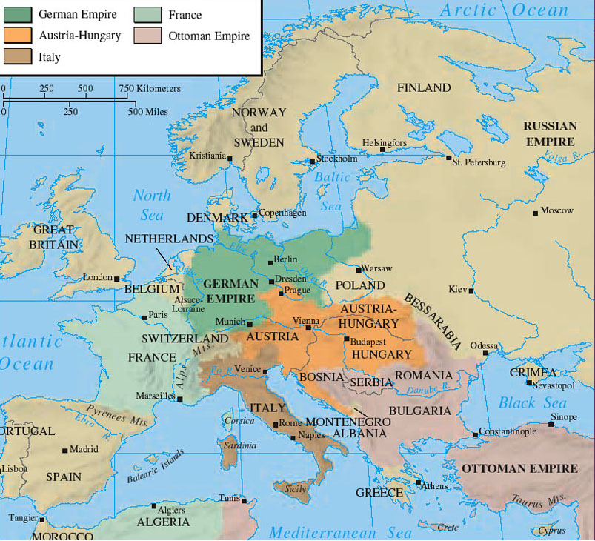
Nineteenth-Century European “Romantic Nationalism”
What is a “nation”?

Slide 9
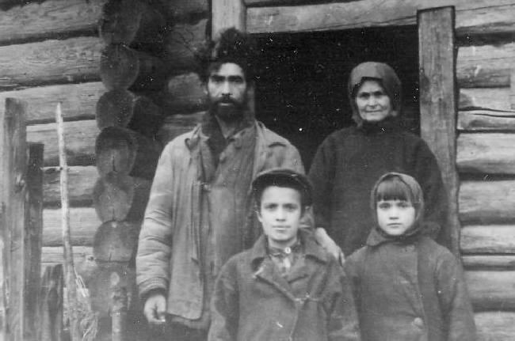
Nineteenth-Century European “Romantic Nationalism”
What is a “nation”?
What constitutes a cultural group and its sense of belonging and separateness?
(Who decides this?
And who decides who
doesn’t belong?)
Russia

Slide 10
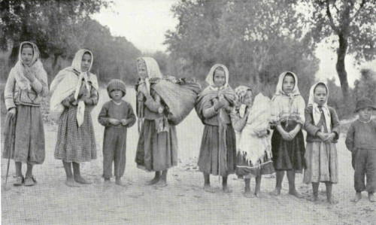
Nineteenth-Century European “Romantic Nationalism”
What is a “nation”?
What constitutes a cultural group and its sense of belonging and separateness?
(Who decides this?
And who decides who
doesn’t belong?)
Bohemia

Slide 11
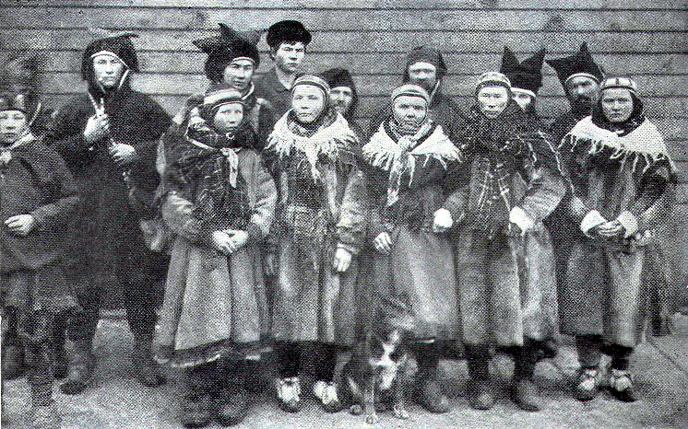
Nineteenth-Century European “Romantic Nationalism”
What is a “nation”?
What constitutes a cultural group and its sense of belonging and separateness?
(Who decides this?
And who decides who
doesn’t belong?)
“Norway”

Slide 12
Why did this nationalistic/folkloric surge (”Romantic nationalism”) well up so powerfully in the nineteenth century?

Slide 13
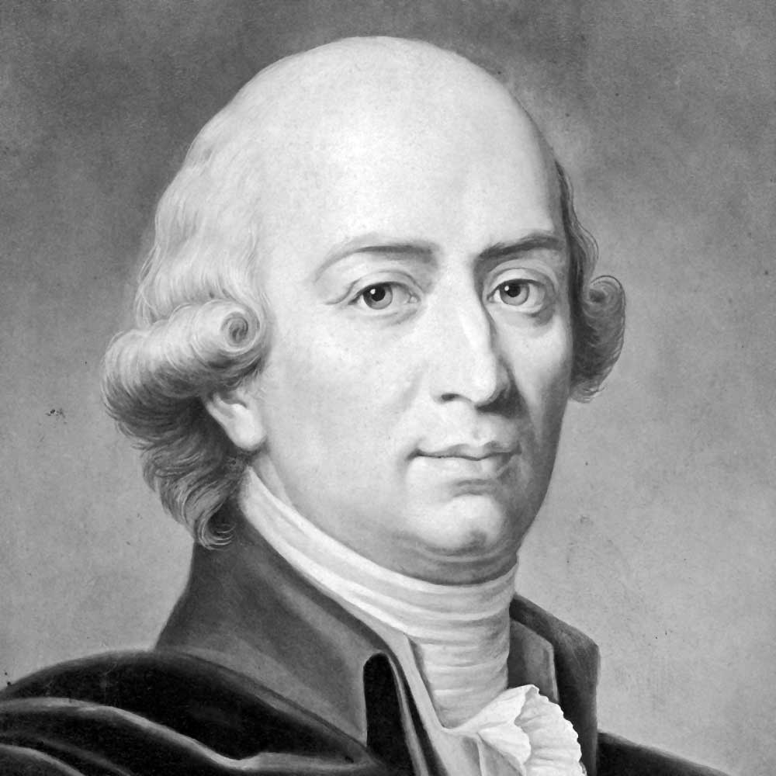
Why did this nationalistic/folkloric surge (”Romantic nationalism”) well up so powerfully in the nineteenth century?
One major source:
Johann Gottfried Herder (1744-1803)
Volk: A community of those who share the same language—reinforced by shared traditional customs, geography and climate, and historical memories.

Slide 14
Why did this nationalistic/folkloric surge (”Romantic nationalism”) well up so powerfully in the nineteenth century?
One major source:
In the 19th century, regional projects of national identity and ethnic legitimacy were primarily missions of educated, urban intellectuals and artists.
Johann Gottfried Herder (1744-1803)
Volk: A community of those who share the same language—reinforced by shared traditional customs, geography and climate, and historical memories.

Slide 15
Why did this nationalistic/folkloric surge (”Romantic nationalism”) well up so powerfully in the nineteenth century?
One major source:
In the 19th century, regional projects of national identity and ethnic legitimacy were primarily missions of educated, urban intellectuals and artists.
The aim: to discover (or, at times, to create) a sense of the “national soul”—and its claim to difference.
Johann Gottfried Herder (1744-1803)
Volk: A community of those who share the same language—reinforced by shared traditional customs, geography and climate, and historical memories.

Slide 16
Why did this nationalistic/folkloric surge (”Romantic nationalism”) well up so powerfully in the nineteenth century?
One major source:
In the 19th century, regional projects of national identity and ethnic legitimacy were primarily missions of educated, urban intellectuals and artists.
The aim: to discover (or, at times, to create) a sense of the “national soul”—and its claim to difference.
How? By recovering and systematizing native vernaculars (newly embraced as “our true language”); by cultivating the “authentic” spirit and style of non-urban, rustic cultures, pre-modern folk cultures; and so on.
Johann Gottfried Herder (1744-1803)
Volk: A community of those who share the same language—reinforced by shared traditional customs, geography and climate, and historical memories.

Slide 17
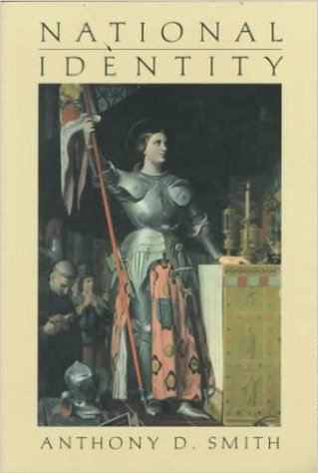
“Ethnic Nationalism”
“The main task of an ethnic intelligentsia [is] to mobilize a formerly passive community into forming a nation around the new vernacular historical culture that it has recovered” (64)

Slide 18
“Ethnic Nationalism”
“The main task of an ethnic intelligentsia [is] to mobilize a formerly passive community into forming a nation around the new vernacular historical culture that it has recovered” (64)
The method: “ethnosymbolism”: “summoning intellectuals everywhere to transform ‘low’ into ‘high’ cultures, oral into written . . . in order to preserve for posterity its fund of irreplaceable culture values” (84)

Slide 19
“Ethnic Nationalism”
“The main task of an ethnic intelligentsia [is] to mobilize a formerly passive community into forming a nation around the new vernacular historical culture that it has recovered” (64)
The method: “ethnosymbolism”: “summoning intellectuals everywhere to transform ‘low’ into ‘high’ cultures, oral into written . . . in order to preserve for posterity its fund of irreplaceable culture values” (84)
Cf. the concept of French writer Pierre Nora:
cultural artifacts, monuments, museums,
symbols, etc., as “sites of memory (lieux de mémoire)

Slide 20
Nineteenth-Century European “Romantic Nationalism”
(Capturing and Promoting the “National Soul”)

Slide 21
Nineteenth-Century European “Romantic Nationalism”
(Capturing and Promoting the “National Soul”)
Defining oneself by difference (language, history of one’s people, folk traditions and customs, culture)

Slide 22
Nineteenth-Century European “Romantic Nationalism”
(Capturing and Promoting the “National Soul”)
Defining oneself by difference (language, history of one’s people, folk traditions and customs, culture)
“Insiders”: markedly different from all other “outsider” cultures (especially from those who have political or cultural power over you)

Slide 23
Nineteenth-Century European “Romantic Nationalism”
(Capturing and Promoting the “National Soul”)
Defining oneself by difference (language, history of one’s people, folk traditions and customs, culture)
“Insiders”: markedly different from all other “outsider” cultures (especially from those who have political or cultural power over you)
Therefore: a self-other binary (Taruskin)

Slide 24
Nineteenth-Century European “Romantic Nationalism”
(Capturing and Promoting the “National Soul”)
Defining oneself by difference (language, history of one’s people, folk traditions and customs, culture)
“Insiders”: markedly different from all other “outsider” cultures (especially from those who have political or cultural power over you)
Therefore: a self-other binary (Taruskin)
Insistence: “‘They’ cannot define who ‘we’ are, authentically! ‘We’ will not fully assimilate into the ‘they!’”

Slide 25
Nineteenth-Century European “Romantic Nationalism”
(Capturing and Promoting the “National Soul”)
Defining oneself by difference (language, history of one’s people, folk traditions and customs, culture)
“Insiders”: markedly different from all other “outsider” cultures (especially from those who have political or cultural power over you)
Therefore: a self-other binary (Taruskin)
Insistence: “‘They’ cannot define who ‘we’ are, authentically! ‘We’ will not fully assimilate into the ‘they!’”
Among the badges of ethnic identity and difference: rural music, folk music (regarded as a “truth language,” as yet uncontaminated by the urban)

Slide 26
Nineteenth-Century European “Romantic Nationalism”
(Capturing and Promoting the “National Soul”)
Defining oneself by difference (language, history of one’s people, folk traditions and customs, culture)
“Insiders”: markedly different from all other “outsider” cultures (especially from those who have political or cultural power over you)
Therefore: a self-other binary (Taruskin)
Insistence: “‘They’ cannot define who ‘we’ are, authentically! ‘We’ will not fully assimilate into the ‘they!’”
Among the badges of ethnic identity and difference: rural music, folk music (regarded as a “truth language,” as yet uncontaminated by the urban)

Slide 27
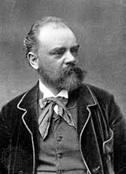
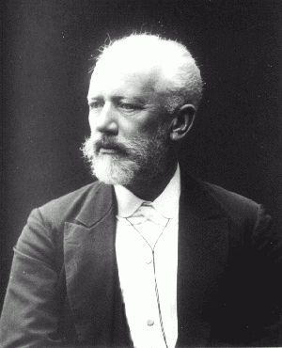
The Twofold Task of the 19th-Century Nationalist Composer:
Absorb and master the standard or cosmopolitan musical language of the era (conservatory practice) as a mark of competence

Slide 28
The Twofold Task of the 19th-Century Nationalist Composer:
Absorb and master the standard or cosmopolitan musical language of the era (conservatory practice) as a mark of competence
But “speak” that musical language with a self-conscious, culturally marked accent

Slide 29
The Three-Note Intervallic “Grieg Formula”
(or, for Grieg, a Melodic Norwegian Identifier --
Also a Characteristic Melodic Turn in Many Folk Melodies)
8 - 7 - 5
Tonic Leading Tone Dominant
“There is one characteristic of our folk music that I have always liked:
the treatment of the leading, especially when the note
Following the leading tone is the dominant.”
Edvard Grieg, 1900
Grieg, Symphonic Dances, Op. 64 no. 3 (1896-1898), Allegro giocoso

Slide 30
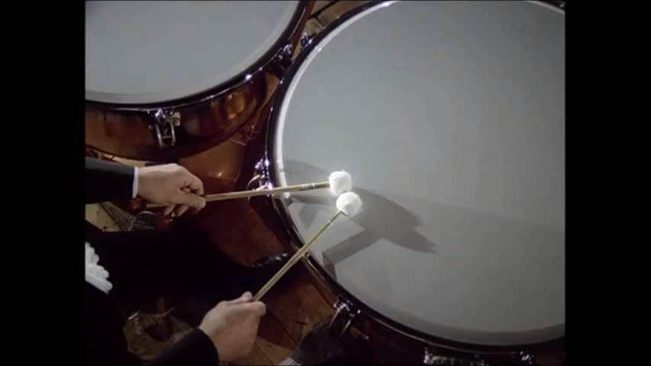
Grieg Formally Presents “Norway” to Larger Europe:
An Announcement of Arrival (Piano Concerto in A Minor, op. 68, 1868)
Ultra-Dramatic 8-7-5! Proclamation followed by a
Grandiloquent Solo Cadenza
in the Lisztian manner
Orchestra enters— with a somber, “Norwegian-inflected” march, soon blossoming into Schumannesque lyricism
Timpani Roll of Anticipation, Crescendo!
(“Here It Comes!”)
= “Norway!”

Slide 31
Grieg, Piano Concerto in A Minor (1968), finale
Evoked: the Norwegian “halling” music/dance type:
2/4, “stomping,” vigorous, athletic

Slide 32
Dvořák, Symphony No. 8 (1889), scherzo

Slide 33
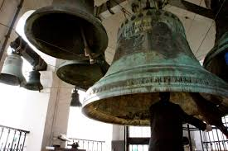
Musorgsky, Boris Godunov (1868-74), opening of the Coronation Scene

Slide 34
“Nationalist” Composers: The Double-Track of Reception
(Provincialism vs. Cosmopolitanism)
(Insiders vs. Outsiders)
Outsider or
small-nation subject seeking recognition
Composer as
self-appointed
representative
Addressed to:
Composer’s own country or region;
local understanding of cultural difference

Slide 35
“Nationalist” Composers: The Double-Track of Reception
(Provincialism vs. Cosmopolitanism)
(Insiders vs. Outsiders)
Outsider or
small-nation subject seeking recognition
Composer as
self-appointed
representative
“Yes: you are the voice of our identity to the larger nations.”
Addressed to:
Composer’s own country or region;
local understanding of cultural difference

Slide 36
“Nationalist” Composers: The Double-Track of Reception
(Provincialism vs. Cosmopolitanism)
(Insiders vs. Outsiders)
Outsider or
small-nation subject seeking recognition
Composer as
self-appointed
representative
A bid for larger-nation (Western European ) high-prestige recognition and acceptance; publication; performance; influence.
The consecrated traditions of Haydn, Mozart, Beethoven, Schubert, Schumann, Liszt, Wagner, etc.
Addressed to:
“Yes: you are the voice of our identity to the larger nations.”
Addressed to:
Composer’s own country or region;
local understanding of cultural difference

Slide 37
“Nationalist” Composers: The Double-Track of Reception
(Provincialism vs. Cosmopolitanism)
(Insiders vs. Outsiders)
Outsider or
small-nation subject seeking recognition
Composer as
self-appointed
representative
A bid for larger-nation (Western European ) high-prestige recognition and acceptance; publication; performance; influence.
The consecrated traditions of Haydn, Mozart, Beethoven, Schubert, Schumann, Liszt, Wagner, etc.
Addressed to:
“Yes. We recognize you. You do exist and are worthy of our attention.”
“Yes: you are the voice of our identity to the larger nations.”
Addressed to:
Composer’s own country or region;
local understanding of cultural difference

Slide 38
Negotiations
“They”
(Other)
The power-group insiders
The arbiters of judgment
“We”
(Self)
The proud outsider

Slide 39
Negotiations
“Let us in!—on our terms!”
“Open the door! Recognize us!”
“They”
(Other)
The power-group insiders
The arbiters of judgment
“We”
(Self)
The proud outsider

Slide 40
Negotiations
“Let us in!—on our terms!”
“Open the door! Recognize us!”
“They”
(Other)
The power-group insiders
The arbiters of judgment
“We”
(Self)
The proud outsider
“Yes! We do recognize you!
You do exist!”

Slide 41
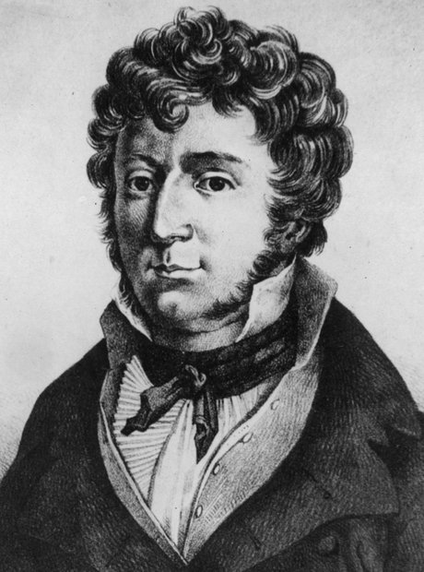
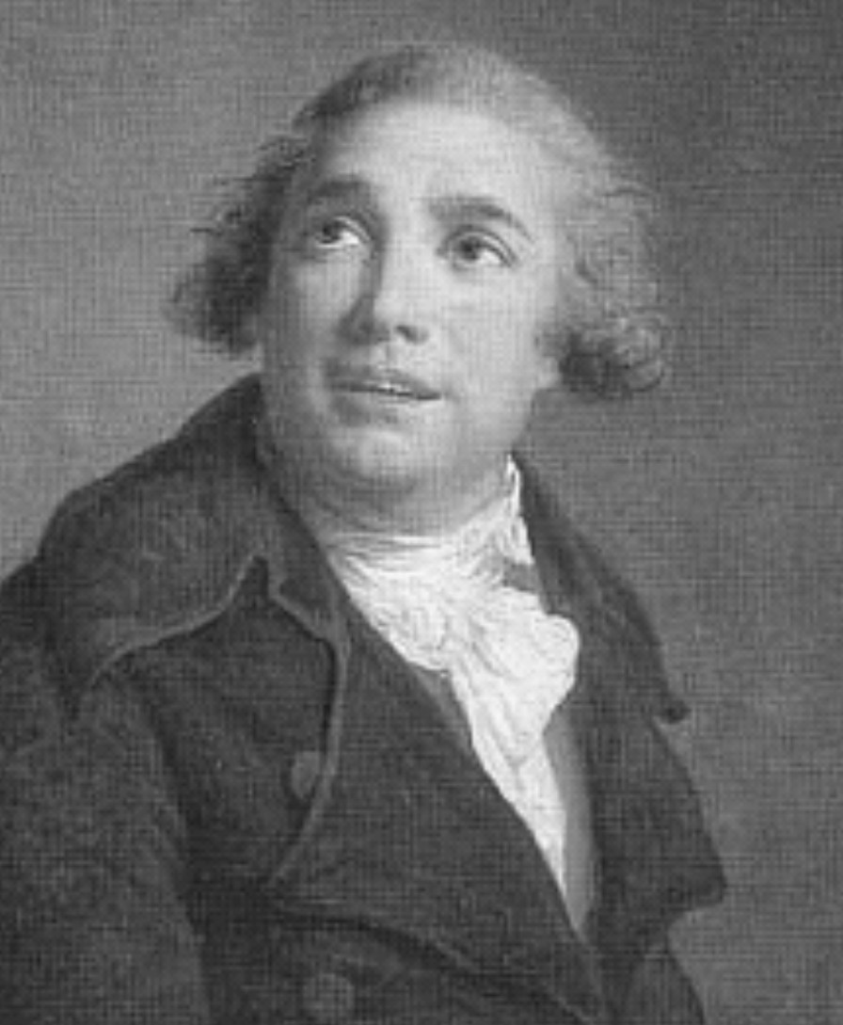
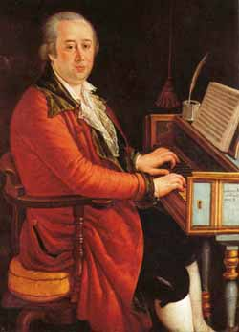
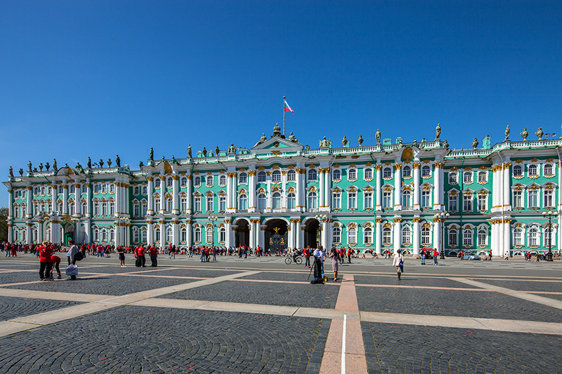
Giovanni Paisiello (1740-1816) Domenico Cimarosa (1749-1801) John Field (1782-1837)

Slide 42
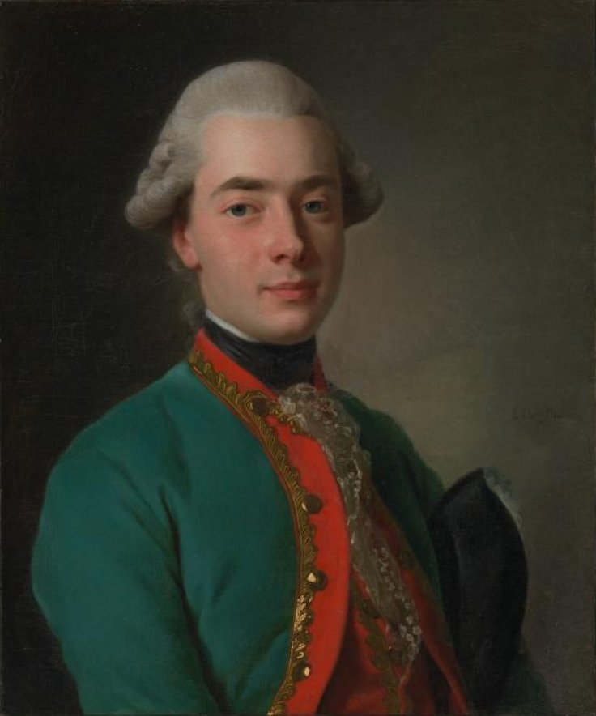
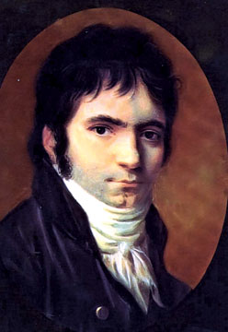
Count Andrey Razumovsky
Russian Ambassador to the Habsburg Court in Vienna
Beethoven, c. 1803
“Razumovsky” Quartets, op. 59 (1806)

Slide 43
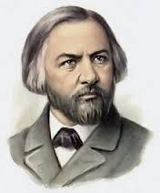
Mikhail Glinka (1804-57)

Slide 44
Mikhail Glinka (1804-57)
“Historical” “Magic”/”Fairy-Tale”
A Life for the Tsar (1836) Ruslan and Lyudmila (1842)

Slide 45
Mikhail Glinka (1804-57)
“Historical” “Magic”/”Fairy-Tale”
A Life for the Tsar (1836) Ruslan and Lyudmila (1842)
Musorgsky, Boris Godunov (1868-74)
Borodin, Prince Igor (1870s, 1880s)

Slide 46
Mikhail Glinka (1804-57)
“Historical” “Magic”/”Fairy-Tale”
A Life for the Tsar (1836) Ruslan and Lyudmila (1842)
Musorgsky, Boris Godunov (1868-74) Tchaikovsky Ballets
Borodin, Prince Igor (1870s, 1880s) Rimsky-Korsakov, Sheherazade (1889)
Stravinsky, Firebird (1910), Petrushka (1911)

Slide 47
Mikhail Glinka (1804-57)
“Historical” “Magic”/”Fairy-Tale”
A Life for the Tsar (1836) Ruslan and Lyudmila (1842)
Musorgsky, Boris Godunov (1868-74) Tchaikovsky Ballets
Borodin, Prince Igor (1870s, 1880s) Rimsky-Korsakov, Sheherazade (1889)
Stravinsky, Firebird (1910), Petrushka (1911)

Slide 48
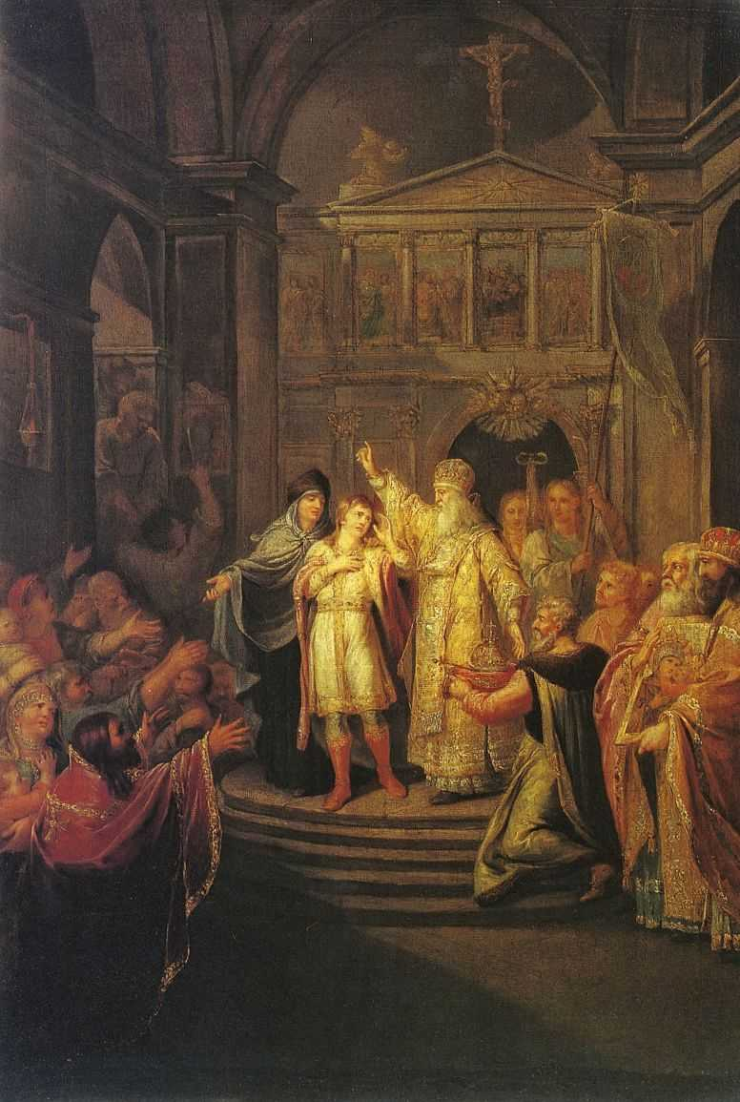
Glinka, A Life for the Tsar (1836)
Commemorates the founding of the Romanov Dynasty, 1612
Mikhail Romanov being offered the crown [1612]: painting by Grigory Ugryumov, 1800

Slide 49
Glinka, A Life for the Tsar (1836)
Commemorates the founding of the Romanov Dynasty, 1612
“Slav’sya” Chorus (“Glory”)
Mikhail Romanov being offered the crown [1612]: painting by Grigory Ugryumov, 1800

Slide 50
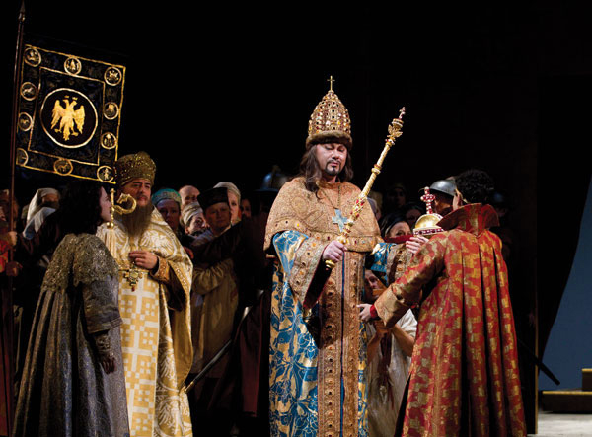
Musorgsky, Boris Godunov (1868-74)
Commemorates the coronation of Boris Godunov as tsar (1598)
“Slava” Chorus (“Glory”)
The (operatic) coronation

Slide 51
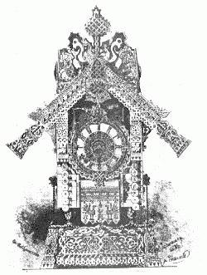
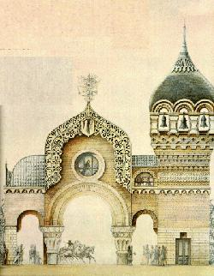
Musorgsky, Pictures at an Exhibition (1874, after pictures by Victor Hartmann)
“Baba Yaga” “The Great Gate of Kiev”

Slide 52
Musorgsky, Pictures at an Exhibition (1874, after pictures by Victor Hartmann)
“Baba Yaga” “The Great Gate of Kiev”

Slide 53
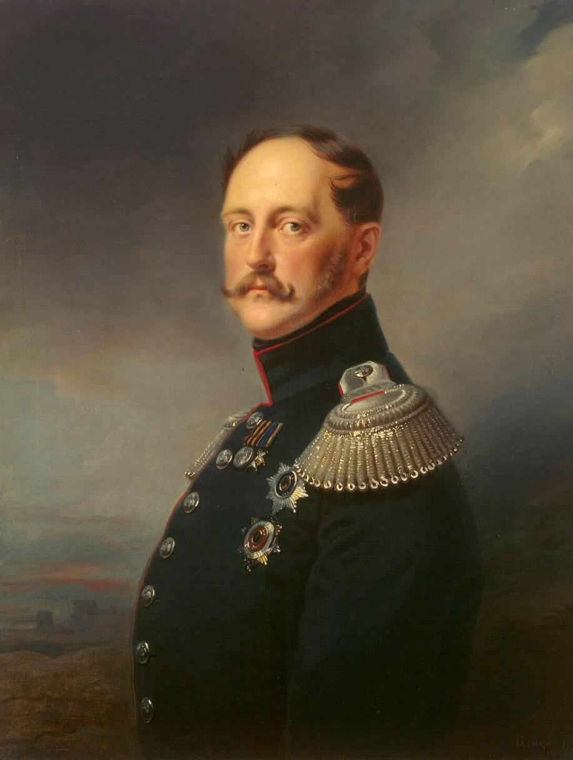
“Official Nationalism” (Top-Down)
Orthodoxy
Autocracy
Nationality
Tsar Nikolai I (reigned 1825-55)

Slide 54
Mikhail Glinka (1804-57)
“Historical” “Magic”/”Fairy-Tale”
A Life for the Tsar (1836) Ruslan and Lyudmila (1842)
Musorgsky, Boris Godunov (1868-74) Tchaikovsky Ballets
Borodin, Prince Igor (1870s, 1880s) Rimsky-Korsakov, Sheherazade (1889)
Stravinsky, Firebird (1910), Petrushka (1911)

Slide 55
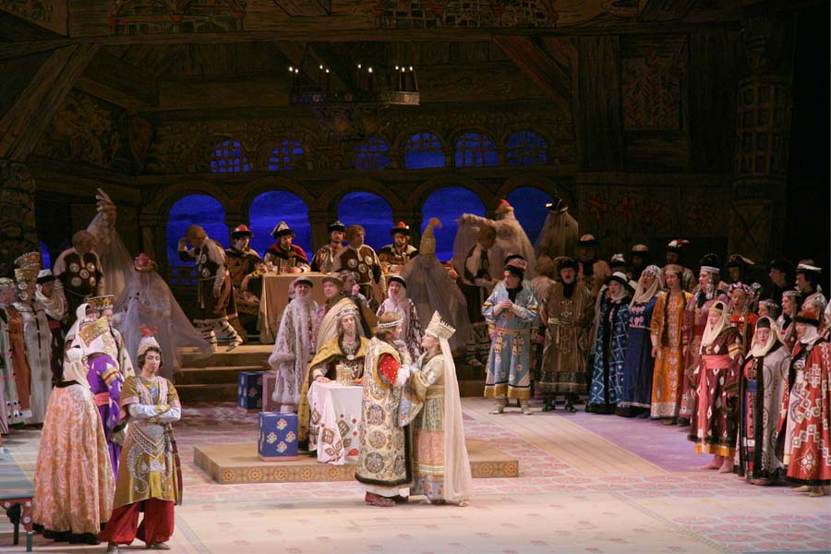
Glinka, Ruslan and Lyudmila (1842)

Slide 56
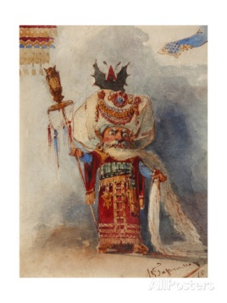
Glinka, Ruslan and Lyudmila (1842)
Chernomor

Slide 57
Glinka, Ruslan and Lyudmila (1842)
A mixture of distinct musical styles:
“Neutral”: the “official” musical language of Western European opera and orchestral works
“Russian”: evocations of Russian
folk styles
“Exotic”: musical flavors of differing “others,” many of whom were claimed within the Russian empire: “Central Asian”/”Orientalist,” Persian, Arabian, etc. (distinctively marked sounds, styles, orchestrations, melodic types)

Slide 58
Glinka, Overture to Ruslan and Lyudmila (1842)

Slide 59
Glinka, Overture to Ruslan and Lyudmila (1842)
Exposition: D ------- F (f) → Ab!

Slide 60
Glinka, Overture to Ruslan and Lyudmila (1842)
Exposition: D ------- F (f) → Ab!
Recapitulation: D ------- A! (a) → C!!

Slide 61
Glinka, Overture to Ruslan and Lyudmila (1842)
Exposition: D ------- F (f) → Ab!
Recapitulation: D ------- A! (a) → C!!
Coda includes: two prominent whole-tone descents
(= Chernomor!)

Slide 62
Glinka, Ruslan and Lyudmila (1842)
Chernomor: key-and scale manipulator

Slide 63
Glinka, Ruslan and Lyudmila (1842)
Chernomor: key-and scale manipulator
One identifier: the whole-tone collection

Slide 64
Glinka, Ruslan and Lyudmila (1842)
A mixture of distinct musical styles:
“Neutral”: the “official” musical language of Western European opera and orchestral works
“Russian”: evocations of Russian
folk styles
Sometimes includes: non-developmental
multiple repetitions of musical modules
“Exotic”: musical flavors of differing “others,” many of whom were claimed within the Russian empire: “Central Asian”/”Orientalist,” Persian, Arabian, etc. (distinctively marked sounds, styles, orchestrations, melodic types)

Slide 65
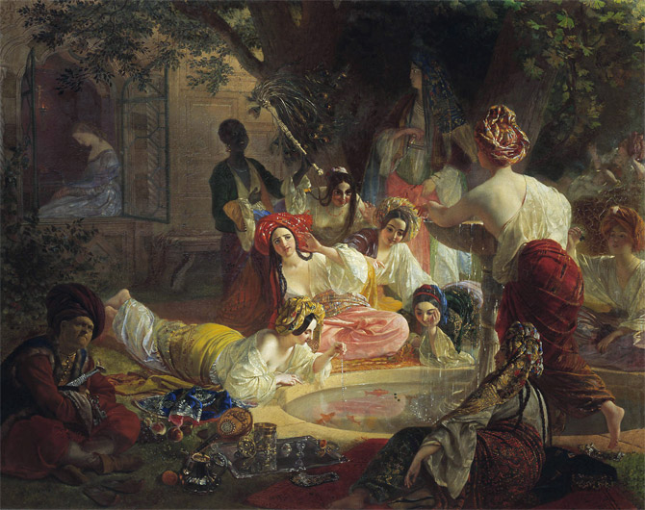
Persian Chorus from Glinka, Ruslan and Lyudmila (1842)

Slide 66
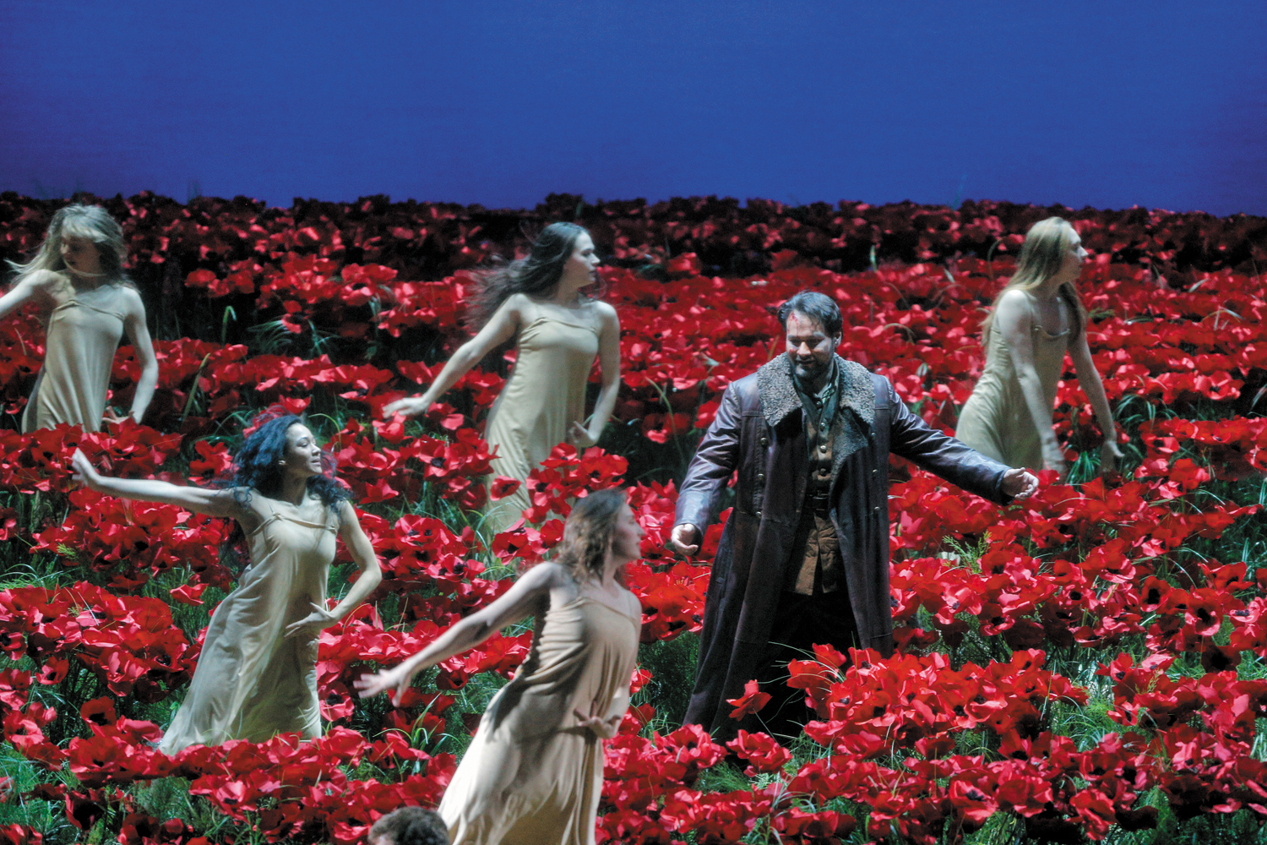
Borodin, Chorus of Polovtsian Maidens, from Prince Igor (1870s,1880s)

Slide 67
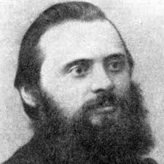
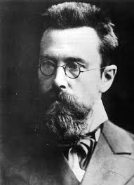
Balakirev, Islamey (1869-70)
Rimsky-Korsakov, Sheherazade (1888),
“The Young Prince and the Princess”

Slide 68
Kamarinskaya (Orchestral Fantasy, 1848)
Mikhail Glinka (1804-57)

Slide 69
Kamarinskaya (Orchestral Fantasy, 1848)
“Changing background technique”
= modular, nondevelopmental repetition
Mikhail Glinka (1804-57)

Slide 70
Kamarinskaya (Orchestral Fantasy, 1848)
“Changing background technique”
= modular, nondevelopmental repetition
Mikhail Glinka (1804-57)
Tchaikovsky, Symphony No. 2, finale

Slide 71
Kamarinskaya (Orchestral Fantasy, 1848)
“Changing background technique”
= modular, nondevelopmental repetition
Mikhail Glinka (1804-57)
Tchaikovsky, Symphony No. 2, finale
Tchaikovsky, Violin Concerto, finale

Slide 72
Kamarinskaya (Orchestral Fantasy, 1848)
“Changing background technique”
= modular, nondevelopmental repetition
Mikhail Glinka (1804-57)
Tchaikovsky, Symphony No. 2, finale
Tchaikovsky, Violin Concerto, finale
Stravinsky, The Firebird, finale

Slide 73
St. Petersburg (folklore, Romantic nationalism)
Moscow (more cosmopolitan, “international”)
Original kuchka, ca. 1858-71:
Mily Balakirev (leader of “amateur composers”)
Nikolay Rimsky-Korsakov
Aleksandr Borodin
Modest Musorgsky
César Cui
(initially: anti-institutional; emphasis on Russia’s claim of difference from the West)
1860s, 1870s, early 1880s
Anton Rubinstein
Pyotr Il’yich Tchaikovsky (but “early Tchaikovsky”—1860s and early 1870s—had some ties to Balakirev and the folkloric school)
(pro-institutional; more “Westernizing”)
1880s, 1890s, early 1900s: the “Belyaev Circle” in and around the St. Petersburg Conservatory:
Nikolay Rimsky-Korsakov (leader, now fully
professionalized)
Aleksandr Glazunov
Anatoly Lyadov
(formalization of the kuchka traditons: folklore,
“exotic” harmony, and orchestral color)
1880s, 1890s, early 1900s
Centering around the Moscow Conservatory and much influenced by the “style of Tchaikovsky.”
Anton Arensky
Sergey Taneyev
(virtuosity; dazzling showmanship; high craft)
Igor Stravinsky
Sergey Prokofiev
Sergey Rachmaninoff
Aleksandr Skryabin

