Slide 1
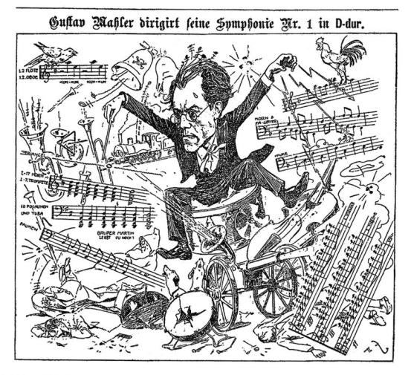
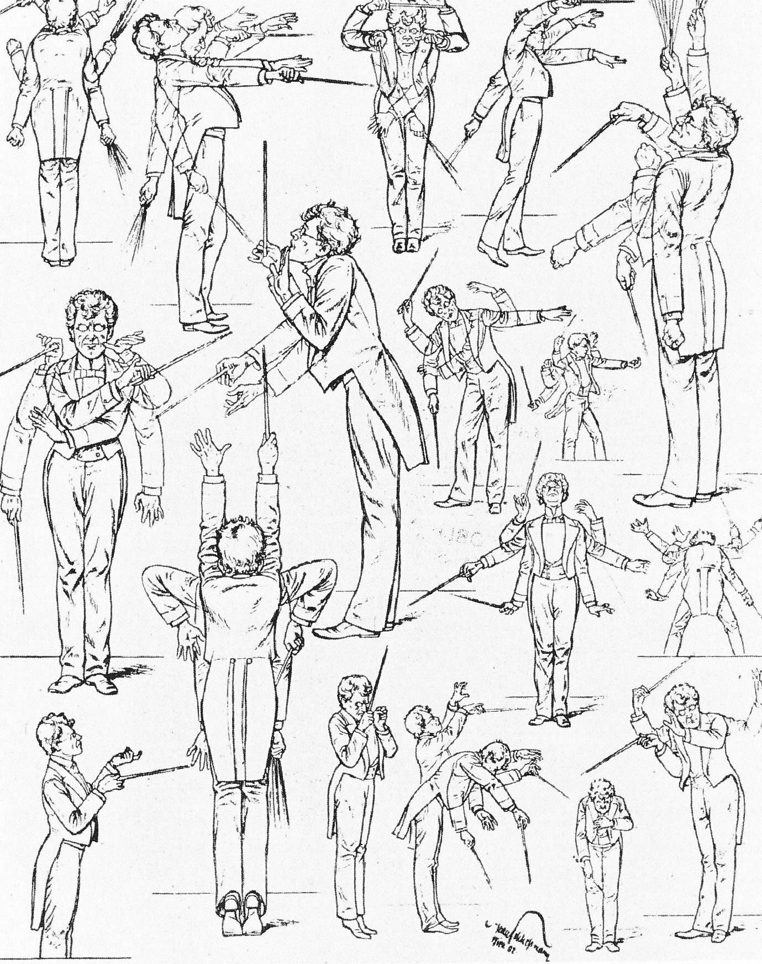
Vienna, 1900-01, Mahler Caricatures

Slide 2
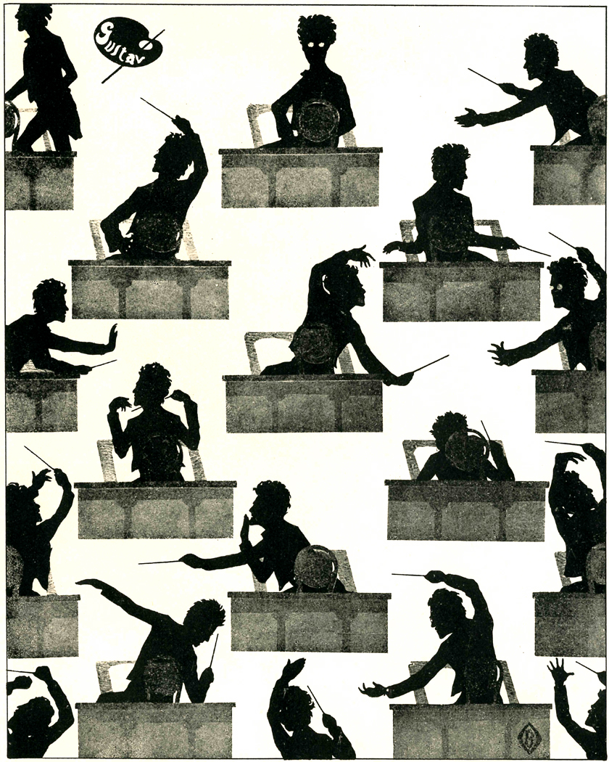
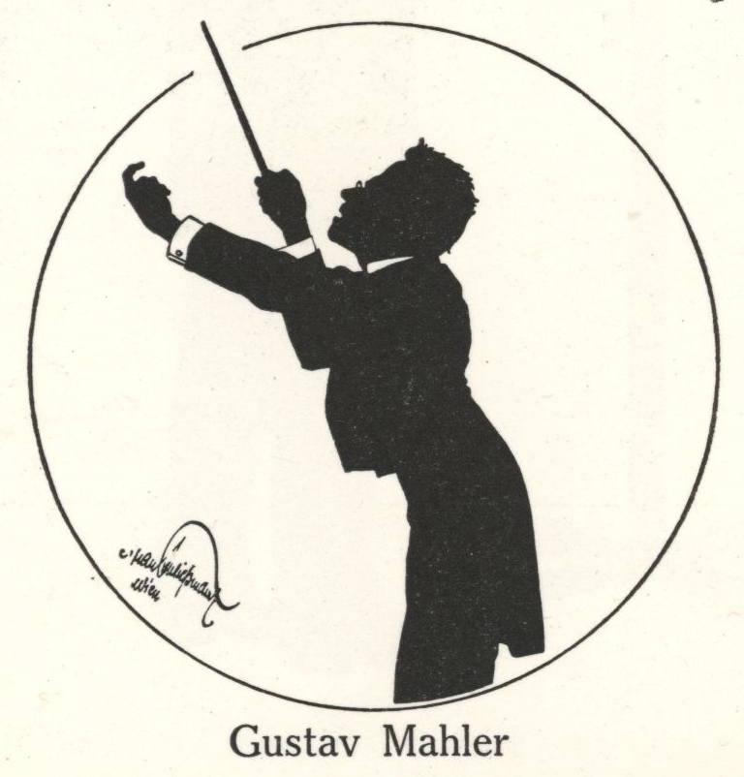

Slide 3
Mahler: Conducting Positions
1880-83: Linz, Laibach (Ljubljana [Slovenia])
1883: Olmütz (Olomouc, [Moravia])
1883-85: Kassel
1885-86: Prague
1886-88: Leipzig
1888-91: Budapest
1891-97: Hamburg
1897-1908: Vienna
1908-11: New York

Slide 4
Mahler: Conducting Positions
1880-83: Linz, Laibach (Ljubljana [Slovenia])
1883: Olmütz (Olomouc, [Moravia])
1883-85: Kassel
1885-86: Prague
1886-88: Leipzig
1888-91: Budapest
1891-97: Hamburg
1897-1908: Vienna
1908-11: New York
Years involving materials for the First Symphony

Slide 5
Mahler: Early Works Include:
Lieder und Gesänge (12 songs for voice and piano, 1880-81/1888-89; some were later orchestrated)
Lieder eines fahrenden Gesellen (song cycle, 4 songs, orig. 1884-85, rev. and orchestrated 1890s)
Early versions of what would become Symphony No. 1 (later 1880s-1897)
Todtenfeier (symphonic poem, 1888; would become the first movement of Symphony No. 2, 1890s)
Des Knaben Wunderhorn (song set, twelve songs for voice and orchestra, 1892-95; several would be incorporated into Symphonies 2-4)

Slide 6
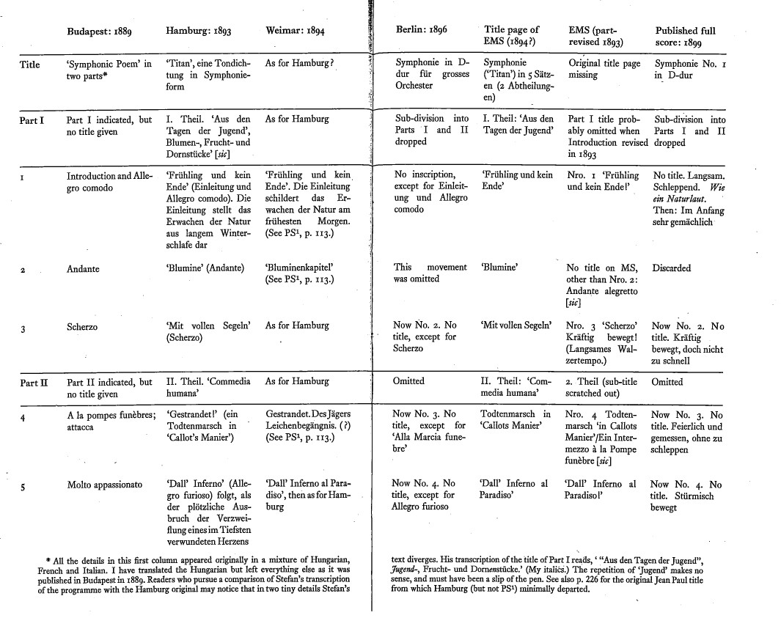
The Compositional History of Mahler, Symphony No. 1
(from Donald Mitchell, Gustav Mahler: The Wunderhorn Years, pp. 158-59)

Slide 7
The Compositional History of Mahler, Symphony No. 1
(from Donald Mitchell, Gustav Mahler: The Wunderhorn Years, pp. 158-59)

Slide 8
The Compositional History of Mahler, Symphony No. 1
(from Donald Mitchell, Gustav Mahler: The Wunderhorn Years, pp. 158-59)
“Abstract,”
four-movement, non-programmatic “symphony.”
1
2
3
4

Slide 9
The Compositional History of Mahler, Symphony No. 1
(from Donald Mitchell, Gustav Mahler: The Wunderhorn Years, pp. 158-59)
“Abstract,”
four-movement, non-programmatic “symphony.”
1
2
3
4

Slide 10
The Compositional History of Mahler, Symphony No. 1
(from Donald Mitchell, Gustav Mahler: The Wunderhorn Years, pp. 158-59)
“Abstract,”
four-movement, non-programmatic “symphony.”
1
2
3
4
Published only after completing Symphonies 2 and 3; Symphony 2 published two years earlier (1897); Symphony 3 also published in 1899.

Slide 11
The Compositional History of Mahler, Symphony No. 1
(from Donald Mitchell, Gustav Mahler: The Wunderhorn Years, pp. 158-59)
“Abstract,”
four-movement, non-programmatic “symphony.”
1
2
3
4
Published only after completing Symphonies 2 and 3; Symphony 2 published two years earlier (1897); Symphony 3 also published in 1899.
Mahler at this point becoming wary of making public any earlier programmatic or non-musical titles for the movements

Slide 12
The Compositional History of Mahler, Symphony No. 1
(from Donald Mitchell, Gustav Mahler: The Wunderhorn Years, pp. 158-59)
“Abstract,”
four-movement, non-programmatic “symphony.”
1
2
3
4
Published only after completing Symphonies 2 and 3; Symphony 2 published two years earlier (1897); Symphony 3 also published in 1899.
Mahler at this point becoming wary of making public any earlier programmatic or non-musical titles for the movements
Autograph manuscript for this published version now lost

Slide 13
The Compositional History of Mahler, Symphony No. 1
(from Donald Mitchell, Gustav Mahler: The Wunderhorn Years, pp. 158-59)
“Abstract,”
four-movement, non-programmatic “symphony.”
Published only after completing Symphonies 2 and 3; Symphony 2 published two years earlier (1897); Symphony 3 also published in 1899.
Mahler at this point becoming wary of making public any earlier programmatic or non-musical titles for the movements
Autograph manuscript for this published version now lost

Slide 14
Mahler: Conducting Positions
1880-83: Linz, Laibach (Ljubljana [Slovenia])
1883: Olmütz (Olomouc, [Moravia])
1883-85: Kassel
1885-86: Prague
1886-88: Leipzig
1888-91: Budapest
1891-97: Hamburg
1897-1908: Vienna
1908-11: New York

Slide 15
The Compositional History of Mahler, Symphony No. 1
(from Donald Mitchell, Gustav Mahler: The Wunderhorn Years, pp. 158-59)
“Abstract,”
four-movement, non-programmatic “symphony.”
Published only after completing Symphonies 2 and 3; Symphony 2 published two years earlier (1897); Symphony 3 also published in 1899.
Mahler at this point becoming wary of making public any earlier programmatic or non-musical titles for the movements
Autograph manuscript for this published version now lost

Slide 16
The Compositional History of Mahler, Symphony No. 1
(from Donald Mitchell, Gustav Mahler: The Wunderhorn Years, pp. 158-59)
“Abstract,”
four-movement, non-programmatic “symphony.”
Not an abstract
“symphony”
Published only after completing Symphonies 2 and 3; Symphony 2 published two years earlier (1897); Symphony 3 also published in 1899.
Mahler at this point becoming wary of making public any earlier programmatic or non-musical titles for the movements
Autograph manuscript for this published version now lost

Slide 17
The Compositional History of Mahler, Symphony No. 1
(from Donald Mitchell, Gustav Mahler: The Wunderhorn Years, pp. 158-59)
“Abstract,”
four-movement, non-programmatic “symphony.”
Not an abstract
“symphony”
Published only after completing Symphonies 2 and 3; Symphony 2 published two years earlier (1897); Symphony 3 also published in 1899.
Mahler at this point becoming wary of making public any earlier programmatic or non-musical titles for the movements
Autograph manuscript for this published version now lost
Autograph manuscript lost

Slide 18
The Compositional History of Mahler, Symphony No. 1
(from Donald Mitchell, Gustav Mahler: The Wunderhorn Years, pp. 158-59)
“Abstract,”
four-movement, non-programmatic “symphony.”
Not an abstract
“symphony”
Published only after completing Symphonies 2 and 3; Symphony 2 published two years earlier (1897); Symphony 3 also published in 1899.
Mahler at this point becoming wary of making public any earlier programmatic or non-musical titles for the movements
Autograph manuscript for this published version now lost
Autograph manuscript lost
A manuscript copy of movements
1, 3, and 5 came to light at the Univ. of Western Ontario in the 1990s; portions are quite different from the final version.

Slide 19
The Compositional History of Mahler, Symphony No. 1
(from Donald Mitchell, Gustav Mahler: The Wunderhorn Years, pp. 158-59)
Autograph manuscript
at Yale
“Abstract,”
four-movement, non-programmatic “symphony.”
Not an abstract
“symphony”
Published only after completing Symphonies 2 and 3; Symphony 2 published two years earlier (1897); Symphony 3 also published in 1899.
Mahler at this point becoming wary of making public any earlier programmatic or non-musical titles for the movements
Autograph manuscript for this published version now lost

Slide 20
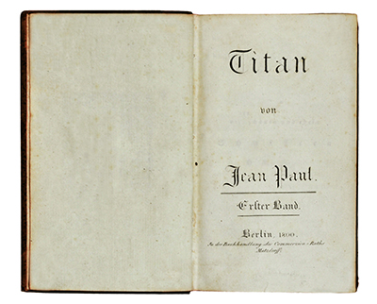

Slide 21
The Compositional History of Mahler, Symphony No. 1
(from Donald Mitchell, Gustav Mahler: The Wunderhorn Years, pp. 158-59)
Autograph manuscript
at Yale
“Abstract,”
four-movement, non-programmatic “symphony.”
Not an abstract
“symphony”
Published only after completing Symphonies 2 and 3; Symphony 2 published two years earlier (1897); Symphony 3 also published in 1899.
Mahler at this point becoming wary of making public any earlier programmatic or non-musical titles for the movements
Autograph manuscript for this published version now lost

Slide 22
The Compositional History of Mahler, Symphony No. 1
(from Donald Mitchell, Gustav Mahler: The Wunderhorn Years, pp. 158-59)
Autograph manuscript
at Yale
“Abstract,”
four-movement, non-programmatic “symphony.”
Not an abstract
“symphony”
Published only after completing Symphonies 2 and 3; Symphony 2 published two years earlier (1897); Symphony 3 also published in 1899.
Mahler at this point becoming wary of making public any earlier programmatic or non-musical titles for the movements
Autograph manuscript for this published version now lost

Slide 23
The Compositional History of Mahler, Symphony No. 1
(from Donald Mitchell, Gustav Mahler: The Wunderhorn Years, pp. 158-59)
Autograph manuscript
at Yale
“Abstract,”
four-movement, non-programmatic “symphony.”
Not an abstract
“symphony”
Published only after completing Symphonies 2 and 3; Symphony 2 published two years earlier (1897); Symphony 3 also published in 1899.
Mahler at this point becoming wary of making public any earlier programmatic or non-musical titles for the movements
Autograph manuscript for this published version now lost

Slide 24
The Compositional History of Mahler, Symphony No. 1
(from Donald Mitchell, Gustav Mahler: The Wunderhorn Years, pp. 158-59)
Autograph manuscript
at Yale
“Abstract,”
four-movement, non-programmatic “symphony.”
Not an abstract
“symphony”
Published only after completing Symphonies 2 and 3; Symphony 2 published two years earlier (1897); Symphony 3 also published in 1899.
Mahler at this point becoming wary of making public any earlier programmatic or non-musical titles for the movements
Autograph manuscript for this published version now lost

Slide 25
The Compositional History of Mahler, Symphony No. 1
(from Donald Mitchell, Gustav Mahler: The Wunderhorn Years, pp. 158-59)
Autograph manuscript
at Yale
“Abstract,”
four-movement, non-programmatic “symphony.”
Not an abstract
“symphony”
Published only after completing Symphonies 2 and 3; Symphony 2 published two years earlier (1897); Symphony 3 also published in 1899.
Mahler at this point becoming wary of making public any earlier programmatic or non-musical titles for the movements
Autograph manuscript for this published version now lost

Slide 26
The Compositional History of Mahler, Symphony No. 1
(from Donald Mitchell, Gustav Mahler: The Wunderhorn Years, pp. 158-59)
Autograph manuscript
at Yale
“Abstract,”
four-movement, non-programmatic “symphony.”
Not an abstract
“symphony”
Published only after completing Symphonies 2 and 3; Symphony 2 published two years earlier (1897); Symphony 3 also published in 1899.
Mahler at this point becoming wary of making public any earlier programmatic or non-musical titles for the movements
Autograph manuscript for this published version now lost

Slide 27
Mahler, “Titan,” a Tone Poem in Symphony Form (Hamburg 1893),
Movement 4 (beginning of Part Two, “The Human Comedy”
Jacques Callot ([17th c. French engraver])
Moritz von Schwind (woodcut, 1850), “The Huntsman’s Funeral Procession”
(included in children’s books of the later 19th century)
(cf. E.T.A. Hoffmann, “Phantasiestücke in Callot’s Manier”)

Slide 28
The Compositional History of Mahler, Symphony No. 1
(from Donald Mitchell, Gustav Mahler: The Wunderhorn Years, pp. 158-59)
Autograph manuscript
at Yale
“Abstract,”
four-movement, non-programmatic “symphony.”
Not an abstract
“symphony”
Published only after completing Symphonies 2 and 3; Symphony 2 published two years earlier (1897); Symphony 3 also published in 1899.
Mahler at this point becoming wary of making public any earlier programmatic or non-musical titles for the movements
Autograph manuscript for this published version now lost

Slide 29
The Compositional History of Mahler, Symphony No. 1
(from Donald Mitchell, Gustav Mahler: The Wunderhorn Years, pp. 158-59)
Autograph manuscript
at Yale
“Abstract,”
four-movement, non-programmatic “symphony.”
Not an abstract
“symphony”
Published only after completing Symphonies 2 and 3; Symphony 2 published two years earlier (1897); Symphony 3 also published in 1899.
Mahler at this point becoming wary of making public any earlier programmatic or non-musical titles for the movements
Autograph manuscript for this published version now lost

Slide 30
The Compositional History of Mahler, Symphony No. 1
(from Donald Mitchell, Gustav Mahler: The Wunderhorn Years, pp. 158-59)
“Abstract,”
four-movement, non-programmatic “symphony.”
Not an abstract
“symphony”
Published only after completing Symphonies 2 and 3; Symphony 2 published two years earlier (1897); Symphony 3 also published in 1899.
Mahler at this point becoming wary of making public any earlier programmatic or non-musical titles for the movements
Autograph manuscript for this published version now lost

Slide 31
The Compositional History of Mahler, Symphony No. 1
(from Donald Mitchell, Gustav Mahler: The Wunderhorn Years, pp. 158-59)
“Abstract,”
four-movement, non-programmatic “symphony.”
Not an abstract
“symphony”
Published only after completing Symphonies 2 and 3; Symphony 2 published two years earlier (1897); Symphony 3 also published in 1899.
Mahler at this point becoming wary of making public any earlier programmatic or non-musical titles for the movements
Autograph manuscript for this published version now lost

Slide 32
The Compositional History of Mahler, Symphony No. 1
(from Donald Mitchell, Gustav Mahler: The Wunderhorn Years, pp. 158-59)
“Abstract,”
four-movement, non-programmatic “symphony.”
Not an abstract
“symphony”
Published only after completing Symphonies 2 and 3; Symphony 2 published two years earlier (1897); Symphony 3 also published in 1899.
Mahler at this point becoming wary of making public any earlier programmatic or non-musical titles for the movements
Autograph manuscript for this published version now lost

Slide 33
The Compositional History of Mahler, Symphony No. 1
(from Donald Mitchell, Gustav Mahler: The Wunderhorn Years, pp. 158-59)
“Abstract,”
four-movement, non-programmatic “symphony.”
Not an abstract
“symphony”
Published only after completing Symphonies 2 and 3; Symphony 2 published two years earlier (1897); Symphony 3 also published in 1899.
Mahler at this point becoming wary of making public any earlier programmatic or non-musical titles for the movements
Autograph manuscript for this published version now lost

Slide 34
The Compositional History of Mahler, Symphony No. 1
(from Donald Mitchell, Gustav Mahler: The Wunderhorn Years, pp. 158-59)
“Abstract,”
four-movement, non-programmatic “symphony.”
Not an abstract
“symphony”
1
2
3
4
Published only after completing Symphonies 2 and 3; Symphony 2 published two years earlier (1897); Symphony 3 also published in 1899.
Mahler at this point becoming wary of making public any earlier programmatic or non-musical titles for the movements
Autograph manuscript for this published version now lost

Slide 35
Vienna, 1900-01, Mahler Caricatures

Slide 36
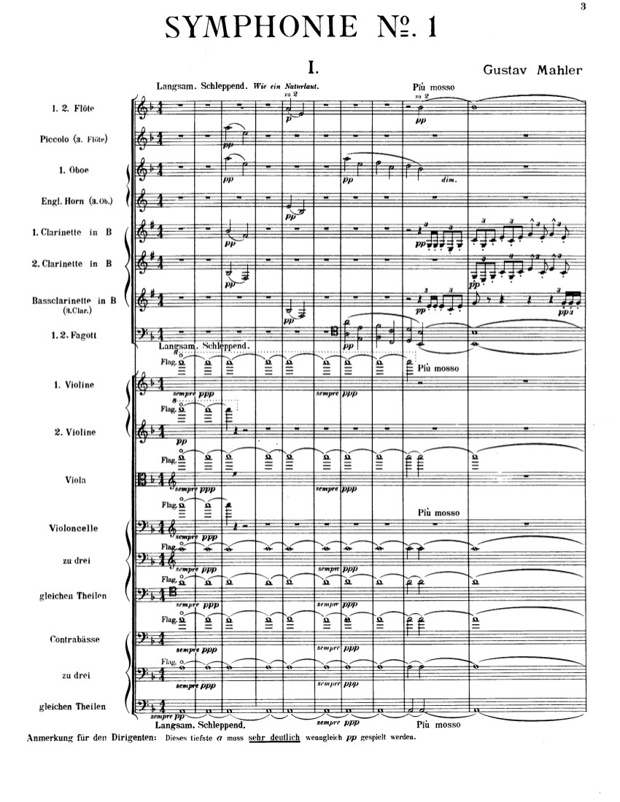
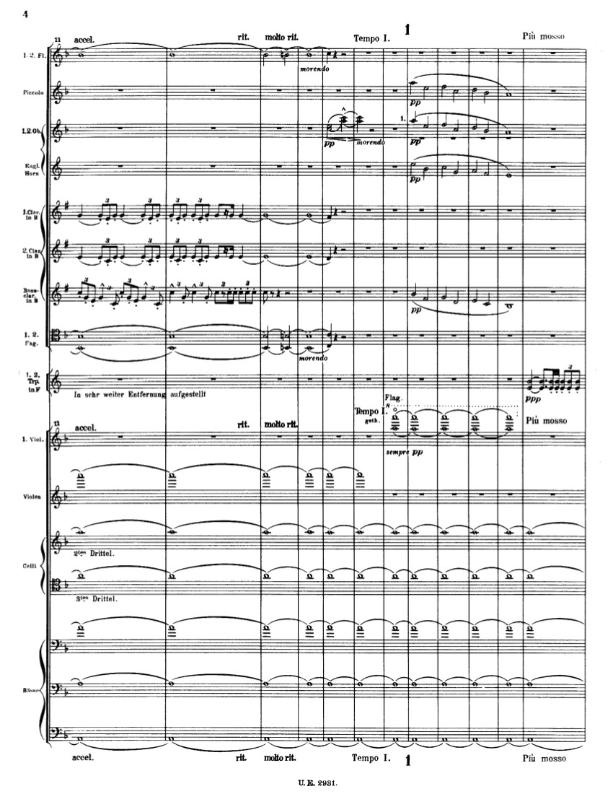
Introduction: the awakening of spring from a long winter’s sleep
“Suspension” of time = Stasis slowly unfreezing
1893 = horns, not clarinets!
Rotation 2
Rotation 1
“fourth-motive”
“Command to awaken!”
“another command to awaken!”
1893 = not yet string harmonics
= v of D minor? key?

Slide 37
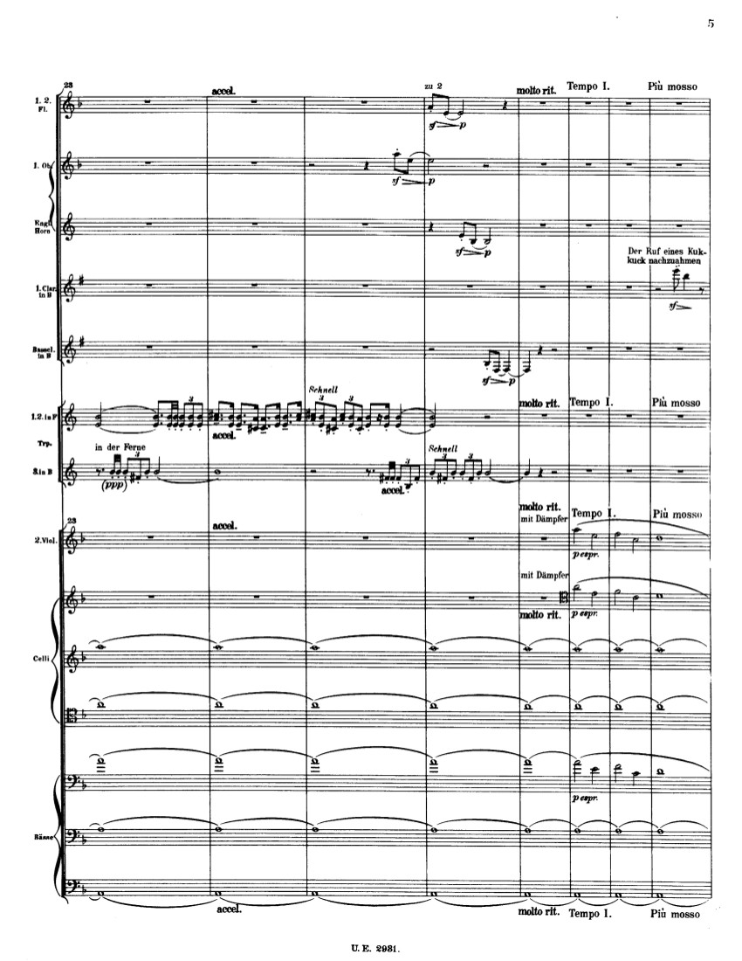
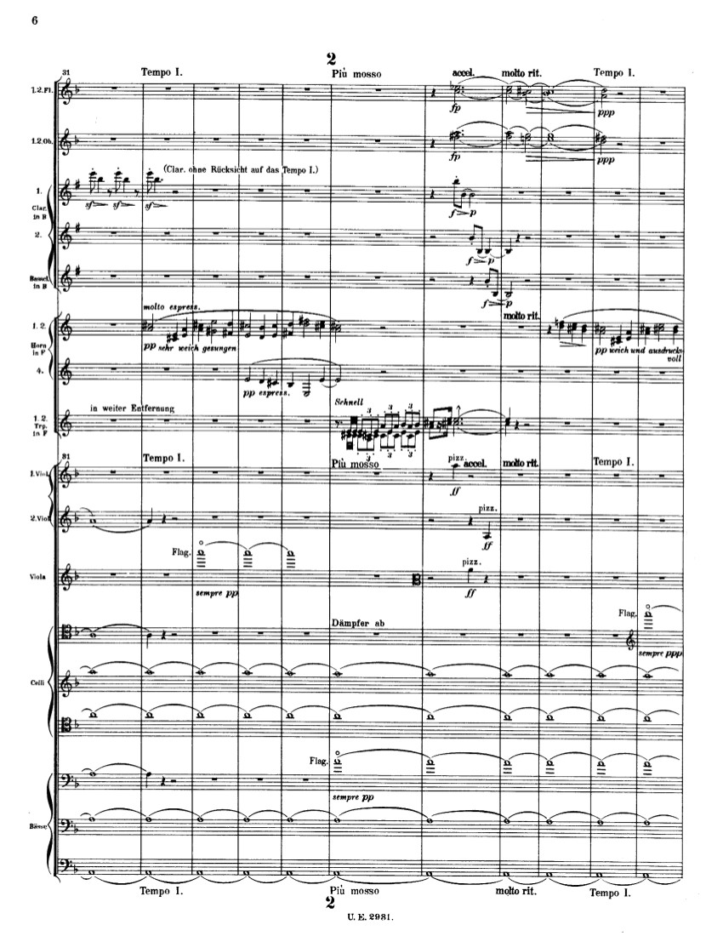
Suddenness: “cuckoo” call as descending fourth: symbol of life awakening
The thaw begins—life begins to be jostled awake
Rotation 3
Again but more emphatic: “cuckoo” call as descending fourth: symbol of life awakening
“the goal”; a potential D major (still distant)?
Horns “Forest” (Waldhorn)

Slide 38
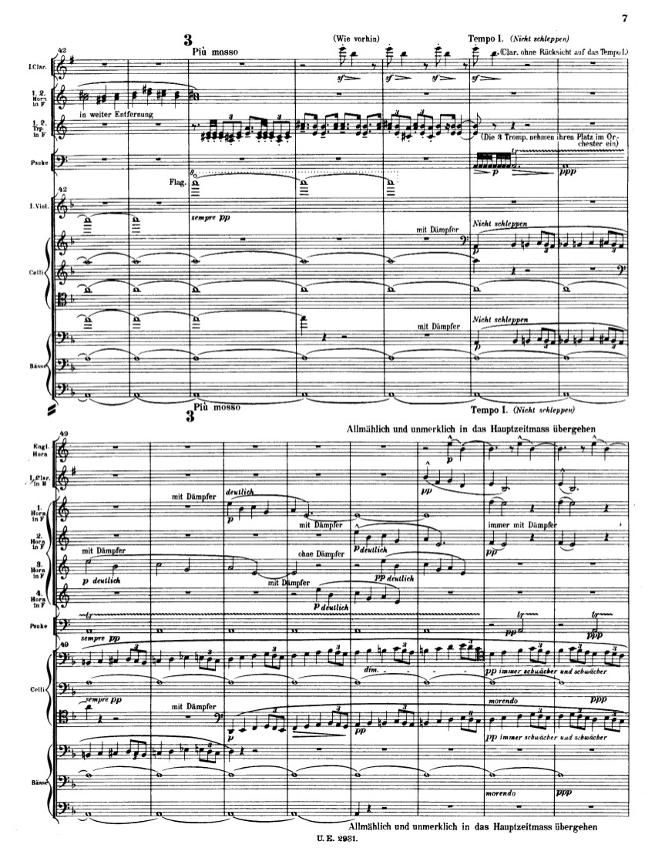
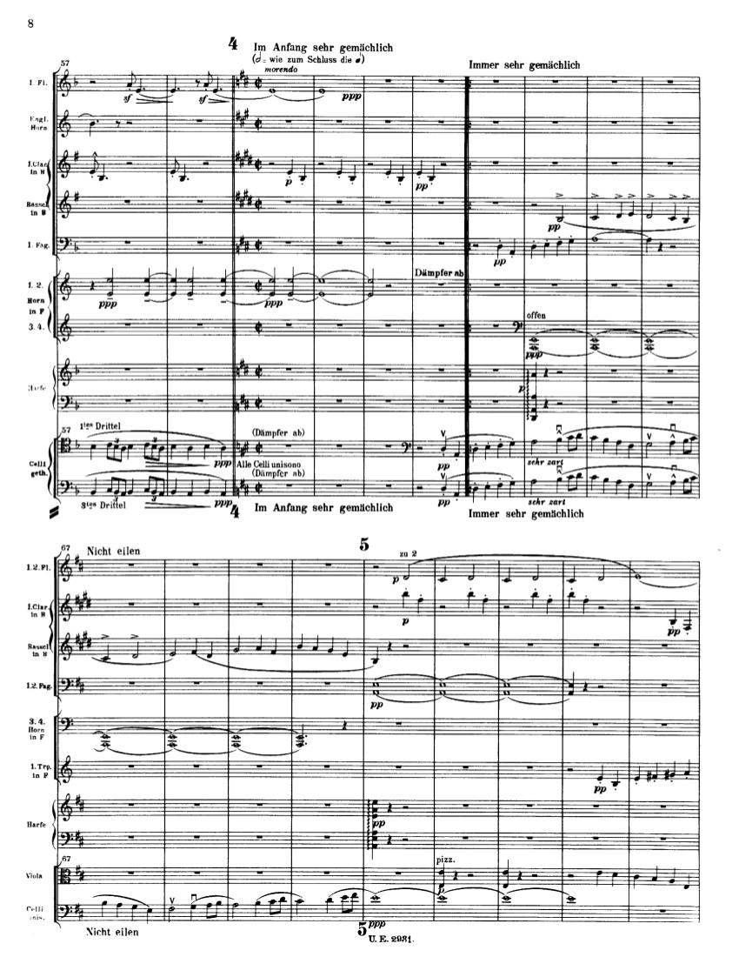
Bass jostled loose! Begins to rise, chromatically!
(Unfreezing the bass) = “Mystical processes of Nature”
“Rotation 5”
= Subrotation 1 of exp.
Rotation 4
= blossoming of the fourth-motive
= Varied transcription of Song 2 from
Lieder eines fahrenden Gesellen

Slide 39
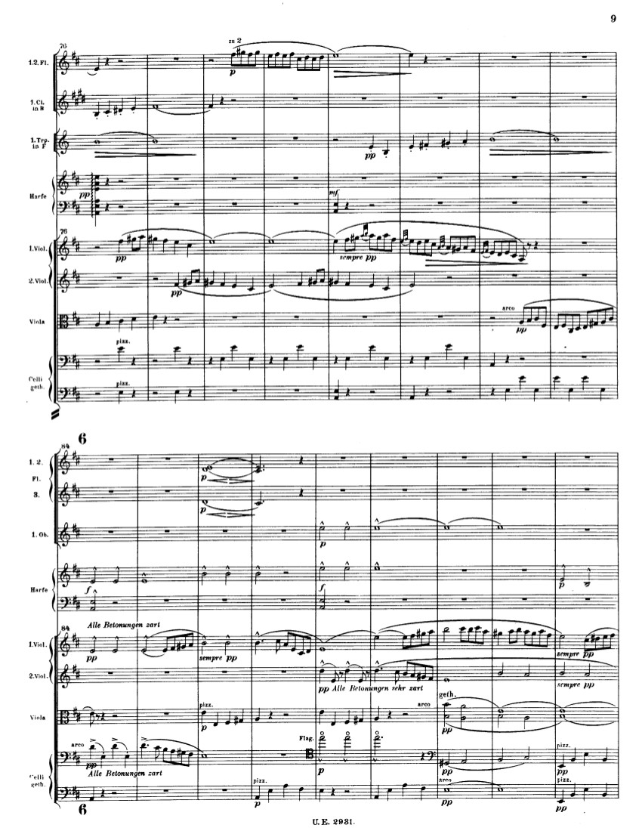
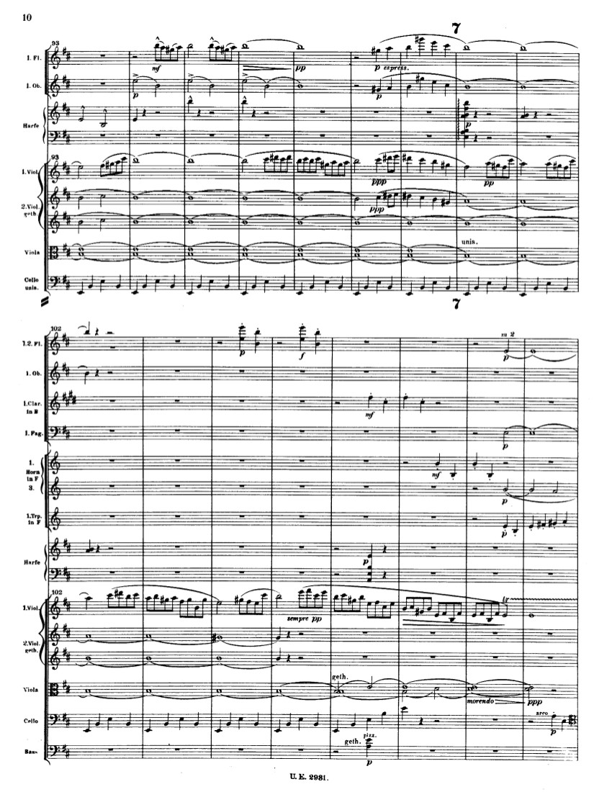

Slide 40
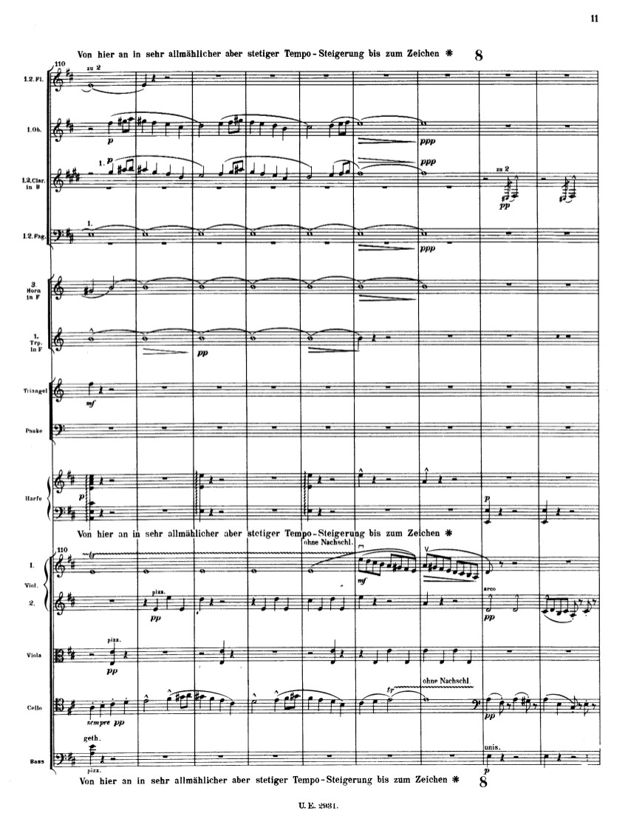
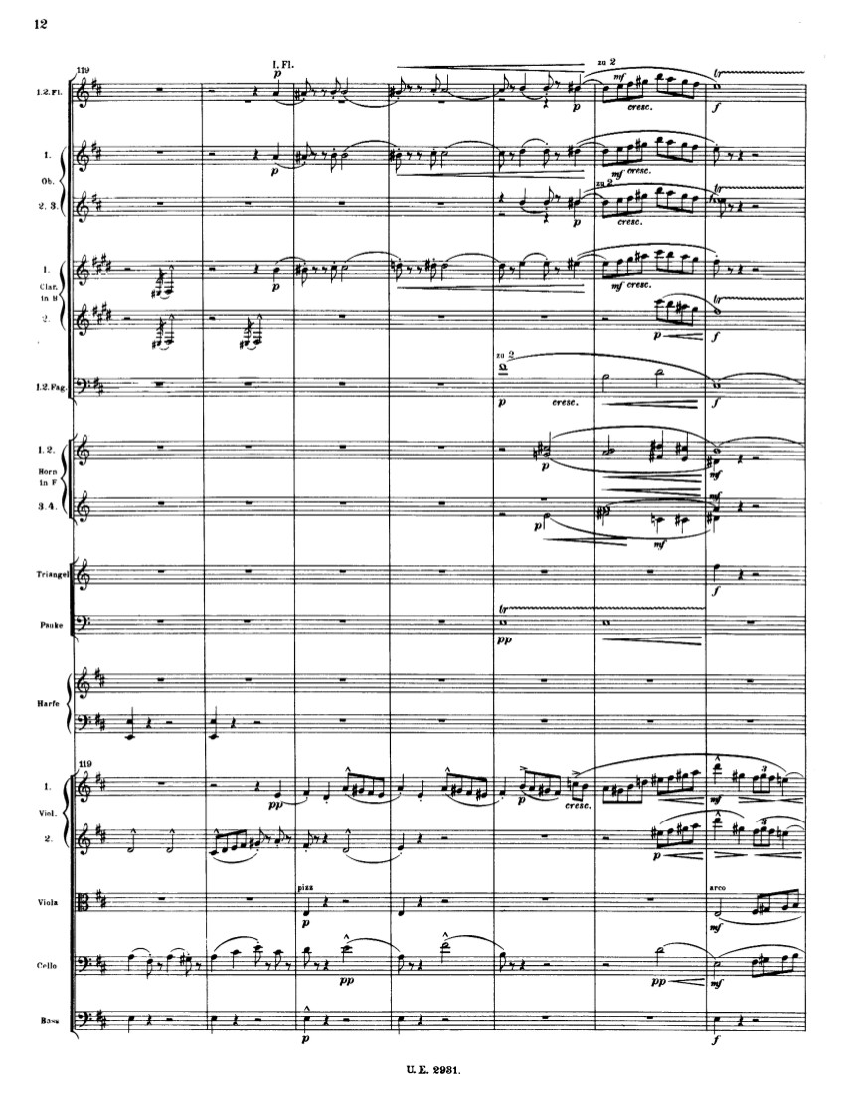
!!

Slide 41
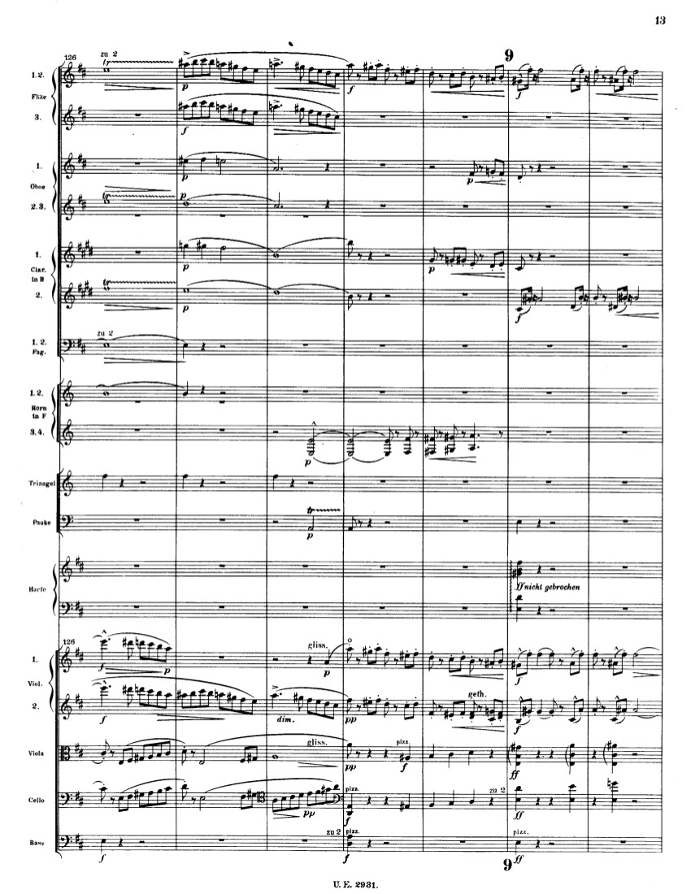
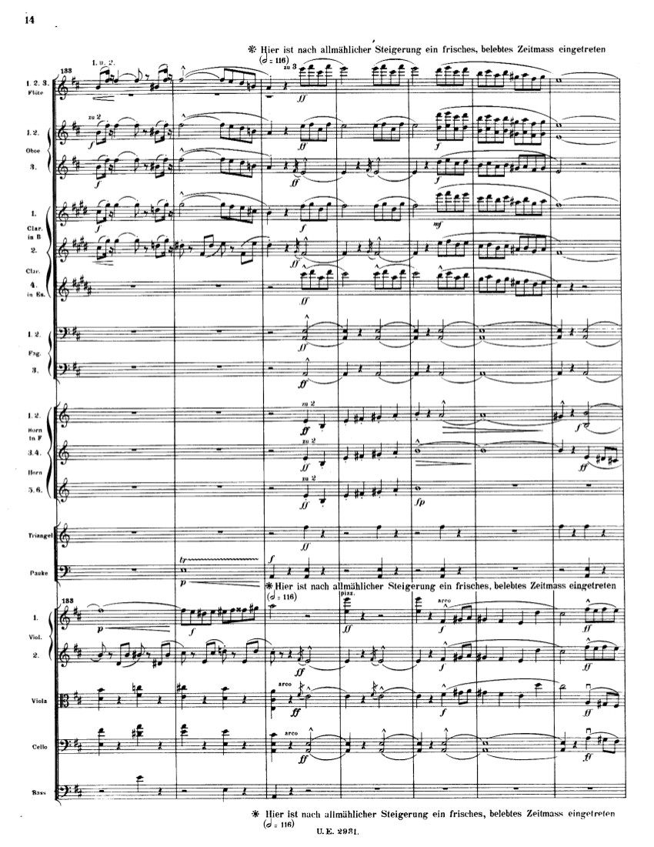

Slide 42
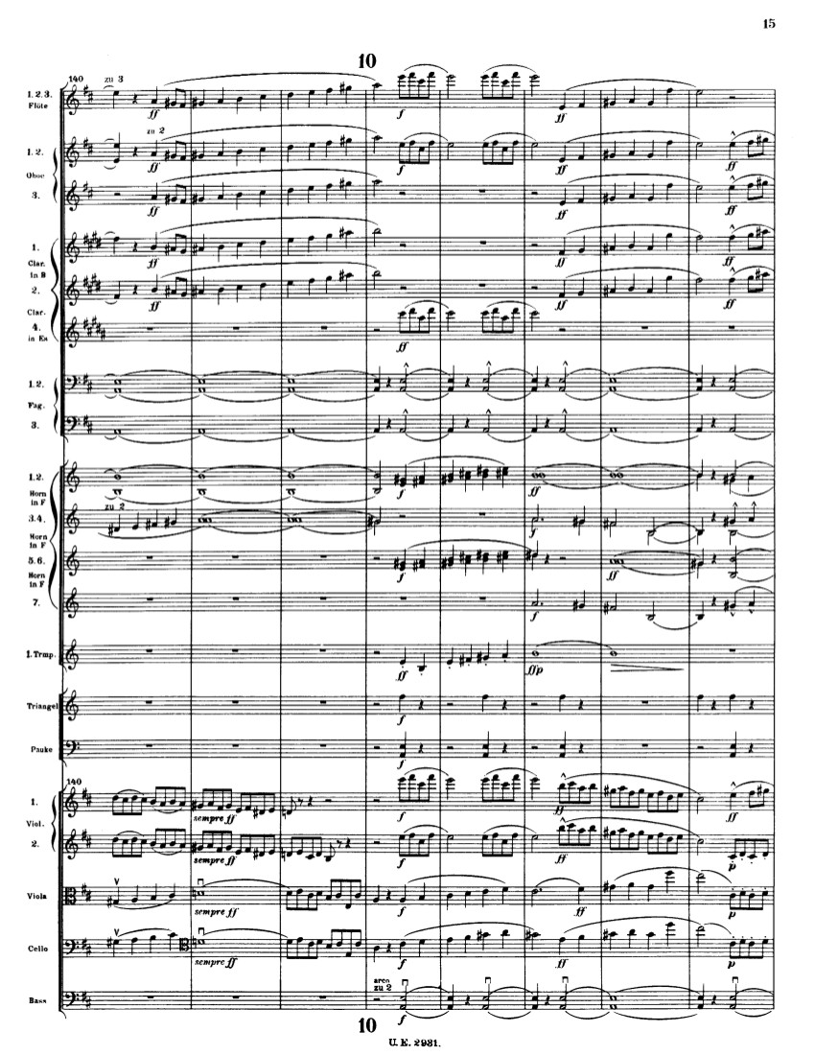
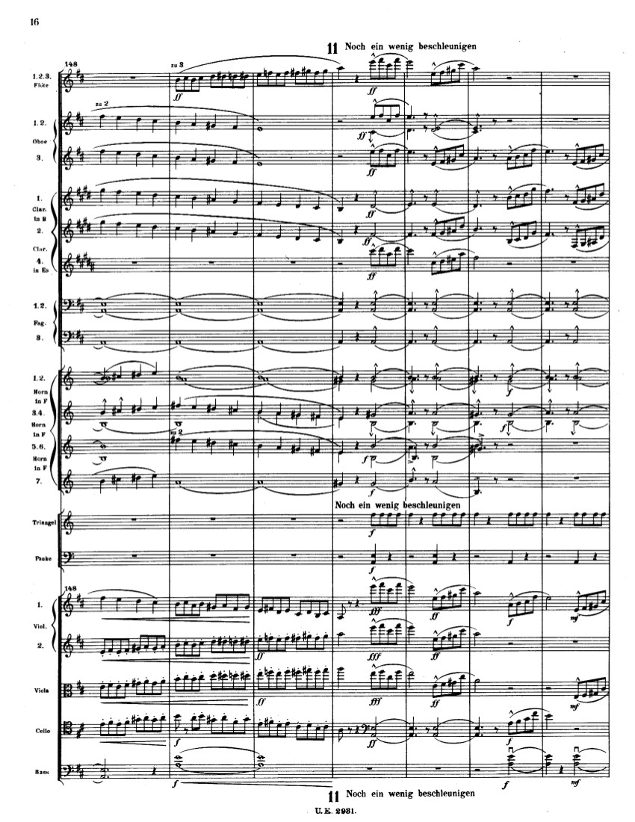

Slide 43
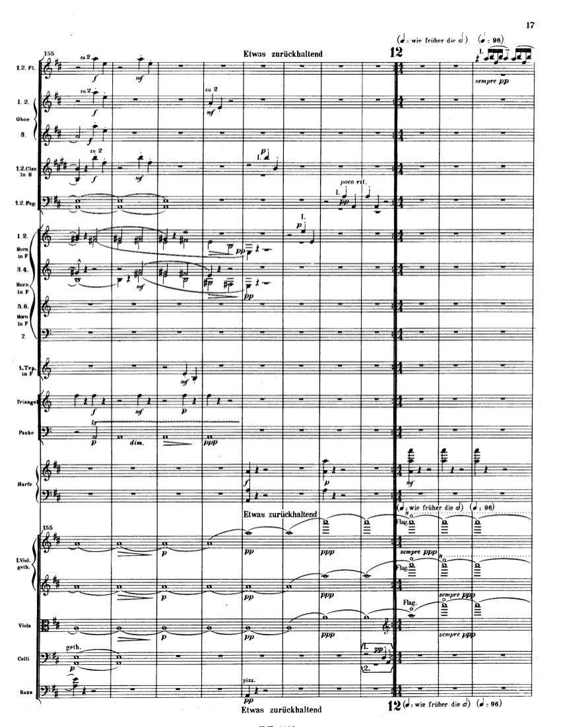
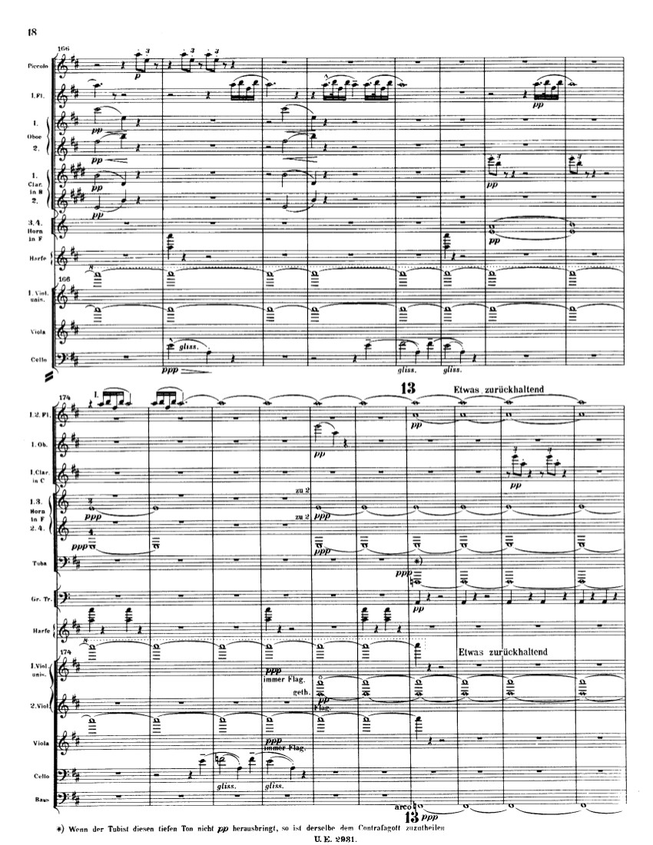
Development: New (large) rotation starts, returning to the introduction—a grand new cycle of further burgeoning

Slide 44
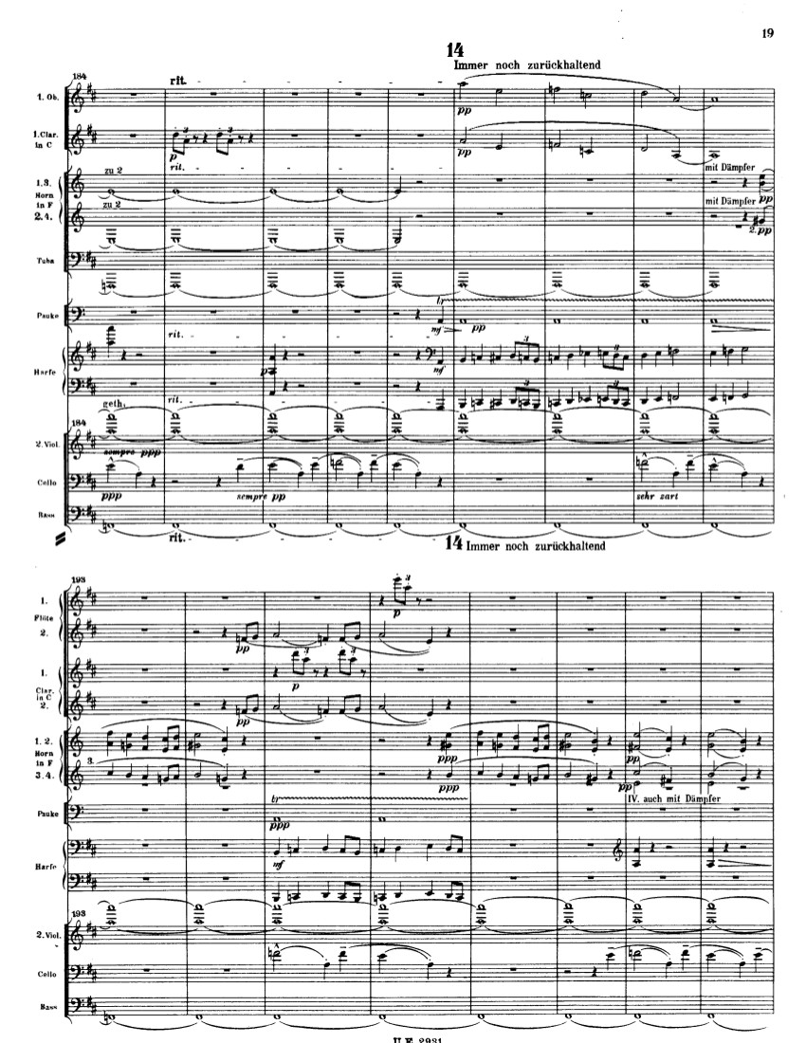
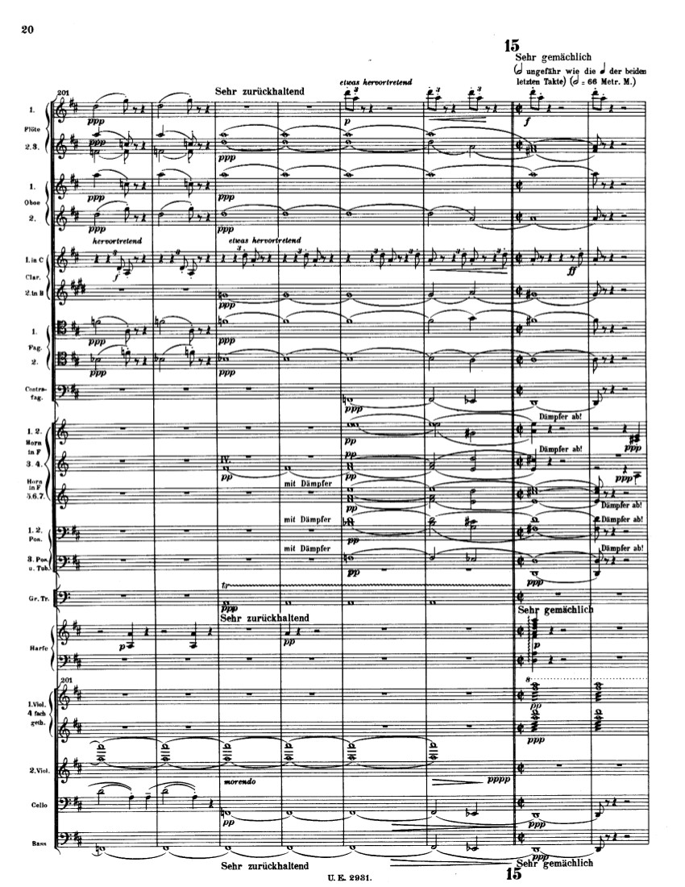

Slide 45
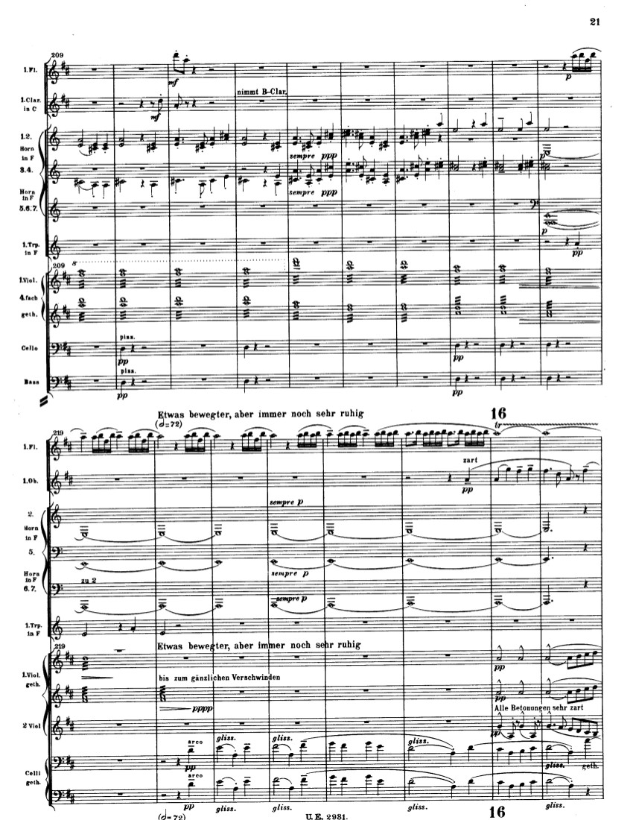
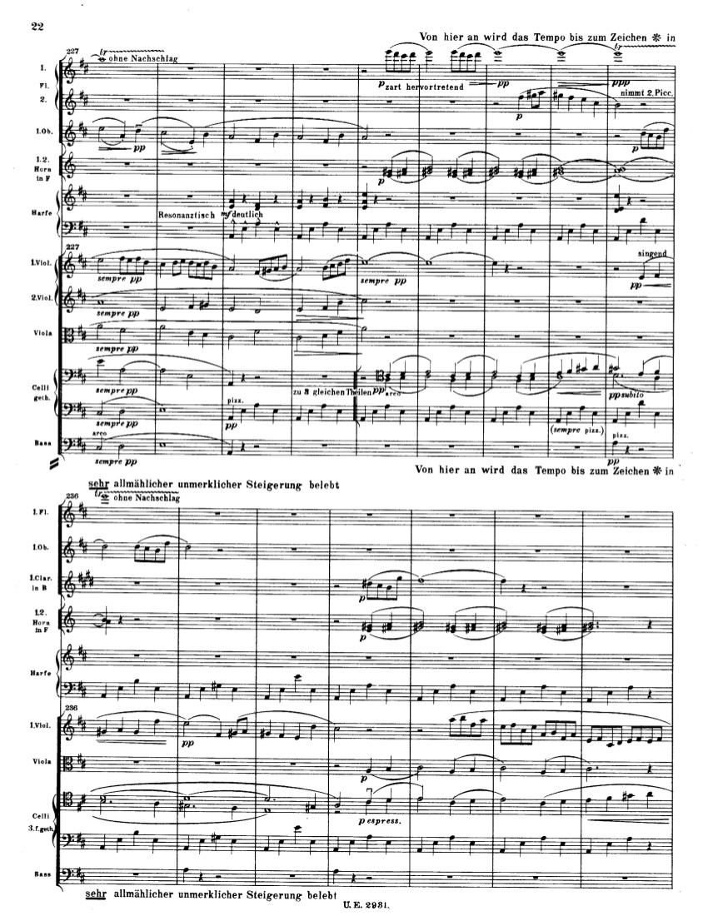

Slide 46
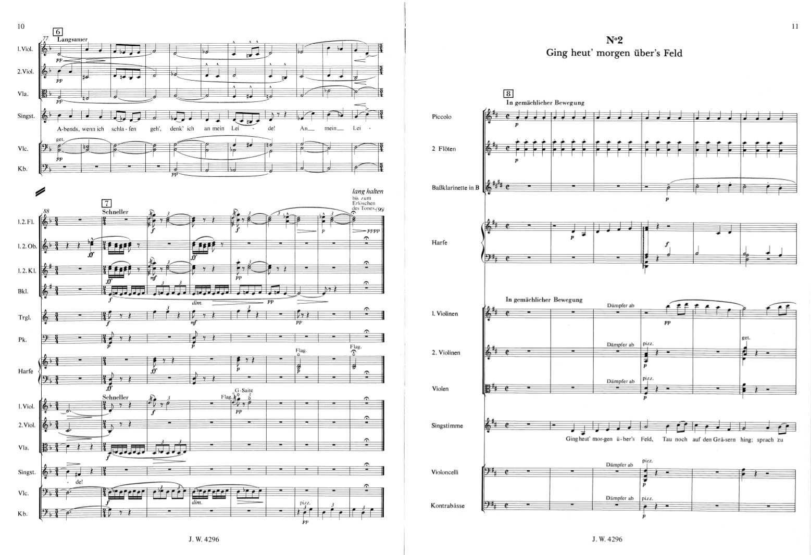
Mahler, Lieder eines fahrenden Gesellen (18 )

Slide 47
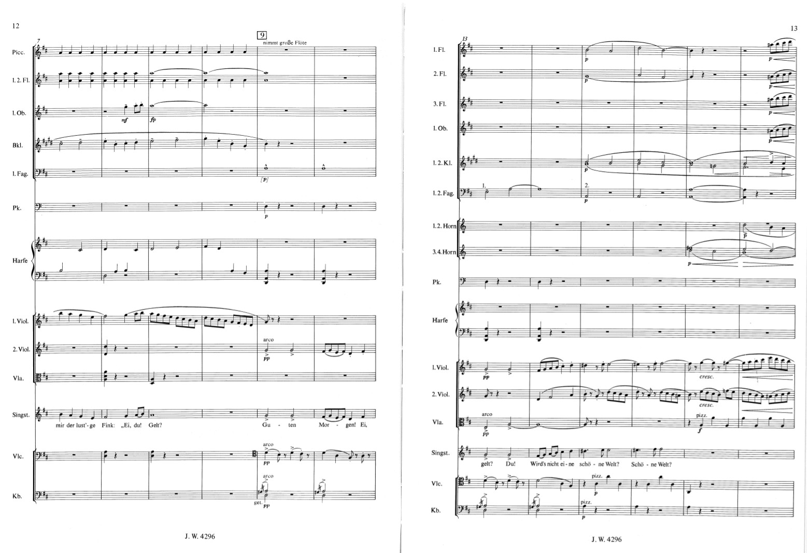

Slide 48
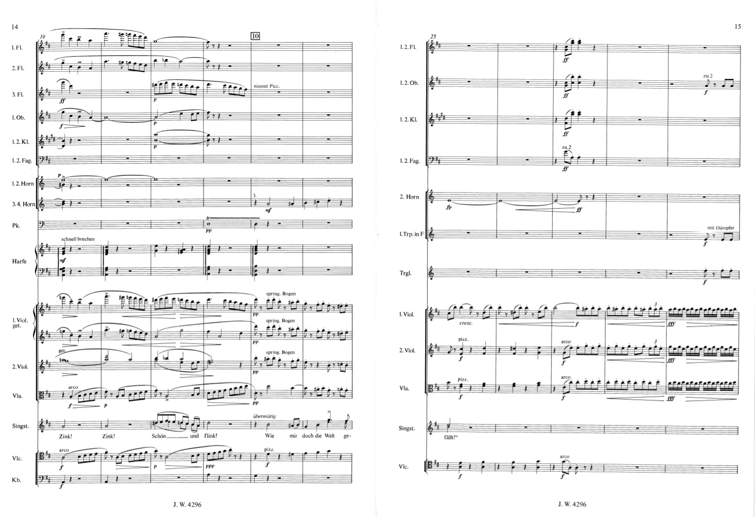

Slide 49
