Slide 1
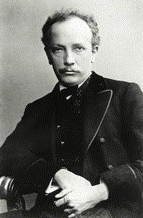
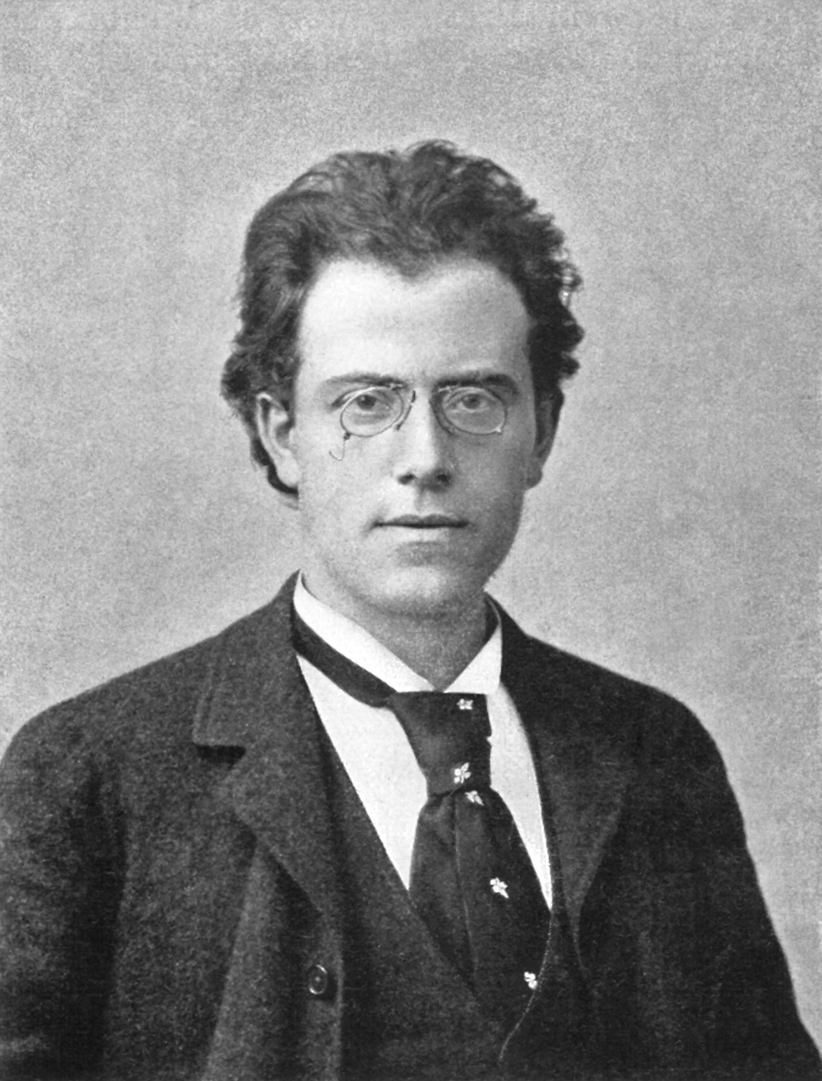
Early Modernism: The Generation of the 1860s
and the Institution of Art Music

Slide 2
Early Modernism: The Generation of the 1860s
and the Institution of Art Music
Tone Poem: Don Juan, 1889

Slide 3
Early Modernism: The Generation of the 1860s
and the Institution of Art Music
Symphony No. 1 (first version), 1889

Slide 4
Early Modernism: The Generation of the 1860s
and the Institution of Art Music
C. 1889: The onset of “early modernism”?
Tone Poem: Don Juan, 1889
Symphony No. 1 (first version), 1889

Slide 5
By the 1870s and 1880s:
The fuller consolidation of the Institution of Art Music
By the 1890s:
The rise of new-generational “early modernism”

Slide 6
By the 1870s and 1880s:
The fuller consolidation of the Institution of Art Music
By the 1890s:
The rise of new-generational “early modernism”

Slide 7
By the 1870s and 1880s:
The fuller consolidation of the Institution of Art Music
Performers and performance venues
Composers
Journalists, critics, educators, patrons,
publishers, facilitators
Listeners
(educated middle
or upper class: consumer demand)

Slide 8
By the 1870s and 1880s:
The fuller consolidation of the Institution of Art Music
Composer
“Institution of Art Music”
(Potential) Audience

Slide 9
By the 1870s and 1880s:
The fuller consolidation of the Institution of Art Music
Composer
“Institution of Art Music”
(Potential) Audience
Universities, conservatories, “music education” and curricula

Slide 10
By the 1870s and 1880s:
The fuller consolidation of the Institution of Art Music
Composer
“Institution of Art Music”
(Potential) Audience
Universities, conservatories, “music education” and curricula
Music-theory textbooks, music-history research and publication, etc.

Slide 11
By the 1870s and 1880s:
The fuller consolidation of the Institution of Art Music
Composer
“Institution of Art Music”
(Potential) Audience
Universities, conservatories, “music education” and curricula
Music-theory textbooks, music-history research and publication, etc.
Civic orchestras, opera houses, concert series

Slide 12
By the 1870s and 1880s:
The fuller consolidation of the Institution of Art Music
Composer
“Institution of Art Music”
(Potential) Audience
Universities, conservatories, “music education” and curricula
Music-theory textbooks, music-history research and publication, etc.
Civic orchestras, opera houses, concert series
Publishing firms, corporations, legal supports, contracts, commissions

Slide 13
By the 1870s and 1880s:
The fuller consolidation of the Institution of Art Music
Composer
“Institution of Art Music”
(Potential) Audience
Universities, conservatories, “music education” and curricula
Music-theory textbooks, music-history research and publication, etc.
Civic orchestras, opera houses, concert series
Publishing firms, corporations, legal supports, contracts, commissions
Newspaper columns (reviews, commentary), journals devoted to music (research, evaluation, critical debates)

Slide 14
By the 1870s and 1880s:
The fuller consolidation of the Institution of Art Music
Composer
“Institution of Art Music”
(Potential) Audience
Universities, conservatories, “music education” and curricula
Music-theory textbooks, music-history research and publication, etc.
Civic orchestras, opera houses, concert series
Publishing firms, corporations, legal supports, contracts, commissions
Newspaper columns (reviews, commentary), journals devoted to music (research, evaluation, critical debates)
Promotion of a succession of canonic historical heroes of composition: Bach, Haydn, Mozart, Beethoven, Weber, Schubert, Mendelssohn, Schumann, Wagner, Brahms, etc. Or in opera: Rossini, Bellini, Donizetti, Verdi, etc.

Slide 15
By the 1870s and 1880s:
The fuller consolidation of the Institution of Art Music
Composer
“Institution of Art Music”
(Potential) Audience
Universities, conservatories, “music education” and curricula
Music-theory textbooks, music-history research and publication, etc.
Civic orchestras, opera houses, concert series
Publishing firms, corporations, legal supports, contracts, commissions
Newspaper columns (reviews, commentary), journals devoted to music (research, evaluation, critical debates)
Promotion of a succession of canonic historical heroes of composition: Bach, Haydn, Mozart, Beethoven, Weber, Schubert, Mendelssohn, Schumann, Wagner, Brahms, etc. Or in opera: Rossini, Bellini, Donizetti, Verdi, etc.
Fully settled aesthetic ideology of “now-liberated” music as ultimately important to the educated person, a mark of civic and personal status and culture

Slide 16
By the 1870s and 1880s:
The fuller consolidation of the Institution of Art Music
Composer
“Institution of Art Music”
(Potential) Audience
An increased bureaucratization: corporate, academic, etc.
Universities, conservatories, “music education” and curricula
Music-theory textbooks, music-history research and publication, etc.
Civic orchestras, opera houses, concert series
Publishing firms, corporations, legal supports, contracts, commissions
Newspaper columns (reviews, commentary), journals devoted to music (research, evaluation, critical debates)
Promotion of a succession of canonic historical heroes of composition: Bach, Haydn, Mozart, Beethoven, Weber, Schubert, Mendelssohn, Schumann, Wagner, Brahms, etc. Or in opera: Rossini, Bellini, Donizetti, Verdi, etc.
Fully settled aesthetic ideology of “now-liberated” music as ultimately important to the educated person, a mark of civic and personal status and culture

Slide 17
By the 1870s and 1880s:
The fuller consolidation of the Institution of Art Music
Maximized claims: elite art music becomes
a signifier of liberal-humanist Europe,
cultural prestige, cultural status, and cultural power
1870s: full emergence of the rival traditions
Brahms, Symphony No. 2 in D (1877)
Wagner, Götterdämmerung (1876)

Slide 18
Additionally Complicating Contexts: Political, Historical, Economic

Slide 19
Additionally Complicating Contexts: Political, Historical, Economic
Rise of modern concepts of political power (e.g., unification of Germany, 1871)

Slide 20
Additionally Complicating Contexts: Political, Historical, Economic
Rise of modern concepts of political power (e.g., unification of Germany, 1871)
European world power now cresting (e.g., imperial rule over distant colonies)

Slide 21
Additionally Complicating Contexts: Political, Historical, Economic
Rise of modern concepts of political power (e.g., unification of Germany, 1871)
European world power now cresting (e.g., imperial rule over distant colonies)
Fuller emergence of modern technology

Slide 22
Additionally Complicating Contexts: Political, Historical, Economic
Rise of modern concepts of political power (e.g., unification of Germany, 1871)
European world power now cresting (e.g., imperial rule over distant colonies)
Fuller emergence of modern technology
Modern methods of organizing labor, corporations, industry, bureaucracy--including remarkably free markets (but rising labor tensions)

Slide 23
Additionally Complicating Contexts: Political, Historical, Economic
Rise of modern concepts of political power (e.g., unification of Germany, 1871)
European world power now cresting (e.g., imperial rule over distant colonies)
Fuller emergence of modern technology
Modern methods of organizing labor, corporations, industry, bureaucracy--including remarkably free markets (but rising labor tensions)
Scientific discoveries, new ways of construing the human and natural world

Slide 24
Additionally Complicating Contexts: Political, Historical, Economic
Rise of modern concepts of political power (e.g., unification of Germany, 1871)
European world power now cresting (e.g., imperial rule over distant colonies)
Fuller emergence of modern technology
Modern methods of organizing labor, corporations, industry, bureaucracy--including remarkably free markets (but rising labor tensions)
Scientific discoveries, new ways of construing the human and natural world
Scientific and humanistic educational challenges to tradition, religion

Slide 25
Additionally Complicating Contexts: Political, Historical, Economic
Rise of modern concepts of political power (e.g., unification of Germany, 1871)
European world power now cresting (e.g., imperial rule over distant colonies)
Fuller emergence of modern technology
Modern methods of organizing labor, corporations, industry, bureaucracy--including remarkably free markets (but rising labor tensions)
Scientific discoveries, new ways of construing the human and natural world
Scientific and humanistic educational challenges to tradition, religion
Key words: materialism, realism

Slide 26
Additionally Complicating Contexts: Political, Historical, Economic
Rise of modern concepts of political power (e.g., unification of Germany, 1871)
European world power now cresting (e.g., imperial rule over distant colonies)
Fuller emergence of modern technology
Modern methods of organizing labor, corporations, industry, bureaucracy--including remarkably free markets (but rising labor tensions)
Scientific discoveries, new ways of construing the human and natural world
Scientific and humanistic educational challenges to tradition, religion
Key words: materialism, realism
Diagnosis: radical desacralization of the European world: increasing rationalization, bureaucracy, organization: “the disenchantment of the world”

Slide 27
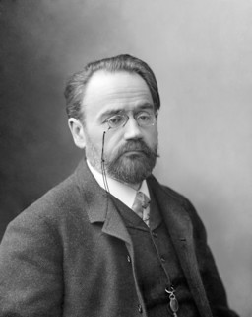
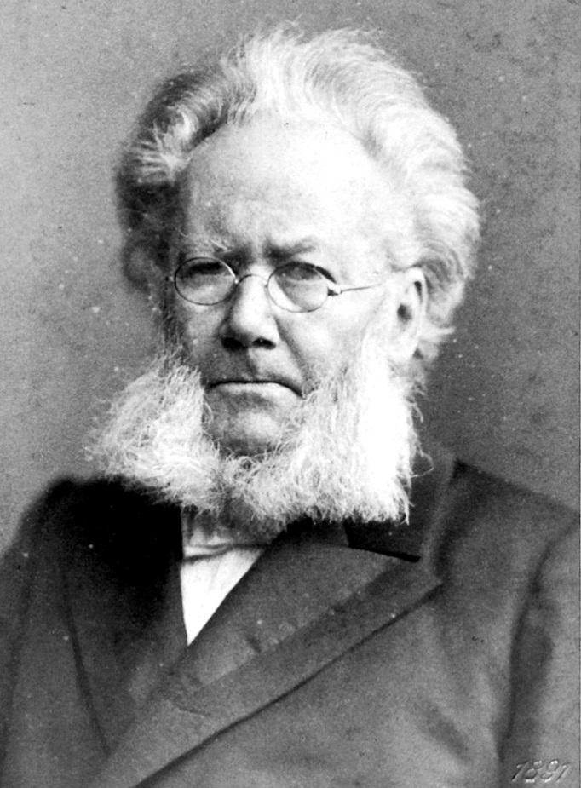
Gritty “Realism” in Literature, late 1870s, 1880s, 1890s
Émile Zola Henrik Ibsen

Slide 28
But – “Realism” in Music??!! Is This Possible?

Slide 29
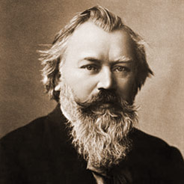
But – “Realism” in Music??!! Is This Possible?

Slide 30
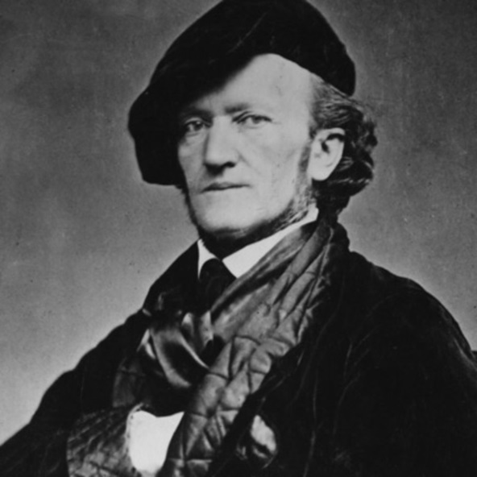
But – “Realism” in Music??!! Is This Possible?

Slide 31
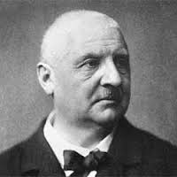
But – “Realism” in Music??!! Is This Possible?

Slide 32
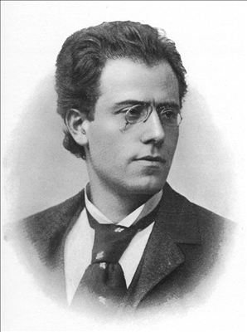
But – “Realism” in Music??!! Is This Possible?

Slide 33
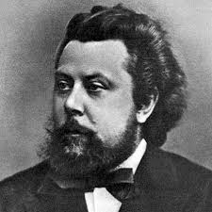
Instances of Russian “Realism,” 1860s
“The Orphan” (1867): text also by Musorgsky
Hear me, for pity’s sake!
Sir, in your charity!
Treat with compassion a poor helpless orphan in dire distress!
Turn not away!
Hunger and cold serve to nourish and strengthen me;
Rain-storm and tempest my lodging in gloom of night;
Hard words and harder blows, curses and angry threats,
These are the only answers that good folk grant to my tale of woe!
If from this cruel world I roam the woods, seeking shelter,
Hunger torments me; once more to the streets I’m driven.
Life will not stand it; a child must have food and drink!
Hear me in pity and help me in need!
Starvation is hard to bear! Cold are my lifeless limbs!
Hear me in pity and help my distress.
Oh! Help a poor orphan beggar!
Modest Musorgsky

Slide 34
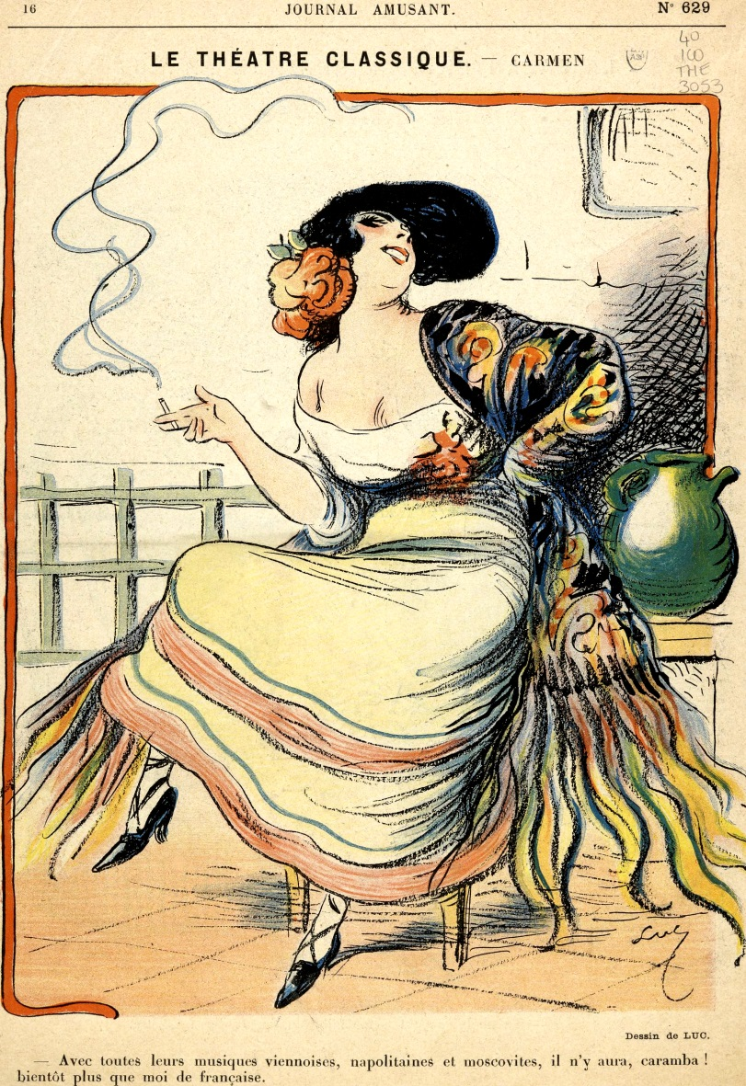
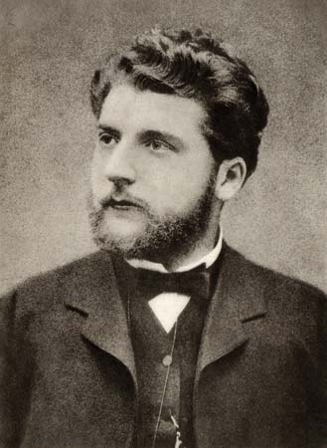
Georges Bizet’s Carmen (1875)

Slide 35
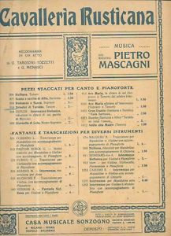
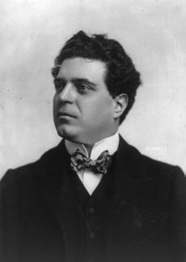
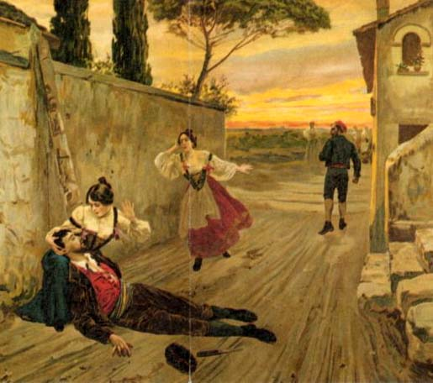
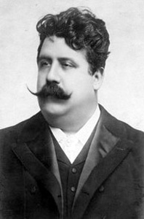
Italian “verismo” opera, 1890s, early 1900s:
“a slice of life” (“uno squarcio di vita”)
1890
Pietro Mascagni
1892
Ruggero Leoncavallo

Slide 36
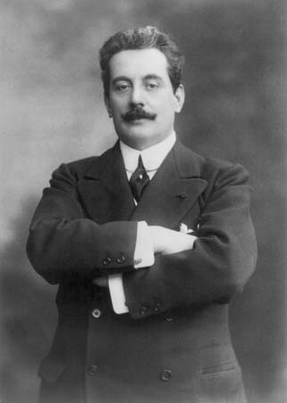
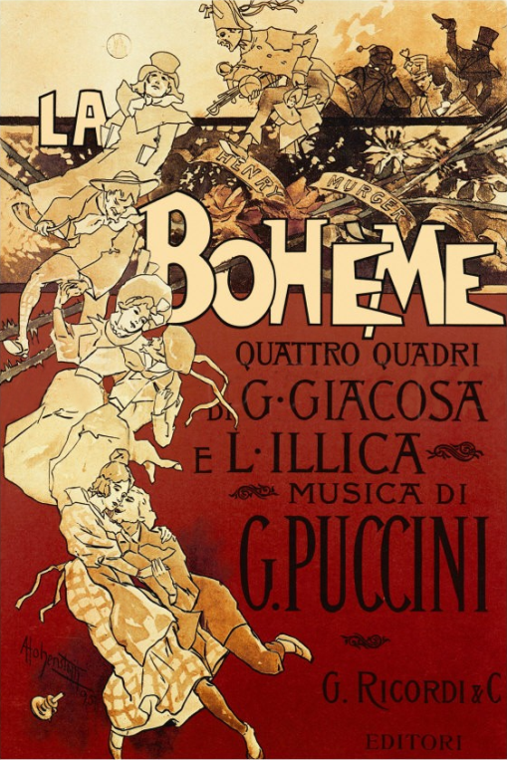
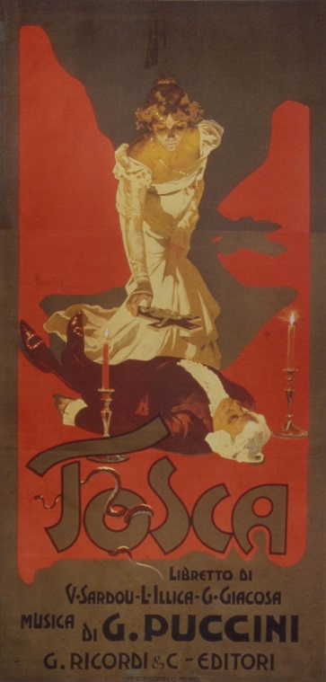
Verismo, Sensationalism, Exoticism: Giacomo Puccini
1896 1900 1904

Slide 37
Richard Strauss (1864-1949)

Slide 38
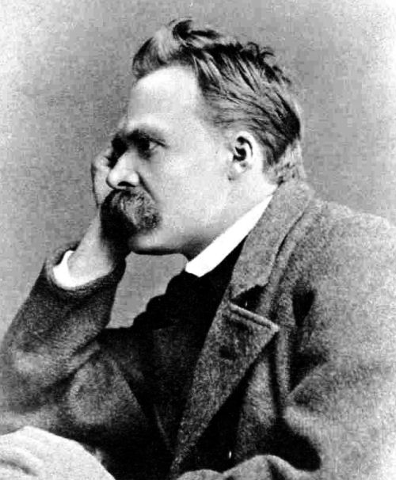
C. 1893-94—renunciation of Wagnerian metaphysics (in favor of the anti-metaphysical Nietzsche)
Richard Strauss (1864-1949)

Slide 39
C. 1893-94—renunciation of Wagnerian metaphysics (in favor of the anti-metaphysical Nietzsche)
“Realist” and man of musical commerce—building a career
Richard Strauss (1864-1949)

Slide 40
C. 1893-94—renunciation of Wagnerian metaphysics (in favor of the anti-metaphysical Nietzsche)
“Realist” and man of musical commerce—building a career
Modern orchestra as color-machine
Richard Strauss (1864-1949)

Slide 41
C. 1893-94—renunciation of Wagnerian metaphysics (in favor of the anti-metaphysical Nietzsche)
“Realist” and man of musical commerce—building a career
Modern orchestra as color-machine
Emphasis on program music and illustrative musical imagery
Richard Strauss (1864-1949)

Slide 42
Tone Poems, 1888-1899:
Two Cycles
Macbeth (1886-88)
Don Juan (1889)
Tod und Verklärung (1889)
Till Eulenspiegels lustige Streiche (1895)
Also sprach Zarathustra (1896)
Don Quixote (1898)
Ein Heldenleben (1899)
Richard Strauss (1864-1949)

Slide 43
Tone Poems, 1888-1899:
Two Cycles
Macbeth (1886-88)
Don Juan (1889)
Tod und Verklärung (1889)
Till Eulenspiegels lustige Streiche (1895)
Also sprach Zarathustra (1896)
Don Quixote (1898)
Ein Heldenleben (1899)
Richard Strauss (1864-1949)

Slide 44
C. 1893-94—renunciation of Wagnerian metaphysics (in favor of the anti-metaphysical Nietzsche)
“Realist” and man of musical commerce—building a career
Modern orchestra as color-machine
Emphasis on program music and illustrative musical imagery
Calculated brashness; transgression; sensationalism
Richard Strauss (1864-1949)

Slide 45
By the 1870s and 1880s:
The fuller consolidation of the Institution of Art Music
By the 1890s:
The rise of new-generational “early modernism”

Slide 46
Early Modernism: The Generation of the 1860s
Janáček (1854)
Elgar (1857)
Puccini (1858)
Mahler (1860)
Wolf (1860)
Debussy (1862)
Delius (1862)
R. Strauss (1864)
Dukas (1865)
Glazunov (1865)
Nielsen (1865)
Sibelius (1865)
Busoni (1866)
Satie (1866)

Slide 47
Early Modernism: The Generation of the 1860s
Janáček (1854)
Elgar (1857)
Puccini (1858)
Mahler (1860)
Wolf (1860)
Debussy (1862)
Delius (1862)
R. Strauss (1864)
Dukas (1865)
Glazunov (1865)
Nielsen (1865)
Sibelius (1865)
Busoni (1866)
Satie (1866)
Steering ever more clear of:
Periodicity

Slide 48
Early Modernism: The Generation of the 1860s
Janáček (1854)
Elgar (1857)
Puccini (1858)
Mahler (1860)
Wolf (1860)
Debussy (1862)
Delius (1862)
R. Strauss (1864)
Dukas (1865)
Glazunov (1865)
Nielsen (1865)
Sibelius (1865)
Busoni (1866)
Satie (1866)
Steering ever more clear of:
Periodicity
Unaltered repetition

Slide 49
Early Modernism: The Generation of the 1860s
Janáček (1854)
Elgar (1857)
Puccini (1858)
Mahler (1860)
Wolf (1860)
Debussy (1862)
Delius (1862)
R. Strauss (1864)
Dukas (1865)
Glazunov (1865)
Nielsen (1865)
Sibelius (1865)
Busoni (1866)
Satie (1866)
Steering ever more clear of:
Periodicity
Unaltered repetition
Symmetrical resolution

Slide 50
Early Modernism: The Generation of the 1860s
Janáček (1854)
Elgar (1857)
Puccini (1858)
Mahler (1860)
Wolf (1860)
Debussy (1862)
Delius (1862)
R. Strauss (1864)
Dukas (1865)
Glazunov (1865)
Nielsen (1865)
Sibelius (1865)
Busoni (1866)
Satie (1866)
Steering ever more clear of:
Periodicity
Unaltered repetition
Symmetrical resolution
Frequent cadences

Slide 51
Early Modernism: The Generation of the 1860s
Janáček (1854)
Elgar (1857)
Puccini (1858)
Mahler (1860)
Wolf (1860)
Debussy (1862)
Delius (1862)
R. Strauss (1864)
Dukas (1865)
Glazunov (1865)
Nielsen (1865)
Sibelius (1865)
Busoni (1866)
Satie (1866)
Steering ever more clear of:
Periodicity
Unaltered repetition
Symmetrical resolution
Frequent cadences
Standardized or traditional forms
(if treated as simplistic grids or formulas)

Slide 52
Early Modernism: The Generation of the 1860s
Janáček (1854)
Elgar (1857)
Puccini (1858)
Mahler (1860)
Wolf (1860)
Debussy (1862)
Delius (1862)
R. Strauss (1864)
Dukas (1865)
Glazunov (1865)
Nielsen (1865)
Sibelius (1865)
Busoni (1866)
Satie (1866)
Problem: how to write an intensified,
new-generational music that can compete in the current “canonic” marketplace?

Slide 53
Early Modernism: The Generation of the 1860s
Janáček (1854)
Elgar (1857)
Puccini (1858)
Mahler (1860)
Wolf (1860)
Debussy (1862)
Delius (1862)
R. Strauss (1864)
Dukas (1865)
Glazunov (1865)
Nielsen (1865)
Sibelius (1865)
Busoni (1866)
Satie (1866)
Problem: how to write an intensified,
new-generational music that can compete in the current “canonic” marketplace?
Timbre: a generation of vivid colorists

Slide 54
Early Modernism: The Generation of the 1860s
Janáček (1854)
Elgar (1857)
Puccini (1858)
Mahler (1860)
Wolf (1860)
Debussy (1862)
Delius (1862)
R. Strauss (1864)
Dukas (1865)
Glazunov (1865)
Nielsen (1865)
Sibelius (1865)
Busoni (1866)
Satie (1866)
Problem: how to write an intensified,
new-generational music that can compete in the current “canonic” marketplace?
Timbre: a generation of vivid colorists
“Individualized” harmony, rhythm, melody

Slide 55
Early Modernism: The Generation of the 1860s
Janáček (1854)
Elgar (1857)
Puccini (1858)
Mahler (1860)
Wolf (1860)
Debussy (1862)
Delius (1862)
R. Strauss (1864)
Dukas (1865)
Glazunov (1865)
Nielsen (1865)
Sibelius (1865)
Busoni (1866)
Satie (1866)
Problem: how to write an intensified,
new-generational music that can compete in the current “canonic” marketplace?
Timbre: a generation of vivid colorists
“Individualized” harmony, rhythm, melody
“Individualized” orchestration

Slide 56
Early Modernism: The Generation of the 1860s
Janáček (1854)
Elgar (1857)
Puccini (1858)
Mahler (1860)
Wolf (1860)
Debussy (1862)
Delius (1862)
R. Strauss (1864)
Dukas (1865)
Glazunov (1865)
Nielsen (1865)
Sibelius (1865)
Busoni (1866)
Satie (1866)
Problem: how to write an intensified,
new-generational music that can compete in the current “canonic” marketplace?
Timbre: a generation of vivid colorists
“Individualized” harmony, rhythm, melody
“Individualized” orchestration
“Individualized” structures

Slide 57
Early Modernism: The Generation of the 1860s
Janáček (1854)
Elgar (1857)
Puccini (1858)
Mahler (1860)
Wolf (1860)
Debussy (1862)
Delius (1862)
R. Strauss (1864)
Dukas (1865)
Glazunov (1865)
Nielsen (1865)
Sibelius (1865)
Busoni (1866)
Satie (1866)
Some Early-Modernist Solutions:

Slide 58
Early Modernism: The Generation of the 1860s
Janáček (1854)
Elgar (1857)
Puccini (1858)
Mahler (1860)
Wolf (1860)
Debussy (1862)
Delius (1862)
R. Strauss (1864)
Dukas (1865)
Glazunov (1865)
Nielsen (1865)
Sibelius (1865)
Busoni (1866)
Satie (1866)
Some Early-Modernist Solutions:
Hypertechnique; orchestral virtuosity

Slide 59
Tone Poems, 1888-1899:
Two Cycles
Macbeth (1886-88)
Don Juan (1889)
Tod und Verklärung (1889)
Till Eulenspiegels lustige Streiche (1895)
Also sprach Zarathustra (1896)
Don Quixote (1898)
Ein Heldenleben (1899)
Hypertechnique – and close, vivid musical depiction of characters and narratives; audacious harmonies and dissonances
Richard Strauss (1864-1949)

Slide 60
Tone Poems, 1888-1899:
Two Cycles
Macbeth (1886-88)
Don Juan (1889)
Tod und Verklärung (1889)
Till Eulenspiegels lustige Streiche (1895)
Also sprach Zarathustra (1896)
Don Quixote (1898)
Ein Heldenleben (1899)
Hypertechnique – and close, vivid musical depiction of characters and narratives; audacious harmonies and dissonances
Richard Strauss (1864-1949)

Slide 61
Tone Poems, 1888-1899:
Two Cycles
Macbeth (1886-88)
Don Juan (1889)
Tod und Verklärung (1889)
Till Eulenspiegels lustige Streiche (1895)
Also sprach Zarathustra (1896)
Don Quixote (1898)
Ein Heldenleben (1899)
Hypertechnique – and close, vivid musical depiction of characters and narratives; audacious harmonies and dissonances
Richard Strauss (1864-1949)

Slide 62
Early Modernism: The Generation of the 1860s
Janáček (1854)
Elgar (1857)
Puccini (1858)
Mahler (1860)
Wolf (1860)
Debussy (1862)
Delius (1862)
R. Strauss (1864)
Dukas (1865)
Glazunov (1865)
Nielsen (1865)
Sibelius (1865)
Busoni (1866)
Satie (1866)
Some Early-Modernist Solutions:
Hypertechnique; orchestral virtuosity
Hyperemotionalism (Nervenkunst)

Slide 63
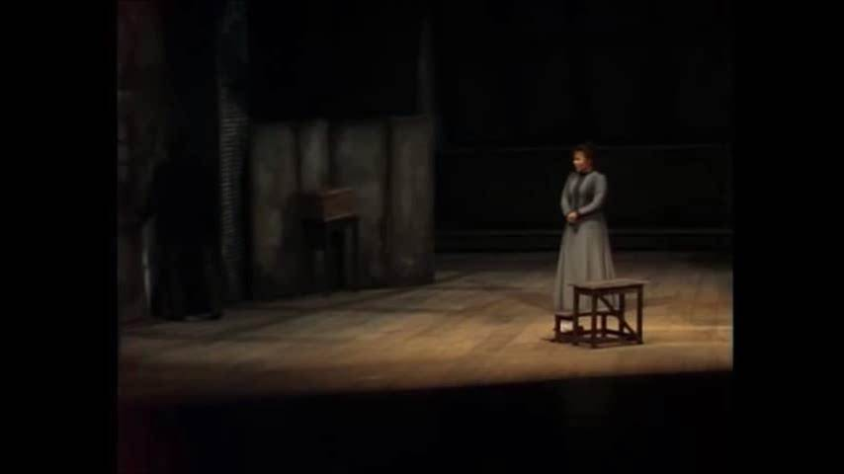
Puccini, La Boheme (1896), “O soave fanciulla”
Luciano Pavarotti, Renata Scotto

Slide 64
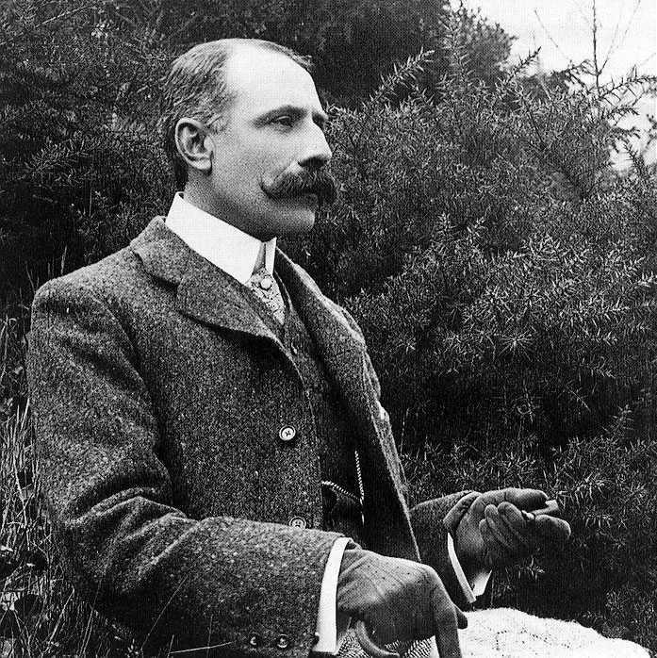
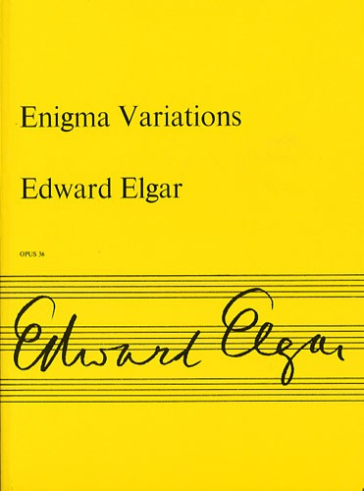
1899

Slide 65
Early Modernism: The Generation of the 1860s
Janáček (1854)
Elgar (1857)
Puccini (1858)
Mahler (1860)
Wolf (1860)
Debussy (1862)
Delius (1862)
R. Strauss (1864)
Dukas (1865)
Glazunov (1865)
Nielsen (1865)
Sibelius (1865)
Busoni (1866)
Satie (1866)
Some Early-Modernist Solutions:
Hypertechnique; orchestral virtuosity
Hyperemotionalism (Nervenkunst)
Nationalistic “modern primitivism”

Slide 66
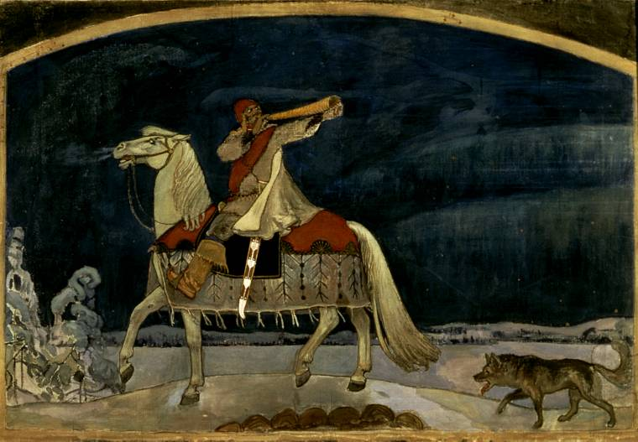
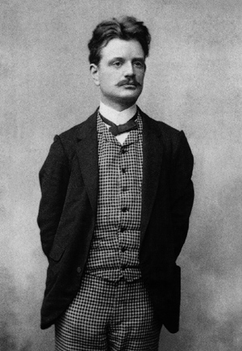
Finlandia (1899)
Symphony No. 1 (1899)
Symphony No. 2 (1902)
(seven symphonies by the mid-1920s)
Jean Sibelius

Slide 67
Finlandia (1899)
Symphony No. 1 (1899)
Symphony No. 2 (1902)
(seven symphonies by the mid-1920s)
Jean Sibelius

Slide 68
Early Modernism: The Generation of the 1860s
Janáček (1854)
Elgar (1857)
Puccini (1858)
Mahler (1860)
Wolf (1860)
Debussy (1862)
Delius (1862)
R. Strauss (1864)
Dukas (1865)
Glazunov (1865)
Nielsen (1865)
Sibelius (1865)
Busoni (1866)
Satie (1866)
Some Early-Modernist Solutions:
Hypertechnique; orchestral virtuosity
Hyperemotionalism (Nervenkunst)
Nationalistic “modern primitivism”
Hyper-monumentality and inclusiveness (the aesthetic of the colossal)

Slide 69
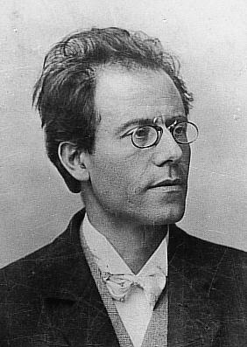
Early Modernism: The Generation of the 1860s
Janáček (1854)
Elgar (1857)
Puccini (1858)
Mahler (1860)
Wolf (1860)
Debussy (1862)
Delius (1862)
R. Strauss (1864)
Dukas (1865)
Glazunov (1865)
Nielsen (1865)
Sibelius (1865)
Busoni (1866)
Satie (1866)
Some Early-Modernist Solutions:
Hypertechnique; orchestral virtuosity
Hyperemotionalism (Nervenkunst)
Nationalistic “modern primitivism”
Hyper-monumentality and inclusiveness (the aesthetic of the colossal)

Slide 70
Hypermonumentality: the aesthetic
of the colossal; the magnum opus

Slide 71
Hypermonumentality: the aesthetic
of the colossal; the magnum opus
Explicit ultimacy of the symphonic project: the symphony exists to confront basic questions of existence at their extremes; no holds barred.

Slide 72
Hypermonumentality: the aesthetic
of the colossal; the magnum opus
Explicit ultimacy of the symphonic project: the symphony exists to confront basic questions of existence at their extremes; no holds barred.
“A symphony is like the world: it must include everything.”

Slide 73
Hypermonumentality: the aesthetic
of the colossal; the magnum opus
Explicit ultimacy of the symphonic project: the symphony exists to confront basic questions of existence at their extremes; no holds barred.
“A symphony is like the world: it must include everything.”
Thus: “philosophical” symphonies: ultimate struggles of life, death, and desperate quests for meaning—or its dizzying absence—in the modernizing world.

Slide 74
Hypermonumentality: the aesthetic
of the colossal; the magnum opus
Explicit ultimacy of the symphonic project: the symphony exists to confront basic questions of existence at their extremes; no holds barred.
“A symphony is like the world: it must include everything.”
Thus: “philosophical” symphonies: ultimate struggles of life, death, and desperate quests for meaning—or its dizzying absence—in the modernizing world.
Mahler, Symphony No. 2 (1894), “Resurrection”: the final goal at the end of the finale: “Auferstehen!”; “Arise!”

Slide 75
Hypermonumentality: the aesthetic
of the colossal; the magnum opus
Explicit ultimacy of the symphonic project: the symphony exists to confront basic questions of existence at their extremes; no holds barred.
“A symphony is like the world: it must include everything.”
Thus: “philosophical” symphonies: ultimate struggles of life, death, and desperate quests for meaning—or its dizzying absence—in the modernizing world.
Hyper-earnestness: existential despair and ecstatic triumph, juxtaposed and often conflicting with or undercutting each other.

Slide 76
Hypermonumentality: the aesthetic
of the colossal; the magnum opus
Explicit ultimacy of the symphonic project: the symphony exists to confront basic questions of existence at their extremes; no holds barred.
“A symphony is like the world: it must include everything.”
Thus: “philosophical” symphonies: ultimate struggles of life, death, and desperate quests for meaning—or its dizzying absence—in the modernizing world.
Hyper-earnestness: existential despair and ecstatic triumph, juxtaposed and often conflicting with or undercutting each other.
Merging/blending of vocal music into some symphonies: soloists (e.g., Lieder) or chorus.

Slide 77
Hypermonumentality: the aesthetic
of the colossal; the magnum opus
Explicit ultimacy of the symphonic project: the symphony exists to confront basic questions of existence at their extremes; no holds barred.
“A symphony is like the world: it must include everything.”
Thus: “philosophical” symphonies: ultimate struggles of life, death, and desperate quests for meaning—or its dizzying absence—in the modernizing world.
Hyper-earnestness: existential despair and ecstatic triumph, juxtaposed and often conflicting with or undercutting each other.
Merging/blending of vocal music into some symphonies: soloists (e.g., Lieder) or chorus.
Vocal sections in Symphonies No. 2, 3, 4, and 8:
2, 3, and 4 interpolate Lieder as individual movements.

Slide 78
Hypermonumentality: the aesthetic
of the colossal; the magnum opus
Explicit ultimacy of the symphonic project: the symphony exists to confront basic questions of existence at their extremes; no holds barred.
“A symphony is like the world: it must include everything.”
Thus: “philosophical” symphonies: ultimate struggles of life, death, and desperate quests for meaning—or its dizzying absence—in the modernizing world.
Hyper-earnestness: existential despair and ecstatic triumph, juxtaposed and often conflicting with or undercutting each other.
Merging/blending of vocal music into some symphonies: soloists (e.g., Lieder) or chorus.
Vocal sections in Symphonies No. 2, 3, 4, and 8:
2, 3, and 4 interpolate Lieder as individual movements.
Music from pre-existing songs, shorn of their original texts, appears in Symphonies 1 and 2.

Slide 79
Hypermonumentality: the aesthetic
of the colossal; the magnum opus
Explicit ultimacy of the symphonic project: the symphony exists to confront basic questions of existence at their extremes; no holds barred.
“A symphony is like the world: it must include everything.”
Thus: “philosophical” symphonies: ultimate struggles of life, death, and desperate quests for meaning—or its dizzying absence—in the modernizing world.
Hyper-earnestness: existential despair and ecstatic triumph, juxtaposed and often conflicting with or undercutting each other.
Merging/blending of vocal music into some symphonies: soloists (e.g., Lieder) or chorus.
Vocal sections in Symphonies No. 2, 3, 4, and 8:
2, 3, and 4 interpolate Lieder as individual movements.
Music from pre-existing songs, shorn of their original texts, appears in Symphonies 1 and 2.
E.g., the melody of “Ging heut’ Morgen” from Lieder eines fahrenden Gesellen (c. 1884) turned into the exposition of the first movement of Symphony No. 1 (1889ff)

Slide 80
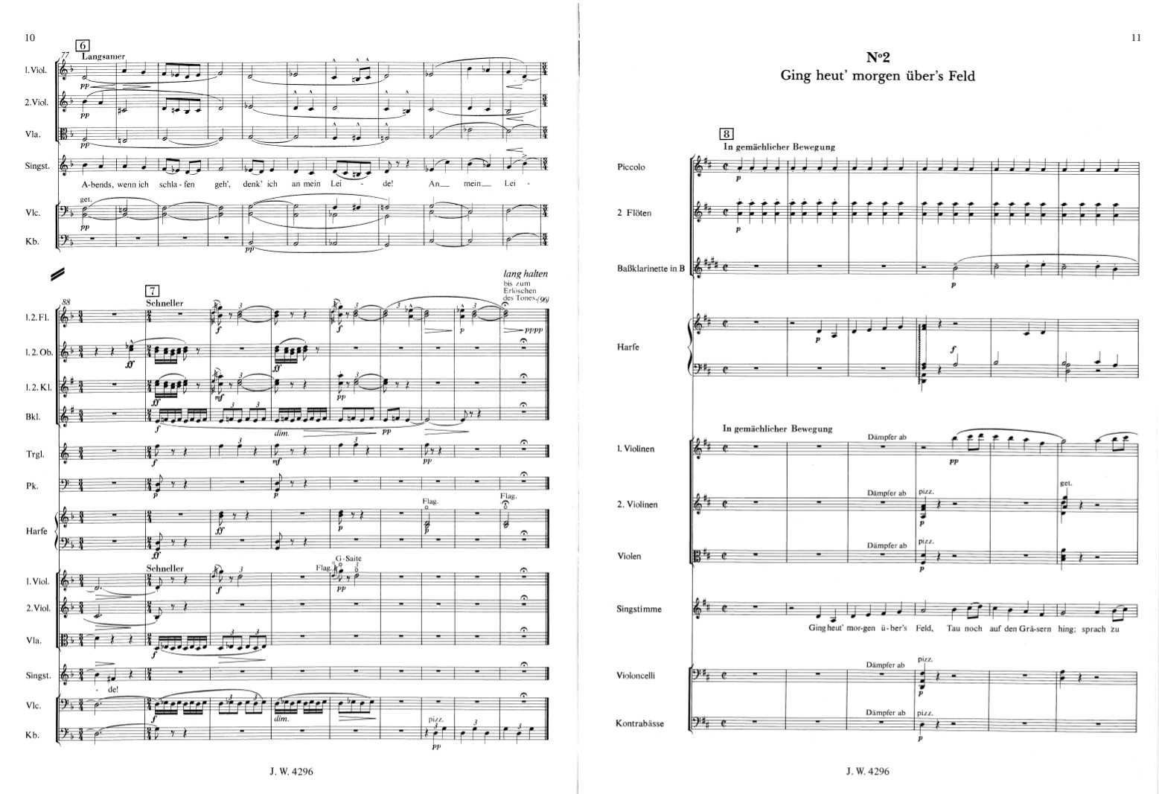
Mahler, Lieder eines fahrenden Gesellen (1884-85, orig. voice and piano)

Slide 81
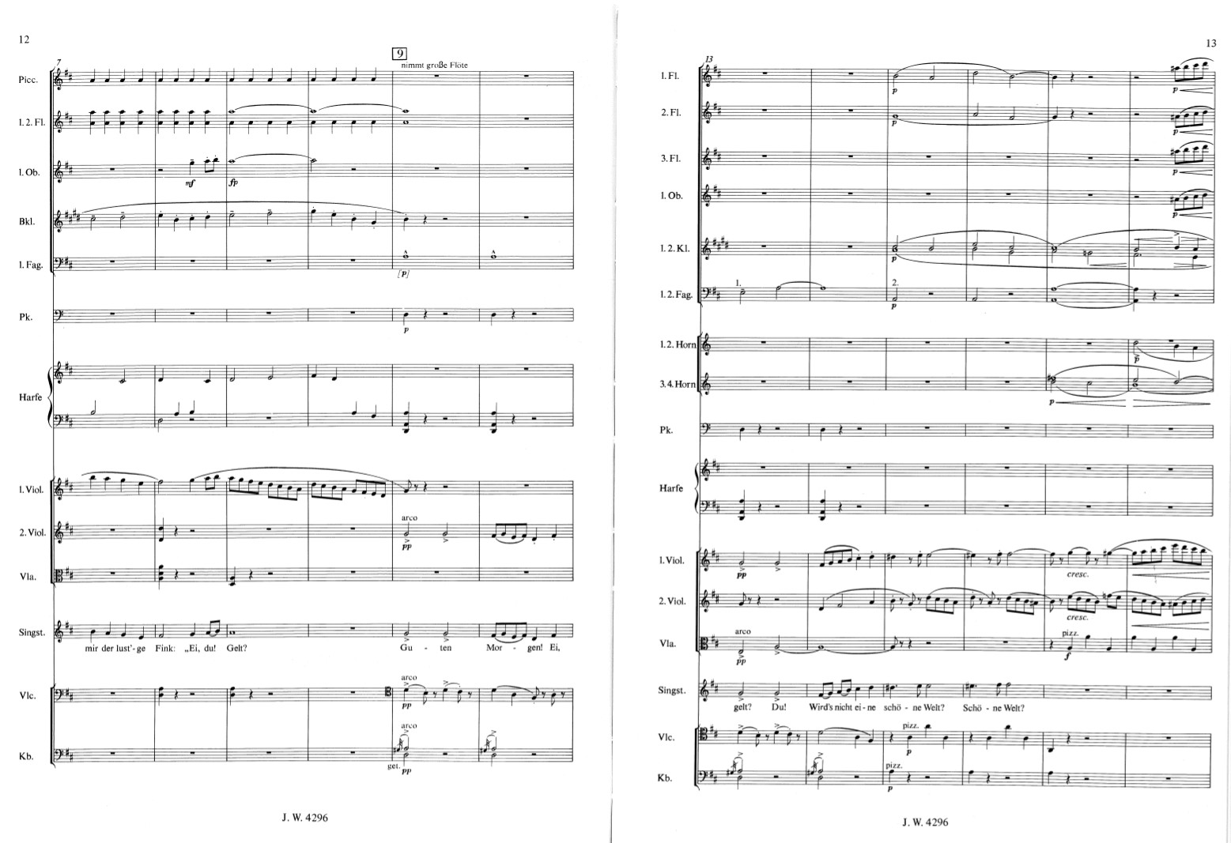

Slide 82
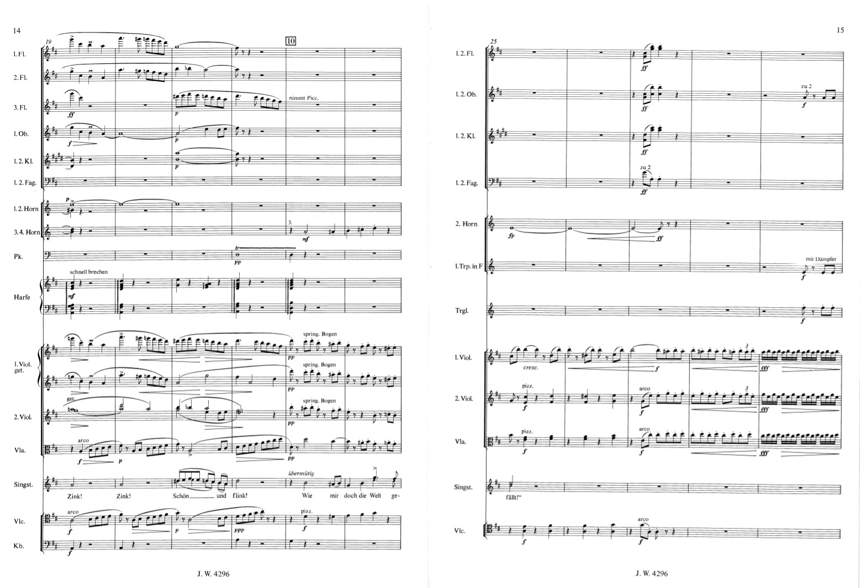

Slide 83
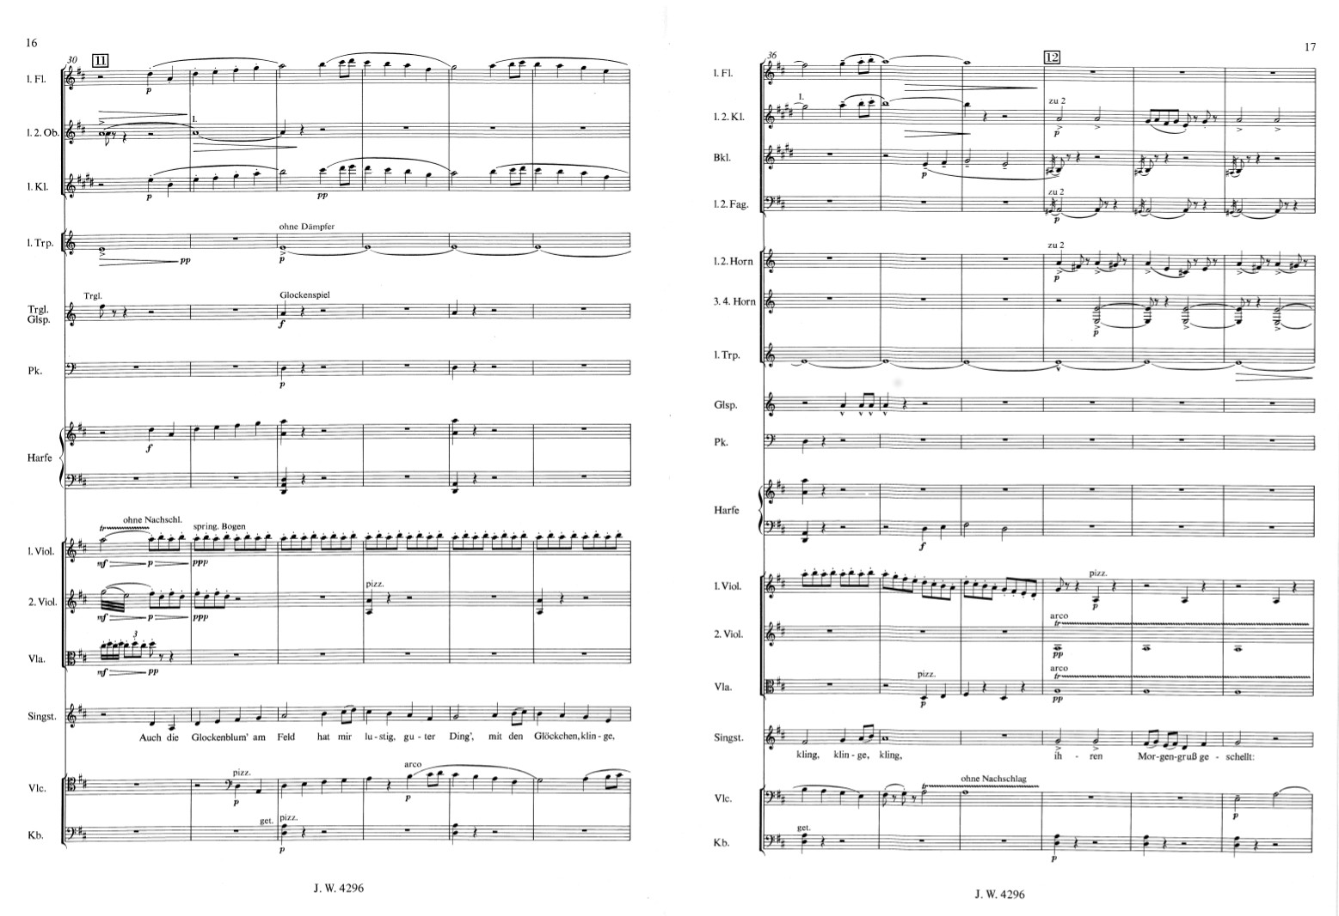

Slide 84
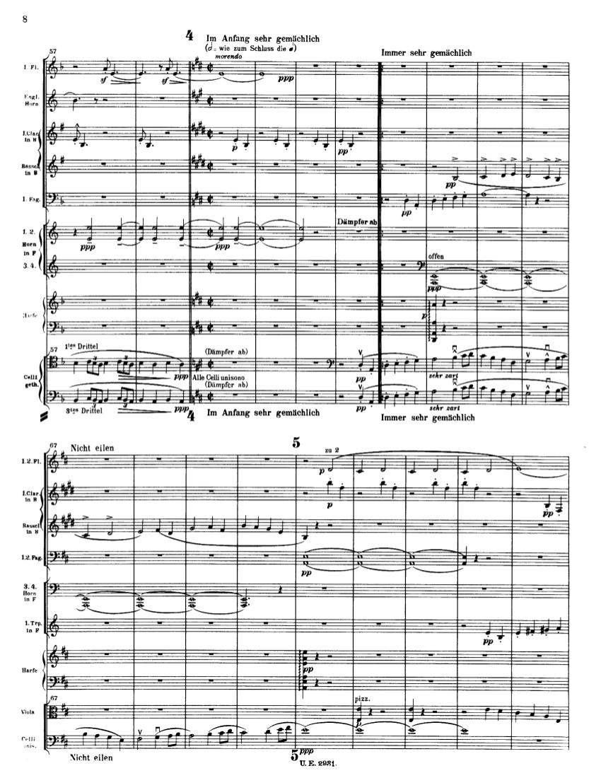
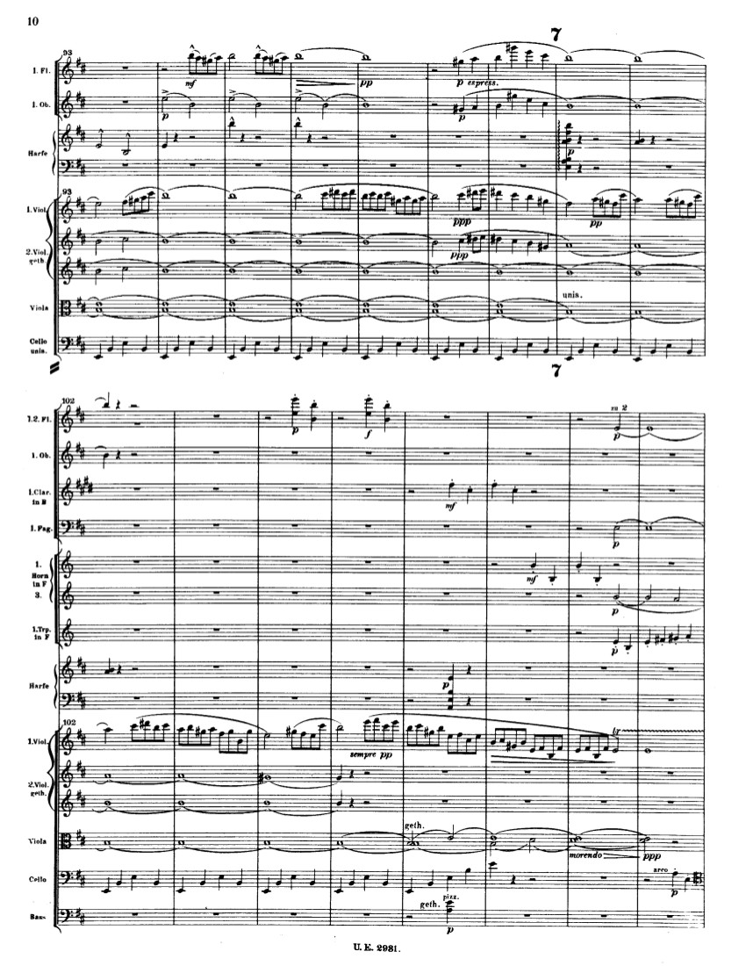
Mahler, Symphony No. 1 (1889-1899)

Slide 85
Hypermonumentality: the aesthetic
of the colossal; the magnum opus
Explicit ultimacy of the symphonic project: the symphony exists to confront basic questions of existence at their extremes; no holds barred.
“A symphony is like the world: it must include everything.”
Thus: “philosophical” symphonies: ultimate struggles of life, death, and desperate quests for meaning—or its dizzying absence—in the modernizing world.
Hyper-earnestness: existential despair and ecstatic triumph, juxtaposed and often conflicting with or undercutting each other.
Merging/blending of vocal music into some symphonies: soloists (e.g., Lieder) or chorus.
Vocal sections in Symphonies No. 2, 3, 4, and 8:
2, 3, and 4 interpolate Lieder as individual movements.
Music from pre-existing songs, shorn of their original texts, appears in Symphonies 1 and 2.
The flip side of Wagner’s reform of opera?; the symphony as a kind of Gesamtkunstwerk (merging symphony, Lied, and cantata?

Slide 86
Hypermonumentality: the aesthetic
of the colossal; the magnum opus
Explicit ultimacy of the symphonic project: the symphony exists to confront basic questions of existence at their extremes; no holds barred.
“A symphony is like the world: it must include everything.”
Thus: “philosophical” symphonies: ultimate struggles of life, death, and desperate quests for meaning—or its dizzying absence—in the modernizing world.
Hyper-earnestness: existential despair and ecstatic triumph, juxtaposed and often conflicting with or undercutting each other.
Merging/blending of vocal music into some symphonies: soloists (e.g., Lieder) or chorus.
Inclusions of moods and styles previously thought as unfit for the “elevated” symphony: the ugly, the grotesque, the absurd, the banal, the empty, the culturally marginalized or rejected; “the whole truth” must be confronted

Slide 87
Hypermonumentality: the aesthetic
of the colossal; the magnum opus
Explicit ultimacy of the symphonic project: the symphony exists to confront basic questions of existence at their extremes; no holds barred.
“A symphony is like the world: it must include everything.”
Thus: “philosophical” symphonies: ultimate struggles of life, death, and desperate quests for meaning—or its dizzying absence—in the modernizing world.
Hyper-earnestness: existential despair and ecstatic triumph, juxtaposed and often conflicting with or undercutting each other.
Merging/blending of vocal music into some symphonies: soloists (e.g., Lieder) or chorus.
Inclusions of moods and styles previously thought as unfit for the “elevated” symphony: the ugly, the grotesque, the absurd, the banal, the empty, the culturally marginalized or rejected; “the whole truth” must be confronted.
Symphony No. 1, movement 3

Slide 88
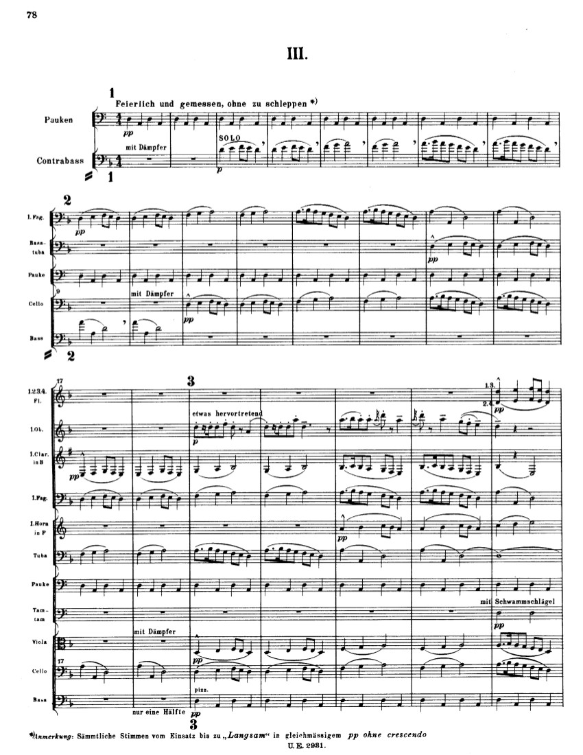
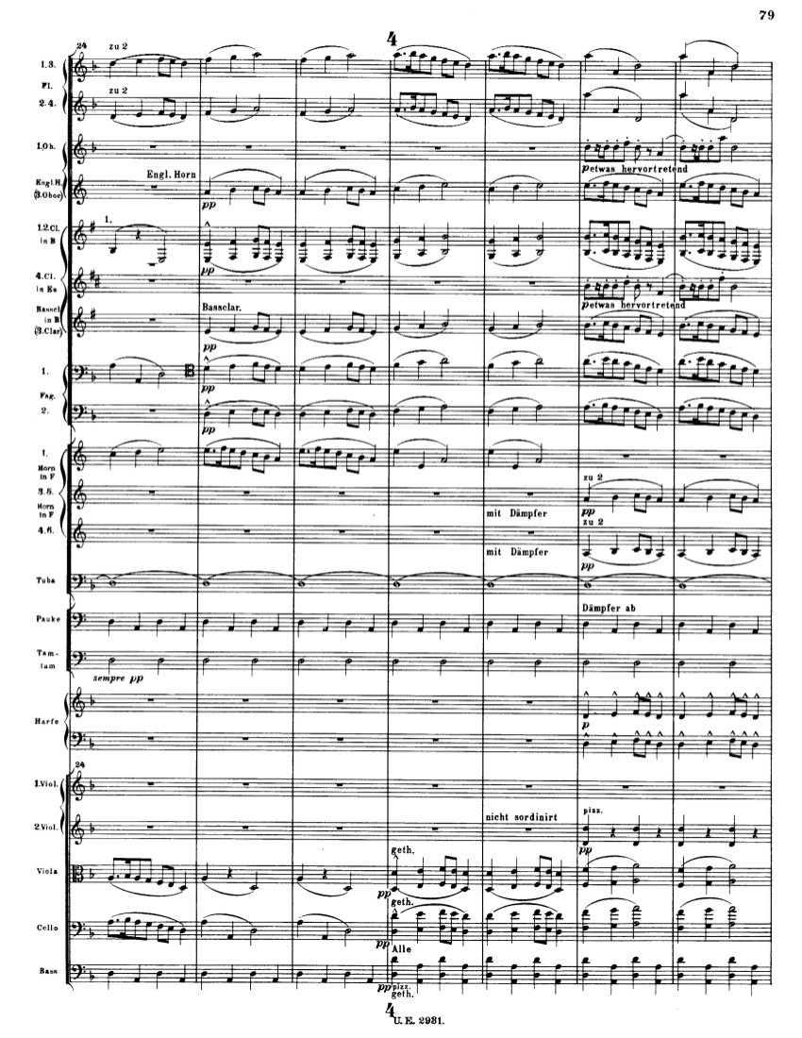
Mahler, Symphony No. 1 (1889-1899)

Slide 89
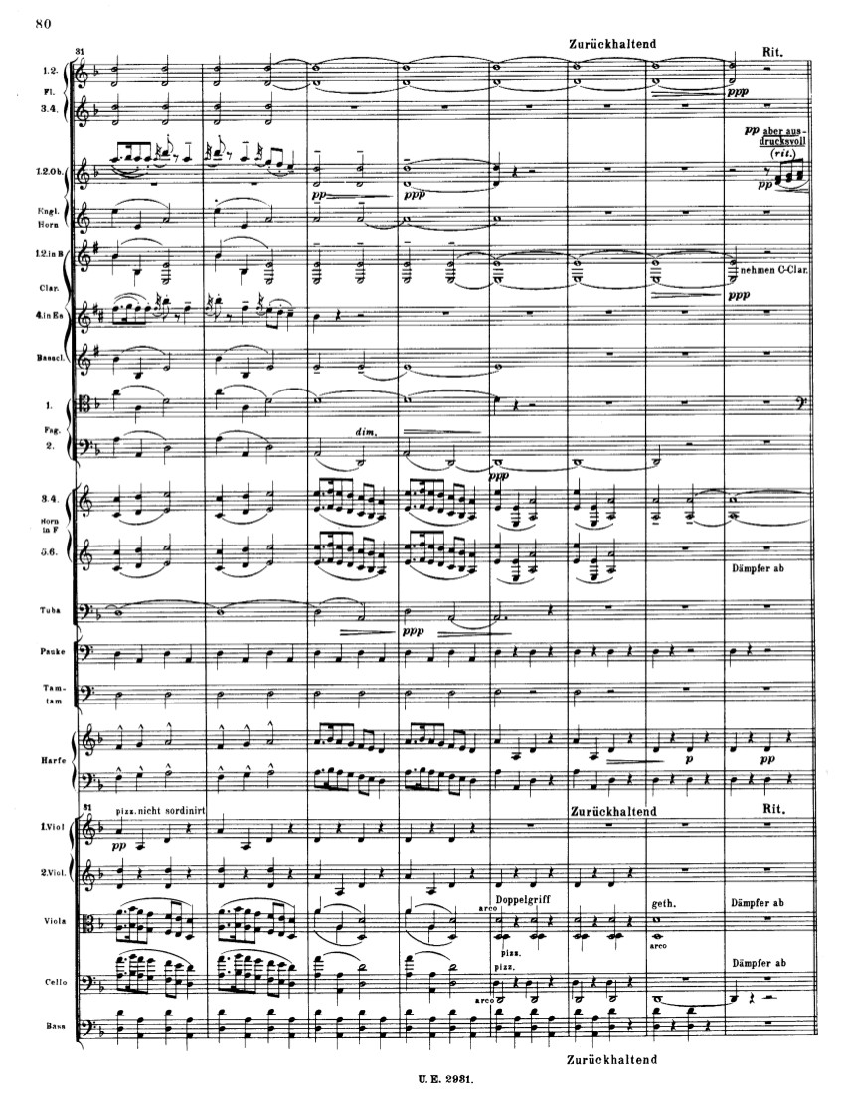
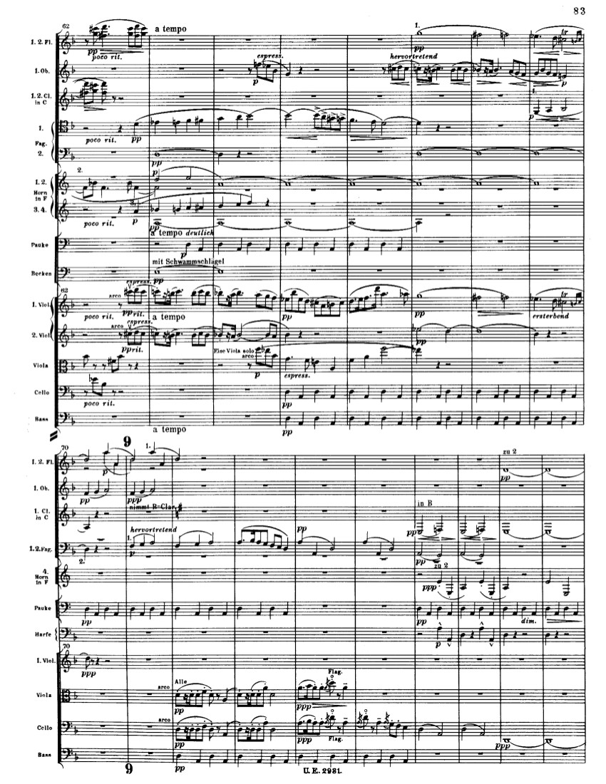
Mahler, Symphony No. 1 (1889-1899)

Slide 90
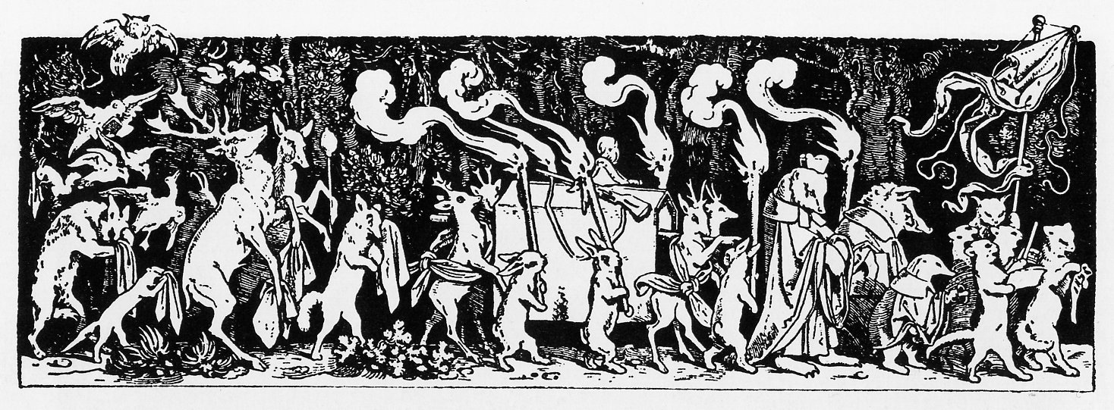
Mahler, Symphony No. 1, third movement
Jacques Callot ([17th c. French engraver])
Moritz von Schwind (woodcut, 1850), “The Huntsman’s Funeral Procession”
(included in children’s books of the later 19th century)
(cf. E.T.A. Hoffmann, “Phantasiestücke in Callot’s Manier”)

Slide 91
Hypermonumentality: the aesthetic
of the colossal; the magnum opus
Explicit ultimacy of the symphonic project: the symphony exists to confront basic questions of existence at their extremes; no holds barred.
“A symphony is like the world: it must include everything.”
Thus: “philosophical” symphonies: ultimate struggles of life, death, and desperate quests for meaning—or its dizzying absence—in the modernizing world.
Hyper-earnestness: existential despair and ecstatic triumph, juxtaposed and often conflicting with or undercutting each other.
Merging/blending of vocal music into some symphonies: soloists (e.g., Lieder) or chorus.
Inclusions of moods and styles previously thought as unfit for the “elevated” symphony: the ugly, the grotesque, the absurd, the banal, the empty, the culturally marginalized or rejected; “the whole truth” must be confronted.
Juxtaposed with passages of deeply felt longing and sentimentality—as if grieving for a world of now-lost meaning.

Slide 92
Hypermonumentality: the aesthetic
of the colossal; the magnum opus
Explicit ultimacy of the symphonic project: the symphony exists to confront basic questions of existence at their extremes; no holds barred.
“A symphony is like the world: it must include everything.”
Thus: “philosophical” symphonies: ultimate struggles of life, death, and desperate quests for meaning—or its dizzying absence—in the modernizing world.
Hyper-earnestness: existential despair and ecstatic triumph, juxtaposed and often conflicting with or undercutting each other.
Merging/blending of vocal music into some symphonies: soloists (e.g., Lieder) or chorus.
Inclusions of moods and styles previously thought as unfit for the “elevated” symphony: the ugly, the grotesque, the absurd, the banal, the empty, the culturally marginalized or rejected; “the whole truth” must be confronted.
Juxtaposed with passages of deeply felt longing and sentimentality—as if grieving for a world of now-lost meaning.
Symphony No. 1, finale, secondary theme

Slide 93
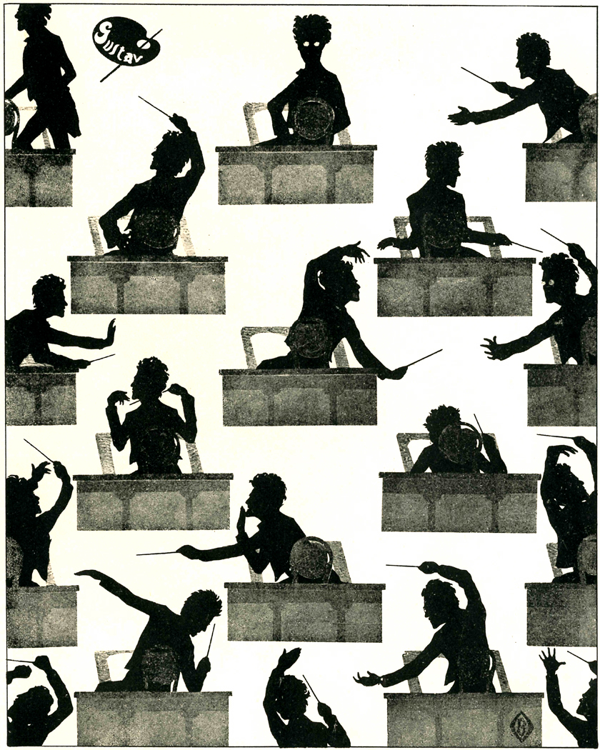
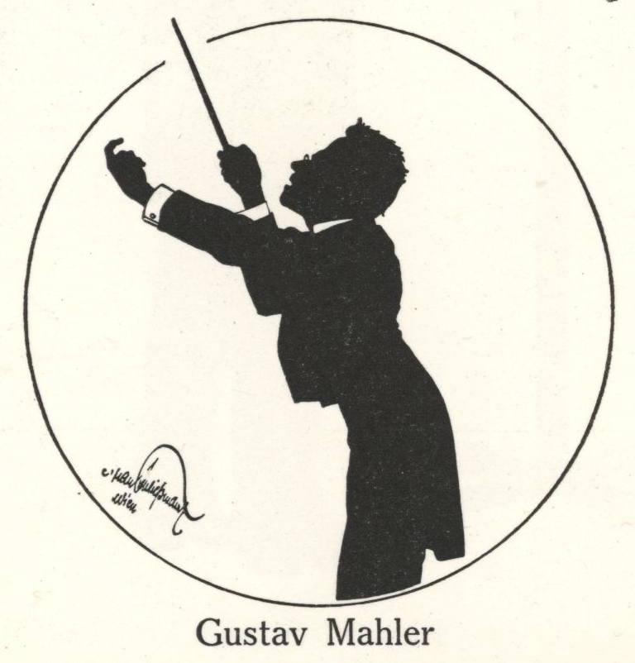

Slide 94
Mahler: Conducting Positions
1880-83: Linz, Laibach (Ljubljana [Slovenia])
1883: Olmütz (Olomouc, [Moravia])
1883-85: Kassel
1885-86: Prague
1886-88: Leipzig
1888-91: Budapest
1891-97: Hamburg
1897-1908: Vienna
1908-11: New York

Slide 95
Mahler: Conducting Positions
1880-83: Linz, Laibach (Ljubljana [Slovenia])
1883: Olmütz (Olomouc, [Moravia])
1883-85: Kassel
1885-86: Prague
1886-88: Leipzig
1888-91: Budapest
1891-97: Hamburg
1897-1908: Vienna
1908-11: New York

Slide 96
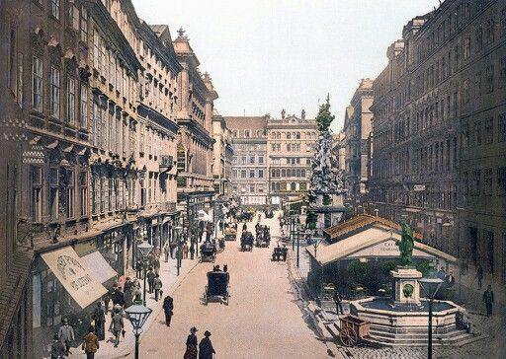
Vienna, 1890s

Slide 97
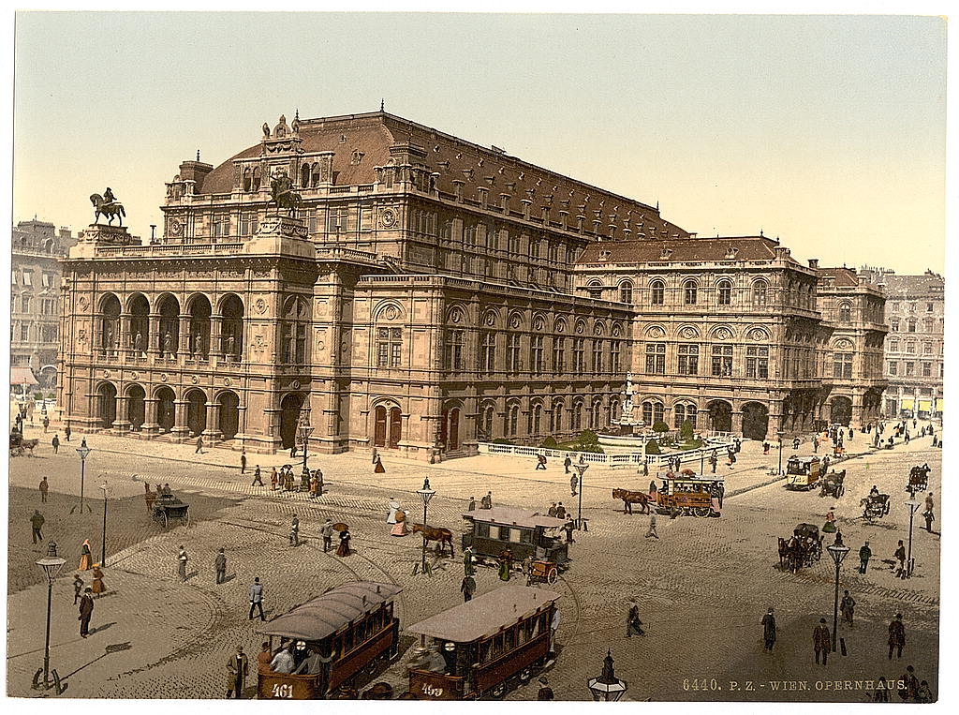
Vienna, 1890s

Slide 98
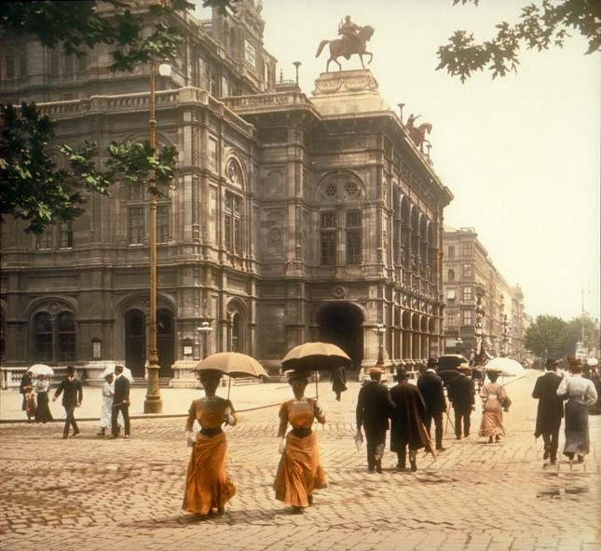
Vienna, 1890s

Slide 99
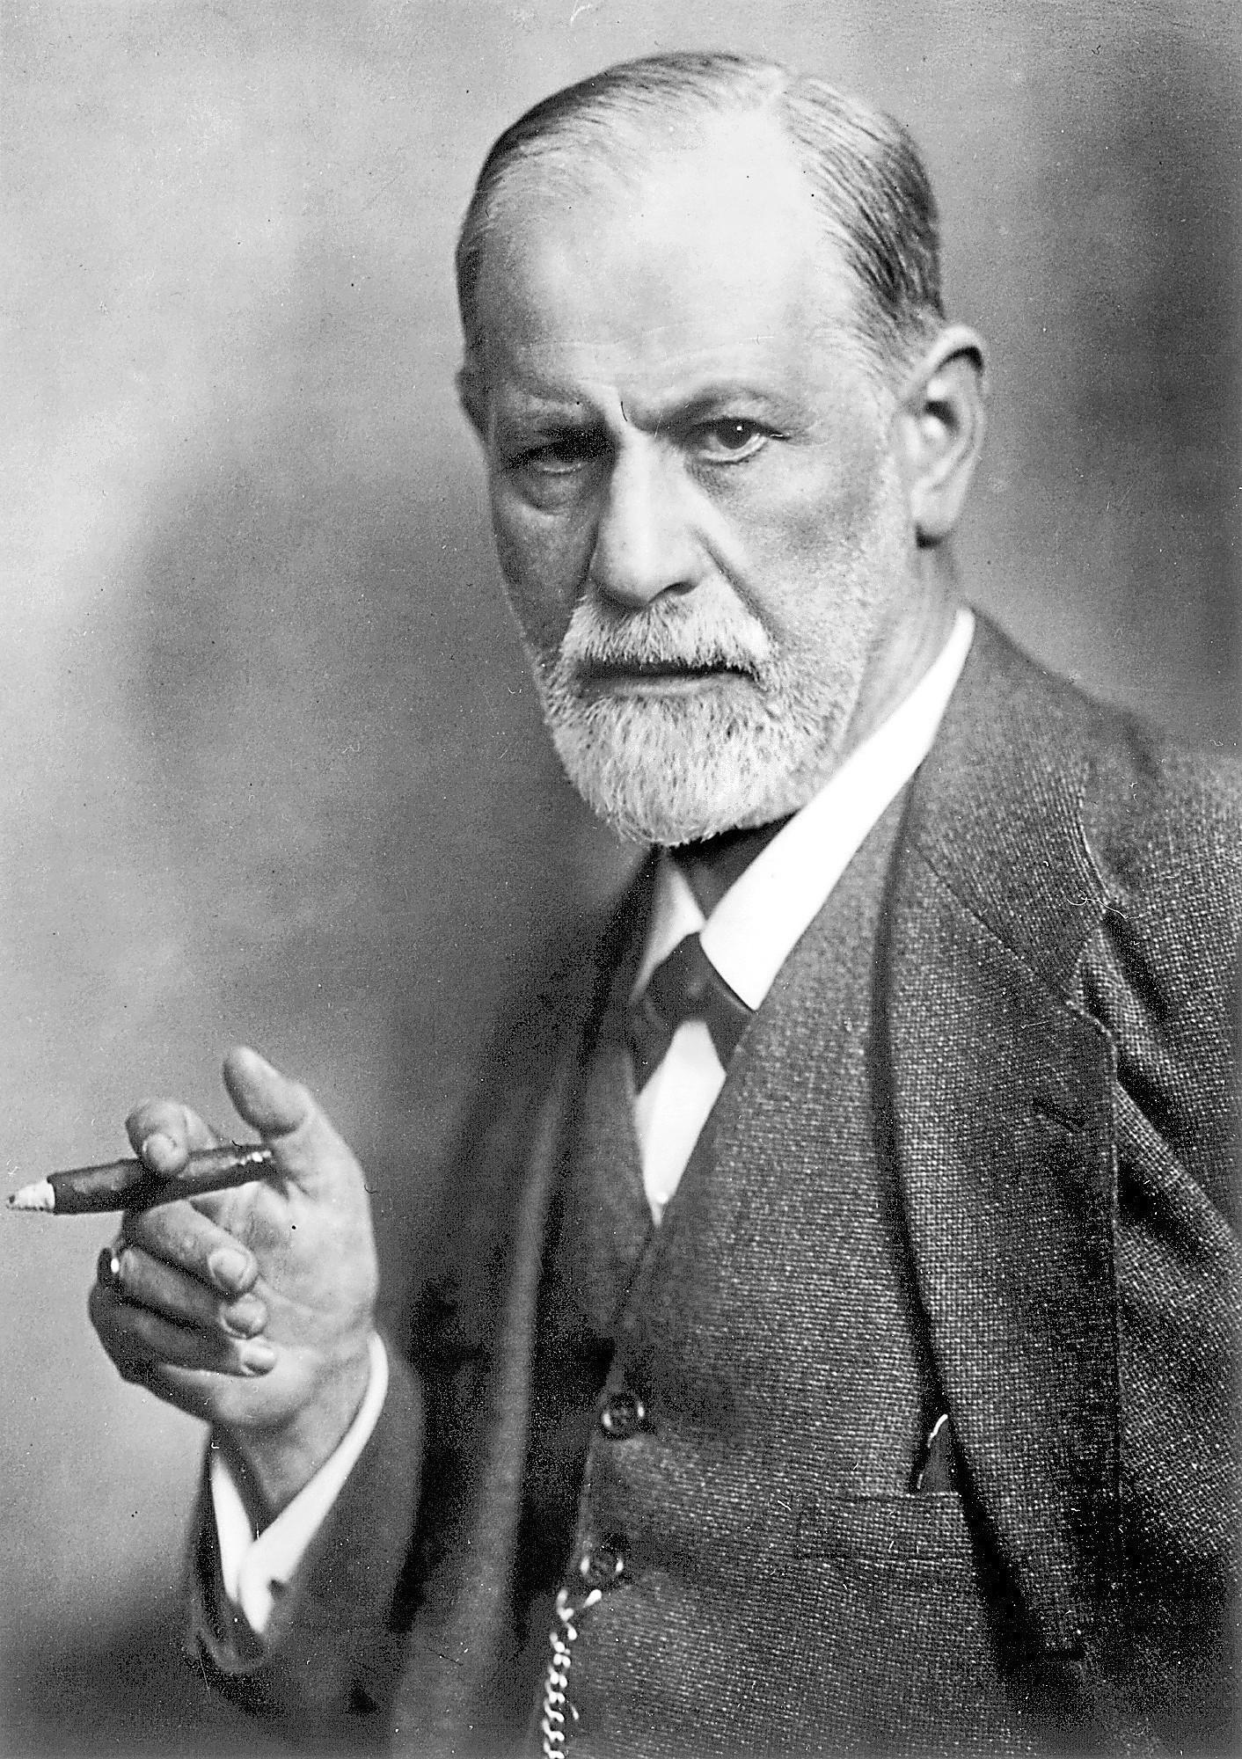
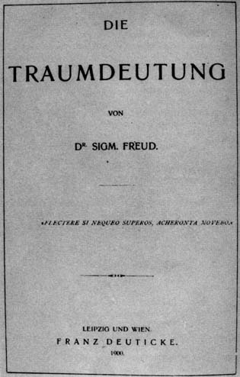

Slide 100
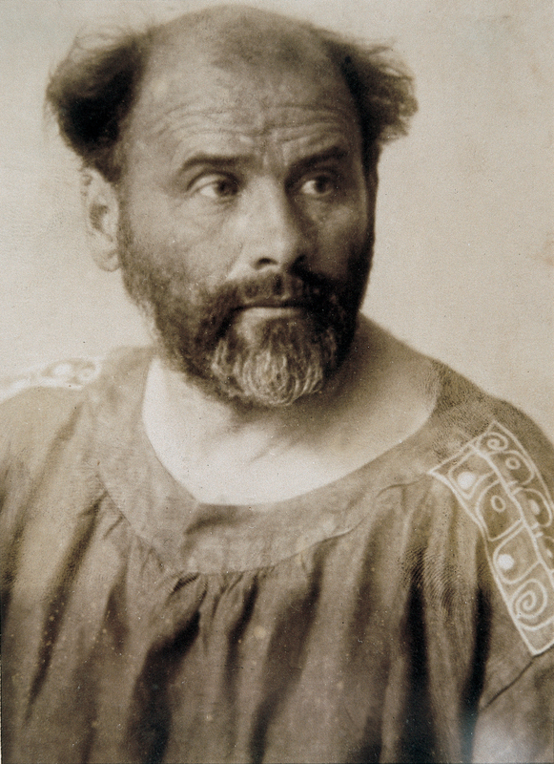
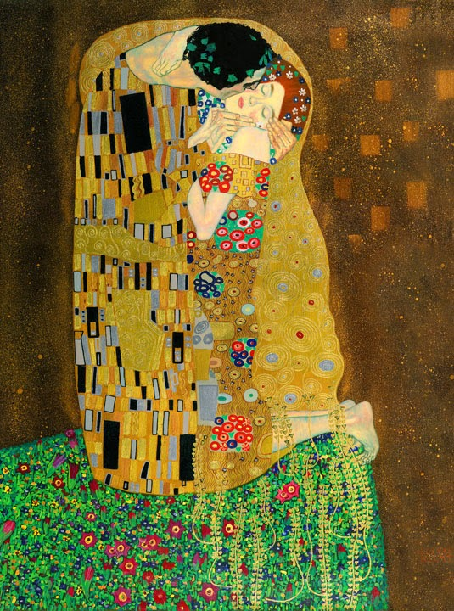
Gustav Klimt “The Kiss” (1907-08)

Slide 101
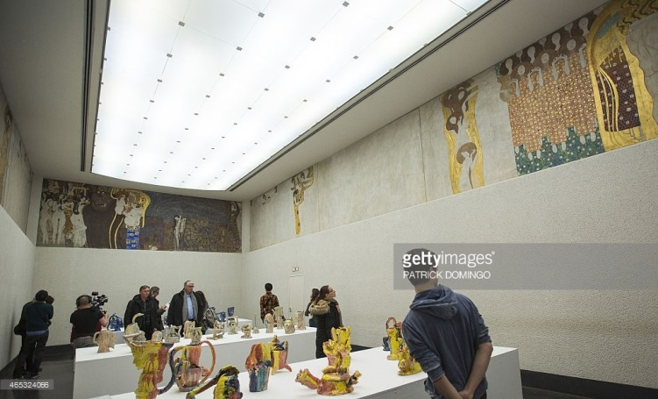
Gustav Klimt, Beethoven Frieze

Slide 102
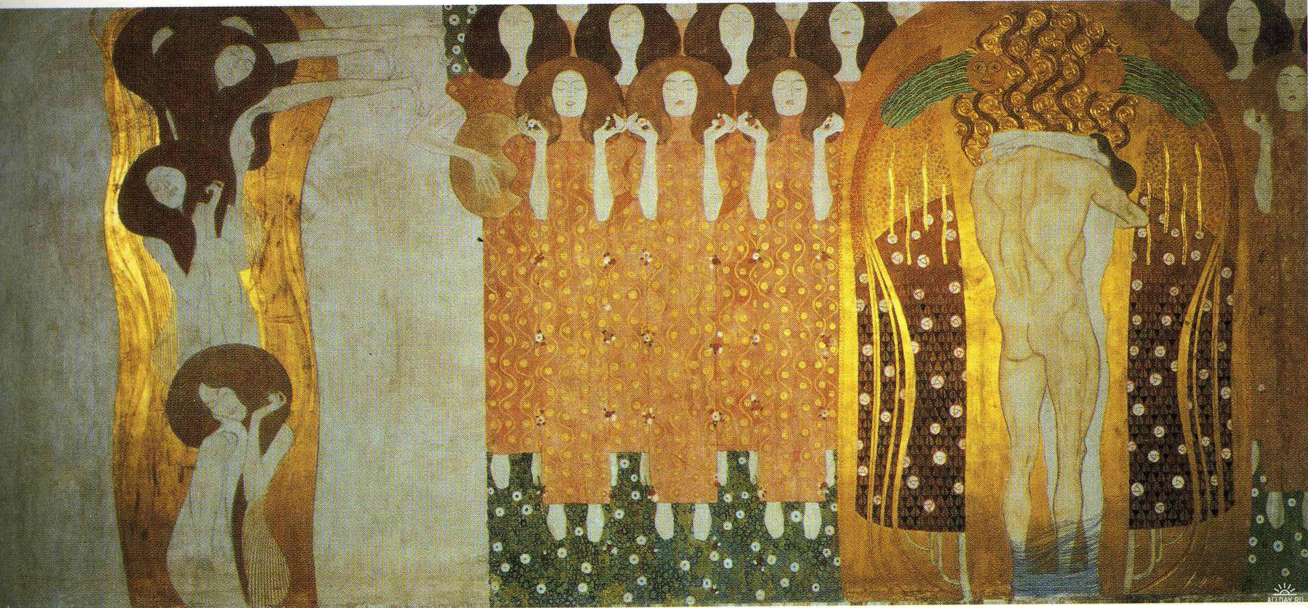
Gustav Klimt, Beethoven Frieze

Slide 103
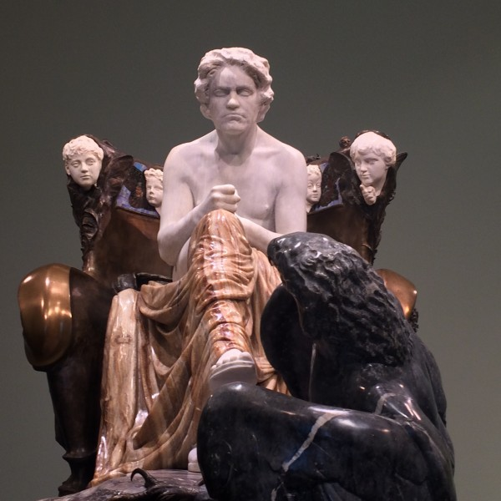
Max Klinger, Beethoven Monument. Displayed at the Vienna Secession Exhibition, 1902

Slide 104
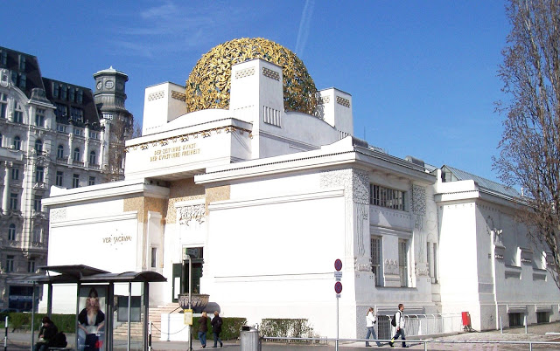
The Vienna Secession Building (1897)
"To every age its art, to every art its freedom"

Slide 105
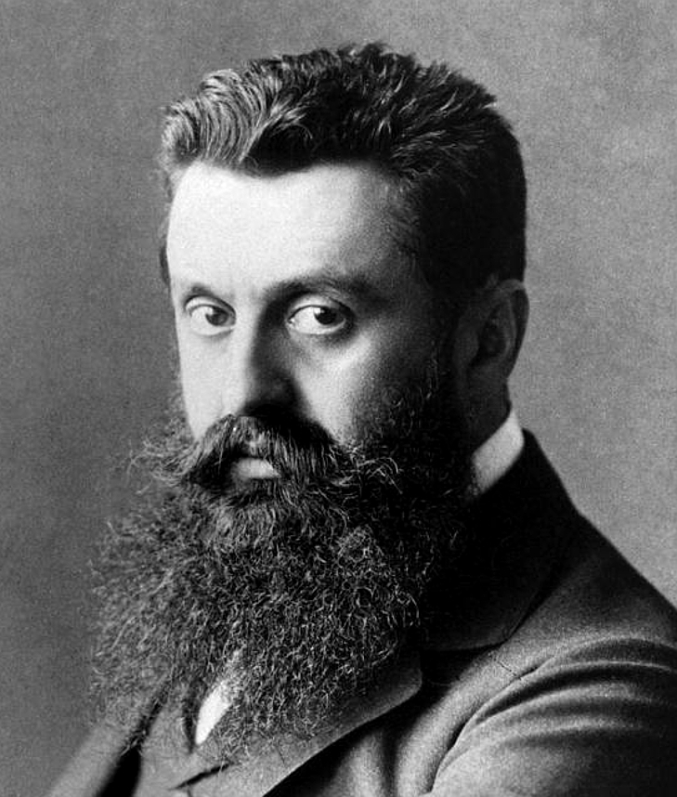
Theodor Herzl

Slide 106
Arnold Schoenberg, 1903

Slide 107
Hapsburg Emperor Franz-Josef
(reigned 1848-1916)

Slide 108
Karl Lueger (Mayor of Vienna, 1897-1910)

Slide 109
Karl Lueger (Mayor of Vienna, 1897-1910)

Slide 110
Mahler: Conducting Positions
1880-83: Linz, Laibach (Ljubljana [Slovenia])
1883: Olmütz (Olomouc, [Moravia])
1883-85: Kassel
1885-86: Prague
1886-88: Leipzig
1888-91: Budapest
1891-97: Hamburg
1897-1908: Vienna
1908-11: New York
Years involving materials for the First Symphony

