Slide 1
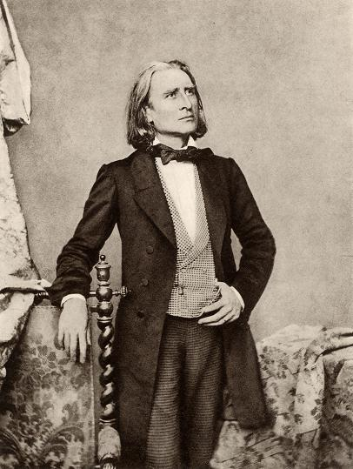
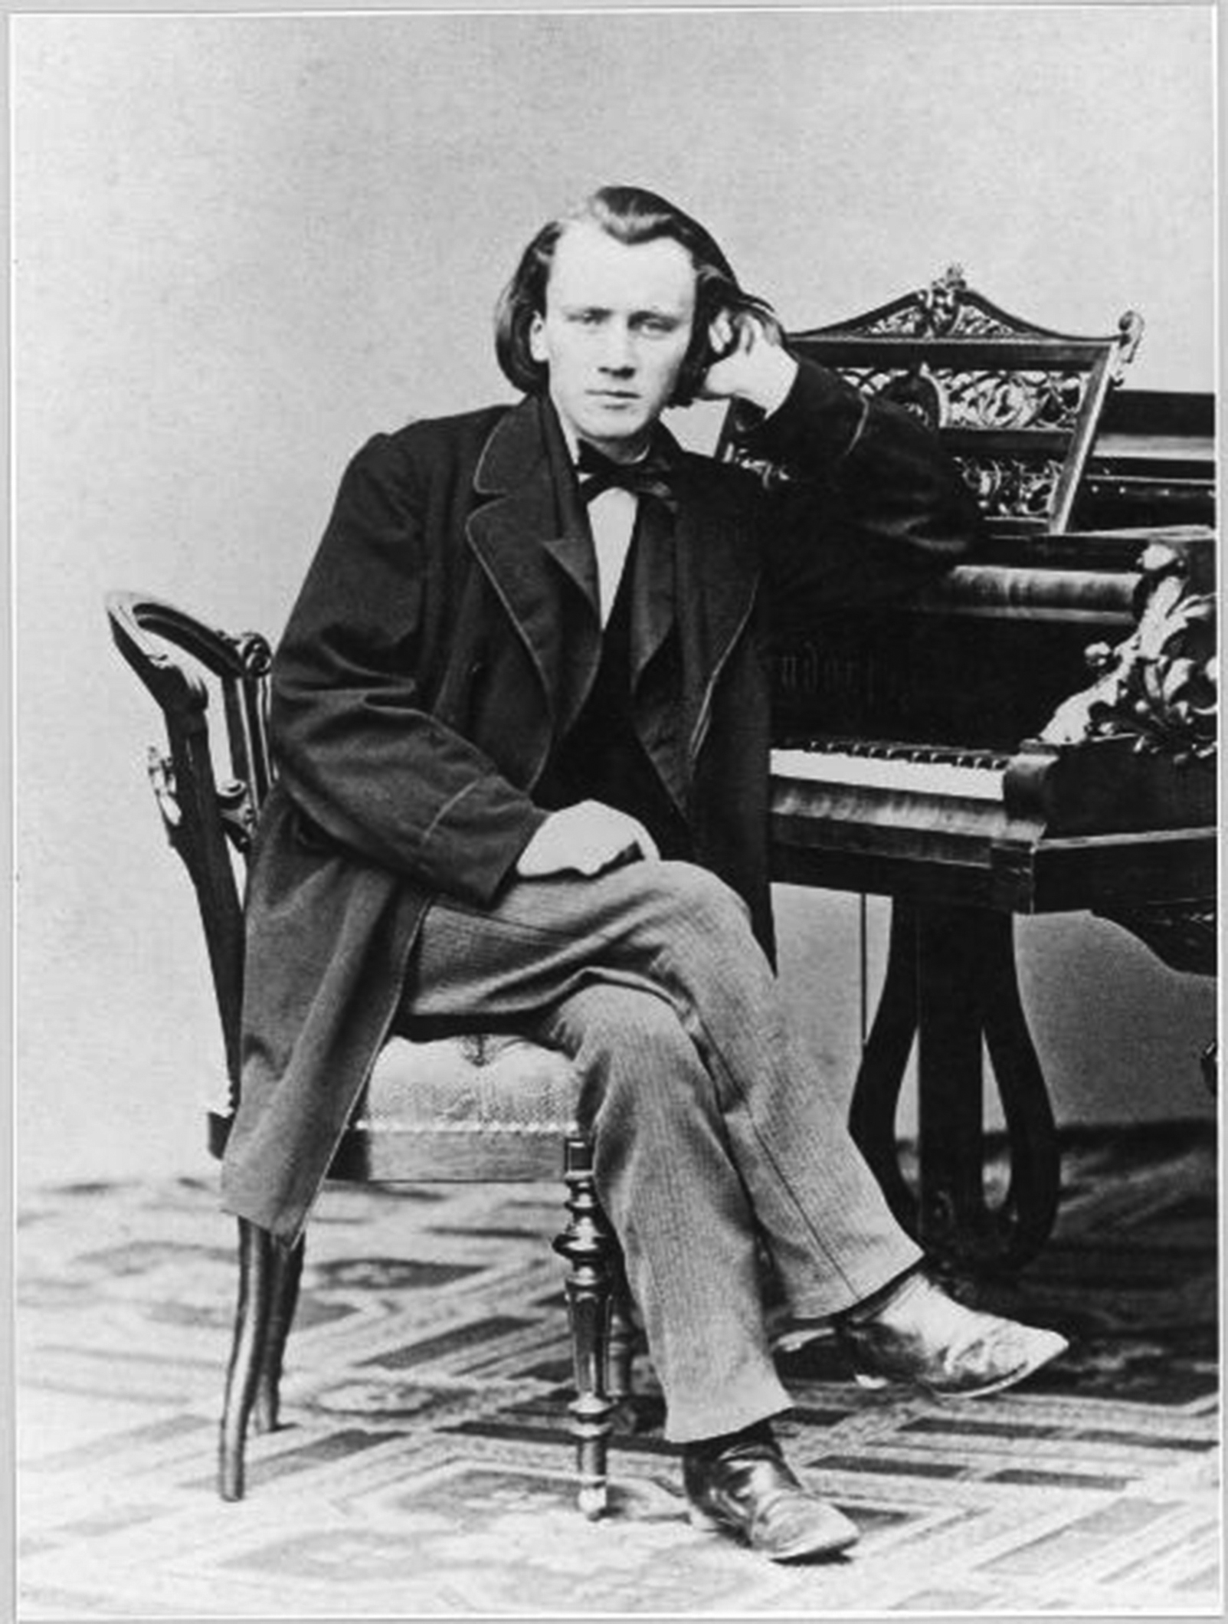
The 1850s Schism and Beyond: Liszt and Brahms

Slide 2
The Crisis of the 1830s, 1840s : The Great Age Now Gone?
Mozart 1791
Haydn 1809
Weber 1826
Beethoven 1827
Schubert 1828

Slide 3
The Crisis of the 1830s, 1840s : The Great Age Now Gone?
The Problem: How to Continue the Tradition?
Mozart 1791
Haydn 1809
Weber 1826
Beethoven 1827
Schubert 1828

Slide 4
The Deepened Crisis of the 1830s, 1840s, and now 1850s!
The Great Age Ever More Distant!
The Problem Remains: How to Continue the Tradition?
Mozart 1791
Haydn 1809
Weber 1826
Beethoven 1827
Schubert 1828
Mendelssohn 1847
Schumann 1856

Slide 5
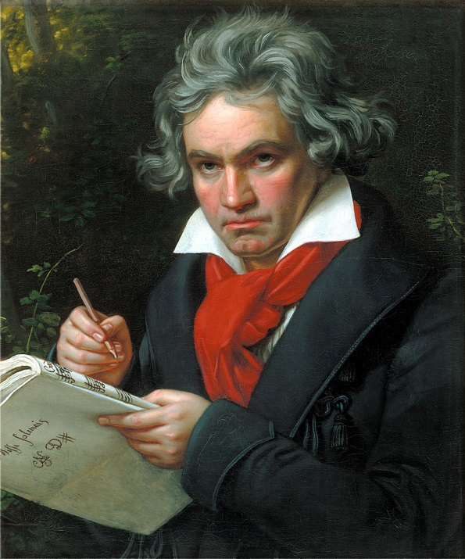
1830s, 1840s, 1850s: How to Continue the Tradition?
“Romantic” innovator (radical)? or “Classical” craftsman?

Slide 6
1830s, 1840s, 1850s: How to Continue the Tradition?
Radical “progress,” innovation, experiment, heightened intensity, flamboyance
(Berlioz [1830s, 1840s])
Liszt (1840s-1880s)
Wagner (1840s-1880s)

Slide 7
1830s, 1840s, 1850s: How to Continue the Tradition?
Cautious preservation of more reserved symphonic and chamber traditions in the name of a higher “art”
Mendelssohn (1840s)
Schumann (1840s, early 1850s, etc.)
Brahms (1850s-1890s)
Radical “progress,” innovation, experiment, heightened intensity, flamboyance
(Berlioz [1830s, 1840s])
Liszt (1840s-1880s)
Wagner (1840s-1880s)

Slide 8
1830s, 1840s, 1850s: How to Continue the Tradition?
Cautious preservation of more reserved symphonic and chamber traditions in the name of a higher “art”
Mendelssohn (1840s)
Schumann (1840s, early 1850s, etc.)
Brahms (1850s-1890s)
Radical “progress,” innovation, experiment, heightened intensity, flamboyance
(Berlioz [1830s, 1840s])
Liszt (1840s-1880s)
Wagner (1840s-1880s)

Slide 9
1830s, 1840s, 1850s: How to Continue the Tradition?
The drive to overwhelm, hypnotize, stun
(emotional intensity, sonic volume, increased
chromaticism, etc.)
Radical “progress,” innovation, experiment, heightened intensity, flamboyance
(Berlioz [1830s, 1840s])
Liszt (1840s-1880s)
Wagner (1840s-1880s)

Slide 10
1830s, 1840s, 1850s: How to Continue the Tradition?
The drive to overwhelm, hypnotize, stun
(emotional intensity, sonic volume, increased
chromaticism, etc.)
Spectacular virtuosity, showmanship, publicity, colorful effects: bigger! grander! higher! louder!
Radical “progress,” innovation, experiment, heightened intensity, flamboyance
(Berlioz [1830s, 1840s])
Liszt (1840s-1880s)
Wagner (1840s-1880s)

Slide 11
1830s, 1840s, 1850s: How to Continue the Tradition?
The drive to overwhelm, hypnotize, stun
(emotional intensity, sonic volume, increased
chromaticism, etc.)
Spectacular virtuosity, showmanship, publicity, colorful effects: bigger! grander! higher! louder!
Formal/structural innovations and experiments (e.g., sonata deformations, thematic transformations, etc.)
Radical “progress,” innovation, experiment, heightened intensity, flamboyance
(Berlioz [1830s, 1840s])
Liszt (1840s-1880s)
Wagner (1840s-1880s)

Slide 12
1830s, 1840s, 1850s: How to Continue the Tradition?
The drive to overwhelm, hypnotize, stun
(emotional intensity, sonic volume, increased
chromaticism, etc.)
Spectacular virtuosity, showmanship, publicity, colorful effects: bigger! grander! higher! louder!
Formal/structural innovations and experiments (e.g., sonata deformations, thematic transformations, etc.)
Rising interest in “program music” and evoking extramusical ideas and images (tone-painting: Tonmalerei)
Radical “progress,” innovation, experiment, heightened intensity, flamboyance
(Berlioz [1830s, 1840s])
Liszt (1840s-1880s)
Wagner (1840s-1880s)

Slide 13
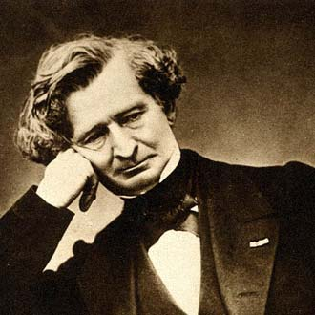
Symphonie fantastique (1830)
Harold en Italie (1834)

Slide 14
1830s, 1840s, 1850s: How to Continue the Tradition?
The drive to overwhelm, hypnotize, stun
(emotional intensity, sonic volume, increased
chromaticism, etc.)
Spectacular virtuosity, showmanship, publicity, colorful effects: bigger! grander! higher! louder!
Formal/structural innovations and experiments (e.g., sonata deformations, thematic transformations, etc.)
Rising interest in “program music” and evoking extramusical ideas and images (tone-painting: Tonmalerei)
Radical “progress,” innovation, experiment, heightened intensity, flamboyance
(Berlioz [1830s, 1840s])
Liszt (1840s-1880s)
Wagner (1840s-1880s)

Slide 15
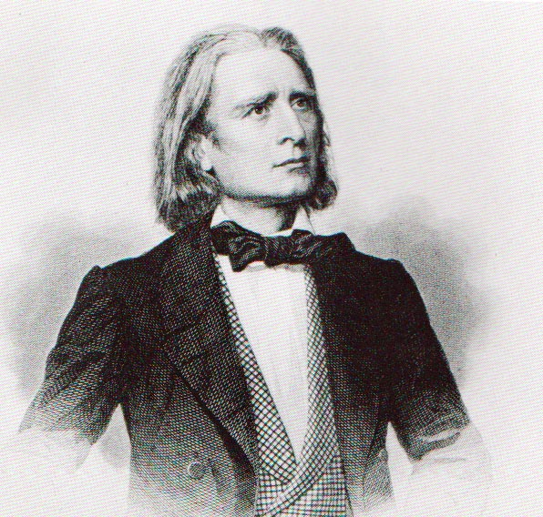
1830s, 1840s, 1850s: How to Continue the Tradition?
The drive to overwhelm, hypnotize, stun
(emotional intensity, sonic volume, increased
chromaticism, etc.)
Spectacular virtuosity, showmanship, publicity, colorful effects: bigger! grander! higher! louder!
Formal/structural innovations and experiments (e.g., sonata deformations, thematic transformations, etc.)
Rising interest in “program music” and evoking extramusical ideas and images (tone-painting: Tonmalerei)
Radical “progress,” innovation, experiment, heightened intensity, flamboyance
(Berlioz [1830s, 1840s])
Liszt (1840s-1880s)
Wagner (1840s-1880s)

Slide 16
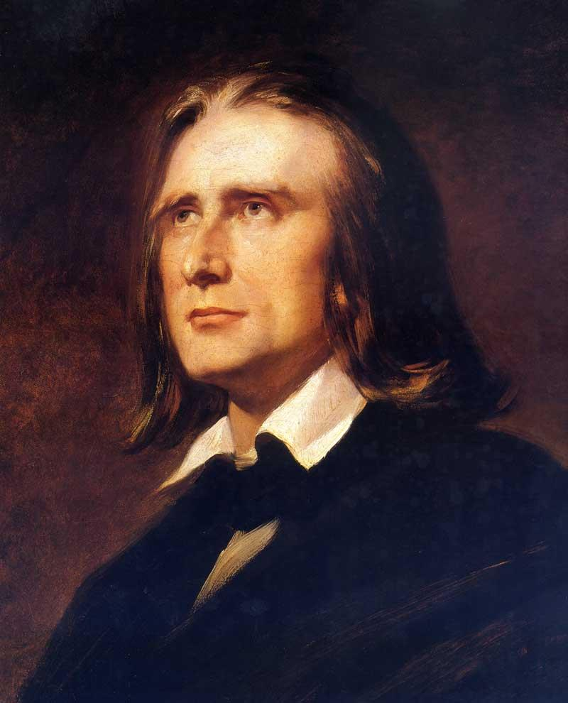
Liszt, 1830s, 1840s, pianist of “transcendental” virtuosity

Slide 17
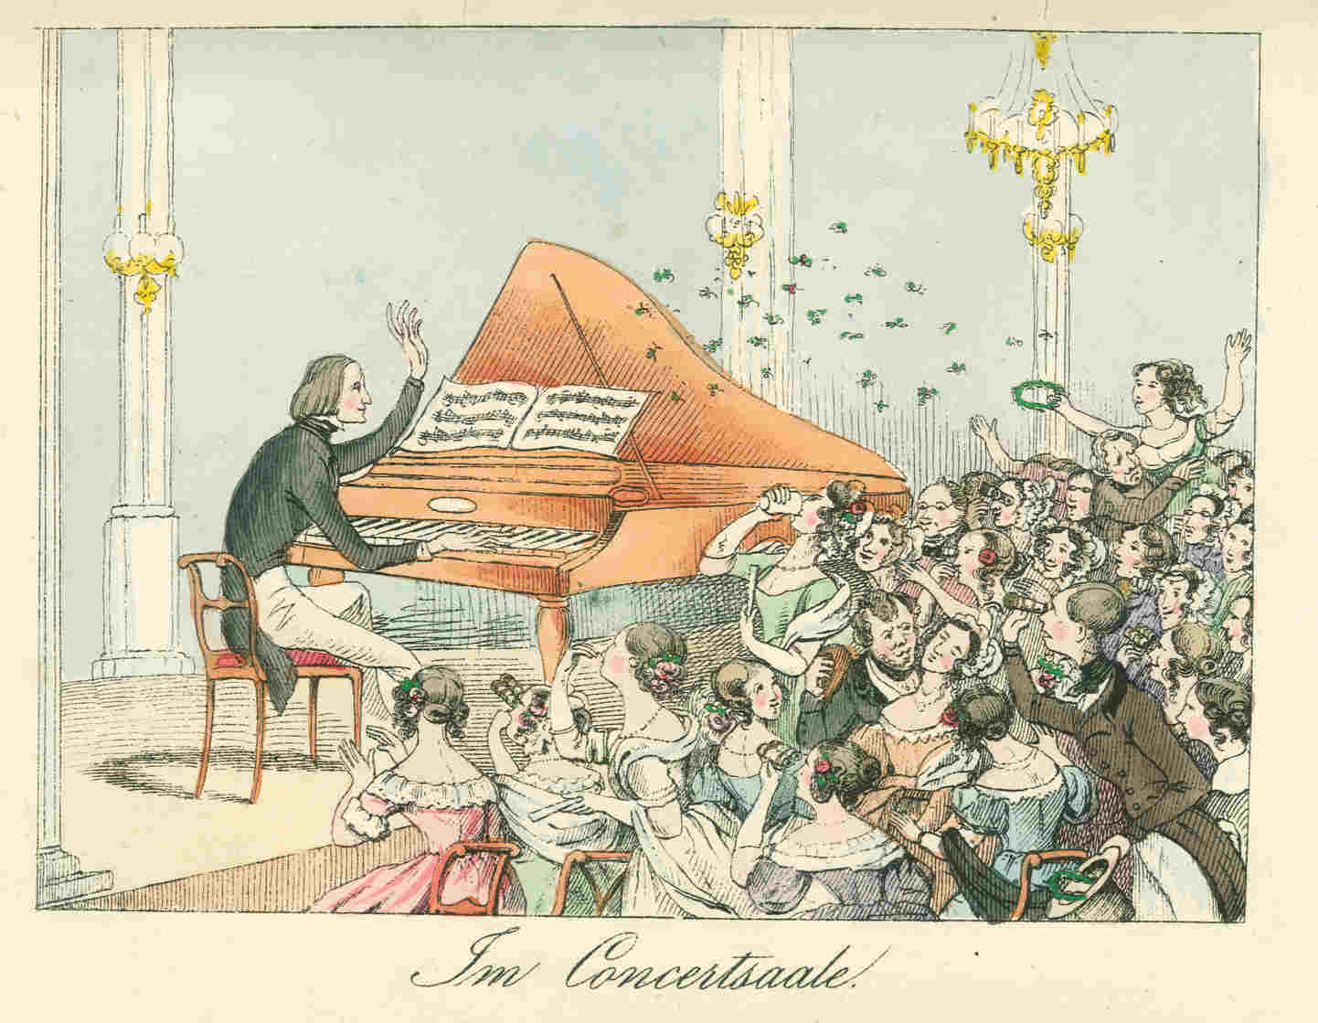
1842

Slide 18
Transcendental Etudes, No. 1, “Preludio” (1830s, rev., publ. 1852)
1842

Slide 19
Transcendental Etudes, No. 1, “Feux follets” (1830s, rev., publ. 1852)
1842

Slide 20
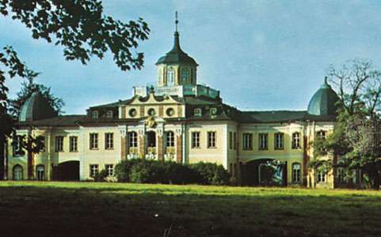
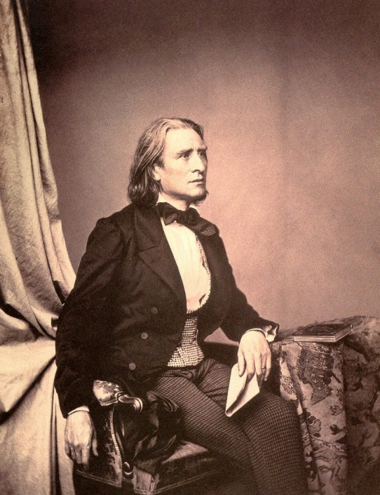
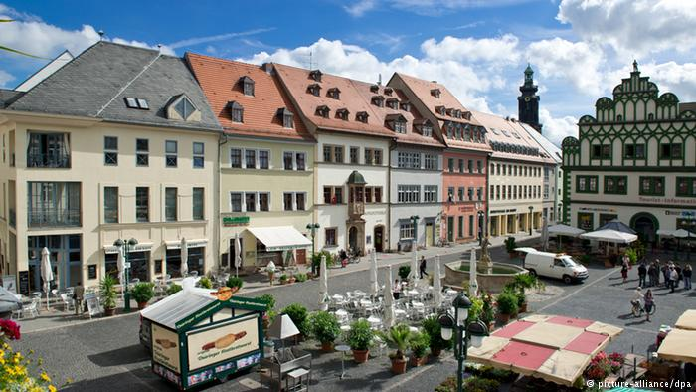
Liszt: Relocates to Weimar, 1848 (Kapellmeister at Court)

Slide 21
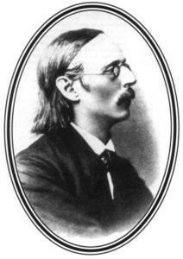
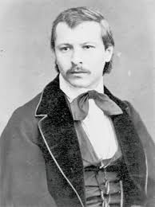
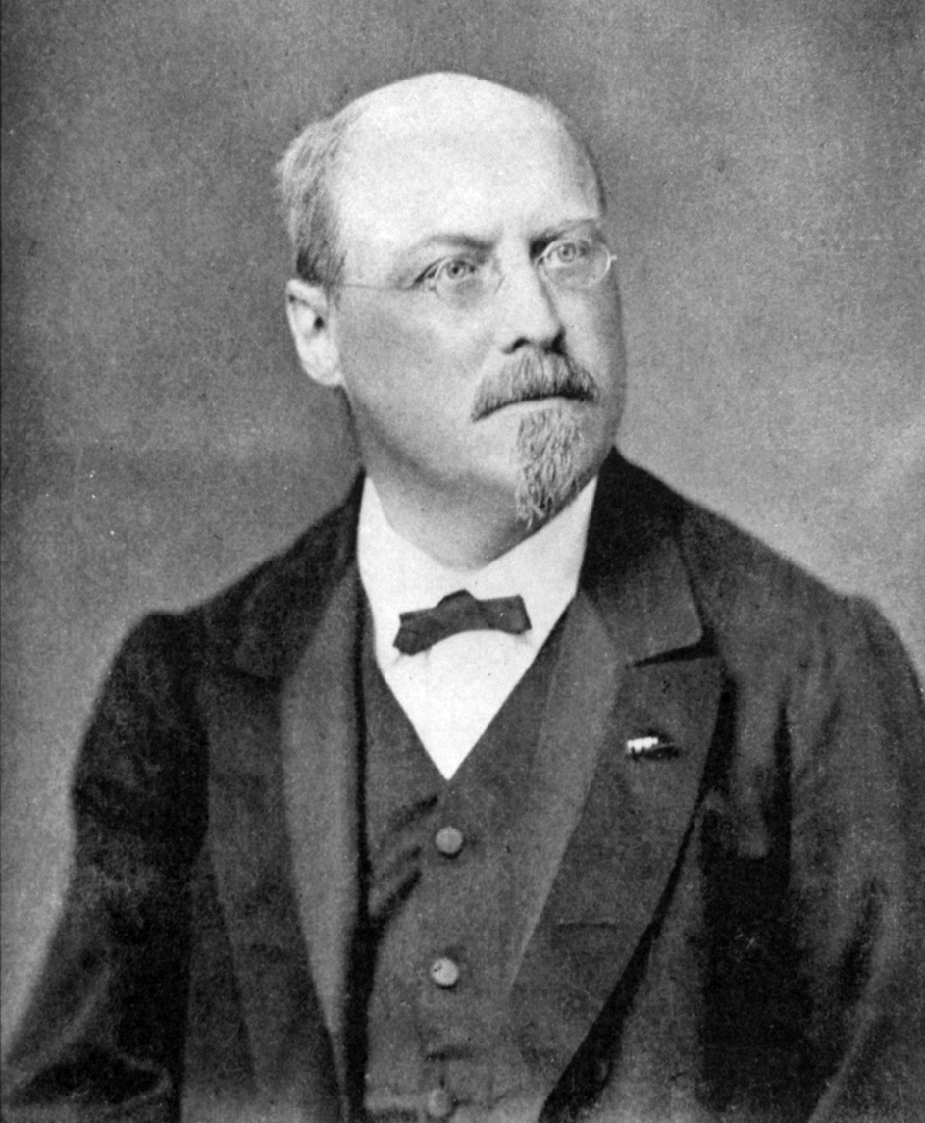
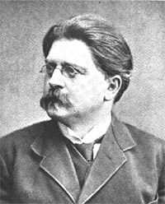
The Liszt Cult in Weimar: the Neu-Deutsche Schule (New German School)
Karl Tausig
Peter Cornelius
Felix Draeseke
Joachim Raff

Slide 22
Orchestral Program Music

Slide 23
Orchestral Program Music
Symphonic Poem (Symphonische Dichtung):
One-movement orchestral work grounded in a poetic or literary idea (its title) with which its content and structure were closely allied

Slide 24
Orchestral Program Music
Symphonic Poem (Symphonische Dichtung):
One-movement orchestral work grounded in a poetic or literary idea (its title) with which its content and structure were closely allied, e.g.
Tasso: lamento e trionfo (1847-54)

Slide 25
Orchestral Program Music
Symphonic Poem (Symphonische Dichtung):
One-movement orchestral work grounded in a poetic or literary idea (its title) with which its content and structure were closely allied, e.g.
Tasso: lamento e trionfo (1847-54)
Les préludes (1849-55)

Slide 26
The Genealogy of the Symphonic Poem
Opera overture with narrative implications
Beethoven: Leonore (Fidelio)
Weber: Der Freischütz, Euryanthe, Oberon)
Berlioz: opera overtures (Benvenuto Cellini, etc.)
Concert overture (or overture to incidental music)
Beethoven: Egmont, Coriolan, etc.
Mendelssohn (!): Midsummer Night’s Dream (1826), Hebrides (1830, rev. 1832)
Calm Sea and Prosperous Voyage (1828, rev. 1834)
The Fair Melusine (1833-34)
Ruy Blas (1839)
Berlioz: program symphony
Symphonie fantastique (1830)
Harold en Italie (1834)
Liszt: Symphonic poem (1850s)

Slide 27
Orchestral Program Music
Symphonic Poem (Symphonische Dichtung):
One-movement orchestral work grounded in a poetic or literary idea (its title) with which its content and structure were closely allied, e.g.
Tasso: lamento e trionfo (1847-54)
Les préludes (1849-55)
Orpheus (1853-54)
Prometheus (1850-55)
Mazeppa (1851-54)
Hamlet (1858)

Slide 28
Orchestral Program Music
Symphonic Poem (Symphonische Dichtung):
One-movement orchestral work grounded in a poetic or literary idea (its title) with which its content and structure were closely allied, e.g.
Tasso: lamento e trionfo (1847-54)
Les préludes (1849-55)
Orpheus (1853-54)
Prometheus (1850-55)
Mazeppa (1851-54)
Hamlet (1858)
Program Symphony:
Eine Faust-Symphonie (1856)
Eine Symphonie zu Dantes Divina Commedia (1856-57)

Slide 29
Aesthetic Claims of Program Music and the Symphonic Poem
(e.g., in Liszt’s manifesto, “Berlioz and His ‘Harold’ Symphony” (1855):

Slide 30
Aesthetic Claims of Program Music and the Symphonic Poem
(e.g., in Liszt’s manifesto, “Berlioz and His ‘Harold’ Symphony” (1855):
“Abstract” music: old-fashioned, sterile, formulaic

Slide 31
Aesthetic Claims of Program Music and the Symphonic Poem
(e.g., in Liszt’s manifesto, “Berlioz and His ‘Harold’ Symphony” (1855):
“Abstract” music: old-fashioned, sterile, formulaic
Non-programmatic music: no fixed meaning; puzzles the listener

Slide 32
Aesthetic Claims of Program Music and the Symphonic Poem
(e.g., in Liszt’s manifesto, “Berlioz and His ‘Harold’ Symphony” (1855):
“Abstract” music: old-fashioned, sterile, formulaic
Non-programmatic music: no fixed meaning; puzzles the listener
Verbal programs (and titles) help to anchor the poetic meaning for the listener

Slide 33
Aesthetic Claims of Program Music and the Symphonic Poem
(e.g., in Liszt’s manifesto, “Berlioz and His ‘Harold’ Symphony” (1855):
“Abstract” music: old-fashioned, sterile, formulaic
Non-programmatic music: no fixed meaning; puzzles the listener
Verbal programs (and titles) help to anchor the poetic meaning for the listener
Extramusical, poetic ideas are paramount and must themselves generate the musical form (instead of being bound to traditional forms)

Slide 34
Aesthetic Claims of Program Music and the Symphonic Poem
(e.g., in Liszt’s manifesto, “Berlioz and His ‘Harold’ Symphony” (1855):
“Abstract” music: old-fashioned, sterile, formulaic
Non-programmatic music: no fixed meaning; puzzles the listener
Verbal programs (and titles) help to anchor the poetic meaning for the listener
Extramusical, poetic ideas are paramount and must themselves generate the musical form (instead of being bound to traditional forms)
Thus: “new ideas demand new forms” (Richard Strauss’s formulation)

Slide 35
Aesthetic Claims of Program Music and the Symphonic Poem
(e.g., in Liszt’s manifesto, “Berlioz and His ‘Harold’ Symphony” (1855):
“Abstract” music: old-fashioned, sterile, formulaic
Non-programmatic music: no fixed meaning; puzzles the listener
Verbal programs (and titles) help to anchor the poetic meaning for the listener
Extramusical, poetic ideas are paramount and must themselves generate the musical form (instead of being bound to traditional forms)
Thus: “new ideas demand new forms” (Richard Strauss’s formulation)
= liberation from the merely conventional traditions of the established
musical forms (encouraging much freer treatments, etc.)

Slide 36
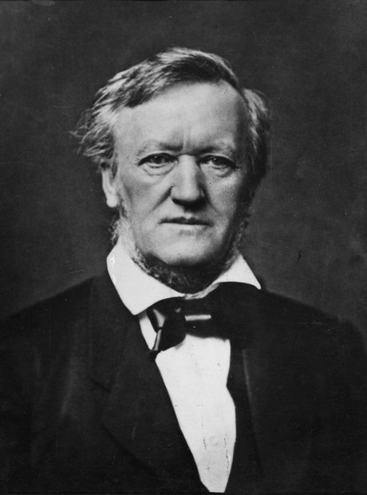
Thus: “progress” is carried only by “the music of the future”
Thus: “progress” is carried only by “the music of the future”
Symphonic Poem (Liszt)
Program Symphony
Music Drama (Wagner)

Slide 37
The Liszt Cult in Weimar: the Neu-Deutsche Schule (New German School)
Karl Tausig
Peter Cornelius
Felix Draeseke
Joachim Raff

Slide 38
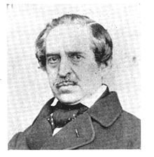
The Liszt Cult in Weimar: the Neu-Deutsche Schule (New German School)
Karl Tausig
Peter Cornelius
Felix Draeseke
Joachim Raff
Franz Brendel

Slide 39
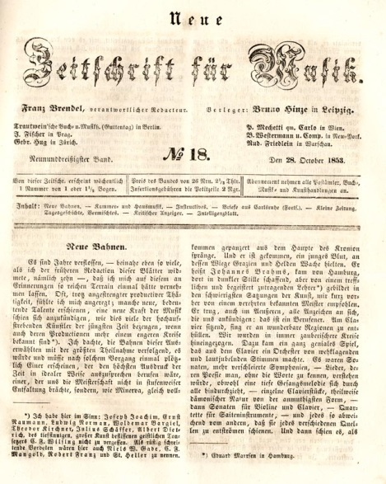
Franz Brendel (succeeds Schumann
as editor of the Neue Zeitschrift für Musik, 1845)

Slide 40
The Liszt Cult in Weimar: the Neu-Deutsche Schule (New German School)
Karl Tausig
Peter Cornelius
Felix Draeseke
Joachim Raff
Franz Brendel

Slide 41
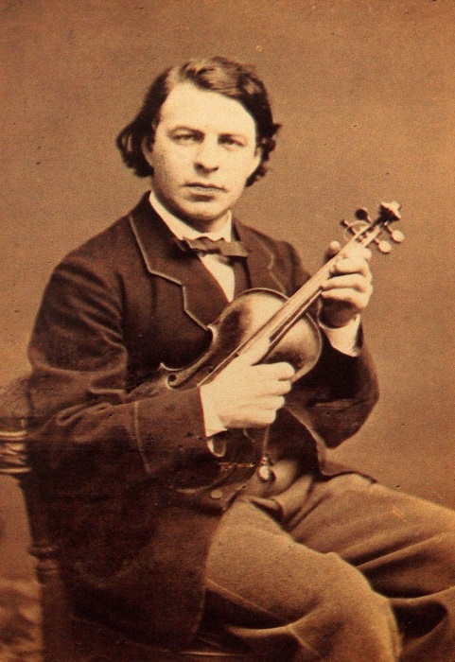
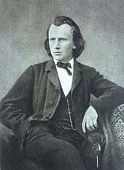
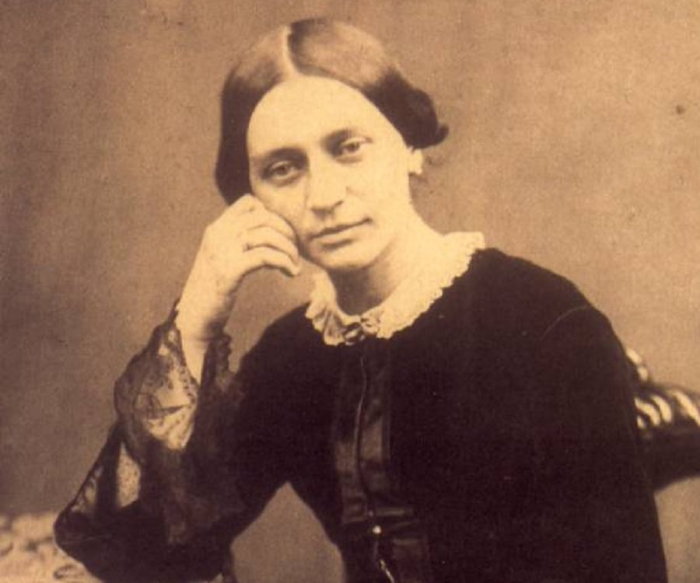
The “Brahms Circle,” later 1850s onward—
centered around:
Joseph Joachim
Clara (Wieck) Schumann (1819-96)
Johannes Brahms (1833-97)

Slide 42
The Brahms Circle and the Conservative Position (late 1850s onward)

Slide 43
The Brahms Circle and the Conservative Position (late 1850s onward)
Fundamentally a moral position: we are the pure remnant, the last of the real artists, struggling against a musical age lapsing into cheap, tawdry decline

Slide 44
The Brahms Circle and the Conservative Position (late 1850s onward)
Fundamentally a moral position: we are the pure remnant, the last of the real artists, struggling against a musical age lapsing into cheap, tawdry decline
Contemptuous dismissal of displays of flashy virtuosity, shallow publicity, cultish fads or fashions, commercialism, personal display

Slide 45
The Brahms Circle and the Conservative Position (late 1850s onward)
Fundamentally a moral position: we are the pure remnant, the last of the real artists, struggling against a musical age lapsing into cheap, tawdry decline
Contemptuous dismissal of displays of flashy virtuosity, shallow publicity, cultish fads or fashions, commercialism, personal display
Thus: contra “program music” and “music of the future” (Liszt, Wagner)

Slide 46
The Brahms Circle and the Conservative Position (late 1850s onward)
Fundamentally a moral position: we are the pure remnant, the last of the real artists, struggling against a musical age lapsing into cheap, tawdry decline
Contemptuous dismissal of displays of flashy virtuosity, shallow publicity, cultish fads or fashions, commercialism, personal display
Thus: contra “program music” and “music of the future” (Liszt, Wagner)
A “moral/aesthetic” high-reverence for past Austro-Germanic masters (with Beethoven at the center)—an effort to remain true to past works (Werktreue) and the emerging “canon” of (usually Germanic) masterworks.

Slide 47
The Brahms Circle and the Conservative Position (late 1850s onward)
Fundamentally a moral position: we are the pure remnant, the last of the real artists, struggling against a musical age lapsing into cheap, tawdry decline
Contemptuous dismissal of displays of flashy virtuosity, shallow publicity, cultish fads or fashions, commercialism, personal display
Thus: contra “program music” and “music of the future” (Liszt, Wagner)
A “moral/aesthetic” high-reverence for past Austro-Germanic masters (with Beethoven at the center)—an effort to remain true to past works (Werktreue) and the emerging “canon” of (usually Germanic) masterworks.
Consolidation and sustaining of the “abstract,” non-programmatic tradition (sonatas, chamber music, concertos, etc.)

Slide 48
The Brahms Circle and the Conservative Position (late 1850s onward)
Fundamentally a moral position: we are the pure remnant, the last of the real artists, struggling against a musical age lapsing into cheap, tawdry decline
Contemptuous dismissal of displays of flashy virtuosity, shallow publicity, cultish fads or fashions, commercialism, personal display
Thus: contra “program music” and “music of the future” (Liszt, Wagner)
A “moral/aesthetic” high-reverence for past Austro-Germanic masters (with Beethoven at the center)—an effort to remain true to past works (Werktreue) and the emerging “canon” of (usually Germanic) masterworks.
Consolidation and sustaining of the “abstract,” non-programmatic tradition (sonatas, chamber music, concertos, etc.)
More cautious, reserved in style, structure, form, orchestration

Slide 49
The Brahms Circle and the Conservative Position (late 1850s onward)
Fundamentally a moral position: we are the pure remnant, the last of the real artists, struggling against a musical age lapsing into cheap, tawdry decline
Contemptuous dismissal of displays of flashy virtuosity, shallow publicity, cultish fads or fashions, commercialism, personal display
Thus: contra “program music” and “music of the future” (Liszt, Wagner)
A “moral/aesthetic” high-reverence for past Austro-Germanic masters (with Beethoven at the center)—an effort to remain true to past works (Werktreue) and the emerging “canon” of (usually Germanic) masterworks.
Consolidation and sustaining of the “abstract,” non-programmatic tradition (sonatas, chamber music, concertos, etc.)
More cautious, reserved in style, structure, form, orchestration
“Historicist” flavor—music self-consciously in dialogue with a growing “standard repertory” or canon (Bach, Haydn, Mozart, Beethoven, Schumann, Brahms,. . . .)

Slide 50
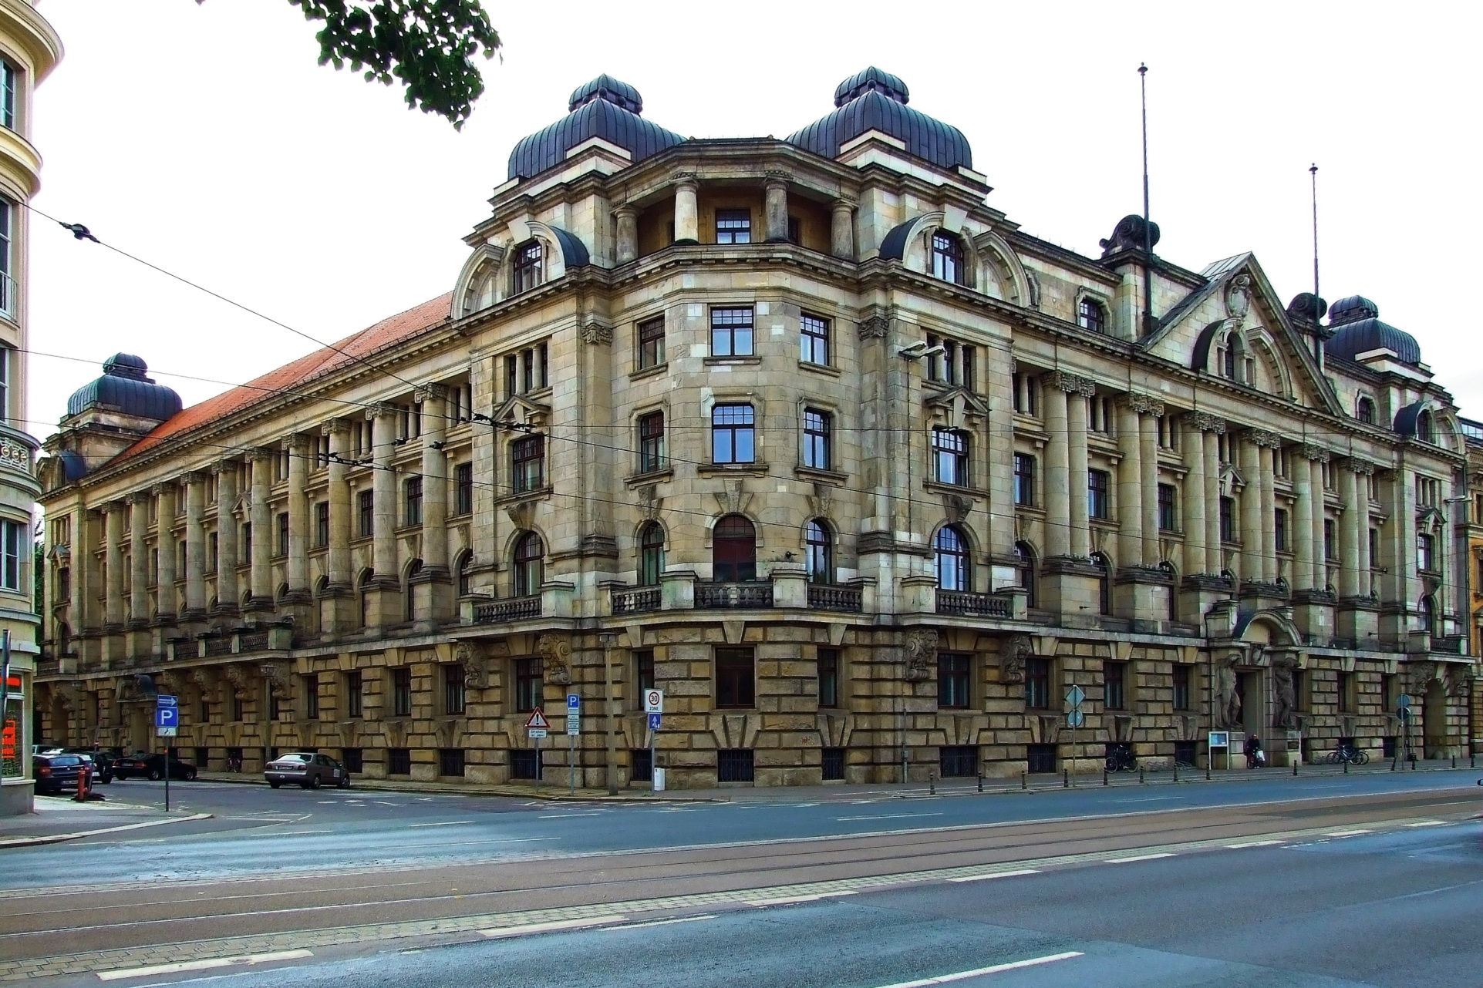
Leipzig Conservatory (founded, Mendelssohn, 1843)

Slide 51
The “Brahms Circle,” later 1850s onward—
centered around:
Joseph Joachim
Clara (Wieck) Schumann (1819-96)
Johannes Brahms (1833-97)

Slide 52
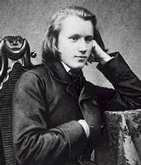
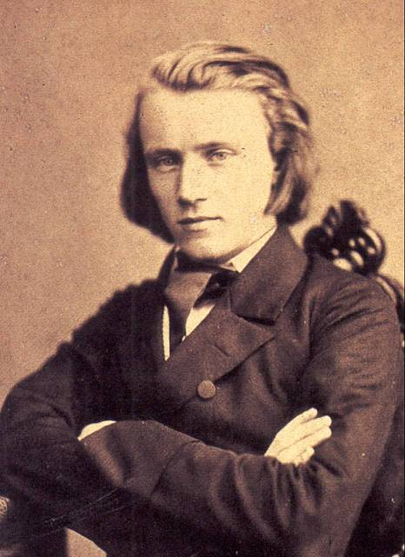

Slide 53
Early 1850s: Young “Brahms the Unknown”

Slide 54
1853
Joseph Joachim (1831-1907)
Johannes Brahms (1833-97)

Slide 55
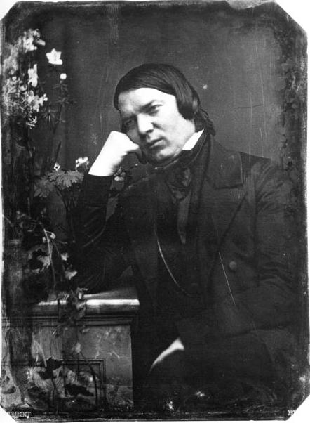
1853
Clara (Wieck) Schumann (1819-96)
Robert Schumann (1810-56)
Johannes Brahms (1833-97)
(“the unknown”)

Slide 56
October 1853
Johannes Brahms (1833-97)
Robert Schumann (1810-56)
“Neue Bahnen” (“New Paths”)

Slide 57
October 1853
Johannes Brahms (1833-97)
Robert Schumann (1810-56)
“Neue Bahnen” (“New Paths”)
Piano Sonata in C, op. 1 (late 1853)

Slide 58
The Split: August 1857
Joseph Joachim (1831-1907)
Franz Liszt (1811-86)

Slide 59
Increasing Tensions, 1859:
Franz Brendel (Neue Zeitschrift) coins the term Neu-Deutsche Schule
(New German School) in praise of
Liszt’s Weimar Circle

Slide 60
Increasing Tensions, 1859:
Franz Brendel (Neue Zeitschrift) coins the term Neu-Deutsche Schule
(New German School) in praise of
Liszt’s Weimar Circle
Brahms’s musical manifesto-by-example contra the Lisztians:
Piano Concerto No. 1 in D Minor

Slide 61
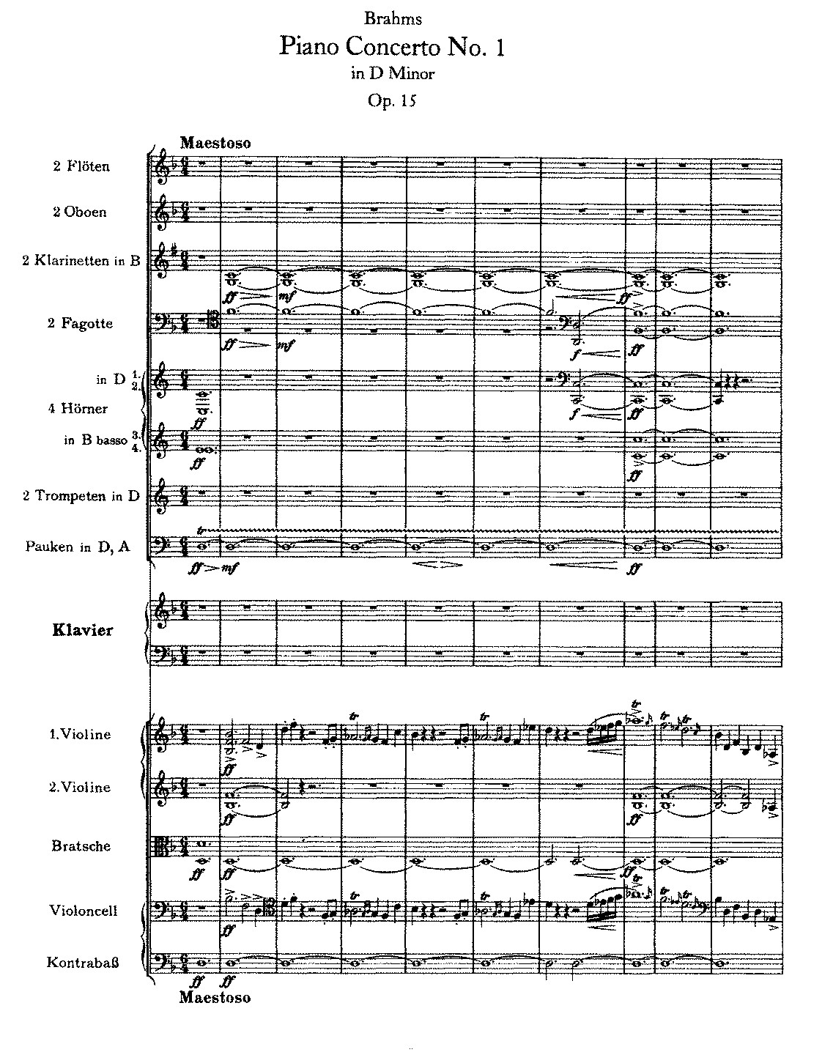
1859 Premiere

Slide 62
The Split—Doubling Down: Brahms, Joachim, and Others:
Manifesto Published in the Echo (Berlin, 1860)

Slide 63
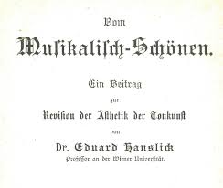
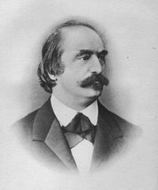
On the Beautiful in Music (1st ed., 1854)
“The essence of music consists of sounding forms in motion” (tőnend bewegte Formen)

Slide 64
The “Brahms Circle,” later 1850s onward—
centered around:
Joseph Joachim
Clara (Wieck) Schumann (1819-96)
Johannes Brahms (1833-97)
Eduard Hanslick

Slide 65
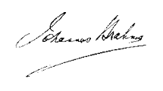
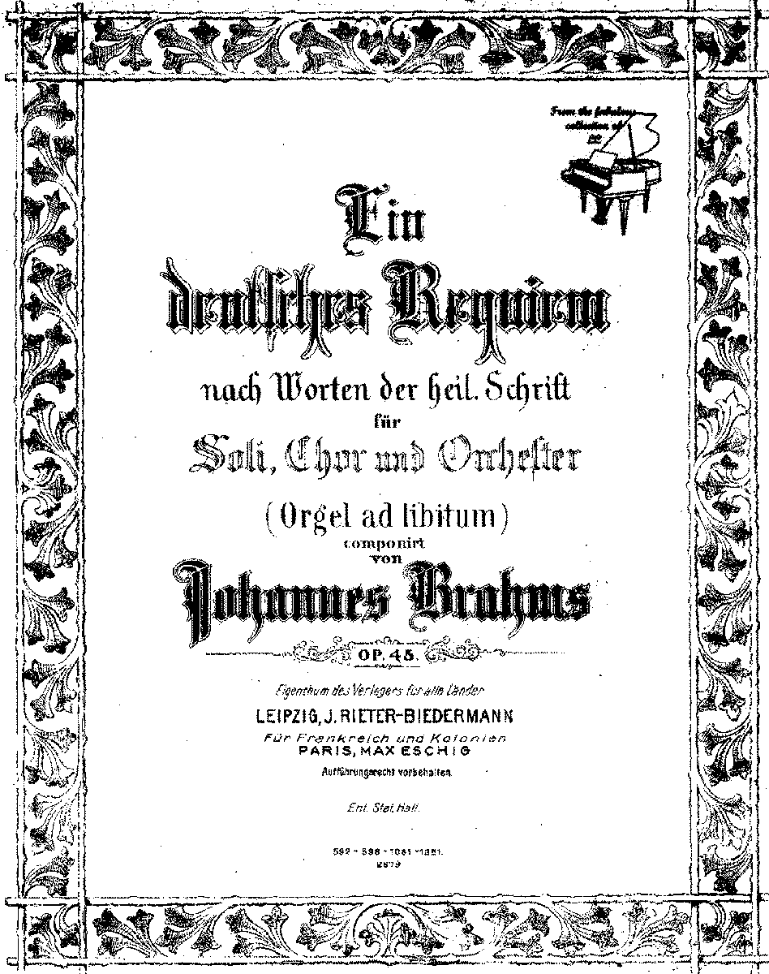

Slide 66
“Selig sind die Toten” (“Blessed Are the Dead”)
(Rev. 14:13)

Slide 67
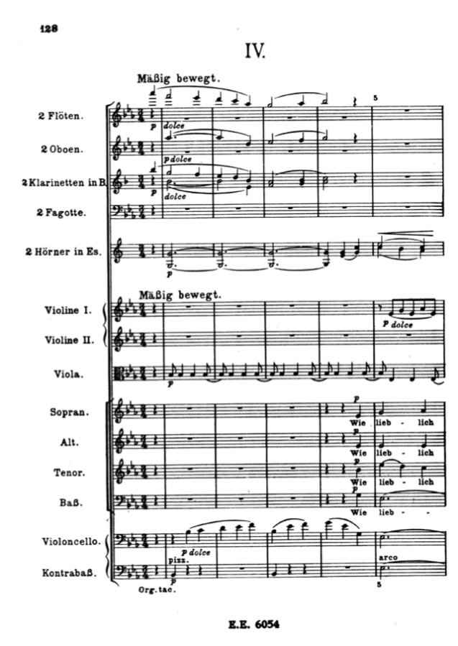
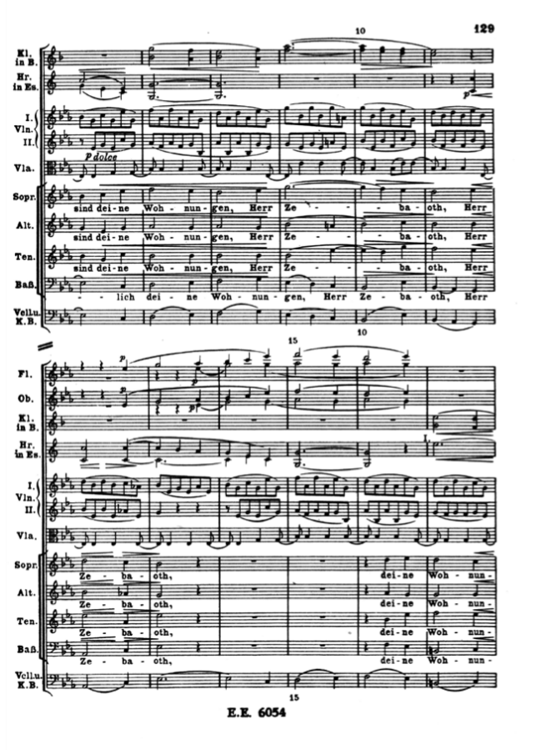
Ein deutsches Requiem (1865-68):
“Wie lieblich sind deine Wohnungen” (Ps. 84: 1-2)

Slide 68
Ein deutsches Requiem (1865-68):
“Wie lieblich sind deine Wohnungen” (Ps. 84: 1-2)
(inversion)

Slide 69
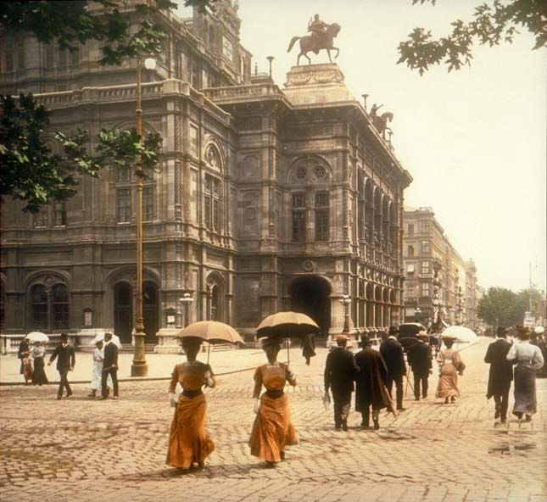
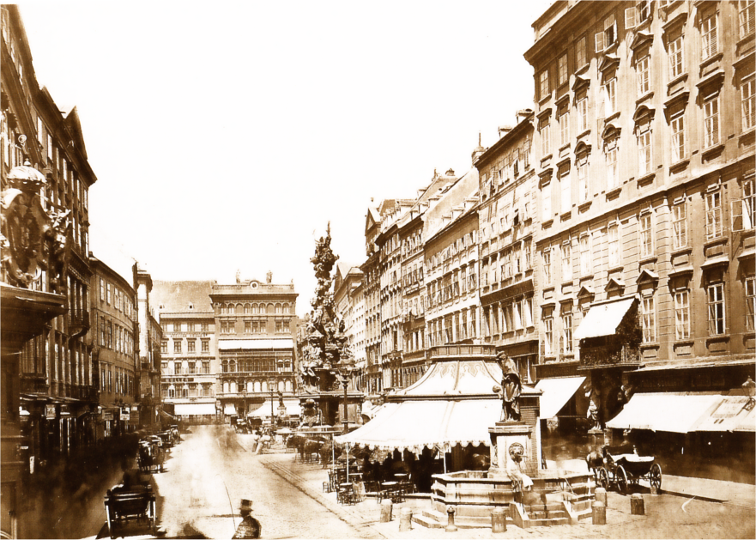
By 1869—Brahms permanently residing in Vienna

Slide 70
Europe in 1871

Slide 71
Europe in 1871

Slide 72
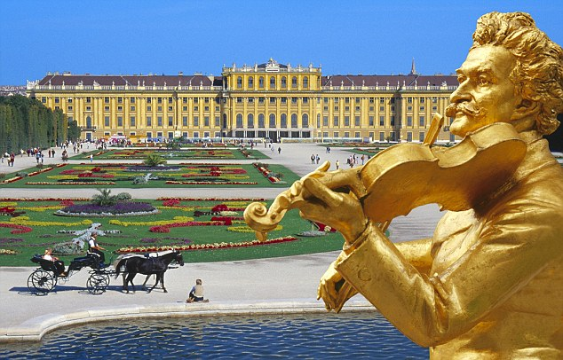
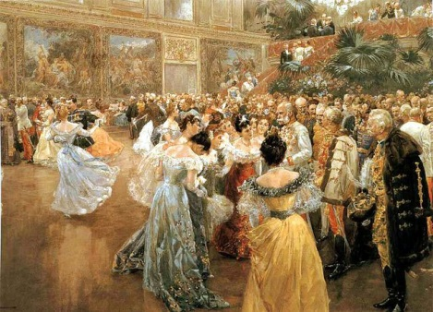
Johann Strauss, Jr
(1825-99)

Slide 73
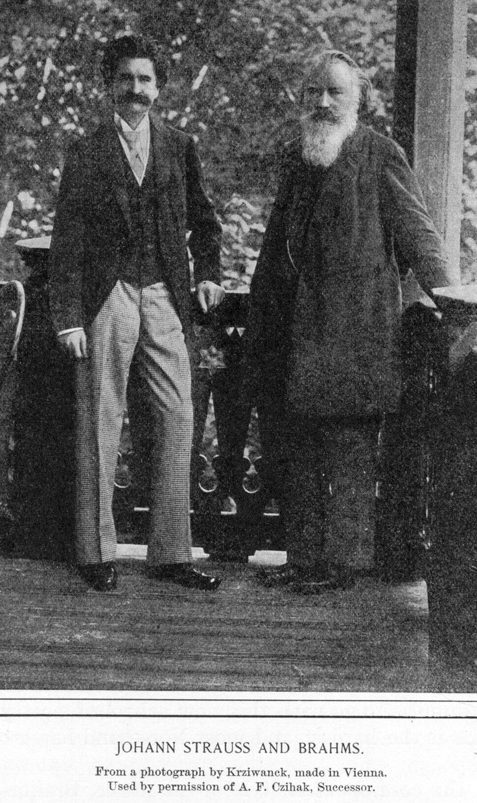

Slide 74
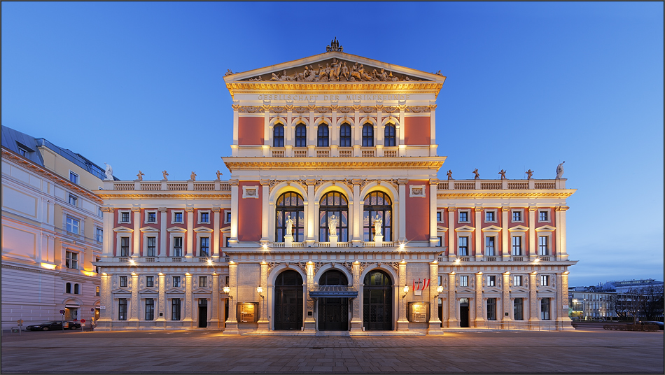
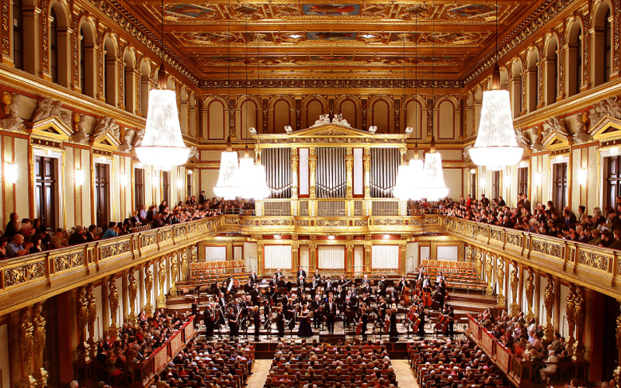
Vienna—Gesellschaft der Musikfreunde

Slide 75
The Rise of Collected Critical Editions of Past Music
Bach Gesellschaft Complete Edition (begun 1851)

Slide 76
The Rise of Collected Critical Editions of Past Music
Bach Gesellschaft Complete Edition (begun 1851)
Handel Complete Edition (begun 1858)

Slide 77
The Rise of Collected Critical Editions of Past Music
Bach Gesellschaft Complete Edition (begun 1851)
Handel Complete Edition (begun 1858)
Palestrina Complete Edition (begun 1862)

Slide 78
The Rise of Collected Critical Editions of Past Music
Bach Gesellschaft Complete Edition (begun 1851)
Handel Complete Edition (begun 1858)
Palestrina Complete Edition (begun 1862)
Beethoven Complete Edition (begun 1868)

Slide 79
The Rise of Collected Critical Editions of Past Music
Bach Gesellschaft Complete Edition (begun 1851)
Handel Complete Edition (begun 1858)
Palestrina Complete Edition (begun 1862)
Beethoven Complete Edition (begun 1868)
Mozart Complete Edition (begun 1877)

Slide 80
The Rise of Collected Critical Editions of Past Music
Bach Gesellschaft Complete Edition (begun 1851)
Handel Complete Edition (begun 1858)
Palestrina Complete Edition (begun 1862)
Beethoven Complete Edition (begun 1868)
Mozart Complete Edition (begun 1877)
Schütz Complete Edition (begun 1885)

Slide 81
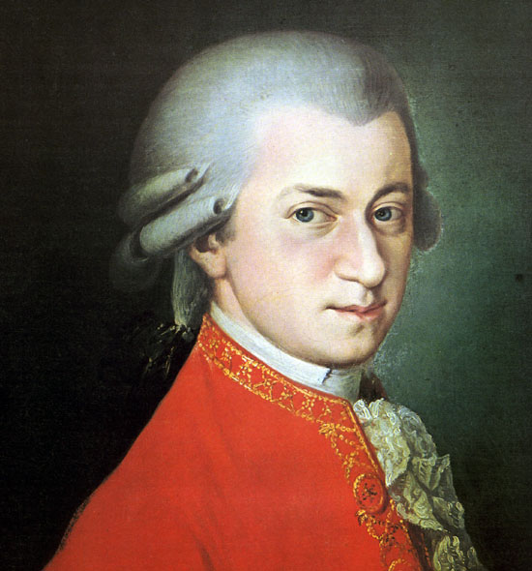
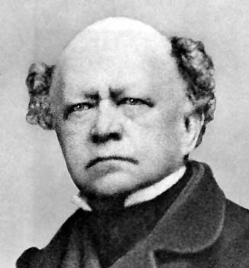
Ludwig von Köchel:
Numbered Catalog of
Mozart’s Complete Works, orig. 1862

Slide 82
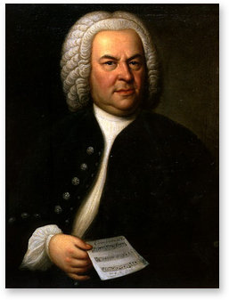
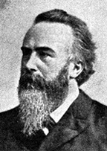
Philipp Spitta:
first volume of his biography of J. S. Bach, 1873

Slide 83
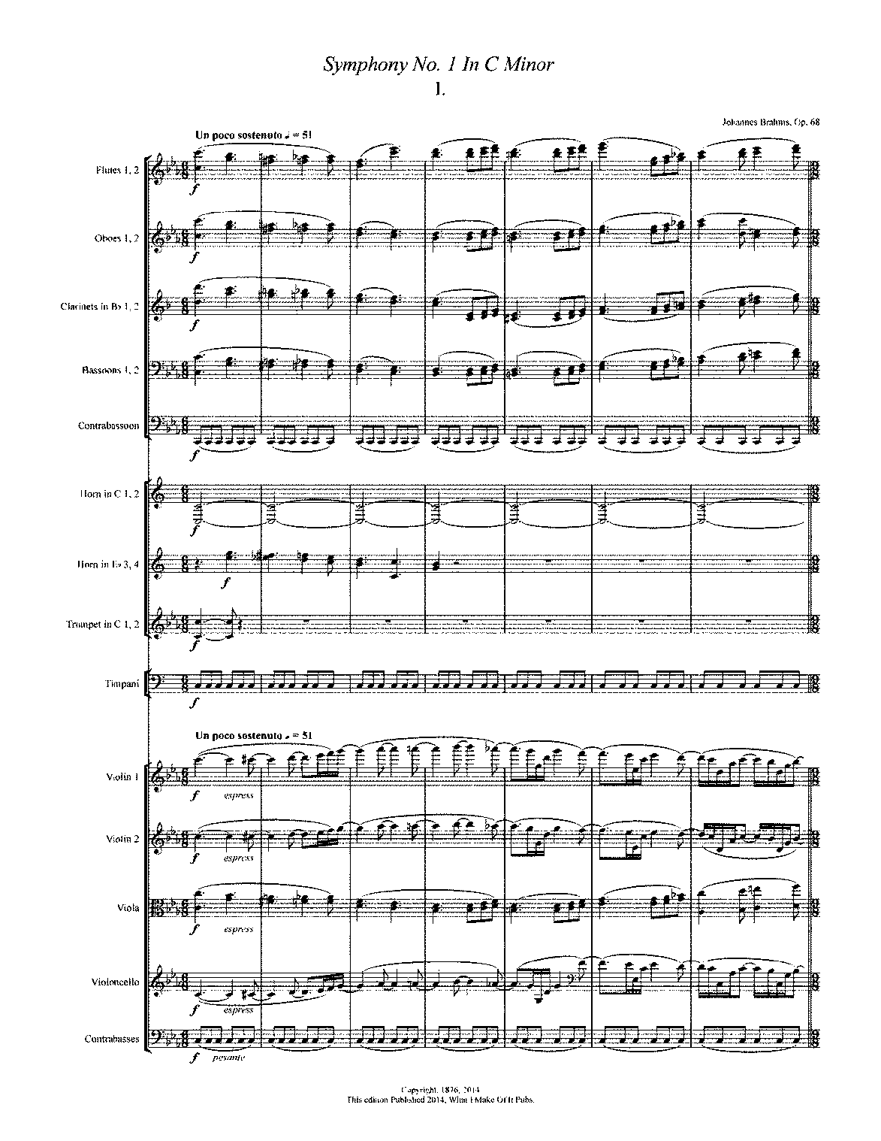
1876!

Slide 84
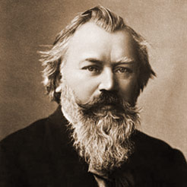
Symphony No. 1 in C Minor (1876)
Symphony No. 2 in D Major (1877)
Violin Concerto in D (1878)
Piano Concerto No. 2 in B-flat (1878-81)
Academic Festival Overture (1880)
Tragic Overture (1880)
Symphony No. 3 in F (1883)
Symphony No. 4 in E Minor (1885)
Concerto for Violin and Cello in A Minor (1887)

Slide 85
Symphony No. 1 in C Minor (1876)
Symphony No. 2 in D Major (1877)
Violin Concerto in D (1878)
Piano Concerto No. 2 in B-flat (1878-81)
Academic Festival Overture (1880)
Tragic Overture (1880)
Symphony No. 3 in F (1883)
Symphony No. 4 in E Minor (1885)
Concerto for Violin and Cello in A Minor (1887)

Slide 86
Symphony No. 1 in C Minor (1876)
Symphony No. 2 in D Major (1877)
Violin Concerto in D (1878)
Piano Concerto No. 2 in B-flat (1878-81)
Academic Festival Overture (1880)
Tragic Overture (1880)
Symphony No. 3 in F (1883)
Symphony No. 4 in E Minor (1885)
Concerto for Violin and Cello in A Minor (1887)

Slide 87
Symphony No. 1 in C Minor (1876)
Symphony No. 2 in D Major (1877)
Violin Concerto in D (1878)
Piano Concerto No. 2 in B-flat (1878-81)
Academic Festival Overture (1880)
Tragic Overture (1880)
Symphony No. 3 in F (1883)
Symphony No. 4 in E Minor (1885)
Concerto for Violin and Cello in A Minor (1887)

