Slide 1
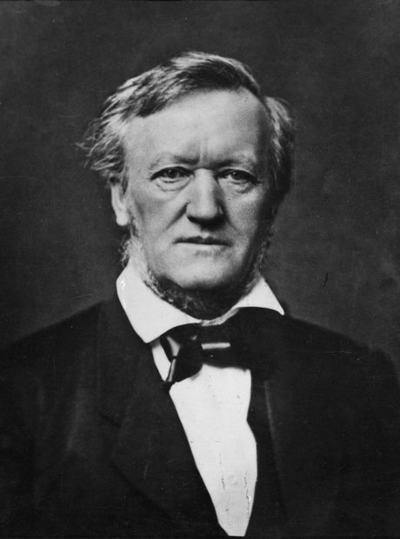

Slide 2
Wagner: A Revolution of Form or Formal Convention?
(Avoidance of standard, closed musical forms, foursquare melody)

Slide 3
Wagner: A Revolution of Form or Formal Convention?
(Avoidance of standard, closed musical forms, foursquare melody)
Rather: “unending/infinite melody” as
a new feature of “the music of the future”

Slide 4
Wagner: A Revolution of Form or Formal Convention?
(Avoidance of standard, closed musical forms, foursquare melody)
Rather: “unending/infinite melody” as
a new feature of “the music of the future”
“Web” of omnipresent Leitmotifs, presented quasi-developmentally—thus steering clear of traditional forms altogether?

Slide 5
Wagner: A Revolution of Form or Formal Convention?
(Avoidance of standard, closed musical forms, foursquare melody)
Rather: “unending/infinite melody” as
a new feature of “the music of the future”
Or: suggestions of various other kinds of free shaping though a variety of means, e.g.:
“Web” of omnipresent Leitmotifs, presented quasi-developmentally—thus steering clear of traditional forms altogether?
Tonal balances (“form” via keys only)?

Slide 6
Wagner: A Revolution of Form or Formal Convention?
(Avoidance of standard, closed musical forms, foursquare melody)
Rather: “unending/infinite melody” as
a new feature of “the music of the future”
Or: suggestions of various other kinds of free shaping though a variety of means, e.g.:
“Web” of omnipresent Leitmotifs, presented quasi-developmentally—thus steering clear of traditional forms altogether?
Tonal balances (“form” via keys only)?
Allusions to more traditional forms that are then not fully realized or closed?

Slide 7
Wagner: A Revolution of Form or Formal Convention?
(Avoidance of standard, closed musical forms, foursquare melody)
Rather: “unending/infinite melody” as
a new feature of “the music of the future”
Or: suggestions of various other kinds of free shaping though a variety of means, e.g.:
“Web” of omnipresent Leitmotifs, presented quasi-developmentally—thus steering clear of traditional forms altogether?
Tonal balances (“form” via keys only)?
Allusions to more traditional forms that are then not fully realized or closed?
Free allusions to symphonic forms (sonata? multimovement forms?

Slide 8
Wagner: A Revolution of Form or Formal Convention?
(Avoidance of standard, closed musical forms, foursquare melody)
Rather: “unending/infinite melody” as
a new feature of “the music of the future”
Or: suggestions of various other kinds of free shaping though a variety of means, e.g.:
“Web” of omnipresent Leitmotifs, presented quasi-developmentally—thus steering clear of traditional forms altogether?
Tonal balances (“form” via keys only)?
Allusions to more traditional forms that are then not fully realized or closed?
Free allusions to symphonic forms (sonata? multimovement forms?
Large, varied cycles (rotations) of thematic and motivic complexes?

Slide 9
“German Romantic Operas”
Wagner, Der fliegende Holländer (1841, Dresden prem., 1843)
Wagner, Tannhäuser (1843-45, Dresden prem., 1845)
Wagner, Lohengrin (1846-48, Weimar prem., 1850)
“Music Dramas”
Der Ring des Nibelungen (Tetralogy):
Das Rheingold (1853-54)
Die Walküre (1854-56)
Siegfried, Acts 1 & 2 (1856-57)
Tristan und Isolde (1857-59)
Die Meistersinger von Nürnberg (1862-67)
Siegfried, Act 3 (1869-71)
Götterdämmerung (1869-74)
Parsifal (1878-81)

Slide 10
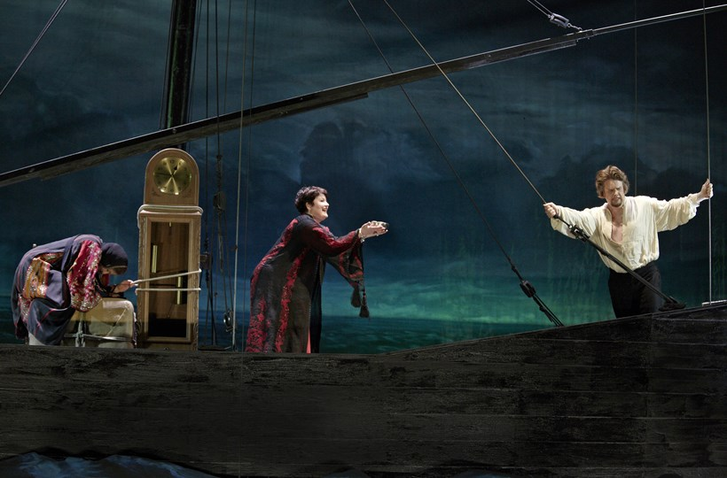
Tristan und Isolde (1857-59; premiere, Munich 1865)

Slide 11
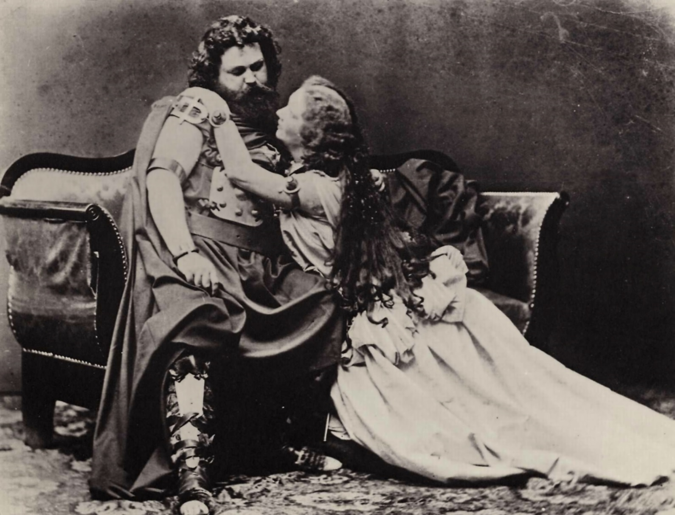
Tristan und Isolde (1857-59; premiere, Munich 1865)
Ludwig and Malvina Schnorr von Carolsfeld costumed as Tristan and Isolde

Slide 12
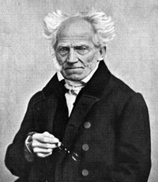
Arthur Schopenhauer (1788-1860)
The World as Will and Representation
(orig. 1819)

Slide 13
The “pessimistic” philosopher
Arthur Schopenhauer (1788-1860)

Slide 14
The “pessimistic” philosopher
Complex philosophy of a ruthless force (the “will”), objectified in human beings, underpinning us all, driving us ever onward: desire, despair, distress
Arthur Schopenhauer (1788-1860)

Slide 15
The “pessimistic” philosopher
Complex philosophy of a ruthless force (the “will”), objectified in human beings, underpinning us all, driving us ever onward: desire, despair, distress
Only two temporary escape routes:
Arthur Schopenhauer (1788-1860)

Slide 16
The “pessimistic” philosopher
Complex philosophy of a ruthless force (the “will”), objectified in human beings, underpinning us all, driving us ever onward: desire, despair, distress
Only two temporary escape routes:
renunciation of desire, becoming
non-conscious of the world and its problems
Arthur Schopenhauer (1788-1860)

Slide 17
The “pessimistic” philosopher
Complex philosophy of a ruthless force (the “will”), objectified in human beings, underpinning us all, driving us ever onward: desire, despair, distress
Only two temporary escape routes:
renunciation of desire, becoming
non-conscious of the world and its problems
music, the highest of the arts, temporarily capable of contemplating the will itself,
accessing the inner essence of things—
a bodiless drive to the “thing-in-itself”
behind all reality
Arthur Schopenhauer (1788-1860)

Slide 18
The “pessimistic” philosopher
Complex philosophy of a ruthless force (the “will”), objectified in human beings, underpinning us all, driving us ever onward: desire, despair, distress
Only two temporary escape routes:
renunciation of desire, becoming
non-conscious of the world and its problems
music, the highest of the arts, temporarily capable of contemplating the will itself,
accessing the inner essence of things—
a bodiless drive to the “thing-in-itself”
behind all reality (music as metaphysics)
Arthur Schopenhauer (1788-1860)

Slide 19
Tristan: Chromaticism and Ambiguity of Tonality

Slide 20
Tristan: Chromaticism and Ambiguity of Tonality
Few strong cadences; frequent vagueness or uncertainty of tonal centers

Slide 21
Tristan: Chromaticism and Ambiguity of Tonality
Few strong cadences; frequent vagueness or uncertainty of tonal centers
?
chromatic; tonally uncertain
Onset
of a
phrase
V⁷
Or
deceptive/
evaded
cadence

Slide 22
Tristan: Chromaticism and Ambiguity of Tonality
Few strong cadences; frequent vagueness or uncertainty of tonal centers
?
chromatic; tonally uncertain
Onset
of a
phrase
V⁷
Or
deceptive/
evaded
cadence
Harmonically ambiguous “Tristanesque” appoggiaturas

Slide 23
“German Romantic Operas”
Wagner, Der fliegende Holländer (1841, Dresden prem., 1843)
Wagner, Tannhäuser (1843-45, Dresden prem., 1845)
Wagner, Lohengrin (1846-48, Weimar prem., 1850)
“Music Dramas”
Der Ring des Nibelungen (Tetralogy):
Das Rheingold (1853-54)
Die Walküre (1854-56)
Siegfried, Acts 1 & 2 (1856-57)
Tristan und Isolde (1857-59)
Die Meistersinger von Nürnberg (1862-67)
Siegfried, Act 3 (1869-71)
Götterdämmerung (1869-74)
Parsifal (1878-81)

Slide 24
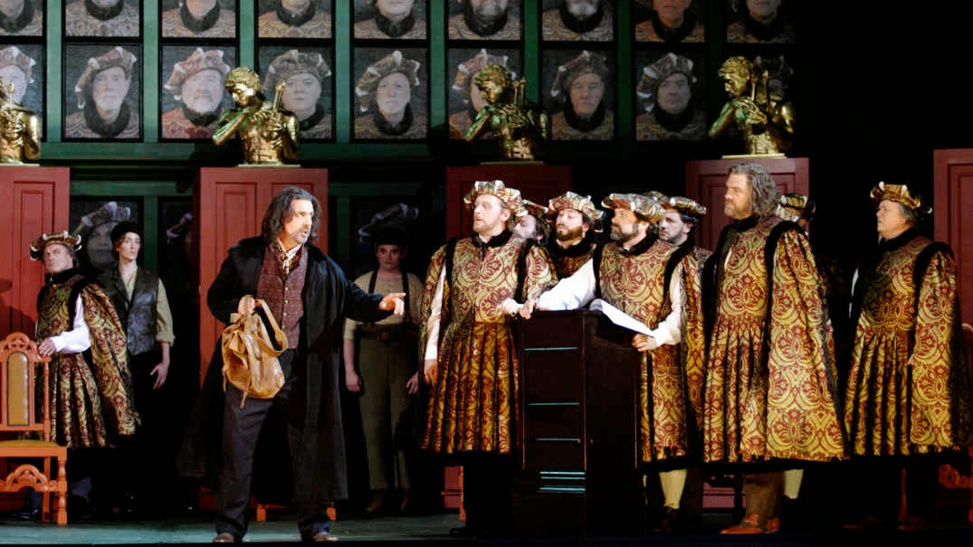
Wagner, Die Meistersinger von Nürnberg (1862-67)

Slide 25
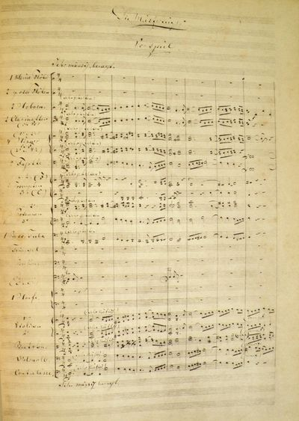
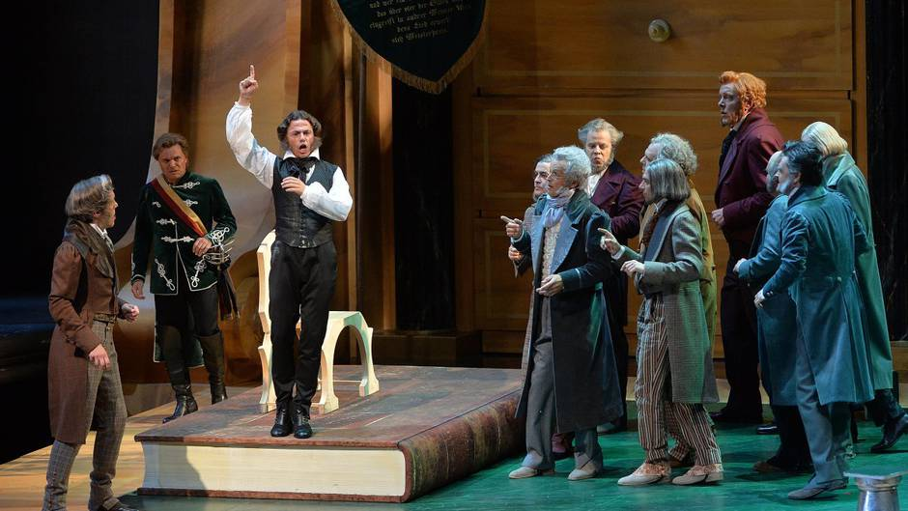
Wagner, Die Meistersinger von Nürnberg (1862-67)

Slide 26
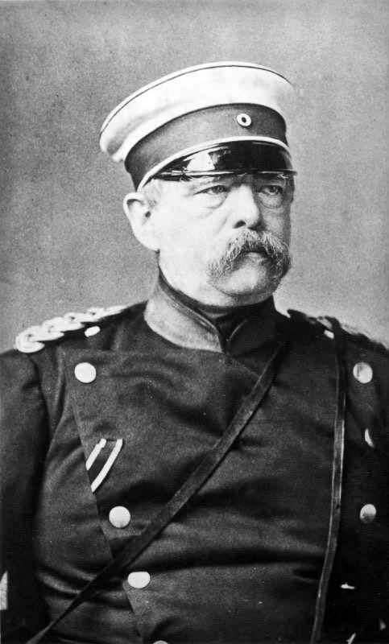
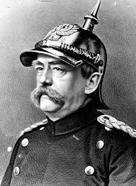
Otto von Bismarck (1815-1898)

Slide 27
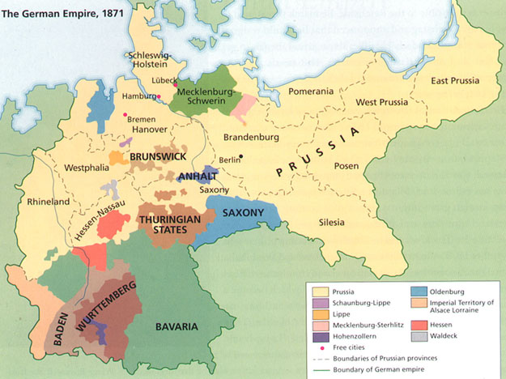
The Unification of Germany, 1871 (The “Second Reich”)

Slide 28
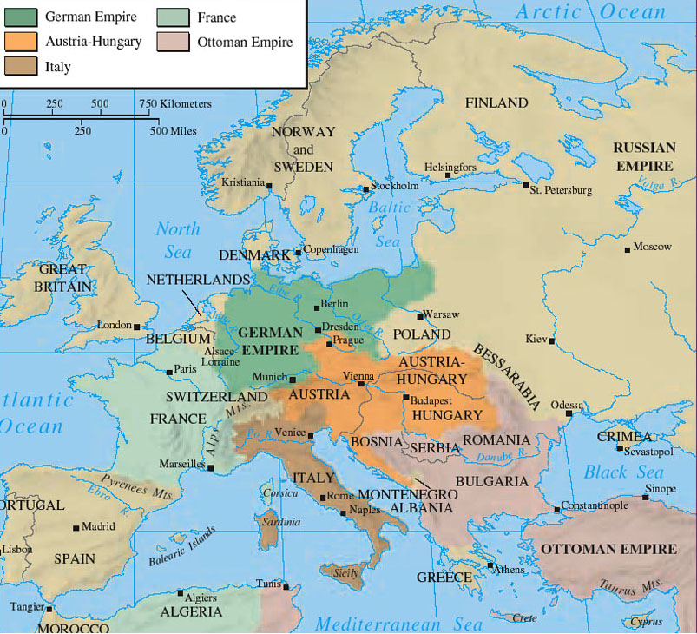
Europe in 1871

Slide 29
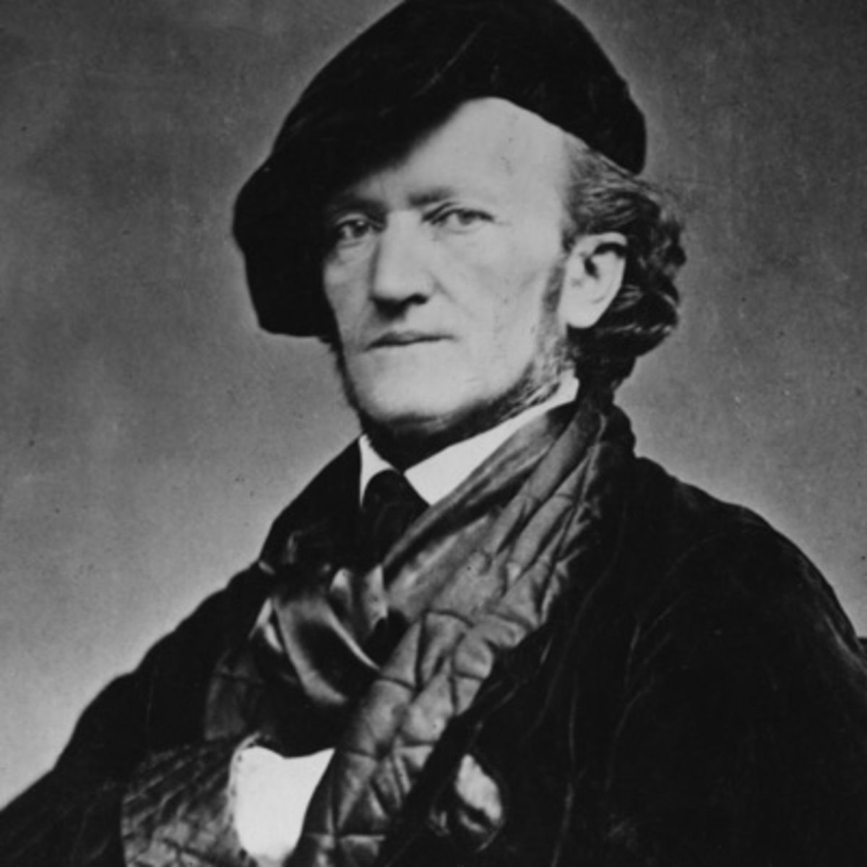

Slide 30
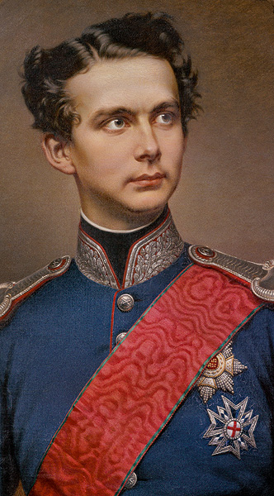
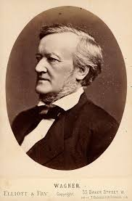
Ludwig II of Bavaria (1845-86)
(reigned 1864-86)

Slide 31
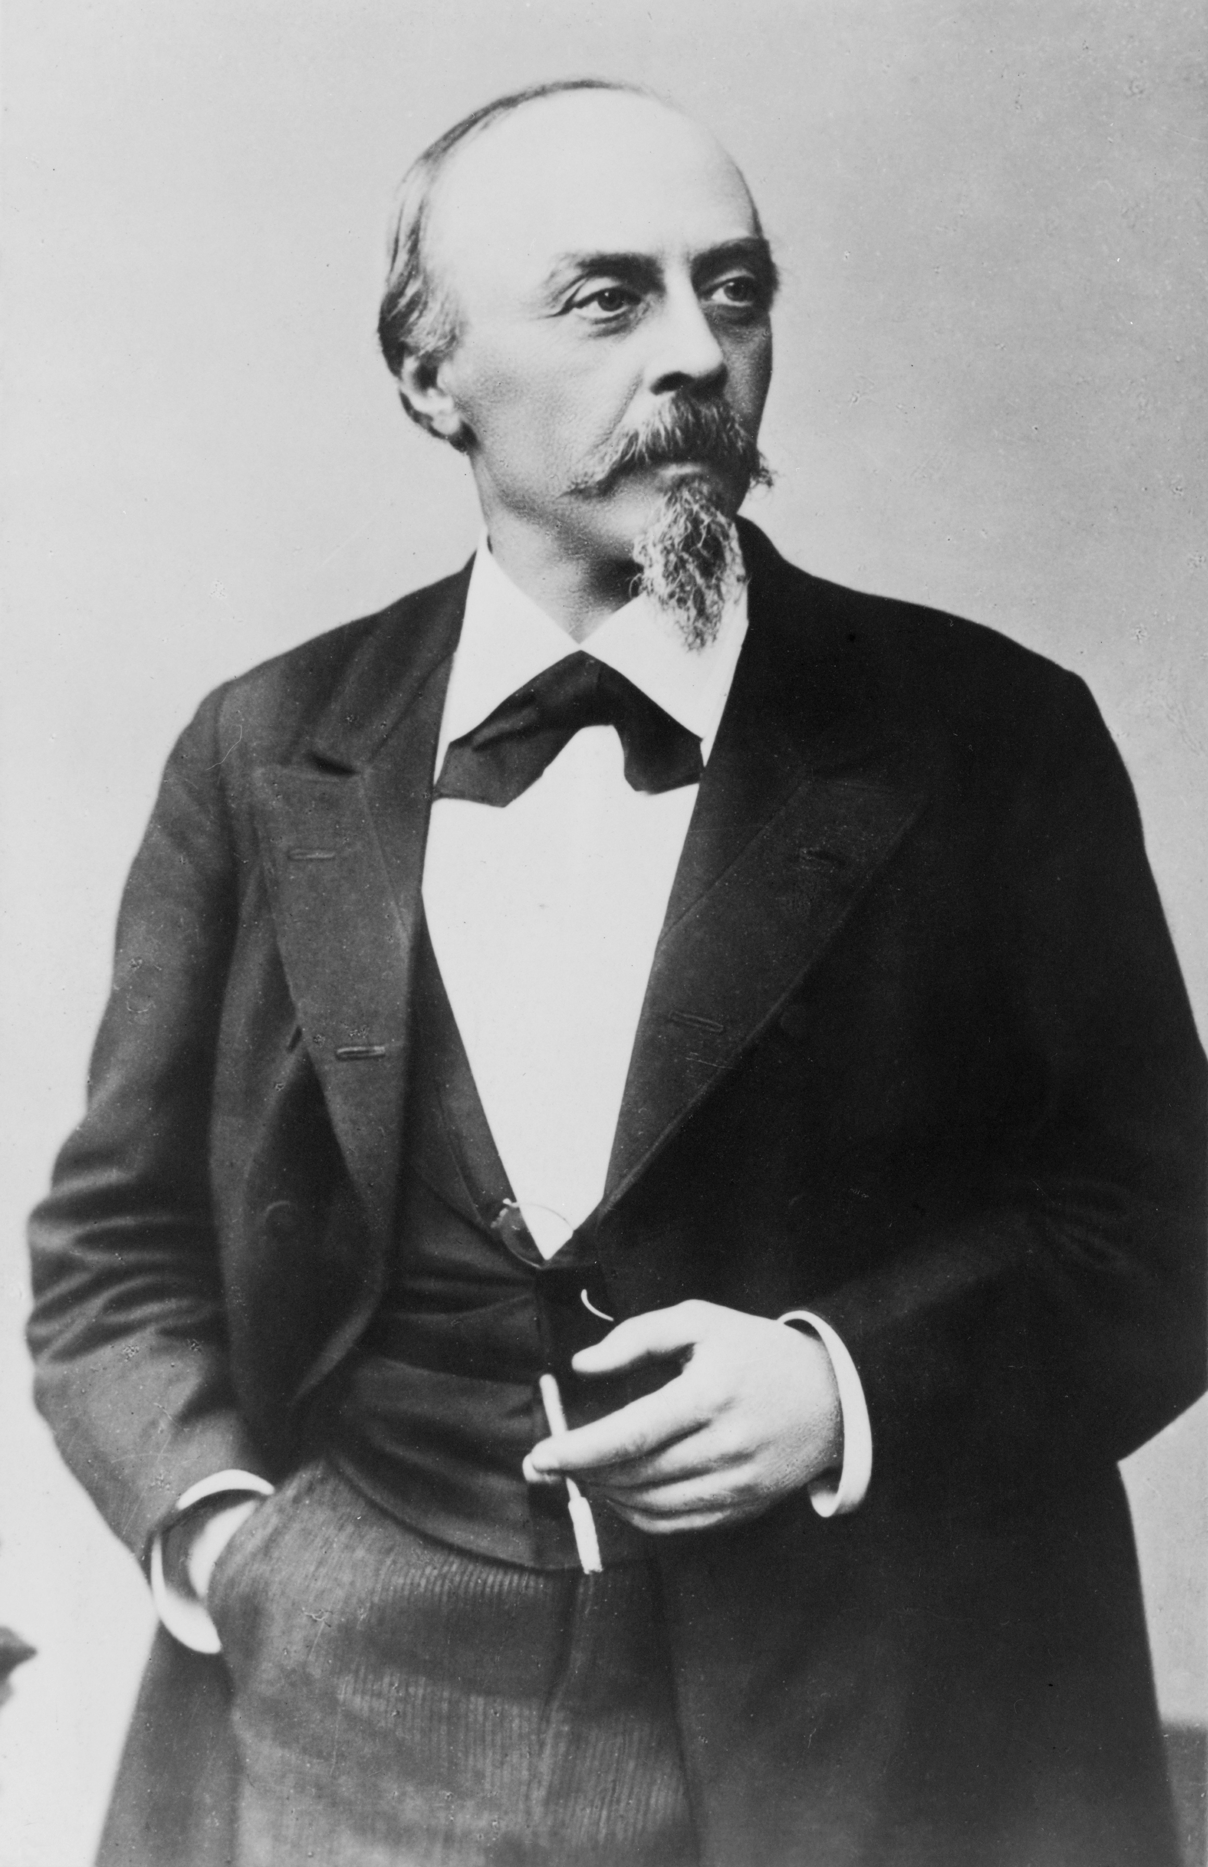
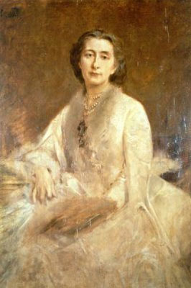
Hans von Bülow Cosima (Liszt) von Bülow

Slide 32
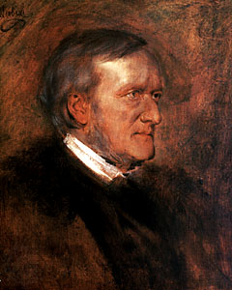
Richard Wagner Cosima (Liszt) von Bülow

Slide 33
Tribschen (Lucerne, Switzerland)

Slide 34
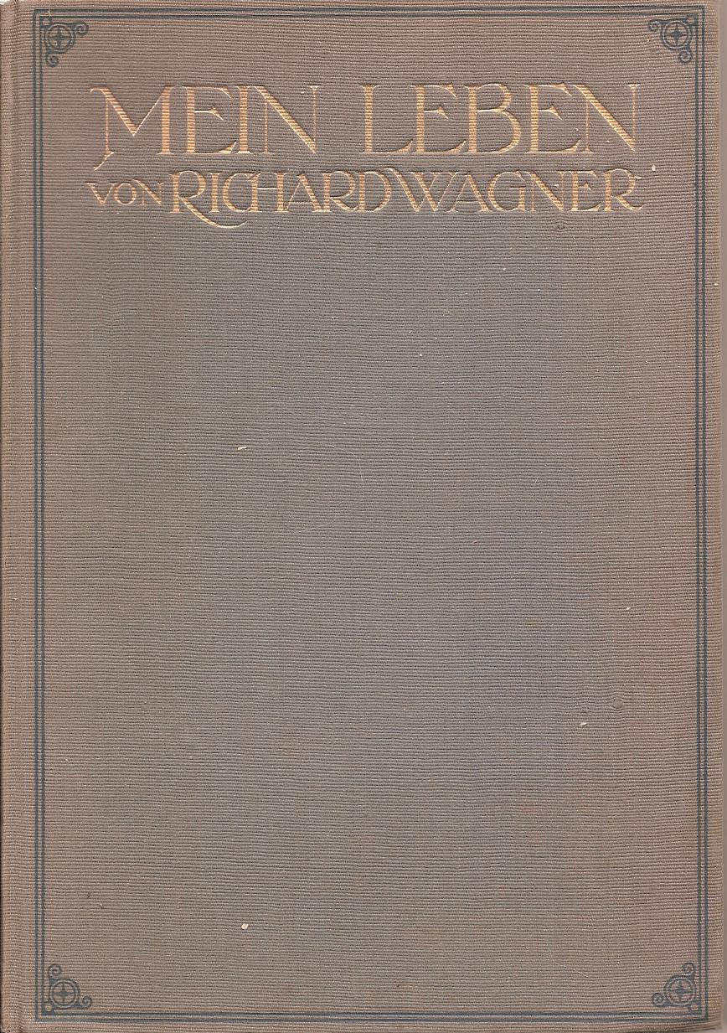
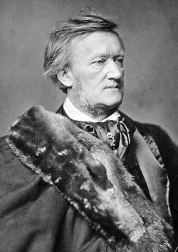

Slide 35
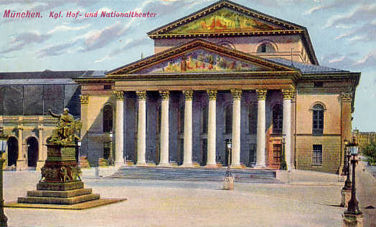
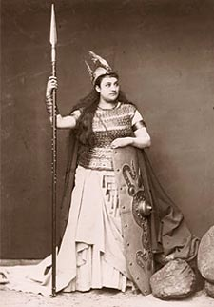
Premieres in Munich
Tristan und Isolde (1857-59) – 1865
Die Meistersinger von Nürnberg (1862-67) – 1868
Das Rheingold (1853-54) – 1869
Die Walküre (1854-56) – 1870

Slide 36
Premieres in Munich
Tristan und Isolde (1857-59) – 1865
Die Meistersinger von Nürnberg (1862-67) – 1868
Das Rheingold (1853-54) – 1869
Die Walküre (1854-56) – 1870
At this time Wagner was also returning to and completing the Ring cycle:
Siegfried, Act 3 (1869-71)
Götterdämmerung (1869-74)

Slide 37
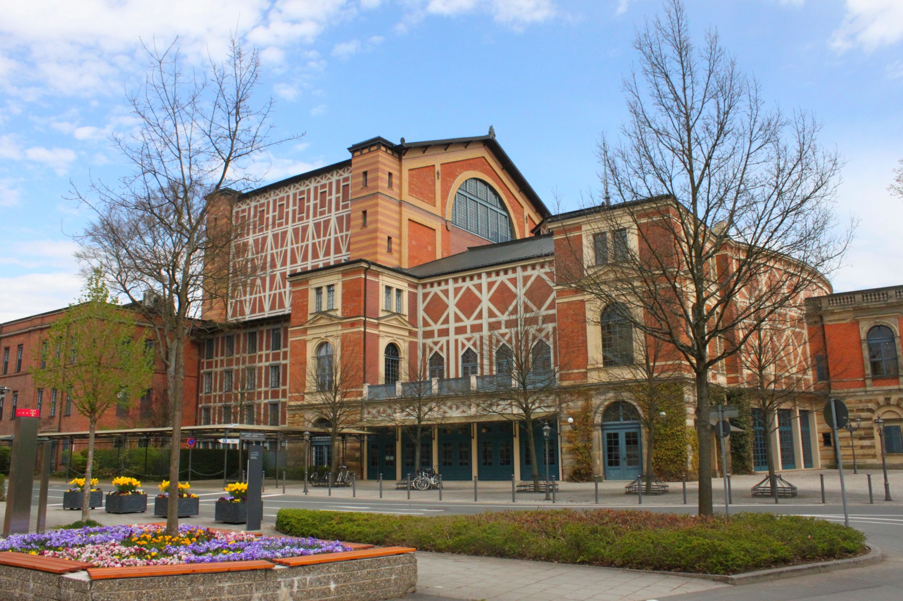
Bayreuth—Festspielhaus (1876)

Slide 38
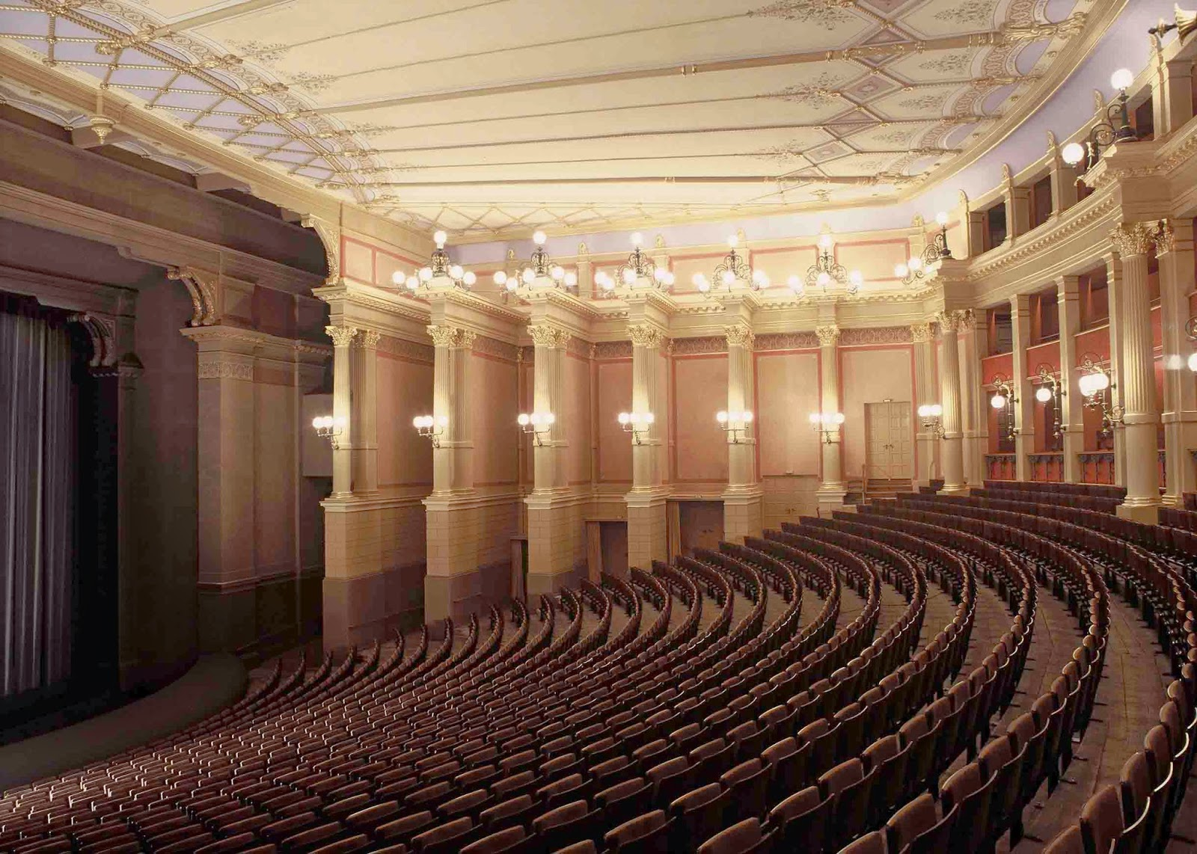
Bayreuth—Festspielhaus (1876)

Slide 39
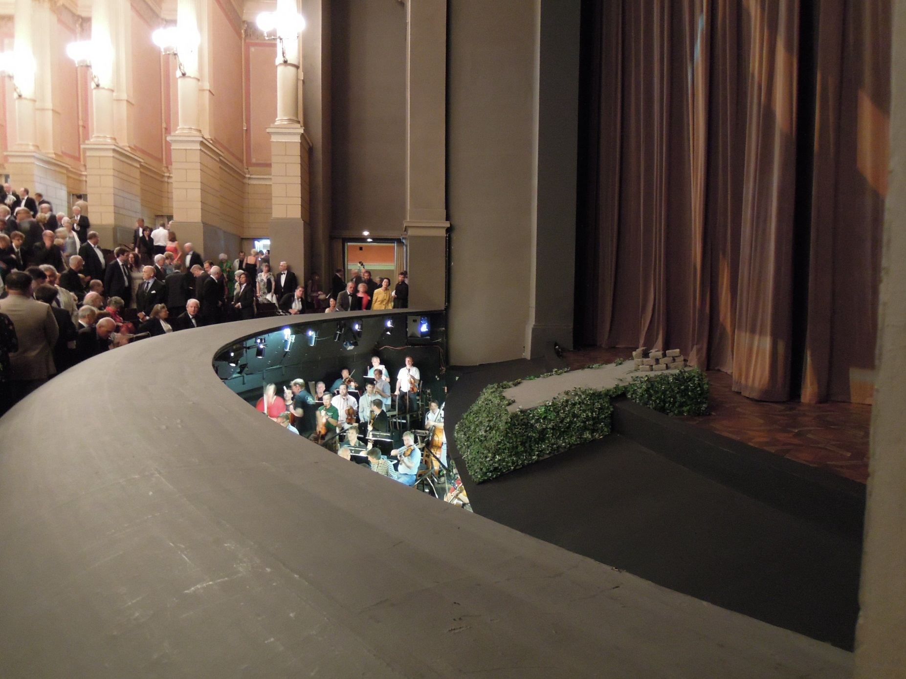
Bayreuth—Festspielhaus (1876)

Slide 40
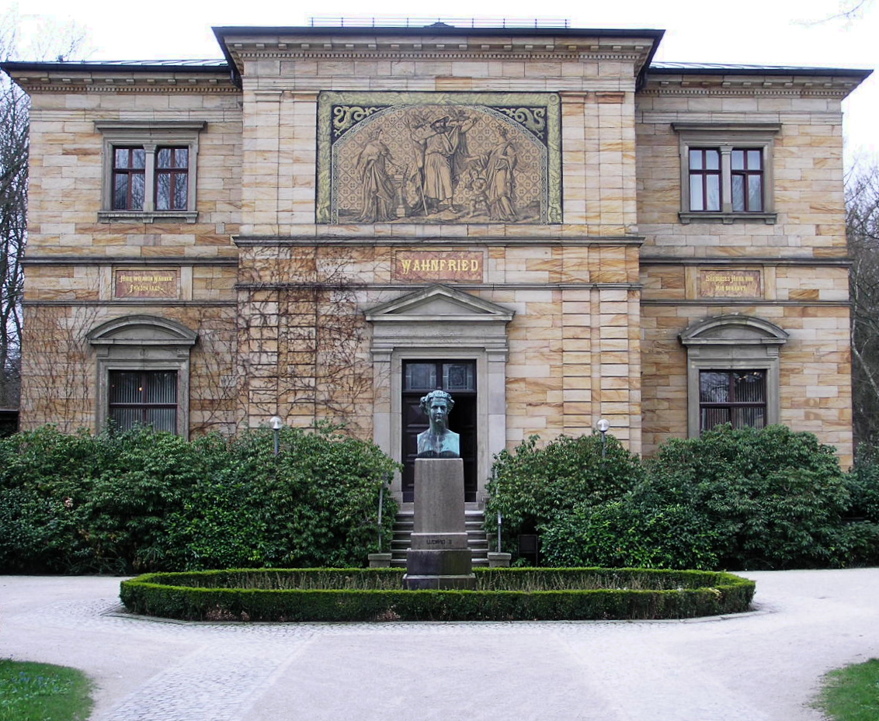
Bayreuth—Haus Wahnfried

Slide 41
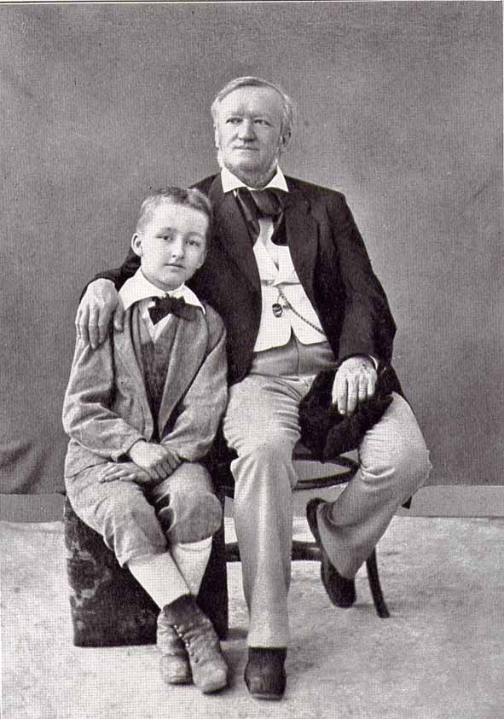
“Beethoven” (1870)
“On the Term ‘Music Drama’” (1872)
“Religion and Art” (1880)
Siegfried and Richard Wagner, 1880

Slide 42
“Beethoven” (1870)
“On the Term ‘Music Drama’” (1872)
Music Drama = “deeds of music
made visible”
“Religion and Art” (1880)
Siegfried and Richard Wagner, 1880

Slide 43
“Religion and Art” (1880)
In former times:
Christian Symbols
Religion
Siegfried and Richard Wagner, 1880

Slide 44
“Religion and Art” (1880)
But today, with Wagner:
Christian Symbols
Religion
Art
(Music)
Siegfried and Richard Wagner, 1880

Slide 45
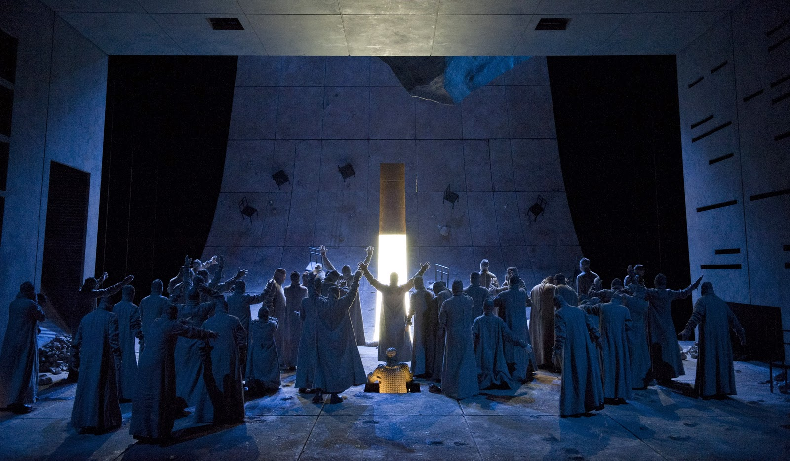
Wagner, Parsifal (1878-81; premiere Bayreuth, 1882)
Ein Bühnenweihfestspiel (A Festival Play for the Consecration of the Stage)

Slide 46
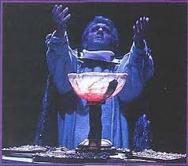
Wagner, Parsifal (1878-81; premiere Bayreuth, 1882)
Ein Bühnenweihfestspiel (A Festival Play for the Consecration of the Stage)

Slide 47
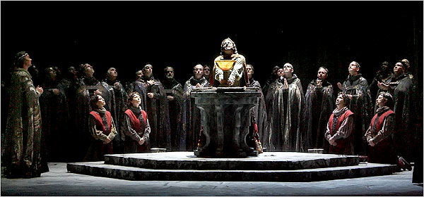
Wagner, Parsifal (1878-81; premiere Bayreuth, 1882)
Ein Bühnenweihfestspiel (A Festival Play for the Consecration of the Stage)

Slide 48
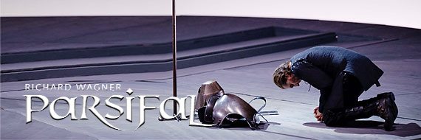
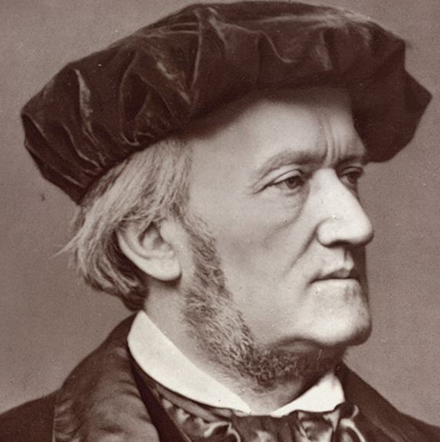
Parsifal: Prelude to Act 1

Slide 51
Wagner, Parsifal (1878-81; premiere Bayreuth, 1882)
Ein Bühnenweihfestspiel (A Festival Play for the Consecration of the Stage)

Slide 52
Wagner, Parsifal (1878-81; premiere Bayreuth, 1882)
Ein Bühnenweihfestspiel (A Festival Play for the Consecration of the Stage)

Slide 53
Wagner, Parsifal (1878-81; premiere Bayreuth, 1882)
Ein Bühnenweihfestspiel (A Festival Play for the Consecration of the Stage)

Slide 54
Parsifal: Prelude to Act 1

