Slide 1
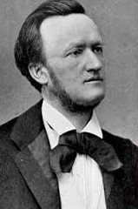
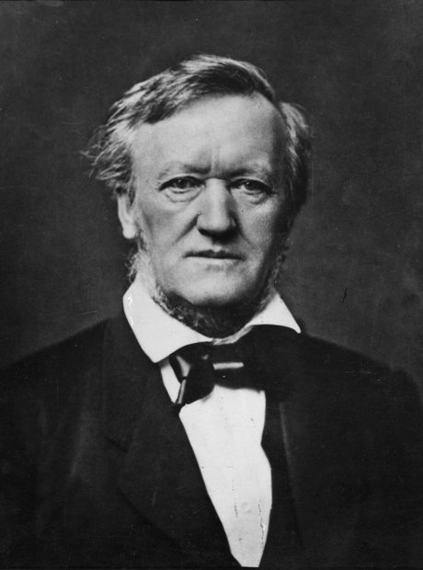
Richard Wagner

Slide 2
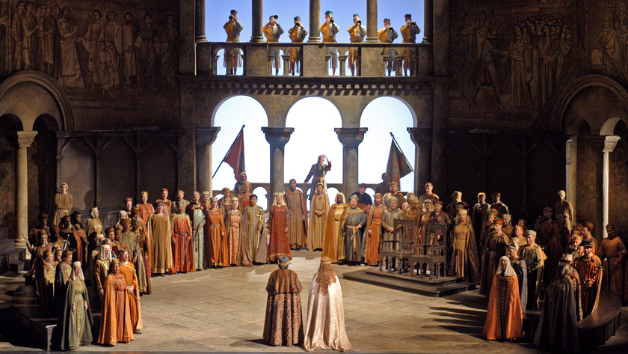
Wagner: Tannhäuser, Overture (1843-45)

Slide 3
Richard Wagner
By c. 1860, proclaiming the necessity of “the music of the future”—which his own music was now ushering in

Slide 4
“German Romantic Operas”
Wagner, Der fliegende Holländer (1841, Dresden prem., 1843)
Wagner, Tannhäuser (1843-45, Dresden prem., 1845)
Wagner, Lohengrin (1846-48, Weimar prem., 1850)
“Music Dramas”
Der Ring des Nibelungen (Tetralogy):
Das Rheingold (1853-54)
Die Walküre (1854-56)
Siegfried, Acts 1 & 2 (1856-57)
Tristan und Isolde (1857-59)
Die Meistersinger von Nürnberg (1862-67)
Siegfried, Act 3 (1869-71)
Götterdämmerung (1869-74)
Parsifal (1878-81)

Slide 5
1848-49: Crucial Years

Slide 6
1848-49: Crucial Years
1848 Revolutions throughout Europe

Slide 7
1848-49: Crucial Years
1848 Revolutions throughout Europe
1849: Revolution spreads to Dresden

Slide 8
1848-49: Crucial Years
1848 Revolutions throughout Europe
1849: Revolution spreads to Dresden
Wagner, agitator, forced to flee Germany—to Switzerland – widespread ban on his music in Germany

Slide 9
“German Romantic Operas”
Wagner, Der fliegende Holländer (1841, Dresden prem., 1843)
Wagner, Tannhäuser (1843-45, Dresden prem., 1845)
Wagner, Lohengrin (1846-48, Weimar prem., 1850)
“Music Dramas”
Der Ring des Nibelungen (Tetralogy):
Das Rheingold (1853-54)
Die Walküre (1854-56)
Siegfried, Acts 1 & 2 (1856-57)
Tristan und Isolde (1857-59)
Die Meistersinger von Nürnberg (1862-67)
Siegfried, Act 3 (1869-71)
Götterdämmerung (1869-74)
Parsifal (1878-81)

Slide 10
1849-51: The Transformation
Aesthetic Writings: Rethinking of Musical Principles and Aims
1849: Art and Revolution
1849: The Artwork of the Future
1851: Opera and Drama

Slide 11
1849-51: The Transformation
Aesthetic Writings: Rethinking of Musical Principles and Aims
1849: Art and Revolution
1849: The Artwork of the Future: Concept, Gesamtkunstwerk (“total artwork,” a new, higher synthesis of drama, poetry, and music)
1851: Opera and Drama

Slide 12
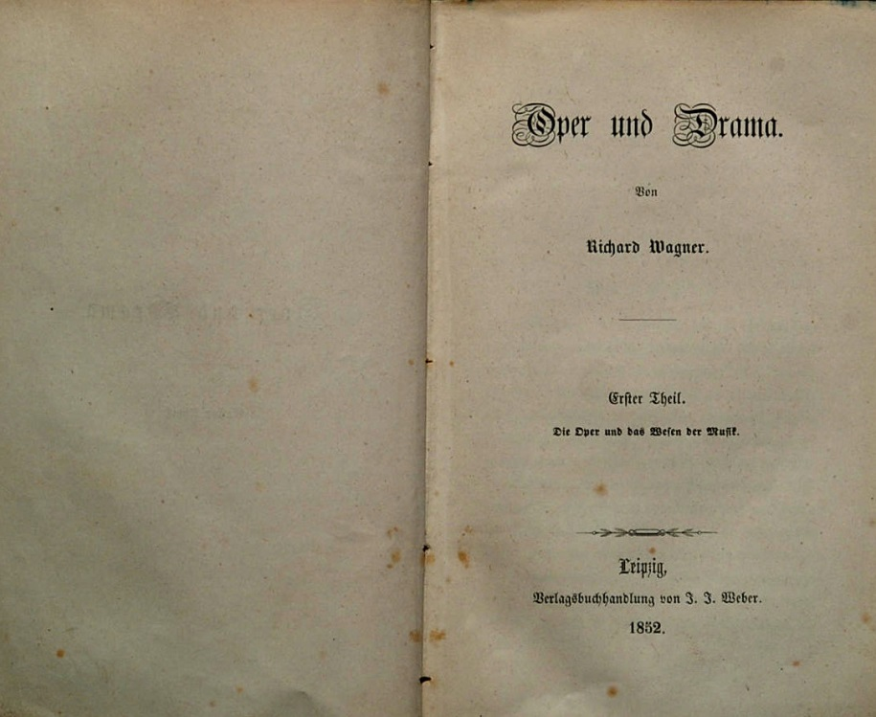
1849-51: The Transformation
Aesthetic Writings: Rethinking of Musical Principles and Aims
1849: Art and Revolution
1849: The Artwork of the Future: Concept, Gesamtkunstwerk (“total artwork,” a new, higher synthesis of drama, poetry, and music)
1851: Opera and Drama: extended description of his new approach to music and music drama

Slide 13
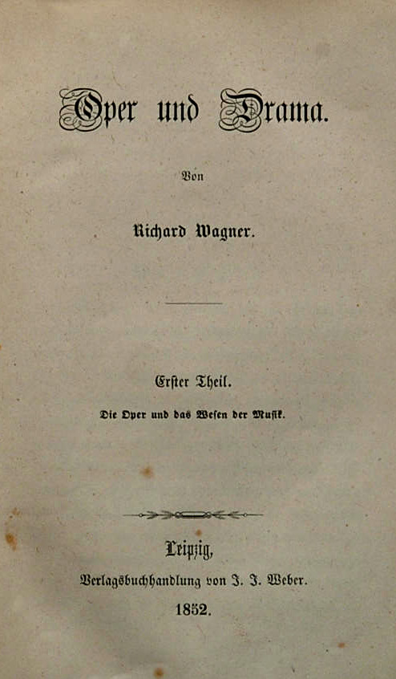
Synthesis/fusion of “opera” and “symphony” (symphonic opera, operatic symphony), with equal emphasis given to all aspects within it.

Slide 14
Synthesis/fusion of “opera” and “symphony” (symphonic opera, operatic symphony), with equal emphasis given to all aspects within it.
“Music Drama” – No longer “opera”

Slide 15
Synthesis/fusion of “opera” and “symphony” (symphonic opera, operatic symphony), with equal emphasis given to all aspects within it.
“Music Drama” – No longer “opera”
Best topic: myths and/or ancient legends

Slide 16
Synthesis/fusion of “opera” and “symphony” (symphonic opera, operatic symphony), with equal emphasis given to all aspects within it.
“Music Drama” – No longer “opera”
Best topic: myths and/or ancient legends
Texts:
Elevated, deep, ancient in flavor
Stabreim, not end-rhyme (shows kinship of feeling)
Free rhythm—replaces regularity of stock poetic meters

Slide 17
Synthesis/fusion of “opera” and “symphony” (symphonic opera, operatic symphony), with equal emphasis given to all aspects within it.
“Music Drama” – No longer “opera”
Best topic: myths and/or ancient legends
Texts:
Elevated, deep, ancient in flavor
Stabreim, not end-rhyme (shows kinship of feeling)
Free rhythm—replaces regularity of stock poetic meters
Modulation and recurrence of keys: a musical equivalent of Stabreim

Slide 18
Synthesis/fusion of “opera” and “symphony” (symphonic opera, operatic symphony), with equal emphasis given to all aspects within it.
“Music Drama” – No longer “opera”
Best topic: myths and/or ancient legends
Texts:
Elevated, deep, ancient in flavor
Stabreim, not end-rhyme (shows kinship of feeling)
Free rhythm—replaces regularity of stock poetic meters
Modulation and recurrence of keys: a musical equivalent of Stabreim
Melody: “the horizontal surface of harmony”; traditional melodic structures are minimized or avoided in favor of ongoing dramatic declamation

Slide 19
Synthesis/fusion of “opera” and “symphony” (symphonic opera, operatic symphony), with equal emphasis given to all aspects within it.
“Music Drama” – No longer “opera”
Best topic: myths and/or ancient legends
Texts:
Elevated, deep, ancient in flavor
Stabreim, not end-rhyme (shows kinship of feeling)
Free rhythm—replaces regularity of stock poetic meters
Modulation and recurrence of keys: a musical equivalent of Stabreim
Melody: “the horizontal surface of harmony”; traditional melodic structures are minimized or avoided in favor of ongoing dramatic declamation
Originally: no chorus; no simultaneous singing

Slide 20
Synthesis/fusion of “opera” and “symphony” (symphonic opera, operatic symphony), with equal emphasis given to all aspects within it.
“Music Drama” – No longer “opera”
Best topic: myths and/or ancient legends
Texts:
Elevated, deep, ancient in flavor
Stabreim, not end-rhyme (shows kinship of feeling)
Free rhythm—replaces regularity of stock poetic meters
Modulation and recurrence of keys: a musical equivalent of Stabreim
Melody: “the horizontal surface of harmony”; traditional melodic structures are minimized or avoided in favor of ongoing dramatic declamation
Originally: no chorus; no simultaneous singing
Active (symphonic) orchestra adds psychological depth to the words and action—sometimes uttering or revealing what is unspoken

Slide 21
Synthesis/fusion of “opera” and “symphony” (symphonic opera, operatic symphony), with equal emphasis given to all aspects within it.
“Music Drama” – No longer “opera”
Best topic: myths and/or ancient legends
Texts:
Elevated, deep, ancient in flavor
Stabreim, not end-rhyme (shows kinship of feeling)
Free rhythm—replaces regularity of stock poetic meters
Modulation and recurrence of keys: a musical equivalent of Stabreim
Melody: “the horizontal surface of harmony”; traditional melodic structures are minimized or avoided in favor of ongoing dramatic declamation
Originally: no chorus; no simultaneous singing
Active (symphonic) orchestra adds psychological depth to the words and action—sometimes uttering or revealing what is unspoken
Symphonic web of nearly omnipresent motives: Leitmotifs (“motives of remembrance”; “motives of foreboding”)

Slide 22
Synthesis/fusion of “opera” and “symphony” (symphonic opera, operatic symphony), with equal emphasis given to all aspects within it.
“Music Drama” – No longer “opera”
Best topic: myths and/or ancient legends
Texts:
Elevated, deep, ancient in flavor
Stabreim, not end-rhyme (shows kinship of feeling)
Free rhythm—replaces regularity of stock poetic meters
Modulation and recurrence of keys: a musical equivalent of Stabreim
Melody: “the horizontal surface of harmony”; traditional melodic structures are minimized or avoided in favor of ongoing dramatic declamation
Originally: no chorus; no simultaneous singing
Active (symphonic) orchestra adds psychological depth to the words and action—sometimes uttering or revealing what is unspoken
Symphonic web of nearly omnipresent motives: Leitmotifs (“motives of remembrance”; “motives of foreboding”)
Leitmotifs: brief, open-ended musical signifiers associated with characters, moods, objects, or events

Slide 23
“German Romantic Operas”
Wagner, Der fliegende Holländer (1841, Dresden premiere, 1843)
Wagner, Tannhäuser (1843-45, Dresden premiere, 1845)
Wagner, Lohengrin (1846-48, Weimar premiere, 1850)
“Music Dramas”
Der Ring des Nibelungen (Tetralogy):
Das Rheingold (1853-54)
Die Walküre (1854-56)
Siegfried (1856-57; 1869-71)
Götterdämmerung (1869-74)

Slide 24
“German Romantic Operas”
Wagner, Der fliegende Holländer (1841, Dresden premiere, 1843)
Wagner, Tannhäuser (1843-45, Dresden premiere, 1845)
Wagner, Lohengrin (1846-48, Weimar premiere, 1850)
“Music Dramas”
Der Ring des Nibelungen (Tetralogy):
Das Rheingold (1853-54)
Die Walküre (1854-56)
Siegfried (1856-57; 1869-71)
Götterdämmerung (1869-74)
Original libretto: Siegfrieds Tod

Slide 25
“German Romantic Operas”
Wagner, Der fliegende Holländer (1841, Dresden premiere, 1843)
Wagner, Tannhäuser (1843-45, Dresden premiere, 1845)
Wagner, Lohengrin (1846-48, Weimar premiere, 1850)
“Music Dramas”
Der Ring des Nibelungen (Tetralogy):
Das Rheingold (1853-54)
Die Walküre (1854-56)
Siegfried (1856-57; 1869-71)
Götterdämmerung (1869-74)

Slide 26
“German Romantic Operas”
Wagner, Der fliegende Holländer (1841, Dresden premiere, 1843)
Wagner, Tannhäuser (1843-45, Dresden premiere, 1845)
Wagner, Lohengrin (1846-48, Weimar premiere, 1850)
“Music Dramas”
Der Ring des Nibelungen (Tetralogy):
Das Rheingold (1853-54)
Die Walküre (1854-56)
Siegfried, Acts 1 & 2 (1856-57)
Tristan und Isolde (1857-59)
Die Meistersinger von Nürnberg (1862-67)
Siegfried, Act 3 (1869-71)
Götterdämmerung (1869-74)
Parsifal (1878-81)

Slide 27
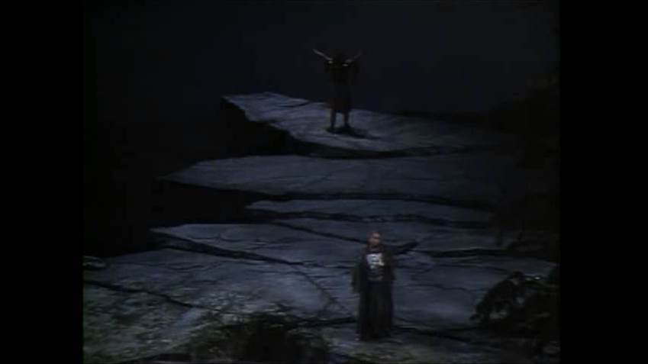
Wagner, Die Walküre, Act 3, “Wotan’s Farewell”
James Morris, Hildegard Behrens: the Metropolitan Opera, 1990

Slide 28
“German Romantic Operas”
Wagner, Der fliegende Holländer (1841, Dresden premiere, 1843)
Wagner, Tannhäuser (1843-45, Dresden premiere, 1845)
Wagner, Lohengrin (1846-48, Weimar premiere, 1850)
“Music Dramas”
Der Ring des Nibelungen (Tetralogy):
Das Rheingold (1853-54)
Die Walküre (1854-56)
Siegfried, Acts 1 & 2 (1856-57)
Tristan und Isolde (1857-59)
Die Meistersinger von Nürnberg (1862-67)
Siegfried, Act 3 (1869-71)
Götterdämmerung (1869-74)
Parsifal (1878-81)

Slide 29
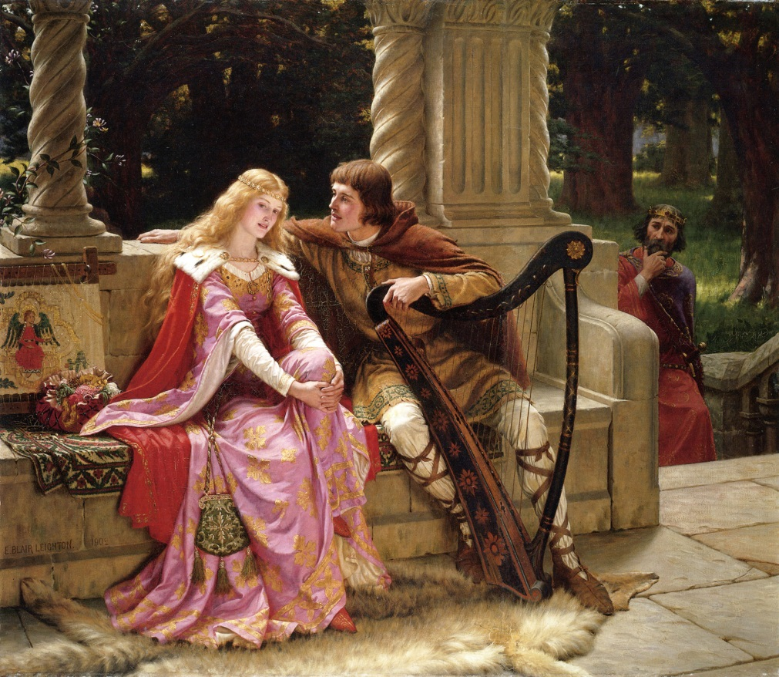
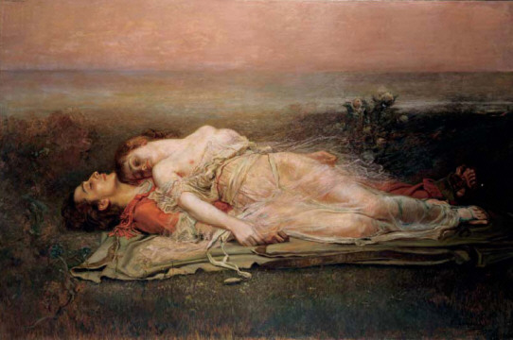
Tristan und Isolde: Love and Death

Slide 30
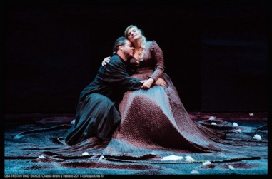
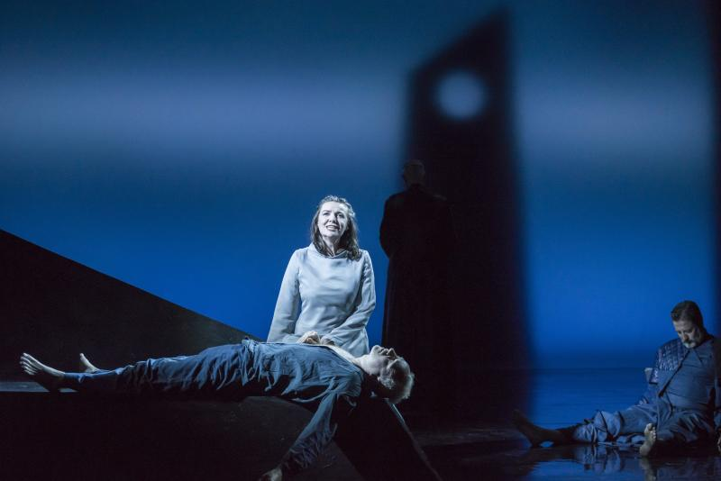
Tristan und Isolde: Love and Death

Slide 31
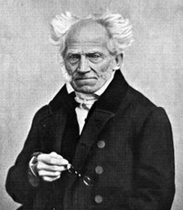
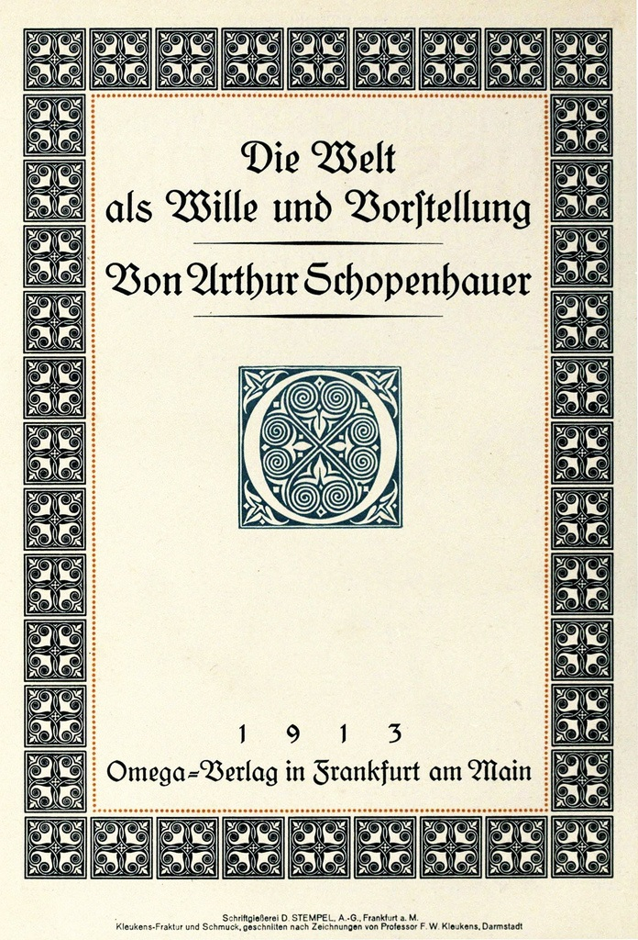
Arthur Schopenhauer (1788-1860)
The World as Will and Representation
(orig. 1819)

Slide 32
The “pessimistic” philosopher
Arthur Schopenhauer (1788-1860)

Slide 33
The “pessimistic” philosopher
Complex philosophy of a ruthless “will,” objectified in human beings, underpinning us all, driving us ever onward: desire, despair, distress
Arthur Schopenhauer (1788-1860)

Slide 34
The “pessimistic” philosopher
Complex philosophy of a ruthless “will,” objectified in human beings, underpinning us all, driving us ever onward: desire, despair, distress
Only two temporary escape routes:
Arthur Schopenhauer (1788-1860)

Slide 35
The “pessimistic” philosopher
Complex philosophy of a ruthless “will,” objectified in human beings, underpinning us all, driving us ever onward: desire, despair, distress
Only two temporary escape routes:
renunciation of desire, becoming
non-conscious of the world and its problems
Arthur Schopenhauer (1788-1860)

Slide 36
The “pessimistic” philosopher
Complex philosophy of a ruthless “will,” objectified in human beings, underpinning us all, driving us ever onward: desire, despair, distress
Only two temporary escape routes:
renunciation of desire, becoming
non-conscious of the world and its problems
music, the highest of the arts, temporarily capable of contemplating the will itself,
accessing the inner essence of things—
a bodiless drive to the “thing-in-itself”
behind all reality
Arthur Schopenhauer (1788-1860)

Slide 37
The “pessimistic” philosopher
Complex philosophy of a ruthless “will,” objectified in human beings, underpinning us all, driving us ever onward: desire, despair, distress
Only two temporary escape routes:
renunciation of desire, becoming
non-conscious of the world and its problems
music, the highest of the arts, temporarily capable of contemplating the will itself,
accessing the inner essence of things—
a bodiless drive to the “thing-in-itself”
behind all reality (music as metaphysics)
Arthur Schopenhauer (1788-1860)

Slide 38
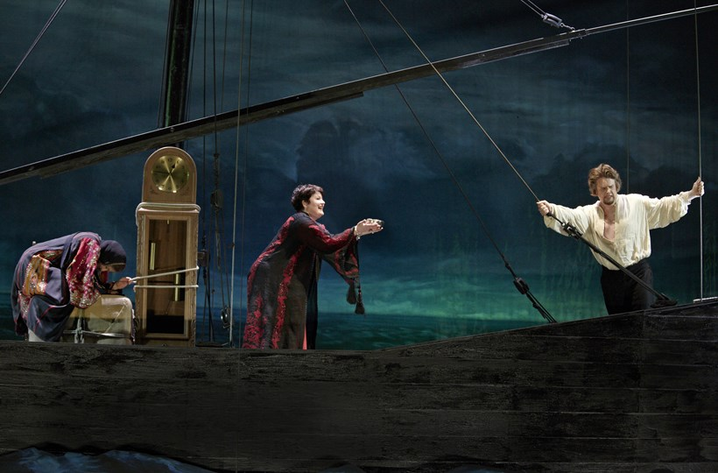
Tristan und Isolde (1857-59; premiere, Munich 1865)

Slide 39
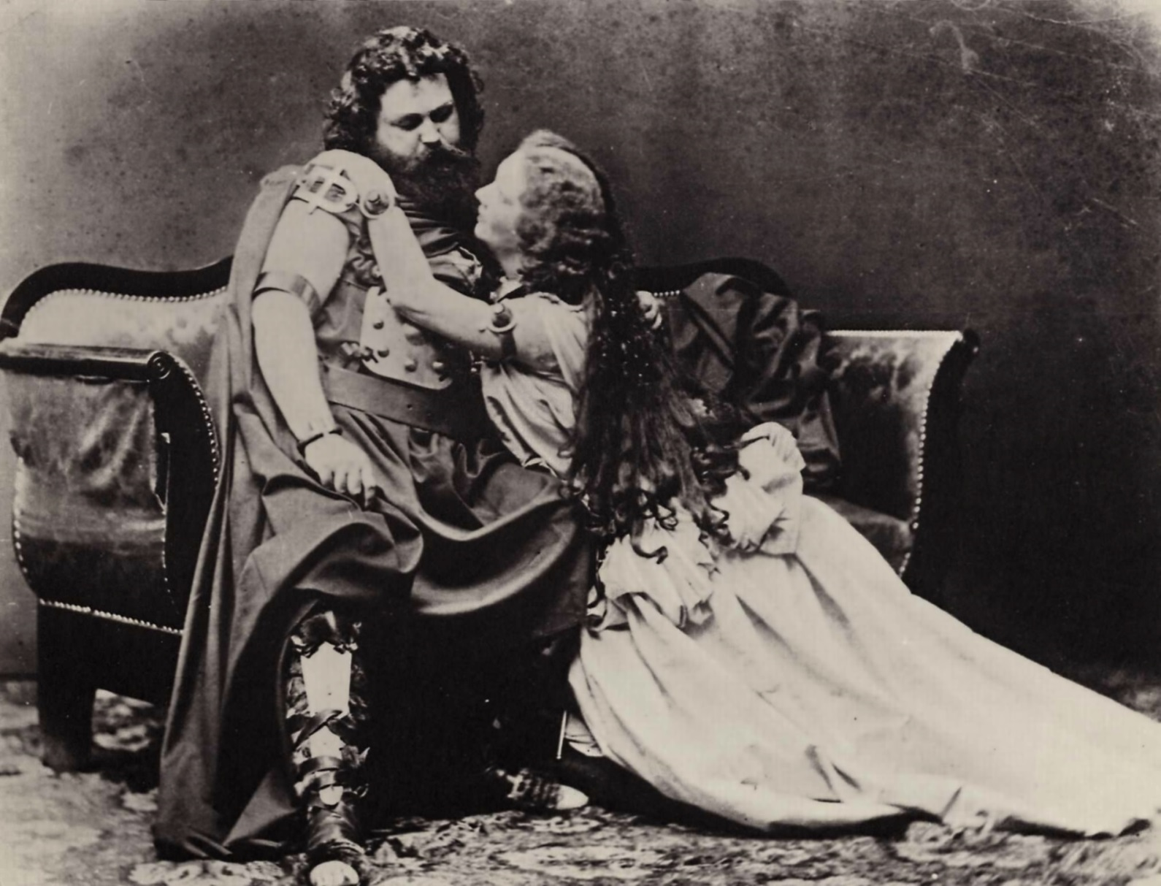
Tristan und Isolde (1857-59; premiere, Munich 1865)
Ludwig and Malvina Schnorr von Carolsfeld costumed as Tristan and Isolde

Slide 40
Tristan: Chromaticism and Ambiguity of Tonality

Slide 41
Tristan: Chromaticism and Ambiguity of Tonality
Few strong cadences; frequent vagueness or uncertainty of tonal centers

Slide 42
Tristan: Chromaticism and Ambiguity of Tonality
Few strong cadences; frequent vagueness or uncertainty of tonal centers
?
chromatic; tonally uncertain
Onset
of a
phrase
V⁷
Or
deceptive/
evaded
cadence

Slide 43
Tristan: Chromaticism and Ambiguity of Tonality
Few strong cadences; frequent vagueness or uncertainty of tonal centers
?
chromatic; tonally uncertain
Onset
of a
phrase
V⁷
Or
deceptive/
evaded
cadence
Harmonically ambiguous “Tristanesque” appoggiaturas

Slide 44
“German Romantic Operas”
Wagner, Der fliegende Holländer (1841, Dresden prem., 1843)
Wagner, Tannhäuser (1843-45, Dresden prem., 1845)
Wagner, Lohengrin (1846-48, Weimar prem., 1850)
“Music Dramas”
Der Ring des Nibelungen (Tetralogy):
Das Rheingold (1853-54)
Die Walküre (1854-56)
Siegfried, Acts 1 & 2 (1856-57)
Tristan und Isolde (1857-59)
Die Meistersinger von Nürnberg (1862-67)
Siegfried, Act 3 (1869-71)
Götterdämmerung (1869-74)
Parsifal (1878-81)

Slide 45
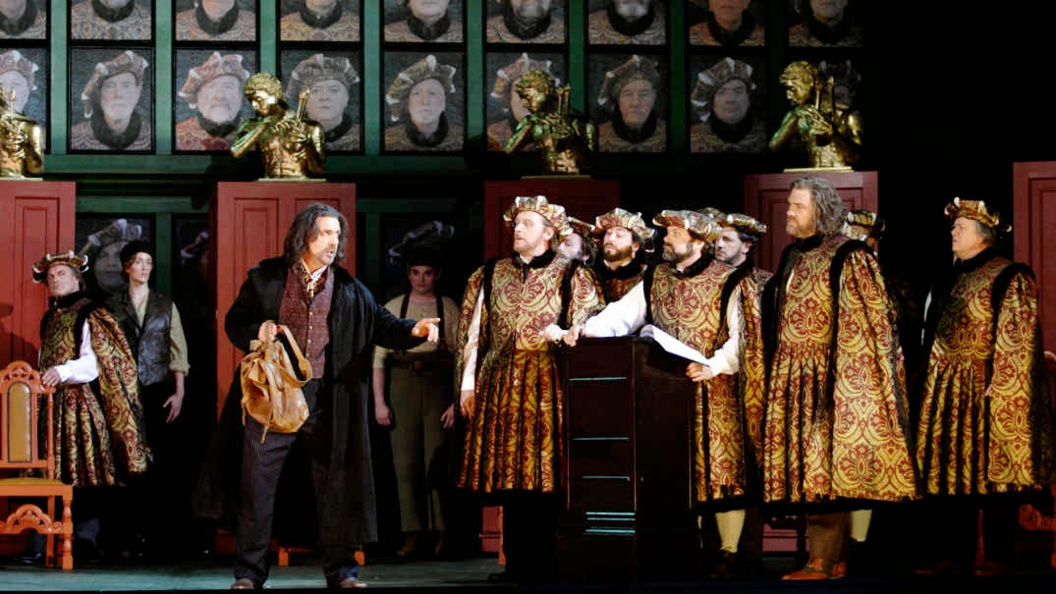
Wagner, Die Meistersinger von Nürnberg (1862-67)

Slide 46
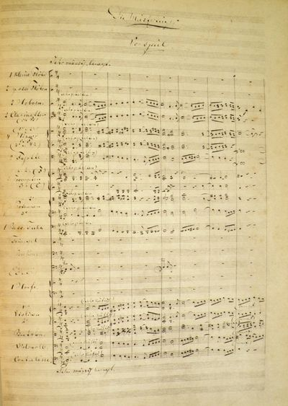
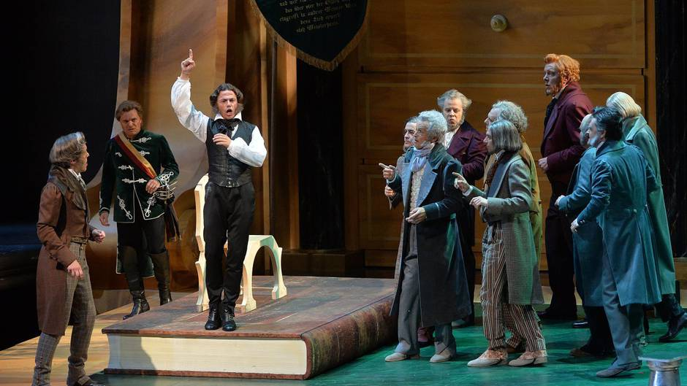
Wagner, Die Meistersinger von Nürnberg (1862-67)

Slide 47
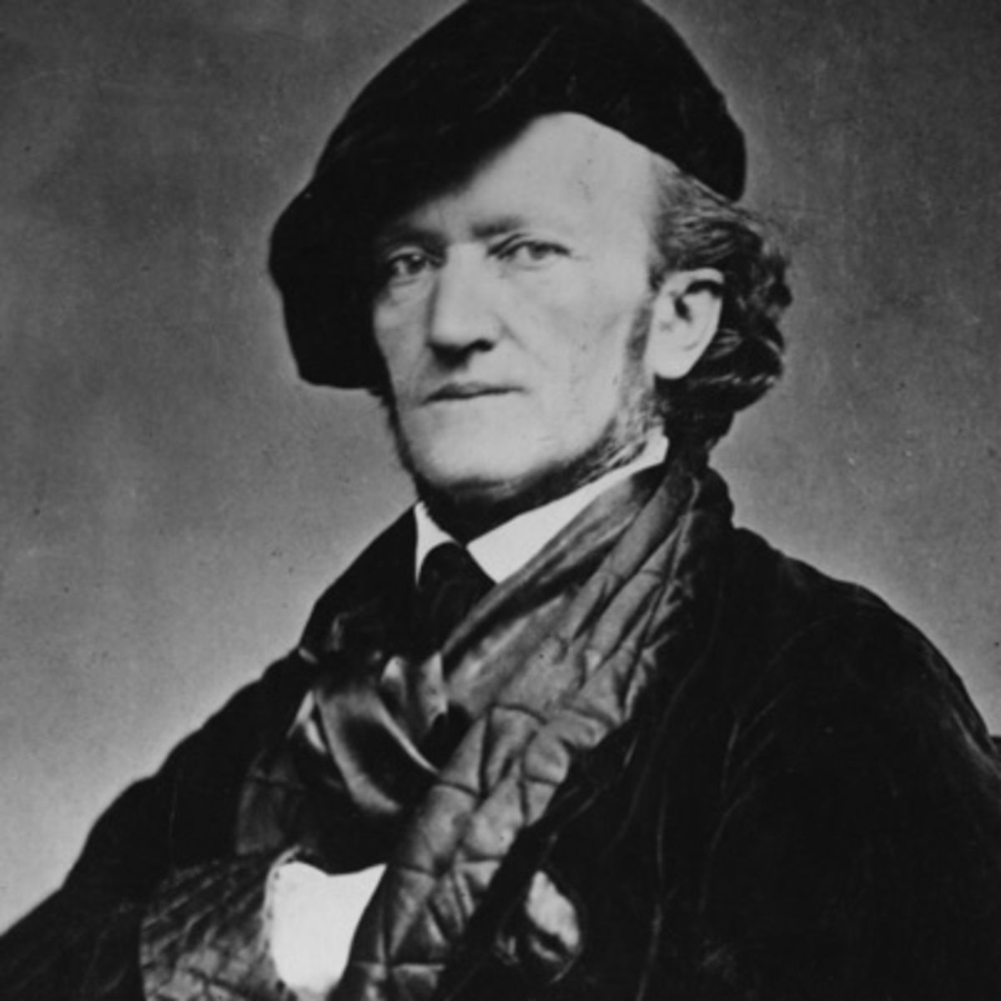

Slide 48
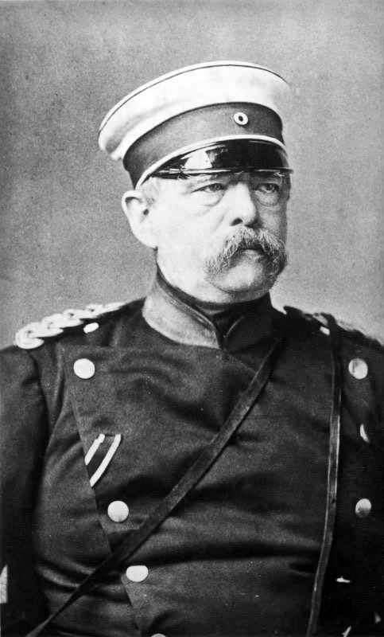
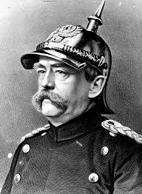
Otto von Bismarck (1815-1898)

Slide 49
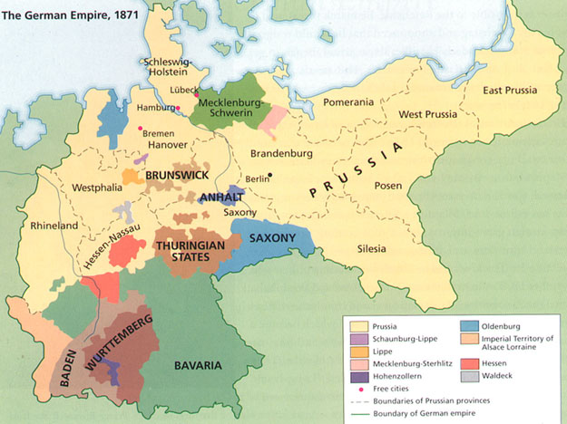
The Unification of Germany, 1871 (The “Second Reich”)

Slide 50
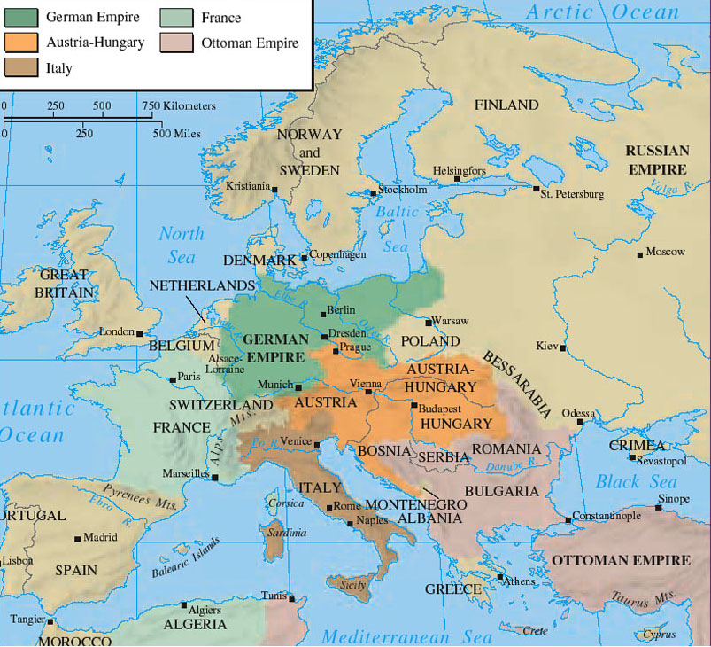
Europe in 1871

Slide 51
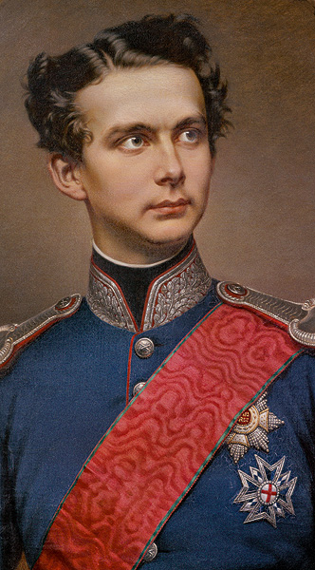
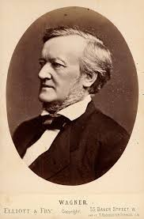
Ludwig II of Bavaria (1845-86)
(reigned 1864-86)

Slide 52
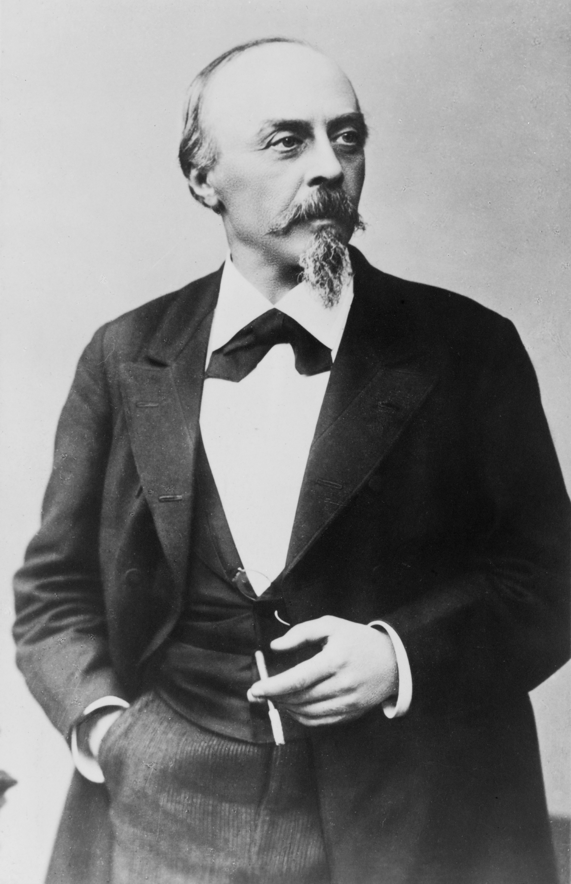
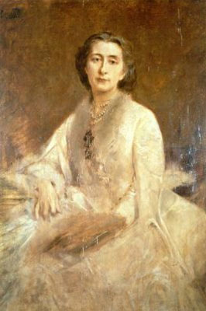
Hans von Bülow Cosima (Liszt) von Bülow

Slide 53
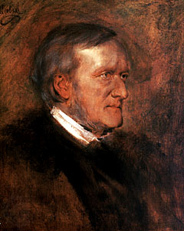
Richard Wagner Cosima (Liszt) von Bülow

Slide 54
Tribschen (Lucerne, Switzerland)

Slide 55
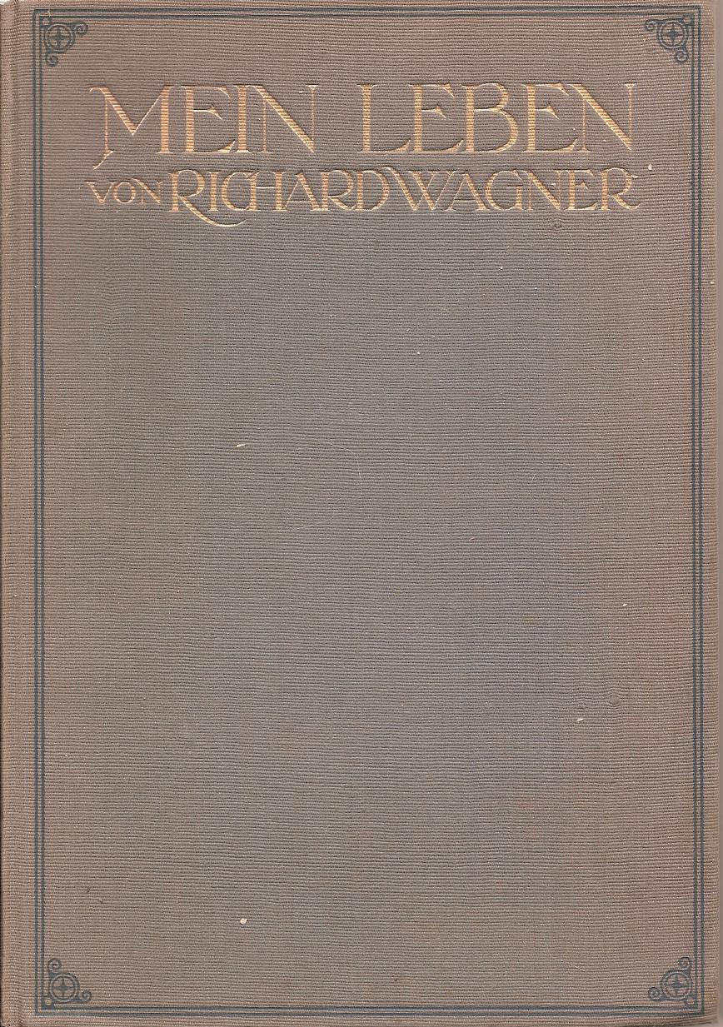
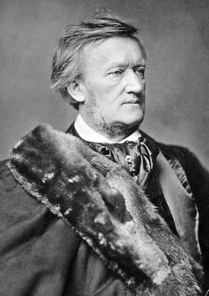

Slide 56
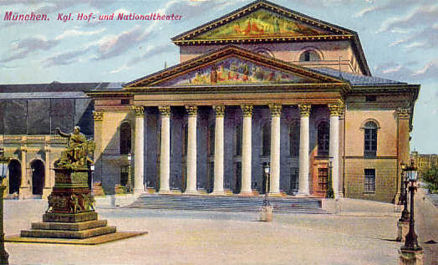
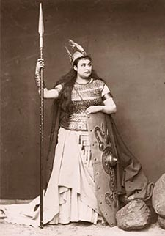
Premieres in Munich
Tristan und Isolde (1857-59) – 1865
Die Meistersinger von Nürnberg (1862-67) – 1868
Das Rheingold (1853-54) – 1869
Die Walküre (1854-56) – 1870

Slide 57
Premieres in Munich
Tristan und Isolde (1857-59) – 1865
Die Meistersinger von Nürnberg (1862-67) – 1868
Das Rheingold (1853-54) – 1869
Die Walküre (1854-56) – 1870
At this time Wagner was also returning to and completing the Ring cycle:
Siegfried, Act 3 (1869-71)
Götterdämmerung (1869-74)

Slide 58
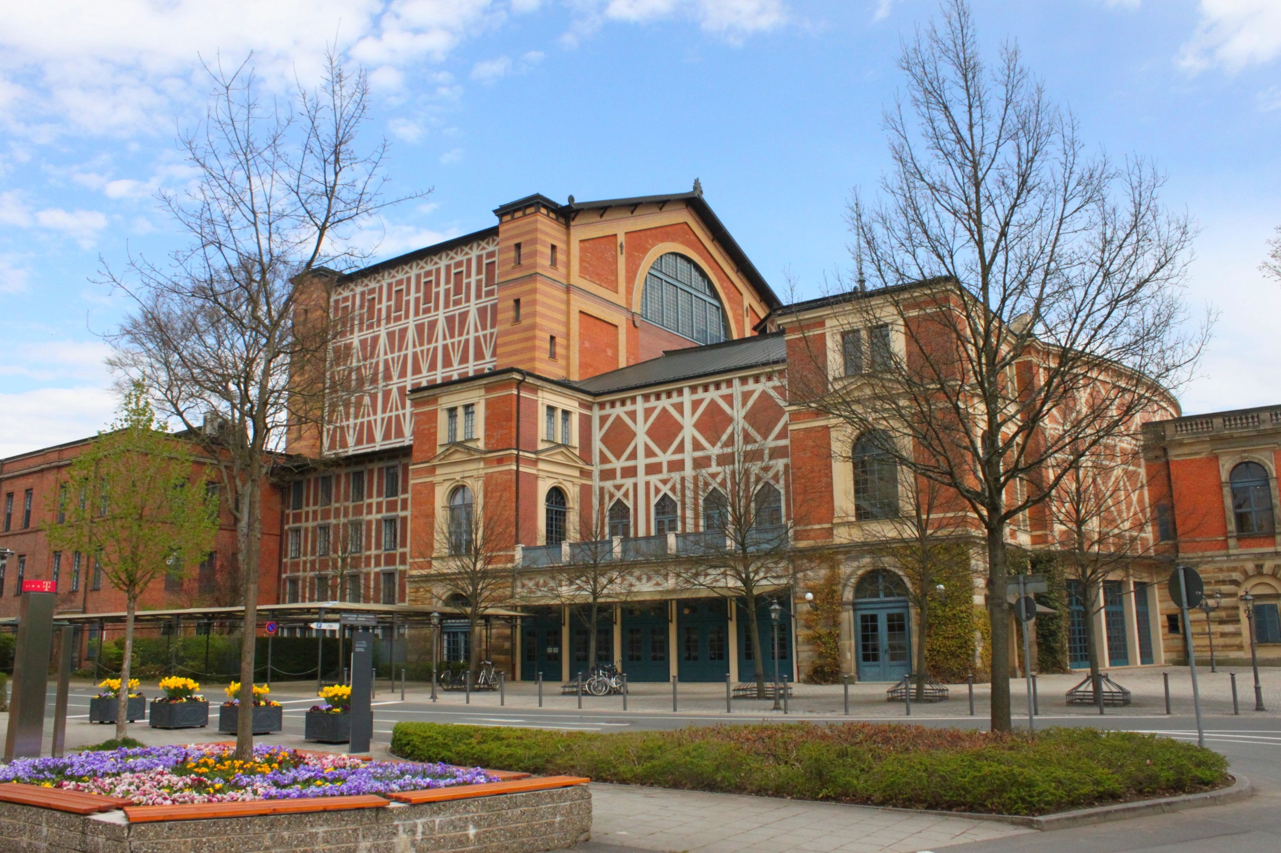
Bayreuth—Festspielhaus (1876)

Slide 59
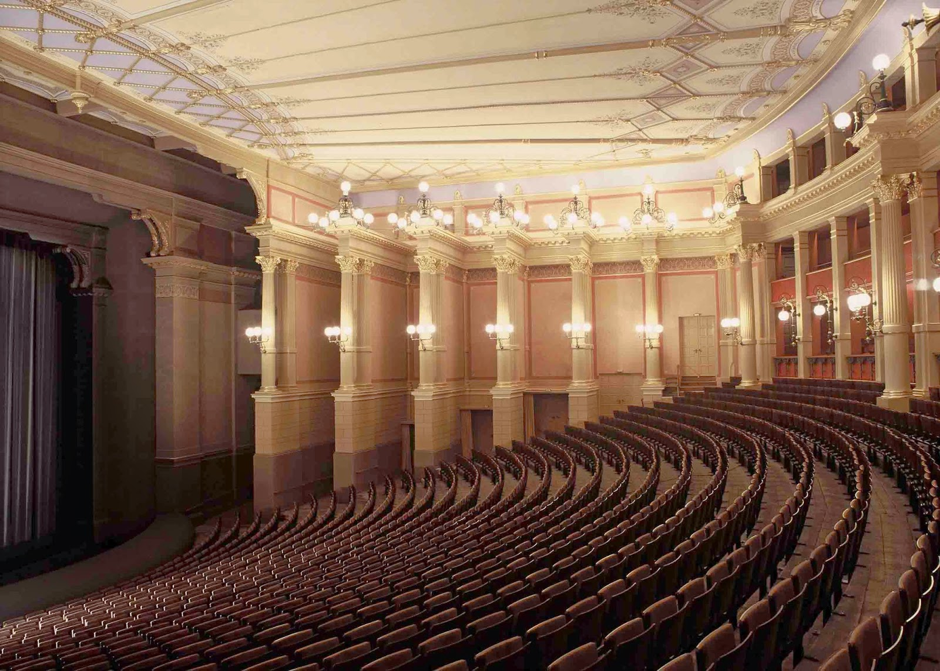
Bayreuth—Festspielhaus (1876)

Slide 60
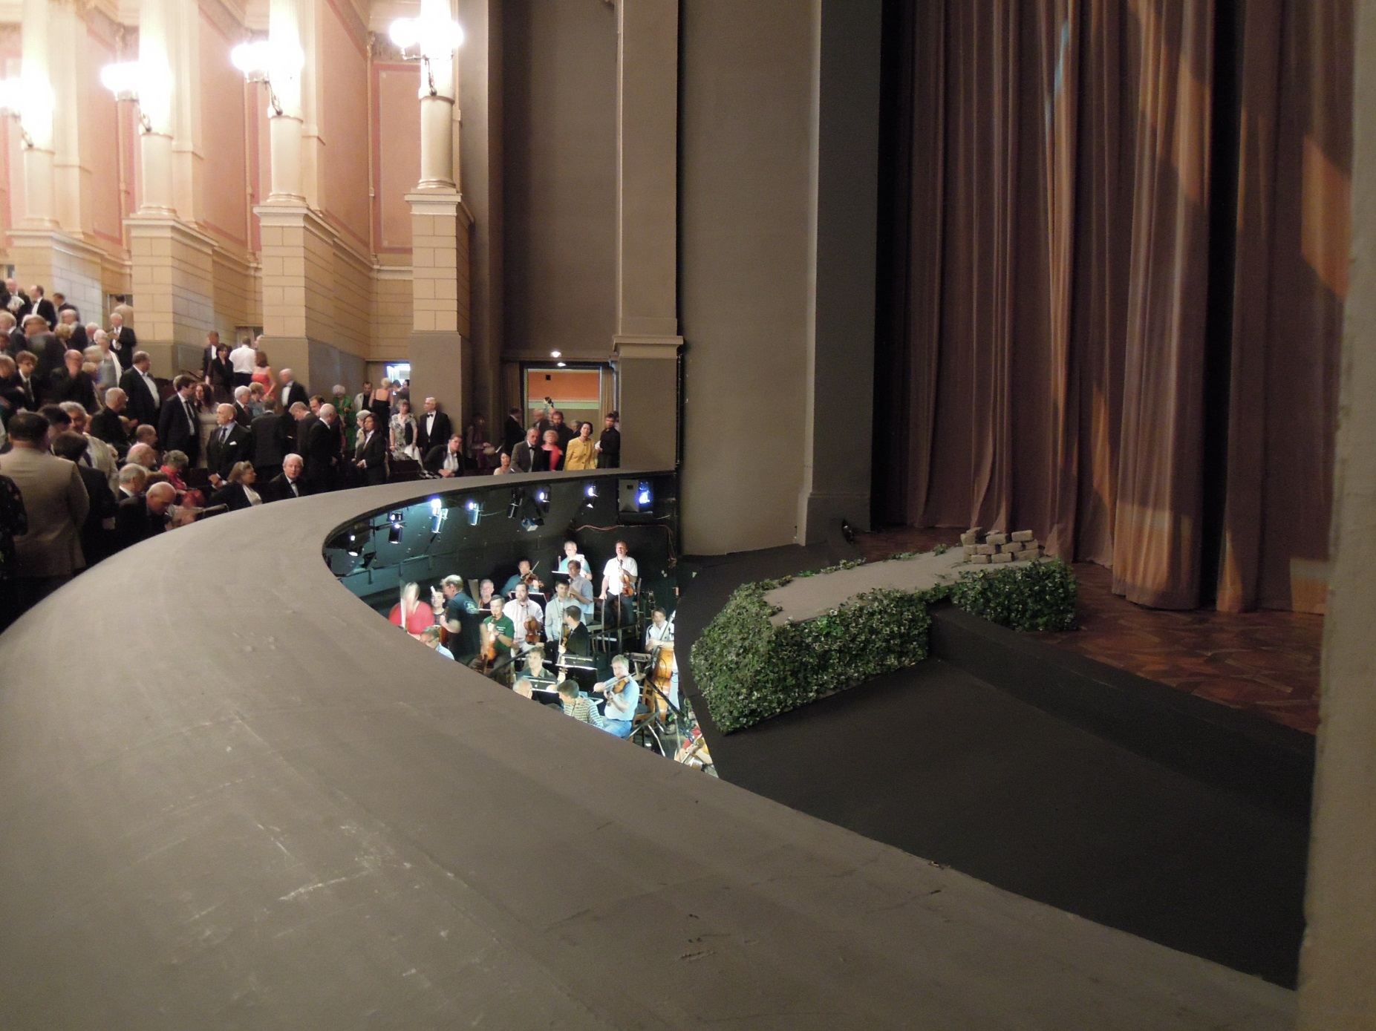
Bayreuth—Festspielhaus (1876)

Slide 61
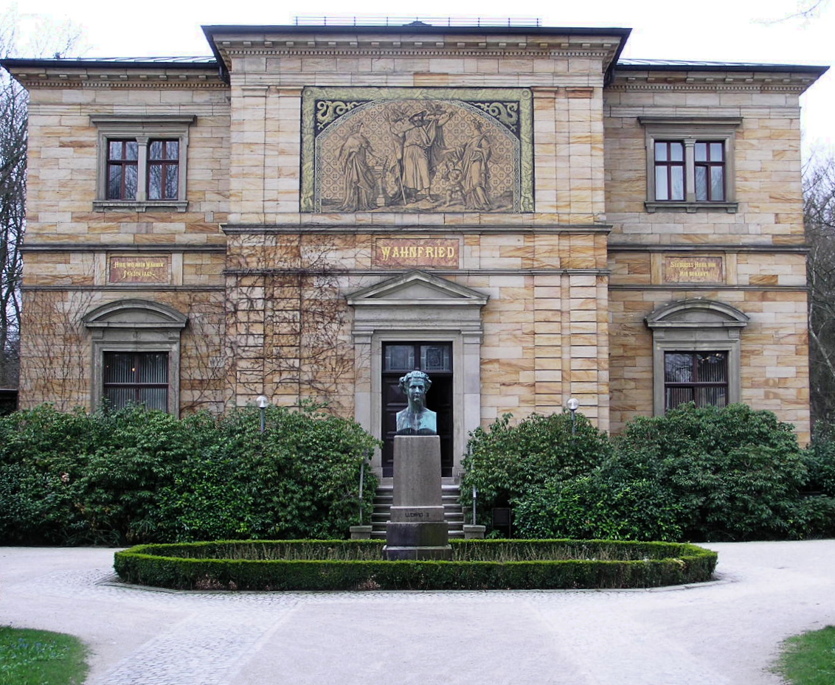
Bayreuth—Haus Wahnfried

Slide 62
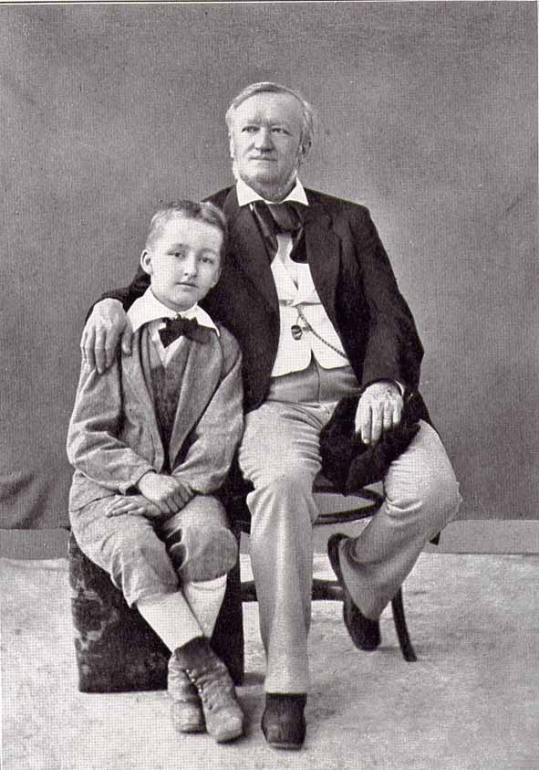
“Beethoven” (1870)
“On the Term ‘Music Drama’” (1872)
“Religion and Art” (1880)
Siegfried and Richard Wagner, 1880

Slide 63
“Beethoven” (1870)
“On the Term ‘Music Drama’” (1872)
Music Drama = “deeds of music
made visible”
“Religion and Art” (1880)
Siegfried and Richard Wagner, 1880

Slide 64
“Religion and Art” (1880)
In former times:
Christian Symbols
Religion
Siegfried and Richard Wagner, 1880

Slide 65
“Religion and Art” (1880)
But today, with Wagner:
Christian Symbols
Religion
Art
(Music)
Siegfried and Richard Wagner, 1880

Slide 66
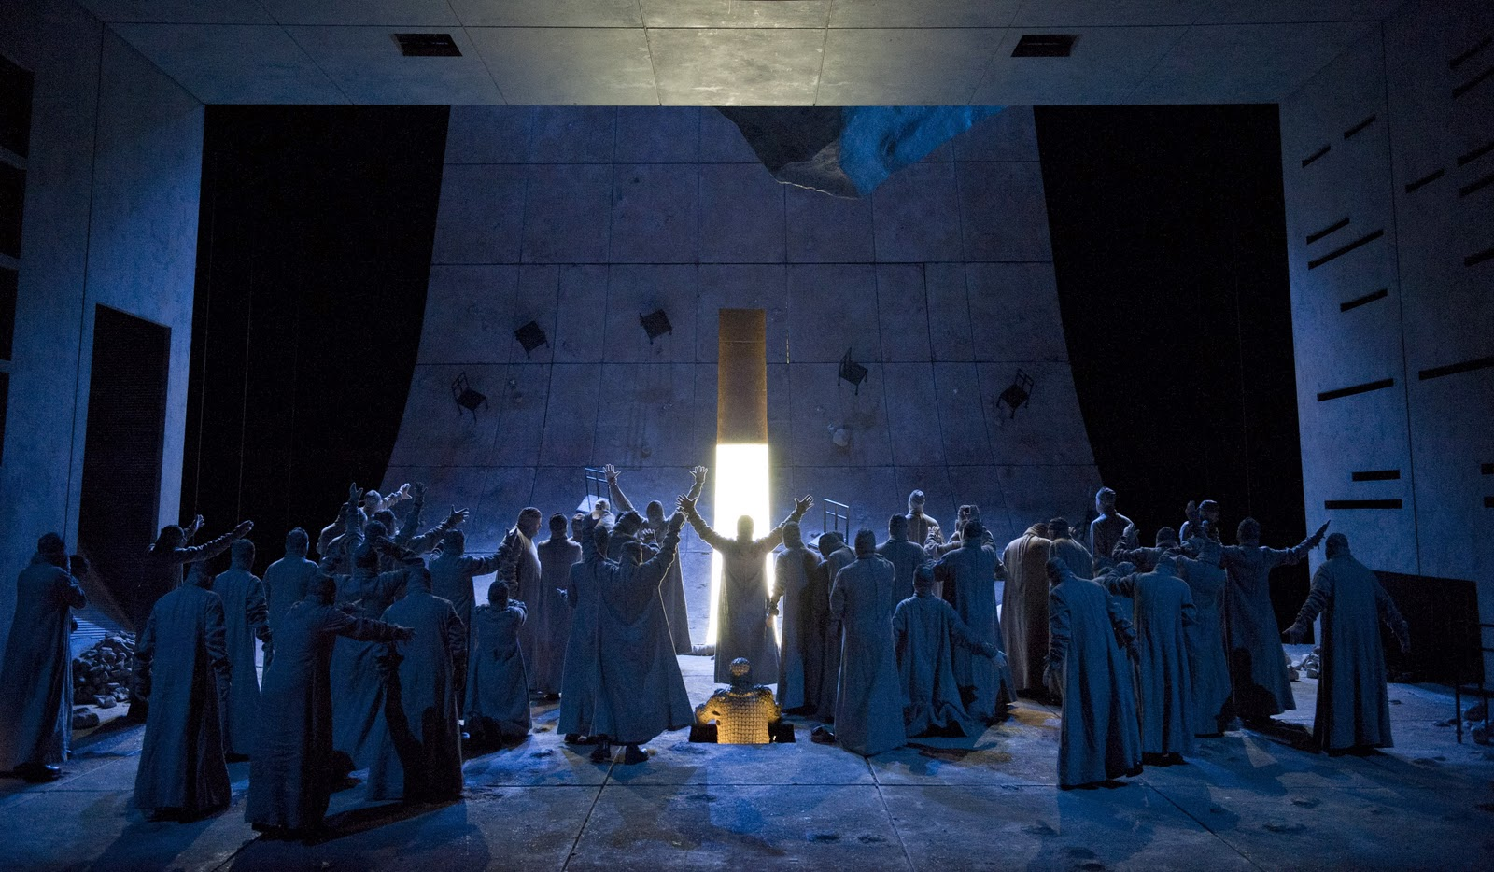
Wagner, Parsifal (1878-81; premiere Bayreuth, 1882)
Ein Bühnenweihfestspiel (A Festival Play for the Consecration of a Stage)

Slide 67
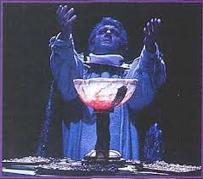
Wagner, Parsifal (1878-81; premiere Bayreuth, 1882)
Ein Bühnenweihfestspiel (A Festival Play for the Consecration of the Stage)

Slide 68
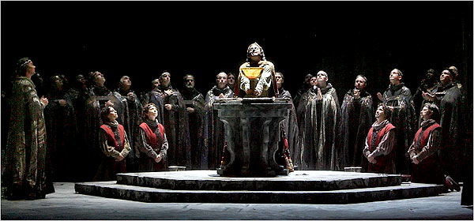
Wagner, Parsifal (1878-81; premiere Bayreuth, 1882)
Ein Bühnenweihfestspiel (A Festival Play for the Consecration of the Stage)

Slide 69
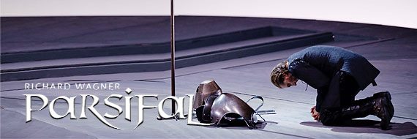
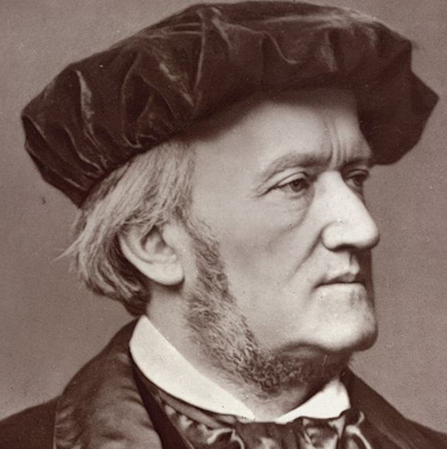
Parsifal: Prelude to Act 1

Slide 70
Wagner, Parsifal (1878-81; premiere Bayreuth, 1882)
Ein Bühnenweihfestspiel (A Festival Play for the Consecration of a Stage)

Slide 71
Wagner, Parsifal (1878-81; premiere Bayreuth, 1882)
Ein Bühnenweihfestspiel (A Festival Play for the Consecration of the Stage)

Slide 72
Wagner, Parsifal (1878-81; premiere Bayreuth, 1882)
Ein Bühnenweihfestspiel (A Festival Play for the Consecration of the Stage)

Slide 73
Parsifal: Prelude to Act 1

