Slide 1
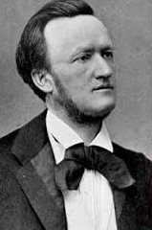

Slide 2
“German Romantic Operas”
Weber, Der Freischütz (1821)
Weber, Euryanthe (1823)
Weber, Oberon (1826) – Weber’s death, 1826

Slide 3
“German Romantic Operas”
Weber, Der Freischütz (1821)
Weber, Euryanthe (1823)
Weber, Oberon (1826) – Weber’s death, 1826
1830s: French Grand Opera (Meyerbeer, Halévy)
1830s: Italian “bel canto” opera (Bellini, Donizetti)

Slide 4
“German Romantic Operas”
Weber, Der Freischütz (1821)
Weber, Euryanthe (1823)
Weber, Oberon (1826) – Weber’s death, 1826
1830s: French Grand Opera (Meyerbeer, Halévy)
1830s: Italian “bel canto” opera (Bellini, Donizetti)
(sporadic, lesser works by minor composers
in the 1830s, but then:)
Wagner, Der fliegende Holländer (1841, Dresden premiere, 1843)

Slide 5
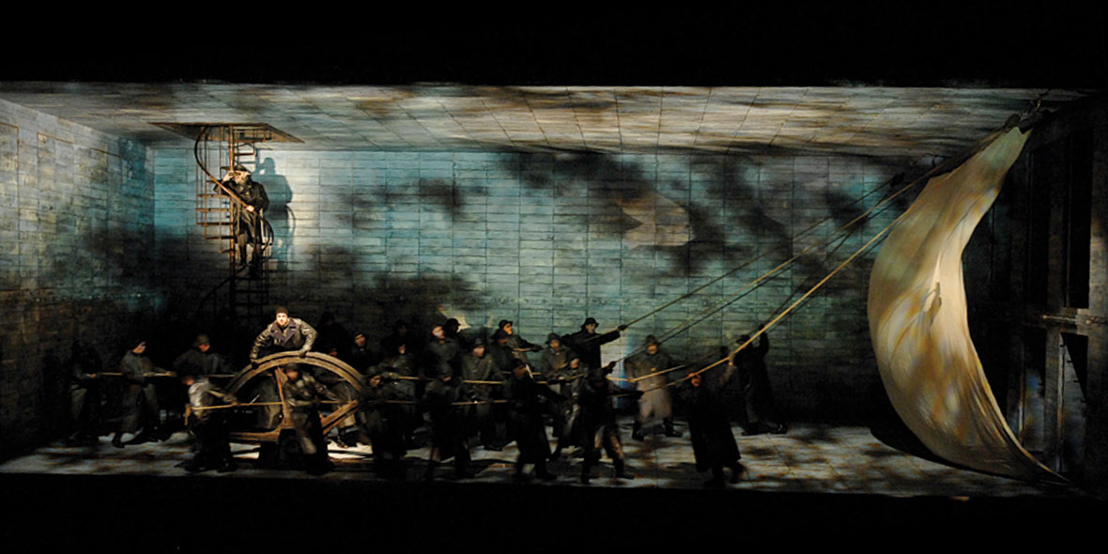
Wagner, Der fliegende Holländer, Sailor’s Chorus, Act 1

Slide 6
“German Romantic Operas”
Weber, Der Freischütz (1821)
Weber, Euryanthe (1823)
Weber, Oberon (1826) – Weber’s death, 1826
1830s: French Grand Opera (Meyerbeer, Halévy)
1830s: Italian “bel canto” opera (Bellini, Donizetti)
(sporadic, lesser works by minor composers
in the 1830s, but then:)
Wagner, Der fliegende Holländer (1841, Dresden premiere, 1843)
Tone of moral earnestness

Slide 7
“German Romantic Operas”
Weber, Der Freischütz (1821)
Weber, Euryanthe (1823)
Weber, Oberon (1826) – Weber’s death, 1826
1830s: French Grand Opera (Meyerbeer, Halévy)
1830s: Italian “bel canto” opera (Bellini, Donizetti)
(sporadic, lesser works by minor composers
in the 1830s, but then:)
Wagner, Der fliegende Holländer (1841, Dresden premiere, 1843)
Tone of moral earnestness
Writes the libretto himself (complete control)

Slide 8
“German Romantic Operas”
Weber, Der Freischütz (1821)
Weber, Euryanthe (1823)
Weber, Oberon (1826) – Weber’s death, 1826
1830s: French Grand Opera (Meyerbeer, Halévy)
1830s: Italian “bel canto” opera (Bellini, Donizetti)
(sporadic, lesser works by minor composers
in the 1830s, but then:)
Wagner, Der fliegende Holländer (1841, Dresden premiere, 1843)
Tone of moral earnestness
Writes the libretto himself (complete control)
“Extremism”: starting to go beyond existing limits of sonority, intensity

Slide 9
“German Romantic Operas”
Weber, Der Freischütz (1821)
Weber, Euryanthe (1823)
Weber, Oberon (1826) – Weber’s death, 1826
1830s: French Grand Opera (Meyerbeer, Halévy)
1830s: Italian “bel canto” opera (Bellini, Donizetti)
(sporadic, lesser works by minor composers
in the 1830s, but then:)
Wagner, Der fliegende Holländer (1841, Dresden premiere, 1843)
Tone of moral earnestness
Writes the libretto himself (complete control)
“Extremism”: starting to go beyond existing limits of sonority, intensity
Overture: maximal contrast of exposition’s P and S (origins: Weber)

Slide 10
Wagner, Der fliegende Holländer, Overture
“Two-Block Exposition” (two tableaux, maximal contrast)
Effect: “camera pan”
S
P
major mediant: III
minor tonic: i
piano
gentle, mild, patient,
The “redemptive feminine”
forte
stormy, troubled
“masculine” image

Slide 11
Effect: “camera pan”
S
P
major mediant: III
Senta
minor tonic: i
Dutchman
piano
gentle, mild, patient,
The “redemptive feminine”
forte
stormy, troubled
“masculine” image
Emerging: musical ideas as more explicit signs

Slide 12
Effect: “camera pan”
S
P
major mediant: III
Senta
minor tonic: i
Dutchman
piano
gentle, mild, patient,
The “redemptive feminine”
forte
stormy, troubled
“masculine” image
Emerging: musical ideas as more explicit signs
Themes and textures to be understood as symbols, signifiers of persons, situations, nameable locations, deeds, or moods

Slide 13
Effect: “camera pan”
S
P
major mediant: III
Senta
minor tonic: i
Dutchman
piano
gentle, mild, patient,
The “redemptive feminine”
forte
stormy, troubled
“masculine” image
Emerging: musical ideas as more explicit signs
Themes and textures to be understood as symbols, signifiers of persons, situations, nameable locations, deeds, or moods
Thus: heightening the semiotic aspect of music
Signifier Signified

Slide 14
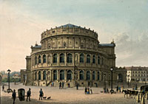
1843: The Flying Dutchman and appointment as Kapellmeister at the Dresden Court
Dresden Court Opera

Slide 15
“German Romantic Operas”
Weber, Der Freischütz (1821)
Weber, Euryanthe (1823)
Weber, Oberon (1826) – Weber’s death, 1826
1830s: French Grand Opera (Meyerbeer, Halévy)
1830s: Italian “bel canto” opera (Bellini, Donizetti)
(sporadic, lesser works by minor composers
in the 1830s, but then:)
Wagner, Der fliegende Holländer (1841, Dresden premiere 1843)
Wagner, Tannhäuser (1843-45, Dresden premiere, 1845)

Slide 16
“German Romantic Operas”
Weber, Der Freischütz (1821)
Weber, Euryanthe (1823)
Weber, Oberon (1826) – Weber’s death, 1826
1830s: French Grand Opera (Meyerbeer, Halévy)
1830s: Italian “bel canto” opera (Bellini, Donizetti)
(sporadic, lesser works by minor composers
in the 1830s, but then:)
Wagner, Der fliegende Holländer (1841, Dresden premiere, 1843)
Wagner, Tannhäuser (1843-45, Dresden premiere, 1845)
Even more maximal contrasts and extremes (e.g., in plot: the struggle between sensual eroticism and spiritual renunciation)

Slide 17
“German Romantic Operas”
Weber, Der Freischütz (1821)
Weber, Euryanthe (1823)
Weber, Oberon (1826) – Weber’s death, 1826
1830s: French Grand Opera (Meyerbeer, Halévy)
1830s: Italian “bel canto” opera (Bellini, Donizetti)
(sporadic, lesser works by minor composers
in the 1830s, but then:)
Wagner, Der fliegende Holländer (1841, Dresden prem., 1843)
Wagner, Tannhäuser (1843-45, Dresden premiere, 1845)
Even more maximal contrasts and extremes (e.g., in plot: the struggle between sensual eroticism and spiritual renunciation)
Musical goal: search for maximal effects to overwhelm the listener—
quasi-hypnotic power

Slide 18
Mendelssohn, [“Nocturne’], Con moto tranquillo, from the Incidental Music to
A Midsummer Night’s Dream (1843): E major

Slide 19
Mendelssohn, [“Nocturne”], Con moto tranquillo, from the Incidental Music to
A Midsummer Night’s Dream (1843): E major
Lyric Binary Format: Often Implied: 8 Lines of Poetic Text (Two Quatrains)
Trajectories toward obligatory cadences
I or V: PAC
I:HC
I:PAC (ESC)
a a’ b a’’ (coda)
Usually a balanced phrase-pair
(often a period) or some other self-contained phrase structure
Sets up V
Climactic
utterance:
“the point”
Post-cadential dissipation
of tension
Thus: an end-accented format

Slide 20
Mendelssohn, [“Nocturne”], Con moto tranquillo, from the Incidental Music to
A Midsummer Night’s Dream (1843): E major
Lyric Binary Format: Often Implied: 8 Lines of Poetic Text (Two Quatrains)
I or V: PAC
I:HC
I:PAC
a a’ b a’’
Period
Sets up V
Climactic
utterance:
“the point”
Thus: an end-accented format

Slide 21
Mendelssohn, [“Nocturne”], Con moto tranquillo, from the Incidental Music to
A Midsummer Night’s Dream (1843): E major
Lyric Binary Format: Often Implied: 8 Lines of Poetic Text (Two Quatrains)
I: PAC
I:HC
I:PAC
a a’ b a’’
Period
Sets up V
Climactic
utterance:
“the point”
Thus: an end-accented format
I:PAC (ESC)
b, recomposed, extended a’’ expanded coda
Post-cadential
dissipation of tension

Slide 22
Wagner, Overture to Tannhäuser, Introduction: E Major
Lyric Binary Format
Dynamic Crest!
I:HC
V:PAC
V: PAC
a a x b b a a x!
sequences
piano
waves of crescendo!
fortissimo!
Sentence
Sets up V
Climactic
utterance:
“the point”
dissolves to exposition
b, revisited in diminuendo a a x . . .

Slide 23
Wagner, Overture to Tannhäuser, Introduction: E Major
Lyric Binary Format
a a x b a a x b a a (x)
!!!
. . .
cresc.

Slide 24
“German Romantic Operas”
Weber, Der Freischütz (1821)
Weber, Euryanthe (1823)
Weber, Oberon (1826) – Weber’s death, 1826
1830s: French Grand Opera (Meyerbeer, Halévy)
1830s: Italian “bel canto” opera (Bellini, Donizetti)
(sporadic, lesser works by minor composers
in the 1830s, but then:)
Wagner, Der fliegende Holländer (1841, Dresden prem., 1843)
Wagner, Tannhäuser (1843-45, Dresden premiere, 1845)
Even more maximal contrasts and extremes (e.g., in plot: the struggle between sensual eroticism and spiritual renunciation)
Musical goal: search for maximal effects to overwhelm the listener—
quasi-hypnotic power – and hence control.

Slide 25
“German Romantic Operas”
Weber, Der Freischütz (1821)
Weber, Euryanthe (1823)
Weber, Oberon (1826) – Weber’s death, 1826
1830s: French Grand Opera (Meyerbeer, Halévy)
1830s: Italian “bel canto” opera (Bellini, Donizetti)
(sporadic, lesser works by minor composers
in the 1830s, but then:)
Wagner, Der fliegende Holländer (1841, Dresden premiere, 1843)
Wagner, Tannhäuser (1843-45, Dresden premiere, 1845)
Wagner, Lohengrin (1846-48, Weimar premiere, 1850)

Slide 26
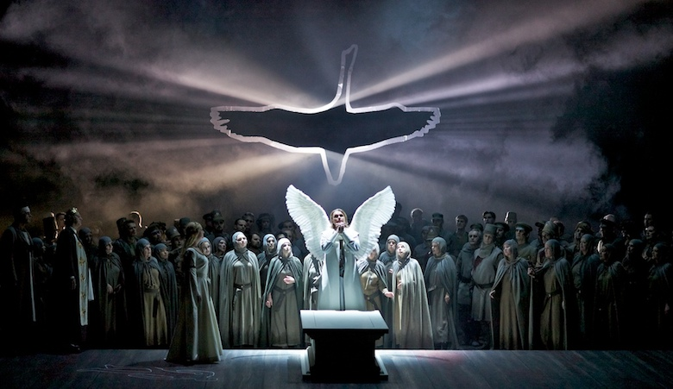
Lohengrin

Slide 27
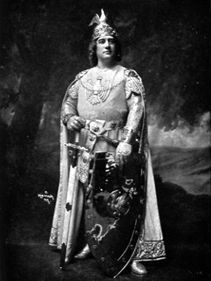
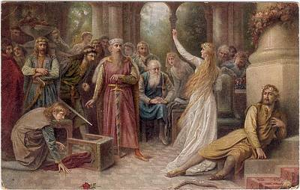
Lohengrin

Slide 28
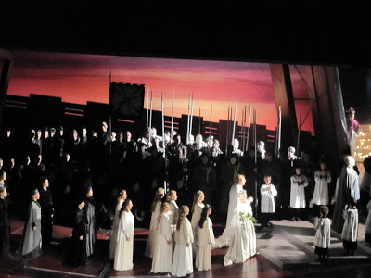
Lohengrin

Slide 29
1848-49: Crucial Years

Slide 30
1848-49: Crucial Years
1848 Revolutions throughout Europe

Slide 31
1848-49: Crucial Years
1848 Revolutions throughout Europe
1849: Revolution spreads to Dresden

Slide 32
1848-49: Crucial Years
1848 Revolutions throughout Europe
1849: Revolution spreads to Dresden
Wagner, agitator, forced to flee Germany—to Switzerland – widespread ban on his music in Germany

Slide 33
1849-51: The Transformation
Aesthetic Writings: Rethinking of Musical Principles and Aims
1849: Art and Revolution
1849: The Artwork of the Future
1851: Opera and Drama

Slide 34
1849-51: The Transformation
Aesthetic Writings: Rethinking of Musical Principles and Aims
1849: Art and Revolution
1849: The Artwork of the Future: Concept, Gesamtkunstwerk (“total artwork,” a synthesis of drama, poetry, and music)
1851: Opera and Drama

Slide 35
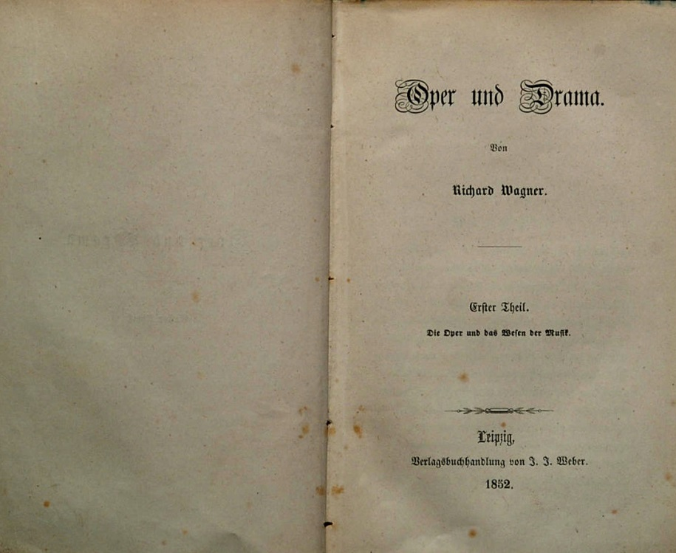
1849-51: The Transformation
Aesthetic Writings: Rethinking of Musical Principles and Aims
1849: Art and Revolution
1849: The Artwork of the Future: Concept, Gesamtkunstwerk (“total artwork,” a synthesis of drama, poetry, and music)
1851: Opera and Drama: extended description of his new approach to music and music drama

Slide 36
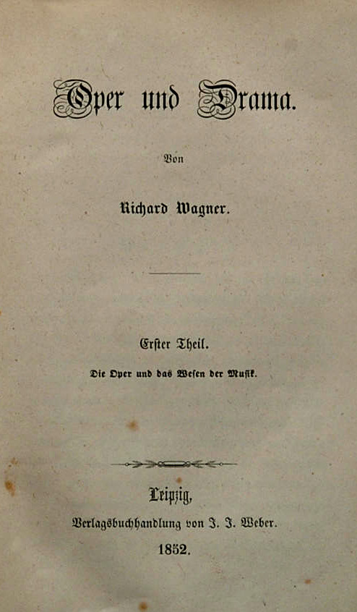
Synthesis/fusion of “opera” and “symphony” (symphonic opera, operatic symphony), with equal emphasis given to all aspects within it.

Slide 37
Synthesis/fusion of “opera” and “symphony” (symphonic opera, operatic symphony), with equal emphasis given to all aspects within it.
“Music Drama” – No longer “opera”

Slide 38
Synthesis/fusion of “opera” and “symphony” (symphonic opera, operatic symphony), with equal emphasis given to all aspects within it.
“Music Drama” – No longer “opera”
Best topic: myths and/or ancient legends

Slide 39
Synthesis/fusion of “opera” and “symphony” (symphonic opera, operatic symphony), with equal emphasis given to all aspects within it.
“Music Drama” – No longer “opera”
Best topic: myths and/or ancient legends
Texts:
Elevated, deep, ancient in flavor
Stabreim, not end-rhyme (shows kinship of feeling)
Free rhythm—replaces regularity of stock poetic meters

Slide 40
Synthesis/fusion of “opera” and “symphony” (symphonic opera, operatic symphony), with equal emphasis given to all aspects within it.
“Music Drama” – No longer “opera”
Best topic: myths and/or ancient legends
Texts:
Elevated, deep, ancient in flavor
Stabreim, not end-rhyme (shows kinship of feeling)
Free rhythm—replaces regularity of stock poetic meters
Modulation and recurrence of keys: a musical equivalent of Stabreim

Slide 41
Synthesis/fusion of “opera” and “symphony” (symphonic opera, operatic symphony), with equal emphasis given to all aspects within it.
“Music Drama” – No longer “opera”
Best topic: myths and/or ancient legends
Texts:
Elevated, deep, ancient in flavor
Stabreim, not end-rhyme (shows kinship of feeling)
Free rhythm—replaces regularity of stock poetic meters
Modulation and recurrence of keys: a musical equivalent of Stabreim
Melody: “the horizontal surface of harmony”; traditional melodic structures are minimized or avoided in favor of ongoing dramatic declamation

Slide 42
Synthesis/fusion of “opera” and “symphony” (symphonic opera, operatic symphony), with equal emphasis given to all aspects within it.
“Music Drama” – No longer “opera”
Best topic: myths and/or ancient legends
Texts:
Elevated, deep, ancient in flavor
Stabreim, not end-rhyme (shows kinship of feeling)
Free rhythm—replaces regularity of stock poetic meters
Modulation and recurrence of keys: a musical equivalent of Stabreim
Melody: “the horizontal surface of harmony”; traditional melodic structures are minimized or avoided in favor of ongoing dramatic declamation
Originally: no chorus; no simultaneous singing

Slide 43
Synthesis/fusion of “opera” and “symphony” (symphonic opera, operatic symphony), with equal emphasis given to all aspects within it.
“Music Drama” – No longer “opera”
Best topic: myths and/or ancient legends
Texts:
Elevated, deep, ancient in flavor
Stabreim, not end-rhyme (shows kinship of feeling)
Free rhythm—replaces regularity of stock poetic meters
Modulation and recurrence of keys: a musical equivalent of Stabreim
Melody: “the horizontal surface of harmony”; traditional melodic structures are minimized or avoided in favor of ongoing dramatic declamation
Originally: no chorus; no simultaneous singing
Active (symphonic) orchestra adds psychological depth to the words and action—sometimes uttering or revealing what is unspoken

Slide 44
Synthesis/fusion of “opera” and “symphony” (symphonic opera, operatic symphony), with equal emphasis given to all aspects within it.
“Music Drama” – No longer “opera”
Best topic: myths and/or ancient legends
Texts:
Elevated, deep, ancient in flavor
Stabreim, not end-rhyme (shows kinship of feeling)
Free rhythm—replaces regularity of stock poetic meters
Modulation and recurrence of keys: a musical equivalent of Stabreim
Melody: “the horizontal surface of harmony”; traditional melodic structures are minimized or avoided in favor of ongoing dramatic declamation
Originally: no chorus; no simultaneous singing
Active (symphonic) orchestra adds psychological depth to the words and action—sometimes uttering or revealing what is unspoken
Symphonic web of nearly omnipresent motives: Leitmotifs (“motives of remembrance”; “motives of foreboding”)

Slide 45
“German Romantic Operas”
Wagner, Der fliegende Holländer (1841, Dresden premiere, 1843)
Wagner, Tannhäuser (1843-45, Dresden premiere, 1845)
Wagner, Lohengrin (1846-48, Weimar premiere, 1850)
“Music Dramas”
Der Ring des Nibelungen (Tetralogy):
Das Rheingold (1853-54)
Die Walküre (1854-56)
Siegfried (1856-57; 1869-71)
Götterdämmerung (1869-74)

Slide 46
“German Romantic Operas”
Wagner, Der fliegende Holländer (1841, Dresden premiere, 1843)
Wagner, Tannhäuser (1843-45, Dresden premiere, 1845)
Wagner, Lohengrin (1846-48, Weimar premiere, 1850)
“Music Dramas”
Der Ring des Nibelungen (Tetralogy):
Das Rheingold (1853-54)
Die Walküre (1854-56)
Siegfried, Acts 1 & 2 (1856-57)
Tristan und Isolde (1857-59)
Die Meistersinger von Nürnberg (1862-67)
Siegfried, Act 3 (1869-71)
Götterdämmerung (1869-74)
Parsifal (1878-81)

Slide 47
Wagner, Die Walküre, Act 3, “Wotan’s Farewell”
James Morris, Hildegard Behrens: the Metropolitan Opera, 1990

Slide 48
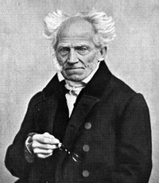
Arthur Schopenhauer (1788-1860)
The World as Will and Representation
(orig. 1819)

Slide 49
The “pessimistic” philosopher
Arthur Schopenhauer (1788-1860)

Slide 50
The “pessimistic” philosopher
Complex philosophy of a ruthless “will,” objectified in human beings, underpinning us all, driving us ever onward: desire, despair, distress
Arthur Schopenhauer (1788-1860)

Slide 51
The “pessimistic” philosopher
Complex philosophy of a ruthless “will,” objectified in human beings, underpinning us all, driving us ever onward: desire, despair, distress
Only two temporary escape routes:
Arthur Schopenhauer (1788-1860)

Slide 52
The “pessimistic” philosopher
Complex philosophy of a ruthless “will,” objectified in human beings, underpinning us all, driving us ever onward: desire, despair, distress
Only two temporary escape routes:
renunciation of desire, becoming
non-conscious of the world and its problems
Arthur Schopenhauer (1788-1860)

Slide 53
The “pessimistic” philosopher
Complex philosophy of a ruthless “will,” objectified in human beings, underpinning us all, driving us ever onward: desire, despair, distress
Only two temporary escape routes:
renunciation of desire, becoming
non-conscious of the world and its problems
music, the highest of the arts, temporarily capable of contemplating the will itself,
accessing the inner essence of things—
a bodiless drive to the “thing-in-itself”
behind all reality
Arthur Schopenhauer (1788-1860)

