Slide 1
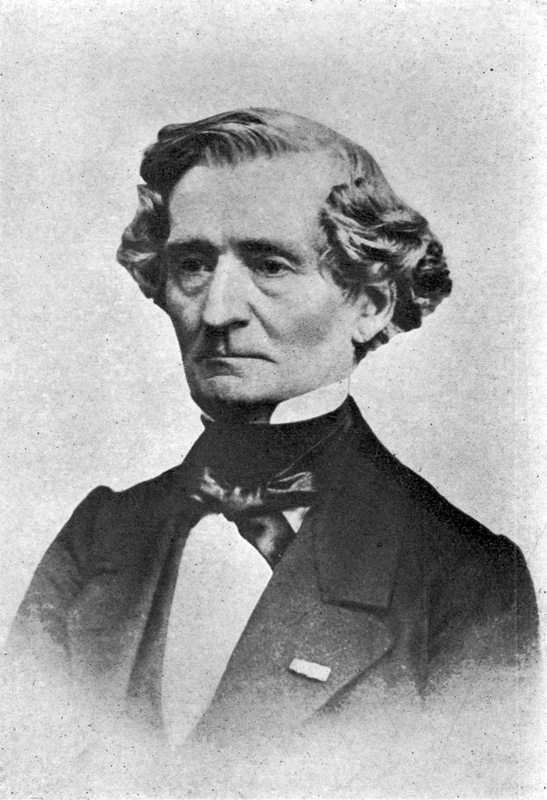
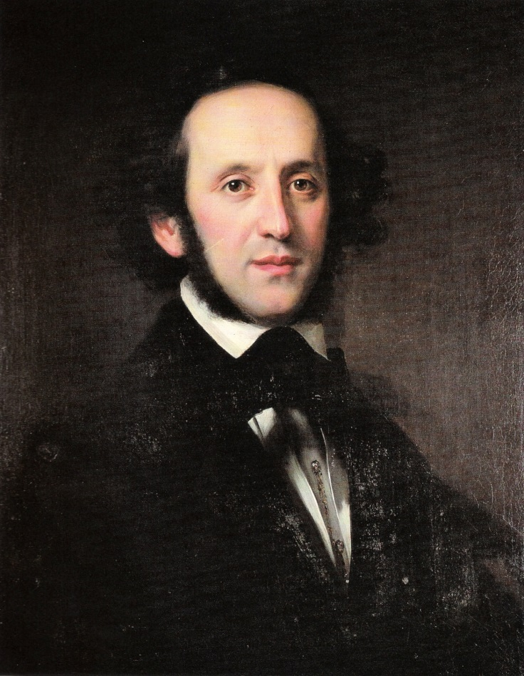
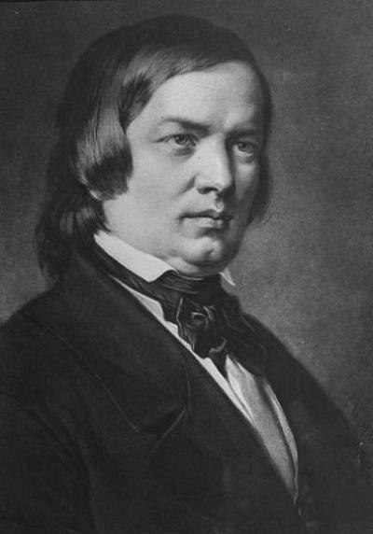
The Symphony, 1830-1876

Slide 2
The Crisis of the 1830s? The Great Age Now Gone?
Mozart 1791
Haydn 1809
Weber 1826
Beethoven 1827
Schubert 1828

Slide 3
The Crisis of the 1830s? The Great Age Now Gone?
Mozart 1791
Haydn 1809
Weber 1826
Beethoven 1827
Schubert 1828
Hegel 1831
Goethe 1832

Slide 4
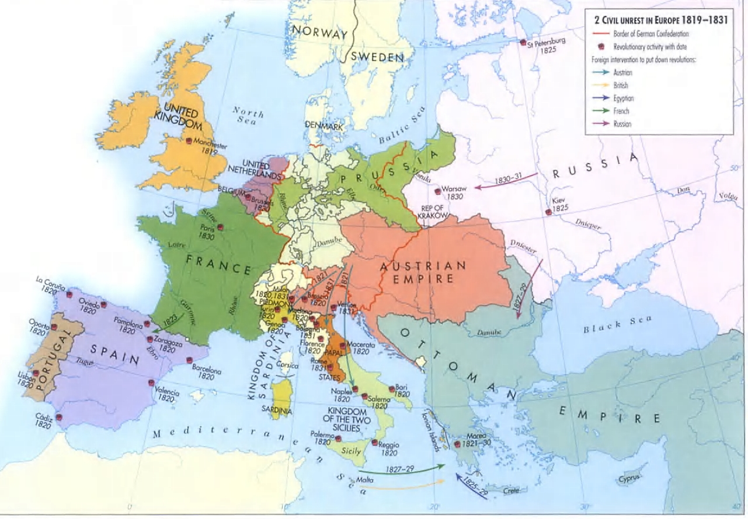
The 1830s: A New Age?; Italy and France Now Leading?

Slide 5
The 1830s: A New Age?; Italy and France Now Leading?
Solo-virtuoso showmanship

Slide 6
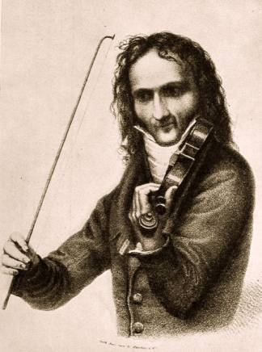
The 1830s: A New Age?; Italy and France Now Leading?
Solo-virtuoso showmanship
Nicolò Paganini

Slide 7
The 1830s: A New Age?; Italy and France Now Leading?
Solo-virtuoso showmanship
Nicolò Paganini
24 Caprices, op. 1 (1820)

Slide 8
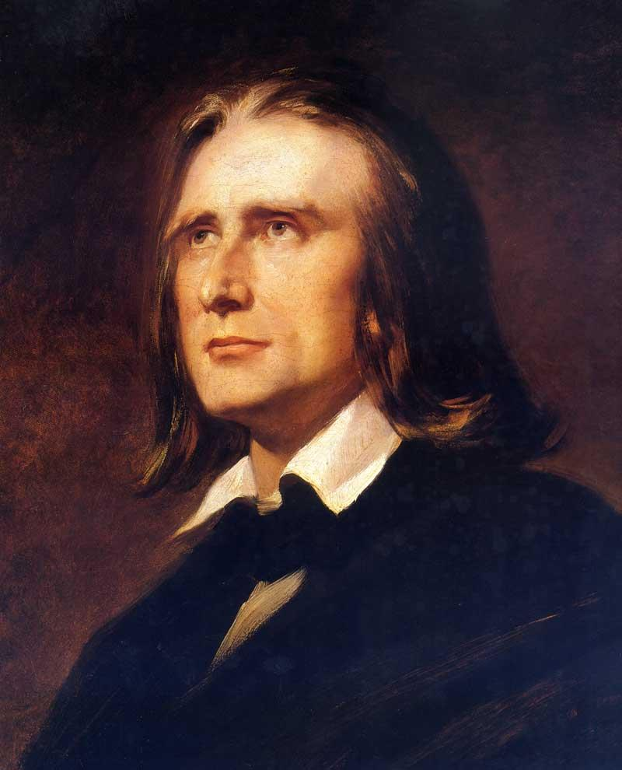
The 1830s: A New Age?; Italy and France Now Leading?
Solo-virtuoso showmanship
Nicolò Paganini
Franz Liszt

Slide 9
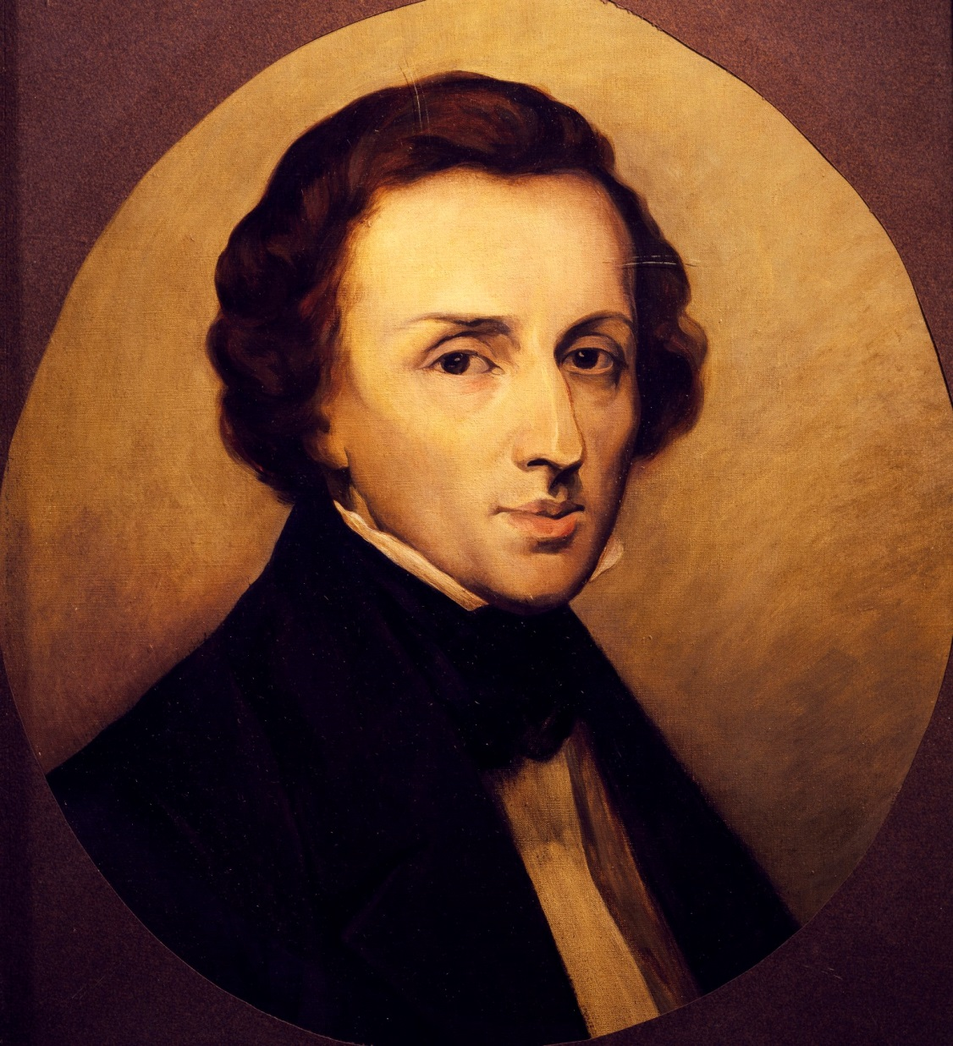
The 1830s: A New Age?; Italy and France Now Leading?
Solo-virtuoso showmanship
Nicolò Paganini
Franz Liszt
Fryderyk Chopin

Slide 10
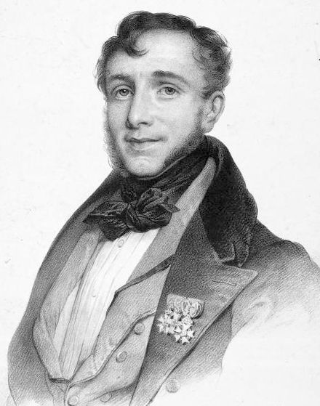
The 1830s: A New Age?; Italy and France Now Leading?
Solo-virtuoso showmanship
Nicolò Paganini
Franz Liszt
Fryderyk Chopin
Friedrich Kalkbrenner

Slide 11
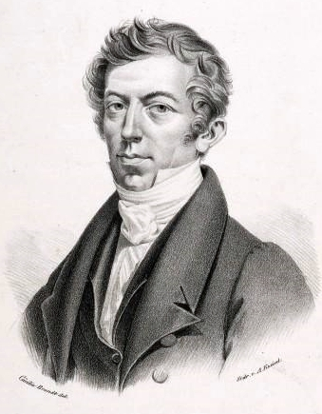
The 1830s: A New Age?; Italy and France Now Leading?
Solo-virtuoso showmanship
Nicolò Paganini
Franz Liszt
Fryderyk Chopin
Friedrich Kalkbrenner
Johann Peter Pixis

Slide 12
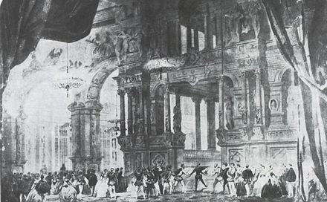
The 1830s: A New Age?; Italy and France Now Leading?
Solo-virtuoso showmanship
Nicolò Paganini
Franz Liszt
Fryderyk Chopin
Friedrich Kalkbrenner
Johann Peter Pixis
2. French “grand opera” (large-scale, 5-act spectacles; “big business”)

Slide 13
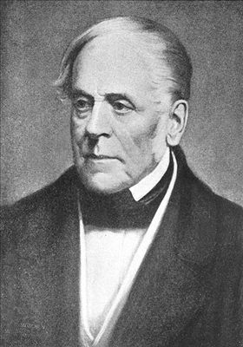
The 1830s: A New Age?; Italy and France Now Leading?
Solo-virtuoso showmanship
Nicolò Paganini
Franz Liszt
Fryderyk Chopin
Friedrich Kalkbrenner
Johann Peter Pixis
2. French “grand opera” (large-scale, 5-act spectacles; “big business”)
Daniel-Franҫois Auber, La muette de Portici (1828)

Slide 14
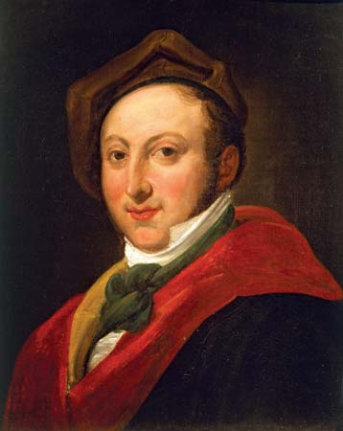
The 1830s: A New Age?; Italy and France Now Leading?
Solo-virtuoso showmanship
Nicolò Paganini
Franz Liszt
Fryderyk Chopin
Friedrich Kalkbrenner
Johann Peter Pixis
2. French “grand opera” (large-scale, 5-act spectacles; “big business”)
Daniel-Franҫois Auber, La muette de Portici (1828)
Gioachino Rossini, Guillaume Tell (1829)

Slide 15
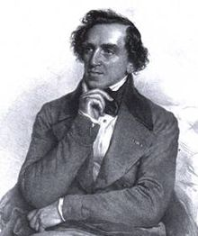
The 1830s: A New Age?; Italy and France Now Leading?
Solo-virtuoso showmanship
Nicolò Paganini
Franz Liszt
Fryderyk Chopin
Friedrich Kalkbrenner
Johann Peter Pixis
2. French “grand opera” (large-scale, 5-act spectacles; “big business”)
Daniel-Franҫois Auber, La muette de Portici (1828)
Gioachino Rossini, Guillaume Tell (1829)
Giacomo Meyerbeer, Robert le diable (1831),
Les huguenots (1836)

Slide 16
The 1830s: A New Age?; Italy and France Now Leading?
Solo-virtuoso showmanship
Nicolò Paganini
Franz Liszt
Fryderyk Chopin
Friedrich Kalkbrenner
Johann Peter Pixis
2. French “grand opera” (large-scale, 5-act spectacles; “big business”)
Huguenots: “Une dame, noble et sage”
(Cavatine du page)
Daniel-Franҫois Auber, La muette de Portici (1828)
Gioachino Rossini, Guillaume Tell (1829)
Giacomo Meyerbeer, Robert le diable (1831),
Les Huguenots (1836)

Slide 17
The 1830s: A New Age?; Italy and France Now Leading?
Solo-virtuoso showmanship
Nicolò Paganini
Franz Liszt
Fryderyk Chopin
Friedrich Kalkbrenner
Johann Peter Pixis
2. French “grand opera” (large-scale, 5-act spectacles; “big business”)
Daniel-Franҫois Auber, La muette de Portici (1828)
Gioachino Rossini, Guillaume Tell (1829)
Giacomo Meyerbeer, Robert le diable (1831),
Les huguenots (1836)
3. Italian “bel canto” opera of the 1830s

Slide 18
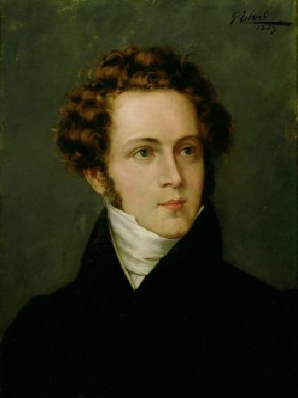
The 1830s: A New Age?; Italy and France Now Leading?
Solo-virtuoso showmanship
Nicolò Paganini
Franz Liszt
Fryderyk Chopin
Friedrich Kalkbrenner
Johann Peter Pixis
2. French “grand opera” (large-scale, 5-act spectacles; “big business”)
Daniel-Franҫois Auber, La muette de Portici (1828)
Gioachino Rossini, Guillaume Tell (1829)
Giacomo Meyerbeer, Robert le diable (1831),
Les huguenots (1836)
3. Italian “bel canto” opera of the 1830s
Vincenzo Bellini, I Capuleti e I Montecchi (1830),
La sonnambula (1831), Norma (1831)

Slide 19
The 1830s: A New Age?; Italy and France Now Leading?
Solo-virtuoso showmanship
Nicolò Paganini
Franz Liszt
Fryderyk Chopin
Friedrich Kalkbrenner
Johann Peter Pixis
2. French “grand opera” (large-scale, 5-act spectacles; “big business”)
Daniel-Franҫois Auber, La muette de Portici (1828)
Gioachino Rossini, Guillaume Tell (1829)
Giacomo Meyerbeer, Robert le diable (1831),
Les huguenots (1836)
3. Italian “bel canto” opera of the 1830s
Vincenzo Bellini, I Capuleti e I Montecchi (1830),
La sonnambula (1831), Norma (1831)
Sonnambula, Duet, “Scritti nel ciel”

Slide 20
The 1830s: A New Age?; Italy and France Now Leading?
Solo-virtuoso showmanship
Nicolò Paganini
Franz Liszt
Fryderyk Chopin
Friedrich Kalkbrenner
Johann Peter Pixis
2. French “grand opera” (large-scale, 5-act spectacles; “big business”)
Daniel-Franҫois Auber, La muette de Portici (1828)
Gioachino Rossini, Guillaume Tell (1829)
Giacomo Meyerbeer, Robert le diable (1831),
Les huguenots (1836)
3. Italian “bel canto” opera of the 1830s
Vincenzo Bellini, I Capuleti e I Montecchi (1830),
La sonnambula (1831), Norma (1831)
Sonnambula, Aria, “Ah, non credea mirarti”

Slide 21
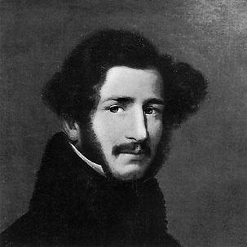
The 1830s: A New Age?; Italy and France Now Leading?
Solo-virtuoso showmanship
Nicolò Paganini
Franz Liszt
Fryderyk Chopin
Friedrich Kalkbrenner
Johann Peter Pixis
2. French “grand opera” (large-scale, 5-act spectacles; “big business”)
Daniel-Franҫois Auber, La muette de Portici (1828)
Gioachino Rossini, Guillaume Tell (1829)
Giacomo Meyerbeer, Robert le diable (1831),
Les huguenots (1836)
3. Italian “bel canto” opera of the 1830s
Vincenzo Bellini, I Capuleti e I Montecchi (1830),
La sonnambula (1831), Norma (1831)
Gaetano Donizetti, Anna Bolena (1830),
L’elisir d’amore (1832),
Lucia de Lammermoor (1835)

Slide 22
The 1830s: A New Age?; Italy and France Now Leading?
Solo-virtuoso showmanship
Nicolò Paganini
Franz Liszt
Fryderyk Chopin
Friedrich Kalkbrenner
Johann Peter Pixis
2. French “grand opera” (large-scale, 5-act spectacles; “big business”)
Daniel-Franҫois Auber, La muette de Portici (1828)
Gioachino Rossini, Guillaume Tell (1829)
Giacomo Meyerbeer, Robert le diable (1831),
Les huguenots (1836)
3. Italian “bel canto” opera of the 1830s
Vincenzo Bellini, I Capuleti e I Montecchi (1830),
La sonnambula (1831), Norma (1831)
Gaetano Donizetti, Anna Bolena (1830),
L’elisir d’amore (1832),
Lucia de Lammermoor (1835)
Sextet, “Chi me frena in tal momento”

Slide 23
Austro-Germanic Culture of the 1830s:
A Crisis of Continuation?

Slide 24
Austro-Germanic Culture of the 1830s:
A Crisis of Continuation?
Responses, New Developments:

Slide 25
Austro-Germanic Culture of the 1830s:
A Crisis of Continuation?
Responses, New Developments:
A new “historical” turn, intertwined with nationalism; recovery of past music

Slide 26
Austro-Germanic Culture of the 1830s:
A Crisis of Continuation?
Responses, New Developments:
A new “historical” turn, intertwined with nationalism; recovery of past music
Music “historicism”
Reaching back to explore and cherish a much-esteemed past

Slide 27
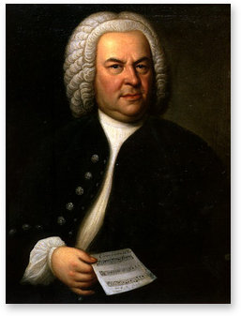
Austro-Germanic Culture of the 1830s:
A Crisis of Continuation?
Responses, New Developments:
A new “historical” turn, intertwined with nationalism; recovery of past music
Mendelssohn’s “discovery” and new premiere of Bach’s
St. Matthew Passion (Leipzig, 1829)

Slide 28
Austro-Germanic Culture of the 1830s:
A Crisis of Continuation?
Responses, New Developments:
A new “historical” turn, intertwined with nationalism; recovery of past music
Mendelssohn’s “discovery” and new premiere of Bach’s
St. Matthew Passion (Leipzig, 1829)
Mendelssohn’s “historicizing oratorios”: St. Paul (1836),
Elijah (1846)

Slide 29
Austro-Germanic Culture of the 1830s:
A Crisis of Continuation?
Responses, New Developments:
A new “historical” turn, intertwined with nationalism; recovery of past music
Mendelssohn’s “discovery” and new premiere of Bach’s
St. Matthew Passion (Leipzig, 1829)
Mendelssohn’s “historicizing oratorios”: St. Paul (1836),
Elijah (1846)
Mendelssohn’s six organ sonatas (1844-46)

Slide 30
Austro-Germanic Culture of the 1830s:
A Crisis of Continuation?
Responses, New Developments:
A new “historical” turn, intertwined with nationalism; recovery of past music
Mendelssohn’s “discovery” and new premiere of Bach’s
St. Matthew Passion (Leipzig, 1829)
Mendelssohn’s “historicizing oratorios”: St. Paul (1836),
Elijah (1846)
Mendelssohn’s six organ sonatas (1844-46)
All part of the “Romantic Baroque Revival”

Slide 31
Austro-Germanic Culture of the 1830s:
A Crisis of Continuation?
Responses, New Developments:
A new “historical” turn, intertwined with nationalism; recovery of past music
Emergence of institutionalized networks of support to sustain and perpetuate the art-music tradition:

Slide 32
Austro-Germanic Culture of the 1830s:
A Crisis of Continuation?
Responses, New Developments:
A new “historical” turn, intertwined with nationalism; recovery of past music
Emergence of institutionalized networks of support to sustain and perpetuate the art-music tradition:
More public concerts and the founding of more civic orchestras as matters of urban pride and historical memory

Slide 33
Austro-Germanic Culture of the 1830s:
A Crisis of Continuation?
Responses, New Developments:
A new “historical” turn, intertwined with nationalism; recovery of past music
Emergence of institutionalized networks of support to sustain and perpetuate the art-music tradition:
More public concerts and the founding of more civic orchestras as matters of urban pride and historical memory
More music criticism and commentary in the press (1824, A. B. Marx’s
Berliner allgemeine musikalische Zeitung; 1834, Schumann’s Neue Zeitschrift für Musik)

Slide 34
Austro-Germanic Culture of the 1830s:
A Crisis of Continuation?
Responses, New Developments:
A new “historical” turn, intertwined with nationalism; recovery of past music
Emergence of institutionalized networks of support to sustain and perpetuate the art-music tradition:
More public concerts and the founding of more civic orchestras as matters of urban pride and historical memory
More music criticism and commentary in the press (1824, A. B. Marx’s
Berliner allgemeine musikalische Zeitung; 1834, Schumann’s Neue Zeitschrift für Musik)
Music begins to be taught in universities (!): 1830, A.B. Marx, University of Berlin

Slide 35
Austro-Germanic Culture of the 1830s:
A Crisis of Continuation?
Responses, New Developments:
A new “historical” turn, intertwined with nationalism; recovery of past music
Emergence of institutionalized networks of support to sustain and perpetuate the art-music tradition:
More public concerts and the founding of more civic orchestras as matters of urban pride and historical memory
More music criticism and commentary in the press (1824, A. B. Marx’s
Berliner allgemeine musikalische Zeitung; 1834, Schumann’s Neue Zeitschrift für Musik)
Music begins to be taught in universities (!): 1830, A.B. Marx, University of Berlin
More conservatories are established to pass on the tradition (1843, Mendelssohn founds the Leipzig Conservatory)

Slide 36
Austro-Germanic Culture of the 1830s:
A Crisis of Continuation?
Responses, New Developments:
A new “historical” turn, intertwined with nationalism; recovery of past music
Emergence of institutionalized networks of support to sustain and perpetuate the art-music tradition:
More public concerts and the founding of more civic orchestras as matters of urban pride and historical memory
More music criticism and commentary in the press (1824, A. B. Marx’s
Berliner allgemeine musikalische Zeitung; 1834, Schumann’s Neue Zeitschrift für Musik)
Music begins to be taught in universities (!): 1830, A.B. Marx, University of Berlin
More conservatories are established to pass on the tradition (1843, Mendelssohn founds the Leipzig Conservatory)
Knowledge about music begins to be more systematized in histories and textbooks (Raphael Kiesewetter, A.B. Marx)—and in published “study scores”

Slide 37
Austro-Germanic Culture of the 1830s:
A Crisis of Continuation?
Responses, New Developments:
A new “historical” turn, intertwined with nationalism; recovery of past music
Emergence of institutionalized networks of support to sustain and perpetuate the art-music tradition:
More public concerts and the founding of more civic orchestras as matters of urban pride and historical memory
More music criticism and commentary in the press (1824, A. B. Marx’s
Berliner allgemeine musikalische Zeitung; 1834, Schumann’s Neue Zeitschrift für Musik)
Music begins to be taught in universities (!): 1830, A.B. Marx, University of Berlin
More conservatories are founded to pass on the tradition (1843, Mendelssohn founds
the Leipzig Conservatory)
Knowledge about music begins to be more systematized in histories and textbooks (Raphael Kiesewetter, A.B. Marx)—and in published “study scores”
New publication projects, critical editions of past masters (1851, founding of the
Bach Gesellschaft)

Slide 38
Austro-Germanic Culture of the 1830s:
A Crisis of Continuation?
Responses, New Developments:
A new “historical” turn, intertwined with nationalism; recovery of past music
Emergence of the liberal-humanist institution of art music to sustain and perpetuate the art-music tradition:
More public concerts and the founding of more civic orchestras as matters of urban pride and historical memory
More music criticism and commentary in the press (1824, A. B. Marx’s
Berliner allgemeine musikalische Zeitung; 1834, Schumann’s Neue Zeitschrift für Musik)
Music begins to be taught in universities (!): 1830, A.B. Marx, University of Berlin
More conservatories are established to pass on the tradition (1843, Mendelssohn founds the Leipzig Conservatory)
Knowledge about music begins to be more systematized in histories and textbooks (Raphael Kiesewetter, A.B. Marx)—and in published “study scores”
New publication projects, critical editions of past masters (1851, founding of the
Bach Gesellschaft)

Slide 39
Austro-Germanic Culture of the 1830s:
A Crisis of Continuation?
Responses, New Developments:
A new “historical” turn, intertwined with nationalism; recovery of past music
Emergence of the liberal-humanist institution of art music to sustain and perpetuate the art-music tradition
Composers: Since the standard forms and genres seem to be played out (or “routinized”), a new premium is put on compositional innovation. How best to continue the now-”old” tradition?

Slide 40
Austro-Germanic Culture of the 1830s:
A Crisis of Continuation?
Responses, New Developments:
A new “historical” turn, intertwined with nationalism; recovery of past music
Emergence of the liberal-humanist institution of art music to sustain and perpetuate the art-music tradition
Composers: Since the standard forms and genres seem to be played out (or “routinized”), a new premium is put on compositional innovation. How best to continue the now-”old” tradition? Thus: the problem of simultaneous conservation and innovation.

Slide 41
Austro-Germanic Culture of the 1830s:
A Crisis of Continuation?
Responses, New Developments:
A new “historical” turn, intertwined with nationalism; recovery of past music
Emergence of the liberal-humanist institution of art music to sustain and perpetuate the art-music tradition
Composers: Since the standard forms and genres seem to be played out (or “routinized”), a new premium is put on compositional innovation. How best to continue the now-”old” tradition? Thus: the problem of simultaneous conservation and innovation.
And who is faced with this problem? A new generation of composers, most of them born between 1809 and 1813:
Mendelssohn (1809)
Schumann (1810)
Liszt (1811)
Wagner (1813)

Slide 42
Austro-Germanic Culture of the 1830s:
A Crisis of Continuation?
Responses, New Developments:
A new “historical” turn, intertwined with nationalism; recovery of past music
Emergence of the liberal-humanist institution of art music to sustain and perpetuate the art-music tradition
Composers: Since the standard forms and genres seem to be played out (or “routinized”), a new premium is put on compositional innovation. How best to continue the now-”old” tradition? Thus: the problem of simultaneous conservation and innovation.
And who is faced with this problem? A new generation of composers, most of them born between 1809 and 1813:
Mendelssohn (1809)
Schumann (1810)
Liszt (1811)
Wagner (1813)
Berlioz (1803)
Chopin (1810)
Verdi (1813)

Slide 43
Austro-Germanic Culture of the 1830s:
A Crisis of Continuation?
Responses, New Developments:
A new “historical” turn, intertwined with nationalism; recovery of past music
Emergence of the liberal-humanist institution of art music to sustain and perpetuate the art-music tradition
Composers: Since the standard forms and genres seem to be played out (or “routinized”), a new premium is put on compositional innovation. How best to continue the now-”old” tradition?
Paradox:
On the one hand, the institution of art music is solidifying, crystallizing, seeking to expand and attract more listeners.

Slide 44
Austro-Germanic Culture of the 1830s:
A Crisis of Continuation?
Responses, New Developments:
A new “historical” turn, intertwined with nationalism; recovery of past music
Emergence of the liberal-humanist institution of art music to sustain and perpetuate the art-music tradition
Composers: Since the standard forms and genres seem to be played out (or “routinized”), a new premium is put on compositional innovation. How best to continue the now-”old” tradition?
Paradox:
On the one hand, the institution of art music is solidifying, crystallizing, seeking to expand and attract more listeners
On the other hand, Austro-Germanic musical composition and style is itself driven to become more difficult, more specialized, more innovative, more complex—because of the imperatives of history and the belief in “progress” (and thus destined to become increasingly autonomous, increasingly removed from concerns about audience)

Slide 45
Austro-Germanic Culture of the 1830s:
A Crisis of Continuation?
Responses, New Developments:
A new “historical” turn, intertwined with nationalism; recovery of past music
Emergence of the liberal-humanist institution of art music to sustain and perpetuate the art-music tradition
Composers: Since the standard forms and genres seem to be played out (or “routinized”), a new premium is put on compositional innovation. How best to continue the now-”old” tradition?
And who is faced with this problem? A new generation of composers, most of them born between 1809 and 1813:
Mendelssohn (1809)
Schumann (1810)
Liszt (1811)
Wagner (1813)
Berlioz (1803)
Chopin (1810)
Verdi (1813)

Slide 46
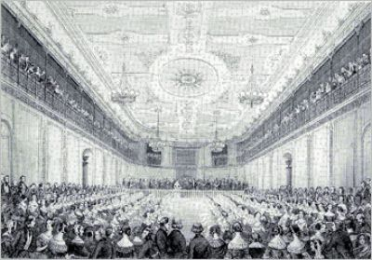
Whither the Symphony?
Leipzig Gewandhaus Concert Hall, pre-1850

Slide 47
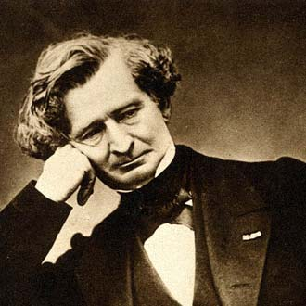
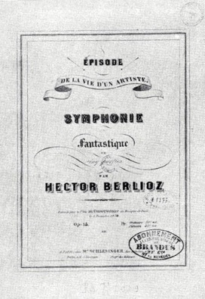
1830
Hector Berlioz (1803-1869)

Slide 48
1830
a “program symphony”
Hector Berlioz (1803-1869)

Slide 49
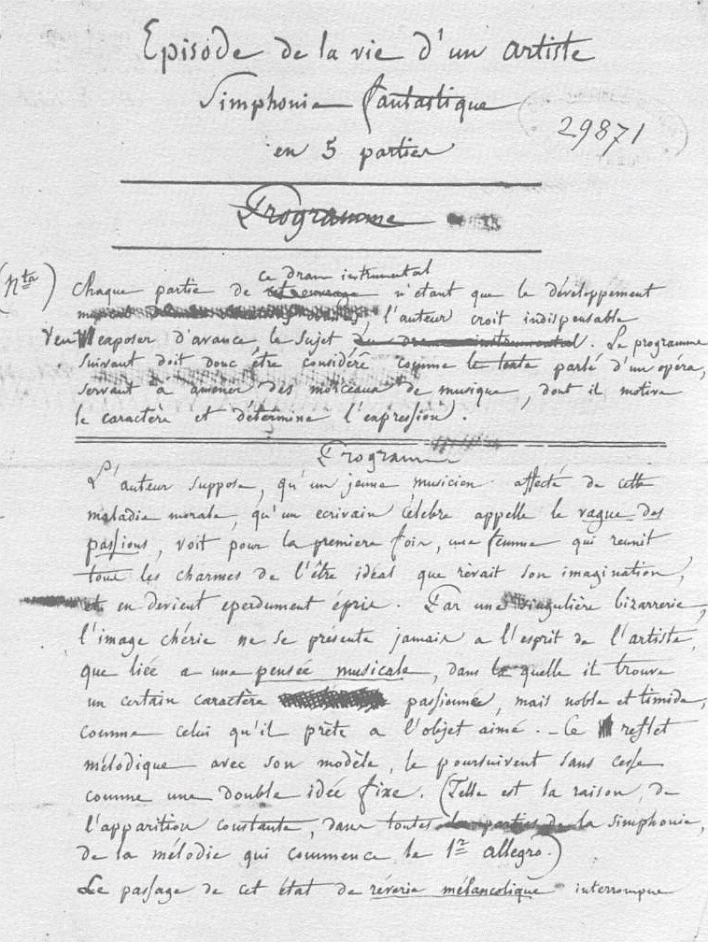
Hector Berlioz (1803-1869)
Draft of the
Symphonie fantastique program

Slide 50
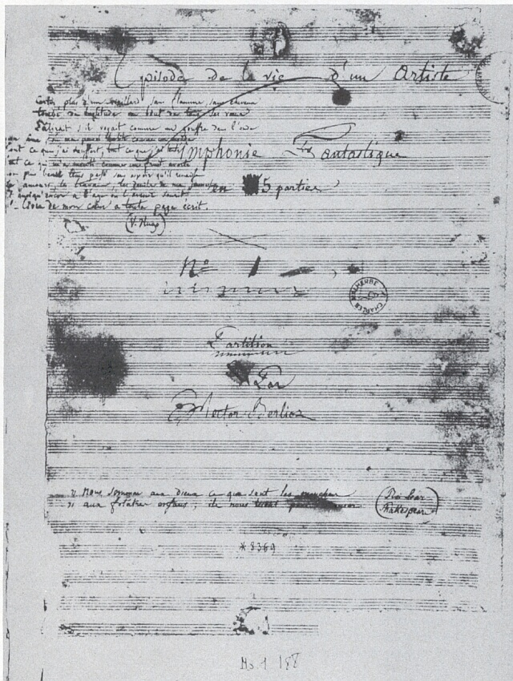
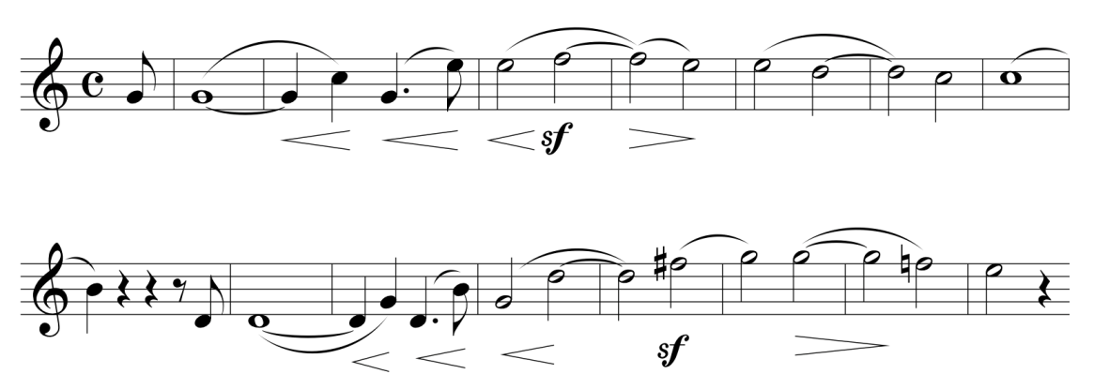
Central Structural Idea:
a recurring theme is identified with a specific personage or verbal concept, threading its way through different sonic environments
“Idée fixe”

Slide 51
Symphonie fantastique:
Episode in the Life of an Artist
Rêveries—Passions C
Un bal A
Scène aux champs F
Marche au supplice g
Songe d’une nuit du Sabbat c-C

Slide 52
Symphonie fantastique:
Episode in the Life of an Artist
Rêveries—Passions C
Un bal A
Scène aux champs F
Marche au supplice g
Songe d’une nuit du Sabbat c-C

Slide 53
Central Structural Idea:
a recurring theme is identified with a specific personage or verbal concept, threading its way through different sonic environments
“Idée fixe”

Slide 54
Symphonie fantastique:
Episode in the Life of an Artist
Rêveries—Passions C
Un bal A
Scène aux champs F
Marche au supplice g
Songe d’une nuit du Sabbat c-C
The aesthetic of the “imprévu”
(unforeseen turns and shocks)

Slide 55
Symphonie fantastique:
Episode in the Life of an Artist
Rêveries—Passions C
Un bal A
Scène aux champs F
Marche au supplice g
Songe d’une nuit du Sabbat c-C
The aesthetic of the “imprévu”
(unforeseen turns and shocks)

Slide 56
Symphonie fantastique:
Episode in the Life of an Artist
Rêveries—Passions C
Un bal A
Scène aux champs F
Marche au supplice g
Songe d’une nuit du Sabbat c-C
The aesthetic of the “imprévu”
(unforeseen turns and shocks)

Slide 57
Symphonie fantastique:
Episode in the Life of an Artist
Rêveries—Passions C
Un bal A
Scène aux champs F
Marche au supplice g
Songe d’une nuit du Sabbat c-C
The aesthetic of the “imprévu”
(unforeseen turns and shocks)

Slide 58
Symphonie fantastique:
Episode in the Life of an Artist
Rêveries—Passions C
Un bal A
Scène aux champs F
Marche au supplice g
Songe d’une nuit du Sabbat c-C
The aesthetic of the “imprévu”
(unforeseen turns and shocks)

Slide 59
Central Structural Idea:
a recurring theme is identified with a specific personage or verbal concept, threading its way through different sonic environments
“Idée fixe”

Slide 60
And in Germany (and Austria)? Crisis of Continuation?

Slide 61
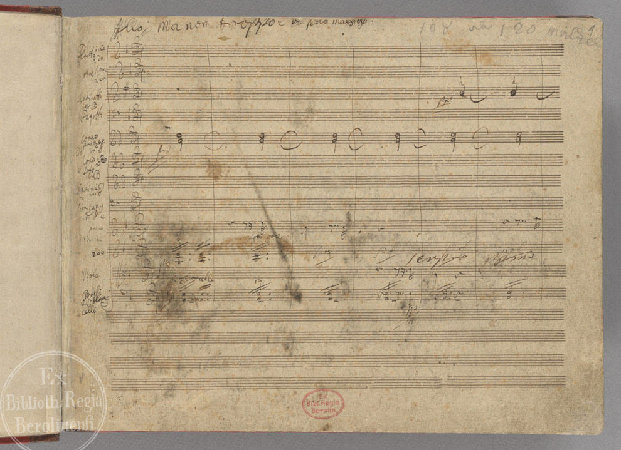
And in Germany (and Austria)? Crisis of Continuation?
Especially after Beethoven’s Ninth! What could follow that?

Slide 62
And in Germany (and Austria)? Crisis of Continuation?
1839: Discovery and performance of Schubert’s C-Major Symphony (No. 9, “Great”)

Slide 63
And in Germany (and Austria)? Crisis of Continuation?
1839: Discovery and performance of Schubert’s C-Major Symphony (No. 9, “Great”)
1840: Mendelssohn, Symphony No. 2, “Lobgesang”

Slide 64
And in Germany (and Austria)? Crisis of Continuation?
1839: Discovery and performance of Schubert’s C-Major Symphony (No. 9, “Great”)
1840: Mendelssohn, Symphony No. 2, “Lobgesang”
1841: Schumann, Symphony No. 1 (“Spring”); (and the first version of what would
become Symphony No. 4)

Slide 65
And in Germany (and Austria)? Crisis of Continuation?
1839: Discovery and performance of Schubert’s C-Major Symphony (No. 9, “Great”)
1840: Mendelssohn, Symphony No. 2, “Lobgesang”
1841: Schumann, Symphony No. 1 (“Spring”); (and the first version of what would
become Symphony No. 4)
1842: Mendelssohn, Symphony No. 3 (“Scottish”)

Slide 66
And in Germany (and Austria)? Crisis of Continuation?
1839: Discovery and performance of Schubert’s C-Major Symphony (No. 9, “Great”)
1840: Mendelssohn, Symphony No. 2, “Lobgesang”
1841: Schumann, Symphony No. 1 (“Spring”); (and the first version of what would
become Symphony No. 4)
1842: Mendelssohn, Symphony No. 3 (“Scottish”)
1846-51: Schumann Symphonies, 2, 3, and 4

Slide 67
And in Germany (and Austria)? Crisis of Continuation?
1839: Discovery and performance of Schubert’s C-Major Symphony (No. 9, “Great”)
1840: Mendelssohn, Symphony No. 2, “Lobgesang”
1841: Schumann, Symphony No. 1 (“Spring”); (and the first version of what would
become Symphony No. 4)
1842: Mendelssohn, Symphony No. 3 (“Scottish”)
1846-51: Schumann Symphonies, 2, 3, and 4
1851: Posthumous publication of Mendelssohn, Symphony No. 4 (“Italian”)

Slide 68
And in Germany (and Austria)? Crisis of Continuation?
1839: Discovery and performance of Schubert’s C-Major Symphony (No. 9, “Great”)
1840: Mendelssohn, Symphony No. 2, “Lobgesang”
1841: Schumann, Symphony No. 1 (“Spring”); (and the first version of what would
become Symphony No. 4)
1842: Mendelssohn, Symphony No. 3 (“Scottish”)
1846-51: Schumann Symphonies, 2, 3, and 4
1851: Posthumous publication of Mendelssohn, Symphony No. 4 (“Italian”)
----------------------------------------------

Slide 69
And in Germany (and Austria)? Crisis of Continuation?
1839: Discovery and performance of Schubert’s C-Major Symphony (No. 9, “Great”)
1840: Mendelssohn, Symphony No. 2, “Lobgesang”
1841: Schumann, Symphony No. 1 (“Spring”); (and the first version of what would
become Symphony No. 4)
1842: Mendelssohn, Symphony No. 3 (“Scottish”)
1846-51: Schumann Symphonies, 2, 3, and 4
1851: Posthumous publication of Mendelssohn, Symphony No. 4 (“Italian”)
----------------------------------------------
1867: Discovery and Publication of Schubert, Symphony No. 8 (“Unfinished”)!

Slide 70
And in Germany (and Austria)? Crisis of Continuation?
1839: Discovery and performance of Schubert’s C-Major Symphony (No. 9, “Great”)
1840: Mendelssohn, Symphony No. 2, “Lobgesang”
1841: Schumann, Symphony No. 1 (“Spring”); (and the first version of what would
become Symphony No. 4)
1842: Mendelssohn, Symphony No. 3 (“Scottish”)
1846-51: Schumann Symphonies, 2, 3, and 4
1851: Posthumous publication of Mendelssohn, Symphony No. 4 (“Italian”)
----------------------------------------------
1867: Discovery and Publication of Schubert, Symphony No. 8 (“Unfinished”)!
1868: Posthumous publication of Mendelssohn’s Symphony No. 5 (”Reformation”)

Slide 71
And in Germany (and Austria)? Crisis of Continuation?
1839: Discovery and performance of Schubert’s C-Major Symphony (No. 9, “Great”)
1840: Mendelssohn, Symphony No. 2, “Lobgesang”
1841: Schumann, Symphony No. 1 (“Spring”); (and the first version of what would
become Symphony No. 4)
1842: Mendelssohn, Symphony No. 3 (“Scottish”)
1846-51: Schumann Symphonies, 2, 3, and 4
1851: Posthumous publication of Mendelssohn, Symphony No. 4 (“Italian”)
----------------------------------------------
1867: Discovery and Publication of Schubert, Symphony No. 8 (“Unfinished”)!
1868: Posthumous publication of Mendelssohn’s Symphony No. 5 (”Reformation”)
1868-70: Bruch, Symphonies 1 and 2

Slide 72
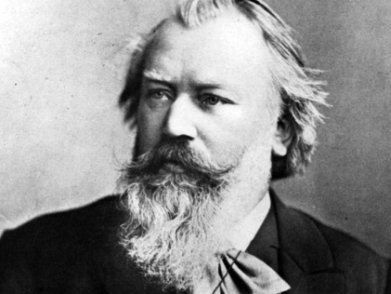
And in Germany (and Austria)? Crisis of Continuation?
1839: Discovery and performance of Schubert’s C-Major Symphony (No. 9, “Great”)
1840: Mendelssohn, Symphony No. 2, “Lobgesang”
1841: Schumann, Symphony No. 1 (“Spring”); (and the first version of what would
become Symphony No. 4)
1842: Mendelssohn, Symphony No. 3 (“Scottish”)
1846-51: Schumann Symphonies, 2, 3, and 4
1851: Posthumous publication of Mendelssohn, Symphony No. 4 (“Italian”)
----------------------------------------------
1867: Discovery and Publication of Schubert, Symphony No. 8 (“Unfinished”)!
1868: Posthumous publication of Mendelssohn’s Symphony No. 5 (”Reformation”)
1868-70: Bruch, Symphonies 1 and 2
1876: Brahms!!! Symphony No. 1

