Slide 1
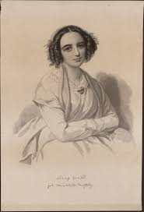
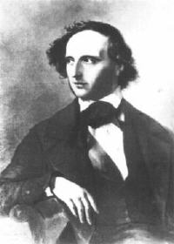
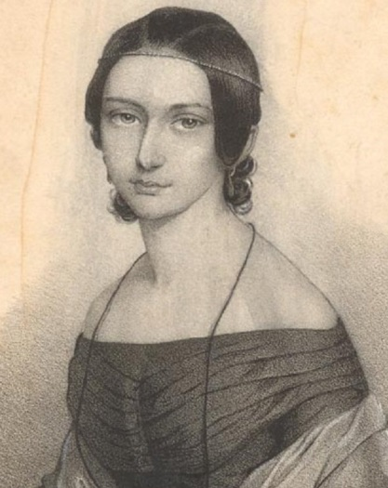
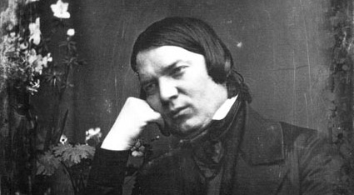
Mendelssohns and Schumanns

Slide 2
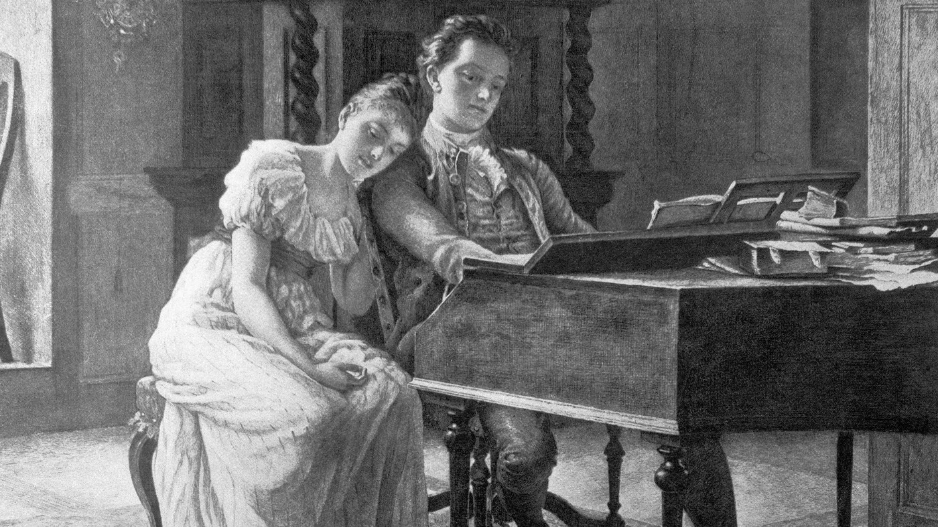
Issue 1: Music, Composition, and Gender

Slide 3
Division of the Experiential Totality into Two Non-Intersecting Worlds
Everyday World
Enlightenment, secular rationality
Emerging world of commerce, industry, the marketplace, the ordinary
Hemmed in by the natural limits of reason
Non-emancipatory (non-redemptive), as in shallow, commonplace life:
Business transactions
“Objective” scientific inquiry & analysis
Practical functioning of government
Commercialized art/Kitsch
Methodical systems of explanation (including systems “analyzing” art)
Indifference to the spiritual
“Public opinion”
Blind acceptance of tradition
Etc.
Idealized, Spiritual World
“Anti-rational” or “trans (or pre-) rational”
“Existential” truth in otherness from the ordinary: healing spaces, private spaces
Transcendent claims: ineffable access beyond the limits of language and reason
Emancipatory (redemptive), with clearly understood sheltering spaces:
New modes of religion
Art, literature, music (the “mystery” of sound)
Nature (as spiritual)
Folk-soul/ethnicity/nation
Domestic life: woman (the feminine), child
Men (the masculine) as priestlike, disclosers of otherwise unutterable truths
Preservation of the great artworks
The pre-modern past (pre-Enlightenment)
The macabre, grotesque

Slide 4
Division of the Experiential Totality into Two Non-Intersecting Worlds
Everyday World
Enlightenment, secular rationality
Emerging world of commerce, industry, the marketplace, the ordinary
Hemmed in by the natural limits of reason
Non-emancipatory (non-redemptive), as in shallow, commonplace life:
Business transactions
“Objective” scientific inquiry & analysis
Practical functioning of government
Commercialized art/Kitsch
Methodical systems of explanation (including systems “analyzing” art)
Indifference to the spiritual
“Public opinion”
Blind acceptance of tradition
Etc.
Idealized, Spiritual World
“Anti-rational” or “trans (or pre-) rational”
“Existential” truth in otherness from the ordinary: healing spaces, private spaces
Transcendent claims: ineffable access beyond the limits of language and reason
Emancipatory (redemptive), with clearly understood sheltering spaces:
New modes of religion
Art, literature, music (the “mystery” of sound)
Nature (as spiritual)
Folk-soul/ethnicity/nation
Domestic life: woman (the feminine), child
Men (the masculine) as priestlike, disclosers of otherwise unutterable truths
Preservation of the great artworks
The pre-modern past (pre-Enlightenment)
The macabre, grotesque

Slide 5
The Nineteenth-Century “Ideology of Separate Spheres”
Feminine
the private, domestic sphere:
children, religion, morality
Masculine
The public sphere:
business; politics

Slide 6
The Gendering of Musical Genres
Masculine: orchestral works; chamber works; sonatas; operas, oratorios; etc.
Feminine: short piano pieces and Lieder, suitable for domestic performance, especially by women, e.g., in salons or home gatherings

Slide 7
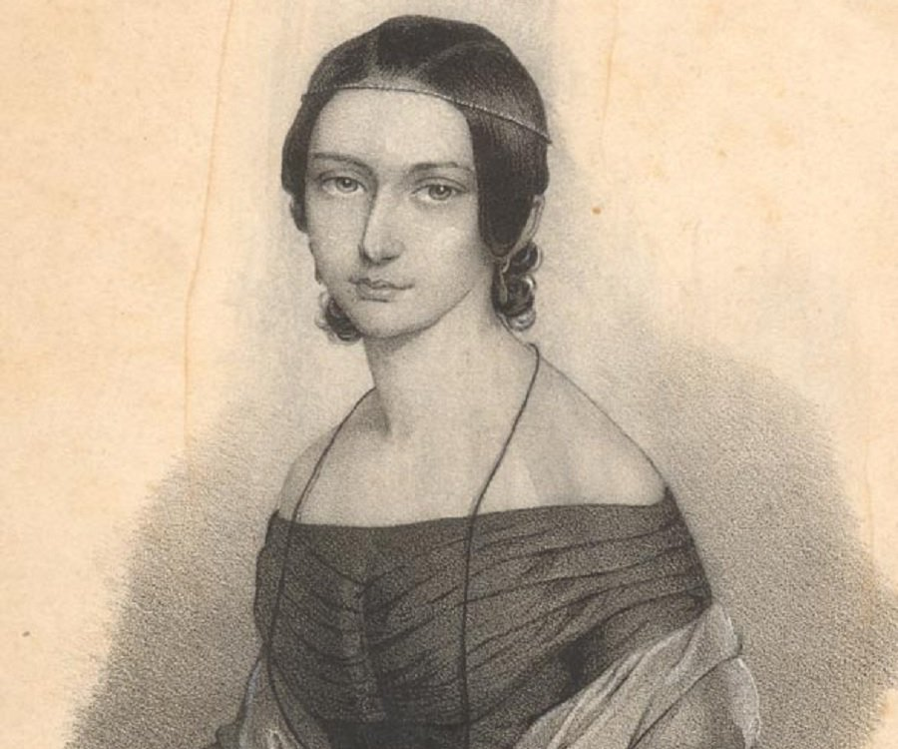
Fanny Mendelssohn Hensel (1805-47) Clara Wieck Schumann (1819-96) Josephine Lang (1815-80)

Slide 8
Fanny Mendelssohn Hensel (1805-47) Clara Wieck Schumann (1819-96) Josephine Lang (1815-80)
“September” from Das Jahr
(1846)

Slide 9
Fanny Mendelssohn Hensel (1805-47) Clara Wieck Schumann (1819-96) Josephine Lang (1815-80)
“Un poco agitato”
from Pièces fugitives
(1841-45)

Slide 10
Issue 2: What is “German?”

Slide 11
Issue 2: What is “German?”
or: Who is “German?”

Slide 12
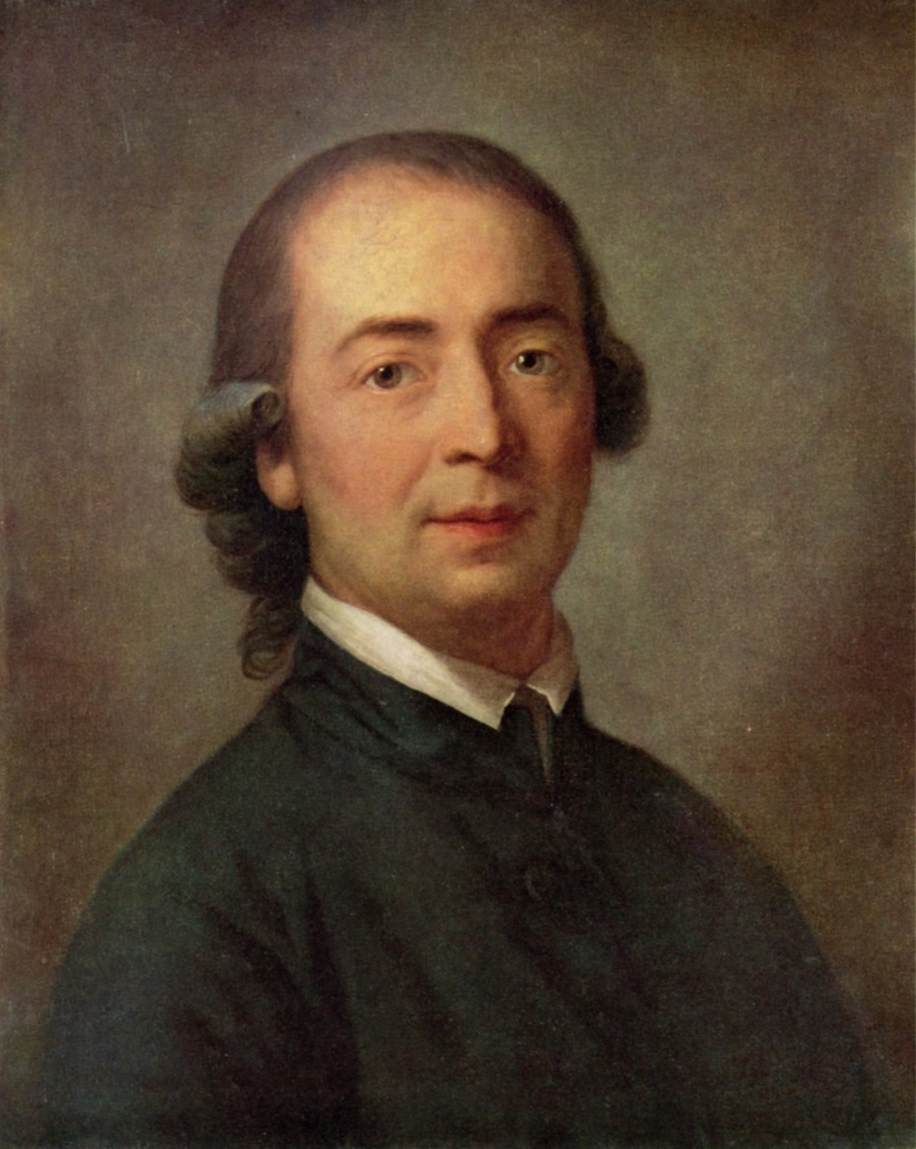
On the Origin of Language (1772)
Basis of consciousness: language
Language: a social and historical phenomenon
Different places with different histories produce different languages, different ways of thinking
Volk: the language-group to which we belong
Volksgeist: the spirit or character shared by those within a
language-group
Captured in grammatical structure,
pre-modern folk tales, folk songs, etc.
Johann Gottfried Herder (1744-1803)

Slide 13
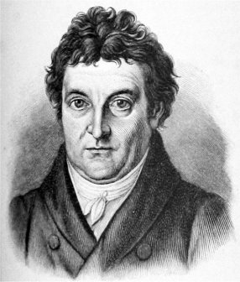
Address “To the German Nation” (1806)
“Those who speak the same language are joined to each other by a multitude of invisible bonds by nature herself, long before any human art begins. They clearly belong together and are by nature one and an inseparable whole. Such a whole, if it wishes to absorb and mingle with itself any other people of different descent and language, cannot do so without itself becoming confused, in the beginning at any rate, and violently disturbing the even progress of its culture. . . . “
“The German nation [is] united within itself by a common language and a common way of thinking, and sharply enough severed from the other peoples—in the middle of Europe, as a wall to divide races not akin. . . .”
Johann Gottlieb Fichte (1762-1814)

Slide 14
Address “To the German Nation” (1806)
“Those who speak the same language are joined to each other by a multitude of invisible bonds by nature herself, long before any human art begins. They clearly belong together and are by nature one and an inseparable whole. Such a whole, if it wishes to absorb and mingle with itself any other people of different descent and language, cannot do so without itself becoming confused, in the beginning at any rate, and violently disturbing the even progress of its culture. . . . “
“The German nation [is] united within itself by a common language and a common way of thinking, and sharply enough severed from the other peoples—in the middle of Europe, as a wall to divide races not akin. . . .”
Johann Gottlieb Fichte (1762-1814)

Slide 15
Address “To the German Nation” (1806)
“Those who speak the same language are joined to each other by a multitude of invisible bonds by nature herself, long before any human art begins. They clearly belong together and are by nature one and an inseparable whole. Such a whole, if it wishes to absorb and mingle with itself any other people of different descent and language, cannot do so without itself becoming confused, in the beginning at any rate, and violently disturbing the even progress of its culture. . . . “
“The German nation [is] united within itself by a common language and a common way of thinking, and sharply enough severed from the other peoples—in the middle of Europe, as a wall to divide races not akin. . . .”
Johann Gottlieb Fichte (1762-1814)

Slide 16
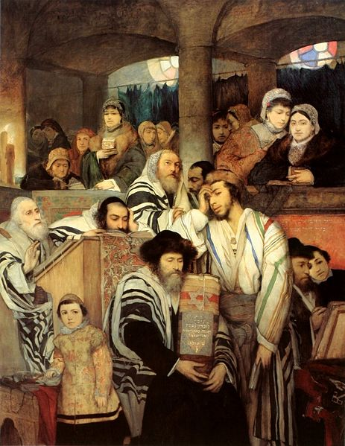
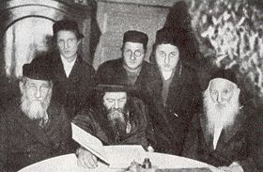
Ashkenazim in Germanic Lands

Slide 17
Address “To the German Nation” (1806)
“Those who speak the same language are joined to each other by a multitude of invisible bonds by nature herself, long before any human art begins. They clearly belong together and are by nature one and an inseparable whole. Such a whole, if it wishes to absorb and mingle with itself any other people of different descent and language, cannot do so without itself becoming confused, in the beginning at any rate, and violently disturbing the even progress of its culture. . . . “
“The German nation [is] united within itself by a common language and a common way of thinking, and sharply enough severed from the other peoples—in the middle of Europe, as a wall to divide races not akin. . . .”
Johann Gottlieb Fichte (1762-1814)

Slide 18
Ashkenazim in Germanic Lands
Address
“To the German Nation” (1806)
“Those who speak the same language are joined to each other by a multitude of invisible bonds by nature herself, long before any human art begins. They clearly belong together and are by nature one and an inseparable whole. Such a whole, if it wishes to absorb and mingle with itself any other people of different descent and language, cannot do so without itself becoming confused, in the beginning at any rate, and violently disturbing the even progress of its culture. . . . “
“The German nation [is] united within itself by a common language and a common way of thinking, and sharply enough severed from the other peoples—in the middle of Europe, as a wall to divide races not akin. . . .”

Slide 19
Ashkenazim in Germanic Lands
Assimilation/Emancipation Process Begins, Later 18th Century

Slide 20
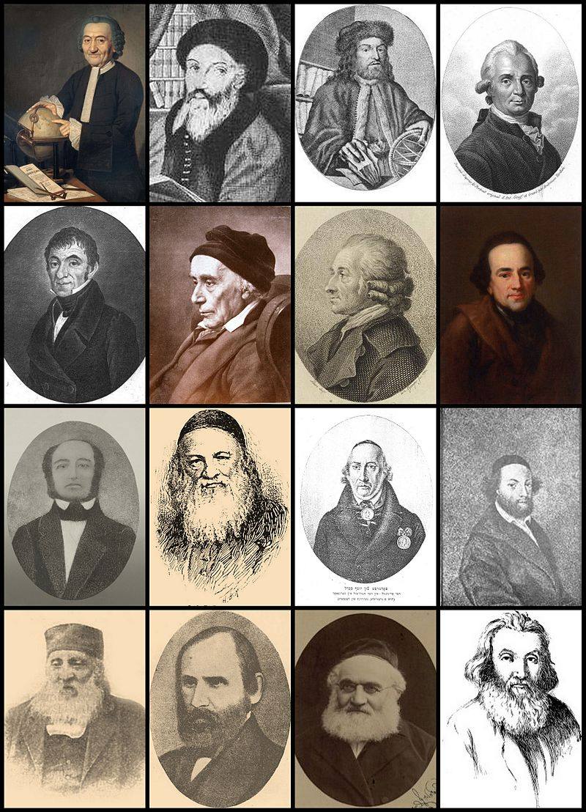
Haskalah movement (1770s-early 19th-C
(the “Jewish Enlightenment”)
1st Row, proto-Maskilim: Raphael Levi Hannover • Solomon Dubno • Tobias Cohn • Marcus Elieser Bloch 2nd Row, Berlin Haskalah: Salomon Jacob Cohen • David Friedländer • Hartwig Wessely • Moses Mendelssohn 3rd Row, Austria and Galicia: Judah Löb Mieses • Solomon Judah Loeb Rapoport • Joseph Perl • Baruch Jeitteles 4th Row, Russia: Avrom Ber Gotlober • Abraham Mapu • Samuel Joseph Fuenn • Isaac Baer Levinsohn

Slide 21
Haskalah movement (1770s-early 19th-C
(the “Jewish Enlightenment”)
Reformist, intellectual, aesthetic
1st Row, proto-Maskilim: Raphael Levi Hannover • Solomon Dubno • Tobias Cohn • Marcus Elieser Bloch 2nd Row, Berlin Haskalah: Salomon Jacob Cohen • David Friedländer • Hartwig Wessely • Moses Mendelssohn 3rd Row, Austria and Galicia: Judah Löb Mieses • Solomon Judah Loeb Rapoport • Joseph Perl • Baruch Jeitteles 4th Row, Russia: Avrom Ber Gotlober • Abraham Mapu • Samuel Joseph Fuenn • Isaac Baer Levinsohn

Slide 22
Haskalah movement (1770s-early 19th-C
(the “Jewish Enlightenment”)
Reformist, intellectual, aesthetic
Rejection of ethnic self-segregation in dress, and manner: instead, build bridges of assimilation into Prussian intellectual/artistic society—via literature, music, and social attainment
1st Row, proto-Maskilim: Raphael Levi Hannover • Solomon Dubno • Tobias Cohn • Marcus Elieser Bloch 2nd Row, Berlin Haskalah: Salomon Jacob Cohen • David Friedländer • Hartwig Wessely • Moses Mendelssohn 3rd Row, Austria and Galicia: Judah Löb Mieses • Solomon Judah Loeb Rapoport • Joseph Perl • Baruch Jeitteles 4th Row, Russia: Avrom Ber Gotlober • Abraham Mapu • Samuel Joseph Fuenn • Isaac Baer Levinsohn

Slide 23
Haskalah movement (1770s-early 19th-C
(the “Jewish Enlightenment”)
Reformist, intellectual, aesthetic
Rejection of ethnic self-segregation in dress, and manner: instead, build bridges of assimilation into Prussian intellectual/artistic society—via literature, music, and social attainment
Linguistic purification: 1) advocate a purer Hebrew (not Yiddish); and
2) enter fluently into German-speaking
culture
1st Row, proto-Maskilim: Raphael Levi Hannover • Solomon Dubno • Tobias Cohn • Marcus Elieser Bloch 2nd Row, Berlin Haskalah: Salomon Jacob Cohen • David Friedländer • Hartwig Wessely • Moses Mendelssohn 3rd Row, Austria and Galicia: Judah Löb Mieses • Solomon Judah Loeb Rapoport • Joseph Perl • Baruch Jeitteles 4th Row, Russia: Avrom Ber Gotlober • Abraham Mapu • Samuel Joseph Fuenn • Isaac Baer Levinsohn

Slide 24
Haskalah movement (1770s-early 19th-C
(the “Jewish Enlightenment”)
Reformist, intellectual, aesthetic
Rejection of ethnic self-segregation in dress, and manner: instead, build bridges of assimilation into Prussian intellectual/artistic society—via literature, music, and social attainment
Linguistic purification: 1) advocate a purer Hebrew (not Yiddish); and
2) enter fluently into German-speaking
culture
In this sense, some advocated that they “become German”
1st Row, proto-Maskilim: Raphael Levi Hannover • Solomon Dubno • Tobias Cohn • Marcus Elieser Bloch 2nd Row, Berlin Haskalah: Salomon Jacob Cohen • David Friedländer • Hartwig Wessely • Moses Mendelssohn 3rd Row, Austria and Galicia: Judah Löb Mieses • Solomon Judah Loeb Rapoport • Joseph Perl • Baruch Jeitteles 4th Row, Russia: Avrom Ber Gotlober • Abraham Mapu • Samuel Joseph Fuenn • Isaac Baer Levinsohn

Slide 25
Haskalah movement (1770s-early 19th-C
(the “Jewish Enlightenment”)
Reformist, intellectual, aesthetic
Rejection of ethnic self-segregation in dress, and manner: instead, build bridges of assimilation into Prussian intellectual/artistic society—via literature, music, and social attainment
Linguistic purification: 1) advocate a purer Hebrew (not Yiddish); and
2) enter fluently into German-speaking
culture
In this sense, some advocated that they “become German”
1st Row, proto-Maskilim: Raphael Levi Hannover • Solomon Dubno • Tobias Cohn • Marcus Elieser Bloch 2nd Row, Berlin Haskalah: Salomon Jacob Cohen • David Friedländer • Hartwig Wessely • Moses Mendelssohn 3rd Row, Austria and Galicia: Judah Löb Mieses • Solomon Judah Loeb Rapoport • Joseph Perl • Baruch Jeitteles 4th Row, Russia: Avrom Ber Gotlober • Abraham Mapu • Samuel Joseph Fuenn • Isaac Baer Levinsohn

Slide 26
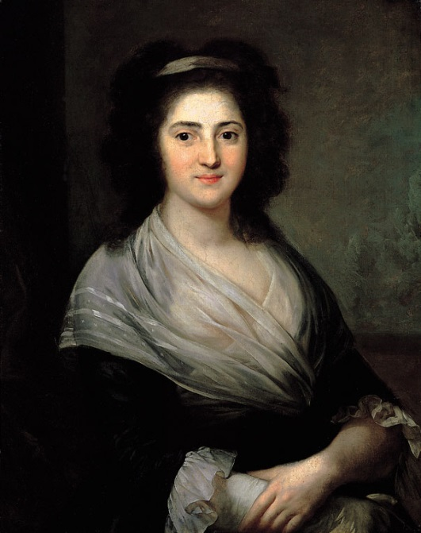
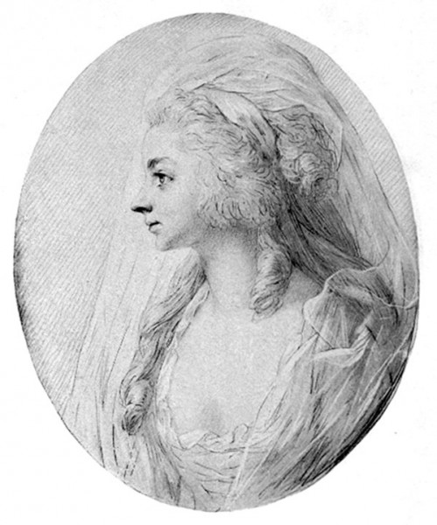
Jewish Assimilation to German Elite-Culture Bourgeoisie,
Berlin, late 18th Century, Early 19th Century
Henriette Herz Sara Levy
Literary Salon Musical Salon

Slide 27
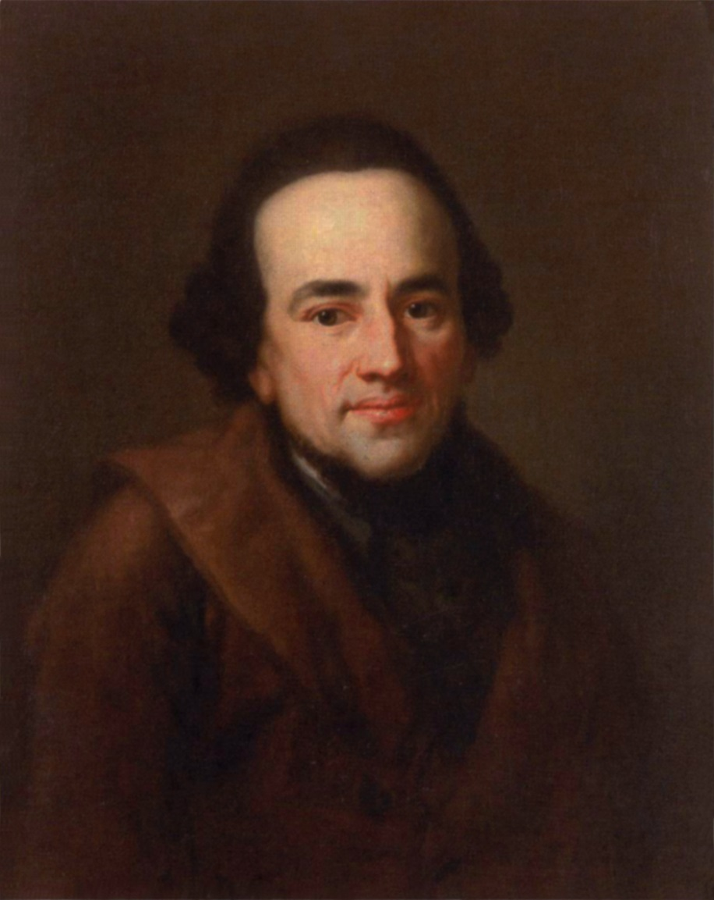
One of the leading figures of the Prussian haskalah, 1770s, 1780s; advocated emancipation of the Jews and religious toleration; bridge-builder
Moses Mendelssohn (1729–1786)
Enlightenment Philosopher, Berlin

Slide 28
One of the leading figures of the Prussian haskalah, 1770s, 1780s; advocated emancipation of the Jews and religious toleration; bridge-builder
Studies in both Biblical Hebrew and current German philosophy
Moses Mendelssohn (1729–1786)
Enlightenment Philosopher, Berlin

Slide 29
One of the leading figures of the Prussian haskalah, 1770s, 1780s; advocated emancipation of the Jews and religious toleration; bridge-builder
Studies in both Biblical Hebrew and current German philosophy
Translated portions of the Hebrew Bible into German, with commentary
Moses Mendelssohn (1729–1786)
Enlightenment Philosopher, Berlin

Slide 30
One of the leading figures of the Prussian haskalah, 1770s, 1780s; advocated emancipation of the Jews and religious toleration; bridge-builder
Studies in both Biblical Hebrew and current German philosophy
Translated portions of the Hebrew Bible into German, with commentary
Widely known, famous, influential:
friend of Gottholt Ephraim Lessing
and an acquaintance of CPE Bach
Moses Mendelssohn (1729–1786)
Enlightenment Philosopher, Berlin

Slide 31
One of the leading figures of the Prussian haskalah, 1770s, 1780s; advocated emancipation of the Jews and religious toleration; bridge-builder
Studies in both Biblical Hebrew and current German philosophy
Translated portions of the Hebrew Bible into German, with commentary
Widely known, famous, influential:
friend of Gottholt Ephraim Lessing
and an acquaintance of CPE Bach
Important treatise on aesthetics and the sublime—including comments on music
Moses Mendelssohn (1729–1786)
Enlightenment Philosopher, Berlin

Slide 32
Born in Dessau
Father’s last name was Mendel
Original name: Moses ben Mendel Dessau
Change of name to “Mendelssohn” to enhance the process of assimilation and acceptance
Moses Mendelssohn (1729–1786)
Enlightenment Philosopher, Berlin

Slide 33
Born in Dessau
Father’s last name was Mendel
Original name: Moses ben Mendel Dessau
Change of name to “Mendelssohn” to enhance the process of assimilation and acceptance
Moses Mendelssohn (1729–1786)
Enlightenment Philosopher, Berlin

Slide 34
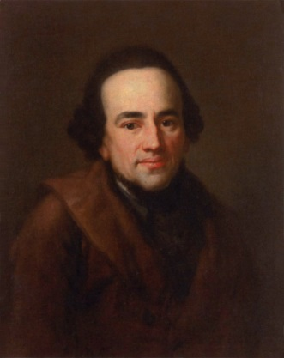
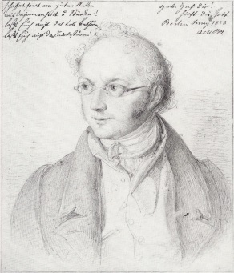
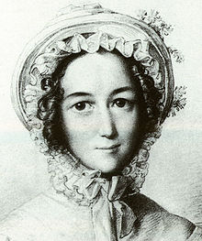
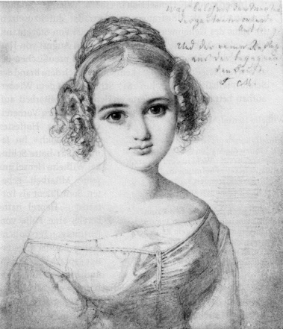
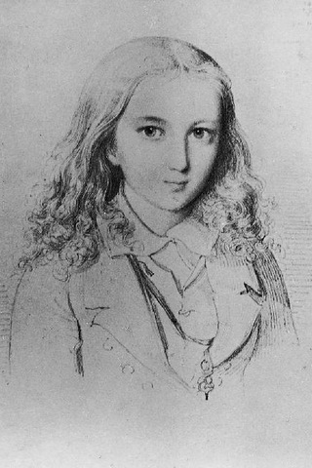
Moses Mendelssohn (1729–1786)
Abraham Mendelssohn (1776–1835)
Lea Salomon Mendelssohn (1777–1842)
Fanny Mendelssohn (1805-1847)
Felix Mendelssohn (1809–1847)

Slide 35
Moses Mendelssohn (1729–1786)
Abraham Mendelssohn (1776–1835)
Lea Salomon Mendelssohn (1777–1842)
Baptized, 1816
Fanny Mendelssohn (1805-1847)
Felix Mendelssohn (1809–1847)

Slide 36
Moses Mendelssohn (1729–1786)
Converted, 1822
Abraham Mendelssohn Bartholdy (1776–1835)
Lea Salomon Bartholdy (1777–1842)
Baptized, 1816
Fanny Mendelssohn (1805-1847)
Felix Mendelssohn (1809–1847)

Slide 37
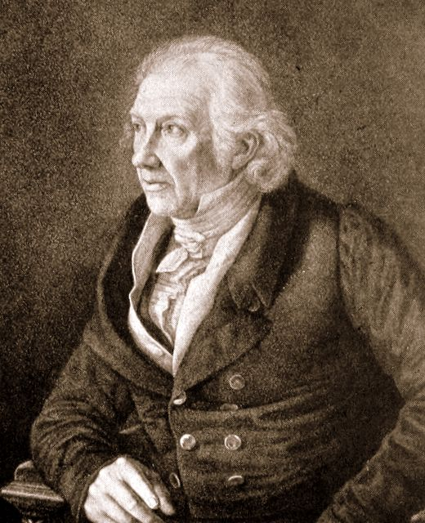
By 1819 : Music-Theoretical Instruction
Harmony
Counterpoint
Chorale
Fugue
Fanny Mendelssohn (1805-1847)
Carl Friedrich Zelter (1758-1832)
Felix Mendelssohn (1809–1847)

Slide 38
Moses Mendelssohn (1729–1786)
Abraham Mendelssohn Bartholdy (1776–1835)
Lea Salomon Bartholdy (1777–1842)
Advice, 1820:
Music as a possible “profession”
Fanny Mendelssohn (1805-1847)
Felix Mendelssohn (1809–1847)

Slide 39
Moses Mendelssohn (1729–1786)
Abraham Mendelssohn Bartholdy (1776–1835)
Lea Salomon Bartholdy (1777–1842)
Advice, 1820:
Music as “ornament”
Fanny Mendelssohn (1805-1847)
Felix Mendelssohn (1809–1847)

Slide 40
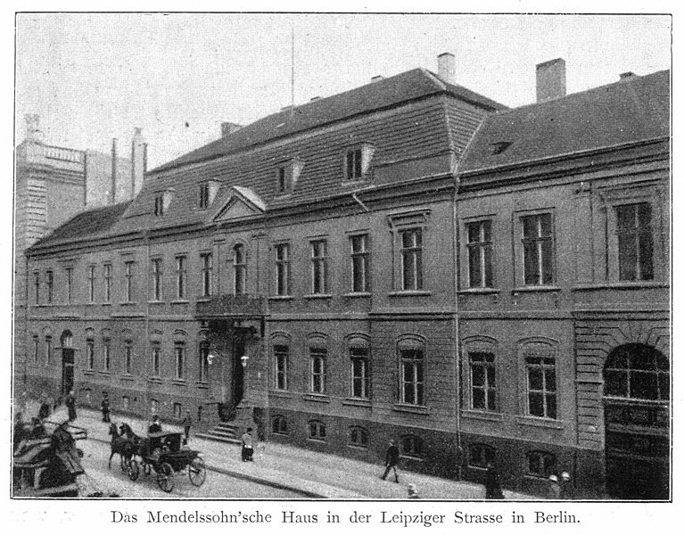
1825: family move to palatial residence, 3 Leipziger Strasse

Slide 41
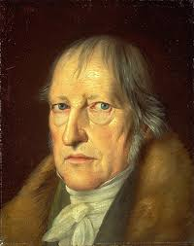
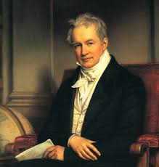
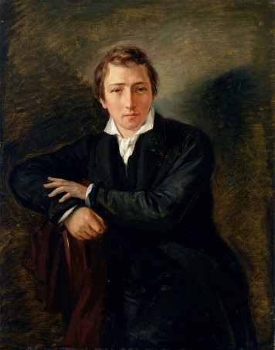
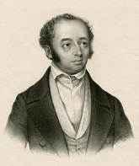
1825: family move to palatial residence, 3 Leipziger Strasse
Hegel Humboldt Heine A.B. Marx

Slide 42
Fanny Mendelssohn (1805-1847)
Abraham Mendelssohn Bartholdy (1776–1835)
Abraham Mendelssohn, letter to Fanny Mendelssohn, on her birthday, 1828
“You must become more steady and collected, and prepare more earnestly and eagerly for your real calling, the only calling of a young woman: I mean the state of a housewife. . . . The appreciation of every moment and its improvement for some benefit or other—all these and more . . . are the weighty duties of a woman.”

Slide 43
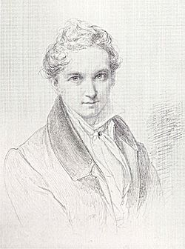
Marriage: 1829
Fanny Mendelssohn Hensel (1805-1847)
Wilhelm Hensel (1794-1861)

Slide 44
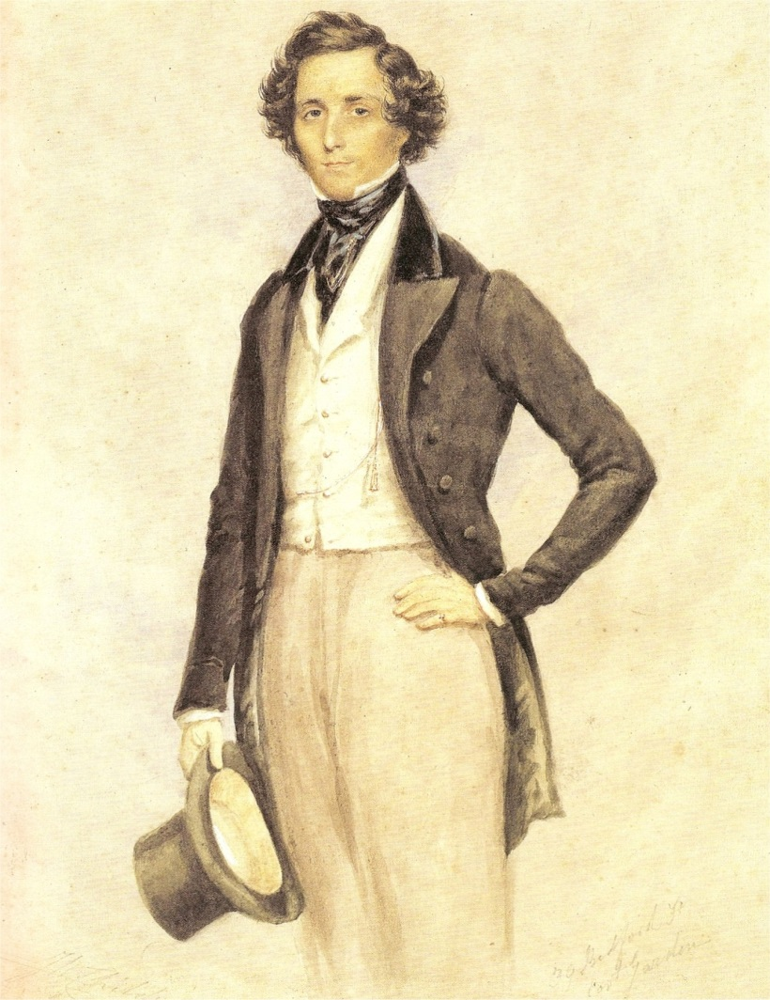
1827, 1830: Felix Mendelssohn publishes
two sets of Lieder
Op. 8: Zwölf Gesänge (Nos. 2, 3, and 12
by Fanny Mendelssohn)
Op. 9: Zwölf Lieder (Nos. 7, 11, and 12
by Fanny Mendelssohn)
(1829)

Slide 45
1827, 1830: Felix Mendelssohn publishes
two sets of Lieder
Op. 8: Zwölf Gesänge (Nos. 2, 3, and 12
by Fanny Mendelssohn)
Op. 9: Zwölf Lieder (Nos. 7, 11, and 12
by Fanny Mendelssohn)
No. 1, “Minnelied im Mai”
(1829)

Slide 46
1827, 1830: Felix Mendelssohn publishes
two sets of Lieder
Op. 8: Zwölf Gesänge (Nos. 2, 3, and 12
by Fanny Mendelssohn)
Op. 9: Zwölf Lieder (Nos. 7, 11, and 12
by Fanny Mendelssohn)
No. 1, “Minnelied im Mai”
No. 2, “Das Heimweh” (1824)
(1829)

Slide 47
Composition and performance are to be encouraged. But . . . publication?
Fanny Mendelssohn Hensel (1805-1847)

Slide 48
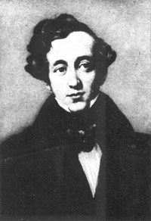
Composition and performance are to be encouraged. But . . . publication?
Felix Mendelssohn (1809–1847)
Lea Salomon Bartholdy 1777–1842)
Fanny Mendelssohn Hensel (1805-1847)
Felix Mendelssohn, letter to his mother, Lea Salomon Bartholdy, 24 June 1837
“I cannot persuade her to publish anything, because it is against my views and convictions. We have previously spoken a great deal about it, and I still hold the same opinion. I consider publishing something serious (it should at least be that) and believe that one should do it only if one wants to appear as an author one's entire life and stick to it. But that necessitates a series of works, one after the other.... Fanny, as I know her, possesses neither the inclination nor calling for authorship. She is too much a woman, as is proper, for that, and looks after her house and thinks neither about the public nor the musical world, nor even about music, unless that primary occupation is accomplished. Publishing would only disturb her in these duties, and I cannot reconcile myself to it. Therefore I will not persuade her—forgive me. If she decides to publish out of self-motivation, or to please Hensel, I am, as I said, ready to be helpful as much as I can, but to encourage her toward something I don't consider right is what I cannot do.”

Slide 49
Fanny Mendelssohn, letter to her brother, Felix Mendelssohn, 9 July 1846
“For forty years I've been afraid of my brother, as I was at fourteen of father, or rather
afraid is not the right word, but rather desirous during my entire life to please you and
everyone whom I love, and if I know in advance that it will not be the case, I therefore
feel rather uncomfortable. In a word, I am beginning to publish. I have Herr Bock's
esteemed offer for my Lieder, I've finally turned a receptive ear to his favorable
terms .... I hope I won't disgrace you through my publishing, as I'm no femme
libre . ... Hopefully you will in no way be bothered by it, as I have proceeded, as you
see, completely independently, in order to spare you any unpleasant moment. If the
venture succeeds, that is if the compositions please [people], then I know that it will be
a great stimulus to me, something I always required in order to publish anything.”

Slide 50
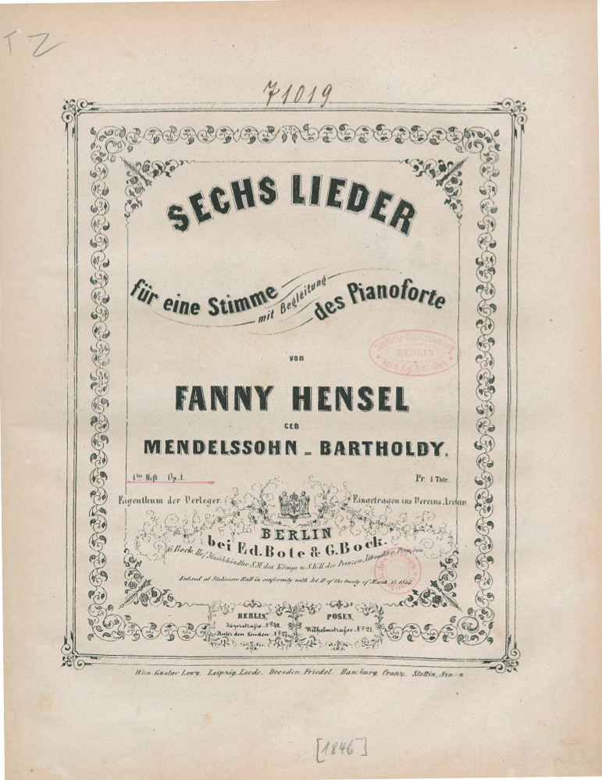
Op. 1 (1846)

Slide 51
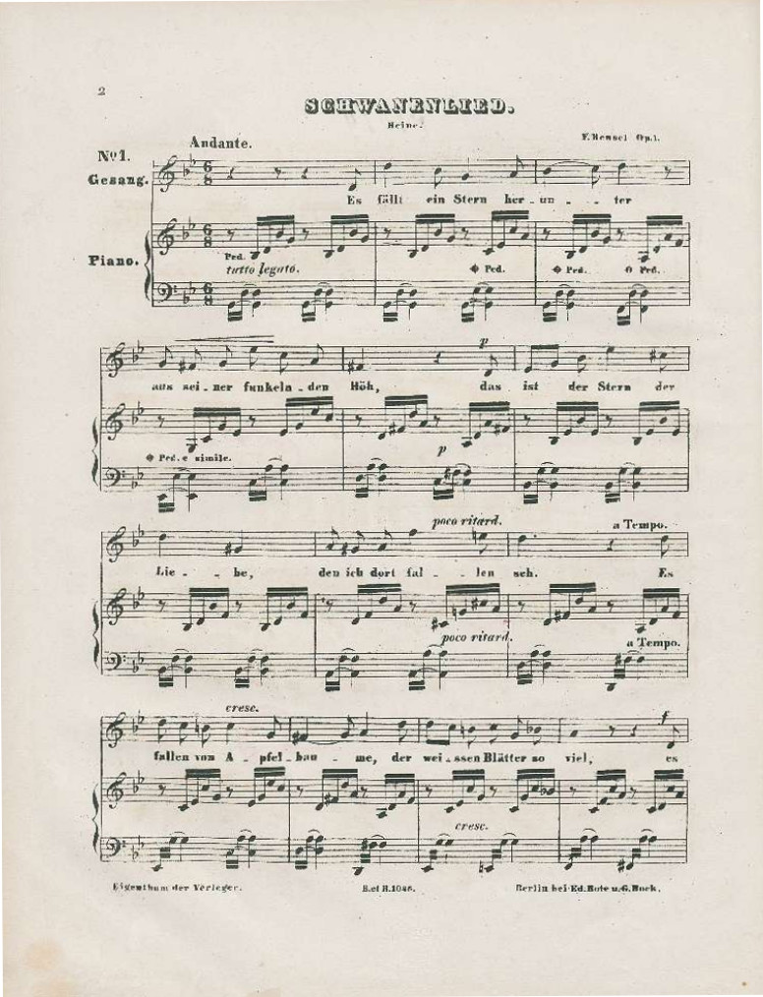
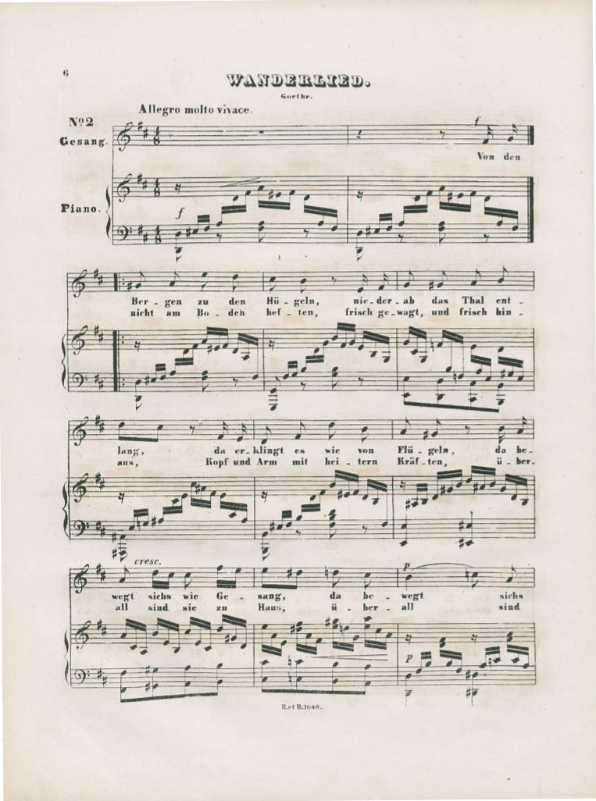
From Fanny Mendelssohn Hensel, op. 1, Sechs Lieder (1846)

Slide 52
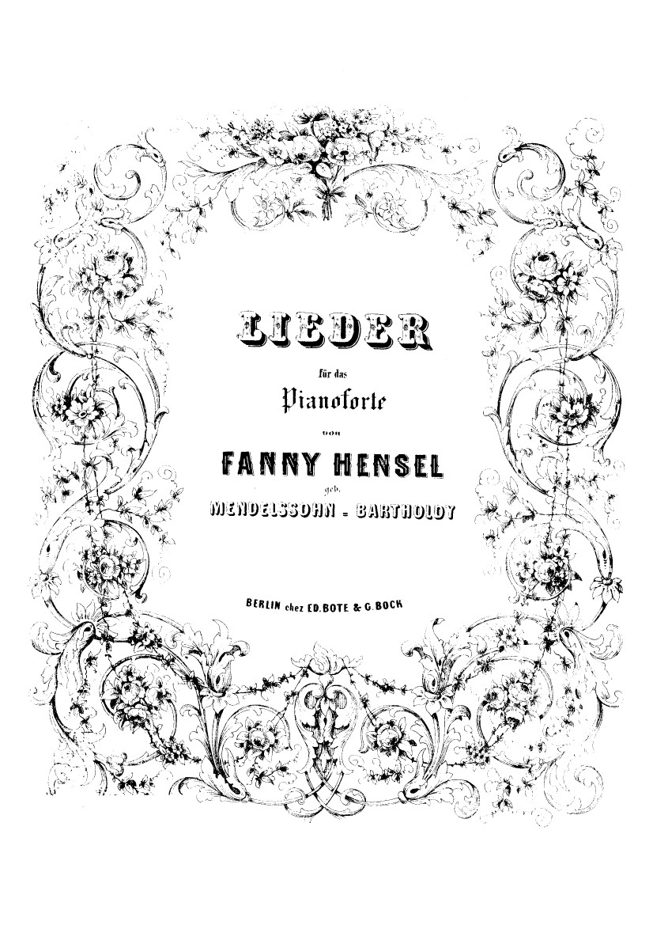
Op. 2 (1846)

Slide 53
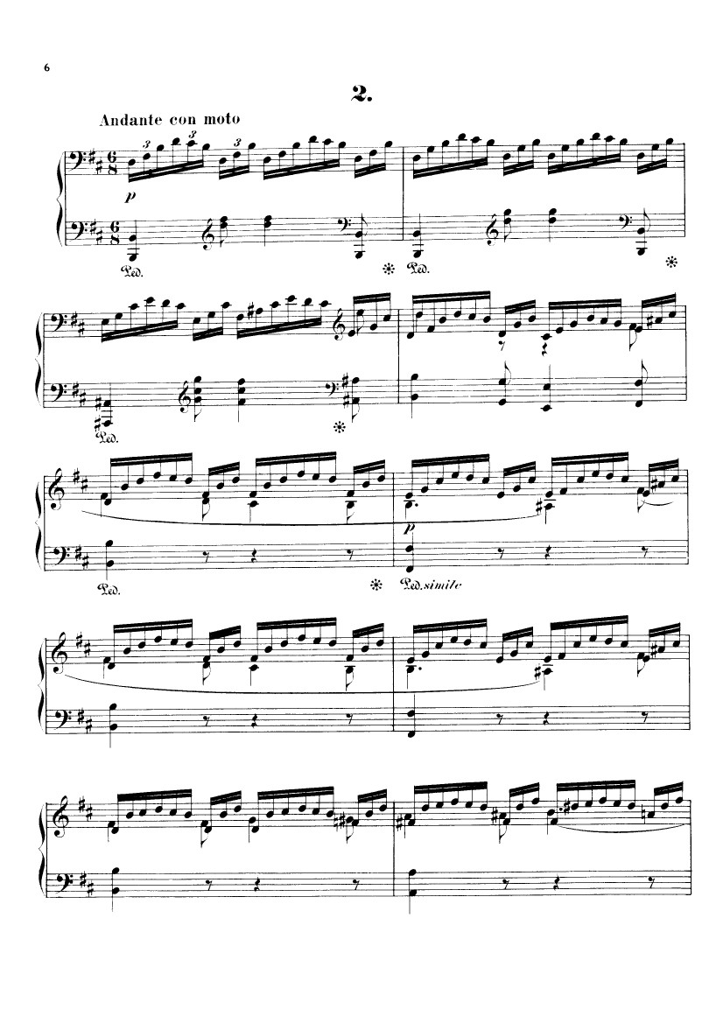
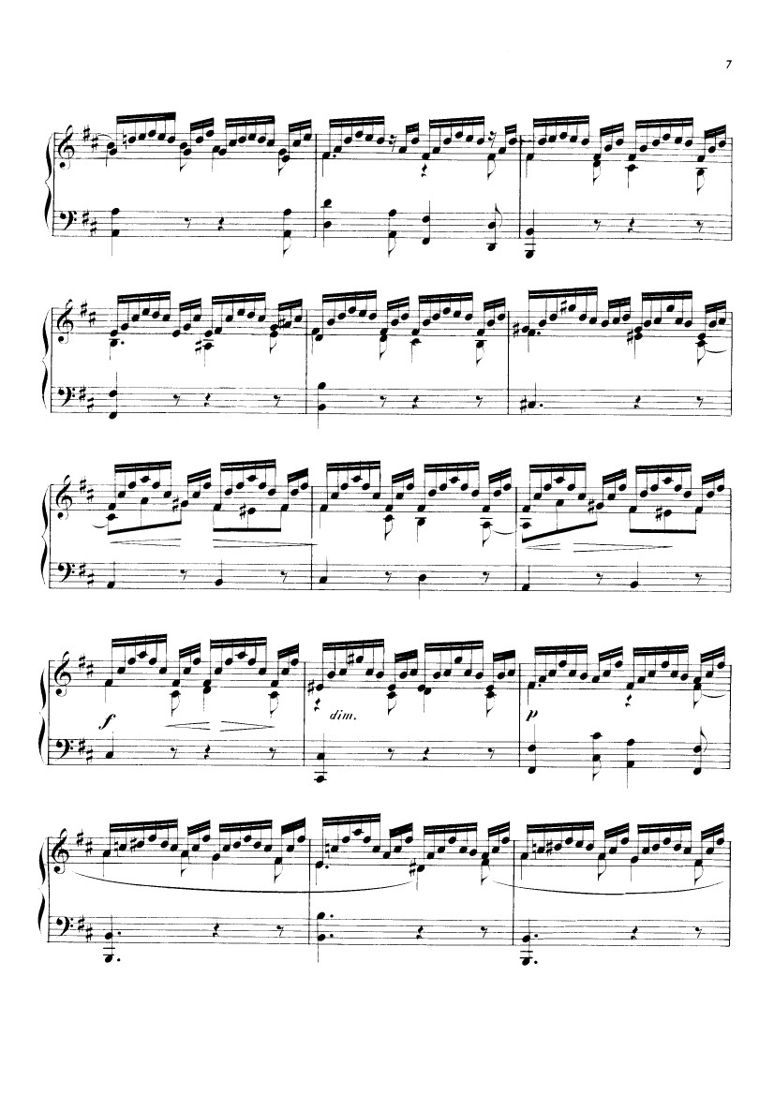
From Fanny Mendelssohn Hensel, op. 2, Vier Lieder (1846)

Slide 54
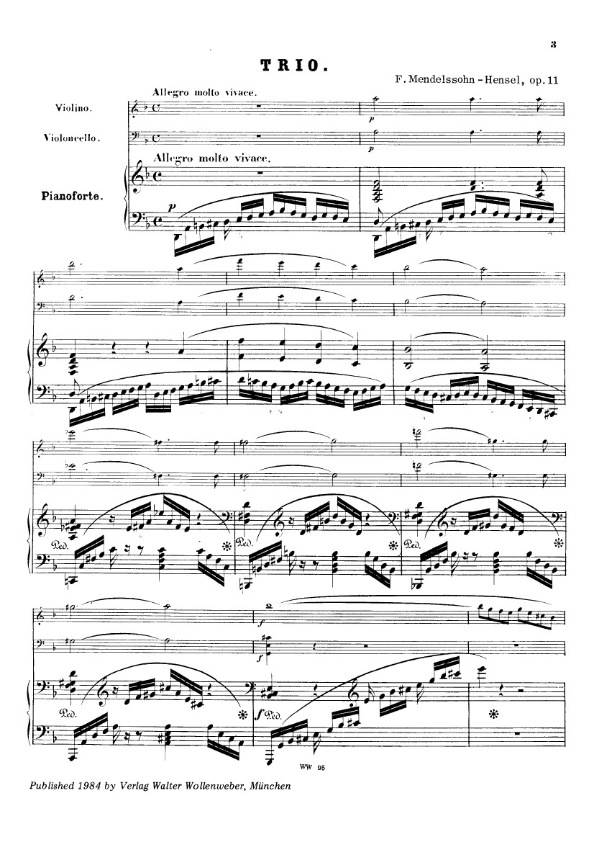
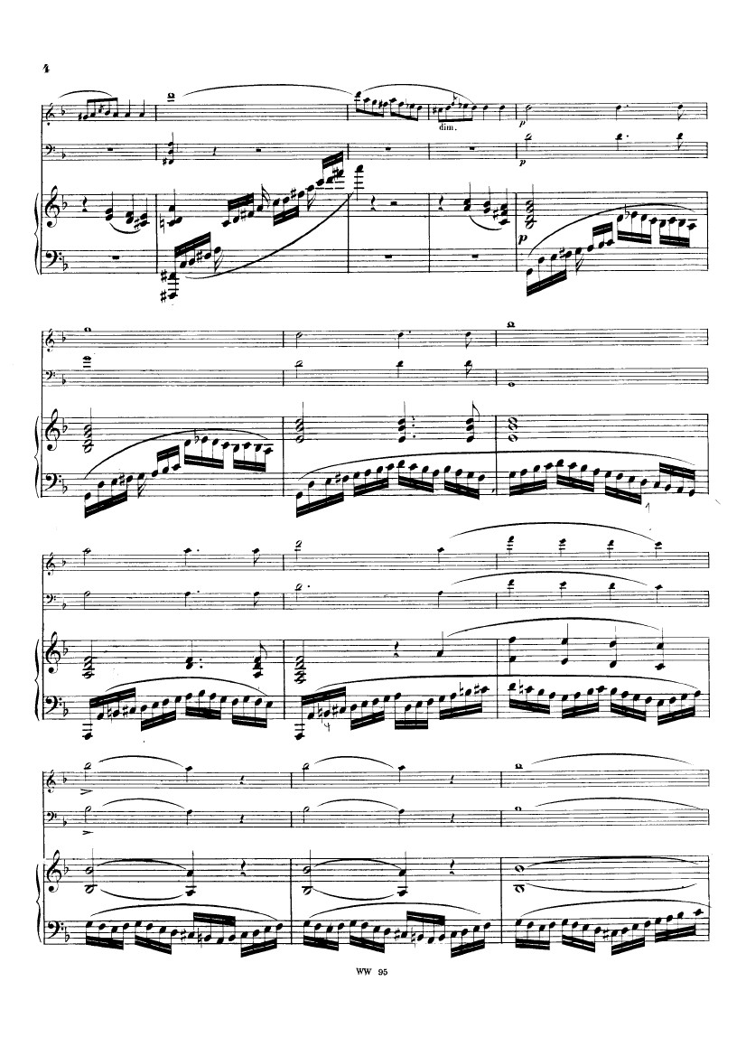

Slide 55
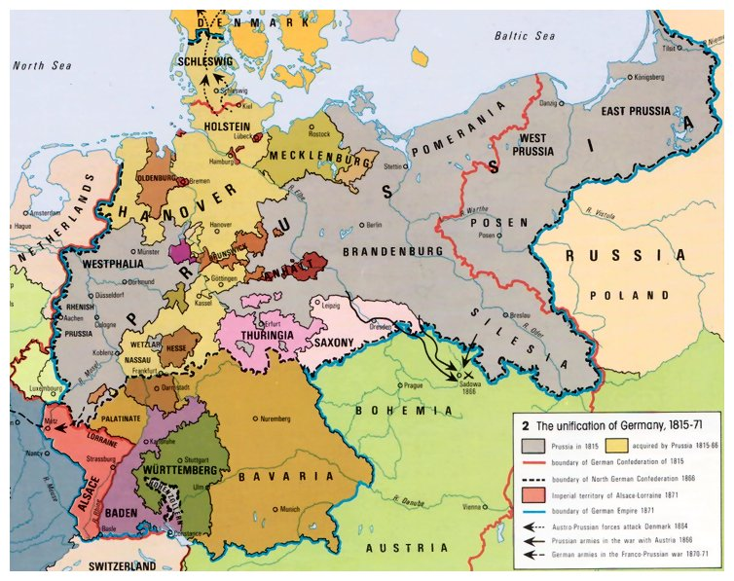

Slide 57
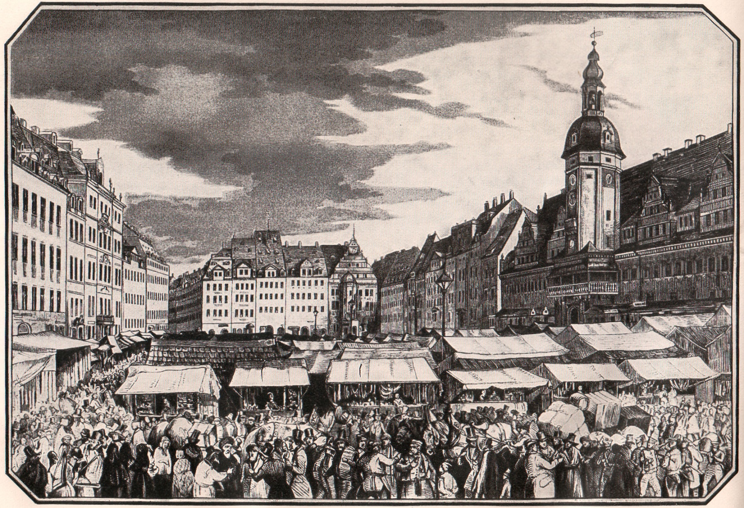
Leipzig, c. 1830

Slide 58
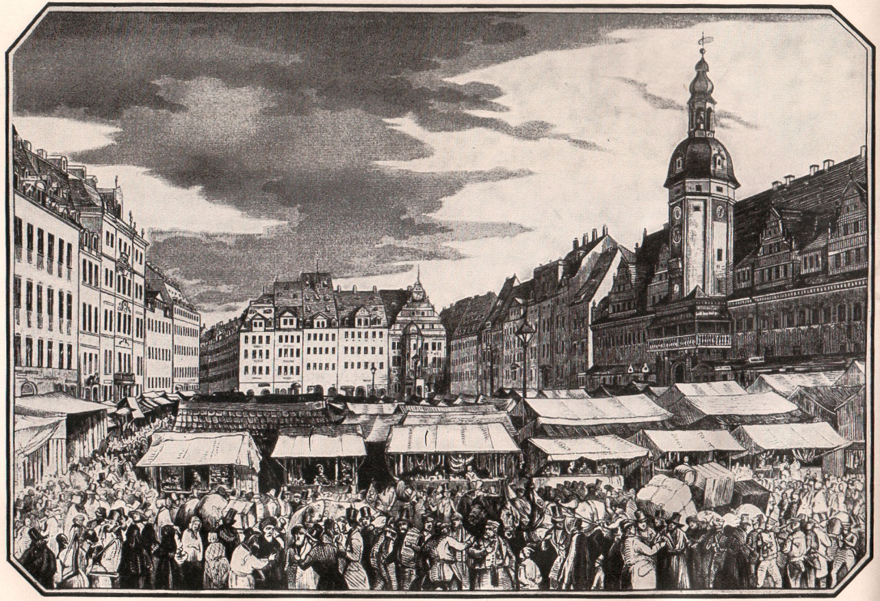
Leipzig, c. 1830
J. S. Bach Heritage

Slide 59
Leipzig, c. 1830
J. S. Bach Heritage
Gewandhaus Orchestra (1781)

Slide 60
Leipzig, c. 1830
J. S. Bach Heritage
Gewandhaus Orchestra (1781)
Major music-publishing city:
Breitkopf & Härtel (1790s)
C. F. Peters (1814)
and others

Slide 61
Leipzig, c. 1830
J. S. Bach Heritage
Gewandhaus Orchestra (1781)
Major music-publishing city:
Breitkopf & Härtel (1790s)
C. F. Peters (1814)
and others
(1843) Leipzig Conservatory (founded by Felix Mendelssohn)

Slide 62
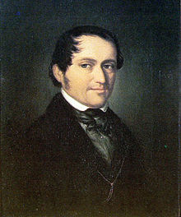
Leipzig, c. 1830
Friedrich Wieck (1785-73 (portrait, c. 1830)

Slide 63
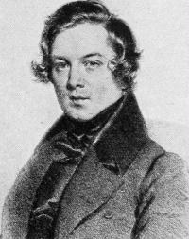
Friedrich Wieck (1785-73 (portrait, c. 1830)
Robert Schumann (1810-56)

Slide 64
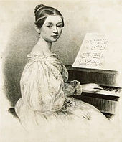
Friedrich Wieck (1785-73 (portrait, c. 1830)
Clara Wieck, 1835 (age 15)

Slide 65
Clara Wieck, 1835 (1819-96)
Robert Schumann (1810-56)

Slide 66
Friedrich Wieck (1785-73 (portrait, c. 1830)
Clara Wieck, 1835 (age 15)
From the 1890s, recalling her upbringing: "It was also a blessing for me that he was extremely strict, rebuked me when I deserved it and thus prevented the praises from making me insolent. Sometimes the rebuke was bitter, yet it was good!"

Slide 67
Celebrated concerts and tours as prodigy
Leipzig (1831, age 11)
Paris (1832, age 12)
Vienna, late 1830s
Clara Wieck, 1835 (1819-96)
(“Wundermädchen” at the piano)

Slide 68
Celebrated concerts and tours as prodigy
Leipzig (1831, age 11)
Paris (1832, age 12)
Vienna, late 1830s
1830s—compositions published
(virtuoso showpieces)
Op. 1: Four Polonaises (1831)
Op. 4: Valses romantiques (1835)
Op. 6: Soirées musicales (1836)
Clara Wieck, 1835 (1819-96)
(“Wundermädchen” at the piano)

Slide 69
Celebrated concerts and tours as prodigy
Leipzig (1831, age 11)
Paris (1832, age 12)
Vienna, late 1830s
1830s—compositions published
(virtuoso showpieces)
Op. 1: Four Polonaises (1831)
Op. 4: Valses romantiques (1835)
Op. 6: Soirées musicales (1836)
Clara Wieck, 1835 (1819-96)
(“Wundermädchen” at the piano)

Slide 70
Piano Sets/Cycles from the 1830s include:
“Abegg” Variations, op. 1 (1830)
Papillons, op. 2 (1830-31)
Carnaval, op. 9 (1834-35)
Davidsbündlertänze , op. 6 (1837)
Fantasiestücke, op. 12 (1837)
Symphonic Etudes, op. 13 (1834-37)
Kinderszenen, op. 15 (1838)
Kreisleriana, op. 16 (1838)
Fantasie in C , op. 17 (1836-38)
Robert Schumann (1810-56)

Slide 71
Piano Sets/Cycles from the 1830s include:
“Abegg” Variations, op. 1 (1830)
Papillons, op. 2 (1830-31)
Carnaval, op. 9 (1834-35)
Davidsbündlertänze , op. 6 (1837)
Fantasiestücke, op. 12 (1837)
Symphonic Etudes, op. 13 (1834-37)
Kinderszenen, op. 15 (1838)
Kreisleriana, op. 16 (1838)
Fantasie in C , op. 17 (1836-38)
Robert Schumann (1810-56)

Slide 72
Piano Sets/Cycles from the 1830s include:
“Abegg” Variations, op. 1 (1830)
Papillons, op. 2 (1830-31)
Carnaval, op. 9 (1834-35)
Davidsbündlertänze , op. 6 (1837)
Fantasiestücke, op. 12 (1837)
Symphonic Etudes, op. 13 (1834-37)
Kinderszenen, op. 15 (1838)
Kreisleriana, op. 16 (1838)
Fantasie in C , op. 17 (1836-38)
Robert Schumann (1810-56)

Slide 73
Piano Sets/Cycles from the 1830s include:
“Abegg” Variations, op. 1 (1830)
Papillons, op. 2 (1830-31)
Carnaval, op. 9 (1834-35)
Davidsbündlertänze , op. 6 (1837)
Fantasiestücke, op. 12 (1837)
Symphonic Etudes, op. 13 (1834-37)
Kinderszenen, op. 15 (1838)
Kreisleriana, op. 16 (1838)
Fantasie in C , op. 17 (1836-38)
Robert Schumann (1810-56)

Slide 74
Piano Sets/Cycles from the 1830s include:
“Abegg” Variations, op. 1 (1830)
Papillons, op. 2 (1830-31)
Carnaval, op. 9 (1834-35)
Davidsbündlertänze , op. 6 (1837)
Fantasiestücke, op. 12 (1837)
Symphonic Etudes, op. 13 (1834-37)
Kinderszenen, op. 15 (1838)
Kreisleriana, op. 16 (1838)
Fantasie in C , op. 17 (1836-38)
Robert Schumann (1810-56)

Slide 75
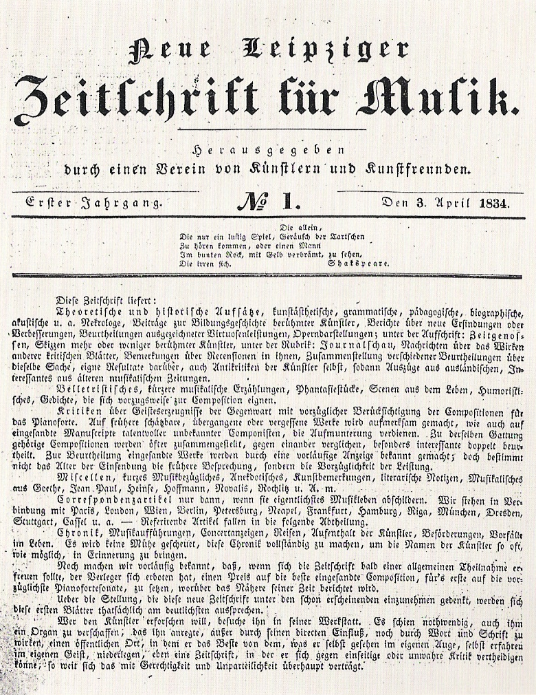
Robert Schumann (1810-56)
1834

Slide 76
Engagement,1837; Marriage,12 September 1840
Clara Wieck, 1835 (age 15)
Robert Schumann (1810-56)

Slide 77
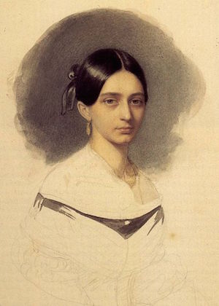
Clara Wieck, Diary Entry, 26 November 1839
(Ten months before her 12 September 1840 marriage to Robert Schumann)
"I once believed that I had creative talent, but I have given up this idea; a woman must not wish to compose—there never was one able to do it. Am I intended to be the one? It would be arrogant to believe that. That was something with which only my father tempted me in former days. But I soon gave up believing this. May Robert always create; that must always make me happy.”

Slide 78
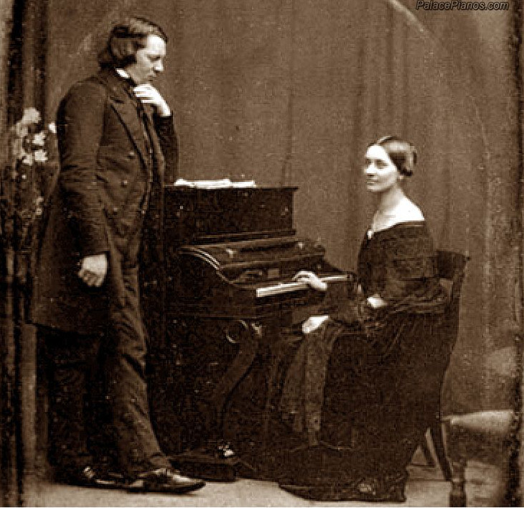

Slide 79
1840-41: Robert Schumann’s Liederjahr (Year of Song)
Schumann, Liederkreis, op. 24 (1840, 9 songs, texts by Heinrich Heine)
Schumann, Liederkreis, op. 39 (1840, 12 songs, texts by Joseph von Eichendorff)
Schumann, Frauenliebe und –leben, op. 42 (1840, 8 songs, texts by Adelbert Chamisso)
Schumann, Dichterliebe, op. 48 (1840, 16 songs, texts by Heinrich Heine)

Slide 80
1840-41: Robert Schumann’s Liederjahr (Year of Song)
Schumann, Liederkreis, op. 24 (1840, 9 songs, texts by Heinrich Heine)
Schumann, Liederkreis, op. 39 (1840, 12 songs, texts by Joseph von Eichendorff)
Schumann, Frauenliebe und –leben, op. 42 (1840, 8 songs, texts by Adelbert Chamisso)
Schumann, Dichterliebe, op. 48 (1840, 16 songs, texts by Heinrich Heine)
Robert and Clara Schumann: Zwölf Gedichte aus F. Rückert’s “Liebesfrühling” (1841, nos. 2, 4, and 11 by Clara)

Slide 81
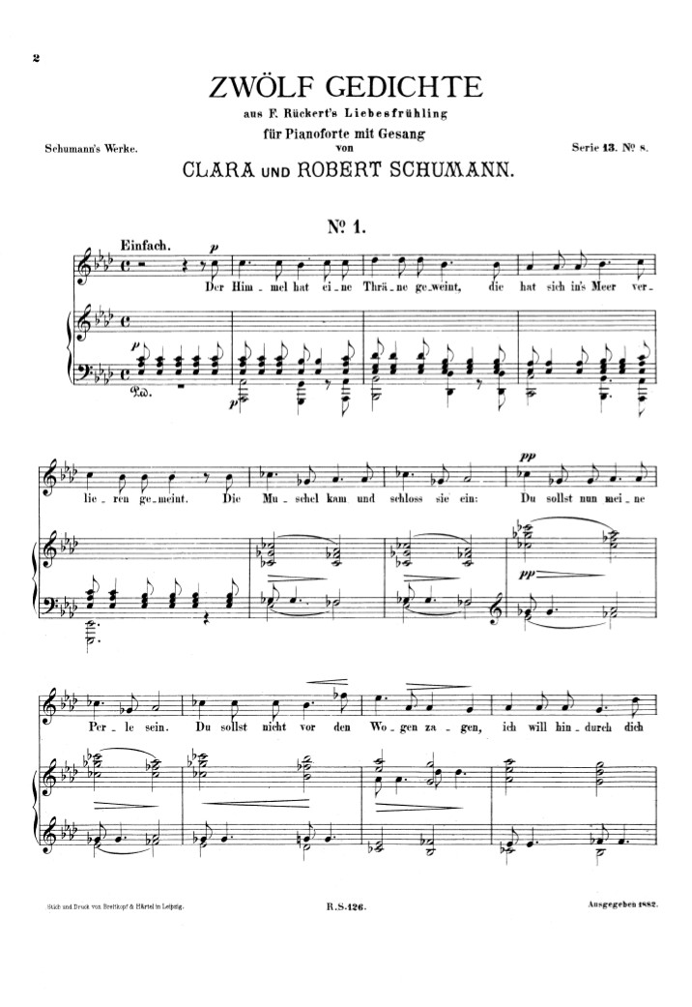

Slide 82
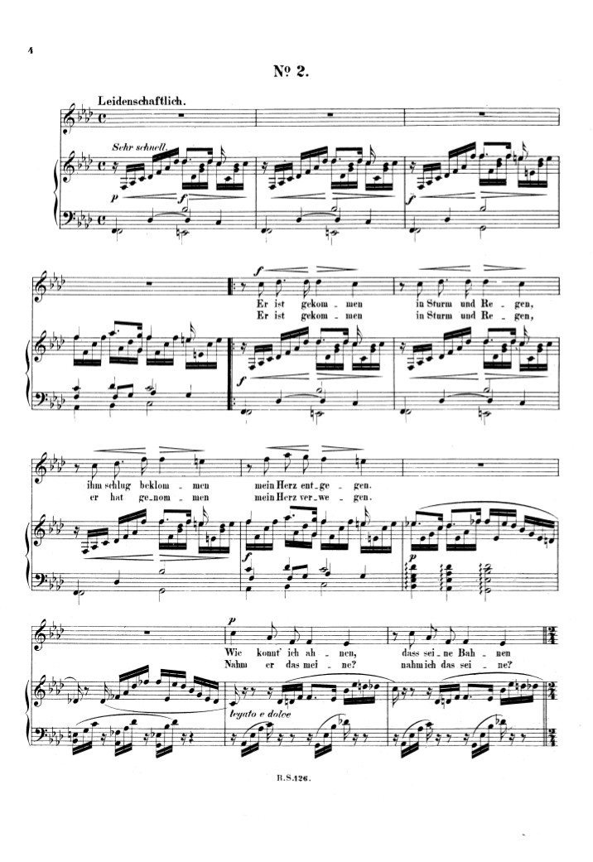
Clara Schumann, “Er ist gekommen in Sturm and Regen” (1841)
Op. 12 no. 1; Robert & Clara Schumann, op. 37 no. 2
Text: Friedrich Rückert
Er ist gekommen in Sturm und Regen | He came in storm and rain
Friedrich Rückert (1788-1866) | Op. 12 No. 2
Er ist gekommen in Sturm und Regen, | He came in storm and rain,
ihm schlug beklommen mein Herz entgegen. | my anxious heart beat against his.
Wie konnt' ich ahnen, daß seine Bahnen | how could I have known, that his path
sich einen sollten meinen Wegen. | should unite itself with mine?
Er ist gekommen in Sturm und Regen, | He came in storm and rain,
er hat genommen mein Herz verwegen. | he boldly stole my heart.
Nahm er das meine? Nahm ich das seine? | Did he steal mine? Did I steal his?
Die beiden kamen sich entgegen. | Both came together.
Er ist gekommen in Sturm und Regen, | He came in storm and rain,
Nun ist gekommen des Frühlings Segen. | Now has come the blessing of spring.
Der Freund zieht weiter, ich seh' es heiter, | My love travels abroad, I watch with cheer,
denn er bleibt mein auf allen Wegen. | for he remains mine, on any road.

Slide 83
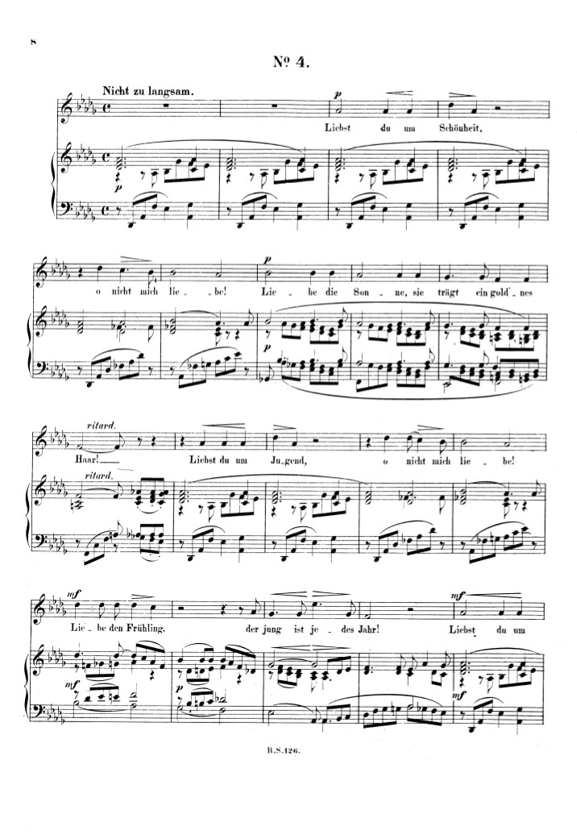

Slide 84
Clara Schumann, “Liebst du um Schönheit” (1841)
Op. 12 no. 1; Robert & Clara Schumann, op. 37 no. 4
Text: Friedrich Rückert
Liebst du um Schönheit | If you love for beauty
Friedrich Rückert (1788-1866) | Op. 12 No. 4
Liebst du um Schönheit, | If you love for beauty,
o nicht mich liebe! | oh, do not love me!
Liebe die Sonne, | Love the sun,
sie trägt ein gold'nes Haar! | she has golden hair!
Liebst du um Jugend, | If you love for youth,
o nicht mich liebe! | oh, do not love me!
Liebe den Frühling, | Love the spring,
der jung ist jedes Jahr! | it is young every year!
Liebst du um Schätze, | If you love for treasure,
o nicht mich liebe. | oh, do not love me!
Liebe die Meerfrau, | Love the mermaid,
sie hat viel Perlen klar. | she has many clear pearls!
Liebst du um Liebe, | If you love for love,
o ja, mich liebe! | oh yes, do love me!
Liebe mich immer, | love me ever,
dich lieb' ich immerdar. | I'll love you evermore!

Slide 85
“Clara has composed a series of small pieces, which show a musical and tender ingenuity such as she has never attained before. But to have children, and a husband who is always living in the realm of imagination, does not go together with composing. She cannot work at it regularly, and I am often disturbed to think how many profound ideas are lost because she cannot work them out. But Clara herself knows her main occupation is as a mother and I believe she is happy in the circumstances and would not want them changed"”
Robert Schumann, from the Robert
& Clara Schumann joint diary, 1843

Slide 86
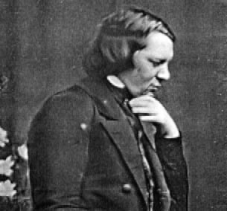
1854—Suicide attempt
1856—Death

Slide 87
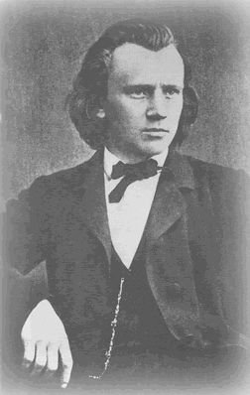
1853
Johannes Brahms, age 20

Slide 88
1846, published 1847

