Slide 1
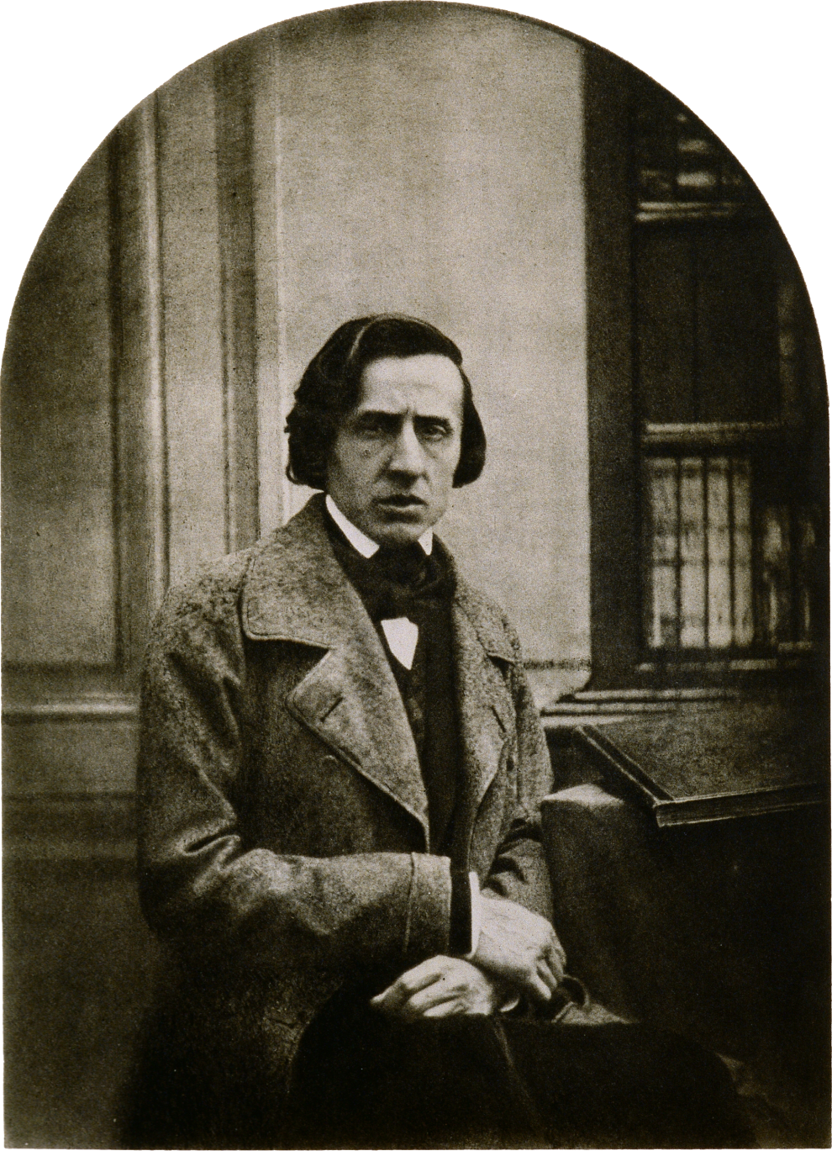
Interiority and the Piano Miniature

Slide 2
Romanticism and Interiority; Inwardness (Innigkeit; Innerlichkeit):
The Piano Miniature

Slide 3
Romanticism and Interiority; Inwardness (Innigkeit; Innerlichkeit):
The Piano Miniature
Romanticism of introversion

Slide 4
Romanticism and Interiority; Inwardness (Innigkeit; Innerlichkeit):
The Piano Miniature
Romanticism of introversion
Staged confessions of moods/secrets said to be lodged in the innermost soul of the composer

Slide 5
Romanticism and Interiority; Inwardness (Innigkeit; Innerlichkeit):
The Piano Miniature
Romanticism of introversion
Staged confessions of moods/secrets said to be lodged in the innermost soul of the composer
Private, inner richness

Slide 6
Romanticism and Interiority; Inwardness (Innigkeit; Innerlichkeit):
The Piano Miniature
Romanticism of introversion
Staged confessions of moods/secrets said to be lodged in the innermost soul of the composer
Private, inner richness
Some Sources and Models?

Slide 7
Romanticism and Interiority; Inwardness (Innigkeit; Innerlichkeit):
The Piano Miniature
Romanticism of introversion
Staged confessions of moods/secrets said to be lodged in the innermost soul of the composer
Private, inner richness
Some Sources and Models?
(Lied as art song)

Slide 8
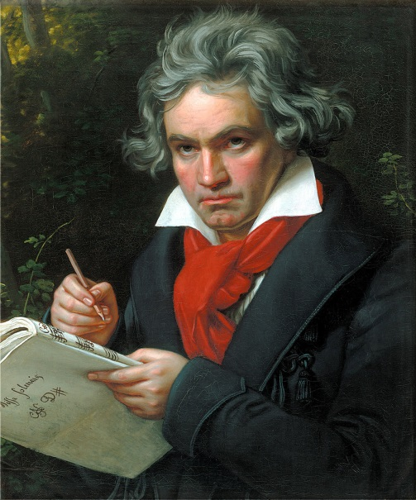
Romanticism and Interiority; Inwardness (Innigkeit; Innerlichkeit):
The Piano Miniature
Romanticism of introversion
Staged confessions of moods/secrets said to be lodged in the innermost soul of the composer
Private, inner richness
Some Sources and Models?
(Lied as art song)
Late Beethoven: Bagatelles (Eleven, op. 119 [1820-22];
Six, op. 126 [1824])

Slide 9
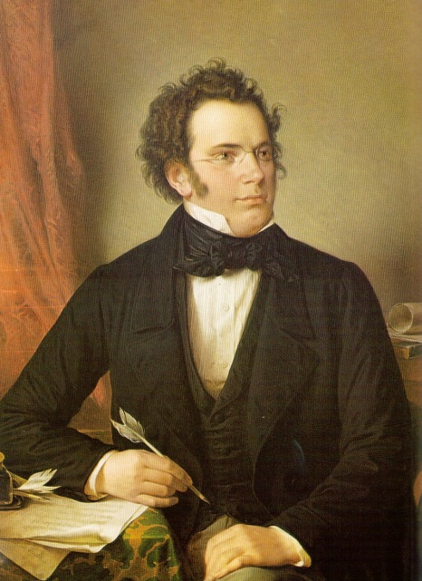
Romanticism and Interiority; Inwardness (Innigkeit; Innerlichkeit):
The Piano Miniature
Romanticism of introversion
Staged confessions of moods/secrets said to be lodged in the innermost soul of the composer
Private, inner richness
Some Sources and Models?
(Lied as art song)
Late Beethoven: Bagatelles (Eleven, op. 119 [1820-22];
Six, op. 126 [1824])
Schubert: Moments musicales (1825)
Schubert: Impromptus (1827-28)

Slide 10
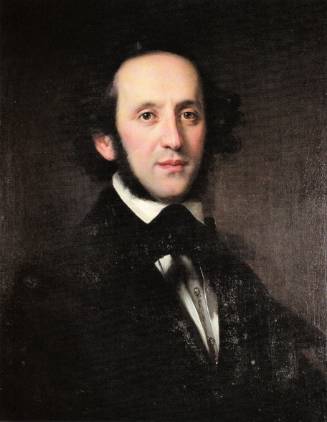
Romanticism and Interiority; Inwardness (Innigkeit; Innerlichkeit):
The Piano Miniature
Romanticism of introversion
Staged confessions of moods/secrets said to be lodged in the innermost soul of the composer
Private, inner richness
Some Sources and Models?
(Lied as art song)
Late Beethoven: Bagatelles (Eleven, op. 119 [1820-22];
Six, op. 126 [1824])
Schubert: Moments musicales (1825)
Schubert: Impromptus (1827-28)
Mendelssohn, Lieder ohne Worte
(starting with op. 19 [publ. 1833])

Slide 11
Romanticism and Interiority; Inwardness (Innigkeit; Innerlichkeit):
The Piano Miniature
Romanticism of introversion
Staged confessions of moods/secrets said to be lodged in the innermost soul of the composer
Private, inner richness
Some Sources and Models?
(Lied as art song)
Late Beethoven: Bagatelles (Eleven, op. 119 [1820-22];
Six, op. 126 [1824])
Schubert: Moments musicales (1825)
Schubert: Impromptus (1827-28)
Mendelssohn, Lieder ohne Worte
(starting with op. 19 [publ. 1833])
Op. 19 no. 6 (“Venetian Gondola Song”)

Slide 12
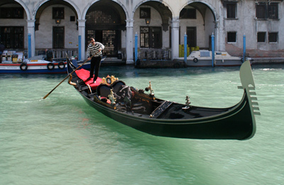
Romanticism and Interiority; Inwardness (Innigkeit; Innerlichkeit):
The Piano Miniature
Romanticism of introversion
Staged confessions of moods/secrets said to be lodged in the innermost soul of the composer
Private, inner richness
Some Sources and Models?
(Lied as art song)
Late Beethoven: Bagatelles (Eleven, op. 119 [1820-22];
Six, op. 126 [1824])
Schubert: Moments musicales (1825)
Schubert: Impromptus (1827-28)
Mendelssohn, Lieder ohne Worte
(starting with op. 19 [publ. 1833])
Op. 19 no. 6 (“Venetian Gondola Song”)
Musical “topic” = barcarole

Slide 13
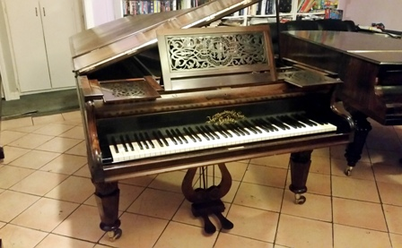
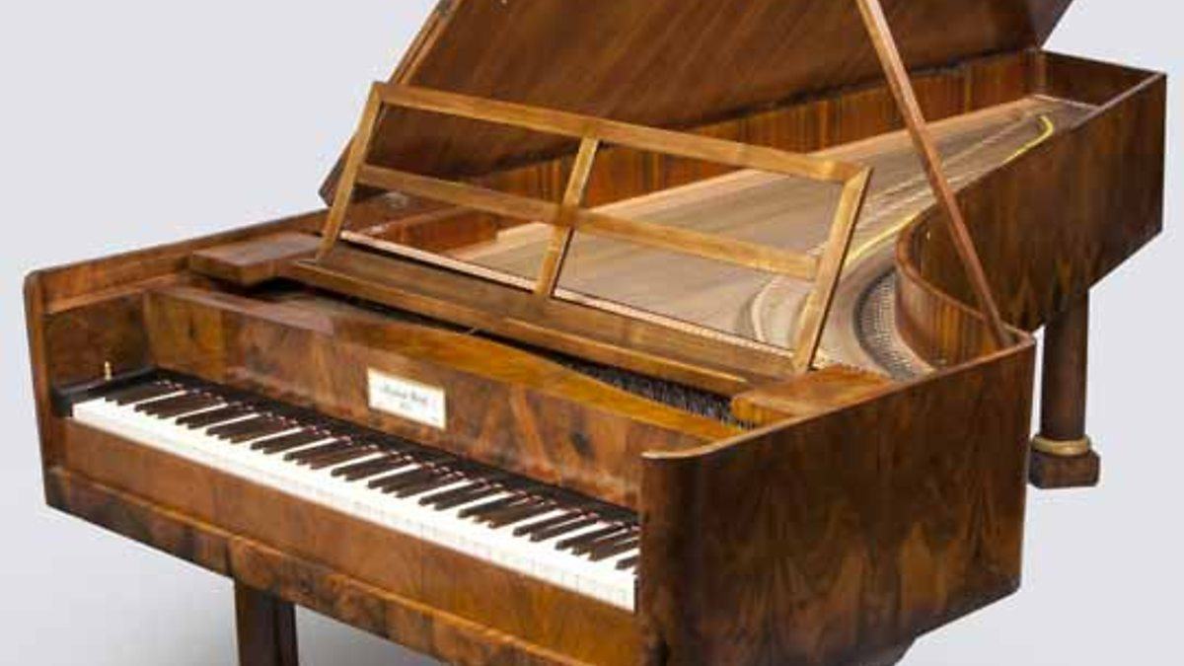
Broadwood, c. 1820 Graf, c. 1820

Slide 14
Helps to enable a soloist-centered art music:
the staging of topically stylized Romantic subjectivity
in the ever-growing marketplace of art
Broadwood, c. 1820 Graf, c. 1820

Slide 15
Innigkeit, subjective interiority
“Private” poetry of the soul
Confessional
Nuanced
Tender, delicate

Slide 16
Innigkeit, subjective interiority
“Private” poetry of the soul
Confessional
Nuanced
Tender, delicate
“Heroic” virtuosity
Individual as conqueror
Bravura conquest of seemingly insuperable technical difficulties
Romantic “resistance”: onward to blazing victories!

Slide 17
RECEPTION IMAGE
Public offerings of the “individual” master-performer (and composer)
“Magic”; hypnotic; the artist who can transport us
Gifted with special, performative insight into art (poetic soul)—and the privileged world of high culture
Innigkeit, subjective interiority
“Private” poetry of the soul
Confessional
Nuanced
Tender, delicate
“Heroic” virtuosity
Individual as conqueror
Bravura conquest of seemingly insuperable technical difficulties
Romantic “resistance”: onward to blazing victories!

Slide 18
The Virtual World of the Romantic Performer
RECEPTION IMAGE
Public offerings of the “individual” master-performer (and composer)
“Magic”; hypnotic; the artist who can transport us
Gifted with special, performative insight into art (poetic soul)—and the privileged world of high culture
Innigkeit, subjective interiority
“Private” poetry of the soul
Confessional
Nuanced
Tender, delicate
“Heroic” virtuosity
Individual as conqueror
Bravura conquest of seemingly insuperable technical difficulties
Romantic “resistance”: onward to blazing victories!
Music for the privileged, elite circle of connoisseurs—those who truly grasp “Art” as a badge of cultural refinement and education

Slide 19
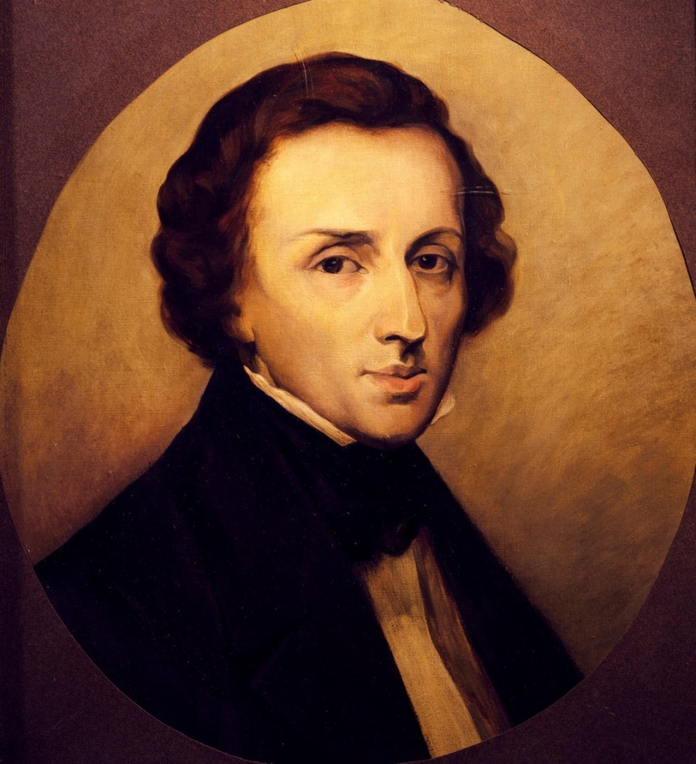
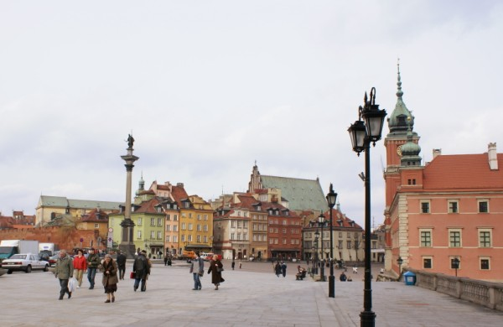
Fryderyk Chopin (1810-1849) Warsaw

Slide 20
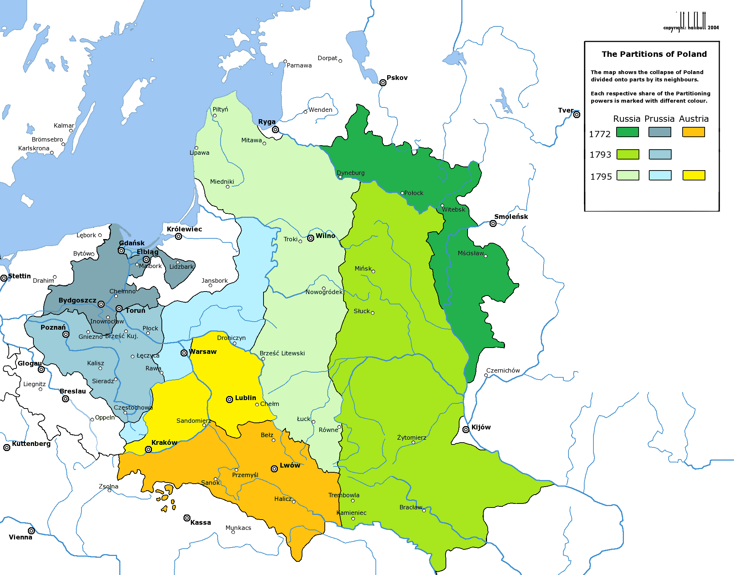

Slide 21
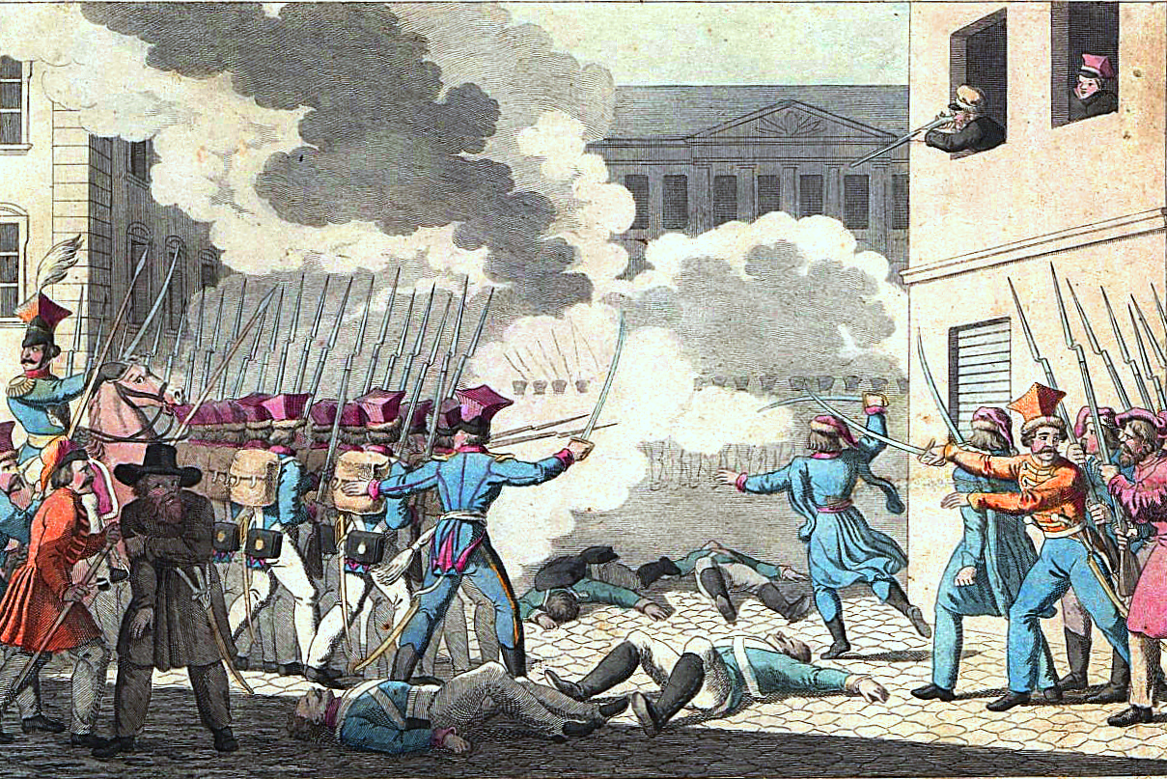
Poland: the “November Uprising” of 1830

Slide 22
Poland: the “November Uprising” of 1830
Chopin, Etude in C Minor, op. 10, no. 12 (1831)

Slide 23
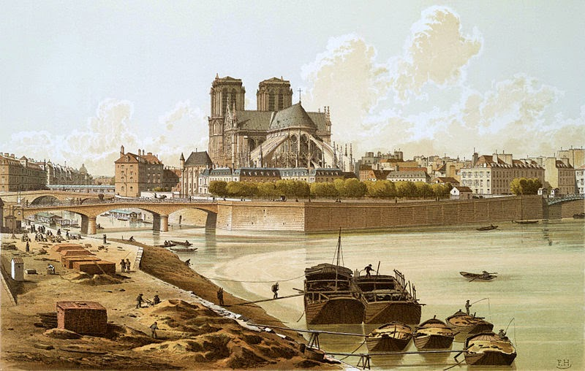
Paris c. 1830

Slide 24
Paris c. 1830
Evocations of Polish Culture
Mazurkas
Polonaises

Slide 25
Paris c. 1830
Evocations of Polish Culture
Mazurkas
Polonaises
Polonaise in A (“Heroic”), 1838

Slide 26
Paris c. 1830
Evocations of Polish Culture
Mazurkas
Polonaises
Polonaise in A (“Heroic”), 1838
Polonaise in A-Flat, 1842-43

Slide 27
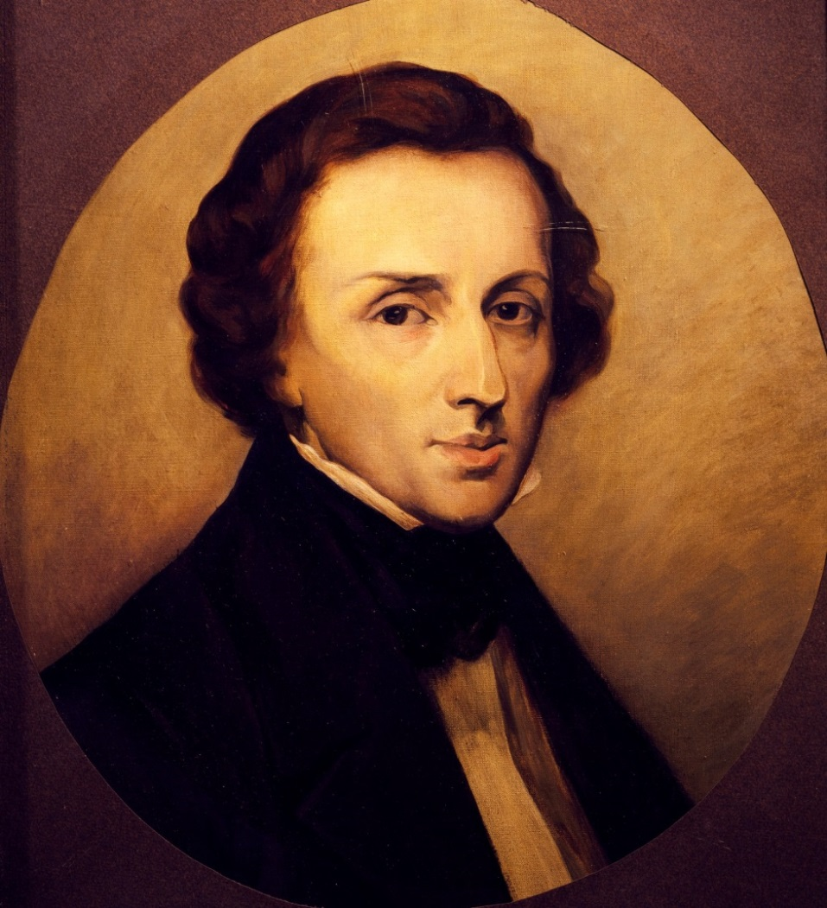
Fryderyk Chopin (1810-1849)
“I have found my way into the best society. I have my place among ambassadors, princes, ministers. . . .” (letter from Paris, 1833)

Slide 28
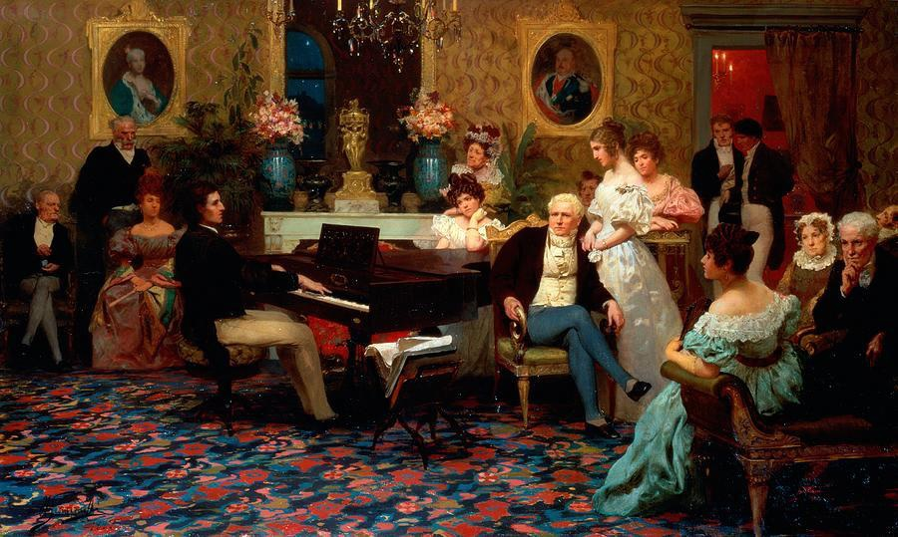
Chopin: A Favorite in Salons of the Wealthy
At the Radziwill Salon, Berlin (painting, Henryk Siemiradzki, 1887)

Slide 29
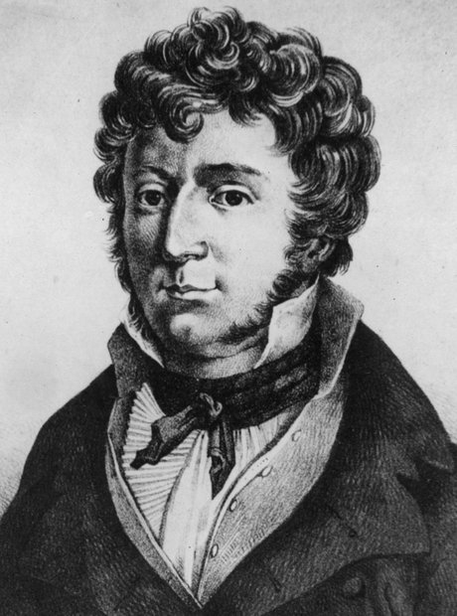
Piano sonatas, piano concertos, and
short piano pieces
John Field (1782-1837)

Slide 30
Piano sonatas, piano concertos, and
short piano pieces, including:
“Nocturnes” (from c. 1812 onward)
John Field (1782-1837)

Slide 31
Piano sonatas, piano concertos, and
short piano pieces, including:
“Nocturnes” (from c. 1812 onward)
No. 3 in A-flat Major (1812)
John Field (1782-1837)

Slide 32
John Field (1782-1837) Fryderyk Chopin (1810-1849)

Slide 33
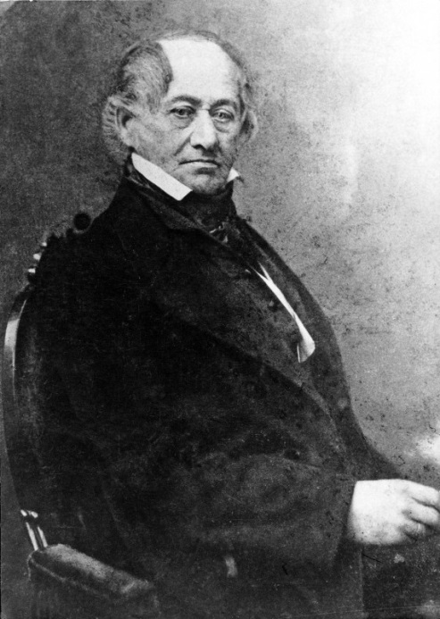
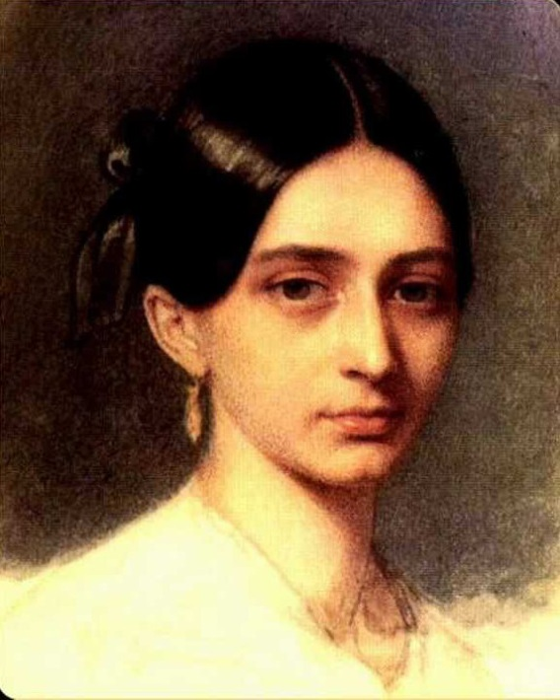
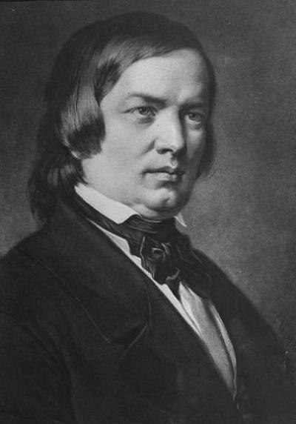
Friedrich Wieck (1785-1873) Clara Wieck (1819-1896)
John Field (1782-1837)
Robert Schumann (1810-1856)

Slide 34
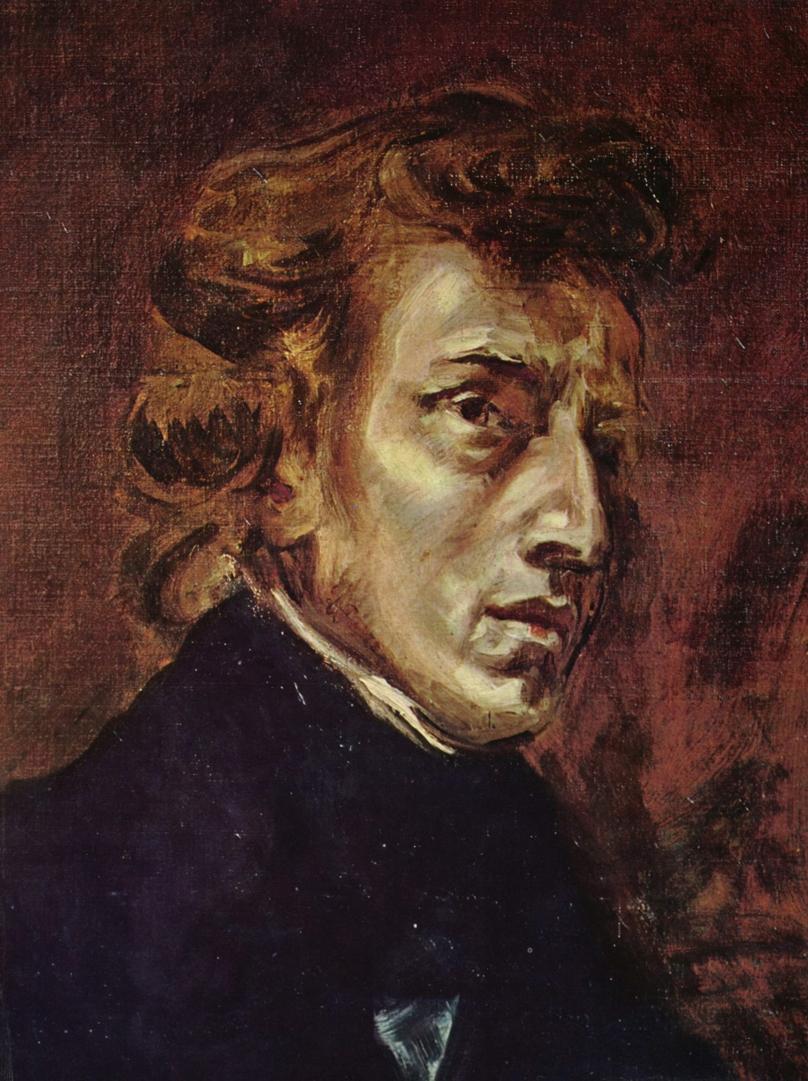
Nocturnes begin with:
Op. 9 (1830-31)
1. B-flat minor
2. E-flat major
3. B major
Op. 15 (1830-33)
F major
F-sharp major
G minor
Fryderyk Chopin (1810-1849) (Delacroix Portrait)

Slide 35
Nocturnes begin with:
Op. 9 (1830-31)
1. B-flat minor
2. E-flat major
3. B major
Op. 15 (1830-33)
F major
F-sharp major
G minor
Fryderyk Chopin (1810-1849) (Delacroix Portrait)

Slide 36
Nocturnes begin with:
Op. 9 (1830-31)
1. B-flat minor
2. E-flat major
3. B major
Op. 15 (1830-33)
F major
F-sharp major
G minor
Fryderyk Chopin (1810-1849) (Delacroix Portrait)

Slide 37
Nocturnes begin with:
Op. 9 (1830-31)
1. B-flat minor
2. E-flat major
3. B major
Op. 15 (1830-33)
F major
F-sharp major
G minor
Fryderyk Chopin (1810-1849) (Delacroix Portrait)

Slide 38
Nocturnes begin with:
Op. 9 (1830-31)
1. B-flat minor
2. E-flat major
3. B major
Op. 15 (1830-33)
F major
F-sharp major
G minor
Fryderyk Chopin (1810-1849) (Delacroix Portrait)

Slide 39
Nocturnes begin with:
Op. 9 (1830-31)
1. B-flat minor
2. E-flat major
3. B major
Op. 15 (1830-33)
F major
F-sharp major
G minor
Fryderyk Chopin (1810-1849) (Delacroix Portrait)

Slide 40
Nocturnes begin with:
Op. 9 (1830-31)
1. B-flat minor
2. E-flat major
3. B major
Op. 15 (1830-33)
F major
F-sharp major
G minor
Fryderyk Chopin (1810-1849) (Delacroix Portrait)

Slide 41
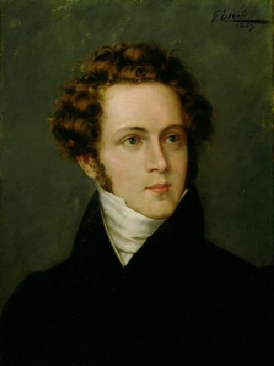
Fryderyk Chopin (1810-1849) (Delacroix Portrait)
Vincenzo Bellini (1810-1849):
“bel canto” opera

Slide 42
“Bel canto” operas include:
I Capuleti e I Montecchi (1830)
Norma (1831)
La sonnambula (1831)
Vincenzo Bellini (1810-1849):

Slide 43
“Bel canto” operas include:
I Capuleti e I Montecchi (1830)
Norma (1831)
La sonnambula (1831)
continues to explore and codify an important
song form: the Italianate lyric binary
Vincenzo Bellini (1810-1849):

Slide 44
Bellini: “Vaga luna” text

Slide 45
Bellini: “Vaga luna” text
Two eight-line stanzas (two ottave)

Slide 46
Bellini: “Vaga luna” text
Two eight-line stanzas (two ottave)
Structure of each displays the most common format for an Italian song text
(or aria text) of this time:

Slide 47
Bellini: “Vaga luna” text
Two eight-line stanzas (two ottave)
Structure of each displays the most common format for an Italian song text
(or aria text) of this time:
Eight lines (ottava), each built from
two quatrains (4+4), demarcated by
rhyme-scheme and punctuation
(separated as thoughts or sentences)

Slide 48
Bellini: “Vaga luna” text
Two eight-line stanzas (two ottave)
Structure of each displays the most common format for an Italian song text
(or aria text) of this time:
Eight lines (ottava), each built from
two quatrains (4+4), demarcated by
rhyme-scheme and punctuation
(separated as thoughts or sentences)
Each quatrain formatted as 2+2

Slide 49
Bellini: “Vaga luna” text
Two eight-line stanzas (two ottave)
Structure of each displays the most common format for an Italian song text
(or aria text) of this time:
Eight lines (ottava), each built from
two quatrains (4+4), demarcated by
rhyme-scheme and punctuation
(separated as thoughts or sentences)
Each quatrain formatted as 2+2
Thus each stanza, square-cut, schematic: 4+4 = (2+2) + (2+2)

Slide 50
Lyric Binary Format: Often Sets 8 Lines of Poetic Text (Two Quatrains)
I or V: PAC
I:HC
I:PAC (ESC)
Intro a a’ b a’’ (coda)
1 2 3 4 5 6 7 8 line repetitions (7 & 8)

Slide 51
Lyric Binary Format: Often Sets 8 Lines of Poetic Text (Two Quatrains)
I or V: PAC
I:HC
I:PAC (ESC)
Intro a a’ b a’’ (coda)
1 2 3 4 5 6 7 8 line repetitions (7 & 8)
Usually a balanced phrase-pair
(often a period) or some other self-contained phrase structure
Sets up V
Climactic
utterance:
“the point”

Slide 52
Lyric Binary Format: Often Sets 8 Lines of Poetic Text (Two Quatrains)
Trajectories toward obligatory cadences
I or V: PAC
I:HC
I:PAC (ESC)
Intro a a’ b a’’ (coda)
1 2 3 4 5 6 7 8 line repetitions (7 & 8)
Usually a balanced phrase-pair
(often a period) or some other self-contained phrase structure
Sets up V
Climactic
utterance:
“the point”

Slide 53
Lyric Binary Format: Often Sets 8 Lines of Poetic Text (Two Quatrains)
Trajectories toward obligatory cadences
I or V: PAC
I:HC
I:PAC (ESC)
Intro a a’ b a’’ (coda)
1 2 3 4 5 6 7 8 line repetitions (7 & 8)
Usually a balanced phrase-pair
(often a period) or some other self-contained phrase structure
Sets up V
Climactic
utterance:
“the point”
Preparation:
“entrance-ramp”
Post-cadential dissipation
of tension
Thus: an end-accented format

Slide 54
Bellini: Song, “Vaga luna” [c. 1830?]: two stanzas
Lyric Binary Format: Often Sets 8 Lines of Poetic Text (Two Quatrains)
Trajectories toward obligatory cadences
I or V: PAC
I:HC
I:PAC (ESC)
Intro a a’ b a’’ (coda)
1 2 3 4 5 6 7 8 line repetitions (7 & 8)
Usually a balanced phrase-pair
(often a period) or some other self-contained phrase structure
Sets up V
Climactic
utterance:
“the point”
Preparation:
“entrance-ramp”
Post-cadential dissipation
of tension
Thus: an end-accented format

Slide 55
Chopin: Nocturne in F-sharp Major, op. 15 no. 2 (1830-31)
Lyric Binary Format: Often Sets 8 Lines of Poetic Text (Two Quatrains)
Trajectories toward obligatory cadences
I or V: PAC
I:HC
I:PAC (ESC)
α α’ β
(No intro)
a a’ b a’’ (coda)
1 2 3 4 5 6 7 8 line repetitions (7 & 8)
Usually a balanced phrase-pair
(often a period) or some other self-contained phrase structure
Sets up V
Climactic
utterance:
“the point”
Thus: an end-accented format

Slide 56
Chopin: Nocturne in F-sharp Major, op. 15 no. 2 (1830-31)
Lyric Binary Format: Often Sets 8 Lines of Poetic Text (Two Quatrains)
Trajectories toward obligatory cadences
I or V: PAC
I:HC
I:PAC (ESC)
α α’ β
α α’ β’
(No intro)
a a’ b a’’ (coda)
1 2 3 4 5 6 7 8 line repetitions (7 & 8)
Usually a balanced phrase-pair
(often a period) or some other self-contained phrase structure
Sets up V
Climactic
utterance:
“the point”
Thus: an end-accented format

Slide 57
Chopin: Nocturne in F-sharp Major, op. 15 no. 2 (1830-31)
Lyric Binary Format: Often Sets 8 Lines of Poetic Text (Two Quatrains)
Turbulent Interpolation!
Trajectories toward obligatory cadences
I or V: PAC
I:HC
I:PAC (ESC)
α α’ β
α α’ β’
(No intro)
a a’ b a’’ (coda)
1 2 3 4 5 6 7 8 line repetitions (7 & 8)
Usually a balanced phrase-pair
(often a period) or some other self-contained phrase structure
Sets up V
Climactic
utterance:
“the point”
Thus: an end-accented format

Slide 58
Chopin: Nocturne in F-sharp Major, op. 15 no. 2 (1830-31)
Lyric Binary Format: Often Sets 8 Lines of Poetic Text (Two Quatrains)
Turbulent Interpolation!
Trajectories toward obligatory cadences
I or V: PAC
I:HC
I:PAC (ESC)
α α’ β
α α’ β’
α α’ β
(No intro)
a a’ b a’’ (coda)
1 2 3 4 5 6 7 8 line repetitions (7 & 8)
Usually a balanced phrase-pair
(often a period) or some other self-contained phrase structure
Sets up V
Climactic
utterance:
“the point”
Thus: an end-accented format

Slide 59
Chopin: Nocturne in F-sharp Major, op. 15 no. 2 (1830-31)
Lyric Binary Format: Often Sets 8 Lines of Poetic Text (Two Quatrains)
Turbulent Interpolation!
Trajectories toward obligatory cadences
I or V: PAC
I:HC
I:PAC (ESC)
α α’ β
α α’ β’
α α’ β
(No intro)
a a’ b a’’ (coda)
1 2 3 4 5 6 7 8 line repetitions (7 & 8)
Usually a balanced phrase-pair
(often a period) or some other self-contained phrase structure
Sets up V
Climactic
utterance:
“the point”
Post-cadential dissipation
of tension
Thus: an end-accented format

Slide 60
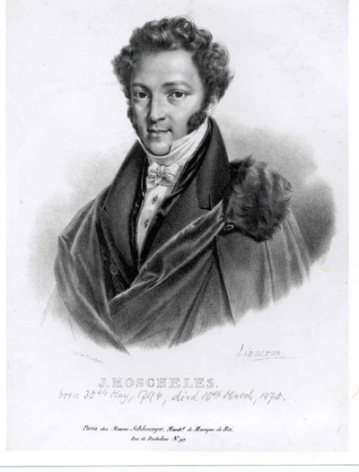
Piano virtuoso and composer
Many works, including:
Ignaz Moscheles (1794-1870)

Slide 61
Piano virtuoso and composer
Many works, including:
Etudes, op. 70 (1825-26)
Ignaz Moscheles (1794-1870)

Slide 62
Piano virtuoso and composer
Many works, including:
Etudes, op. 70 (1825-26)
Op. 70, no. 12, Bb minor (figural repetitions)
Ignaz Moscheles (1794-1870)

Slide 63
Piano virtuoso and composer
Many works, including:
Etudes, op. 70 (1825-26)
Op. 70, no. 12, Bb minor (figural repetitions)
Op. 70, no. 13, D major (etude in thirds)
Ignaz Moscheles (1794-1870)

Slide 64
The Fourteenth Annual Moscheles-Chopin Contest

Slide 65
The Fourteenth Annual Moscheles-Chopin Contest
Moscheles: Op. 70, no. 12, Bb minor Chopin: Op. 25 No. 3, F major

Slide 66
The Fourteenth Annual Moscheles-Chopin Contest
Moscheles: Op. 70, no. 12, Bb minor Chopin: Op. 25 No. 3, F major
Moscheles: Op. 70, no. 13, D major Chopin: Op. 25 No. 6, G-sharp minor

