Slide 1
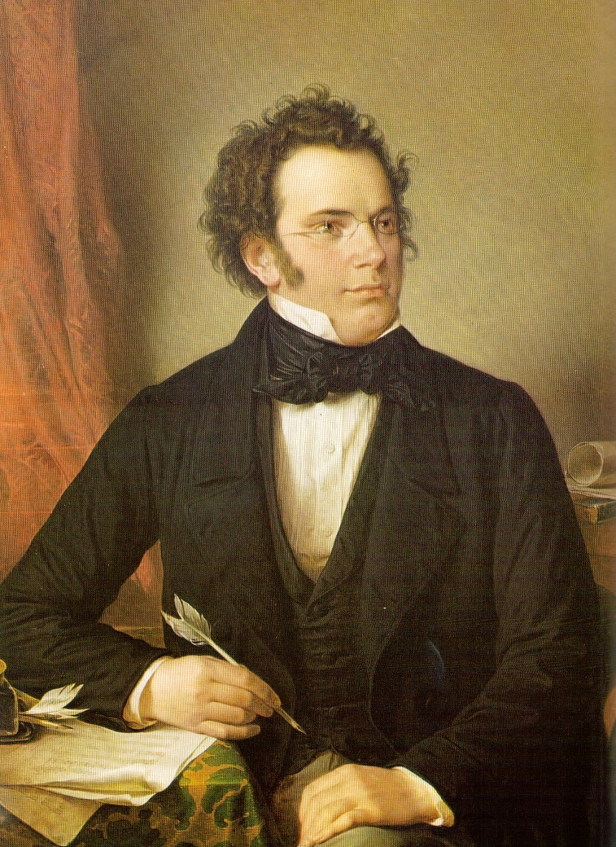
Schubert: Harmonic Style; Instrumental Music

Slide 2
The German Lied:

Slide 3
The German Lied:
German-language art song for solo voice and piano

Slide 4
The German Lied:
German-language art song for solo voice and piano
Poetic text with “art” claims; literary merit (often distinguished,
pre-existing poetry)

Slide 5
The German Lied:
German-language art song for solo voice and piano
Poetic text with “art” claims; literary merit (often distinguished,
pre-existing poetry)
Text: stanzaic verse (disposed in a series of parallel stanzas or strophes)

Slide 6
The German Lied:
German-language art song for solo voice and piano
Poetic text with “art” claims; literary merit (often distinguished,
pre-existing poetry)
Text: stanzaic verse (disposed in a series of parallel stanzas or strophes)
Music: typically, a close reading of the poem, highlighting individual words, phrases, moments. May itself be stanzaic (with the same music for each poetic stanza), through-composed, or anything in between.

Slide 7
The German Lied:
German-language art song for solo voice and piano
Poetic text with “art” claims; literary merit (often distinguished,
pre-existing poetry)
Text: stanzaic verse (disposed in a series of parallel stanzas or strophes)
Music: typically, a close reading of the poem, highlighting individual words, phrases, moments. May itself be stanzaic (with the same music for each poetic stanza), through-composed, or anything in between.
Expressive or illustrative accompaniments (frequently along with telling introductions and postludes in the piano as a frame)

Slide 8
The German Lied:
German-language art song for solo voice and piano
Poetic text with “art” claims; literary merit (often distinguished,
pre-existing poetry)
Text: stanzaic verse (disposed in a series of parallel stanzas or strophes)
Music: typically, a close reading of the poem, highlighting individual words, phrases, moments. May itself be stanzaic (with the same music for each poetic stanza), through-composed, or anything in between.
Expressive or illustrative accompaniments (frequently along with telling introductions and postludes in the piano as a frame)
Often: a prizing of “folk-like” naiveté and simplicity of melody
(the “folk-song ideal”; seeming “artlessness”; Volkston [“folk-tone”])

Slide 9
The German Lied:
German-language art song for solo voice and piano
Poetic text with “art” claims; literary merit (often distinguished,
pre-existing poetry)
Text: stanzaic verse (disposed in a series of parallel stanzas or strophes)
Music: typically, a close reading of the poem, highlighting individual words, phrases, moments. May itself be stanzaic (with the same music for each poetic stanza), through-composed, or anything in between.
Expressive or illustrative accompaniments (frequently along with telling introductions and postludes in the piano as a frame)
Often: a prizing of “folk-like” naiveté and simplicity of melody
(the “folk-song ideal”; seeming “artlessness”; Volkston [“folk-tone”])
Originally intended to be performed privately, in a salon or among a small circle of connoisseurs—not intended for large audiences (“private”)

Slide 10
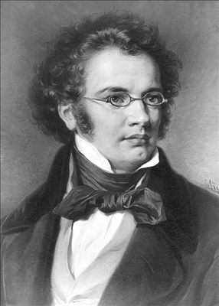
c. 1810
c. 1823
1797
1828

Slide 11
c. 1810
c. 1823
1797
1828
Early Works: Mostly Lighter, Entertainment Genres
Lieder
Viennese Dances, etc.
Only a few works published by 1821
The vast bulk: unpublished in Schubert’s lifetime
Several early, experiments with larger forms (piano sonatas, string quartets, symphonies):
all unpublished in Schubert’s lifetime

Slide 12
c. 1810
c. 1823
1797
1828
Illness
Early Works: Mostly Lighter, Entertainment Genres
Lieder
Viennese Dances, etc.
Only a few works published by 1821
The vast bulk: unpublished in Schubert’s lifetime
Several early, experiments with larger forms (piano sonatas, string quartets, symphonies):
all unpublished in Schubert’s lifetime
A turn to include the composition of larger-scale works: quartets, symphonies, piano sonatas.
Often darker, unsettling in tone;
Often fatalistic, or drifting off into imagined (but lost)
fantasy-dreamscapes.

Slide 13
c. 1823
“Der Doppelgänger” (1828)
c. 1810
1797
1828
Illness
Early Works: Mostly Lighter, Entertainment Genres
Lieder
Viennese Dances, etc.
Only a few works published by 1821
The vast bulk: unpublished in Schubert’s lifetime
Several early, experiments with larger forms (piano sonatas, string quartets, symphonies):
all unpublished in Schubert’s lifetime
A turn to include the composition of larger-scale works: quartets, symphonies, piano sonatas.
Often darker, unsettling in tone;
Often fatalistic, or drifting off into imagined (but lost)
fantasy-dreamscapes.

Slide 14
c. 1810
c. 1823
1797
1828
Illness
Early Works: Mostly Lighter, Entertainment Genres
Lieder
Viennese Dances, etc.
Only a few works published by 1821
The vast bulk: unpublished in Schubert’s lifetime
Several early, experiments with larger forms (piano sonatas, string quartets, symphonies):
all unpublished in Schubert’s lifetime
A turn to include the composition of larger-scale works: quartets, symphonies, piano sonatas.
Often darker, unsettling in tone;
Often fatalistic, or drifting off into imagined (but lost)
fantasy-dreamscapes.

Slide 15
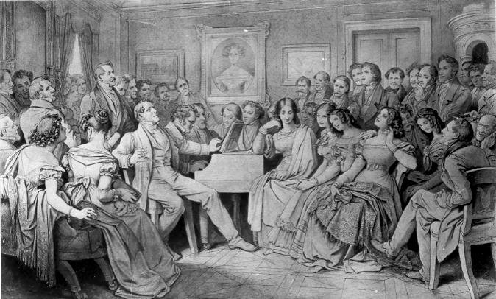
1818-22: “Schubert himself looked back on [those] five . . . years as the happiest of his life, a lost Eden.”
John M. Gingerich,
Schubert’s Beethoven Project (2014), p. 13
Moritz von Schwind, Drawing, 1868:
“A Schubert-Evening at the Home of Joseph von Spaun” [A “Schubertiade”]

Slide 16
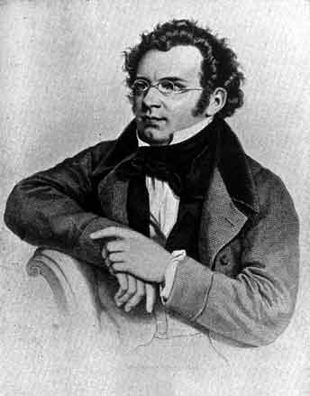
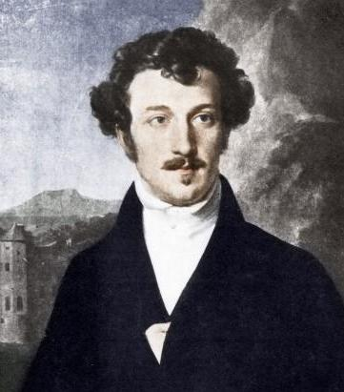
“Who will bring back just one hour of that happy time! That time when we sat together confidingly, and each exposed his artistic children to the others with motherly shyness . . . that time when each inspired the other, and thus a united striving for the highest beauty animated us all.”
Franz Schubert,
Letter to Franz von Schober, 21 September 1824

Slide 17
“Who will bring back just one hour of that happy time! That time when we sat together confidingly, and each exposed his artistic children to the others with motherly shyness . . . that time when each inspired the other, and thus a united striving for the highest beauty animated us all.”
Franz Schubert,
Letter to Franz von Schober, 21 September 1824
F-sharp-minor slow movement
of the Piano Sonata in A, D. 959 (1828)

Slide 18
The Main Lines of Schubert’s Musical Legacy:
Schubert’s Lieder (Collections, Cycles)
Schubert’s Explorations of Expressive Chromatic Harmony
Schubert’s Lyrical, Differing Approach to Sonata Form

Slide 19
The Main Lines of Schubert’s Musical Legacy:
Schubert’s Lieder (Collections, Cycles)
Schubert’s Explorations of Expressive Chromatic Harmony
Schubert’s Lyrical, Differing Approach to Sonata Form

Slide 20
The Individual Lied: Published Separately
Op. 1, “Erlkönig” (1815, four versions, published 1821; ballade by Goethe )
Op. 2, “Gretchen am Spinnrade” (1815, published 1821; text from Goethe’s Faust)
Schubert’s
First-Published Works

Slide 21
The Individual Lied: Published Separately
Op. 1, “Erlkönig” (1815, four versions, published 1821; ballade by Goethe )
Op. 2, “Gretchen am Spinnrade” (1815, published 1821; text from Goethe’s Faust)
Schubert’s
First-Published Works
The Song Set or Collection: A Group of Individual,
Separate Lieder Published Together in a Single Opus
Op. 3, “Three Songs of Goethe” (1814-15, published 1821)
Schwanengesang, D. 957 (1828, published posthumously in 1829; settings of fourteen poems, most by two different poets—Rellstab and Heine)

Slide 22
The Song Cycle (Liederkreis): a narratively connected set of songs, a coherent and integrated whole, meant to be understood and typically performed together, in order.
(Each song: a brief episode or tableau of an ongoing narrative or progressive emotional plan, literal or implied.)
Schubert, Die schöne Müllerin, D. 795 (1823, published 1824 as op. 25; a cycle of 20 songs, texts by Wilhelm Müller)
Schubert, Winterreise, D. 911 (1827-28, published 1828 as op. 89; a cycle of 24 songs, texts by Wilhelm Müller)

Slide 23
Song Cycles: The “Big Seven” (pre-1850)
Beethoven, An die ferne Geliebte, op. 98 (1816, 6 Songs, texts by Alois Jeitteles)
Schubert, Die schöne Müllerin, D. 795 (1823; 20 songs, texts by Wilhelm Müller)
Schubert, Winterreise, D. 911 (1827-28, 24 songs, texts by Wilhelm Müller)
Schumann, Liederkreis, op. 24 (1840, 9 songs, texts by Heinrich Heine)
Schumann, Liederkreis, op. 39 (1840, 12 songs, texts by Joseph von Eichendorff)
Schumann, Frauenliebe und –leben, op. 42 (1840, 8 songs, texts by Adelbert Chamisso)
Schumann, Dichterliebe, op. 48 (1840, 16 songs, texts by Heinrich Heine)

Slide 24
Song Cycles: The “Big Seven” (pre-1850)
Beethoven, An die ferne Geliebte, op. 98 (1816, 6 Songs, texts by Alois Jeitteles)
Schubert, Die schöne Müllerin, D. 795 (1823; 20 songs, texts by Wilhelm Müller)
Schubert, Winterreise, D. 911 (1827-28, 24 songs, texts by Wilhelm Müller)
Schumann, Liederkreis, op. 24 (1840, 9 songs, texts by Heinrich Heine)
Schumann, Liederkreis, op. 39 (1840, 12 songs, texts by Joseph von Eichendorff)
Schumann, Frauenliebe und –leben, op. 42 (1840, 8 songs, texts by Adelbert Chamisso)
Schumann, Dichterliebe, op. 48 (1840, 16 songs, texts by Heinrich Heine)

Slide 25
The Main Lines of Schubert’s Musical Legacy:
Schubert’s Lieder (Collections, Cycles)
Schubert’s Explorations of Expressive Chromatic Harmony
Schubert’s Lyrical, Differing Approach to Sonata Form

Slide 26
Schubert’s Explorations of Expressive Chromatic Harmony
(Expressive Color Shifts)

Slide 27
Schubert’s Explorations of Expressive Chromatic Harmony
(Expressive Color Shifts)
Major-Minor Modal Shifts (“Modal Instability”)

Slide 28
Schubert’s Explorations of Expressive Chromatic Harmony
(Expressive Color Shifts)
Major-Minor Modal Shifts (“Modal Instability”)
Major keys often threaten to be shot through with parallel
minor-mode touches (collapses into minor [I-i, + to -] )

Slide 29
Schubert’s Explorations of Expressive Chromatic Harmony
(Expressive Color Shifts)
Major-Minor Modal Shifts (“Modal Instability”)
Major keys often threaten to be shot through with parallel
minor-mode touches (collapses into minor [I-i, + to -] )
Minor keys sometimes “release” into a dreamlike, fantasy
parallel major (i-I [- to +]): “false hope” or “if only!”)

Slide 30
Schubert, “Gute Nacht,” song 1 from the cycle, Winterreise, D. 911 (1827-28)
Four Stanzas
1 2 3 4
Bb! same same
F (= intensified cycles, imprinting the invariable pattern) G!
d d D D d!

Slide 31
Schubert, “Gute Nacht,” song 1 from the cycle, Winterreise, D. 911 (1827-28)
Four Stanzas
1 2 3 4
Bb! same same
F (= intensified cycles, imprinting the invariable pattern) G!
d d D D d!

Slide 32
Schubert, “Gute Nacht,” song 1 from the cycle, Winterreise, D. 911 (1827-28)
Four Stanzas
1 2 3 4
Bb! same same
F (= intensified cycles, imprinting the invariable pattern) G!
d d D D d!

Slide 33
Schubert, “Gute Nacht,” song 1 from the cycle, Winterreise, D. 911 (1827-28)
Four Stanzas
1 2 3 4
Bb! same same
F (= intensified cycles, imprinting the invariable pattern) G!
d d D D d!

Slide 34
Schubert, “Gute Nacht,” song 1 from the cycle, Winterreise, D. 911 (1827-28)
Four Stanzas
1 2 3 4
Bb! same same
F (= intensified cycles, imprinting the invariable pattern) G!
d d D D d!

Slide 35
Schubert, “Gute Nacht,” song 1 from the cycle, Winterreise, D. 911 (1827-28)
Four Stanzas
1 2 3 4
Bb! same same
F (= intensified cycles, imprinting the invariable pattern) G!
d d D D d!

Slide 36
Schubert’s Explorations of Expressive Chromatic Harmony
(Expressive Color Shifts)
Major-Minor Modal Shifts (“Modal Instability”)
Major keys often threaten to be shot through with parallel
minor-mode touches (collapses into minor [I-i, + to -] )
Minor keys sometimes “release” into a dreamlike, fantasy
parallel major (i-I [- to +]): “false hope” or “if only!”)
Other Chromatic Color Shifts (Sudden Changes of Harmonic Color to Differing, Sometimes Relatively Remote Chords)

Slide 37
The Main Lines of Schubert’s Musical Legacy:
Schubert’s Lieder (Collections, Cycles)
Schubert’s Explorations of Expressive Chromatic Harmony
Schubert’s Lyrical, Differing Approach to Sonata Form

Slide 38
c. 1810
c. 1823
1797
1828
Illness
Early Works: Mostly Lighter, Entertainment Genres
Lieder
Viennese Dances, etc.
Only a few works published by 1821
The vast bulk: unpublished in Schubert’s lifetime
Several early, experiments with larger forms (piano sonatas, string quartets, symphonies):
all unpublished in Schubert’s lifetime
A turn to include the composition of larger-scale works: quartets, symphonies, piano sonatas.
Often darker, unsettling in tone;
Often fatalistic, or drifting off into imagined (but lost)
fantasy-dreamscapes.

Slide 39
8 Symphonies
Nos. 8 & 9 from the 1820s
“23” Piano Sonatas
Along with the “Wanderer Fantasy” for Piano; and the “Grand Duo” in C and Fantasy in F minor for two pianos.
Over 15 String Quartets
The final three, from 1824-26:
a, d, and G
2 Piano Trios (Bb, Eb, 1827-28)
Piano Quintet (“Forelle”) (c. 1819)
String Quintet in C (1828)

Slide 40
Schubert’s Lyrical, Differing Approach to Sonata Form
Often melodic, “songlike” themes (expressively heightened, sensuous pools of melody)

Slide 41
Schubert’s Lyrical, Differing Approach to Sonata Form
Often melodic, “songlike” themes (expressively heightened, sensuous pools of melody)
Usually not “driven” onward, in the Beethovenian sense

Slide 42
Schubert’s Lyrical, Differing Approach to Sonata Form
Often melodic, “songlike” themes (expressively heightened, sensuous pools of melody)
Usually not “driven” onward, in the Beethovenian sense
Thus: a more leisurely pace, lingering, sometimes with a “static” feel—vibrating musical motion “not going anywhere”—or temporarily trapped by internal repetitions within itself

Slide 43
Schubert’s Lyrical, Differing Approach to Sonata Form
Often melodic, “songlike” themes (expressively heightened, sensuous pools of melody)
Usually not “driven” onward, in the Beethovenian sense
Thus: a more leisurely pace, lingering, sometimes with a “static” feel—vibrating musical motion “not going anywhere”—or temporarily trapped by internal repetitions within itself
Frequent undermining of what ought to be solid keys via unexpected harmonic shifts, cadence evasions, deceptive cadences, and the like

Slide 44
Schubert’s Lyrical, Differing Approach to Sonata Form
Often melodic, “songlike” themes (expressively heightened, sensuous pools of melody)
Usually not “driven” onward, in the Beethovenian sense
Thus: a more leisurely pace, lingering, sometimes with a “static” feel—vibrating musical motion “not going anywhere”—or temporarily trapped by internal repetitions within itself
Frequent undermining of what ought to be solid keys via unexpected harmonic shifts, cadence evasions, deceptive cadences, and the like
Hence: a “looser” sense of structure

Slide 45
Schubert’s Lyrical, Differing Approach to Sonata Form
Often melodic, “songlike” themes (expressively heightened, sensuous pools of melody)
Usually not “driven” onward, in the Beethovenian sense
Thus: a more leisurely pace, lingering, sometimes with a “static” feel—vibrating musical motion “not going anywhere”—or temporarily trapped by internal repetitions within itself
Frequent undermining of what ought to be solid keys via unexpected harmonic shifts, cadence evasions, deceptive cadences, and the like
Hence: a “looser” sense of structure
Often: unusual or unorthodox key-plans within expositions and recapitulations; visiting three keys in an exposition is not uncommon
(“three-key expositions”)

Slide 46
Schubert’s “Three-Key” Expositions:
One Typical Model (Major Mode)
V:PAC / EEC
’
’
S^{1.2?}
C
.
.
.
.
S^{1.1?}
TR
often brief
P
fragile, wistful, unstable, sometimes inadequately prepared; often the most “memorable” theme
often lengthy, songlike, seemingly reluctant to leave the tonic
I III? bIII? other? V

Slide 48
Schubert’s Lyrical, Differing Approach to Sonata Form
His sonata-based instrumental compositions (almost all of which were published after his death) include:
8 symphonies (Nos. 1-6, 8-9 [B minor, “Unfinished”; C major])
At least 23 piano sonatas
Much chamber music:
Over 15 string quartets (the last 3 are the principal achievements: A minor, D minor [“Death and the Maiden], G major)
2 celebrated piano trios (Eb, Bb)
“Trout” Quintet, D. 667 (1819)
String Quintet in C, D. 956 (1828)

