Slide 1
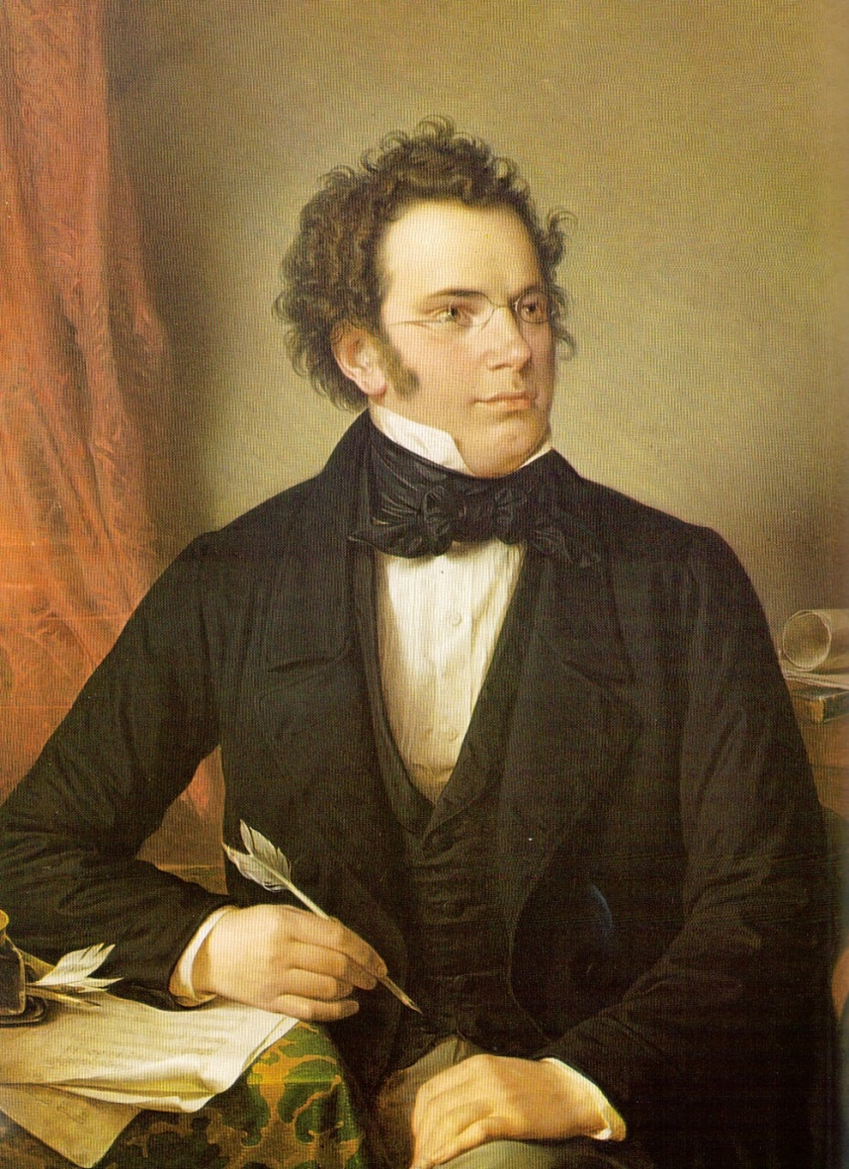
“Romanticism” – and Schubert

Slide 2
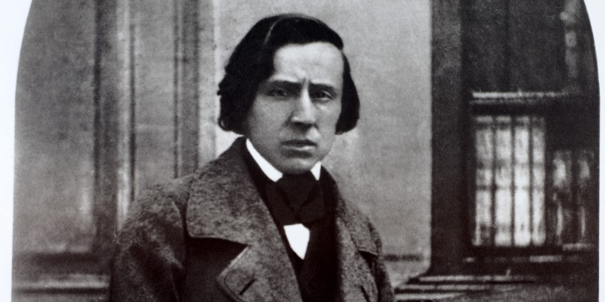
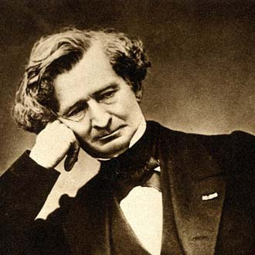
What is “Romanticism” in Music?

Slide 3
What is “Romanticism” in Music?
Taruskin, vol. III, ch. 2
The reliance on individual subjectivity as truth (62) (71)
The “I”: Inwardness, interiority: Innigkeit, Innerlichkeit (63): the “public display of privacy” 63); “private music” allowed to be overheard (63)
Refuge in aestheticism as a bearer of truth, estranged from politics (62)

Slide 4
What is “Romanticism” in Music?
Taruskin, vol. III, ch. 2
The reliance on individual subjectivity as truth (62) (71)
The “I”: Inwardness, interiority: Innigkeit, Innerlichkeit (63): the “public display of privacy” 63); “private music” allowed to be overheard (63)
Refuge in aestheticism as a bearer of truth, estranged from politics (62)
“The music trance” (title of Ch. 2); trances or personal reveries as proper artistic responses for the listener (71)
“Music as trance-induction” (73)—i.e., fusing oneself totally with the tone and processes of the music; total absorption; becoming one with the music
“Altered consciousness” (69); stepping out of real time—and the “real world” into a more purely subjective world

Slide 5
What is “Romanticism” in Music?
Taruskin, vol. III, ch. 2
The reliance on individual subjectivity as truth (62) (71)
The “I”: Inwardness, interiority: Innigkeit, Innerlichkeit (63): the “public display of privacy” 63); “private music” allowed to be overheard (63)
Refuge in aestheticism as a bearer of truth, estranged from politics (62)
“The music trance” (title of Ch. 2); trances or personal reveries as proper artistic responses for the listener (71)
“Music as trance-induction” (73)—i.e., fusing oneself totally with the tone and processes of the music; total absorption; becoming one with the music
“Altered consciousness” (69); stepping out of real time—and the “real world” into a more purely subjective world
Schubert, opening of Symphony No. 8 in B Minor (“Unfinished,” 1822)

Slide 6
What Is “Romanticism” More Generally?

Slide 7
What Is “Romanticism” More Generally?
The subjective restlessness of a new, aesthetic generation—unsettled by the demystifying, secular-rational thrust of modernizing times

Slide 8
What Is “Romanticism” More Generally?
The subjective restlessness of a new, aesthetic generation—unsettled by the demystifying, secular-rational thrust of modernizing times, e.g.,
Enlightenment thought, questioning the metaphysical and spiritual, placing limits on philosophical reflection and personal experience.

Slide 9
What Is “Romanticism” More Generally?
The subjective restlessness of a new, aesthetic generation—unsettled by the demystifying, secular-rational thrust of modernizing times, e.g.,
Enlightenment thought, questioning the metaphysical and spiritual, placing limits on philosophical reflection and personal experience.
The growing impact of science and technology (“industrial revolution”) merged with everyday urban-economic and legal practice: practical concerns and claims that likewise rendered the spiritual increasingly irrelevant.

Slide 10
What Is “Romanticism” More Generally?
The subjective restlessness of a new, aesthetic generation—unsettled by the demystifying, secular-rational thrust of modernizing times, e.g.,
Enlightenment thought, questioning the metaphysical and spiritual, placing limits on philosophical reflection and personal experience.
The growing impact of science and technology (“industrial revolution”) merged with everyday urban-economic and legal practice: practical concerns and claims that likewise rendered the spiritual increasingly irrelevant.
Thus: a search within art, poetry, music, to reinflate the collapsing (collapsed?) canopy of the spirit, the metaphysical—claiming through art and emotion to reach beyond the limits of normative experience.

Slide 11
What Is “Romanticism” More Generally?
The subjective restlessness of a new, aesthetic generation—unsettled by the demystifying, secular-rational thrust of modernizing times, e.g.,
Enlightenment thought, questioning the metaphysical and spiritual, placing limits on philosophical reflection and personal experience.
The growing impact of science and technology (“industrial revolution”) merged with everyday urban-economic and legal practice: practical concerns and claims that likewise rendered the spiritual increasingly irrelevant.
Thus: a search within art, poetry, music, to reinflate the collapsing (collapsed?) canopy of the spirit, the metaphysical—claiming through art and emotion to reach beyond the limits of normative experience.
From this perspective: Germanic “Romanticism” (along with Romantic nationalism) is a counter-Enlightenment movement.

Slide 12
What Is “Romanticism” in Music?

Slide 13
What Is “Romanticism” in Music?
An intricate, internally networked system of new-generational belief:

Slide 14
What Is “Romanticism” in Music?
An intricate, internally networked system of new-generational belief:
A complex dogmatics of faith (faith in music/art), originating in limited circles in Austria (Vienna) and Germany

Slide 15
What Is “Romanticism” in Music?
An intricate, internally networked system of new-generational belief:
A complex dogmatics of faith (faith in music/art), originating in limited circles in Austria (Vienna) and Germany
Central tenet: music as a subjectively devotional practice, in pursuit of deeper, truer experiences—a better, alternative world

Slide 16
What Is “Romanticism” in Music?
An intricate, internally networked system of new-generational belief:
A complex dogmatics of faith (faith in music/art), originating in limited circles in Austria (Vienna) and Germany
Central tenet: music as a subjectively devotional practice, in pursuit of deeper, truer experiences—a better, alternative world
Thus: “The Ongoing Romantic Project”

Slide 17
What Is “Romanticism” in Music?
An intricate, internally networked system of new-generational belief:
A complex dogmatics of faith (faith in music/art), originating in limited circles in Austria (Vienna) and Germany
Central tenet: music as a subjectively devotional practice, in pursuit of deeper, truer experiences—a better, alternative world
Thus: “The Ongoing Romantic Project”
And thus: a new-generational view of music as “Art” (capital-A)—grounded in a spiritualized or metaphysical core; insight; authenticity; disclosure; revelation; truth

Slide 18
What Is “Romanticism” in Music?
An intricate, internally networked system of new-generational belief:
A complex dogmatics of faith (faith in music/art), originating in limited circles in Austria (Vienna) and Germany
Central tenet: music as a subjectively devotional practice, in pursuit of deeper, truer experiences—a better, alternative world
Thus: “The Ongoing Romantic Project”
And thus: a new-generational view of music as “Art” (capital-A)—grounded in a spiritualized or metaphysical core; insight; authenticity; disclosure; revelation; truth
Schubert, Piano Sonata in A, D. 664 (1819)

Slide 19
The “Enlightenment” world, or the “rational” world of cognition and normative interaction.
Here there are limits, borders to our knowledge—to that knowledge only accessible by reason or everyday reflection and action, etc.
Trapped? No escape beyond?

Slide 20
?
?
The “Enlightenment” world, or the “rational” world of cognition and normative interaction.
Here there are limits, borders to our knowledge—to that knowledge only accessible by reason or everyday reflection and action, etc.
Trapped? No escape beyond?
?
?

Slide 21
The External Sublime
Instrumental
music as a conduit, a quasi-sacred mystery; a purifier; a discloser of truth; beyond the limits
Interiority;
The Pre-Cognitive Soul

Slide 22
The External Sublime
Instrumental
music as a conduit, a quasi-sacred mystery; a purifier; a discloser of truth; beyond the limits
Interiority;
The Pre-Cognitive Soul
Schubert, Impromptu in G-flat,
D. 899 (1827)

Slide 23
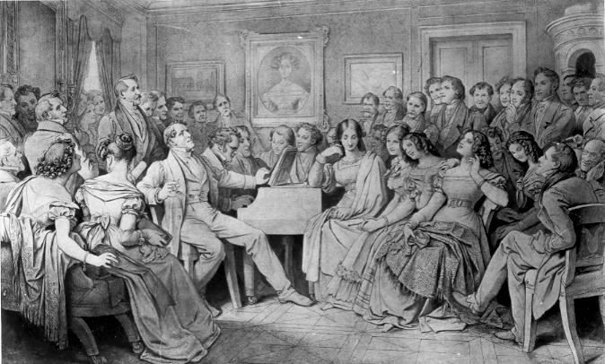
An “aesthetics of absorption”;
“the music trance,” immune from rational critique:
Schubert, Impromptu in G-flat, D. 899 (1827)
Moritz von Schwind, Drawing, 1868:
“A Schubert-Evening at the Home of Joseph von Spaun” [a “Schubertiade”]

Slide 24
An “aesthetics of absorption”;
“the music trance,” immune from rational critique:
Schubert: String Quintet in C, D. 956 (1828), Adagio
Moritz von Schwind, Drawing, 1868:
“A Schubert-Evening at the Home of Joseph von Spaun” [a “Schubertiade”]

Slide 25
An “aesthetics of absorption”;
“the music trance,” immune from rational critique:
Schubert: String Quintet in C, D. 956 (1828), Adagio
Composer
Performer/Listener
Moritz von Schwind, Drawing, 1868:
“A Schubert-Evening at the Home of Joseph von Spaun” [a “Schubertiade”]

Slide 26
“Romanticism” in Music [JH]
An intricate, internally networked system of new-generational belief, a complex dogmatics of faith (faith in music/art). Music as a subjectively devotional practice, in pursuit of deeper, truer experiences. Music as “Art” (capital-A), with a spiritualized or metaphysical core; insight; authenticity; disclosure; revelation; truth.

Slide 27
“Romanticism” in Music [JH]
An intricate, internally networked system of new-generational belief, a complex dogmatics of faith (faith in music/art). Music as a subjectively devotional practice, in pursuit of deeper, truer experiences. Music as “Art” (capital-A), with a spiritualized or metaphysical core; insight; authenticity; disclosure; revelation; truth.
What are the obligations for members of the faithful?

Slide 28
“Romanticism” in Music [JH]
An intricate, internally networked system of new-generational belief, a complex dogmatics of faith (faith in music/art). Music as a subjectively devotional practice, in pursuit of deeper, truer experiences. Music as “Art” (capital-A), with a spiritualized or metaphysical core; insight; authenticity; disclosure; revelation; truth.
What are the obligations for members of the faithful?
1. To pursue the aesthetic cultivation of the self (a personal regimen of Bildung)

Slide 29
“Romanticism” in Music [JH]
An intricate, internally networked system of new-generational belief, a complex dogmatics of faith (faith in music/art). Music as a subjectively devotional practice, in pursuit of deeper, truer experiences. Music as “Art” (capital-A), with a spiritualized or metaphysical core; insight; authenticity; disclosure; revelation; truth.
What are the obligations for members of the faithful?
1. To pursue the aesthetic cultivation of the self (a personal regimen of Bildung)
Embrace and cultivate the highest and best

Slide 30
“Romanticism” in Music [JH]
An intricate, internally networked system of new-generational belief, a complex dogmatics of faith (faith in music/art). Music as a subjectively devotional practice, in pursuit of deeper, truer experiences. Music as “Art” (capital-A), with a spiritualized or metaphysical core; insight; authenticity; disclosure; revelation; truth.
What are the obligations for members of the faithful?
1. To pursue the aesthetic cultivation of the self (a personal regimen of Bildung)
Embrace and cultivate the highest and best
Reject and flee Kitsch: the second-rate, the tawdry, the imitative, the commercial

Slide 31
Schubert, Piano Sonata in A, D. 664 (1819)
Moritz von Schwind, Drawing, 1868:
“A Schubert-Evening at the Home of Joseph von Spaun” [a “Schubertiade”]

Slide 32
“Romanticism” in Music [JH]
An intricate, internally networked system of new-generational belief, a complex dogmatics of faith (faith in music/art). Music as a subjectively devotional practice, in pursuit of deeper, truer experiences. Music as “Art” (capital-A), with a spiritualized or metaphysical core; insight; authenticity; disclosure; revelation; truth.
What are the obligations for members of the faithful?
1. To pursue the aesthetic cultivation of the self (a personal regimen of Bildung)
Embrace and cultivate the highest and best
Reject and flee Kitsch: the second-rate, the tawdry, the imitative, the commercial
2. To understand the romantic/aesthetic program as culture-critical, unwilling
to merge into dominant culture (shallow, deceived, “false consciousness”)

Slide 33
“Romanticism” in Music [JH]
An intricate, internally networked system of new-generational belief, a complex dogmatics of faith (faith in music/art). Music as a subjectively devotional practice, in pursuit of deeper, truer experiences. Music as “Art” (capital-A), with a spiritualized or metaphysical core; insight; authenticity; disclosure; revelation; truth.
What are the obligations for members of the faithful?
1. To pursue the aesthetic cultivation of the self (a personal regimen of Bildung)
Embrace and cultivate the highest and best
Reject and flee Kitsch: the second-rate, the tawdry, the imitative, the commercial
2. To understand the romantic/aesthetic program as culture-critical, unwilling
to merge into dominant culture (shallow, deceived, “false consciousness”)
Thus: the artist viewed as eternal outsider

Slide 34
“Romanticism” in Music [JH]
An intricate, internally networked system of new-generational belief, a complex dogmatics of faith (faith in music/art). Music as a subjectively devotional practice, in pursuit of deeper, truer experiences. Music as “Art” (capital-A), with a spiritualized or metaphysical core; insight; authenticity; disclosure; revelation; truth.
What are the obligations for members of the faithful?
1. To pursue the aesthetic cultivation of the self (a personal regimen of Bildung)
Embrace and cultivate the highest and best
Reject and flee Kitsch: the second-rate, the tawdry, the imitative, the commercial
2. To understand the romantic/aesthetic program as culture-critical, unwilling
to merge into dominant culture (shallow, deceived, “false consciousness”)
Thus: the artist viewed as eternal outsider
Escape, then, into the truer world of music/art

Slide 35
Division of the Experiential Totality into Two Non-Intersecting Worlds

Slide 36
Division of the Experiential Totality into Two Non-Intersecting Worlds
Everyday World

Slide 37
Division of the Experiential Totality into Two Non-Intersecting Worlds
Everyday World
Enlightenment, secular rationality

Slide 38
Division of the Experiential Totality into Two Non-Intersecting Worlds
Everyday World
Enlightenment, secular rationality
Emerging world of commerce, industry, the marketplace, the ordinary

Slide 39
Division of the Experiential Totality into Two Non-Intersecting Worlds
Everyday World
Enlightenment, secular rationality
Emerging world of commerce, industry, the marketplace, the ordinary
Hemmed in by the natural limits of reason

Slide 40
Division of the Experiential Totality into Two Non-Intersecting Worlds
Everyday World
Enlightenment, secular rationality
Emerging world of commerce, industry, the marketplace, the ordinary
Hemmed in by the natural limits of reason
Non-emancipatory (non-redemptive), as in shallow, commonplace life:

Slide 41
Division of the Experiential Totality into Two Non-Intersecting Worlds
Everyday World
Enlightenment, secular rationality
Emerging world of commerce, industry, the marketplace, the ordinary
Hemmed in by the natural limits of reason
Non-emancipatory (non-redemptive), as in shallow, commonplace life:
Business transactions

Slide 42
Division of the Experiential Totality into Two Non-Intersecting Worlds
Everyday World
Enlightenment, secular rationality
Emerging world of commerce, industry, the marketplace, the ordinary
Hemmed in by the natural limits of reason
Non-emancipatory (non-redemptive), as in shallow, commonplace life:
Business transactions
“Objective” scientific inquiry & analysis

Slide 43
Division of the Experiential Totality into Two Non-Intersecting Worlds
Everyday World
Enlightenment, secular rationality
Emerging world of commerce, industry, the marketplace, the ordinary
Hemmed in by the natural limits of reason
Non-emancipatory (non-redemptive), as in shallow, commonplace life:
Business transactions
“Objective” scientific inquiry & analysis
Practical functioning of government

Slide 44
Division of the Experiential Totality into Two Non-Intersecting Worlds
Everyday World
Enlightenment, secular rationality
Emerging world of commerce, industry, the marketplace, the ordinary
Hemmed in by the natural limits of reason
Non-emancipatory (non-redemptive), as in shallow, commonplace life:
Business transactions
“Objective” scientific inquiry & analysis
Practical functioning of government
Commercialized art/Kitsch

Slide 45
Division of the Experiential Totality into Two Non-Intersecting Worlds
Everyday World
Enlightenment, secular rationality
Emerging world of commerce, industry, the marketplace, the ordinary
Hemmed in by the natural limits of reason
Non-emancipatory (non-redemptive), as in shallow, commonplace life:
Business transactions
“Objective” scientific inquiry & analysis
Practical functioning of government
Commercialized art/Kitsch
Methodical systems of explanation (including systems “analyzing” art)

Slide 46
Division of the Experiential Totality into Two Non-Intersecting Worlds
Everyday World
Enlightenment, secular rationality
Emerging world of commerce, industry, the marketplace, the ordinary
Hemmed in by the natural limits of reason
Non-emancipatory (non-redemptive), as in shallow, commonplace life:
Business transactions
“Objective” scientific inquiry & analysis
Practical functioning of government
Commercialized art/Kitsch
Methodical systems of explanation (including systems “analyzing” art)
Indifference to the spiritual

Slide 47
Division of the Experiential Totality into Two Non-Intersecting Worlds
Everyday World
Enlightenment, secular rationality
Emerging world of commerce, industry, the marketplace, the ordinary
Hemmed in by the natural limits of reason
Non-emancipatory (non-redemptive), as in shallow, commonplace life:
Business transactions
“Objective” scientific inquiry & analysis
Practical functioning of government
Commercialized art/Kitsch
Methodical systems of explanation (including systems “analyzing” art)
Indifference to the spiritual
“Public opinion”

Slide 48
Division of the Experiential Totality into Two Non-Intersecting Worlds
Everyday World
Enlightenment, secular rationality
Emerging world of commerce, industry, the marketplace, the ordinary
Hemmed in by the natural limits of reason
Non-emancipatory (non-redemptive), as in shallow, commonplace life:
Business transactions
“Objective” scientific inquiry & analysis
Practical functioning of government
Commercialized art/Kitsch
Methodical systems of explanation (including systems “analyzing” art)
Indifference to the spiritual
“Public opinion”
Blind acceptance of tradition

Slide 49
Division of the Experiential Totality into Two Non-Intersecting Worlds
Everyday World
Enlightenment, secular rationality
Emerging world of commerce, industry, the marketplace, the ordinary
Hemmed in by the natural limits of reason
Non-emancipatory (non-redemptive), as in shallow, commonplace life:
Business transactions
“Objective” scientific inquiry & analysis
Practical functioning of government
Commercialized art/Kitsch
Methodical systems of explanation (including systems “analyzing” art)
Indifference to the spiritual
“Public opinion”
Blind acceptance of tradition
Etc.

Slide 50
Division of the Experiential Totality into Two Non-Intersecting Worlds
Everyday World
Enlightenment, secular rationality
Emerging world of commerce, industry, the marketplace, the ordinary
Hemmed in by the natural limits of reason
Non-emancipatory (non-redemptive), as in shallow, commonplace life:
Business transactions
“Objective” scientific inquiry & analysis
Practical functioning of government
Commercialized art/Kitsch
Methodical systems of explanation (including systems “analyzing” art)
Indifference to the spiritual
“Public opinion”
Blind acceptance of tradition
Etc.

Slide 51
Division of the Experiential Totality into Two Non-Intersecting Worlds
Everyday World
Enlightenment, secular rationality
Emerging world of commerce, industry, the marketplace, the ordinary
Hemmed in by the natural limits of reason
Non-emancipatory (non-redemptive), as in shallow, commonplace life:
Business transactions
“Objective” scientific inquiry & analysis
Practical functioning of government
Commercialized art/Kitsch
Methodical systems of explanation (including systems “analyzing” art)
Indifference to the spiritual
“Public opinion”
Blind acceptance of tradition
Etc.
Idealized, Spiritual World

Slide 52
Division of the Experiential Totality into Two Non-Intersecting Worlds
Everyday World
Enlightenment, secular rationality
Emerging world of commerce, industry, the marketplace, the ordinary
Hemmed in by the natural limits of reason
Non-emancipatory (non-redemptive), as in shallow, commonplace life:
Business transactions
“Objective” scientific inquiry & analysis
Practical functioning of government
Commercialized art/Kitsch
Methodical systems of explanation (including systems “analyzing” art)
Indifference to the spiritual
“Public opinion”
Blind acceptance of tradition
Etc.
Idealized, Spiritual World
“Anti-rational” or “trans (or pre-) rational”

Slide 53
Division of the Experiential Totality into Two Non-Intersecting Worlds
Everyday World
Enlightenment, secular rationality
Emerging world of commerce, industry, the marketplace, the ordinary
Hemmed in by the natural limits of reason
Non-emancipatory (non-redemptive), as in shallow, commonplace life:
Business transactions
“Objective” scientific inquiry & analysis
Practical functioning of government
Commercialized art/Kitsch
Methodical systems of explanation (including systems “analyzing” art)
Indifference to the spiritual
“Public opinion”
Blind acceptance of tradition
Etc.
Idealized, Spiritual World
“Anti-rational” or “trans (or pre-) rational”
“Existential” truth in otherness from the ordinary: healing spaces, private spaces

Slide 54
Division of the Experiential Totality into Two Non-Intersecting Worlds
Everyday World
Enlightenment, secular rationality
Emerging world of commerce, industry, the marketplace, the ordinary
Hemmed in by the natural limits of reason
Non-emancipatory (non-redemptive), as in shallow, commonplace life:
Business transactions
“Objective” scientific inquiry & analysis
Practical functioning of government
Commercialized art/Kitsch
Methodical systems of explanation (including systems “analyzing” art)
Indifference to the spiritual
“Public opinion”
Blind acceptance of tradition
Etc.
Idealized, Spiritual World
“Anti-rational” or “trans (or pre-) rational”
“Existential” truth in otherness from the ordinary: healing spaces, private spaces
Transcendent claims: ineffable access beyond the limits of language and reason

Slide 55
Division of the Experiential Totality into Two Non-Intersecting Worlds
Everyday World
Enlightenment, secular rationality
Emerging world of commerce, industry, the marketplace, the ordinary
Hemmed in by the natural limits of reason
Non-emancipatory (non-redemptive), as in shallow, commonplace life:
Business transactions
“Objective” scientific inquiry & analysis
Practical functioning of government
Commercialized art/Kitsch
Methodical systems of explanation (including systems “analyzing” art)
Indifference to the spiritual
“Public opinion”
Blind acceptance of tradition
Etc.
Idealized, Spiritual World
“Anti-rational” or “trans (or pre-) rational”
“Existential” truth in otherness from the ordinary: healing spaces, private spaces
Transcendent claims: ineffable access beyond the limits of language and reason
Emancipatory (redemptive), with clearly understood sheltering spaces:

Slide 56
Division of the Experiential Totality into Two Non-Intersecting Worlds
Everyday World
Enlightenment, secular rationality
Emerging world of commerce, industry, the marketplace, the ordinary
Hemmed in by the natural limits of reason
Non-emancipatory (non-redemptive), as in shallow, commonplace life:
Business transactions
“Objective” scientific inquiry & analysis
Practical functioning of government
Commercialized art/Kitsch
Methodical systems of explanation (including systems “analyzing” art)
Indifference to the spiritual
“Public opinion”
Blind acceptance of tradition
Etc.
Idealized, Spiritual World
“Anti-rational” or “trans (or pre-) rational”
“Existential” truth in otherness from the ordinary: healing spaces, private spaces
Transcendent claims: ineffable access beyond the limits of language and reason
Emancipatory (redemptive), with clearly understood sheltering spaces:
New modes of religion

Slide 57
Division of the Experiential Totality into Two Non-Intersecting Worlds
Everyday World
Enlightenment, secular rationality
Emerging world of commerce, industry, the marketplace, the ordinary
Hemmed in by the natural limits of reason
Non-emancipatory (non-redemptive), as in shallow, commonplace life:
Business transactions
“Objective” scientific inquiry & analysis
Practical functioning of government
Commercialized art/Kitsch
Methodical systems of explanation (including systems “analyzing” art)
Indifference to the spiritual
“Public opinion”
Blind acceptance of tradition
Etc.
Idealized, Spiritual World
“Anti-rational” or “trans (or pre-) rational”
“Existential” truth in otherness from the ordinary: healing spaces, private spaces
Transcendent claims: ineffable access beyond the limits of language and reason
Emancipatory (redemptive), with clearly understood sheltering spaces:
New modes of religion
Art, literature, music (the “mystery” of sound)

Slide 58
Division of the Experiential Totality into Two Non-Intersecting Worlds
Everyday World
Enlightenment, secular rationality
Emerging world of commerce, industry, the marketplace, the ordinary
Hemmed in by the natural limits of reason
Non-emancipatory (non-redemptive), as in shallow, commonplace life:
Business transactions
“Objective” scientific inquiry & analysis
Practical functioning of government
Commercialized art/Kitsch
Methodical systems of explanation (including systems “analyzing” art)
Indifference to the spiritual
“Public opinion”
Blind acceptance of tradition
Etc.
Idealized, Spiritual World
“Anti-rational” or “trans (or pre-) rational”
“Existential” truth in otherness from the ordinary: healing spaces, private spaces
Transcendent claims: ineffable access beyond the limits of language and reason
Emancipatory (redemptive), with clearly understood sheltering spaces:
New modes of religion
Art, literature, music (the “mystery” of sound)
Nature (as spiritual)

Slide 59
Division of the Experiential Totality into Two Non-Intersecting Worlds
Everyday World
Enlightenment, secular rationality
Emerging world of commerce, industry, the marketplace, the ordinary
Hemmed in by the natural limits of reason
Non-emancipatory (non-redemptive), as in shallow, commonplace life:
Business transactions
“Objective” scientific inquiry & analysis
Practical functioning of government
Commercialized art/Kitsch
Methodical systems of explanation (including systems “analyzing” art)
Indifference to the spiritual
“Public opinion”
Blind acceptance of tradition
Etc.
Idealized, Spiritual World
“Anti-rational” or “trans (or pre-) rational”
“Existential” truth in otherness from the ordinary: healing spaces, private spaces
Transcendent claims: ineffable access beyond the limits of language and reason
Emancipatory (redemptive), with clearly understood sheltering spaces:
New modes of religion
Art, literature, music (the “mystery” of sound)
Nature (as spiritual)
Folk-soul/ethnicity/nation

Slide 60
Division of the Experiential Totality into Two Non-Intersecting Worlds
Everyday World
Enlightenment, secular rationality
Emerging world of commerce, industry, the marketplace, the ordinary
Hemmed in by the natural limits of reason
Non-emancipatory (non-redemptive), as in shallow, commonplace life:
Business transactions
“Objective” scientific inquiry & analysis
Practical functioning of government
Commercialized art/Kitsch
Methodical systems of explanation (including systems “analyzing” art)
Indifference to the spiritual
“Public opinion”
Blind acceptance of tradition
Etc.
Idealized, Spiritual World
“Anti-rational” or “trans (or pre-) rational”
“Existential” truth in otherness from the ordinary: healing spaces, private spaces
Transcendent claims: ineffable access beyond the limits of language and reason
Emancipatory (redemptive), with clearly understood sheltering spaces:
New modes of religion
Art, literature, music (the “mystery” of sound)
Nature (as spiritual)
Folk-soul/ethnicity/nation
Domestic life: woman (the feminine), child

Slide 61
Division of the Experiential Totality into Two Non-Intersecting Worlds
Everyday World
Enlightenment, secular rationality
Emerging world of commerce, industry, the marketplace, the ordinary
Hemmed in by the natural limits of reason
Non-emancipatory (non-redemptive), as in shallow, commonplace life:
Business transactions
“Objective” scientific inquiry & analysis
Practical functioning of government
Commercialized art/Kitsch
Methodical systems of explanation (including systems “analyzing” art)
Indifference to the spiritual
“Public opinion”
Blind acceptance of tradition
Etc.
Idealized, Spiritual World
“Anti-rational” or “trans (or pre-) rational”
“Existential” truth in otherness from the ordinary: healing spaces, private spaces
Transcendent claims: ineffable access beyond the limits of language and reason
Emancipatory (redemptive), with clearly understood sheltering spaces:
New modes of religion
Art, literature, music (the “mystery” of sound)
Nature (as spiritual)
Folk-soul/ethnicity/nation
Domestic life: woman (the feminine), child
Men (the masculine) as priestlike, disclosers of otherwise unutterable truths

Slide 62
Division of the Experiential Totality into Two Non-Intersecting Worlds
Everyday World
Enlightenment, secular rationality
Emerging world of commerce, industry, the marketplace, the ordinary
Hemmed in by the natural limits of reason
Non-emancipatory (non-redemptive), as in shallow, commonplace life:
Business transactions
“Objective” scientific inquiry & analysis
Practical functioning of government
Commercialized art/Kitsch
Methodical systems of explanation (including systems “analyzing” art)
Indifference to the spiritual
“Public opinion”
Blind acceptance of tradition
Etc.
Idealized, Spiritual World
“Anti-rational” or “trans (or pre-) rational”
“Existential” truth in otherness from the ordinary: healing spaces, private spaces
Transcendent claims: ineffable access beyond the limits of language and reason
Emancipatory (redemptive), with clearly understood sheltering spaces:
New modes of religion
Art, literature, music (the “mystery” of sound)
Nature (as spiritual)
Folk-soul/ethnicity/nation
Domestic life: woman (the feminine), child
Men (the masculine) as priestlike, disclosers of otherwise unutterable truths
Preservation of the great artworks

Slide 63
Division of the Experiential Totality into Two Non-Intersecting Worlds
Everyday World
Enlightenment, secular rationality
Emerging world of commerce, industry, the marketplace, the ordinary
Hemmed in by the natural limits of reason
Non-emancipatory (non-redemptive), as in shallow, commonplace life:
Business transactions
“Objective” scientific inquiry & analysis
Practical functioning of government
Commercialized art/Kitsch
Methodical systems of explanation (including systems “analyzing” art)
Indifference to the spiritual
“Public opinion”
Blind acceptance of tradition
Etc.
Idealized, Spiritual World
“Anti-rational” or “trans (or pre-) rational”
“Existential” truth in otherness from the ordinary: healing spaces, private spaces
Transcendent claims: ineffable access beyond the limits of language and reason
Emancipatory (redemptive), with clearly understood sheltering spaces:
New modes of religion
Art, literature, music (the “mystery” of sound)
Nature (as spiritual)
Folk-soul/ethnicity/nation
Domestic life: woman (the feminine), child
Men (the masculine) as priestlike, disclosers of otherwise unutterable truths
Preservation of the great artworks
The pre-modern past (pre-Enlightenment)

Slide 64
Division of the Experiential Totality into Two Non-Intersecting Worlds
Everyday World
Enlightenment, secular rationality
Emerging world of commerce, industry, the marketplace, the ordinary
Hemmed in by the natural limits of reason
Non-emancipatory (non-redemptive), as in shallow, commonplace life:
Business transactions
“Objective” scientific inquiry & analysis
Practical functioning of government
Commercialized art/Kitsch
Methodical systems of explanation (including systems “analyzing” art)
Indifference to the spiritual
“Public opinion”
Blind acceptance of tradition
Etc.
Idealized, Spiritual World
“Anti-rational” or “trans (or pre-) rational”
“Existential” truth in otherness from the ordinary: healing spaces, private spaces
Transcendent claims: ineffable access beyond the limits of language and reason
Emancipatory (redemptive), with clearly understood sheltering spaces:
New modes of religion
Art, literature, music (the “mystery” of sound)
Nature (as spiritual)
Folk-soul/ethnicity/nation
Domestic life: woman (the feminine), child
Men (the masculine) as priestlike, disclosers of otherwise unutterable truths
Preservation of the great artworks
The pre-modern past (pre-Enlightenment)
The macabre, grotesque

Slide 65
Division of the Experiential Totality into Two Non-Intersecting Worlds
Everyday World
Enlightenment, secular rationality
Emerging world of commerce, industry, the marketplace, the ordinary
Hemmed in by the natural limits of reason
Non-emancipatory (non-redemptive), as in shallow, commonplace life:
Business transactions
“Objective” scientific inquiry & analysis
Practical functioning of government
Commercialized art/Kitsch
Methodical systems of explanation (including systems “analyzing” art)
Indifference to the spiritual
“Public opinion”
Blind acceptance of tradition
Etc.
Idealized, Spiritual World
“Anti-rational” or “trans (or pre-) rational”
“Existential” truth in otherness from the ordinary: healing spaces, private spaces
Transcendent claims: ineffable access beyond the limits of language and reason
Emancipatory (redemptive), with clearly understood sheltering spaces:
New modes of religion
Art, literature, music (the “mystery” of sound)
Nature (as spiritual)
Folk-soul/ethnicity/nation
Domestic life: woman (the feminine), child
Men (the masculine) as priestlike, disclosers of otherwise unutterable truths
Preservation of the great artworks
The pre-modern past (pre-Enlightenment)
The macabre, grotesque

Slide 66
Division of the Experiential Totality into Two Non-Intersecting Worlds
Everyday World
Enlightenment, secular rationality
Emerging world of commerce, industry, the marketplace, the ordinary
Hemmed in by the natural limits of reason
Non-emancipatory (non-redemptive), as in shallow, commonplace life:
Business transactions
“Objective” scientific inquiry & analysis
Practical functioning of government
Commercialized art/Kitsch
Methodical systems of explanation (including systems “analyzing” art)
Indifference to the spiritual
“Public opinion”
Blind acceptance of tradition
Etc.
Idealized, Spiritual World
“Anti-rational” or “trans (or pre-) rational”
“Existential” truth in otherness from the ordinary: healing spaces, private spaces
Transcendent claims: ineffable access beyond the limits of language and reason
Emancipatory (redemptive), with clearly understood sheltering spaces:
New modes of religion
Art, literature, music (the “mystery” of sound)
Nature (as spiritual)
Folk-soul/ethnicity/nation
Domestic life: woman (the feminine), child
Men (the masculine) as priestlike, disclosers of otherwise unutterable truths
Preservation of the great artworks
The pre-modern past (pre-Enlightenment)
The macabre, grotesque

Slide 67
The German Lied:

Slide 68
The German Lied:
German-language art song for solo voice and piano

Slide 69
The German Lied:
German-language art song for solo voice and piano
Poetic text with “art” claims; literary merit (often distinguished,
pre-existing poetry)

Slide 70
The German Lied:
German-language art song for solo voice and piano
Poetic text with “art” claims; literary merit (often distinguished,
pre-existing poetry)
Text: stanzaic verse (disposed in a series of parallel stanzas or strophes)

Slide 71
The German Lied:
German-language art song for solo voice and piano
Poetic text with “art” claims; literary merit (often distinguished,
pre-existing poetry)
Text: stanzaic verse (disposed in a series of parallel stanzas or strophes)
Music: typically, a close reading of the poem, highlighting individual words, phrases, moments

Slide 72
The German Lied:
German-language art song for solo voice and piano
Poetic text with “art” claims; literary merit (often distinguished,
pre-existing poetry)
Text: stanzaic verse (disposed in a series of parallel stanzas or strophes)
Music: typically, a close reading of the poem, highlighting individual words, phrases, moments
Expressive or illustrative accompaniments (frequently along with telling introductions and postludes in the piano as a frame)

Slide 73
The German Lied:
German-language art song for solo voice and piano
Poetic text with “art” claims; literary merit (often distinguished,
pre-existing poetry)
Text: stanzaic verse (disposed in a series of parallel stanzas or strophes)
Music: typically, a close reading of the poem, highlighting individual words, phrases, moments
Expressive or illustrative accompaniments (frequently along with telling introductions and postludes in the piano as a frame)
Often: a prizing of “folk-like” naiveté and simplicity of melody
(the “folk-song ideal”; seeming “artlessness”; Volkston [“folk-tone”])

Slide 74
The German Lied:
German-language art song for solo voice and piano
Poetic text with “art” claims; literary merit (often distinguished,
pre-existing poetry)
Text: stanzaic verse (disposed in a series of parallel stanzas or strophes)
Music: typically, a close reading of the poem, highlighting individual words, phrases, moments
Expressive or illustrative accompaniments (frequently along with telling introductions and postludes in the piano as a frame)
Often: a prizing of “folk-like” naiveté and simplicity of melody
(the “folk-song ideal”; seeming “artlessness”; Volkston [“folk-tone”])
Originally intended to be performed privately, in a salon or among a small circle of connoisseurs—not intended for large audiences (“private”)

