Slide 1
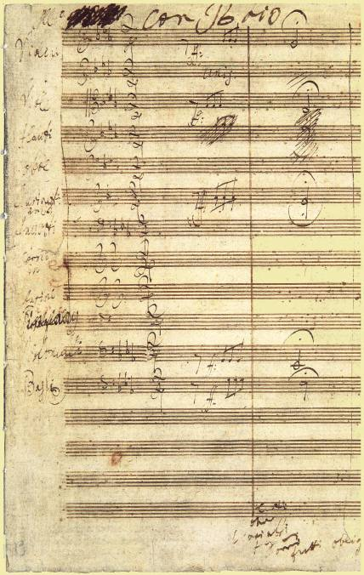
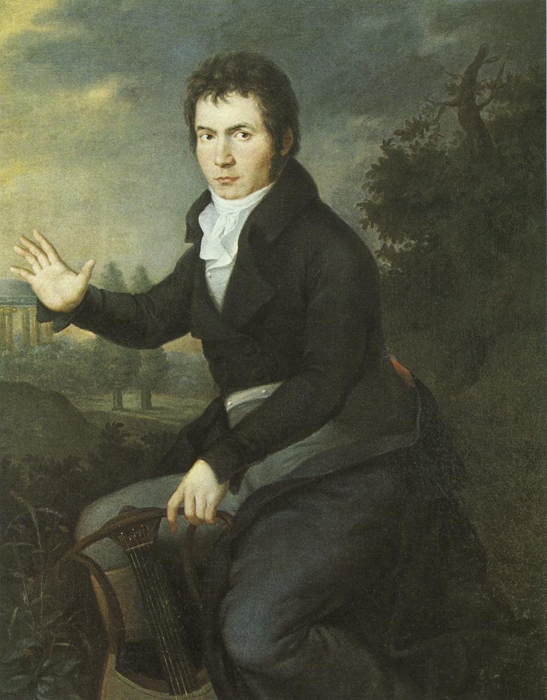
Symphony No. 5, movements 2, 3, and 4

Slide 2
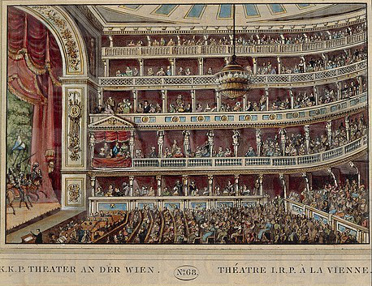
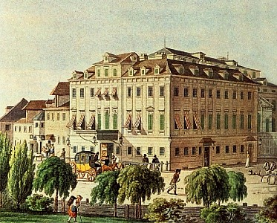
Beethoven: Akademie Concert, December 22, 1808: Theater an der Wien

Slide 3
Beethoven: Akademie Concert, December 22, 1808: Theater an der Wien
Grand Symphony No. 5 [sic], “A Recollection of Country Life”
Concert Aria, “Ah, perfido,” op. 65
“Gloria” from the Mass in C , op. 86
Piano Concerto No. 4 in G, op. 58
-------
Grand Symphony in C Minor, No. 6 [sic]
“Sanctus” from the Mass in C, op. 86
Fantasia—Improvisation
Choral Fantasy, op. 80

Slide 4
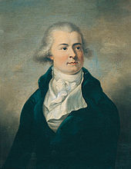
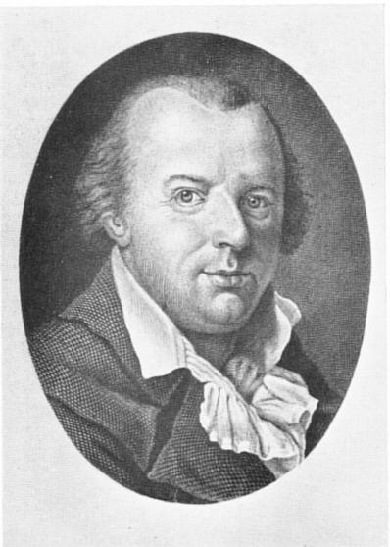
Prince Lobkowitz
Johann Friedrich Reichardt

Slide 5
Prince Lobkowitz
“In the bitterest cold [for four hours, we] experienced
the truth that one can have too much of a good thing.”
Johann Friedrich Reichardt:

Slide 6
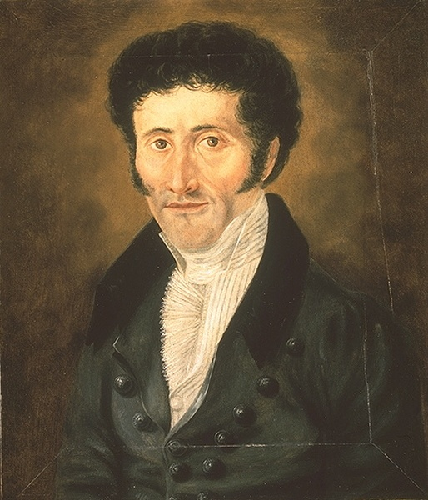
1810 Review of Beethoven’s Fifth Symphony
(Allgemeine musikalische Zeitung)
“[Music] opens up to the realm of the monstrous and immeasurable. . . . [Music] is the most romantic of all the arts . . . for its sole object is the expression
of the infinite. . . . Music discloses to man an unknown kingdom, a world having nothing in common with the external sensual world . . . a spirit world . . . a kingdom not of this world.”
E.T.A. Hoffmann (1776-1822)

Slide 7
1810 Review of Beethoven’s Fifth Symphony
(Allgemeine musikalische Zeitung)
“[Music] opens up to the realm of the monstrous and immeasurable. . . . [Music] is the most romantic of all the arts . . . for its sole object is the expression
of the infinite. . . . Music discloses to man an unknown kingdom, a world having nothing in common with the external sensual world . . . a spirit world . . . a kingdom not of this world.”
E.T.A. Hoffmann (1776-1822)
This seeks to turn instrumental music’s perennial “problem” [vagueness, lack of specificity] into the solution: precisely because it is vague, it is capable of leading us beyond the confining chains of language.

Slide 8
Immeasurable vastness of size and volume beyond our comprehension; uncommon magnitude or intensity of feeling, often associated with fear, horror . . . or revelation.
Evocations of “The Sublime”
(Rather than “The Beautiful”)
Edmund Burke, A Philosophical Inquiry into the Origin of the Ideas of the Sublime and Beautiful (1756)
Immanuel Kant, Critique of Judgment (1790)
E.T.A Hoffmann on Beethoven’s Fifth Symphony (1810): “open[s] the realm of the colossal and the immeasurable . . . induces terror, fright, horror, and pain and awakens that endless longing that is the essence of romanticism.”

Slide 9
Sonata
Slow
Minuet/Scherzo
Finale
1
2
3
4
Major:
Tonic Off-tonic? Tonic Tonic
(IV, V, i)
Minor:
Tonic Off-tonic? Tonic Tonic
(III, I, VI) major or minor
Beethoven’s Symphony No. 5, op. 67
C minor Ab major C minor C major!

Slide 10
Sonata
Slow
Minuet/Scherzo
Finale
1
2
3
4
Major:
Tonic Off-tonic? Tonic Tonic
(IV, V, i)
Minor:
Tonic Off-tonic? Tonic Tonic
(III, I, VI) major or minor
Beethoven’s Symphony No. 5, op. 67
C minor Ab major C minor C major!

Slide 11
Minuet-Trio (or Scherzo-Trio) Form (Compound Rounded Binary/Small Ternary)
Da Capo
I:PAC
.
.
.
.
.
.
.
.
.
.
.
.
.
.
.
.
A B A’ C D C’
Global Tonic Key
Various Key Options
“Minuet” (“Scherzo”) “Trio”

Slide 12
Minuet-Trio (or Scherzo-Trio) Form (Compound Rounded Binary/Small Ternary)
Da Capo
I:PAC
.
.
.
.
.
.
.
.
.
.
.
.
.
.
.
.
A B A’ C D C’
Global Tonic Key
Various Key Options
“Minuet” (“Scherzo”) “Trio”
Beethoven, Symphony No. 5, Scherzo
i:PAC
iii: HC iv:HC
Varied Da Capo!
1 2 3
.
.
.
.
.
.
.
.
C D C’
Global Tonic Key (C minor)
C major! [fugato!]
“Scherzo” “Trio”

Slide 13
V?

Slide 14
Sonata
Slow
Minuet/Scherzo
Finale
1
2
3
4
Major:
Tonic Off-tonic? Tonic Tonic
(IV, V, i)
Minor:
Tonic Off-tonic? Tonic Tonic
(III, I, VI) major or minor
Beethoven’s Symphony No. 5, op. 67
C minor Ab major C minor C major!

Slide 15
Beethoven, Symphony No. 5, finale
S^{1.1}
S^{1.2}
Exposition
.
.
.
.
P
TR
V
I
Developmental Space
Recapitulation
P
TR
S^{1.1}
S^{1.2}
I I
Tonal Resolution

Slide 16
Beethoven, Symphony No. 5, finale
V: PAC (EEC)
Essential Expositional Closure
What we anticipate:
S^{1.1}
S^{1.2}
Exposition
.
.
.
.
P
TR
V
I
Developmental Space
I: PAC (ESC)
Essential Structural Closure
Recapitulation
P
TR
S^{1.1}
S^{1.2}
I I
Tonal Resolution

Slide 17
Beethoven, Symphony No. 5, finale
V: PAC (EEC)
Essential Expositional Closure
What we anticipate:
S^{1.1}
S^{1.2}
Exposition
.
.
.
.
P
TR
V
I
Developmental Space
I: PAC (ESC)
Essential Structural Closure
Recapitulation
P
TR
S^{1.1}
S^{1.2}
“Victory!”
I I
Tonal Resolution

Slide 18
Beethoven, Symphony No. 5, finale
S^{1.1}
S^{1.2}
Exposition
.
.
.
.
P
TR
V
I
Developmental Space
Recapitulation
P
TR
S^{1.1}
S^{1.2}
I I
Tonal Resolution

Slide 19
Beethoven, Symphony No. 5, finale
S^{1.1}
S^{1.2}
Exposition
.
.
.
.
P
TR
V
I
Developmental Space
Recapitulation
P
TR
S^{1.1}
S^{1.2}
I I
Tonal Resolution

Slide 20
Beethoven, Symphony No. 5, finale
S^{1.1}
S^{1.2}
Exposition
.
.
.
.
P
TR
V
I
Developmental Space
Recapitulation
P
TR
S^{1.1}
S^{1.2}
I I
Tonal Resolution

Slide 21
Beethoven, Symphony No. 5, finale
S^{1.1}
S^{1.2}
Exposition
.
.
.
.
P
TR
V
I
Developmental Space
Recapitulation
P
TR
S^{1.1}
S^{1.2}
I I
Tonal Resolution

Slide 22
Beethoven, Symphony No. 5, finale
No EEC!
“Failed Exposition!”
S^{1.1}
S^{1.2}
Exposition
.
.
.
.
P
TR
V
Crisis!
I
Developmental Space
Recapitulation
P
TR
S^{1.1}
S^{1.2}
I I
Tonal Resolution

Slide 23
Beethoven, Symphony No. 5, finale
S^{1.1}
S^{1.2}
Exposition
.
.
.
.
P
TR
V
I
Developmental Space
Recapitulation
P
TR
S^{1.1}
S^{1.2}
I I
Tonal Resolution

Slide 24
Beethoven, Symphony No. 5, finale
S^{1.1}
S^{1.2}
Exposition
.
.
.
.
P
TR
V
I
Developmental Space
Recapitulation
P
TR
S^{1.1}
S^{1.2}
I I
Tonal Resolution

Slide 25
Beethoven, Symphony No. 5, finale
S^{1.1}
S^{1.2}
Exposition
.
.
.
.
P
TR
V
I
Developmental Space
Recapitulation
P
TR
S^{1.1}
S^{1.2}
I I
Tonal Resolution

Slide 26
Beethoven, Symphony No. 5, finale
S^{1.1}
S^{1.2}
Exposition
.
.
.
.
P
TR
V
I
Developmental Space
Recapitulation
P
TR
S^{1.1}
S^{1.2}
I I
Tonal Resolution

Slide 27
Beethoven, Symphony No. 5, finale
No EEC!
“Failed Exposition!”
S^{1.1}
S^{1.2}
Exposition
.
.
.
.
P
TR
V
Crisis!
I
Developmental Space
Recapitulation
P
TR
S^{1.1}
S^{1.2}
I I
Tonal Resolution

Slide 28
Beethoven, Symphony No. 5, finale
No EEC!
“Failed Exposition!”
S^{1.1}
S^{1.2}
Exposition
.
.
.
.
P
TR
V
Crisis!
“Onward!”
I
Developmental Space
Recapitulation
P
TR
S^{1.1}
S^{1.2}
I I
Tonal Resolution

Slide 29
Beethoven, Symphony No. 5, finale
No EEC!
“Failed Exposition!”
S^{1.1}
S^{1.2}
Exposition
.
.
.
.
P
TR
V
Crisis!
“Onward!”
I
!!
Developmental Space
Return of Scherzo!
(and minor-mode “threat”)
Recapitulation
P
TR
S^{1.1}
S^{1.2}
I I
Tonal Resolution

Slide 30
Beethoven, Symphony No. 5, finale
No EEC!
“Failed Exposition!”
S^{1.1}
S^{1.2}
Exposition
.
.
.
.
P
TR
V
Crisis!
“Onward!”
I
!!
Developmental Space
Return of Scherzo!
(and minor-mode “threat”)
Recapitulation
P
TR
S^{1.1}
S^{1.2}
I I
Tonal Resolution

Slide 31
Beethoven, Symphony No. 5, finale
No EEC!
“Failed Exposition!”
S^{1.1}
S^{1.2}
Exposition
.
.
.
.
P
TR
V
Crisis!
“Onward!”
I
!!
Developmental Space
Return of Scherzo!
(and minor-mode “threat”)
Recapitulation
P
TR
S^{1.1}
S^{1.2}
I I
Tonal Resolution

Slide 32
Beethoven, Symphony No. 5, finale
No EEC!
“Failed Exposition!”
S^{1.1}
S^{1.2}
Exposition
.
.
.
.
P
TR
V
Crisis!
“Onward!”
I
!!
Developmental Space
Return of Scherzo!
(and minor-mode “threat”)
Recapitulation
P
TR
S^{1.1}
S^{1.2}
I I
Tonal Resolution

Slide 33
Beethoven, Symphony No. 5, finale
No EEC!
“Failed Exposition!”
S^{1.1}
S^{1.2}
Exposition
.
.
.
.
P
TR
V
Crisis!
“Onward!”
I
!!
Developmental Space
Return of Scherzo!
(and minor-mode “threat”)
Recapitulation
P
TR
S^{1.1}
S^{1.2}
I I
Tonal Resolution

Slide 34
Beethoven, Symphony No. 5, finale
No EEC!
“Failed Exposition!”
S^{1.1}
S^{1.2}
Exposition
.
.
.
.
P
TR
V
Crisis!
“Onward!”
I
!!
Developmental Space
Return of Scherzo!
(and minor-mode “threat”)
Recapitulation
No ESC!
“Failed Sonata!”
P
TR
S^{1.1}
S^{1.2}
I I
Tonal Resolution

Slide 35
Beethoven, Symphony No. 5, finale
No EEC!
“Failed Exposition!”
S^{1.1}
S^{1.2}
Exposition
.
.
.
.
P
TR
V
Crisis!
“Onward!”
I
!!
Developmental Space
Return of Scherzo!
(and minor-mode “threat”)
Recapitulation
No ESC!
“Failed Sonata!”
P
TR
S^{1.1}
S^{1.2}
CODA! Must secure
The “missing” I:PAC!
I I
Tonal Resolution

Slide 36
Beethoven, Symphony No. 5, finale
No EEC!
“Failed Exposition!”
S^{1.1}
S^{1.2}
Exposition
.
.
.
.
P
TR
V
Crisis!
“Onward!”
I
!!
Developmental Space
Return of Scherzo!
(and minor-mode “threat”)
I:PAC!!
ESC!
Success!
Recapitulation
No ESC!
“Failed Sonata!”
P
TR
S^{1.1}
S^{1.2}
CODA! Must secure
The “missing” I:PAC!
I I
Tonal Resolution

