Slide 1
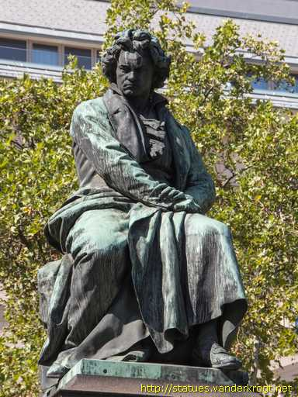
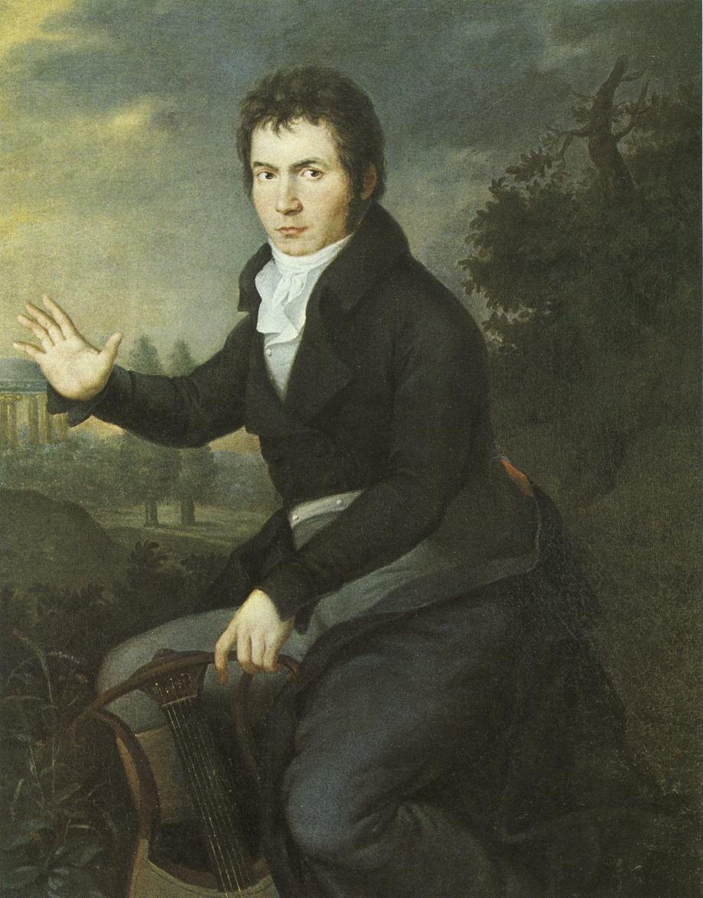
Beethoven: Leading Ideas and the Fifth Symphony

Slide 2
In Certain of Vienna’s Elite Musical Circles, c. 1780-1810:
The Elevation and Validation of New, Higher Claims for Instrumental Music

Slide 3
In Certain of Vienna’s Elite Musical Circles, c. 1780-1810:
The Elevation and Validation of New, Higher Claims for Instrumental Music
From: To (supplementary claims):
Language of the heart/emotions Language of the soul/mind

Slide 4
In Certain of Vienna’s Elite Musical Circles, c. 1780-1810:
The Elevation and Validation of New, Higher Claims for Instrumental Music
From: To (supplementary claims):
Language of the heart/emotions Language of the soul/mind
Idealized emotion Idealized “thought”/spirit

Slide 5
In Certain of Vienna’s Elite Musical Circles, c. 1780-1810:
The Elevation and Validation of New, Higher Claims for Instrumental Music
From: To (supplementary claims):
Language of the heart/emotions Language of the soul/mind
Idealized emotion Idealized “thought”/spirit
Tasteful entertainment Earnest personal confession;
a devotional practice

Slide 6
In Certain of Vienna’s Elite Musical Circles, c. 1780-1810:
The Elevation and Validation of New, Higher Claims for Instrumental Music
From: To (supplementary claims):
Language of the heart/emotions Language of the soul/mind
Idealized emotion Idealized “thought”/spirit
Tasteful entertainment Earnest personal confession;
a devotional practice
A mere grace of life Ideal sphere of autonomous
beauty and high craft

Slide 7
In Certain of Vienna’s Elite Musical Circles, c. 1780-1810:
The Elevation and Validation of New, Higher Claims for Instrumental Music
From: To (supplementary claims):
Language of the heart/emotions Language of the soul/mind
Idealized emotion Idealized “thought”/spirit
Tasteful entertainment Earnest personal confession;
a devotional practice
A mere grace of life Ideal sphere of autonomous
beauty and high craft
A badge of social prestige, wealth, An spiritual enactment capable or taste of stirring and healing the soul: moral and physical benefits

Slide 8
The “Ideology of the Aesthetic,”
enabled by the “Profundity Contract”: A Feedback Loop (c. 1790ff)
Composer
Performer/Listener

Slide 9
Friedrich Schiller: art as the ultimate pursuit in the perfection of humanity

Slide 10
Friedrich Schiller: art as the ultimate pursuit in the perfection of humanity
Wilhelm Wackenroder: “music as motions of the soul” (Taruskin, II, 399)

Slide 11
Friedrich Schiller: art as the ultimate pursuit in the perfection of humanity
Wilhelm Wackenroder: “music as motions of the soul” (Taruskin, II, 399)
E. T. A. Hoffmann: Beethoven leads us “into the spirit realm . . . disclosing the infinite”

Slide 12
Friedrich Schiller: art as the ultimate pursuit in the perfection of humanity
Wilhelm Wackenroder: “music as motions of the soul” (Taruskin, II, 399)
E. T. A. Hoffmann: Beethoven leads us “into the spirit realm . . . disclosing the infinite”
Friedrich Wilhelm Joseph Schelling: art presents to us “the forms of eternal things”

Slide 13
But how can we validate “music as thought”
(rather than regard it as merely tasteful entertainment)?
1. “Poetic Ideas”
Political connotations (dramatized musical myths of struggle and liberation)
Nature images or references
Deep personal contemplation (music as “depth”)

Slide 14
But how can we validate “music as thought”
(rather than regard it as merely tasteful entertainment)?
1. “Poetic Ideas”
Political connotations (dramatized musical myths of struggle and liberation)
Nature images or references
Deep personal contemplation (music as “depth”)
2. Music as Primal Gesture

Slide 15
But how can we validate “music as thought”
(rather than regard it as merely tasteful entertainment)?
1. “Poetic Ideas”
Political connotations (dramatized musical myths of struggle and liberation)
Nature images or references
Deep personal contemplation (music as “depth”)
2. Music as Primal Gesture
3. Monumentality

Slide 16
But how can we validate “music as thought”
(rather than regard it as merely tasteful entertainment)?
1. “Poetic Ideas”
Political connotations (dramatized musical myths of struggle and liberation)
Nature images or references
Deep personal contemplation (music as “depth”)
2. Music as Primal Gesture
3. Monumentality
Breakthroughs beyond earlier limits of high-galant taste in such aspects as:
dimensions of individual movements or parts thereof
dramatic tension, suspense, mystery, shock
roughness, accent, dissonance
loudness and “noise”

Slide 17
But how can we validate “music as thought”
(rather than regard it as merely tasteful entertainment)?
1. “Poetic Ideas”
Political connotations (dramatized musical myths of struggle and liberation)
Nature images or references
Deep personal contemplation (music as “depth”)
2. Music as Primal Gesture
3. Monumentality
4. Individualization of the Artwork

Slide 18
But how can we validate “music as thought”
(rather than regard it as merely tasteful entertainment)?
1. “Poetic Ideas”
Political connotations (dramatized musical myths of struggle and liberation)
Nature images or references
Deep personal contemplation (music as “depth”)
2. Music as Primal Gesture
3. Monumentality
4. Individualization of the Artwork
Shift from “generic expression” to “individualized expression,” in which
each work is a unique utterance, not merely a well-crafted exemplar of a genre.

Slide 19
But how can we validate “music as thought”
(rather than regard it as merely tasteful entertainment)?
1. “Poetic Ideas”
Political connotations (dramatized musical myths of struggle and liberation)
Nature images or references
Deep personal contemplation (music as “depth”)
2. Music as Primal Gesture
3. Monumentality
4. Individualization of the Artwork
5. Enhanced Dramatic/Motivic Coherence from Moment to Moment

Slide 20
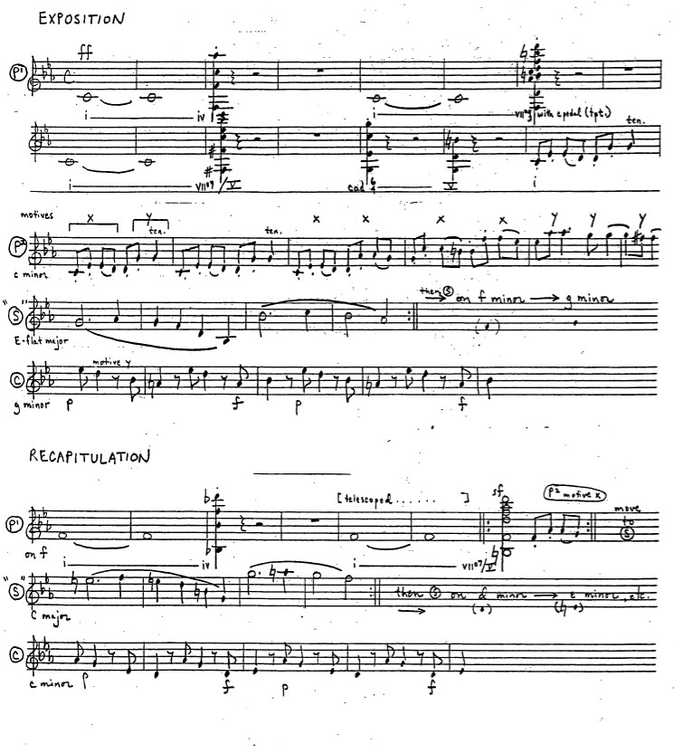
Coriolan Overture, op. 62 (1807)

Slide 21
Coriolan Overture, op. 62 (1807)
music as “process” and “organic” growth
“musical logic”

Slide 22
But how can we validate “music as thought”
(rather than regard it as merely tasteful entertainment)?
1. “Poetic Ideas”
Political connotations (dramatized musical myths of struggle and liberation)
Nature images or references
Deep personal contemplation (music as “depth”)
2. Music as Primal Gesture
3. Monumentality
4. Individualization of the Artwork
5. Enhanced Dramatic/Motivic Coherence from Moment to Moment

Slide 23
But how can we validate “music as thought”
(rather than regard it as merely tasteful entertainment)?
1. “Poetic Ideas”
Political connotations (dramatized musical myths of struggle and liberation)
Nature images or references
Deep personal contemplation (music as “depth”)
2. Music as Primal Gesture
3. Monumentality
4. Individualization of the Artwork
5. Enhanced Dramatic/Motivic Coherence from Moment to Moment
6. Dramatizing Ideas over Long Spans of Time

Slide 24
The Multimovement Work as a Coherent, Connected Discourse (“Novelistic”) in Four Movements (“Chapters”)

Slide 25
The Multimovement Work as a Coherent, Connected Discourse (“Novelistic”) in Four Movements (“Chapters”)
Concept: the “finale symphony”:
1
2
3
4

Slide 26
Sonata
Slow
Minuet/Scherzo
Finale
1
2
3
4

Slide 27
Sonata
Slow
Minuet/Scherzo
Finale
1
2
3
4
Major:
Tonic Off-tonic? Tonic Tonic
(IV, V, i. . .)

Slide 28
Sonata
Slow
Minuet/Scherzo
Finale
1
2
3
4
Major:
Tonic Off-tonic? Tonic Tonic
(IV, V, i. . .)
Minor:
Tonic Off-tonic? Tonic minor Tonic
(III, I, VI. . .) major or minor

Slide 29
Sonata
Slow
Minuet/Scherzo
Finale
1
2
3
4
Major:
Tonic Off-tonic? Tonic Tonic
(IV, V, i. . .)
Minor:
Tonic Off-tonic? Tonic minor Tonic
(III, I, VI. . .) major or minor

Slide 30
Sonata
Slow
Minuet/Scherzo
Finale
1
2
3
4
Major:
Tonic Off-tonic? Tonic Tonic
(IV, V, i)
Minor:
Tonic Off-tonic? Tonic minor Tonic
(III, I, VI) major or minor
Beethoven’s Symphony No. 5, op. 67
C minor Ab major C minor C major!

Slide 31
Sonata
Slow
Minuet/Scherzo
Finale
1
2
3
4
Major:
Tonic Off-tonic? Tonic Tonic
(IV, V, i)
Minor:
Tonic Off-tonic? Tonic Tonic
(III, I, VI) major or minor
Beethoven’s Symphony No. 5, op. 67
C minor Ab major C minor C major!

Slide 32
Beethoven, Symphony No. 5 in C Minor, op. 67, first movement
Aspects of the plot
“C-Minor Mood” (as often in Beethoven)–struggling with fearful anxiety, grim fate, or external threat.

Slide 33
Beethoven, Symphony No. 5 in C Minor, op. 67, first movement
Aspects of the plot
“C-Minor Mood” (as often in Beethoven)–struggling with fearful anxiety, grim fate, or external threat.
The threat: persistently signified in two ways: the minor mode (initially, C minor) and the “fate” rhythm (short-short-short-long)

Slide 34
Beethoven, Symphony No. 5 in C Minor, op. 67, first movement
Aspects of the plot
“C-Minor Mood” (as often in Beethoven)–struggling with fearful anxiety, grim fate, or external threat.
The threat: persistently signified in two ways: the minor mode (initially, C minor) and the “fate” rhythm (short-short-short-long)
Obsessive multiplication of the “fate” rhythm;
music as ongoing generative growth; bar-to-bar coherence and
“musical logic”; “form as process”; “organicism”

Slide 35
Beethoven, Symphony No. 5 in C Minor, op. 67, first movement
Aspects of the plot
“C-Minor Mood” (as often in Beethoven)–struggling with fearful anxiety, grim fate, or external threat.
The threat: persistently signified in two ways: the minor mode (initially, C minor) and the “fate” rhythm (short-short-short-long)
Obsessive multiplication of the “fate” rhythm;
music as ongoing generative growth; bar-to-bar coherence and
“musical logic”; “form as process”; “organicism”
Seeking relief or emancipation from C minor: Ultimately seeking
C major. BUT HOW?

Slide 36
Beethoven, Symphony No. 5 in C Minor, op. 67, first movement
Aspects of the plot
“C-Minor Mood” (as often in Beethoven)–struggling with fearful anxiety, grim fate, or external threat.
The threat: persistently signified in two ways: the minor mode (initially, C minor) and the “fate” rhythm (short-short-short-long)
Obsessive multiplication of the “fate” rhythm;
music as ongoing generative growth; bar-to-bar coherence and
“musical logic”; “form as process”; “organicism”
Seeking relief or emancipation from C minor: Ultimately seeking
C major. BUT HOW?
The initial hope (first movement): via the built-in processes offered by minor-mode sonata form, a dramatic-structural format that is capable, over its course, of transforming minor into major.

Slide 37
C-minor sonata form with secondary theme in major III
Exposition Development Recapitulation
.
.
S
.
.
P
P
S
Eb
c-
c-
C (+ or - ?)
Sonata-Space

Slide 38
C-minor sonata form with secondary theme in major III
Exposition Development Recapitulation
.
.
S
.
.
P
P
S
Eb
c-
c-
C (+ or - ?)
Sonata-Space

Slide 39
C-minor sonata form with secondary theme in major III
Exposition Development Recapitulation
.
.
S
.
.
P
P
S
Eb
c-
c-
C+?
One wins!
Sonata-Space

Slide 40
C-minor sonata form with secondary theme in major III
Exposition Development Recapitulation
.
.
S
.
.
P
P
S
Eb
c-
c-
C-?
One loses!
Sonata-Space

Slide 41
Beethoven, Symphony No. 5 in C Minor, op. 67, first movement
Exposition Development Recapitulation Coda
.
.
S
.
.
P
P
S
Eb
c-
c-
C+?
C+?
Sonata-Space

Slide 42
Two-Part Exposition: Minor Mode with Second Part in Major III
III: PAC (EEC)
Essential Expositional Closure
MC
(medial caesura)
,
S
C
.
.
.
.
P
TR
Eb!
Eb!
c-
c-, mod to
V of Eb
(energy-gain)
The Four Standard Action-Zones of a Two-Part Sonata Exposition

Slide 43
Beethoven, Symphony No. 5 in C Minor, op. 67, first movement
III: PAC (EEC)
Essential Expositional Closure
MC
(medial caesura)
,
S
C
.
.
.
.
P
TR
Eb!
Eb!
c-
c-, mod to
V of Eb
(energy-gain)

Slide 44
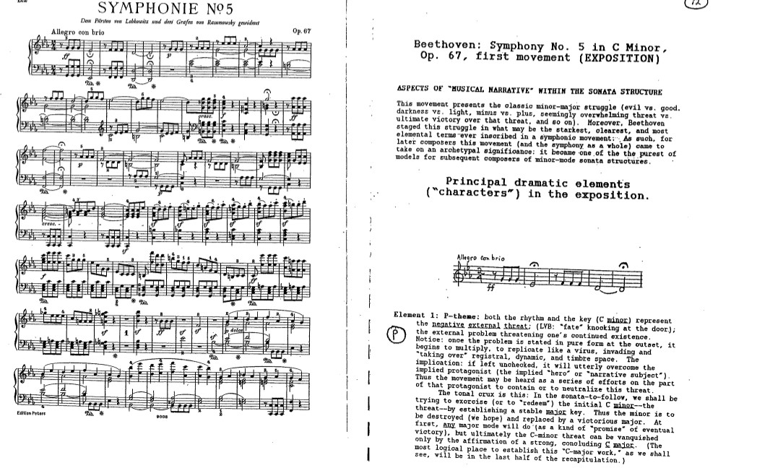
P
TR
S

Slide 45
Beethoven, Symphony No. 5 in C Minor, op. 67, first movement
III: PAC (EEC)
Essential Expositional Closure
MC
(medial caesura)
,
S
C
.
.
.
.
P
TR
Eb!
Eb!
c-
c-, mod to
V of Eb
(energy-gain)

Slide 46
P
TR
S

Slide 47
Beethoven, Symphony No. 5 in C Minor, op. 67, first movement
III: PAC (EEC)
Essential Expositional Closure
MC
(medial caesura)
,
S
C
.
.
.
.
P
TR
Eb!
Eb!
c-
c-, mod to
V of Eb
(energy-gain)

Slide 48
P
TR
S

Slide 49
Beethoven, Symphony No. 5 in C Minor, op. 67, first movement
III: PAC (EEC)
Essential Expositional Closure
MC
(medial caesura)
,
S
C
.
.
.
.
P
TR
Eb!
Eb!
c-
c-, mod to
V of Eb
(energy-gain)
Victory predicted!

Slide 50
Beethoven, Symphony No. 5 in C Minor, op. 67, first movement
III: PAC (EEC)
Essential Expositional Closure
MC
(medial caesura)
,
S
C
.
.
.
.
P
TR
Eb!
Eb!
c-
c-, mod to
V of Eb
(energy-gain)

Slide 51
Beethoven, Symphony No. 5 in C Minor, op. 67, first movement
III: PAC (EEC)
Essential Expositional Closure
MC
(medial caesura)
,
S
C
.
.
.
.
P
TR
Eb!
Eb!
c-
c-, mod to
V of Eb
(energy-gain)

Slide 52
Beethoven, Symphony No. 5 in C Minor, op. 67, first movement
III: PAC (EEC)
Essential Expositional Closure
MC
(medial caesura)
,
S
C
.
.
.
.
P
TR
Eb!
Eb!
c-
c-, mod to
V of Eb
(energy-gain)

Slide 53
Beethoven, Symphony No. 5 in C Minor, op. 67, first movement
III: PAC (EEC)
Essential Expositional Closure
MC
(medial caesura)
,
S
C
.
.
.
.
P
TR
Eb!
Eb!
c-
c-, mod to
V of Eb
(energy-gain)
Victory predicted!

Slide 54
Beethoven, Symphony No. 5 in C Minor, op. 67, first movement
Exposition Development Recapitulation Coda
EEC
ESC
.
.
S
C
.
.
???
P
TR
P
TR
S
C
c-
c-
C+?
C+?
“Victory!”
???
Sonata-Space

Slide 55
Beethoven, Symphony No. 5/i: Development
CRISIS! (+ panic-antidote response!)
g g
c c
f f (grind down antidote)
V/ f : THREAT RECURS! DEFENSELESS! . . . & THREAT RECURS!!
AND MULTIPLIES FURTHER!

Slide 56
Beethoven, Symphony No. 5/i: Development
CRISIS! (+ panic-antidote response!)
g g
c c
f f (grind down antidote)
V/ f : THREAT RECURS! DEFENSELESS! . . . & THREAT RECURS!!
AND MULTIPLIES FURTHER!

Slide 57
Beethoven, Symphony No. 5/i: Development
CRISIS! (+ panic-antidote response!)
g g
c c
f f (grind down antidote)
V/ f : THREAT RECURS! DEFENSELESS! . . . & THREAT RECURS!!
AND MULTIPLIES FURTHER!

Slide 58
Beethoven, Symphony No. 5/i: Development
CRISIS! (+ panic-antidote response!)
g g
c c
f f (grind down antidote)
V/ f : THREAT RECURS! DEFENSELESS! . . . & THREAT RECURS!!
AND MULTIPLIES FURTHER!

Slide 59
Beethoven, Symphony No. 5/i: Development
CRISIS! (+ panic-antidote response!)
g g
c c
f f (grind down antidote)
V/ f : THREAT RECURS! DEFENSELESS! . . . & THREAT RECURS!!
AND MULTIPLIES FURTHER!

Slide 60
Beethoven, Symphony No. 5/i: Development
CRISIS! (+ panic-antidote response!)
g g
c c
f f (grind down antidote)
V/ f : THREAT RECURS! DEFENSELESS! . . . & THREAT RECURS!!
AND MULTIPLIES FURTHER!

Slide 61
Beethoven, Symphony No. 5/i: Development
CRISIS! (+ panic-antidote response!)
g g
c c
f f (grind down antidote)
V/ f : THREAT RECURS! DEFENSELESS! . . . & THREAT RECURS!!
AND MULTIPLIES FURTHER!

Slide 62
Beethoven, Symphony No. 5/i: Development
CRISIS! (+ panic-antidote response!)
g g
c c
f f (grind down antidote)
V/ f : THREAT RECURS! DEFENSELESS! . . . & THREAT RECURS!!
AND MULTIPLIES FURTHER!

Slide 63
Beethoven, Symphony No. 5/i: Development
CRISIS! (+ panic-antidote response!)
g g
c c
f f (grind down antidote)
V/ f : THREAT RECURS! DEFENSELESS! . . . & THREAT RECURS!!
AND MULTIPLIES FURTHER!

Slide 64
Beethoven, Symphony No. 5/i: Development
CRISIS! (+ panic-antidote response!)
g g
c c
f f (grind down antidote)
V/ f : THREAT RECURS! DEFENSELESS! . . . & THREAT RECURS!!
AND MULTIPLIES FURTHER!

Slide 65
Beethoven, Symphony No. 5/i: Development
CRISIS! (+ panic-antidote response!)
g g
c c
f f (grind down antidote)
V/ f : THREAT RECURS! DEFENSELESS! . . . & THREAT RECURS!!
AND MULTIPLIES FURTHER!

Slide 66
Beethoven, Symphony No. 5 in C Minor, op. 67, first movement
Exposition Development Recapitulation Coda
EEC
ESC
.
.
S
C
.
.
P
TR
P
TR
S
C
Eb
c-
c-
C+?
C+?
“Victory!”
???
Sonata-Space

Slide 67
Beethoven, Symphony No. 5 in C Minor, op. 67, first movement
Exposition Development Recapitulation Coda
EEC
ESC
.
.
S
C
.
.
P
TR
P
TR
S
C
Eb
c-
c-
C+?
C+?
“Victory!”
???
Sonata-Space

Slide 68
Beethoven, Symphony No. 5 in C Minor, op. 67, first movement
Exposition Development Recapitulation Coda
EEC
ESC
.
.
S
C
.
.
P
TR
P
TR
S
C
Eb
c-
c-
C+?
C+?
???
Sonata-Space

Slide 69
Beethoven, Symphony No. 5 in C Minor, op. 67, first movement
Exposition Development Recapitulation Coda
EEC
ESC
.
.
S
C
.
.
P
TR
P
TR
S
C
Eb
c-
c-
C+?
C+?
“Victory!”
???
Sonata-Space

Slide 70
Beethoven, Symphony No. 5 in C Minor, op. 67, first movement
Exposition Development Recapitulation Coda???
EEC
ESC
.
.
S
C
.
.
P
TR
P
TR
S
C
Eb
c-
c-
C+!!
C+?
“Victory!”
???
Sonata-Space

Slide 71
Beethoven, Symphony No. 5 in C Minor, op. 67, first movement
Exposition Development Recapitulation Coda
EEC
ESC
!!!
.
.
S
C
.
.
P
TR
P
TR
S
C
Eb
c-
c-
C+?
c- !!!
“Victory!”
Collapse,
Defeat!!
Sonata-Space

