Slide 1
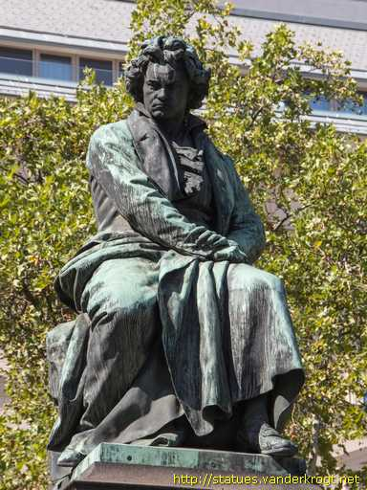
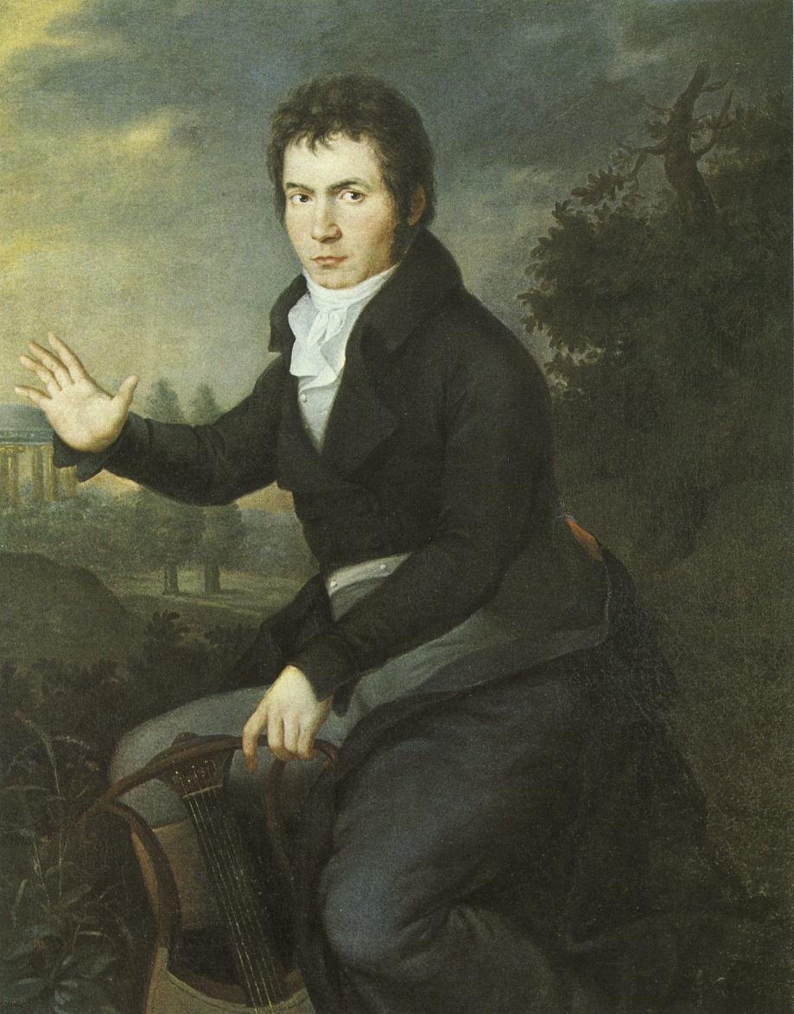
Music 352: The European Art-Music Tradition
Beethoven: Art Music in Search of Freedom and Autonomy

Slide 2
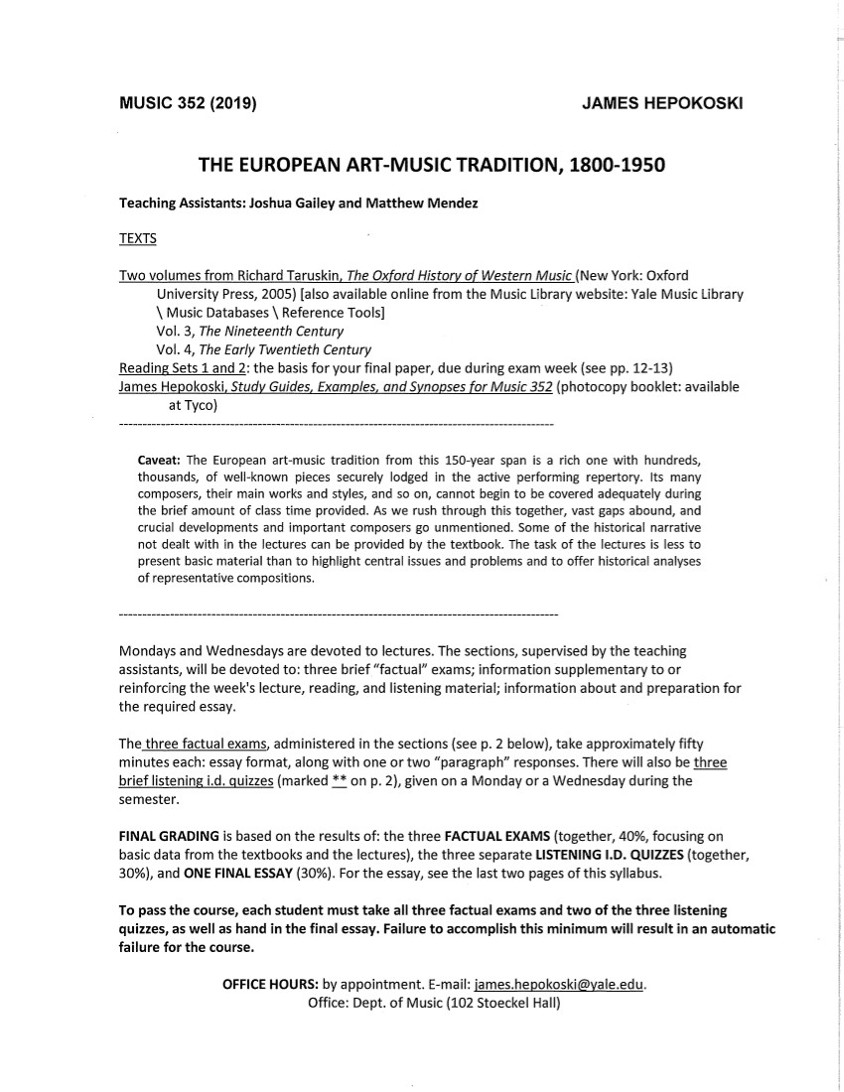

Slide 3
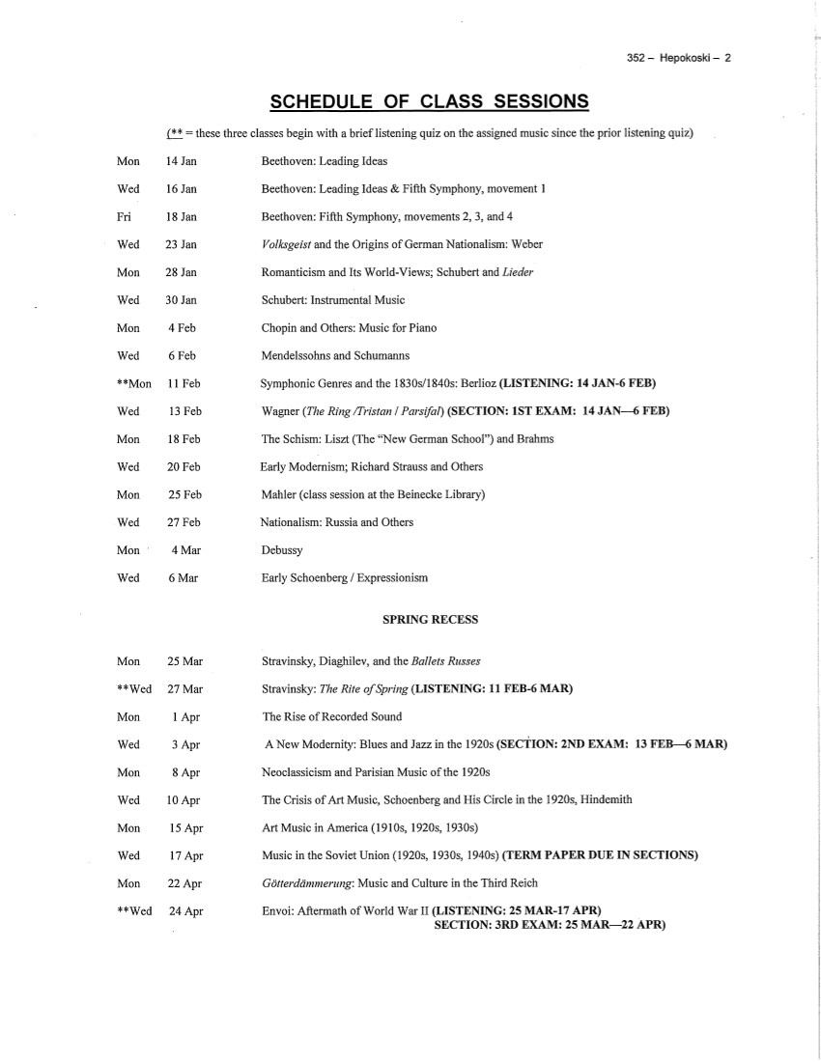

Slide 4
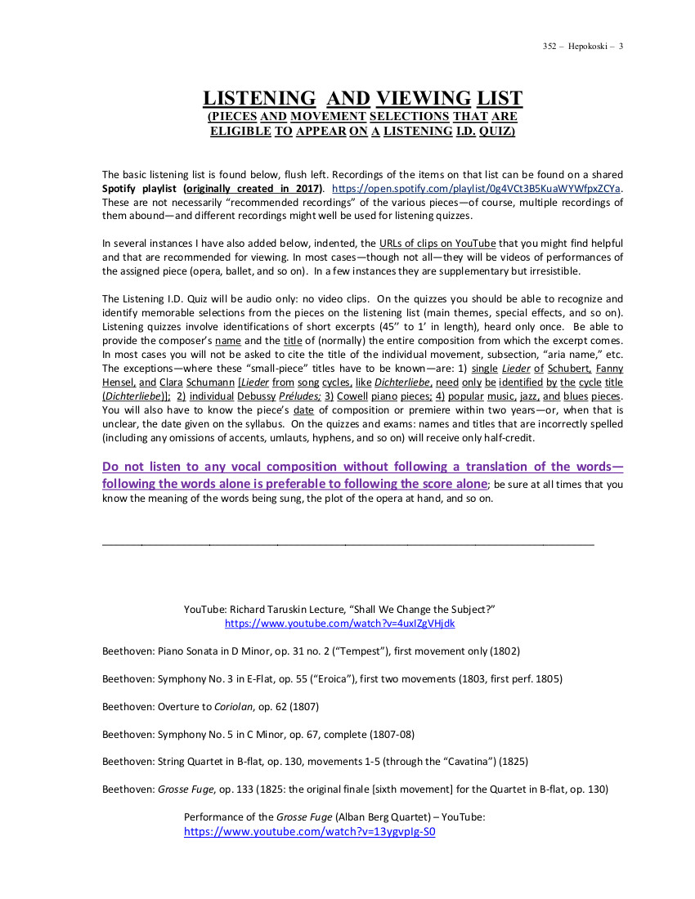

Slide 5
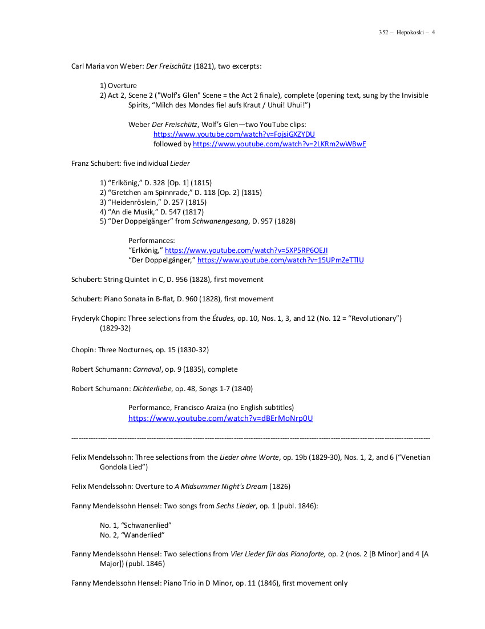

Slide 6
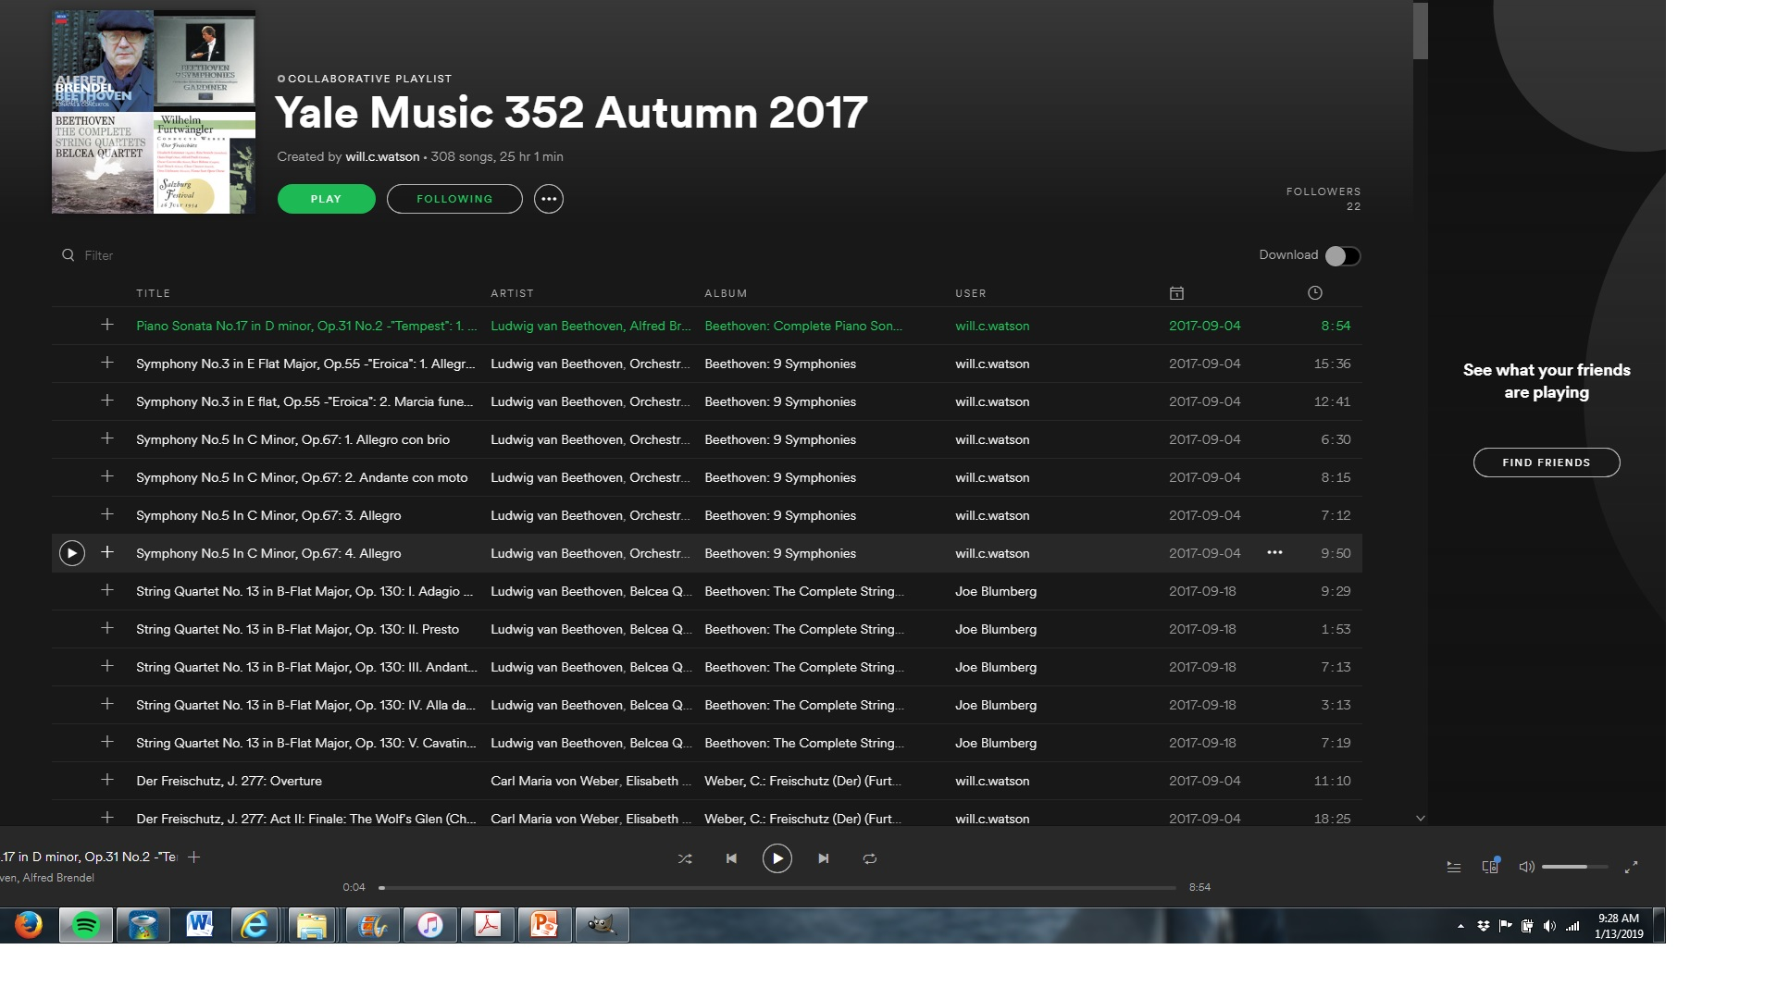

Slide 7
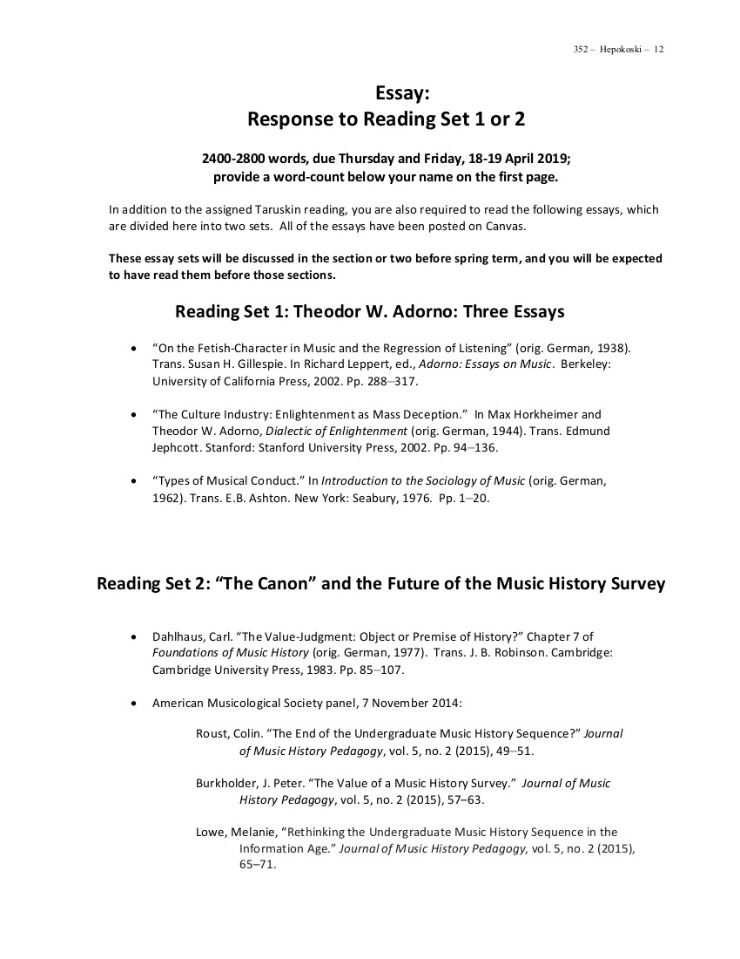

Slide 8
Music 352: The European Art-Music Tradition
Beethoven: Art Music in Search of Freedom and Autonomy

Slide 9
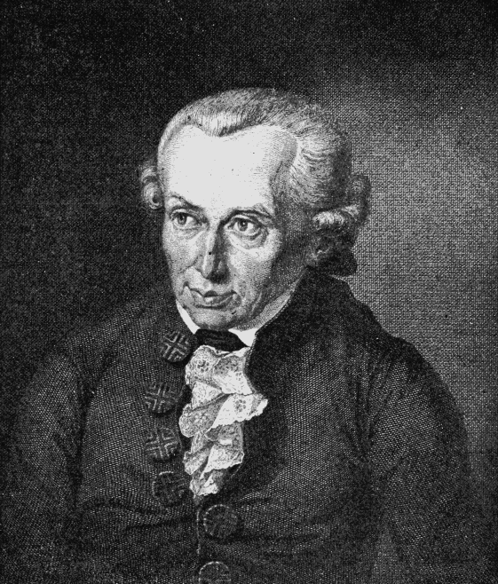
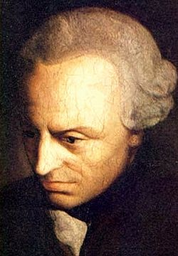
“Enlightenment is mankind’s emergence [or release] from its self-incurred immaturity. . . the inability to make use of one’s own understanding without the guidance of another. . . . Sapere aude [‘Dare to know!’]”
(also quoted, Taruskin, II, 461)
Immanuel Kant: What is Enlightenment?
(Was ist Aufklärung?, 1789).

Slide 10
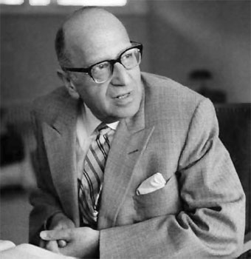
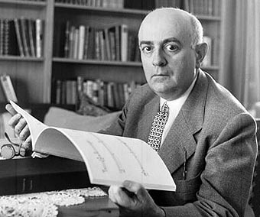
“The program of the Enlightenment was the disenchantment of the world; the dissolution of myths and the substitution of knowledge for fancy. . . . The human mind, which overcomes superstition, is to hold sway over a disenchanted nature.”
Max Horkheimer and Theodor W. Adorno,
Dialectic of Enlightenment (Dialektik der Aufklärung, 1944)

Slide 11
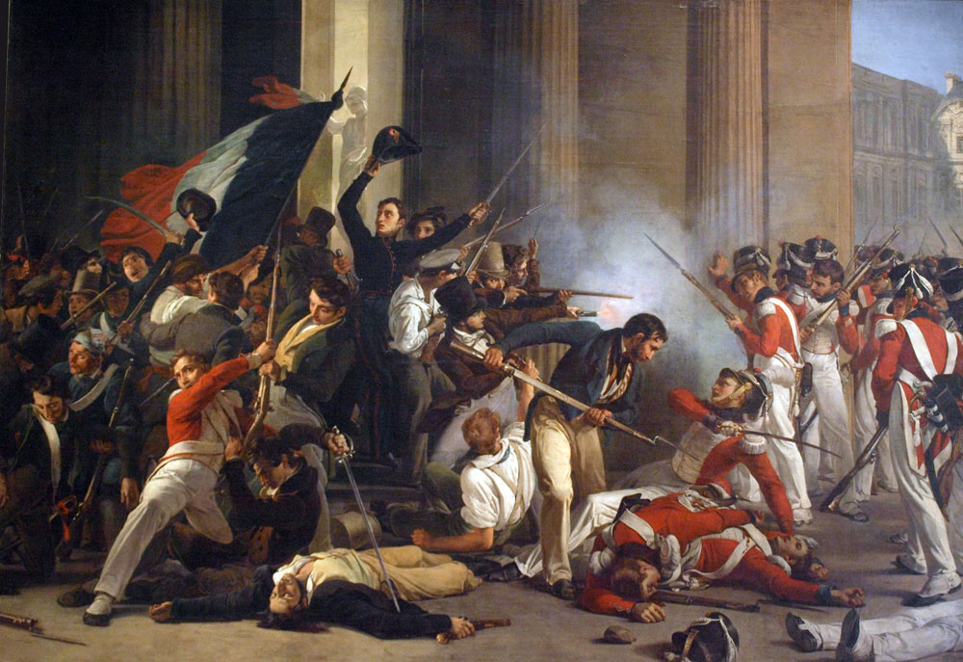
French Revolution (1789)

Slide 12
French Revolution (1789): “Reign of Terror” (1793-94)

Slide 13
Napoleonic Wars, 1803-15

Slide 14
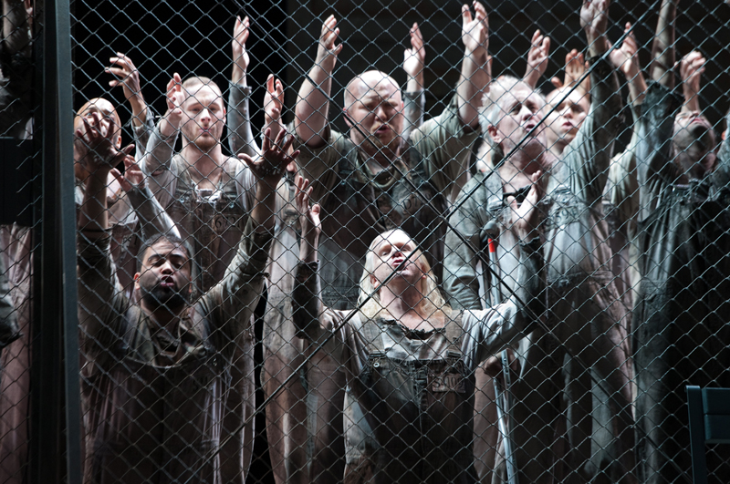
Beethoven, Fidelio (= Leonore, 1805, 1806, rev. 1814): Prisoner’s Chorus
(Seattle Opera Production, 2012)

Slide 15
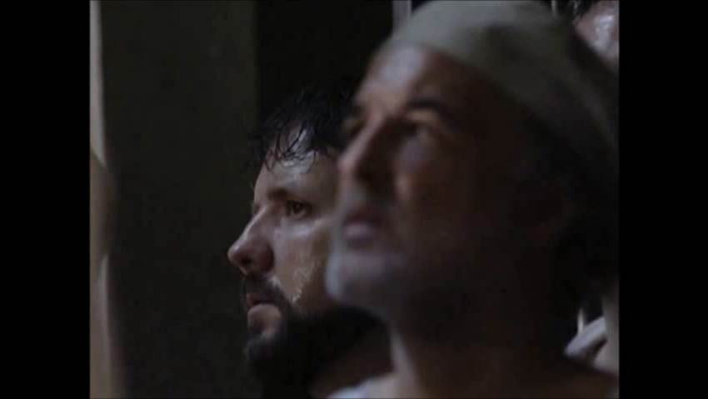
Beethoven, Fidelio (= Leonore, 1805, 1806, rev. 1814): Prisoner’s Chorus
Metropolitan Opera, 2000 (James Levine, Conductor)
O welche Lust in freier Luft O, what joy, in the free air
Den Atem leicht zu heben! To draw in one’s breath so easily!
Nur hier, nur hier ist Leben. Only here, only here is life.
Der Kerker eine Gruft. The dungeon—a tomb.

Slide 16
Music 352: The European Art-Music Tradition
Beethoven: Art Music in Search of Freedom and Autonomy

Slide 17
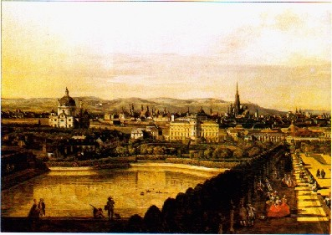
Vienna, c. 1800

Slide 18
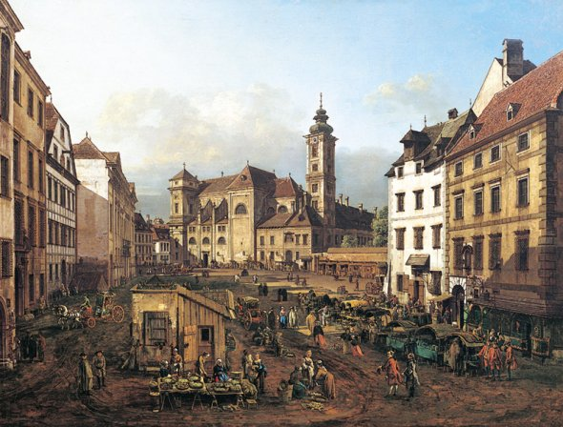
Vienna, c. 1800

Slide 19
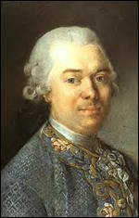
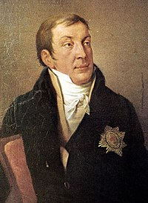
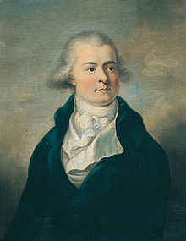
Among Vienna’s patrons of music (power brokers)
Baron Gottfried von Swieten Prince Lichnowsky Prince Lobkowitz

Slide 20
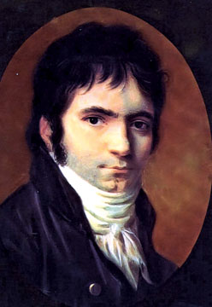
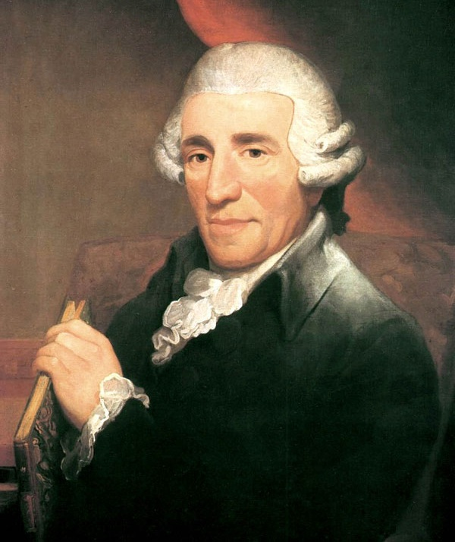
Young Beethoven Moves from Bonn to Vienna, November 1792
Beethoven Haydn

Slide 21
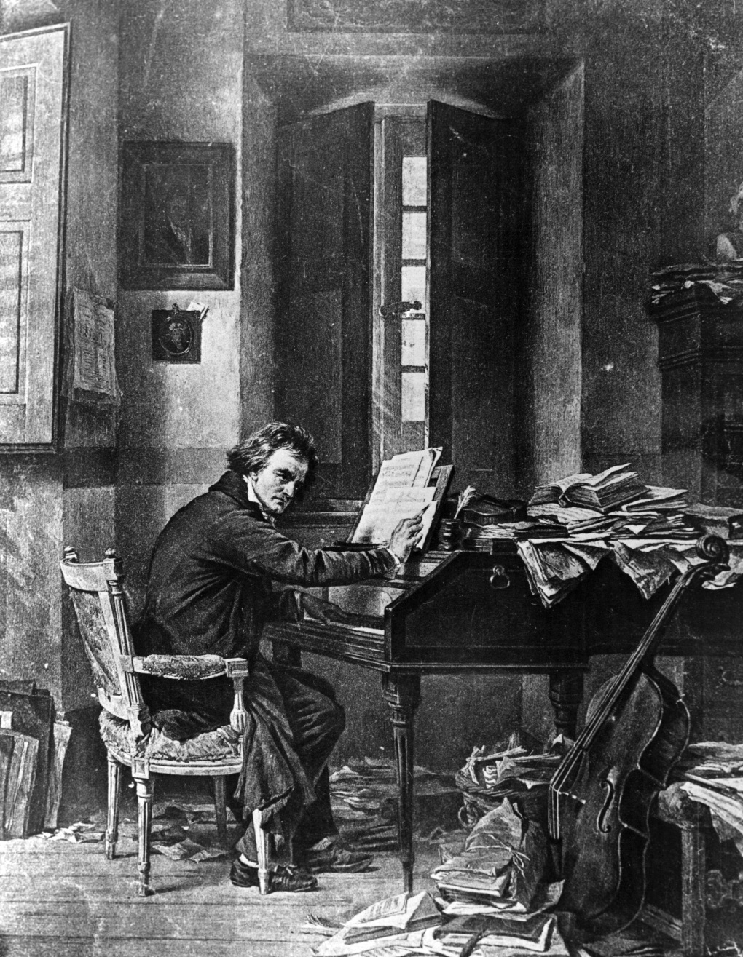
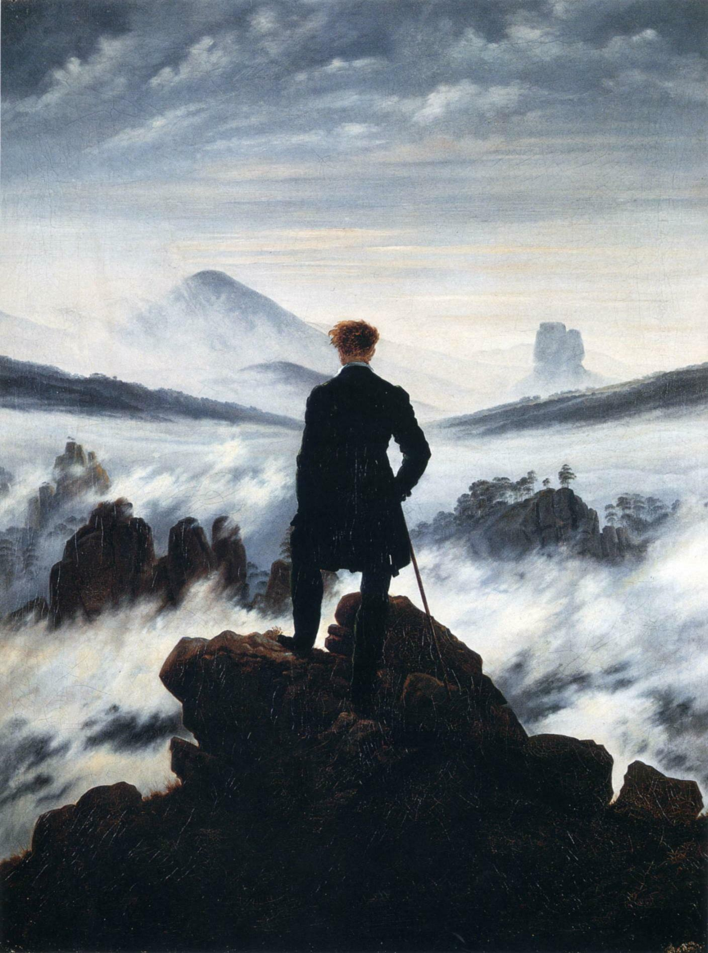
A bold plunge into vastness, power, conflict: the dynamic sublime
“Wanderer above the Sea of Fog,” Caspar David Friedrich, 1818

Slide 22
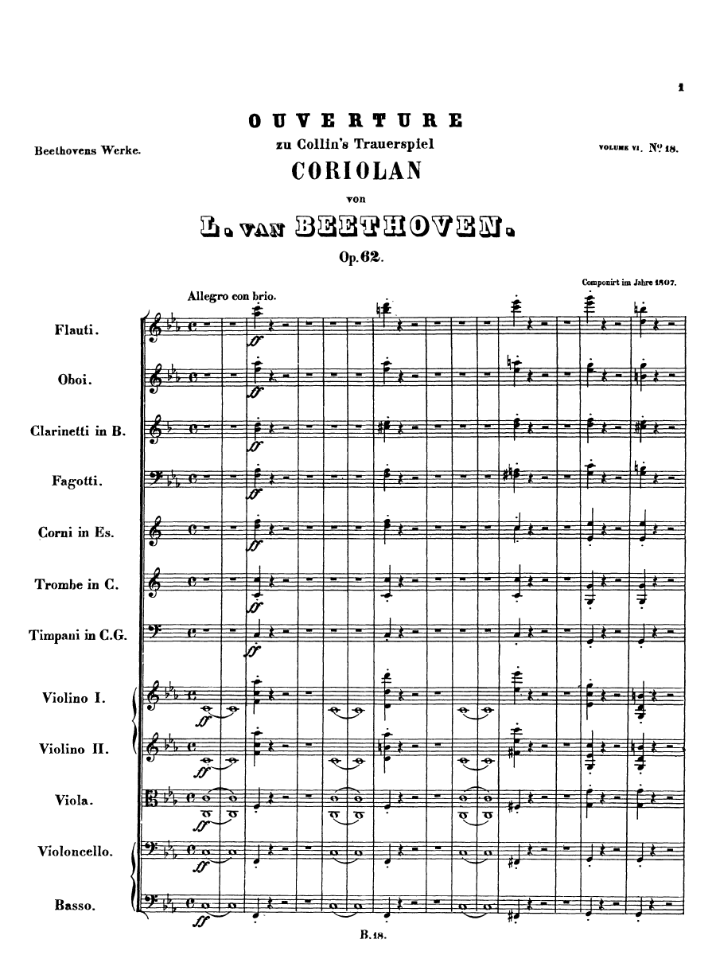
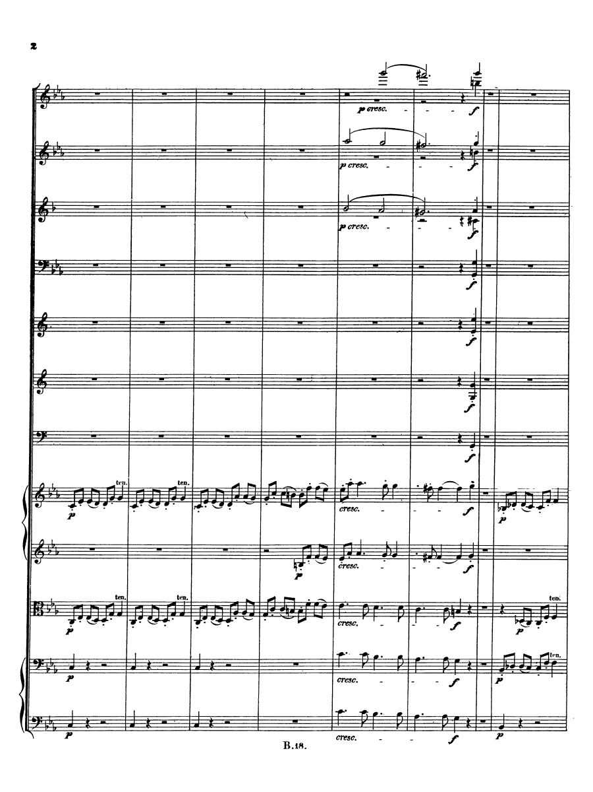
Beethoven, Coriolan Overture, op. 62 (1807)

Slide 24
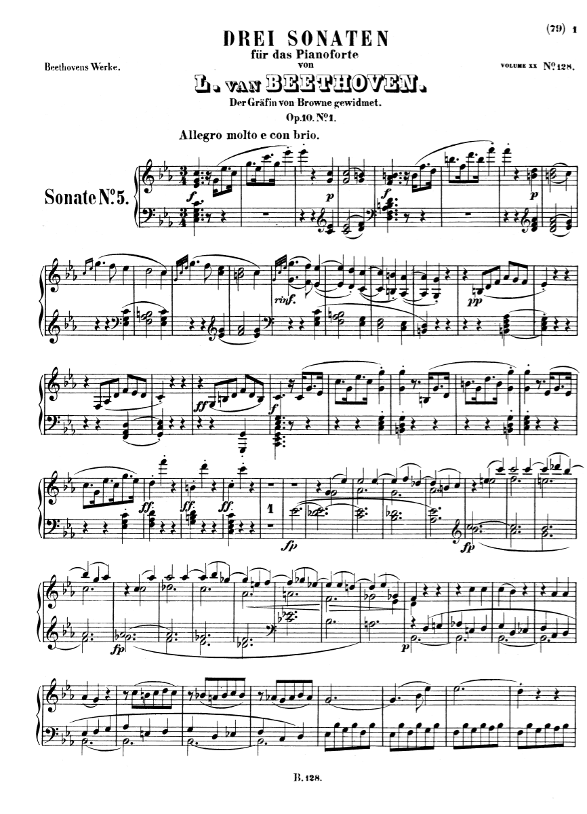

Slide 25
The Idea: A Self-Legitimizing, Self-Justifying Instrumental Music

Slide 26
The Idea: A Self-Legitimizing, Self-Justifying Instrumental Music
Relatively detached from an overreliance on social function;
produced and existing primarily for its own sake.

Slide 27
The Idea: A Self-Legitimizing, Self-Justifying Instrumental Music
Relatively detached from an overreliance on social function;
produced and existing primarily for its own sake.
Music whose compositional practice is not regulated by the demands of outside institutions, such as court or church—but rather by the presumed demands of the higher callings of “Art.”

Slide 28
The Idea: A Self-Legitimizing, Self-Justifying Instrumental Music
Relatively detached from an overreliance on social function;
produced and existing primarily for its own sake.
Music whose compositional practice is not regulated by the demands of outside institutions, such as court or church—but rather by the presumed demands of the higher callings of “Art.”
Music as a world unto itself, a separate, valued domain with its own norms and imperatives.

Slide 29
The Idea: A Self-Legitimizing, Self-Justifying Instrumental Music
Relatively detached from an overreliance on social function;
produced and existing primarily for its own sake.
Music whose compositional practice is not regulated by the demands of outside institutions, such as court or church—but rather by the presumed demands of the higher callings of “Art.”
Music as a world unto itself, a separate, valued domain with its own norms and imperatives.
Music practice that understands itself as following its own internal laws for growth and change (= “autonomy”; “autonomous music”): a music increasingly freed from the external commands of its patrons.

Slide 30
The Idea: A Self-Legitimizing, Self-Justifying Instrumental Music
Relatively detached from an overreliance on social function;
produced and existing primarily for its own sake.
Music whose compositional practice is not regulated by the demands of outside institutions, such as court or church—but rather by the presumed demands of the higher callings of “Art.”
Music as a world unto itself, a separate, valued domain with its own norms and imperatives.
Music practice that understands itself as following its own internal laws for growth and change (= “autonomy”; “autonomous music”): a music increasingly freed from the external commands of its patrons.

Slide 31
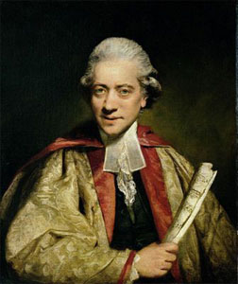
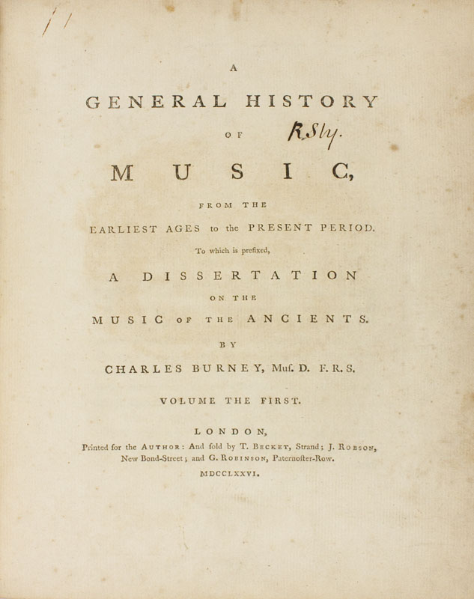
Charles Burney (1776-89)
“Music is an innocent luxury, unnecessary, indeed, to our existence,
but a great improvement and gratification to the sense of hearing.”

Slide 32
Music “has the lowest place among the fine arts”: “It speaks through nothing but sensations without concepts, so that unlike poetry, it leaves us with nothing to meditate about. . . . It is more a matter of enjoyment than of culture.”

Slide 33
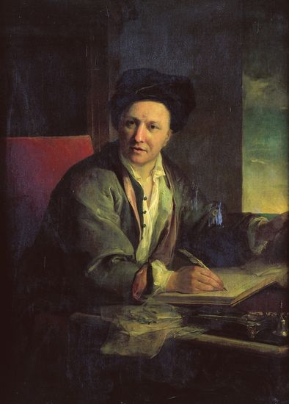
“I shall never forget the witty riposte of the celebrated Fontenelle” [wrote
Jean-Jacques Rousseau], “who, finding himself bored to death by these eternal Symphonies, cried out in a burst of impatience: ‘Sonate, que me veux-tu?’”
Bernard le Bovier de Fontenelle (1657-1757)

Slide 34
“I shall never forget the witty riposte of the celebrated Fontenelle” [wrote
Jean-Jacques Rousseau], “who, finding himself bored to death by these eternal Symphonies, cried out in a burst of impatience:
‘Sonate, que me veux-tu?’”
Bernard le Bovier de Fontenelle (1657-1757)

Slide 37
The Characteristic Eighteenth-Century View:
Music as a Series of Idealized Emotional States (tasteful, stylized, elegant)

Slide 38
The Characteristic Eighteenth-Century View:
Music as a Series of Idealized Emotional States (tasteful, stylized, elegant)
But could it ever be regarded as more than that?

Slide 39
Beethoven: new truth-claims: dreams and metaphors of freedom
Taking the established high-galant (“classical”) conventions and
dramatizing them in increasingly political and war-torn decades (1790s, 1800s)

Slide 40
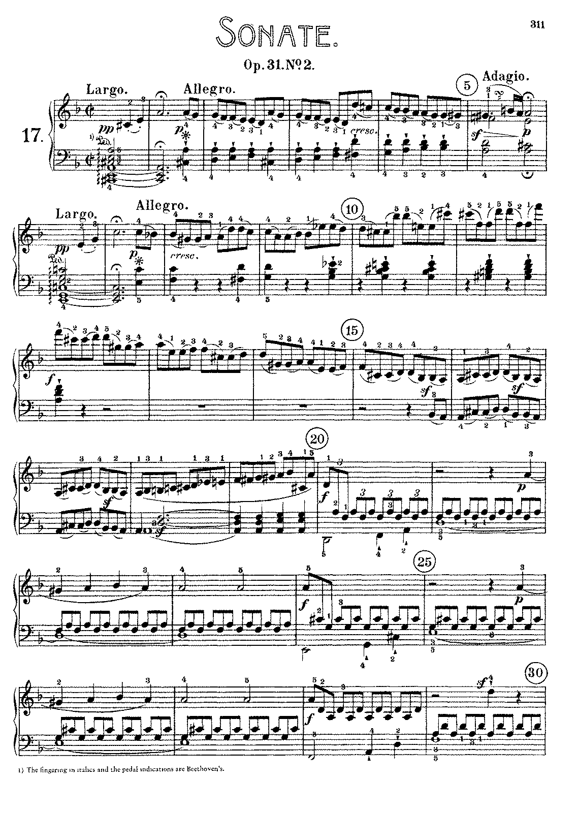

Slide 41
Taking the established high-galant (“classical”) conventions and
dramatizing them in increasingly political and war-torn decades
(1790s, 1800s).
Can music be an ethical
training-ground for the soul?
Beethoven: new truth-claims:
dreams and metaphors of freedom

Slide 42
Taking the established high-galant (“classical”) conventions and
dramatizing them in increasingly political and war-torn decades
(1790s, 1800s).
Can music be an ethical
training-ground for the soul?
Can performers and listeners be invited freely to construct their own identities around these musical images of sturdy confidence?
Beethoven: new truth-claims:
dreams and metaphors of freedom

Slide 43
Beethoven, Coriolan Overture, op. 62 (1807)

Slide 44
The Characteristic Eighteenth-Century View:
Music as a Series of Idealized Emotional States (tasteful, stylized, elegant)

Slide 45
The Characteristic Eighteenth-Century View:
Music as a Series of Idealized Emotional States (tasteful, stylized, elegant)
But increasingly, 1780s, 1790s, 1800s:
“ “ “ “ “ “ Moral States (grounding truths around and within us)

Slide 46
The Characteristic Eighteenth-Century View:
Music as a Series of Idealized Emotional States (tasteful, stylized, elegant)
But increasingly, 1780s, 1790s, 1800s:
“ “ “ “ “ “ Moral States (grounding truths around and within us)
“ “ “ “ “ “ “Soul States” (Seelenzustände)

Slide 47
The Characteristic Eighteenth-Century View:
Music as a Series of Idealized Emotional States (tasteful, stylized, elegant)
But increasingly, 1780s, 1790s, 1800s:
“ “ “ “ “ “ Moral States (grounding truths around and within us)
“ “ “ “ “ “ “Soul States” (Seelenzustände)
Therefore: an emerging belief that “music” was capable of housing
and communicating “soul states” of ethical seriousness

Slide 48
The Categorical Imperative: “Act only on that maxim through which you can
at the same time will that it should become a universal law.”

Slide 49
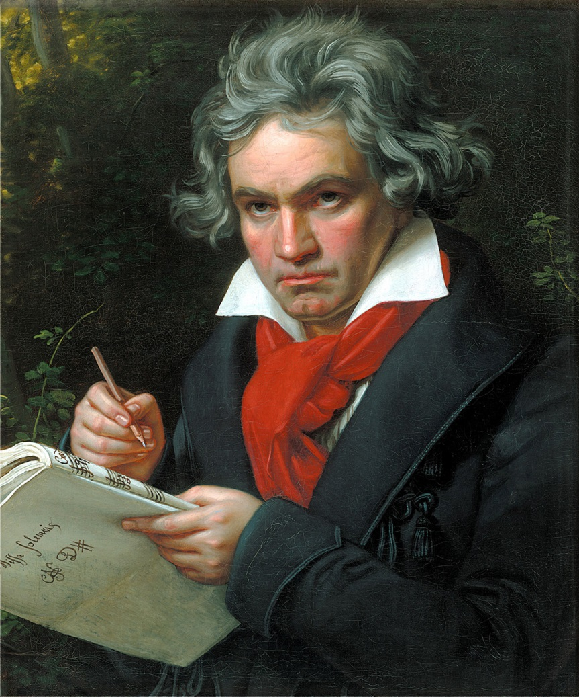
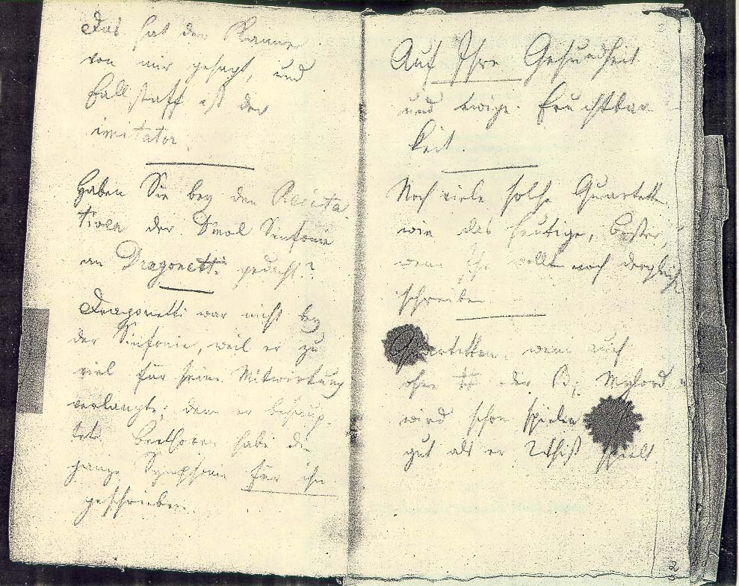
Beethoven, written into a Conversation Book, 1820:
“The moral law within us and the starry heavens above us: Kant!”

Slide 50
Earnest, morally idealized images?

Slide 51
Earnest, morally idealized images?
Thus (e.g.) the human being can be—and ideally should be—something like this:

Slide 52
Earnest, morally idealized images?
Thus (e.g.) the human being can be—and ideally should be—something like this:
Piano Concerto No. 5 in E-flat, movement 2,
Adagio un poco mosso (1809)

Slide 53
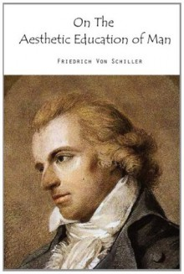
Idealized program for the perfection of humankind; the goal is to become “fully human.” But how?
1795

Slide 54
Idealized program for the perfection of humankind; the goal is to become “fully human.” But how?
Essential humanness: molding one’s environment—imposing form on content.
1795

Slide 55
Idealized program for the perfection of humankind; the goal is to become “fully human.” But how?
Essential humanness: molding one’s environment—imposing form on content.
The highest human activity: indulging the play drive (Spieltrieb); the free shaping of things for the sake and joy of creating them.
1795

Slide 56
Idealized program for the perfection of humankind; the goal is to become “fully human.” But how?
Essential humanness: molding one’s environment—imposing form on content.
The highest human activity: indulging the play drive (Spieltrieb); the free shaping of things for the sake and joy of creating them.
The highest form of play: Art, which is capable of healing the broken person, making the fractured person—torn apart by society— whole again.
1795

Slide 57
Idealized program for the perfection of humankind; the goal is to become “fully human.” But how?
Essential humanness: molding one’s environment—imposing form on content.
The highest human activity: indulging the play drive (Spieltrieb); the free shaping of things for the sake and joy of creating them.
The highest form of play: Art, which is capable of healing the broken person, making the fractured person—torn apart by society— whole again.
Thus art, as an ethic of healing, unites humankind’s emotional side with its rational side.
1795

Slide 58
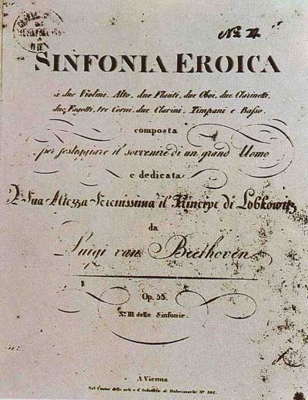
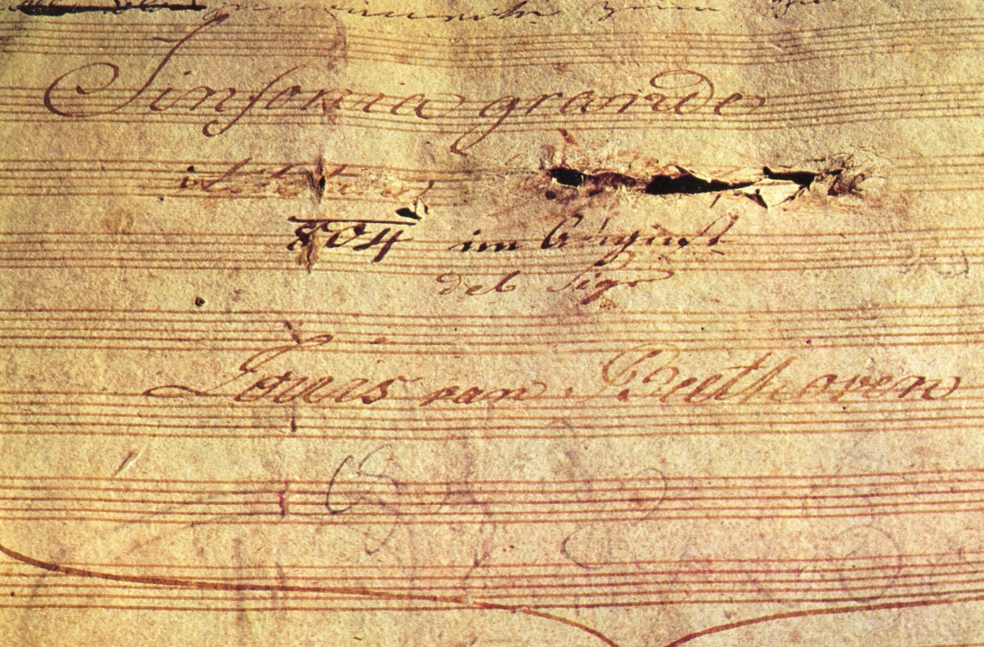
Symphony No. 3 in E-Flat, op. 55, “Eroica”—ms. and first printed edition

Slide 59
Profundity Contract
The undersigned parties concur that much of the new European instrumental art music of the 1780s and succeeding years, stemming initially from in and around Austria, has now advanced beyond any mere entertainment function. Music striving toward this condition of heightened connoisseurship is therefore to be created, regarded, and absorbed in an appropriately new way, with reverential devotion, as ultimately important, as a truth-disclosing, transcendent medium whose soul-stirring revelations are not capturable by other means, including especially those of mere words. We therefore agree to the following conditions:
The composer hereby agrees increasingly to write music on these terms, producing display objects for devotional contemplation and study.
The performer, as the immediate conveyor of the revelation, agrees to treat the performance of such works in a similar manner and to inculcate the same response in his or her listeners.
The listener hereby agrees to listen to and absorb this music contemplatively, as a sonic disclosure of an essential humanness or a quasi-spiritualized contact.

Slide 60
The “Profundity Contract”: A Feedback Loop (c. 1790ff)
Composer
Performer/Listener

Slide 61
But how can we validate “music as thought”
(rather than as merely tasteful entertainment)?

Slide 62
But how can we validate “music as thought”
(rather than as merely tasteful entertainment)?
1. “Poetic ideas”

Slide 63
But how can we validate “music as thought”
(rather than as merely tasteful entertainment)?
1. “Poetic ideas”
A) Political connotations (dramatized musical myths of struggle and liberation)

Slide 64
But how can we validate “music as thought”
(rather than as merely tasteful entertainment)?
1. “Poetic ideas”
A) Political connotations (dramatized musical myths of struggle and liberation)

Slide 65
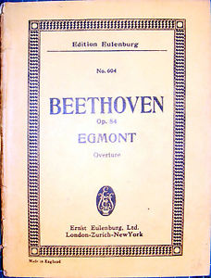
But how can we validate “music as thought”
(rather than as merely tasteful entertainment)?
1. “Poetic ideas”
A) Political connotations (dramatized musical myths of struggle and liberation)

Slide 66
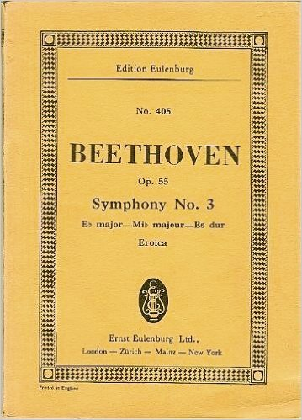
But how can we validate “music as thought”
(rather than as merely tasteful entertainment)?
1. “Poetic ideas”
A) Political connotations (dramatized musical myths of struggle and liberation)

Slide 67
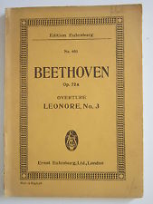
But how can we validate “music as thought”
(rather than as merely tasteful entertainment)?
1. “Poetic ideas”
A) Political connotations (dramatized musical myths of struggle and liberation)

Slide 68
But how can we validate “music as thought”
(rather than as merely tasteful entertainment)?
1. “Poetic ideas”
Political connotations (dramatized musical myths of struggle and liberation)
Nature images or references

Slide 69
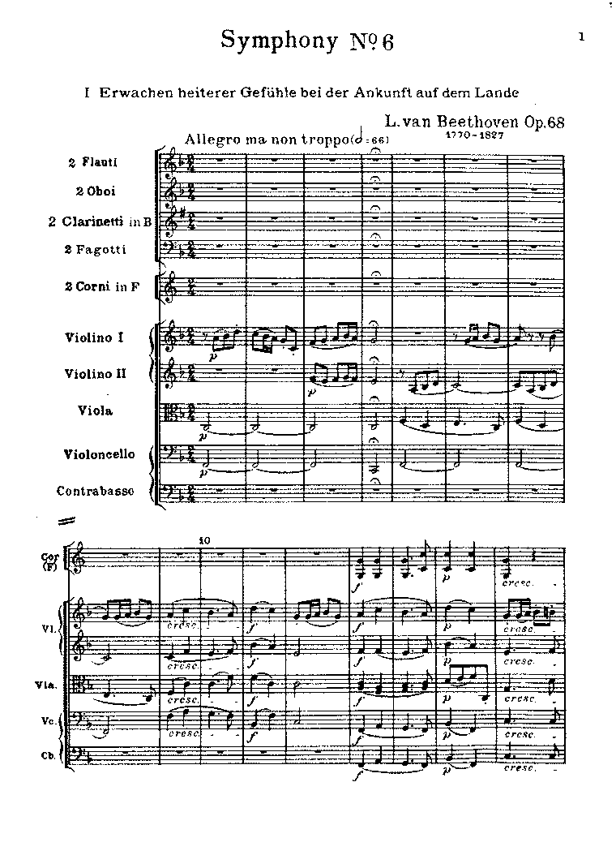
But how can we validate “music as thought”
(rather than as merely tasteful entertainment)?
1. “Poetic ideas”
Political connotations (dramatized musical myths of struggle and liberation)
Nature images or references

Slide 70
Nature Images in Illustrative or “Program Music”
Composer
Music
“Objective” imitation

Slide 71
Nature Images in Illustrative or “Program Music”
Composer
Music
“Objective” imitation
Nature Images Construed as “Poetic Ideas”
Composer
Music

Slide 72
Immeasurable vastness of size and volume beyond our comprehension; uncommon magnitude or intensity of feeling, often associated with fear, horror . . . or revelation.
Evocations of “The Sublime”
(rather than “The Beautiful”)

Slide 73
Immeasurable vastness of size and volume beyond our comprehension; uncommon magnitude or intensity of feeling, often associated with fear, horror . . . or revelation.
Evocations of “The Sublime”
(Rather than “The Beautiful”)
Edmund Burke, A Philosophical Inquiry into the Origin of the Ideas of the Sublime and Beautiful (1756)

Slide 74
Immeasurable vastness of size and volume beyond our comprehension; uncommon magnitude or intensity of feeling, often associated with fear, horror . . . or revelation.
Evocations of “The Sublime”
(Rather than “The Beautiful”)
Edmund Burke, A Philosophical Inquiry into the Origin of the Ideas of the Sublime and Beautiful (1756)
Immanuel Kant, Critique of Judgment (1790)

Slide 76
Immeasurable vastness of size and volume beyond our comprehension; uncommon magnitude or intensity of feeling, often associated with fear, horror . . . or revelation.
Evocations of “The Sublime”
(Rather than “The Beautiful”)
Edmund Burke, A Philosophical Inquiry into the Origin of the Ideas of the Sublime and Beautiful (1756)
Immanuel Kant, Critique of Judgment (1790)
E.T.A Hoffmann on Beethoven’s Fifth Symphony (1810): “open[s] the realm of the colossal and the immeasurable . . . induces terror, fright, horror, and pain and awakens that endless longing that is the essence of romanticism.”

Slide 77
But how can we validate “music as thought”
(rather than as merely tasteful entertainment)?
1. “Poetic ideas”
Political connotations (dramatized musical myths of struggle and liberation)
Nature images or references

Slide 78
But how can we validate “music as thought”
(rather than as merely tasteful entertainment)?
1. “Poetic ideas”
Political connotations (dramatized musical myths of struggle and liberation)
Nature images or references
Deep personal contemplation (music as “depth”)

Slide 79
But how can we validate “music as thought”
(rather than as merely tasteful entertainment)?
1. “Poetic ideas”
Political connotations (dramatized musical myths of struggle and liberation)
Nature images or references
Deep personal contemplation (music as “depth”)
Piano Sonata in D, op. 10 no. 3/ii (1798), Largo e mesto (D minor)

Slide 80
But how can we validate “music as thought”
(rather than as merely tasteful entertainment)?
1. “Poetic ideas”
Political connotations (dramatized musical myths of struggle and liberation)
Nature images or references
Deep personal contemplation (music as “depth”)
Piano Sonata in D, op. 10 no. 3/ii (1798), Largo e mesto (D minor)
Piano Sonata in C, op. 53/ii, “Waldstein” (1803-04): Introduzione:
Adagio molto

Slide 81
But how can we validate “music as thought”
(rather than as merely tasteful entertainment)?
1. “Poetic ideas”
Political connotations (dramatized musical myths of struggle and liberation)
Nature images or references
Deep personal contemplation (music as “depth”)
Piano Sonata in D, op. 10 no. 3/ii (1798), Largo e mesto (D minor)
Piano Sonata in C, op. 53/ii, “Waldstein” (1803-04): Introduzione:
Adagio molto
Piano Concerto No. 5 in E-flat, op. 73/ii (1809) Adagio un poco mosso
(B major)

Slide 82
But how can we validate “music as thought”
(rather than as merely tasteful entertainment)?
1. “Poetic ideas”
Political connotations (dramatized musical myths of struggle and liberation)
Nature images or references
Deep personal contemplation (music as “depth”)
Piano Sonata in D, op. 10 no. 3/ii (1798), Largo e mesto (D minor)
Piano Sonata in C, op. 53/ii, “Waldstein” (1803-04): Introduzione:
Adagio molto
Piano Concerto No. 5 in E-flat, op. 73/ii (1809) Adagio un poco mosso
(B major)
Symphony No. 9 in D Minor, op. 125/iii (1822-24) Adagio (B-flat)

