Slide 1
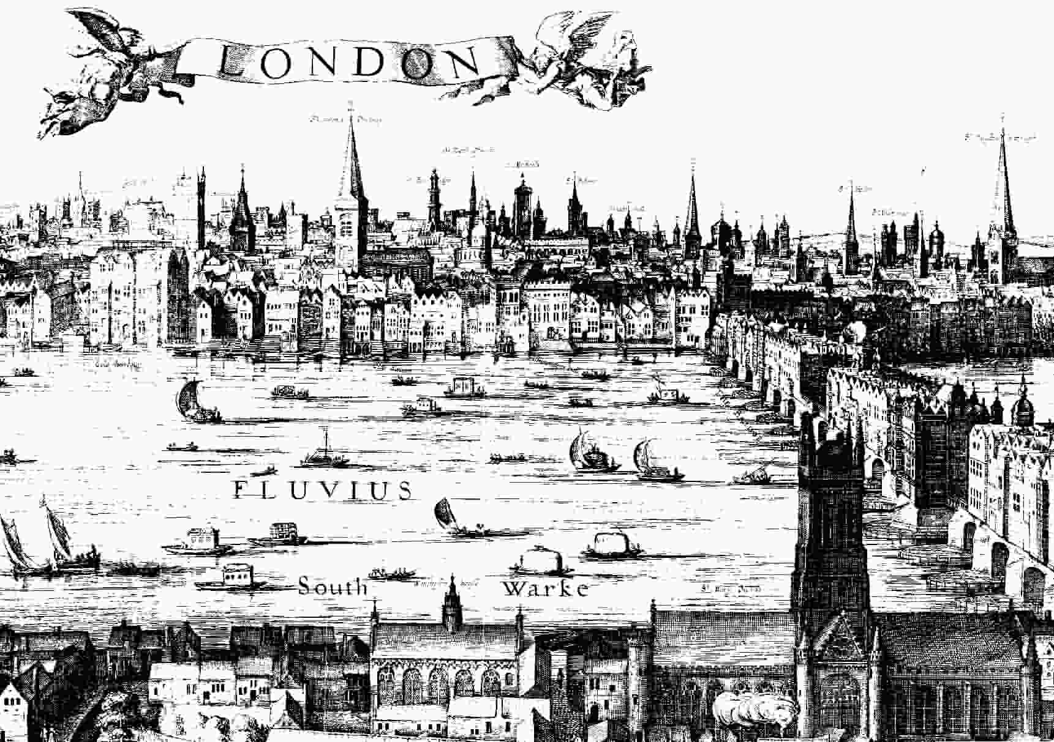
England and Music in the 17th Century

Slide 2
Vocal Music:
Dominant, Highest Prestige in the 16th- and 17th Centuries

Slide 3
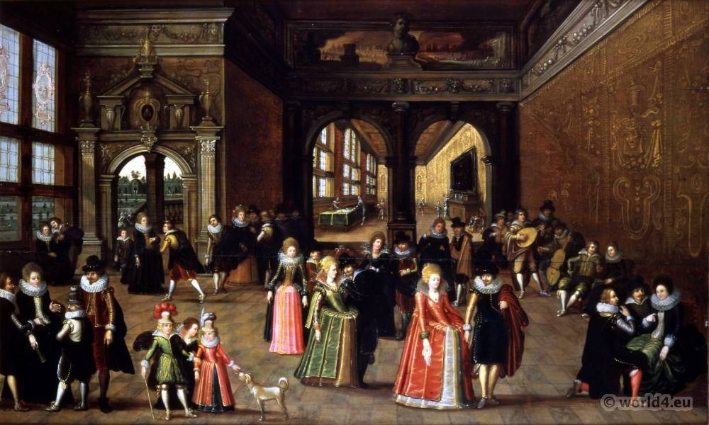
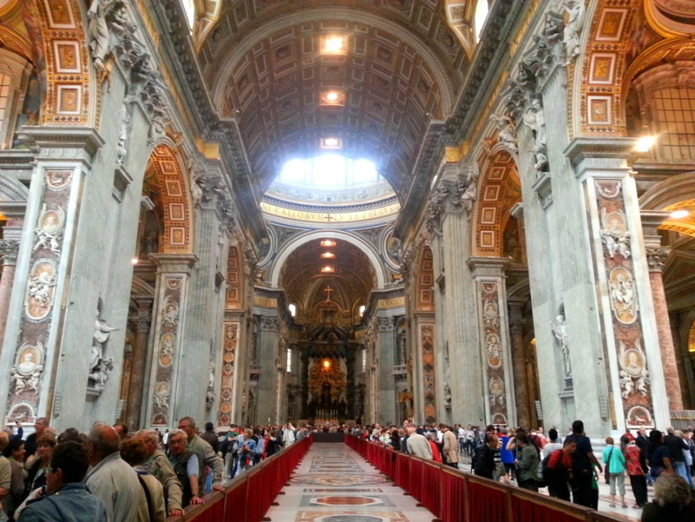
Vocal Music:
Dominant, Highest Prestige in the 16th- and 17th Centuries
particularly in:
high-prestige courts and churches

Slide 4
Vocal Music:
Dominant, Highest Prestige in the 16th- and 17th Centuries
Purpose: cultural display of privilege and power in tasteful entertainments

Slide 5
Vocal Music:
Dominant, Highest Prestige in the 16th- and 17th Centuries
Purpose: cultural display of privilege and power in tasteful entertainments
Or: underwriting the devotional authority of the church

Slide 6
Vocal Music:
Dominant, Highest Prestige in the 16th- and 17th Centuries
Purpose: cultural display of privilege and power in tasteful entertainments
Or: underwriting the devotional authority of the church
Thus: subservient to the certainties of faith, power, and class, believed to be ideally fixed and eternal

Slide 7
Vocal Music:
Dominant, Highest Prestige in the 16th- and 17th Centuries
Purpose: cultural display of privilege and power in tasteful entertainments
Or: underwriting the devotional authority of the church
Thus: subservient to the certainties of faith, power, and class, believed to be ideally fixed and eternal
Thus: as a decorator of language, music “points at” authorities and realities (truths) higher than itself

Slide 8
Vocal Music:
Dominant, Highest Prestige in the 16th- and 17th Centuries
Purpose: cultural display of privilege and power in tasteful entertainments
Or: underwriting the devotional authority of the church
Thus: subservient to the certainties of faith, power, and class, believed to be ideally fixed and eternal
Thus: as a decorator of language, music “points at” authorities and realities (truths) higher than itself
And at the same time: this music is growing grander, more splendid,
more sumptuous—as “tonality” begins to crystallize out of the old
hexachord-based modality

Slide 9
Vocal Music:
Dominant, Highest Prestige in the 16th- and 17th Centuries
Purpose: cultural display of privilege and power in tasteful entertainments
Or: underwriting the devotional authority of the church
Thus: subservient to the certainties of faith, power, and class, believed to be ideally fixed and eternal
Thus: as a decorator of language, music “points at” authorities and realities (truths) higher than itself
And at the same time: this music is growing grander, more splendid,
more sumptuous—as “tonality” begins to crystallize out of the old
hexachord-based modality
“Early baroque” (c. 1600-50?) “Middle baroque” (c. 1650-1700?) “High baroque” (c. 1700-1730s?)

Slide 10
Vocal Music:
Dominant, Highest Prestige in the 16th- and 17th Centuries
(but beginning to stir: the rise of instrumental music)
1600 1700 1800

Slide 11
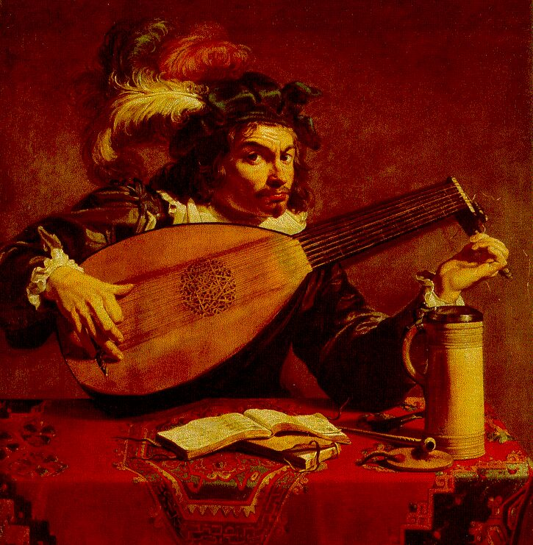
Seventeenth-Century Instrumental Genres Include:
Music for solo lute (Denis & Ennemond Gaultier and others)

Slide 12
Seventeenth-Century Instrumental Genres Include:
Music for solo lute (Denis & Ennemond Gaultier and others)
Ennemond Gaultier, gigue, “La poste” (c. 1640)

Slide 13
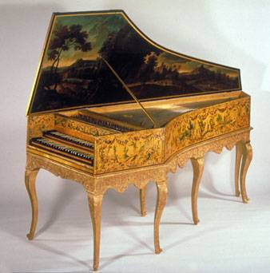
Seventeenth-Century Instrumental Genres Include:
Music for solo lute (Denis & Ennemond Gaultier and others)
Or harpsichord (clavecin; Chambonnières, Louis Couperin, Frescobaldi, Froberger)
Individual pieces (dances, variations, toccate, capricci, etc.)
Arrangements into dance suites (Froberger)

Slide 14
Seventeenth-Century Instrumental Genres Include:
Music for solo lute (Denis & Ennemond Gaultier and others)
Or harpsichord (clavecin; Chambonnières, Louis Couperin, Frescobaldi, Froberger)
Individual pieces (dances, variations, toccate, capricci, etc.)
Arrangements into dance suites (Froberger)
Girolamo Frescobaldi,
Centro partite sopra passacagli [1637]

Slide 15
Seventeenth-Century Instrumental Genres Include:
Music for solo lute (Denis & Ennemond Gaultier and others)
Or harpsichord (clavecin; Chambonnières, Louis Couperin, Frescobaldi, Froberger)
Individual pieces (dances, variations, toccate, capricci, etc.)
Arrangements into dance suites (Froberger)
Johann Jakob Froberger
Suite in A Minor (1649):
(Study Guides, 29-30)
Allemande
Courante
Sarabande
Gigue

Slide 16
Seventeenth-Century Instrumental Genres Include:
Music for solo lute (Denis & Ennemond Gaultier and others)
Or harpsichord (clavecin; Chambonnières, Louis Couperin, Frescobaldi, Froberger)
Individual pieces (dances, variations, toccate, capricci, etc.)
Arrangements into dance suites (Froberger)
Italy: Rise of the early sonata and canzona (sources of the end-of century trio sonata and instrumental concerto)

Slide 17
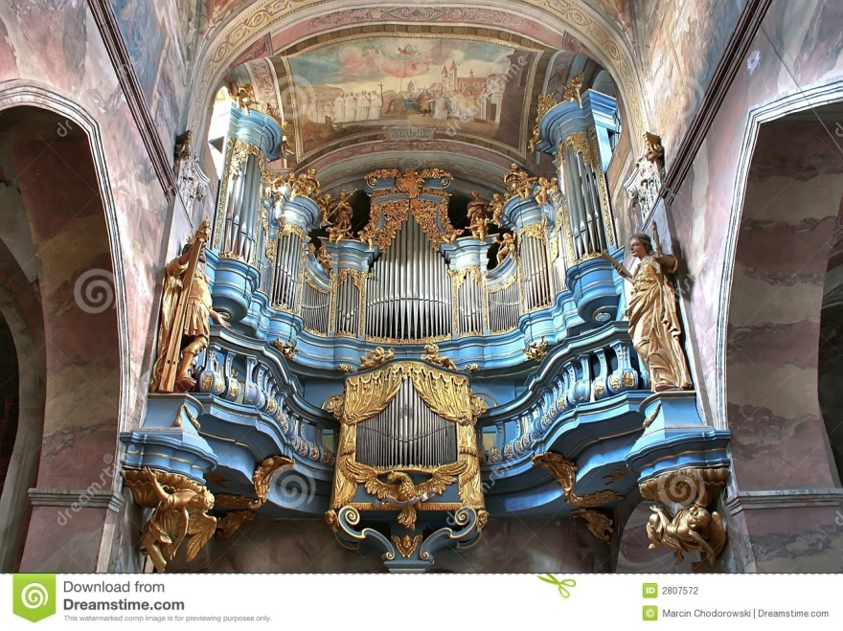
Seventeenth-Century Instrumental Genres Include:
Music for solo lute (Denis & Ennemond Gaultier and others)
Or harpsichord (clavecin; Chambonnières, Louis Couperin, Frescobaldi, Froberger)
Individual pieces (dances, variations, toccate, capricci, etc.)
Arrangements into dance suites (Froberger)
Italy: Rise of the early sonata and canzona (sources of the end-of century trio sonata and instrumental concerto)
Music for organ (e.g., in German lands, predecessors of Bach: Sweelinck, Buxtehude)

Slide 18
Seventeenth-Century Instrumental Genres Include:
Music for solo lute (Denis & Ennemond Gaultier and others)
Or harpsichord (clavecin; Chambonnières, Louis Couperin, Frescobaldi, Froberger)
Individual pieces (dances, variations, toccate, capricci, etc.)
Arrangements into dance suites (Froberger)
Italy: Rise of the early sonata and canzona (sources of the end-of century trio sonata and instrumental concerto)
Music for organ (e.g., in German lands, predecessors of Bach: Sweelinck, Buxtehude)
Instrumental music before and within French opera (overture, interludes)

Slide 19
Seventeenth-Century Instrumental Genres Include:
Music for solo lute (Denis & Ennemond Gaultier and others)
Or harpsichord (clavecin; Chambonnières, Louis Couperin, Frescobaldi, Froberger)
Individual pieces (dances, variations, toccate, capricci, etc.)
Arrangements into dance suites (Froberger)
Italy: Rise of the early sonata and canzona (sources of the end-of century trio sonata and instrumental concerto)
Music for organ (e.g., in German lands, predecessors of Bach: Sweelinck, Buxtehude)
Instrumental music before and within French opera (overture, interludes)
Entertainment music for court or domestic small groups—”chamber music”
(esp. in England, ensembles of viols [“consort of viols”]: Locke, Lawes, Purcell)

Slide 20
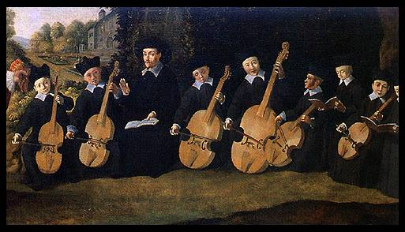
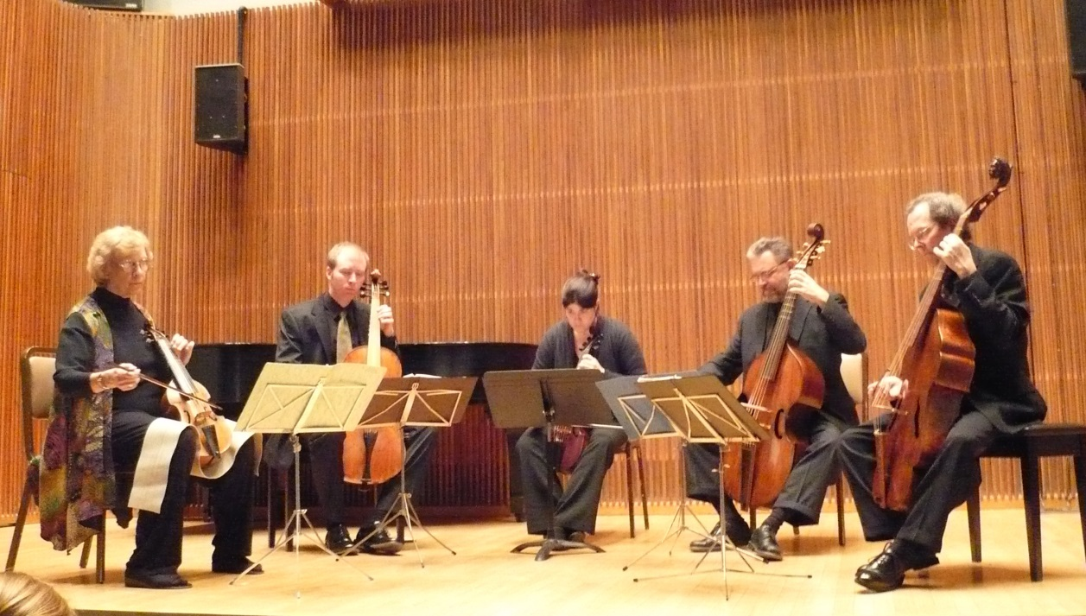
Consort of Viols

Slide 21
Matthew Locke, “Courante” (c. 1660)
Consort of Viols

Slide 22
Seventeenth-Century Instrumental Genres Include:
Music for solo lute (Denis & Ennemond Gaultier and others)
Or harpsichord (clavecin; Chambonnières, Louis Couperin, Frescobaldi, Froberger)
Individual pieces (dances, variations, toccate, capricci, etc.)
Arrangements into dance suites (Froberger)
Italy: Rise of the early sonata and canzona (sources of the end-of century trio sonata and instrumental concerto)
Music for organ (e.g., in German lands, predecessors of Bach: Sweelinck, Buxtehude)
Instrumental music before and within French opera (overture, interludes)
Entertainment music for court or domestic small groups—”chamber music” (esp. in England, ensembles of viols [“consort of viols”]: Locke, Lawes, Purcell)

Slide 23
17th-Century England: Consort of Viols

Slide 24
Fantasies and Suites for Consort of Viols—Composers:
Orlando Gibbons (1583-1625)
William Lawes (1602-1645)
John Jenkins (1592-1678)
Matthew Locke (1621/22-1677)
Henry Purcell (1659-1695)

Slide 25
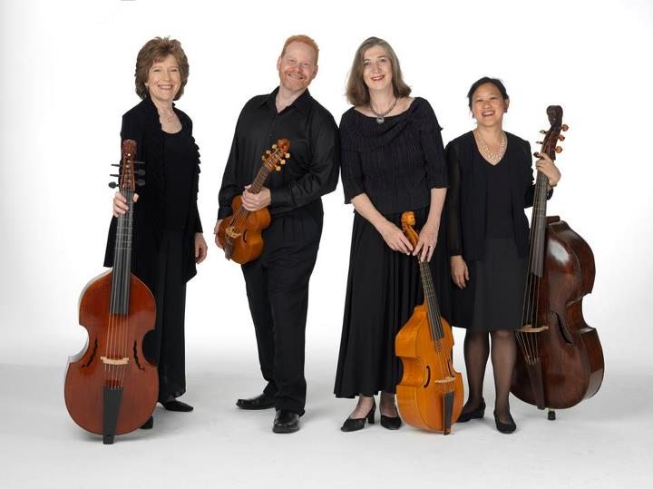
Consort of Viols: Matthew Locke, Suite No. 1 for Four Viols [c. 1660], opening “Fantasia”

Slide 26
Consort of Viols: Matthew Locke, Suite No. 1 for Four Viols [c. 1660], “Courante”

Slide 27
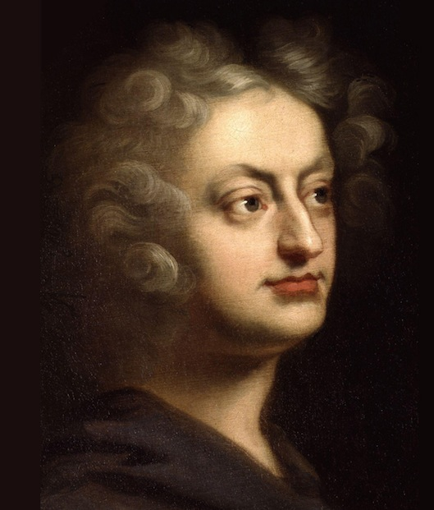
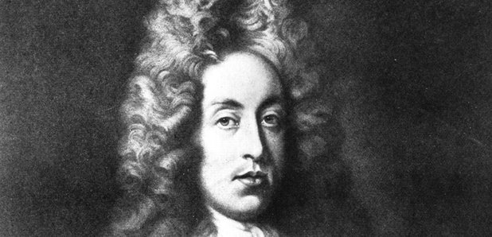
Henry Purcell (1659-1695)

Slide 28
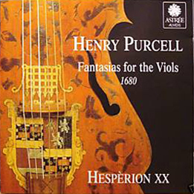
Henry Purcell (1659-1695)

Slide 29
The Development of Opera in 17th-Century England

Slide 30
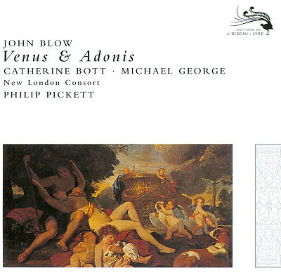
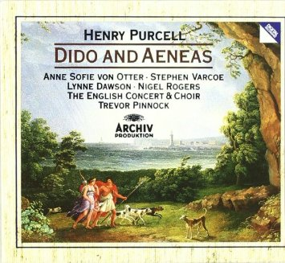
1683 1689

Slide 31
Predecessors of “Opera” Include:
Italy: Intermedio

Slide 32
Predecessors of “Opera” Include:
Italy: Intermedio
France: Ballet de cour and Comédie ballet

Slide 33
Predecessors of “Opera” Include:
Italy: Intermedio
France: Ballet de cour and Comédie ballet
England: Court Masque and Semi-Opera (“Dramatick Opera”)

Slide 34
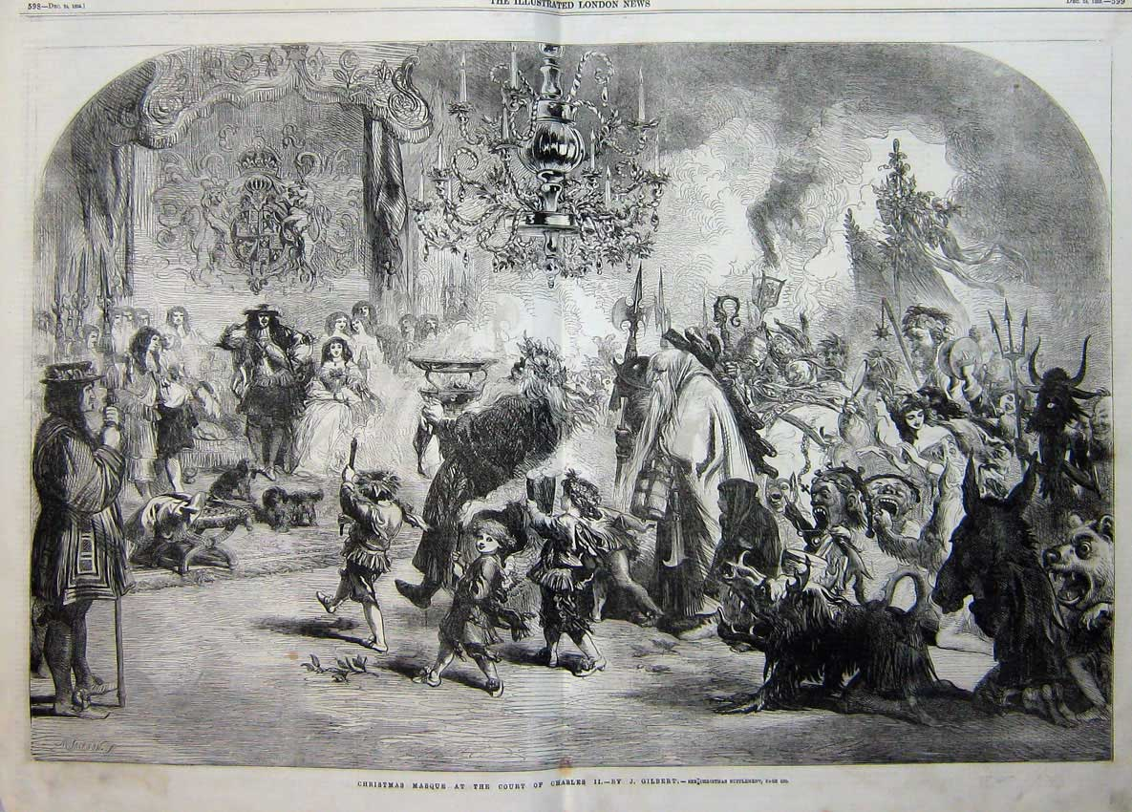
English Court Masque

Slide 35
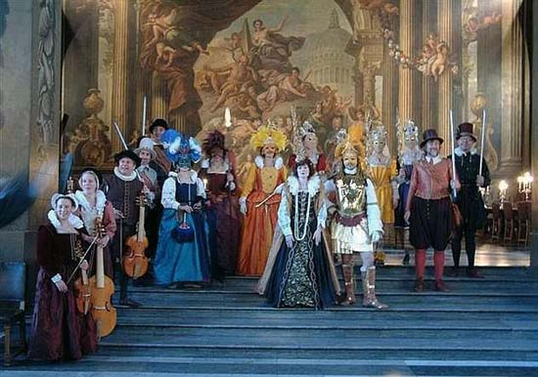
English Court Masque

Slide 36
English Court Masque
(among the most notable: Brittania Triumphans (1638), music by William Lawes)

Slide 37
Restoration England, 1660-1688 (Stuart Kings: Charles II, James II)
Semi-Operas (“Dramatick Operas”), e.g.,
The Tempest (1674, music by several composers)
Matthew Locke, Psyche (1675)

Slide 38
Restoration England, 1660-1688 (Stuart Kings: Charles II, James II)
Semi-Operas (“Dramatick Operas”), e.g.,
The Tempest (1674, music by several composers)
Matthew Locke, Psyche (1675)
Opera
John Blow, Venus and Adonis (1683)
(Henry Purcell’s Dido and Aeneas would follow in 1689)

Slide 39
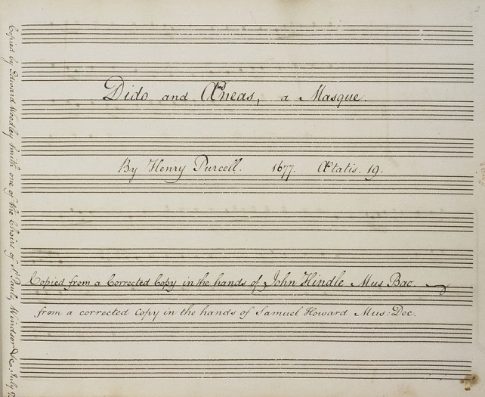
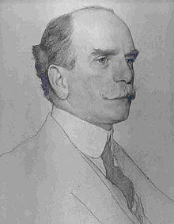
1880s: William Barclay Squire (British Library) discovers a manuscript copy of Purcell’s Dido and Aeneas
(finally published, Purcell Society, 1889)

Slide 40
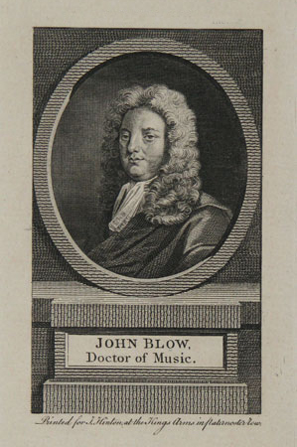

Slide 41
1683 1689

Slide 42
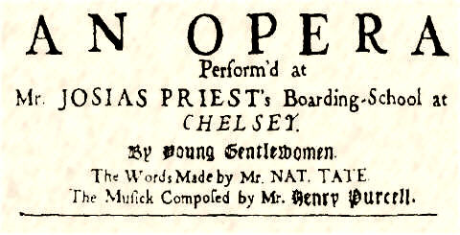
From the original libretto of Dido and Aeneas

Slide 43
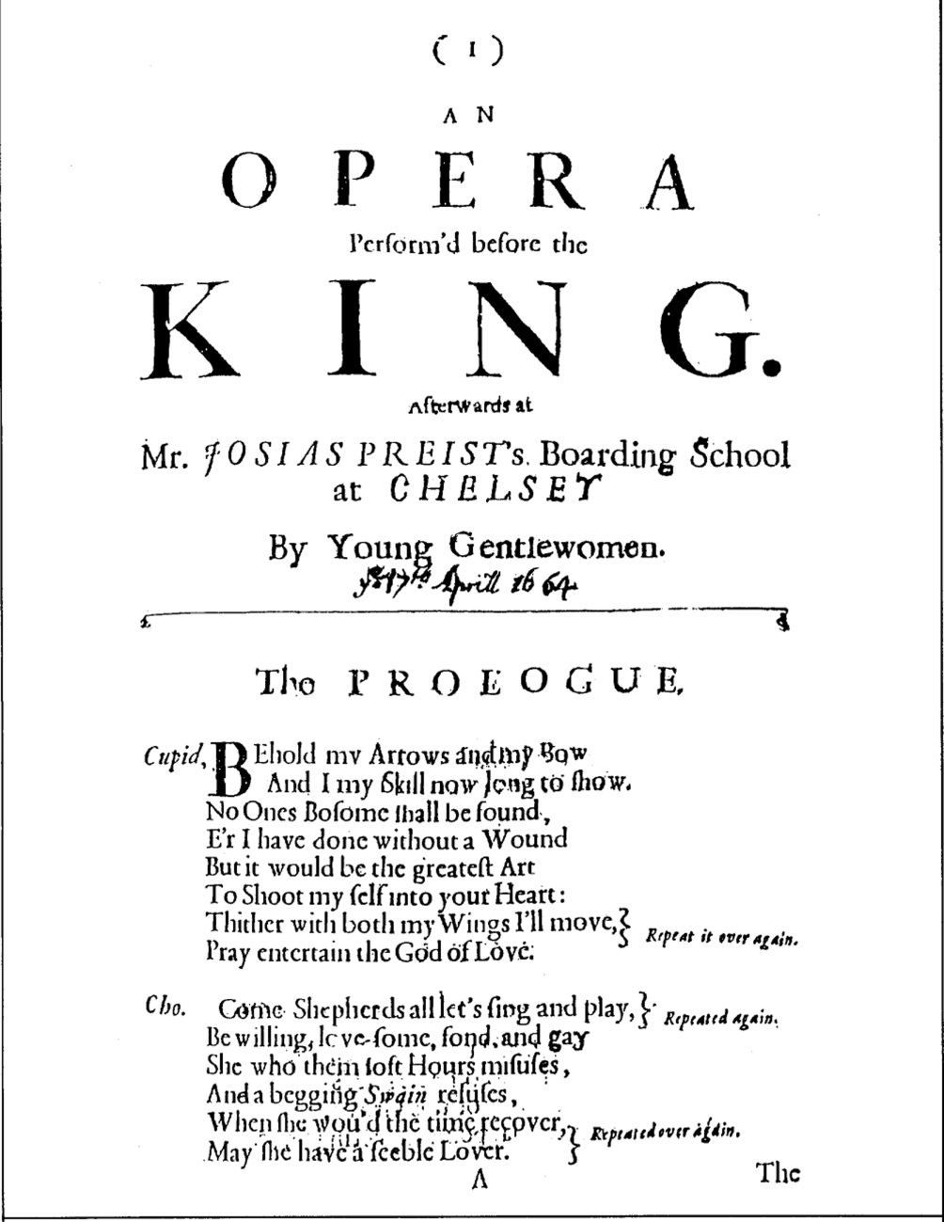
Venus and Adonis, 1683

Slide 44
Venus and Adonis, 1683

Slide 45
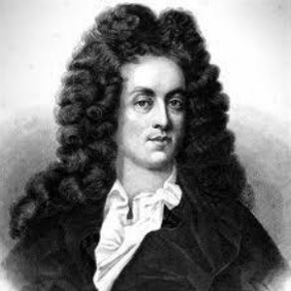
Dido and Aeneas (1689)
Henry Purcell Nahum Tate (poet, librettist)

