Slide 1
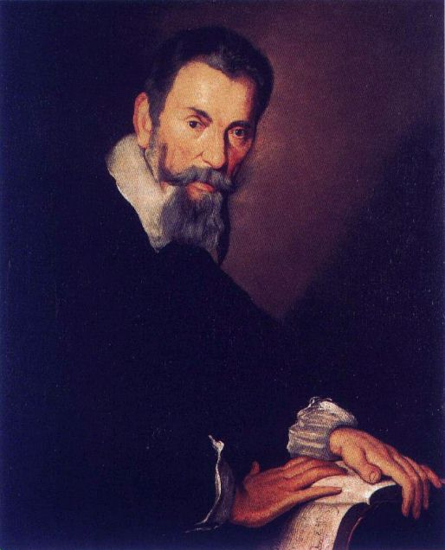
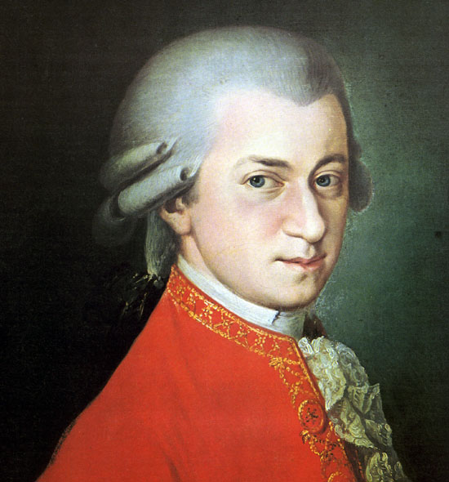
European Music from M to M?

Slide 2
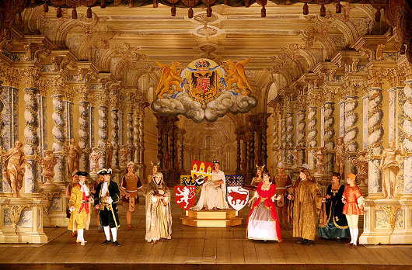
Music 351:
Music in European Court, Church, and Theater, 1600-1800

Slide 3
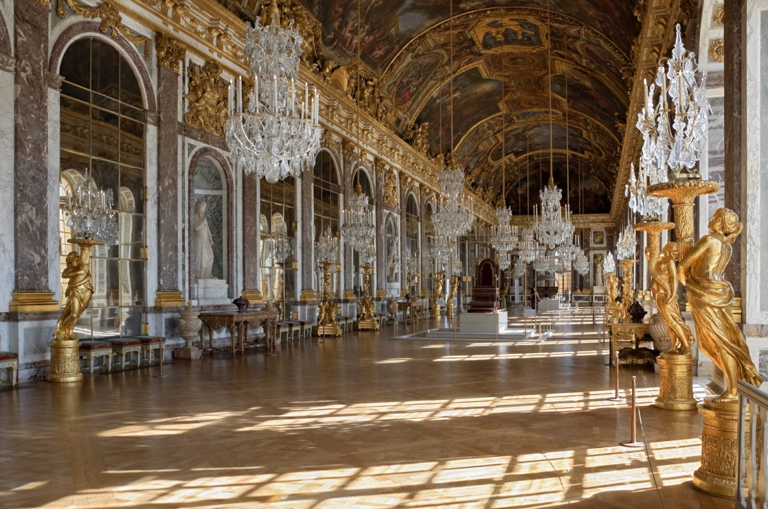
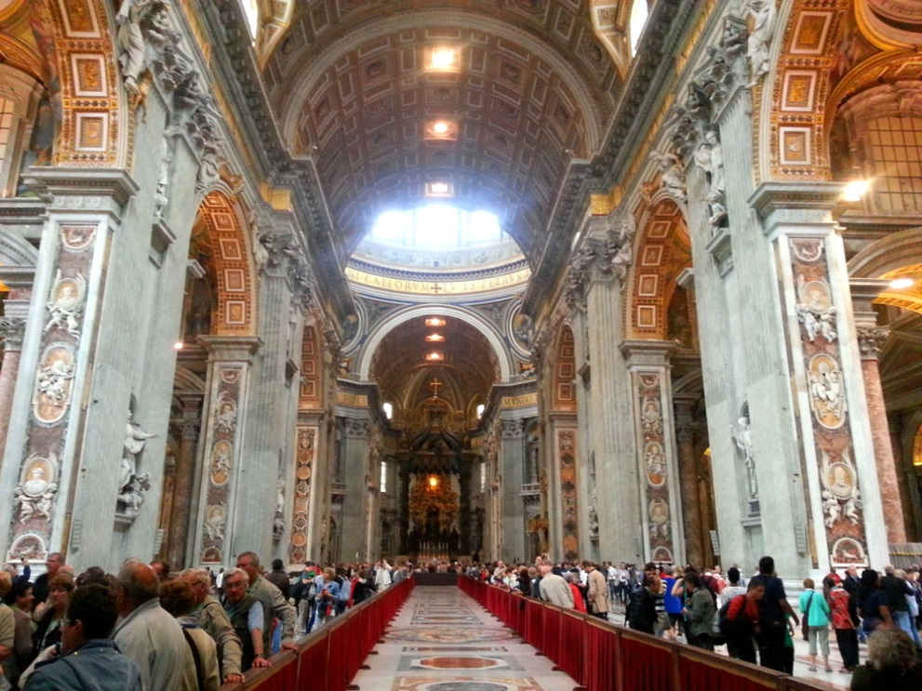
Court and church: sites of cultural authority and power
(aristocratic; monarchical)

Slide 4
Music in European Court, Church, and Theater, 1600-1800:
Vocal Music: Highest Prestige
1550 1600 1700 1800

Slide 5
Music in European Court, Church, and Theater, 1600-1800:
The Rise of Instrumental Music
Vocal Music: Highest Prestige
1550 1600 1700 1800

Slide 6
Music in European Court, Church, and Theater, 1600-1800:
The Rise of Instrumental Music
Vocal Music: Highest Prestige
Instrumental Music
1550 1600 1700 1800

Slide 7
Music in European Court, Church, and Theater, 1600-1800:
The Rise of Instrumental Music
Vocal Music: Highest Prestige
Instrumental Music
(along with the rise of “modernity”)
1550 1600 1700 1800

Slide 8
Music in European Court, Church, and Theater, 1600-1800:
The Rise of Instrumental Music
Vocal Music: Highest Prestige
Instrumental Music
(along with the rise of “modernity”)
1550 1600 1700 1800

Slide 9
Music in European Court, Church, and Theater, 1600-1800:
The Rise of Instrumental Music
Vocal Music: Highest Prestige
Instrumental Music
(along with the rise of “modernity”)
1550 1600 1700 1800
c. 1735

Slide 10
Music in European Court, Church, and Theater, 1600-1800:
The Rise of Instrumental Music
Vocal Music: Highest Prestige
Instrumental Music
(along with the rise of “modernity”)
1550 1600 1700 1800 c. 1781?
c. 1735

Slide 11
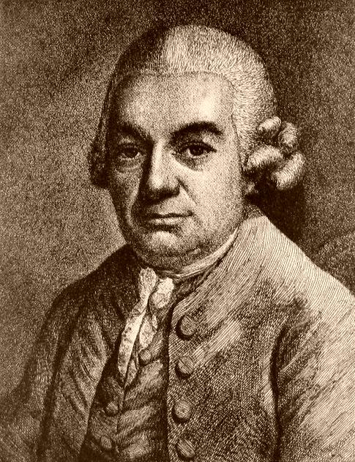
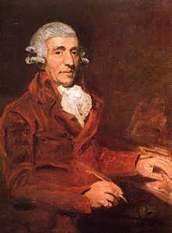
C. P. E. Bach Haydn Mozart

Slide 12
C. P. E. Bach Haydn Mozart

Slide 13
C. P. E. Bach Haydn Mozart

Slide 14
C. P. E. Bach Haydn Mozart

Slide 15
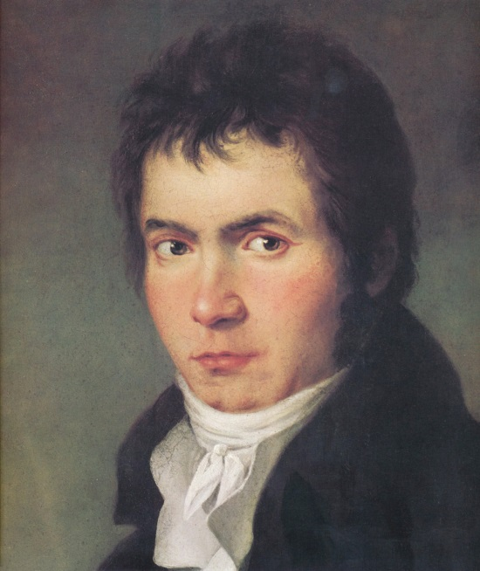
C. P. E. Bach Haydn Mozart
Beethoven

Slide 16
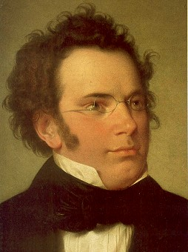
C. P. E. Bach Haydn Mozart
Beethoven
Schubert

Slide 17
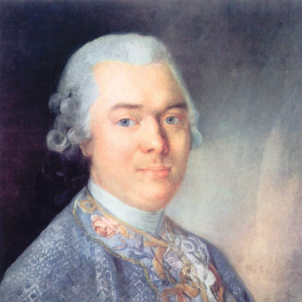
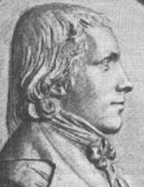
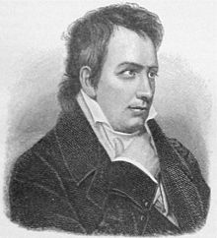
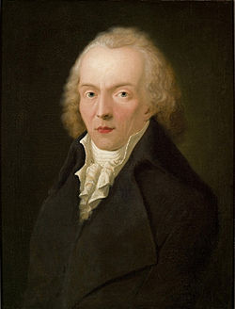
Musical Devotees, Connoisseurs , Promoting the Rising Claims of Instrumental Music
Baron van Swieten
Wilhelm Wackenroder Ludwig Tieck “Jean Paul”

Slide 18
Musical Devotees, Connoisseurs , Promoting the Rising Claims of Instrumental Music
Music as a display object
for contemplation, devotion, even reverence
Baron van Swieten
Wilhelm Wackenroder Ludwig Tieck “Jean Paul”

Slide 19
Musical Devotees, Connoisseurs , Promoting the Rising Claims of Instrumental Music
Music as a display object
for contemplation, devotion, even reverence
Music as profound, revelatory, an agent of disclosure:
a truth language
Baron van Swieten
Wilhelm Wackenroder Ludwig Tieck “Jean Paul”

Slide 20
Profundity Contract
The undersigned parties concur that much of the new European instrumental art music of the 1780s and succeeding years, stemming initially from in and around Austria, has now advanced beyond any mere entertainment function. Music striving toward this condition of heightened connoisseurship is therefore to be created, regarded, and absorbed in an appropriately new way, with reverential devotion, as ultimately important, as a truth-disclosing, transcendent medium whose soul-stirring revelations are not capturable by other means, including especially those of mere words. We therefore agree to the following conditions:
The composer hereby agrees increasingly to write music on these terms, producing display objects for devotional contemplation and study.
The performer, as the immediate conveyor of the revelation, agrees to treat the performance of such works in a similar manner and to inculcate the same response in his or her listeners.
The listener hereby agrees to listen to and absorb this music contemplatively, as a sonic disclosure of an essential humanness or a quasi-spiritualized contact.

Slide 21
Profundity Contract
The undersigned parties concur that much of the new European instrumental art music of the 1780s and succeeding years, stemming initially from in and around Austria, has now advanced beyond any mere entertainment function. Music striving toward this condition of heightened connoisseurship is therefore to be created, regarded, and absorbed in an appropriately new way, with reverential devotion, as ultimately important, as a truth-disclosing, transcendent medium whose soul-stirring revelations are not capturable by other means, including especially those of mere words. We therefore agree to the following conditions:
The composer hereby agrees increasingly to write music on these terms, producing display objects for devotional contemplation and study.
The performer, as the immediate conveyor of the revelation, agrees to treat the performance of such works in a similar manner and to inculcate the same response in his or her listeners.
The listener hereby agrees to listen to and absorb this music contemplatively, as a sonic disclosure of an essential humanness or a quasi-spiritualized contact.
✓

Slide 22
Profundity Contract
The undersigned parties concur that much of the new European instrumental art music of the 1780s and succeeding years, stemming initially from in and around Austria, has now advanced beyond any mere entertainment function. Music striving toward this condition of heightened connoisseurship is therefore to be created, regarded, and absorbed in an appropriately new way, with reverential devotion, as ultimately important, as a truth-disclosing, transcendent medium whose soul-stirring revelations are not capturable by other means, including especially those of mere words. We therefore agree to the following conditions:
The composer hereby agrees increasingly to write music on these terms, producing display objects for devotional contemplation and study.
The performer, as the immediate conveyor of the revelation, agrees to treat the performance of such works in a similar manner and to inculcate the same response in his or her listeners.
The listener hereby agrees to listen to and absorb this music contemplatively, as a sonic disclosure of an essential humanness or a quasi-spiritualized contact.
✓
✓

Slide 23
Profundity Contract
The undersigned parties concur that much of the new European instrumental art music of the 1780s and succeeding years, stemming initially from in and around Austria, has now advanced beyond any mere entertainment function. Music striving toward this condition of heightened connoisseurship is therefore to be created, regarded, and absorbed in an appropriately new way, with reverential devotion, as ultimately important, as a truth-disclosing, transcendent medium whose soul-stirring revelations are not capturable by other means, including especially those of mere words. We therefore agree to the following conditions:
The composer hereby agrees increasingly to write music on these terms, producing display objects for devotional contemplation and study.
The performer, as the immediate conveyor of the revelation, agrees to treat the performance of such works in a similar manner and to inculcate the same response in his or her listeners.
The listener hereby agrees to listen to and absorb this music contemplatively, as a sonic disclosure of an essential humanness or a quasi-spiritualized contact.
✓
✓
✓

Slide 24
Mid- and late 1800s, early 1900s:
Emerging within Austro-Germanic universities: the quasi-ideological construction
of a “history of music” [Geschichte der Musik] centered around what came to be regarded
as the apogee and culmination of European musical development,
a music that has been finally “emancipated” or has “come of age”—
encouraging an institutional recovery and celebration of “great music’s heroes”

Slide 25
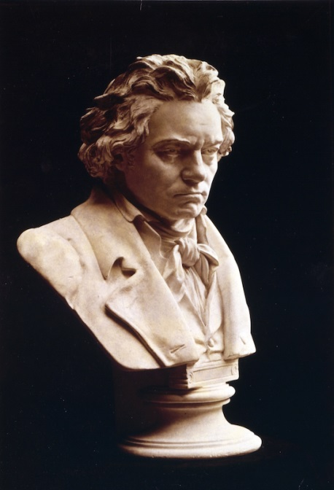
Mid- and late 1800s, early 1900s:
Emerging within Austro-Germanic universities: the quasi-ideological construction
of a “history of music” [Geschichte der Musik] centered around what came to be regarded
as the apogee and culmination of European musical development,
a music that has been finally “emancipated” or has “come of age”—
encouraging an institutional recovery and celebration of “great music’s heroes”
1. start here

Slide 26
Mid- and late 1800s, early 1900s:
Emerging within Austro-Germanic universities: the quasi-ideological construction
of a “history of music” [Geschichte der Musik] centered around what came to be regarded
as the apogee and culmination of European musical development,
a music that has been finally “emancipated” or has “come of age”—
encouraging an institutional recovery and celebration of “great music’s heroes”
now dubbed “classical”
1. start here

Slide 27
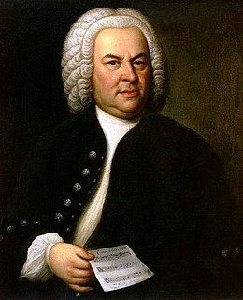
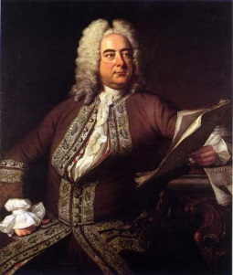
Mid- and late 1800s, early 1900s:
Emerging within Austro-Germanic universities: the quasi-ideological construction
of a “history of music” [Geschichte der Musik] centered around what came to be regarded
as the apogee and culmination of European musical development,
a music that has been finally “emancipated” or has “come of age”—
encouraging an institutional recovery and celebration of “great music’s heroes”
2. recover a past “history” that led up to this culmination and helped
to make it possible
. . .
now dubbed “classical”
1. start here

Slide 28
Mid- and late 1800s, early 1900s:
Emerging within Austro-Germanic universities: the quasi-ideological construction
of a “history of music” [Geschichte der Musik] centered around what came to be regarded
as the apogee and culmination of European musical development,
a music that has been finally “emancipated” or has “come of age”—
encouraging an institutional recovery and celebration of “great music’s heroes”
2. recover a past “history” that led up to this culmination and helped
to make it possible
. . .
3. reconstruct the
long-distant past
to the extent possible
now dubbed “classical”
1. start here

Slide 29
Mid- and late 1800s, early 1900s:
Emerging within Austro-Germanic universities: the quasi-ideological construction
of a “history of music” [Geschichte der Musik] centered around what came to be regarded
as the apogee and culmination of European musical development,
a music that has been finally “emancipated” or has “come of age”—
encouraging an institutional recovery and celebration of “great music’s heroes”
2. recover a past “history” that led up to this culmination and helped
to make it possible
4. construct later “music history”
as aftermath: continuations and repercussions of Bach, Handel, Haydn, Mozart, and Beethoven—emergence of a “classical music” canon of masterworks
. . .
3. reconstruct the
long-distant past
to the extent possible
now dubbed “classical”
1. start here

Slide 30
Mid- and late 1800s, early 1900s:
Emerging within Austro-Germanic universities: the quasi-ideological construction
of a “history of music” [Geschichte der Musik] centered around what came to be regarded
as the apogee and culmination of European musical development,
a music that has been finally “emancipated” or has “come of age”—
encouraging an institutional recovery and celebration of “great music’s heroes”
2. recover a past “history” that led up to this culmination and helped
to make it possible
4. construct later “music history”
as aftermath: continuations and repercussions of Bach, Handel, Haydn, Mozart, and Beethoven—emergence of a “classical music” canon of masterworks
. . .
(often told as a narrative of slow but inexorable decline away from prior “perfection”)
3. reconstruct the
long-distant past
to the extent possible
now dubbed “classical”
1. start here

Slide 31
Mozart’s Last Six Symphonies:
Strongly individualized; monumentalized
No. 35 in D, K. 385 , “Haffner” (1782. rev. 1783)
No. 36 in C, K. 425, “Linz” (1783)
No. 38 In D, K. 504, “Prague” (hyper-monumental)

Slide 32
Mozart’s Last Six Symphonies:
Strongly individualized; monumentalized
No. 35 in D, K. 385 , “Haffner” (1782. rev. 1783)
No. 36 in C, K. 425, “Linz” (1783)
No. 38 In D, K. 504, “Prague” (hyper-monumental)

Slide 33
Mozart’s Last Six Symphonies:
Strongly individualized; monumentalized
No. 35 in D, K. 385 , “Haffner” (1782. rev. 1783)
No. 36 in C, K. 425, “Linz” (1783)
No. 38 In D, K. 504, “Prague” (hyper-monumental)

Slide 34
Mozart’s Last Six Symphonies:
Strongly individualized; monumentalized
No. 35 in D, K. 385 , “Haffner” (1782. rev. 1783)
No. 36 in C, K. 425, “Linz” (1783)
No. 38 In D, K. 504, “Prague” (hyper-monumental)

Slide 35
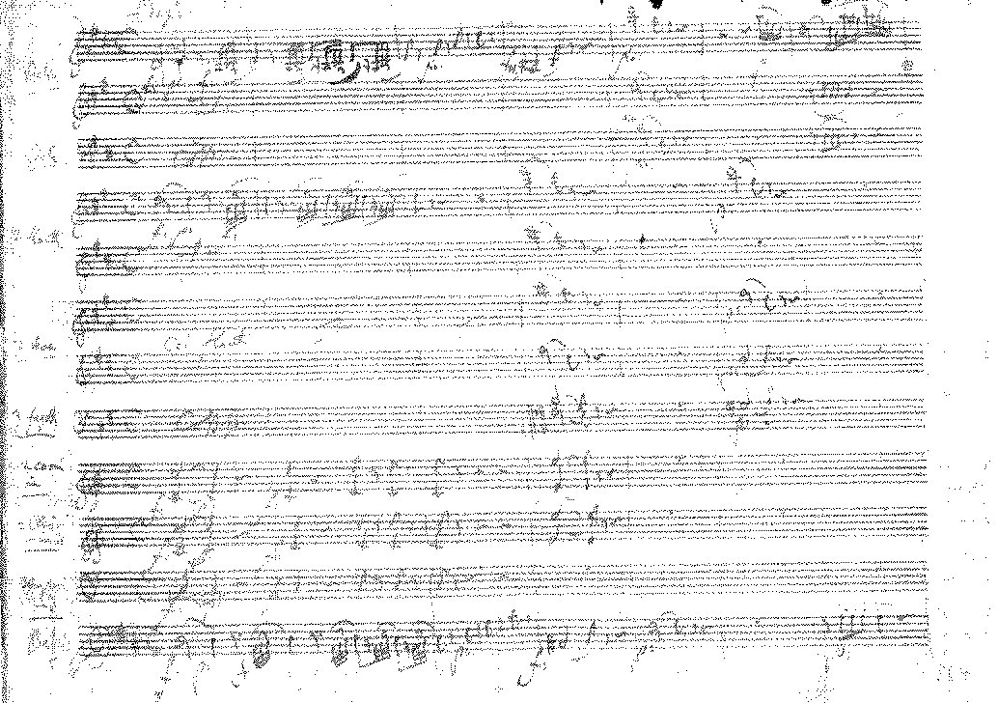
Mozart, Symphony No. 38 in D, K. 504, “Prague” (1786)

Slide 36
Mozart’s Last Six Symphonies:
Strongly individualized; monumentalized
No. 35 in D, K. 385 , “Haffner” (1782. rev. 1783)
No. 36 in C, K. 425, “Linz” (1783)
No. 38 In D, K. 504, “Prague” (1786, hyper-monumental)
No. 39 in E-flat, K. 543 (1788)
No. 40 in G Minor, K. 550 (1788)
No. 41 in C, K. 551, “Jupiter” (1788, hyper-monumental)

Slide 37
Mozart’s Last Six Symphonies:
Strongly individualized; monumentalized
No. 35 in D, K. 385 , “Haffner” (1782. rev. 1783)
No. 36 in C, K. 425, “Linz” (1783)
No. 38 In D, K. 504, “Prague” (1786, hyper-monumental)
No. 39 in E-flat, K. 543 (1788)
No. 40 in G Minor, K. 550 (1788)
No. 41 in C, K. 551, “Jupiter” (1788, hyper-monumental)

Slide 38
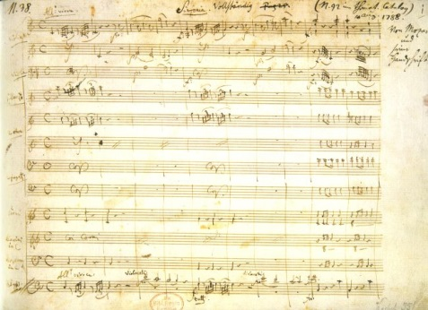
Mozart, Symphony No. 41 in C, K. 551, “Jupiter” (1788)

Slide 39
Mozart, Symphony No. 41 in C, K. 551, “Jupiter” (1788): finale
Antecedent (oppositional topics)
I:HC
P
“old world” (serious)
“new world” (buffa)
1
2
Consequent
I:HC & Dominant-Lock
I:PAC
“old world”
Codetta
1
2
2
3
!!
!!
!!
Insistence! Bluster! “No, you don’t” “So there!”

Slide 40
“old world” “new world” (buffa laughter)
V:HC MC
1
4
3
TR
!!
Sober, learned style;
“Spacious dignity”;
6 entries of the subject
“Breakout”
“So there!”

Slide 41
“old world” new world” (buffa laughter)
V:PAC
EEC
C
Intermixed with commentary of:
Emphatic!
.
.
5, 6, 7
3
4
2
3!!
S
“So there!” & “Breakout”
“So there!”
(in florid contrapuntal display!!)
“Strenuous
Counterpoint!!”
“Counterpoint of particles”;
Counterpoint of “old world”
in the light, nimble guise
of the “new world”
Buffa retort
and laughter!
Laughing away the
seriousness in the
spirit of a liberated
high play!
a a b

Slide 42
CODA
(The Centerpiece)
(entrance ramp)
Dazzlingly contrapuntal:
Exuberant build-up of the contrapuntal interplay
of five different particles
In invertible counterpoint,
shifting registers and positions.
1
3
“Curtain!”
and bow!
2
Inversion, in stretto -
overlaps with itself
“So there!”
Buffa! Laughter!
Shout of joy!
Two-part 4 bars
Three-part 4 bars
Four-part 4 bars
Five-part! 4 bars
Five-part! 4 bars
Five-part! 4 bars
Five-part! 3 bars!
Five-part! 4 bars
Tutti!

Slide 43
CODA
(The Centerpiece)
(entrance ramp)
Dazzlingly contrapuntal:
Exuberant build-up of the contrapuntal interplay
of five different particles
In invertible counterpoint,
shifting registers and positions.
1
3
“Curtain!”
and bow!
2
Inversion, in stretto -
overlaps with itself
“So there!”
Buffa! Laughter!
Shout of joy!
Two-part 4 bars
Three-part 4 bars
Four-part 4 bars
Five-part! 4 bars
Five-part! 4 bars
Five-part! 4 bars
Five-part! 3 bars!
Five-part! 4 bars
Tutti!

Slide 44
CODA
(The Centerpiece)
(entrance ramp)
Dazzlingly contrapuntal:
Exuberant build-up of the contrapuntal interplay
of five different particles
In invertible counterpoint,
shifting registers and positions.
1
3
“Curtain!”
and bow!
2
Inversion, in stretto -
overlaps with itself
“So there!”
Buffa! Laughter!
Shout of joy!
Two-part 4 bars
Three-part 4 bars
Four-part 4 bars
Five-part! 4 bars
Five-part! 4 bars
Five-part! 4 bars
Five-part! 3 bars!
Five-part! 4 bars
Tutti!

Slide 45
CODA
(The Centerpiece)
(entrance ramp)
Dazzlingly contrapuntal:
Exuberant build-up of the contrapuntal interplay
of five different particles
In invertible counterpoint,
shifting registers and positions.
1
3
“Curtain!”
and bow!
2
Inversion, in stretto -
overlaps with itself
“So there!”
Buffa! Laughter!
Shout of joy!
Two-part 4 bars
Three-part 4 bars
Four-part 4 bars
Five-part! 4 bars
Five-part! 4 bars
Five-part! 4 bars
Five-part! 3 bars!
Five-part! 4 bars
Tutti!

Slide 46
CODA
(The Centerpiece)
(entrance ramp)
Dazzlingly contrapuntal:
Exuberant build-up of the contrapuntal interplay
of five different particles
In invertible counterpoint,
shifting registers and positions.
1
3
“Curtain!”
and bow!
2
Inversion, in stretto -
overlaps with itself
“So there!”
Buffa! Laughter!
Shout of joy!
Two-part 4 bars
Three-part 4 bars
Four-part 4 bars
Five-part! 4 bars
Five-part! 4 bars
Five-part! 4 bars
Five-part! 3 bars!
Five-part! 4 bars
Tutti!

Slide 47
CODA
(The Centerpiece)
(entrance ramp)
Dazzlingly contrapuntal:
Exuberant build-up of the contrapuntal interplay
of five different particles
In invertible counterpoint,
shifting registers and positions.
1
3
“Curtain!”
and bow!
2
Inversion, in stretto -
overlaps with itself
“So there!”
Buffa! Laughter!
Shout of joy!
Two-part 4 bars
Three-part 4 bars
Four-part 4 bars
Five-part! 4 bars
Five-part! 4 bars
Five-part! 4 bars
Five-part! 3 bars!
Five-part! 4 bars
Tutti!

Slide 48
CODA
(The Centerpiece)
(entrance ramp)
Dazzlingly contrapuntal:
Exuberant build-up of the contrapuntal interplay
of five different particles
In invertible counterpoint,
shifting registers and positions.
1
3
“Curtain!”
and bow!
2
Inversion, in stretto -
overlaps with itself
“So there!”
Buffa! Laughter!
Shout of joy!
Two-part 4 bars
Three-part 4 bars
Four-part 4 bars
Five-part! 4 bars
Five-part! 4 bars
Five-part! 4 bars
Five-part! 3 bars!
Five-part! 4 bars
Tutti!

Slide 49
CODA
(The Centerpiece)
(entrance ramp)
Dazzlingly contrapuntal:
Exuberant build-up of the contrapuntal interplay
of five different particles
In invertible counterpoint,
shifting registers and positions.
1
3
“Curtain!”
and bow!
2
Inversion, in stretto -
overlaps with itself
“So there!”
Buffa! Laughter!
Shout of joy!
Two-part 4 bars
Three-part 4 bars
Four-part 4 bars
Five-part! 4 bars
Five-part! 4 bars
Five-part! 4 bars
Five-part! 3 bars!
Five-part! 4 bars
Tutti!

Slide 50
CODA
(The Centerpiece)
(entrance ramp)
Dazzlingly contrapuntal:
Exuberant build-up of the contrapuntal interplay
of five different particles
In invertible counterpoint,
shifting registers and positions.
1
3
“Curtain!”
and bow!
2
Inversion, in stretto -
overlaps with itself
“So there!”
Buffa! Laughter!
Shout of joy!
Two-part 4 bars
Three-part 4 bars
Four-part 4 bars
Five-part! 4 bars
Five-part! 4 bars
Five-part! 4 bars
Five-part! 3 bars!
Five-part! 4 bars
Tutti!

Slide 51
CODA
(The Centerpiece)
(entrance ramp)
Dazzlingly contrapuntal:
Exuberant build-up of the contrapuntal interplay
of five different particles
In invertible counterpoint,
shifting registers and positions.
1
3
“Curtain!”
and bow!
2
Inversion, in stretto -
overlaps with itself
“So there!”
Buffa! Laughter!
Shout of joy!
Two-part 4 bars
Three-part 4 bars
Four-part 4 bars
Five-part! 4 bars
Five-part! 4 bars
Five-part! 4 bars
Five-part! 3 bars!
Five-part! 4 bars
Tutti!

Slide 52
CODA
(The Centerpiece)
(entrance ramp)
Dazzlingly contrapuntal:
Exuberant build-up of the contrapuntal interplay
of five different particles
In invertible counterpoint,
shifting registers and positions.
1
3
“Curtain!”
and bow!
2
Inversion, in stretto -
overlaps with itself
“So there!”
Buffa! Laughter!
Shout of joy!
Two-part 4 bars
Three-part 4 bars
Four-part 4 bars
Five-part! 4 bars
Five-part! 4 bars
Five-part! 4 bars
Five-part! 3 bars!
Five-part! 4 bars
Tutti!

Slide 53
CODA
(The Centerpiece)
(entrance ramp)
Dazzlingly contrapuntal:
Exuberant build-up of the contrapuntal interplay
of five different particles
In invertible counterpoint,
shifting registers and positions.
1
3
“Curtain!”
and bow!
2
Inversion, in stretto -
overlaps with itself
“So there!”
Buffa! Laughter!
Shout of joy!
Two-part 4 bars
Three-part 4 bars
Four-part 4 bars
Five-part! 4 bars
Five-part! 4 bars
Five-part! 4 bars
Five-part! 3 bars!
Five-part! 4 bars
Tutti!

Slide 54
CODA
(The Centerpiece)
(entrance ramp)
Dazzlingly contrapuntal:
Exuberant build-up of the contrapuntal interplay
of five different particles
In invertible counterpoint,
shifting registers and positions.
1
3
“Curtain!”
and bow!
2
Inversion, in stretto -
overlaps with itself
“So there!”
Buffa! Laughter!
Shout of joy!
Two-part 4 bars
Three-part 4 bars
Four-part 4 bars
Five-part! 4 bars
Five-part! 4 bars
Five-part! 4 bars
Five-part! 3 bars!
Five-part! 4 bars
Tutti!

Slide 56
Beethoven
Schubert

