Slide 1
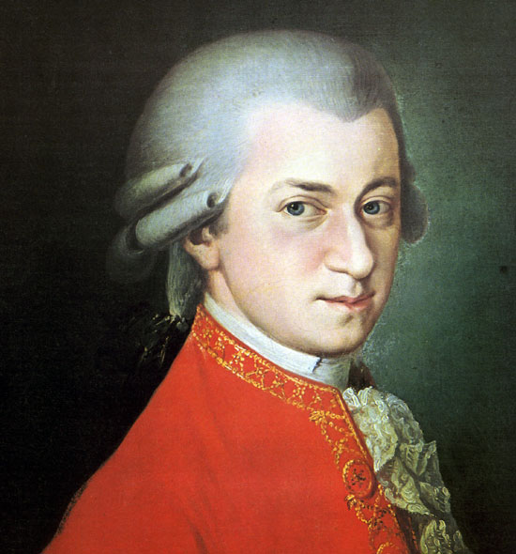
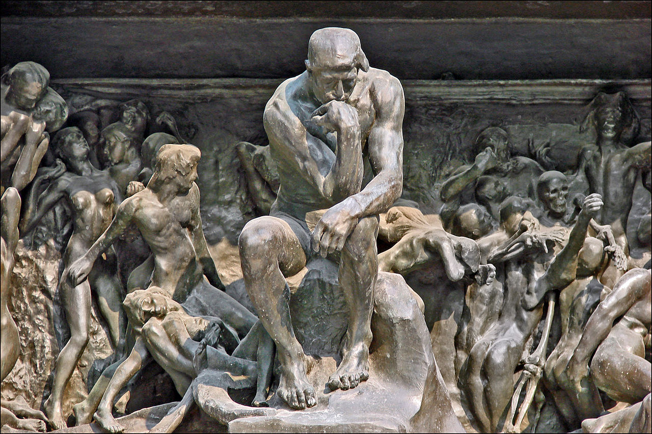
Mozart in the 1780s: Instrumental Music with New Claims, New Implications?

Slide 2
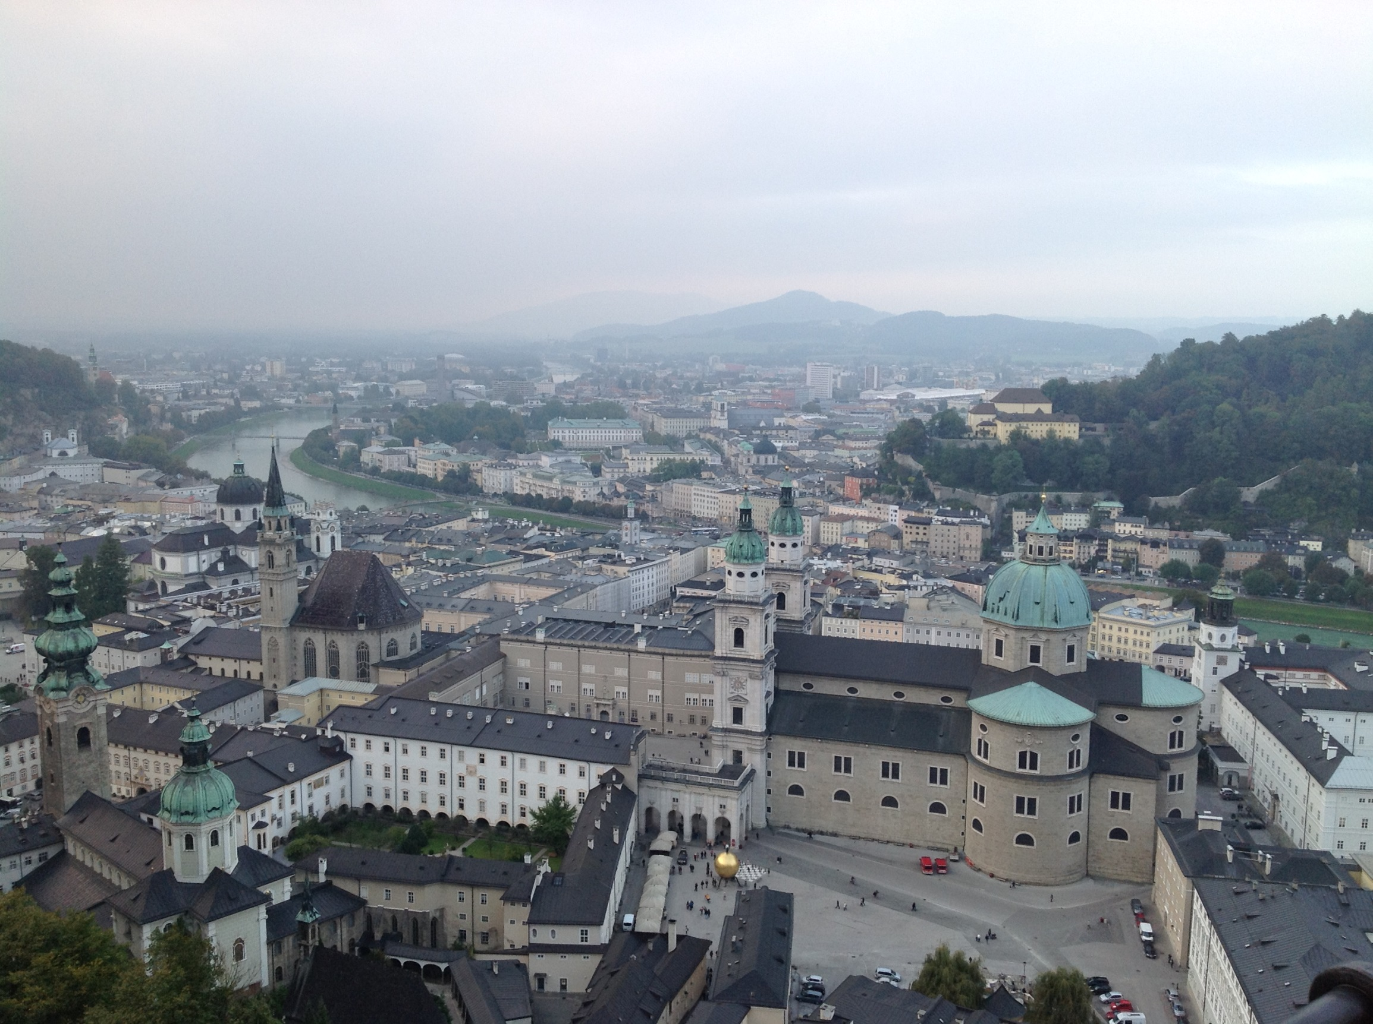
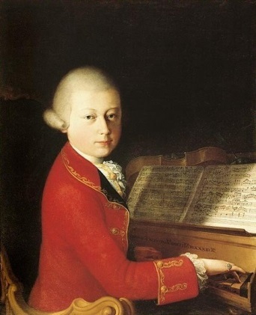
Mozart mostly back in Salzburg, 1773-81: age 17-25

Slide 3
Mozart mostly back in Salzburg, 1773-81: age 17-25

Slide 4
Mozart mostly back in Salzburg, 1773-81: age 17-25
Symphony No. 25 in G Minor, K. 183
(October 1773) [“stormy style”)

Slide 5
Mozart mostly back in Salzburg, 1773-81: age 17-25
Symphony No. 25 in G Minor, K. 183
(October 1773) [“stormy style”)
Symphony No. 29 in A, K. 201
(April 1774)

Slide 6
Mozart mostly back in Salzburg, 1773-81: age 17-25
Symphony No. 25 in G Minor, K. 183
(October 1773) [“stormy style”)
Symphony No. 29 in A, K. 201
(April 1774)
Five Piano Sonatas, K. 279-283
(Munich trip, 1775)

Slide 7
Mozart mostly back in Salzburg, 1773-81: age 17-25
Symphony No. 25 in G Minor, K. 183
(October 1773) [“stormy style”)
Symphony No. 29 in A, K. 201
(April 1774)
Five Piano Sonatas, K. 279-283
(Munich trip, 1775)
Bassoon Concerto in B-flat, K. 191
(June 1774)

Slide 8
Mozart mostly back in Salzburg, 1773-81: age 17-25
Trips away from Salzburg: September 1777 – January 1779
Munich (2 ½ weeks)
Mannheim (5 months)
Paris (6 months)

Slide 9
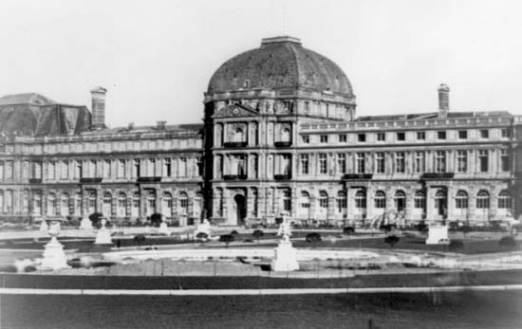
Mozart, Symphony No. 31 in D, “Paris,” K. 297
Performed at the Concerts Spirituels, Tuileries Palace (June 1778)

Slide 10
Mozart, Symphony No. 31 in D, “Paris,” K. 297
Performed at the Concerts Spirituels, Tuileries Palace (June 1778)
exposition as a display of abundance and boundless creativity
a continuing, non-stop chain of contrasting ideas, one stunning idea after another
EEC
S
C
P
TR
V
I

Slide 11
Mozart, Symphony No. 31 in D, “Paris,” K. 297
Performed at the Concerts Spirituels, Tuileries Palace (June 1778)
exposition as a display of abundance and boundless creativity
a continuing, non-stop chain of contrasting ideas, one stunning idea after another
EEC
S
C
P
TR
V
I

Slide 12
Mozart, Symphony No. 31 in D, “Paris,” K. 297
Performed at the Concerts Spirituels, Tuileries Palace (June 1778)
exposition as a display of abundance and boundless creativity
a continuing, non-stop chain of contrasting ideas, one stunning idea after another
EEC
S
C
P
TR
V
I

Slide 13
Mozart, Symphony No. 31 in D, “Paris,” K. 297
Performed at the Concerts Spirituels, Tuileries Palace (June 1778)
exposition as a display of abundance and boundless creativity
a continuing, non-stop chain of contrasting ideas, one stunning idea after another
EEC
S
C
P
TR
V
I

Slide 14
Mozart mostly back in Salzburg, 1773-81: age 17-25
Trips away from Salzburg: September 1777 – January 1779
Munich (2 ½ weeks)
Mannheim (5 months)
Paris (6 months)

Slide 15
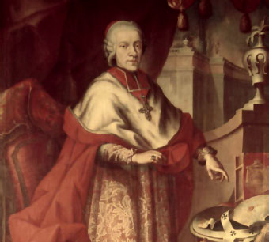
Mozart mostly back in Salzburg, 1773-81: age 17-25
Under the thumb of Prince-Archbishop Colleredo

Slide 16
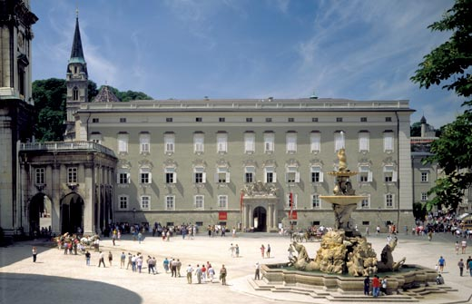
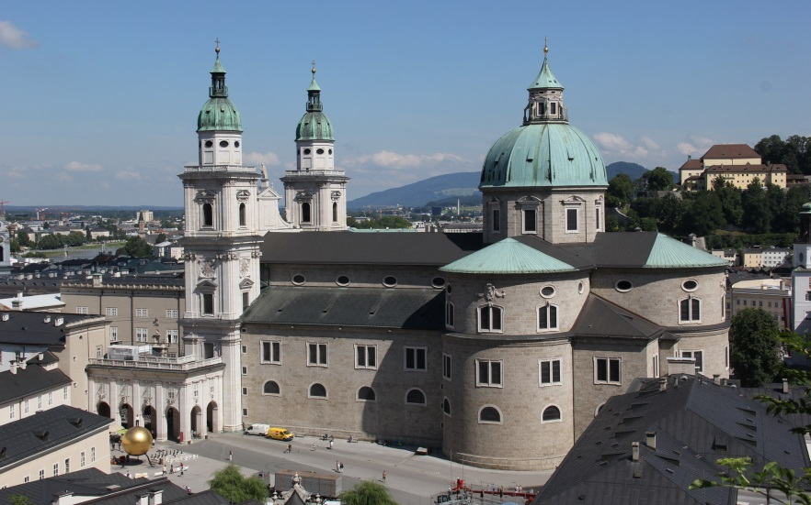
Mozart: The Crucial Year, 1781
Age 25
Starts out in Salzburg
Salzburg: Court
Prince-Archbishop Colleredo
Salzburg: Cathedral

Slide 17
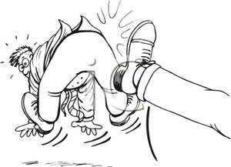
Mozart: The Crucial Year, 1781: Moves to Vienna
May 1781
Starts out in Salzburg

Slide 18
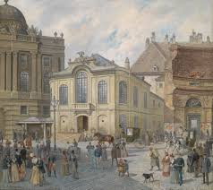
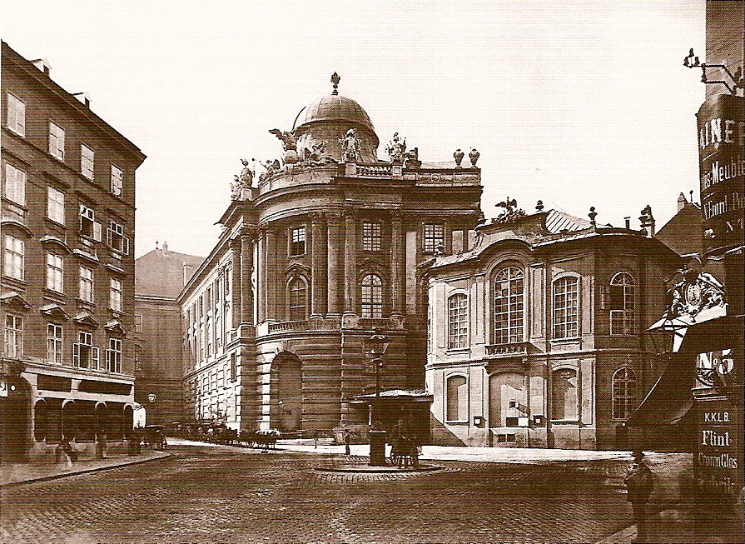
Mozart Moves to Vienna, May 1781: age 25

Slide 19
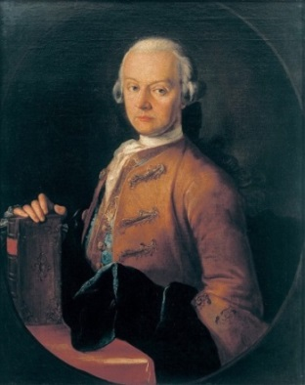
Mozart Moves to Vienna, May 1781: age 25

Slide 20
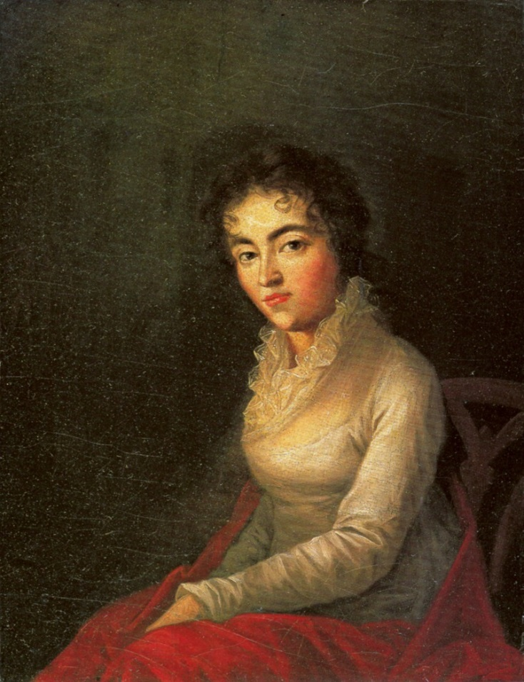
Mozart Moves to Vienna, May 1781: age 25
Constanze (Weber) Mozart
(Marriage: August 1782)

Slide 21
Mozart in Vienna, 1781-91: age 25-36
Income:
Teaching privately

Slide 22
Mozart in Vienna, 1781-91: age 25-36
Income:
Teaching privately
Selling works to publishers
(e.g., Artaria)

Slide 23
Mozart in Vienna, 1781-91: age 25-36
Income:
Teaching privately
Selling works to publishers
(e.g., Artaria)
Performances in homes of aristocrats or wealthy bourgeoisie

Slide 24
Mozart in Vienna, 1781-91: age 25-36
Income:
Teaching privately
Selling works to publishers
(e.g., Artaria)
Performances in homes of aristocrats or wealthy bourgeoisie
Benefit Concerts: “Academies”

Slide 25
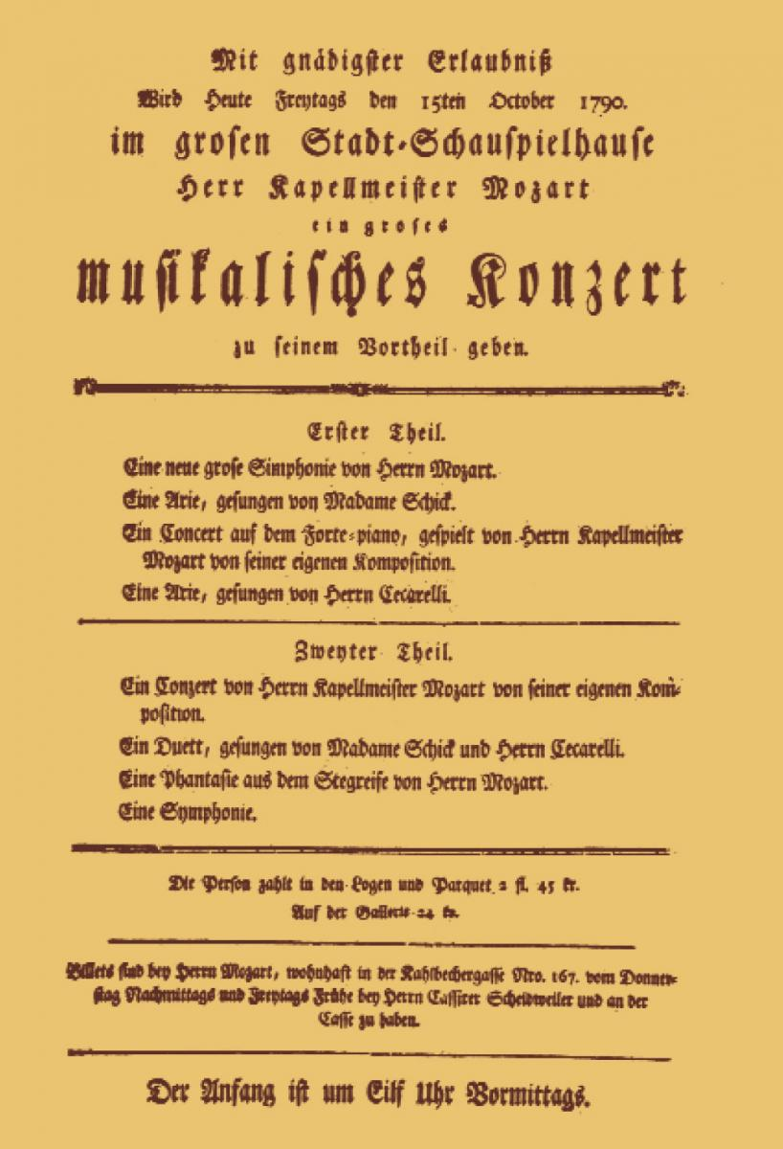
One of Mozart’s Benefit Concerts (“Academies”): Frankfurt, 1790

Slide 26
One of Mozart’s Benefit Concerts (“Academies”): 1790
Friday, 15 October 1790

Slide 27
One of Mozart’s Benefit Concerts (“Academies”): Frankfurt, 1790
Friday, 15 October 1790
To be given for his benefit

Slide 28
One of Mozart’s Benefit Concerts (“Academies”): Frankfurt, 1790
Friday, 15 October 1790
To be given for his benefit
Part 1
A new symphony
An aria
A piano concerto (Mozart performing) [No. 26 in D]
Another aria

Slide 29
One of Mozart’s Benefit Concerts (“Academies”): Frankfurt, 1790
Friday, 15 October 1790
To be given for his benefit
Part 1
A new symphony
An aria
A piano concerto (Mozart performing) [No. 26 in D]
Another aria
Part 2
Another piano concerto (Mozart performing)
[No. 19 in F]
A duet
A “fantasy” (Mozart improvising at the keyboard)
Another symphony

Slide 30
One of Mozart’s Benefit Concerts (“Academies”): 1790
Friday, 15 October 1790
To be given for his benefit
Part 1
A new symphony
An aria
A piano concerto (Mozart performing) [No. 26 in D]
Another aria
Part 2
Another piano concerto (Mozart performing)
[No. 19 in F]
A duet
A “fantasy” (Mozart improvising at the keyboard)
Another symphony
The price of tickets in loges, parquet, and gallery

Slide 31
One of Mozart’s Benefit Concerts (“Academies”): Frankfurt, 1790
Friday, 15 October 1790
To be given for his benefit
Part 1
A new symphony
An aria
A piano concerto (Mozart performing) [No. 26 in D]
Another aria
Part 2
Another piano concerto (Mozart performing)
[No. 19 in F]
A duet
A “fantasy” (Mozart improvising at the keyboard)
Another symphony
The price of tickets in loges, parquet, and gallery
Tickets can be obtained from Mozart himself

Slide 32
One of Mozart’s Benefit Concerts (“Academies”): Frankfurt, 1790
Friday, 15 October 1790
To be given for his benefit
Part 1
A new symphony
An aria
A piano concerto (Mozart performing) [No. 26 in D]
Another aria
Part 2
Another piano concerto (Mozart performing)
[No. 19 in F]
A duet
A “fantasy” (Mozart improvising at the keyboard)
Another symphony
The price of tickets in loges, parquet, and gallery
Tickets can be obtained from Mozart himself
The concert begins at 11 a.m.

Slide 33
Mozart in Vienna, 1781-91: age 25-36
Income:
Teaching privately
Selling works to publishers (e.g., Artaria)
Performances in homes of aristocrats or wealthy bourgeoisie
Benefit Concerts: “Academies”
1787-91: Only in the later years beginning to obtain foothold posts at the Habsburg court—future beginning to look more secure

Slide 34
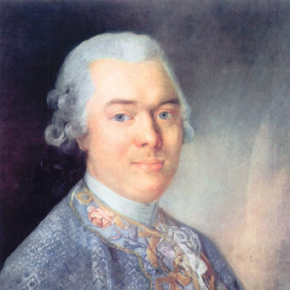
Influential Music Circle in Vienna, 1780s, 1790s
Viennese aristocrat, ambassador to Berlin court
Baron Gottfried van Swieten (1733-1803)

Slide 35
Influential Music Circle in Vienna, 1780s, 1790s
Viennese aristocrat, ambassador to Berlin court
C. P. E. Bach supporter
Baron Gottfried van Swieten (1733-1803)

Slide 36
Influential Music Circle in Vienna, 1780s, 1790s
Viennese aristocrat, ambassador to Berlin court
C. P. E. Bach supporter
Super-connoisseur and patron of music
Baron Gottfried van Swieten (1733-1803)

Slide 37
Influential Music Circle in Vienna, 1780s, 1790s
Viennese aristocrat, ambassador to Berlin court
C. P. E. Bach supporter
Super-connoisseur and patron of music
Encourages a new , worshipful attitude toward music (silence, reverence, study)
Baron Gottfried van Swieten (1733-1803)

Slide 38
Influential Music Circle in Vienna, 1780s, 1790s
Viennese aristocrat, ambassador to Berlin court
C. P. E. Bach supporter
Super-connoisseur and patron of music
Encourages a new , worshipful attitude toward music (silence, reverence, study)
Sunday concerts at his residence (both new and old music)
Baron Gottfried van Swieten (1733-1803)

Slide 39
Influential Music Circle in Vienna, 1780s, 1790s
Viennese aristocrat, ambassador to Berlin court
C. P. E. Bach supporter
Super-connoisseur and patron of music
Encourages a new , worshipful attitude toward music (silence, reverence, study)
Sunday concerts at his residence (both new and old music)
Enthusiast also for the “forgotten” works of J. S. Bach [!]
Baron Gottfried van Swieten (1733-1803)

Slide 40
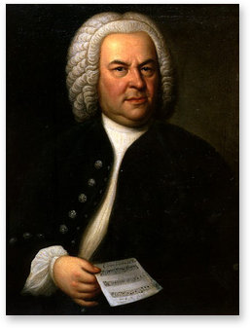
Early 1780s (via van Swieten): Mozart “introduced”
to the contrapuntal works of J. S. Bach
Beginning his “return to history”?
String transcriptions of several preludes and fugues from The Well-Tempered Clavier

Slide 41
Mozart, Vienna, 1781-91: the Decade of Astonishing Production

Slide 42
Mozart, Vienna, 1781-91: the Decade of Astonishing Production
Seven Operas (seria, buffa, Singspiel)

Slide 43
Mozart, Vienna, 1781-91: the Decade of Astonishing Production
Seven Operas (seria, buffa, Singspiel)
Choral Work: C Minor Mass (1782-83) (+ the incomplete Requiem, 1791)

Slide 44
Mozart, Vienna, 1781-91: the Decade of Astonishing Production
Seven Operas (seria, buffa, Singspiel)
Choral Work: C Minor Mass (1782-83) (+ the incomplete Requiem, 1791)
Numerous Piano Sonatas, Violin Sonatas

Slide 45
Mozart, Vienna, 1781-91: the Decade of Astonishing Production
Seven Operas (seria, buffa, Singspiel)
Choral Work: C Minor Mass (1782-83) (+ the incomplete Requiem, 1791)
Numerous Piano Sonatas, Violin Sonatas
Numerous Concertos (esp. Seventeen Piano Concertos, “Nos. 11-27”)

Slide 46
Mozart, Vienna, 1781-91: the Decade of Astonishing Production
Seven Operas (seria, buffa, Singspiel)
Choral Work: C Minor Mass (1782-83) (+ the incomplete Requiem, 1791)
Numerous Piano Sonatas, Violin Sonatas
Numerous Concertos (esp. Seventeen Piano Concertos, “Nos. 11-27”)
Six [Grand] Symphonies (“Nos. 35, 36, 38, 39, 40, 41”)

Slide 47
Mozart, Vienna, 1781-91: the Decade of Astonishing Production
Seven Operas (seria, buffa, Singspiel)
Choral Work: C Minor Mass (1782-83) (+ the incomplete Requiem, 1791)
Numerous Piano Sonatas, Violin Sonatas
Numerous Concertos (esp. Seventeen Piano Concertos, “Nos. 11-27”)
Six [Grand] Symphonies (“Nos. 35, 36, 38, 39, 40, 41”)
Many Works of Chamber Music (quartets, quintets, etc.)

Slide 48
Mozart, Vienna, 1781-91: the Decade of Astonishing Production
Seven Operas (seria, buffa, Singspiel)
Choral Work: C Minor Mass (1782-83) (+ the incomplete Requiem, 1791)
Numerous Piano Sonatas, Violin Sonatas
Numerous Concertos (esp. Seventeen Piano Concertos, “Nos. 11-27”)
Six [Grand] Symphonies (“Nos. 35, 36, 38, 39, 40, 41”)
Many Works of Chamber Music (quartets, quintets, etc.)
For performance by elite connoisseurs and aristocrats

Slide 49
Mozart, Vienna, 1781-91: the Decade of Astonishing Production
Seven Operas (seria, buffa, Singspiel)
Choral Work: C Minor Mass (1782-83) (+ the incomplete Requiem, 1791)
Numerous Piano Sonatas, Violin Sonatas
Numerous Concertos (esp. Seventeen Piano Concertos, “Nos. 11-27”)
Six [Grand] Symphonies (“Nos. 35, 36, 38, 39, 40, 41”)
Many Works of Chamber Music (quartets, quintets, etc.)
For performance by elite connoisseurs and aristocrats
Connotations: high-prestige, distillation of pure craft; “abstract” composition at its purest; elevated “conversation” and mutual support among four/five equal partners

Slide 50
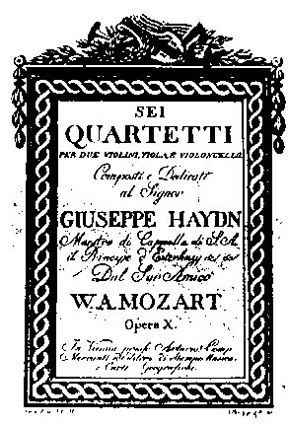
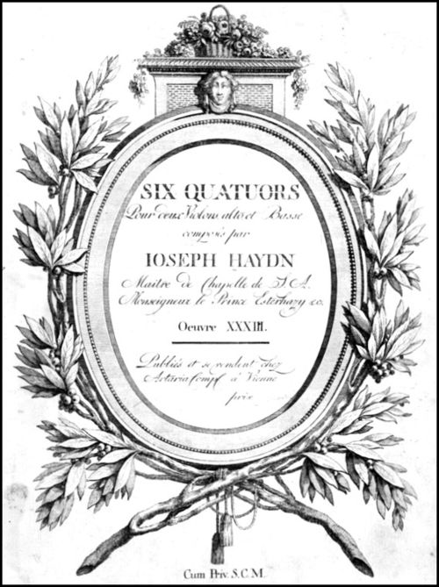
Mozart: The Six Quartets Dedicated to Haydn
Haydn: Six Quartets, op. 33 (1781)
Mozart: Six Quartets in Honorific Reply (1785)

Slide 51
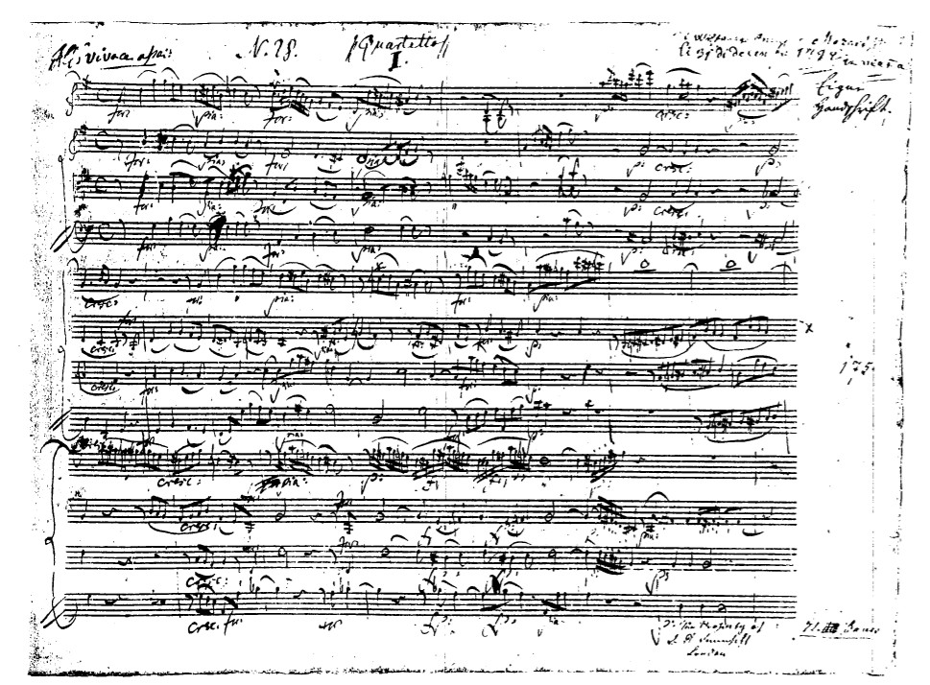
K. 387 in G, first movement

Slide 52
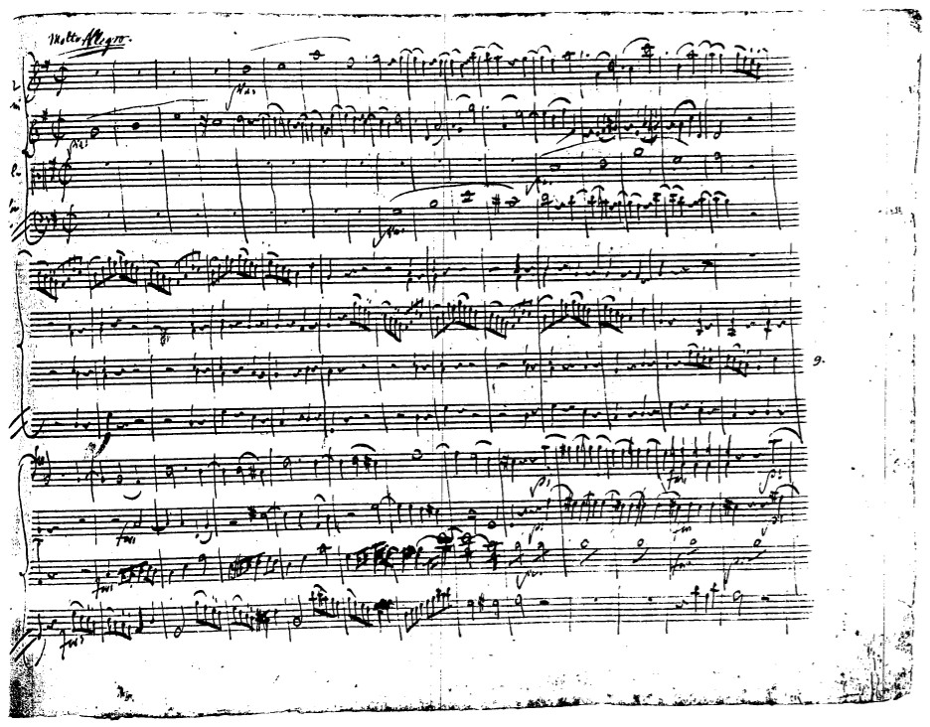
K. 387 in G, finale

Slide 53
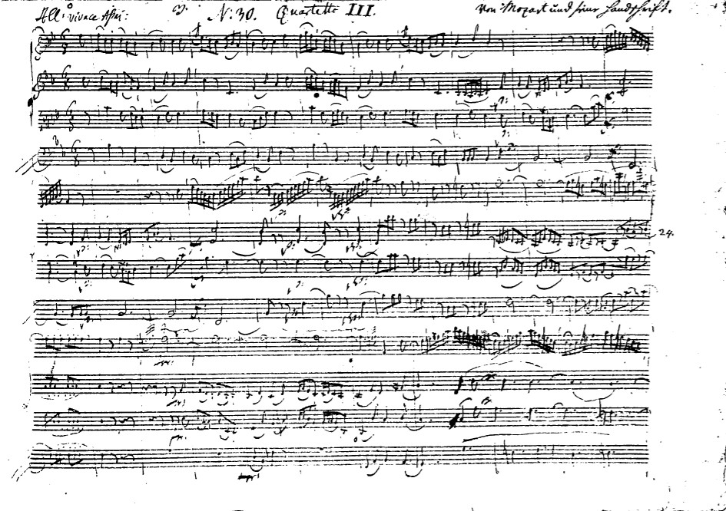
K. 458 in B-flat (“Hunt”), first movement

Slide 54
Mozart: The Six Quartets Dedicated to Haydn
Haydn: Six Quartets, op. 33 (1781)
Mozart: Six Quartets in Reply (1785)
Leopold Mozart to Wolfgang, February 1785: “Herr Haydn said to me, ‘I tell you before God and as an honest man that your son is the greatest composer I know, either personally or by reputation. He has taste and, moreover, the greatest possible knowledge of the science of composing.’”

Slide 55
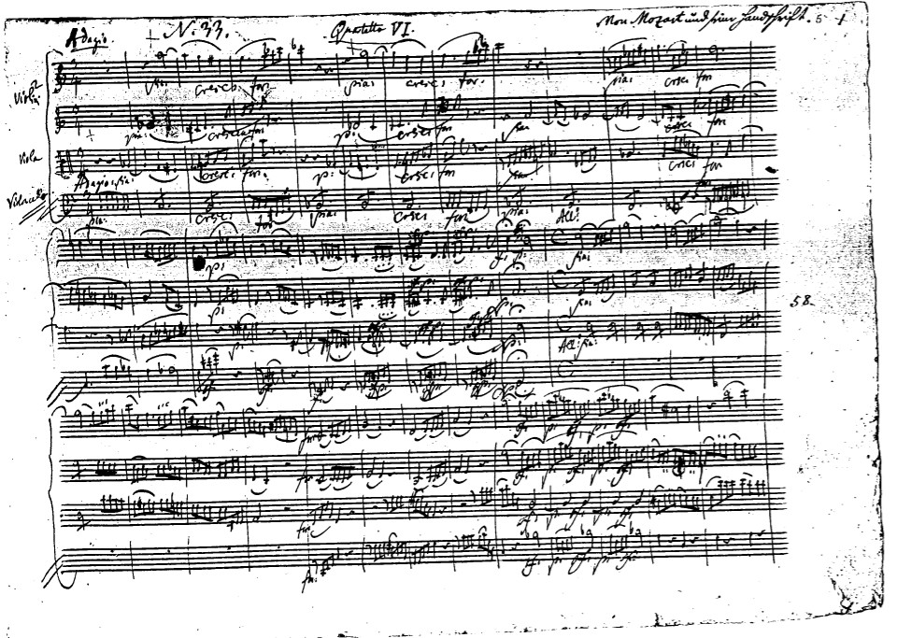
K.465 in C (“Dissonance”), first movement

Slide 56
K.465 in C (“Dissonance”), first movement
“Searching” type of introduction

Slide 57
K.465 in C (“Dissonance”), first movement
“Searching” type of introduction
“Problematizing” a tonic

Slide 58
K.465 in C (“Dissonance”), first movement
“Searching” type of introduction
“Problematizing” a tonic
A tonal world thought to be secure is exposed as contingent, disoriented

Slide 59
K.465 in C (“Dissonance”), first movement
“Searching” type of introduction
“Problematizing” a tonic
A tonal world thought to be secure is exposed as contingent, disoriented
Local vision of a world without certainties?

Slide 60
K.465 in C (“Dissonance”), first movement
“Searching” type of introduction
“Problematizing” a tonic
A tonal world thought to be secure is exposed as contingent, disoriented
Local vision of a world without certainties?
The galant “mask” drops to suggest what lies below?

Slide 61
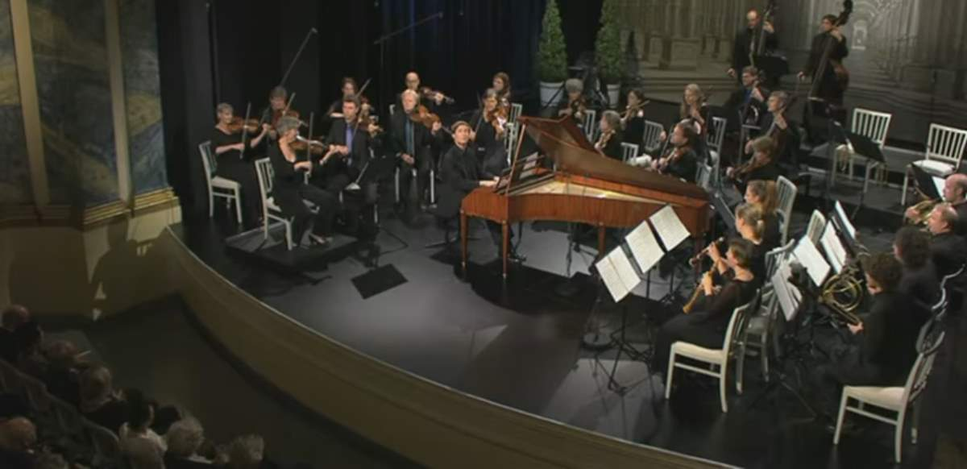

Slide 62
A Major, K. 488/ii (1786)

Slide 63
A Major, K. 488/ii (1786)
A Major, K. 488/ii (f-sharp minor; minor-mode siciliana)

Slide 64
A Major, K. 488/ii (1786)
A Major, K. 488/ii (f-sharp minor; minor-mode siciliana)
D Minor, K. 466/i (1785)

Slide 65
A Major, K. 488/ii (1786)
A Major, K. 488/ii (f-sharp minor; minor-mode siciliana)
D Minor, K. 466/i (1785)
C Minor, K. 491/i (1786)

Slide 66
A Major, K. 488/ii (1786)
A Major, K. 488/ii (f-sharp minor; minor-mode siciliana)
D Minor, K. 466/i (1785)
C Minor, K. 491/i (1786)
C Minor, K. 491/iii (1786)

Slide 67
Mozart to his father, 28 December 1782: [My new piano concertos are] something between too easy and too difficult. . . Here and there sustaining the interest of connoisseurs only, but in such a way the non-connoisseurs must also be pleased with it without knowing why.”

Slide 68
The Dilemma?
“Kenner” (Connoisseur)
Growing “Cult” of Art Music (for Insiders)
“Higher Level” of Sophisticated Composition
More Aesthetic/Philosophical Claims
Aristocratic Patrons

Slide 69
The Dilemma?
“Kenner” (Connoisseur)
Growing “Cult” of Art Music (for Insiders)
“Higher Level” of Sophisticated Composition
More Aesthetic/Philosophical Claims
Aristocratic Patrons
“Liebhaber” (Amateur)
Domestic Consumption for a “Universal Public”
Art: Taste, moderation, simplicity for a wider appeal
Avoidance of Excessive Subtlety or Complexity

Slide 70
The Dilemma?
Mozart to his father, 28 December 1782: [My new piano concertos are] something between too easy and too difficult. . . Here and there sustaining the interest of connoisseurs only, but in such a way the non-connoisseurs must also be pleased with it without knowing why.”
“Kenner” (Connoisseur)
Growing “Cult” of Art Music (for Insiders)
“Higher Level” of Sophisticated Composition
More Aesthetic/Philosophical Claims
Aristocratic Patrons
“Liebhaber” (Amateur)
Domestic Consumption for a “Universal Public”
Art: Taste, moderation, simplicity for a wider appeal
Avoidance of Excessive Subtlety or Complexity

Slide 71
The Dilemma?
Mozart to his father, 28 December 1782: [My new piano concertos are] something between too easy and too difficult. . . Here and there sustaining the interest of connoisseurs only, but in such a way the non-connoisseurs must also be pleased with it without knowing why.”
C.P.E. Bach, Six Collections of Keyboard Music “für Kenner und Liebhaber” (publ. 1779-1787): sonatas, rondos, fantasias
“Kenner” (Connoisseur)
Growing “Cult” of Art Music (for Insiders)
“Higher Level” of Sophisticated Composition
More Aesthetic/Philosophical Claims
Aristocratic Patrons
“Liebhaber” (Amateur)
Domestic Consumption for a “Universal Public”
Art: Taste, moderation, simplicity for a wider appeal
Avoidance of Excessive Subtlety or Complexity

Slide 72
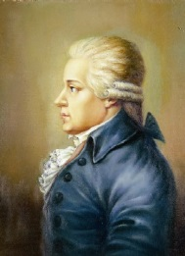
Karl Ditters von Dittersdorf
“Mozart’s string quartets . . . because of their unrelenting,
extreme artfulness, are not everyone’s purchase.” (1788)

Slide 73
The Dilemma?
Mozart to his father, 28 December 1782: [My new piano concertos are] something between too easy and too difficult. . . Here and there sustaining the interest of connoisseurs only, but in such a way the non-connoisseurs must also be pleased with it without knowing why.”
C.P.E. Bach, Six Collections of Keyboard Music “für Kenner und Liebhaber” (publ. 1779-1787): sonatas, rondos, fantasias
“Kenner” (Connoisseur)
Growing “Cult” of Art Music (for Insiders)
“Higher Level” of Sophisticated Composition
More Aesthetic/Philosophical Claims
Aristocratic Patrons
“Liebhaber” (Amateur)
Domestic Consumption for a “Universal Public”
Art: Taste, moderation, simplicity for a wider appeal
Avoidance of Excessive Subtlety or Complexity

Slide 74
The Dilemma?
“Liebhaber” (Amateur)
Domestic Consumption for a “Universal Public”
Art: Taste, moderation, simplicity for a wider appeal
Avoidance of Excessive Subtlety or Complexity
“Kenner” (Connoisseur)
Growing “Cult” of Art Music (for Insiders)
“Higher Level” of Sophisticated Composition
More Aesthetic/Philosophical Claims
Aristocratic Patrons

Slide 75
“Mozart endowed music with the fiction of subjectivity, the fiction that the music is itself a listening, acting, and reacting subject, with a past and a future, a desire for origins and for reconciliation with the world in both space and time. . . . This new musical subjectivity is in turn able to embody melancholy, not as a [mere] description or correlative of human mood, but as a function of its own inner life.”
Michael P. Steinberg, “Music and Melancholy,” Critical Inquiry 40 (2014), 291.

Slide 76
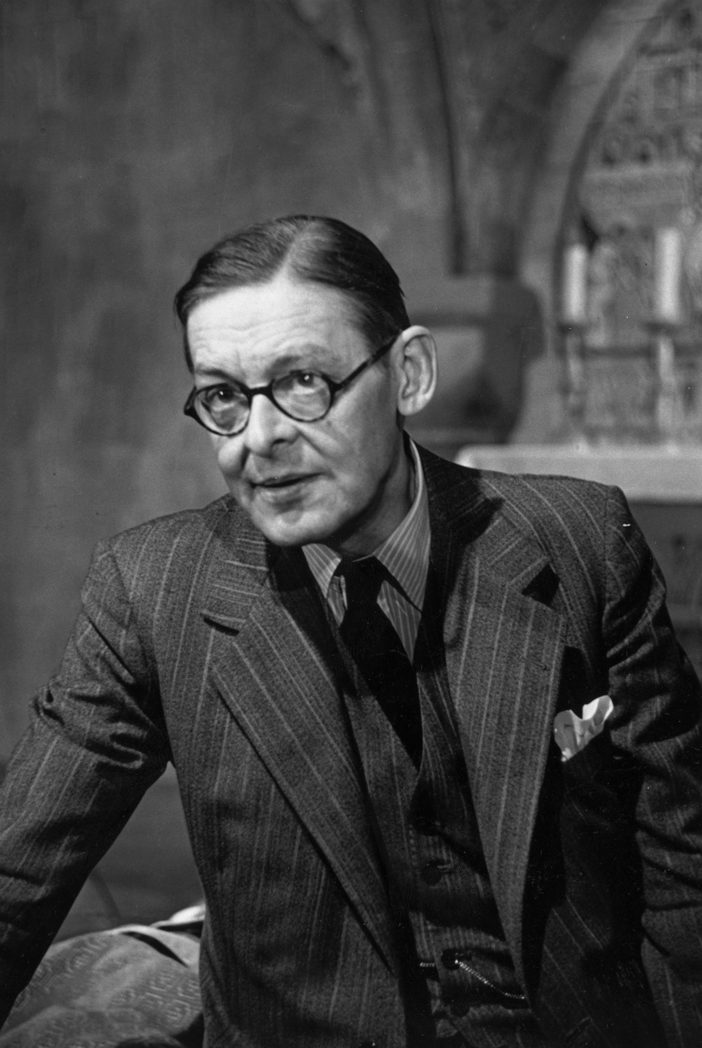
T. S. Eliot, “The Dry Salvages,” extract (from Four Quartets, 1941)
. . . . . .
For most of us, there is only the unattended Moment, the moment in and out of time, The distraction fit, lost in a shaft of sunlight, The wild thyme unseen, or the winter lightning Or the waterfall, or music heard so deeply That it is not heard at all, but you are the music While the music lasts. These are only hints and guesses, Hints followed by guesses; and the rest Is prayer, observance, discipline, thought and action.

