Slide 1
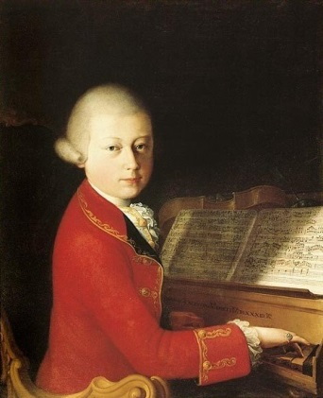
Mozart: Salzburg (1770s) and the Move to Vienna (1781)

Slide 2
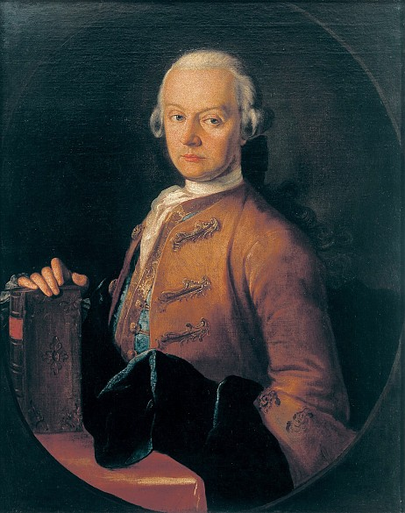
Young Mozart in Italy: Three Trips
December 1769-March 1771: age 14-15
August-December 1771
October 1772 – March 1773
Mozart in 1770

Slide 3
Mozart mostly back in Salzburg, 1773-81: age 17-25

Slide 4
Mozart mostly back in Salzburg, 1773-81: age 17-25

Slide 5
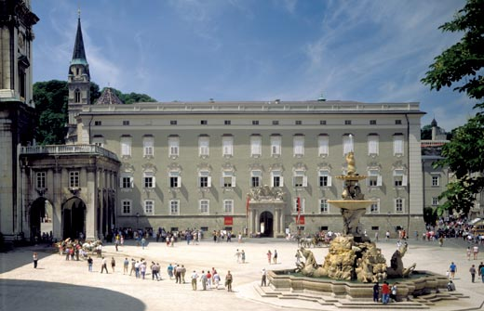
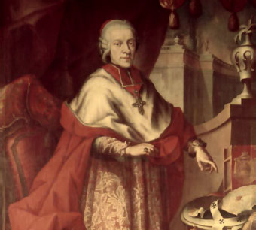
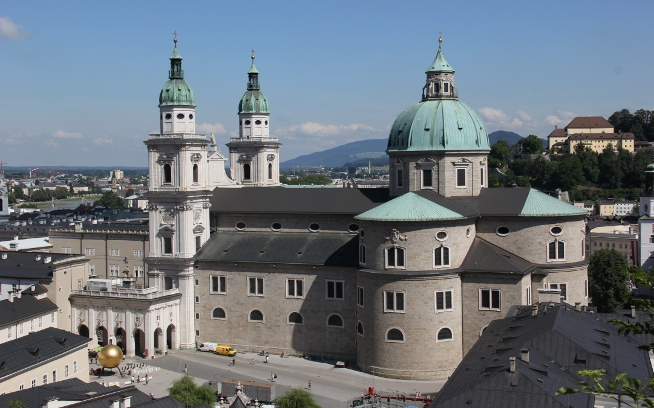
Salzburg: Court
Prince-Archbishop Colleredo
Salzburg: Cathedral

Slide 6
Mozart mostly back in Salzburg, 1773-81: age 17-25
Symphony No. 25 in G Minor, K. 183
(October 1773) [“stormy style”]

Slide 7
Mozart mostly back in Salzburg, 1773-81: age 17-25
Symphony No. 25 in G Minor, K. 183
(October 1773) [“stormy style”)
Symphony No. 29 in A, K. 201
(April 1774)

Slide 8
Mozart mostly back in Salzburg, 1773-81: age 17-25
Symphony No. 25 in G Minor, K. 183
(October 1773) [“stormy style”)
Symphony No. 29 in A, K. 201
(April 1774)
Five Piano Sonatas, K. 279-283
(Munich trip, 1775)

Slide 9
Mozart mostly back in Salzburg, 1773-81: age 17-25
Symphony No. 25 in G Minor, K. 183
(October 1773) [“stormy style”)
Symphony No. 29 in A, K. 201
(April 1774)
Five Piano Sonatas, K. 279-283
(Munich trip, 1775)
Bassoon Concerto in B-flat, K. 191
(June 1774)

Slide 10
Five Sonata Types/Formats (Sonata Theory)

Slide 11
Five Sonata Types/Formats (Sonata Theory)
Type 1 – Exposition and recapitulation only (no development); double rotational (two cycles through P, TR, S, C)

Slide 12
Five Sonata Types/Formats (Sonata Theory)
Type 1 – Exposition and recapitulation only (no development); double rotational (two cycles through P, TR, S, C)
Type 2 – Exposition (P, TR, S, C), development (usually P- and/or TR-based) and tonal resolution (S, C in the tonic); no “recapitulation” starting with P in the tonic; double rotational

Slide 13
Five Sonata Types/Formats (Sonata Theory)
Type 1 – Exposition and recapitulation only (no development); double rotational (two cycles through P, TR, S, C)
Type 2 – Exposition (P, TR, S, C), development (usually P- and/or TR-based) and tonal resolution (S, C in the tonic); no “recapitulation” starting with P in the tonic; double rotational
Type 3 – “Textbook” sonata: exposition, development, recapitulation

Slide 14
Five Sonata Types/Formats (Sonata Theory)
Type 1 – Exposition and recapitulation only (no development); double rotational (two cycles through P, TR, S, C)
Type 2 – Exposition (P, TR, S, C), development (usually P- and/or TR-based) and tonal resolution (S, C in the tonic); no “recapitulation” starting with P in the tonic; double rotational
Type 3 – “Textbook” sonata: exposition, development, recapitulation
Type 4 – “Sonata rondo”

Slide 15
Five Sonata Types/Formats (Sonata Theory)
Type 1 – Exposition and recapitulation only (no development); double rotational (two cycles through P, TR, S, C)
Type 2 – Exposition (P, TR, S, C), development (usually P- and/or TR-based) and tonal resolution (S, C in the tonic); no “recapitulation” starting with P in the tonic; double rotational
Type 3 – “Textbook” sonata: exposition, development, recapitulation
Type 4 – “Sonata rondo”
Type 5 – First-movement concerto form (with opening tutti for orchestra alone, concluding in the tonic); a hybrid of sonata form with the older ritornello concerto format

Slide 16
Sonata Theory Terminology:
The “Type 5 Sonata” refers to that type of sonata-form practice
(developed 1750-1800) that was specifically adapted to the concerto
(C.P. E. Bach, J. C. Bach, Mozart, Haydn, Beethoven, and others)

Slide 17
Sonata Theory Terminology:
The “Type 5 Sonata” refers to that type of sonata-form practice
(developed 1750-1800) that was specifically adapted to the concerto
(C.P. E. Bach, J. C. Bach, Mozart, Haydn, Beethoven, and others)
It is characterized by the presence of emphatically separate sections for orchestra alone (sections in which the soloist does not play).

Slide 18
Sonata Theory Terminology:
The “Type 5 Sonata” refers to that type of sonata-form practice
(developed 1750-1800) that was specifically adapted to the concerto
(C.P. E. Bach, J. C. Bach, Mozart, Haydn, Beethoven, and others)
It is characterized by the presence of emphatically separate sections for orchestra alone (sections in which the soloist does not play).
The touchstone feature of a Type 5: an opening orchestral “ritornello” (or “tutti”), all in the tonic, sounded before the soloist enters, and typically laying out a proposal for the main themes of the concerto.

Slide 19
Sonata Theory Terminology:
The “Type 5 Sonata” refers to that type of sonata-form practice
(developed 1750-1800) that was specifically adapted to the concerto
(C.P. E. Bach, J. C. Bach, Mozart, Haydn, Beethoven, and others)
It is characterized by the presence of emphatically separate sections for orchestra alone (sections in which the soloist does not play).
The touchstone feature of a Type 5: an opening orchestral “ritornello” (or “tutti”), all in the tonic, sounded before the soloist enters, and typically laying out a proposal for the main themes of the concerto.
Portions of that opening orchestral ritornello (or tutti) will recur later in the movement as orchestral punctuations or reinforcements.

Slide 20
Sonata Theory Terminology:
The “Type 5 Sonata” refers to that type of sonata-form practice
(developed 1750-1800) that was specifically adapted to the concerto
(C.P. E. Bach, J. C. Bach, Mozart, Haydn, Beethoven, and others)
It is characterized by the presence of emphatically separate sections for orchestra alone (sections in which the soloist does not play).
The touchstone feature of a Type 5: an opening orchestral “ritornello” (or “tutti”), all in the tonic, sounded before the soloist enters, and typically laying out a proposal for the main themes of the concerto.
Portions of that opening orchestral ritornello (or tutti) will recur later in the movement as orchestral punctuations or reinforcements.
Those sections featuring the soloist often articulate a sufficient “sonata form” on their own, one that the ritornellos only reinforce.

Slide 21
Sonata Theory Terminology:
The “Type 5 Sonata” refers to that type of sonata-form practice
(developed 1750-1800) that was specifically adapted to the concerto
(C.P. E. Bach, J. C. Bach, Mozart, Haydn, Beethoven, and others)
It is characterized by the presence of emphatically separate sections for orchestra alone (sections in which the soloist does not play).
The touchstone feature of a Type 5: an opening orchestral “ritornello” (or “tutti”), all in the tonic, sounded before the soloist enters, and typically laying out a proposal for the main themes of the concerto.
Portions of that opening orchestral ritornello (or tutti) will recur later in the movement as orchestral punctuations or reinforcements.
Those sections featuring the soloist often articulate a sufficient “sonata form” on their own, one that the ritornellos only reinforce.
Hence the Type 5 can seem like a “bulkier” sonata—or a standard (Type 3) sonata with “extra” orchestral sections interpolated at various points.

Slide 22
To build a Type 5 concerto movement,
one can start with the usual Type 3 sonata format:
Exposition
Development
Recapitulation

Slide 23
To build a Type 5 concerto movement,
one can start with the usual Type 3 sonata format:
Then “pull apart” the three main sections
Exposition
Development
Recapitulation

Slide 24
To turn a Type-3 “sonata form” into a Type 5 concerto movement:
Pull apart these sections and compose suitable orchestral tuttis
to introduce and reinforce the crucial cadential points
Exposition
Development
Recapitulation
Tutti
Tutti
Tutti
Tutti

Slide 25
One Characteristic (Idealized) Model of the Baroque Ritornello Format
V:PAC
R2
(frag.)
I:PAC
I: PAC
I: PAC
S1
S2
S3
Rit 1 (R1):
The Generating
Ritornello-Complex:
R4
(tonic)
R3
(frag)

Slide 26
Baroque Ritornello Format, Now Tailored to Become a Type 5 Sonata
V:PAC
R2
(frag.)
I:PAC
I: PAC
I: PAC
S1
S2
S3
Rit 1 (R1):
The Generating
Ritornello-Complex:
P TR ‘ S C
But no modulation!
R4
(tonic)
R3
(frag)
Exposition Development Recapitulation
I – V I -- I

Slide 27
Baroque Ritornello Format, Now Tailored to Become a Type 5 Sonata
V:PAC
R2
(frag.)
I:PAC
I: PAC
I: PAC
S1
S2
S3
Rit 1 (R1):
The Generating
Ritornello-Complex:
P TR ‘ S C
But no modulation!
R4
(tonic)
R3
(frag)
Exposition Development Recapitulation
I – V I -- I

Slide 28
Baroque Ritornello Format, Now Tailored to Become a Type 5 Sonata
V:PAC
R2
(frag.)
I:PAC
I: PAC
I: PAC
S1
S2
S3
Rit 1 (R1):
The Generating
Ritornello-Complex:
P TR ‘ S C
But no modulation!
R4¹
tonic
R4²
tonic
R3
(frag)
Exposition Development Recapitulation
I – V I -- I
Solo Cadenza

Slide 29
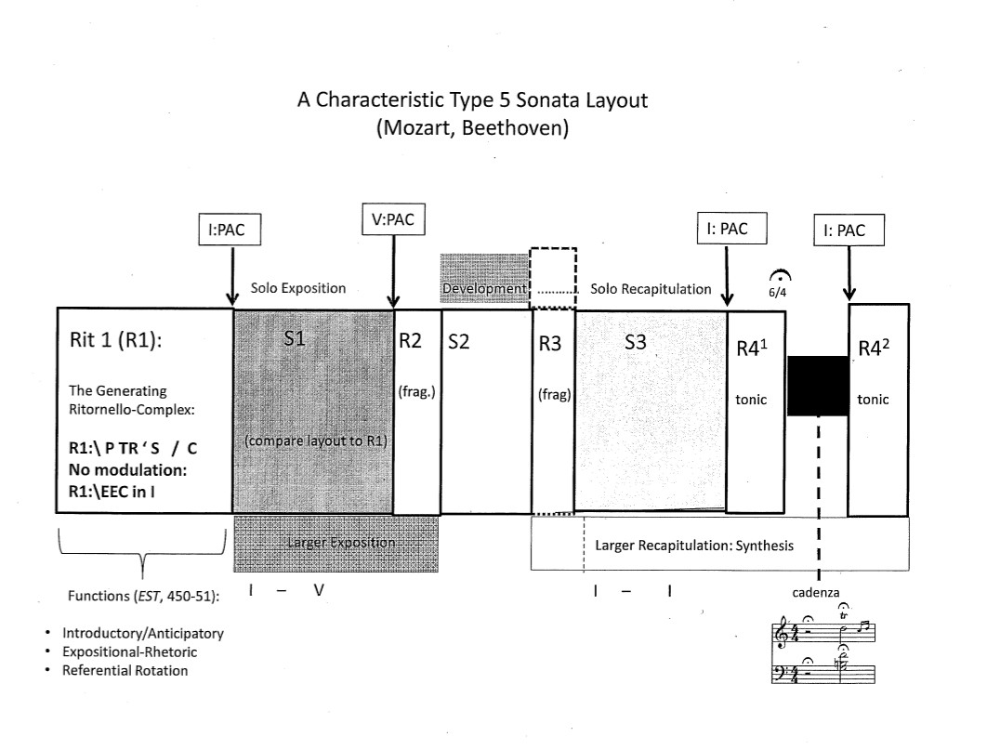

Slide 30
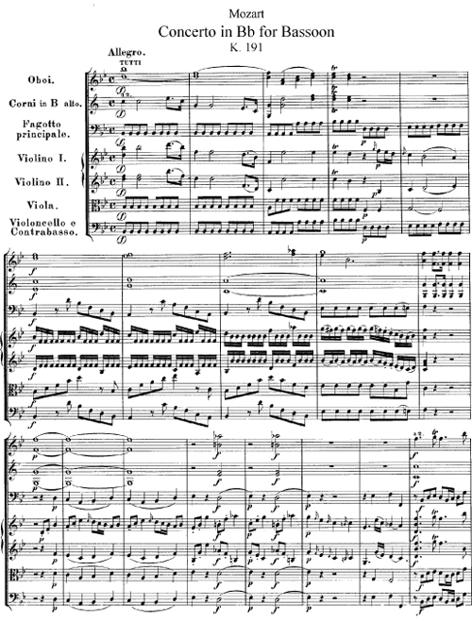
Tutti/Ritornello 1 (R1)

Slide 31
Tutti/Ritornello 1 (R1)
R1:\P
R1:\P = march topic
Trommelbass (viola, cello, bass)
R1:\S^{1.1}
(in tonic)
R1:\S^{1.2}
(in tonic)

Slide 32
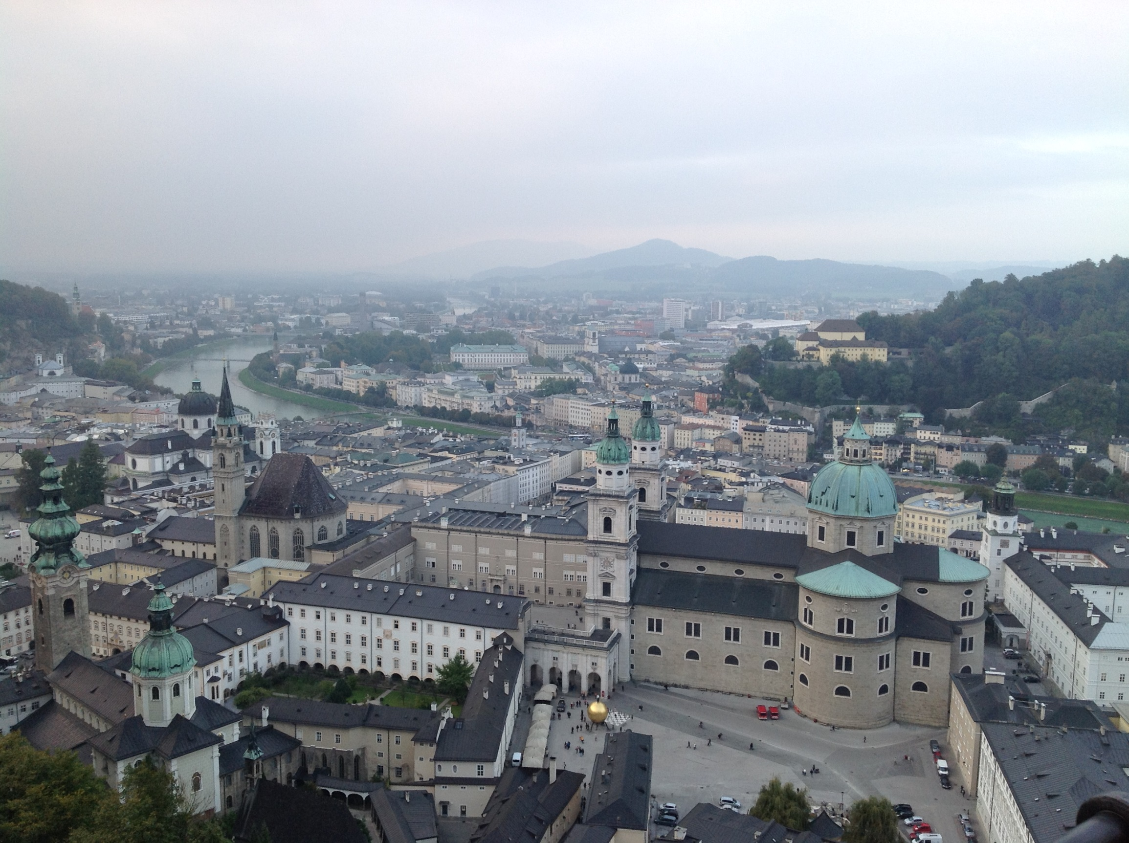

Slide 33
Mozart mostly back in Salzburg, 1773-81: age 17-25

Slide 34
Mozart mostly back in Salzburg, 1773-81: age 17-25
Prince-Archbishop Colleredo

Slide 35
Another Mozart Tour: September 1777 – January 1779

Slide 36
Another Mozart Tour: September 1777 – January 1779
Munich (2 ½ weeks)

Slide 37
Another Mozart Tour: September 1777 – January 1779
Munich (2 ½ weeks)
Mannheim (5 months)

Slide 38
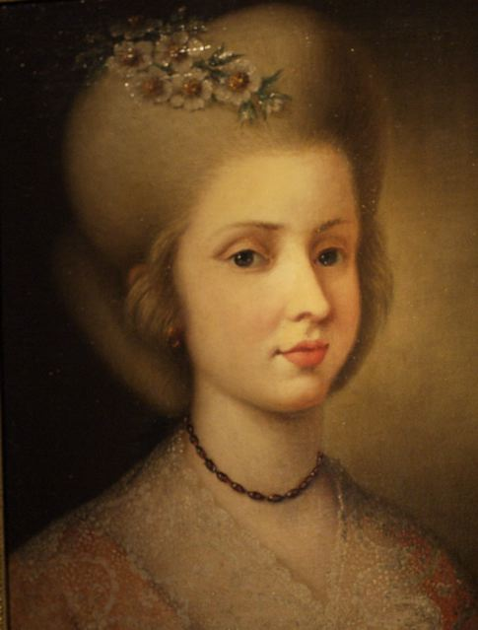
Another Mozart Tour: September 1777 – January 1779
Munich (2 ½ weeks)
Mannheim (5 months)
Aloysia Weber

Slide 39
Another Mozart Tour: September 1777 – January 1779
Munich (2 ½ weeks)
Mannheim (5 months)
3 Piano Sonatas
K. 309 (D)
K. 310 (a)
K. 311 (D)
Aloysia Weber

Slide 40
Another Mozart Tour: September 1777 – January 1779
Munich (2 ½ weeks)
Mannheim (5 months)
Paris (6 months)

Slide 41
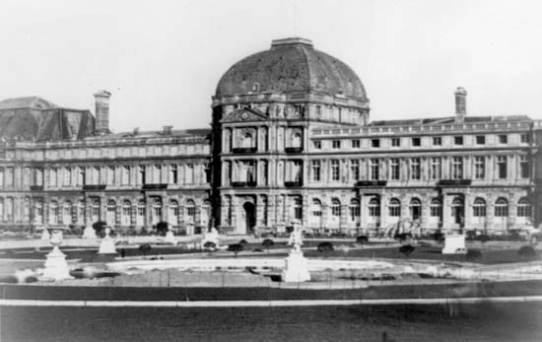
Mozart, Symphony No. 31 in D, “Paris,” K. 297
Performed at the Concerts Spirituels, Tuileries Palace (June 1778)

Slide 42
Mozart, Symphony No. 31 in D, “Paris,” K. 297
Performed at the Concerts Spirituels, Tuileries Palace (June 1778)
“Just in the middle of the first Allegro there was a passage that I felt certain must please. The audience was quite carried away—and there was a tremendous burst of applause. . . . [And when I] introduced the passage again at the close . . . there were shouts of ‘Da capo!’ . . . [The same happened in the finale.] I was so happy that as soon as the symphony was over, I went off to the Palais Royal, where I had a large ice, said the Rosary as I had vowed to do—and went home.” [Mozart, letter to Leopold, 3 July 1778].

Slide 43
Mozart, Symphony No. 31 in D, “Paris,” K. 297
Performed at the Concerts Spirituels, Tuileries Palace (June 1778)
exposition as a display of abundance and boundless creativity
a continuing, non-stop chain of contrasting ideas, one stunning idea after another
EEC
S
C
P
TR
V
I

Slide 44
Mozart, Symphony No. 31 in D, “Paris,” K. 297
Performed at the Concerts Spirituels, Tuileries Palace (June 1778)
exposition as a display of abundance and boundless creativity
a continuing, non-stop chain of contrasting ideas, one stunning idea after another
EEC
S
C
P
TR
V
I

Slide 45
Mozart, Symphony No. 31 in D, “Paris,” K. 297
Performed at the Concerts Spirituels, Tuileries Palace (June 1778)
exposition as a display of abundance and boundless creativity
a continuing, non-stop chain of contrasting ideas, one stunning idea after another
EEC
S
C
P
TR
V
I

Slide 46
Mozart, Symphony No. 31 in D, “Paris,” K. 297
Performed at the Concerts Spirituels, Tuileries Palace (June 1778)
exposition as a display of abundance and boundless creativity
a continuing, non-stop chain of contrasting ideas, one stunning idea after another
EEC
S
C
P
TR
V
I

Slide 47
Mozart, Symphony No. 31 in D, “Paris,” K. 297
Performed at the Concerts Spirituels, Tuileries Palace (June 1778)
exposition as a display of abundance and boundless creativity
a continuing, non-stop chain of contrasting ideas, one stunning idea after another
EEC
S
C
P
TR
V
I

Slide 48
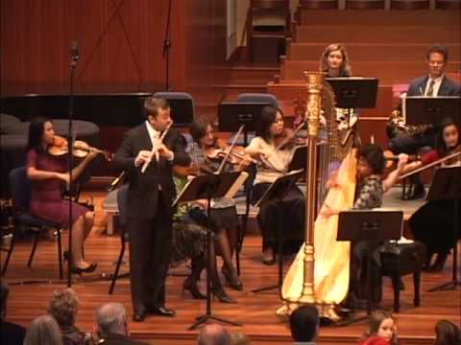
Mozart, Concerto for Flute and Harp, K. 299, mvmt. 2, Andantino (Paris, 1778)

Slide 49
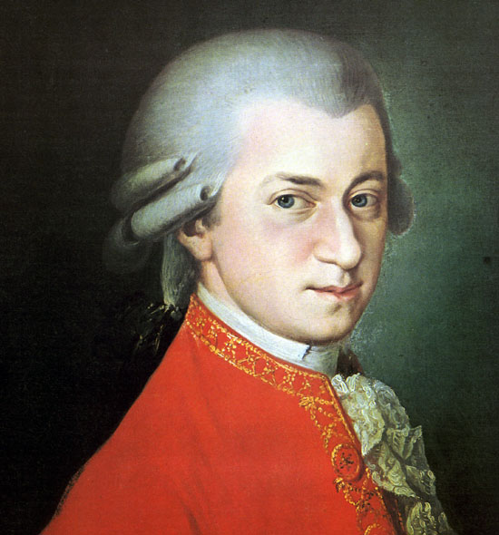
Mozart: 1781
Age 25
Prince-Archbishop Colleredo

Slide 50
Mozart: The Crucial Year, 1781
Starts out in Salzburg
Salzburg: Court
Prince-Archbishop Colleredo
Salzburg: Cathedral

Slide 51
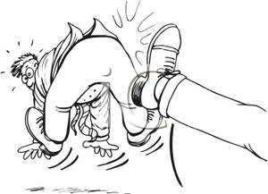
Mozart: The Crucial Year, 1781
May 1781
Starts out in Salzburg
Prince-Archbishop Colleredo

Slide 52
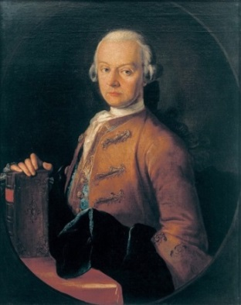
Mozart Moves to Vienna, May 1781: age 24

Slide 53
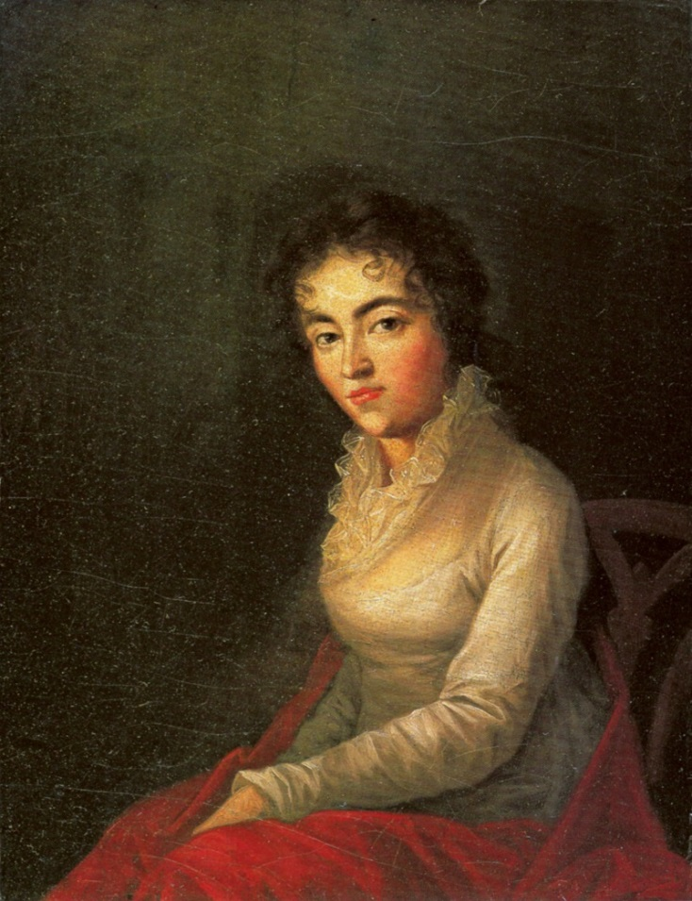
Mozart Moves to Vienna, May 1781: age 24
Constanze (Weber) Mozart
(Marriage: August 1782)

Slide 54
Mozart in Vienna, 1781-91: age 24-36
Income:
Teaching privately

Slide 55
Mozart in Vienna, 1781-91: age 24-36
Income:
Teaching privately
Selling works to publishers
(e.g., Artaria)

Slide 56
Mozart in Vienna, 1781-91: age 24-36
Income:
Teaching privately
Selling works to publishers
(e.g., Artaria)
Performances in homes of aristocrats or wealthy bourgeoisie

Slide 57
Mozart in Vienna, 1781-91: age 24-36
Income:
Teaching privately
Selling works to publishers
(e.g., Artaria)
Performances in homes of aristocrats or wealthy bourgeoisie
Benefit Concerts: “Academies”

Slide 58
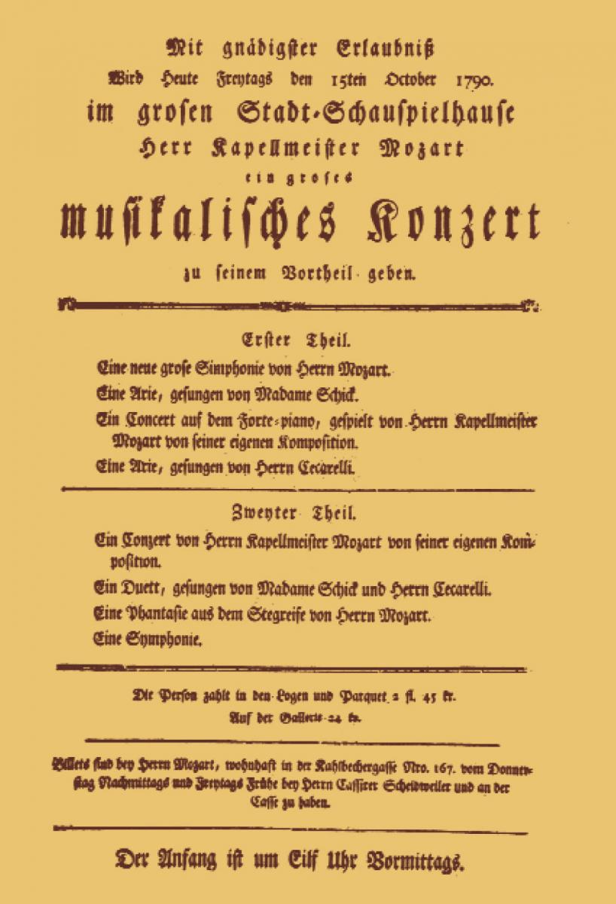
One of Mozart’s Benefit Concerts (“Academies”): Frankfurt, 1790

Slide 59
One of Mozart’s Benefit Concerts (“Academies”): 1790
Friday, 15 October 1790

Slide 60
One of Mozart’s Benefit Concerts (“Academies”): Frankfurt, 1790
Friday, 15 October 1790
To be given for his benefit

Slide 61
One of Mozart’s Benefit Concerts (“Academies”): Frankfurt, 1790
Friday, 15 October 1790
To be given for his benefit
Part 1
A new symphony
An aria
A piano concerto (Mozart performing) [No. 26 in D]
Another aria

Slide 62
One of Mozart’s Benefit Concerts (“Academies”): Frankfurt, 1790
Friday, 15 October 1790
To be given for his benefit
Part 1
A new symphony
An aria
A piano concerto (Mozart performing) [No. 26 in D]
Another aria
Part 2
Another piano concerto (Mozart performing)
[No. 19 in F]
A duet
A “fantasy” (Mozart improvising at the keyboard)
Another symphony

Slide 63
One of Mozart’s Benefit Concerts (“Academies”): 1790
Friday, 15 October 1790
To be given for his benefit
Part 1
A new symphony
An aria
A piano concerto (Mozart performing) [No. 26 in D]
Another aria
Part 2
Another piano concerto (Mozart performing)
[No. 19 in F]
A duet
A “fantasy” (Mozart improvising at the keyboard)
Another symphony
The price of tickets in loges, parquet, and gallery

Slide 64
One of Mozart’s Benefit Concerts (“Academies”): Frankfurt, 1790
Friday, 15 October 1790
To be given for his benefit
Part 1
A new symphony
An aria
A piano concerto (Mozart performing) [No. 26 in D]
Another aria
Part 2
Another piano concerto (Mozart performing)
[No. 19 in F]
A duet
A “fantasy” (Mozart improvising at the keyboard)
Another symphony
The price of tickets in loges, parquet, and gallery
Tickets can be obtained from Mozart himself

Slide 65
One of Mozart’s Benefit Concerts (“Academies”): Frankfurt, 1790
Friday, 15 October 1790
To be given for his benefit
Part 1
A new symphony
An aria
A piano concerto (Mozart performing) [No. 26 in D]
Another aria
Part 2
Another piano concerto (Mozart performing)
[No. 19 in F]
A duet
A “fantasy” (Mozart improvising at the keyboard)
Another symphony
The price of tickets in loges, parquet, and gallery
Tickets can be obtained from Mozart himself
The concert begins at 11 a.m.

Slide 66
Mozart in Vienna, 1781-91: age 24-36
Income:
Teaching privately
Selling works to publishers (e.g., Artaria)
Performances in homes of aristocrats or wealthy bourgeoisie
Benefit Concerts: “Academies”
1787-89: Beginning to obtain posts at the Habsburg court—future beginning to look more secure

Slide 67
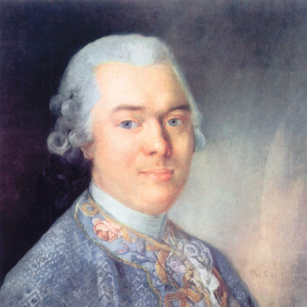
Influential Music Circle in Vienna, 1780s, 1790s
Viennese aristocrat, ambassador to Berlin court
Baron Gottfried van Swieten (1733-1803)

Slide 68
Influential Music Circle in Vienna, 1780s, 1790s
Viennese aristocrat, ambassador to Berlin court
C. P. E. Bach supporter
Baron Gottfried van Swieten (1733-1803)

Slide 69
Influential Music Circle in Vienna, 1780s, 1790s
Viennese aristocrat, ambassador to Berlin court
C. P. E. Bach supporter
Super-connoisseur and patron of music
Baron Gottfried van Swieten (1733-1803)

Slide 70
Influential Music Circle in Vienna, 1780s, 1790s
Viennese aristocrat, ambassador to Berlin court
C. P. E. Bach supporter
Super-connoisseur and patron of music
Encourages a new , worshipful attitude toward music (silence, reverence, study)
Baron Gottfried van Swieten (1733-1803)

Slide 71
Influential Music Circle in Vienna, 1780s, 1790s
Viennese aristocrat, ambassador to Berlin court
C. P. E. Bach supporter
Super-connoisseur and patron of music
Encourages a new , worshipful attitude toward music (silence, reverence, study)
Sunday concerts at his residence (both new and old music)
Baron Gottfried van Swieten (1733-1803)

Slide 72
Influential Music Circle in Vienna, 1780s, 1790s
Viennese aristocrat, ambassador to Berlin court
C. P. E. Bach supporter
Super-connoisseur and patron of music
Encourages a new , worshipful attitude toward music (silence, reverence, study)
Sunday concerts at his residence (both new and old music)
Enthusiast also for the “forgotten” works of J. S. Bach [!]
Baron Gottfried van Swieten (1733-1803)

Slide 73
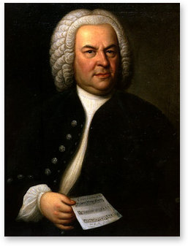
Early 1780s (via van Swieten): Mozart “introduced”
to the contrapuntal works of J. S. Bach
Beginning his “return to history”?
String transcriptions of several preludes and fugues from The Well-Tempered Clavier

Slide 74
Mozart, Vienna, 1781-91: the Decade of Astonishing Production

Slide 75
Mozart, Vienna, 1781-91: the Decade of Astonishing Production
Seven Operas (seria, buffa, Singspiel)

Slide 76
Mozart, Vienna, 1781-91: the Decade of Astonishing Production
Seven Operas (seria, buffa, Singspiel)
Choral Work: C Minor Mass (1782-83) (+ the incomplete Requiem, 1791)

Slide 77
Mozart, Vienna, 1781-91: the Decade of Astonishing Production
Seven Operas (seria, buffa, Singspiel)
Choral Work: C Minor Mass (1782-83) (+ the incomplete Requiem, 1791)
Numerous Piano Sonatas, Violin Sonatas

Slide 78
Mozart, Vienna, 1781-91: the Decade of Astonishing Production
Seven Operas (seria, buffa, Singspiel)
Choral Work: C Minor Mass (1782-83) (+ the incomplete Requiem, 1791)
Numerous Piano Sonatas, Violin Sonatas
Numerous Concertos (esp. Seventeen Piano Concertos, “Nos. 11-27”)

Slide 79
Mozart, Vienna, 1781-91: the Decade of Astonishing Production
Seven Operas (seria, buffa, Singspiel)
Choral Work: C Minor Mass (1782-83) (+ the incomplete Requiem, 1791)
Numerous Piano Sonatas, Violin Sonatas
Numerous Concertos (esp. Seventeen Piano Concertos, “Nos. 11-27”)
Six [Grand] Symphonies (“Nos. 35, 36, 38, 39, 40, 41”)

Slide 80
Mozart, Vienna, 1781-91: the Decade of Astonishing Production
Seven Operas (seria, buffa, Singspiel)
Choral Work: C Minor Mass (1782-83) (+ the incomplete Requiem, 1791)
Numerous Piano Sonatas, Violin Sonatas
Numerous Concertos (esp. Seventeen Piano Concertos, “Nos. 11-27”)
Six [Grand] Symphonies (“Nos. 35, 36, 38, 39, 40, 41”)
Many Works of Chamber Music (quartets, quintets, etc.)

Slide 81
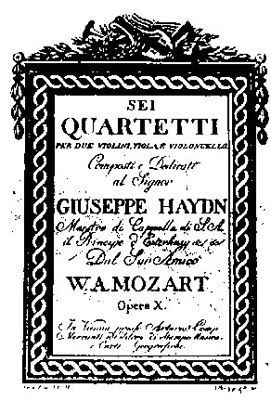
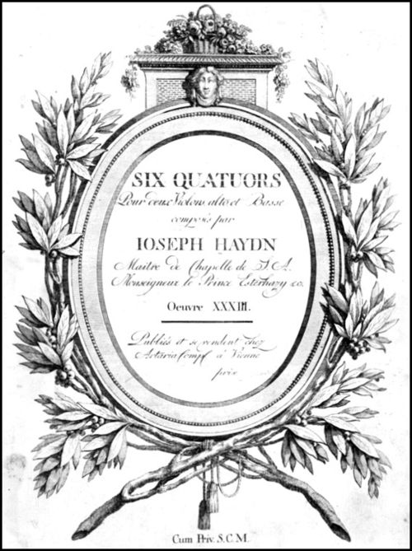
Mozart: The Six Quartets Dedicated to Haydn
Haydn: Six Quartets, op. 33 (1781)
Mozart: Six Quartets in Reply (1785)

Slide 82
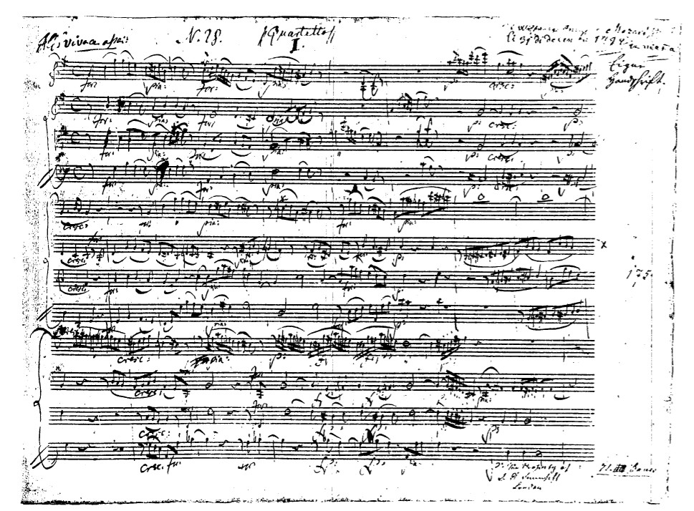
K. 387 in G, first movement

Slide 83
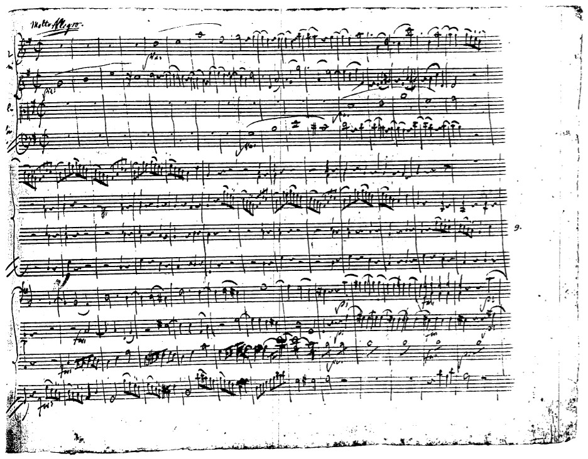
K. 387 in G, finale

Slide 84
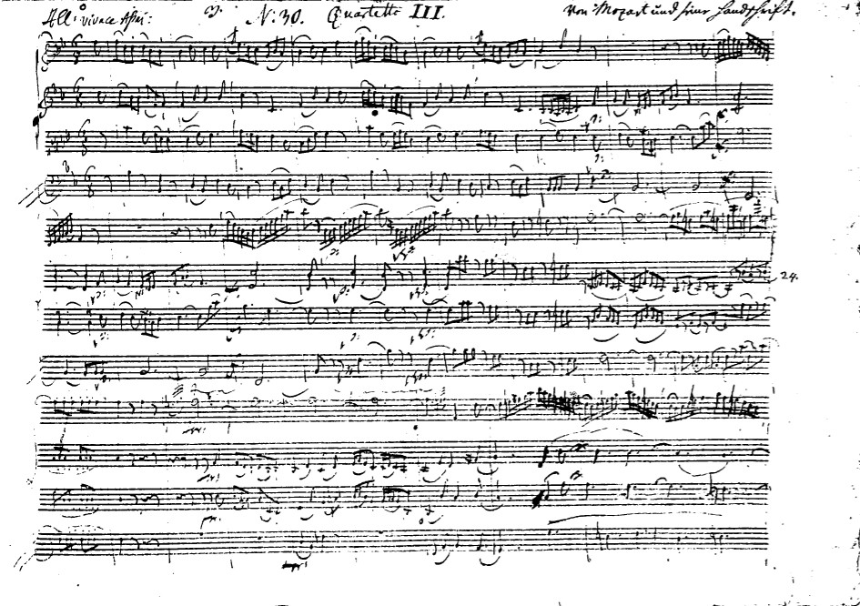
K. 458 in B-flat (“Hunt”), first movement

Slide 85
Mozart: The Six Quartets Dedicated to Haydn
Haydn: Six Quartets, op. 33 (1781)
Mozart: Six Quartets in Reply (1785)
Leopold Mozart to Wolfgang, February 1785: “Herr Haydn said to me, ‘I tell you before God and as an honest man that your son is the greatest composer I know, either personally or by reputation. He has taste and, moreover, the greatest possible knowledge of the science of composing.’”

Slide 86
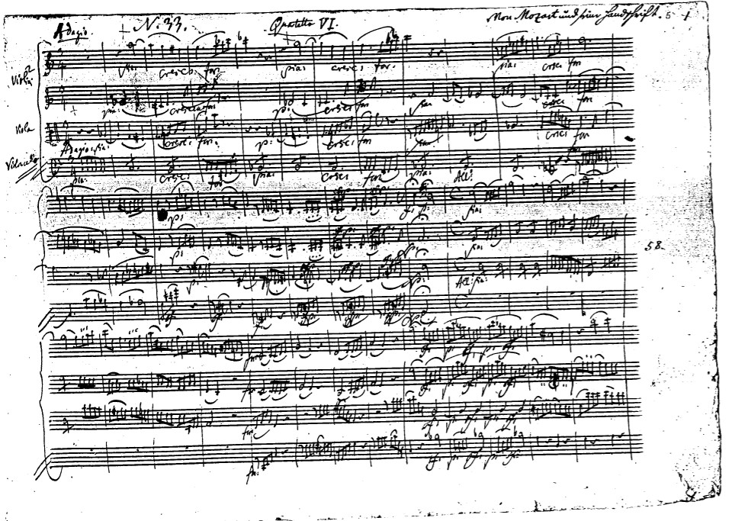
K.465 in C (“Dissonance”), first movement

Slide 87
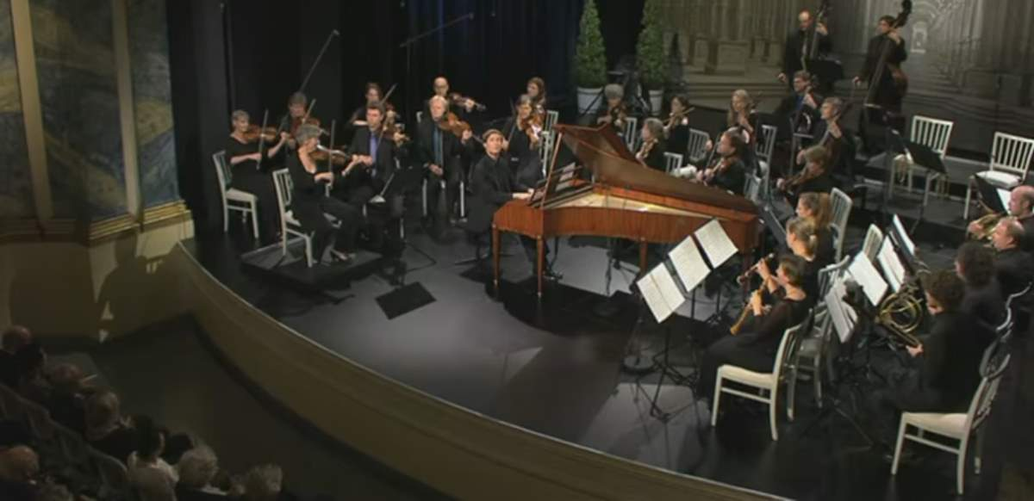

Slide 88
A Major, K. 488/ii (1786)

Slide 89
A Major, K. 488/ii (1786)
A Major, K. 488/ii (f-sharp minor; minor-mode siciliana)

Slide 90
A Major, K. 488/ii (1786)
A Major, K. 488/ii (f-sharp minor; minor-mode siciliana)
D Minor, K. 466/i (1785)

Slide 91
A Major, K. 488/ii (1786)
A Major, K. 488/ii (f-sharp minor; minor-mode siciliana)
D Minor, K. 466/i (1785)
C Minor, K. 491/i (1786)

Slide 92
A Major, K. 488/ii (1786)
A Major, K. 488/ii (f-sharp minor; minor-mode siciliana)
D Minor, K. 466/i (1785)
C Minor, K. 491/i (1786)
C Minor, K. 491/iii (1786)

Slide 93
Mozart to his father, 28 December 1782: [My new piano concertos are] something between too easy and too difficult. . . Here and there sustaining the interest of connoisseurs only, but in such a way the non-connoisseurs must also be pleased with it without knowing why.”

Slide 94
The Dilemma?
“Kenner” (Connoisseur)
Growing “Cult” of Art Music (for Insiders)
“Higher Level” of Sophisticated Composition
More Aesthetic/Philosophical Claims
Aristocratic Patrons
“Liebhaber” (Amateur)
Domestic Consumption for a “Universal Public”
Art: Taste, moderation, simplicity for a wider appeal
Avoidance of Excessive Subtlety or Complexity

Slide 95
The Dilemma?
Mozart to his father, 28 December 1782: [My new piano concertos are] something between too easy and too difficult. . . Here and there sustaining the interest of connoisseurs only, but in such a way the non-connoisseurs must also be pleased with it without knowing why.”
C.P.E. Bach, Six Collections of Keyboard Music “für Kenner und Liebhaber” (publ. 1779-1787): sonatas, rondos, fantasias
“Kenner” (Connoisseur)
Growing “Cult” of Art Music (for Insiders)
“Higher Level” of Sophisticated Composition
More Aesthetic/Philosophical Claims
Aristocratic Patrons
“Liebhaber” (Amateur)
Domestic Consumption for a “Universal Public”
Art: Taste, moderation, simplicity for a wider appeal
Avoidance of Excessive Subtlety or Complexity

Slide 96
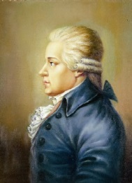
Karl Ditters von Dittersdorf
“Mozart’s string quartets . . . because of their unrelenting,
extreme artfulness, are not everyone’s purchase.” (1788)

Slide 97
The Dilemma?
Mozart to his father, 28 December 1782: [My new piano concertos are] something between too easy and too difficult. . . Here and there sustaining the interest of connoisseurs only, but in such a way the non-connoisseurs must also be pleased with it without knowing why.”
C.P.E. Bach, Six Collections of Keyboard Music “für Kenner und Liebhaber” (publ. 1779-1787): sonatas, rondos, fantasias
“Kenner” (Connoisseur)
Growing “Cult” of Art Music (for Insiders)
“Higher Level” of Sophisticated Composition
More Aesthetic/Philosophical Claims
Aristocratic Patrons
“Liebhaber” (Amateur)
Domestic Consumption for a “Universal Public”
Art: Taste, moderation, simplicity for a wider appeal
Avoidance of Excessive Subtlety or Complexity

Slide 98
The Dilemma?
“Liebhaber” (Amateur)
Domestic Consumption for a “Universal Public”
Art: Taste, moderation, simplicity for a wider appeal
Avoidance of Excessive Subtlety or Complexity
“Kenner” (Connoisseur)
Growing “Cult” of Art Music (for Insiders)
“Higher Level” of Sophisticated Composition
More Aesthetic/Philosophical Claims
Aristocratic Patrons

Slide 99
Not only do Mozart’s uncanny human portraits in sound seem to resonate with the reality of a concrete personality; they inspire empathy as well—and this was Mozart’s other breakthrough. One is apt to respond to a work by him not only thinking “it’s about him,” but also by thinking that, somehow, “it’s about me.” The bond of kinship thus established between the composer’s subjectivity and the listener’s—a human bond of empathy seemingly capable of transcending differences in age, rank, gender, nation, or any other barrier—is supremely in the optimistic spirit of the Enlightenment. When the feat is duplicated [by Mozart] in the wordless realm of instrumental music . . . that music is invested with a sense of importance—indeed, of virtual holiness—it had never known before. We can begin to see why Mozart could be worshiped, particularly by his nineteenth-century posterity, as a kind of musical god who worked a beneficent, miraculous influence in the world.
Richard Taruskin, II, 475

Slide 100
“Mozart endowed music with the fiction of subjectivity, the fiction that the music is itself a listening, acting, and reacting subject, with a past and a future, a desire for origins and for reconciliation with the world in both space and time. . . . This new musical subjectivity is in turn able to embody melancholy, not as a [mere] description or correlative of human mood, but as a function of its own inner life.”
Michael P. Steinberg, “Music and Melancholy,” Critical Inquiry 40 (2014), 291.

Slide 101
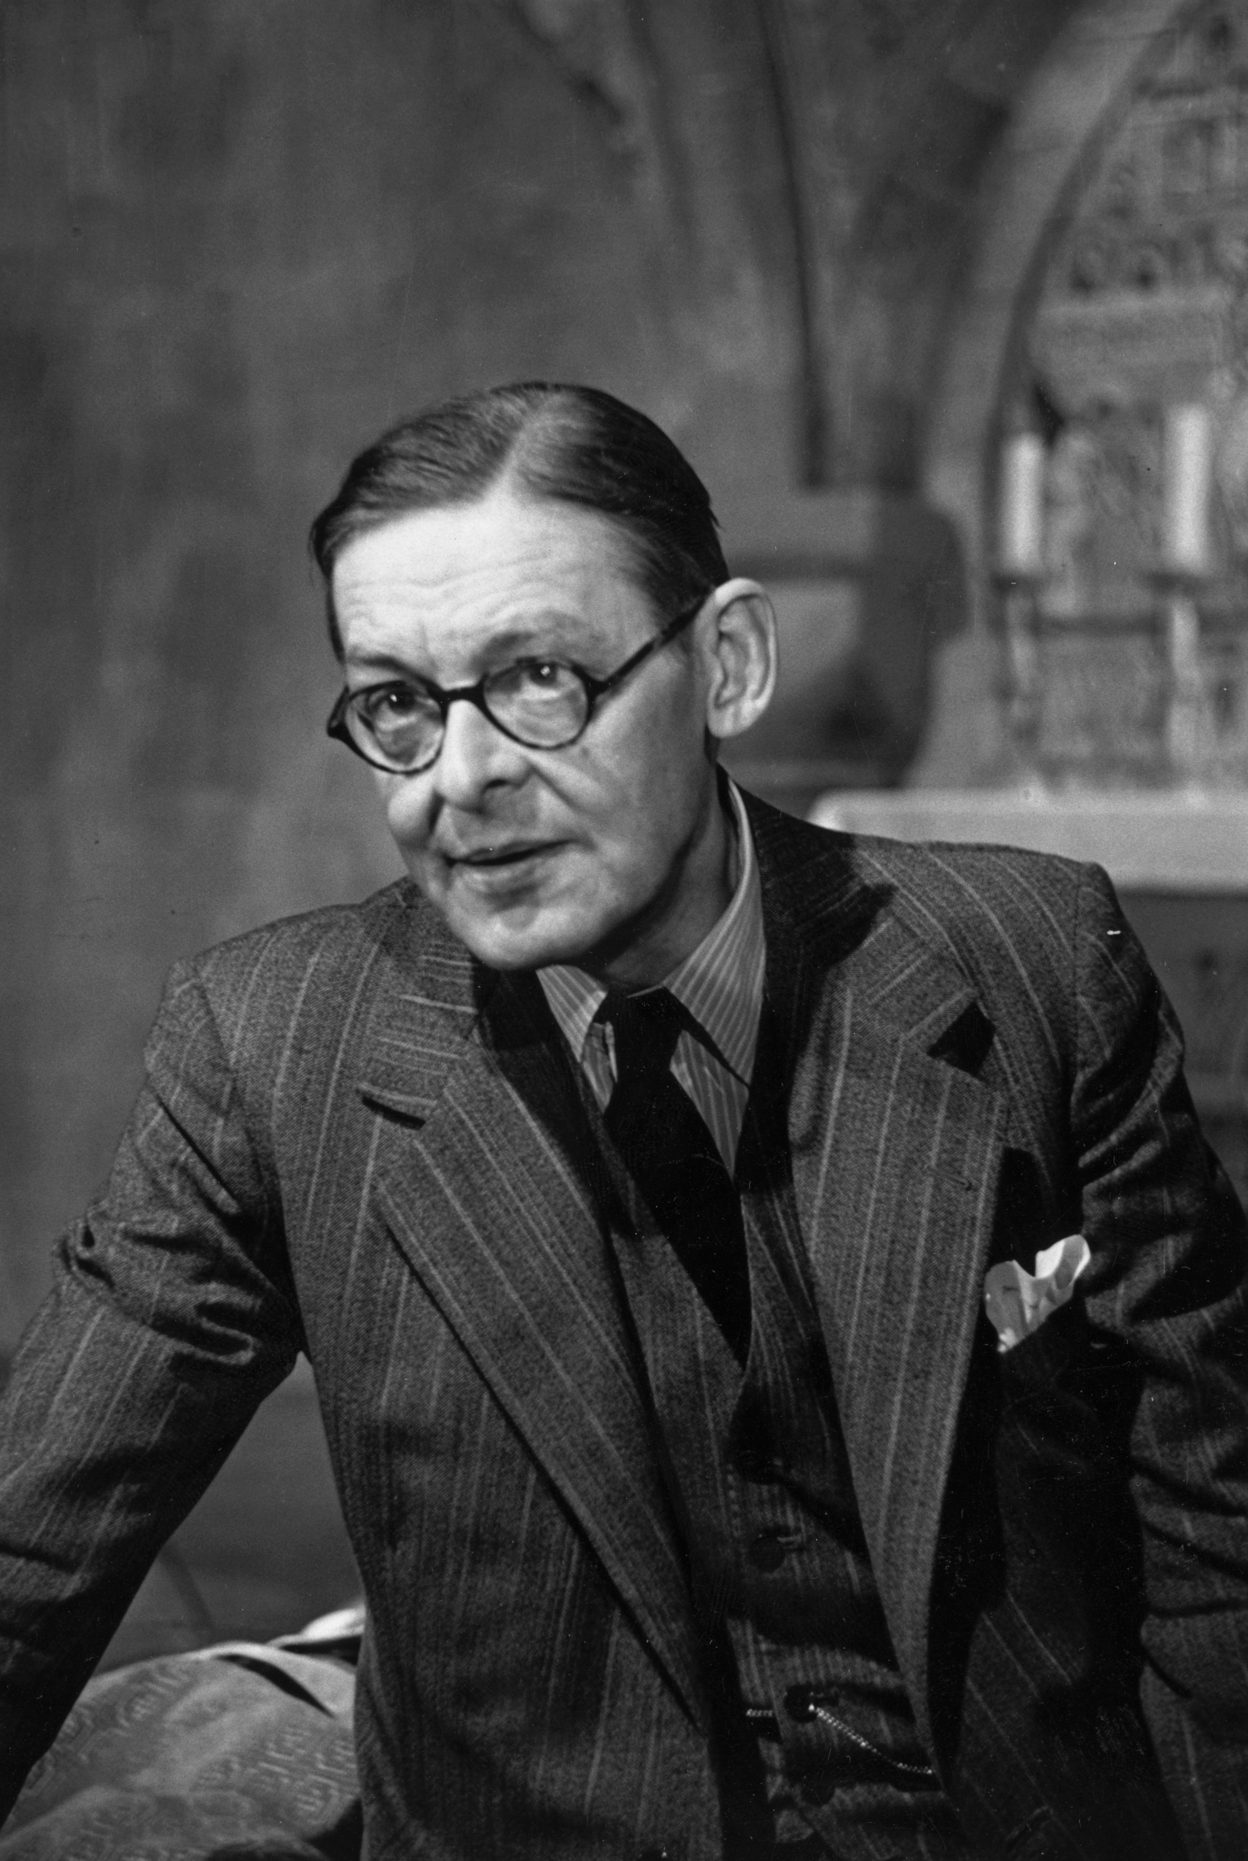
T. S. Eliot, “The Dry Salvages,” extract (from Four Quartets, 1941)
. . . . . .
For most of us, there is only the unattended Moment, the moment in and out of time, The distraction fit, lost in a shaft of sunlight, The wild thyme unseen, or the winter lightning Or the waterfall, or music heard so deeply That it is not heard at all, but you are the music While the music lasts. These are only hints and guesses, Hints followed by guesses; and the rest Is prayer, observance, discipline, thought and action.

