Slide 1
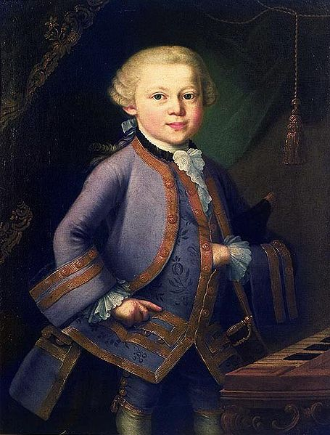
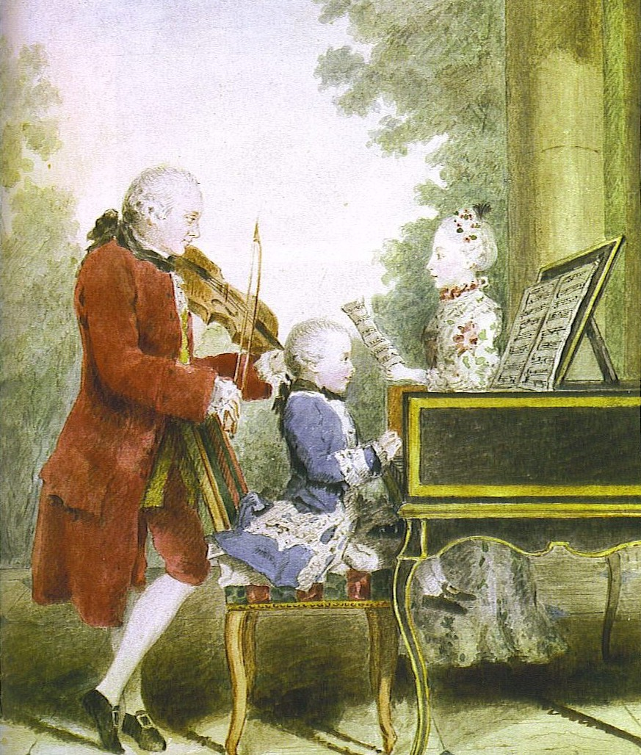
Mozart: Child Prodigy

Slide 2
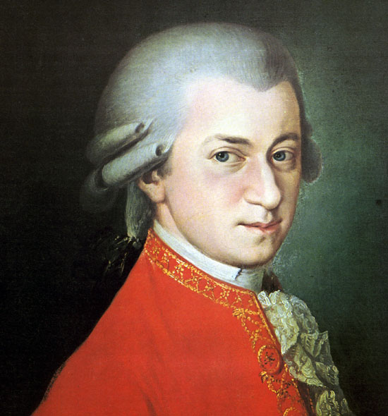
January 1756 [Salzburg] – December 1791 [Vienna]

Slide 3
The Vienna Years, 1781-91, age 25-35

Slide 4
The Vienna Years, 1781-91, age 25-35
Overture, Le nozze di Figaro (1786)

Slide 5
The Vienna Years, 1781-91, age 25-35
Piano Concerto in B-flat, K. 595 (1791)

Slide 6
The Vienna Years, 1781-91, age 25-35
Funeral Motet, Ave verum corpus, K. 618 (1791)

Slide 7
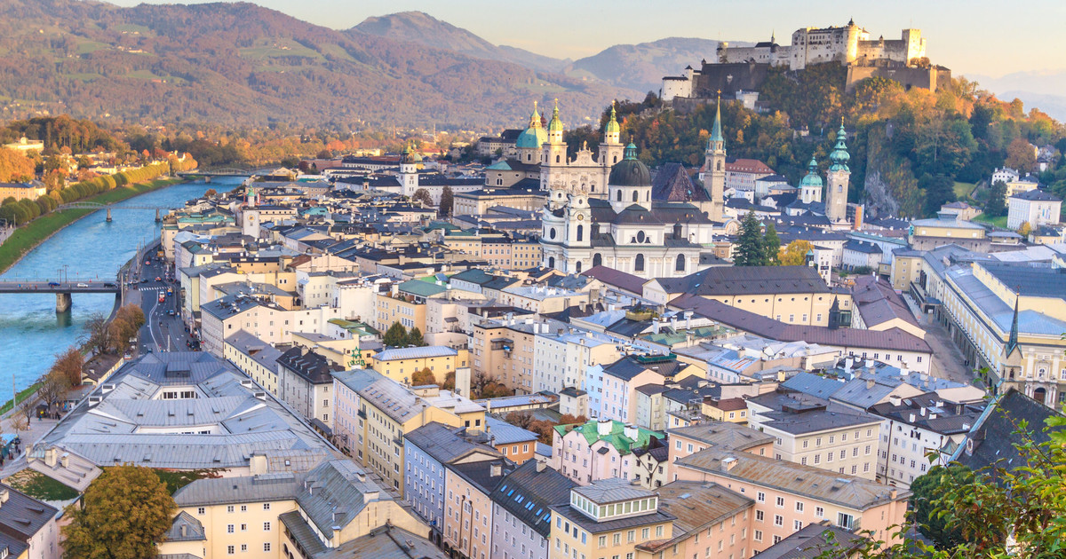
Salzburg

Slide 8
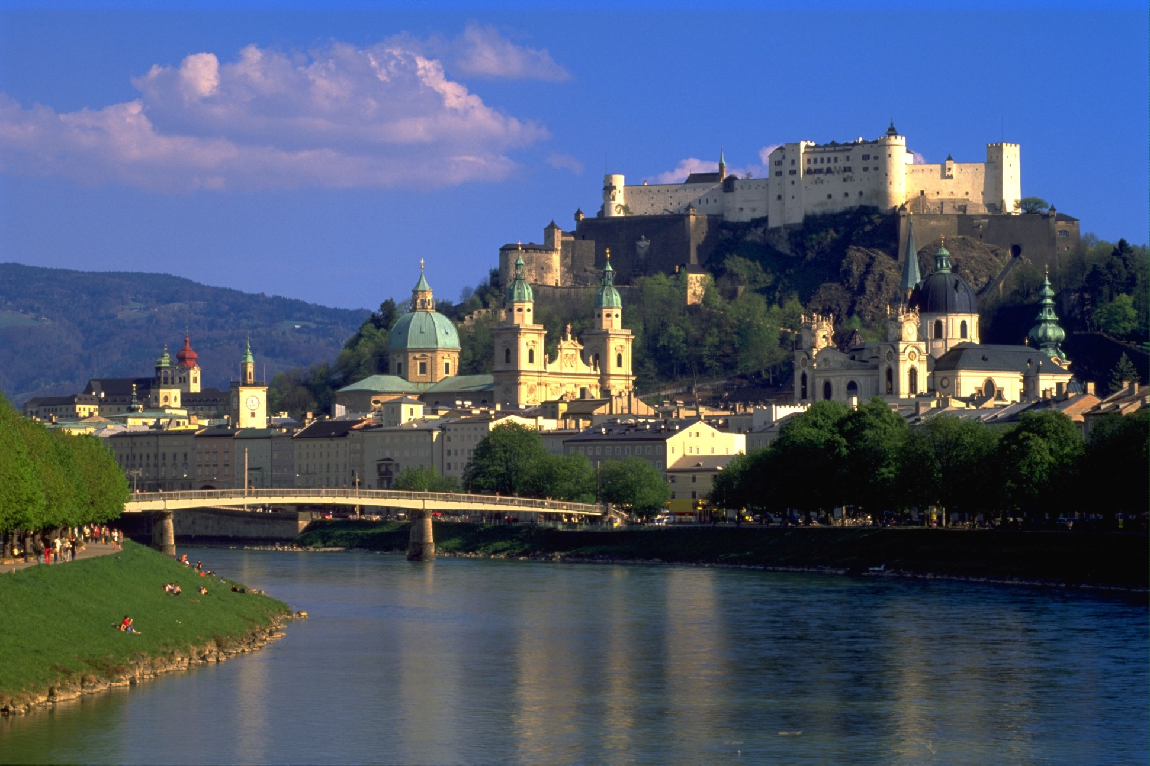
Salzburg

Slide 9
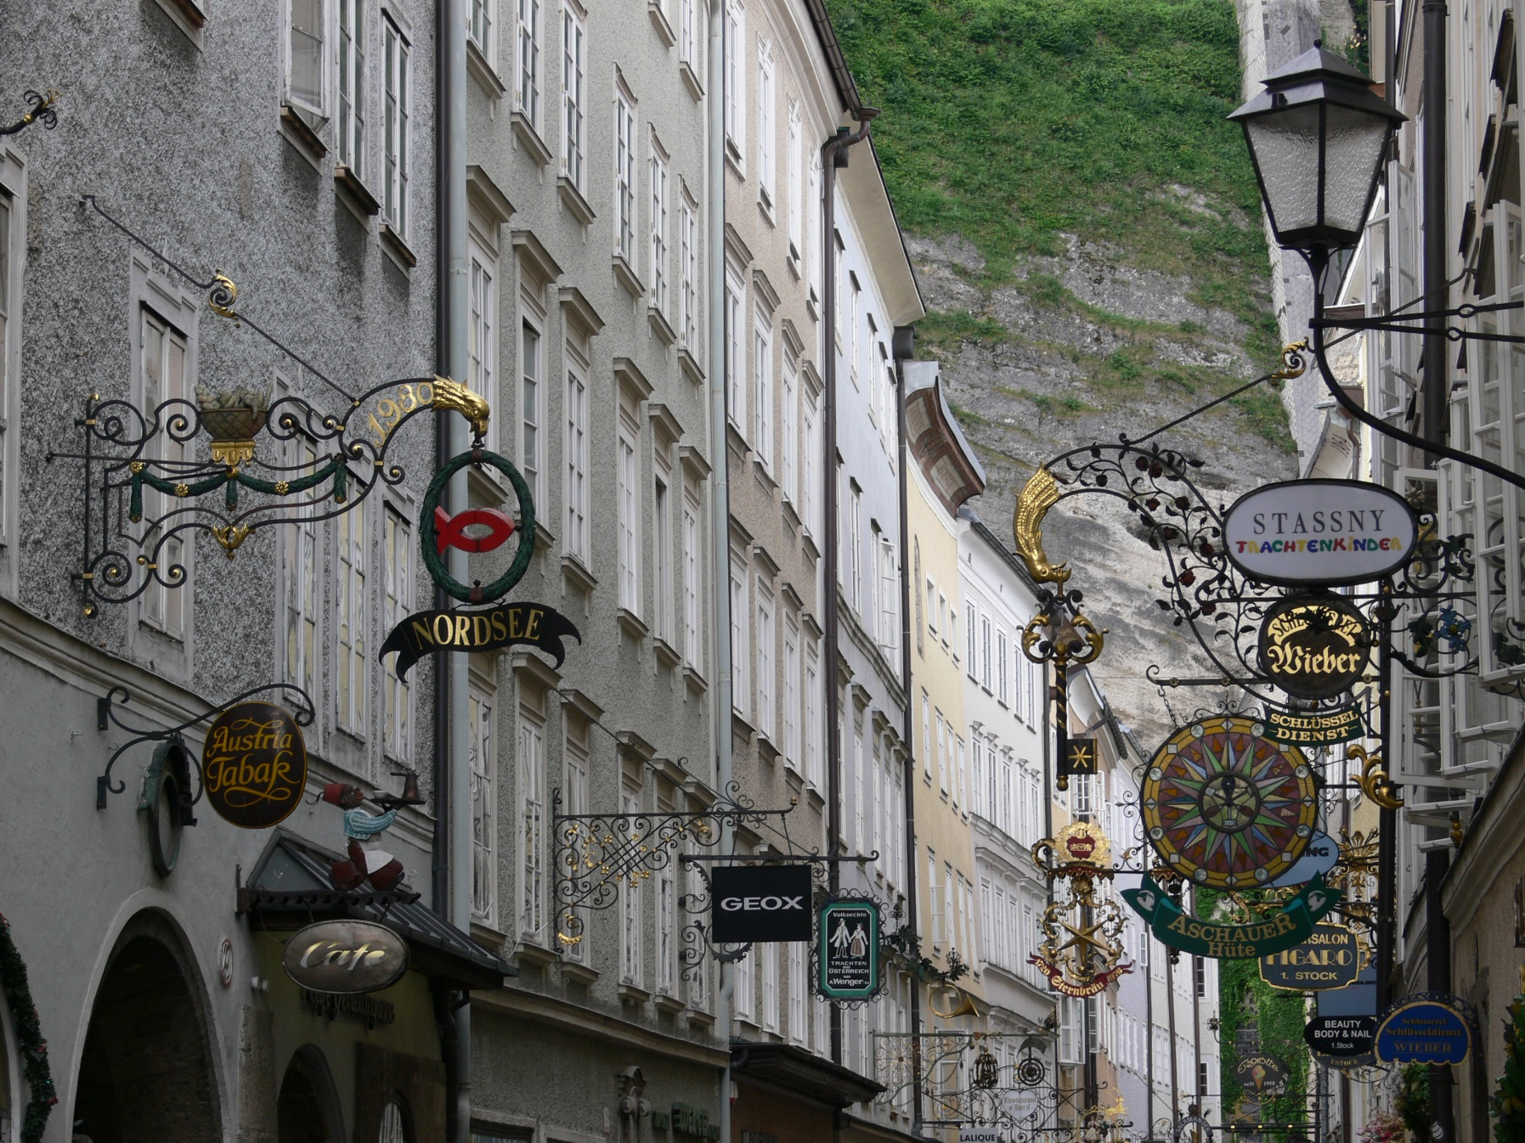
Salzburg: Getreidegasse

Slide 10
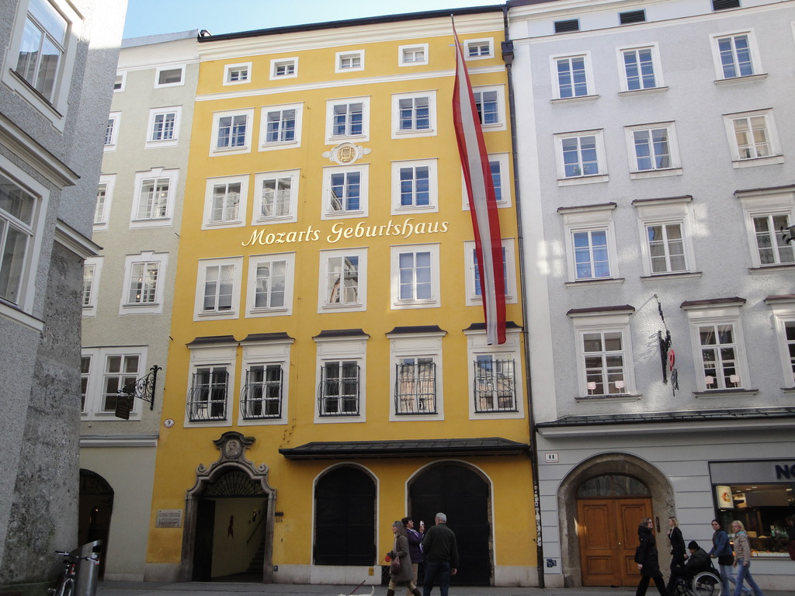

Slide 11
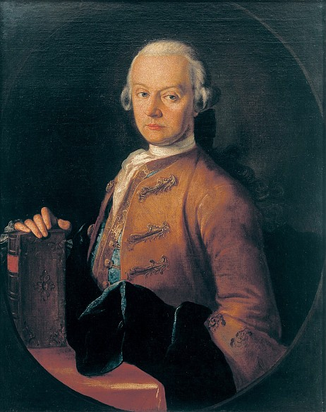
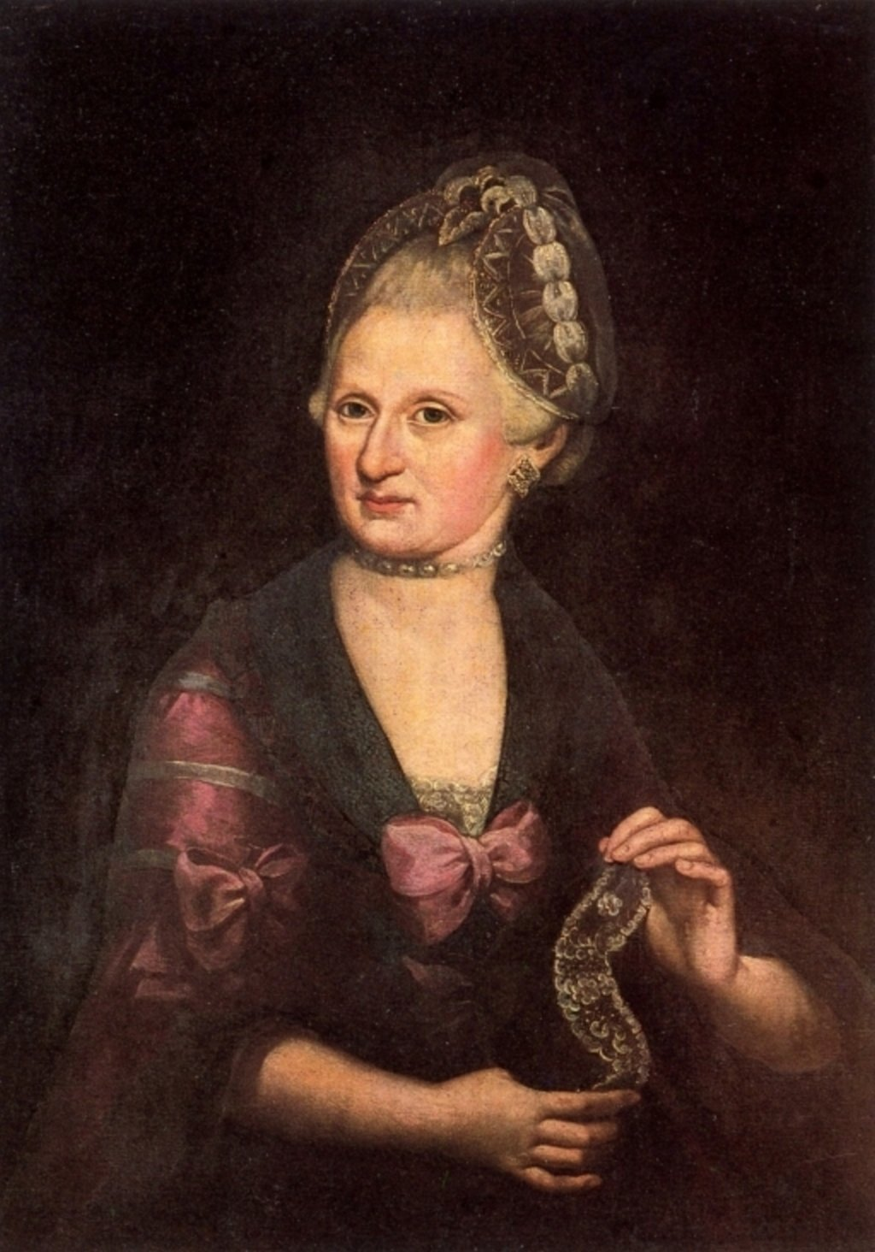
Leopold Mozart (1719-1787) Anna Maria Mozart (1720-1778)

Slide 12
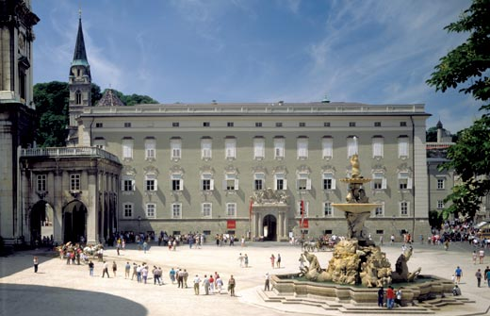
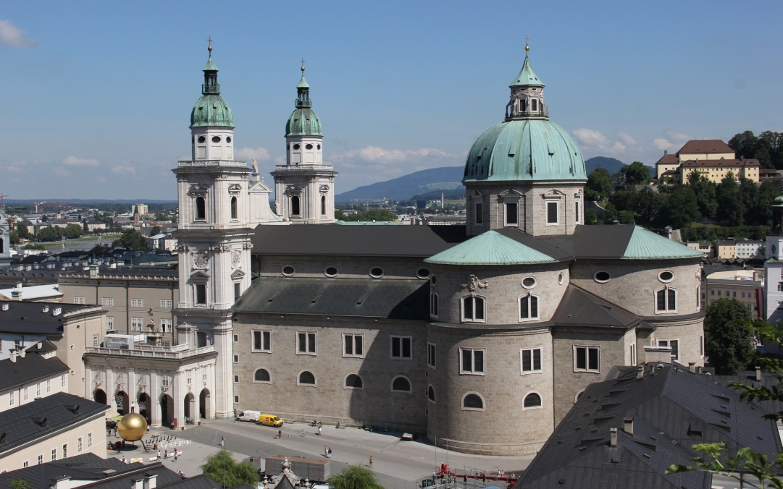
Salzburg: Court
Leopold Mozart (1719-1787)
Salzburg: Cathedral

Slide 13
Leopold Mozart (1719-1787) Anna Maria Mozart (1720-1778)
Marianne (Maria Anna): “Nannerl” (b. 1751)
Wolfgang (b. 1756)

Slide 14
The Salzburg court trumpeter, Johann Schachtner, reports on a visit to the Mozart home, c. 1760, where he noticed that the four-year-old Wolfgang had been writing inkblot-scrawls on music paper:
At first we laughed at what seemed such pure gibberish, but his father then began to observe the most important matter, the notes and the music. He stared long at the sheet, and then tears, tears of joy and wonder, fell from his eyes. “Look, Herr Schachtner,” he said, “see how correctly and properly it is all written, only it can’t be used, for it is so very difficult that no one could play it.”
[Four-year-old] Wolfgangerl said, “That’s why it’s a concerto. You must practice it until you get it right. Look! That’s how it goes.” He played and managed to bring out just enough to give us a notion of what he intended.

Slide 15
Mozart’s Earliest Surviving Compositions:
Minuet in G, K. 1 (December 1761, almost age 6)
Minuet in F, K. 2 (January 1762, age 6)

Slide 16
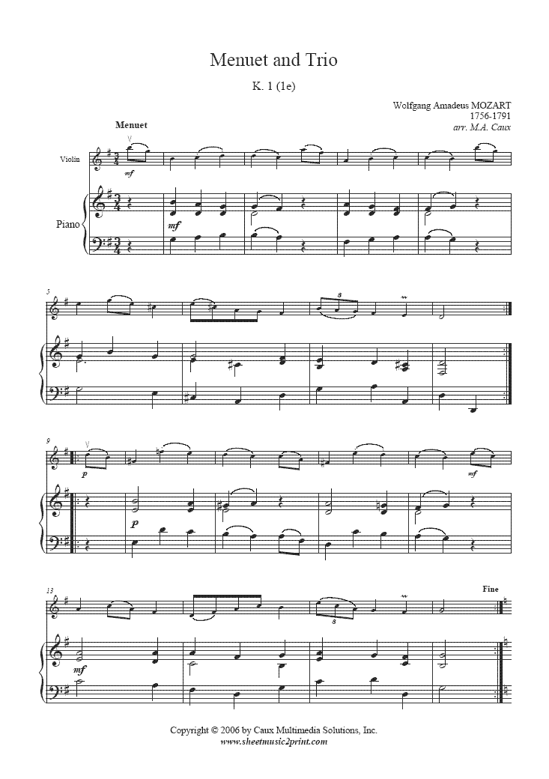
Mozart’s Earliest Surviving Compositions:
Minuet in G, K. 1 (December 1761, almost age 6)
Minuet in F, K. 2 (January 1762, age 6)

Slide 17
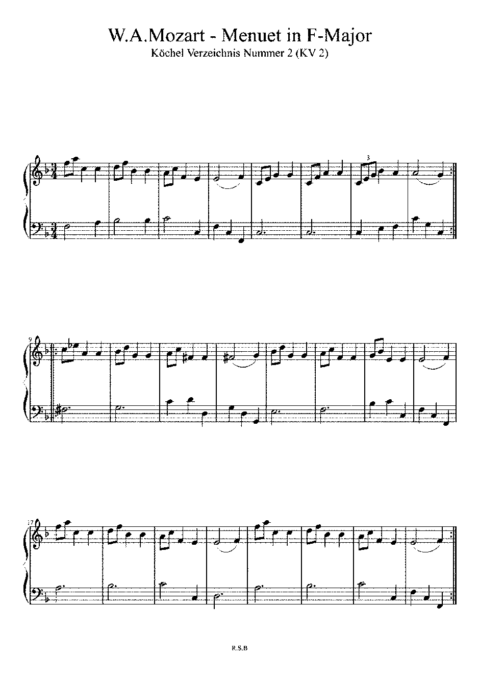
Mozart’s Earliest Surviving Compositions:
Minuet in G, K. 1 (December 1761, almost age 6)
Minuet in F, K. 2 (January 1762, age 6)

Slide 18
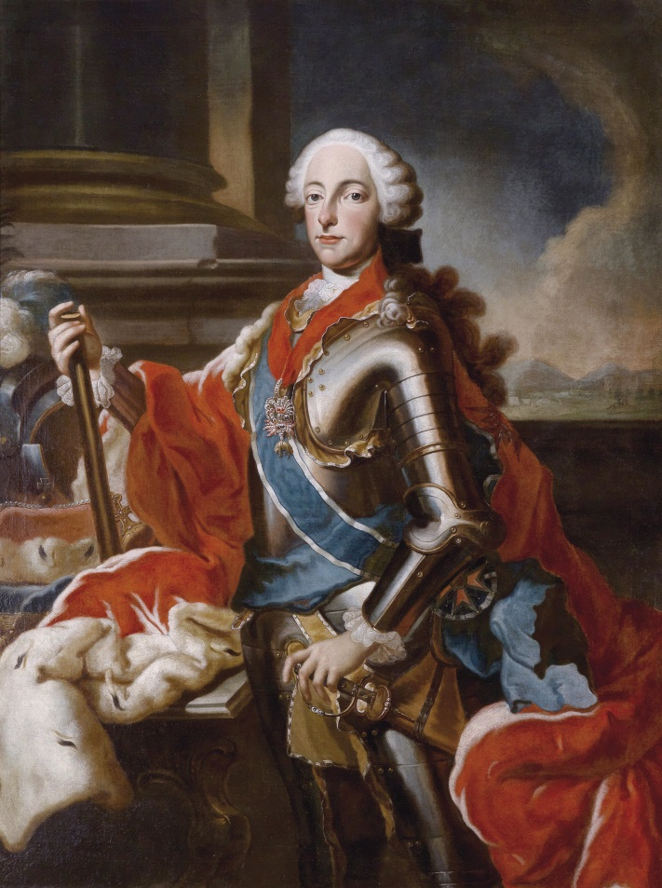
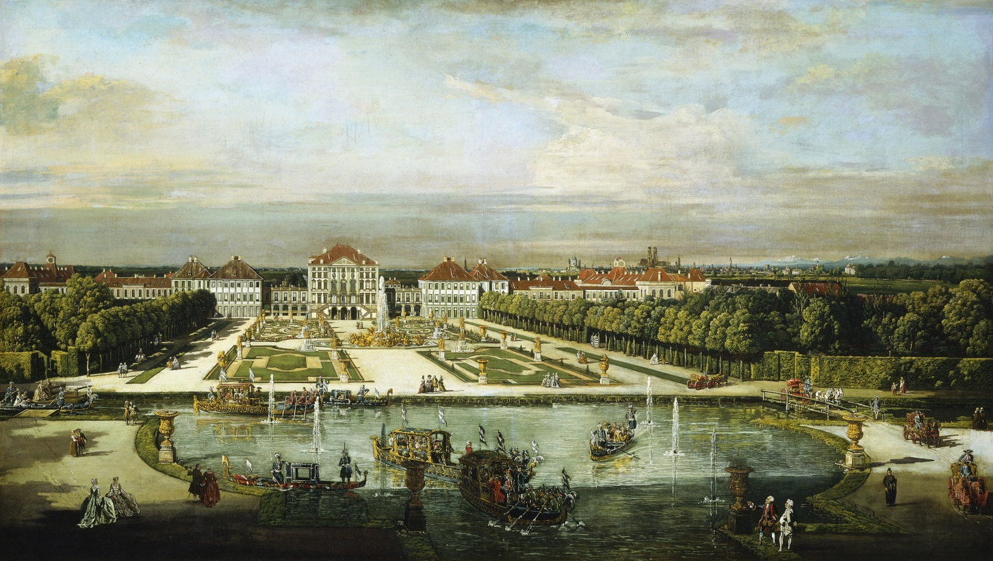
The Child Mozart on Display
January 1762 (age 6) – Munich, performed for the Elector of Bavaria, Maximilian III.
Munich, Nymphenburg Palace

Slide 19
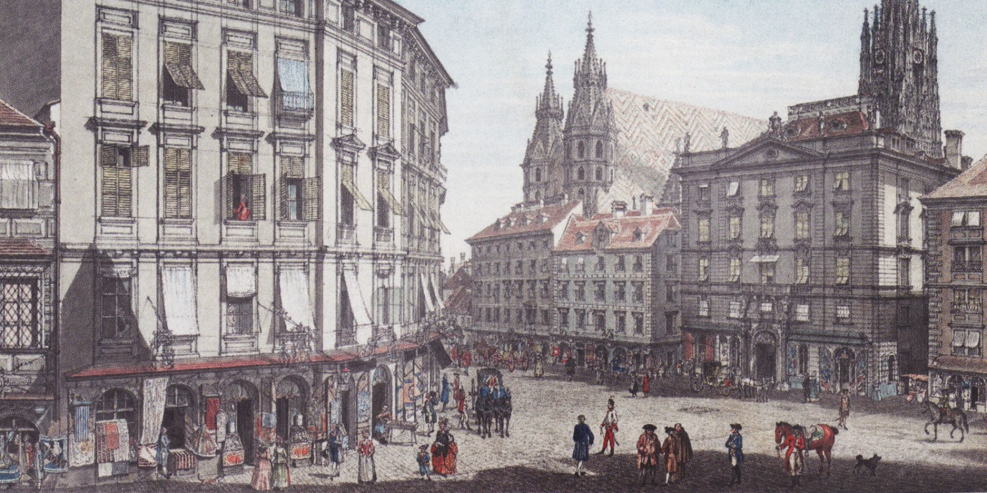
The Child Mozart on Display
January 1762 (age 6) – Munich, performed for the Elector of Bavaria, Maximilian III.
October-December 1762 (age 6) – Vienna (Imperial Capital)

Slide 20
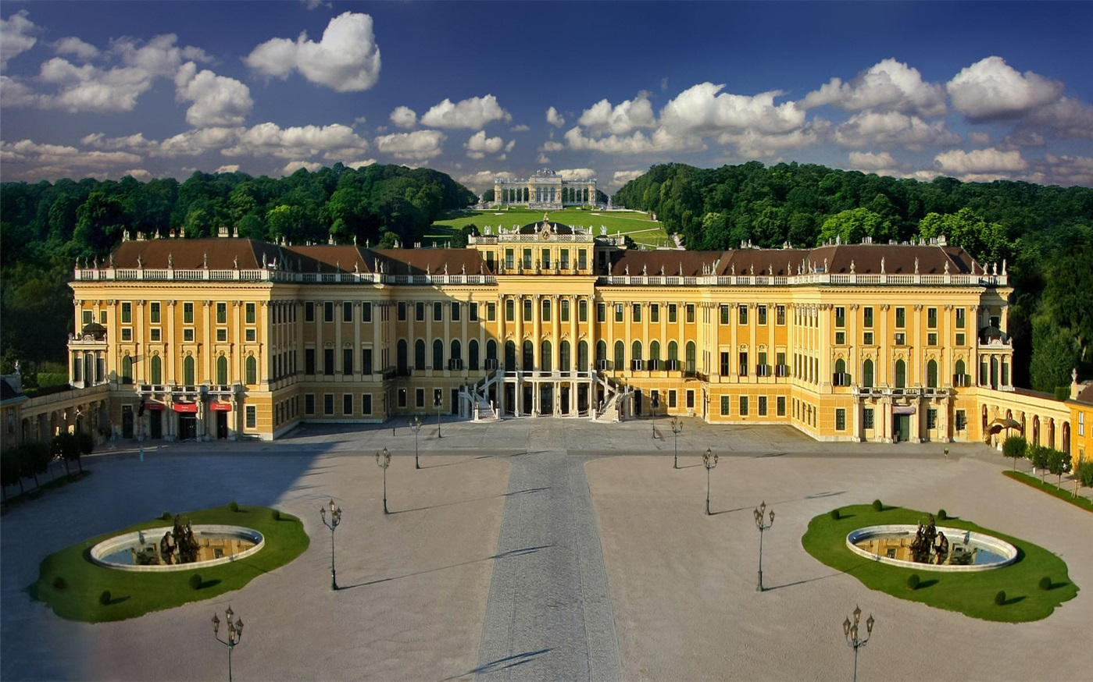
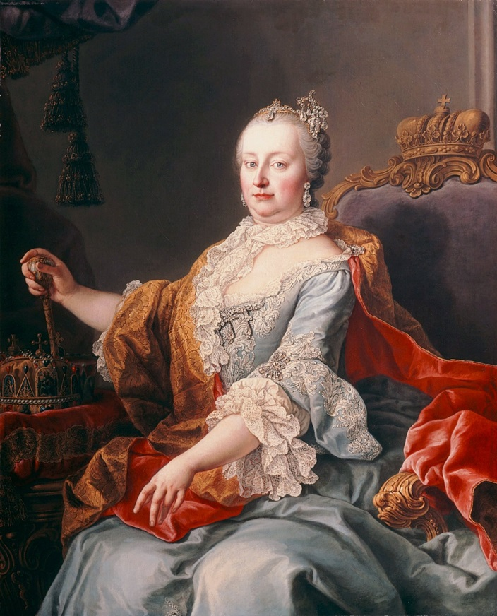
The Child Mozart in Vienna, October-December 1762
Schönbrunn Palace
Empress Maria Theresa

Slide 21
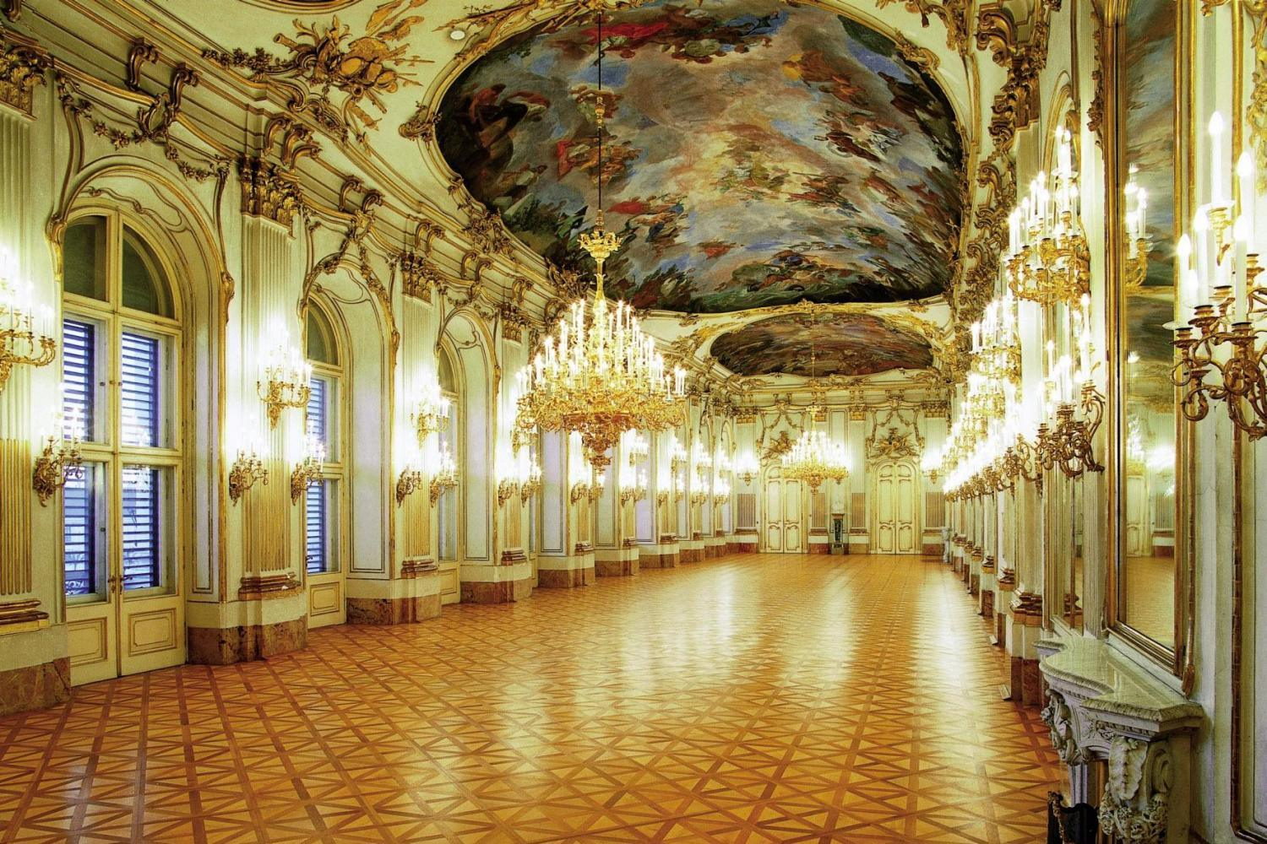
The Child Mozart in Vienna, October-December 1762
Schönbrunn Palace
Empress Maria Theresa

Slide 22
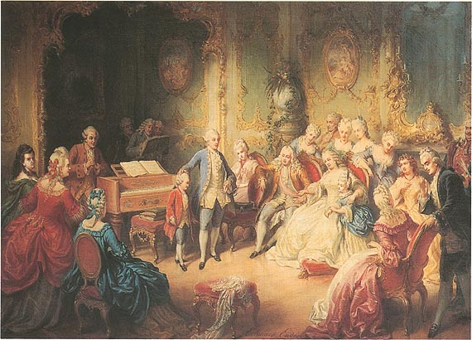
Joseph II Presents Mozart (Age 6) to Empress Maria Theresa at Schönbrunn
(Edward Ender, 1869)

Slide 23
Mozart, Age 6, in the formal clothing given to him
by the Empress Maria Theresa (painting, anon., 1762-63)

Slide 24
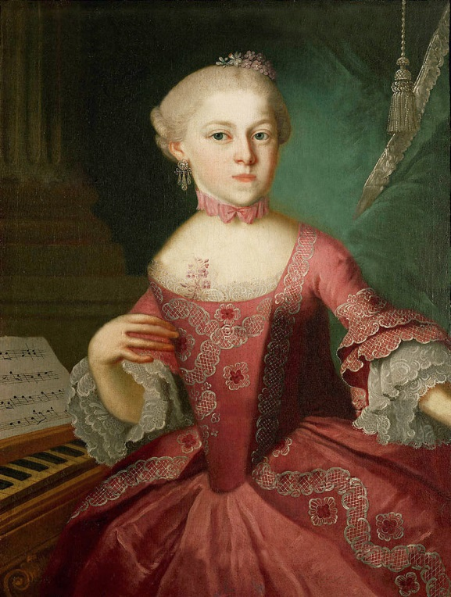
Wolfgang and Nannerl, 1763

Slide 25
The Child Mozart on Display:
The Grand Tour of 3 ½ Years (80 cities): age 7-10
June 1763-November 1766

Slide 26
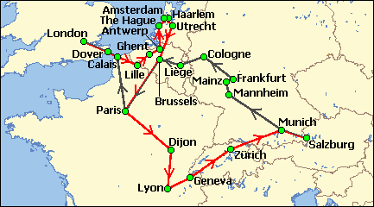
The Child Mozart on Display:
The Grand Tour of 3 ½ Years (80 cities): age 7-10
June 1763-November 1766

Slide 27
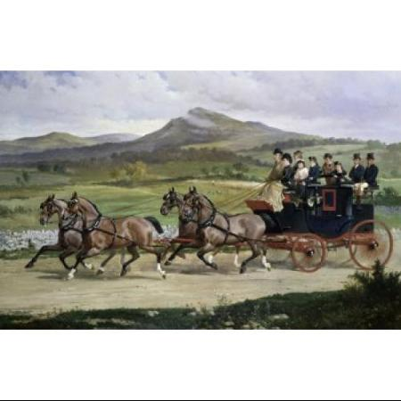
The Child Mozart on Display:
The Grand Tour of 3 ½ Years (80 cities): age 7-10
June 1763-November 1766

Slide 28
The Child Mozart on Display:
The Grand Tour of 3 ½ Years (80 cities): age 7-10
June 1763-November 1766

Slide 29
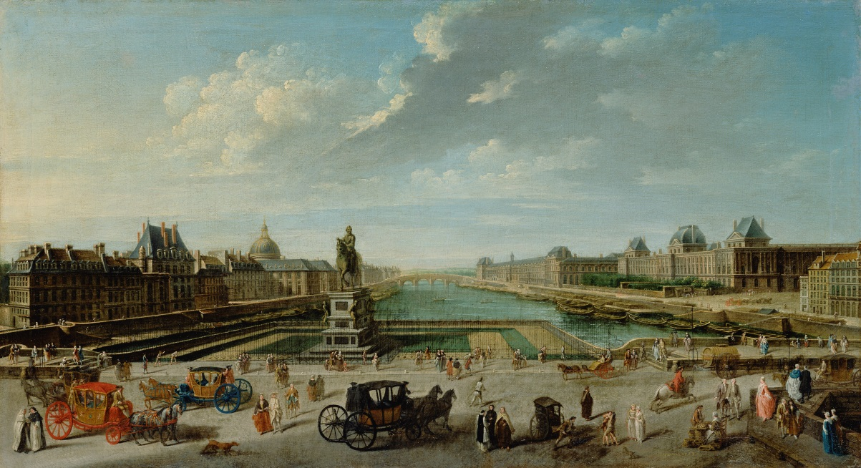
The Child Mozart in Paris, November 1763-April 1764: age 7-8

Slide 30
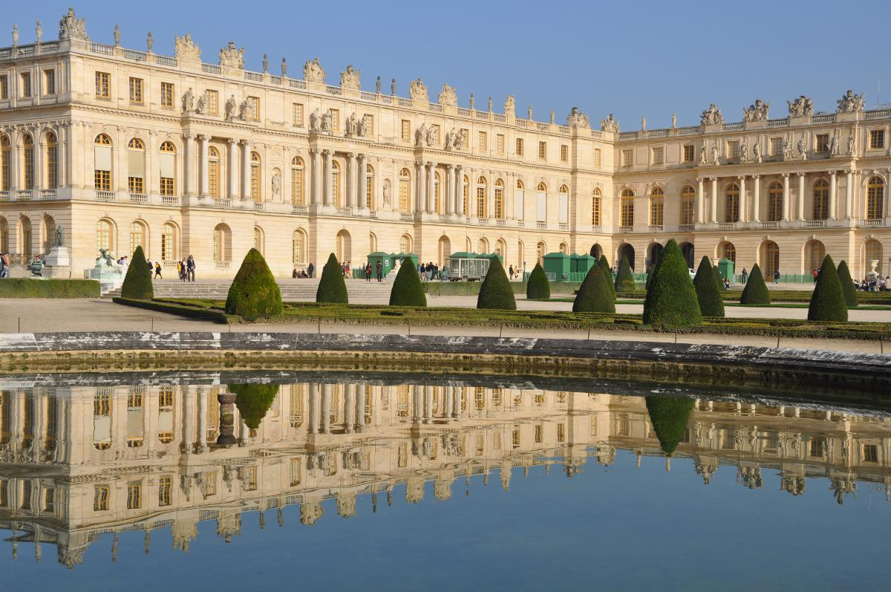
Mozart, early 1764 (age 8), performs at Versailles
for King Louis XV and the Queen Consort Marie

Slide 31
The Child Mozart in Paris, November 1763-April 1764: age 7-8
Violin Sonata in C, K. 6 (1764)
Violin Sonata in D, K. 7 (1764)

Slide 32
The Child Mozart in Paris, November 1763-April 1764: age 7-8
Violin Sonata in C, K. 6 (1764)
Violin Sonata in D, K. 7 (1764)

Slide 33
The Child Mozart in Paris, November 1763-April 1764: age 7-8
Violin Sonata in C, K. 6 (1764)
Violin Sonata in D, K. 7 (1764)

Slide 34
The Child Mozart on Display:
The Grand Tour of 3 ½ Years (80 cities): age 7-10
June 1763-November 1766

Slide 35
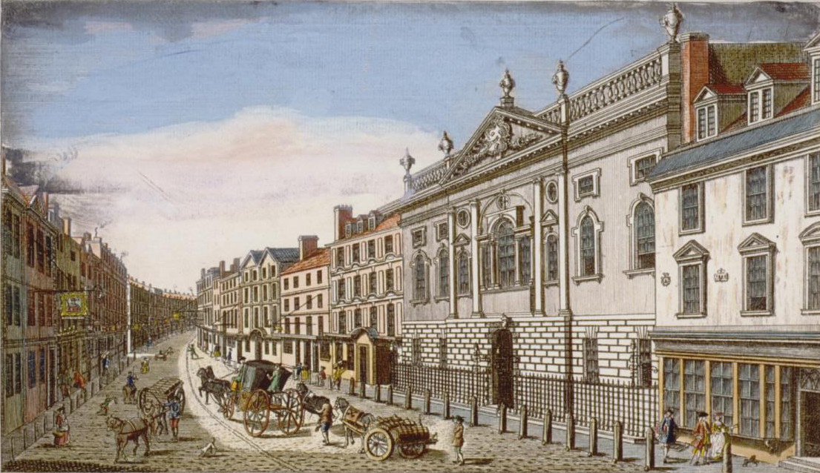
The Child Mozart in London, April 1764-August 1765: age 8-9

Slide 36
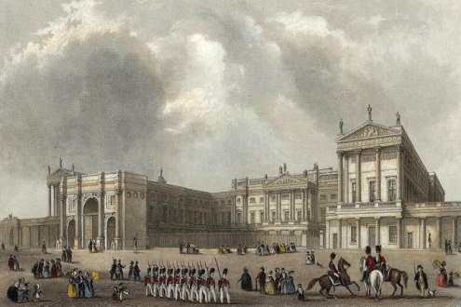
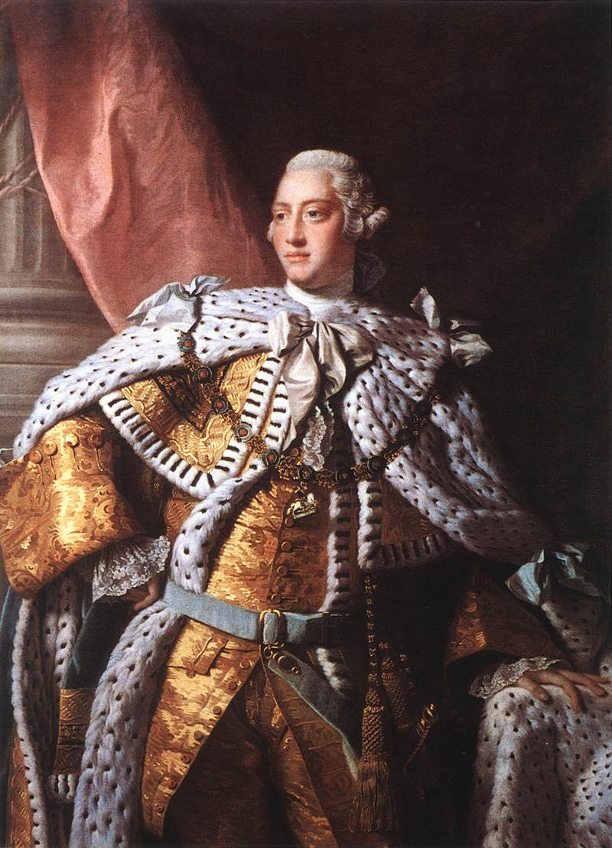
The Child Mozart in London, April 1764-August 1765: age 8-9
Buckingham House
King George III

Slide 37
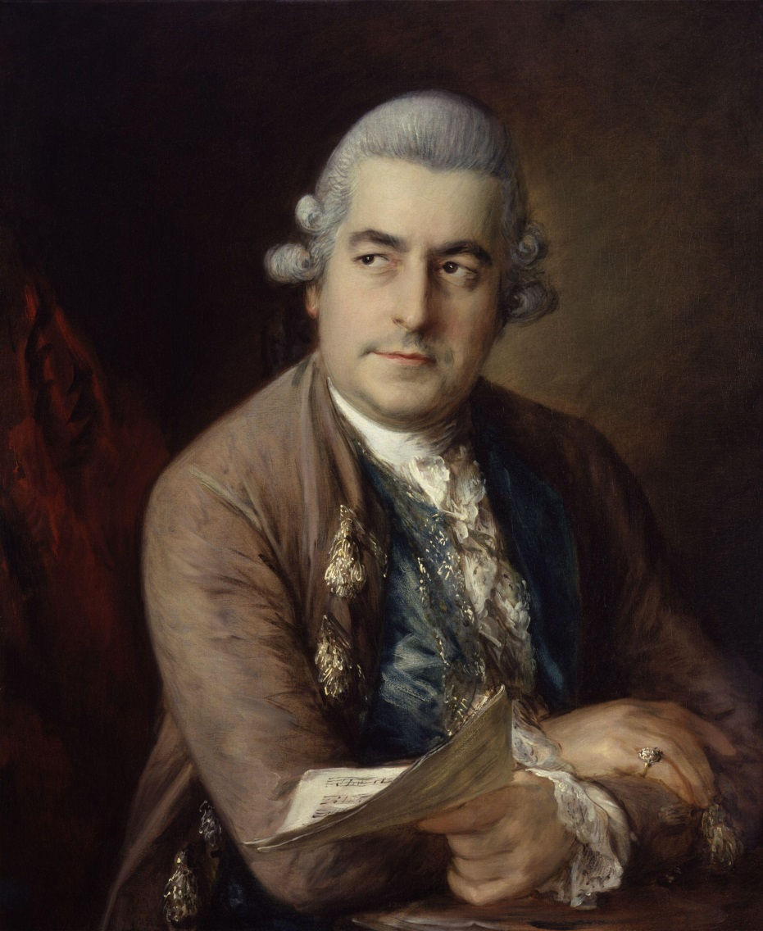
The Child Mozart in London, April 1764-August 1765: age 8-9
Johann Christian Bach
(Bach-Abel Concerts begin, 1765)

Slide 38
The Child Mozart in London, April 1764-August 1765: age 8-9
Johann Christian Bach
Symphony in D, op. 3 no. 1 (1765))

Slide 39
The Child Mozart in London, April 1764-August 1765: age 8-9
Symphony No. 1 in E-flat,
K. 16 (late 1764)
Johann Christian Bach

Slide 41
The Child Mozart on Display:
The Grand Tour of 3 ½ Years (80 cities): age 7-10
June 1763-November 1766

Slide 42
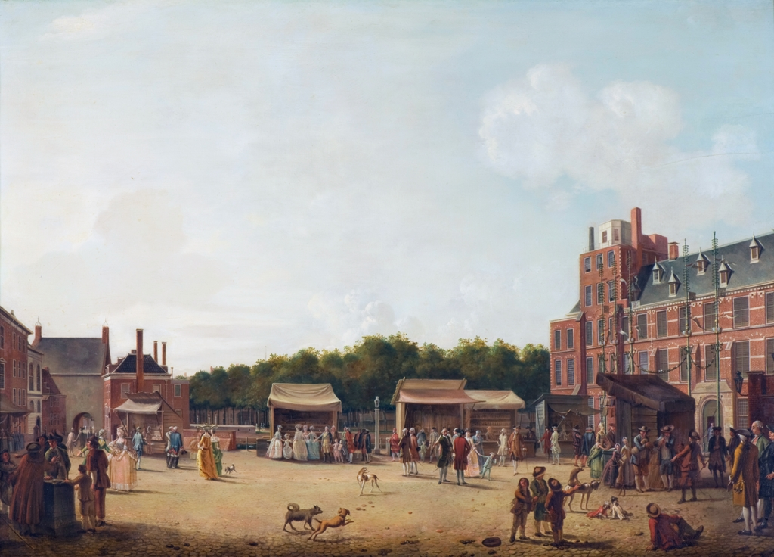
The Child Mozart in the Netherlands, September 1765-April 1766: age 9-10
The Hague
Mozart, Symphony “No. 5” in B-flat, K. 22 (December 1765)

Slide 43
The Child Mozart on Display:
The Grand Tour of 3 ½ Years (80 cities): age 7-10
June 1763-November 1766

Slide 44
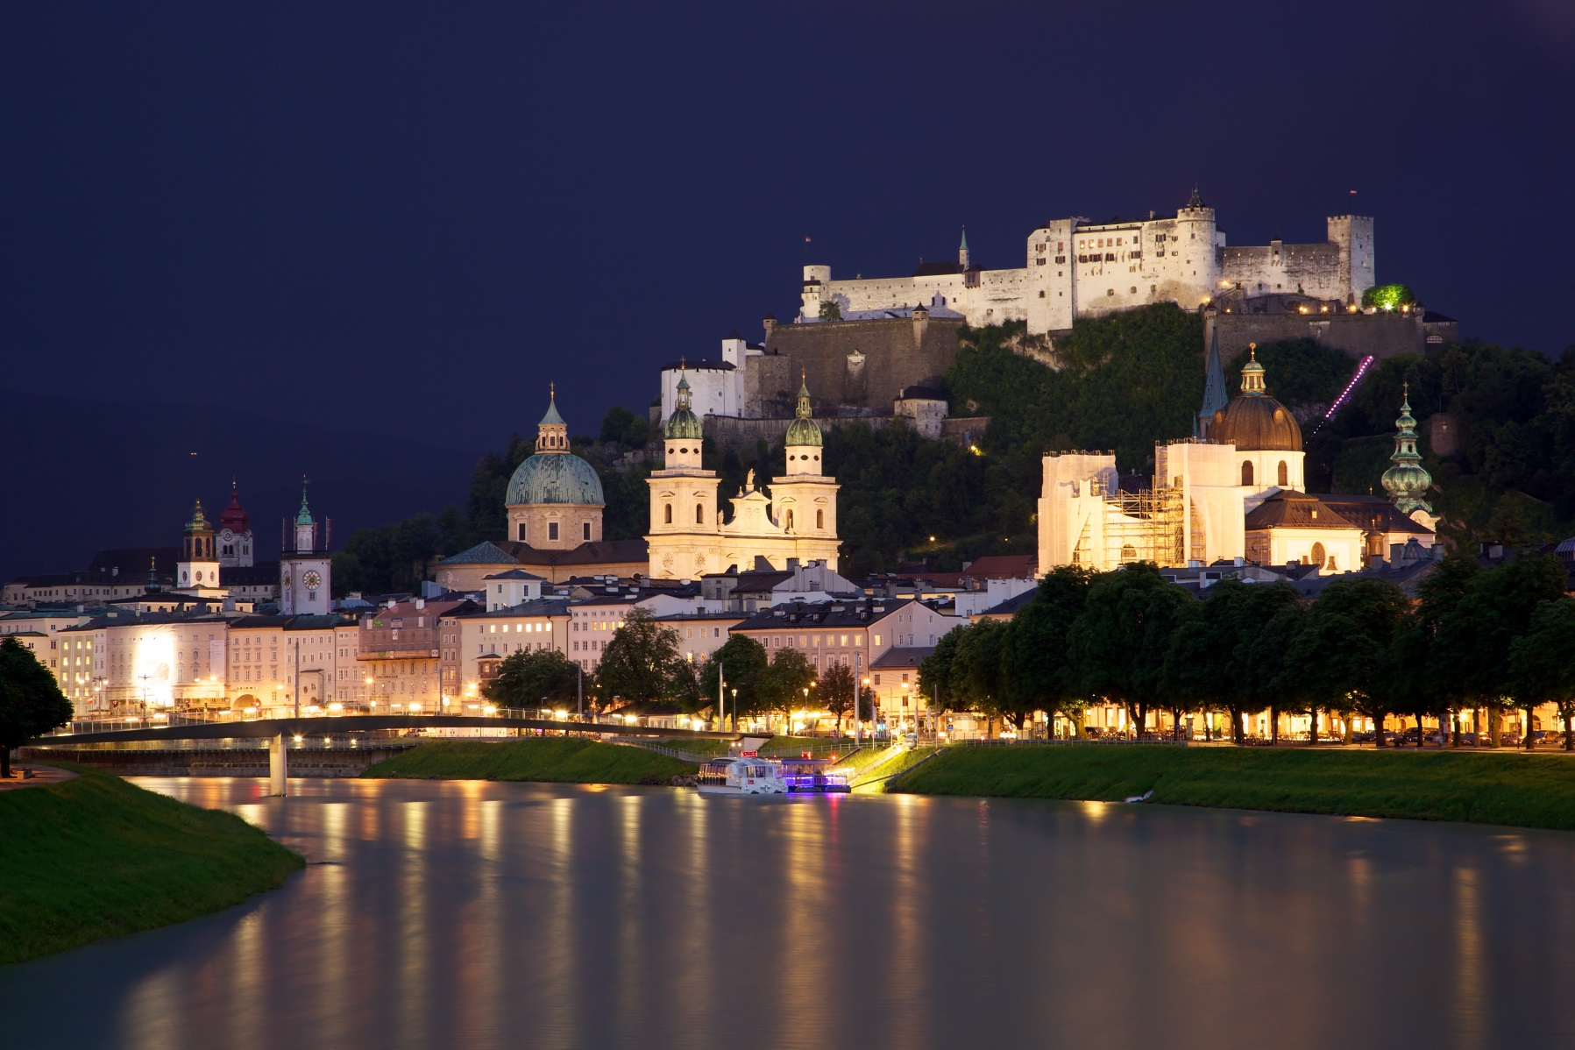
After the 3 ½-Year Tour, the Mozart Family Returns to Salzburg, November 1766 (age 10)

Slide 45
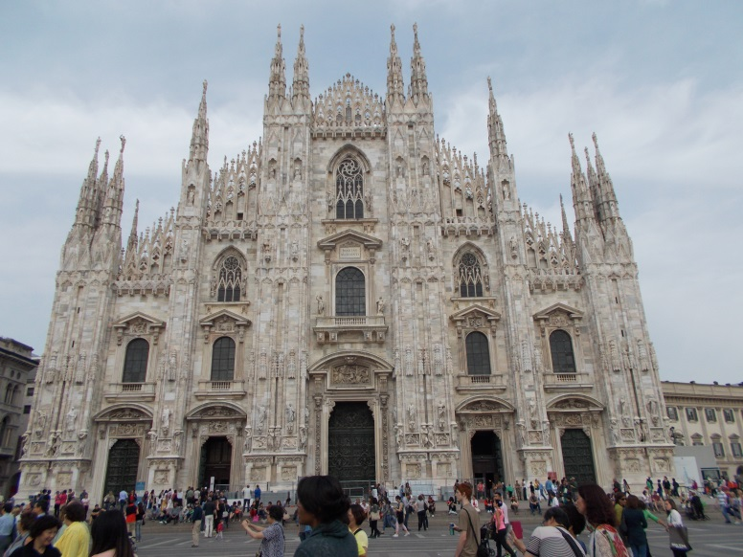
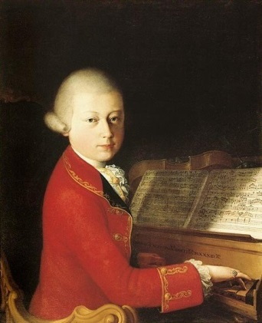
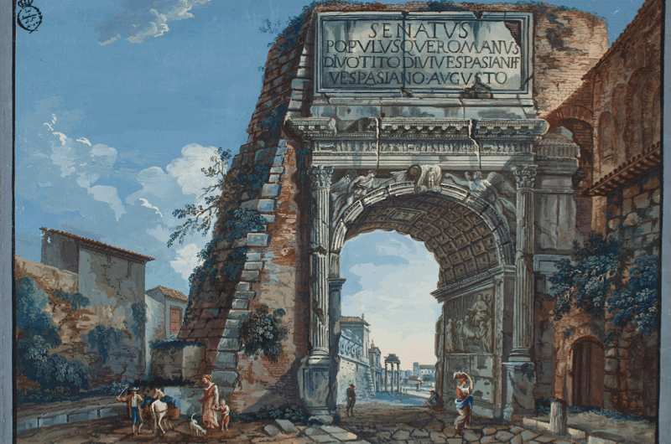
Young Mozart in Italy, December 1769-March 1771: age 14-15
Mozart in 1770

Slide 46
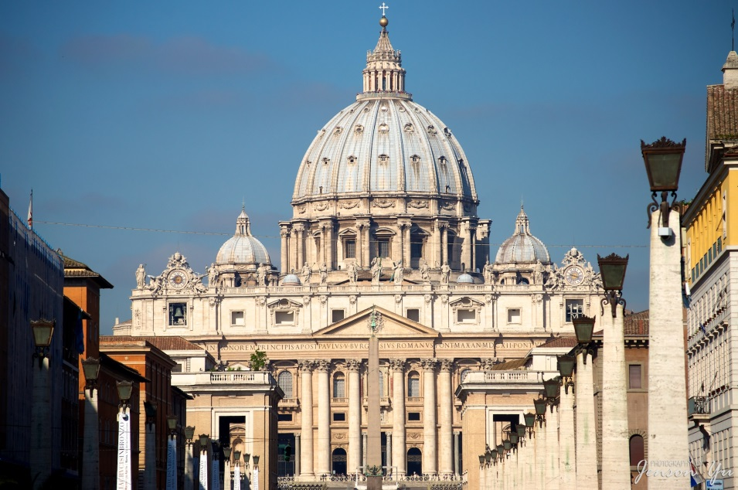
Young Mozart at St. Peter’s Basilica, Rome (April 1770)
Mozart in 1770

Slide 47
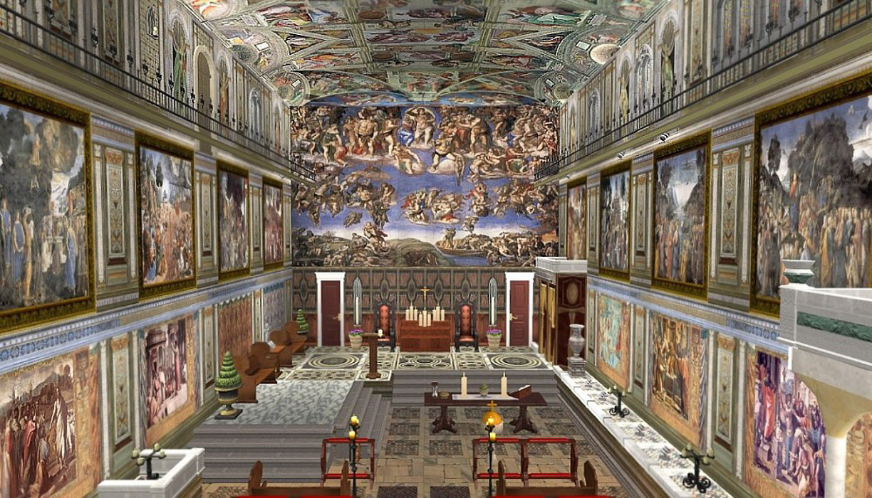

Slide 48
Gregorio Allegri,
“Miserere” (Penitential Psalm, c. 1638)

Slide 49
Young Mozart in Italy: Three Trips
December 1769-March 1771: age 14-15
August-December 1771
October 1772 – March 1773
Mozart in 1770

Slide 50
“Alleluia” from the motet, “Exsultate, jubilate,” K. 165 (1773)

Slide 51
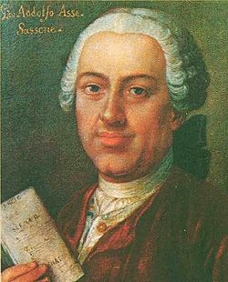
“Alleluia” from the motet, “Exsultate, jubilate,” K. 165 (1773)
Johann Adolph Hasse (1699-1783)

Slide 52
“Alleluia” from the motet, “Exsultate, jubilate,” K. 165 (1773)
Johann Adolph Hasse (1699-1783)
“This boy will consign
us all to oblivion!”

