Slide 1
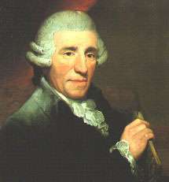
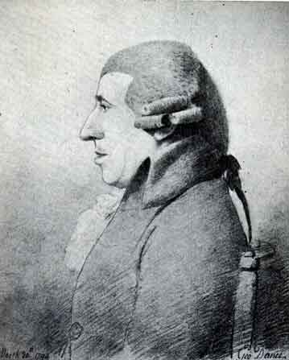
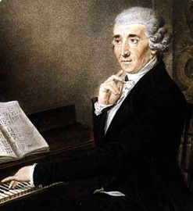
The Mature Haydn: 1780s, 1790s
1792 1794 1795

Slide 2
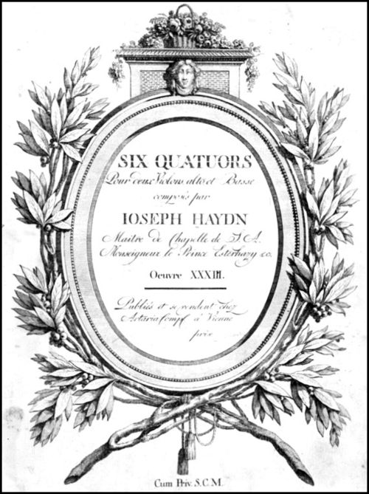
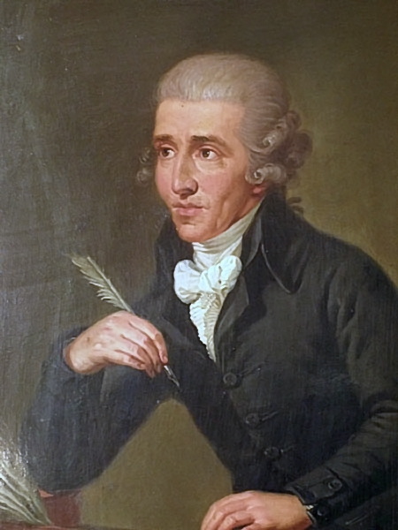
1781 Watershed: Publication of the Six Quartets, op. 33 (Vienna, Artaria)
Haydn, letter to possible patrons for op. 33: [These quartets are] written
in a new and special way (for I haven’t composed any [others] for ten years.”

Slide 3
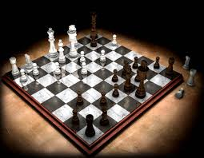
Sonata form as a game-like enterprise, 1780s, 1790s

Slide 4
Sonata form as a game-like enterprise, 1780s, 1790s
Each sonata movement (quartet, sonata, symphony, concerto):
Personalized by a master player
Appeal: connoisseurship

Slide 5
1781 Watershed: Publication of the Six Quartets, op. 33 (Vienna, Artaria)
Haydn, letter to possible patrons for op. 33: [These quartets are] written
in a new and special way (for I haven’t composed any [others] for ten years.”

Slide 6
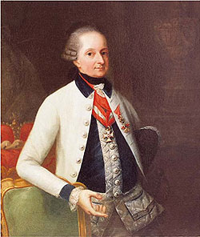
Haydn’s Principal Patron, 1763-1790
Prince Nicolaus I Esterházy (1714-90)

Slide 7
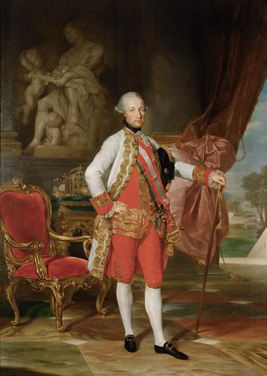
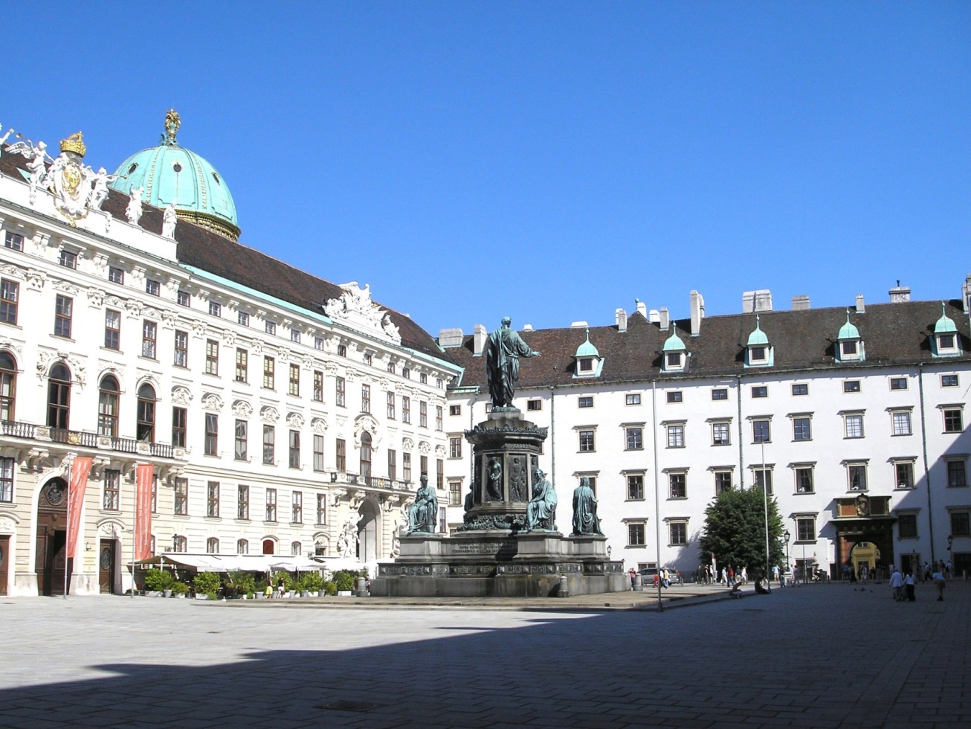
Joseph II (reigned 1780-90)
Vienna: Hofburg Palace

Slide 8
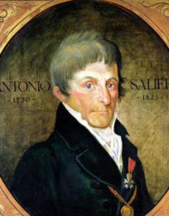
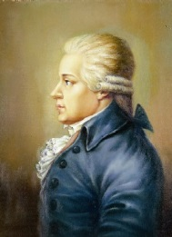
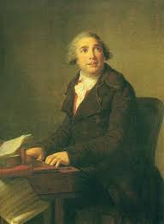
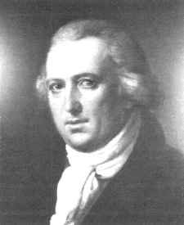
Antonio Salieri ( 1750-1825)
Karl Ditters von Dittersdorf
( 1739-99)
Joseph II (reigned 1780-90)
Giovanni Paisiello ( 1740-1816)
Johann Vanhal (1739-1813)

Slide 9
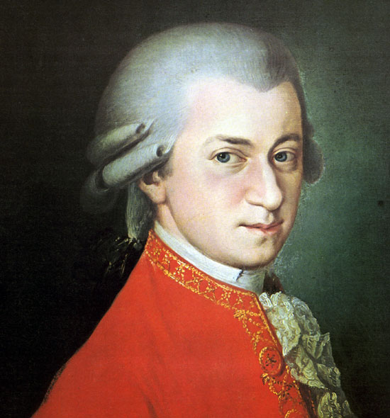
Encounters in Vienna: 1781? 1783-84? But certainly by 1785

Slide 10
1780s: the decade of now-fully matured “Viennese Classicism”
(1781 a decisive year: Haydn’s op. 33; Mozart moves to Vienna)

Slide 11
1780s: the decade of now-fully matured “Viennese Classicism”
(1781 a decisive year: Haydn’s op. 33; Mozart moves to Vienna)
Elaborating, deepening, and monumentalizing the galant style:
Symphony, concerto, sonata, quartet, piano trio (Haydn, Mozart)
Opera seria, opera buffa, Singspiel (Mozart)

Slide 12
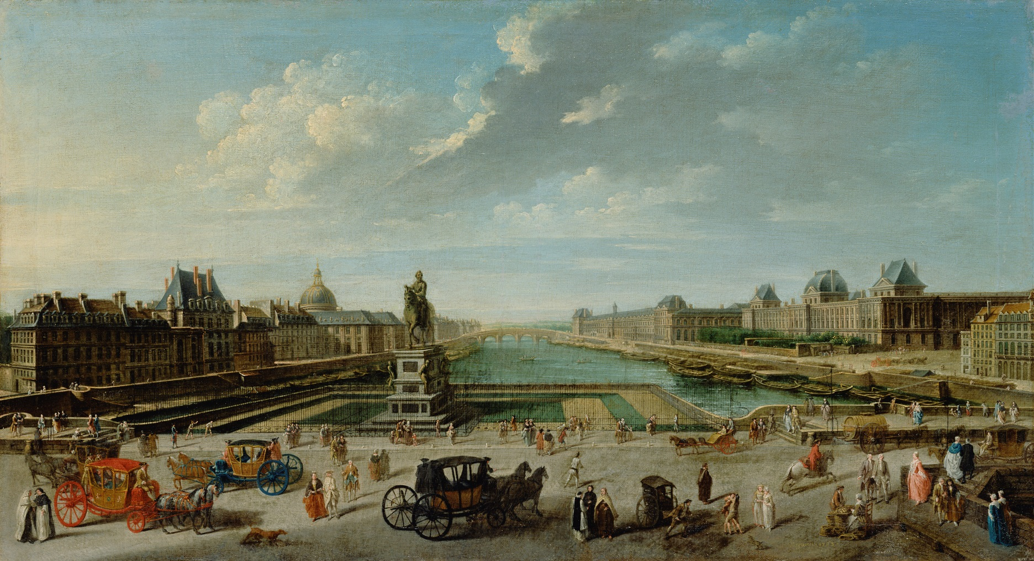
Eighteenth-Century Paris

Slide 13
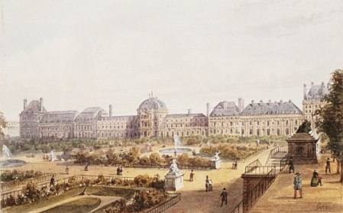
1784-85: Commission for Six Symphonies for Paris,
Scheduled for Performance in 1787
Paris: Palais des Tuileries, Royal Residence
(Concerts de la Loge Olympique)

Slide 14
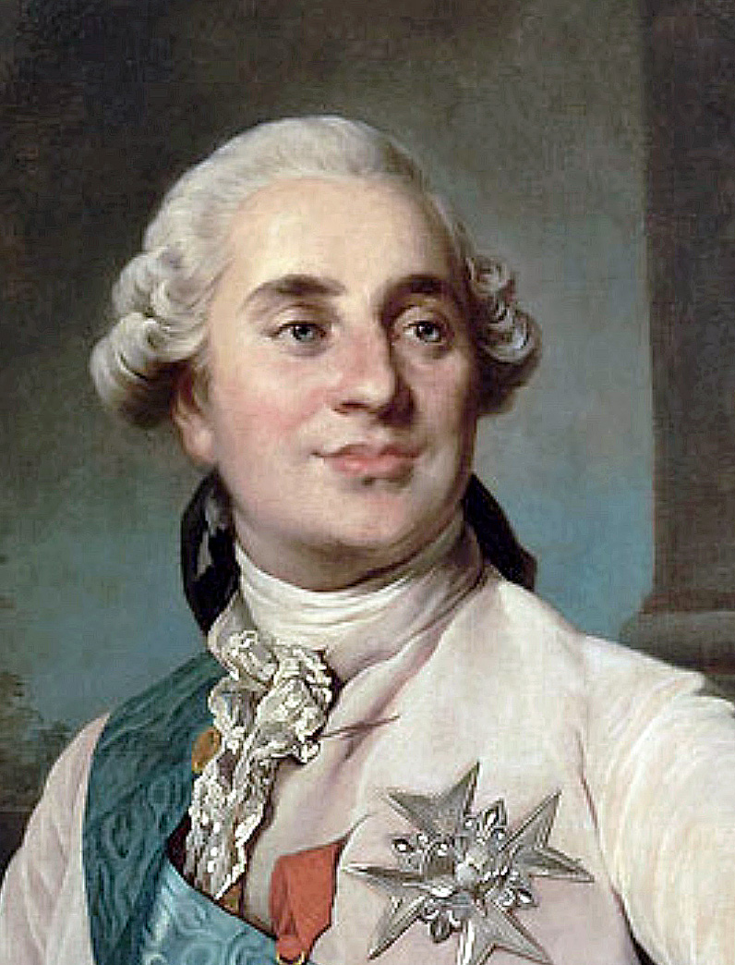
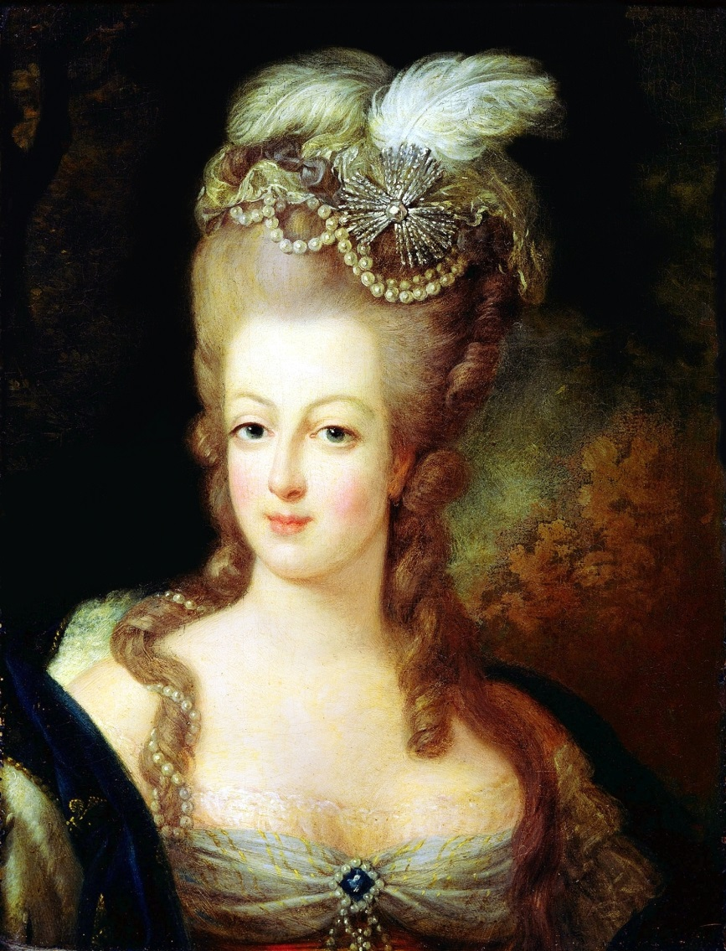
King and Queen of France, 1787
Louis XVI
Marie Antoinette

Slide 15
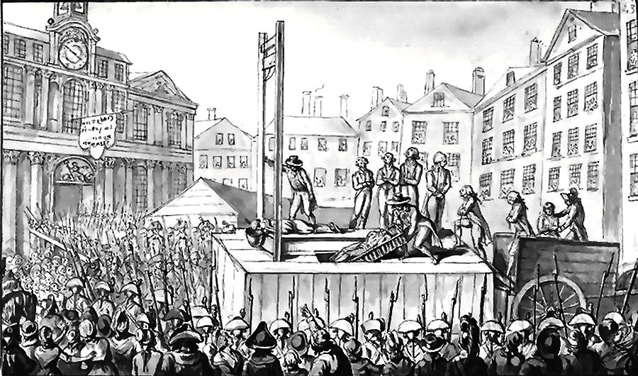
1789: Storming of the Bastille; onset of the French Revolution;
1792: Formal arrests of Louis XVI and family; trials
1793: January—Louis XVI guillotined; October—Marie Antoinette guillotined
1793-94: “La Terreur”

Slide 16
1784-85: Commission for Six Symphonies for Paris,
Scheduled for Performance in 1787
Paris: Palais des Tuileries, Royal Residence
(Concerts de la Loge Olympique)

Slide 17
Haydn: The “Paris” Symphonies (1787): Monumentalizations of the Genre
82 in C Major, “L’ours” (“The Bear”)
83 in G Minor, “La poule” (“The Hen”)
84 in E-flat Major
85 in B-flat Major, “La reine” (“The Queen”)
86 in D Major
87 in A major

Slide 18
Haydn: The “Paris” Symphonies (1787): Monumentalizations of the Genre
82 in C Major, “L’ours” (“The Bear”)
83 in G Minor, “La poule” (“The Hen”)
84 in E-flat Major
85 in B-flat Major, “La reine” (“The Queen”)
86 in D Major
87 in A major
Public success

Slide 19
Haydn: The “Paris” Symphonies (1787): Monumentalizations of the Genre
82 in C Major, “L’ours” (“The Bear”)
83 in G Minor, “La poule” (“The Hen”)
84 in E-flat Major
85 in B-flat Major, “La reine” (“The Queen”)
86 in D Major
87 in A major
Public success
Frequently repeated (one of the beginnings of the claim
of repertorial permanence—the emergence of a “canon”)

Slide 20
Haydn: The “Paris” Symphonies (1787): Monumentalizations of the Genre
82 in C Major, “L’ours” (“The Bear”)
83 in G Minor, “La poule” (“The Hen”)
84 in E-flat Major
85 in B-flat Major, “La reine” (“The Queen”)
86 in D Major
87 in A major
Slow, Monumentalized Introductions
(Adagio, Largo) Allegro (sonata form)
( silence )
(“Attention!” . . . . . Magisterial or Regal Entry . . . Preparation) “Go!” (the start of the sonata process)

Slide 21
Haydn: The “Paris” Symphonies (1787): Monumentalizations of the Genre
82 in C Major, “L’ours” (“The Bear”)
83 in G Minor, “La poule” (“The Hen”)
84 in E-flat Major
85 in B-flat Major, “La reine” (“The Queen”)
86 in D Major
87 in A major
Slow, Monumentalized Introductions
(Adagio, Largo) Allegro (sonata form)
( silence )
(“Attention!” . . . . . Magisterial or Regal Entry . . . Preparation) “Go!” (the start of the sonata process)

Slide 22
Symphony No. 85 in B-Flat, “La reine,” first movement, exposition
V:PAC
EEC
MC!
S^{1.1}?? (more TR?) S proper?! C
MC?
Vivace
Stormy! P-based S
F minor! F major!
Adagio
P¹ P² P¹(!!) TR (=P²)
Short! Forte! Again! Forte!
(like a TR) Really TR this time!
“Go!”
I v V
B-flat F minor! F major

Slide 23
One characteristic Haydn strategy to open a sonata exposition:
But at TR (usually a forte affirmation), spin out the governing motive via Fortspinnung, seemingly spontaneously, effortlessly—”developing” the motive in free play, filling out and fulfilling the expected requirements of the ensuing action-zones (TR, S, C)
P: Initial idea: melodic,
curious, charming,
provocative—attracting one’s attention

Slide 24
One characteristic Haydn strategy to open a sonata exposition:
But at TR (usually a forte affirmation), spin out the governing motive via Fortspinnung, seemingly spontaneously, effortlessly—”developing” the motive in free play, filling out and fulfilling the expected requirements of the ensuing action-zones (TR, S, C)
P: Initial idea: melodic,
curious, charming,
provocative—attracting one’s attention
“Simple” [?] “Complex”

Slide 25
Symphony No. 85 in B-Flat, “La reine,” first movement, exposition
V:PAC
EEC
MC!
S^{1.1}?? (more TR?) S proper?! C
MC?
Vivace
Stormy! P-based S
F minor! F major!
Adagio
P¹ P² P¹(!!) TR (=P²)
Short! Forte! Again! Forte!
(like a TR) Really TR this time!
“Go!”
I v V
B-flat F minor! F major

Slide 26
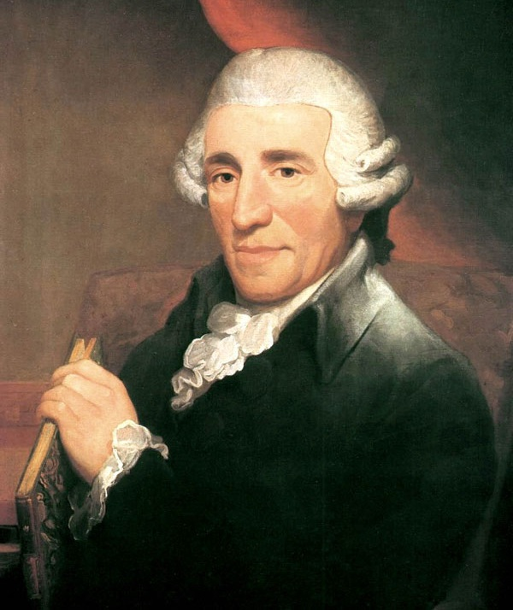
Haydn, remark to Georg August Griesinger [biographer, publ. 1808-09]
“Once I had seized upon an idea, my whole endeavor was to develop and sustain it in keeping with the rules of art. . . . That is what so many younger composers lack; they string one little idea after another; they break off when they have scarcely begun. Hence nothing remains in the heart after one has heard it.”

Slide 27
Haydn, remark to Georg August Griesinger [biographer, publ. 1809-10]
“Once I had seized upon an idea, my whole endeavor was to develop and sustain it in keeping with the rules of art. . . . That is what so many younger composers lack; they string one little idea after another; they break off when they have scarcely begun. Hence nothing remains in the heart after one has heard it.”
Moment-to-moment “coherence”
Motivic “integration”
Impression of ongoing musical “process” and “becoming”
Technique of “developing variation”

Slide 28
Symphony No. 85 in B-Flat, “La reine,” first movement, exposition
V:PAC
EEC
MC!
S^{1.1}?? (more TR?) S proper?! C
MC?
Vivace
Stormy! P-based S
F minor! F major!
Adagio
P¹ P² P¹(!!) TR (=P²)
Short! Forte! Again! Forte!
(like a TR) Really TR this time!
“Go!”
I v V
B-flat F minor! F major

Slide 29
Haydn’s Mature Symphonies (82-104):

Slide 30
In the “grand style” (i.e, length, monumentality, orchestral sonority)
Haydn’s Mature Symphonies (82-104):

Slide 31
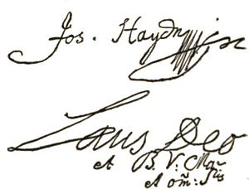
In the “grand style” (i.e, length, monumentality, orchestral sonority)
The composer claimed to portray “moral characters” in music
(Common inscriptions in the manuscripts of several of his symphonic scores:
“In nomine Domini” or “Laus Deo”)
Haydn’s Mature Symphonies (82-104):

Slide 32
In the “grand style” (i.e, length, monumentality, orchestral sonority)
The composer claimed to portray “moral characters” in music
(Common inscriptions in the mss.
of several of his symphonic scores:
“In nomine Domini” or “Laus Deo”)
Principal aim: “to move the heart”
Haydn’s Mature Symphonies (82-104):

Slide 33
In the “grand style” (i.e, length, monumentality, orchestral sonority)
The composer claimed to portray “moral characters” in music
(Common inscriptions in the mss.
of several of his symphonic scores:
“In nomine Domini” or “Laus Deo”)
Principal aim: “to move the heart”
(Perhaps: nondisclosed programs, narratives, or implicit dramatic scenarios?)
Haydn’s Mature Symphonies (82-104):

Slide 34
In the “grand style” (i.e, length, monumentality, orchestral sonority)
The composer claimed to portray “moral characters” in music
(Common inscriptions in the mss.
of several of his symphonic scores:
“In nomine Domini” or “Laus Deo”)
Principal aim: “to move the heart”
(Perhaps: nondisclosed programs, narratives, or implicit dramatic scenarios?)
Now individualizing several works through charming, affable musical effects or “stamps” (ear-catching gimmicks?)
Haydn’s Mature Symphonies (82-104):

Slide 35
Haydn: The “Paris” Symphonies (1787): Monumentalizations of the Genre
82 in C Major, “L’ours” (“The Bear”)
83 in G Minor, “La poule” (“The Hen”)
84 in E-flat Major
85 in B-flat Major, “La reine” (“The Queen”)
86 in D Major
87 in A major
Slow, Monumentalized Introductions

Slide 36
Haydn: The “Paris” Symphonies (1787): Monumentalizations of the Genre
82 in C Major, “L’ours” (“The Bear”)
83 in G Minor, “La poule” (“The Hen”)
84 in E-flat Major
85 in B-flat Major, “La reine” (“The Queen”)
86 in D Major
87 in A major
Slow, Monumentalized Introductions

Slide 37
Haydn in the years after the six “Paris” symphonies (late 1780s)
Six Quartets, op. 50 (1787)
Three Quartets, op. 54 (1788)
Three Quartets, op. 55 (1788)
Six Quartets, op. 64 (1790)
Numerous Piano Trios

Slide 38
Haydn in the years after the six “Paris” symphonies (late 1780s)
Six Quartets, op. 50 (1787)
Three Quartets, op. 54 (1788)
Three Quartets, op. 55 (1788)
Six Quartets, op. 64 (1790)
Numerous Piano Trios
1790: Death of the Emperor, Joseph II

Slide 39
Haydn in the years after the six “Paris” symphonies (late 1780s)
Six Quartets, op. 50 (1787)
Three Quartets, op. 54 (1788)
Three Quartets, op. 55 (1788)
Six Quartets, op. 64 (1790)
Numerous Piano Trios
1790: Death of the Emperor, Joseph II
1790: Death of Prince Nicolaus Esterházy; theater & orchestra dissolved

Slide 40
Haydn in the years after the six “Paris” symphonies (late 1780s)
Six Quartets, op. 50 (1787)
Three Quartets, op. 54 (1788)
Three Quartets, op. 55 (1788)
Six Quartets, op. 64 (1790)
Numerous Piano Trios
1790: Death of the Emperor, Joseph II
1790: Death of Prince Nicolaus Esterházy; theater & orchestra dissolved
1790: Haydn moves to Vienna

Slide 41
Haydn in the years after the six “Paris” symphonies (late 1780s)
Six Quartets, op. 50 (1787)
Three Quartets, op. 54 (1788)
Three Quartets, op. 55 (1788)
Six Quartets, op. 64 (1790)
Numerous Piano Trios
1790: Death of the Emperor, Joseph II
1790: Death of Prince Nicolaus Esterházy; theater & orchestra dissolved
1790: Haydn moves to Vienna
(5 December 1791: Mozart dies unexpectedly)

Slide 42
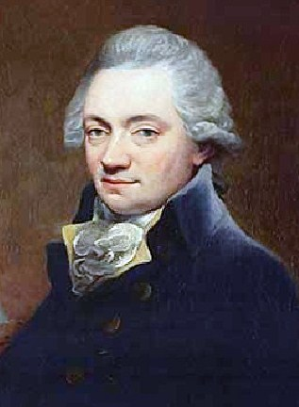
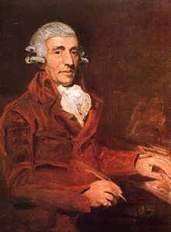
January 1791 – June 1792: Haydn in England an Honored Guest
Johann Peter Salomon (1745-1815)
Haydn in 1791 (Hoppner Portrait)

Slide 43
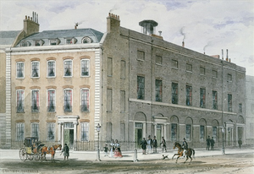
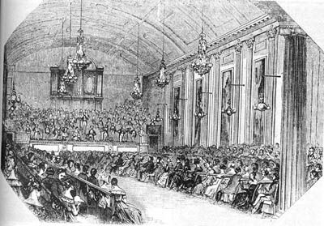
London: Hanover Square Concert Rooms

Slide 44
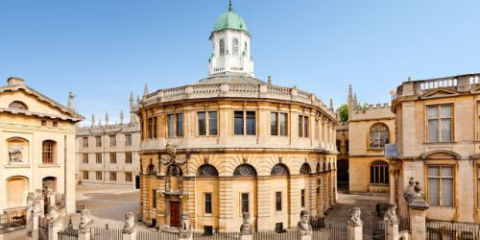
Haydn: Honorary Doctorate from Oxford, July 1791
Performed there: Symphony No. 92 [1789], “Oxford:

Slide 45
London (First Trip, 1791-92): Hanover Square Concert Rooms
Second Season: February-May 1792:
Symphony No. 93 in D
Symphony No. 98 in B-flat
Symphony No. 94 in G (“Surprise”)
Symphony NO. 97 in C
First Season, February-March 1791:
Symphony No. 95 in C Minor),
Symphony No. 96 in D (“Miracle”)

Slide 46
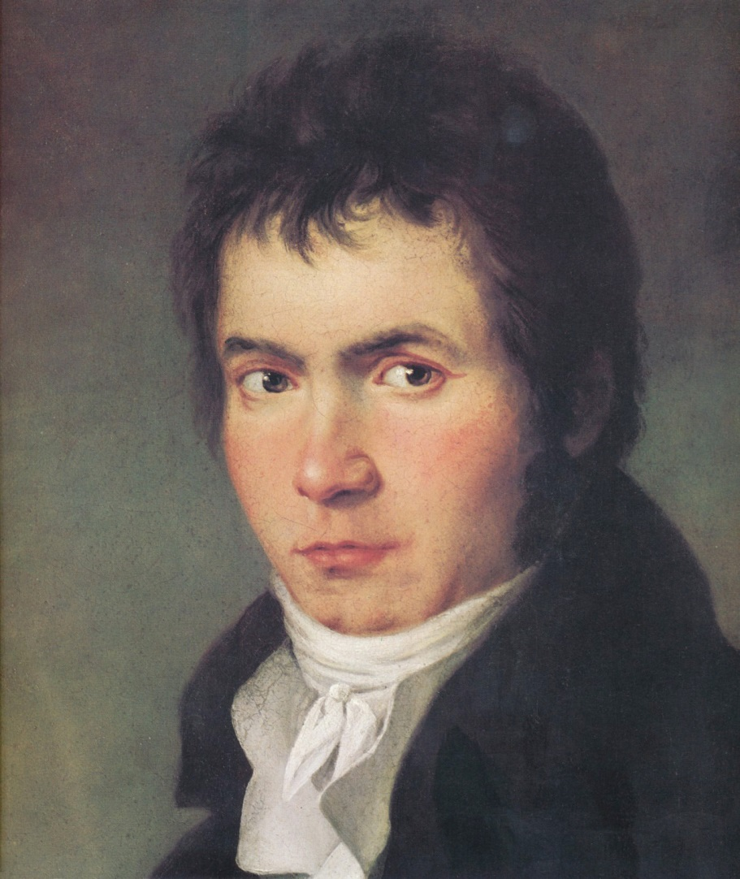
Haydn, July 1792-January 1794: in Vienna
New arrival in town, November 1792

Slide 47
London (Second Trip, 1794-95): Hanover Square Concert Rooms
Third Season, February-March 1794:
Symphony No. 99 in E-Flat
Symphony No. 101 in D (“Clock”)
Symphony No. 100 in G (“Military”)
Fourth Season: February-May 1795:
Symphony No. 102 in B-flat
Symphony No. 103 in E-flat (“Drum Roll”)
Symphony No. 104 in D (“London”)

Slide 48
London (Second Trip, 1794-95): Hanover Square Concert Rooms
Third Season, February-March 1794:
Symphony No. 99 in E-Flat
Symphony No. 101 in D (“Clock”)
Symphony No. 100 in G (“Military”)
Fourth Season: February-May 1795:
Symphony No. 102 in B-flat
Symphony No. 103 in E-flat (“Drum Roll”)
Symphony No. 104 in D (“London”)

Slide 49
Haydn, August 1975: Back in Vienna
Still There! Celebrity Growing!

Slide 50
Haydn the Honored Master: Sets of Quartets Include:
Six Quartets, op. 50 (1787)
Three Quartets. Op. 54 (1788)
Three Quartets, op. 55 (1788)
Six Quartets, op. 64 (1790)
Three Quartets, op. 71 (1793)
Three Quartets, op. 74 (1793)
Six Quartets, op. 76 (1796-97)
Two Quartets, op. 77 (1799)
For London

Slide 51
Haydn the Honored Master: Sets of Quartets Include:
Six Quartets, op. 50 (1787)
Three Quartets. Op. 54 (1788)
Three Quartets, op. 55 (1788)
Six Quartets, op. 64 (1790)
Three Quartets, op. 71 (1793)
Three Quartets, op. 74 (1793)
Six Quartets, op. 76 (1796-97)
No. 2 in D Minor (“Quinten”; “Fifths”)
No. 3 in C (“Kaiser”; “Emperor”)
Two Quartets, op. 77 (1799)
For London

Slide 52
Haydn the Honored Master: Sets of Quartets Include:
Six Quartets, op. 50 (1787)
Three Quartets. Op. 54 (1788)
Three Quartets, op. 55 (1788)
Six Quartets, op. 64 (1790)
Three Quartets, op. 71 (1793)
Three Quartets, op. 74 (1793)
Six Quartets, op. 76 (1796-97)
No. 2 in D Minor (“Quinten”; “Fifths”)
No. 3 in C (“Kaiser”; “Emperor”)
Two Quartets, op. 77 (1799)
For London

Slide 53
Haydn the Honored Master: Sets of Quartets Include:
Six Quartets, op. 50 (1787)
Three Quartets. Op. 54 (1788)
Three Quartets, op. 55 (1788)
Six Quartets, op. 64 (1790)
Three Quartets, op. 71 (1793)
Three Quartets, op. 74 (1793)
Six Quartets, op. 76 (1796-97)
No. 2 in D Minor (“Quinten”; “Fifths”)
No. 3 in C (“Kaiser”; “Emperor”)
Two Quartets, op. 77 (1799)
For London

Slide 54
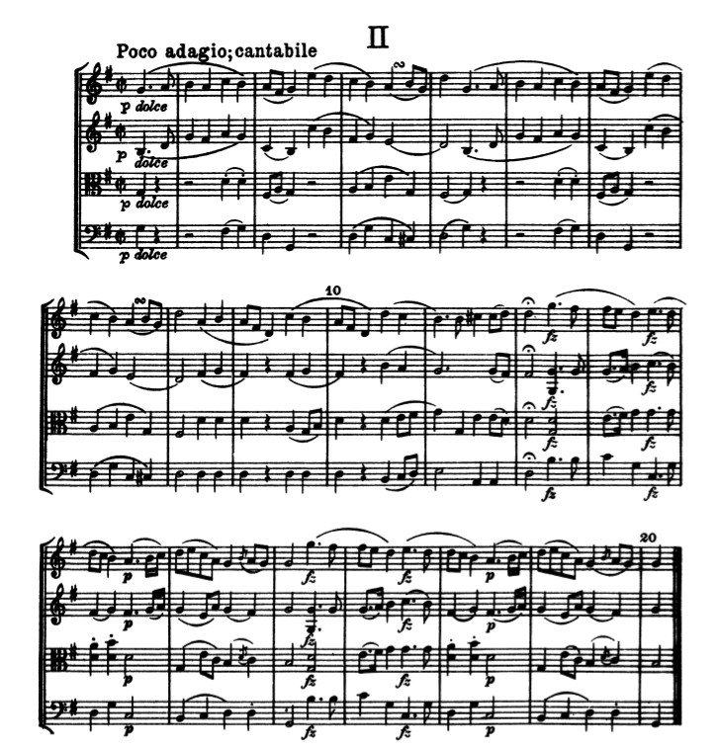
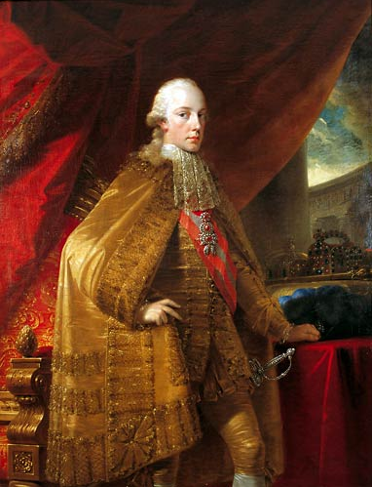
Emperor Franz (reigned 1792-1835)
Haydn, Quartet, op. 76 no. 3
(Variations on “Gott erhalte Franz den Kaiser”)

Slide 55
Haydn’s Last Major Vocal Compositions (1796-1802): Masses, Oratorios
Six Masses, including:
Missa in tempore belli (Mass in Time of War, aka Paukenmesse) (1797)
Missa in angustiis (Mass in Troubled Times, aka “Lord Nelson” Mass) (1798)
Harmoniemesse (Wind-Band Mass) (1802)

Slide 56
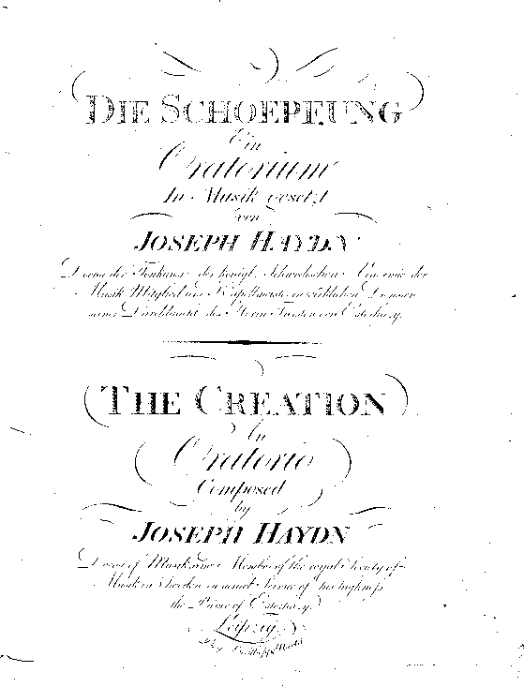
Haydn’s Last Major Vocal Compositions (1796-1802): Oratorios, Masses
Six Masses, including:
Missa in tempore belli (Mass in Time of War, aka Paukenmesse) (1797)
Missa in angustiis (Mass in Troubled Times, aka “Lord Nelson” Mass) (1798)
Harmoniemesse (Wind-Band Mass) (1802)
Two Oratorios
The Creation (1798)
The Seasons (1799-1801)

Slide 57
1700
1800
c. 1730?
c. 1765?
Some stylistic retentions
Some stylistic retentions
Some stylistic retentions
“Late Baroque” “Galant” High-Galant (“Classical”) merge: “Romanticism
Haydn, Mozart . . . . . . .Beethoven . . . . . .
Final flowering of Emergence & codification Enriching, deepening, More subjectivity,
older-world style of the new, “modern” style emerging “subjectivity,” individualism,
and individual styles” higher aesthetic claims, etc.
Haydn & Mozart
as the grand culminations of the new, 18th-c musical language

Slide 58
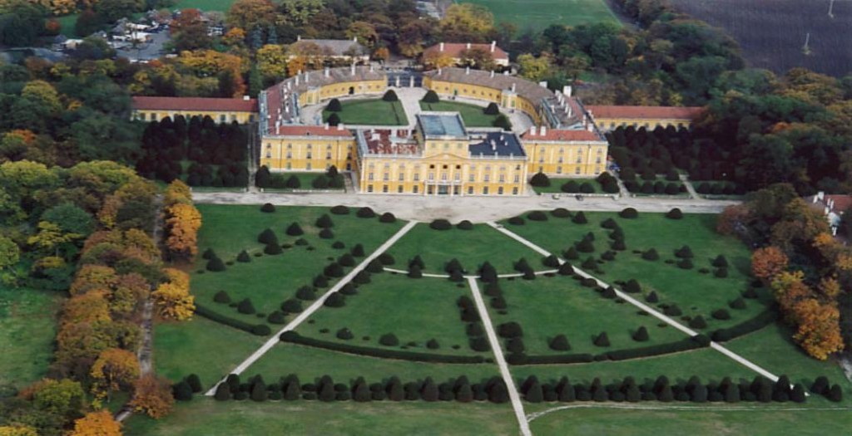
Haydn at Esterháza (mid-1760s-1790)
Galant (Entertainment) Style
Intensified, Concentrated, Deepened:
“The Classical Style”

