Slide 1
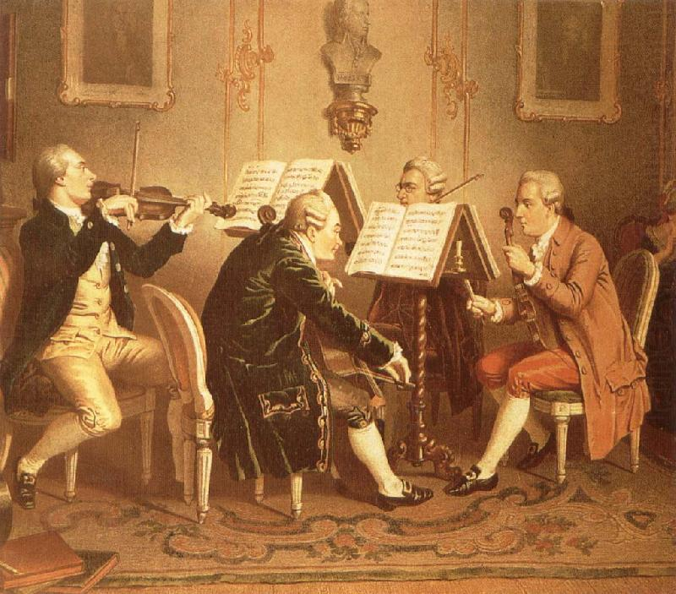
Haydn in the 1770s: The Rise of the String Quartet

Slide 2
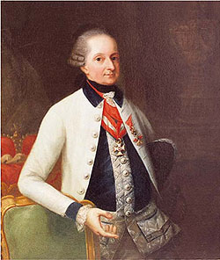
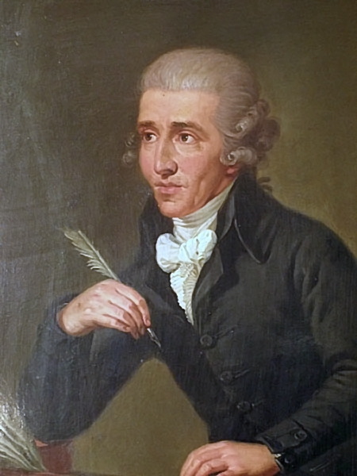
Haydn’s Principal Patron, 1763-1790
Prince Nikolaus I Esterházy (1714-90)

Slide 3
Four stages in the maturing
of the string quartet:
increasing complexity and
appeals to connoisseurship
Six Quartets, op. 9 (1769-70, publ. 1772)
Six Quartets, op. 17 (1771, publ. 1772)
Six Quartets, op. 20 (1772, publ. 1774)
Six Quartets, op. 33 (publ. 1781)

Slide 4
Four stages in the maturing
of the string quartet:
increasing complexity and
appeals to connoisseurship
Six Quartets, op. 9 (1769-70, publ. 1772)
Six Quartets, op. 17 (1771, publ. 1772)
Six Quartets, op. 20 (1772, publ. 1774)
Six Quartets, op. 33 (publ. 1781)

Slide 5
Six Quartets, op. 20 (1772, publ. 1774 as “divertimenti”)
A new density of style and motivic concentration:
creative and surprising compositional decisions at nearly every turn.

Slide 6
Six Quartets, op. 20 (1772, publ. 1774 as “divertimenti”)
A new density of style and motivic concentration:
creative and surprising compositional decisions at nearly every turn.
Essentials of the emerging style:

Slide 7
Six Quartets, op. 20 (1772, publ. 1774 as “divertimenti”)
A new density of style and motivic concentration:
creative and surprising compositional decisions at nearly every turn.
Essentials of the emerging style:
Haydn’s basic compositional principle strengthened:
the impression of the “organic” growth of small motivic
particles, spun out to create an entire movement.

Slide 8
Six Quartets, op. 20 (1772, publ. 1774 as “divertimenti”)
A new density of style and motivic concentration:
creative and surprising compositional decisions at nearly every turn.
Essentials of the emerging style:
Haydn’s basic compositional principle strengthened:
the impression of the “organic” growth of small motivic
particles, spun out to create an entire movement.
Ongoing originality and inventiveness: steering more and more away from exact repetitions of musical ideas in favor of variants and recompositions.

Slide 9
Six Quartets, op. 20 (1772, publ. 1774 as “divertimenti”)
A new density of style and motivic concentration:
creative and surprising compositional decisions at nearly every turn.
Essentials of the emerging style:
Haydn’s basic compositional principle strengthened:
the impression of the “organic” growth of small motivic
particles, spun out to create an entire movement.
Ongoing originality and inventiveness: steering more and more away from exact repetitions of musical ideas in favor of variants and recompositions.
Increasingly common in Haydn’s two-part expositions: the incipit of S is based on that of P (= “the P-based S”).

Slide 10
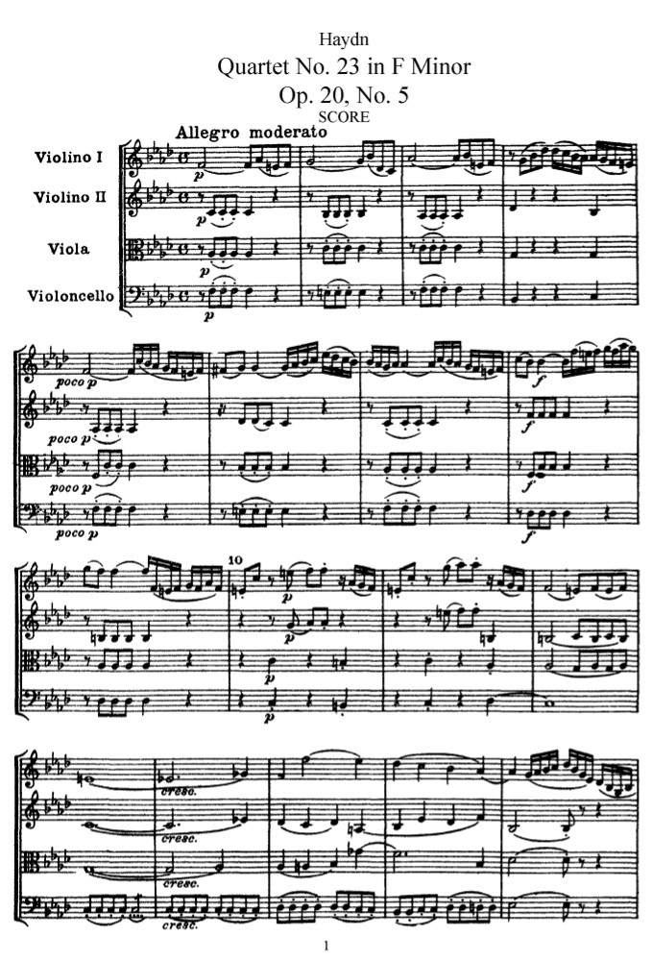
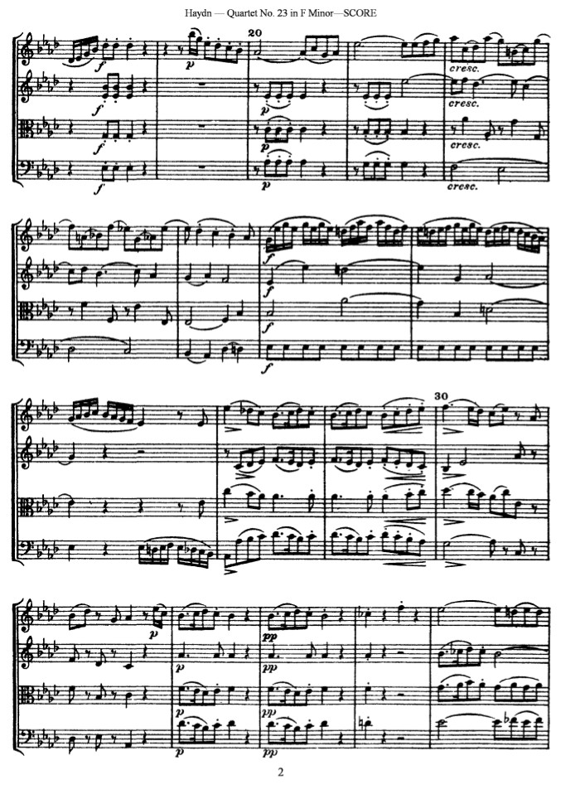
S
“The P-based S”
P

Slide 11
S^{1.1}
P
MC
“The P-based S”
TR
Another III:HC!
dominant lock
Another MC !*
Another “S”! = S^{1.2}
i:HC dominant lock
undone!
III:HC
III:PAC
. . . but “this theme” continues . . . . . . . . .
More PAC delays
on the path to
the EEC
* (Example of “apparent double MCs”)

Slide 12
Six Quartets, op. 20 (1772, publ. 1774 as “divertimenti”)
A new density of style and motivic concentration:
creative and surprising compositional decisions at nearly every turn
Haydn’s basic compositional principle strengthened:
the impression of the “organic” growth of small motivic
particles, spun out to create an entire movement.
Ongoing originality and inventiveness: steering more and more away from exact repetitions of musical ideas in favor of variants and recompositions.
Increasingly common in Haydn’s two-part expositions: the incipit of S is based on that of P (= “the P-based S”).
Three of the quartets have fugal finales (!):
No. 2 in C (“Fuga a 4 soggetti”)
No. 5 in F Minor (“Fuga a due soggetti”)
No. 6 in S (“Fuga a 3 soggetti”)

Slide 13
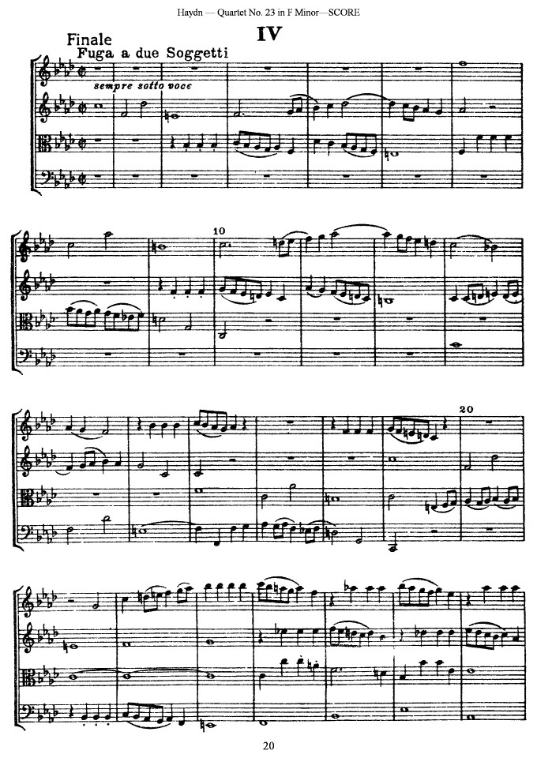

Slide 14
In minor-key works, especially ones that begin with imitative entries, one familiar opening move is what some musicologists call
the “pathotype” figure:
a permutation of
scale degrees
5, 6, ♮7,and 1.
Here:
5-1-6-♮7

Slide 15
Haydn in the 1770s
Operas for the Esterházy Theater, e.g.:
Il mondo della luna (1777)
La fedeltà premiata (1781)
Orlando paladino (1782)
Symphony Production Continues:
No. 50 in C (1773, one of the earliest symphonies with a slow introduction)
Experiments with the option of lighter, rondo finales

Slide 16
Haydn in the early 1780s

Slide 17
Haydn in the early 1780s
By now, one of the two most celebrated composers in the European world
(the other: C. P. E. Bach)

Slide 18
Haydn in the early 1780s
By now, one of the two most celebrated composers in the European world
(the other: C. P. E. Bach)
New and important contact with an influential Viennese publisher:
Artaria (wider publication and distribution
of his works)

Slide 19
Haydn in the early 1780s
By now, one of the two most celebrated composers in the European world
(the other: C. P. E. Bach)
New and important contact with an influential Viennese publisher:
Artaria (wider publication and distribution
of his works)
Still employed by Prince Nicolaus Esterházy but becoming more and more
“semi-independent”

Slide 20
Haydn in the early 1780s
By now, one of the two most celebrated composers in the European world
(the other: C. P. E. Bach)
New and important contact with an influential Viennese publisher:
Artaria (wider publication and distribution
of his works)
Still employed by Prince Nicolaus Esterházy but becoming more and more
“semi-independent”
Becomes acquainted with Mozart
in Vienna (1781? 1783-84?)

Slide 21
Haydn in the early 1780s
By now, one of the two most celebrated composers in the European world
(the other: C. P. E. Bach)
New and important contact with an influential Viennese publisher:
Artaria (wider publication and distribution
of his works)
Still employed by Prince Nicolaus Esterházy but becoming more and more
“semi-independent”
Becomes acquainted with Mozart
in Vienna (1781? 1783-84?)
The solidifying or coming of age
of Viennese Classicism (the “Classical Style”)

Slide 22
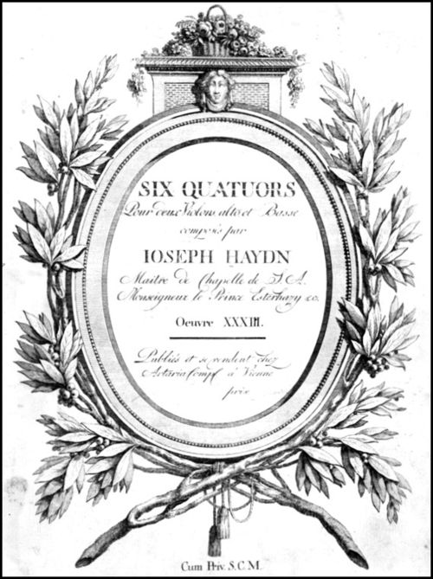
1781 Watershed: Publication of the Six Quartets, op. 33 (Vienna, Artaria)
Haydn, letter to possible patrons for op. 33: [These quartets are] written
in a new and special way (for I haven’t composed any [others] for ten years.”

Slide 23
1781 Watershed: Publication of the Six Quartets, op. 33 (Vienna, Artaria):
Dedicated to the Russian Grand Duke Pavel Petrovich
(The “Russian Quartets” or “Gli Scherzi” [minuets labeled as “scherzo”/”scherzando”])
“New and Special Way”?
Haydn, letter to possible patrons for op. 33: [These quartets are] written
in a new and special way (for I haven’t composed any [others] for ten years.”

Slide 24
1781 Watershed: Publication of the Six Quartets, op. 33 (Vienna, Artaria):
Dedicated to the Russian Grand Duke Pavel Petrovich
(The “Russian Quartets” or “Gli Scherzi” [minuets labeled as “scherzo”/”scherzando”])
“New and Special Way”?
Increased clarity of musical ideas
Haydn, letter to possible patrons for op. 33: [These quartets are] written
in a new and special way (for I haven’t composed any [others] for ten years).”

Slide 25
1781 Watershed: Publication of the Six Quartets, op. 33 (Vienna, Artaria):
Dedicated to the Russian Grand Duke Pavel Petrovich
(The “Russian Quartets” or “Gli Scherzi” [minuets labeled as “scherzo”/”scherzando”])
“New and Special Way”?
Increased clarity of musical ideas
Yet even more compositionally concentrated, compressed, and ambitious
Haydn, letter to possible patrons for op. 33: [These quartets are] written
in a new and special way (for I haven’t composed any [others] for ten years.)”

Slide 26
1781 Watershed: Publication of the Six Quartets, op. 33 (Vienna, Artaria):
Dedicated to the Russian Grand Duke Pavel Petrovich
(The “Russian Quartets” or “Gli Scherzi” [minuets labeled as “scherzo”/”scherzando”])
“New and Special Way”?
Increased clarity of musical ideas
Yet even more compositionally concentrated, compressed, and ambitious
Four performers: equal conversationalists; each active; each significant (“quartet style”)
Haydn, letter to possible patrons for op. 33: [These quartets are] written
in a new and special way (for I haven’t composed any [others] for ten years.)”

Slide 27
1781 Watershed: Publication of the Six Quartets, op. 33 (Vienna, Artaria):
Dedicated to the Russian Grand Duke Pavel Petrovich
(The “Russian Quartets” or “Gli Scherzi” [minuets labeled as “scherzo”/”scherzando”])
“New and Special Way”?
Increased clarity of musical ideas
Yet even more compositionally concentrated, compressed, and ambitious
Four performers: equal conversationalists; each active; each significant (“quartet style”)
Compositional cleverness and originality abound: ingenious surprises around every corner
Haydn, letter to possible patrons for op. 33: [These quartets are] written
in a new and special way (for I haven’t composed any [others] for ten years.)”

Slide 28
1781 Watershed: Publication of the Six Quartets, op. 33 (Vienna, Artaria):
Dedicated to the Russian Grand Duke Pavel Petrovich
(The “Russian Quartets” or “Gli Scherzi” [minuets labeled as “scherzo”/”scherzando”])
“New and Special Way”?
Increased clarity of musical ideas
Yet even more compositionally concentrated, compressed, and
ambitious
Four performers: equal conversationalists; each active; each significant (“quartet style”)
Compositional cleverness and
originality abound: ingenious surprises
around every corner
“idealized” form of pure composition
for connoisseurs, private performances
Haydn, letter to possible patrons for op. 33: [These quartets are] written
in a new and special way (for I haven’t composed any [others] for ten years.)”

Slide 29
Haydn: “Witz” (“wit”)
Not reducible to “humor” but rather:
cleverness, amusing idiosyncrasy or surprise

Slide 30
Haydn: “Witz” (“wit”)
Not reducible to “humor” but rather:
cleverness, amusing idiosyncrasy or surprise
Example: conclusion of the rondo finale
of Op. 33 no. 2 in E-flat, “Joke”

Slide 31
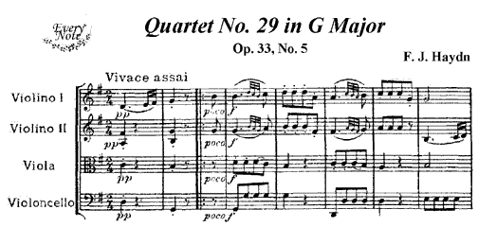
Haydn: “Witz” (“wit”)
Not reducible to “humor” but rather:
cleverness, amusing idiosyncrasy or surprise
Example:

Slide 32
Key ideas to describe the “Haydn Style” include:

Slide 33
Key ideas to describe the “Haydn Style” include:
Compositional originality at every turn: surprises, displacements, engaging curiosities (“Witz”—not so much “comic” or “witty” as attractively clever and idiosyncratic)

Slide 34
Key ideas to describe the “Haydn Style” include:
Compositional originality at every turn: surprises, displacements, engaging curiosities (“Witz”—not so much “comic” or “witty” as attractively clever and idiosyncratic)
Individualization of works

Slide 35
Key ideas to describe the “Haydn Style” include:
Compositional originality at every turn: surprises, displacements, engaging curiosities (“Witz”—not so much “comic” or “witty” as attractively clever and idiosyncratic)
Individualization of works
A master of Fortspinnung, motivic concentration, and complexity

Slide 36
Key ideas to describe the “Haydn Style” include:
Compositional originality at every turn: surprises, displacements, engaging curiosities (“Witz”—not so much “comic” or “witty” as attractively clever and idiosyncratic)
Individualization of works
A master of Fortspinnung, motivic concentration, and complexity
Appeal to high connoisseurship (density of compositional thought)

Slide 37
Key ideas to describe the “Haydn Style” include:
Compositional originality at every turn: surprises, displacements, engaging curiosities (“Witz”—not so much “comic” or “witty” as attractively clever and idiosyncratic)
Individualization of works
A master of Fortspinnung, motivic concentration, and complexity
Appeal to high connoisseurship (density of compositional thought)
Economy of Materials:

Slide 38
Key ideas to describe the “Haydn Style” include:
Compositional originality at every turn: surprises, displacements, engaging curiosities (“Witz”—not so much “comic” or “witty” as attractively clever and idiosyncratic)
Individualization of works
A master of Fortspinnung, motivic concentration, and complexity
Appeal to high connoisseurship (density of compositional thought)
Economy of Materials:
“Generative Form” (“form as process”: impression of form as a process of motivic growth)

Slide 39
Key ideas to describe the “Haydn Style” include:
Compositional originality at every turn: surprises, displacements, engaging curiosities (“Witz”—not so much “comic” or “witty” as attractively clever and idiosyncratic)
Individualization of works
A master of Fortspinnung, motivic concentration, and complexity
Appeal to high connoisseurship (density of compositional thought)
Economy of Materials:
“Generative Form” (“form as process”: impression of form as a process of motivic growth)
Motivic growth and integration

Slide 40
Key ideas to describe the “Haydn Style” include:
Compositional originality at every turn: surprises, displacements, engaging curiosities (“Witz”—not so much “comic” or “witty” as attractively clever and idiosyncratic)
Individualization of works
A master of Fortspinnung, motivic concentration, and complexity
Appeal to high connoisseurship (density of compositional thought)
Economy of Materials:
“Generative Form” (“form as process”: impression of form as a process of motivic growth)
Motivic growth and integration
“Thematische Arbeit” (thematic work; thematic development)

Slide 41
Key ideas to describe the “Haydn Style” include:
Compositional originality at every turn: surprises, displacements, engaging curiosities (“Witz”—not so much “comic” or “witty” as attractively clever and idiosyncratic)
Individualization of works
A master of Fortspinnung, motivic concentration, and complexity
Appeal to high connoisseurship (density of compositional thought)
Economy of Materials:
“Generative Form” (“form as process”: impression of form as a process of motivic growth)
Motivic growth and integration
“Thematische Arbeit” (thematic work; thematic development)
“Thinking in music” = “musical logic”

Slide 42
Haydn’s Style: A Hyper-Sophisticated Interplay between:
EXTERNAL CONVENTIONS
(performer’s and listener’s expectations: normative, socially shared generic expectations within the style)
(Taruskin: “extroversive signs”)

Slide 43
Haydn’s Style: A Hyper-Sophisticated Interplay between:
EXTERNAL CONVENTIONS
(performer’s and listener’s expectations: normative, socially shared generic expectations within the style)
(Taruskin: “extroversive signs”)
INTERNAL PROCESSES, IDIOSYNCRASIES, UNIQUENESSES
(any given work’s particular individuality/personality)
(Taruskin: “introversive signs”)

Slide 44
Haydn’s Style: A Hyper-Sophisticated Interplay between:
EXTERNAL CONVENTIONS
(performer’s and listener’s expectations: normative, socially shared generic expectations within the style)
(Taruskin: “extroversive signs”)
INTERNAL PROCESSES, IDIOSYNCRASIES, UNIQUENESSES
(any given work’s particular individuality/personality)
(Taruskin: “introversive signs”)
GENRE INDIVIDUAL EXEMPLAR

Slide 45
Haydn’s Style: A Hyper-Sophisticated Interplay between:
EXTERNAL CONVENTIONS
(performer’s and listener’s expectations: normative, socially shared generic expectations within the style)
(Taruskin: “extroversive signs”)
INTERNAL PROCESSES, IDIOSYNCRASIES, UNIQUENESSES
(any given work’s particular individuality/personality)
(Taruskin: “introversive signs”)
GENRE INDIVIDUAL EXEMPLAR
TYPE TOKEN

Slide 46
Haydn’s Style: A Hyper-Sophisticated Interplay between:
“Dialogic form”
EXTERNAL CONVENTIONS
(performer’s and listener’s expectations: normative, socially shared generic expectations within the style)
(Taruskin: “extroversive signs”)
INTERNAL PROCESSES, IDIOSYNCRASIES, UNIQUENESSES
(any given work’s particular individuality/personality)
(Taruskin: “introversive signs”)
GENRE INDIVIDUAL EXEMPLAR
TYPE TOKEN

Slide 47
Key ideas to describe the “Haydn Style” include:
Compositional originality at every turn: surprises, displacements, engaging curiosities (“Witz”—not so much “comic” or “witty” as attractively clever and idiosyncratic)
Individualization of works
A master of Fortspinnung, motivic concentration, and complexity
Appeal to high connoisseurship (density of compositional thought)
Economy of Materials:
“Generative Form” (“form as process”: impression of form as a process of motivic growth)
Motivic growth and integration
“Thematische Arbeit” (thematic work; thematic development)

Slide 48
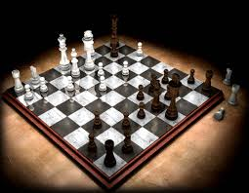
Sonata Form in Haydn’s (and Mozart’s) Hands, 1780s, 1790s

Slide 49
Sonata Form in Haydn’s (and Mozart’s) Hands, 1780s, 1790s
Each sonata movement (quartet, sonata, symphony, concerto):
Personalized by a master player
Appeal: Connoisseurship

