Slide 1
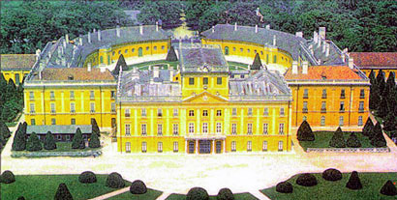
Franz Joseph Haydn: Early Career
Esterházy Palace

Slide 2
1700
1800
c. 1730?
c. 1765?
Some stylistic retentions
Some stylistic retentions
Some stylistic retentions
“Late Baroque” “Galant” High-Galant (“Classical”) merge: “Romanticism”
Final flowering of Emergence & codification Enriching, deepening, More subjectivity,
older-world style of the new, “modern” style emerging “subjectivity,” individualism,
and individual styles higher aesthetic claims, etc.

Slide 3
1700
1800
c. 1730?
c. 1765?
Some stylistic retentions
Some stylistic retentions
Some stylistic retentions
“Late Baroque” “Galant” High-Galant (“Classical”) merge: “Romanticism”
Final flowering of Emergence & codification Enriching, deepening, More subjectivity,
older-world style of the new, “modern” style emerging “subjectivity,” individualism,
and individual styles higher aesthetic claims, etc.

Slide 4
1700
1800
c. 1730?
c. 1765?
Some stylistic retentions
Some stylistic retentions
Some stylistic retentions
“Late Baroque” “Galant” High-Galant (“Classical”) merge: “Romanticism”
Final flowering of Emergence & codification Enriching, deepening, More subjectivity,
older-world style of the new, “modern” style emerging “subjectivity,” individualism,
and individual styles higher aesthetic claims, etc.
Haydn & Mozart
as the grand culminations of the new, 18th-c musical language

Slide 5
1700
1800
c. 1730?
c. 1765?
Some stylistic retentions
Some stylistic retentions
Some stylistic retentions
“Late Baroque” “Galant” High-Galant (“Classical”) merge: “Romanticism”
Final flowering of Emergence & codification Enriching, deepening, More subjectivity,
older-world style of the new, “modern” style emerging “subjectivity,” individualism,
and individual styles higher aesthetic claims, etc.
Haydn & Mozart
as the grand culminations of the new, 18th-c musical language
Heir Apparent: Ludwig van Beethoven

Slide 6
1781
1700
1800
c. 1730?
c. 1765?
Some stylistic retentions
Some stylistic retentions
Some stylistic retentions
“Late Baroque” “Galant” High-Galant (“Classical”) merge: “Romanticism”
Final flowering of Emergence & codification Enriching, deepening, More subjectivity,
older-world style of the new, “modern” style emerging “subjectivity,” individualism,
and individual styles higher aesthetic claims, etc.
Haydn & Mozart
as the grand culminations of the new, 18th-c musical language
Heir Apparent: Ludwig van Beethoven

Slide 7
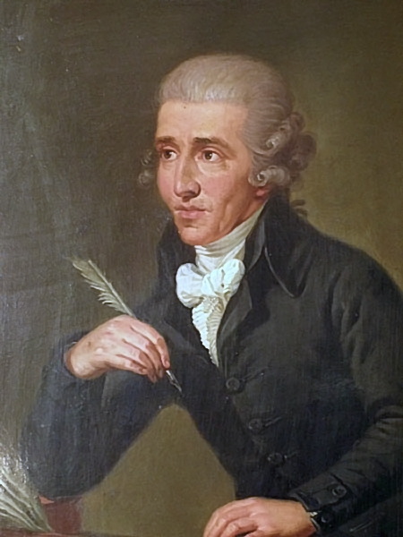
(Franz) Joseph Haydn (1732-1809)

Slide 8
The last and ablest musical representative of the later eighteenth century
(Franz) Joseph Haydn (1732-1809)

Slide 9
The last and ablest musical representative of the later eighteenth century
The main carrier of the unanticipated rise in prestige of instrumental music, 1760-1800
(Franz) Joseph Haydn (1732-1809)

Slide 10
The last and ablest musical representative of the later eighteenth century
The main carrier of the unanticipated rise in prestige of instrumental music, 1760-1800
Elevations of tone, depth, technique, complexity, and variety--and of larger expressive implications
(Franz) Joseph Haydn (1732-1809)

Slide 11
The last and ablest musical representative of the later eighteenth century
The main carrier of the unanticipated rise in prestige of instrumental music, 1760-1800
Elevations of tone, depth, technique, complexity, and variety--and of larger expressive implications
Over 80 string quartets
Over 50 piano sonatas
Over 100 symphonies
Numerous piano trios and other chamber works
Several operas
Two major oratorios
Several masses
(Franz) Joseph Haydn (1732-1809)

Slide 12
“the last great product of aristocratic patronage”
Over 80 string quartets
Over 50 piano sonatas
Over 100 symphonies
Numerous piano trios and other chamber works
Several operas
Two major oratorios
Several masses
(Franz) Joseph Haydn (1732-1809)

Slide 13
“the last great product of aristocratic patronage”
Over 80 string quartets
Over 50 piano sonatas
Over 100 symphonies
Numerous piano trios and other chamber works
Several operas
Two major oratorios
Several masses
But by the 1790s the practice of the wealthy, aristocratic patron subsidizing a complete house orchestra was disintegrating—becoming increasingly expensive in changing times:
“patronage” patterns now begin to shift.
(Franz) Joseph Haydn (1732-1809)

Slide 14
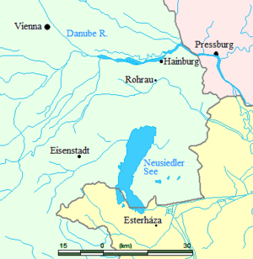
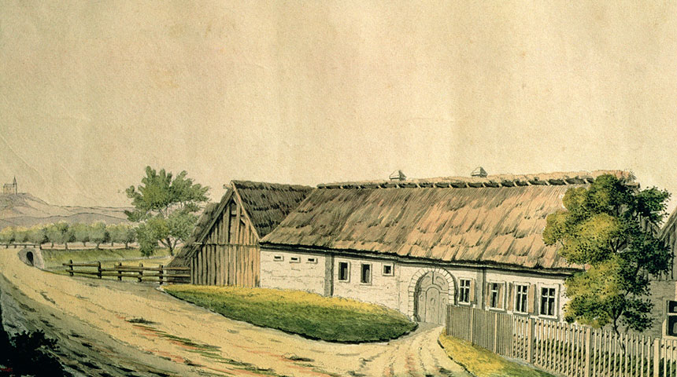
Haydn: b. 1732, Rohrau, Austria

Slide 15
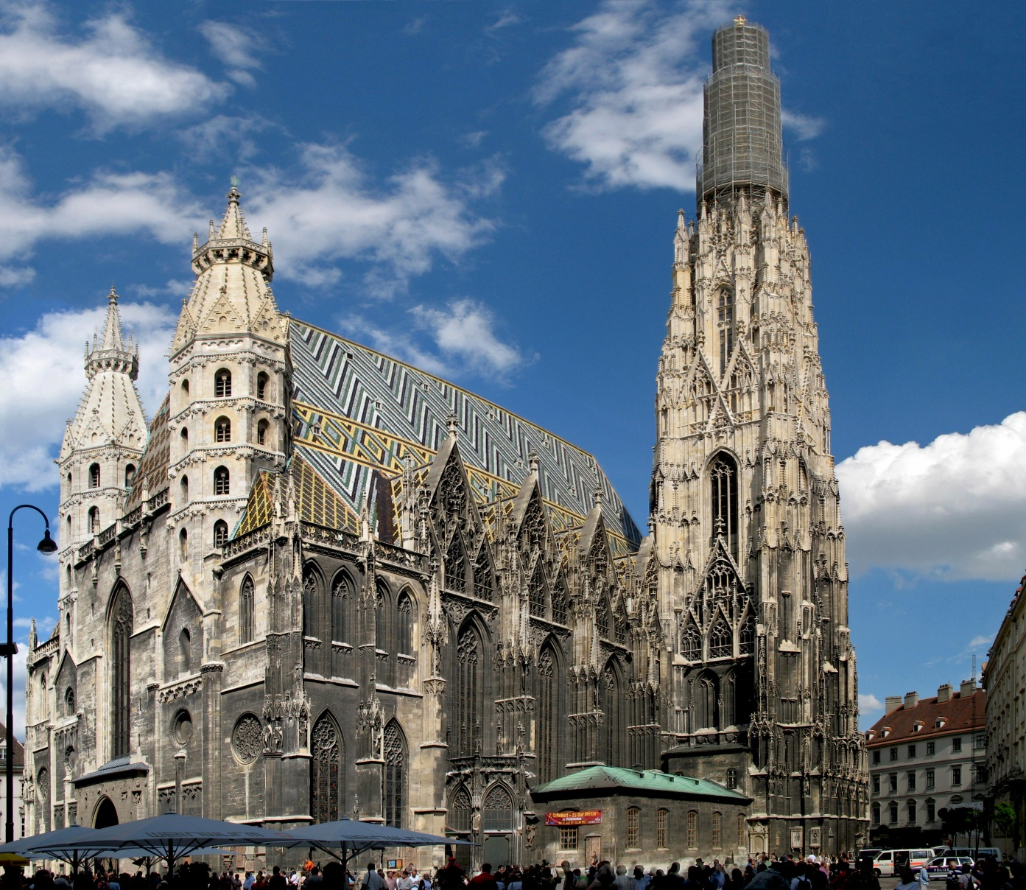
Haydn, 1739-40 (age 7): Choirboy, Vienna, St. Stephen’s Cathedral

Slide 16
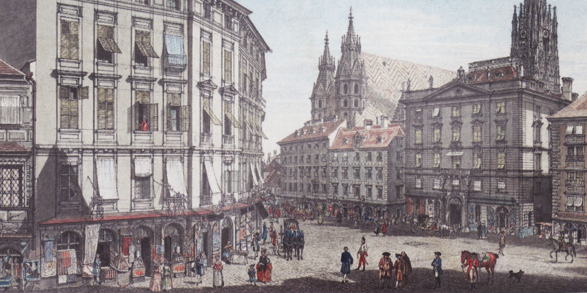
Vienna, c. 1750

Slide 17
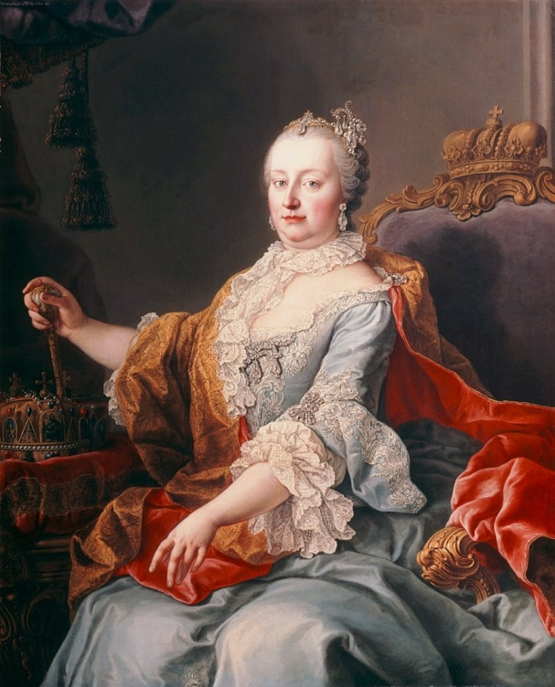
Vienna, c. 1750

Slide 18
Haydn, 1756-57 (age 24): First Position—Music Master at the Summer Home of Baron Carl Joseph Fürnberg (Vienna)

Slide 19
Haydn, 1756-57 (age 24): First Position—Music Master at the Summer Home of Baron Carl Joseph Fürnberg (Vienna)
“Divertimento” [“String Quartet No. 1”] in B-flat, Hob. III:1
1. Presto
2. Minuet
3. Adagio
4. Minuet
5. Finale: Presto

Slide 20
Genre: String Quartet (Origins?)

Slide 21
Genre: String Quartet (Origins?)
Reduced-group performances
(without continuo)
of pre-existing ensemble genres
(sinfonia, ripieno concerto, etc.)?

Slide 22
Genre: String Quartet (Origins?)
Reduced-group performances
(without continuo)
of pre-existing ensemble genres
(sinfonia, ripieno concerto, etc.)?
Or perhaps a local Austrian tradition emerging on its own,
c. 1750s?

Slide 23
Haydn, 1756-57 (age 24): First Position—Music Master at the Summer Home of Baron Carl Joseph Fürnberg (Vienna)
“Divertimento” [“String Quartet No. 1”] in B-flat, Hob. III:1
1. Presto
2. Minuet
3. Adagio
4. Minuet
5. Finale: Presto

Slide 24
Haydn, 1757-c. 1760 (age 25-28): More Secure Position—
Music Director to Count Ferdinand Franz Morzin (Vienna)

Slide 25
Haydn, 1757-c. 1760 (age 25-28): More Secure Position—
Music Director to Count Ferdinand Franz Morzin (Vienna)
For Morzin: began to write “symphonies”

Slide 26
Haydn, 1757-c. 1760 (age 25-28): More Secure Position—
Music Director to Count Ferdinand Franz Morzin (Vienna)
Haydn’s Earliest Symphonies:
“Symphony No. 37” in C (c. 1757)
Symphony No. 1 in D (c. 1757)
1. Presto
2. Andante
3. Finale: Presto

Slide 27
Haydn, 1757-c. 1760 (age 25-28): More Secure Position—
Music Director to Count Ferdinand Franz Morzin (Vienna)
Haydn’s Earliest Symphonies:
“Symphony No. 37” in C (c. 1757)
Symphony No. 1 in D (c. 1757)
1. Presto
2. Andante
3. Finale: Presto

Slide 28
Haydn, 1757-c. 1760 (age 25-28): More Secure Position—
Music Director to Count Ferdinand Franz Morzin (Vienna)
Haydn’s Earliest Symphonies:
“Symphony No. 37” in C (c. 1757)
Symphony No. 1 in D (c. 1757)
1. Presto
2. Andante
3. Finale: Presto

Slide 29
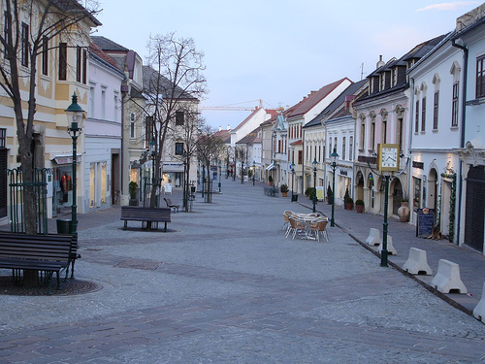
Haydn, 1761-1790 (age 29-58): Resident Musician & Composer
for the Esterházy Family (Eisenstadt)

Slide 30
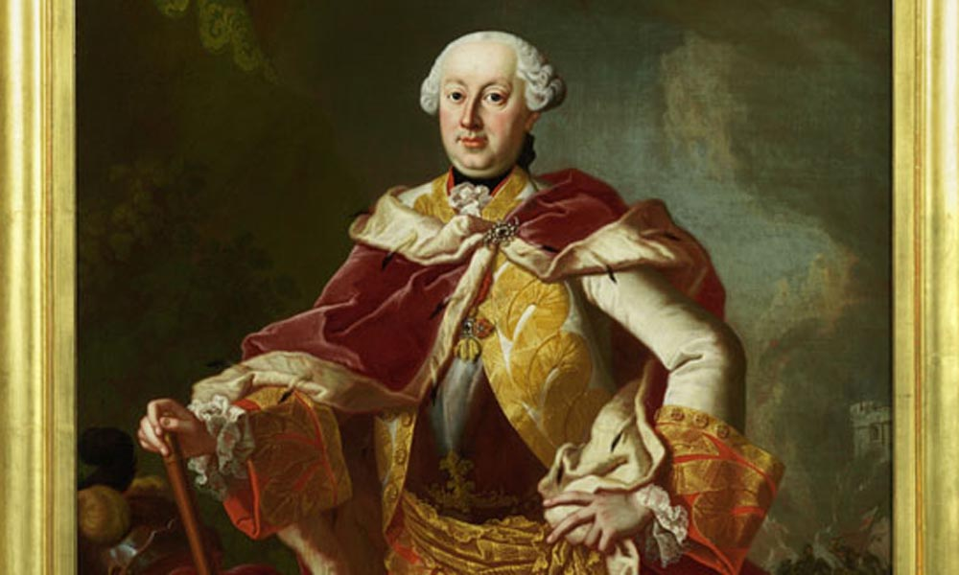
Haydn Arrives in Eisenstadt, Early 1760s
Prince Paul II Anton Esterházy (1711-62)

Slide 31
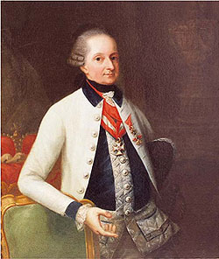
Haydn’s Principal Patron, 1763-1790
Prince Nicolaus I Esterházy (1714-90)

Slide 32
“Esterháza”: Esterházy Palace outside of Eisenstadt

Slide 33
“Esterháza”: Esterházy Palace outside of Eisenstadt

Slide 34
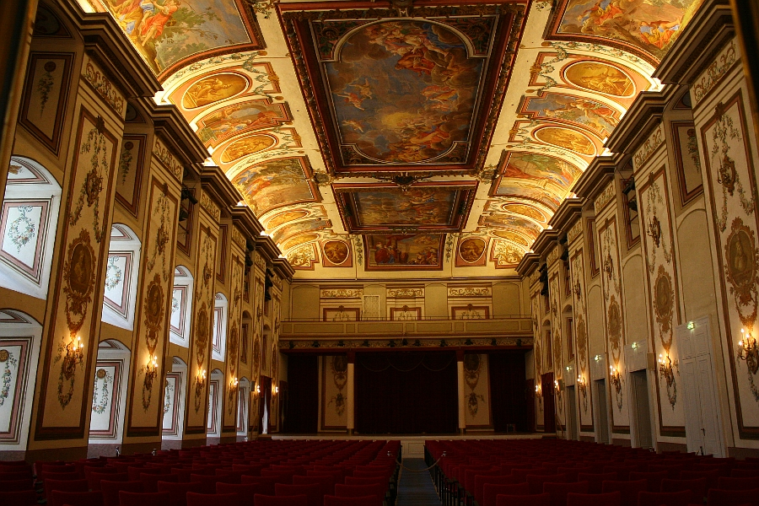
“Esterháza”: Esterházy Palace outside of Eisenstadt

Slide 35
A Patron’s Request
Prince Paul II Anton Esterházy (1711-62)
Haydn’s Symphonies Nos. 6, 7, and 8 (1761): Illustrative of The Times of Day
6. “Le Matin” in D
7. “Le Midi” in C
8. “Le Soir” in G

Slide 36
A Patron’s Request
Prince Paul II Anton Esterházy (1711-62)
Haydn’s Symphonies Nos. 6, 7, and 8 (1761): Illustrative of The Times of Day
6. “Le Matin” in D
7. “Le Midi” in C
8. “Le Soir” in G

Slide 37
Haydn: Tag-Line Titles for Certain Individual Instrumental Works
(Illustrative or Associative Titles)
Symphony No. 22 in E-flat, “Der Philosoph” (1764)
Symphony No. 26 in D Minor, “Lamentation” (c. 1768-70?)
Symphony No. 31 in D, “Hornsignal” (1765)
Symphony No. 48 in C, “Maria Theresa” (c. 1769?)

Slide 38
Haydn, Symphony No. 6 in D, “Le Matin,” Mvmt 1
Adagio
Slow, “Sunrise” Introduction!
EEC
Allegro
S^{1.1}, S^{1.2}
C
Exposition
.
.
.
.
P
TR
V
Binary, Pt. 1
“noble hunt” topic?
I
vi:PAC
.
.
Developmental Space
Binary, Pt. 2
First Section
P-launched. . . . . . “tempest” . . . . . vi::PAC . . . RT
Recapitulation
ESC
(telescoped, fused)
P
TR
S^{1.2}
C
.
.
Binary, Pt. 2
Second Section
merge: no MC
I I
Tonal Resolution

Slide 39
Haydn, Symphony No. 6 in D, “Le Matin,” Mvmt 1
Adagio
Slow, “Sunrise” Introduction!
EEC
Allegro
S^{1.1}, S^{1.2}
C
Exposition
.
.
.
.
P
TR
V
Binary, Pt. 1
“noble hunt” topic?
I
vi:PAC
.
.
Developmental Space
Binary, Pt. 2
First Section
P-launched. . . . . . “tempest” . . . . . vi::PAC . . . RT
Recapitulation
ESC
(telescoped, fused)
P
TR
S^{1.2}
C
.
.
Binary, Pt. 2
Second Section
merge: no MC
I I
Tonal Resolution

Slide 40
Haydn, Symphony No. 6 in D, “Le Matin,” Mvmt 1
Adagio
Slow, “Sunrise” Introduction!
EEC
Allegro
S^{1.1}, S^{1.2}
C
Exposition
.
.
.
.
P
TR
V
Binary, Pt. 1
“noble hunt” topic?
I
vi:PAC
.
.
Developmental Space
Binary, Pt. 2
First Section
P-launched. . . . . . “tempest” . . . . . vi::PAC . . . RT
Recapitulation
ESC
(telescoped, fused)
P
TR
S^{1.2}
C
.
.
Binary, Pt. 2
Second Section
merge: no MC
I I
Tonal Resolution

Slide 41
Haydn, Symphony No. 6 in D, “Le Matin,” Mvmt 1
Adagio
Slow, “Sunrise” Introduction!
EEC
Allegro
S^{1.1}, S^{1.2}
C
Exposition
.
.
.
.
P
TR
V
Binary, Pt. 1
“noble hunt” topic?
I
vi:PAC
.
.
Developmental Space
Binary, Pt. 2
First Section
P-launched. . . . . . “tempest” . . . . . vi::PAC . . . RT
Recapitulation
ESC
(telescoped, fused)
P
TR
S^{1.2}
C
.
.
Binary, Pt. 2
Second Section
merge: no MC
I I
Tonal Resolution

Slide 42
Haydn, Symphony No. 6 in D, “Le Matin,” Mvmt 1
Adagio
Slow, “Sunrise” Introduction!
EEC
Allegro
S^{1.1}, S^{1.2}
C
Exposition
.
.
.
.
P
TR
V
Binary, Pt. 1
“noble hunt” topic?
I
vi:PAC
.
.
Developmental Space
Binary, Pt. 2
First Section
P-launched. . . . . . “tempest” . . . . . vi::PAC . . . RT
Recapitulation
ESC
(telescoped, fused)
P
TR
S^{1.2}
C
.
.
Binary, Pt. 2
Second Section
merge: no MC
I I
Tonal Resolution

Slide 43
Haydn, Symphony No. 6 in D, “Le Matin,” Mvmt 1
Adagio
Slow, “Sunrise” Introduction!
EEC
Allegro
S^{1.1}, S^{1.2}
C
Exposition
.
.
.
.
P
TR
V
Binary, Pt. 1
“noble hunt” topic?
I
vi:PAC
.
.
Developmental Space
Binary, Pt. 2
First Section
P-launched. . . . . . “tempest” . . . . . vi::PAC . . . RT
Recapitulation
ESC
(telescoped, fused)
P
TR
S^{1.2}
C
.
.
Binary, Pt. 2
Second Section
merge: no MC
I I
Tonal Resolution

Slide 44
Haydn, Symphony No. 6 in D, “Le Matin,” Mvmt 1
Adagio
Slow, “Sunrise” Introduction!
EEC
Allegro
S^{1.1}, S^{1.2}
C
Exposition
.
.
.
.
P
TR
V
Binary, Pt. 1
“noble hunt” topic?
I
vi:PAC
.
.
Developmental Space
Binary, Pt. 2
First Section
P-launched. . . . . . “tempest” . . . . . vi::PAC . . . RT
Recapitulation
ESC
(telescoped, fused)
P
TR
S^{1.2}
C
.
.
Binary, Pt. 2
Second Section
merge: no MC
I I
Tonal Resolution

Slide 45
Haydn, Symphony No. 6 in D, “Le Matin,” Mvmt 1
Adagio
Slow, “Sunrise” Introduction!
EEC
Allegro
S^{1.1}, S^{1.2}
C
Exposition
.
.
.
.
P
TR
V
Binary, Pt. 1
“noble hunt” topic?
I
vi:PAC
.
.
Developmental Space
Binary, Pt. 2
First Section
P-launched. . . . . . “tempest” . . . . . vi::PAC . . . RT
Recapitulation
ESC
(telescoped, fused)
P
TR
S^{1.2}
C
.
.
Binary, Pt. 2
Second Section
merge: no MC
I I
Tonal Resolution

Slide 46
Haydn, Symphony No. 6 in D, “Le Matin,” Mvmt 1
Adagio
Slow, “Sunrise” Introduction!
EEC
Allegro
S^{1.1}, S^{1.2}
C
Exposition
.
.
.
.
P
TR
V
Binary, Pt. 1
“noble hunt” topic?
I
vi:PAC
.
.
Developmental Space
Binary, Pt. 2
First Section
P-launched. . . . . . “tempest” . . . . . vi::PAC . . . RT
Recapitulation
ESC
(telescoped, fused)
P
TR
S^{1.2}
C
.
.
Binary, Pt. 2
Second Section
merge: no MC
I I
Tonal Resolution

Slide 47
Haydn, Symphony No. 6 in D, “Le Matin,” Mvmt 1
Adagio
Slow, “Sunrise” Introduction!
EEC
Allegro
S^{1.1}, S^{1.2}
C
Exposition
.
.
.
.
P
TR
V
Binary, Pt. 1
“noble hunt” topic?
I
vi:PAC
.
.
Developmental Space
Binary, Pt. 2
First Section
P-launched. . . . . . “tempest” . . . . . vi::PAC . . . RT
Recapitulation
ESC
(telescoped, fused)
P
TR
S^{1.2}
C
.
.
Binary, Pt. 2
Second Section
merge: no MC
I I
Tonal Resolution

Slide 48
Haydn, Symphony No. 6 in D, “Le Matin,” Mvmt 1
Adagio
Slow, “Sunrise” Introduction!
EEC
Allegro
S^{1.1}, S^{1.2}
C
Exposition
.
.
.
.
P
TR
V
Binary, Pt. 1
“noble hunt” topic?
I
vi:PAC
.
.
Developmental Space
Binary, Pt. 2
First Section
P-launched. . . . . . “tempest” . . . . . vi::PAC . . . RT
Recapitulation
ESC
(telescoped, fused)
P
TR
S^{1.2}
C
.
.
Binary, Pt. 2
Second Section
merge: no MC
I I
Tonal Resolution

Slide 49
Haydn, Symphony No. 6 in D, “Le Matin,” Mvmt 1
Adagio
Slow, “Sunrise” Introduction!
EEC
Allegro
S^{1.1}, S^{1.2}
C
Exposition
.
.
.
.
P
TR
V
Binary, Pt. 1
“noble hunt” topic?
I
vi:PAC
.
.
Developmental Space
Binary, Pt. 2
First Section
P-launched. . . . . . “tempest” . . . . . vi::PAC . . . RT
Recapitulation
ESC
(telescoped, fused)
P
TR
S^{1.2}
C
.
.
Binary, Pt. 2
Second Section
merge: no MC
I I
Tonal Resolution

Slide 50
Haydn, Symphony No. 6 in D, “Le Matin,” Mvmt 1
Adagio
Slow, “Sunrise” Introduction!
EEC
Allegro
S^{1.1}, S^{1.2}
C
Exposition
.
.
.
.
P
TR
V
Binary, Pt. 1
“noble hunt” topic?
I
vi:PAC
.
.
Developmental Space
Binary, Pt. 2
First Section
P-launched. . . . . . “tempest” . . . . . vi::PAC . . . RT
Recapitulation
ESC
(telescoped, fused)
P
TR
S^{1.2}
C
.
.
Binary, Pt. 2
Second Section
merge: no MC
I I
Tonal Resolution

Slide 51
Haydn, Symphony No. 6 in D, “Le Matin,” Mvmt 1
Adagio
Slow, “Sunrise” Introduction!
EEC
Allegro
S^{1.1}, S^{1.2}
C
Exposition
.
.
.
.
P
TR
V
Binary, Pt. 1
“noble hunt” topic?
I
vi:PAC
.
.
Developmental Space
Binary, Pt. 2
First Section
P-launched. . . . . . “tempest” . . . . . vi::PAC . . . RT
Recapitulation
ESC
(telescoped, fused)
P
TR
S^{1.2}
C
.
.
Binary, Pt. 2
Second Section
merge: no MC
I I
Tonal Resolution

Slide 52
Haydn, Symphony No. 6 in D, “Le Matin,” Mvmt 1
Adagio
Slow, “Sunrise” Introduction!
EEC
Allegro
S^{1.1}, S^{1.2}
C
Exposition
.
.
.
.
P
TR
V
Binary, Pt. 1
“noble hunt” topic?
I
vi:PAC
.
.
Developmental Space
Binary, Pt. 2
First Section
P-launched. . . . . . “tempest” . . . . . vi::PAC . . . RT
Recapitulation
ESC
(telescoped, fused)
P
TR
S^{1.2}
C
.
.
Binary, Pt. 2
Second Section
merge: no MC
I I
Tonal Resolution

Slide 53
Haydn, Symphony No. 6 in D, “Le Matin” (1761)
Adagio—Allegro
Adagio
Minuet
Finale: Allegro

Slide 54
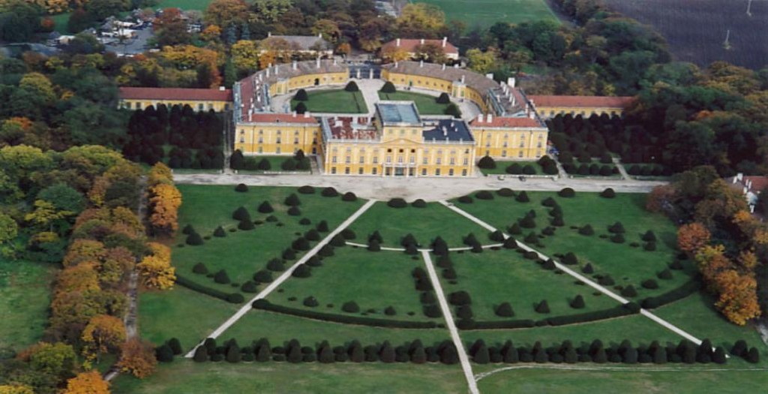
Haydn at Esterháza (mid-1760s, early 1770s)

Slide 55
Haydn at Esterháza (mid-1760s, early 1770s)

Slide 56
Haydn at Esterháza (mid-1760s, early 1770s)
Haydn to his biographer, Georg August Griesinger (publ. 1808-09): “I was cut off from the world. Nobody in my vicinity could upset my self-confidence or annoy me, and so I had no choice but to become original.”

Slide 57
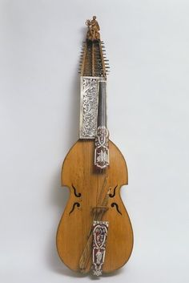
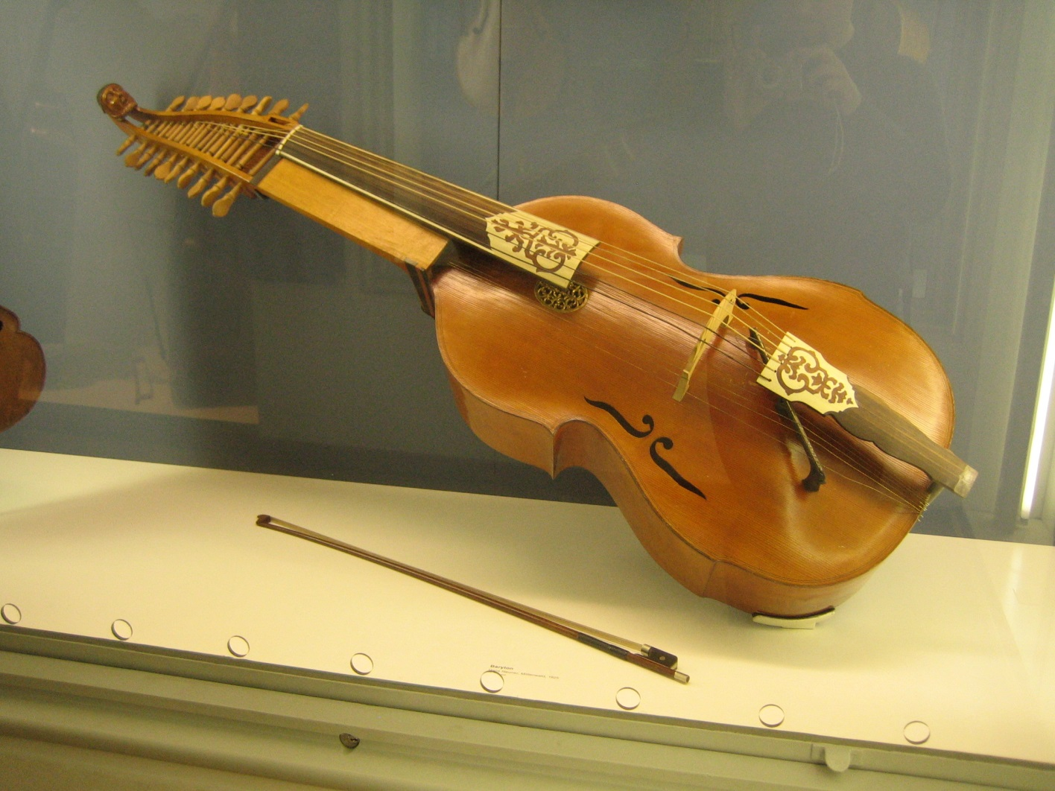
Baryton

Slide 58
Haydn, Baryton Trio No. 97 in D (1760s?), Adagio cantabile

Slide 59
Haydn at Esterháza (mid-1760s, early 1770s)
Galant (Entertainment) Style
Intensified, Concentrated, Deepened

Slide 60
Late 1760s in Austria, Germany, England:
C. P. E. Bach moves to Hamburg
Christoph Willibald Gluck, Reform Operas (Vienna)
J. C. Bach Thriving in London
Various Lesser Masters in Court Positions: Wagenseil, Vanhal, Ditttersdorf, etc.
Boy prodigy Mozart returns from display tours throughout Europe
Late 1760s, Early 1770s
Short-Lived, Minor-Mode “Sturm und Drang” Style

Slide 61
Late 1760s, Early 1770s: Short-Lived, Minor-Mode “Sturm und Drang” Style
(better: the “stormy style”)

Slide 62
Late 1760s, Early 1770s: Short-Lived, Minor-Mode “Sturm und Drang” Style
(better: the “stormy style”)
Dittersdorf, Symphony in G Minor (c. 1768)

Slide 63
Late 1760s, Early 1770s: Short-Lived, Minor-Mode “Sturm und Drang” Style
(better: the “stormy style”)
Dittersdorf, Symphony in G Minor (c. 1768)
J. C. Bach, Symphony In G Minor, op. 6 no. 6 (publ. 1770)

Slide 64
Late 1760s, Early 1770s: Short-Lived, Minor-Mode “Sturm und Drang” Style
(better: the “stormy style”)
Dittersdorf, Symphony in G Minor (c. 1768)
J. C. Bach, Symphony In G Minor, op. 6 no. 6 (publ. 1770)
W. A. Mozart, Symphony No. 25 in G Minor, K. 183 (c. 1773)

Slide 65
1740s 1770s 1790s, 1800s
Emerging Subjectivity,
Individuality, “Romanticism”
Sturm und Drang
Empfindsamkeit

Slide 66
1740s 1770s 1790s, 1800s
Emerging Subjectivity,
Individuality, “Romanticism”
Sturm und Drang
Empfindsamkeit
the “composer’s feelings”?
“subjectivity” or “personal expression”?

Slide 67
1740s 1770s 1790s, 1800s
Emerging Subjectivity,
Individuality, “Romanticism”
Sturm und Drang
Empfindsamkeit
the “composer’s feelings”?
“subjectivity” or “personal expression”?
Probably not! Rather: the vogue for the musical staging of the well-known tempesta (storm) topic for dramatic or eccentric effects

Slide 68
Late 1760s, Early 1770s: Short-Lived, Minor-Mode “Sturm und Drang” Style
(better: the “stormy style”)
Dittersdorf, Symphony in G Minor (c. 1768)
J. C. Bach, Symphony In G Minor, op. 6 no. 6 (publ. 1770)
W. A. Mozart, Symphony No. 25 in G Minor, K. 183 (c. 1773)
Joseph Haydn, Symphony No. 44 in E Minor, “Trauer” (c. 1771)

Slide 69
Late 1760s, Early 1770s: Short-Lived, Minor-Mode “Sturm und Drang” Style
(better: the “stormy style”)
Dittersdorf, Symphony in G Minor (c. 1768)
J. C. Bach, Symphony In G Minor, op. 6 no. 6 (publ. 1770)
W. A. Mozart, Symphony No. 25 in G Minor, K. 183 (c. 1773)
Joseph Haydn, Symphony No. 44 in E Minor, “Trauer” (c. 1771)
Joseph Haydn, Symphony No. 45 in F-Sharp Minor, “Farewell” (1772

Slide 70
[The following slide contained a 7-minute video clip.

Slide 71
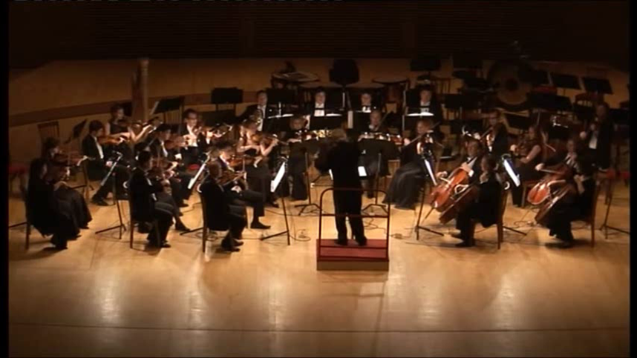
Haydn, Symphony No. 45 in F-Sharp Minor, “Farewell” (1772), finale
(Igor Gruppman, conductor)

Slide 72
Minor-Mode Continuous Exposition (No formalized MC, No S-relaunch)
III:PAC = EEC
.
.
.
.
P - - - - - - - TR - - - - - - - - -(FS) - - - - - - - - cadential - - C (optional)
Minor Major (positive outcome, prospects)
i . . . . . . . . . . . . . . . . . . . . . . . . . . . . . . . III . . . . . . . . . . . . . . . . . . . . . . . .
Minor-Mode Continuous Exposition (No formalized MC, No S-relaunch)
v:PAC = EEC
.
.
.
.
P - - - - - - - TR - - - - - - - - -(FS) - - - - - - - - cadential - - C (optional)
Minor Minor (negative outcome, prospects)
i . . . . . . . . . . . . . . . . . . . . . . . . . . . . . . . v . . . . . . . . . . . . . . . . . . . . . . . .

Slide 73
Haydn: Symphony No. 45 in F-sharp Minor, “Farewell” (1772),
first movement, exposition (Tempesta or Sturm und Drang topic)
m. 16
m. 65
m. 38!: P-idea bursts out in
A minor! – but not as S!
m. 17
v:PAC = EEC
!!
.
.
.
.
P - - - - - - - TR - - - - - - - - -(FS) - - - - - - - - - - - cadential C
Minor (Major?) Minor (negative outcome, prospects)
i . . . . . . . . . . [toward III!] . . [collapse!, iii!]. .v . . . . . . . . . . . . . . . . . . . . . .
f# toward A! a minor!! c# minor!

Slide 74
Haydn: Symphony No. 45 in F-sharp Minor, “Farewell” (1772),
first movement, exposition (Tempesta or Sturm und Drang topic)
m. 16
m. 65
m. 38!: P-idea bursts out in
A minor! – but not as S!
m. 17
v:PAC = EEC
!!
.
.
.
.
P - - - - - - - TR - - - - - - - - -(FS) - - - - - - - - - - - cadential C
Minor (Major?) Minor (negative outcome, prospects)
i . . . . . . . . . . [toward III!] . . [collapse!, iii!]. .v . . . . . . . . . . . . . . . . . . . . . .
f# toward A! a minor!! c# minor!
Initially provides signals
of a two-part exposition
driving toward a hoped-for S [“relief!”] in A major
Two-part,
A-major “hope”
misfires!!
Result: An “unrelieved”
continuous
exposition, thrashing onward

Slide 75
Haydn: Symphony No. 45 in F-sharp Minor, “Farewell” (1772),
first movement, exposition (Tempesta or Sturm und Drang topic)
Expositional break in the “wrong place”
(m. 55) (like a gasp!)
m. 16
m. 65
m. 38!: P-idea bursts out in
A minor! – but not as S!
m. 17
v:PAC = EEC
!!
.
.
.
.
P - - - - - - - TR - - - - - - - - -(FS) - - - - - - - - - - - cadential C
Minor (Major?) Minor (negative outcome, prospects)
i . . . . . . . . . . [toward III!] . . [collapse!, iii!]. .v . . . . . . . . . . . . . . . . . . . . . .
f# toward A! a minor!! c# minor!
Initially provides signals
of a two-part exposition
driving toward a hoped-for S [“relief!”] in A major
Two-part,
A-major “hope”
misfires!!
Result: An “unrelieved”
continuous
exposition, thrashing onward

