Slide 1
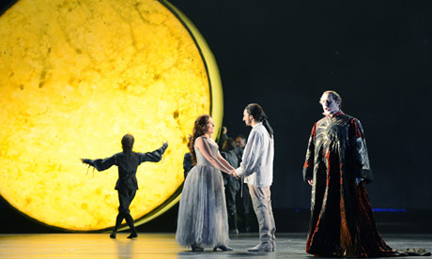
Mozart: Opera and Singspiel

Slide 2
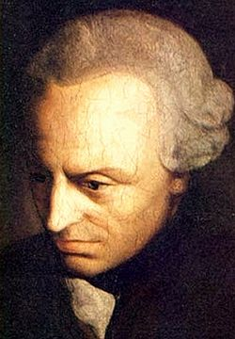
Mozart: Opera and Singspiel
“Enlightenment is mankind’s emergence [or release] from its self-incurred immaturity. . . the inability to make use of one’s own understanding without the guidance of another. . . . Sapere aude [‘Dare to know!’]”
Immanuel Kant: What is Enlightenment?
(Was ist Aufklärung?, 1784)

Slide 3
Rationality/Order vs Idiosyncratic or Personalized Subjectivity/Emotion:
A Continuum
Normative Range
(in balance)
Pure, dry rationality, schematic order
Pure emotion, disruptive or self-indulgent passions, irrationality
The “acceptable”
(in art—and in life)

Slide 4
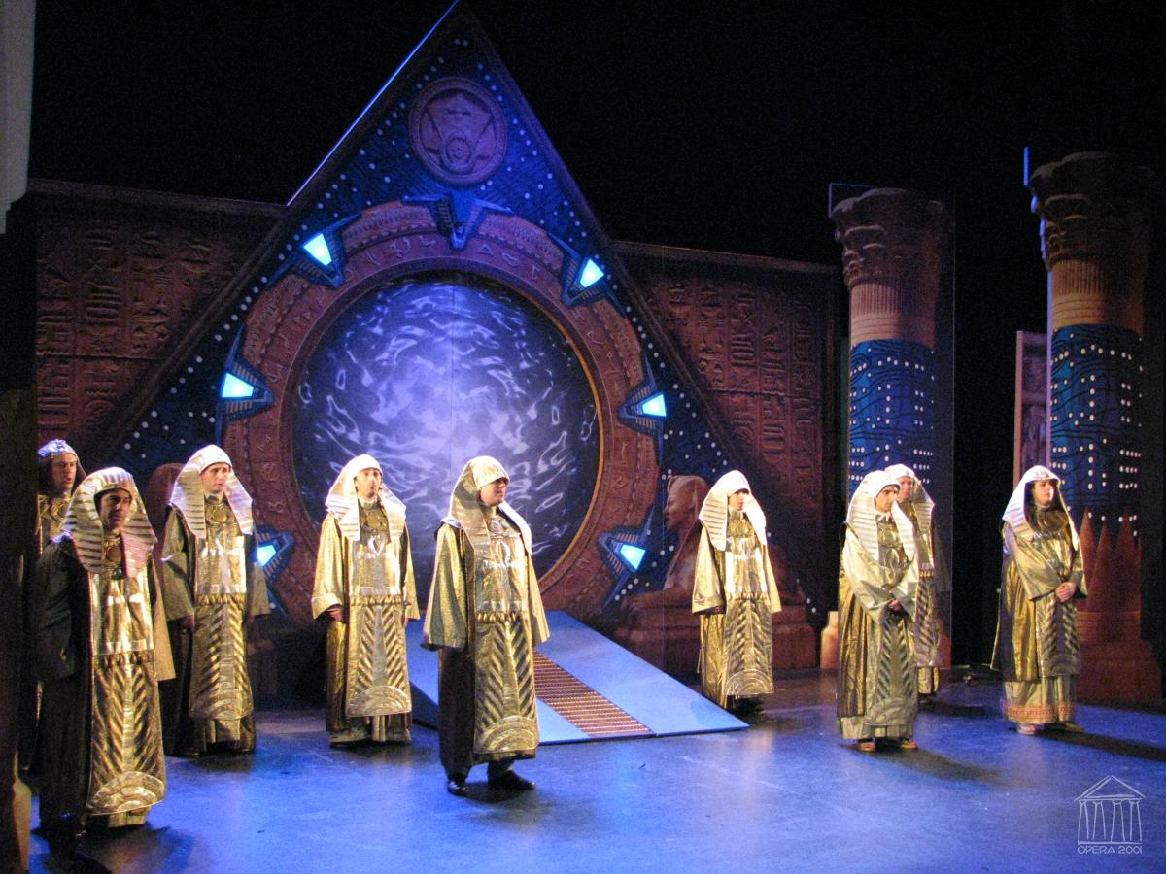
Die Zauberflöte (1791), March of the Priests

Slide 5
Characteristic midcentury views of society, art, culture

Slide 6
Characteristic midcentury views of society, art, culture
Nature is held to be luminously clear, orderly

Slide 7
Characteristic midcentury views of society, art, culture
Nature is held to be luminously clear, orderly
Elite society’s models are its orderly, cultivated members; even while prizing the “natural,” taste and emotional restraint remain imperative

Slide 8
Characteristic midcentury views of society, art, culture
Nature is held to be luminously clear, orderly
Elite society’s models are its orderly, cultivated members; even while prizing the “natural,” taste and emotional restraint remain imperative
Art: a problem? (Potentially disruptive? anarchic?)

Slide 9
Characteristic midcentury views of society, art, culture
Nature is held to be luminously clear, orderly
Elite society’s models are its orderly, cultivated members; even while prizing the “natural,” taste and emotional restraint remain imperative
Art: a problem? (Potentially disruptive? anarchic?)
Hence: art should be restrained and groomed by a system of moderating conventions, guidelines, norms, a “mirror” of natural order.

Slide 10
Characteristic midcentury views of society, art, culture
Nature is held to be luminously clear, orderly
Elite society’s models are its orderly, cultivated members; even while prizing the “natural,” taste and emotional restraint remain imperative
Art: a problem? (Potentially disruptive? anarchic?)
Hence: art should be restrained and groomed by a system of moderating conventions, guidelines, norms, a “mirror” of natural order.
Music: as the carrier of moods and emotions (transporting affects) runs particular dangers along these lines.

Slide 11
High-Galant/Enlightenment Music: Dangers to Avoid!
Normative Range
(in balance)
Pure, dry rationality, schematic order
Pure emotion, disruptive or self-indulgent passions, irrationality
Excessive complexity,
learned counterpoint, “difficult” music
The “acceptable”
(in art—and in life)

Slide 12
High-Galant/Enlightenment Music: Dangers to Avoid!
Normative Range
(in balance)
Pure, dry rationality, schematic order
Pure emotion, disruptive or self-indulgent passions, irrationality
Excessive complexity,
learned counterpoint, “difficult” music
The “acceptable”
(in art—and in life)
Excessive , self-indulgent emotion, disruptive passion
or uncontrolled obsession

Slide 13
Galant/Enlightenment Musical Style, Forms, and Genres, 1740-c. 1790:
Insistence on a “natural” or simplified, streamlined style, readily accessible to cultivated listeners

Slide 14
Galant/Enlightenment Musical Style, Forms, and Genres, 1740-c. 1790:
Insistence on a “natural” or simplified, streamlined style, readily accessible to cultivated listeners
Music’s affective signs/gestures (“the language of emotions”)
are to be presented, groomed, and tamed by a generalized system
of balances, symmetries, and resolutions.

Slide 15
Galant/Enlightenment Musical Forms and Genres, 1740-c. 1790:
Insistence on a “natural” or simplified, streamlined style, readily accessible to cultivated listeners
Music’s affective signs/gestures (“the language of emotions”)
are to be presented, groomed, and tamed by a generalized system
of balances, symmetries, and resolutions.
Thus: musical “form” and ”genre” (linchpins of “the classical style”) can be understood as strategies of containment in order to stay within the boundaries of good taste.

Slide 16
Mozart, Symphony No. 34 in C, K. 338, second movement,
Andante di molto più tosto Allegretto (1780):
Primary Theme (P), a compound period
First half of P-theme: a 14-bar compound sentential antecedent
(antecedent structured as a compound sentence)
I:HC
4 + 4 + 4 + 2
sotto voce
!
I V⁷/ii ii V⁷ I ii V6/4--5/3
Presentation Continuation Cadence
(= HM) (fragmentation,
compression)

Slide 17
Exceptions?

Slide 18
Exceptions?
Empfindsamkeit? (C. P. E. Bach)

Slide 19
Exceptions?
Empfindsamkeit? (C. P. E. Bach)
Sturm und Drang vogue, late 1760s, early 1770s (“stormy,” minor-mode music)?

Slide 20
Exceptions?
Empfindsamkeit? (C. P. E. Bach)
Sturm und Drang vogue, late 1760s, early 1770s (“stormy,” minor-mode music)?
Parodistic depiction of presumably unbalanced, dangerous, or irrational “others”?

Slide 21
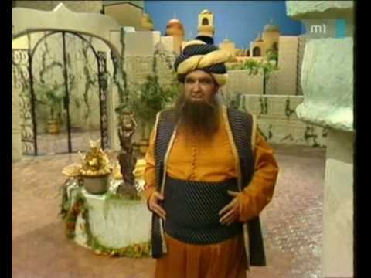
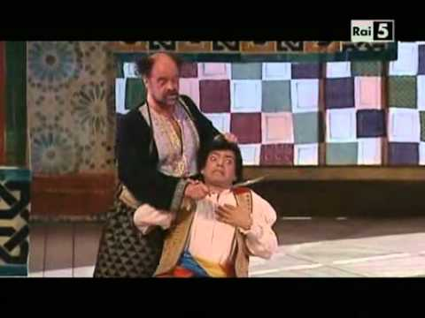
Exceptions?
Empfindsamkeit? (C. P. E. Bach)
Sturm und Drang vogue, late 1760s, early 1770s (“stormy,” minor-mode music)?
Parodistic depiction of presumably unbalanced, dangerous, or irrational “others”?
Mozart, Osmin’s Rage Aria, “Solche hergelaufne Laffen,”
Singspiel: Die Entführung aus dem Serail (1782)

Slide 22
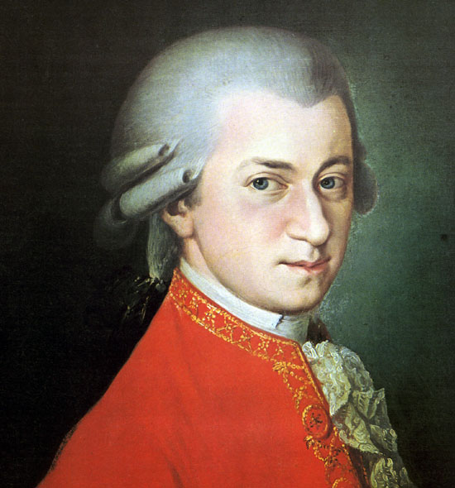
“Reformed” or Enriched Italian Opera Seria:
Idomeneo (Munich, 1781)
La Clemenza di Tito (Vienna, 1791)

Slide 23
“Reformed” or Enriched Italian Opera Seria:
Idomeneo (Munich, 1781)
La Clemenza di Tito (Vienna, 1791)
Nimble Social Critique via Italian Opera Buffa
(Librettist: Lorenzo da Ponte):
Le nozze de Figaro (Vienna, 1786)
Don Giovanni (Prague, 1787)
Così fan tutte (Vienna 1790)

Slide 24
“Reformed” or Enriched Italian Opera Seria:
Idomeneo (Munich, 1781)
La Clemenza di Tito (Vienna, 1791)
Nimble Social Critique via Italian Opera Buffa
(Librettist: Lorenzo da Ponte):
Le nozze de Figaro (Vienna, 1786)
Don Giovanni (Prague, 1787)
Così fan tutte (Vienna 1790)
More “democratized” comic German Singspiel:
Die Entführung aus dem Serail (Vienna, 1782)
Die Zauberflöte (Vienna, 1791)

Slide 25
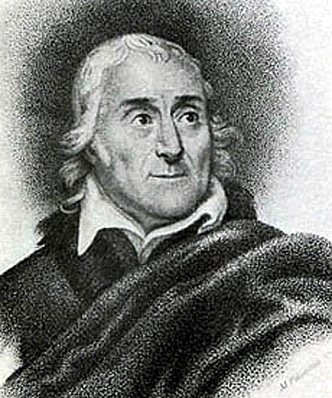
Viennese Opera Buffa
Wolfgang Amadé Mozart
Lorenzo da Ponte
Le nozze de Figaro (Vienna, 1786)
Don Giovanni (Prague, 1787): “dramma giocoso”
Così fan tutte (Vienna 1790)

Slide 26
Viennese Opera Buffa
Wolfgang Amadé Mozart
Lorenzo da Ponte
Le nozze de Figaro (Vienna, 1786)
Don Giovanni (Prague, 1787): “dramma giocoso”
Così fan tutte (Vienna 1790)

Slide 27
[The next two slides were originally brief video clips.]

Slide 28
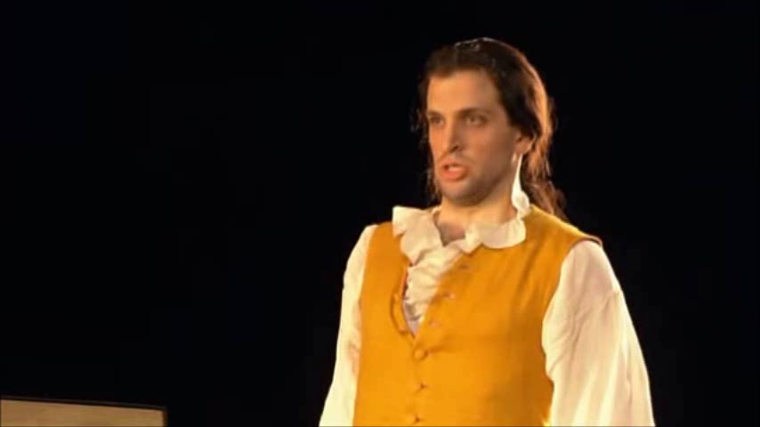
Mozart, “Se vuol ballare” (Figaro), from Le nozze di Figaro, Act 1
Luca Pisaroni (Paris, 2004)

Slide 29
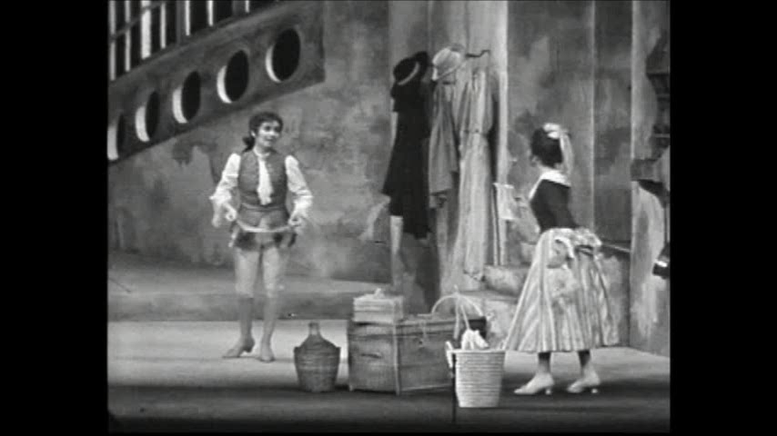
Mozart, “Non so più cosa son, cosa faccio” (Cherubino) from Le nozze di Figaro, Act 1
Edith Mathis (1966 Salzburg Festival, Karl Böhm, conductor)

Slide 30
Not only do Mozart’s uncanny human portraits in sound seem to resonate with the reality of a concrete personality; they inspire empathy as well—and this was Mozart’s other breakthrough. One is apt to respond to a work by him not only thinking “it’s about him,” but also by thinking that, somehow, “it’s about me.” The bond of kinship thus established between the composer’s subjectivity and the listener’s—a human bond of empathy seemingly capable of transcending differences in age, rank, gender, nation, or any other barrier—is supremely in the optimistic spirit of the Enlightenment. When the feat is duplicated [by Mozart] in the wordless realm of instrumental music . . . that music is invested with a sense of importance—indeed, of virtual holiness—it had never known before. We can begin to see why Mozart could be worshiped, particularly by his nineteenth-century posterity, as a kind of musical god who worked a beneficent, miraculous influence in the world.
Richard Taruskin, II, 475

Slide 31
Mozart, “Contessa, perdono” (Count, Countess) from Le nozze di Figaro, Act 4
Rodney Gilfry, Hillevi Martinpelto--John Eliot Gardiner, Conductor

Slide 32
“Reformed” or Enriched Italian Opera Seria:
Idomeneo (Munich, 1781)
La Clemenza di Tito (Vienna, 1791)
Nimble, Social Critique via Italian Opera Buffa
(Librettist: Lorenzo da Ponte):
Le nozze de Figaro (Vienna, 1786)
Don Giovanni (Prague, 1787)
Così fan tutte (Vienna 1790)
More “democratized” comic German Singspiel:
Die Entführung aus dem Serail (Vienna, 1782)
Die Zauberflöte (Vienna, 1791)

Slide 33
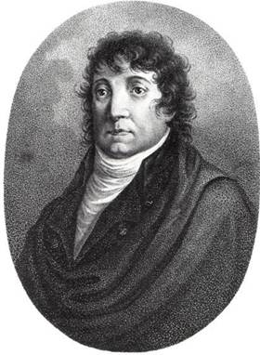
Die Zauberflöte (Vienna, 1791)
Mozart (1756-1791)
Emanuel Schikaneder (1751-1812)

Slide 34
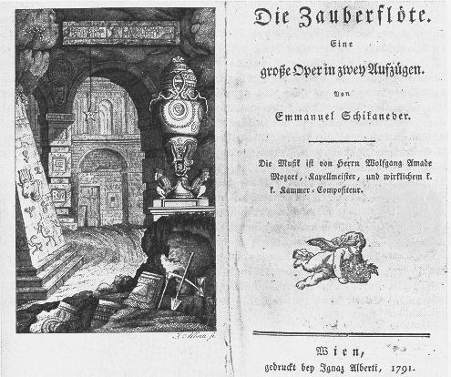
Original Libretto and Masonic Image (1791)

Slide 35
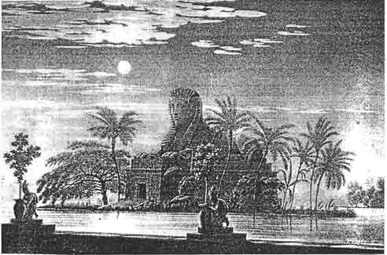
Die Zauberflöte: Stage Set Design from 1815

Slide 36
Die Zauberflöte (Singspiel, 1791):
Enlightenment Parable or Allegory

Slide 37
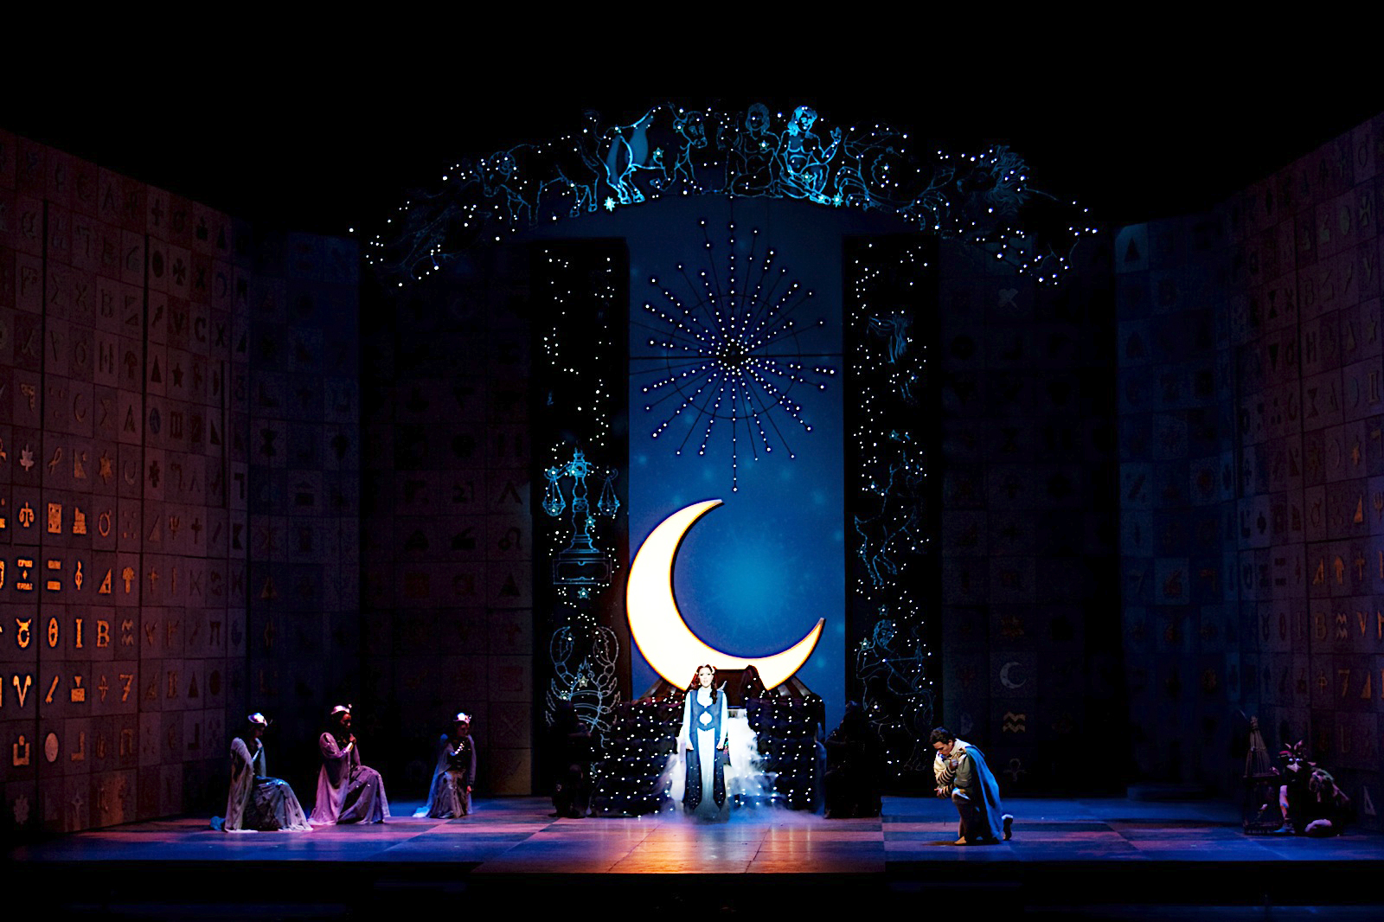
Die Zauberflöte (Singspiel, 1791):
Enlightenment Parable or Allegory

Slide 38
Die Zauberflöte (Singspiel, 1791):
Enlightenment Parable or Allegory

Slide 39
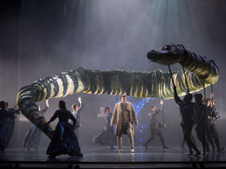
Die Zauberflöte, Opening Scene: Tamino Threatened by a Snake

Slide 40
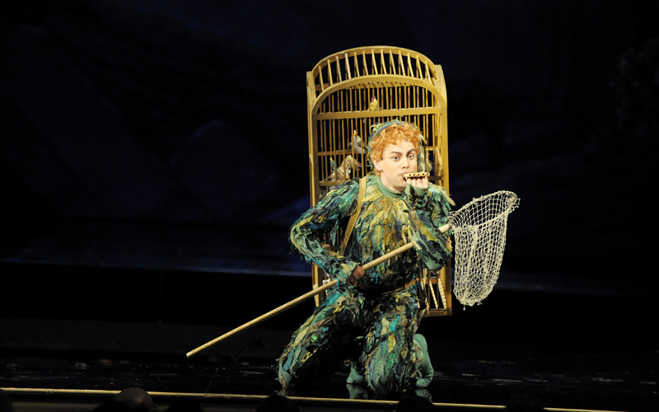
Papageno, the Bird-Catcher

Slide 41
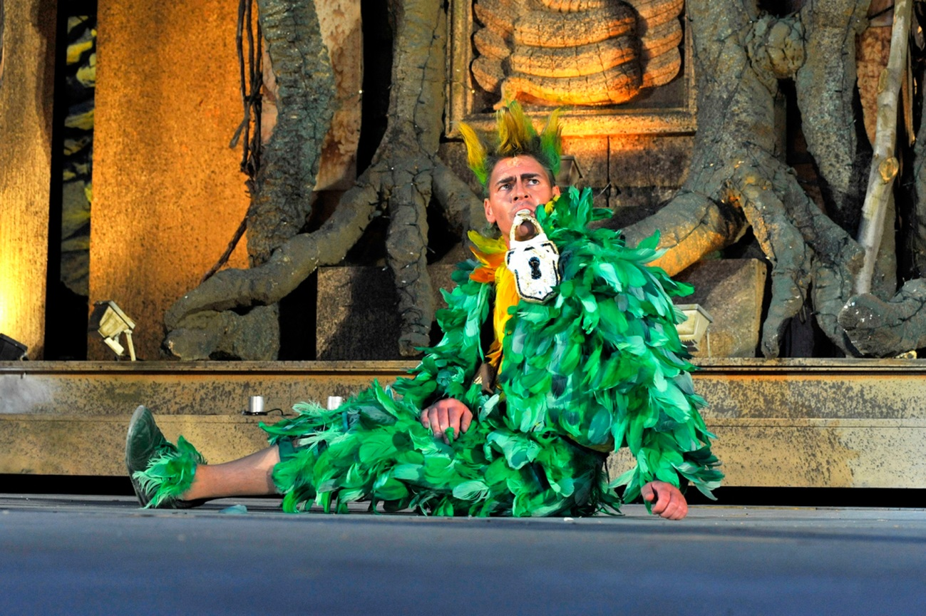
Papageno Punished

Slide 42
[Several of the following slides were originally video clips.
Some of them appear here only as pictures in order not to exceed uploadable file size.]

Slide 43
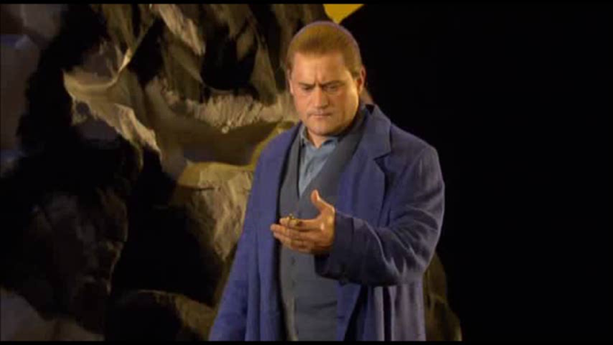
Tamino, “Dies Bildnis ist bezaubernd schön (Paul Groves, 2006)

Slide 44
Pamina, “Ach, ich fühl’s” (Kathleen Battle)

Slide 45
Papageno, “Der Vogelfänger bin ich ja” (Hermann Prey)

Slide 46
Queen of the Night, excerpt from “Der Hölle Rache kocht in meinem Herzen” (Natalie Dessay)

Slide 47
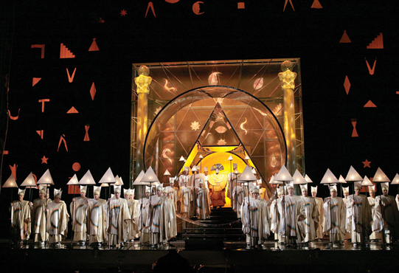
Sarastro’s Realm, “O Isis und Osiris”

Slide 48
The Three Boys from Sarastro’s Realm, “Zum Ziele führt dich diesen Bahn”

Slide 49
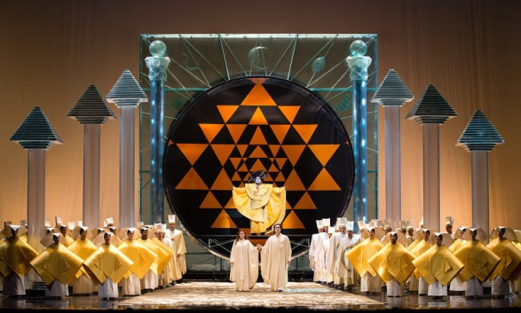
Mozart, Overture to Die Zauberflöte

Slide 50
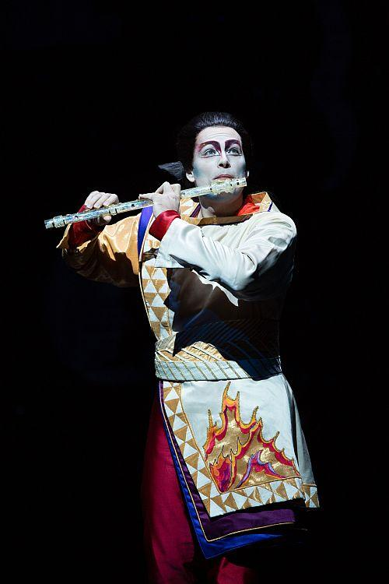
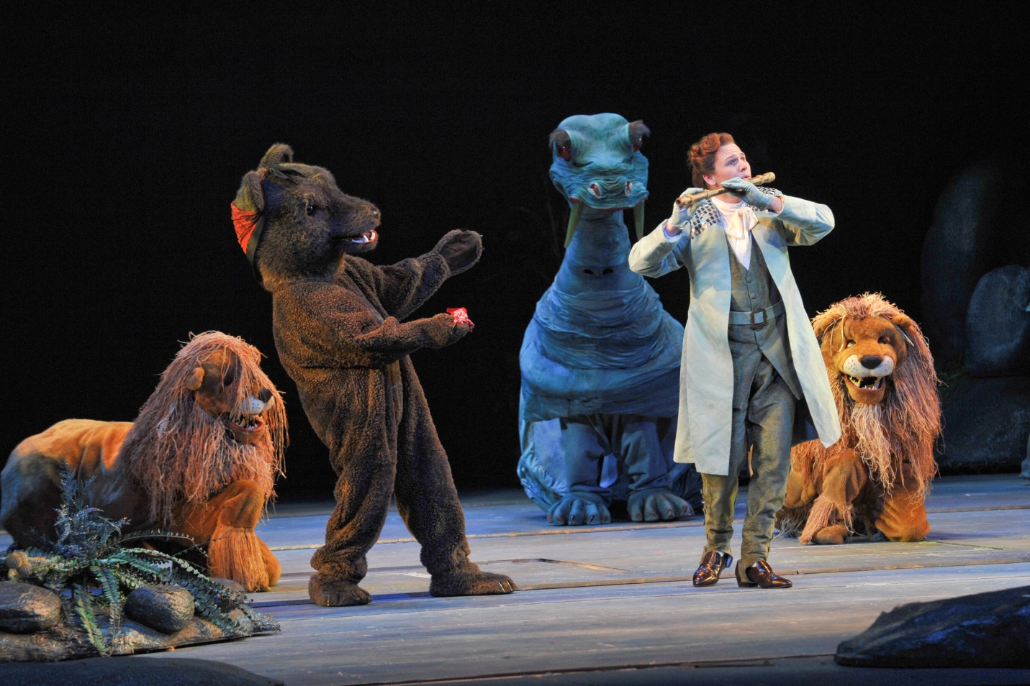

Slide 51
Sarastro’s Realm, “O Isis und Osiris”

Slide 52
Die Zauberflöte (1791), March of the Priests

Slide 53
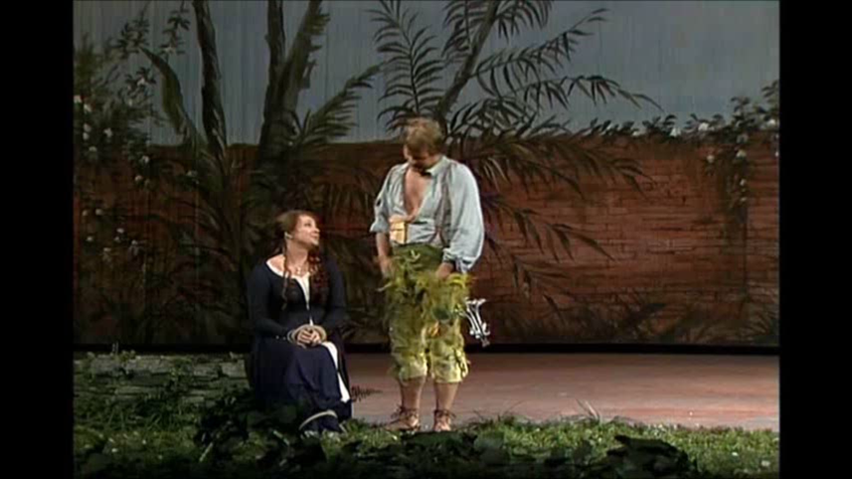
“Bei Männern” Duet (Pamina, Papageno
Lucia Popp, Wolfgang Brendel, cond. Wolfgang Sawallisch (Munich, 1983)

Slide 54
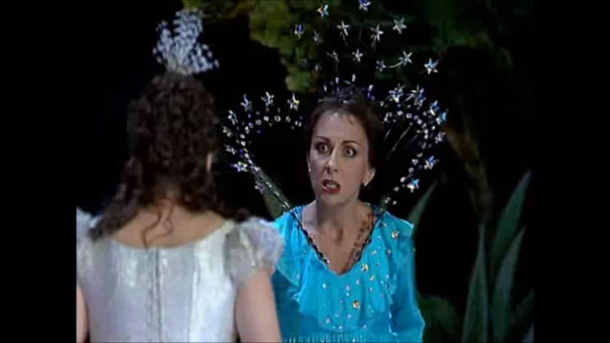
“Der Hölle Rache kocht in meinem Herzen” (Queen of the Night) Natalie Dessay (Paris, 2001)

