Slide 1
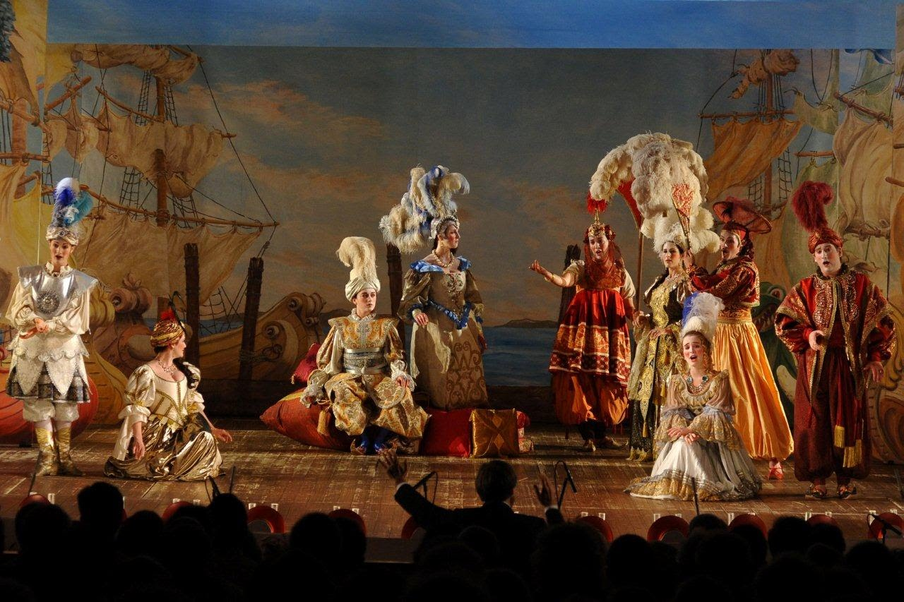
Mid-Eighteenth Century: Operatic Reform

Slide 2
Emerging Enlightenment, mid-late 18th Century:

Slide 3
Emerging Enlightenment, mid-late 18th Century:
An age of “nature” and a prizing of the “natural”

Slide 4
Emerging Enlightenment, mid-late 18th Century:
An age of “nature” and a prizing of the “natural”
An age of reason (the rational)

Slide 5
Emerging Enlightenment, mid-late 18th Century:
An age of “nature” and a prizing of the “natural”
An age of reason (the rational)
An age of critique

Slide 6
Emerging Enlightenment, mid-late 18th Century:
An age of “nature” and a prizing of the “natural”
An age of reason (the rational)
An age of critique
An age that began to initiate self-conscious reforms
of old-world institutions

Slide 7
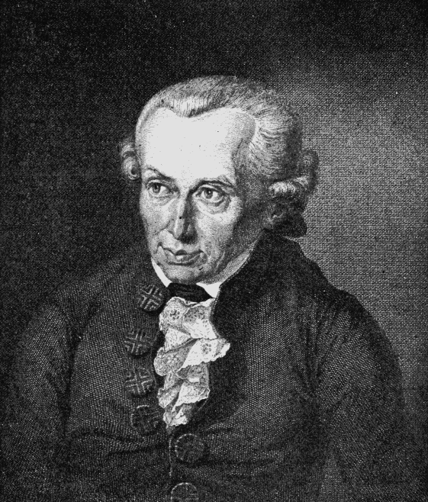
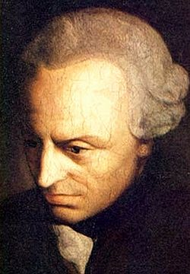
“Enlightenment is mankind’s emergence [or release] from its self-incurred immaturity. . . the inability to make use of one’s own understanding without the guidance of another. . . . Sapere aude [‘Dare to know!’]”
(also quoted, Taruskin, II, 461)
Immanuel Kant: What is Enlightenment?
(Was ist Aufklärung?, 1784)

Slide 8
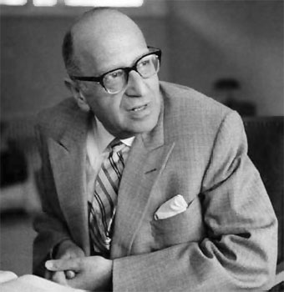
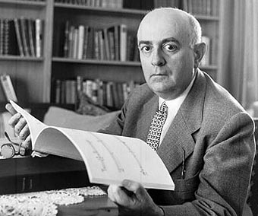
“The program of the Enlightenment was the disenchantment of the world; the dissolution of myths and the substitution of knowledge for fancy. . . . The human mind, which overcomes superstition, is to hold sway over a disenchanted nature.”
Max Horkheimer and Theodor W. Adorno,
Dialectic of Enlightenment (Dialektik der Aufklärung, 1944)

Slide 9
Gradually Emerging into a Modernizing World:
A Program of Reforms, Change

Slide 10
Gradually Emerging into a Modernizing World:
A Program of Reforms, Change
The concern for an individualized, personal subjectivity (self-understanding, self-expression, personal sentiment, honest and “natural”)

Slide 11
Gradually Emerging into a Modernizing World:
A Program of Reforms, Change
The concern for an individualized, personal subjectivity (self-understanding, self-expression, personal sentiment, honest and “natural”)
Political theories and manifestos of liberty and democracy

Slide 12
Gradually Emerging into a Modernizing World:
A Program of Reforms, Change
The concern for an individualized, personal subjectivity (self-understanding, self-expression, personal sentiment, honest and “natural”)
Political theories and manifestos of liberty and democracy
Increasingly secular/scientific views of the world

Slide 13
Gradually Emerging into a Modernizing World:
A Program of Reforms, Change
The concern for an individualized, personal subjectivity (self-understanding, self-expression, personal sentiment, honest and “natural”)
Political theories and manifestos of liberty and democracy
Increasingly secular/scientific views of the world
New philosophical views (e.g., Locke [17th c]; Berkeley, Hume, Burke, Kant)

Slide 14
Gradually Emerging into a Modernizing World:
A Program of Reforms, Change
The concern for an individualized, personal subjectivity (self-understanding, self-expression, personal sentiment, honest and “natural”)
Political theories and manifestos of liberty and democracy
Increasingly secular/scientific views of the world
New philosophical views (e.g., Locke [17th c]; Berkeley, Hume, Burke, Kant
And—the ever-deepening musical galant (the high-galant or “classical style” by the 1770s, 1780s: Haydn, Mozart)

Slide 15
Mid-18th Century: Vocal Music Still Reigns, Most Prestigious

Slide 16
Mid-18th Century: Vocal Music Still Reigns, Most Prestigious
Mass
Oratorio
Anthem
Sacred Music

Slide 17
Mid-18th Century: Vocal Music Still Reigns, Most Prestigious
Mass
Oratorio
Anthem
Sacred Music
Secular Music
Opera

Slide 18
European Opera, 1750s-1780s: diversifies to Include:
Italy: France: Austrian Empire
Opera seria Tragédie lyrique Opera seria
Opera buffa Opéra comique (spoken dialogue) Singspiel (German language spoken dialogue)

Slide 19
European Opera, 1750s-1780s: diversifies to Include:
Italy: France: Austrian Empire
Opera seria Tragédie lyrique Opera seria
Opera buffa Opéra comique (spoken dialogue) Singspiel (German language spoken dialogue)

Slide 20
European Opera, 1750s-1780s: diversifies to Include:
Italy: France: Austrian Empire
Opera seria Tragédie lyrique Opera seria
Opera buffa Opéra comique (spoken dialogue) Singspiel (German language spoken dialogue)
High prestige; the elevated tradition
Most “artificially” formalized
Elite claims; cultural authority, wealth, and traditional power
“Old World”: court and class structure

Slide 21
European Opera, 1750s-1780s: diversifies to Include:
Italy: France: Austrian Empire
Opera seria Tragédie lyrique Opera seria
Opera buffa Opéra comique (spoken dialogue) Singspiel (German language, spoken dialogue)
more overtly political: critical of class privilege
More “natural,” less encumbered with projecting
the high dignity of the older styles

Slide 22
European Opera, 1750s-1780s: diversifies to Include:
Italy: France: Austrian Empire
Opera seria Tragédie lyrique Opera seria
Opera buffa Opéra comique (spoken dialogue) Singspiel (German language, spoken dialogue)

Slide 23
European Opera, 1750s-1780s: diversifies to Include:
Italy: France: Austrian Empire
Opera seria Tragédie lyrique Opera seria
Opera buffa Opéra comique (spoken dialogue) Singspiel (German language, spoken dialogue)
Pergolesi, La serva padrona, 1733, perf. Paris, 1752
France: Querelle des bouffons (early 1750s)

Slide 24
Jean Philippe Rameau (1693-1764), Hippolyte et Aricie (1733)

Slide 25
Giovanni Battista Pergolesi (1710-36) “Stizzoso, mio stizzoso,”La serva padrona (1733, perf. Paris, 1752)

Slide 26
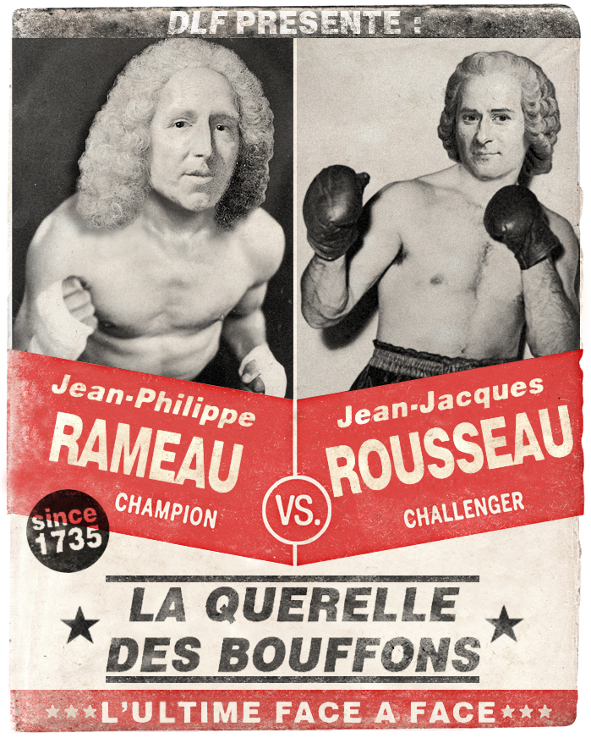
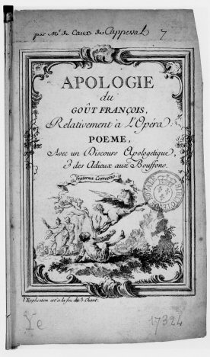
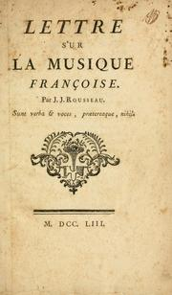
Operatic/Political Debates, Paris, c. 1752-54

Slide 27
European Opera, 1750s-1780s: Diversifies to Include:
Italy: France: Austrian Empire
Opera seria Tragédie lyrique Opera seria
Opera buffa Opéra comique (spoken dialogue) Singspiel (German language spoken dialogue)

Slide 28
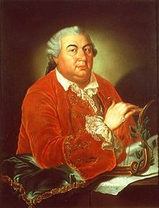
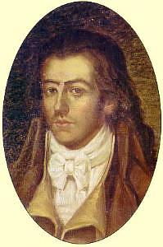
Midcentury Opera Seria Reformers in Italy Include:
Niccolò Jommelli Tommaso Traetta

Slide 29
Midcentury Opera Seria Reformers in Italy Include:
Niccolò Jommelli Tommaso Traetta
Intermixed with the usual da capo arias are:
Choruses
Occasional divertissements
More accompanied recitative
More active orchestra
Occasional experiments with duets
Relaxing of the traditional da capo aria conventions

Slide 30
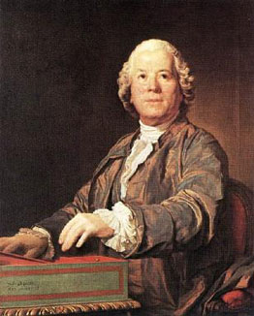
“Reform Operas”
(with librettist, Ranieri Calzabigi
[Raniero de’ Calzabigi])
Orfeo ed Euridice (Vienna, 1762,
rev. for France, 1774)
Alceste (Vienna, 1767,
rev. for France 1776)
Christoph Willibald Gluck (1714-87)

Slide 31
“Reform Opera”
Orfeo ed Euridice (1762, rev. for France, 1774)
No da capo arias [!!]; no recitativo secco
Continuous stage action
Suppression of florid ornaments
Purity and naturalness of melody:
“a beautiful simplicity”
(or “a noble simplicity”)
Christoph Willibald Gluck (1714-87)

Slide 32
(Originally a video clip. Here only a picture.)
Gluck, “Che farò senza Euridice?”, Orfeo ed Euridice (1762, rev. for France, 1774)
(Janet Baker)

Slide 33
“Reform Opera”
Orfeo ed Euridice (1762, rev. for France, 1774)
No da capo arias [!!]; no recitativo secco
Continuous stage action
Suppression of florid ornaments
Purity and naturalness of melody:
“a beautiful simplicity”
(or “a noble simplicity”)
Christoph Willibald Gluck (1714-87)

Slide 34
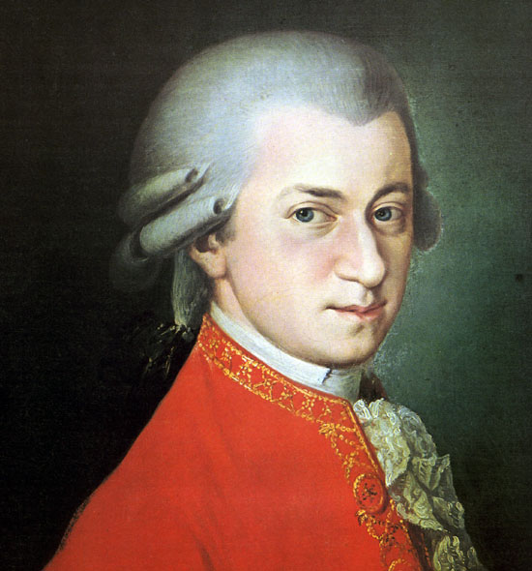
Wolfgang Amadé Mozart (1756-91)

Slide 35
Breakthrough:
Opera Seria: Idomeneo, Re di Creta (Munich, 1781)
Wolfgang Amadé Mozart (1756-91)

Slide 36
Breakthrough:
Opera Seria: Idomeneo, Re di Creta (Munich, 1781)
Chorus, Act 2, “Placido è il mar”
Wolfgang Amadé Mozart (1756-91)

Slide 37
Breakthrough:
Opera Seria: Idomeneo, Re di Creta (Munich, 1781)
Chorus, Act 2, “Placido è il mar”
E major, 6/8, Siciliana/Pastoral Topic
Wolfgang Amadé Mozart (1756-91)

Slide 38
Breakthroughs:
Opera Seria: Idomeneo, Re di Creta (Munich, 1781)
Singspiel: Die Entführung aus dem Serail (Vienna, 1782)
Wolfgang Amadé Mozart (1756-91)

Slide 39
European Opera, 1750s-1780s: Diversifies to Include:
Italy: France: Austrian Empire
Opera seria Tragédie lyrique Opera seria
Opera buffa Opéra comique (spoken dialogue) Singspiel (German language, spoken dialogue)

Slide 40
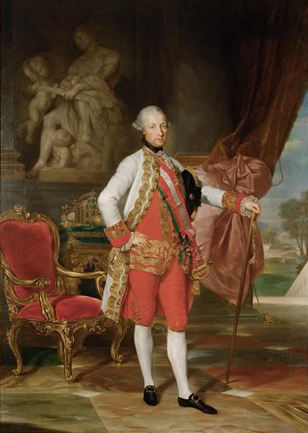
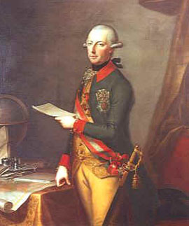
Singspiel: [Comic] German-language opera
with spoken dialogue (1760s—early 1800s)
Joseph II (Hapsburg Emperor of Austria, reigned, 1780-90)

Slide 41
Singspiel: German-language opera
with spoken dialogue (1760s—early 1800s):
a move toward “democratization of opera”?
Early Mozart Examples: Bastien et Bastienne (1768); Zaïde (1779-80)
Mozart, Die Entführung aus dem Serail (1782)
Mozart, Die Zauberflöte (1791)
(transformation: more political, more serious in the 19th century)
Beethoven, Fidelio (1805, 1806, rev. 1814)
Weber, Der Freischütz (1821) [German Romantic Opera]

Slide 42
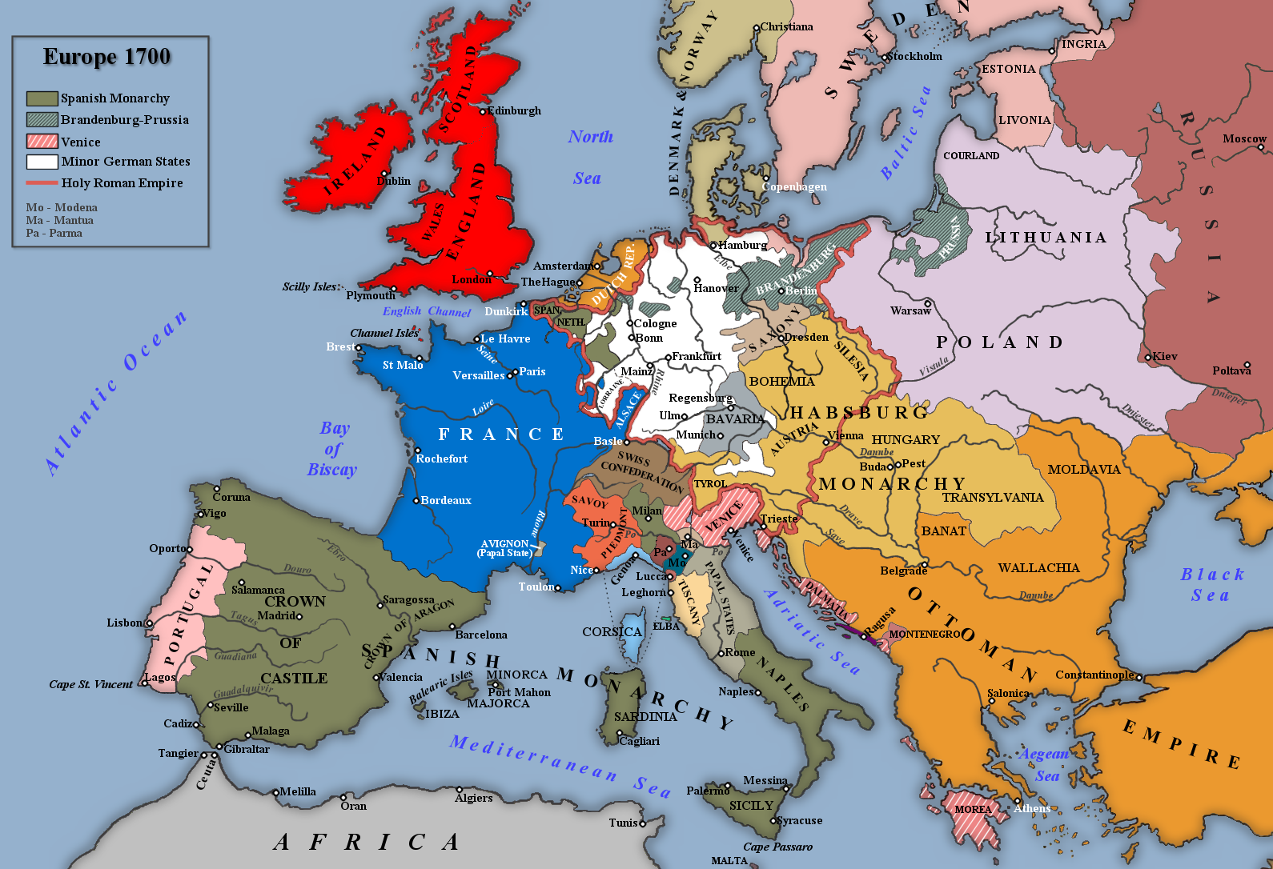

Slide 43
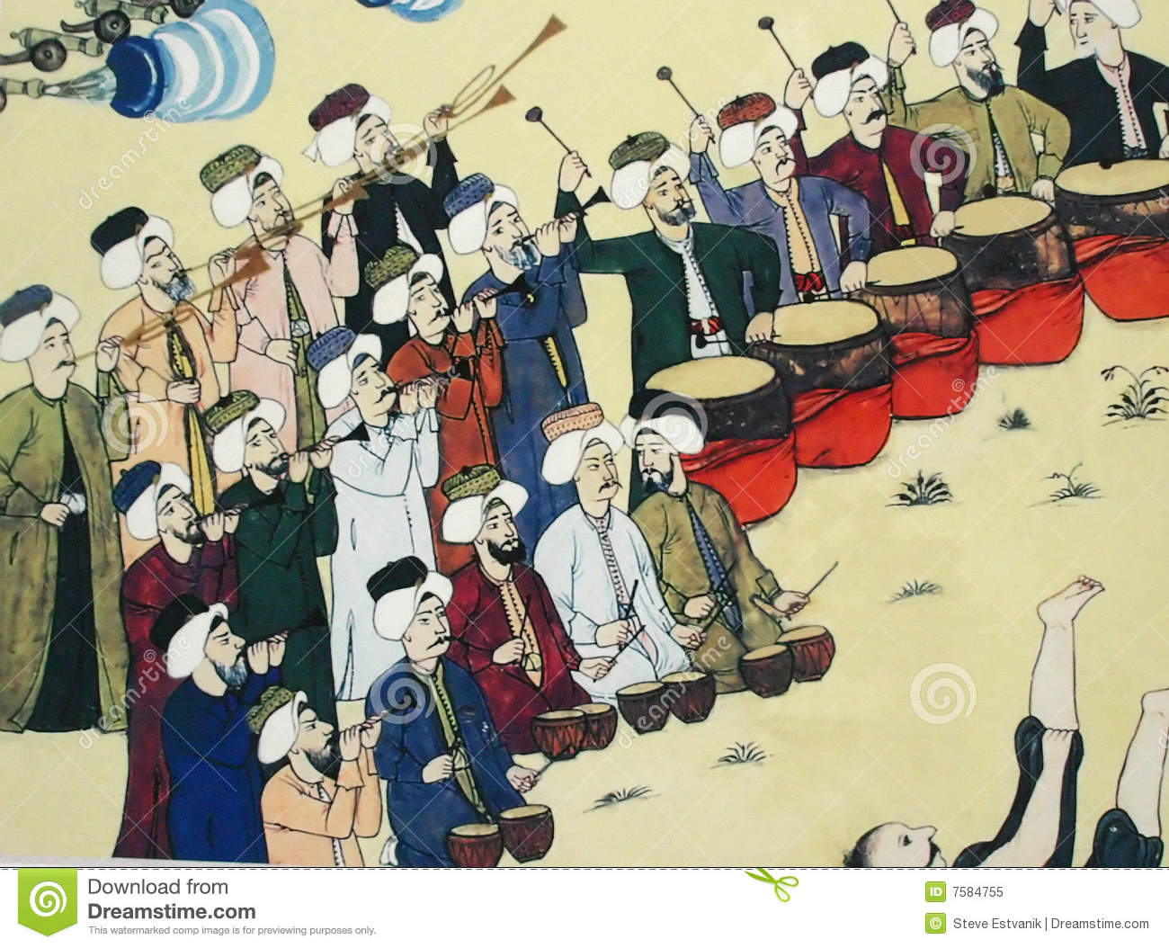
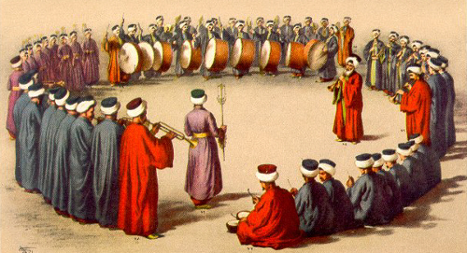
[Turkish] Janissary Band

Slide 44
[Turkish] Janissary Band
1760s, 1770s: the Austrian parody-vogue of “Turkish music”
major-minor fluctuation
“odd” or exotic melodic turns, “zigzag” sixteenth-notes
“noisy” percussion: metallic, jangling

Slide 45
[Turkish] Janissary Band

Slide 46
Mozart: Chorus, “Singt dem groβen Bassa Lieder,”
From Die Entführung aus dem Serail (1782), Act 1
Intro A B A Intro
(major) (soft) (major)
(Arch or) Chiastic Structure

Slide 47
Mozart, Overture to Die Entführung aus dem Serail (1782)
Sonata Form, but with an episode filling the developmental space
Exposition Episode Recapitulation
“Turkish” C major
Minor-mode version of the opening aria from Act 1, Belmonte’s “Hier soll ich sich denn sehen”
“Turkish” C major
I V I I

Slide 48
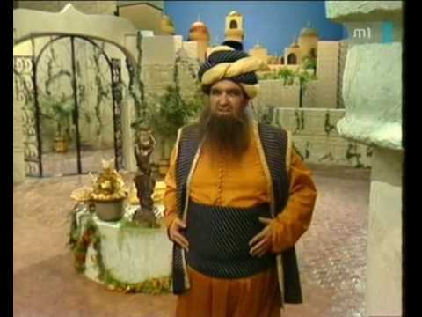
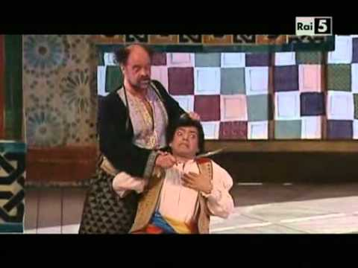
Mozart, Osmin’s Rage Aria, “Solche hergelaufne Laffen,”
Singspiel: Die Entführung aus dem Serail (1782)

Slide 49
Mozart: Letter to his father, 26 September 1781, concerning his satisfaction with having just composed Osmin’s “Rage Aria”
“[The Turk] Osmin’s rage is rendered comical by the use of Turkish music. . . .
As Osmin’s rage gradually increases, there comes (just when the aria seems to be at an end) the allegro assai, which is in a totally different meter and in a different key; this is bound to be very effective. For just as a man in such a towering rage oversteps all the bounds of order, moderation, and propriety and completely forgets himself, so must the music never forget itself. . . . Passions, whether violent or not, must never be expressed to the point of exciting disgust. . . . Music even in the most terrible situations, must never offend the ear, but must please the listener, or in other words never cease to be music.”

Slide 50
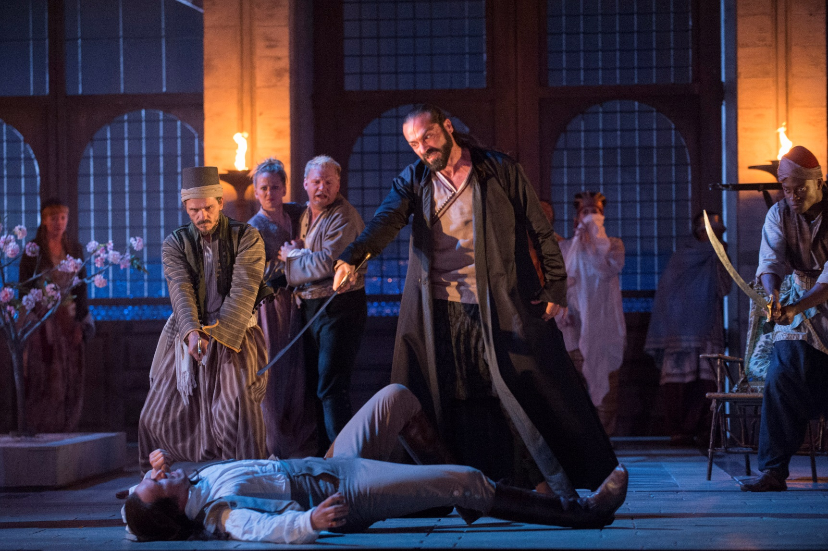
Mozart, Die Entführung aus dem Serail (1782)
(Photo: Glyndebourne Production)

Slide 51
“Turkish Music”
Mozart, Violin Concerto No. 5 in A, K. 219 (1775), finale
Mozart, Piano Sonata in A, K. 331, finale, Rondo alla Turca

Slide 52
Hungarian or “Gypsy” Music (modeled on Hungarian verbunkos style)
Haydn, Piano Trio in G, Hob XVI: 25, finale, “Rondo all’ongarese”

