Slide 1
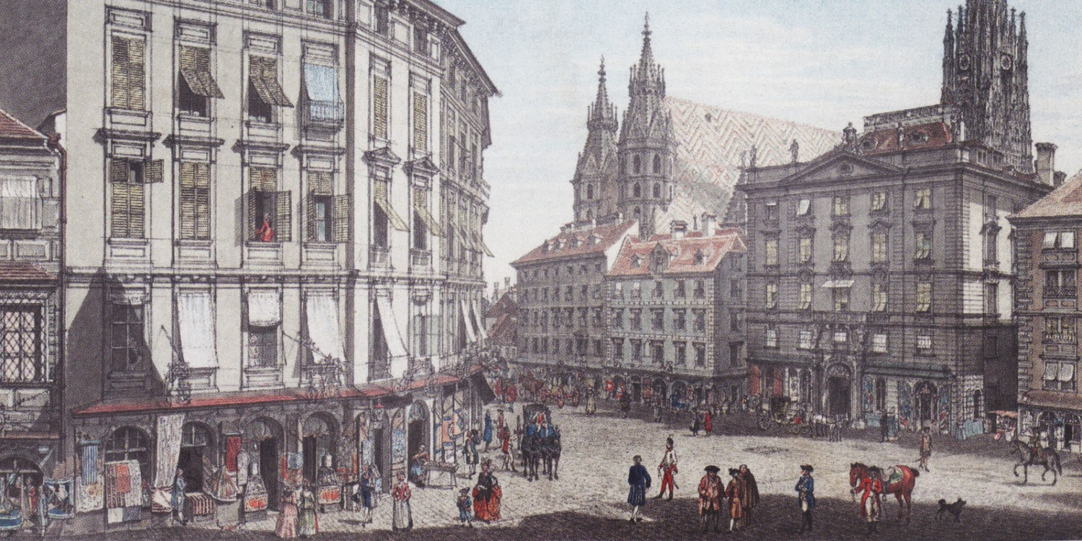
The Midcentury Symphony: Vienna, Mannheim, London, Hamburg
Vienna, c. 1750

Slide 2
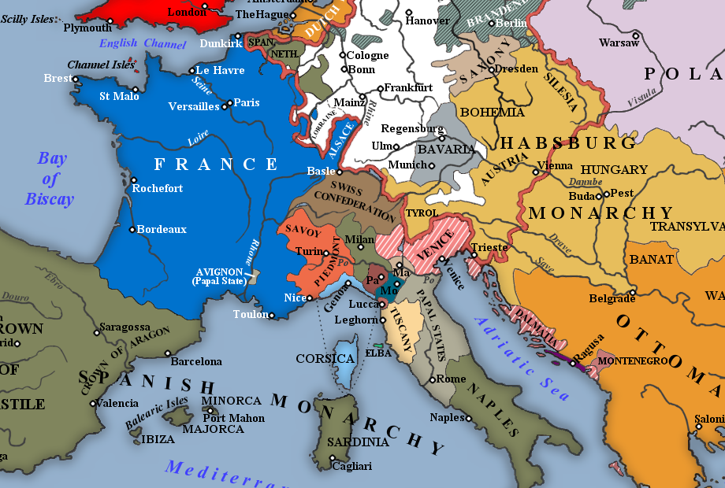
1740s, 1750s: The Symphony Spreads Northward

Slide 3
1740s, 1750s: The Symphony Spreads Northward

Slide 4
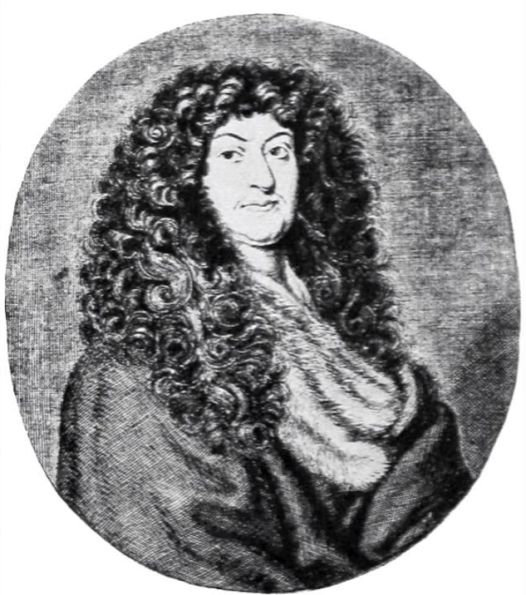
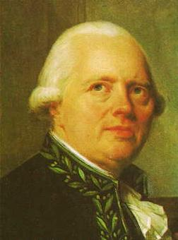
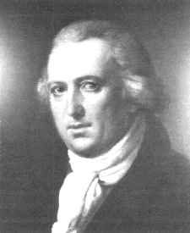
Viennese Symphonists at Midcentury
A generation later
Mathias Georg Monn (1717-50)
Georg Christoph Wagenseil (1715-77)
Johann Vanhal (1739-1813)

Slide 5
The New Genre of the [Court] Symphony
Spreads to Austria (and Germany), 1740s, 1750s
Tendencies:
Longer individual movements (more internal variety)
The whole work increases in length (10, 12, 14 minutes)
The originally normative three movements are sometimes expanded to four (outer movements, binary format)
F – S – F F – S – M – F
Often: minuet/trio minuet/trio rapid finale
or gigue gigue?
(typical: triple-time finale) or other Allegro
triple-time finale?

Slide 6
Symphony in A Major, WV 432 (c. 1750):
first movement, “Con spirito”
Georg Christoph Wagenseil (1715-77)

Slide 7
Binary Format, Part 1 (“exposition”): Continuous Format,
Essential
V: PAC Closure
.
.
“Fortspinnung” or modular chain
.
.
HM (P) - - - - - - - - - - - - (mod.) - - - - - - - cadential - - C (optional)
I . . . . . . . . . . . . . . . . . . . . . . . . . . V . . . . . . . . . . . . . . . . . . . . . . . . .

Slide 8
Binary Format, Part 1 (“exposition”): Continuous Format,
Essential
V: PAC Closure
.
.
“Fortspinnung” or modular chain
.
.
HM (P) - - - - - - - - - - - - (mod.) - - - - - - - cadential - - C (optional)
I . . . . . . . . . . . . . . . . . . . . . . . . . . V . . . . . . . . . . . . . . . . . . . . . . . . .
Strategy for Broadening: Provide a Caesura-Break in the Middle
medial caesura
(MC)
Essential
V: PAC Closure
I:HC
V:HC or
V:PAC
Relaunch in V
.
.
S - - - - - - - - - - - - - - - C (optional)
.
.
(brought to some kind of tonal-rhetorical closure)
HM (P) - - - - - - - - - - - - - - - - - - -
New theme
(often contrasting)
I . . . . . . . . . . . . . . . . . . (V?) V . . . . . . . . . . . . . . . . . . . . . . . . .

Slide 9
Binary Format, Part 1 (“exposition”): Continuous Format,
Essential
V: PAC Closure
.
.
“Fortspinnung” or modular chain
.
.
HM (P) - - - - - - - - - - - - (mod.) - - - - - - - cadential - - C (optional)
I . . . . . . . . . . . . . . . . . . . . . . . . . . V . . . . . . . . . . . . . . . . . . . . . . . . .
Strategy for Broadening: Provide a Caesura-Break in the Middle
medial caesura
(MC)
Essential
V: PAC Closure
I:HC
V:HC or
V:PAC
Relaunch in V
.
.
S - - - - - - - - - - - - - - - C (optional)
.
.
(brought to some kind of tonal-rhetorical closure)
HM (P) - - - - - - - - - - - - - - - - - - -
New theme
(often contrasting)
I . . . . . . . . . . . . . . . . . . (V?) V . . . . . . . . . . . . . . . . . . . . . . . . .

Slide 10
Strategy for Broadening: Provide a Caesura-Break in the Middle
Essential
V: PAC Closure
medial caesura
(MC)
I:HC
V:HC or
V:PAC
Relaunch in V
.
.
S - - - - - - - - - - - - - - - C (optional)
.
.
(brought to some kind of tonal-rhetorical closure)
HM (P) - - - - - - - - - - - - - - - - - - -
New theme
(often contrasting)
I . . . . . . . . . . . . . . . . . . (V?) V . . . . . . . . . . . . . . . . . . . . . . . . .
Result: A Two-Part, Four-Zone “Exposition”
Essential
Expositional Closure (EEC)
medial caesura
(MC)
Relaunch in V
I:HC
V:HC or
V:PAC
.
.
.
.
S - - - - - - - - - - - - - - - C (optional)
P - - - - - - TR - - - - - - - - - - - - - -
New theme
(often contrasting)
(Typically: a gain in energy here)
I . . . . . . . . . . . . . . . . . . (V?) V . . . . . . . . . . . . . . . . . . . . . . . . .

Slide 11
By c. 1750: Two Types of Expositional Strategies Have Emerged
Continuous Exposition (No formalized MC, No S-relaunch)
Essential
Expositional Closure (EEC)
.
.
.
.
P - - - - - - - TR - - - - - - - - -(FS) - - - - - - - - cadential - - C (optional)
I . . . . . . . . . . . . . . . . . . . . . . . . . . V . . . . . . . . . . . . . . . . . . . . . . . . .
Two-Part, Four-Zone Exposition
medial caesura
(MC)
Essential
Expositional Closure (EEC)
I:HC
V:HC or
V:PAC
Relaunch in V
.
.
S - - - - - - - - - - - - - - - C (optional)
.
.
P - - - - - - TR - - - - - - - - - - - - - -
New theme
(often contrasting)
(Typically: a gain of energy here)
I . . . . . . . . . . . . . . . . . . (V?) V . . . . . . . . . . . . . . . . . . . . . . . . .

Slide 12
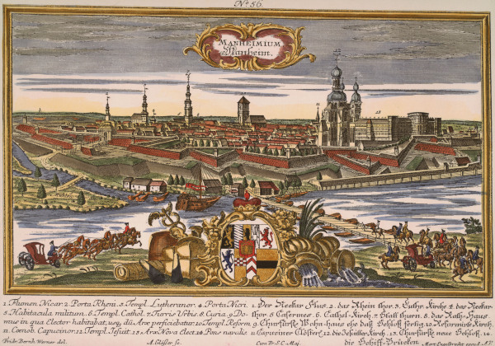
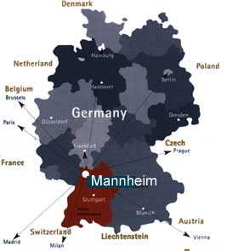
Mid-18th Century: Court of Mannheim

Slide 13
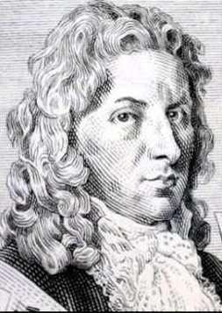
Johann Stamitz (1717-57):
Mannheim Court Composer

Slide 14
The Symphony in Mannheim, 1750s
Norm: four movements
Johann Stamitz (1717-57):
Mannheim Court Composer

Slide 15
The Symphony in Mannheim, 1750s
Norm: four movements
More colorful scoring (“louder” Allegros)
Johann Stamitz (1717-57):
Mannheim Court Composer

Slide 16
The Symphony in Mannheim, 1750s
Norm: four movements
More colorful scoring (“louder” Allegros)
If a two-part exposition (with MC): the exposition’s four action-zones (P, TR, S, C) tend to be filled with zone-specialized music: dramatized, contrasting musical styles
Johann Stamitz (1717-57):
Mannheim Court Composer

Slide 17
The Symphony in Mannheim, 1750s
Norm: four movements
More colorful scoring (“louder” Allegros)
If a two-part exposition (with MC): the exposition’s four action-zones (P, TR, S, C) tend to be filled with zone-specialized music: dramatized, contrasting musical styles
Often: clear treatment of MC
(e.g., hammer-blows), followed by:
Johann Stamitz (1717-57):
Mannheim Court Composer

Slide 18
The Symphony in Mannheim, 1750s
Norm: four movements
More colorful scoring (“louder” Allegros)
If a two-part exposition (with MC): the exposition’s four action-zones (P, TR, S, C) tend to be filled with zone-specialized music: dramatized, contrasting musical styles
Often: clear treatment of MC
(e.g., hammer-blows), followed by:
Often: piano, more cantabile, lyrical S theme (contrasting S)
Johann Stamitz (1717-57):
Mannheim Court Composer

Slide 19
The Symphony in Mannheim, 1750s
Norm: four movements
More colorful scoring (“louder” Allegros)
If a two-part exposition (with MC): the exposition’s four action-zones (P, TR, S, C) tend to be filled with zone-specialized music: dramatized, contrasting musical styles
Often: clear treatment of MC
(e.g., hammer-blows), followed by:
Often: piano, more cantabile, lyrical S theme (contrasting S)
Sometimes longer C-zones after the EEC (V:PAC)
Johann Stamitz (1717-57):
Mannheim Court Composer

Slide 20
The Symphony in Mannheim, 1750s
Norm: four movements
More colorful scoring (“louder” Allegros)
If a two-part exposition (with MC): the exposition’s four action-zones (P, TR, S, C) tend to be filled with zone-specialized music: dramatized, contrasting musical styles
Often: clear treatment of MC
(e.g., hammer-blows), followed by:
Often: piano, more cantabile, lyrical S theme (contrasting S)
Sometimes longer C-zones after the EEC (V:PAC)
Sometimes: “Mannheim Crescendo” in P or TR (albeit a misnomer: not unique to Mannheim)
Johann Stamitz (1717-57):
Mannheim Court Composer

Slide 21
Specialized theme types or characters for different portions of the exposition
(easily recognized types and styles also characteristic of 18th-c. opera)

Slide 22
Specialized theme types or characters for different portions of the exposition
(easily recognized types and styles also characteristic of 18th-c. opera)
E.g. (as options, not requirements)
energetic, assertive P? (one possibility)
forte onset of TR (frequent in orchestral works)
cantabile, piano S (a frequent choice)

Slide 23
Specialized theme types or characters for different portions of the exposition
(easily recognized types and styles also characteristic of 18th-c. opera)
18th-Century “Topics” and “Styles”

Slide 24
Specialized theme types or characters for different portions of the exposition
(easily recognized types and styles also characteristic of 18th-c. opera)
18th-Century “Topics” and “Styles” include
march (military connotations)
dance styles: minuet, gavotte, gigue, etc.
cantabile or “singing” style Allegro
tempest (minor-mode” stormy” style); “rage” style
musette (drone, bagpipe)
hunt (lively 6/8, often with hunting-horn calls)
fanfare
pastoral (placid, often 6/8, over a drone)
siciliana (6/8 or 3/8)
“learned style” (counterpoint, fugato, fugue, canon)
“ombra” (minor-mode, demonic or underworld scenes)
. . . . . . .

Slide 25
Specialized theme types or characters for different portions of the exposition
(easily recognized types and styles also characteristic of 18th-c. opera)
18th-Century “Topics” and “Styles” include
march (military connotations)
dance styles: minuet, gavotte, gigue, etc.
cantabile or “singing” style Allegro
tempest (minor-mode” stormy” style); “rage” style
musette (drone, bagpipe)
hunt (lively 6/8, often with hunting-horn calls)
fanfare
pastoral (placid, often 6/8, over a drone)
siciliana (6/8 or 3/8)
“learned style” (counterpoint, fugato, fugue, canon)
“ombra” (minor-mode, demonic or underworld scenes)
. . . . . . .
Other standard symphonic effects include:
double or triple “hammer-blows” (points of articulation)
“Mannheim rocket”
“brilliant style”
crescendo effects (“Mannheim crescendo”)

Slide 26
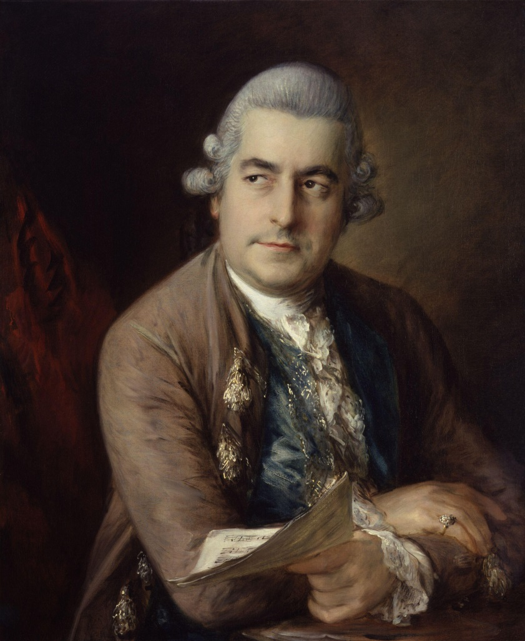
The “London Bach”
Johann Christian Bach (1735-82)

Slide 27
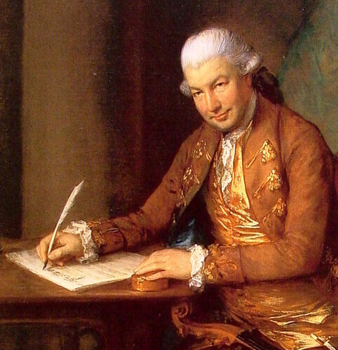
The “London Bach”
“Bach-Abel Concerts” begin, 1765
Johann Christian Bach (1735-82) Carl Friedrich Abel (1723-1787)

Slide 28
The “London Bach”
Five Sets of Symphonies, 1760s, 1770s
Op. 3 (six)
Op. 6 (six)
Op. 8 (three)
Op. 9 (three)
Op. 18 (six)
Johann Christian Bach (1735-82)

Slide 29
The “London Bach”
Symphony in C, op. 3 no. 2 (publ. 1765)
First movement, Allegro
Johann Christian Bach (1735-82)

Slide 30
Type 3 Sonata: Action-Zones
EEC
S
C
Exposition
.
.
.
.
P
TR
V
Binary, Pt. 1
I
.
.
Developmental Space
Binary, Pt. 2
First Section
ESC
Recapitulation
P
TR
S
C
.
.
Binary, Pt. 2
Second Section
I I
Tonal Resolution

Slide 31
Type 3 Sonata (here without repeats): Action-Zones
EEC
S
C
Exposition
P
TR
V
Binary, Pt. 1
I
Developmental Space
Binary, Pt. 2
First Section
ESC
Recapitulation
Binary, Pt. 2
Second Section
P
TR
S
C
I I
Tonal Resolution

Slide 32
Type 3 Sonata (here without repeats): Action-Zones
EEC
Example: Johann Christian Bach, Symphony in C, op. 3 no. 2, first movement (Allegro)—published 1765
S
C
Exposition
P
TR
V
Binary, Pt. 1
I
Developmental Space
Binary, Pt. 2
First Section
ESC
Recapitulation
Binary, Pt. 2
Second Section
P
TR
S
C
I I
Tonal Resolution

Slide 33
Type 3 Sonata (here without repeats): Action-Zones
EEC
Johann Christian Bach, Symphony in C, op. 3 no. 2,
first movement (Allegro)—published 1765
S
C
Exposition
P
TR
V
Binary, Pt. 1
I
Developmental Space
Binary, Pt. 2
First Section
ESC
Recapitulation
Binary, Pt. 2
Second Section
P
TR
S
C
I I
Tonal Resolution

Slide 34
Type 3 Sonata (here without repeats): Action-Zones
EEC
Johann Christian Bach, Symphony in C, op. 3 no. 2,
first movement (Allegro)—published 1765
S
C
Exposition
P
TR
V
Binary, Pt. 1
I
Developmental Space
Binary, Pt. 2
First Section
ESC
Recapitulation
Binary, Pt. 2
Second Section
P
TR
S
C
I I
Tonal Resolution

Slide 35
Type 3 Sonata (here without repeats): Action-Zones
EEC
Johann Christian Bach, Symphony in C, op. 3 no. 2,
first movement (Allegro)—published 1765
S
C
Exposition
P
TR
V
Binary, Pt. 1
I
Developmental Space
Binary, Pt. 2
First Section
ESC
Recapitulation
Binary, Pt. 2
Second Section
P
TR
S
C
I I
Tonal Resolution

Slide 36
Type 3 Sonata (here without repeats): Action-Zones
EEC
Johann Christian Bach, Symphony in C, op. 3 no. 2,
first movement (Allegro)—published 1765
S
C
Exposition
P
TR
V
Binary, Pt. 1
I
Developmental Space
Binary, Pt. 2
First Section
ESC
Recapitulation
Binary, Pt. 2
Second Section
P
TR
S
C
I I
Tonal Resolution

Slide 37
Type 3 Sonata (here without repeats): Action-Zones
EEC
Johann Christian Bach, Symphony in C, op. 3 no. 2,
first movement (Allegro)—published 1765
S
C
Exposition
P
TR
V
Binary, Pt. 1
I
Developmental Space
Binary, Pt. 2
First Section
ESC
Recapitulation
Binary, Pt. 2
Second Section
P
TR
S
C
I I
Tonal Resolution

Slide 38
Type 3 Sonata (here without repeats): Action-Zones
EEC
Johann Christian Bach, Symphony in C, op. 3 no. 2,
first movement (Allegro)—published 1765
S
C
Exposition
P
TR
V
Binary, Pt. 1
I
Developmental Space
Binary, Pt. 2
First Section
ESC
Recapitulation
Binary, Pt. 2
Second Section
P
TR
S
C
I I
Tonal Resolution

Slide 39
Type 3 Sonata (here without repeats): Action-Zones
EEC
Johann Christian Bach, Symphony in C, op. 3 no. 2,
first movement (Allegro)—published 1765
S
C
Exposition
P
TR
V
Binary, Pt. 1
I
Developmental Space
Binary, Pt. 2
First Section
ESC
Recapitulation
Binary, Pt. 2
Second Section
P
TR
S
C
I I
Tonal Resolution

Slide 40
Type 3 Sonata (here without repeats): Action-Zones
EEC
Johann Christian Bach, Symphony in C, op. 3 no. 2,
first movement (Allegro)—published 1765
S
C
Exposition
P
TR
V
Binary, Pt. 1
I
Developmental Space
Binary, Pt. 2
First Section
ESC
Recapitulation
Binary, Pt. 2
Second Section
P
TR
S
C
I I
Tonal Resolution

Slide 41
Type 3 Sonata (here without repeats): Action-Zones
EEC
Johann Christian Bach, Symphony in C, op. 3 no. 2,
first movement (Allegro)—published 1765
S
C
P
TR
V
Binary, Pt. 1
I
Developmental Space
Binary, Pt. 2
First Section
ESC
Recapitulation
Binary, Pt. 2
Second Section
P
TR
S
C
I I
Tonal Resolution

Slide 42
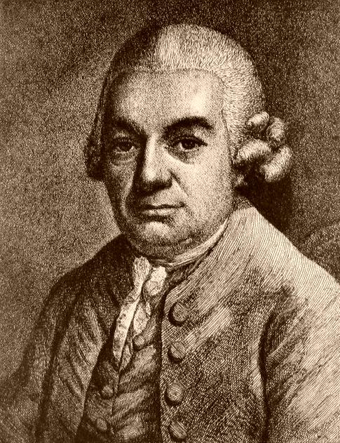
Berlin, 1740-68 (Empfindsamkeit)
Carl Philipp Emanuel Bach (1714-1788)

Slide 43
Berlin, 1740-68 (Empfindsamkeit)
Hamburg, 1768-88
Carl Philipp Emanuel Bach (1714-1788)

Slide 44
Berlin, 1740-68 (Empfindsamkeit)
Hamburg, 1768-88
Also note in Germany, Austria,
1770s: Rise of the “Cult of Genius”
Carl Philipp Emanuel Bach (1714-1788)

Slide 45
Type 3 Sonata (here without repeats): Action-Zones
EEC
C. P. E. Bach, Symphony for Strings “No. 3” in C
(Hamburg, 1773)
S
C
Exposition
P
TR
V
Binary, Pt. 1
I
Developmental Space
Binary, Pt. 2
First Section
ESC
Recapitulation
Binary, Pt. 2
Second Section
P
TR
S
C
I I
Tonal Resolution

Slide 46
Type 3 Sonata (here without repeats): Action-Zones
EEC
C. P. E. Bach, Symphony for Strings “No. 3” in C
(Hamburg, 1773)
S
C
Exposition
P
TR
V
Binary, Pt. 1
I
Developmental Space
Binary, Pt. 2
First Section
ESC
Recapitulation
Binary, Pt. 2
Second Section
P
TR
S
C
I I
Tonal Resolution

Slide 47
Type 3 Sonata (here without repeats): Action-Zones
EEC
C. P. E. Bach, Symphony for Strings “No. 3” in C
(Hamburg, 1773)
S
C
Exposition
P
TR
V
Binary, Pt. 1
I
Developmental Space
Binary, Pt. 2
First Section
ESC
Recapitulation
Binary, Pt. 2
Second Section
P
TR
S
C
I I
Tonal Resolution

Slide 48
Type 3 Sonata (here without repeats): Action-Zones
EEC
C. P. E. Bach, Symphony for Strings “No. 3” in C
(Hamburg, 1773)
S
C
Exposition
P
TR
V
Binary, Pt. 1
I
Developmental Space
Binary, Pt. 2
First Section
ESC
Recapitulation
Binary, Pt. 2
Second Section
P
TR
S
C
I I
Tonal Resolution

Slide 49
Type 3 Sonata (here without repeats): Action-Zones
EEC
C. P. E. Bach, Symphony for Strings “No. 3” in C
(Hamburg, 1773)
S
C
Exposition
P
TR
V
Binary, Pt. 1
I
Developmental Space
Binary, Pt. 2
First Section
ESC
Recapitulation
Binary, Pt. 2
Second Section
P
TR
S
C
I I
Tonal Resolution

Slide 50
Type 3 Sonata (here without repeats): Action-Zones
EEC
C. P. E. Bach, Symphony for Strings “No. 3” in C
(Hamburg, 1773)
S
C
Exposition
P
TR
V
Binary, Pt. 1
I
Developmental Space
Binary, Pt. 2
First Section
ESC
Recapitulation
Binary, Pt. 2
Second Section
P
TR
S
C
I I
Tonal Resolution

Slide 51
Type 3 Sonata (here without repeats): Action-Zones
EEC
C. P. E. Bach, Symphony for Strings “No. 3” in C
(Hamburg, 1773)
S
C
Exposition
P
TR
V
Binary, Pt. 1
I
I
Developmental Space
Binary, Pt. 2
First Section
ESC
Recapitulation
Binary, Pt. 2
Second Section
P
TR
S
C
III (wrong key!) I
Tonal Resolution

Slide 52
Type 3 Sonata (here without repeats): Action-Zones
EEC
C. P. E. Bach, Symphony for Strings “No. 3” in C
(Hamburg, 1773)
S
C
Exposition
P
TR
V
Binary, Pt. 1
I
Developmental Space
Binary, Pt. 2
First Section
ESC
Recapitulation
Binary, Pt. 2
Second Section
P
TR
S
C
III (wrong key!) I
Tonal Resolution

Slide 53
Type 3 Sonata (here without repeats): Action-Zones
EEC
C. P. E. Bach, Symphony for Strings “No. 3” in C
(Hamburg, 1773)
S
C
Exposition
P
TR
V
Binary, Pt. 1
I
Developmental Space
Binary, Pt. 2
First Section
ESC
Recapitulation
Binary, Pt. 2
Second Section
P
TR
S
C
III (wrong key!) I
Tonal Resolution

Slide 54
Type 3 Sonata (here without repeats): Action-Zones
EEC
C. P. E. Bach, Symphony for Strings “No. 3” in C
(Hamburg, 1773)
S
C
P
TR
V
Binary, Pt. 1
I
Developmental Space
Binary, Pt. 2
First Section
ESC
Recapitulation
Binary, Pt. 2
Second Section
P
TR
S
C
III (wrong key!) I
Tonal Resolution

Slide 55
Type 3 Sonata (here without repeats): Action-Zones
EEC
C. P. E. Bach, Symphony for Strings “No. 3” in C
(Hamburg, 1773)
S
C
P
TR
V
Binary, Pt. 1
I
Developmental Space
Binary, Pt. 2
First Section
End of Recapitulation
ESC
CODA
Recapitulation
Binary, Pt. 2
Second Section
P
TR
S
C
P
III (wrong key!) I
Tonal Resolution

Slide 56
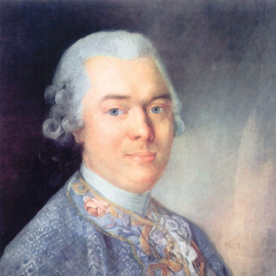
Carl Philipp Emanuel Bach (1714-1788)
Gottfried van Swieten (1733-1803)

Slide 57
End of slides for Session 16
[JH: The next few slides are all-purpose sonata form templates
that can be adapted for different pieces heard in class. As the sonata proceeds, go through the slides one by one as each action zone is entered.]

Slide 58
Type 3 Sonata: Action-Zones
EEC
S
C
Exposition
.
.
.
.
P
TR
V
Binary, Pt. 1
I
.
.
Developmental Space
Binary, Pt. 2
First Section
ESC
Recapitulation
P
TR
S
C
.
.
Binary, Pt. 2
Second Section
I I
Tonal Resolution

Slide 59
Type 3 Sonata: Action-Zones
EEC
S
C
Exposition
.
.
.
.
P
TR
V
Binary, Pt. 1
I
.
.
Developmental Space
Binary, Pt. 2
First Section
ESC
Recapitulation
P
TR
S
C
.
.
Binary, Pt. 2
Second Section
I I
Tonal Resolution

Slide 60
Type 3 Sonata: Action-Zones
EEC
S
C
Exposition
.
.
.
.
P
TR
V
Binary, Pt. 1
I
.
.
Developmental Space
Binary, Pt. 2
First Section
ESC
Recapitulation
P
TR
S
C
.
.
Binary, Pt. 2
Second Section
I I
Tonal Resolution

Slide 61
Type 3 Sonata: Action-Zones
EEC
S
C
Exposition
.
.
.
.
P
TR
V
Binary, Pt. 1
I
.
.
Developmental Space
Binary, Pt. 2
First Section
ESC
Recapitulation
P
TR
S
C
.
.
Binary, Pt. 2
Second Section
I I
Tonal Resolution

Slide 62
Type 3 Sonata: Action-Zones
EEC
S
C
Exposition
.
.
.
.
P
TR
V
Binary, Pt. 1
I
.
.
Developmental Space
Binary, Pt. 2
First Section
ESC
Recapitulation
P
TR
S
C
.
.
Binary, Pt. 2
Second Section
I I
Tonal Resolution

Slide 63
Type 3 Sonata: Action-Zones
EEC
S
C
Exposition
.
.
.
.
P
TR
V
Binary, Pt. 1
I
.
.
Developmental Space
Binary, Pt. 2
First Section
ESC
Recapitulation
P
TR
S
C
.
.
Binary, Pt. 2
Second Section
I I
Tonal Resolution

Slide 64
Type 3 Sonata: Action-Zones
EEC
S
C
Exposition
.
.
.
.
P
TR
V
Binary, Pt. 1
I
.
.
Developmental Space
Binary, Pt. 2
First Section
ESC
Recapitulation
P
TR
S
C
.
.
Binary, Pt. 2
Second Section
I I
Tonal Resolution

Slide 65
Type 3 Sonata: Action-Zones
EEC
S
C
Exposition
.
.
.
.
P
TR
V
Binary, Pt. 1
I
.
.
Developmental Space
Binary, Pt. 2
First Section
ESC
Recapitulation
P
TR
S
C
.
.
Binary, Pt. 2
Second Section
I I
Tonal Resolution

Slide 66
Type 3 Sonata: Action-Zones
EEC
S
C
Exposition
.
.
.
.
P
TR
V
Binary, Pt. 1
I
.
.
Developmental Space
Binary, Pt. 2
First Section
ESC
Recapitulation
P
TR
S
C
.
.
Binary, Pt. 2
Second Section
I I
Tonal Resolution

Slide 67
Type 3 Sonata: Action-Zones
EEC
S
C
Exposition
.
.
.
.
P
TR
V
Binary, Pt. 1
I
.
.
Developmental Space
Binary, Pt. 2
First Section
ESC
Recapitulation
P
TR
S
C
.
.
Binary, Pt. 2
Second Section
I I
Tonal Resolution

