Slide 1
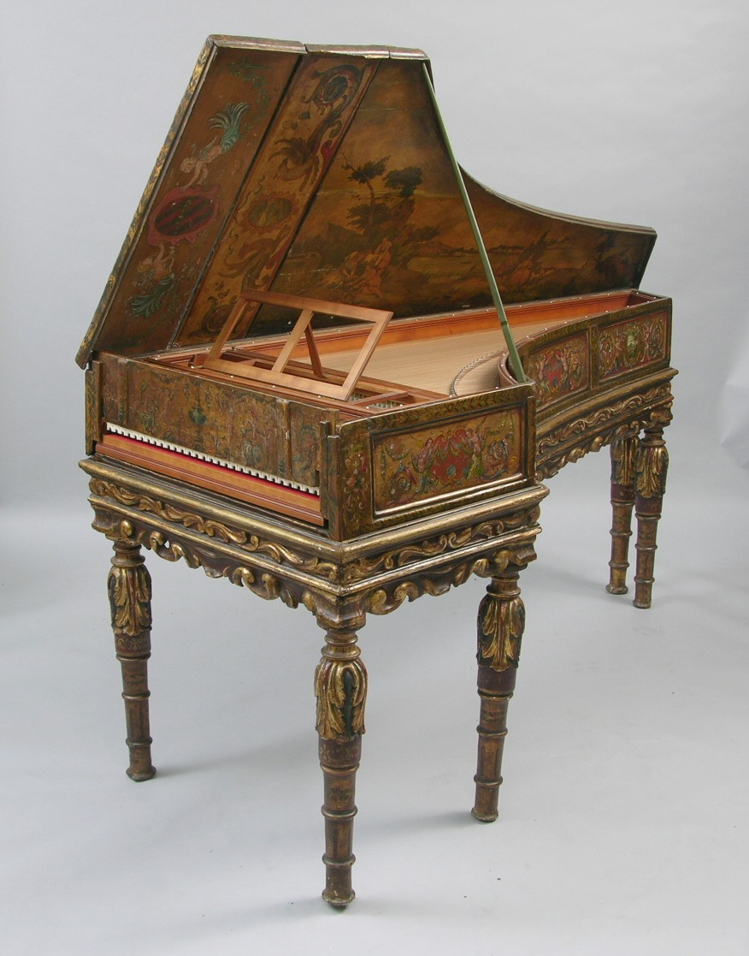
Domenico Scarlatti

Slide 2
In retrospect, one of the most enduring achievements, c. 1730-1760:
Emerging from baroque binary (dance) form:
The gradual emergence and diversification of what we now call “sonata form”:
the epitome of the instrumental-music galant or “Enlightenment” style

Slide 3
In retrospect, one of the most enduring achievements, c. 1730-1760:
Emerging from baroque binary (dance) form:
The gradual emergence and diversification of what we now call “sonata form”:
the epitome of the instrumental-music galant or “Enlightenment” style
An essential aspect of “the emancipation of instrumental music”

Slide 4
In retrospect, one of the most enduring achievements, c. 1730-1760:
The gradual emergence and diversification of what we now call “sonata form”:
the epitome of the instrumental-music galant or “Enlightenment” style
An essential aspect of “the emancipation of instrumental music”
Especially in rapid-tempo first movements and finales

Slide 5
In retrospect, one of the most enduring achievements, c. 1730-1760:
The gradual emergence and diversification of what we now call “sonata form”:
the epitome of the instrumental-music galant or “Enlightenment” style
An essential aspect of “the emancipation of instrumental music”
Especially in rapid-tempo first movements and finales
And in some slow movements

Slide 6
Ongoing Expansion and Diversification of Interior Contents
“Sonata Form”
(by 1750s, 1760s)
(= Expanded Binary Form Particularly Apt for Rapid, Allegro Movements)
Small-Scale
Binary Formats
(esp. c. 1710s-1740s)
.
.
.
.
.
.
.
.

Slide 7
Binary Form: Origins in Repeated Dance Strains (16th C)
Part 1 Part 2 Part 3
.
.
.
.
.
.
.
.
.
.

Slide 8
Binary Form: Origins in Repeated Dance Strains (16th C)
Part 1 Part 2 Part 3
.
.
.
.
.
.
.
.
.
.
More Common by Mid-Late 17th Century: Two Repeated Strains
V:PAC
I:PAC
Part 1 Part 2
.
.
.
.
.
.
.
.

Slide 9
Binary Form: Origins in Repeated Dance Strains (16th C)
Part 1 Part 2 Part 3
.
.
.
.
.
.
.
.
.
.
More Common by Mid-Late 17th Century: Two Repeated Strains
V:PAC
I:PAC
Part 1 Part 2
.
.
.
.
.
.
.
.
Possible:
HM
HM

Slide 10
Binary Form: Origins in Repeated Dance Strains (16th C)
Part 1 Part 2 Part 3
.
.
.
.
.
.
.
.
.
.
More Common by Mid-Late 17th Century: Two Repeated Strains
V:PAC
I:PAC
Part 1 Part 2
.
.
.
.
.
.
.
.
Possible:
HM
HM
or: “end rhymes”

Slide 11
More Common by Mid-Late 17th Century: Two Repeated Strains
V:PAC
I:PAC
Part 1 Part 2
.
.
.
.
.
.
.
.
By First Third of the 18th-Century (e.g., J. S. Bach), a Common Pattern:
V:PAC
I:PAC
Part 1 Part 2
x:PAC
.
.
.
.
.
.
.
.

Slide 12
More Common by Mid-Late 17th Century: Two Repeated Strains
V:PAC
I:PAC
Part 1 Part 2
.
.
.
.
.
.
.
.
By First Third of the 18th-Century (e.g., J. S. Bach), a Common Pattern:
V:PAC
I:PAC
Part 1 Part 2
x:PAC
.
.
.
.
.
.
.
.

Slide 13
By 1680s, 1690s, 1700s, and into the first few decades
of the eighteenth century, binary [dance) formats spread to:

Slide 14
By 1680s, 1690s, 1700s, and into the first few decades
of the eighteenth century, binary [dance) formats spread to:
Trio Sonata (especially the Sonata da camera)

Slide 15
By 1680s, 1690s, 1700s, and into the first few decades
of the eighteenth century, binary [dance) formats spread to:
Trio Sonata (especially the Sonata da camera)
Concerto grosso (some of Corelli, op. 6)

Slide 16
By 1680s, 1690s, 1700s, and into the first few decades
of the eighteenth century, binary [dance) formats spread to:
Trio Sonata (especially the Sonata da camera)
Concerto grosso (some of Corelli, op. 6)
Ripieno Concerto (initially, finales)
Fast Slow Fast
(non-binary) (often minuet
or gigue
character)

Slide 17
By 1680s, 1690s, 1700s, and into the first few decades
of the eighteenth century, binary [dance) formats spread to:
Trio Sonata (especially the Sonata da camera)
Concerto grosso (some of Corelli, op. 6)
Ripieno Concerto (initially, finales)
Sinfonia avanti l’opera (Scarlatti, Pergolesi, Leo, and others)
Fast Slow Fast
(non-binary) (often minuet
or gigue
character)

Slide 18
By 1680s, 1690s, 1700s, and into the first few decades
of the eighteenth century, binary [dance) formats spread to:
Trio Sonata (especially the Sonata da camera)
Concerto grosso (Corelli, op. 6)
Ripieno Concerto (initially, finales)
Sinfonia avanti l’opera (Scarlatti, Pergolesi, Leo, and others)
Self-standing Sinfonie (later 1730s, Sammartini, first and last movements)

Slide 19
By 1680s, 1690s, 1700s, and into the first few decades
of the eighteenth century, binary [dance) formats spread to:
Trio Sonata (especially the Sonata da camera)
Concerto grosso (Corelli, op. 6)
Ripieno Concerto (initially, finales)
Sinfonia avanti l’opera (Scarlatti, Pergolesi, Leo, and others)
Self-standing Sinfonie (later 1730s, Sammartini, first and last movements)
Fast Slow Fast
(often minuet
or gigue
character)

Slide 20
By 1680s, 1690s, 1700s, and into the first few decades
of the eighteenth century, binary [dance) formats spread to:
Trio Sonata (especially the Sonata da camera)
Concerto grosso (Corelli, op. 6)
Ripieno Concerto (initially, finales)
Sinfonia avanti l’opera (Scarlatti, Pergolesi, Leo, and others)
Self-standing Sinfonie (later 1730s, Sammartini, first and last movements)
But also, in various ways, some solo keyboard works called “sonatas”

Slide 21
Domenico Scarlatti

Slide 22
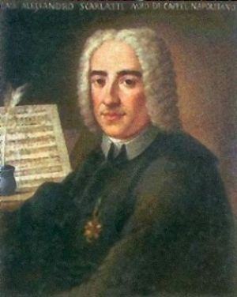
Alessandro Scarlatti (1660-1725) Domenico Scarlatti (1685-1757)

Slide 23
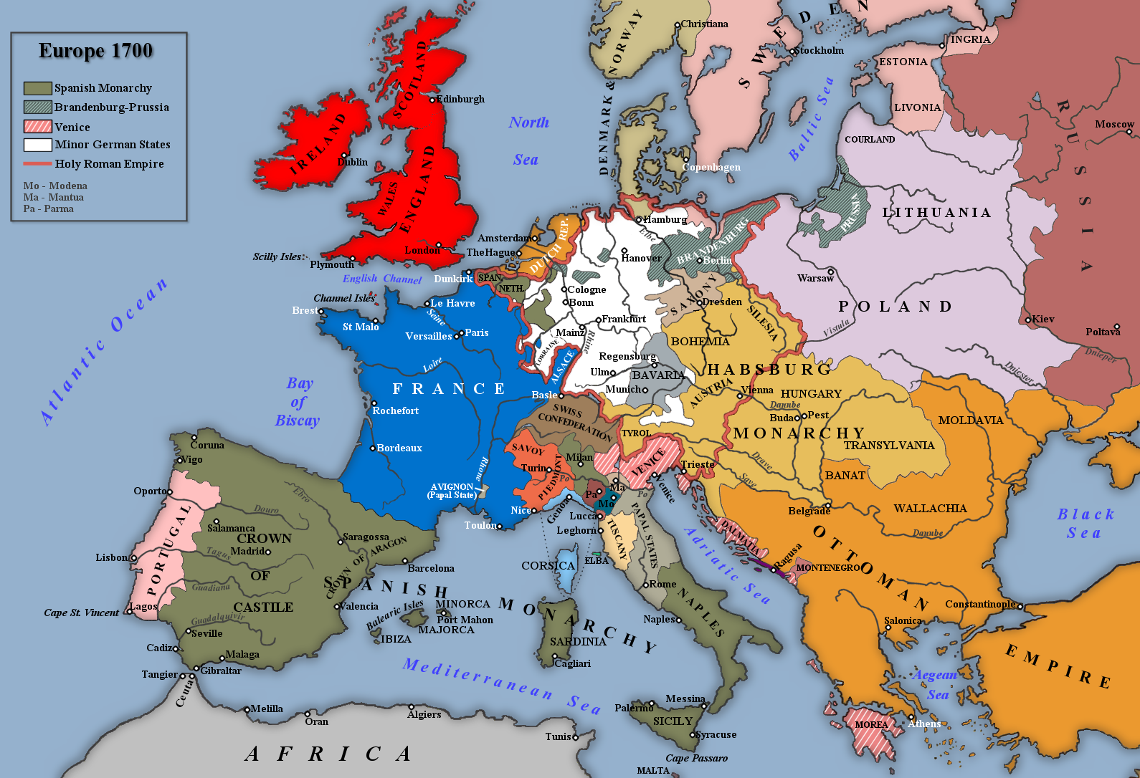
Domenico Scarlatti (1685-1757)

Slide 24
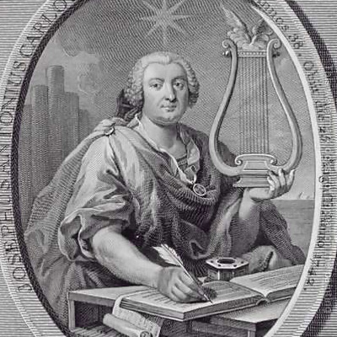
Portuguese Court Harpsichordists (1720s)
Carlos Seixas (1704-42) Domenico Scarlatti (1685-1757)

Slide 25
Portuguese Court (1720s)
1720s: starts composing
(but not publishing)
one-movement binary-form works for harpsichord called “sonatas” or “essercizi”
Domenico Scarlatti (1685-1757)

Slide 26
D. Scarlatti: moves from Portugal to Spain, 1729
(Princess Maria Barbara marries into
the Spanish royal family: Scarlatti follows)
Domenico Scarlatti (1685-1757)
Essercizi per gravicembalo (publ. 1738; 30 single-movement “sonatas” in binary format)

Slide 27
Domenico Scarlatti, Sonata in G, K. 2 (from Essercizi, 1720s, publ. 1738)
V: PAC
I: PAC
C
.
.
HM
.
.
.
.
.
.
Fortspinnung
Fortspinnung
alterations
HM
C
I V V I

Slide 28
Domenico Scarlatti, Sonata in G, K. 2 (from Essercizi, 1720s, publ. 1738)
Essential Structural Closure
Essential Closure of Part 1
“ESC”
V: PAC
I: PAC
C
.
.
HM
.
.
.
.
.
.
Fortspinnung
Fortspinnung
alterations
HM
C
I V V I

Slide 29
Domenico Scarlatti, Sonata in G, K. 2 (from Essercizi, 1720s, publ. 1738)
Essential Structural Closure
Essential Closure of Part 1
“ESC”
V: PAC
I: PAC
C
.
.
HM
.
.
.
.
.
.
Fortspinnung
Fortspinnung
alterations
HM
C
I V V I

Slide 30
Domenico Scarlatti, Sonata in G, K. 2 (from Essercizi, 1720s, publ. 1738)
Essential Structural Closure
Essential Closure of Part 1
“ESC”
V: PAC
I: PAC
C
.
.
HM
.
.
.
.
.
.
Fortspinnung
Fortspinnung
alterations
HM
C
Correspondence Measures
I V V I

Slide 31
Domenico Scarlatti, Sonata in G, K. 2 (from Essercizi, 1720s, publ. 1738)
Essential Structural Closure
Essential Closure of Part 1
“ESC”
V: PAC
I: PAC
C
.
.
HM
.
.
.
.
.
.
Fortspinnung
Fortspinnung
alterations
HM
C
Correspondence Measures
I V V I
“TONAL RESOLUTION”

Slide 32
Domenico Scarlatti, Sonata in G, K. 2 (from Essercizi, 1720s, publ. 1738)
Essential Structural Closure
Essential Closure of Part 1
“ESC”
V: PAC
I: PAC
“Crux”
C
.
.
HM
.
.
.
.
.
.
Fortspinnung
Fortspinnung
alterations
HM
C
“Crux”
C
Correspondence Measures
I V V I
“TONAL RESOLUTION”

Slide 33
Domenico Scarlatti, Sonata in G, K. 2 (from Essercizi, 1720s, publ. 1738)
Essential Structural Closure
Essential Closure of Part 1
“ESC”
V: PAC
I: PAC
“Crux”
C
.
.
HM
.
.
.
.
.
.
Fortspinnung
Fortspinnung
alterations
HM
C
“Crux”
C
Correspondence Measures
I V V I
“TONAL RESOLUTION”

Slide 34
Domenico Scarlatti, Sonata in G, K. 2 (from Essercizi, 1720s, publ. 1738)
Essential Structural Closure
Essential Closure of Part 1
“ESC”
V: PAC
I: PAC
“Crux”
C
.
.
HM
.
.
.
.
.
.
Fortspinnung
Fortspinnung
alterations
HM
C
C
“Crux”
C
Correspondence Measures
I V V I
“TONAL RESOLUTION”
Rotation 1 Rotation 2

Slide 35
Rotational Pattern, Scarlatti, K. 2 in G (Rotations 1 & 2)
HM
(Head Motive)
C
Cadence (PAC):
Essential
Closure
Fortspinnung
(or a successive chaining of differing modules)

Slide 36
Domenico Scarlatti, Sonata in G, K. 2 (from Essercizi, 1702s, publ. 1738)
Essential Closure of Part 1
“ESC”
V: PAC
I: PAC
“Crux”
C
.
.
HM
.
.
.
.
.
.
Fortspinnung
Fortspinnung
alterations
HM
C
C
“Crux”
C
Correspondence Measures
“TONAL RESOLUTION”
I V V I
Rotation 1 Rotation 2

Slide 37
Essential Closure of Part 1
“ESC”
V: PAC
I: PAC
“New”
“Crux”
C
.
.
HM
.
.
.
.
.
.
Fortspinnung
Fortspinnung
alterations
HM
C
C
C
C
“Crux”
C
Correspondence Measures
I V V I
“TONAL RESOLUTION”
Rotation 1 Rotation 2

Slide 38
“Italianate Binary” Format or “Scarlatti Binary” Format
Essential Closure of Part 1
“ESC”
V: PAC
I: PAC
“Crux”
C
“New”
.
.
.
.
.
.
.
.
Fortspinnung
Fortspinnung
alterations
HM
C
C
C
“Crux”
C
Correspondence Measures
“TONAL RESOLUTION”
I V V I
Rotation 1 Rotation 2

Slide 39
“Italianate Binary” Format or “Scarlatti Binary” Format
Domenico Scarlatti, Sonata in D, K. 21 (from Essercizi, 1720s, publ. 1738)
Essential Closure of Part 1
No C in K. 21
“ESC”
V: PAC
I: PAC
No C in K. 21
“Crux”
C
“New”
.
.
.
.
.
.
.
.
Fortspinnung
Fortspinnung
alterations
HM
C
C
C
“Crux”
C
Correspondence Measures
“TONAL RESOLUTION”
I V V I
Rotation 1 Rotation 2

Slide 40
“Full-Reprise” Format (Head Motive Restarts Midway through part 2)
Essential Closure of Part 1
“ESC”
V: PAC
I: PAC
’
“New”
“Crux”
C
.
.
.
.
.
.
.
.
Fortspinnung
HM
HM
alterations
C
“Crux”
Restart!
Correspondence Measures
“TONAL RESOLUTION”
I V “V” I
(or modulatory)
Rotation 1 Rotation 2

Slide 41
“Full-Reprise” Format (Head Motive Restarts Midway through part 2)
Domenico Scarlatti, Sonata in C, K. 159 (from Essercizi, 1720s, publ. 1738)
No C in K. 159
Essential Closure of Part 1
No C in K. 159
“ESC”
V: PAC
V: PAC
I: PAC
I: PAC
’
“New”
“Crux”
C
.
.
.
.
.
.
.
.
Fortspinnung
HM
HM
alterations
C
“Crux”
Restart!
Correspondence Measures
“TONAL RESOLUTION”
I V “V” I
(modulatory)
Rotation 1 Rotation 2

