Slide 1
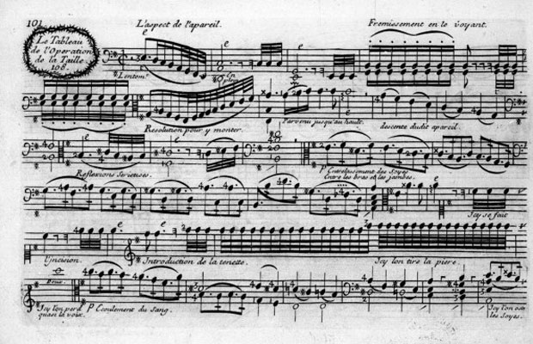
Sonic Images: Illustrative and Program Music of the Baroque

Slide 2
“Topic Family”
A broad network of related signifying traditions
in music that can be traced historically
e.g.
Birds

Slide 3
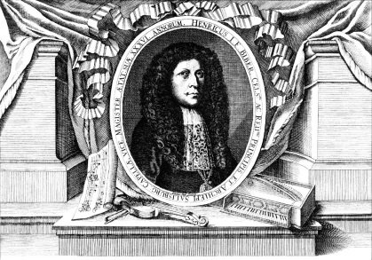
Sonata violino solo representativa (c. 1669)
“Cu-Cu”
Heinrich Biber (1644-1704)

Slide 4
Sonata violino solo representativa (c. 1669)
“Cu-Cu”
“Quail”
Heinrich Biber (1644-1704)

Slide 5
Sonata violino solo representativa (c. 1669)
“Cu-Cu”
“Quail”
“Nightingale”
Heinrich Biber (1644-1704)

Slide 6
Sonata violino solo representativa (c. 1669)
“Cu-Cu”
“Quail”
“Nightingale”
“Hen”
Heinrich Biber (1644-1704)

Slide 7
“Contemporary Metaphor Theory”
(e.g., Lakoff and Johnson, 1980, and many others)
Target Domain to be construed in terms of a specific Source Domain
is [like]
LIFE is a JOURNEY
SILENCE is GOLDEN
JULIET is the SUN
PRICES are GOING UP
(in a metaphor one is asked to pick out the similar attributes between the source and target domains)
“Cross-domain mappings” resulting in a “conceptual blend” or “blended space”

Slide 8
Illustrative Music
(instrumental music that evokes images, actions, or states)
Target Domain to be construed in terms of a specific Source Domain
is [like]
THIS MUSIC is like a _____________
(represents, illustrates)
(in a metaphor one is asked to pick out the similar attributes between the source and target domains)
“Cross-domain mappings” resulting in a “conceptual blend” or “blended space”

Slide 9
“Conceptual Blending”: Fauconnier-Turner 1998, frames 9-10
Generic Space
(recognizes the concept or structure belonging to both input spaces; perceives the nature of the cross-space mapping to be undertaken)
Input Space 1
(mental space 1: partial and relevant aspects of this are projected in into the resultant blended space )
Input Space 2
(mental space 2: partial and relevant aspects of this are projected in into the resultant blended space )
Blended Space
(“formal integration” and “emergent structure”: contains the generic structure of generic space but also blends (projects) relatable aspects of the more specific structure of the two input spaces)

Slide 10
Sonata violino solo representativa (c. 1669)
“Cu-Cu”
“Quail”
“Nightingale”
“Hen”
Heinrich Biber (1644-1704)
18th, 19th, 20th, 21st Century Tradition: a topic family of bird representations in music

Slide 11
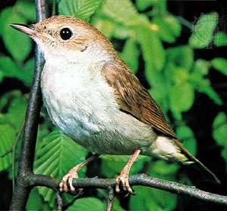
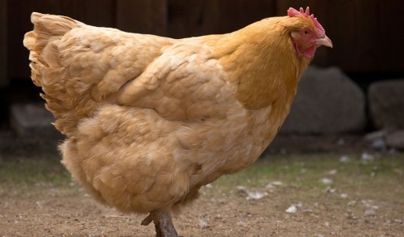
“Topic Family”
A broad network of related signifying traditions
in music that can be traced historically
e.g.
Birds
Sonata violino solo representativa (c. 1669)
“Cu-Cu”
“Quail”
“Nightingale”
“Hen”
Heinrich Biber (1644-1704)

Slide 12
“Topic Family”
A broad network of related signifying traditions
in music that can be traced historically
e.g.
Birds
Cats
Carlo Farina, Capriccio stravagante, “Cat” (c. 1625)

Slide 13
“Topic Family”
A broad network of related signifying traditions
in music that can be traced historically
e.g.
Birds
Cats
Carlo Farina, Capriccio stravagante, “Cat” (c. 1625)
Biber, Sonata violino solo representativa (c. 1669)

Slide 14
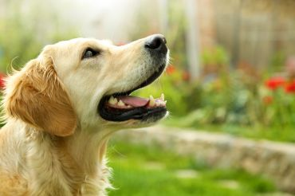
“Topic Family”
A broad network of related signifying traditions
in music that can be traced historically
e.g.
Birds
Cats
Dogs
Carlo Farina, Capriccio stravagante, “Dog” (c. 1625)

Slide 15
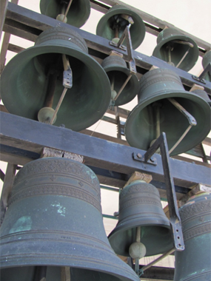
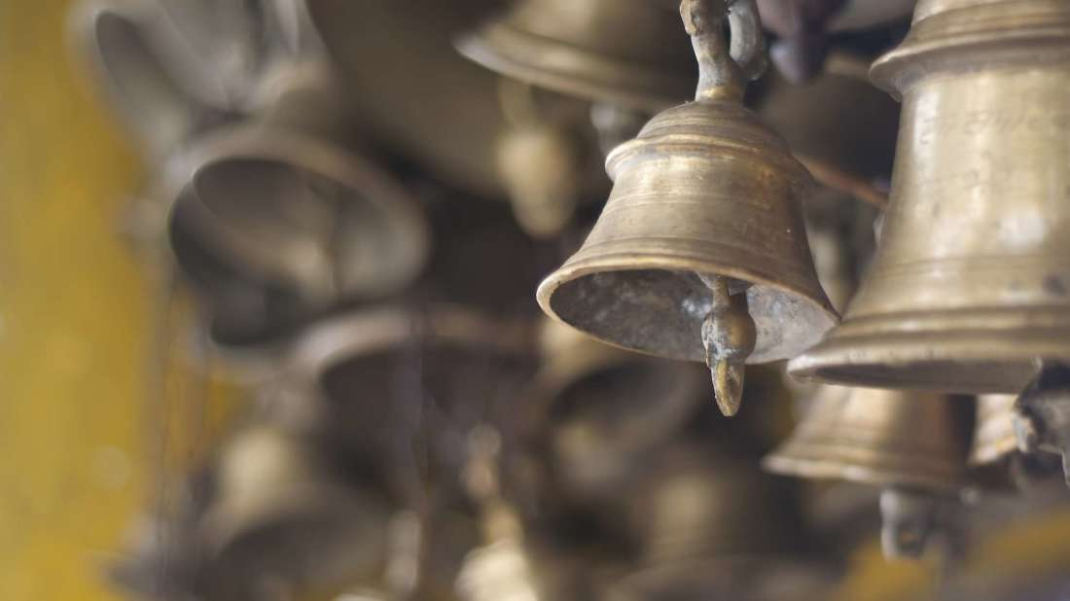
“Topic Family”
A broad network of related signifying traditions
in music that can be traced historically
e.g.
Birds
Cats
Dogs
Bells
William Byrd, “The Bells,” Fitzwilliam Virginal Book (late 16th c.)

Slide 16
“Topic Family”
A broad network of related signifying traditions
in music that can be traced historically
e.g.
Birds
Cats
Dogs
Bells
William Byrd, “The Bells,” Fitzwilliam Virginal Book (late 16th c.)
Marin Marais, “La sonnerie de Sainte-Geneviève” (1723)

Slide 17
“Topic Family”
A broad network of related signifying traditions
in music that can be traced historically
e.g.
Birds
Cats
Dogs
Bells
William Byrd, “The Bells,” Fitzwilliam Virginal Book (late 16th c.)
Marin Marais, “La sonnerie de Sainte-Geneviève” (1723)
François Couperin, “Le carillon de Cythère” (1722)

Slide 18
“Topic Family”
A broad network of related signifying traditions
in music that can be traced historically
e.g.
Birds
Cats
Dogs
Bells
William Byrd, “The Bells,” Fitzwilliam Virginal Book (late 16th c.)
Marin Marais, “La sonnerie de Sainte-Geneviève” (1723)
François Couperin, “Le carillon de Cythère” (1722)
François Couperin, “Le Tic-Toc Choc” (1722)

Slide 19
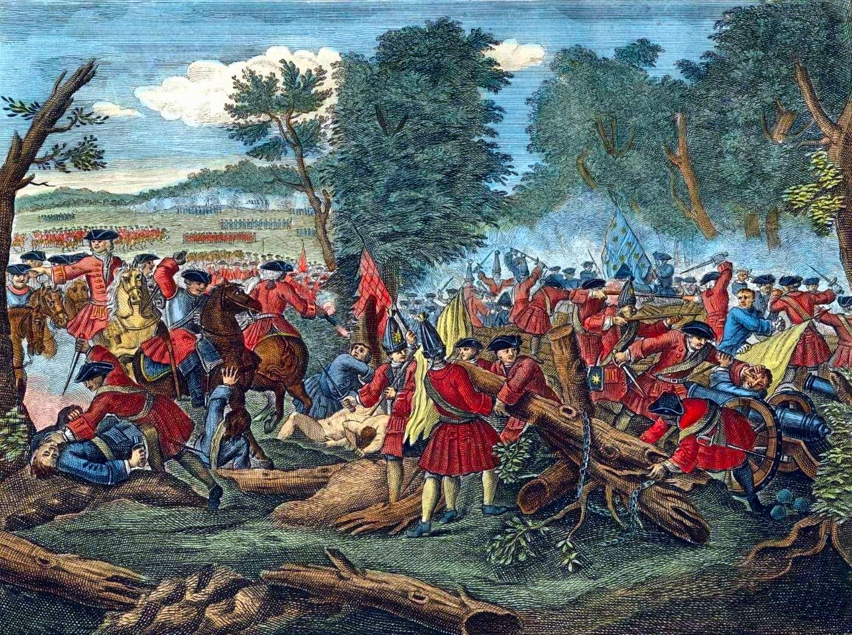
“Topic Family”
A broad network of related signifying traditions
in music that can be traced historically
e.g.
Birds
Cats
Dogs
Bells
Battles
Heinrich Biber, Battalia, “Die Schlacht” (1673)

Slide 20
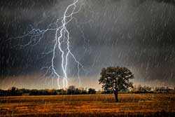
“Topic Family”
A broad network of related signifying traditions
in music that can be traced historically
e.g.
Birds
Cats
Dogs
Bells
Battles
Storms/Tempests
Marin Marais, Alcyone (1706), “Tempête”

Slide 21
“Topic Family”
A broad network of related signifying traditions
in music that can be traced historically
e.g.
Birds
Cats
Dogs
Bells
Battles
Storms/Tempests
Marin Marais, Alcyone (1706), “Tempête”
Jean-Philippe Rameau, Hippolyte et Aricie (1733),
“Tonnerre”

Slide 22
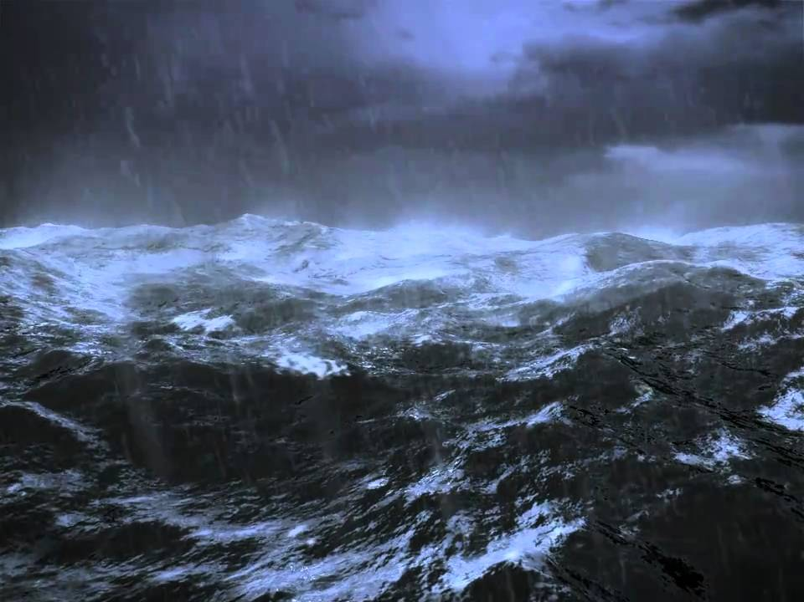
“Topic Family”
A broad network of related signifying traditions
in music that can be traced historically
e.g.
Birds
Cats
Dogs
Bells
Battles
Storms/Tempests
Marin Marais, Alcyone (1706), “Tempête”
Jean-Philippe Rameau, Hippolyte et Aricie (1733),
“Tonnerre”
Antonio Vivaldi, Violin Concerto, op. 8 no. 5,
“La tempesta di mare”

Slide 23
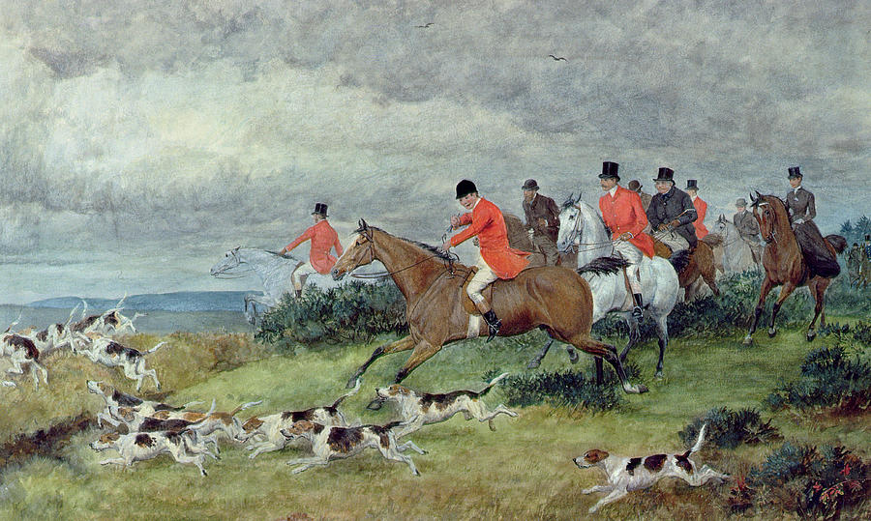
“Topic Family”
A broad network of related signifying traditions
in music that can be traced historically
e.g.
Birds
Cats
Dogs
Bells
Battles
Storms/Tempests
Hunt
Antonio Vivaldi, The Four Seasons, “Autumn” (finale)

Slide 24
“Topic Family”
A broad network of related signifying traditions
in music that can be traced historically
e.g.
Birds
Cats
Dogs
Bells
Battles
Storms/Tempests
Hunt
Antonio Vivaldi, The Four Seasons, “Autumn” (finale)
Domenico Scarlatti, Sonata in C, K. 159

Slide 25
“Topic Family”
A broad network of related signifying traditions
in music that can be traced historically
e.g.
Birds
Cats
Dogs
Bells
Battles
Storms/Tempests
Hunt
Antonio Vivaldi, The Four Seasons, “Autumn” (finale)
Domenico Scarlatti, Sonata in C, K. 159
Mozart, Quartet in B-flat, K. 458/i

Slide 26
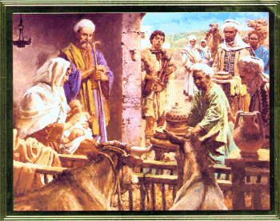
“Topic Family”
A broad network of related signifying traditions
in music that can be traced historically
e.g.
Birds
Cats
Dogs
Bells
Battles
Storms/Tempests
Hunt
Pastoral
Corelli, “Christmas Concerto,” op. 6 no. 12

Slide 27
“Topic Family”
A broad network of related signifying traditions
in music that can be traced historically
e.g.
Birds
Cats
Dogs
Bells
Battles
Storms/Tempests
Hunt
Pastoral
Corelli, “Christmas Concerto,” op. 6 no. 12
Bach, Christmas Oratorio (1734-35), “Sinfonia”

Slide 28
“Topic Family”
A broad network of related signifying traditions
in music that can be traced historically
e.g.
Birds
Cats
Dogs
Bells
Battles
Storms/Tempests
Hunt
Pastoral
Corelli, “Christmas Concerto,” op. 6 no. 12
Bach, Christmas Oratorio (1734-35), “Sinfonia”
Handel, Messiah, “Pastoral Symphony”

Slide 29
“Program Music”
Illustrative music that extends over time to feature also a narrative component:
the representation of a story or a related set of differing situations or actions

Slide 30
“Program Music”
Illustrative music that extends over time to feature also a narrative component:
the representation of a story or a related set of differing situations or actions
Perhaps in a series of illustrative sections, tableaux, or even separate movements

Slide 31
“Contemporary Metaphor Theory”
(e.g., Lakoff and Johnson, 1980, and many others)
Target Domain to be construed in terms of a specific Source Domain
is [like]
LIFE is a JOURNEY
SILENCE is GOLDEN
JULIET is the SUN
PRICES are GOING UP
(in a metaphor one is asked to pick out the similar attributes between the source and target domains)
“Cross-domain mappings” resulting in a “conceptual blend” or “blended space”

Slide 32
Illustrative Music
(instrumental music that evokes images, actions, or states)
Target Domain to be construed in terms of a specific Source Domain
is [like]
THIS MUSIC is like a _____________
(abstract) (represents, illustrates) (something concrete)
(in a metaphor one is asked to pick out the similar attributes between the source and target domains)
“Cross-domain mappings” resulting in a “conceptual blend” or “blended space”

Slide 33
“Program Music”
(illustrative music that is also narrative,
suggesting a story or sequence of occurrences)
Target Domain to be construed in terms of a specific Source Domain
is [like]
THIS MUSIC’S CHANGING FEATURES are like a _____________
(abstract) (represents, illustrates) (something concrete)
(in a metaphor one is asked to pick out the similar attributes between the source and target domains)
“Cross-domain mappings” resulting in a “conceptual blend” or “blended space”

Slide 34
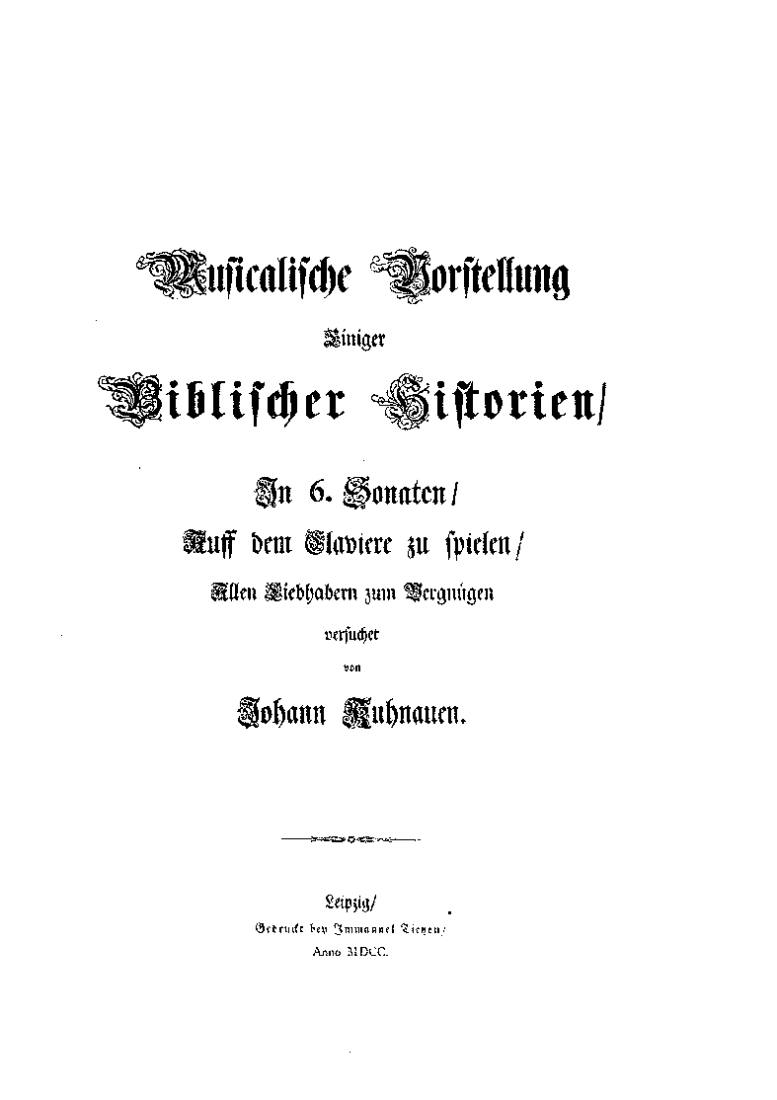
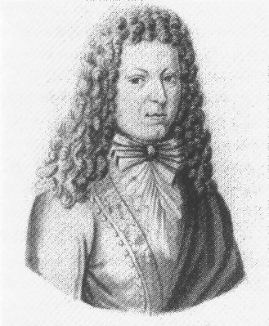
“Program Music”
Illustrative music that extends over time to feature also a narrative component:
the representation of a story or a related set of differing situations or actions
Perhaps in a series of illustrative sections, tableaux, or even separate movements
“Biblical Sonatas” (1700)
Johann Kuhnau (1660-1722)

Slide 35
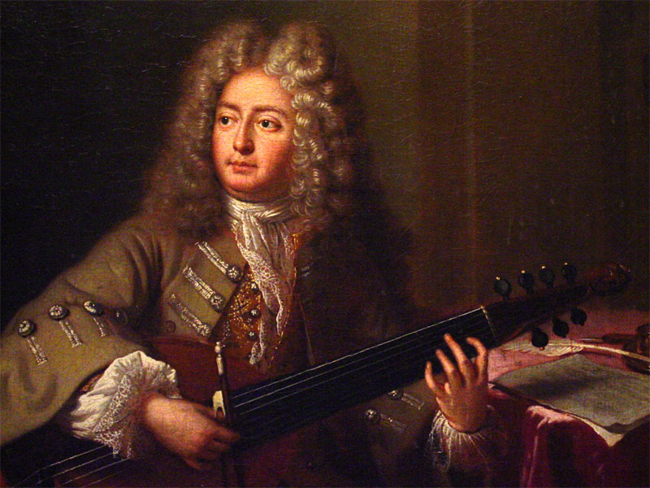
“Program Music”
Illustrative music that extends over time to feature also a narrative component:
the representation of a story or a related set of differing situations or actions
Perhaps in a series of illustrative sections, tableaux, or even separate movements
Marin Marais (1656-1728)
"Tableau de l'opération de la taille" (1725)

Slide 36
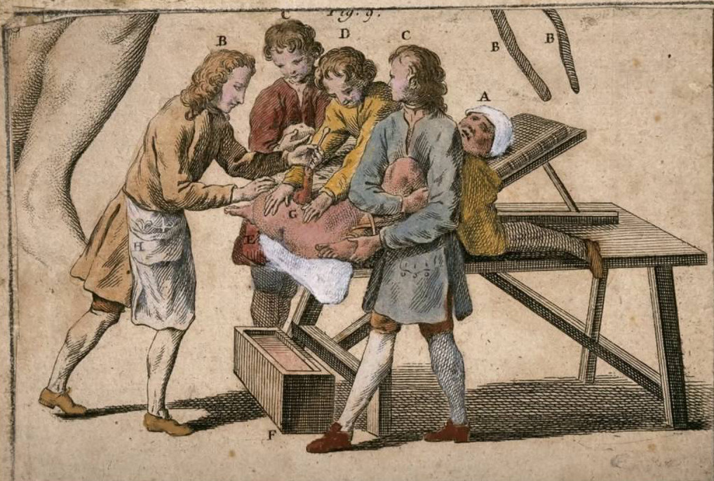

Slide 37
Baroque instrumental music: developing a tradition of recognized signs/signifiers
Rhetoric Affect
Representation:
Metaphor,
Topic Families

