Slide 1
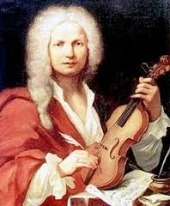
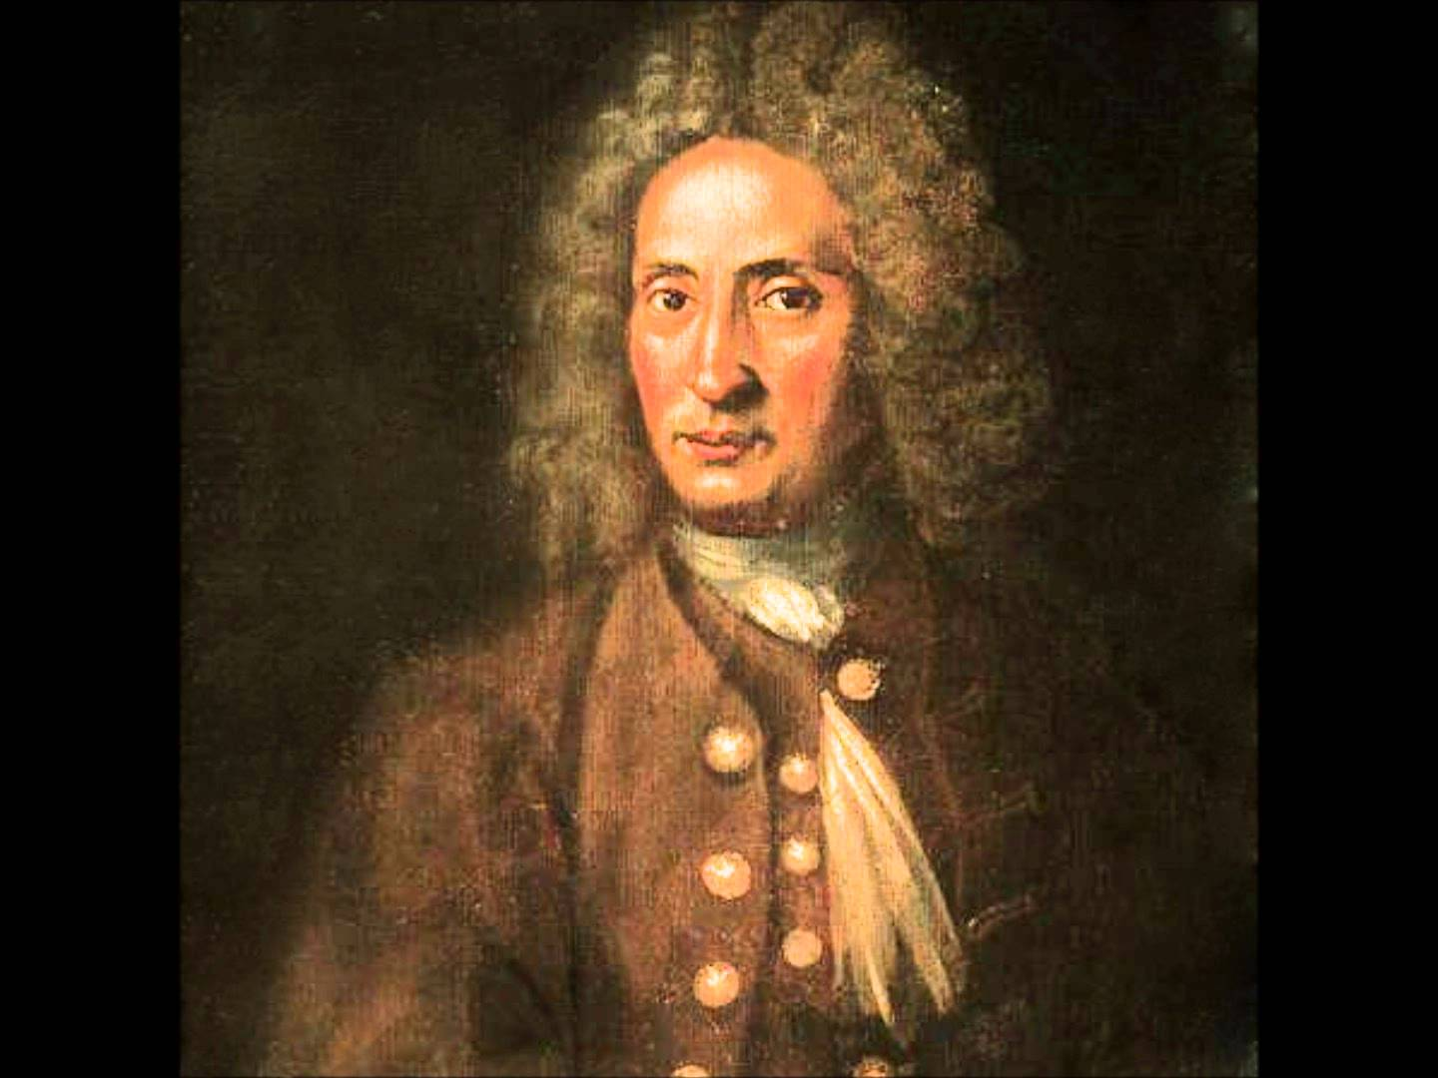
The Italian Baroque Concerto: Torelli and Vivaldi

Slide 2
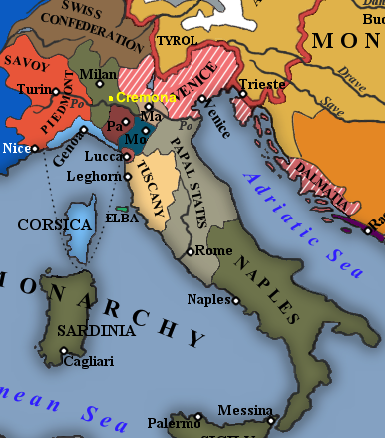
Rome Bologna Venice

Slide 3
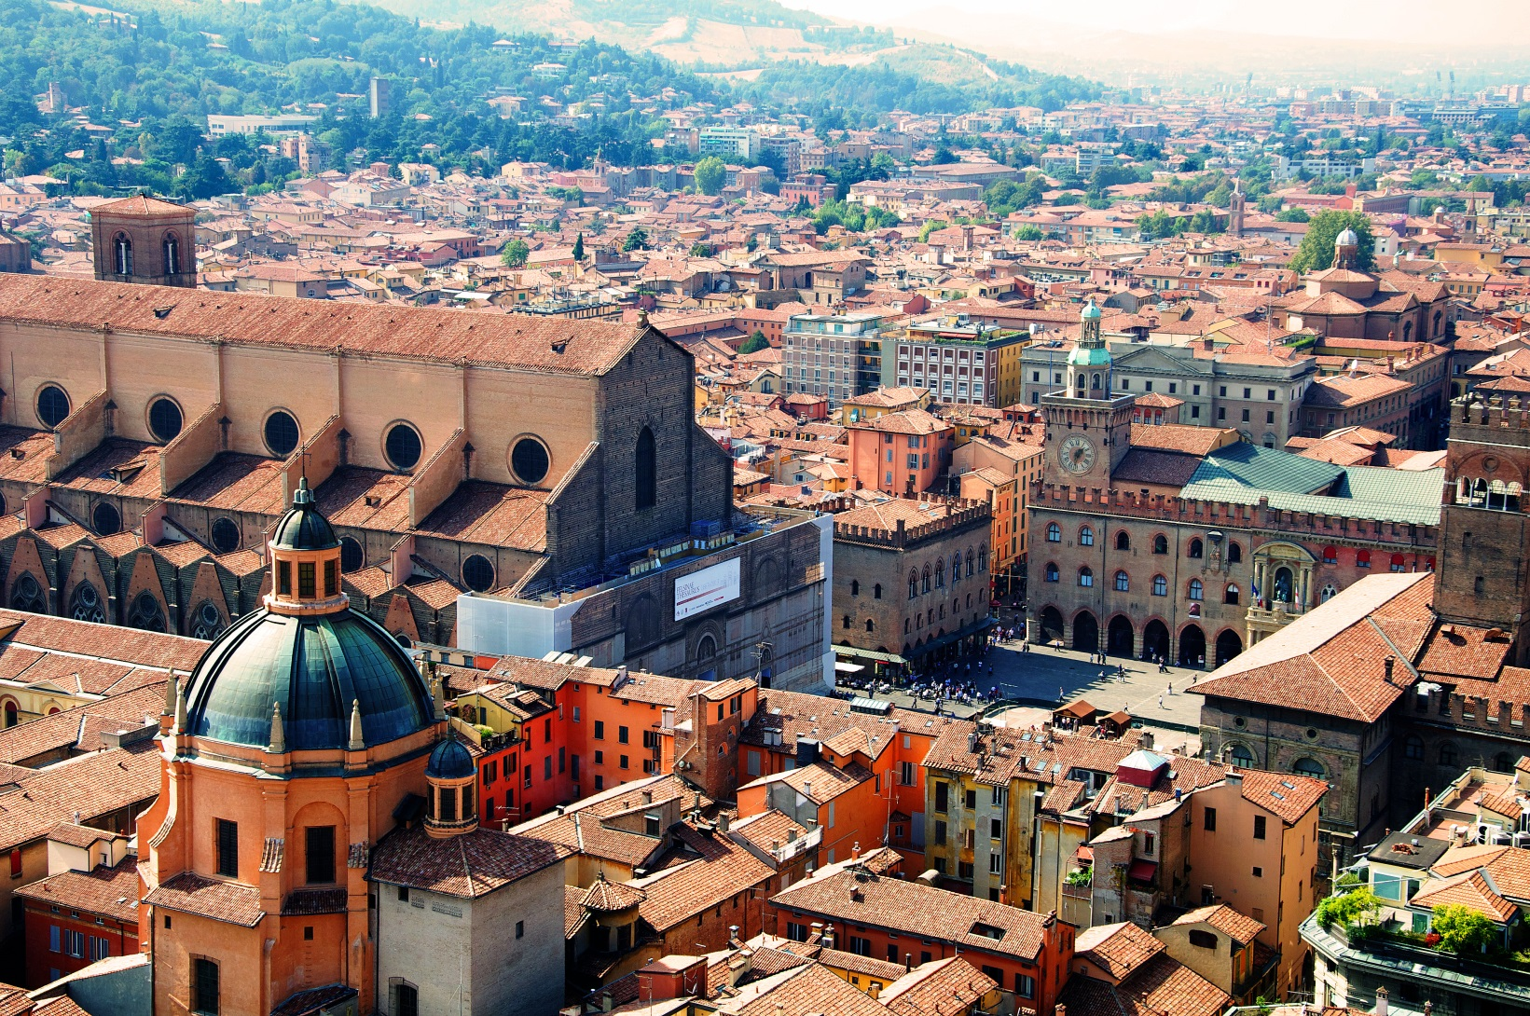
Bologna, with the Cathedral of San Petronio

Slide 4
Giuseppe Torelli (1658-1709)

Slide 5
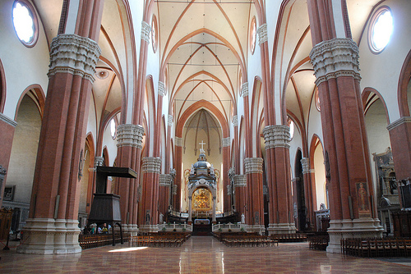
Sinfonia in D for Trumpet and Strings (c. 1700)
Giuseppe Torelli (1658-1709)
Bologna: San Petronio, Interior

Slide 6
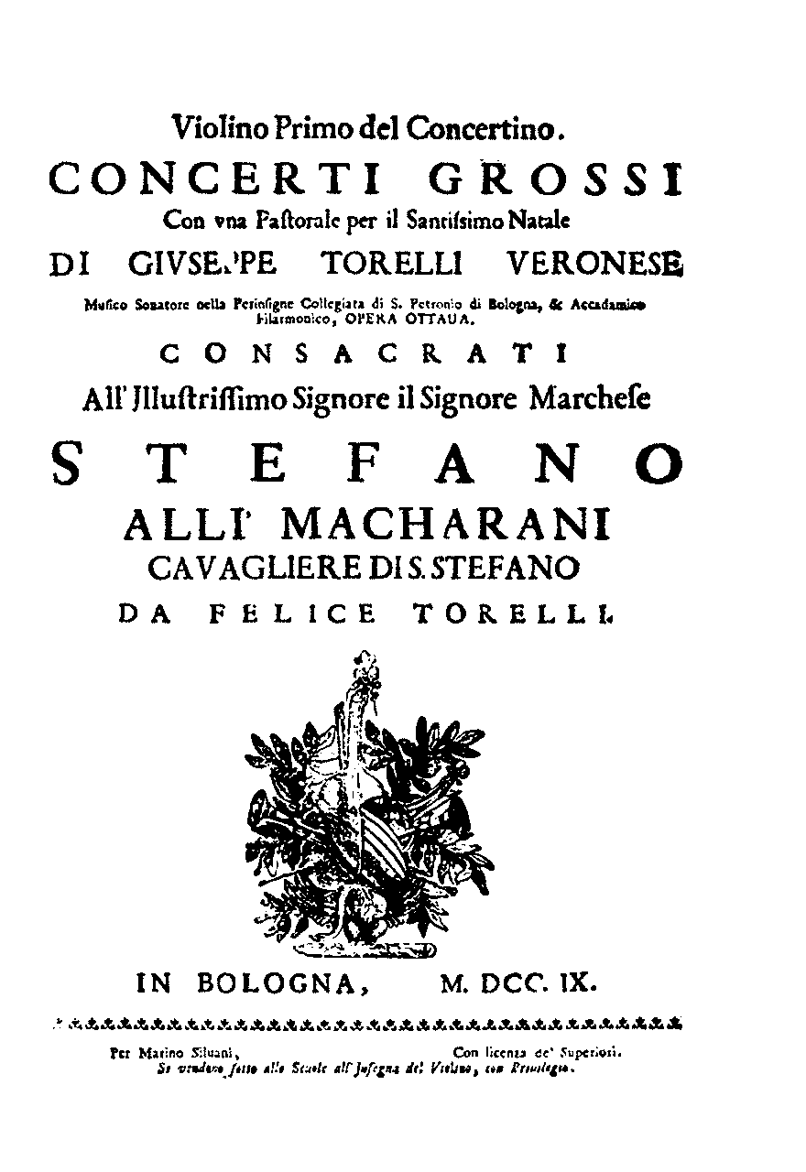
Consistent composition of some of the earliest “concertos” for soloist and orchestra
Giuseppe Torelli (1658-1709)
Twelve Concertos, op. 8 (publ. 1709)

Slide 7
Rome Bologna Venice

Slide 8
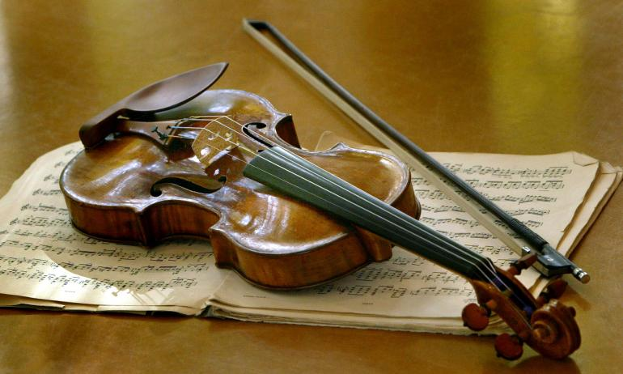
The Rise of Master Violin Manufacture In Italy, 1670-1740
Niccolò Amati (Cremona, d. 1684)
Antonio Stradivari (Cremona, d. 1737)
Giuseppe Guarneri (Mantua, d. 1739/40)

Slide 9
Torelli: the Early Years of the Solo Concerto (Early 1700s)
Twelve Concertos, op. 8 (publ. 1709)
Six for Solo Violin, Six for Two or More
Giuseppe Torelli (1658-1709)

Slide 10
Torelli: the Early Years of the Solo Concerto (Early 1700s)
Twelve Concertos, op. 8 (publ. 1709)
Six for Solo Violin, Six for Two or More
Three-Movement Formats Given More Preference: F-S-F
Giuseppe Torelli (1658-1709)

Slide 11
Torelli: the Early Years of the Solo Concerto (Early 1700s)
Twelve Concertos, op. 8 (publ. 1709)
Six for Solo Violin, Six for Two or More
Three-Movement Formats Given More Preference: F-S-F
Fuller Emergence of Textural Contrast between the Solo and the “Tutti”
Giuseppe Torelli (1658-1709)

Slide 12
Torelli: the Early Years of the Solo Concerto (Early 1700s)
Twelve Concertos, op. 8 (publ. 1709)
Six for Solo Violin, Six for Two or More
Three-Movement Formats Given More Preference: F-S-F
Fuller Emergence of Textural Contrast between the Solo and the “Tutti”
Exploring the ritornello principle
as a vehicle for structure
Giuseppe Torelli (1658-1709)

Slide 13
Torelli: the Early Years of the Solo Concerto (Early 1700s)
Twelve Concertos, op. 8 (publ. 1709)
Six for Solo Violin, Six for Two or More
Three-Movement Formats Given More Preference: F-S-F
Fuller Emergence of Textural Contrast between the Solo and the “Tutti”
Exploring the ritornello principle
as a vehicle for structure
Alternations of lightly accompanied
Solo material reinforced by returns
of the full Tutti group
Giuseppe Torelli (1658-1709)

Slide 14
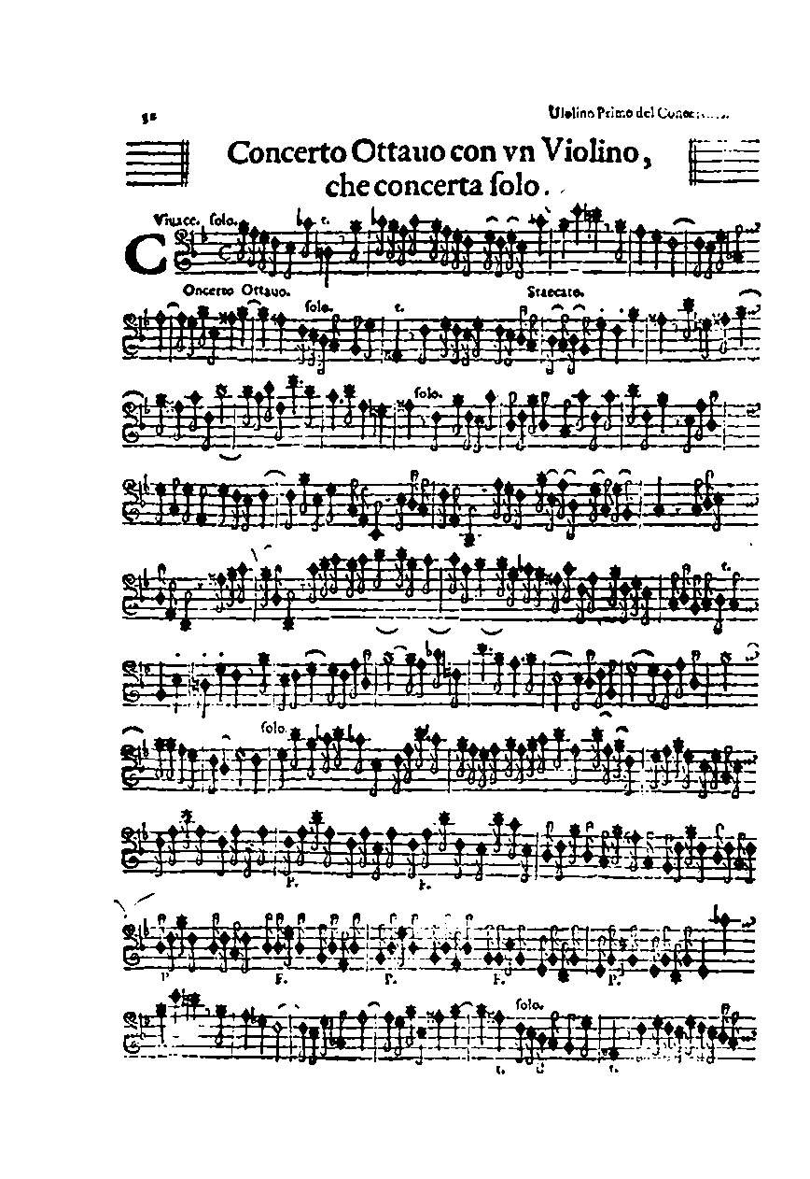
Torelli, Solo Violin Concerto in C Minor,
op. 8 no. 8, first movement, Vivace
Red: solo violin + light accompaniment
Black: tutti (blocks)
c g d g Eb g evaded d
g: PAC
Evaded d
g: PAC
Eb: PAC
g: PAC
Evaded d
1
2
3
4=1
5=2
(Quasi Da Capo)

Slide 15
Torelli, Concerto for Violin in C Minor, op. 8 no. 8, first movement:
initial two solo-tutti statements
Begins on C minor
g: PAC
Evaded d
Solo
Tutti 1
(reinforcer)
Solo
Tutti 2
(reinforcer)
Solo
“ignites” →
“ignites” →
slightly varied sequence
up a fifth

Slide 16
Torelli, Solo Violin Concerto in C Minor,
op. 8 no. 8, first movement, Vivace
Red: solo violin + light accompaniment
Black: tutti (blocks)
c g d g Eb g evaded d
g: PAC
Evaded d
g: PAC
Eb: PAC
g: PAC
Evaded d
1
2
3
4=1
5=2
(Quasi Da Capo)

Slide 17
Torelli, Solo Violin Concerto in C Minor, op. 8 no. 8 (publ. 1709)
Fast Slow Fast
Vivace
([Early] Ritornello Format)
Adagio
(effect: free, quasi-”improvisatory” interlude)
Allegro
([Early] Ritornello Format: in this case, beginning with the head motive of movement 1)

Slide 18
Rome Bologna Venice

Slide 19
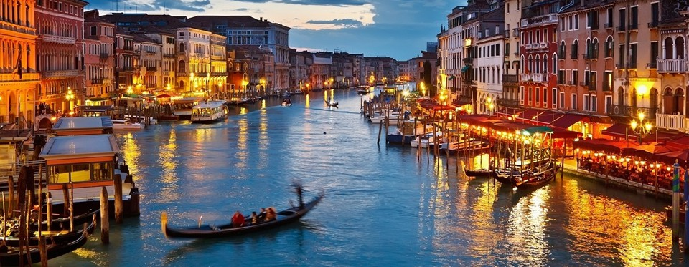
Venice

Slide 20
Antonio Vivaldi (1678-1741)

Slide 21
Flamboyant musical experimenter
drawn to imaginative,
memorable musical ideas
Antonio Vivaldi (1678-1741)

Slide 22
Flamboyant musical experimenter
drawn to imaginative,
memorable musical ideas
Vivid clarifier of structure
Antonio Vivaldi (1678-1741)

Slide 23
Violin Concerto in E, op. 3, no. 12 (publ. 1711):
First movement, opening ritornello (tutti):
I:HC
V:PAC
1
1
2
3
3
4
(echo)
(echo)
(Statement: tonic)
(Balance: dominant)
Antonio Vivaldi (1678-1741)

Slide 24
Violin Concerto in E, op. 3, no. 12 (publ. 1711):
First movement, opening ritornello (tutti):
I:HC
V:PAC
1
1
2
3
3
4
(echo)
(echo)
(Statement: tonic)
(Balance: dominant)
In this case: less HM – FS – CAD
than a chainlike succession of melodically
& rhythmically attractive modules
Antonio Vivaldi (1678-1741)

Slide 25
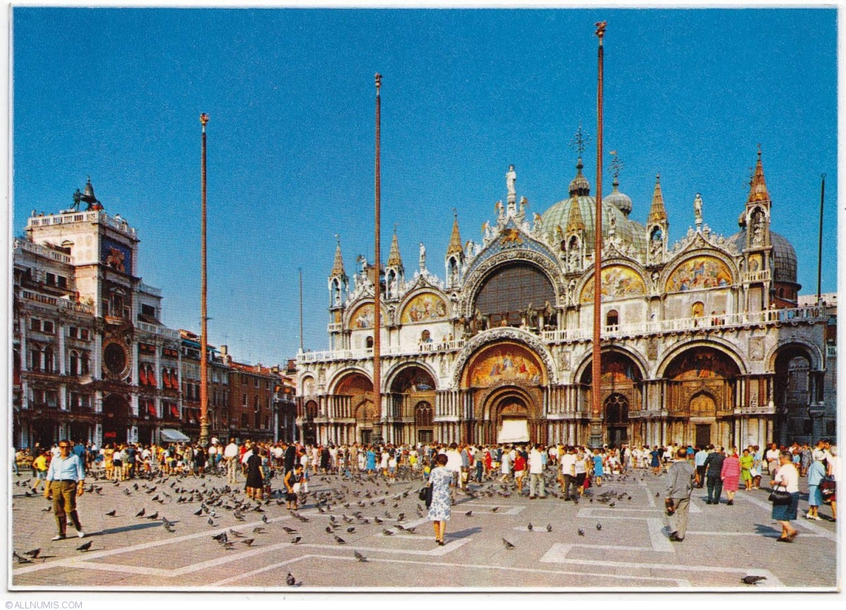
Antonio Vivaldi (1678-1741)
Venice: St. Mark’s Basilica

Slide 26
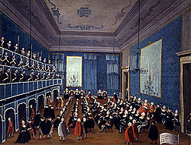
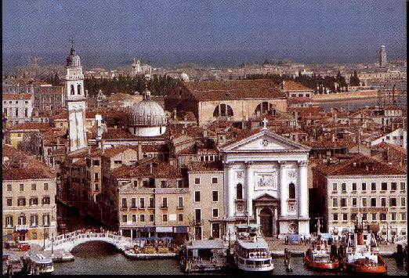
Venice: Pio Ospedale della Pietà

Slide 27
The best young musicians: invited to join the figlie di coro
(“daughters of the chorus”)
Venice: Pio Ospedale della Pietà

Slide 28
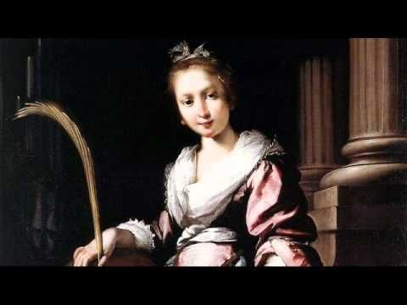
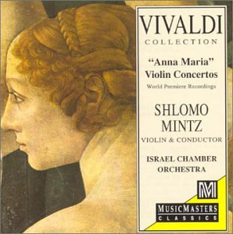
At the Pio Ospedale, one of the figlie di coro: “Anna Maria dal Violin”
Venice: Pio Ospedale della Pietà

Slide 29
Op. 1 (1705) Twelve Sonate da camera
Op. 2 (1709) Twelve Violin Sonatas
Antonio Vivaldi (1678-1741)

Slide 30
Op. 1 (1705) Twelve Sonate da camera
Op. 2 (1709) Twelve Violin Sonatas
Op. 3 (1711) Twelve Concertos for One
or More Violins
Antonio Vivaldi (1678-1741)

Slide 31
Op. 1 (1705) Twelve Sonate da camera
Op. 2 (1709) Twelve Violin Sonatas
Op. 3 (1711) Twelve Concertos for One
or More Violins
4, 2, 1 / 4, 2, 1 / 4, 2, 1 / 4, 2, 1
Antonio Vivaldi (1678-1741)

Slide 32
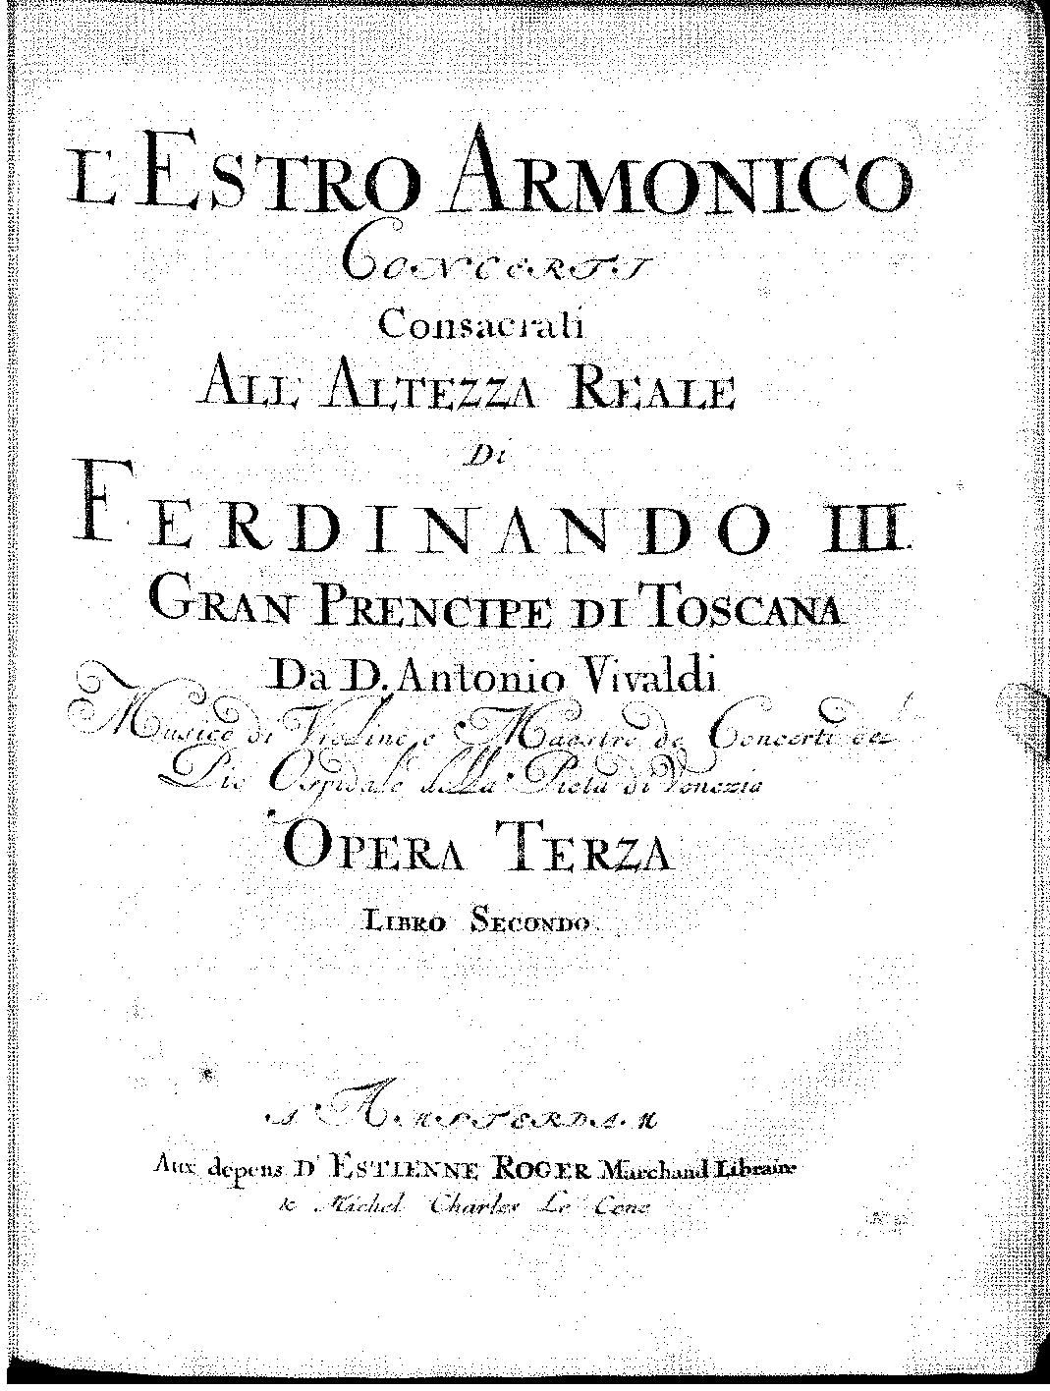

Slide 33
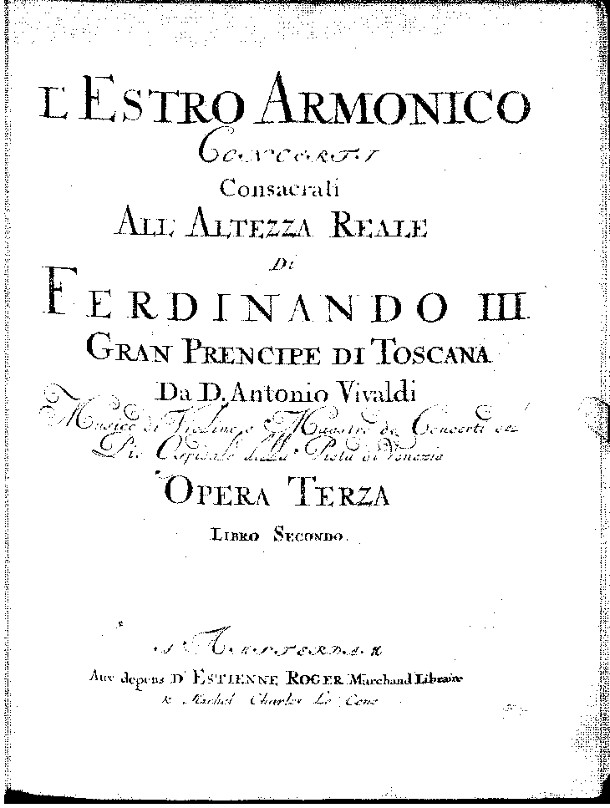
Op. 3 no. 1 in D, for four violins
Allegro, D major

Slide 34
Op. 3 no. 1 in D, for four violins
Allegro, D major
Largo e spiccato, B minor

Slide 35
Op. 3 no. 1 in D, for four violins
Allegro, D major
Largo e spiccato, B minor
Allegro, D major

Slide 36
Vivaldi and Ritornello Formatting
(Arias, Allegro Movements of Concertos)
“Schematic” Alternation of Tutti (Ritornello) Blocks with “Free” Solo Episodes

Slide 37
Vivaldi and Ritornello Formatting
(Arias, Allegro Movements of Concertos)
“Schematic” Alternation of Tutti (Ritornello) Blocks with “Free” Solo Episodes
More often than not: a ritornello begins the movement

Slide 38
Vivaldi and Ritornello Formatting
(Arias, Allegro Movements of Concertos)
“Schematic” Alternation of Tutti (Ritornello) Blocks with “Free” Solo Episodes
More often than not: a ritornello begins the movement
The recurring ritornello-blocks typically stabilize or restabilize the musical discourse

Slide 39
Vivaldi and Ritornello Formatting
(Arias, Allegro Movements of Concertos)
“Schematic” Alternation of Tutti (Ritornello) Blocks with “Free” Solo Episodes
More often than not: a ritornello begins the movement
The recurring ritornello-blocks typically stabilize or restabilize the musical discourse
Internal ritornelli (often shorter, fragmentary): affirmative punctuation completing and framing the solo episodes

Slide 40
Vivaldi and Ritornello Formatting
(Arias, Allegro Movements of Concertos)
“Schematic” Alternation of Tutti (Ritornello) Blocks with “Free” Solo Episodes
More often than not: a ritornello begins the movement
The recurring ritornello-blocks typically stabilize or restabilize the musical discourse
Internal ritornelli (often shorter, fragmentary): affirmative punctuation completing and framing the solo episodes
Internal ritornelli: can be regarded as shots of “tutti energy” to propel the discourse onward, or, at the end, to bring it to a close

Slide 41
Vivaldi and Ritornello Formatting
(Arias, Allegro Movements of Concertos)
“Schematic” Alternation of Tutti (Ritornello) Blocks with “Free” Solo Episodes
More often than not: a ritornello begins the movement
The recurring ritornello-blocks typically stabilize or restabilize the musical discourse
Internal ritornelli (often shorter, fragmentary): affirmative punctuation completing and framing the solo episodes
Internal ritornelli: can be regarded as shots of “tutti energy” to propel the discourse onward, or, at the end, to bring it to a close
Final ritornello: normally ends with a strong cadence (and may—or may not–replicate the initial ritornello, somewhat in the manner of a da capo)

Slide 42
Vivaldi and Ritornello Formatting
(Arias, Allegro Movements of Concertos)
“Schematic” Alternation of Tutti (Ritornello) Blocks with “Free” Solo Episodes
Episodes (Free, Virtuosic Flights for the Soloist(s):

Slide 43
Vivaldi and Ritornello Formatting
(Arias, Allegro Movements of Concertos)
“Schematic” Alternation of Tutti (Ritornello) Blocks with “Free” Solo Episodes
Episodes (Free, Virtuosic Flights for the Soloist(s):
Music may or may not be related to the ritornello material

Slide 44
Vivaldi and Ritornello Formatting
(Arias, Allegro Movements of Concertos)
“Schematic” Alternation of Tutti (Ritornello) Blocks with “Free” Solo Episodes
Episodes (Free, Virtuosic Flights for the Soloist(s):
Music may or may not be related to the ritornello material
May or may not modulate

Slide 45
Vivaldi and Ritornello Formatting
(Arias, Allegro Movements of Concertos)
“Schematic” Alternation of Tutti (Ritornello) Blocks with “Free” Solo Episodes
Episodes (Free, Virtuosic Flights for the Soloist(s):
Music may or may not be related to the ritornello material
May or may not modulate
Most common purpose: display of virtuosity

Slide 46
One Characteristic (Idealized) Model of the Ritornello Format
(but there are many exceptions, especially in modulatory and/or cadential practice)

Slide 47
One Characteristic (Idealized) Model of the Ritornello Format
(but there are many exceptions, especially in modulatory and/or cadential practice)
I:PAC
Rit 1 (R1):
The Generating
Ritornello-Complex:
HM | FS………….|CAD

Slide 48
One Characteristic (Idealized) Model of the Ritornello Format
(but there are many exceptions, especially in modulatory and/or cadential practice)
PAC
R2
(frag.)
I:PAC
Rit 1 (R1):
The Generating
Ritornello-Complex:
HM | FS………….|CAD
S1
(may modulate)

Slide 49
One Characteristic (Idealized) Model of the Ritornello Format
(but there are many exceptions, especially in modulatory and/or cadential practice)
PAC
R2
(frag.)
I:PAC
Rit 1 (R1):
The Generating
Ritornello-Complex:
HM | FS………….|CAD
S1
(may modulate)
S2
PAC
R3
(frag.)

Slide 50
One Characteristic (Idealized) Model of the Ritornello Format
(but there are many exceptions, especially in modulatory and/or cadential practice)
PAC
R2
(frag.)
I:PAC
(visits various keys)
Rit 1 (R1):
The Generating
Ritornello-Complex:
HM | FS………….|CAD
S1
(may modulate)
S2
PAC
. . .
R3
(frag.)
S3

Slide 51
One Characteristic (Idealized) Model of the Ritornello Format
(but there are many exceptions, especially in modulatory and/or cadential practice)
PAC
R2
(frag.)
I:PAC
(visits various keys)
S^{x}
I: PAC
I: PAC
Final Rit
(tonic)
Rit 1 (R1):
The Generating
Ritornello-Complex:
HM | FS………….|CAD
S1
(may modulate)
S2
PAC
. . .
[etc. . . . . . . . . . to]
R3
(frag.)
S3
May or may not have a quasi da capo effect, returning to Rit 1

Slide 52
One Characteristic (Idealized) Model of the Ritornello Format
(but there are many exceptions, especially in modulatory and/or cadential practice)
PAC
R2
(frag.)
I:PAC
(visits various keys)
S^{x}
I: PAC
I: PAC
Final Rit
(tonic)
Rit 1 (R1):
The Generating
Ritornello-Complex:
HM | FS………….|CAD
S1
(may modulate)
S2
PAC
. . .
[etc. . . . . . . . . . to]
R3
(frag.)
S3
May or may not have a quasi da capo effect, returning to Rit 1
“Additive construction”; a “tonal-thematic travelogue”; not a fixed “form”

Slide 53
Some opening ritornellos can be quite lengthy—
normally by expanding the Fortspinnung central phase
An “extreme” case? Violin Concerto in E, RV 271, “L’amoroso”
I:PAC
Rit 1 (R1):
The Generating
Ritornello-Complex:
HM | FS……………………………………………………………………...|CAD

Slide 54
Some opening ritornellos can be quite lengthy—
normally by expanding the Fortspinnung central phase
Or very short! An “extreme” case: “Spring” from The Four Seasons
I:PAC
Rit 1 (R1):
The Generating
Ritornello-Complex:

Slide 55
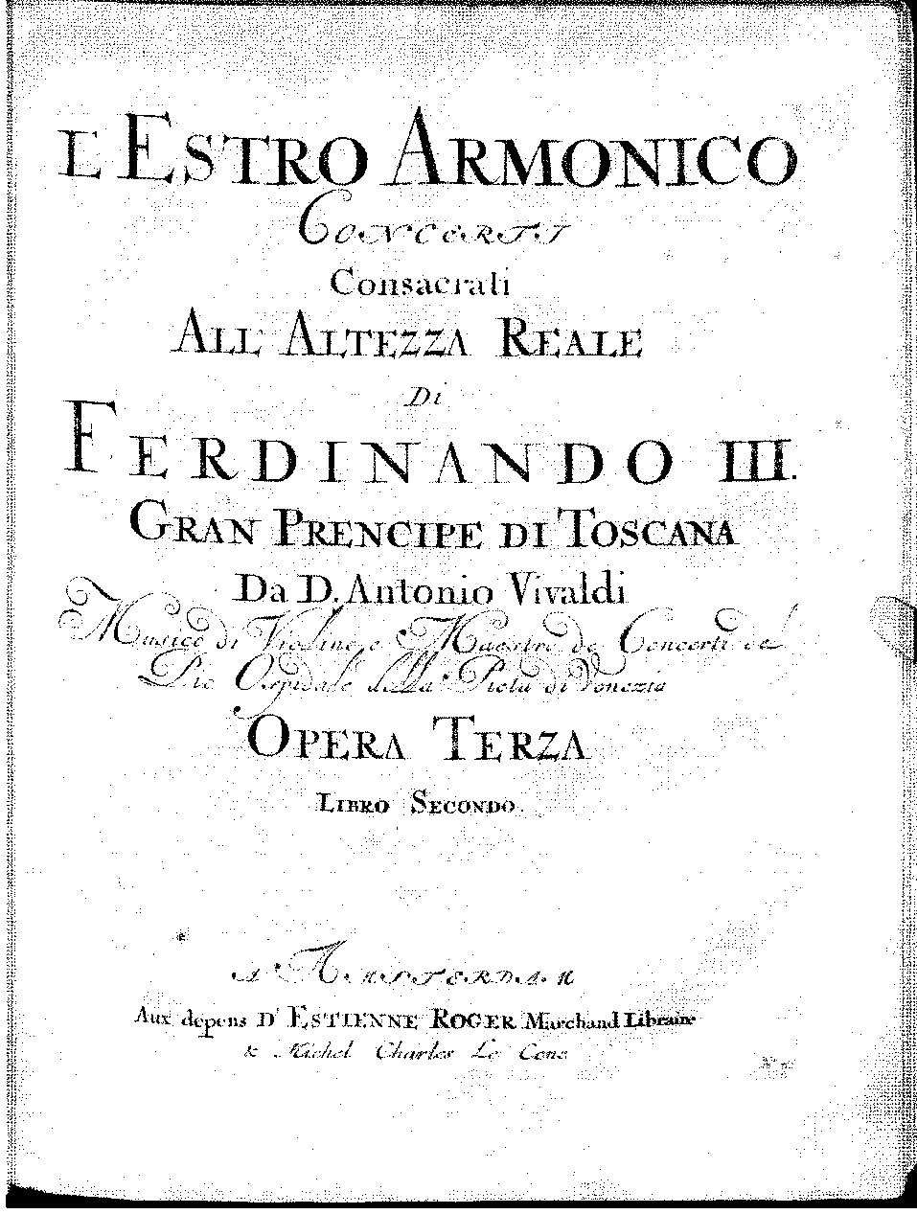
Antonio Vivaldi (1678-1741)

Slide 56
Vivaldi, From the collection, L’estro armonico, op. 3 (publ. 1711)
Concerto for Two Violins in A Minor, op. 3 no. 8
Fast Slow Fast
Allegro
(A Minor)
(Ritornello Format)
Larghetto
(D minor)
(unisono opening, quasi-ground-bass)
Allegro
(A Minor)
(Ritornello Format)

Slide 57
Antonio Vivaldi (1678-1741)

Slide 58
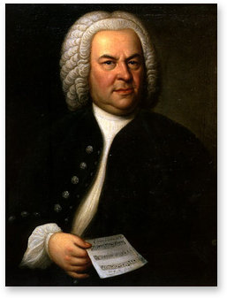
Bach (Weimar) acquires copies of Vivaldi’s L’estro armonico, op. 3
(and other instrumental scores of Italian composers), c. 1713-14
Johann Sebastien Bach (1685-1750)
Antonio Vivaldi (1678-1741)

