Slide 1
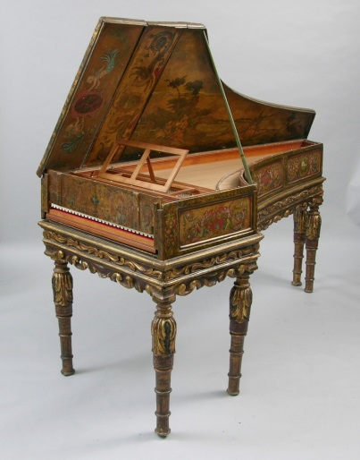
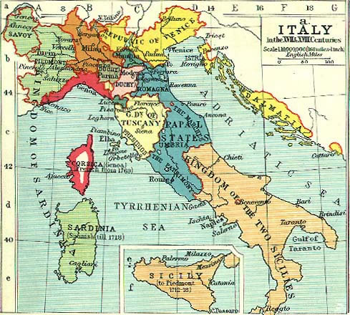
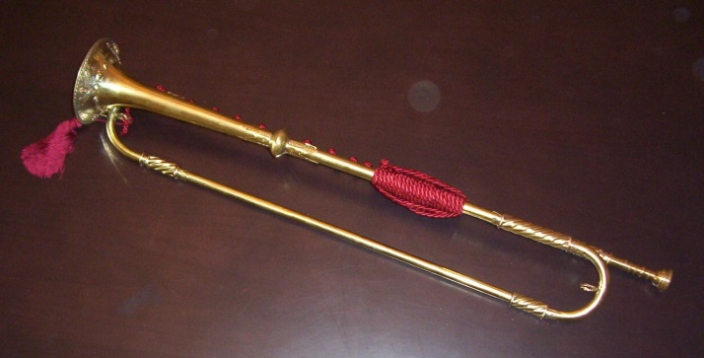
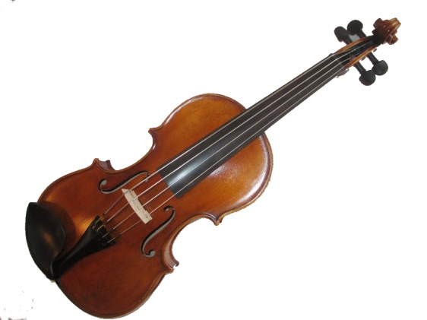
The Rise of the Italian Canzona, Sonata, and Concerto, 1630-1700

Slide 2
Vocal Music:
Dominant, Highest Prestige in the 16th- and 17th Centuries
(but beginning to stir: the rise of instrumental music)
1600 1700 1800

Slide 3
The Rise in the Cultural Significance of Instrumental Music
Music without text

Slide 4
The Rise in the Cultural Significance of Instrumental Music
Music without text
Idiomatic display pieces

Slide 5
The Rise in the Cultural Significance of Instrumental Music
Music without text
Idiomatic display pieces
“Pure music” coming to be seen as its own justification

Slide 6
The Rise in the Cultural Significance of Instrumental Music
Music without text
Idiomatic display pieces
“Pure music” coming to be seen as its own justification
Early stirrings of what would be later claimed as “absolute music”

Slide 7
The Rise in the Cultural Significance of Instrumental Music
Music without text
Idiomatic display pieces
“Pure music” coming to be seen as its own justification
Early stirrings of what would be later claimed as “absolute music”
Challenge: ever-larger, self-sustaining musical structures that
“make sense” on their own terms

Slide 8
The Rise in the Cultural Significance of Instrumental Music
Music without text
Idiomatic display pieces
“Pure music” coming to be seen as its own justification
Early stirrings of what would be later claimed as “absolute music”
Challenge: ever-larger, self-sustaining musical structures that
“make sense” on their own terms
Challenge: abstract (textless) but comprehensible structures of feeling

Slide 9
The Rise in the Cultural Significance of Instrumental Music
Music without text
Idiomatic display pieces
“Pure music” coming to be seen as its own justification
Early stirrings of what would be later claimed as “absolute music”
Challenge: ever-larger, self-sustaining musical structures that
“make sense” on their own terms
Challenge: abstract (textless) but comprehensible structures of feeling
Challenge: abstraction as meaningful, communicable experience

Slide 10
The Rise in the Cultural Significance of Instrumental Music
Music without text
Idiomatic display pieces
“Pure music” coming to be seen as its own justification
Early stirrings of what would be later claimed as “absolute music”
Challenge: ever-larger, self-sustaining musical structures that
“make sense” on their own terms
Challenge: abstract (textless) but comprehensible structures of feeling
Challenge: abstraction as meaningful, communicable experience
The historical solution: begin with smaller, comprehensible structures and, through time, expand them into ever-grander formats and forms

Slide 11
The Genealogy of the Multimovement Principle
In Sonatas and Concertos
The Seventeenth-Century Sources Include:
Suites of Binary-Form Dances
(originally France; then to Italy,
Austria, Germany, etc.)

Slide 12
The Genealogy of the Multimovement Principle
In Sonatas and Concertos
The Seventeenth-Century Sources Include:
Suites of Binary-Form Dances
(originally France; then to Italy,
Austria, Germany, etc.)
The Multisectional “Canzona”
(cf. also the multisectional “fantasy”)

Slide 13
The Genealogy of the Multimovement Principle
In Sonatas and Concertos
The Seventeenth-Century Sources Include:
Suites of Binary-Form Dances
(originally France; then to Italy,
Austria, Germany, etc.)
The Multisectional “Canzona”
(cf. also the multisectional “fantasy”)

Slide 14
The Early Instrumental Canzona (17th Century)
Often a dactyl-rhythm opening (or variant thereof)
Opening [dactyl] figure usually opens a point of imitation
Remainder of the canzona consists of three or four brief, contrasting sections—often in different styles, tempos, and time signatures.

Slide 15
The Free, Multisectional Canzona (Early- and Mid-Seventeenth Century)
(short: 3 or 4 minutes in length)
A
B
C
D
(Etc.)
. . . . . .
Moves through differing, contrasting sections (tempi)

Slide 16
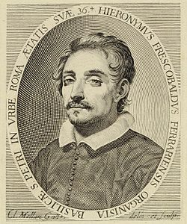
Girolamo Frescobaldi, “Canzona sesta detta La Pesenti” (published 1645)
PAC
PAC
IAC
PAC
1
2
3
4
Dissolve
Dissolve
Dissolve
Dissolve
“4/4”
Ends
HC
New Triple-Time
Section, Imitative
Imitative Opening:
Typical “Canzona”
Triple-Time Dance
New Section

Slide 17
Seventeenth-Century Canzone for Keyboard:
Girolamo Frescobaldi (1583-1643)
Tarquinio Merula (c. 1595-1665)
Johann Jakob Froberger (1616-67)

Slide 18
Seventeenth-Century Canzone for Keyboard:
Girolamo Frescobaldi (1583-1643)
Tarquinio Merula (c. 1595-1665)
Johann Jakob Froberger (1616-67)
Or Seventeenth-Century Canzone for Instrumental Ensembles:
Biagio Marini (1597-1665)
Tarquinio Merula (c. 1595-1665)
Giovanni Legrenzi (1620-1698)
Maurizio Cazzati (1620-1677)

Slide 19
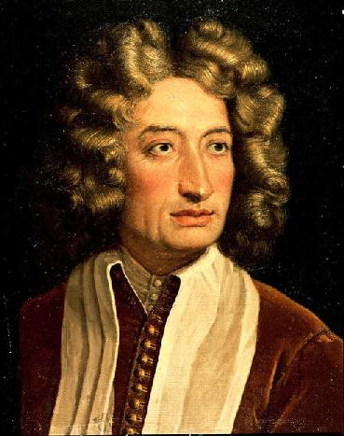
Maurizio Cazzati, Sonata à 4 in G Minor, “La Sampiera” (Bologna, publ. 1665)
(internal cadences)
IAC
PAC
Allegro
Imitative; duple time
Grave
Homophonic “interlude”
somber, devout,
hymnlike
Largo
Head motive: lamenting chromatic descent

Slide 20
Canzona/Sonata “Sections” Sonata/Concerto “Movements”

Slide 21
“Canzona” “Sonata” “Sinfonia” “Concerto”

Slide 22
“Canzona” “Sonata” “Sinfonia” “Concerto”
By late 17th-C
the term becomes uncommon

Slide 23
“Canzona” “Sonata” “Sinfonia” “Concerto”
By late 17th-C
the term becomes uncommon
Tendency: fewer instruments, more polarized treble and bass

Slide 24
“Canzona” “Sonata” “Sinfonia” “Concerto”
By late 17th-C
the term becomes uncommon
Tendency: fewer instruments, more polarized treble and bass
Tendency: music for larger ensembles and fuller textures

Slide 25
“Canzona” “Sonata” “Sinfonia” “Concerto”
By late 17th-C
the term becomes uncommon
Tendency: fewer instruments, more polarized treble and bass
Tendency: music for larger ensembles and fuller textures
Tendency: fuller textures, but often with a contrasting internal group—or, later, with a soloist or group of soloists

Slide 26
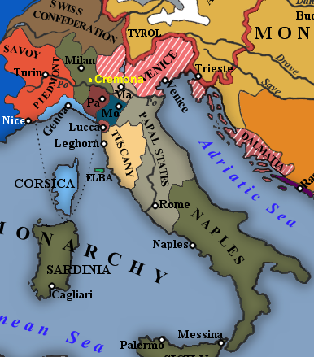
Rome

Slide 27
Rome Bologna

Slide 28
Rome Bologna Venice

Slide 29
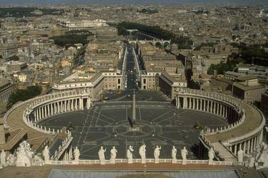
Rome
Piazza di San Pietro (Bernini, 1650s, 1660s)

Slide 30
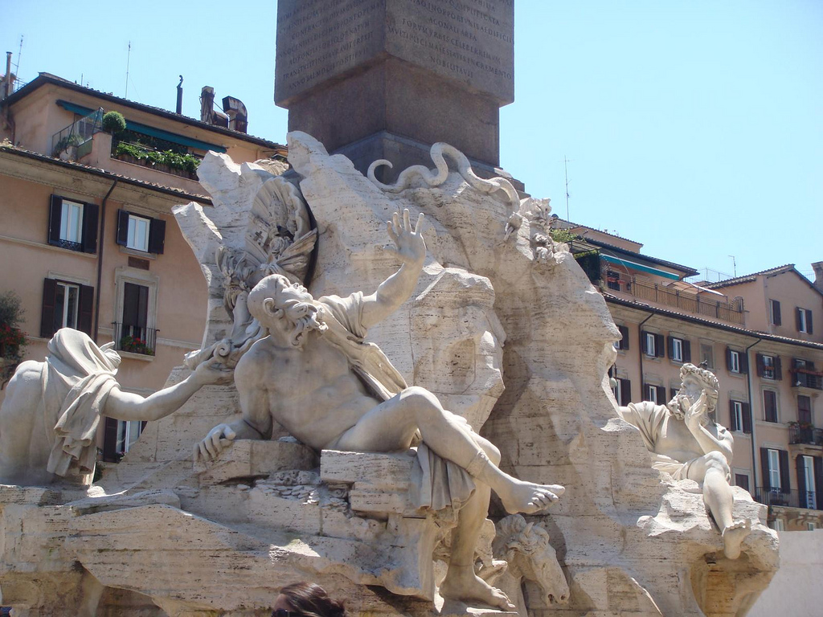
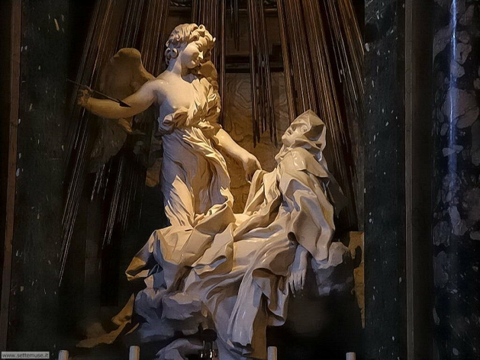
Gian Lorenzo Bernini (1598-1680)

Slide 31
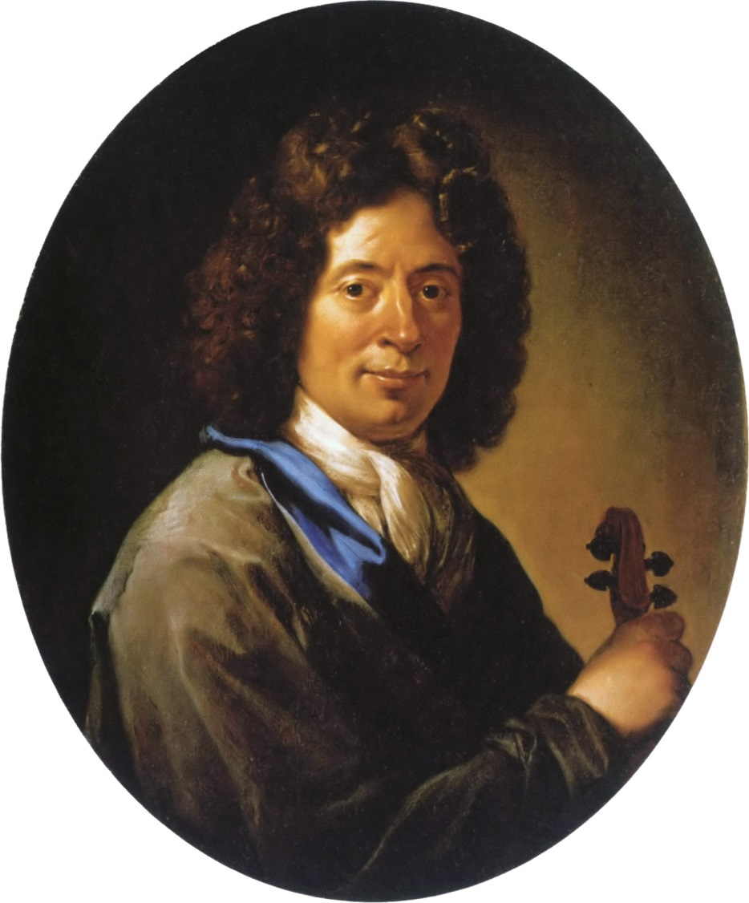
Arcangelo Corelli (1653-1713)

Slide 32
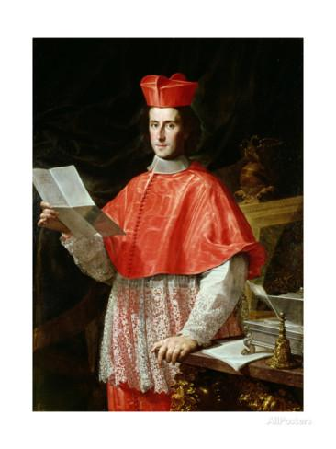
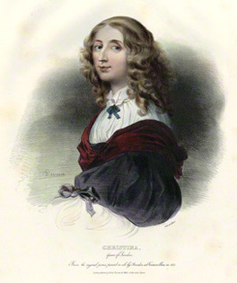
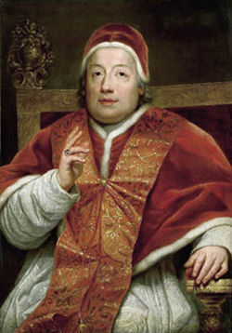
Corelli’s Patrons in Rome
Queen Christina of Sweden (1675-1685) Cardinal Pamphili (1687-1690) Cardinal Ottoboni (1690-1708)

Slide 33
Corelli’s Patrons in Rome
Trio Sonata in D, op. 4 no. 4
(publ. 1694): “Giga” finale
Queen Christina of Sweden (1675-1685) Cardinal Pamphili (1687-1690) Cardinal Ottoboni (1690-1708)

Slide 34
Corelli’s Patrons in Rome
Trio Sonata in F, op. 3 no. 1
(publ. 1689): the opening “Grave”
Queen Christina of Sweden (1675-1685) Cardinal Pamphili (1687-1690) Cardinal Ottoboni (1690-1708)

Slide 35
Corelli’s Patrons in Rome
Trio Sonata in D, op. 3 no. 2
(publ. 1689): “Allegro” finale
Queen Christina of Sweden (1675-1685) Cardinal Pamphili (1687-1690) Cardinal Ottoboni (1690-1708)

Slide 36
Vividly Crystallized Major-Minor “Tonality” in Corelli

Slide 37
Vividly Crystallized Major-Minor “Tonality” in Corelli
Grounded in the creative re-use of a large number of compact, standardized voice-leading patterns (ready-to-hand formulas, now called “schemata”) with functional-tonal implications.

Slide 38
Vividly Crystallized Major-Minor “Tonality” in Corelli
Grounded in the creative re-use of a large number of compact, standardized voice-leading patterns (ready-to-hand formulas, now called “schemata”) with functional-tonal implications. E.g.:
Cadential formulas to secure a sense of the tonic through authentic and half cadences.

Slide 39
Vividly Crystallized Major-Minor “Tonality” in Corelli
Grounded in the creative re-use of a large number of compact, standardized voice-leading patterns (ready-to-hand formulas, now called “schemata”) with functional-tonal implications. E.g.:
Cadential formulas to secure a sense of the tonic through authentic and half cadences.
e.g., the “complete cadential progression”
T P D T
I⁽⁶⁾ ii⁶ V I
IV
“trigger” “cadence proper”
“onset”

Slide 40
Vividly Crystallized Major-Minor “Tonality” in Corelli
Grounded in the creative re-use of a large number of compact, standardized voice-leading patterns (ready-to-hand formulas, now called “schemata”) with functional-tonal implications. E.g.:
Cadential formulas to secure a sense of the tonic through authentic and half cadences.
Standardized harmonic progressions

Slide 41
Vividly Crystallized Major-Minor “Tonality” in Corelli
Grounded in the creative re-use of a large number of compact, standardized voice-leading patterns (ready-to-hand formulas, now called “schemata”) with functional-tonal implications. E.g.:
Cadential formulas to secure a sense of the tonic through authentic and half cadences.
Standardized harmonic progressions
Standardized formulas for modulating to other keys (V, III, etc.)

Slide 42
Vividly Crystallized Major-Minor “Tonality” in Corelli
Grounded in the creative re-use of a large number of compact, standardized voice-leading patterns (ready-to-hand formulas, now called “schemata”) with functional-tonal implications. E.g.:
Cadential formulas to secure a sense of the tonic through authentic and half cadences.
Standardized harmonic progressions
Standardized formulas for modulating to other keys (V, III, etc.)
Standardized sequential formulas for Fortspinnung (ascending or descending 5-6 patterns, ascending- or descending-fifth sequences
[“circle of fifths”], etc.)

Slide 43
Vividly Crystallized Major-Minor “Tonality” in Corelli
Grounded in the creative re-use of a large number of compact, standardized voice-leading patterns (ready-to-hand formulas, now called “schemata”) with functional-tonal implications. E.g.:
Cadential formulas to secure a sense of the tonic through authentic and half cadences.
Standardized harmonic progressions
Standardized formulas for modulating to other keys (V, III, etc.)
Standardized sequential formulas for Fortspinnung (ascending or descending 5-6 patterns, ascending- or descending-fifth sequences
[“circle of fifths”], etc.)
Result: “the normative harmonic style” [John Hill]
“the standardizing of harmonic functions” [Richard Taruskin, 181]

Slide 44
Vividly Crystallized Major-Minor “Tonality” in Corelli
Grounded in the creative re-use of a large number of compact, standardized voice-leading patterns (ready-to-hand formulas, now called “schemata”) with functional-tonal implications. E.g.:
Cadential formulas to secure a sense of the tonic through authentic and half cadences.
Standardized harmonic progressions
Standardized formulas for modulating to other keys (V, III, etc.)
Standardized sequential formulas for Fortspinnung (ascending or descending 5-6 patterns, ascending- or descending-fifth sequences
[“circle of fifths”], etc.)
Result: “the normative harmonic style” [John Hill]
“the standardizing of harmonic functions” [Richard Taruskin, 181]
Example: Trio Sonata in D, op. 3 no. 2 (publ. 1689): The opening “Grave”

Slide 45
Corelli, Trio Sonata in D, op. 3 no. 2, movement 1, Grave
(opening harmonic moves)
“V:HC”
(Descending fifths,
with each half-bar)
E
E
“I:HC”
. . . . . . . . . . .(Fortspinnung) . . . . .
A
A
A
vi: PAC
D
D
(toward D, but…)
B minor
“walking bass”
Sequence:
Repetition up a fifth
G
Model
= IV of D

Slide 46
His Only Publications: 72 Instrumental Works
12 X 6 (Six Opus Numbers)
Opp. 1-4 = Trio Sonatas (12 in each opus)
Arcangelo Corelli (1653-1713)

Slide 47
His Only Publications: 72 Instrumental Works
12 X 6 (Six Opus Numbers)
Opp. 1-4 = Trio Sonatas (12 in each opus)
Op. 1 = Twelve Sonate [da chiesa] (1681)
Op. 3 = Twelve Sonate [da chiesa] (1689)
Arcangelo Corelli (1653-1713)

Slide 48
Sonata [da chiesa]: no dance movements;
often in four “abstract” movements, designated only by tempo marking;
a common pattern: slow-fast-slow-fast
e.g., Corelli, Trio Sonata in D, op. 3 no. 2 (publ. 1689)
S F S F
Grave
Allegro
Adagio
Allegro
D D B minor (vi) D

Slide 49
His Only Publications: 72 Instrumental Works
12 X 6 (Six Opus Numbers)
Opp. 1-4 = Trio Sonatas (12 in each opus)
Op. 1 = Twelve Sonate [da chiesa] (1681)
Op. 2 = Twelve Sonate da camera (1685)
Op. 3 = Twelve Sonate [da chiesa] (1689)
Op. 4 = Twelve Sonate da camera (1694)
Arcangelo Corelli (1653-1713)

Slide 50
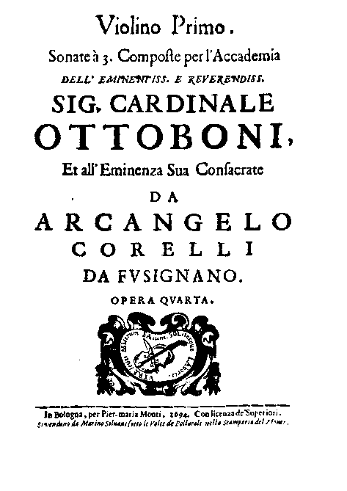
Sonata da camera: includes binary-form dance movements;
A prelude + two, three, or four movements—at least two of which are dances
e.g., Corelli, Trio Sonata in D, op. 4 no. 4 (publ. 1694)
Preludio
Grave
Corrente
(Binary dance)
Adagio
Giga
(Binary dance)
D D B minor (vi) D

Slide 51
His Only Publications: 72 Instrumental Works
12 X 6 (Six Opus Numbers)
Op. 1 = Twelve Sonate [da chiesa] (1681)
Op. 2 = Twelve Sonate da camera (1685)
Op. 3 = Twelve Sonate [da chiesa] (1689)
Op. 4 = Twelve Sonate da camera (1694)
Op. 5 = Twelve Violin Sonatas (1700)
Arcangelo Corelli (1653-1713)

Slide 52
His Only Publications: 72 Instrumental Works
12 X 6 (Six Opus Numbers)
Op. 1 = Twelve Sonate [da chiesa] (1681)
Op. 2 = Twelve Sonate da camera (1685)
Op. 3 = Twelve Sonate [da chiesa] (1689)
Op. 4 = Twelve Sonate da camera (1694)
Op. 5 = Twelve Violin Sonatas (1700)
Folia Bass (here in G minor)
Arcangelo Corelli (1653-1713)

Slide 53
His Only Publications: 72 Instrumental Works
12 X 6 (Six Opus Numbers)
Op. 1 = Twelve Sonate [da chiesa] (1681)
Op. 2 = Twelve Sonate da camera (1685)
Op. 3 = Twelve Sonate [da chiesa] (1689)
Op. 4 = Twelve Sonate da camera (1694)
Op. 5 = Twelve Violin Sonatas (1700)
Op. 6 = Twelve Concerti Grossi (publ. 1714)
Arcangelo Corelli (1653-1713)

Slide 54
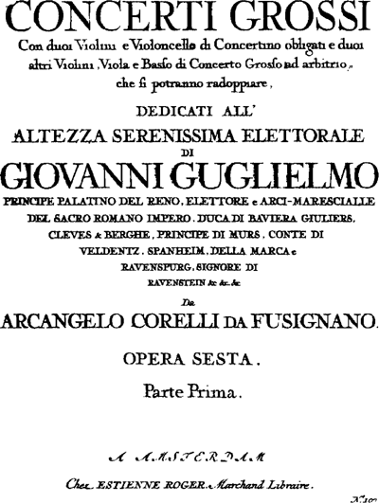
Arcangelo Corelli (1653-1713)

Slide 55
Corelli, Concerto Grosso in D, op. 6 no. 4 (publ. 1713)
Adagio Allegro
(binary
format!)
Adagio
Vivace,
3/4
(binary format!)
Allegro
(binary format: “gigue” topic)
D D B Minor D D

