Slide 1
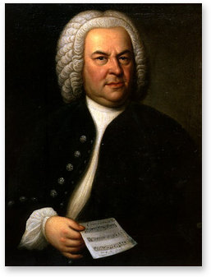
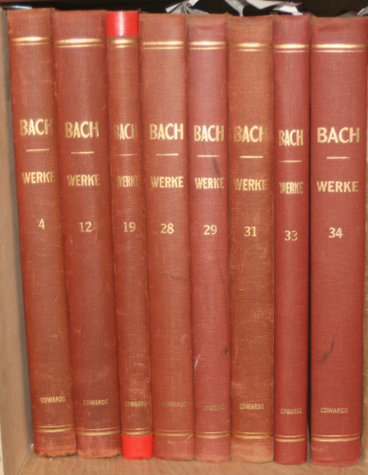

Slide 2
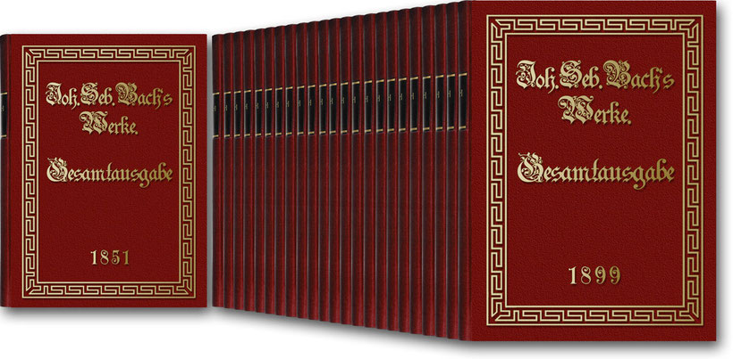

Slide 3
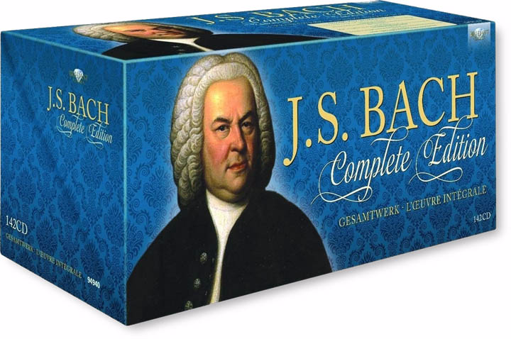

Slide 4
Music as Christian Symbol

Slide 5
Music as Christian Symbol
Especially the Chorale:

Slide 6
Music as Christian Symbol
Especially the Chorale:
Cantata “Concluder” (Final Movement)

Slide 7
Music as Christian Symbol
Especially the Chorale:
Cantata “Concluder” (Final Movement)
More Elaborate Treatments in Sacred Cantatas

Slide 8
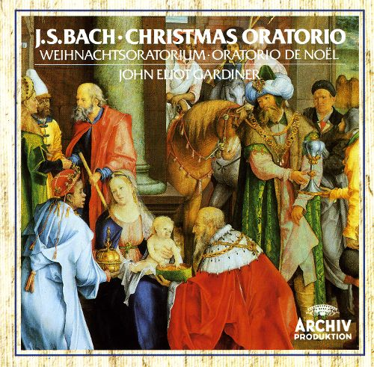

Slide 9
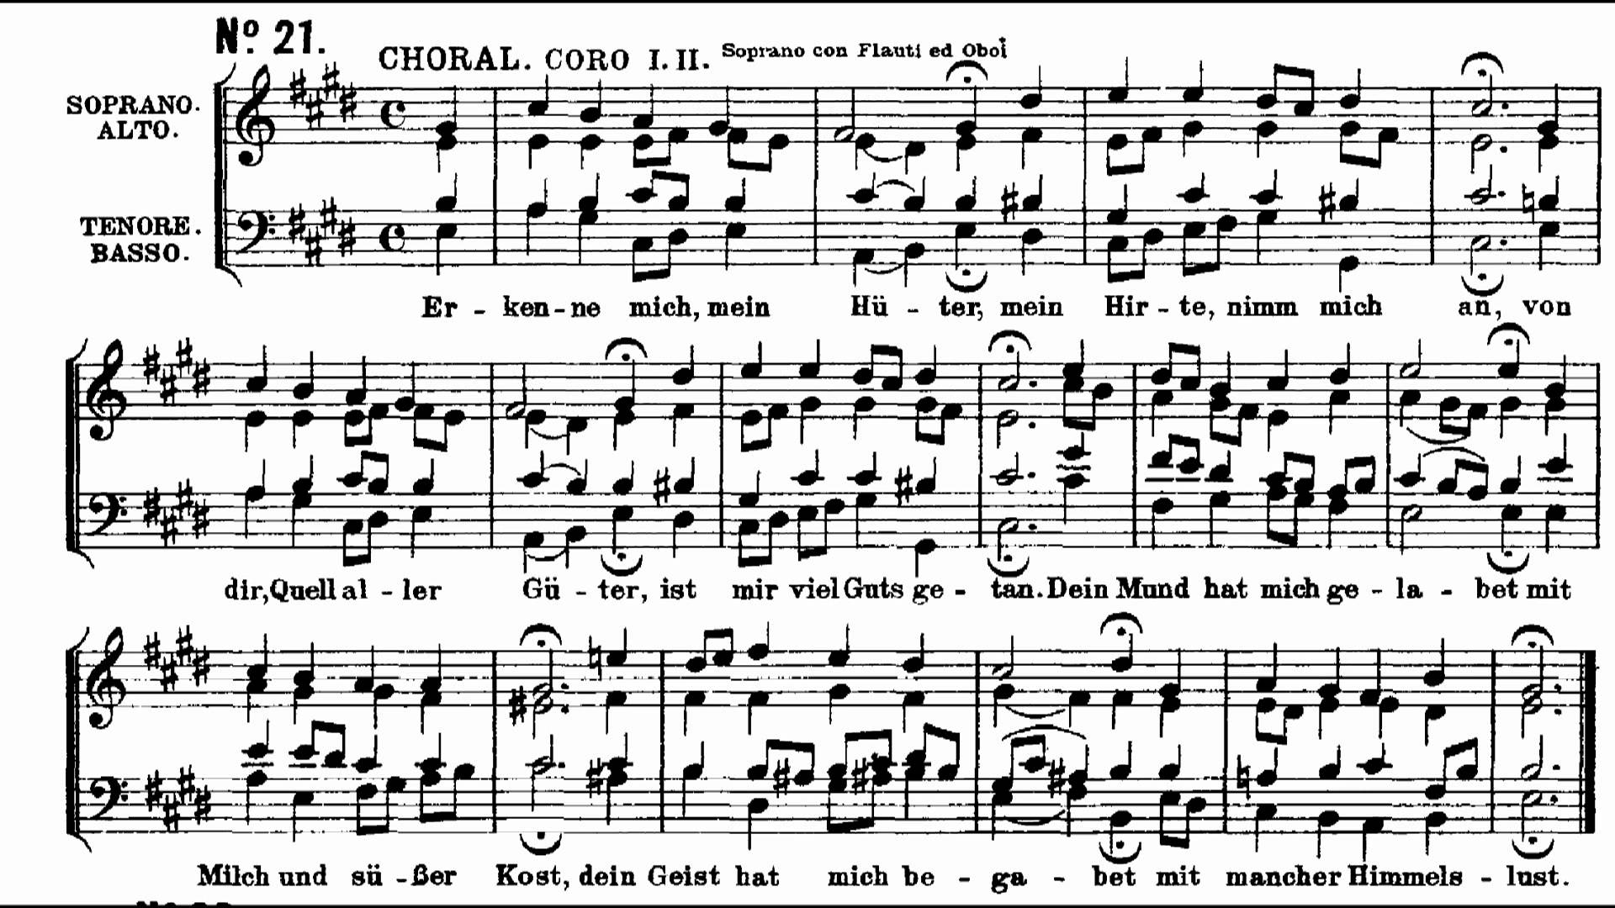
One harmonization of the “Passion Chorale” in the St. Matthew Passion
(Chorale melody originally composed by Hans Leo Hassler, c. 1600)

Slide 10
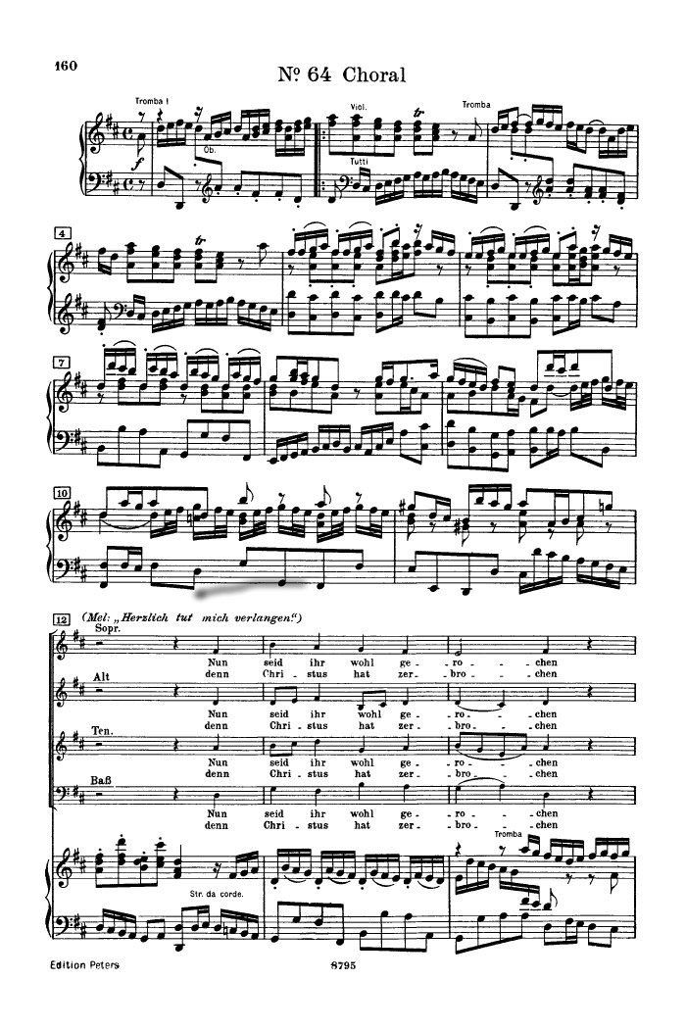
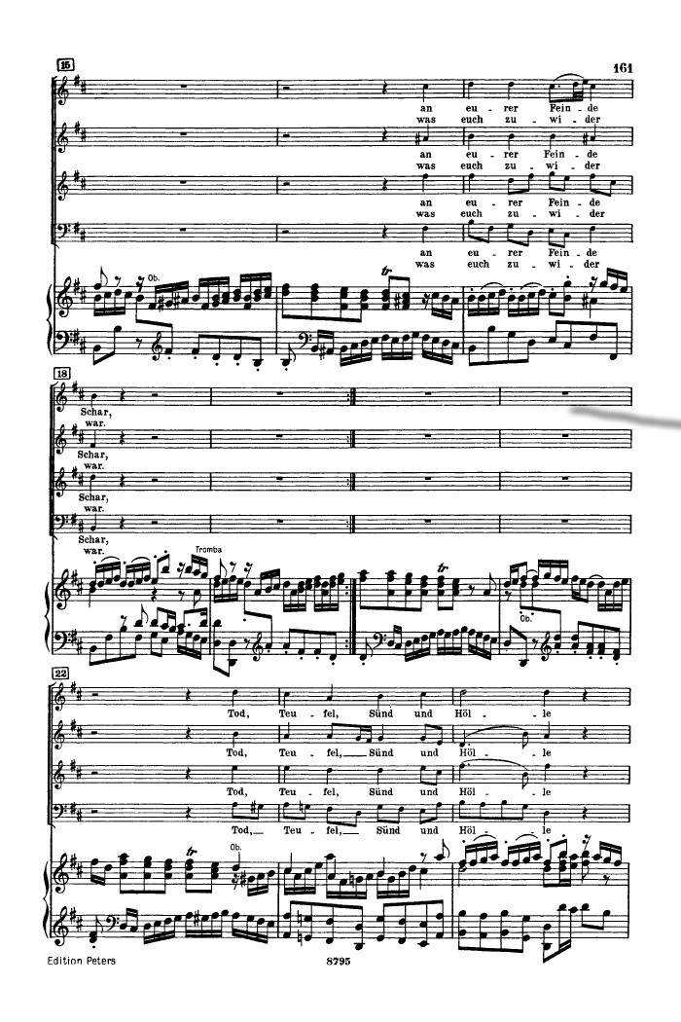
Christmas Oratorio (1734-35): final celebratory “chorale fantasy”

Slide 11
Christmas Oratorio (1734-35): final celebratory “chorale fantasy”
Opening Ritornello
head motive
Fortspinnung
“cadential attempt”—foiled!
cadence—I:PAC

Slide 12
Christmas Oratorio (1734-35): final celebratory “chorale fantasy”
Opening Ritornello
head motive
Fortspinnung
“cadential attempt”—foiled!
Stollen
Abgesang
cadence—I:PAC

Slide 13
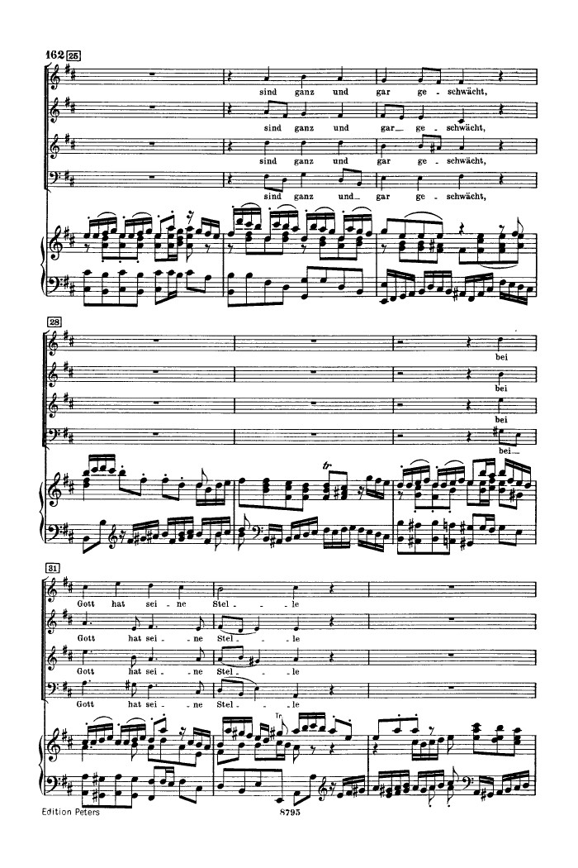
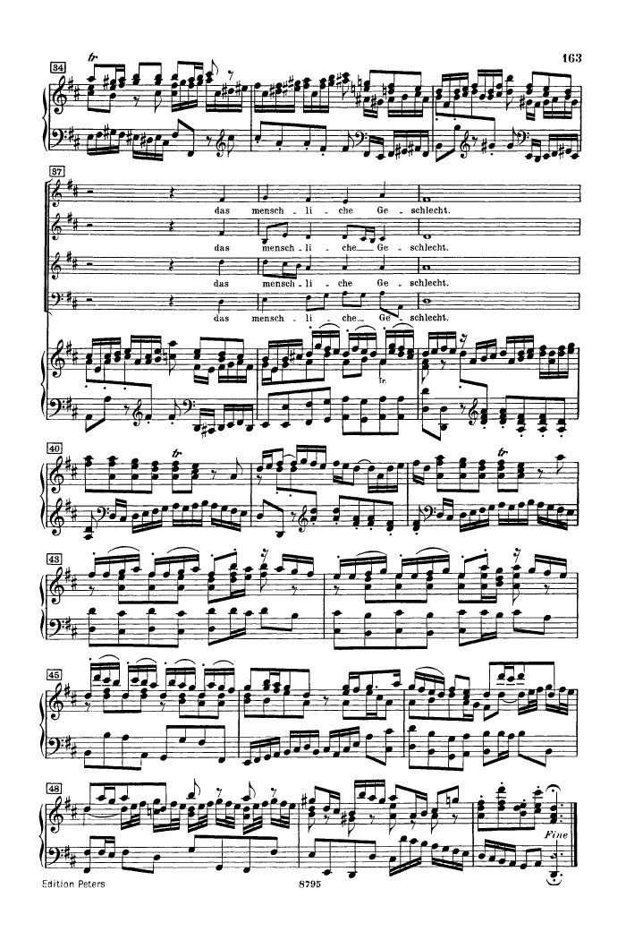
Closing Ritornello

Slide 14
Music as Christian Symbol
Especially the Chorale:
Cantata “Concluder” (Final Movement)
More Elaborate Treatments in Sacred Cantatas
Related: Organ “Chorale Preludes”

Slide 15
Music as Christian Symbol
Especially the Chorale:
Cantata “Concluder” (Final Movement)
More Elaborate Treatments in Sacred Cantatas
Related: Organ “Chorale Preludes”
Interpolations into Bach Passions (St. Matthew)

Slide 16
Music as Christian Symbol
Especially the Chorale:
Cantata “Concluder” (Final Movement)
More Elaborate Treatments in Sacred Cantatas
Related: Organ “Chorale Preludes”
Interpolations into Bach Passions (St. Matthew)
Mystical Numbers?

Slide 17
Music as Christian Symbol
Especially the Chorale:
Cantata “Concluder” (Final Movement)
More Elaborate Treatments in Sacred Cantatas
Related: Organ “Chorale Preludes”
Interpolations into Bach Passions (St. Matthew)
Mystical Numbers?
# = Kreuz (“Cross’)

Slide 18
Music as Christian Symbol
Especially the Chorale:
Cantata “Concluder” (Final Movement)
More Elaborate Treatments in Sacred Cantatas
Related: Organ “Chorale Preludes”
Interpolations into Bach Passions (St. Matthew)
Mystical Numbers?
# = Kreuz (“Cross”)
“Halo” for Words of Christ (St. Matthew Passion)

Slide 19
Music as Christian Symbol
Especially the Chorale:
Cantata “Concluder” (Final Movement)
More Elaborate Treatments in Sacred Cantatas
Related: Organ “Chorale Preludes”
Interpolations into Bach Passions (St. Matthew)
Mystical Numbers?
# = Kreuz (“Cross”)
“Halo” for Words of Christ (St. Matthew Passion)
Standard Musical “Topics” or Styles
(Pastoral, Jubilation, Royalty, Lament, Siciliana,
Various Dances, etc.)

Slide 20
Music as Christian Symbol

Slide 21
Music as Christian Symbol
2. Contrapuntal Equality of Voices (“The Contrapuntal Ideal”)

Slide 22
Music as Christian Symbol
2. Contrapuntal Equality of Voices (“The Contrapuntal Ideal”)
Mastery of Fortspinnung (the spinning-out of a single idea)

Slide 23
Music as Christian Symbol
2. Contrapuntal Equality of Voices (“The Contrapuntal Ideal”)
Mastery of Fortspinnung (the spinning-out of a single idea)
Harmonic Richness

Slide 24
Music as Christian Symbol
2. Contrapuntal Equality of Voices (“The Contrapuntal Ideal”)
Mastery of Fortspinnung (the spinning-out of a single idea)
Harmonic Richness
5. Fulfilling/Realizing All of the Possibilities of the Grounding Musical Idea

Slide 25
Music as Christian Symbol
2. Contrapuntal Equality of Voices (“The Contrapuntal Ideal”)
Mastery of Fortspinnung (the spinning-out of a single idea)
Harmonic Richness
5. Fulfilling/Realizing All of the Possibilities of the Grounding Musical Idea
6. (Late Style) the Withdrawal into the Esoteric, the Encyclopedic

Slide 26
