Slide 1
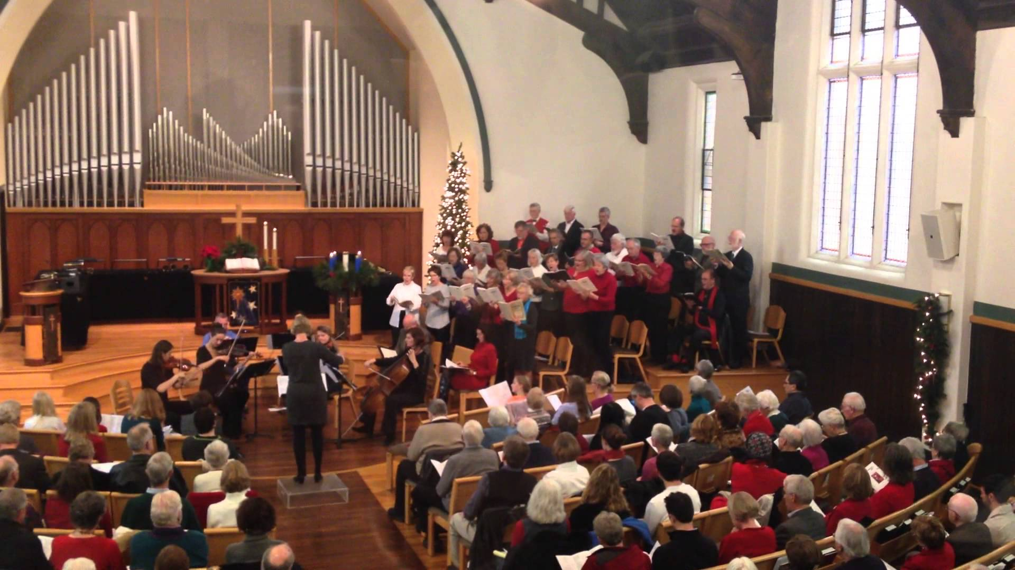
Bach: Cantatas

Slide 2
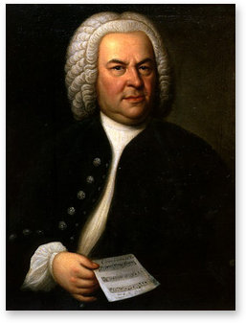

Slide 3
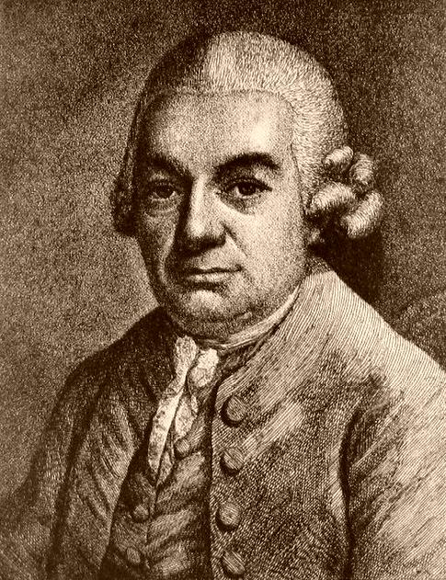
Post-1750
“Old Bach”
“The Great Bach”
C. P. E. Bach (1714-1788)

Slide 4
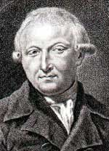
Renewed Interest in J. S Bach, c. 1801-1802
Johann Nicolaus Forkel

Slide 5
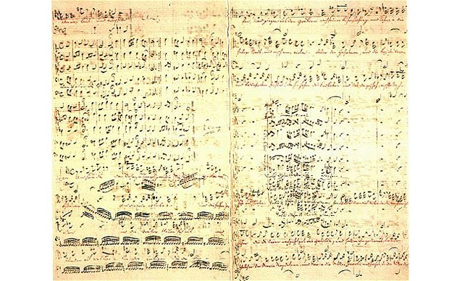
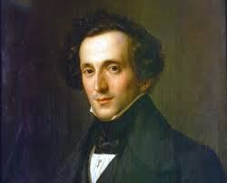
1829: Mendelssohn Discovers the St. Matthew Passion
In Leipzig (unperformed for a century)

Slide 6
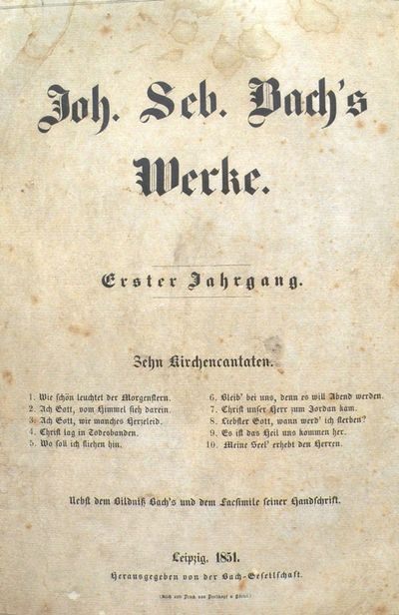
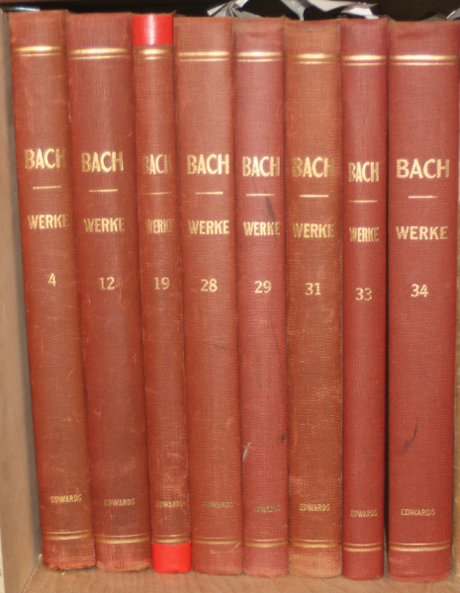
1850: Founding of the Bach Gesellschaft (Bach Society)
Publication of the Complete Works in Critical Editions Begun

Slide 7
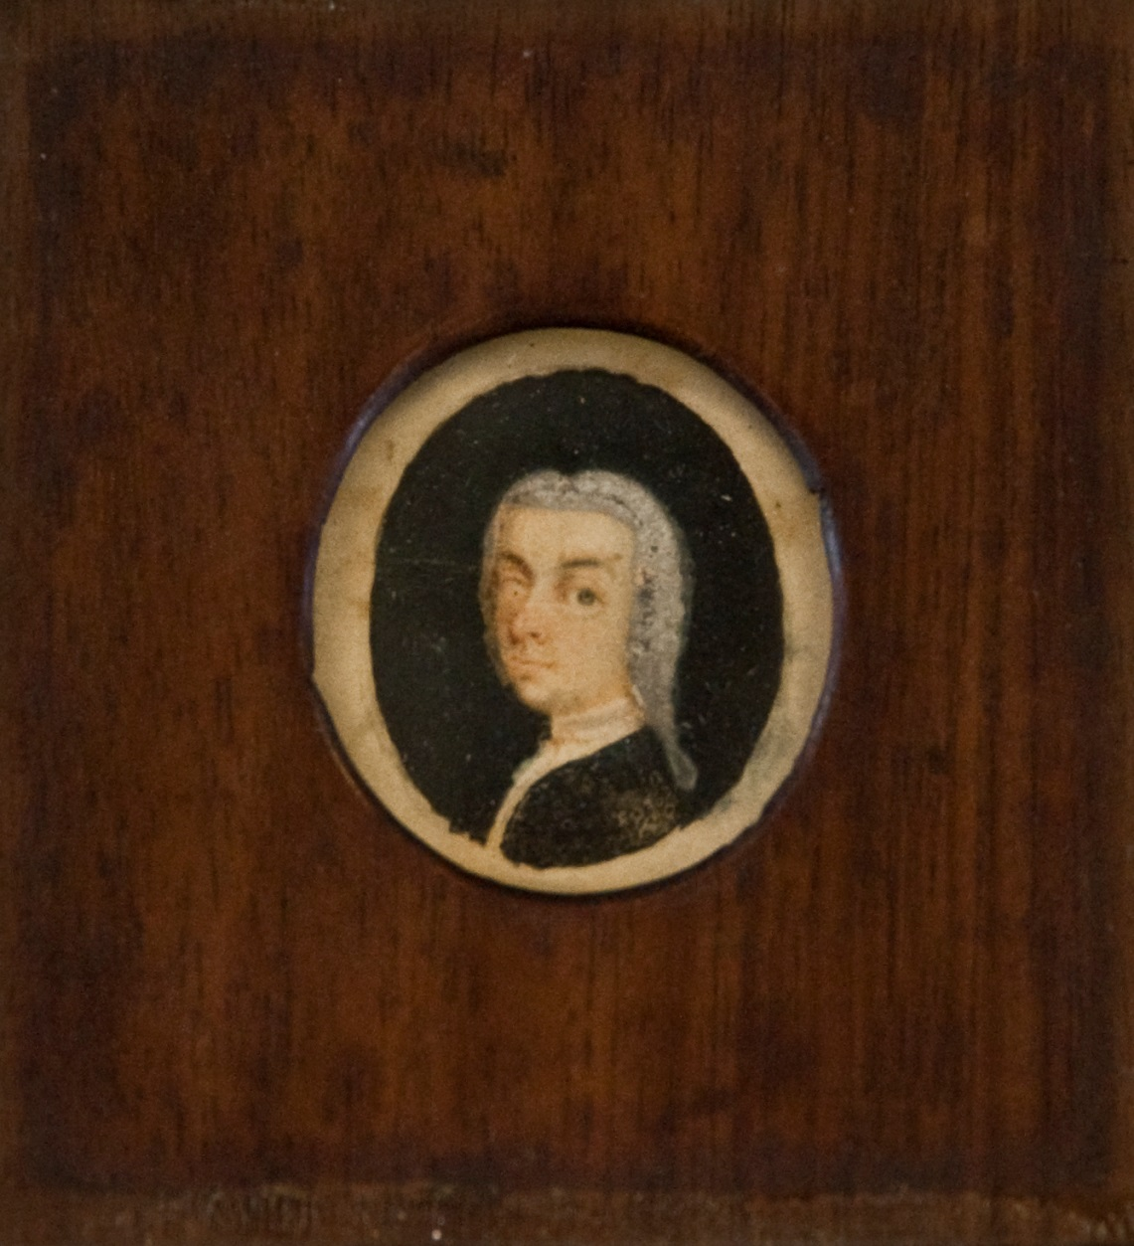
Johann Adolph Scheibe

Slide 8
Music As Christian Symbol
2. Contrapuntal Equality of Voices (“The Contrapuntal Ideal”)
Mastery of Fortspinnung
Harmonic Richness
5. Fulfilling/Realizing All of the Possibilities of the Grounding Musical Idea
6. (Late Style) the Withdrawal into the Esoteric, the Encyclopedic

Slide 9
Music As Christian Symbol
2. Contrapuntal Equality of Voices (“The Contrapuntal Ideal”)
Mastery of Fortspinnung
Harmonic Richness
5. Fulfilling/Realizing All of the Possibilities of the Grounding Musical Idea
6. (Late Style) the Withdrawal into the Esoteric, the Encyclopedic

Slide 10
1. Music As Christian Symbol

Slide 11
1. Music As Christian Symbol
Lutheran “Chorale” (Hymn, German text, sung by congregation)

Slide 12
1. Music As Christian Symbol
Lutheran “Chorale” (Hymn, German text, sung by congregation)
Hymn tune and text in multiple stanzas/verses

Slide 13
1. Music As Christian Symbol
Lutheran “Chorale” (Hymn, German text, sung by congregation)
Hymn tune and text in multiple stanzas/verses
Simple, memorable hymn melodies, many originally composed as melodies only,
without harmonization

Slide 14
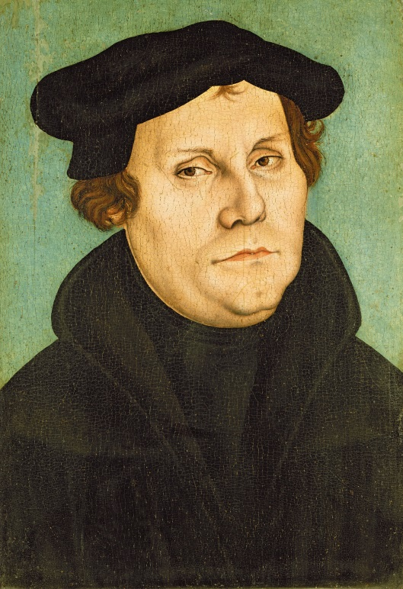
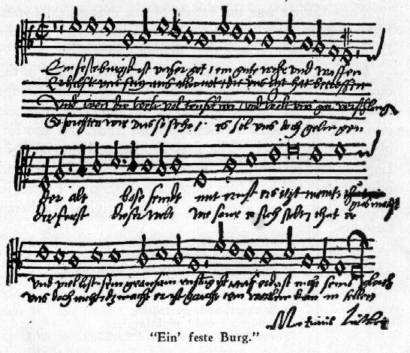
Music As Christian Symbol
Lutheran “Chorale” (Hymn, German text, sung by congregation)
E.g., “Ein feste Burg ist unser Gott” [c. 1527-1529]
(“A mighty fortress is our God”)
Martin Luther

Slide 15
The basis of Bach, Cantata No. 80, “Ein feste Burg,”
written for Reformation Sunday,
Leipzig, 1st or 2nd Jahrgang, 1723 or 1724
Music As Christian Symbol
Lutheran “Chorale” (Hymn, German text, sung by congregation)
E.g., “Ein feste Burg ist unser Gott” [c. 1527-1529]
(“A mighty fortress is our God”)
Martin Luther

Slide 16
The basis of Bach, Cantata No. 80, “Ein feste Burg,”
written for Reformation Sunday,
Leipzig, 1st or 2nd Jahrgang, 1723 or 1724
Music As Christian Symbol
Lutheran “Chorale” (Hymn, German text, sung by congregation)
Bach: “expressive harmonizations”
E.g., “Ein feste Burg ist unser Gott” [c. 1527-1529]
(“A mighty fortress is our God”)
Martin Luther

Slide 17
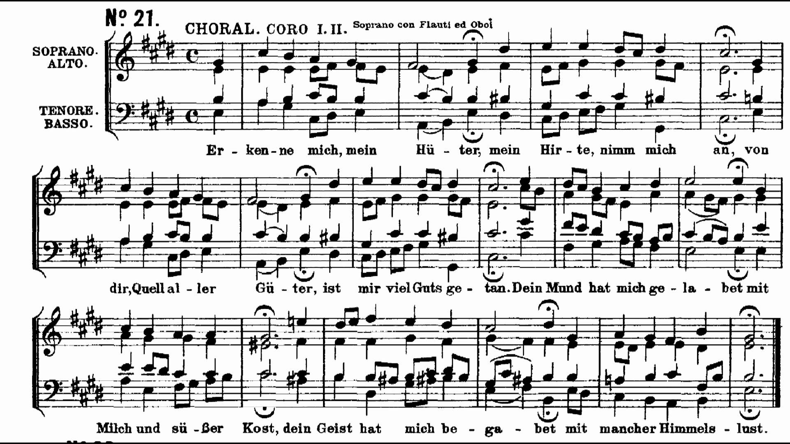

Slide 18
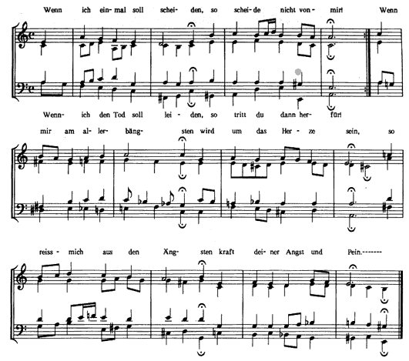

Slide 19
Leipzig, especially from the 2nd Jahrgang (1724-25) onward:
“Chorale Cantatas”: multimovement cantatas built around a single chorale melody, one appropriate for the season, which melody, with differing textual stanzas, appears in several, though not all,
of the movements, functioning as the chorale “pillars” of the cantata

Slide 20
Leipzig, especially from the 2nd Jahrgang (1724-25) onward:
“Chorale Cantatas”: multimovement cantatas built around a single chorale melody, one appropriate for the season, which melody, with differing textual stanzas, appears in several, though not all,
of the movements, functioning as the chorale “pillars” of the cantata
One or more earlier movements treat the chorale melody decoratively, in decorative musical elaboration
The final movement presents the chorale melody in its simplest, most direct form: a four-part hymn

Slide 21
Leipzig, especially from the 2nd Jahrgang (1724-25) onward:
“Chorale Cantatas”: multimovement cantatas built around a single chorale melody, one appropriate for the season, which melody, with differing textual stanzas, appears in several, though not all,
of the movements, functioning as the chorale “pillars” of the cantata
One or more earlier movements treat the chorale melody decoratively, in decorative musical elaboration
The final movement presents the chorale melody in its simplest, most direct form: a four-part hymn
Additional movements present freer reflections on the meaning of the chorale text: recitatives leading to an aria or duet

Slide 22
Bach: [Chorale] Cantata No.140, “Wachet auf, ruft uns die Stimme”

Slide 23
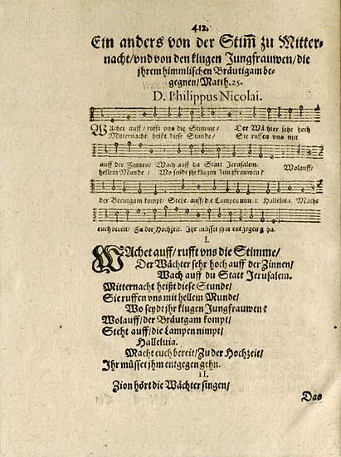
“Wachet auf” chorale melody and text:
First published, Philipp Nicolai, 1599

Slide 24
Bach, Cantata No. 140, “Wachet auf, ruft uns die Stimme,” BWV 140 (1731)
1
2 3
4
5 6
7
Recit. Duet
Recit. Duet
1
2
3
Chorale:
Stanza 1,
“Gapped Chorale [Fantasy]”
Chorale:
Stanza 2,
“Gapped Chorale”
(cf. for Organ: Chorale Prelude)
Chorale:
Stanza 3,
Four-Part
Harmonization

Slide 25
Bach, Cantata No. 140, “Wachet auf, ruft uns die Stimme,” BWV 140 (1731)
1
2 3
4
5 6
7
Recit. Duet
Recit. Duet
1
2
3
Chorale:
Stanza 1,
“Gapped Chorale [Fantasy]”
Chorale:
Stanza 2,
“Gapped Chorale”
(cf. for Organ: Chorale Prelude)
Chorale:
Stanza 3,
Four-Part
Harmonization

Slide 26
Bach, Cantata No. 140, “Wachet auf, ruft uns die Stimme,” BWV 140 (1731)
1
2 3
4
5 6
7
Recit. Duet
Recit. Duet
1
2
3
Chorale:
Stanza 1,
“Gapped Chorale [Fantasy]”
Chorale:
Stanza 2,
“Gapped Chorale”
(cf. for Organ: Chorale Prelude)
Chorale:
Stanza 3,
Four-Part
Harmonization

Slide 27
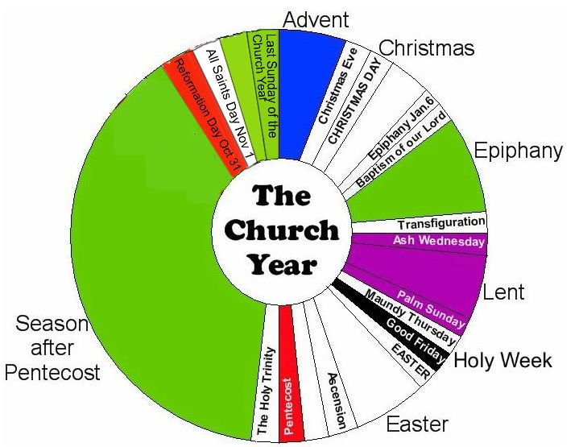

Slide 29
Lutheran Service: Readings Appropriate
for the 27th Sunday after Trinity, November 25, 1731
. . . . . . .
Epistle (Pauline Letter):
prob. 1 Thessalonians 5: 1-11)
(Watch and be sober for the second coming)

Slide 30
Lutheran Service: Readings Appropriate
for the 27th Sunday after Trinity, November 25, 1731
. . . . . . .
Epistle (Pauline Letter):
prob. 1 Thessalonians 5: 1-11)
(Watch and be sober for the second coming)
Gospel: Matthew 25: 1-13

Slide 31
Lutheran Service: Readings Appropriate
for the 27th Sunday after Trinity, November 25, 1731
. . . . . . .
Epistle (Pauline Letter):
prob. 1 Thessalonians 5: 1-11)
(Watch and be sober for the second coming)
Gospel: Matthew 25: 1-13
CANTATA

Slide 32
Lutheran Service: Readings Appropriate
for the 27th Sunday after Trinity, November 25, 1731
. . . . . . .
Epistle (Pauline Letter):
prob. 1 Thessalonians 5: 1-11)
(Watch and be sober for the second coming),
Gospel: Matthew 25: 1-13
CANTATA
Sermon

Slide 33
Lutheran Service: Readings Appropriate
for the 27th Sunday after Trinity, November 25, 1731
. . . . . . .
Epistle (Pauline Letter):
prob. 1 Thessalonians 5: 1-11)
(Watch and be sober for the second coming),
Gospel: Matthew 25: 1-13
CANTATA
Sermon

Slide 34
Bach, Cantata No. 140, “Wachet auf, ruft uns die Stimme,” BWV 140 (1731)
1
2 3
4
5 6
7
Recit. Duet
Recit. Duet
1
2
3
Chorale:
Stanza 1,
“Gapped Chorale [Fantasy]”
Chorale:
Stanza 2,
“Gapped Chorale”
(cf. for Organ: Chorale Prelude)
Chorale:
Stanza 3,
Four-Part
Harmonization

Slide 35
Bach, Cantata No. 140, “Wachet auf, ruft uns die Stimme,” BWV 140 (1731)
1
2 3
4
5 6
7
Recit. Duet
Recit. Duet
1
2
3
Chorale:
Stanza 1,
“Gapped Chorale [Fantasy]”
Chorale:
Stanza 2,
“Gapped Chorale”
(cf. for Organ: Chorale Prelude)
Chorale:
Stanza 3,
Four-Part
Harmonization

Slide 36
Bach, Cantata No. 140, “Wachet auf, ruft uns die Stimme,” BWV 140 (1731)
1
2 3
4
5 6
7
Recit. Duet
Recit. Duet
1
2
3
Chorale:
Stanza 1,
“Gapped Chorale [Fantasy]”
Chorale:
Stanza 2,
“Gapped Chorale”
(cf. for Organ: Chorale Prelude)
Chorale:
Stanza 3,
Four-Part
Harmonization

Slide 37
