Slide 1
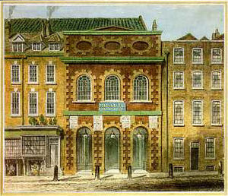
Handel: Opera, Oratorio
London: Queen/s/King’s Theater (Haymarket Theater)

Slide 2
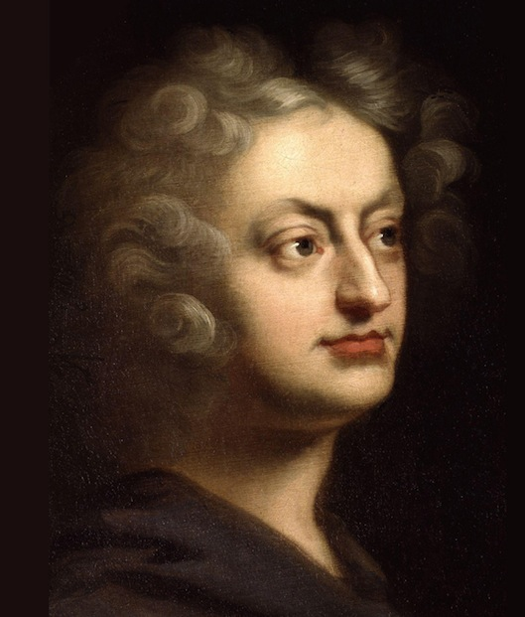
The Stirrings of English Opera
Purcell: Opera, Dido and Aeneas (1689)
Purcell: Semi-Operas (or “Dramatick Operas”)
1690 – Dioclesian
1691 – King Arthur
1692 – The Fairy Queen
1695 – The Indian Queen
1695 – The Tempest

Slide 3
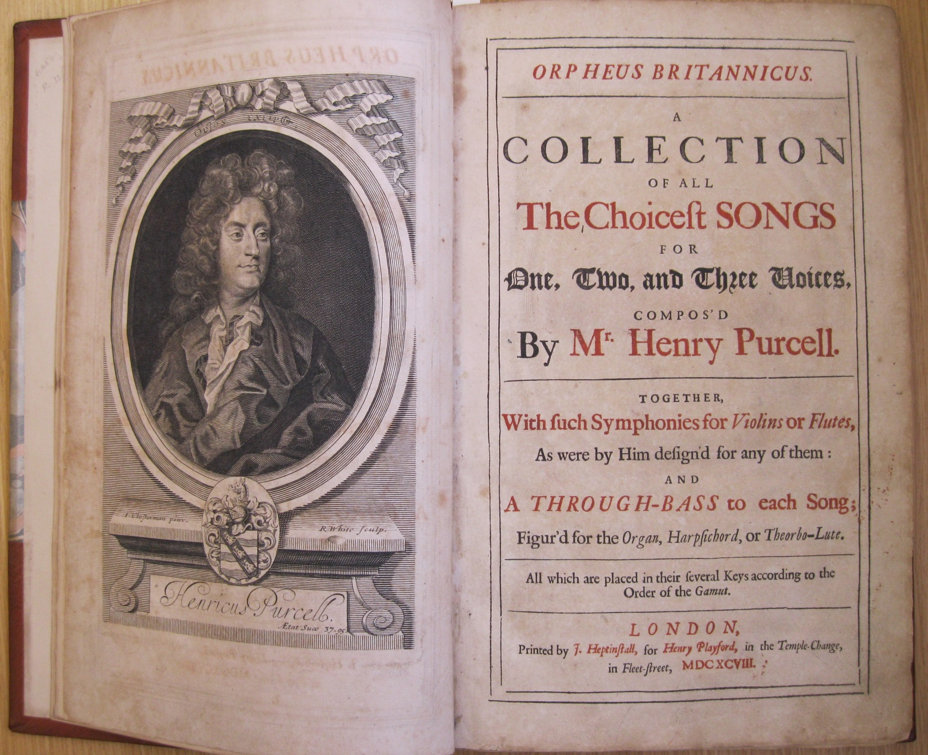
Orpheus Britannicus:
Published posthumously, 1698 (Purcell’s death, 1695)

Slide 4
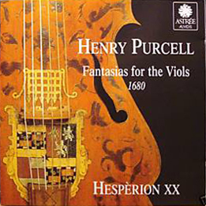
Henry Purcell (1659-1695)

Slide 5
Henry Purcell (1659-1695)

Slide 6
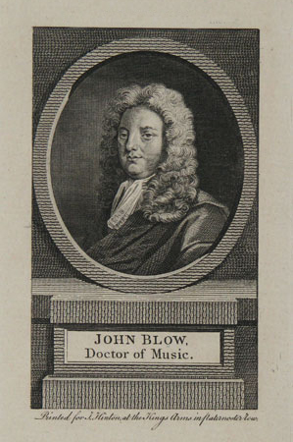
1649-1708

Slide 7
English opera: languishes, falters after 1700
(a vacuum)

Slide 8
English opera: languishes, falters after 1700
Italian Opera Seria
rushes in to fill the void, 1705ff
(a vacuum)

Slide 9
English opera: languishes, falters after 1700
Italian Opera Seria
rushes in to fill the void, 1705ff
“the virtuoso baroque”

Slide 10
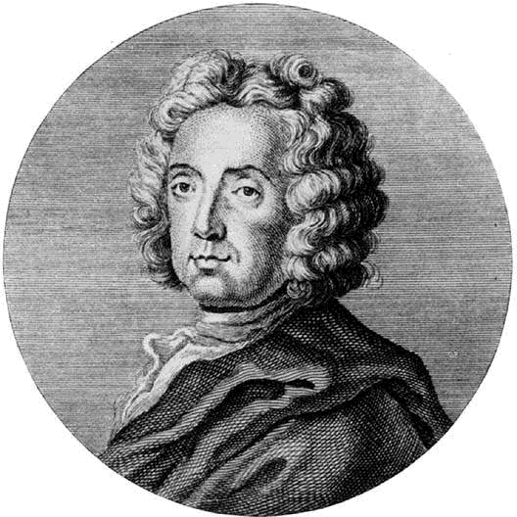
Camilla (Naples, 1696)
(London, 1706)
Giovanni Bononcini (1670-1747)

Slide 11
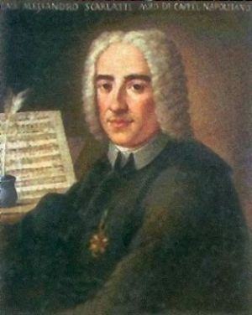
Pirro e Demetrio (Naples, 1694)
(London, 1708)
Alessandro Scarlatti (1660-1725)

Slide 12
Touchstones of the new, “reformed” opera seria—now in London
Camilla (Naples, 1696)
(London, 1706)
Giovanni Bononcini (1670-1747)
Pirro e Demetrio (Naples, 1694)
(London, 1708)
Alessandro Scarlatti (1660-1725)

Slide 13
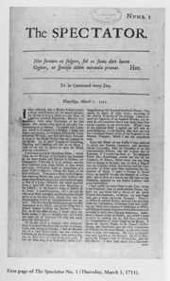
Joseph Addison

Slide 14
Joseph Addison
Italian opera seria in London?!. . . Nothing less than the importing of “unmanly Venice” with its “loose desires!”

Slide 15
Joseph Addison
“We no longer understand the language of our own stage . . . We are transported with anything that is not English. . . . In short, our English Musick is quite rooted out, and nothing yet planted in its stead.” (1711)

Slide 16
Italian Opera Seria, 1690s and onward (Naples, Venice)

Slide 17
Italian Opera Seria, 1690s and onward (Naples, Venice)
Aria-centered; increasingly schematic and virtuosic

Slide 18
Italian Opera Seria, 1690s and onward (Naples, Venice)
Aria-centered; increasingly schematic and virtuosic
Exit
“Standardized” Da Capo Aria
A B A
(Showpiece for Star Singers)
Plot, Action = Recitative (Set-Up)

Slide 19
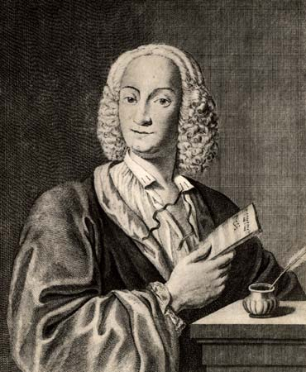
Italian Opera Seria, 1690s and onward (Naples, Venice)
Aria-centered; increasingly schematic and virtuosic
Exit
“Standardized” Da Capo Aria
A B A
(Showpiece for Star Singers)
Plot, Action = Recitative (Set-Up)
Alessandro Scarlatti
Giovanni Bononcini
Antonio Vivaldi

Slide 20
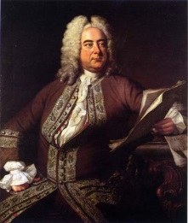
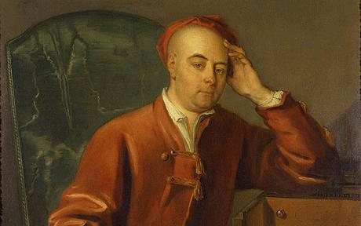
Georg Friedrich Händel -- George Frideric Handel (1685-1759)

Slide 21
Italian Opera Seria, 1690s and onward (Naples, Venice)
Aria-Centered, Increasingly Schematic and Virtuosic
Exit
“Standardized” Da Capo Aria
A B A
(Showpiece for Star Singers)
Plot, Action = Recitative (Set-Up)
“Agitata da due venti,” from Griselda (1735)
Antonio Vivaldi

Slide 22
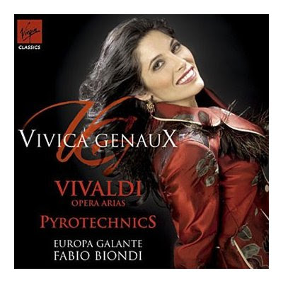
Italian Opera Seria, 1690s and onward (Naples, Venice)
Aria-Centered, Increasingly Schematic and Virtuosic
Exit
“Standardized” Da Capo Aria
A B A
(Showpiece for Star Singers)
Plot, Action = Recitative (Set-Up)
“Agitata da due venti,” from Griselda (1735)
Antonio Vivaldi

Slide 23
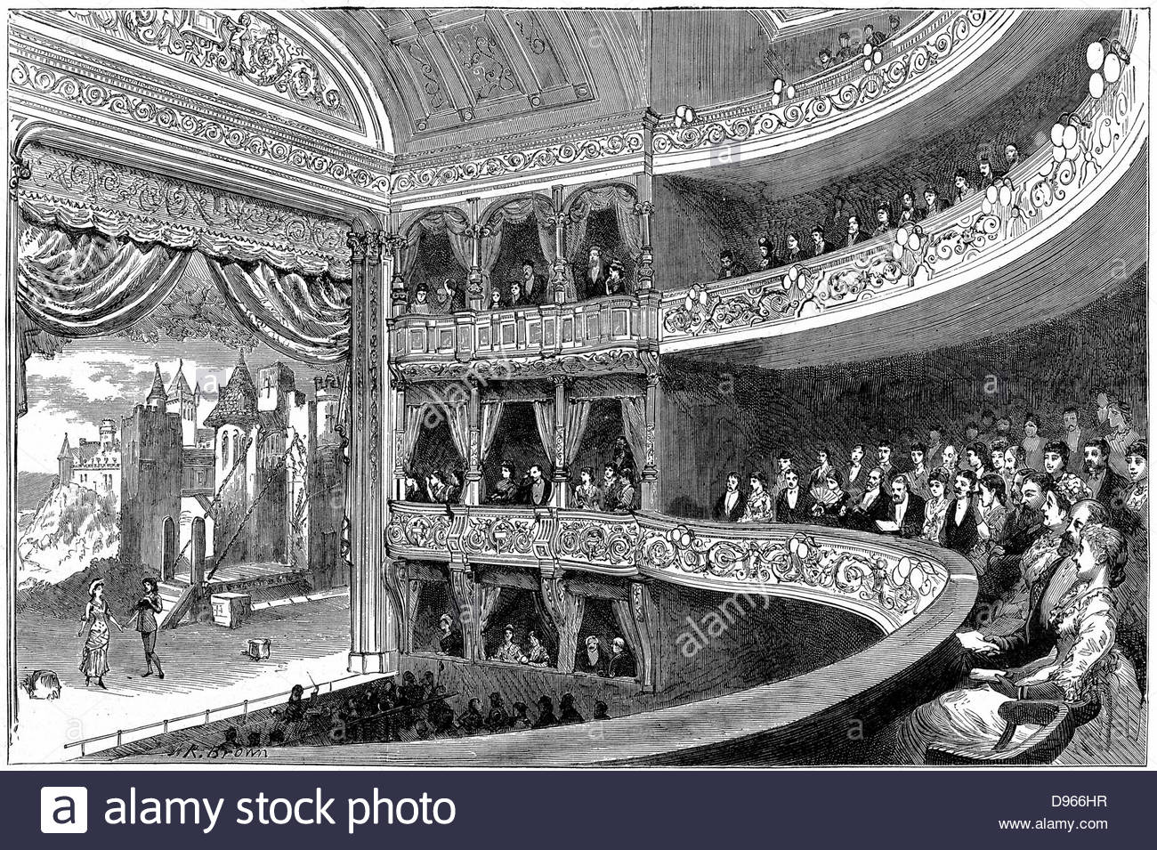
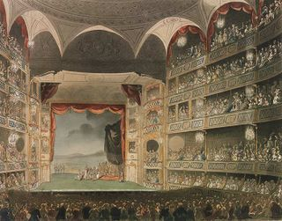
London, 18th Century: Commercial, Public Theaters:
Drury Lane, Haymarket, etc.

Slide 24
London, 18th Century: Commercial, Public Theaters:
Also opera theaters

Slide 25
London, 18th Century: Commercial, Public Theaters:
Italian-language opera seria as a competitive business enterprise

Slide 26
Georg Friedrich Händel -- George Frideric Handel (1685-1759)

Slide 27
Georg Friedrich Händel -- George Frideric Handel (1685-1759)
Prior to London: composed and studied in Italy, 1706-10

Slide 28
Georg Friedrich Händel -- George Frideric Handel (1685-1759)
First London Opera Seria = Rinaldo (1711)

Slide 29
Georg Friedrich Händel -- George Frideric Handel (1685-1759)
First London Opera Seria = Rinaldo (1711)
e.g., Argante’s aria: “Sibillar gli’angui d’Aletto”

Slide 30
Georg Friedrich Händel -- George Frideric Handel (1685-1759)
First London Opera Seria = Rinaldo (1711)
e.g., Rinaldo’s aria, “Cara sposa”

Slide 31
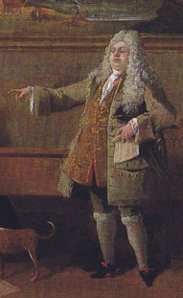
Castrato in Rinaldo, 1711: “Nicolini” (Nicolo Grimaldi)

Slide 32
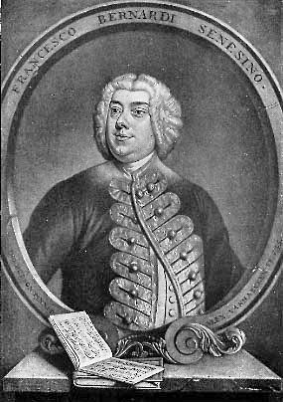
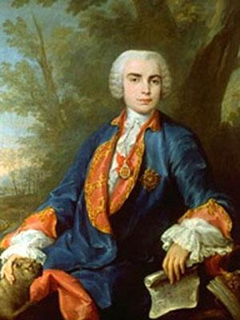
The Castrato as Star/Virtuoso in Italian Opera Seria
“Nicolini” (1710s) “Senesino” (1720s) “Farinelli” (1730s)

Slide 33
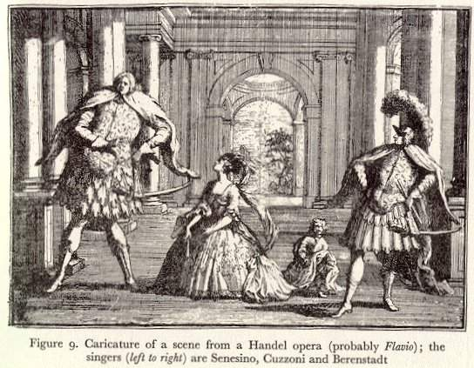

Slide 34
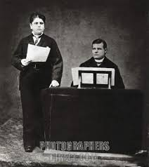
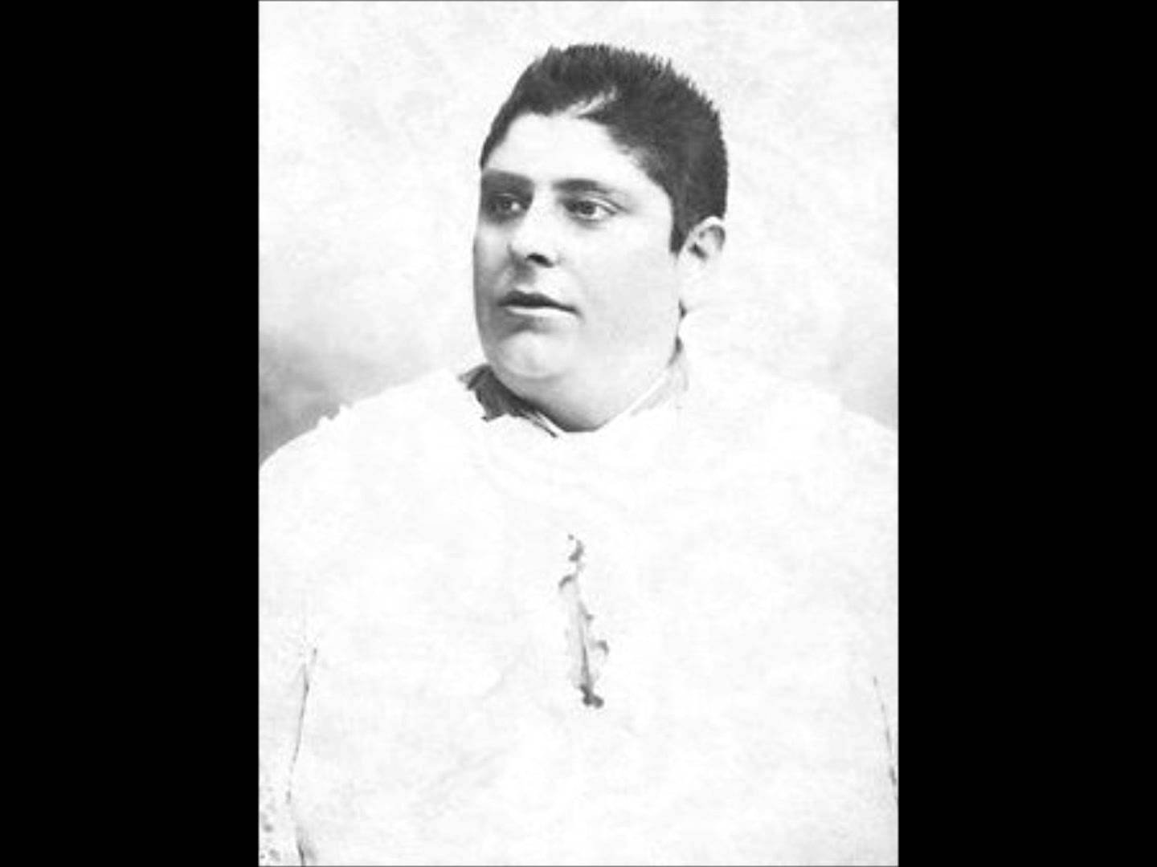
Alessandro Moreschi (1858-1921)

Slide 35
Castrato in Rinaldo, 1711: “Nicolini” (Nicolo Grimaldi)

Slide 36
Italian opera seria in London
Handel Operas Include:
Rinaldo (1711)
Giulio Cesare (1724)
Tamerlano (1724)
Rodelinda (1725)
Alessandro (1726)
Ariodante (1735)
Alcina (1735)
Serse (1739)
Three acts; based on tales of historical of legendary heroes

Slide 37
Opera seria: largely a string of da capo arias, with only a few ad hoc alternatives
(etc.) . . . . . . .
Exit
Plot, Action = Recitative (Set-Up)
“Standardized” Da Capo Aria
A B A
(Showpiece for Star Singers)
Usually recitativo semplice
(over basso continuo)
in 19th c. called “recitativo secco”)
Less often recitativo accompagnato
(additional instruments for special
effects or enhancements)
“Kinetic” “Static”

Slide 38
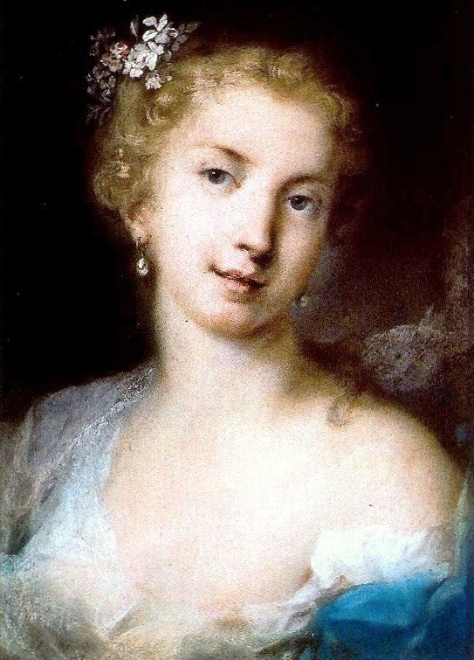
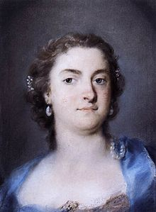
Rival Prime Donne in Handel’s Operas, 1720s
Francesca Cuzzoni Faustina Bordoni

Slide 39
Senesino: the Castrato Role of Giulio Cesare (1724)

Slide 40
Handel: The English Oratorio
Saul (1738)
Israel in Egypt (1739)
Messiah (1742)
Samson (1743)
Susanna (1749)
Solomon (1749)

Slide 41
Handel: The English Oratorio
Saul (1738)
Israel in Egypt (1739)
Messiah (1742)
Samson (1743)
Susanna (1749)
Solomon (1749)

Slide 42
Handel: The English Oratorio
Saul (1738)
Israel in Egypt (1739)
Messiah (1742)
Samson (1743)
Susanna (1749)
Solomon (1749)
Chorus from Saul (text from Psalm 8):
“How excellent thy name, o Lord, in all the world is known . . . . . . Allelulia!”

