Slide 1
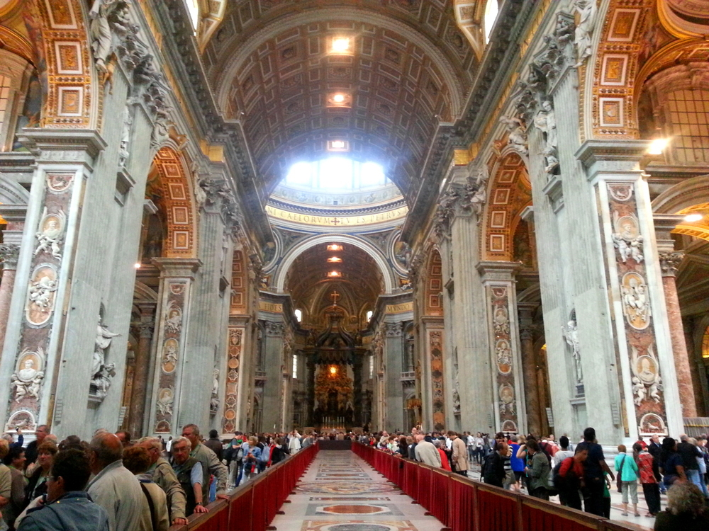
Seventeenth-Century Sacred Vocal Genres

Slide 2
Italian Baroque Vocal Genres, 1600-1670
Secular
“Monodies” (Solo Madrigal, Air)
Continuo Madrigal (Concertato Madrigal)
Early “opera”

Slide 3
Italian Baroque Vocal Genres, 1600-1670
Secular
“Monodies” (Solo Madrigal, Air)
Continuo Madrigal (Concertato Madrigal)
Early “opera”
Sacred
Cantata
Oratorio
Sacred Concerto

Slide 4
Italian Baroque Vocal Genres, 1600-1670
Secular
“Monodies” (Solo Madrigal, Air)
Continuo Madrigal (Concertato Madrigal)
Early “opera”
Sacred
Cantata
Oratorio
Sacred Concerto

Slide 5
Italian Baroque Vocal Genres, 1600-1670
Secular
“Monodies” (Solo Madrigal, Air)
Continuo Madrigal (Concertato Madrigal)
Early “opera”
Sacred
Cantata
Oratorio
Sacred Concerto

Slide 6
Oratorio – 17th Century
Non-staged, third-person retelling of a Biblical or other sacred narrative

Slide 7
Oratorio – 17th Century
Non-staged, third-person retelling of a Biblical or other sacred narrative.
Accompaniment: basso continuo, sometimes augmented with other instruments

Slide 8
Oratorio – 17th Century
Non-staged, third-person retelling of a Biblical or other sacred narrative.
Accompaniment: basso continuo, sometimes augmented with other instruments.
Proceeds in successive sections or parts:

Slide 9
Oratorio – 17th Century
Non-staged, third-person retelling of a Biblical or other sacred narrative.
Accompaniment: basso continuo, sometimes augmented with other instruments.
Proceeds in successive sections or parts:
Recitative (the story proper), interspersed with:

Slide 10
Oratorio – 17th Century
Non-staged, third-person retelling of a Biblical or other sacred narrative.
Accompaniment: basso continuo, sometimes augmented with other instruments.
Proceeds in successive sections or parts:
Recitative (the story proper), interspersed with:
Set pieces for solo singer(s) (personifying protagonists)

Slide 11
Oratorio – 17th Century
Non-staged, third-person retelling of a Biblical or other sacred narrative.
Accompaniment: basso continuo, sometimes augmented with other instruments.
Proceeds in successive sections or parts:
Recitative (the story proper), interspersed with:
Set pieces for solo singer(s) (personifying protagonists)
Choruses (commentary, reaction)

Slide 12
Oratorio – 17th Century
(a sacred alternative to secular opera, especially during the Lenten season, when performing opera was forbidden)
Non-staged, third-person retelling of a Biblical or other sacred narrative.
Accompaniment: basso continuo, sometimes augmented with other instruments.
Proceeds in successive sections or parts:
Recitative (the story proper), interspersed with:
Set pieces for solo singer(s) (personifying protagonists)
Choruses (commentary, reaction)

Slide 13
Oratorio – 17th Century
(a sacred alternative to secular opera, especially during the Lenten season, when performing opera was forbidden)
Non-staged, third-person retelling of a Biblical or other sacred narrative.
Accompaniment: basso continuo, sometimes augmented with other instruments.
Proceeds in successive sections or parts:
Recitative (the story proper), interspersed with:
Set pieces for solo singer(s) (personifying protagonists)
Choruses (commentary, reaction)
For example: Giacomo Carissimi’s Jephte [comp. before June 1648]

Slide 14
Origins of the word “oratorio”

Slide 15
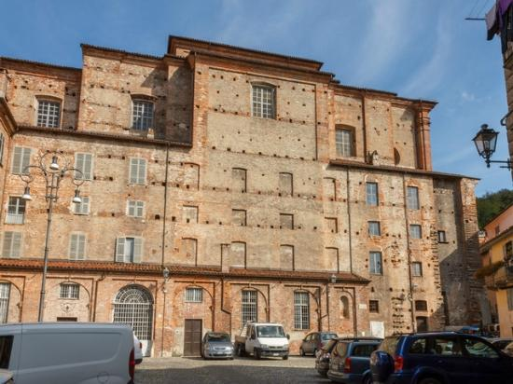
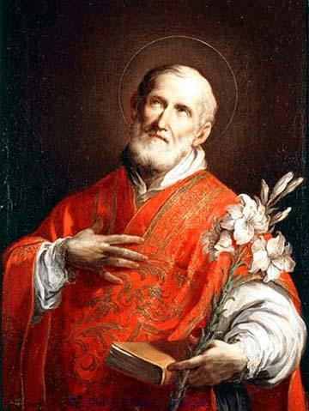
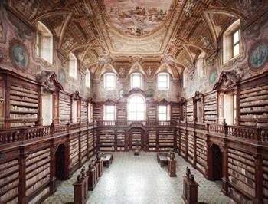
Origins of the word “oratorio”
= a prayer hall for devotional exercises
Rome, Congregazione dell’Oratorio
St. Filippo Neri (1515-95)

Slide 16
Mid-17th-Century Italian Oratorio: Two Types
Oratorio Volgare
Italian texts
poetic

Slide 17
Mid-17th-Century Italian Oratorio: Two Types
Oratorio Volgare Oratorio Latino
Italian texts Latin texts
poetic prose

Slide 18
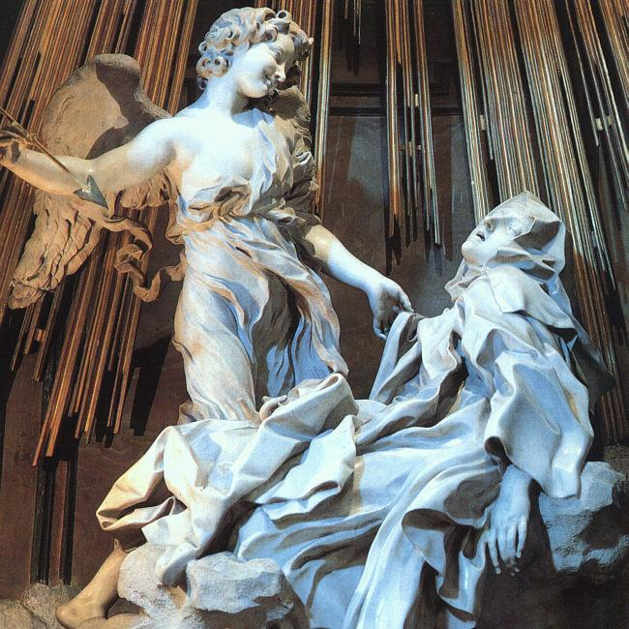
Bernini: The Ecstasy of St. Theresa (1640s)

Slide 19
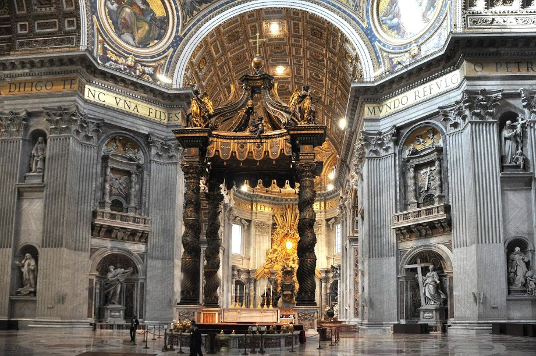
Bernini: Interior of St. Peter’s Basilica

Slide 21
Mid-17th-Century Italian Oratorio: Two Types
Oratorio Volgare Oratorio Latino
Italian texts Latin texts
poetic prose

Slide 22
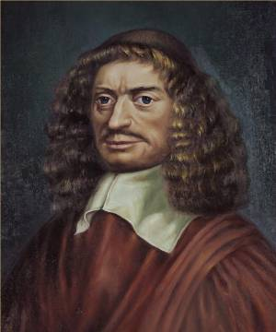
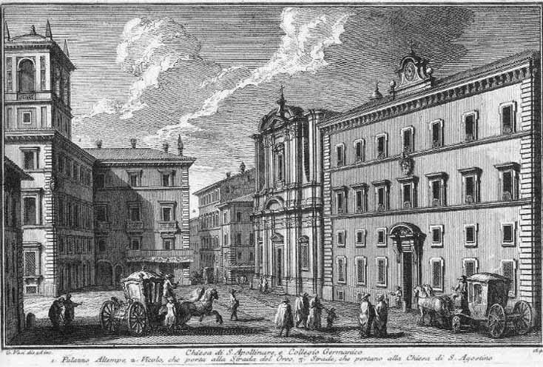
Giacomo Carissimi (1605-1674)
Rome, Collegio Germanico

Slide 23
(Latin-Text) Oratorios Include:
Baltazar
Ezekiel
The Universal Flood
Jephte [before June 1648]
Jonas
The Last Judgment
The Judgment of Solomon
Giacomo Carissimi (1605-1674)

Slide 24
(Latin-Text) Oratorios Include:
Baltazar
Ezekiel
The Universal Flood
Jephte [before June 1648]
Jonas
The Last Judgment
The Judgment of Solomon
All are narrated paraphrases of Biblical texts.
The musical settings include:
a narrator (“historicus”)
one or more vocal soloists
a chorus
a small instrumental ensemble
Giacomo Carissimi (1605-1674)

Slide 25
(Latin-Text) Oratorios Include:
Baltazar
Ezekiel
The Universal Flood
Jephte [before June 1648]
Jonas
The Last Judgment
The Judgment of Solomon
All are narrated paraphrases of Biblical texts.
The musical setting includes:
a narrator (“historicus”)
one or more vocal soloists
a chorus
a small instrumental ensemble
Giacomo Carissimi (1605-1674)
Solo arioso for soprano, “Plorate colles”

Slide 26
(Latin-Text) Oratorios Include:
Baltazar
Ezekiel
The Universal Flood
Jephte [before June 1648]
Jonas
The Last Judgment
The Judgment of Solomon
All are narrated paraphrases of Biblical texts.
The musical setting includes:
a narrator (“historicus”)
one or more vocal soloists
a chorus
a small instrumental ensemble
Giacomo Carissimi (1605-1674)
Solo arioso for soprano, “Plorate colles” (increasing importance of the spotlighted “set piece”)

Slide 27
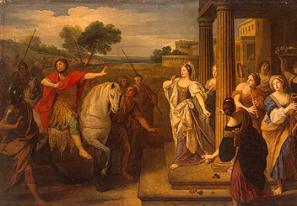
Carissimi, Jephte [before June 1648]: from the story in Judges 11:29-38

Slide 28
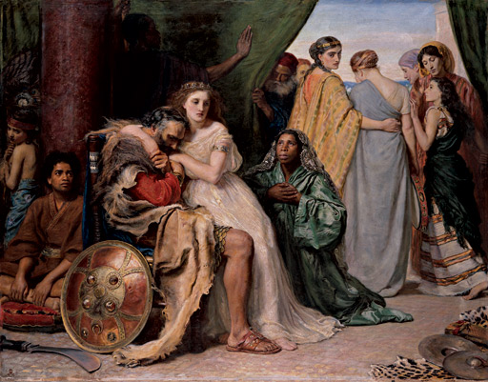
Carissimi, Jephte [before June 1648]: from the story in Judges 11:29-38

Slide 29
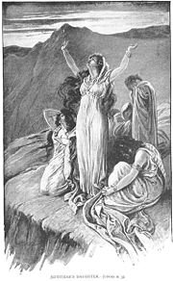
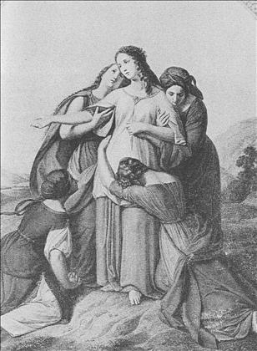
Carissimi, Jephte [before June 1648]: from the story in Judges 11:29-38
Solo arioso, “Plorate, colles”

Slide 30
Carissimi, Jephte [before June 1648]: from the story in Judges 11:29-38
Solo arioso, “Plorate, colles”
Chorus, “Plorate,filii Israel”

Slide 31
Carissimi, Jephte [before June 1648]: from the story in Judges 11:29-38
Solo arioso, “Plorate, colles”
Chorus, “Plorate,filii Israel”
“modular” construction: brief musical modules, often subjected
to immediate repetition or sequence

Slide 32
Carissimi, Jephte [before June 1648]: from the story in Judges 11:29-38
Solo arioso, “Plorate, colles”
Chorus, “Plorate,filii Israel”
“modular” construction: brief musical modules, often subjected
to immediate repetition or sequence
often: near-”regular” two- or four-bar syntax

Slide 33
Carissimi, Jephte [before June 1648]: from the story in Judges 11:29-38
Solo arioso, “Plorate, colles”
Chorus, “Plorate,filii Israel”
“modular” construction: brief musical modules, often subjected
to immediate repetition or sequence
often: near-”regular” two- or four-bar syntax
harmonically rich, expressive, coloristic, sumptuous

Slide 34
Italian Baroque Vocal Genres, 1600-1670
Secular
“Monodies” (Solo Madrigal, Air)
Continuo Madrigal (Concertato Madrigal)
Early “opera”
Sacred
Cantata
Oratorio
Sacred Concerto

Slide 35
Italian Baroque Vocal Genres, 1600-1670
Secular
“Monodies” (Solo Madrigal, Air)
Continuo Madrigal (Concertato Madrigal)
Early “opera”
Sacred
Cantata
Oratorio
Sacred Concerto

Slide 36
Italian Baroque Vocal Genres, 1600-1670
Secular
“Monodies” (Solo Madrigal, Air)
Continuo Madrigal (Concertato Madrigal)
Early “opera”
Sacred
Cantata
Oratorio
Sacred Concerto
= sacred/biblical text + instrumental accompaniment

Slide 37
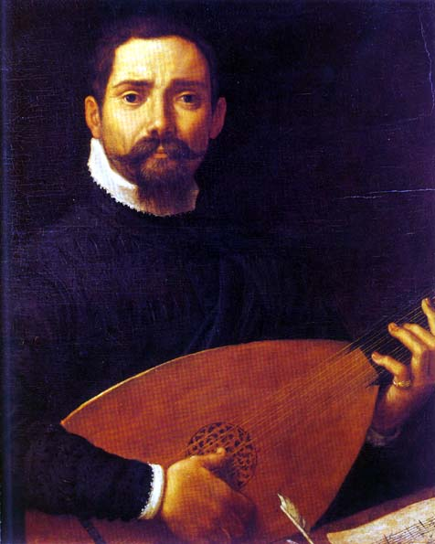
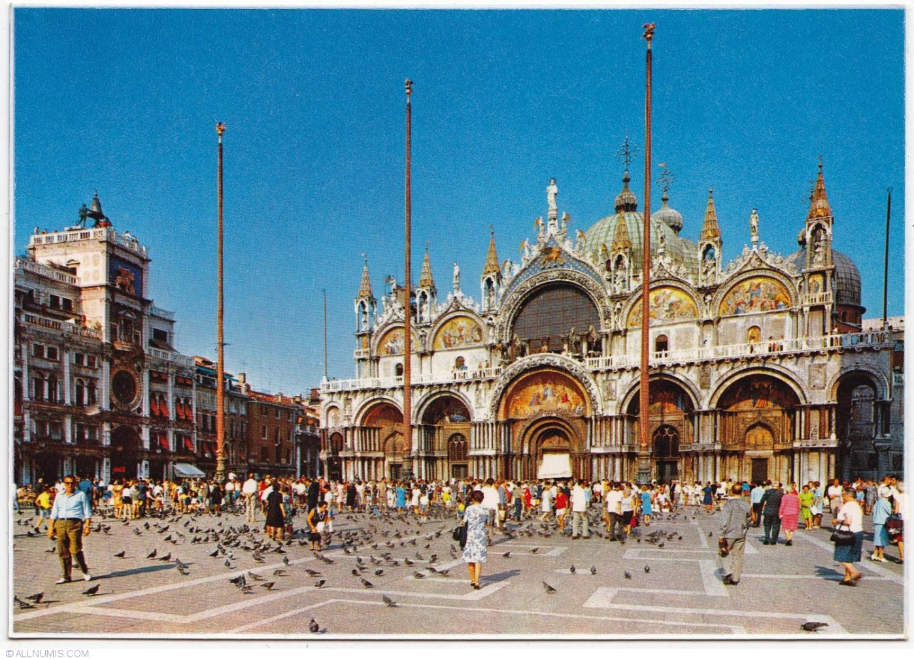
Influential composer of early, often large-scale “sacred concertos”
Giovanni Gabrieli (1553-1612)
Venice, Basilica of St. Mark

Slide 38
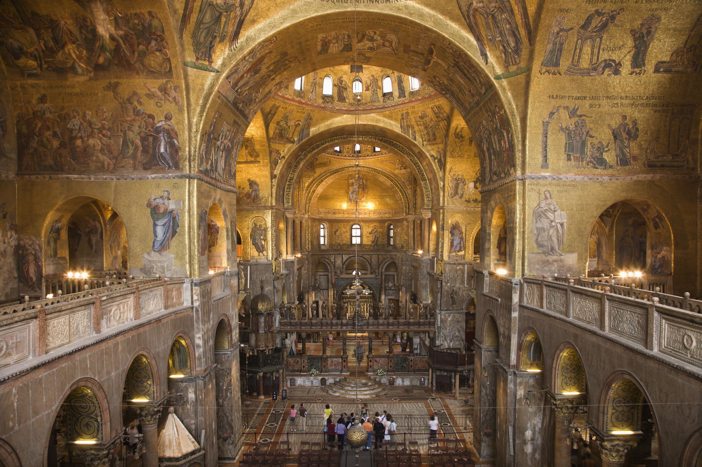
Venice, Basilica of St. Mark, Interior

Slide 39
Divided choirs possible (cori spezzati)
“polychoral”
Venice, Basilica of St. Mark, Interior

Slide 40
Giovanni Gabrieli, “In ecclesiis,” Symphoniae sacrae II, publ. posth. 1615
Psalms 67, 61, 102: “In the churches, bless the Lord; in all high places . . . .”
Solo Voice – Choral Alleluia –Solo Voice – Choral Alleluia – Instrumental interlude . . .
Venice, Basilica of St. Mark, Interior

Slide 41
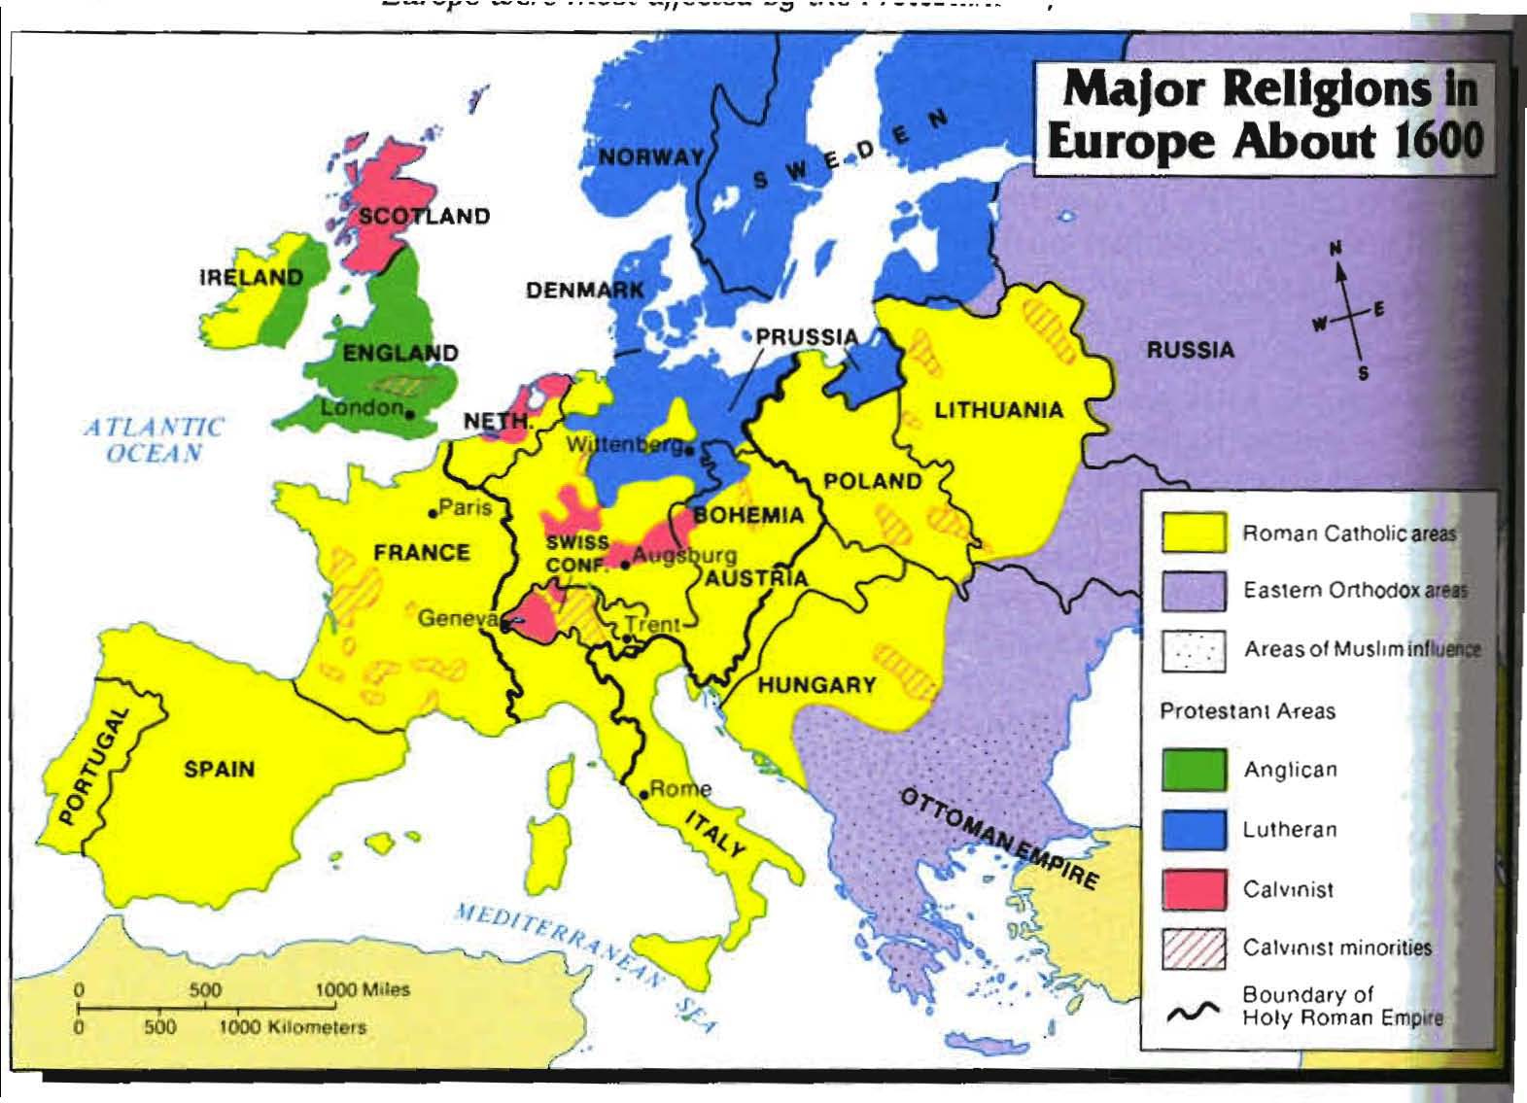

Slide 42
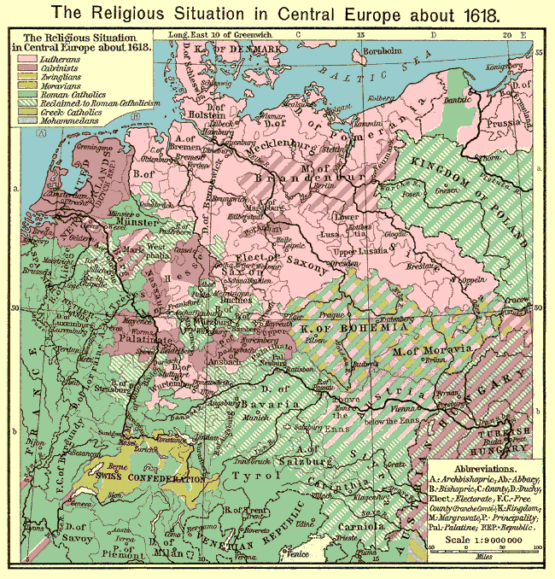
The Protestant North

Slide 43
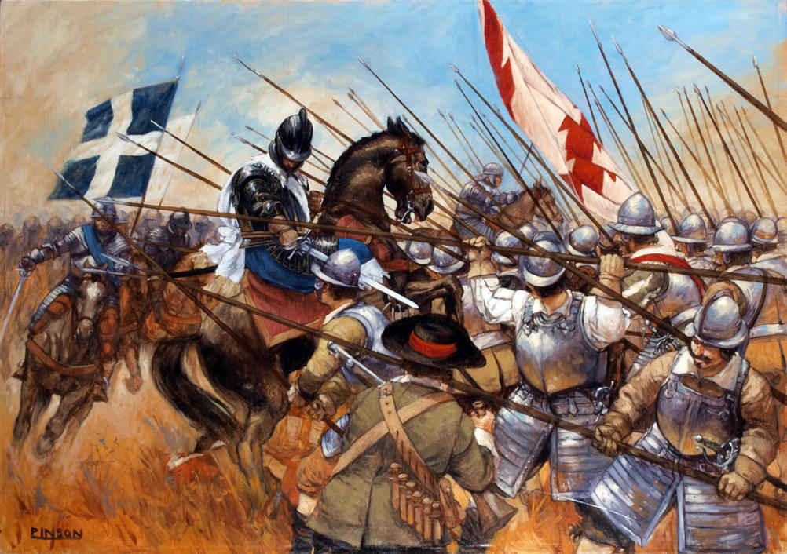
At war over religion:
The “Thirty Years’ War,” 1618-48

Slide 44
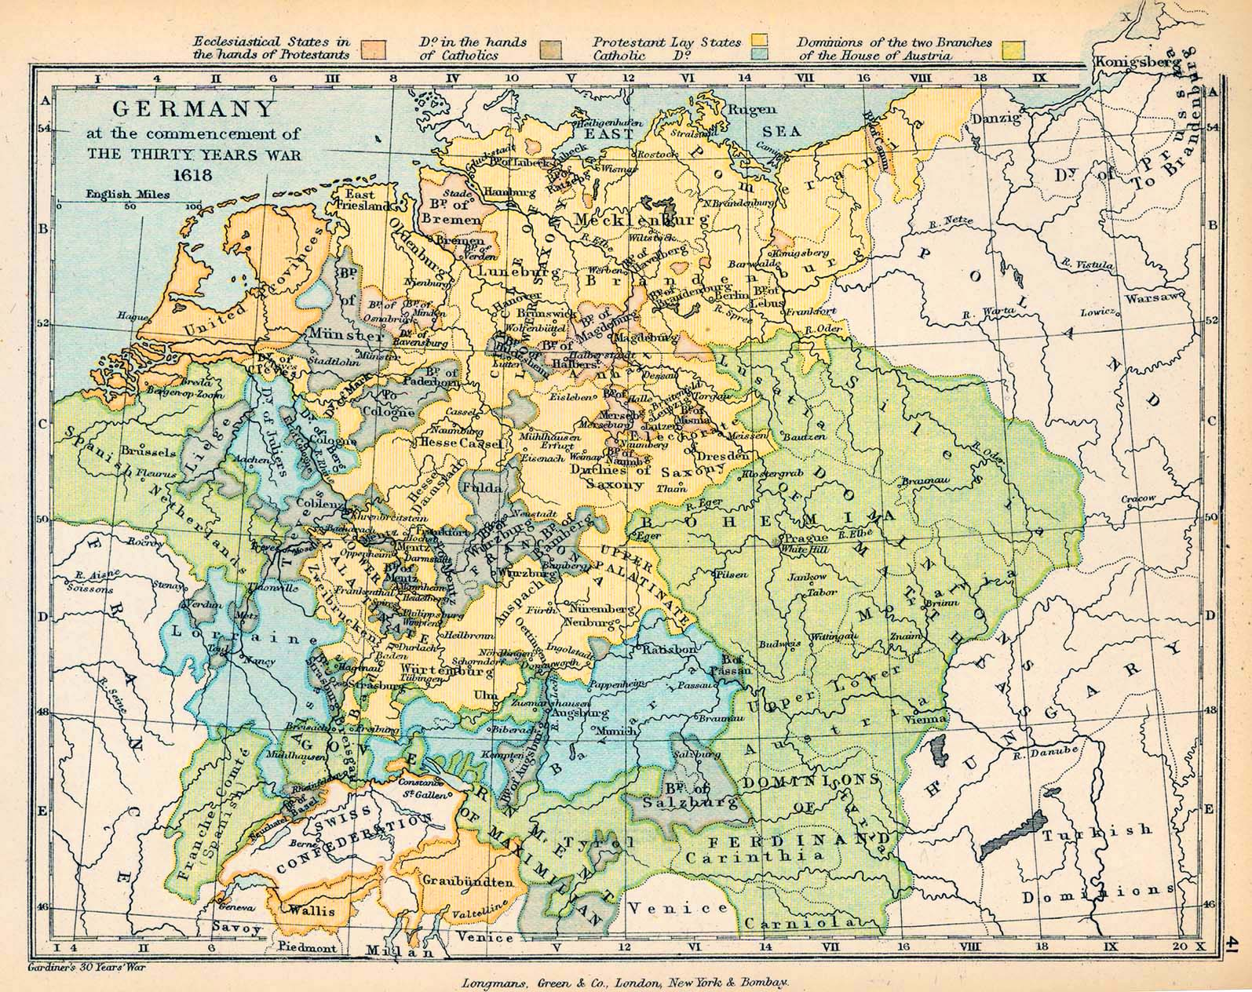

Slide 45
Northern Germanic Lands: The “Protestant Baroque”
(in contrast with the “Catholic Baroque”)

Slide 46
Northern Germanic Lands: The “Protestant Baroque”
(in contrast with the “Catholic Baroque”)
Architecturally more restrained, sometimes spare church interiors: removal of much Catholic decoration

Slide 47
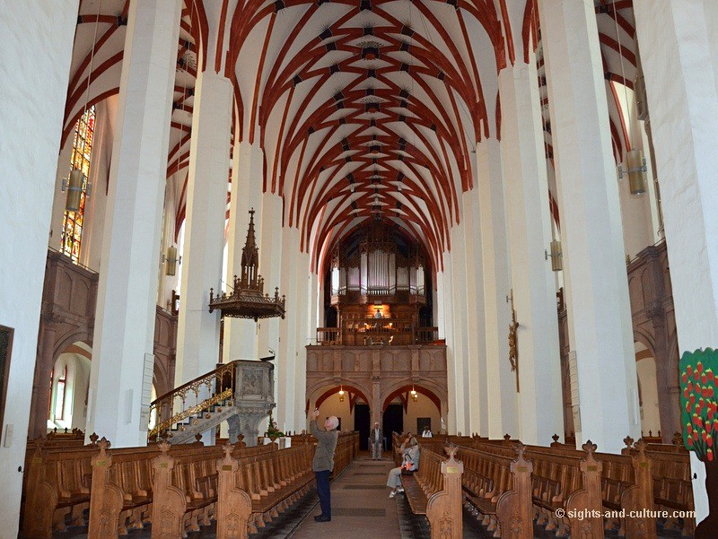
St. Peter’s (Rome) St. Thomas (Leipzig)

Slide 48
Northern Germanic Lands: The “Protestant Baroque”
(in contrast with the “Catholic Baroque”)
Architecturally more restrained, sometimes spare church interiors: removal of much Catholic decoration
Emphasis on internal, private or personal devotion rather than an external, sensual “flooding of all five senses”

Slide 49
Northern Germanic Lands: The “Protestant Baroque”
(in contrast with the “Catholic Baroque”)
Architecturally more restrained, sometimes spare church interiors: removal of much Catholic decoration
Emphasis on internal, private or personal devotion rather than an external, sensual “flooding of all five senses”
A more abstract focus on the biblical “Word” and its individual, congregational significance

Slide 50
Northern Germanic Lands: The “Protestant Baroque”
(in contrast with the “Catholic Baroque”)
Architecturally more restrained, sometimes spare church interiors: removal of much Catholic decoration
Emphasis on internal, private or personal devotion rather than an external, sensual “flooding of all five senses”
A more abstract focus on the biblical “Word” and its individual, congregational significance
Thus: an early step on the way to a view of music as spiritually “internal” rather than an item of external display

Slide 51
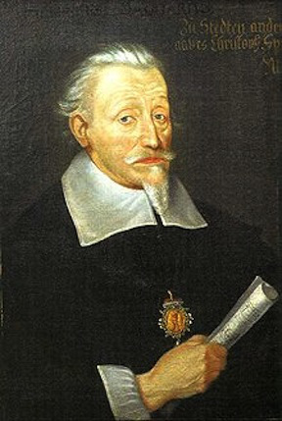
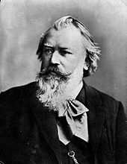
Northern Germanic Lands: The “Protestant Baroque”
(in contrast with the “Catholic Baroque”)
Architecturally more restrained, sometimes spare church interiors: removal of much Catholic decoration
Emphasis on internal, private or personal devotion rather than an external, sensual “flooding of all five senses”
A more abstract focus on the biblical “Word” and its individual, congregational significance
Thus: an early step on the way to a view of music as spiritually “internal” rather than an item of external display
Heinrich Schütz (1585-1672)

Slide 52
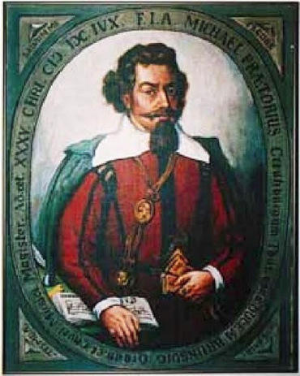
Musae Sionae (1605-1610)
Michael Praetorius (1571-1621)

Slide 53
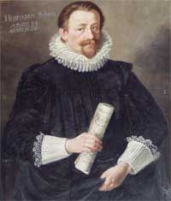
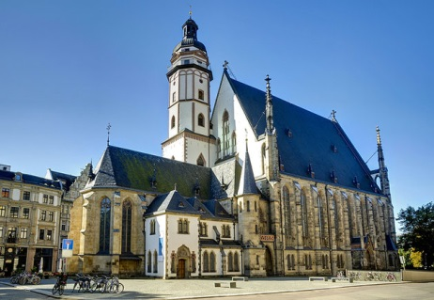
Johann Hermann Schein (1586-1630)
Leipzig, St. Thomas Church

Slide 54
Opella nova, Part 1 (1618)
30 Sacred Concertos
for two or three
voices and continuo
Opella nova, Part 2 (1626)
32 Sacred Concertos for three, four, or
five voices and
continuo, occasionally
enhanced with
additional instruments
Johann Hermann Schein (1586-1630)

Slide 55
Opella nova, Part 1 (1618)
30 Sacred Concertos
for two or three
voices and continuo
Opella nova, Part 2 (1626)
32 Sacred Concertos for three, four, or
five voices and
continuo, occasionally
enhanced with
additional instruments
Johann Hermann Schein (1586-1630)
e.g, “Mach dich auf, werde Licht Zion”
(Isaiah 60: “Arise, shine, O Zion, for thy light shall come”)

Slide 56
Heinrich Schütz (1585-1672)
Saxony, Dresden

Slide 57
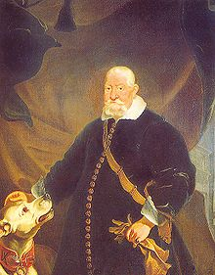
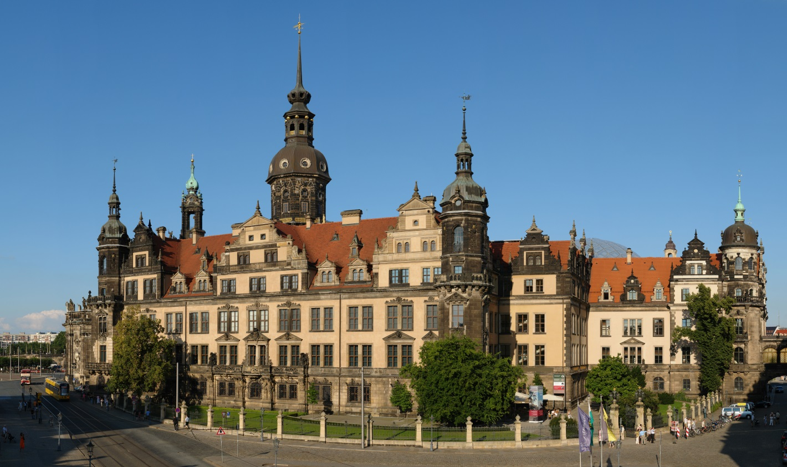
Dresden Castle
Dresden, Elector Johann Georg I of Saxony

Slide 58
Dresden Castle
Dresden, Elector Johann Georg I of Saxony
Heinrich Schütz: Court Kapellmeister in Dresden, 1617-56

Slide 59
Dresden Castle
Dresden, Elector Johann Georg I of Saxony
Heinrich Schütz: Court Kapellmeister in Dresden, 1617-56
Italian influence: two trips to Venice, 1609-12, 1628-29

Slide 60
Psalmen Davids (1619)
26 polychoral sacred concertos
Heinrich Schütz (1585-1672)

Slide 61
Psalmen Davids (1619)
26 polychoral sacred concertos
e.g., “Lobe den Herren, meine Seele”
(Psalm 103: “Praise the Lord, o my soul”)
Heinrich Schütz (1585-1672)

Slide 62
Psalmen Davids (1619)
26 polychoral sacred concertos
Symphoniae Sacrae, Part 1 (1629)
20 sacred concertos
(Latin texts, e.g., “O quam tu pulchra es”)
Heinrich Schütz (1585-1672)

Slide 63
Psalmen Davids (1619)
26 polychoral sacred concertos
Symphoniae Sacrae, Part 1 (1629)
20 sacred concertos
(Latin texts, e.g., “O quam tu pulchra es”)
Symphoniae Sacrae, Part 2 (1647)
27 sacred concertos
(German texts)
Heinrich Schütz (1585-1672)

Slide 64
Psalmen Davids (1619)
26 polychoral sacred concertos
Symphoniae Sacrae, Part 1 (1629)
20 sacred concertos
(Latin texts, e.g., “O quam tu pulchra es”)
Symphoniae Sacrae, Part 2 (1647)
27 sacred concertos
(German texts)
Symphoniae Sacrae, Part 3 (1650)
21 sacred concertos
(German texts, e.g., “Saul, Saul, was verfolgst du mich?”
and “Vater unser”)
Heinrich Schütz (1585-1672)

Slide 65
Sacred Concerto: Two Settings of “Vater unser”
Johann Hermann Schein (1586-1630)
Opella Nova 2 (1626)
Heinrich Schütz (1585-1672)
Symphoniae sacrae 3 (1650)

