Slide 1
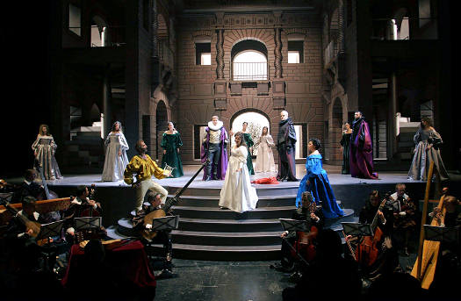
Monteverdi, L’Orfeo (Favola in Musica, Mantua 1607)

Slide 2
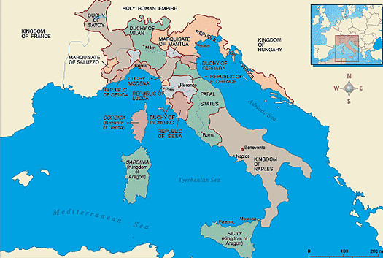
Music in the Early Modern Era: Italy, c. 1600
Florence
Naples
Rome
Mantua
Ferrara
Venice

Slide 3
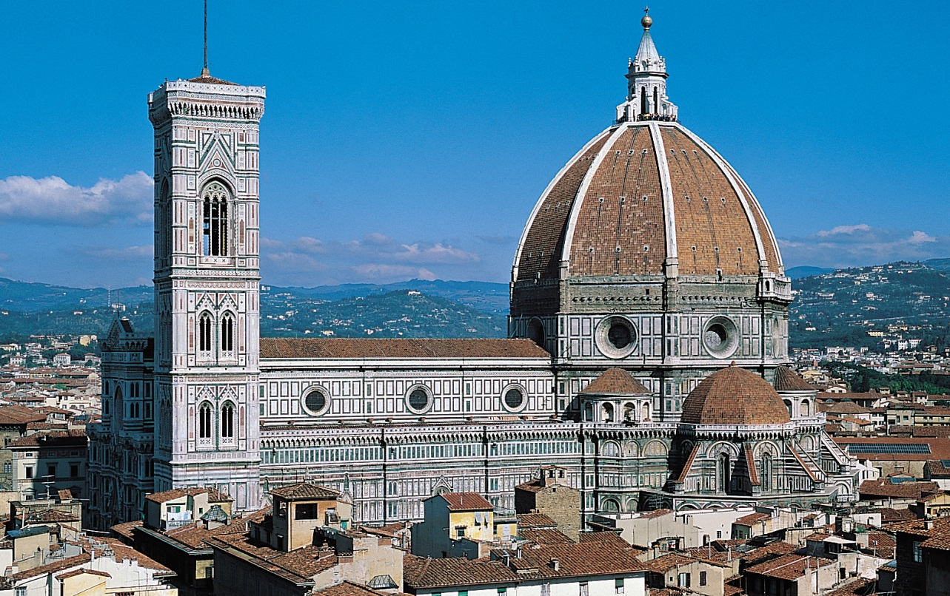
Music in the Early Modern Era: Italy, c. 1600
Florence
Naples
Rome
Mantua
Ferrara
Venice

Slide 4
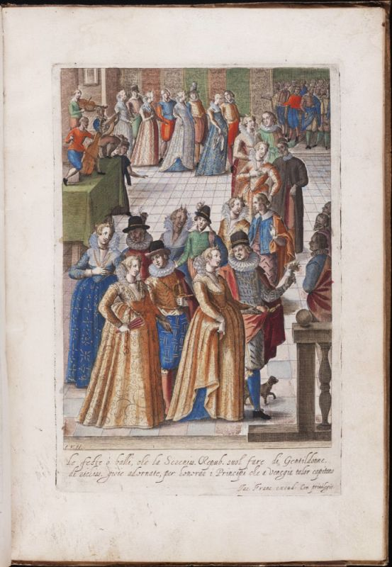
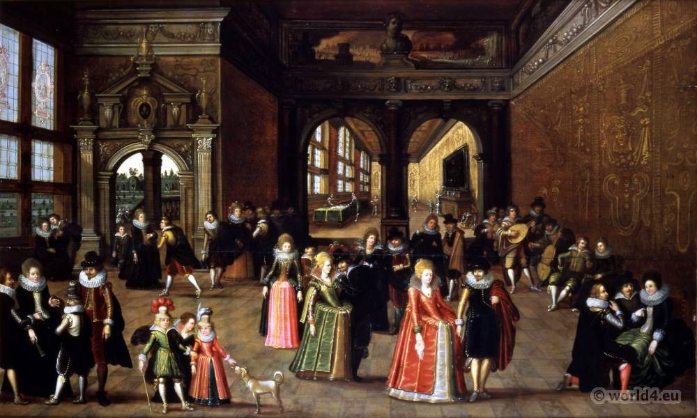
Music in the Early Modern Era: Italy, c. 1600
Florence: The Medici Court

Slide 5
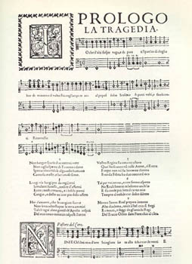
Florence: The Medici Court
The Opening Music of Peri’s Euridice (1600)

Slide 6
An advance? . . . . or a decline?
“Mannerism”?
Florence: The Medici Court
The Opening Music of Peri’s Euridice (1600)

Slide 7
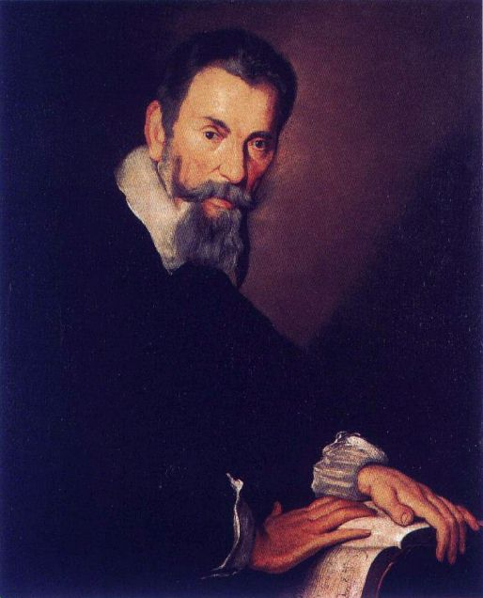
Claudio Monteverdi (1567-1643):
master of extravagant musical color and affect

Slide 8
musica moderna
stile moderno
“seconda prat[t]ica”
Claudio Monteverdi (1567-1643):
master of extravagant musical color and affect

Slide 9
musica moderna
stile moderno
“seconda prat[t]ica”
vocal music accompanied by instruments—including especially a keyboard or string instrument playing from
figured bass (thoroughbass, basso continuo)
Claudio Monteverdi (1567-1643):
master of extravagant musical color and affect

Slide 10
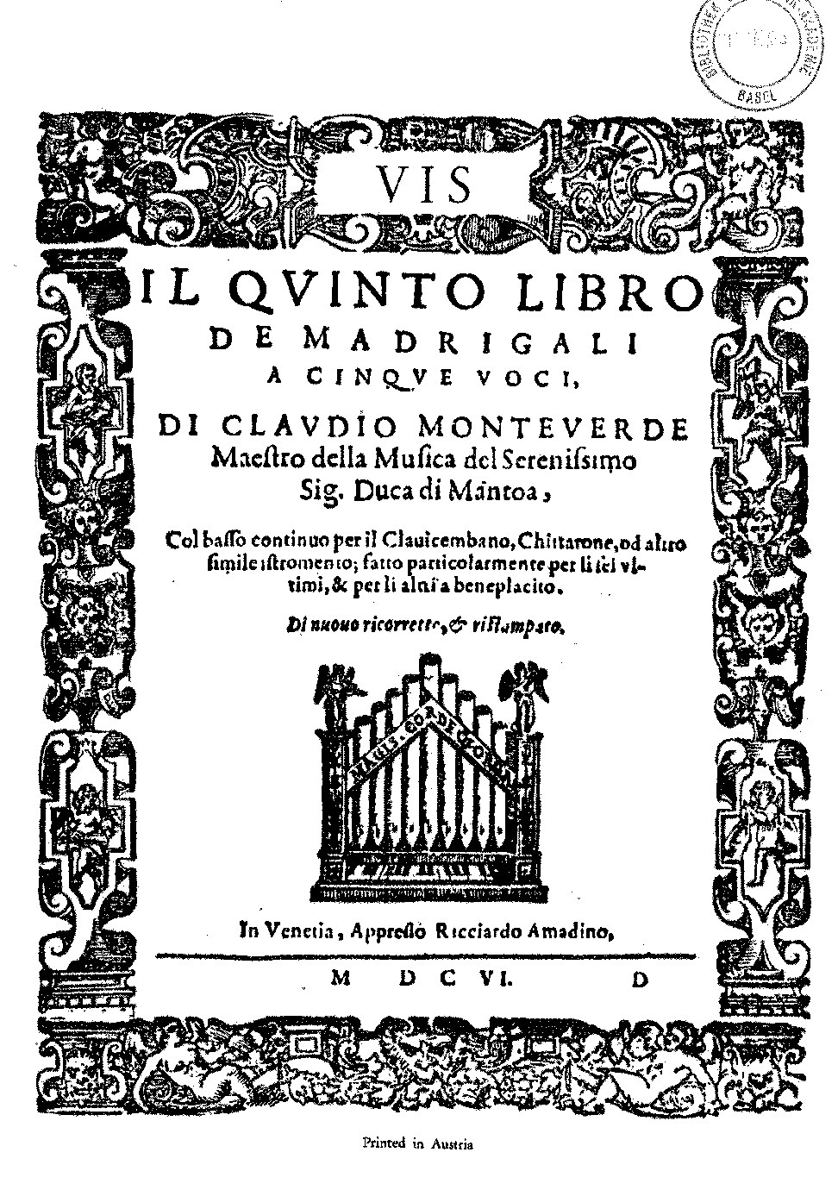
Monteverdi, Madrigals, Book 5
(1605)

Slide 11
“With basso continuo for harpsichord, chitarrone, and other similar instruments, produced especially for the last six [madrigals], and optional for the others.”
Monteverdi, Madrigals, Book 5
(1605, the last six are “continuo madrigals”—or “concertato madrigals”)

Slide 12
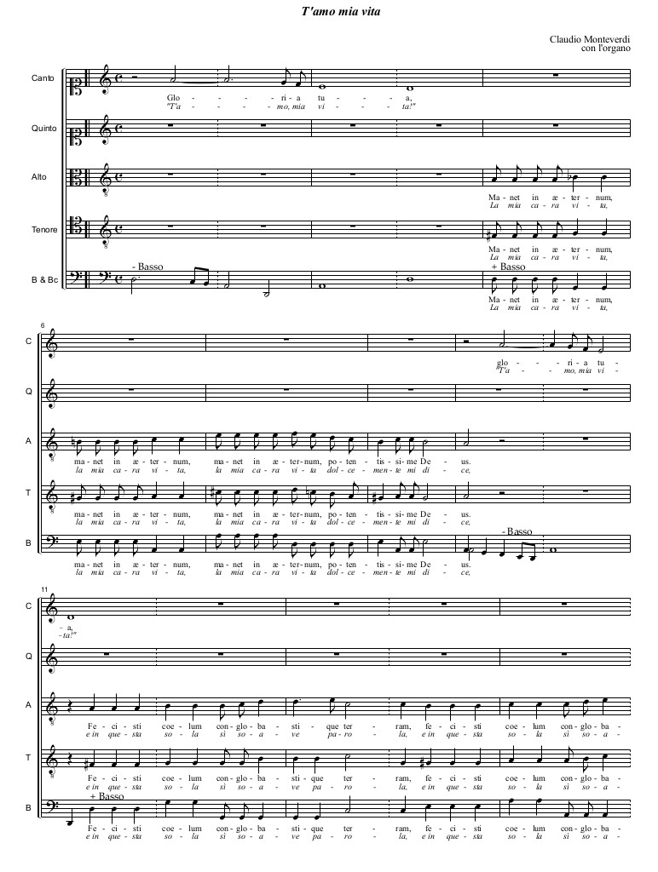
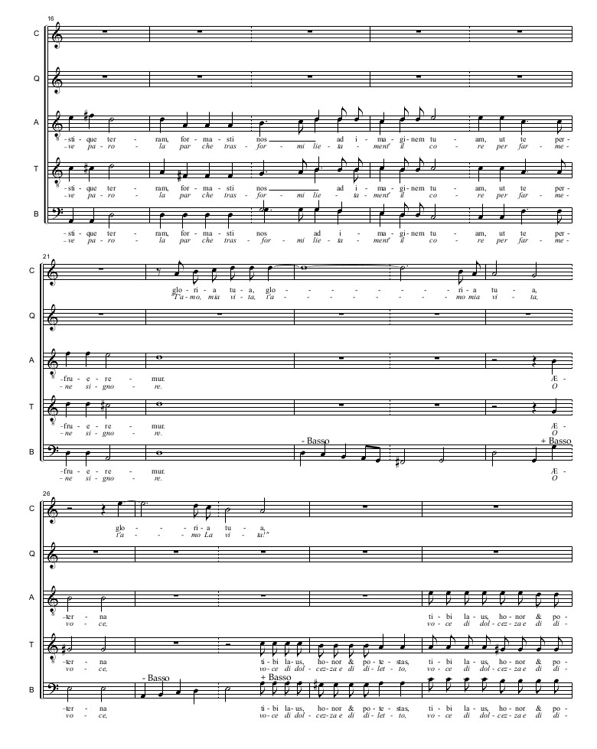
Monteverdi: Concertato Madrigal (Continuo Madrigal):
“T’amo mia vita” from Book 5 (1605)

Slide 13
Italian Madrigals by 1605:
Three Types
Vocal Only
(group, unaccompanied:
Traditional)
Solo Madrigal
(solo voice, continuo)
Concertato Madrigal
(voice(s) + additional, essential instrumental parts (including basso continuo)

Slide 14
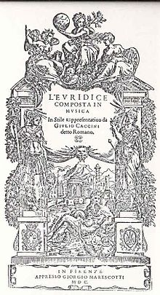
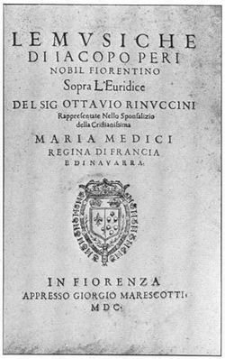
Caccini’s Version
Peri’s Version

Slide 15
1600: extended musical illustrations of an academic intellectual theory
Caccini’s Version
Peri’s Version

Slide 16
1600: extended musical illustrations of an academic intellectual theory
by which it was both enabled and constrained
Caccini’s Version
Peri’s Version

Slide 17
1600: extended musical illustrations of an academic intellectual theory
by which it was both enabled and constrained
re-creation of solo-sung declamation of ancient Greek drama
Caccini’s Version
Peri’s Version

Slide 18
1600: extended musical illustrations of an academic intellectual theory
by which it was both enabled and constrained
re-creation of solo-sung declamation of ancient Greek drama
simplicity of texture: avoidance of elaborate polyphony or other “learned” elements
Caccini’s Version
Peri’s Version

Slide 19
1600: extended musical illustrations of an academic intellectual theory
by which it was both enabled and constrained
re-creation of solo-sung declamation of ancient Greek drama
simplicity of texture: avoidance of elaborate polyphony or other “learned” elements
straightforward recitation over figured bass (stile rappresentativo)
Caccini’s Version
Peri’s Version

Slide 20
1600: extended musical illustrations of an academic intellectual theory
by which it was both enabled and constrained
re-creation of solo-sung declamation of ancient Greek drama
simplicity of texture: avoidance of elaborate polyphony or other “learned” elements
straightforward recitation over figured bass (stile rappresentativo)
emotional effect largely through the personalized delivery of the performer,
along with a few special effects in the harmonies
Caccini’s Version
Peri’s Version

Slide 21
Euridice (1600): the general structure of each of the five scenes
Change of poetic meter
Concluding choral refrain (summary-reaction), intermixed with recitative verses
Dialogue: scene-setting and action
(“monody”; varying intensities of “recitative”;
stile rappresentativo; mostly dramatic poetic declamation over figured bass, basso continuo)
(cf. ancient Greek “chorus”)

Slide 22
Claudio Monteverdi
L’Orfeo (1607), published in 1609 and again in 1615

Slide 23
Mantua

Slide 24
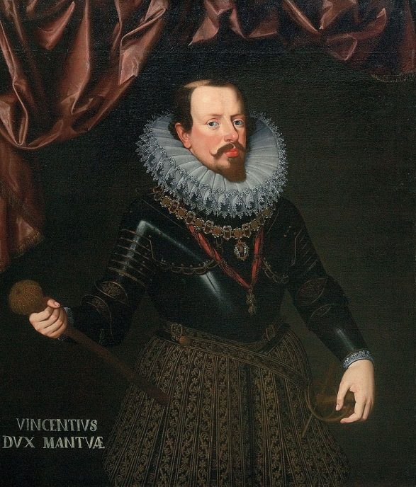
Claudio Monteverdi
Vincenzo I of Gonzaga (Mantua)

Slide 25
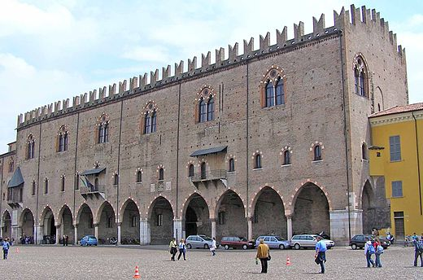
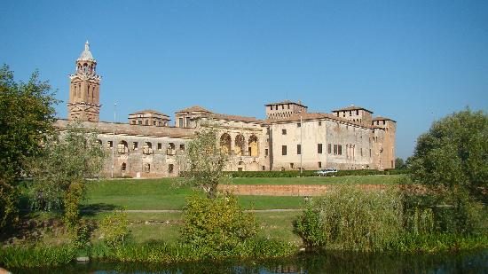
Vincenzo I of Gonzaga (Mantua)
Mantua – Ducal Palace (Gonzaga Family)

Slide 26
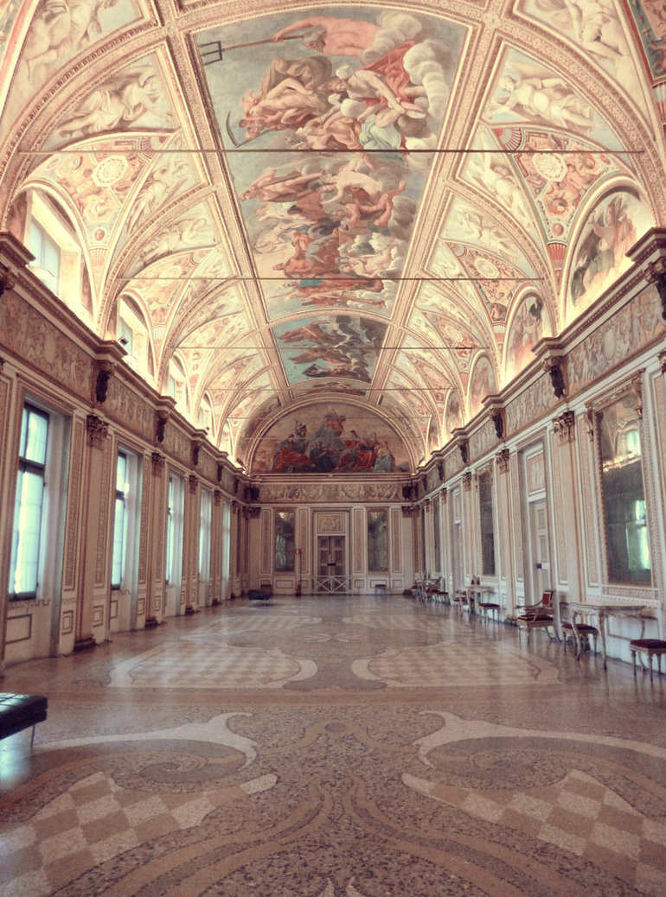
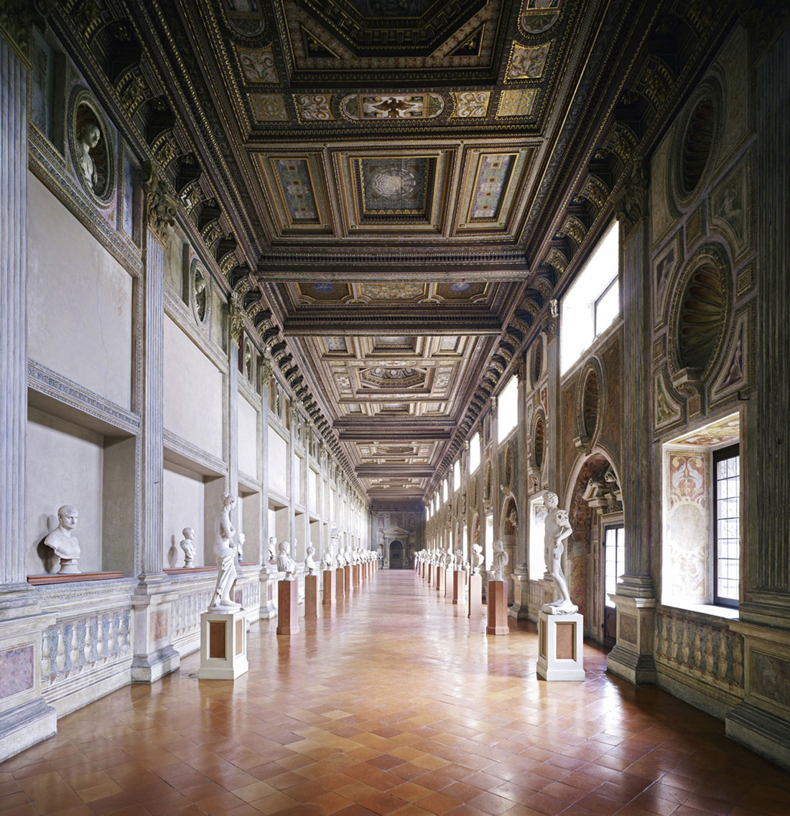
Mantua – Ducal Palace -- Interior

Slide 27
Claudio Monteverdi
L’Orfeo (1607), published in 1609 and again in 1615

Slide 28
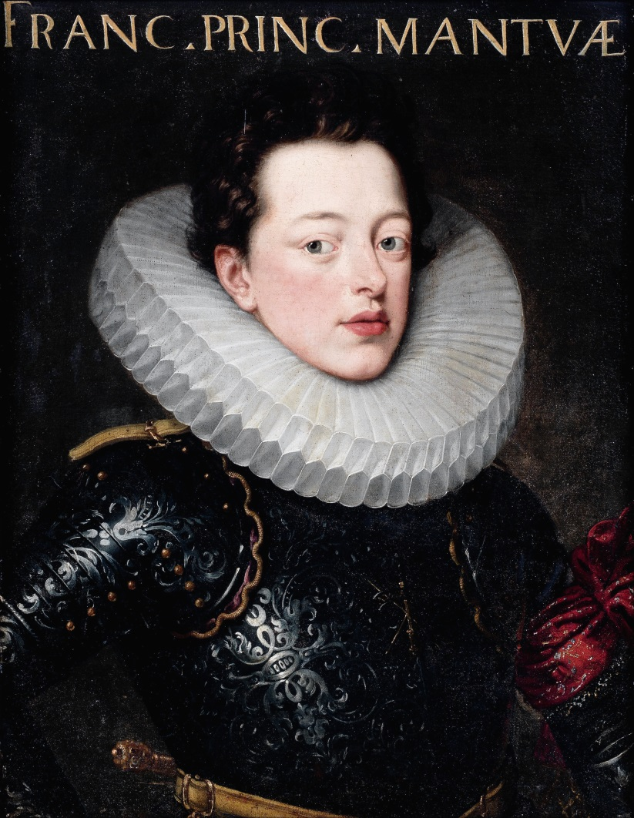
Francesco II Gonzaga
(son of Vincenzo I)
L’Orfeo (1607), published in 1609 and again in 1615

Slide 29
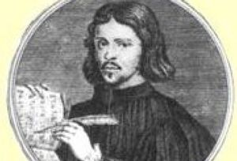
Claudio Monteverdi
L’Orfeo (1607), published in 1609 and again in 1615
Alessandro Striggio (librettist)

Slide 30
Mantua—Gonzaga Palace: Interior Room/Hall (Orfeo, 1607)

Slide 31
“Monteverdi the Extravagant”

Slide 32
“Monteverdi the Extravagant”

Slide 33
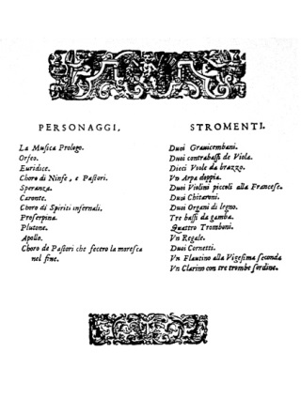

Slide 34
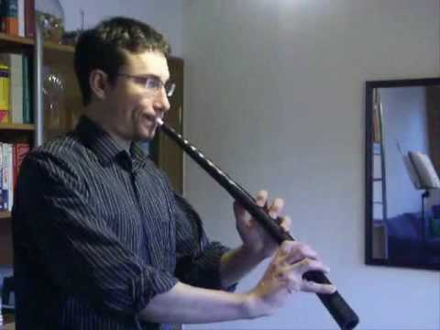
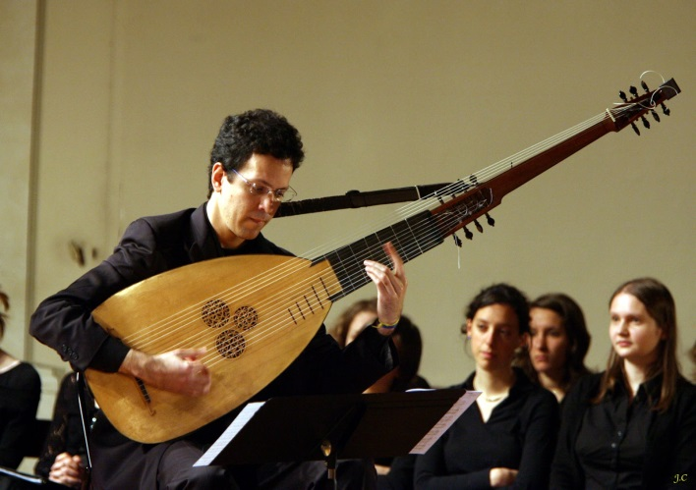
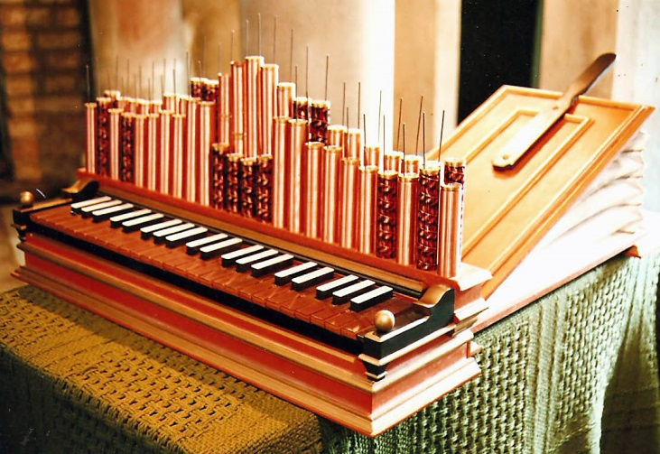
Clarino
Cornetto
Chitarrone
Regalo (Regal)

Slide 35
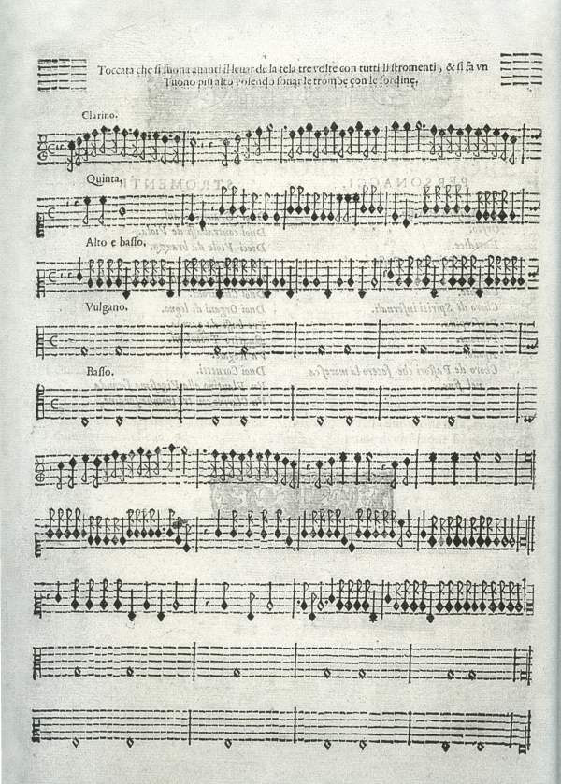
Monteverdi, L’Orfeo (Mantua, 1607), opening “Toccata”

Slide 36
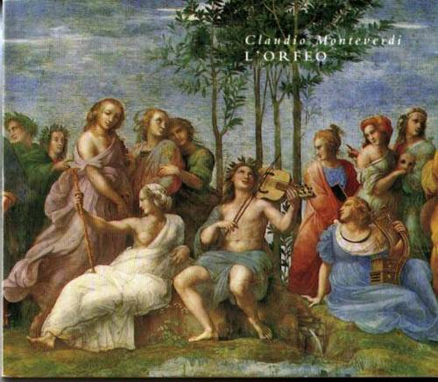
Monteverdi, L’Orfeo (1607): “Prologue” with instrumental “ritornello”

Slide 37
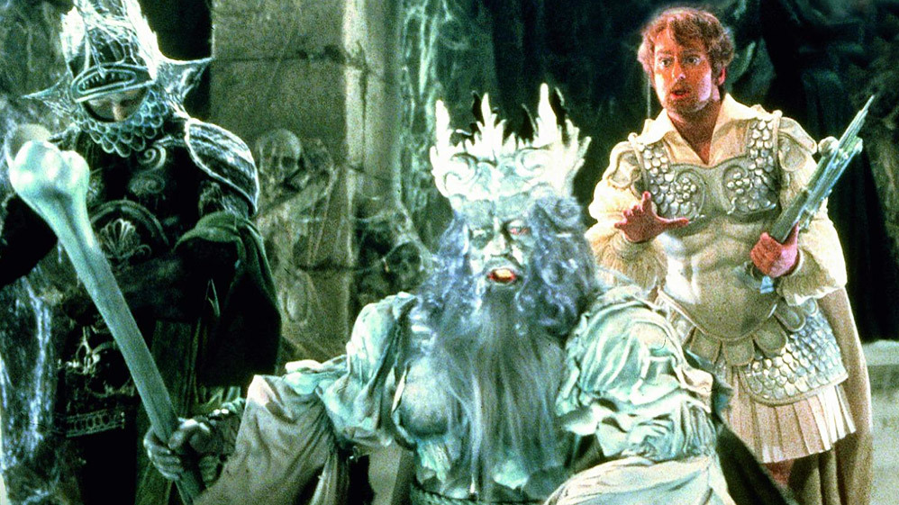
Monteverdi, L’Orfeo (1607): “Sinfonia” to Act 3 (Orpheus in the underworld)

Slide 38
Clarino
Cornetto
Chitarrone
Regalo (Regal)

Slide 39
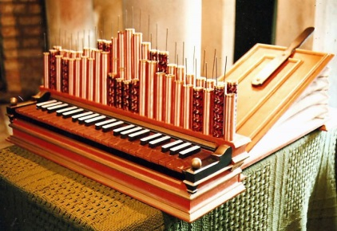
Clarino
Thus→ Orfeo (1607) compared with Peri’s Euridice (1600):
Cornetto
Chitarrone
Regalo (Regal)

Slide 40
Clarino
Thus→ Orfeo (1607) compared with Peri’s Euridice (1600):
expressive use of diverse timbres, tone colors
Cornetto
Chitarrone
Regalo (Regal)

Slide 41
Clarino
Thus→ Orfeo (1607) compared with Peri’s Euridice (1600):
expressive use of diverse timbres, tone colors
far more diversity in kinds/varieties of pieces and special effects
Cornetto
Chitarrone
Regalo (Regal)

Slide 42
Clarino
Thus→ Orfeo (1607) compared with Peri’s Euridice (1600):
expressive use of diverse timbres, tone colors
far more diversity in kinds/varieties of pieces and special effects
Cornetto
Orfeo: a tossed salad of different part, styles, and musical effects
Chitarrone
Regalo (Regal)

Slide 43
Euridice (1600): the general structure of each of the five scenes
Change of poetic meter
Concluding choral refrain (summary-reaction), intermixed with recitative verses
Dialogue: scene-setting and action
(“monody”; varying intensities of “recitative”;
stile rappresentativo; mostly dramatic poetic declamation over figured bass, basso continuo)
(cf. ancient Greek “chorus”)

Slide 44
[The following seven slides were short video clips from a production of Orfeo. They appear here only as pictures in order not to exceed uploadable file size.]

Slide 45
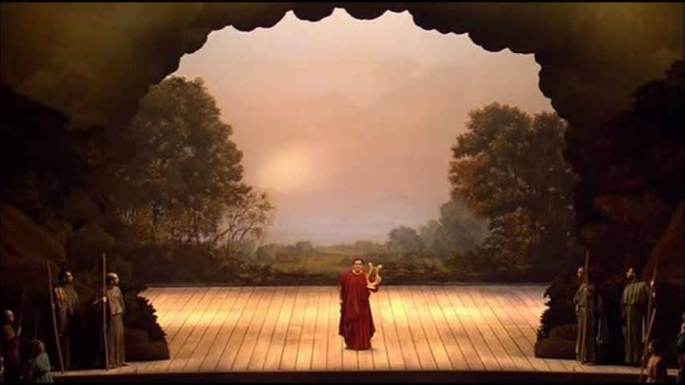
Act 2, Shepherds’ Songs, “Mira, ch’a sè n’alletta,” etc.

Slide 46
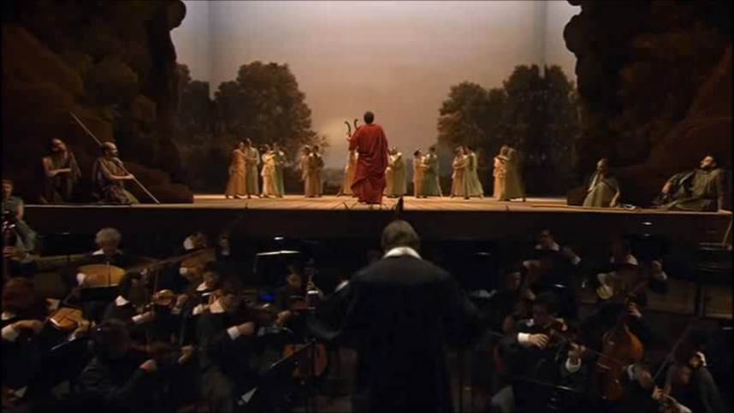
Act 2, Orfeo’s air, “Vi ricorda, o boschi ambrosi”

Slide 47
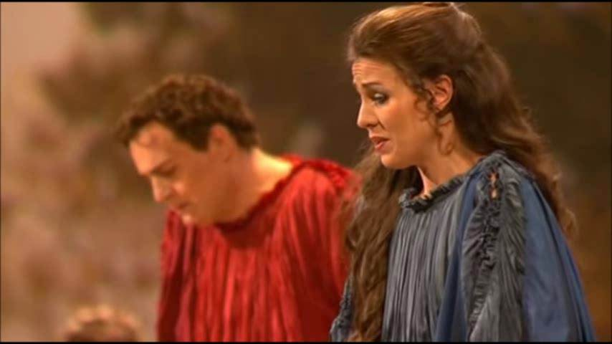
Act 2, “In un fiorito prato”

Slide 48
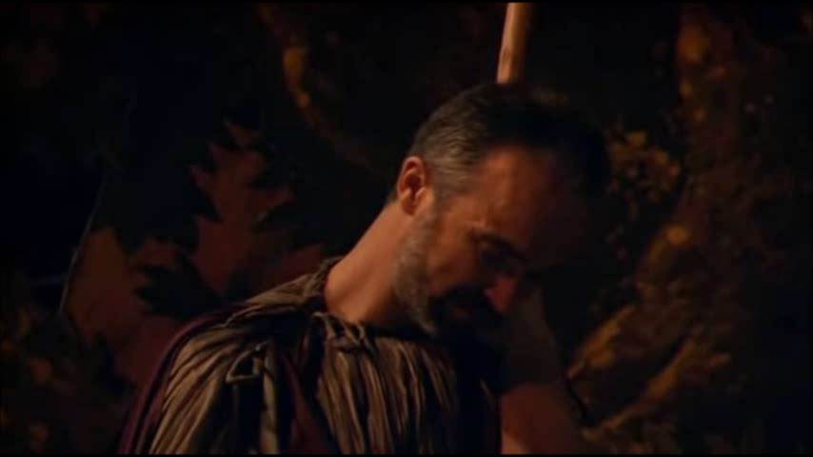
Act 2, “Tu sei morta” (Orfeo’s Lament)

Slide 49
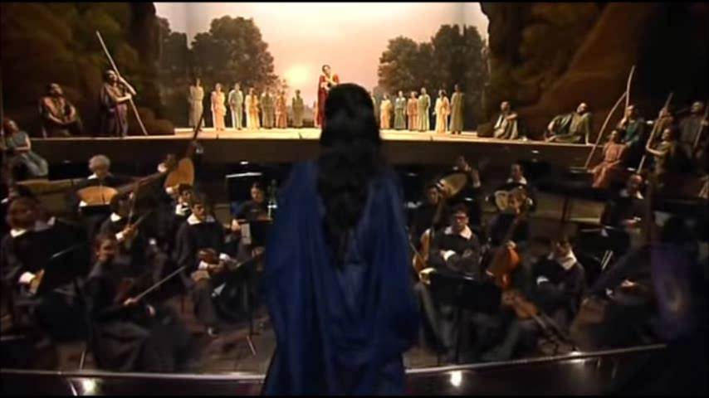
Act 2, “Ahi, caso acerbo” (2)

Slide 50
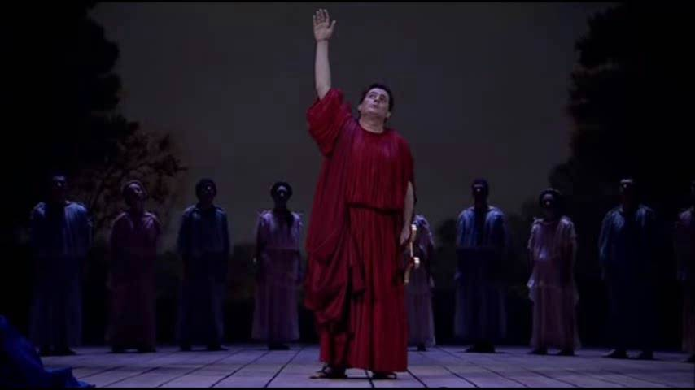
Act 2, “Ahi, caso acerbo” (3)

Slide 51
Mantua

Slide 52
Mantua

Slide 53
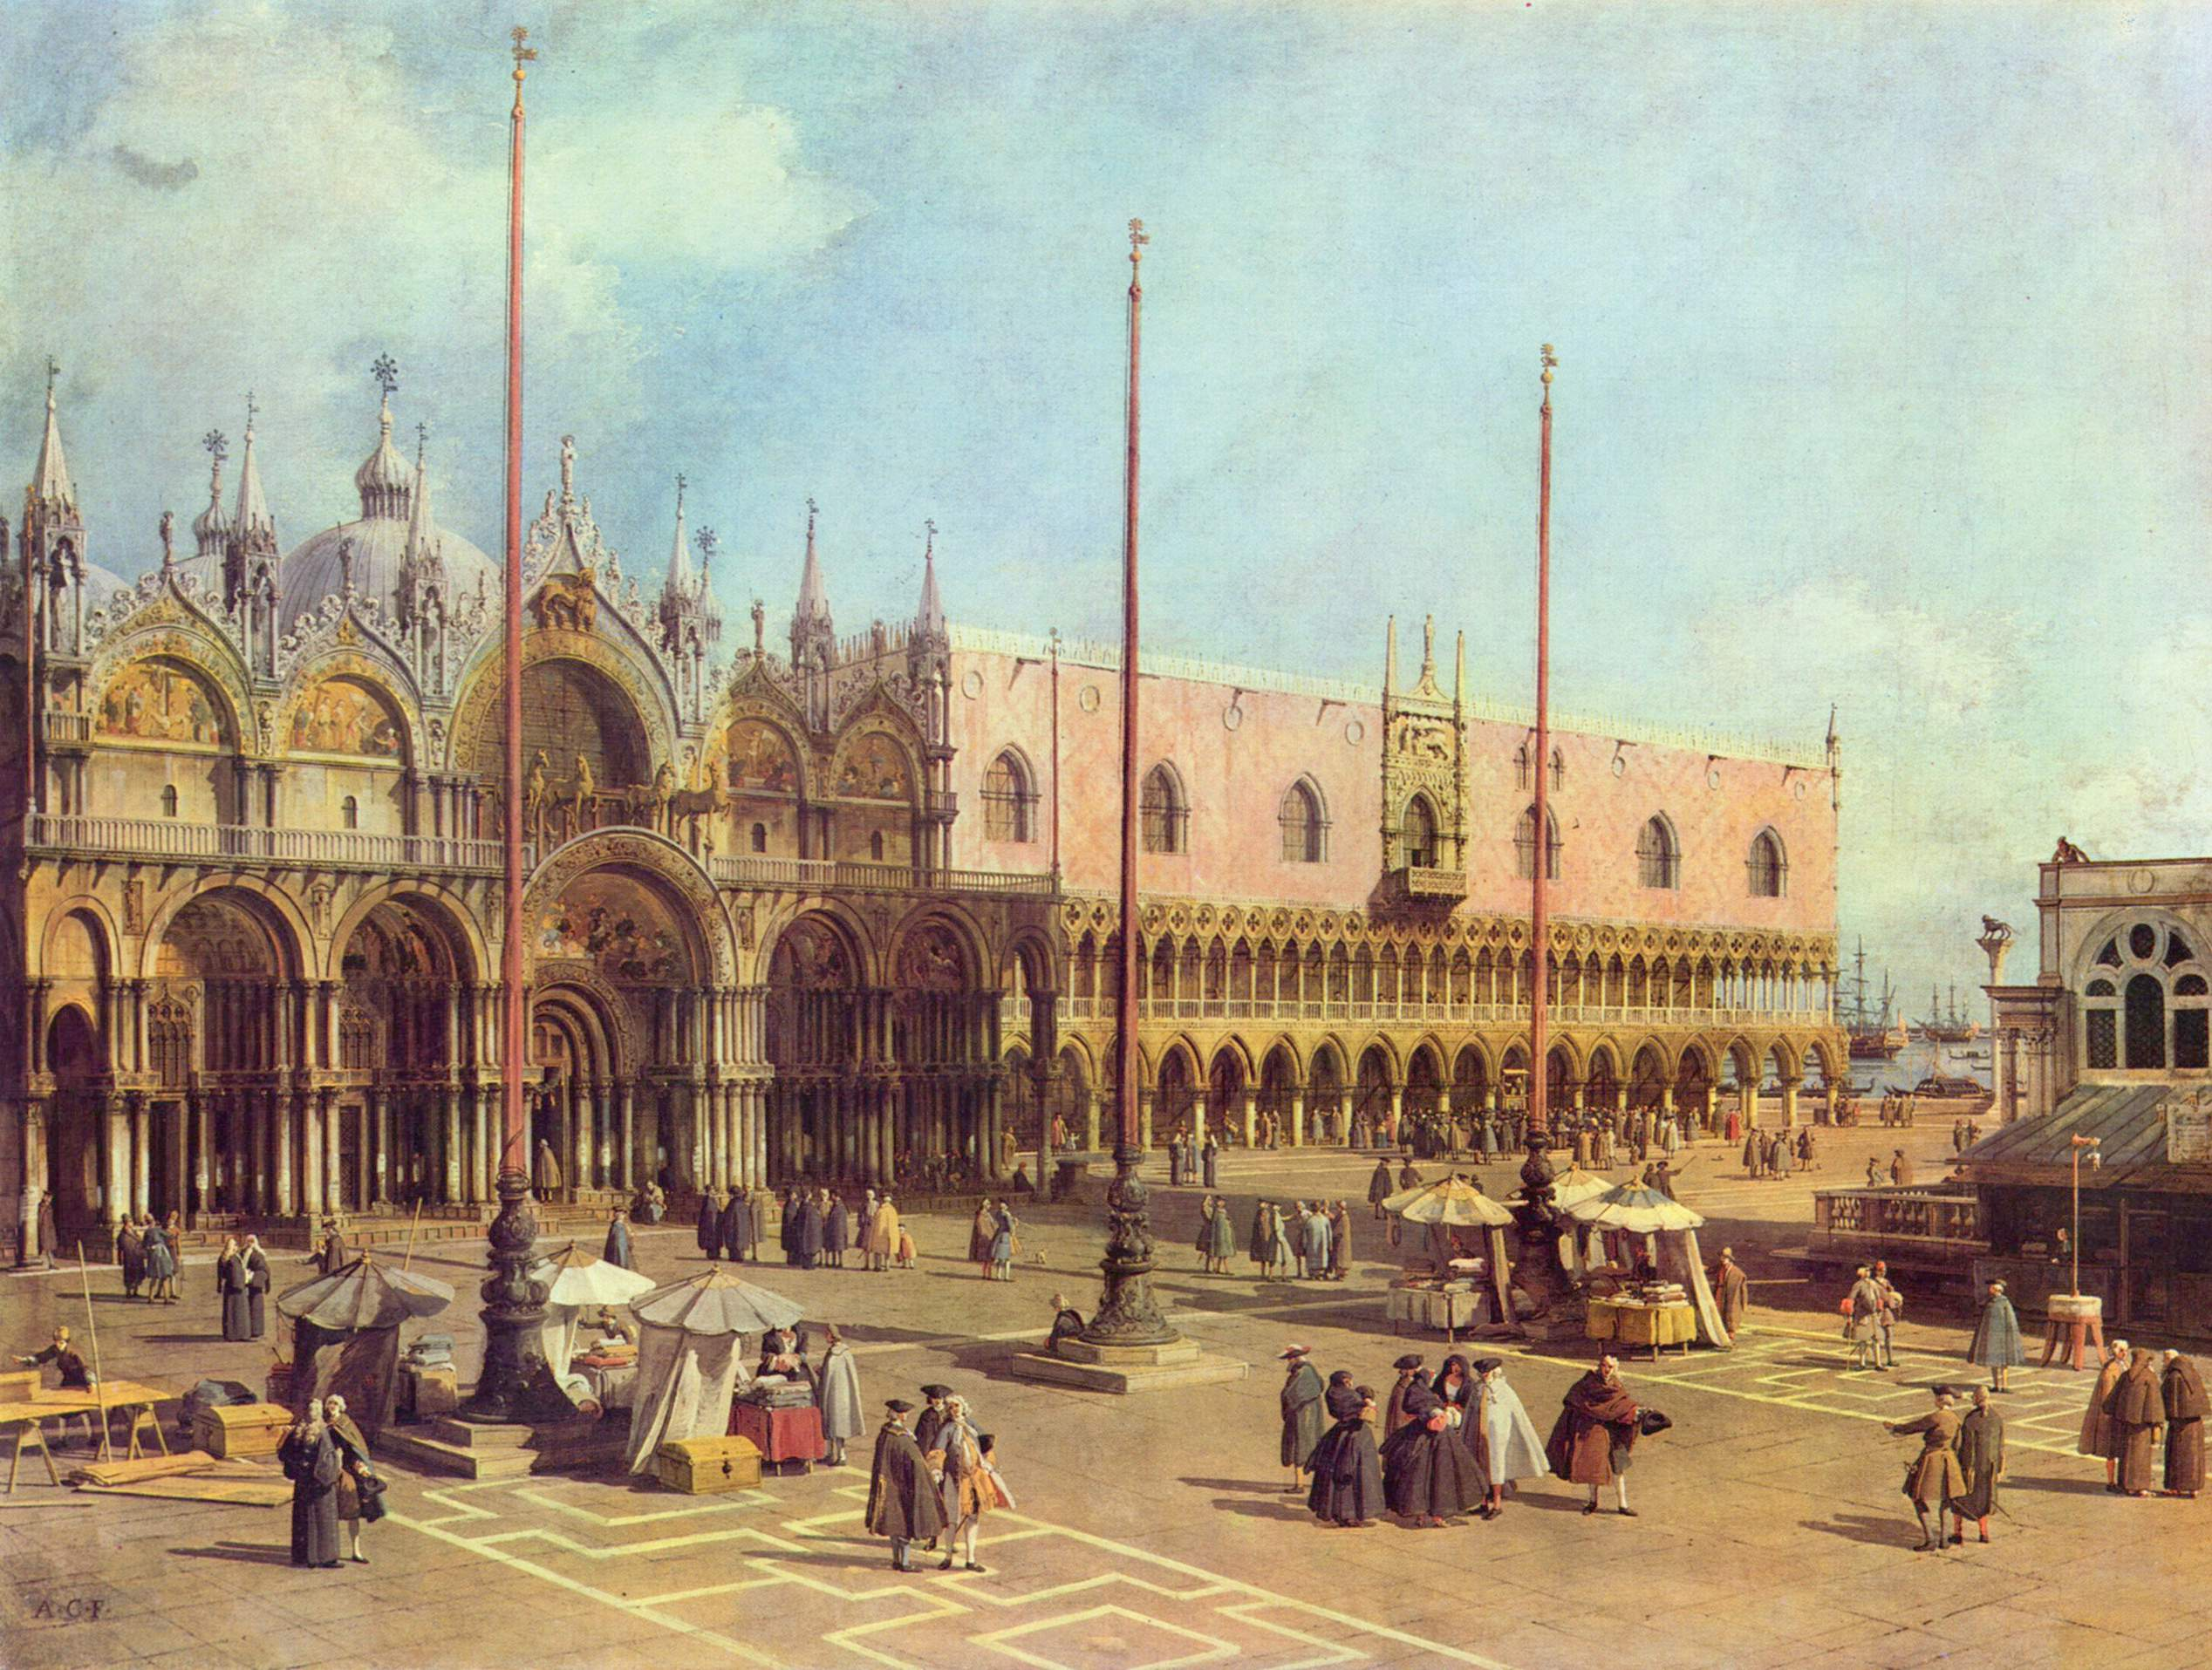
Monteverdi, 1613: leaves Mantuan court for employment in Venice
(Maestro di Capella, San Marco)

Slide 54
Monteverdi, 1613: leaves Mantuan court for employment in Venice
(Maestro di Capella, San Marco)
Madrigals, Book 6 (concertato)—1614

Slide 55
Monteverdi, 1613: leaves Mantuan court for employment in Venice
(Maestro di Capella, San Marco)
Madrigals, Book 6 (concertato)—1614
Madrigals, Book 7 (concertato)—1617

Slide 56
Monteverdi, 1613: leaves Mantuan court for employment in Venice
(Maestro di Capella, San Marco)
Madrigals, Book 6 (concertato)—1614
Madrigals, Book 7 (concertato)—1617
Madrigals, Book 8 (concertato)—1638

Slide 57
Monteverdi, 1613: leaves Mantuan court for employment in Venice
(Maestro di Capella, San Marco)
Madrigals, Book 6 (concertato)—1614
Madrigals, Book 7 (concertato)—1617
Madrigals, Book 8 (concertato)—1638
Opera: L’incoronazione di Poppea–1643

Slide 58
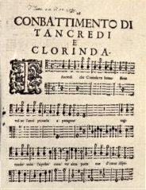
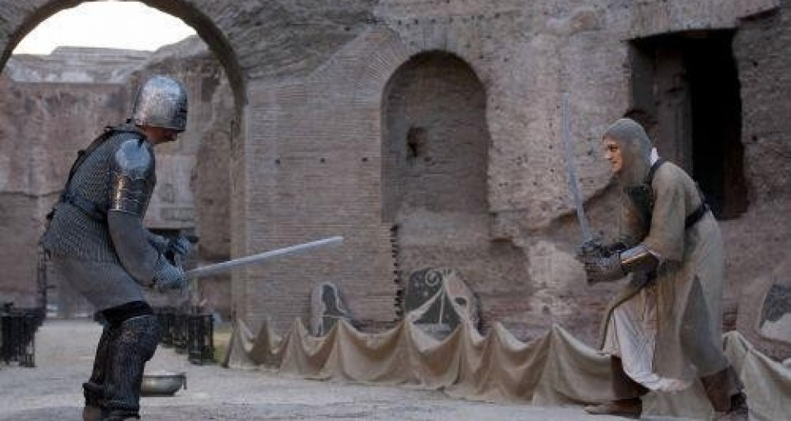
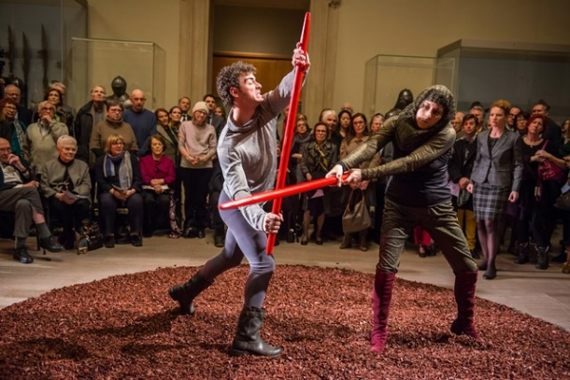
Poetically narrated tale, extracted from Torquato Tasso, Gerusalemme liberata (1581)

Slide 59
First performed, 1624 (Mocenigo court); published in Madrigals, Book 8 (1638)

Slide 60
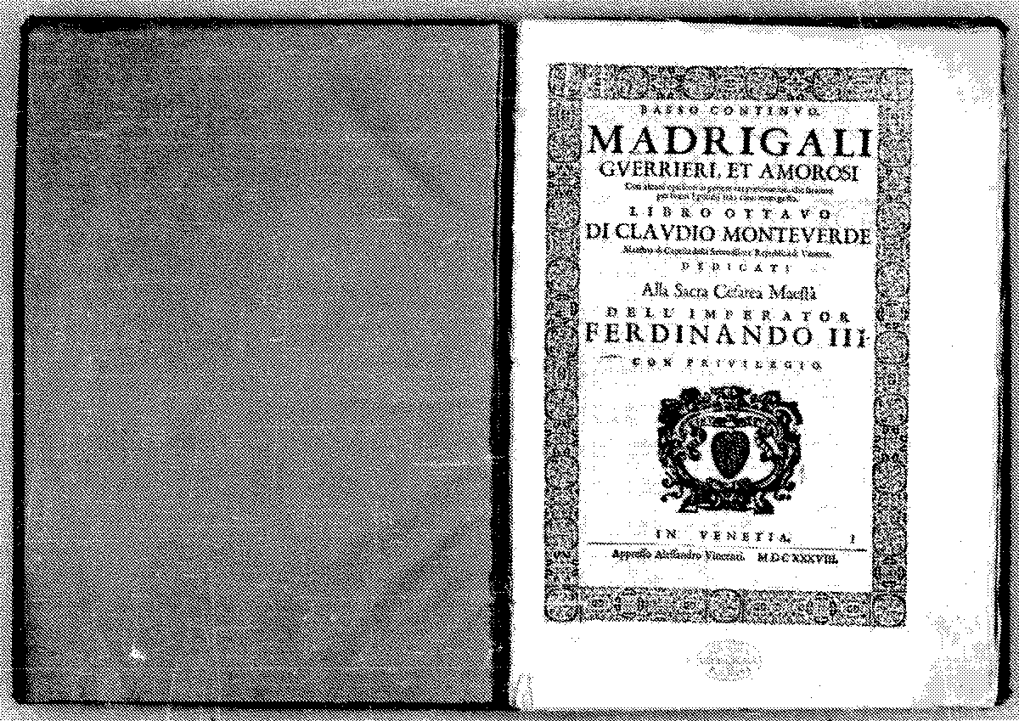
Monteverdi, Madrigals, Book 8

Slide 61
Poetically narrated tale, extracted from Torquato Tasso, Gerusalemme liberata (1581)

Slide 62
Monteverdi, Madrigals, Book 8

Slide 63
First performed, 1624 (Mocenigo court); published in Madrigals, Book 8 (1638)

Slide 64
Monteverdi, Preface to Book 8, Madrigali guerrieri ed amorosi (1638)
The three principal passions Signified musically by
anger [should be agitated—concitato—
but seems absent?]
moderation soft (molle), “low register”
humility “moderate” (temperato), “medium register”

Slide 65
Monteverdi, Preface to Book 8, Madrigali guerrieri ed amorosi (1638)
The three principal passions Signified musically by
anger new, agitated style—stile concitato—
extremely rapid declamation, spat out at
lightning speed, to express “anger and disdain”
or situations in the “warlike genus”
moderation soft (molle), “low register”
humility “moderate” (temperato), “medium register”

Slide 66
Monteverdi, Preface to Book 8, Madrigali guerrieri ed amorosi (1638)
Thesis: “it is [emotional] contraries which [most] greatly move our mind”
The three principal passions Signified musically by
anger new, agitated style—stile concitato—
extremely rapid declamation, spat out at
lightning speed, to express “anger and disdain”
or situations in the “warlike genus”
moderation soft (molle), “low register”
humility “moderate” (temperato), “medium register”

Slide 67
Monteverdi, Preface to Book 8, Madrigali guerrieri ed amorosi (1638)
Thesis: “it is [emotional] contraries which [most] greatly move our mind”
Combattimento = an opportunity to juxtapose “contrary passions”—
sudden shifts among conflicting emotions
The three principal passions Signified musically by
anger new, agitated style—stile concitato—
extremely rapid declamation, spat out at
lightning speed, to express “anger and disdain”
or situations in the “warlike genus”
moderation soft (molle), “low register”
humility “moderate” (temperato), “medium register”

Slide 68
First performed, 1624 (Mocenigo court); published in Madrigals, Book 8 (1638)

