Slide 1
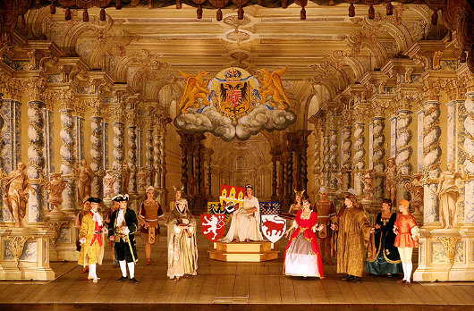
James Hepokoski
Music 351:
Music in European Court, Church, and Theater, 1600-1800

Slide 2
Italian “Innovations,” c. 1580-1610
The striving for an intensely heightened, word-oriented expressivity
The rise of figured bass/basso continuo practice
The origin of “opera”

Slide 3
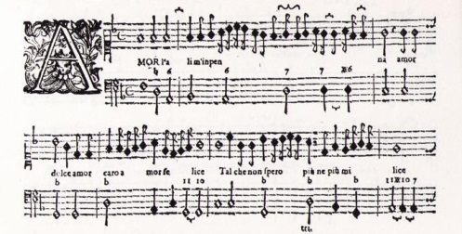
Figured Bass in Caccini’s Le nuove musiche (1601-02)

Slide 4
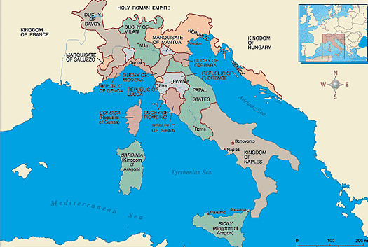

Slide 5
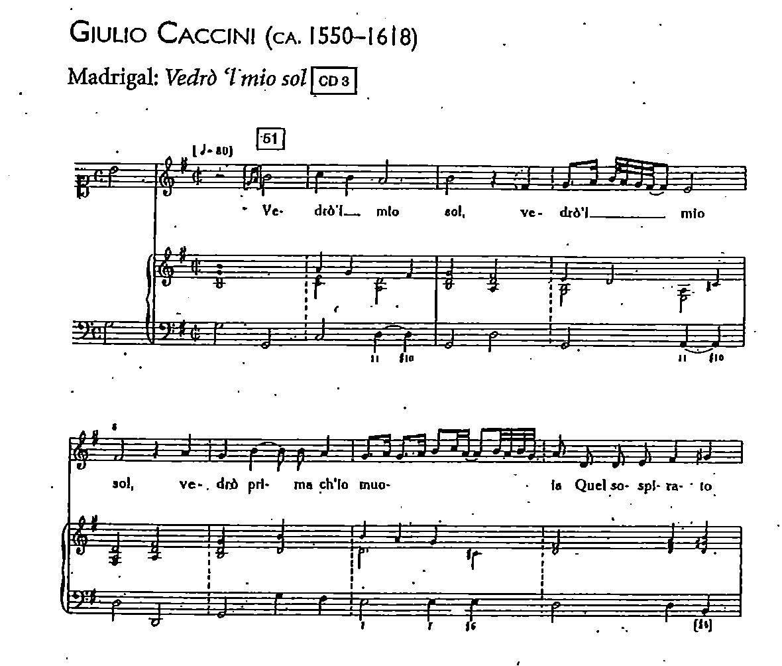

Slide 7
Figured bass notation liberates certain kinds of music
(especially solo song) from fixed, contrapuntal grids
and strict rhythmic performance:

Slide 8
Figured bass notation liberates certain kinds of music
(especially solo song) from fixed, contrapuntal grids
and strict rhythmic performance:
Accompaniment: freer, mixing the fixed principle of specified chords with the musically improvisatory spontaneity of how to realize them.

Slide 9
Figured bass notation liberates certain kinds of music
(especially solo song) from fixed, contrapuntal grids
and strict rhythmic performance:
Accompaniment: freer, mixing the fixed principle of specified chords with the musically improvisatory spontaneity of how to realize them.
With the accompaniment thus freed, the solo voice can now perform the music more flexibly, dramatically: rhythmically fluid, freely ornamented, etc.

Slide 10
Italian “Innovations,” c. 1580-1610
c
The striving for an intensely heightened, word-oriented expressivity
The rise of figured bass/basso continuo practice
The origin of “opera”
c

Slide 11
But: who “invented” figured bass—c. 1580/90-1600?
Is there a person to whom we can attribute this?

Slide 12
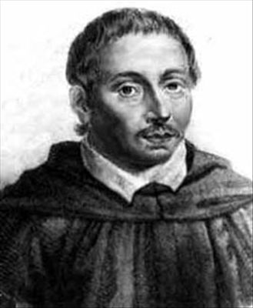
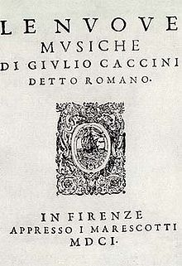
Giulio Caccini (1551-1618)
“It occurred to me to introduce a kind of music by which anyone could almost speak in music,
using (as I have said elsewhere) a certain noble sprezzatura in the melody. . . . while sustaining the pitch of the bass note . . . and with the middle lines played by the instrument to express some affetto.”

Slide 13
The Origins of Figured Bass?

Slide 14
The Origins of Figured Bass?
Common practice: solo singing over a freely
strummed or played
instrumental accompaniment?
. . . 1570s, 1580s, 1590s . . .

Slide 15
The Origins of Figured Bass?
Innovation, c. 1580s, 1590s:
formalize the improvisatory practice
into a new manner of notation?
Common practice: solo singing over a freely
strummed or played
instrumental accompaniment?
. . . 1570s, 1580s, 1590s . . .

Slide 16
The Origins of Figured Bass?
Innovation, c. 1580s, 1590s:
formalize the improvisatory practice
into a new manner of notation?
Common practice: solo singing over a freely
strummed or played
instrumental accompaniment?
Figured bass (notated!) as an increasingly common practice
for any “accompanying” instrument
. . . 1570s, 1580s, 1590s . . .
. . . 1590s [?], 1600s . . . .

Slide 17
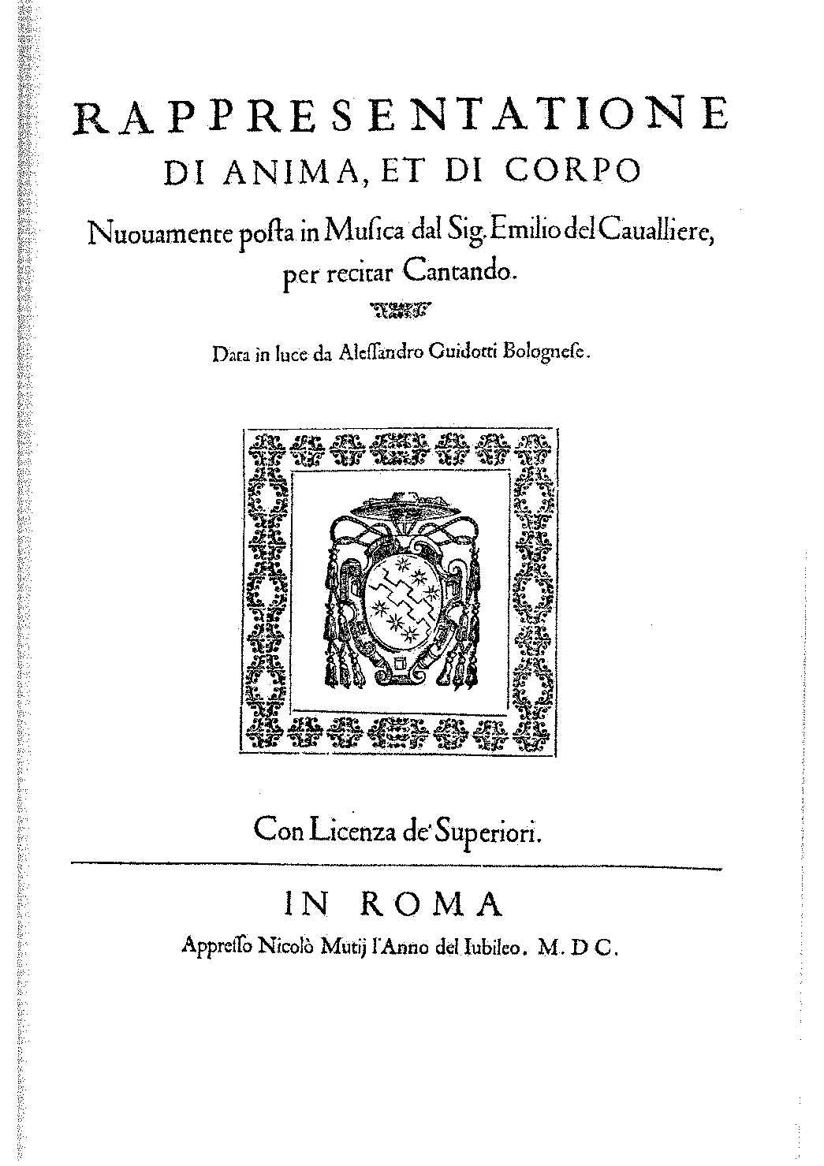
1600

Slide 18
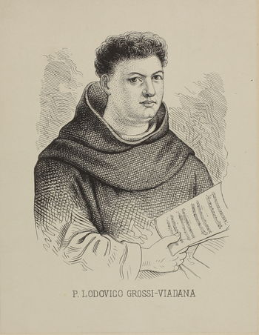
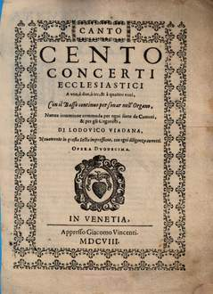
Another early publication featuring figured bass—but sacred; Latin texts
Lodovico Viadana (c. 1560 –1627)
Cento concerti ecclesiactici
“100 Sacred Concertos” (Venice, 1602)

Slide 19
Another early publication featuring figured bass—but sacred; Latin texts
Lodovico Viadana (c. 1560 –1627)
Cento concerti ecclesiactici
“100 Sacred Concertos” (Venice, 1602)

Slide 20
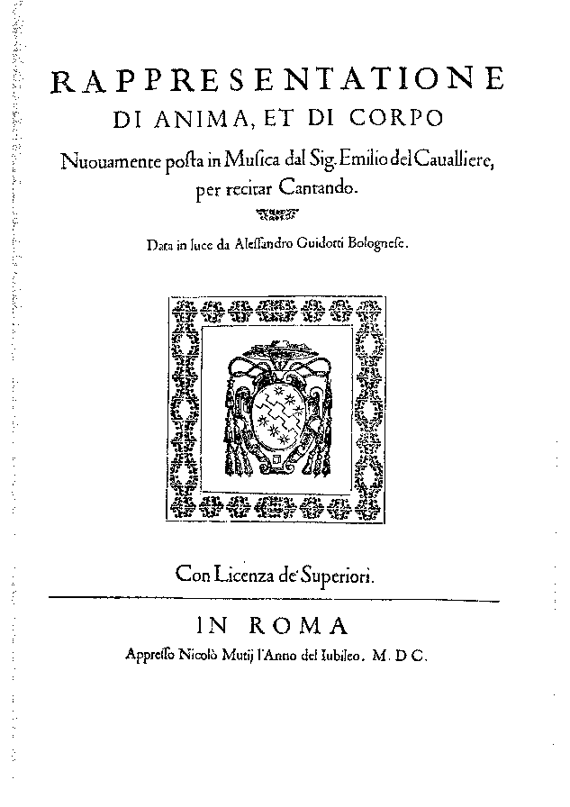
Early publications with figured bass
Emilio de’ Cavalieri Giulio Caccini Lodovico Viadana
Rome, 1600
(sacred play:
Italian text)
Florence, 1601-02 (solo madrigals and airs:
Italian text)
Venice, 1602
(sacred concertos, voice & basso continuo
Latin text)

Slide 21
Early publications with figured bass
Omitted here so far: recitative style singing
over figured bass in early “opera” (Florence, c. 1600)
Emilio de’ Cavalieri Giulio Caccini Lodovico Viadana
Rome, 1600
(sacred play:
Italian text)
Florence, 1601-02 (solo madrigals and airs:
Italian text)
Venice, 1602
(sacred concertos, voice & basso continuo
Latin text)

Slide 22
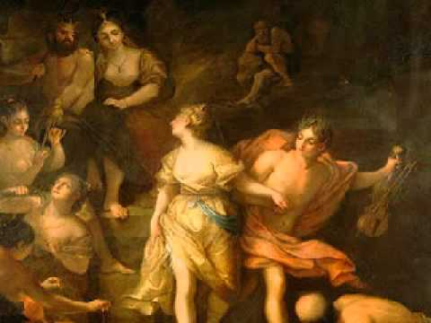
Early publications with figured bass
Omitted here so far: recitative style singing
over figured bass in early “opera” (Florence, c. 1600)
An emerging, grander-scale new genre: staged secular drama (especially favoring pastoral tales from ancient Greek literature)

Slide 23
“Monody,” c. 1600-02: Four Types of Music
Solo Madrigals Solo Airs Sacred Concertos “Operatic Recitative”
Caccini Viadana Caccini & Peri

Slide 24
Italian “Innovations,” c. 1580-1610
The striving for an intensely heightened, word-oriented expressivity
The rise of figured bass/basso continuo practice
The origin of “opera”

Slide 25
Italian “Innovations,” c. 1580-1610
The striving for an intensely heightened, word-oriented expressivity
The rise of figured bass/basso continuo practice
The origin of “opera”
“sung plays” (dramatized spectacles) conceived and devised in and around Florence,
1590s-1600—as “special-event” political celebrations

Slide 26
“Opera’s Origins in Italy
(Florence)
Intermedio (16th Century) “Opera” (c. 1600)

Slide 27
“Opera’s Origins in Italy
(Florence)
Intermedio (16th Century) “Opera” (c. 1600)
Court-sponsored,
costumed, and semi-staged
musical-theatrical spectacle:
an entertainment

Slide 28
The 16th-Century Intermedio:
Predecessor of Florentine “Opera”
Acts (spoken drama) 1 2 3 4 5
Intermedi x x x x

Slide 29
The 16th-Century Intermedio:
Predecessor of Florentine “Opera”
Acts (spoken drama) 1 2 3 4 5
Intermedi x x x x
Sometimes grew to become lavish and extended:
rich and sumptuous displays of scenery, costuming, stage-postures, and music
(Cf. tableaux vivants)

Slide 30
The 16th-Century Intermedio:
Predecessor of Florentine “Opera”
Acts (spoken drama) 1 2 3 4 5
Intermedi x¹ x² x³ x⁴
Sometimes interrelated in plot or theme
Sometimes grew to become lavish and extended:
rich and sumptuous displays of scenery, costuming, stage-postures, and music
(Cf. tableaux vivants)

Slide 31
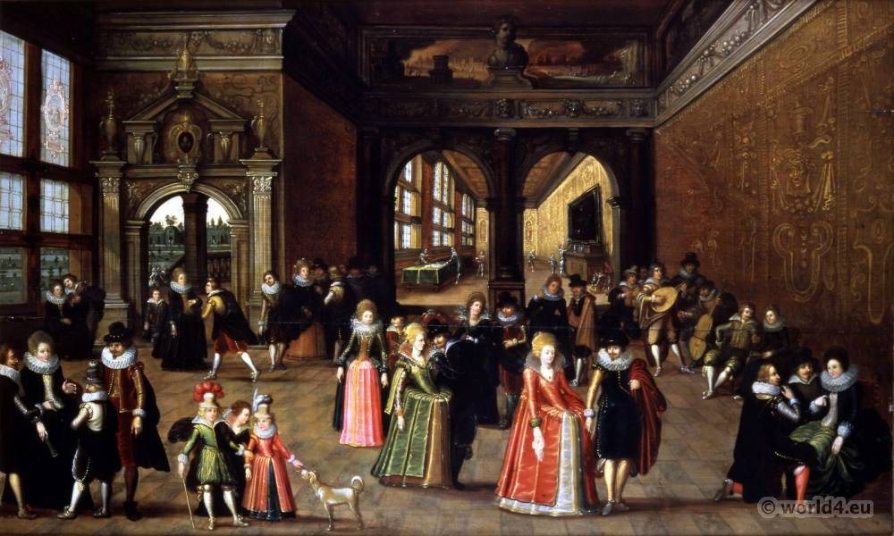
The Medici Court (Florence)

Slide 32
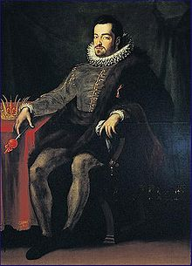
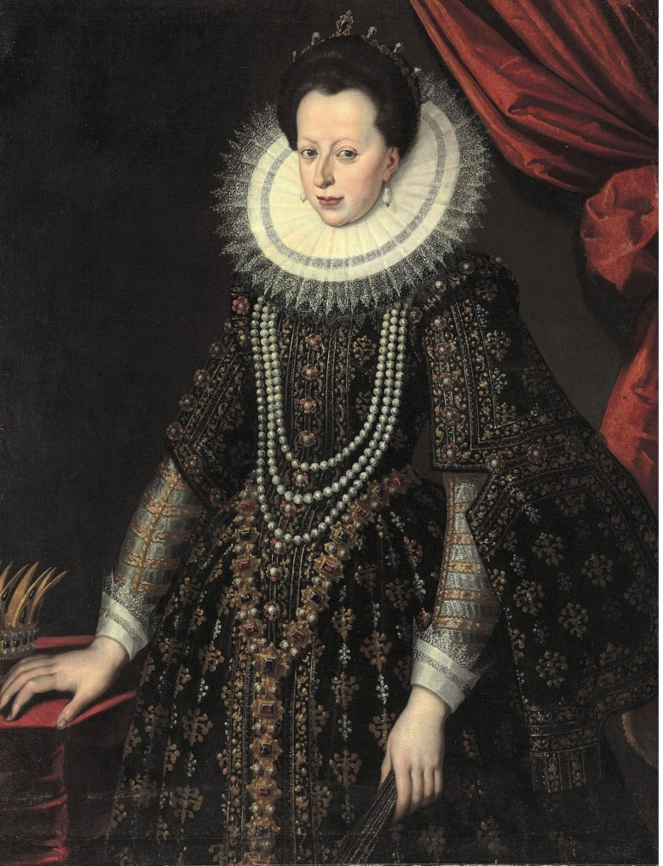
Politics on a Grand Scale: The Wedding in Florence, May 2, 1589
Ferdinando de’ Medici
Christine of Lorraine
Grand Duke of Tuscany (Florence)
Granddaughter of the King of France

Slide 33
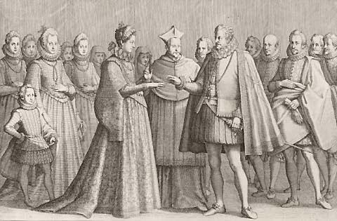
Ferdinando de’ Medici & Christine of Lorraine:
The Wedding in Florence, May 2, 1589

Slide 34
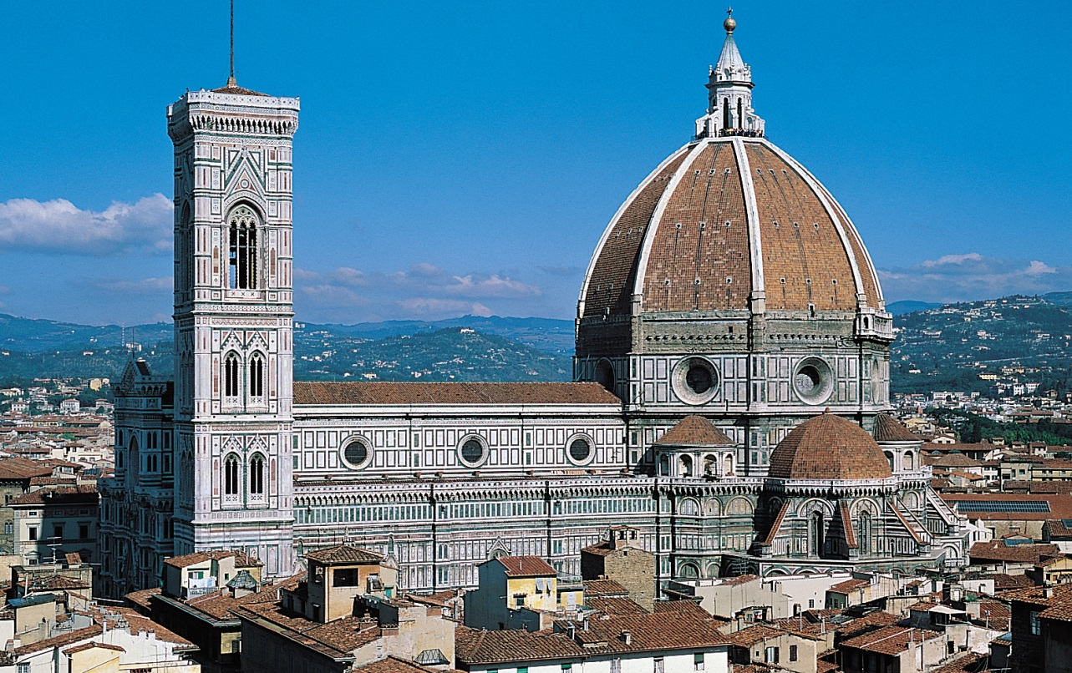
Florence: Cathedral

Slide 35
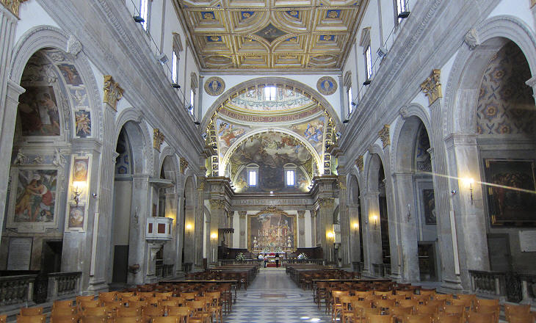
Florence: Cathedral Interior

Slide 36
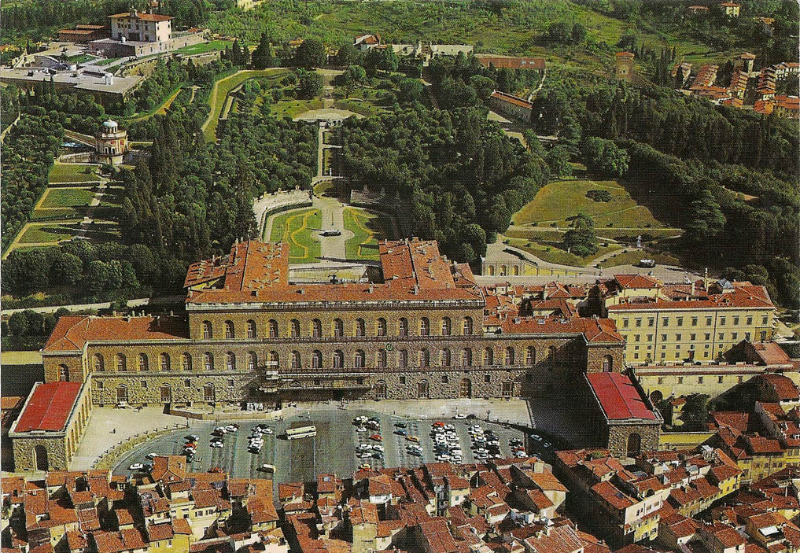
Florence: The Pitti Palace

Slide 37
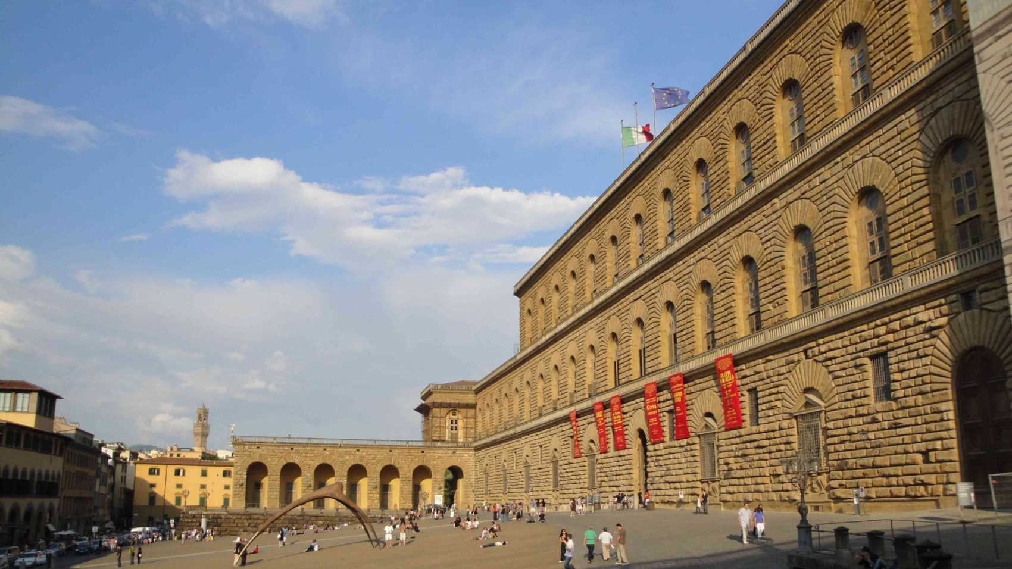
Florence: the Pitti Palace

Slide 38
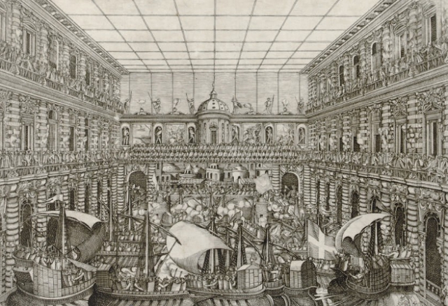
The 1589 Wedding Celebrations: Pitti Palace, the Mock Sea-Battle

Slide 39
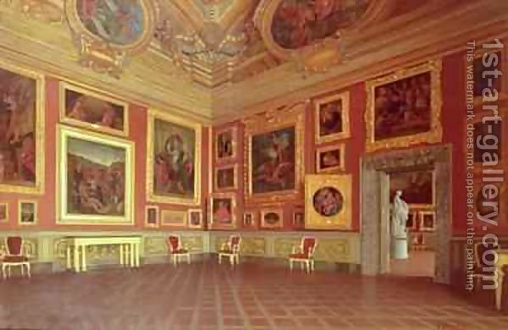
Florence: Pitti Palace, Interior Room

Slide 40
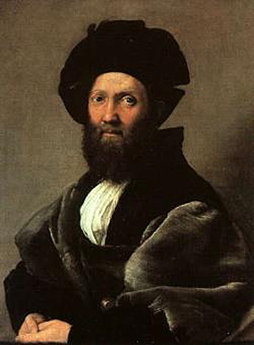
In charge of the 1589 entertainments:
Giovanni de’ Bardi

Slide 41
One set of spectacular entertainments
for the 1589 wedding:
Six extended Intermedi between the acts
of the spoken play, “La Pellegrina”
A compilation of music by several composers:
Jacopo Peri
Giulio Caccini
Emilio de’ Cavalieri
etc.
Giovanni de’ Bardi

Slide 42
One set of spectacular entertainments
for the 1589 wedding:
Six extended Intermedi between the acts
of the spoken play, “La Pellegrina”
A compilation of music by several composers:
Jacopo Peri
Giulio Caccini
Emilio de’ Cavalieri
etc.
Giovanni de’ Bardi
The music for these intermedi was published in 1591 (in 14 partbooks; but no figured bass or basso continuo)

Slide 43
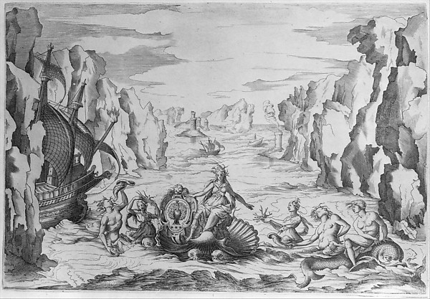
1589 Intermedio image : Sea Goddess surrounded by other mythological figures

Slide 44
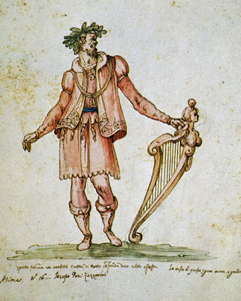
Jacopo Peri in the costume of Orpheus in an Intermedio for “La Pellegrina” (1589)

Slide 45
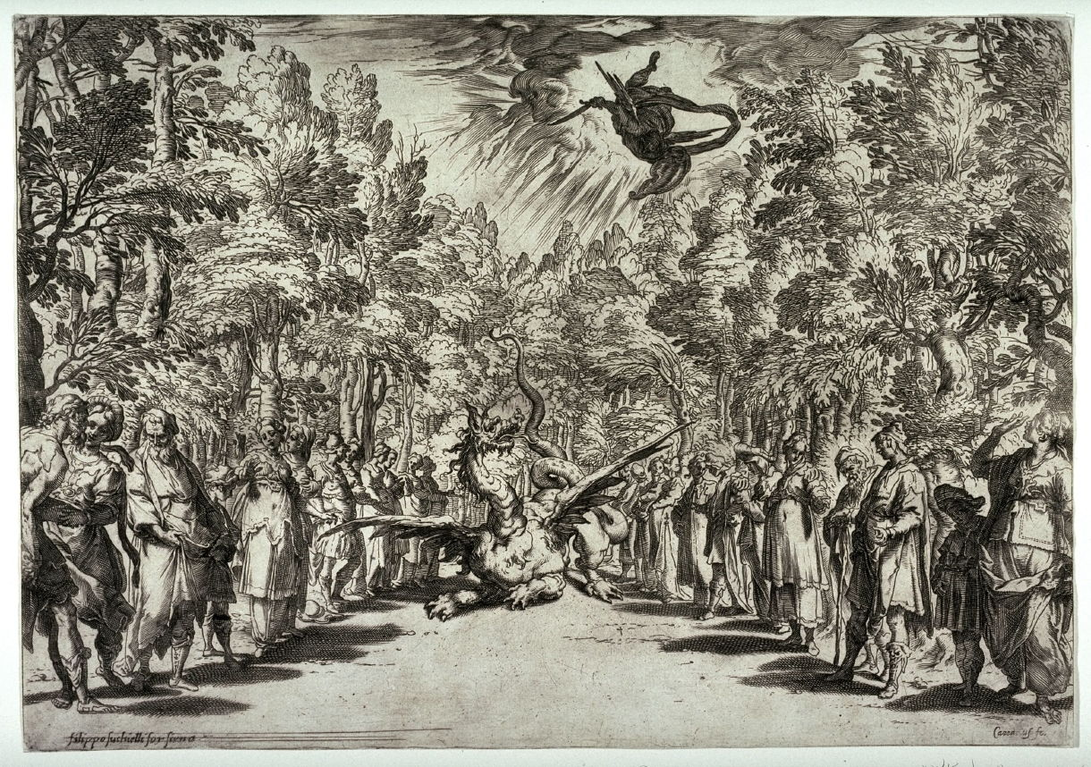
Intermedio 3 (1589): The Battle of [the Infant] Apollo with Python

Slide 46
Politics on a Grand Scale: The Wedding in Florence, May 2, 1589
Ferdinando de’ Medici
Christine of Lorraine
Grand Duke of Tuscany (Florence)
Granddaughter of the King of France

Slide 47
“Opera’s Origins in Italy
(Florence)
Intermedio (16th Century) “Opera” (c. 1600)
Court-sponsored,
costumed, and semi-staged
musical-theatrical spectacle:
an entertainment

Slide 48
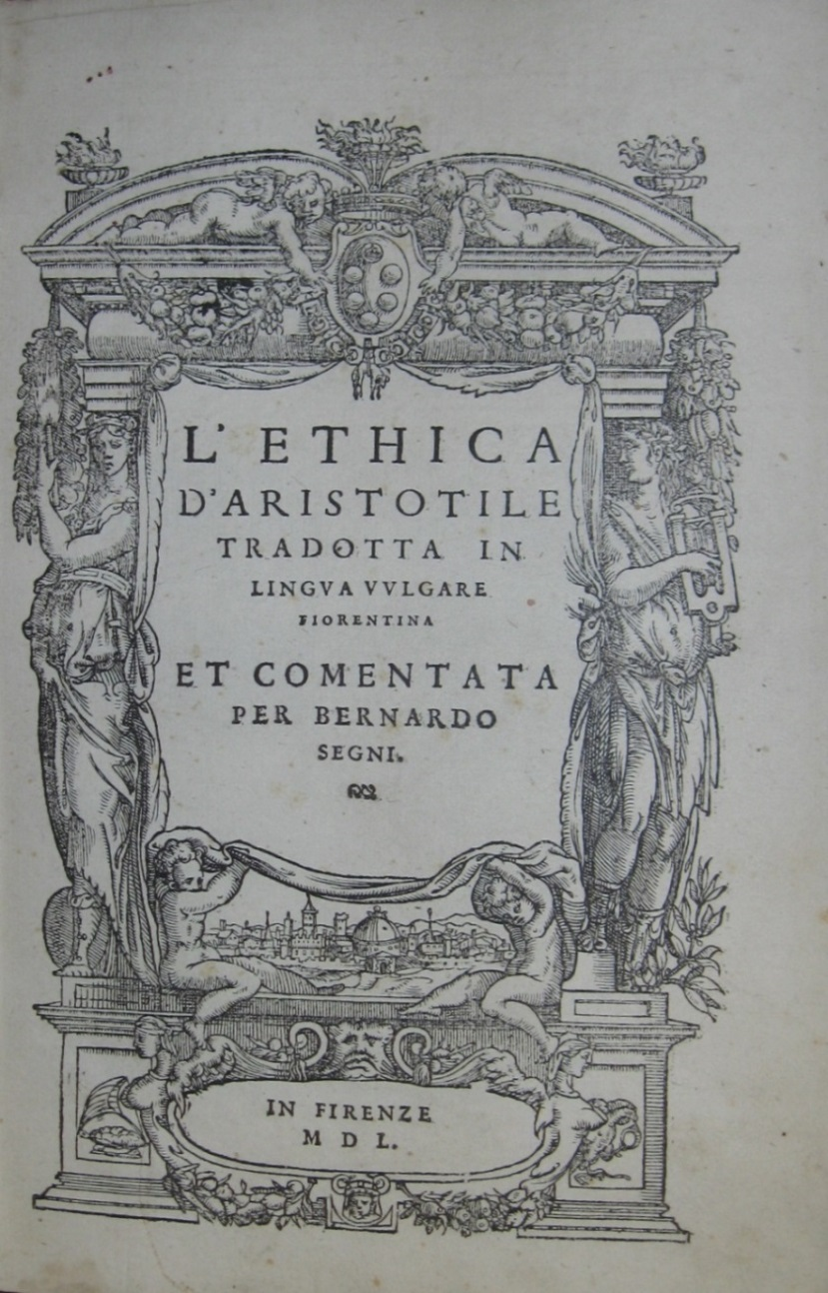
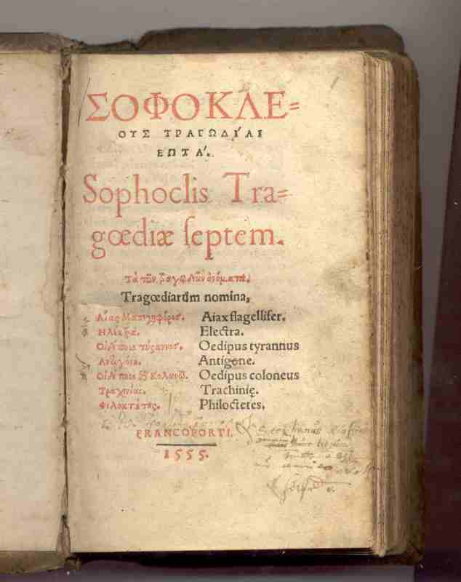
Aspects of 16th-century humanism:
the recovery and study of ancient Greek texts

Slide 49
Aspects of 16th-century humanism:
the recovery and study of ancient Greek texts
But what was ancient
Greek drama really like?

Slide 50
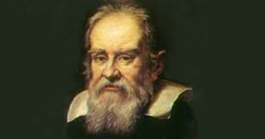
Girolamo Mei
Vincenzo Galilei
Giovanni de’ Bardi

Slide 51
solo-voice singing (not contrapuntal)
Girolamo Mei
Vincenzo Galilei
Giovanni de’ Bardi

Slide 52
solo-voice singing (not contrapuntal)
single melodic lines
Girolamo Mei
Vincenzo Galilei
Giovanni de’ Bardi

Slide 53
solo-voice singing (not contrapuntal)
single melodic lines
flexible rhythms
Girolamo Mei
Vincenzo Galilei
Giovanni de’ Bardi

Slide 54
solo-voice singing (not contrapuntal)
single melodic lines
flexible rhythms
suppression of decoration & ornament
Girolamo Mei
Vincenzo Galilei
Giovanni de’ Bardi

Slide 55
solo-voice singing (not contrapuntal)
single melodic lines
flexible rhythms
suppression of decoration & ornament
Girolamo Mei
Vincenzo Galilei
Giovanni de’ Bardi

Slide 56
Girolamo Mei
Vincenzo Galilei
Giovanni de’ Bardi

Slide 57
Two musicians and composers in Bardi’s Florentine/humanist circle, 1570s, 1580s
Giulio Caccini
Jacopo Peri (Costumed, 1589)

Slide 58
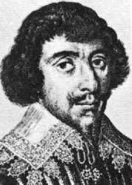
The Florentine Camerata (1570s, 1580s)
Vincenzo Galilei
Giovanni de’ Bardi
Giulio Caccini
Jacopo Peri
Ottavio Rinuccini (poet)

Slide 59
Bardi, Discorso, 1578

Slide 60
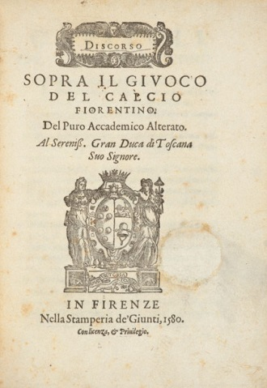
Bardi, Discorso, 1578
One of Bardi’s (other!) Discorsi (1580)

Slide 61
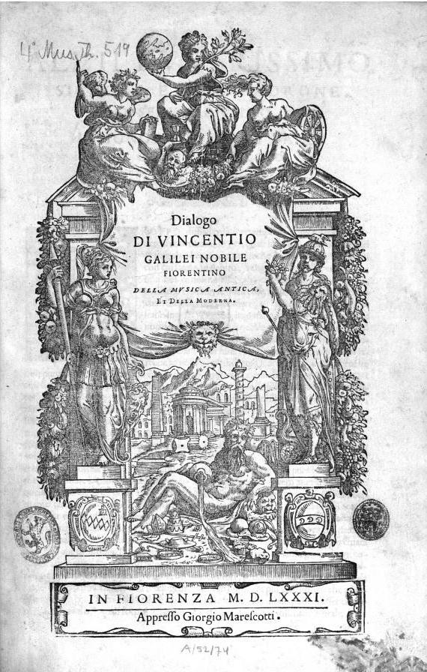
Galilei, Dialogo della musica antica et della moderna (1581)
Bardi, Discorso, 1578
One of Bardi’s (other!) Discorsi (1580)

Slide 62
The Florentine Camerata (1590s)
Vincenzo Galilei
Jacopo Corsi
Giulio Caccini
Jacopo Peri
Ottavio Rinuccini (poet)

Slide 63
La Dafne (Florence, 1598): the first “opera” [?]
Ottavio Rinuccini (poet)
Giulio Caccini
Jacopo Peri

Slide 65
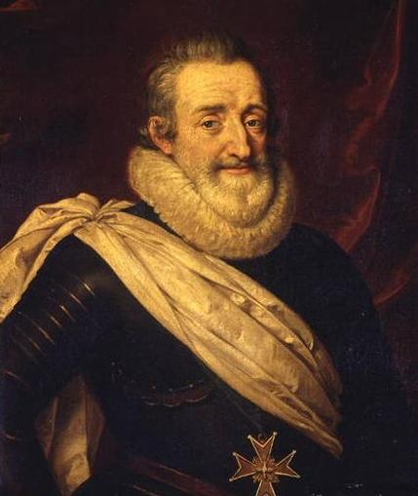
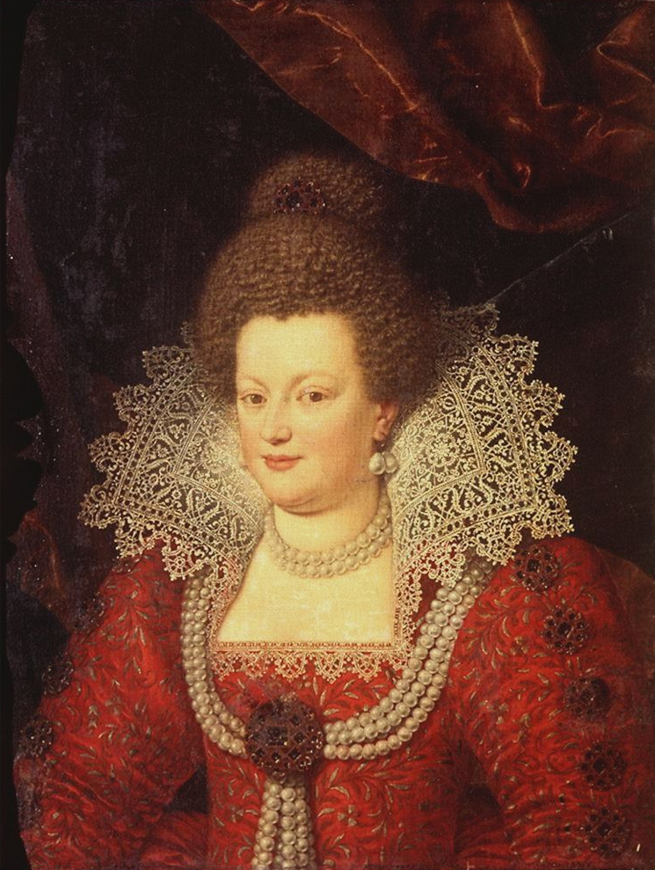
1600: A Royal Wedding in Florence
Henry IV of France
Maria de’ Medici

Slide 66
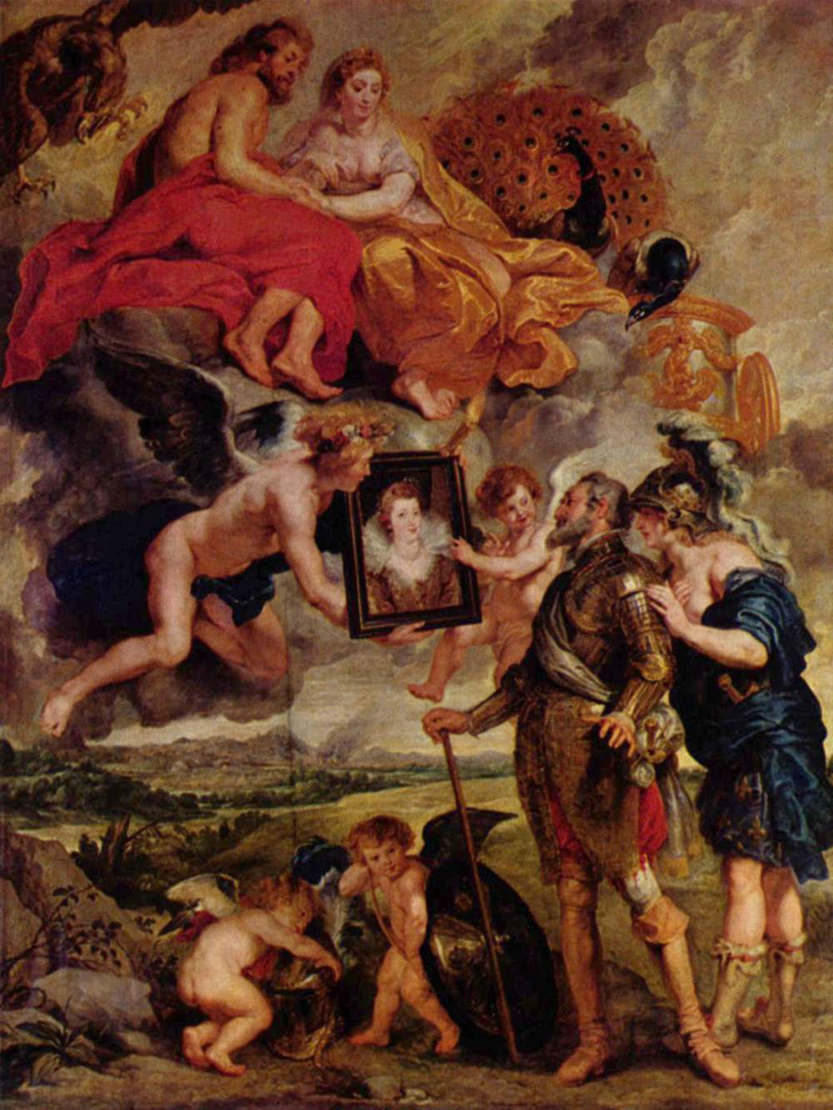
From the Rubens Maria de’ Medici Cycle of 24 Paintings (1621):
The Presentation of Her Portrait to the King

Slide 67
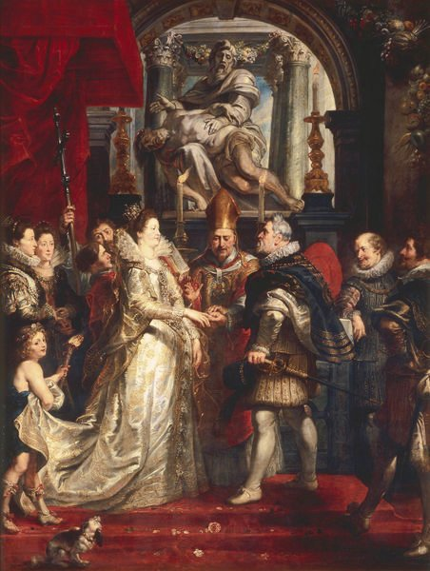
Rubens (1621): The (1600) Wedding of Henry IV and Maria de’ Medici

Slide 68
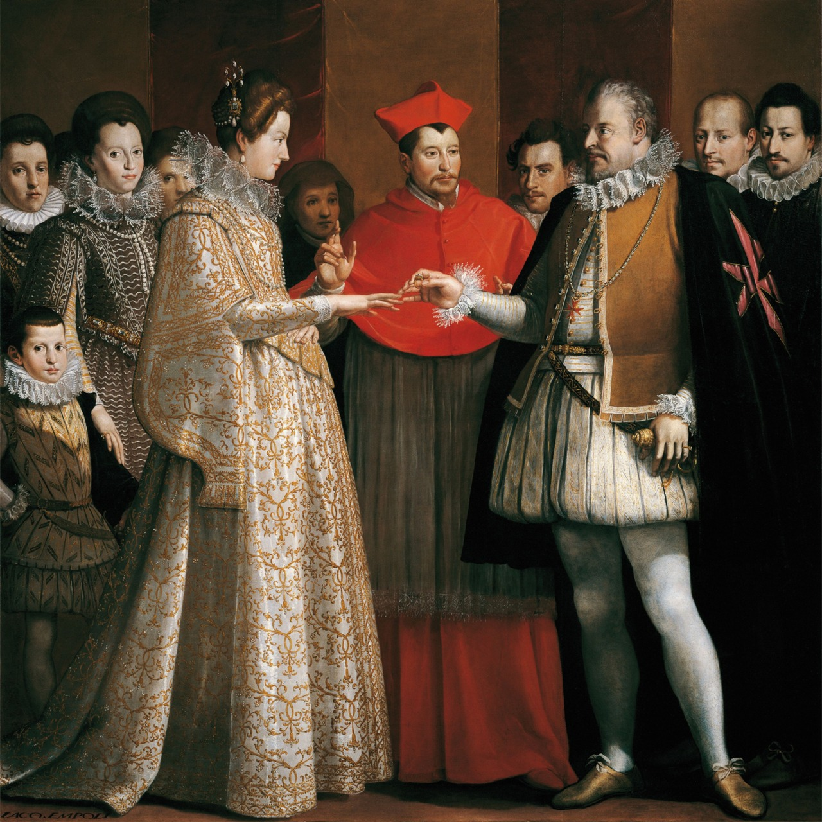
Jacopo Chimenti: The Wedding of Henry IV and Maria de’ Medici

Slide 69
Rubens (1621): The (1600) Wedding of Henry IV and Maria de’ Medici
A new and notable feature of the lavish wedding festivities/entertainments in Florence:
A completely, sung, staged, costumed play [“opera”], based on the tale of Orpheus and Eurydice [Ovid, Metamorphoses, Book 10] and to be performed before the newly wedded king and queen of France.

Slide 70
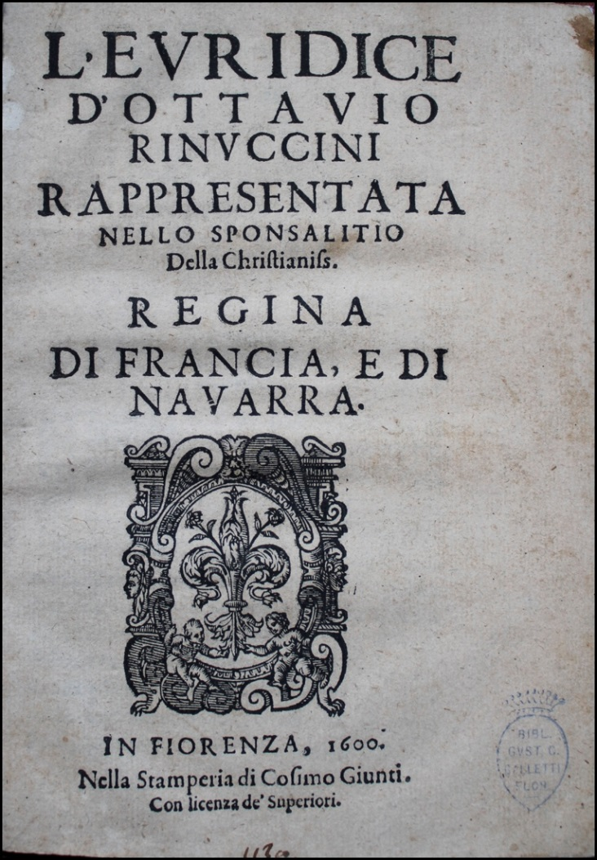
The poetic text of Euridice (1600) written by:
Ottavio Rinuccini (poet)
Publication of Rinuccini’s libretto, 1600

Slide 71
Pitti Palace, Florence

Slide 72
The Original Euridice (Florence, 1600: Music by Two Composers)
Giulio Caccini
Ottavio Rinuccini (poet)
Jacopo Peri

Slide 73
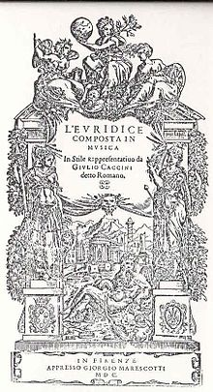
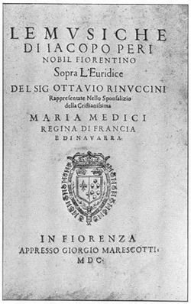
Caccini’s Version
Peri’s Version

Slide 74
Caccini’s Version
Peri’s Version

Slide 75
Musical aims:
textural simplicity
Peri’s Version

Slide 76
Musical aims:
textural simplicity
primarily simple, straightforward declamatory or recitational style
(stile rappresentativo)
Peri’s Version

Slide 77
Musical aims:
textural simplicity
primarily simple, straightforward declamatory or recitational style
(stile rappresentativo)
music as enhancer of the dramatic text
Peri’s Version

Slide 78
Libretto of [Peri’s] Euridice (1600): Prologue + Five Dramatic Scenes
Prologue (strophic, declamatory “song” delivered by “Tragedy”
Pastoral backdrop; anticipation of marriage, Orfeo & Euridice
Celebratory happiness shattered; death of Euridice; Orfeo’s lament
Reports to others of Orfeo’s reaction
Orfeo in the underworld, pleading for the release of Euridice
Happy ending [reversing the tragic ending of the original myth]

Slide 79
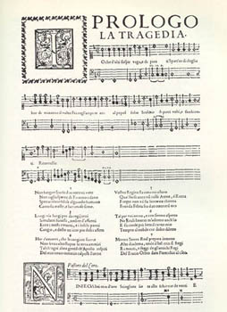
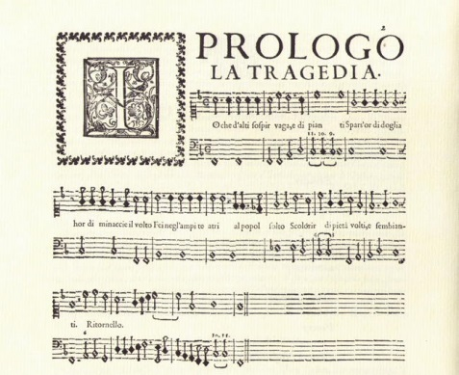
The Opening Music of Peri’s Euridice (1600)

Slide 80
Peri, Euridice (1600): Prologue (Accademia degli Imperfetti, "LABYRINTHOS,” 2006)
(First Four Stanzas Only)

Slide 81
Libretto of [Peri’s] Euridice (1600): Prologue + Five Dramatic Scenes
Prologue (strophic, declamatory “song” delivered by “Tragedy”
Pastoral backdrop; anticipation of marriage, Orfeo & Euridice
Celebratory happiness shattered; death of Euridice; Orfeo’s lament
Reports to others of Orfeo’s reaction
Orfeo in the underworld, pleading for the release of Euridice
Happy ending [reversing the tragic ending of the original myth]

Slide 82
Euridice (1600): the general structure of each of the five scenes
Change of poetic meter
Concluding choral refrain (summary-reaction), intermixed with recitative verses
Dialogue: scene-setting and action
(“monody”; varying intensities of “recitative”;
stile rappresentativo; mostly dramatic poetic declamation over figured bass, basso continuo)
(cf. ancient Greek “chorus”)

Slide 83
Euridice (1600): the general structure of each of the five scenes
Change of poetic meter
Concluding choral refrain (summary-reaction), intermixed with recitative verses
Dialogue: scene-setting and action
(“monody”; varying intensities of “recitative”;
stile rappresentativo; mostly dramatic poetic declamation over figured bass, basso continuo)
(cf. ancient Greek “chorus”)
Note: the central aesthetic point and burden of expression (in the new style) is here, not in the final chorus

Slide 84
Euridice (1600): the general structure of each of the five scenes
Change of poetic meter
Concluding choral refrain (summary-reaction), intermixed with recitative verses
Dialogue: scene-setting and action
(“monody”; varying intensities of “recitative”;
stile rappresentativo; mostly dramatic poetic declamation over figured bass, basso continuo)
(cf. ancient Greek “chorus”)
Note: the central aesthetic point and burden of expression (in the new style) is here, not in the final chorus
(not the main musical feature of the scene but only a point of final arrival: an expressive reaction and scene-concluder)

Slide 85
Libretto of [Peri’s] Euridice (1600): Prologue + Five Dramatic Scenes
Prologue (strophic, declamatory “song” delivered by “Tragedy”
Pastoral backdrop; anticipation of marriage, Orfeo & Euridice
Celebratory happiness shattered; death of Euridice; Orfeo’s lament
Reports to others of Orfeo’s reaction
Orfeo in the underworld, pleading for the release of Euridice
Happy ending [reversing the tragic ending of the original myth]

Slide 86
Euridice (1600): the general structure of each of the five scenes
Change of poetic meter
Concluding choral refrain (summary-reaction), intermixed with recitative verses
Dialogue: scene-setting and action
(“monody”; varying intensities of “recitative”;
stile rappresentativo; mostly dramatic poetic declamation over figured bass, basso continuo)
(cf. ancient Greek “chorus”)
Note: the central aesthetic point and burden of expression (in the new style) is here, not in the final chorus
(not the main musical feature of the scene but only a point of final arrival: an expressive reaction and scene-concluder)

Slide 87
Euridice (1600): the general structure of each of the five scenes
Change of poetic meter
Concluding choral refrain (summary-reaction), intermixed with recitative verses
Dialogue: scene-setting and action
(“monody”; varying intensities of “recitative”;
stile rappresentativo; mostly dramatic poetic declamation over figured bass, basso continuo)
(cf. ancient Greek “chorus”)
Note: the central aesthetic point and burden of expression (in the new style) is here, not in the final chorus
(not the main musical feature of the scene but only a point of final arrival: an expressive reaction and scene-concluder)

Slide 88
Euridice (1600): the general structure of each of the five scenes
E.g., end of Scene 1, chorus,
“Al canto, al ballo”
Change of poetic meter
Concluding choral refrain (summary-reaction), intermixed with recitative verses
Dialogue: scene-setting and action
(“monody”; varying intensities of “recitative”;
stile rappresentativo; mostly dramatic poetic declamation over figured bass, basso continuo)
(cf. ancient Greek “chorus”)
Note: the central aesthetic point and burden of expression (in the new style) is here, not in the final chorus
(not the main musical feature of the scene but only a point of final arrival: an expressive reaction and scene-concluder)

Slide 89
Euridice (1600): the general structure of each of the five scenes
Scene 2: interpolated air, “Nel puro ardor”
Change of poetic meter
Concluding choral refrain (summary-reaction), intermixed with recitative verses
Dialogue: scene-setting and action
(“monody”; varying intensities of “recitative”;
stile rappresentativo; mostly dramatic poetic declamation over figured bass, basso continuo)
(cf. ancient Greek “chorus”)
Note: the central aesthetic point and burden of expression (in the new style) is here, not in the final chorus
(not the main musical feature of the scene but only a point of final arrival: an expressive reaction and scene-concluder)

Slide 90
“Monody,” c. 1600-02: Four Types of Music
Solo Madrigals Solo Airs Sacred Concertos “Operatic Recitative”
Caccini Viadana Caccini & Peri

